Slide 1
Virginia Extremes: Assessing the Weather & Climate Scenario
Michael j. Allen, Ph.D.
Department Political Science & Geography
Old Dominion University
Mitigation & Adaptation Research in Virginia
Tuesday, August 11, 2015

Slide 2
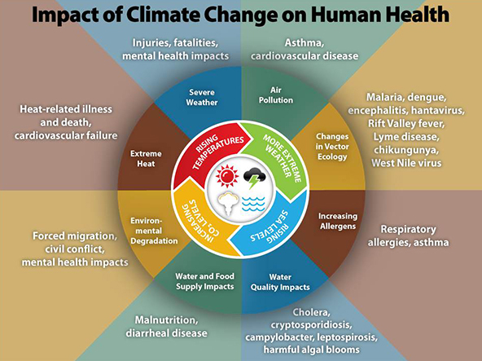
My Research
Geographic Variability
Weather/Climate Impacts

Slide 3
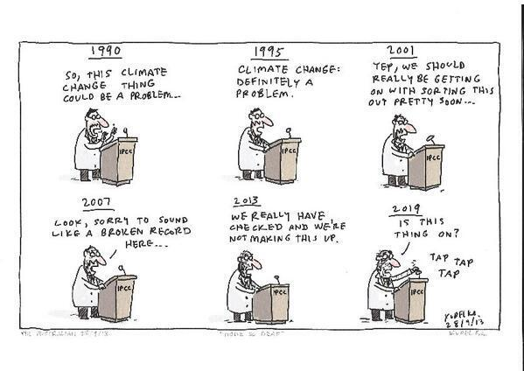
Overview
What do we know?
What do we not know?
Research Opportunities

Slide 4
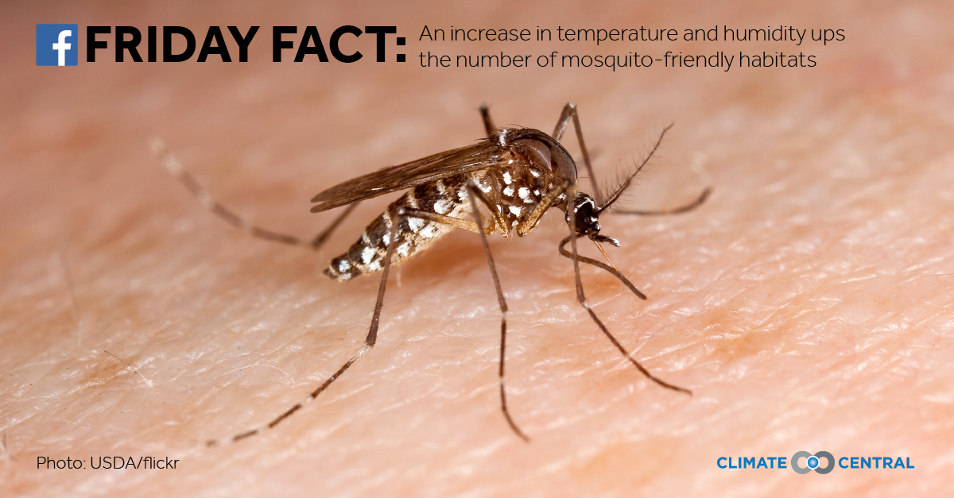
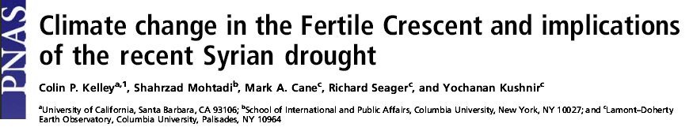

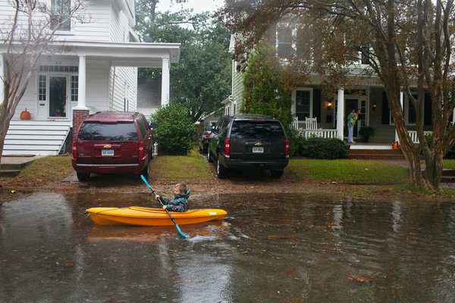
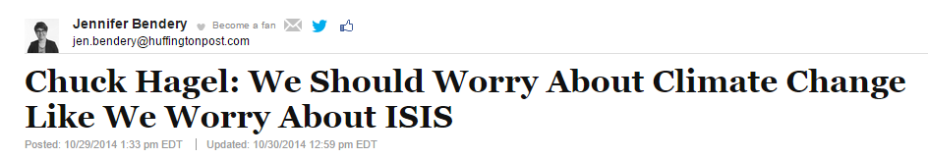
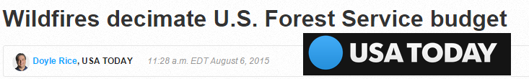

Slide 5
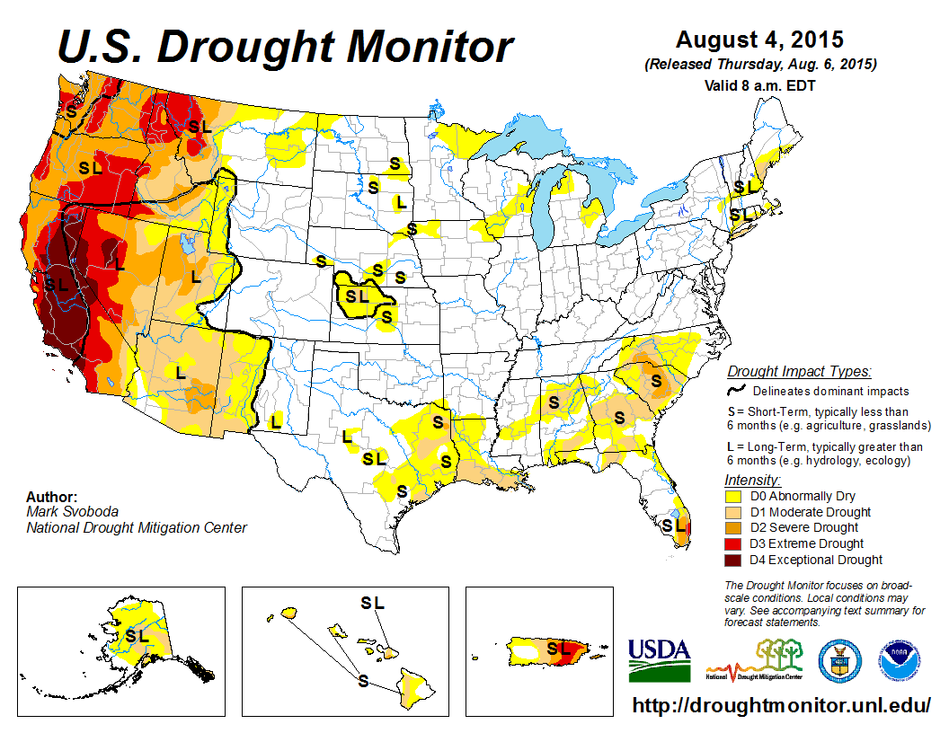
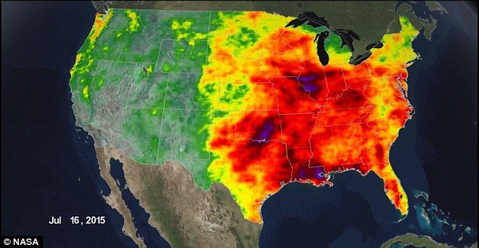
Too Much/Little – Wrong Place/Time
Heavy Rainfall and Snowfall (ENSO, Polar Vortex)
Agriculture – Resources
Notes:
http://www.dailymail.co.uk/sciencetech/article-3181540/A-tale-two-coasts-Stunning-Nasa-satellite-animation-reveals-record-rainfall-east-west-scorches.html

Slide 6
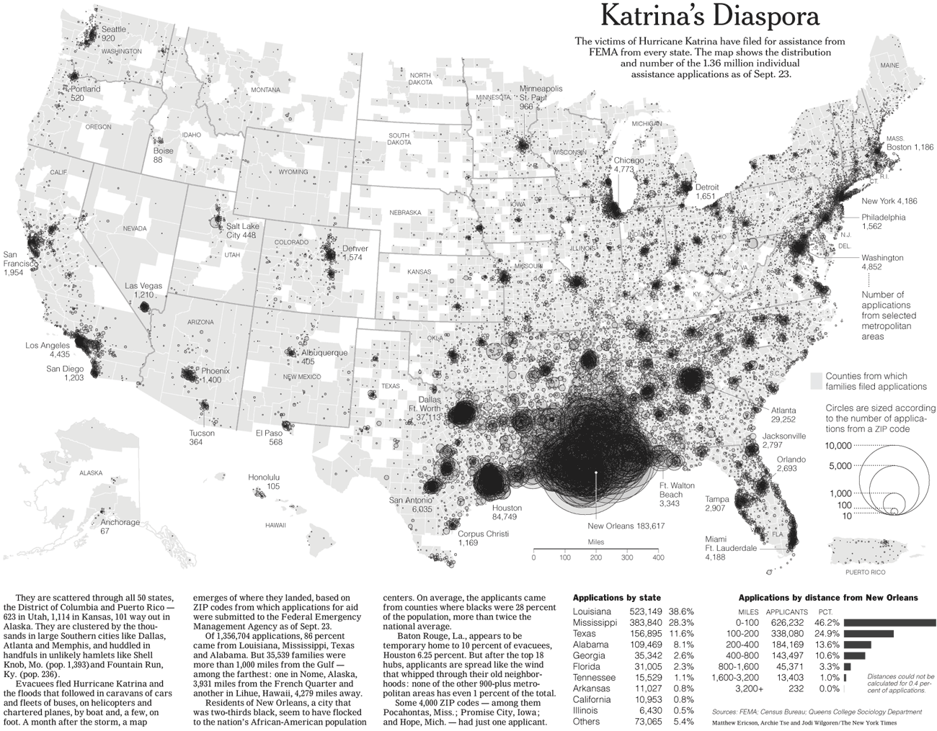
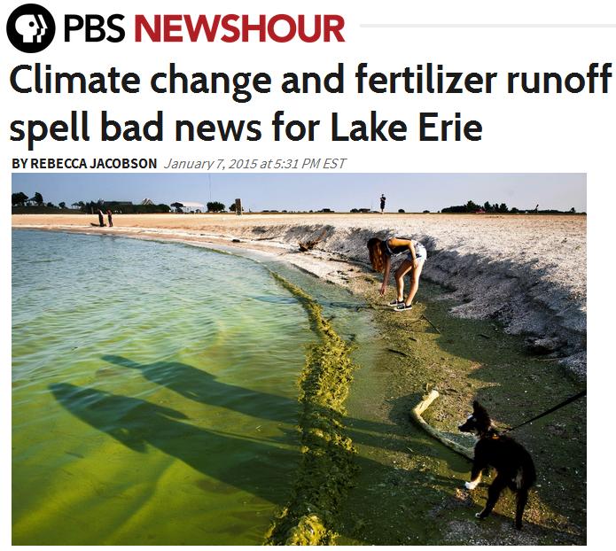
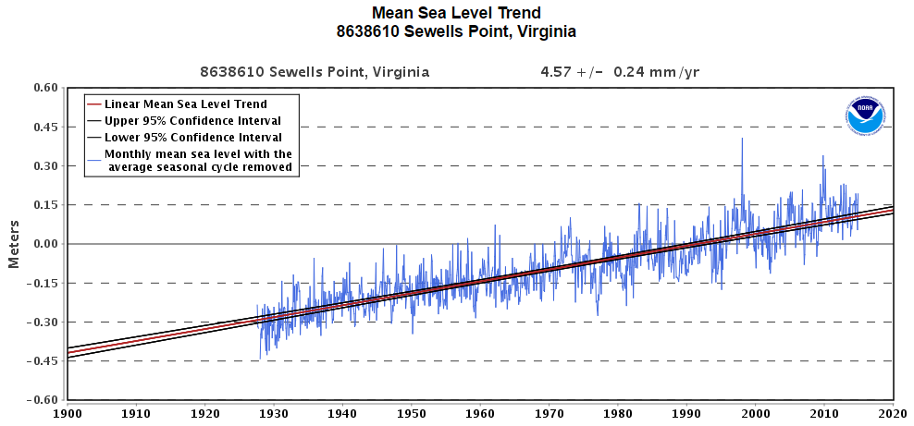

Slide 7
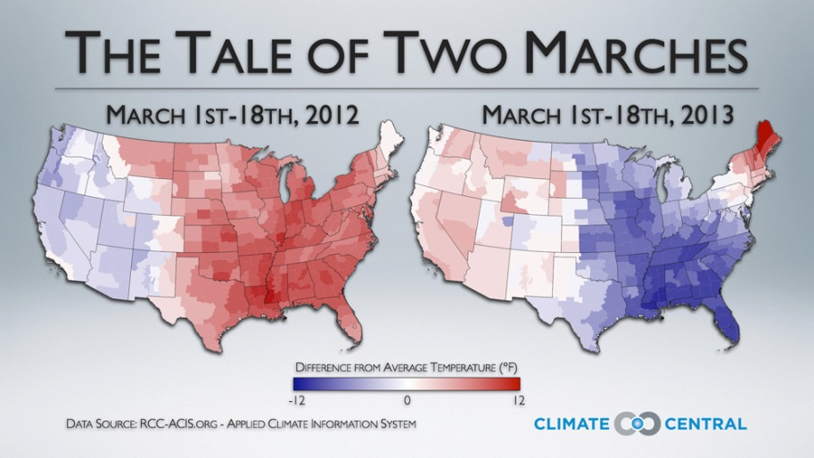
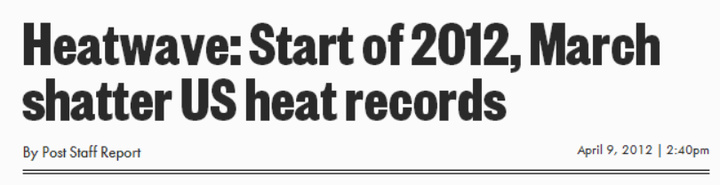
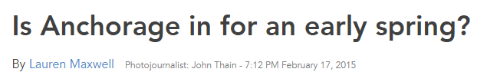
What is Summer? Winter?
Importance of Seasons: WNV 2012 (286 deaths)
Seasons vary spatially and temporally- Changed?
Human Health(Kalkstein et al. 2009)
Phenology: Bloom dates (Schwartz and Reiter 2000)
Ecological Patterns (Walther 2002)

Slide 8
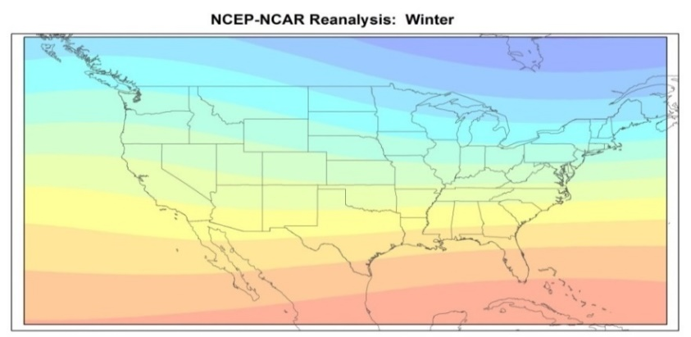
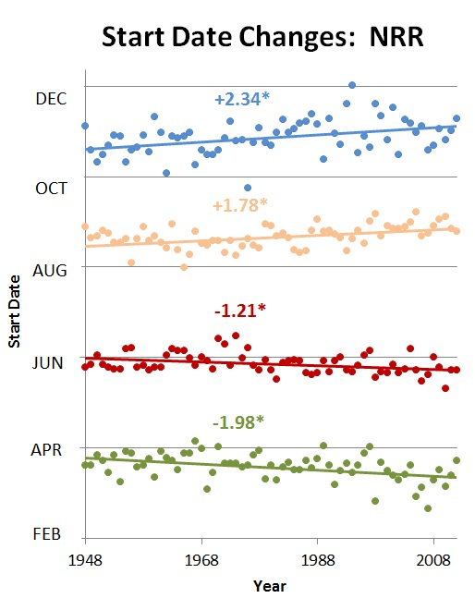
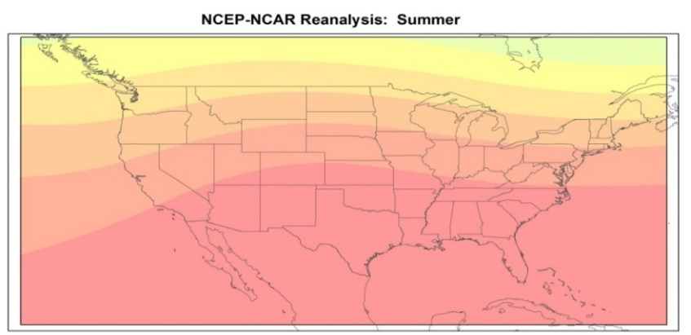
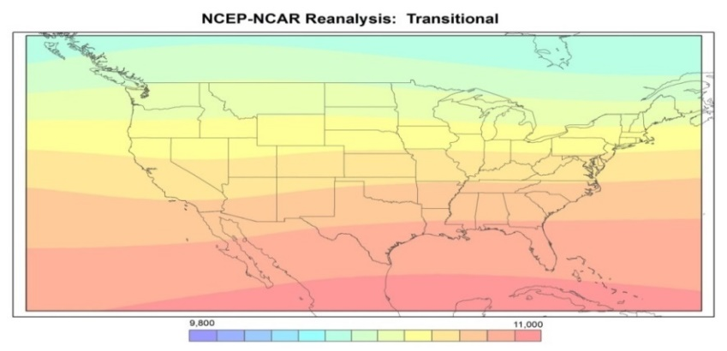
Allen and Sheridan 2015

Slide 9
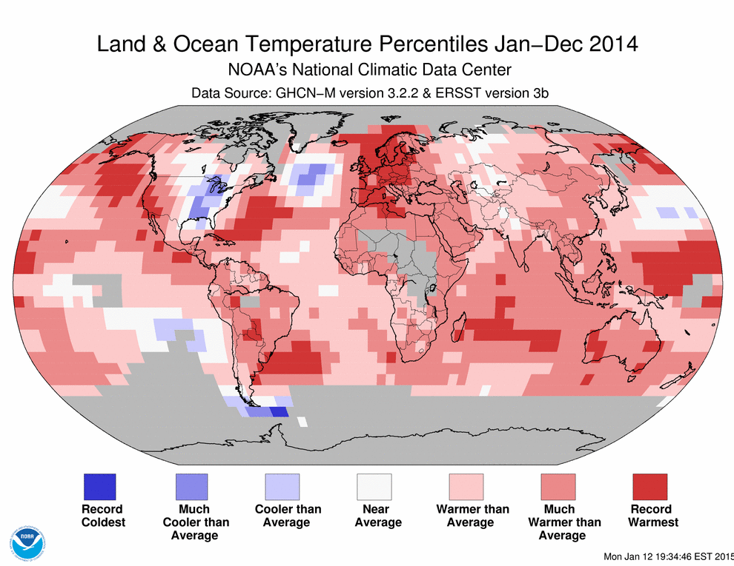
Extreme Temperature Events
38th Consecutive Year (1977)
1.53F from 1880 to 2012
Hottest on Record
Notes:
http://www.bloomberg.com/graphics/2014-hottest-year-on-record/

Slide 10
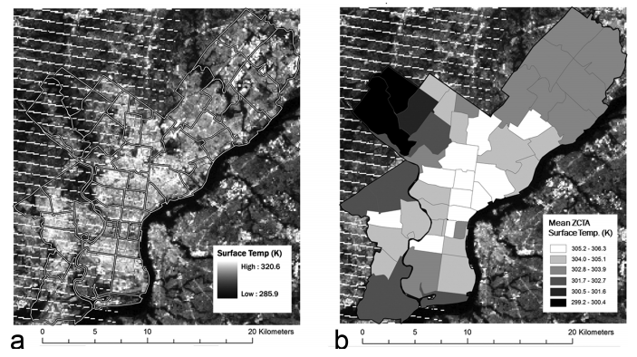
Extreme Temperatures
1995 Chicago Heat Wave
Hondula et al. 2012

Slide 11
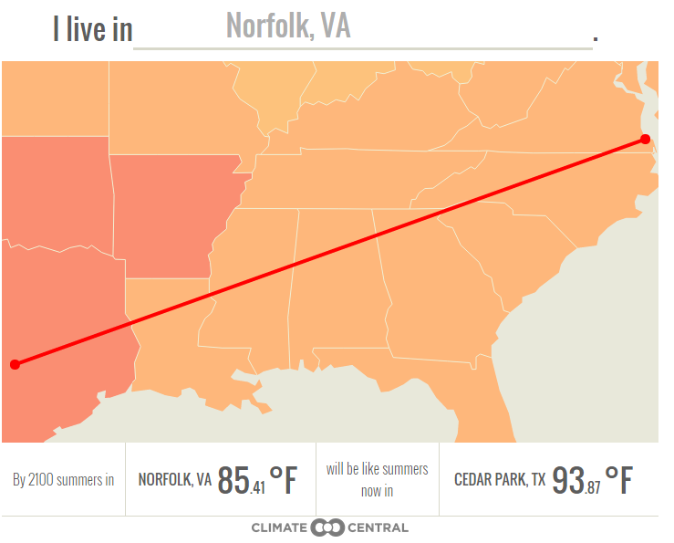
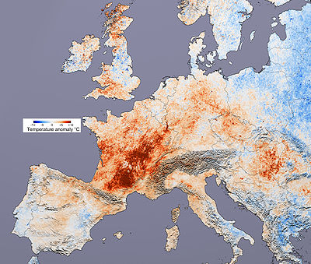
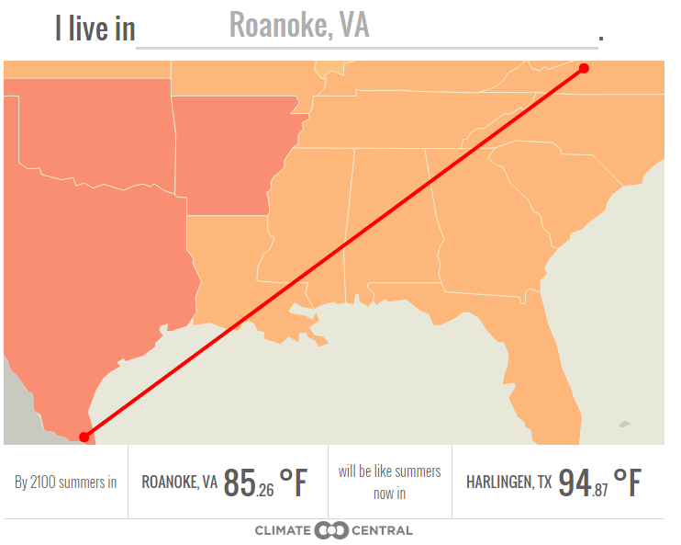
Extreme Temperatures
NASA: 2003 European Heat Wave

Slide 12
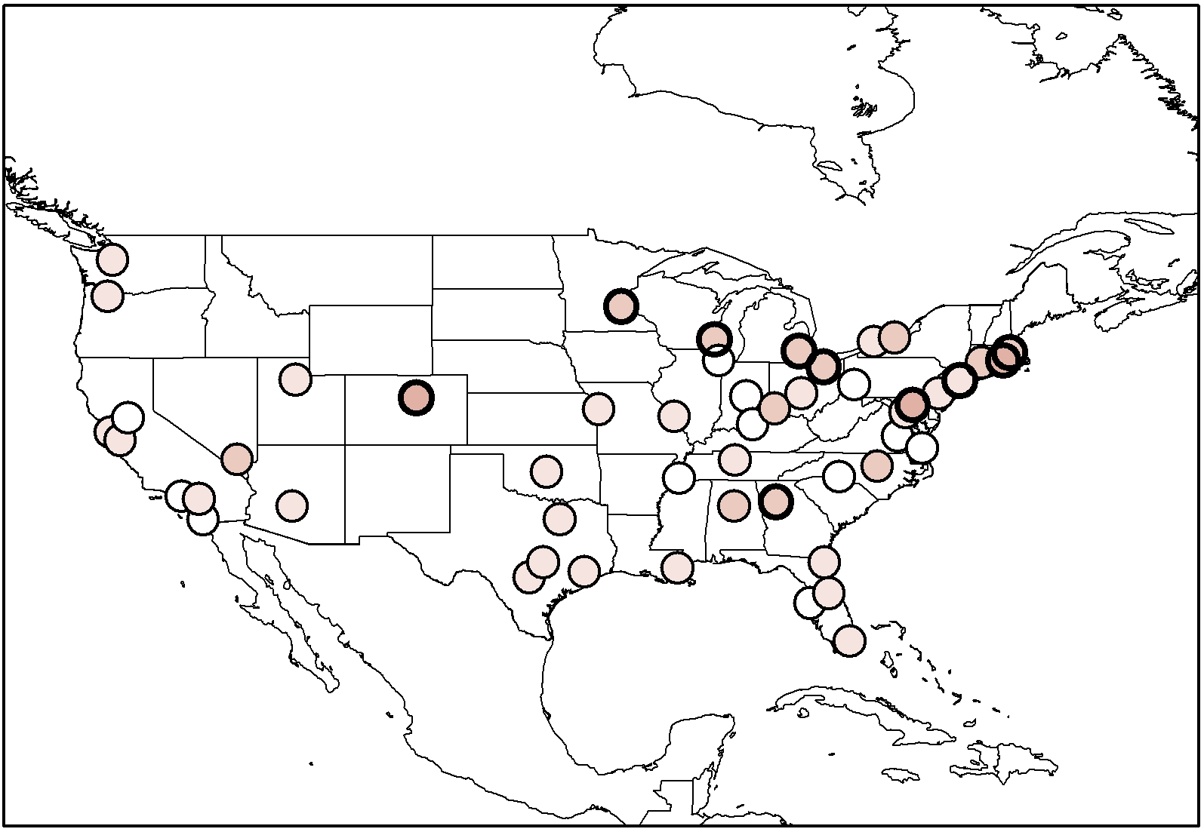
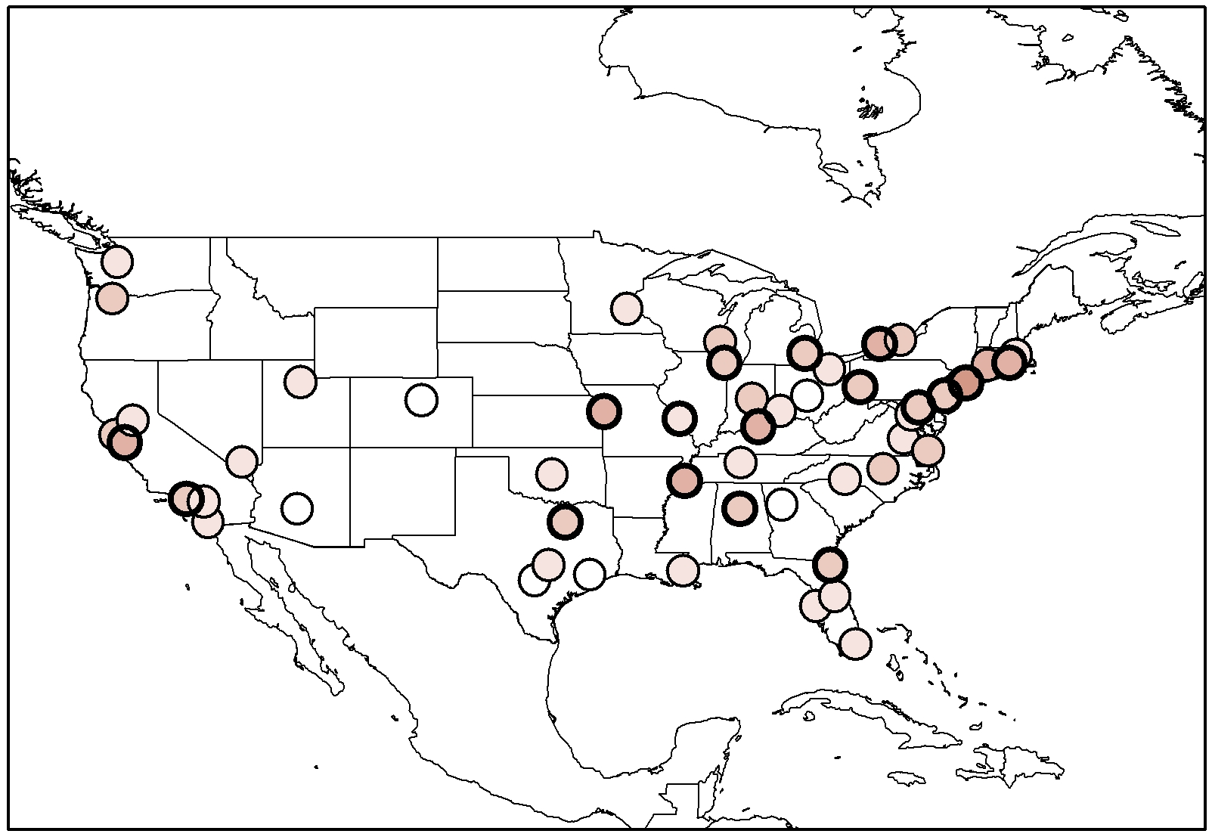
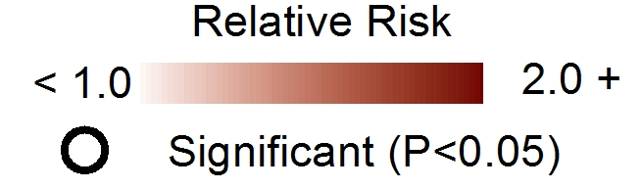
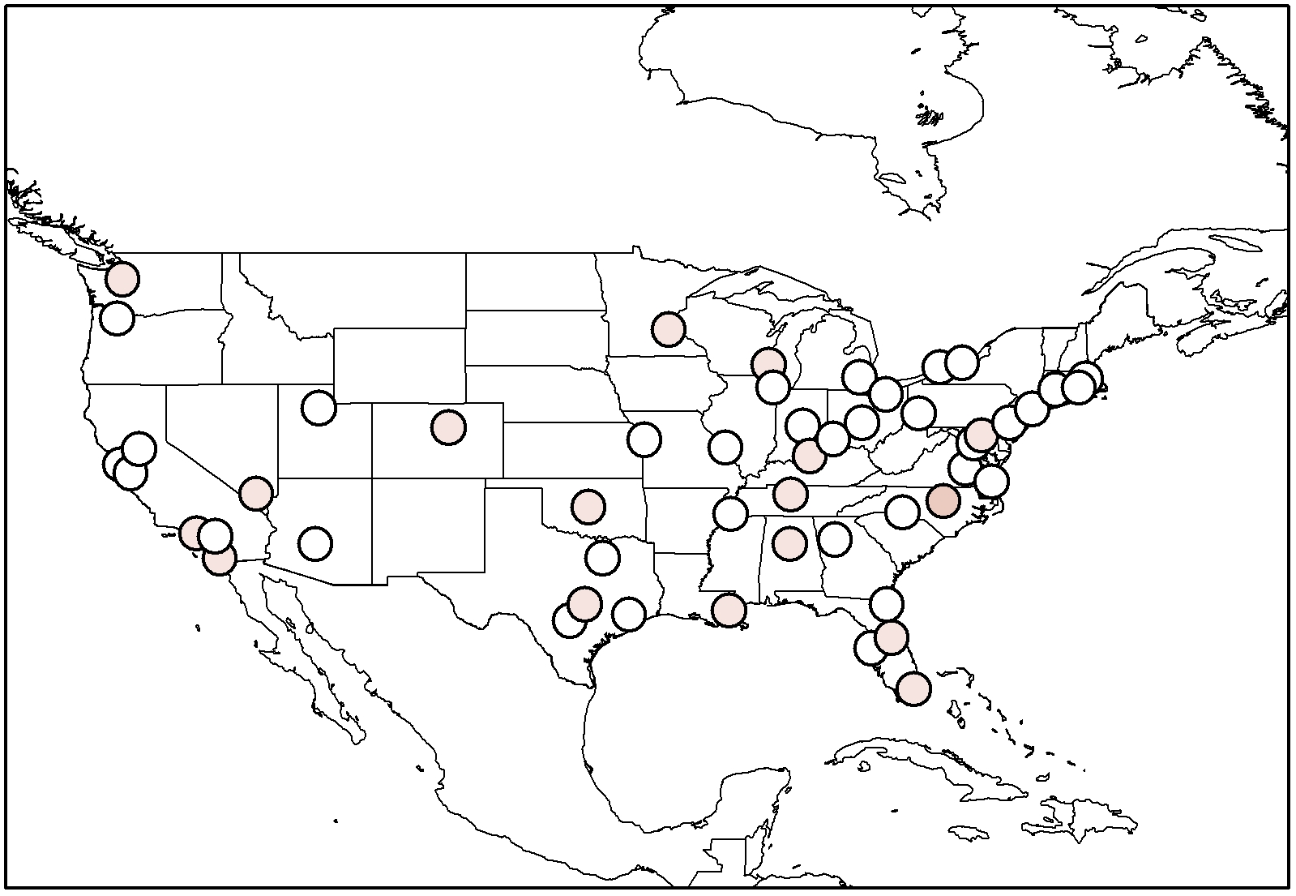
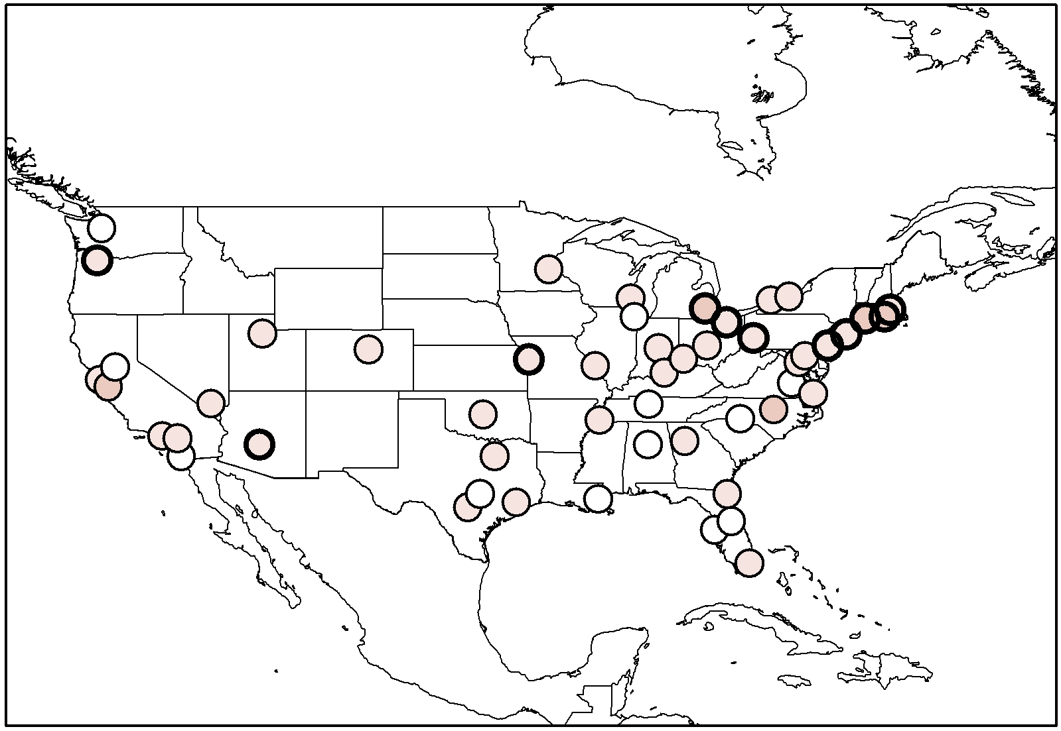
SHORT (<3 DAYS)
LONG (3+ DAYS)
Allen and Sheridan, Submitted
EARLY
LATE
Notes:
Results: again, a lot of maps
The first image here sets the stage for the remaining maps on the slide…..
Relative risks are colored red…darker red signifies higher risk…
Significant values (again, minimum and mean values both higher than 1) are colored with a black circle.
You see is higher risks in the north with generally high values scattered throughout the domain…
Next, I evaluated early-long events..so, these events took place in the first half of the season still but with a longer duration…Again, you see high values throughout….higher than the shorter events
Short-late events are almost a wash…nothing signficiant
BUT- long late events stand out again with regards to significance and higher RR values….especially in the northern domain…

Slide 13
SHORT (<3 DAYS)
LONG (3+ DAYS)
Allen and Sheridan, Submitted
EARLY
Seasonal Timing
Earlier = Higher RR
LATE
Notes:
Results: again, a lot of maps
The first image here sets the stage for the remaining maps on the slide…..
Relative risks are colored red…darker red signifies higher risk…
Significant values (again, minimum and mean values both higher than 1) are colored with a black circle.
You see is higher risks in the north with generally high values scattered throughout the domain…
Next, I evaluated early-long events..so, these events took place in the first half of the season still but with a longer duration…Again, you see high values throughout….higher than the shorter events
Short-late events are almost a wash…nothing signficiant
BUT- long late events stand out again with regards to significance and higher RR values….especially in the northern domain…

Slide 14
SHORT (<3 DAYS)
LONG (3+ DAYS)
Allen and Sheridan, Submitted
EARLY
Duration is important
LATE
Notes:
Results: again, a lot of maps
The first image here sets the stage for the remaining maps on the slide…..
Relative risks are colored red…darker red signifies higher risk…
Significant values (again, minimum and mean values both higher than 1) are colored with a black circle.
You see is higher risks in the north with generally high values scattered throughout the domain…
Next, I evaluated early-long events..so, these events took place in the first half of the season still but with a longer duration…Again, you see high values throughout….higher than the shorter events
Short-late events are almost a wash…nothing signficiant
BUT- long late events stand out again with regards to significance and higher RR values….especially in the northern domain…

Slide 15
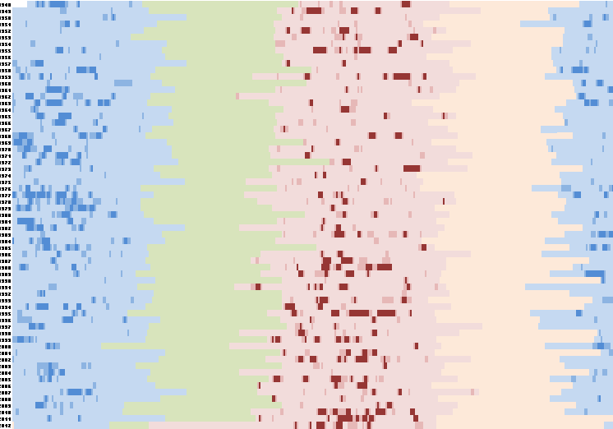
Tying it together… Example
WINTER SPRING SUMMER FALL
1948
1970
1990
2012
Longer
Earlier
Frequent
Notes:
To begin tying the piences together;
I showed heat events are becoming more frequeny, longer, and occurring earlier in the season.
Seasons are changing..they;re changing differently across the U.S. with some of the largest shifts taking place in urban areas such as PHX and MIA
Health consequences follow…with a changing climate, we need to evaluate ways in which we consider these processes in future climate health research.
Vulnerability changes....people change….local environments matter…ultimately, interventions to address these concerns will benefit human health outcomes related to heat related mortality and morbidity

Slide 16
Static Seasons?
WINTER SPRING SUMMER FALL
1948
1970
1990
2012
Longer
Earlier
Frequent
Notes:
To begin tying the piences together;
I showed heat events are becoming more frequeny, longer, and occurring earlier in the season.
Seasons are changing..they;re changing differently across the U.S. with some of the largest shifts taking place in urban areas such as PHX and MIA
Health consequences follow…with a changing climate, we need to evaluate ways in which we consider these processes in future climate health research.
Vulnerability changes....people change….local environments matter…ultimately, interventions to address these concerns will benefit human health outcomes related to heat related mortality and morbidity

Slide 17
Changing Patterns of Heat/Cold Events
WINTER SPRING SUMMER FALL
1948
1970
1990
2012
Longer
Earlier
Frequent
Notes:
To begin tying the piences together;
I showed heat events are becoming more frequeny, longer, and occurring earlier in the season.
Seasons are changing..they;re changing differently across the U.S. with some of the largest shifts taking place in urban areas such as PHX and MIA
Health consequences follow…with a changing climate, we need to evaluate ways in which we consider these processes in future climate health research.
Vulnerability changes....people change….local environments matter…ultimately, interventions to address these concerns will benefit human health outcomes related to heat related mortality and morbidity
Not many people are doing this….accounting for seasonal variability….fewer are looking at the DLNM (Grady Dixon)….fewer still are the climatologists doing this type of work….

Slide 18
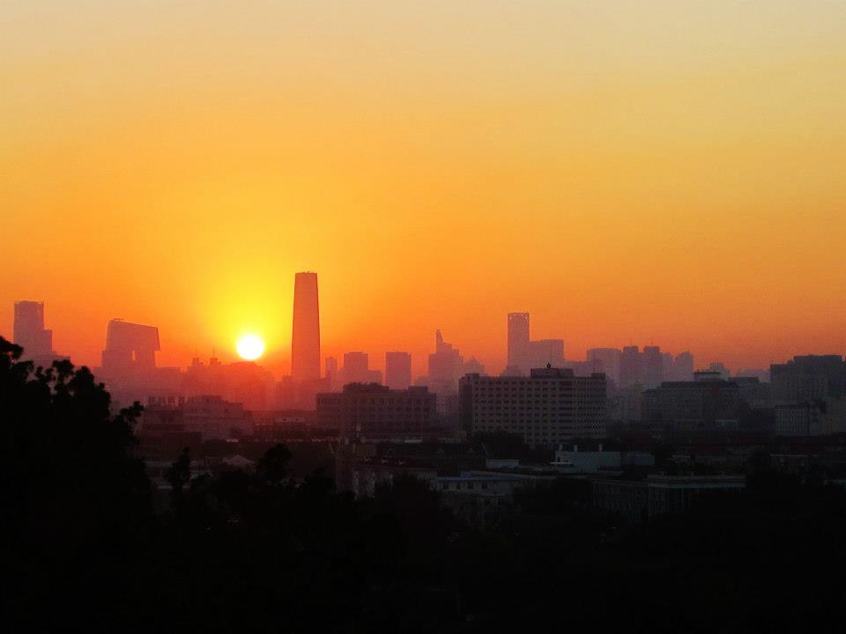
Overview
What do we know?
What do we not know?
Research Opportunities

Slide 19
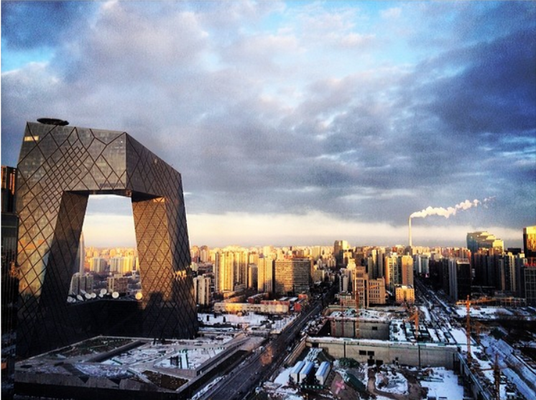
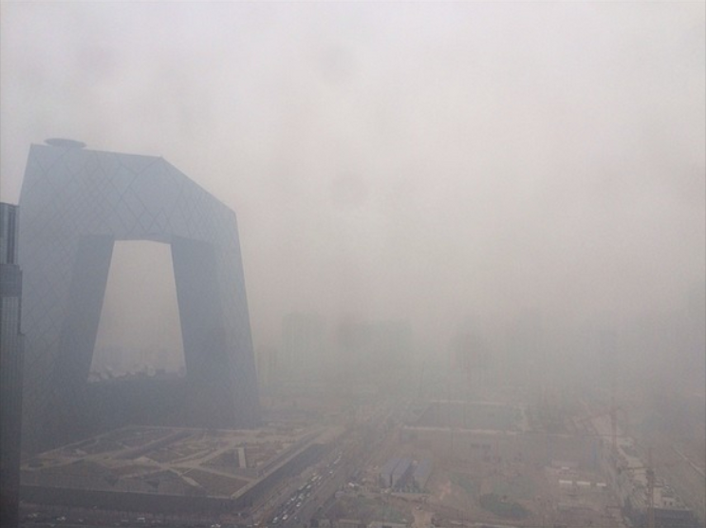
How will urban/rural communities change?
February 8, 2014 February 24, 2014
Business Insider

Slide 20
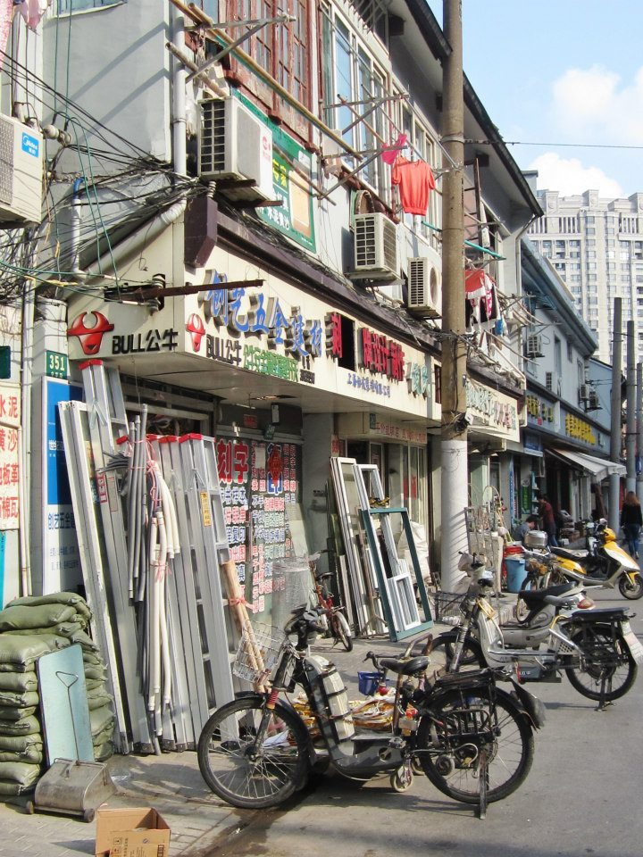
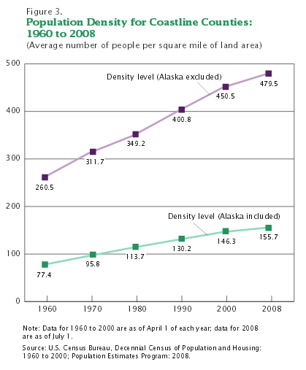
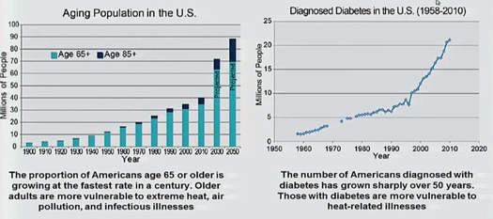
How will vulnerability change?

Slide 21
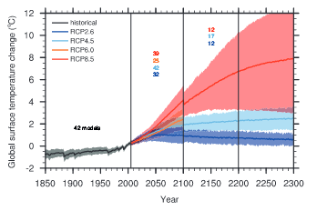
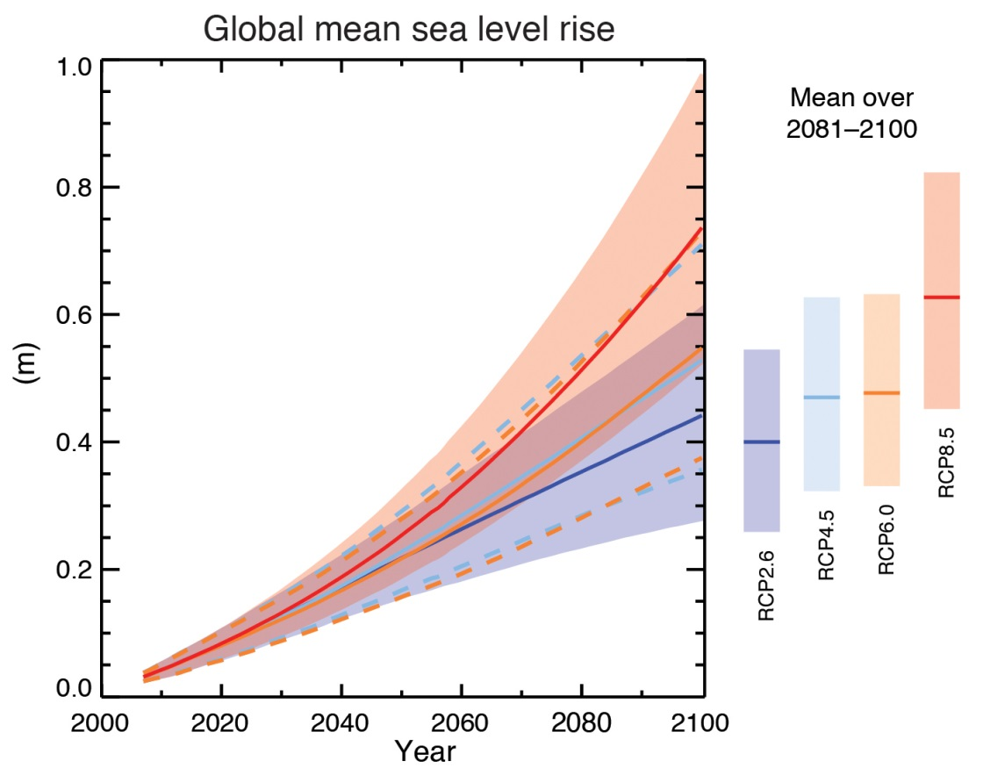
Projections vs. Forecasts
IPCC

Slide 22
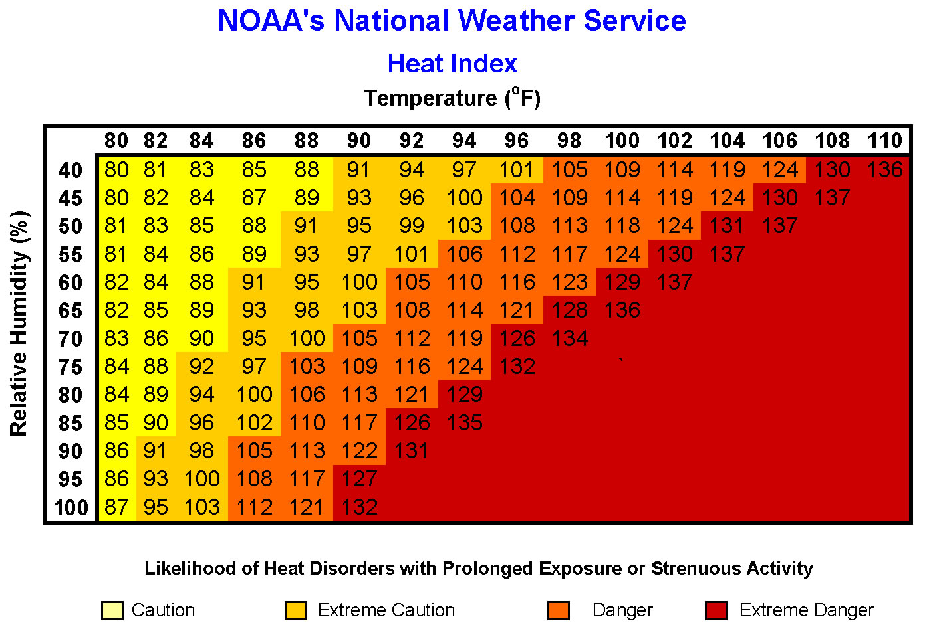
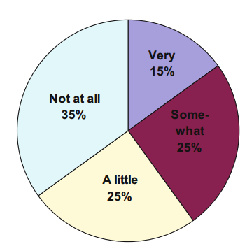
Perceptions vs. Reality
Sheridan 2007

Slide 23
Overview
What do we know?
What do we not know?
Research Opportunities

Slide 24





Research Opportunities
Science (Weather/Climate) Literacy
Personal Relationships/Trust
Multi (Anti) Discipline Approaches
Root Causes
Social Injustice
Energy Consumption

Slide 25



Thanks!
Michael Allen
mallen@odu.edu

Slide 26
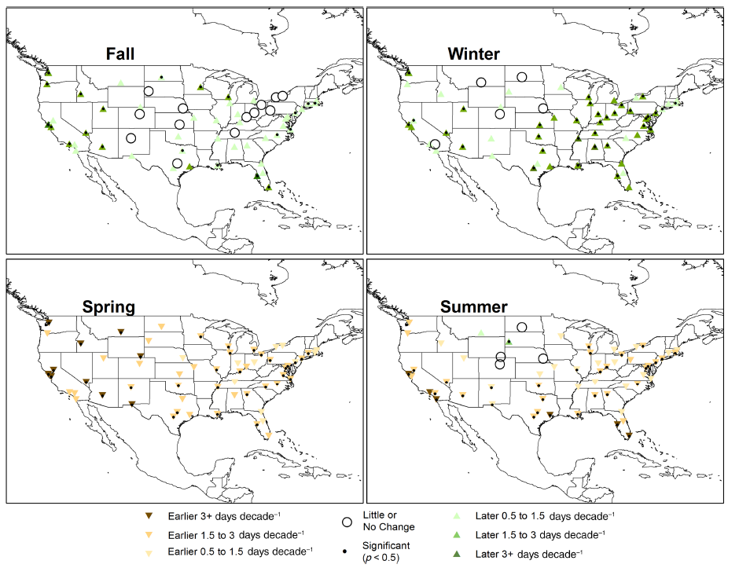

Slide 27
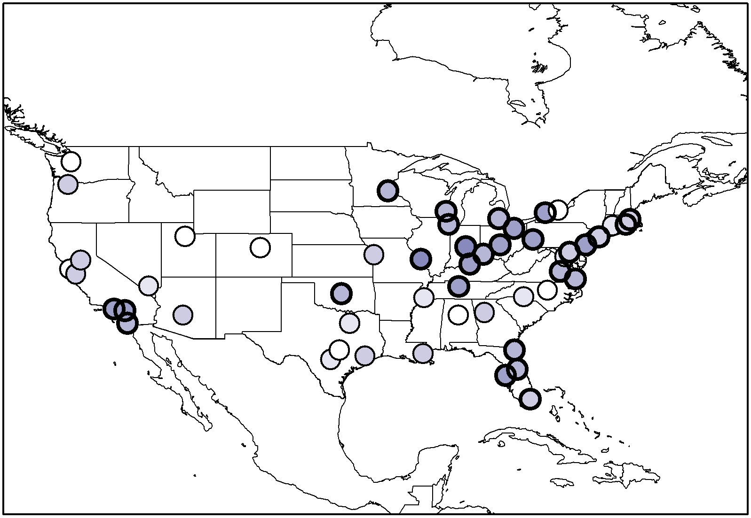
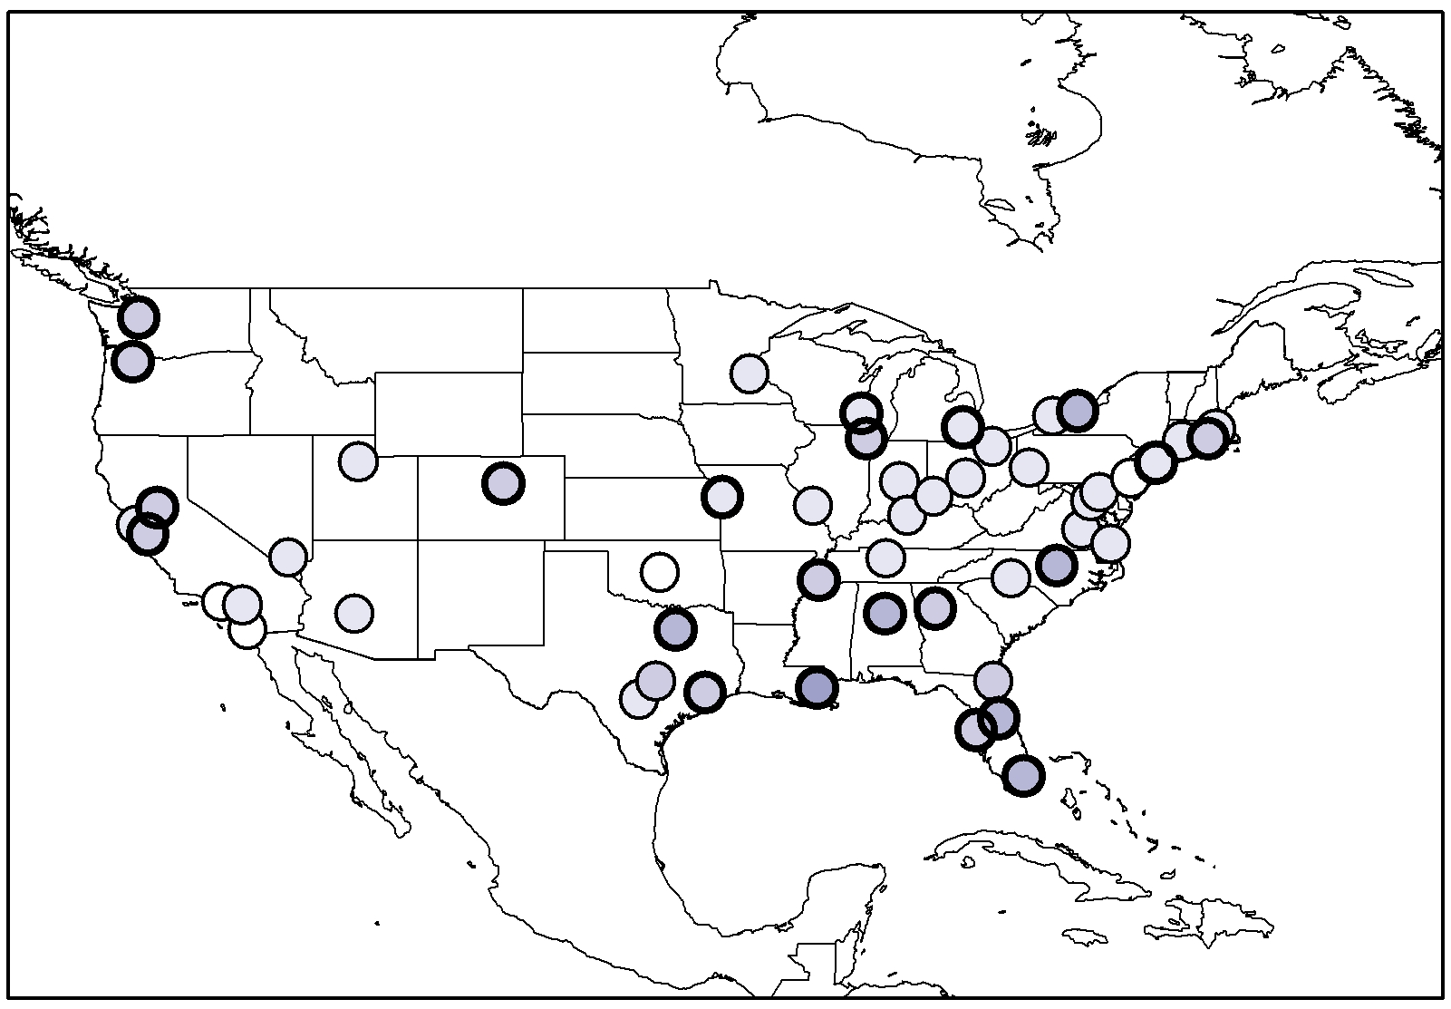
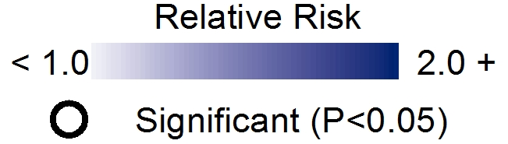
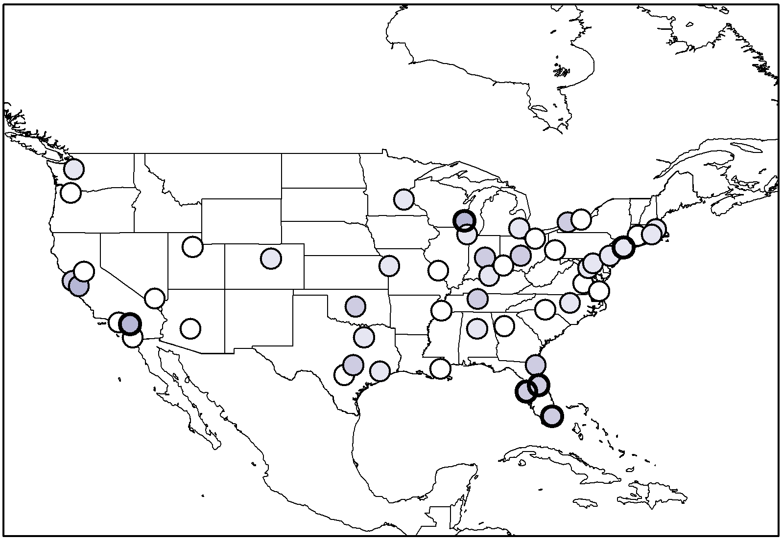
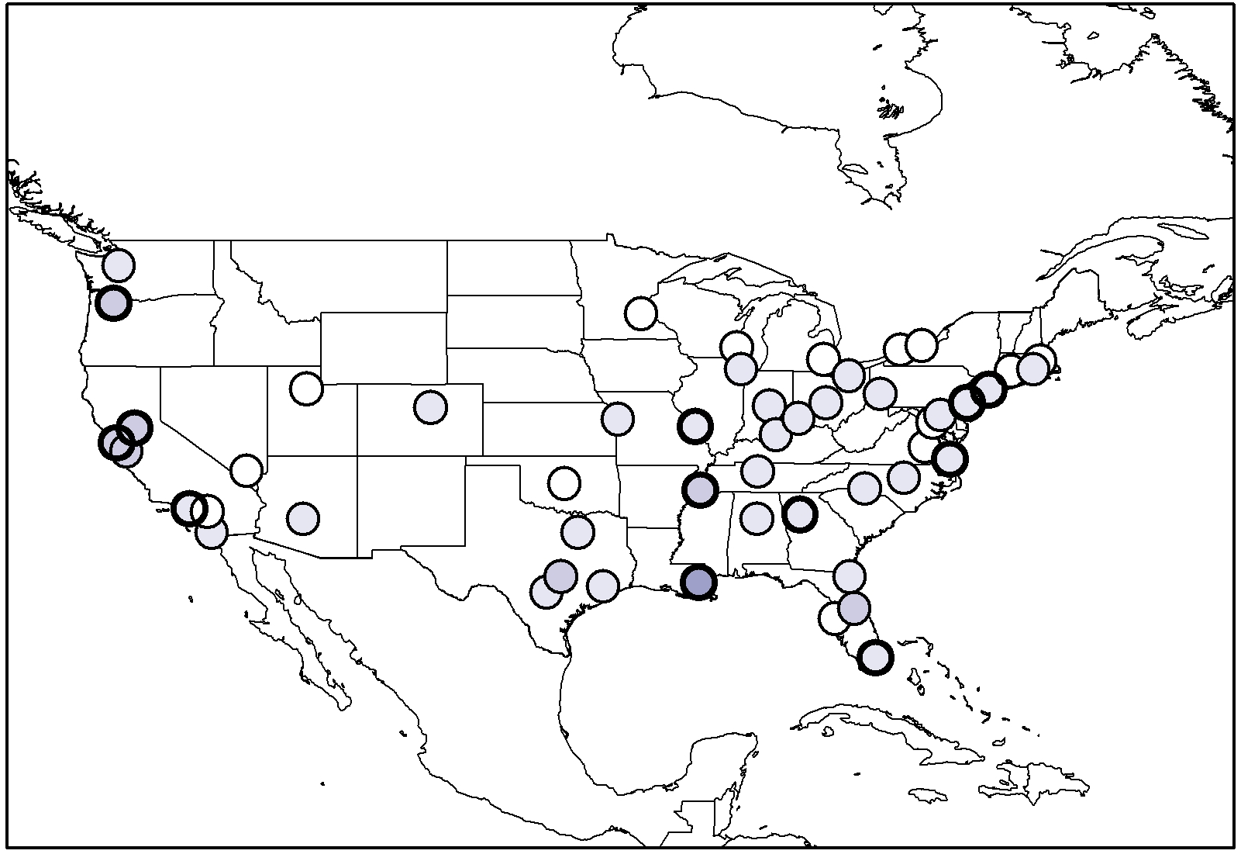
SHORT (<3 DAYS)
LONG (3+ DAYS)
EARLY
LATE

Slide 28
SHORT (<3 DAYS)
LONG (3+ DAYS)
EARLY
LATE
Earlier Events

