Slide 1
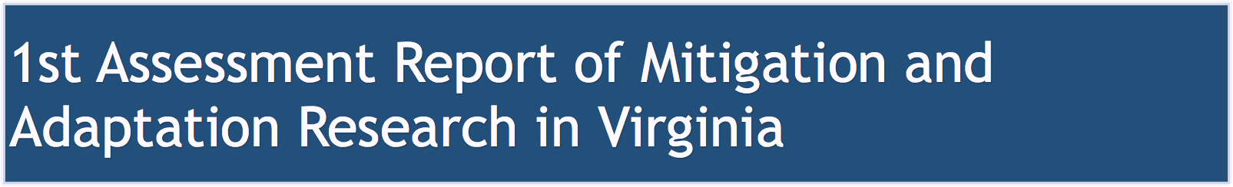

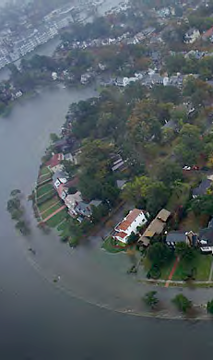
Goals
Schedule
Chapter Contents
Hans-Peter Plag
August 13, 2015

Slide 2
Mitigation and Adaptation Research in Virginia
The Report will be:
- first comprehensive assessment of our knowledge and research
needs
- produced by the academic community in Virginia
- comparable to IPCC and national assessments
- open to non-peer reviewed publications (e.g., state-mandated
reports),
- not seeking government endorsement

Slide 3
Schedule
- Preparation up to August 2015
- First author meeting: August 2015
- August 14: names to HPP
- August 31: chapter version to HPP
- September 2: First version available
- September 30: 25% version of chapters
- October 2: Second version of report available
- Draft Report Available: December 2015
- January 2016: Author meeting to refine report
- Academic Review and Hearing: January-February 2016
- Final Report available: April 2016

Slide 4
Mitigation and Adaptation Research in Virginia
- Introduction
- The Hazards (Co-leads: Michael Allen, ?)
- Vulnerabilities (Co-Leads: Joshua Behr, ?)
- Foresight (Co-Leads: Hans-Peter Plag)
- Decision making and decision support (Co-Lead: Cindy Tomovic, Wie Yusuf tbc)
- Options (Co-Leads: Anamaria Bukvic, ?)
- Knowledge Gaps
- Research Needs
- Towards a Research Framework
- Assessment and Recommendations

Slide 5

Introduction of the chapter subject
What of this is relevant for Virginia
Overview of the research and the resulting knowledge in Virginia concerning the subject - focus on knowledge
Assessment of the knowledge, availability of knowledge, and identification of the gaps
What research is needed/should be prioritized to address the gaps
Recommendations

Slide 6
1. (Brief) Introduction of Climate Change and Sea Level Rise hazards
2. Hazards relevant to Virginia:
storm surges/hurricanes
sea level rise
hazardous ecosystem changes (including infectious diseases)
changes in precipitation
wind
droughts
tornadoes
extreme cold spells, ice storms
wildfires
ocean warming and acidification
3. Research on Hazards in Virginia
4. Assessment of Knowledge and Gaps
5. Research Needs
6. Recommendations
This should discuss the different time scales (short-term, long-term)

Slide 7
Brief Introduction to the concept(s) of vulnerability
Vulnerabilities in Virginia
Our concept used in the report
- Public services (transportation, communication, food and water supply, sewage systems, power,
health, ecosystem service)
- built infrastructure/environment
- economics
- social community structure/inequality/migration/population changes
- external impacts (social instability, migration, population growth)
- natural environment
3. Research on Vulnerability in Virginia
4. Assessment of Knowledge and Gaps
5. Research Needs
6. Recommendations
For all vulnerabilities, we need to consider those that have short time scales (more or less immediately in response to a hazardous event, and those that would developed on longer-terms if exposed to a hazard for a long time.

Slide 8
Brief introduction to the concept of foresight, foreseeability and the differences to prediction and projections
Foresight in our contexts is the an act of looking forward and taking care or provision for the future. It refers to the insight of what the future might be. Like for hazards and vulnerability, the time scale is important and we have to consider short-term and long-term foresight.
2. The Role of Foresight in Virginia
We need foresight with respect to hazards and their changing probabilities and vulnerabilities that are changing with a changing build environment, social fabric, and socio-economic interdependencies.
3. Research leading to Foresight
4. Assessment of the role of foresight, gaps, and needs
5. Research Needs
6. Recommendations

Slide 9
Brief introduction to the role of decision making in mitigation and adaptation
Specifics of decision making in Virginia (various levels, role of knowledge, integration of science, engagement of academic community, …)
Research on decision making and decision support in Virginia
Assessment of the knowledge on decision making and identification of gaps, including the reasons for insufficient/lag of decision support
Research Needs
Recommendations

Slide 10
Brief introduction to options to mitigate impacts and adapt to changes (including preparedness, resilience, etc.)
2. Overview of options relevant for Virginia
3. Research on options for build environment, natural environment, social, economic,
community
4. Assessment of the knowledge on options and knowledge gaps
5. Research Needs
6. Recommendations

