Slide 1
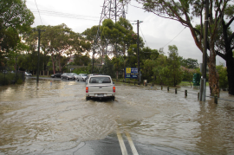

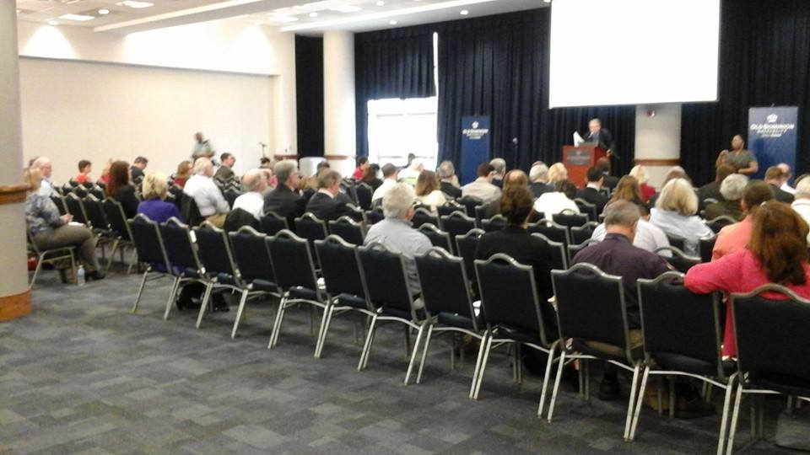
INTERGOVERNMENTAL PILOT PROGRAM: Update
May 4, 2015

Slide 2
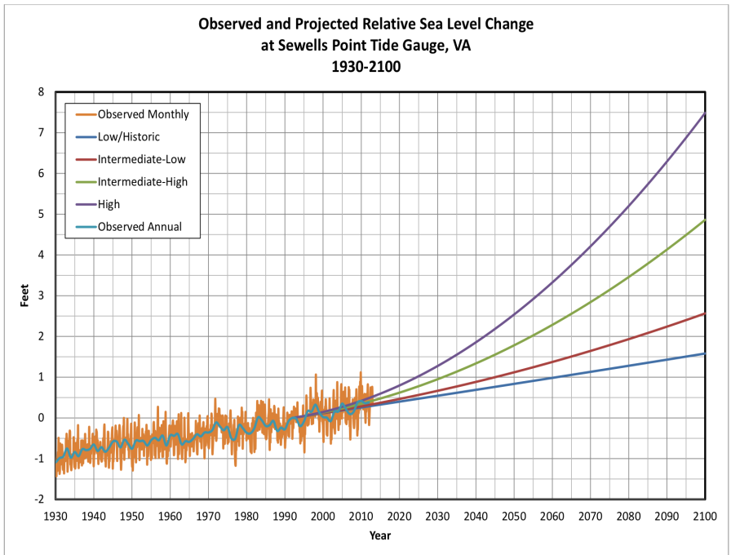
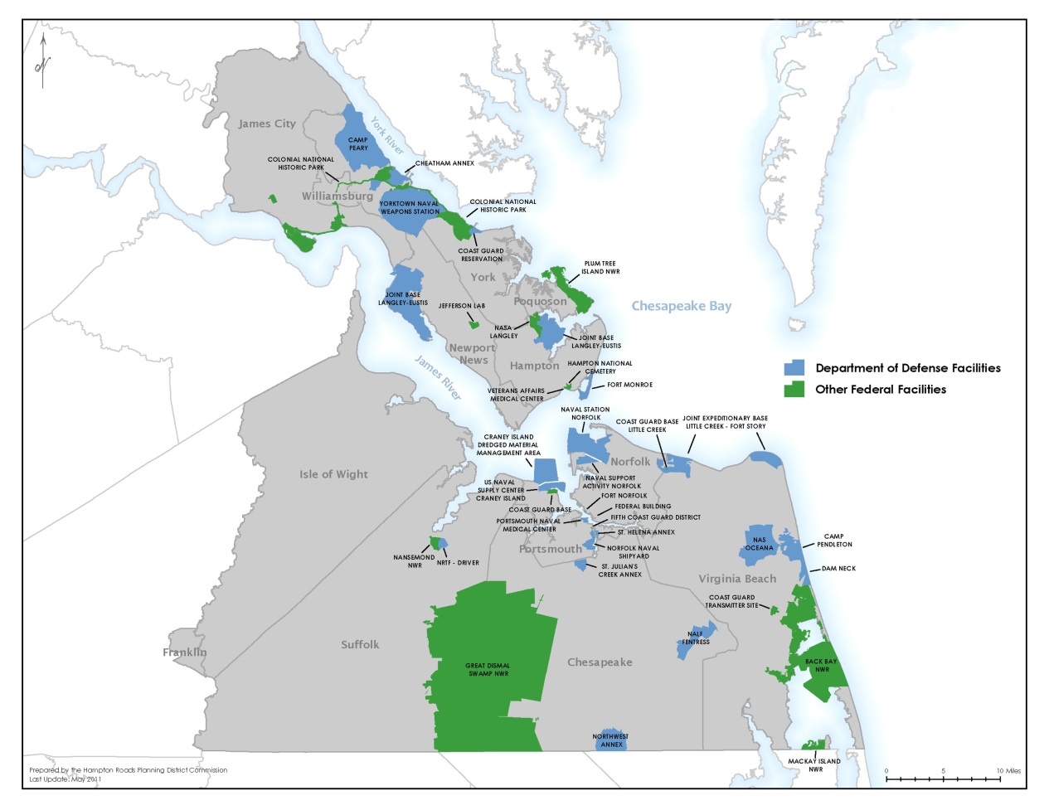
Federal Facilities & SLR in Hampton Roads
HRPDC
Courtesy of HRMFFA

Slide 3
Intergovernmental Pilot Program
MISSION
Develop a regional “WHOLE OF GOVERNMENT” and “WHOLE OF COMMUNITY” approach to SLR Preparedness and Resilience Planning by June 2016
VISION
An intergovernmental planning organization that can effectively coordinate the sea level rise preparedness and resilience planning of Federal, state and local government agencies and the private sector, taking into account the perspectives and concerns of the citizens of the region.

Slide 4
Timeline
Phase I
Charter Signed
Phase II
Focus on Regional and Model Deliverables
Develop Collaborative Organization
Future
Continued “Whole of” Collaboration for Effective and Efficient SLR Planning in Hampton Roads
Network of Regions
Committees Develop Work Plans & Deliverables
Data Integration
Stakeholder Engagement & Fact Finding

Slide 5
Whole of Government & Community
Effective Resilience Planning
Civic
Engagement
Land Use
Legal
Infra-structure
Economic Impacts
Science
Other
Stakeholders
Military
Local Gov
Commonwealth
Federal Gov
Private Sector

Slide 6
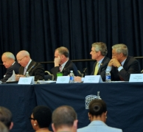
Proposed Regional Deliverables
Trusted, Neutral Venue for Discussion, Collaboration, Planning, and Action
Draft Principles for Living With the Water in HR
This is not a challenge that can be fixed, but a dynamic environment to which we must continuously adapt
Common (and periodically dry) ground for ongoing communication and collaboration for truly regional SLR strategic planning and action
Clearing House Tailored for Hampton Roads
Localized Scientific Projections, Mapping, Simulation, etc.
Integrated network of SLR & Subsidence Measurements (real-time and near-real-time)
Analyses of Regionally Relevant Legal Issues & Policy Guidance Where Appropriate
Framework to Understand Critical Infrastructure Interdependencies in HR

Slide 7
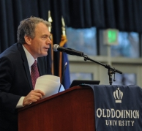
Proposed Model Template Deliverables
“Whole of Government” Template for Regional Collaboration
Customizable Base Level “Whole of Community” Engagement & Communications Template
Public Health Resilience Toolkit
Land Use Vulnerability Index
Infrastructure Prioritization Toolkit (Resiliency Recommendations)
Identification of Legal Impediments to Regional Planning and Action & Potential Solution Recommendations

Slide 8
On the Horizon
Legal Primer: Reference Guide for SLR Planning
Infrastructure Interdependencies
Engage New Stakeholders:
Public Health
Economic Impacts & Development
Long-lasting Networks within Hampton Roads and with similarly situated regions to facilitate effective planning.

Slide 9
Proposed Center for Sea Level Rise
In partnership with VIMS
Integrate Federal, state, and local data sources creating real-time or near-real-time climate resiliency monitoring and planning network for the Hampton Roads Region.
Use data to enable both emergency and long-term decision-making through street level predictions and more.
Develop the network as a national model for adaptation to sea level rise.
To provide technical assistance in implementing this model in other US regions that experience sea level rise.

Slide 10
Contact
Ray Toll
Director of Coastal Resilience Research
rtoll@odu.edu
(757) 683-6650
Emily E. Steinhilber
Assistant Director of Coastal Resilience Research
esteinhi@odu.edu
(757) 683-5031
Ray TollOnline
Online
www.centerforsealevelrise.org
www.facebook.com/centerforsealevelrise
@ODUsealevelrise

