Slide 1
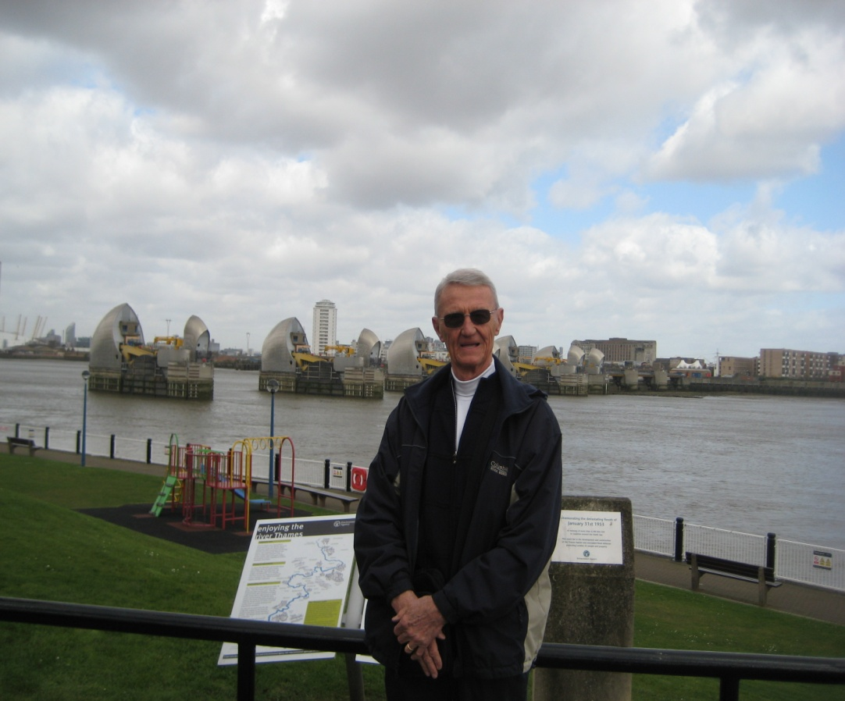
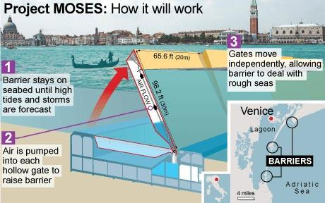
Tidal Flood Gates for Tidewater Virginia : Study Costs, Construction Costs, Annual Maintenance Costs – Who Pays ?
David R. Basco PhD, PE
Professor Emeritus
Old Dominion University
August 12, 2015
Movable Flood Gates- Tidal Inlets
Venice Lagoon , Italy
Movable Flood Gates- Thames Barrier London (2013)

Slide 2
Outline of Presentation
Existing project in Central Business District in Norfolk at Nauticus on Boush Street
Proposed project for The Hague area in Norfolk
Proposed project for transportation corridor on Hampton Blvd in Norfolk

Slide 3
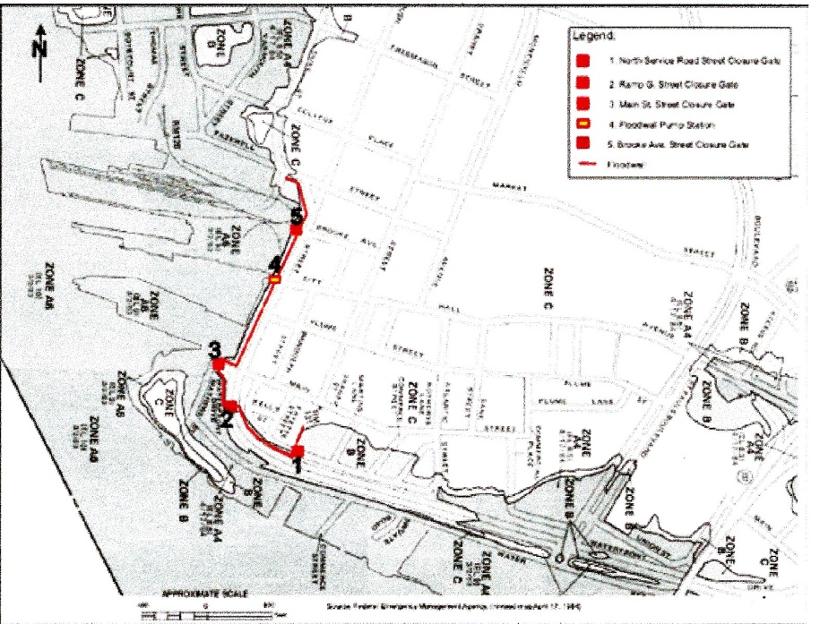
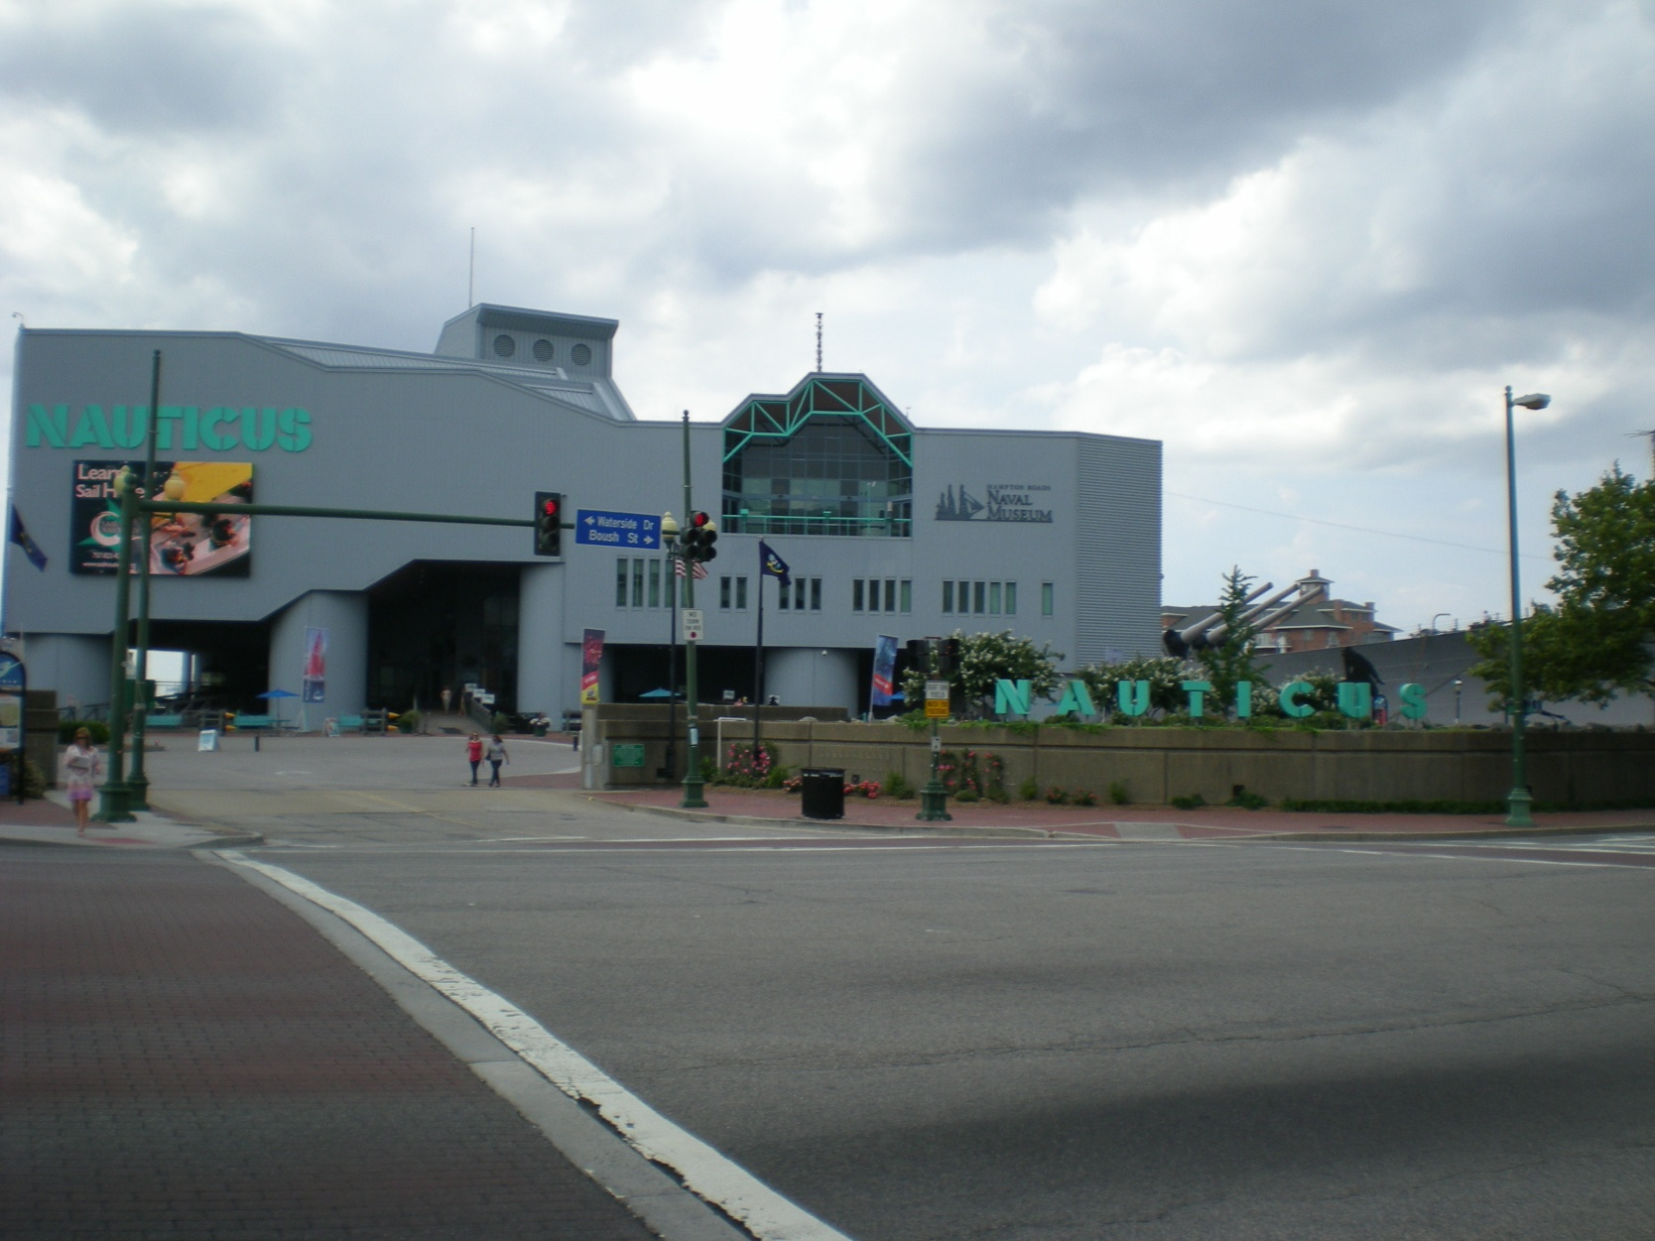
1.Norfolk Downtown Flood Wall on Boush Street:
Two Storm Surge Flood Gates

Slide 4
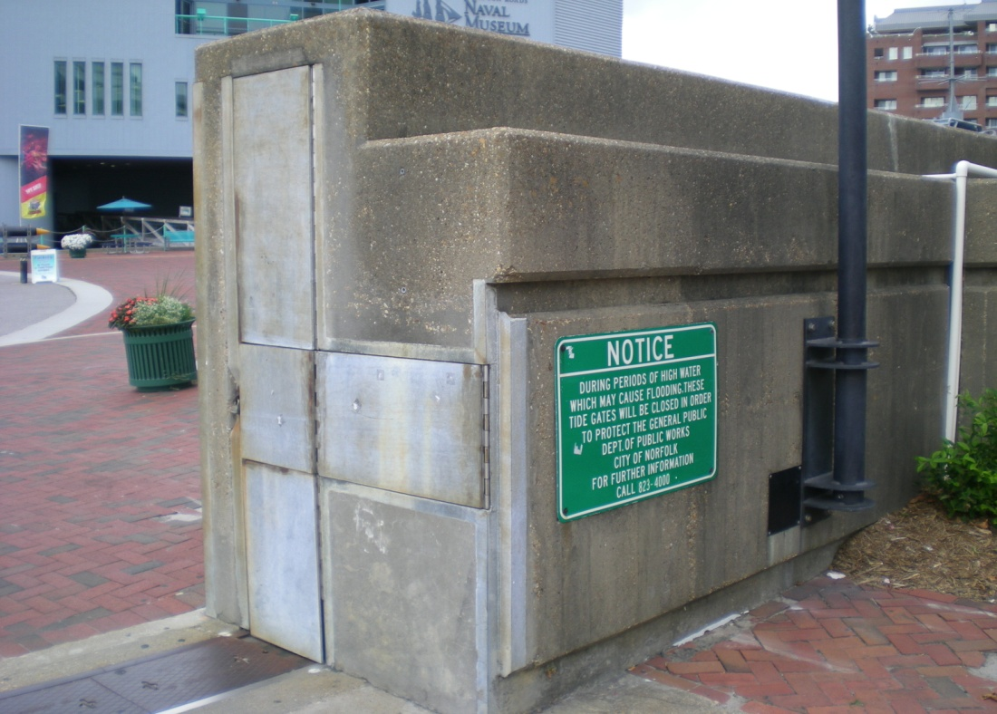
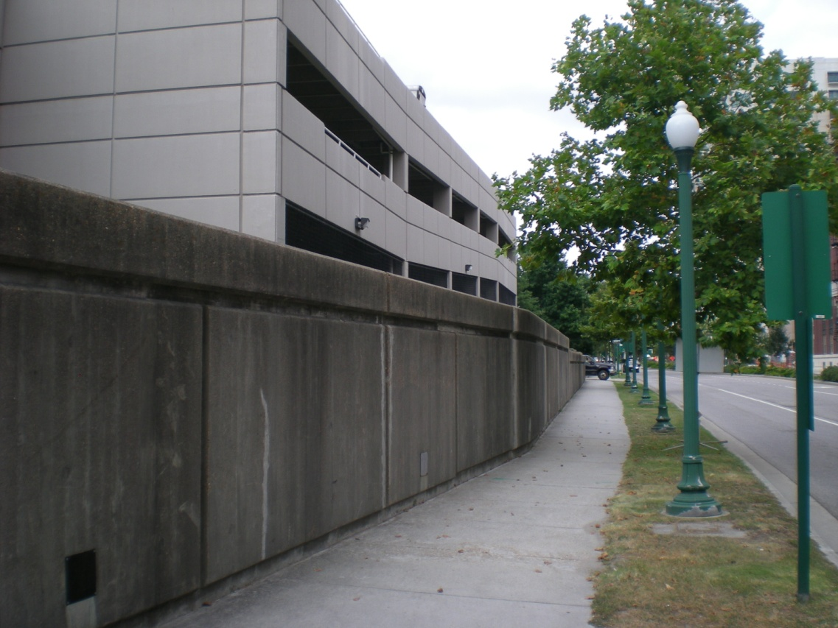
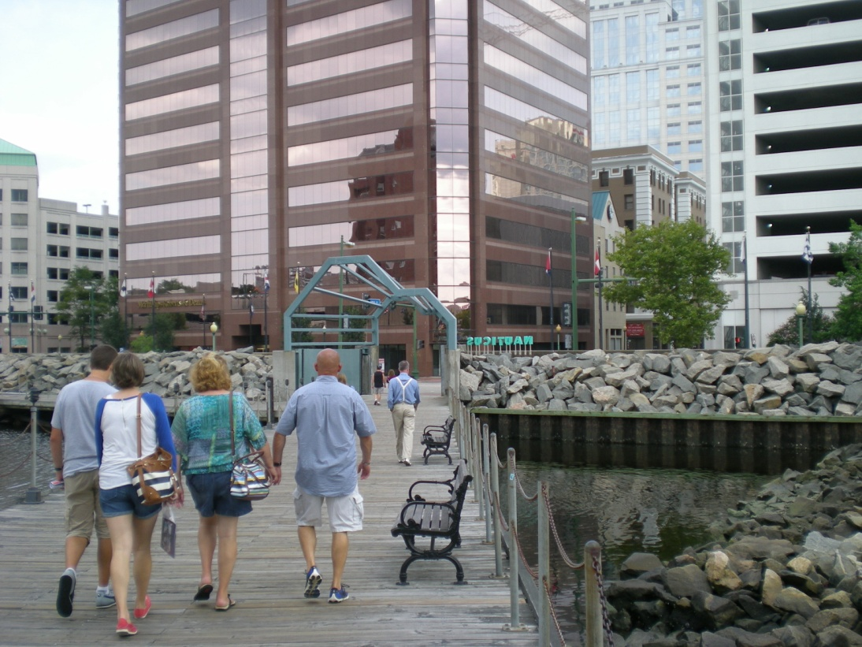
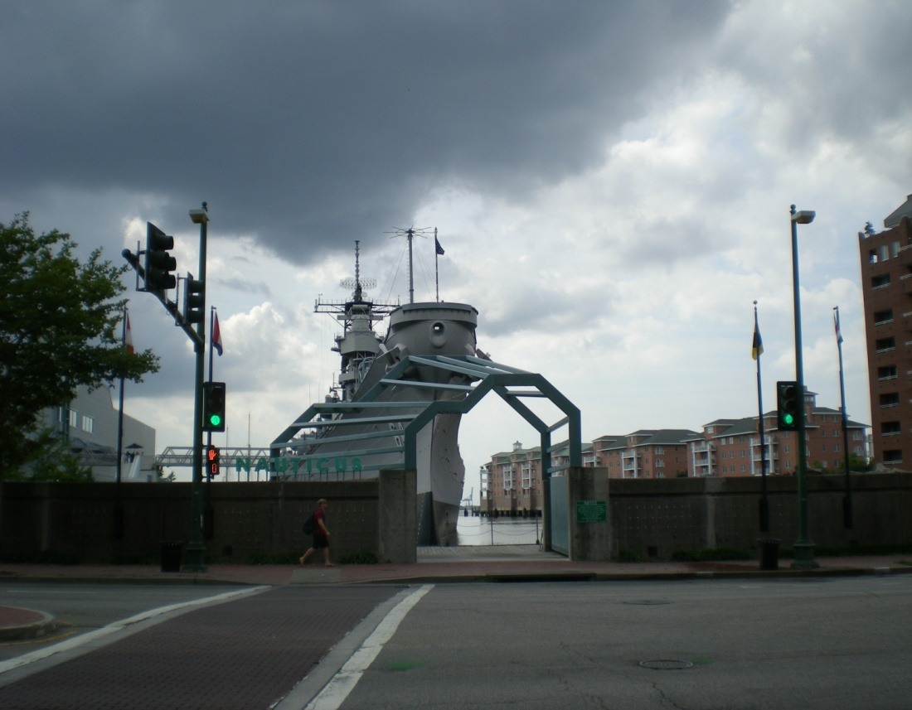

Slide 5
Norfolk Downtown Floodwall
Designed by Corps of Engineers 1964
Constructed in 1965
Construction Cost $2.5M (1965) $50M (2015)
Operated and Maintained by City of Norfolk
Annual Maintenance Costs ???? (2015)
Benefit/Cost ratio 2.6 (1965)
Cost share 70% Federal 30% City of Norfolk

Slide 6
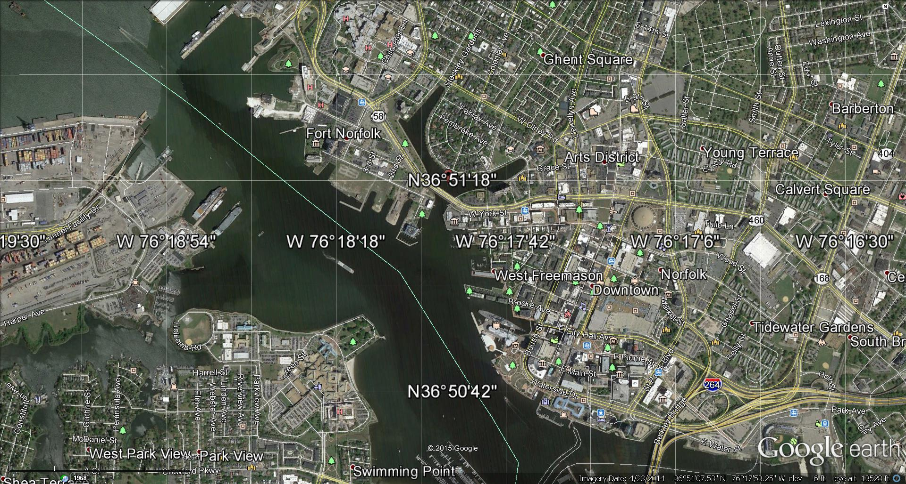
2. Proposed Flood Gates (Brambleton Ave ) The Hague
1. Downtown Business District Flood Wall & Gates

Slide 7
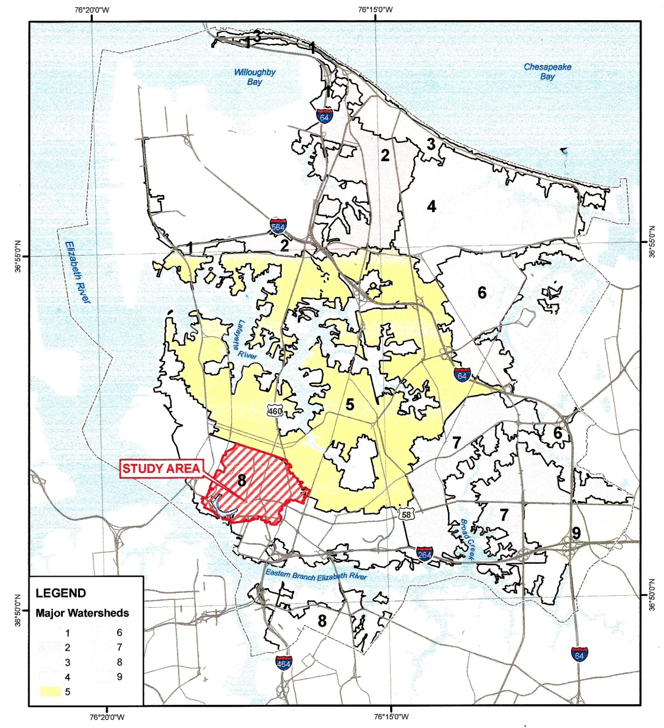
2. Proposed Flood Gates : The Hague Watershed

Slide 8
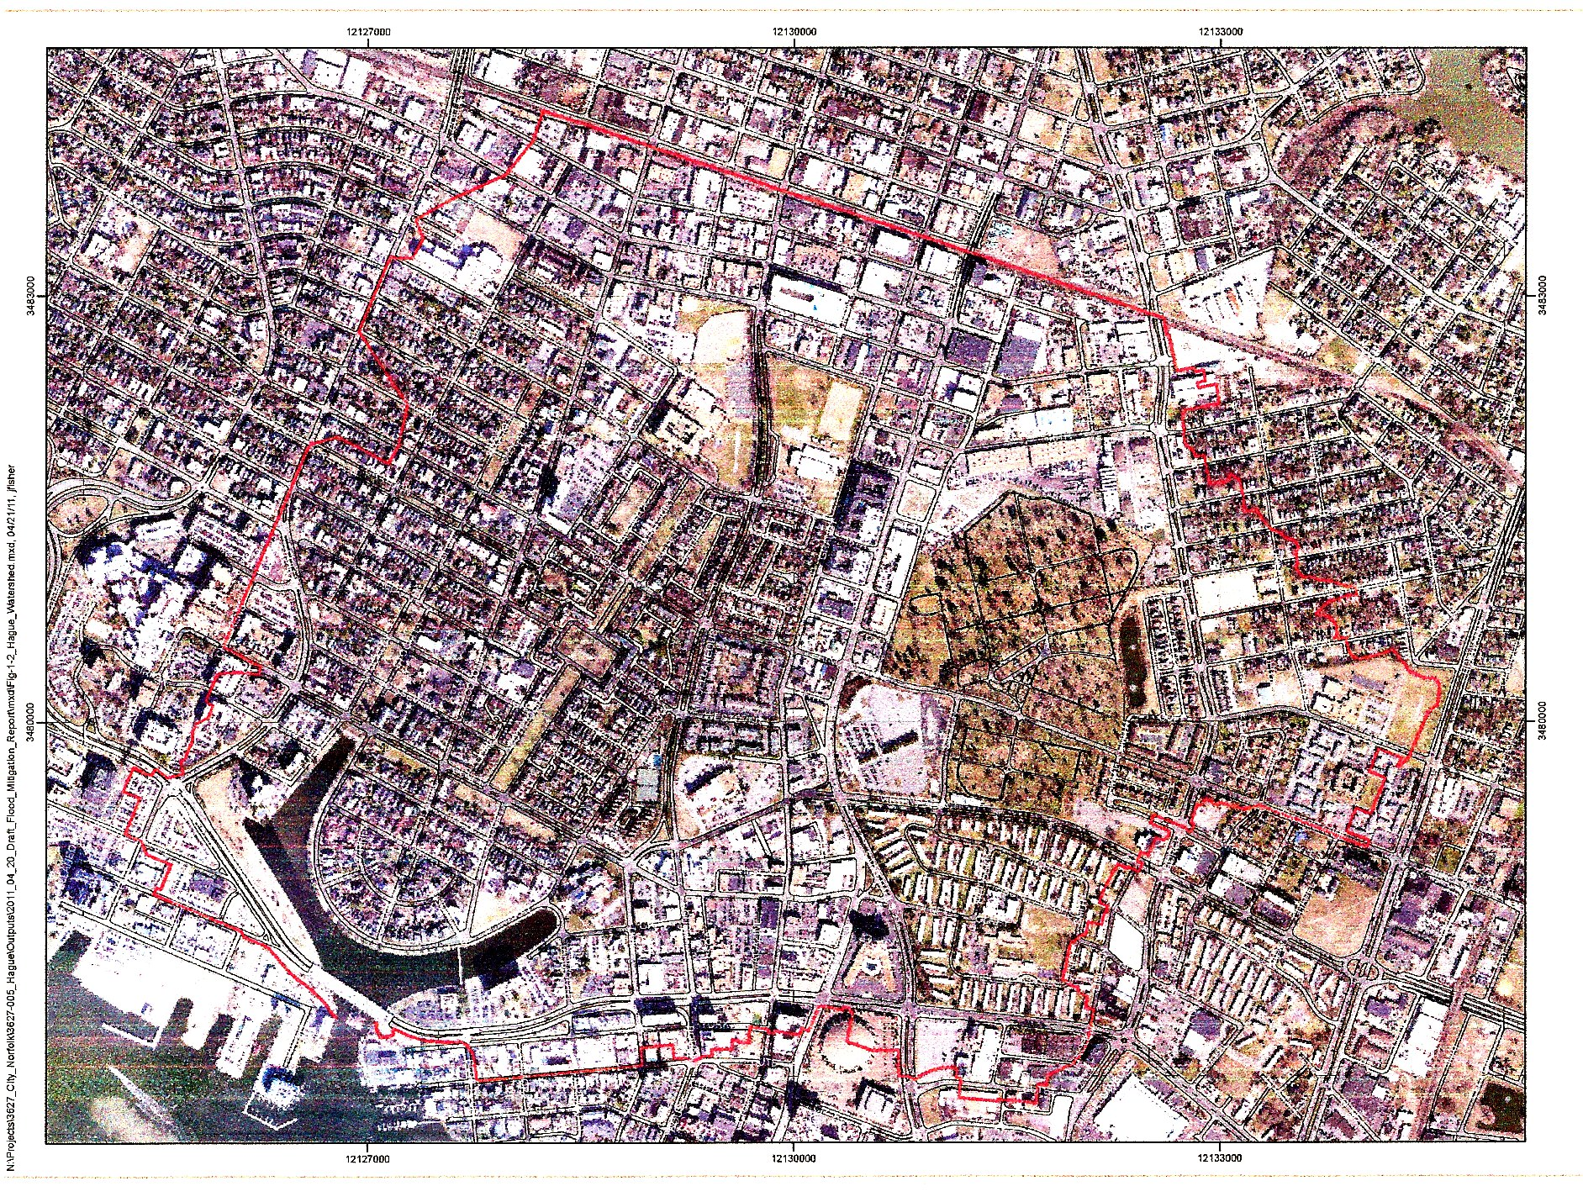

Slide 9
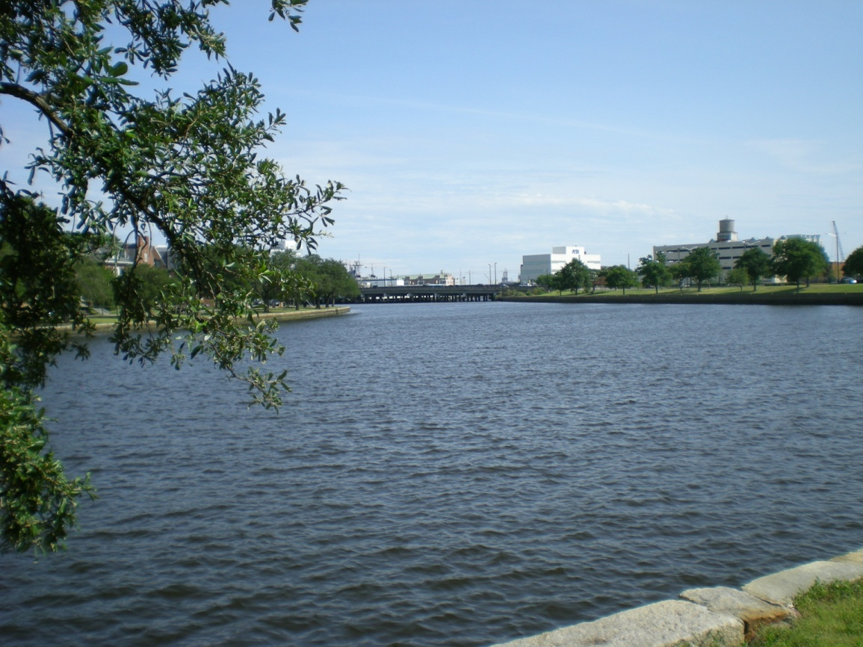
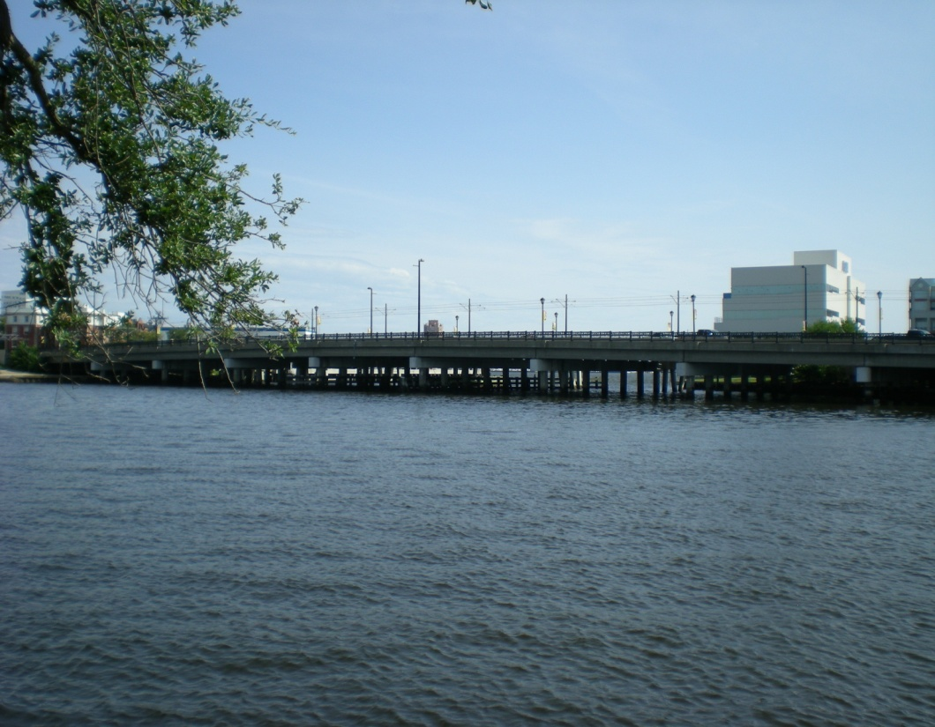
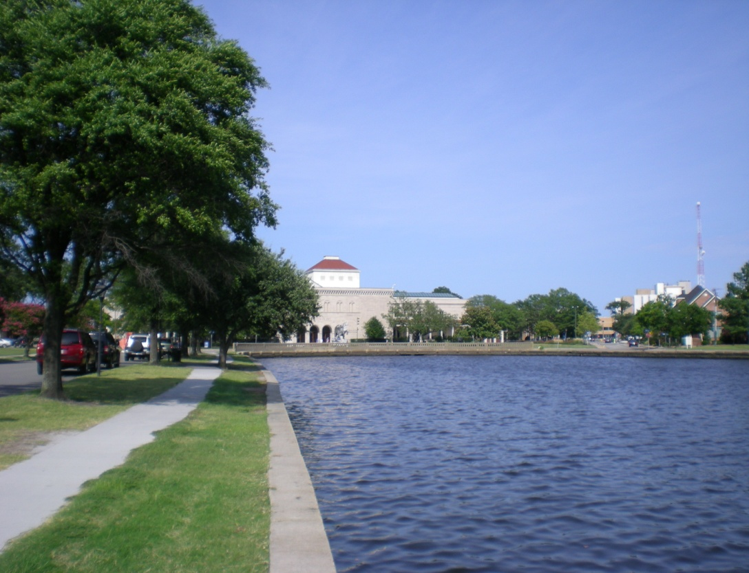
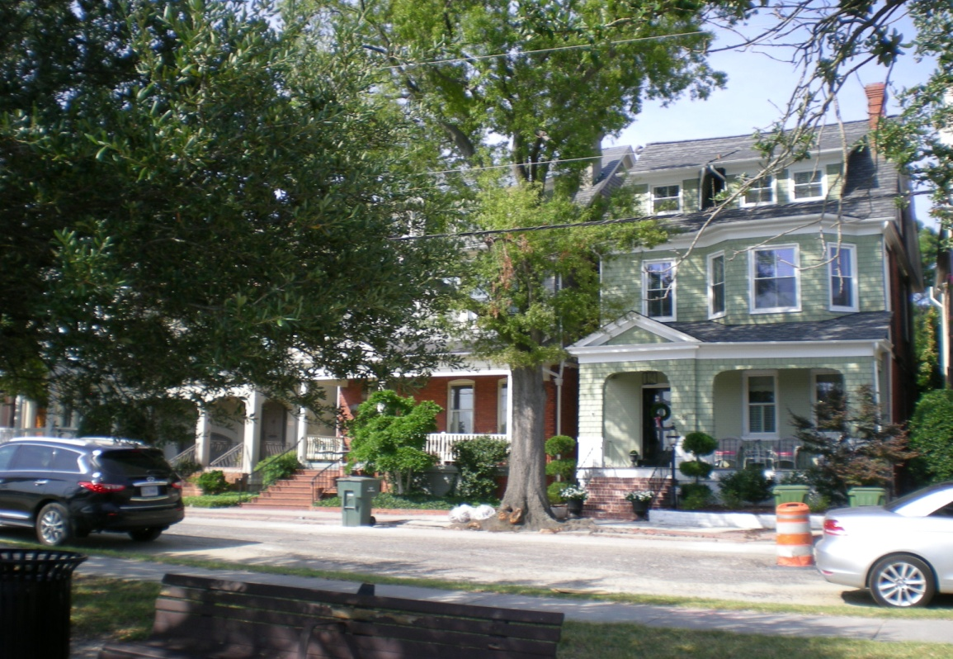

Slide 10
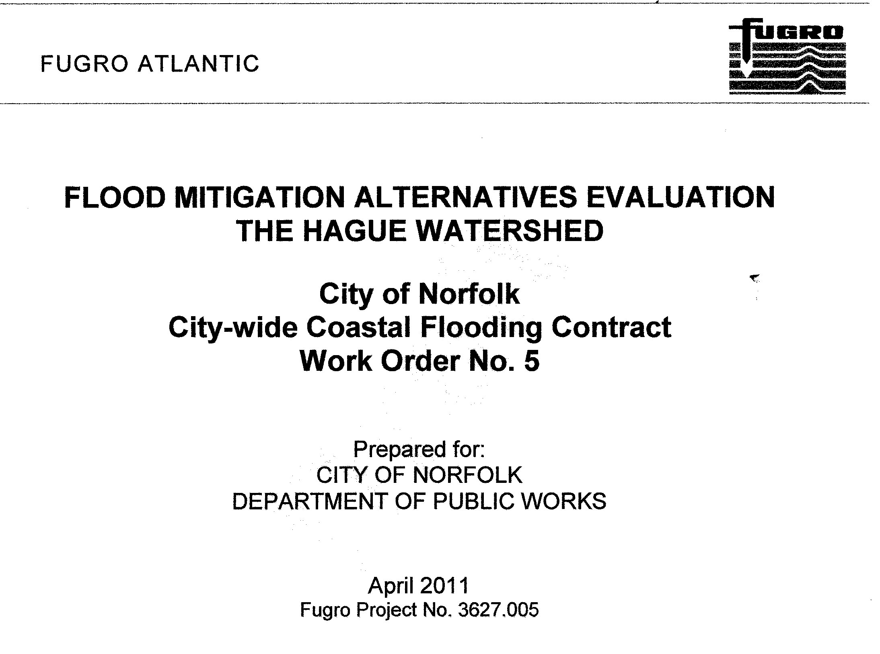

Slide 11
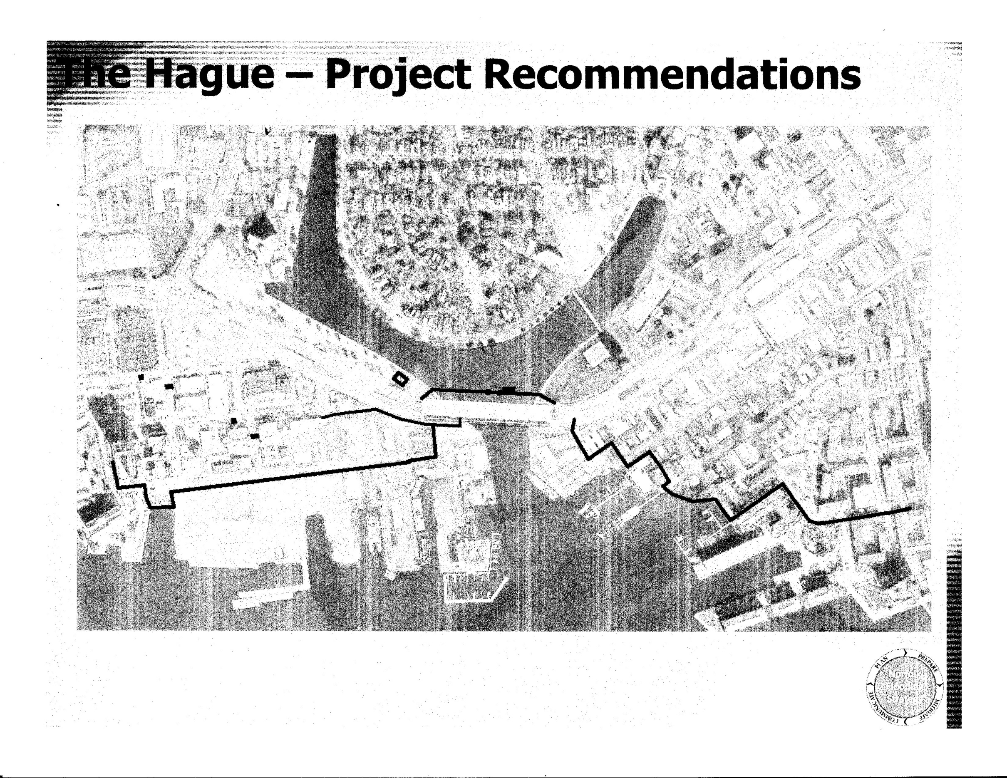

Slide 12
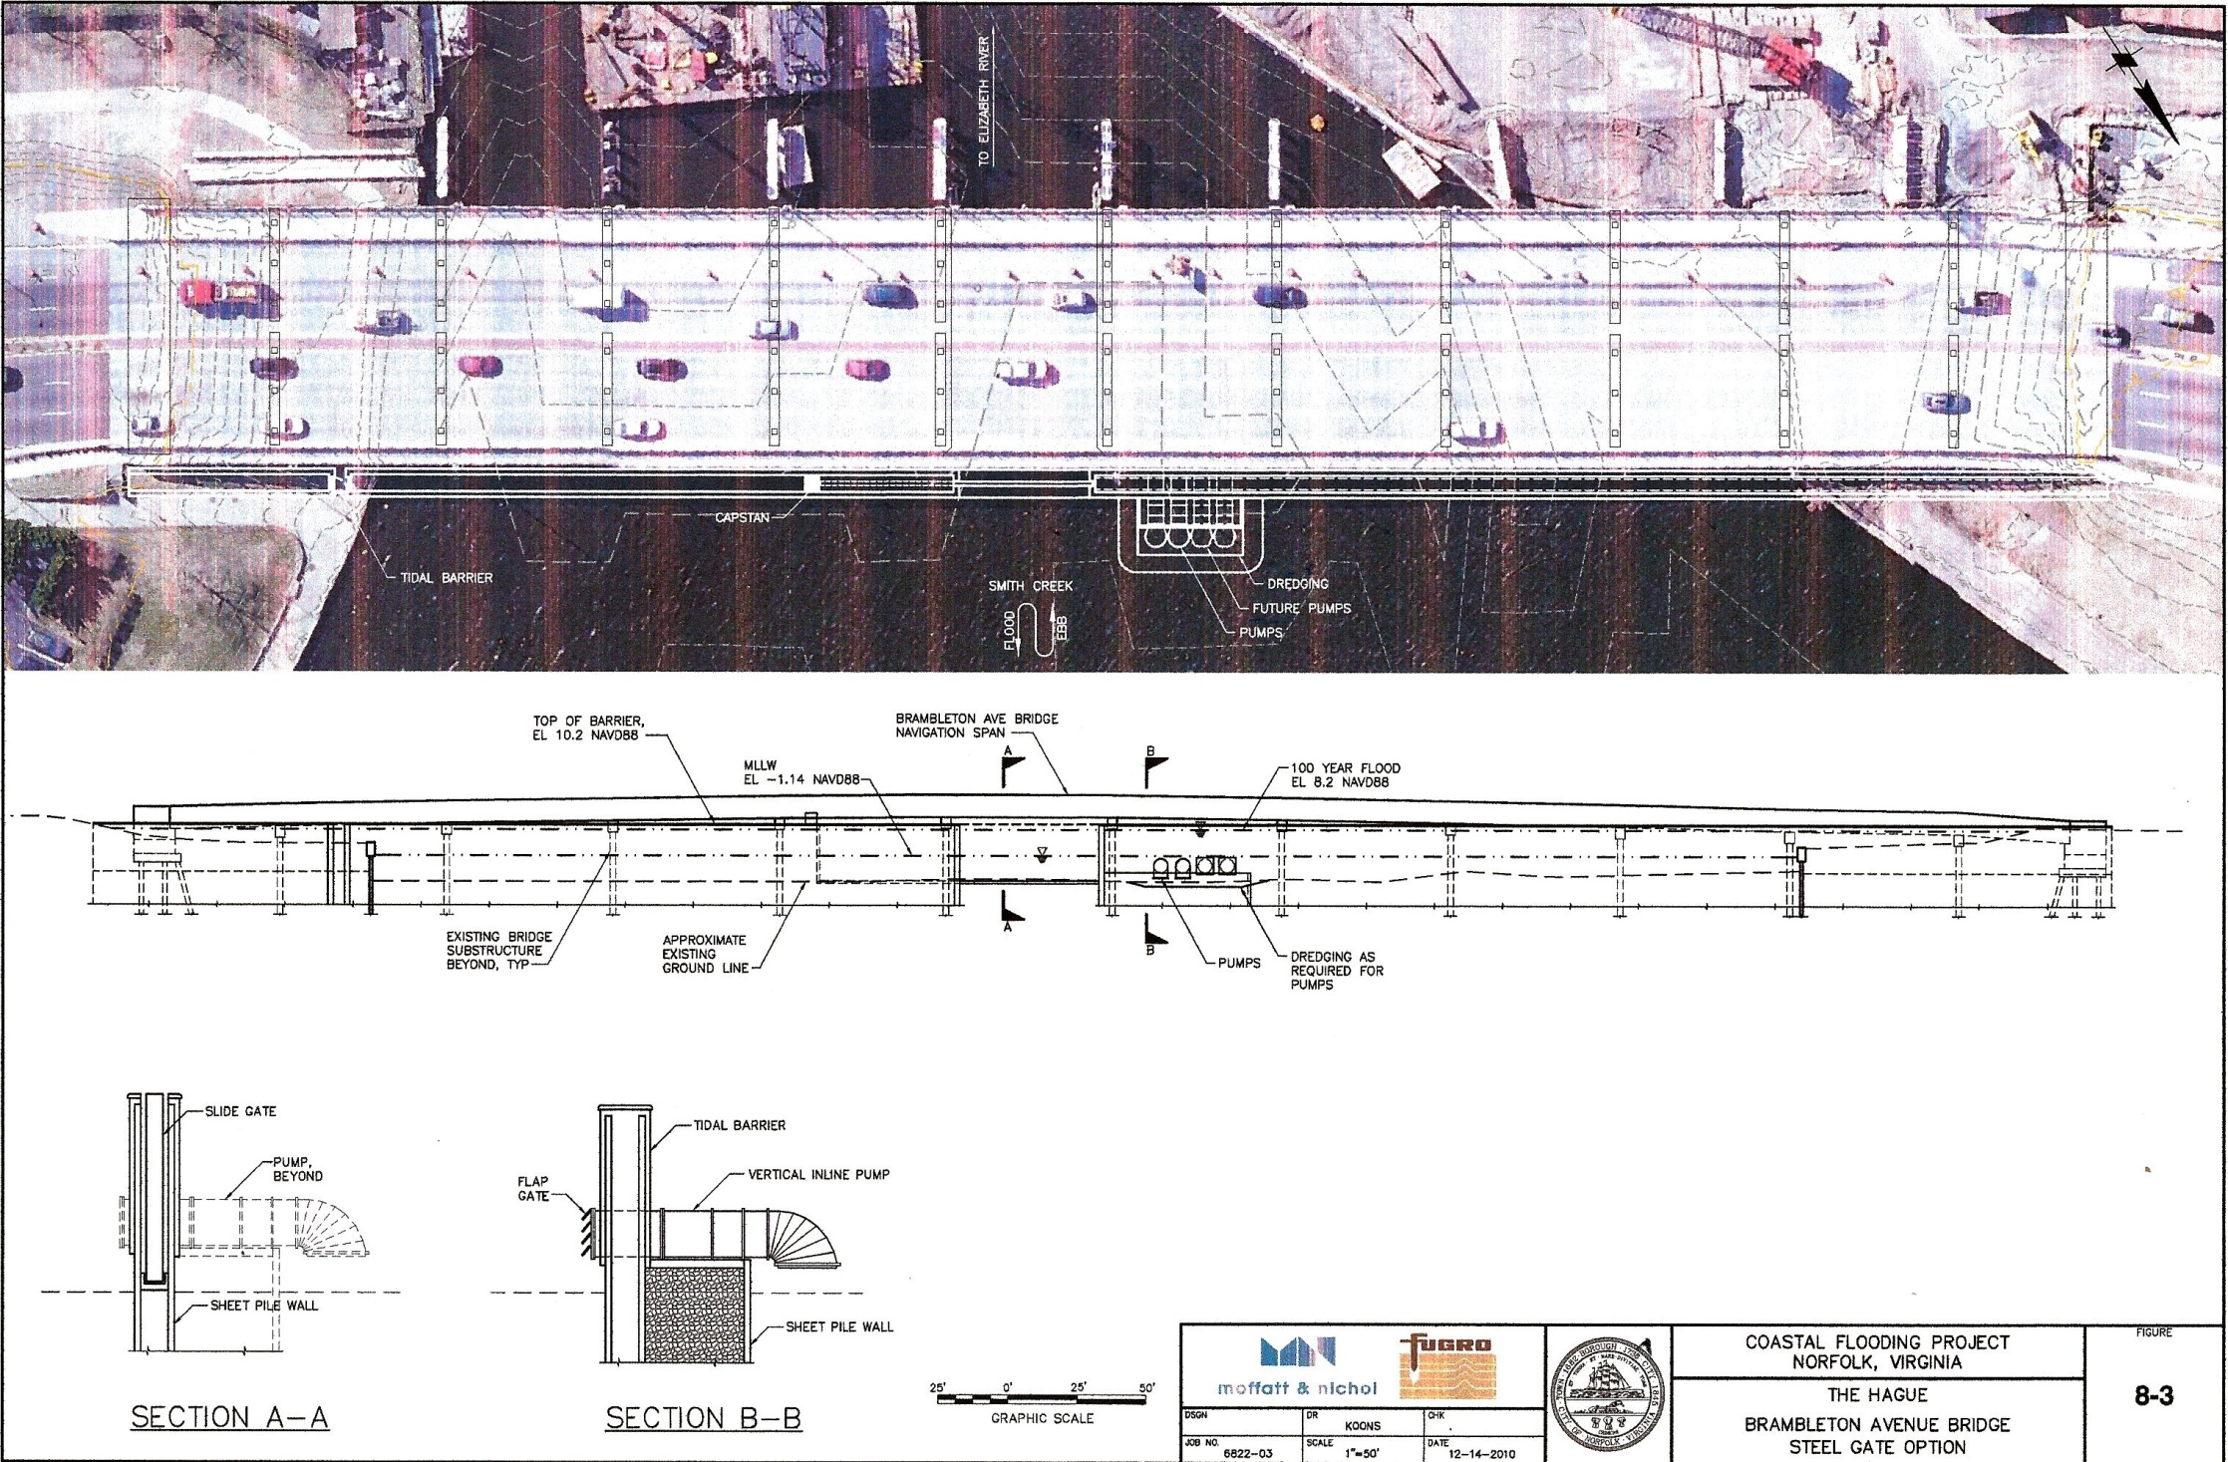
Movable Flood Gates Stay Open to Permit Normal Daily Tidal Cycles then Closed for Storm Surge Events

Slide 13
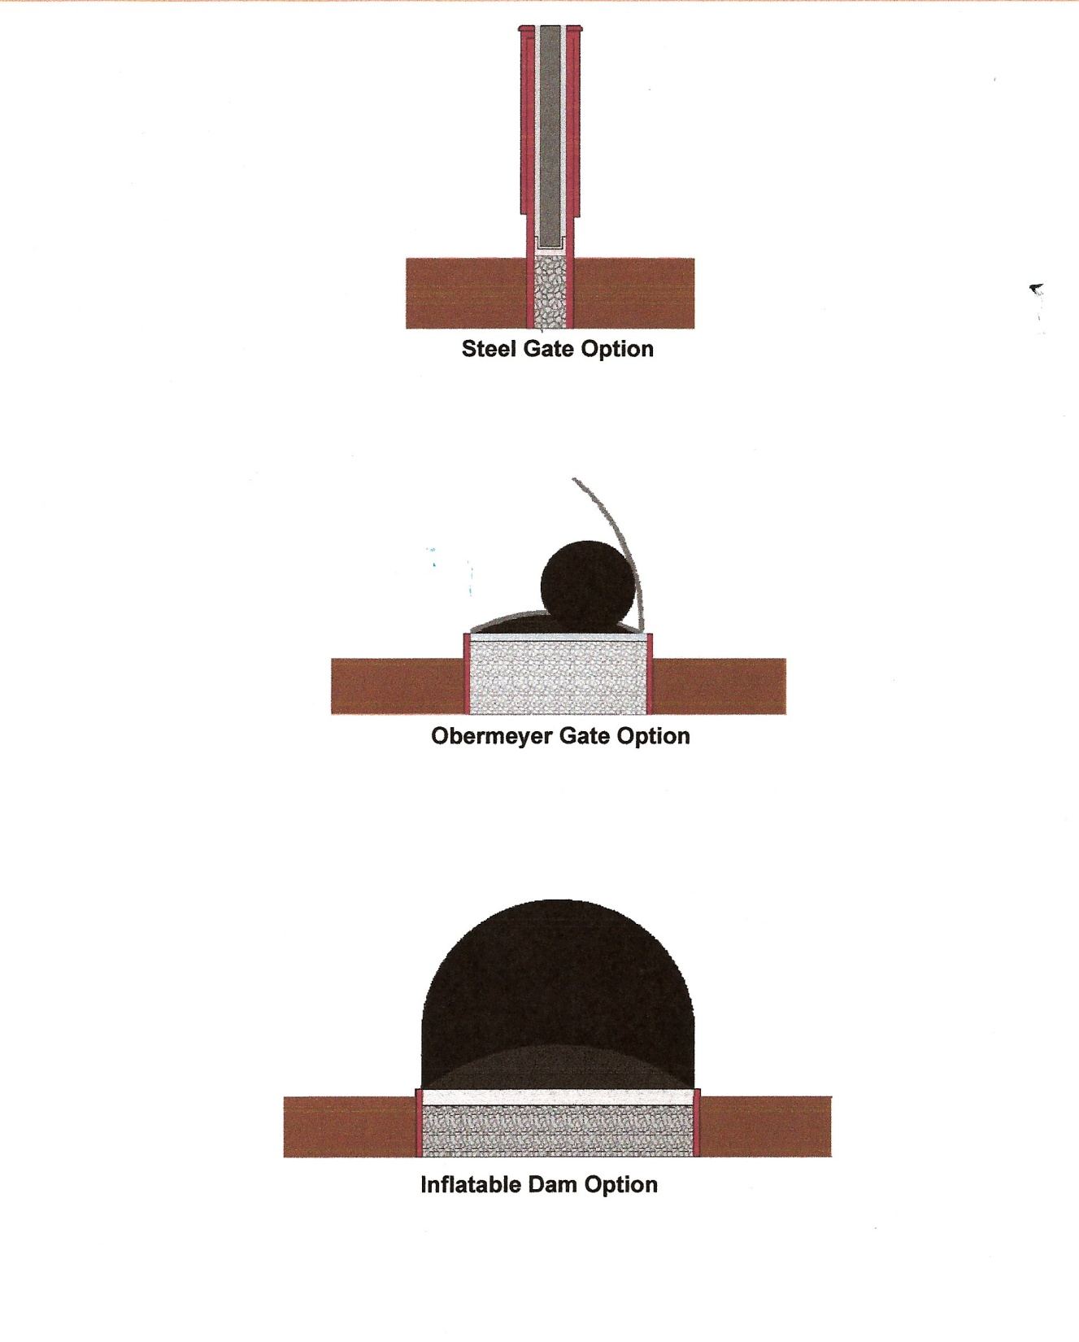
Steel Gate Option Best

Slide 14
The Hague Watershed Project- Proposed
Study of Alternatives -Fugro Atlantic 2012
Study Cost $170,000 (2012)
Estimated Construction Costs $60M (2010)
Annual Maintenance Costs $360K (2010)
Benefit/Cost ratio 1.34 (does not include vehicle damage, displacement costs, emergency response, lost business and rental income, others)
Potential Funding - Corps’ Continuing Authorization Program and HUD’s National Disaster Application Grant

Slide 15
The Hague Watershed Project- Proposed
Study of Alternatives -Fugro Atlantic 2012
Study Cost $170,000 (2012)
Estimated Construction Costs $60M (2010)
Annual Maintenance Costs $360K (2010)
Benefit/Cost ratio 1.34 (does not include vehicle damage, displacement costs, emergency response, lost business and rental income, others)
Property Buyout Option $ 460M (2010)

Slide 16
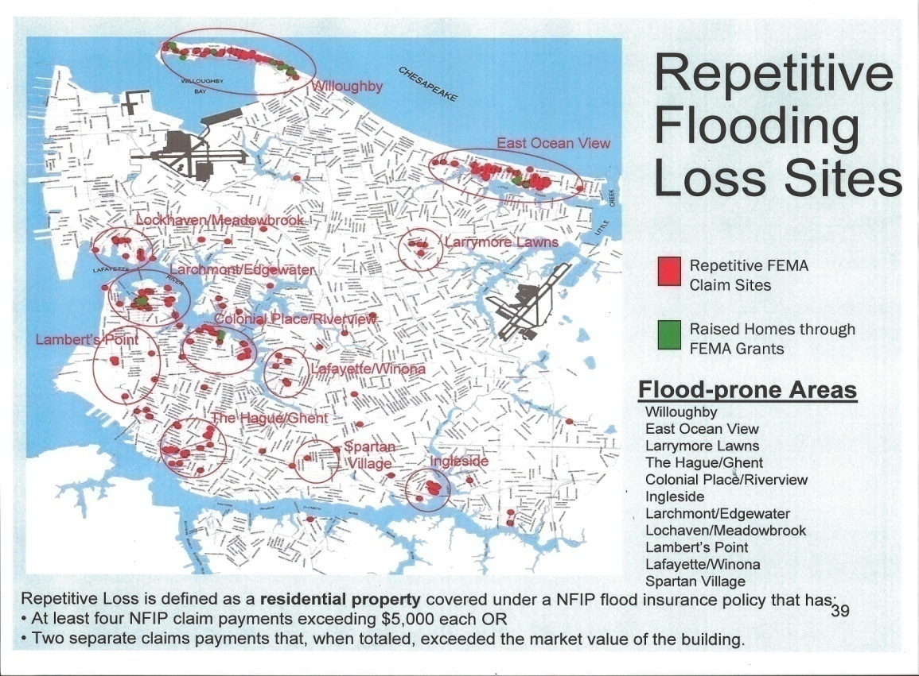
3. Proposed Flooding Risk Reduction Benefits to Transportation Systems
1. Identify major arterials with high traffic volumes
Property Losses
2. Identify locations where past experience has proven that rainfall and coastal storm flooding have stopped traffic as a result of high water elevations covering the roadway.
An example is Hampton Blvd on the South side of the Lafayette river bridge.

Slide 17
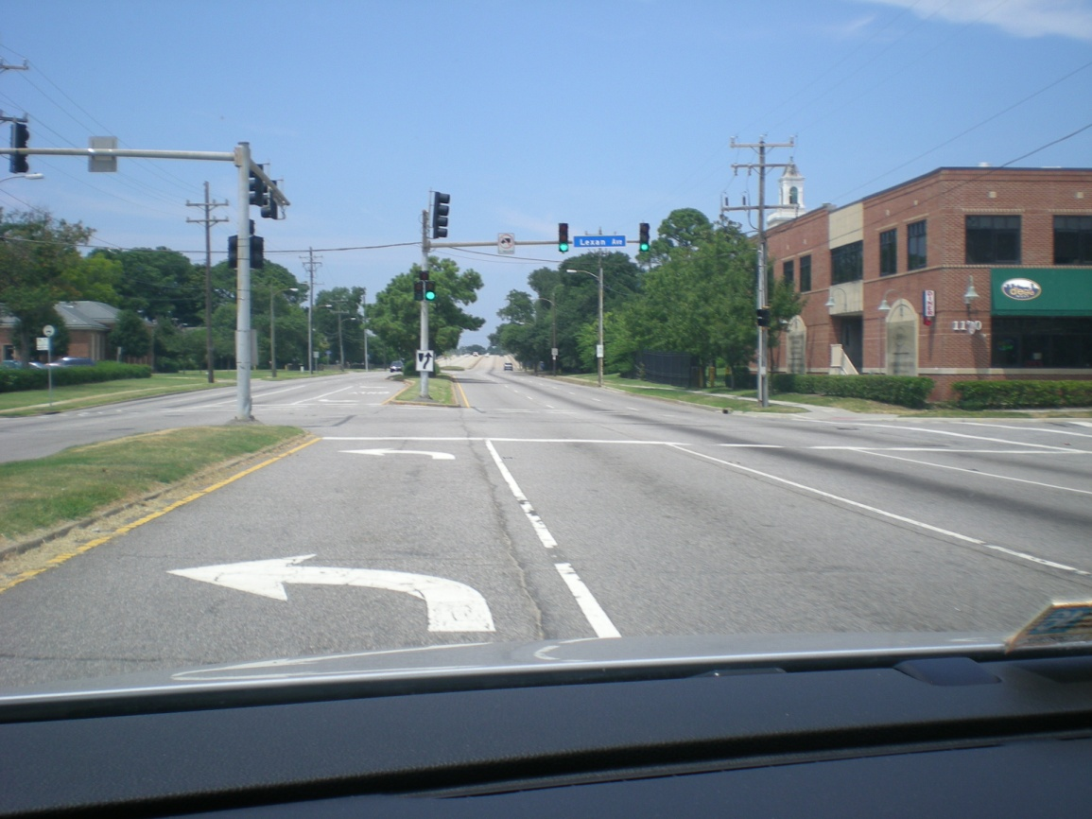
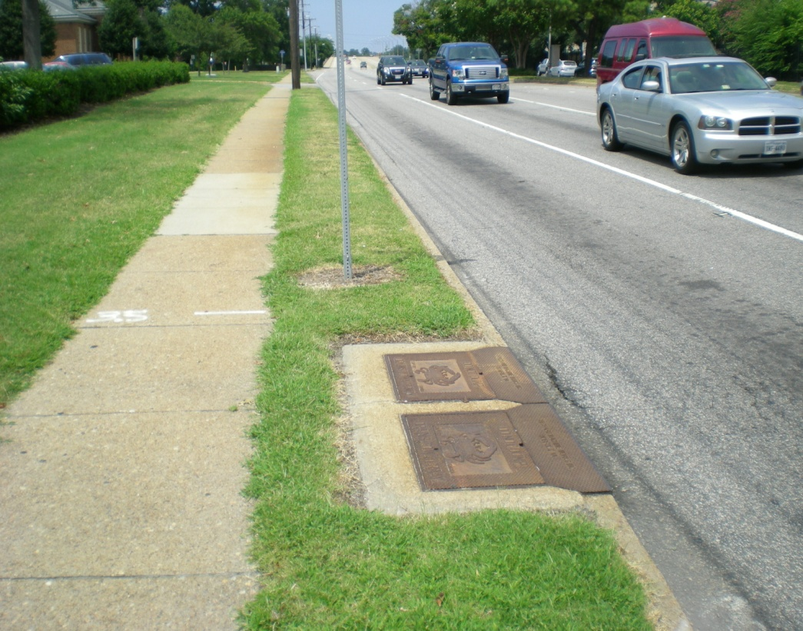
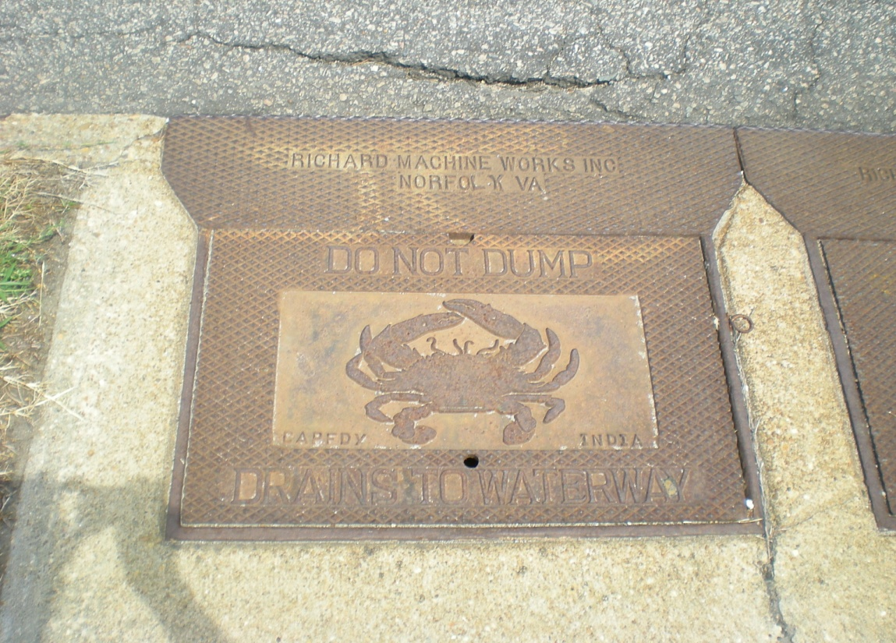
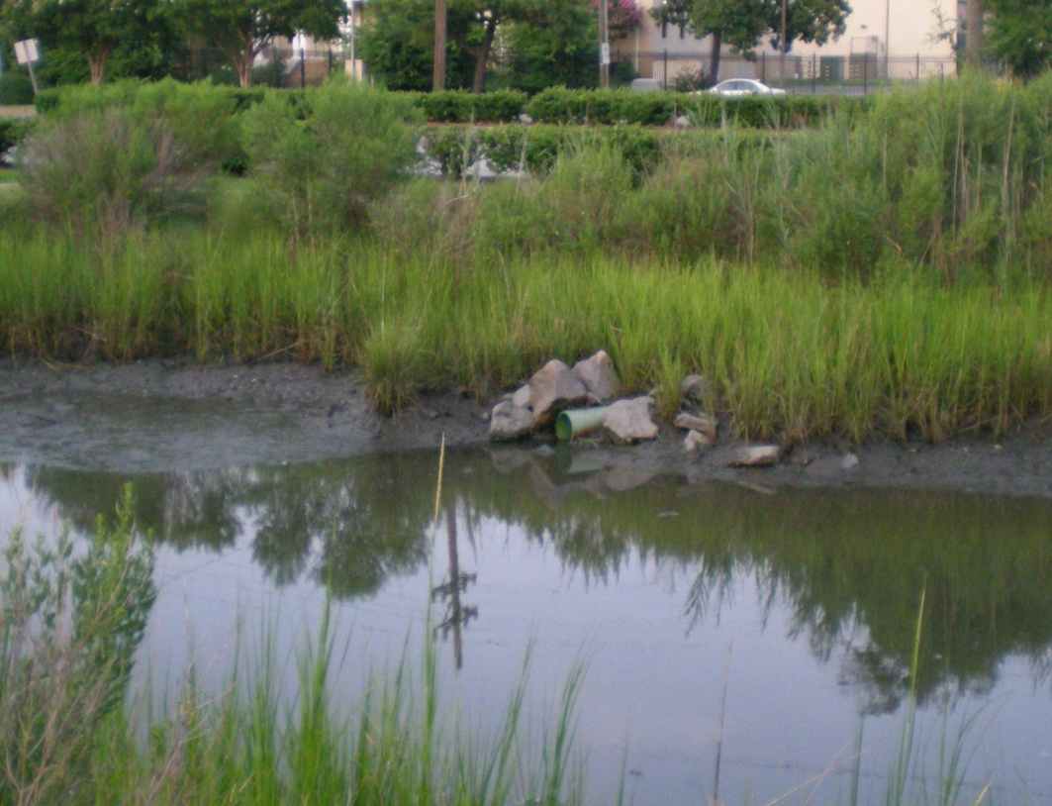
Navy Base
ODU
Do Not Dump
Drains To Waterway

Slide 18
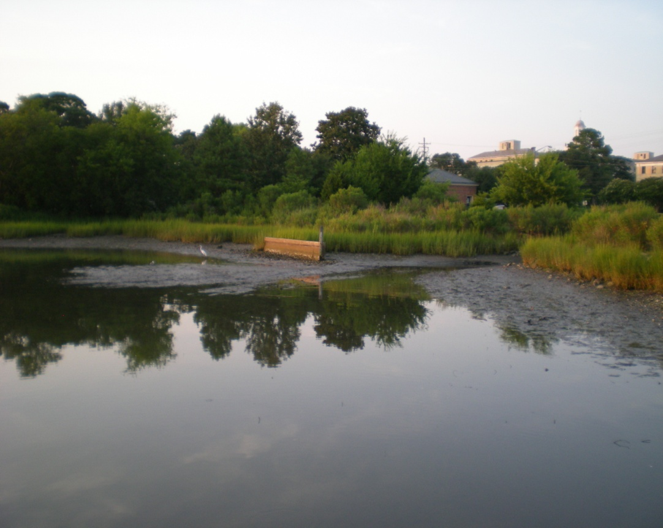
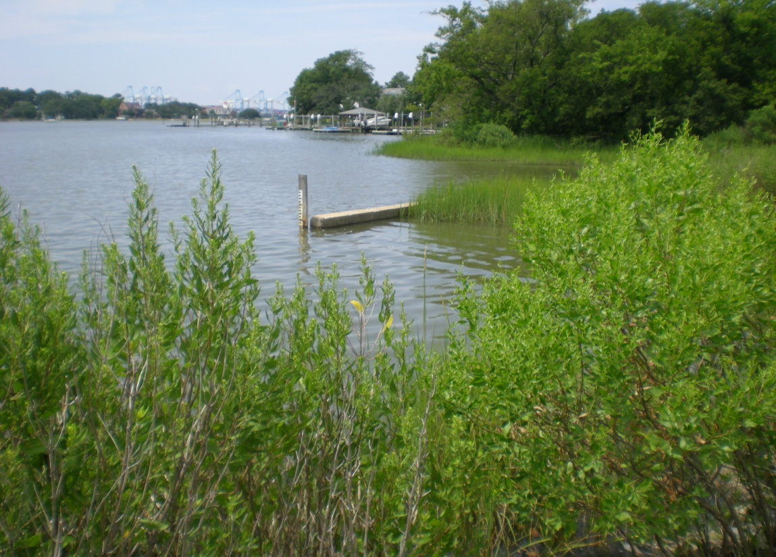
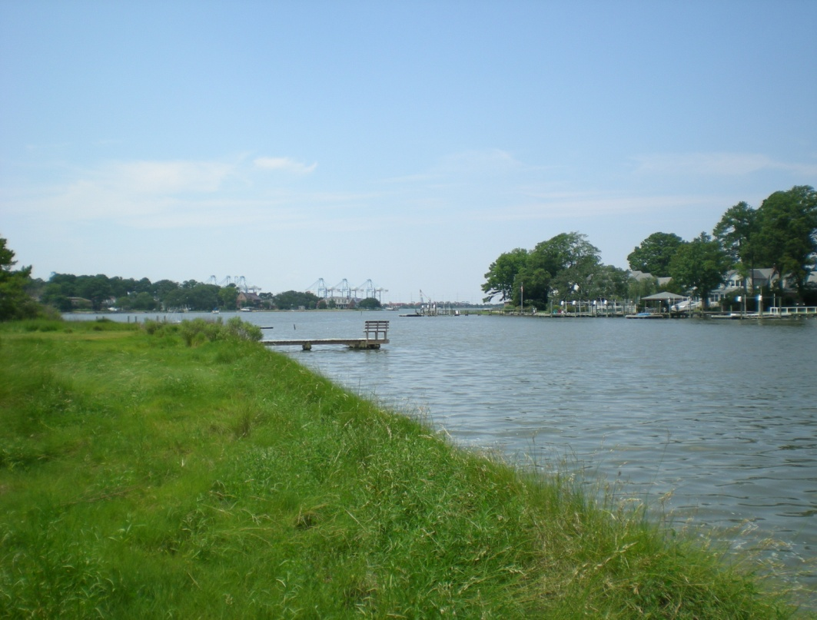
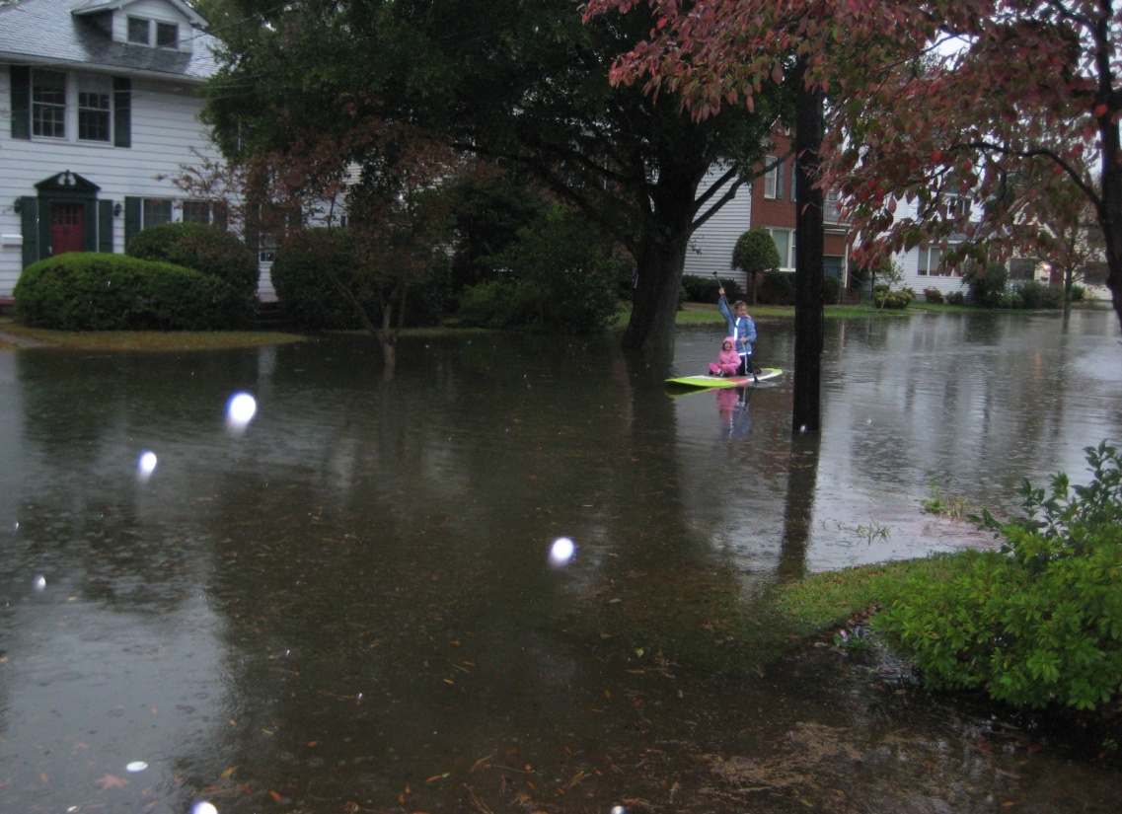

Slide 19
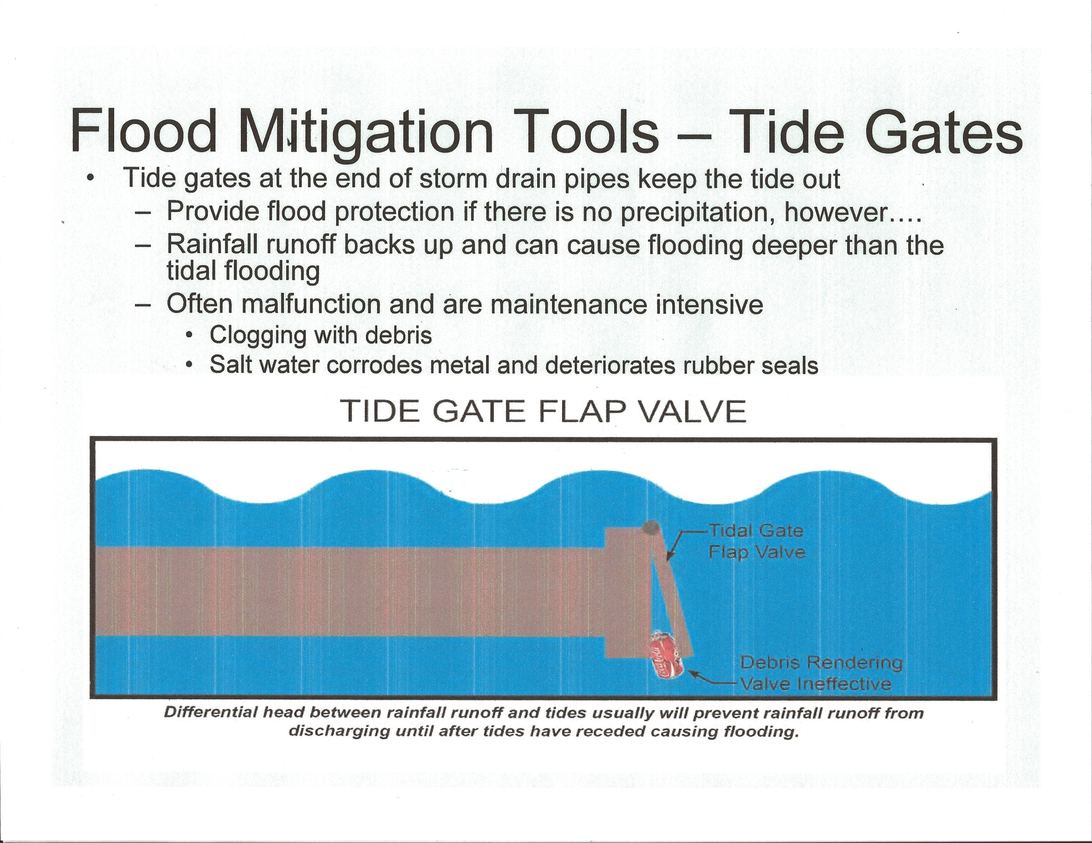
Kirsten, 2010 City of Norfolk’s position on Tide Gate Flap Valves is Negative

Slide 20
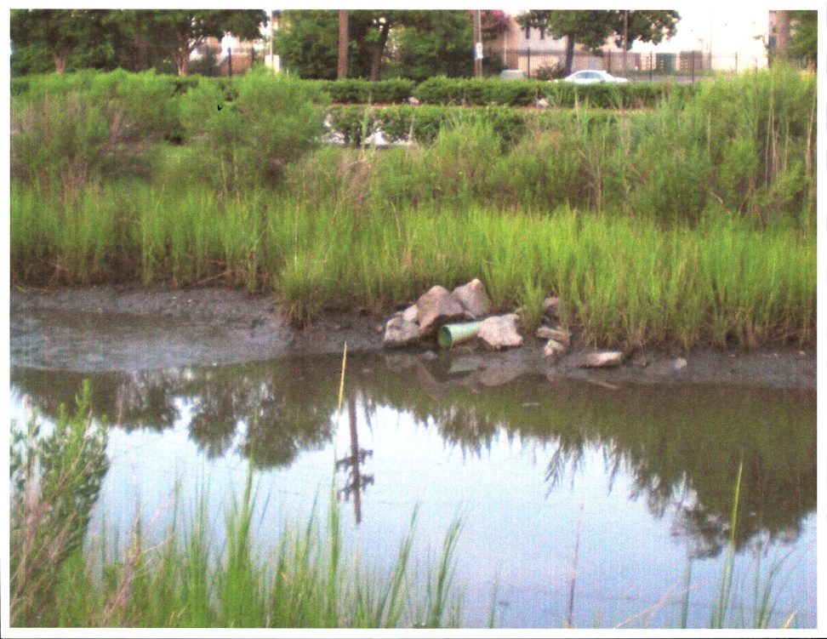
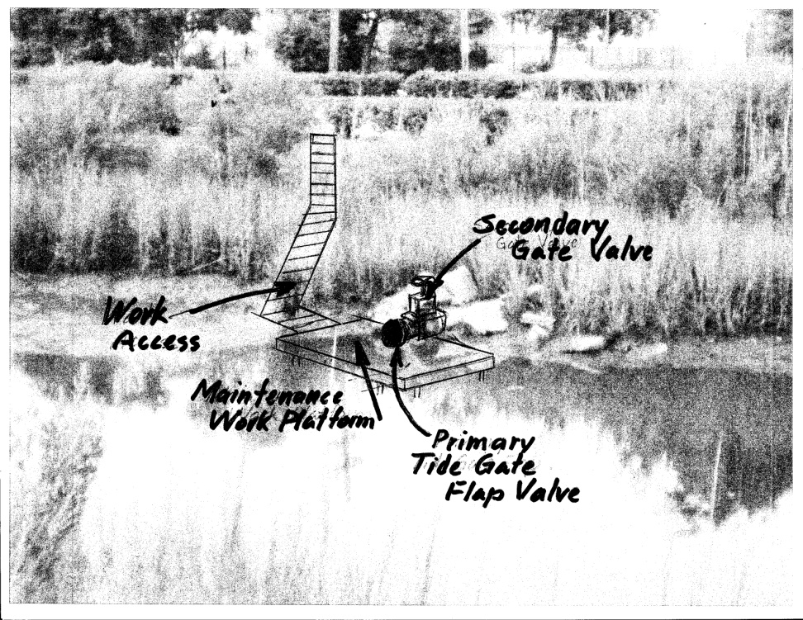
Tide Gate Station Design and Maintenance Plan
What’s Missing ?
Tide Gate Station Design & Maintenance

Slide 21
Tide Gate Station No. 1 (Hampton Blvd at Lexan Ave.
Design to facilitate maintenance, testing, and operation during storm surge flooding events.
City Worker crews responsible for maintenance, testing and operation.
Design and field testing needed to learn if “Tide Gate Station Design and Maintenance” alternative is the most economic option?

Slide 22
Summary
Tide flood gates of many types but all require continual maintenance to operate properly.
Norfolk has long history of tide flood gate operations and continues to fund studies that require tide flood gates to mitigate flooding.
What about Virginia Beach, Chesapeake, Portsmouth, Hampton, Newport News, etc. in Tidewater Virginia? Are you just talking about it or are you funding studies with coastal engineering consulting companies?

