Slide 1


Decision Support and Practice-Relevant Research:
The View from the User Side
Joseph F. Bouchard, PhD
Fellow, blue moon fund
Coastal Virginia Climate Change Adaptation Program
August 12, 2015

Slide 2
Your Challenge: A Plethora of Users
And they have needs that vary widely
“All climate change is local”
Government: Federal, state, local, tribal, regional bodies
Geographic scope of their responsibilities
Functions fragmented across departments and agencies
Overlapping responsibilities
Different needs for different “customers”
Professionals: engineers, planners, front-line managers
Elected/appointed officials and legislators
The public
Politics can drive data and analysis requirements
Remember Appomattox
Don’t forget other important users
Business and industry
Advocacy organizations and other non-profits

Slide 3
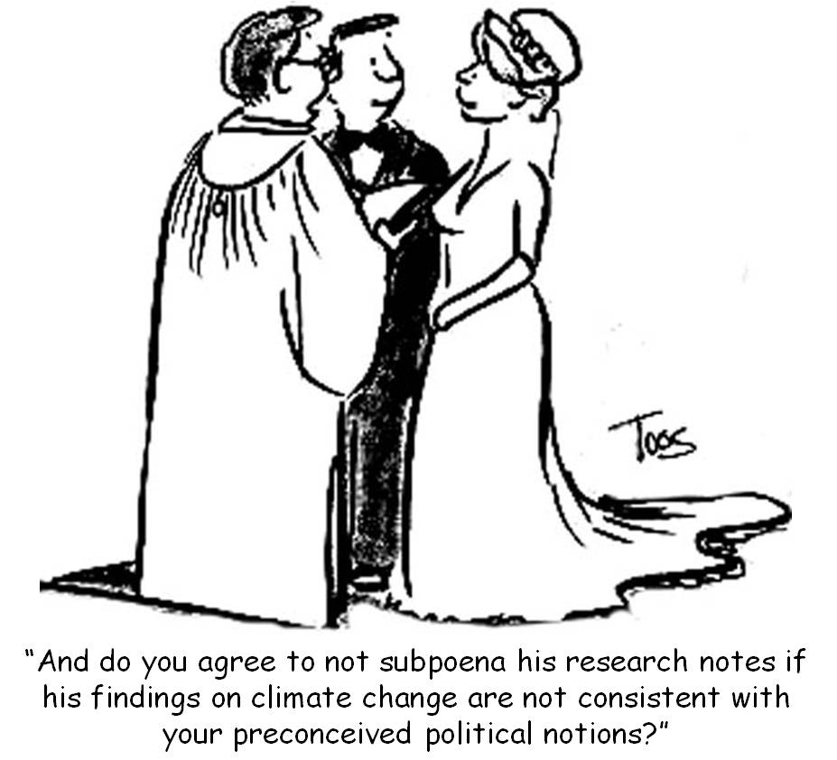
What Users Want – And What Makes Them Froggy
What they want: CERTAINTY
DON’T GIVE IT TO THEM!
Consistency and knowing who to turn to for information and advice
Most users are not good at planning under uncertainty
Quantifying risk is critical, but extraordinarily difficult
Prioritizing vulnerabilities is essential,
but also very difficult
Under conditions of uncertainty
politics skews the process
One of the most pressing needs:
Assessment methodologies, planning tools
and management approaches

Slide 4
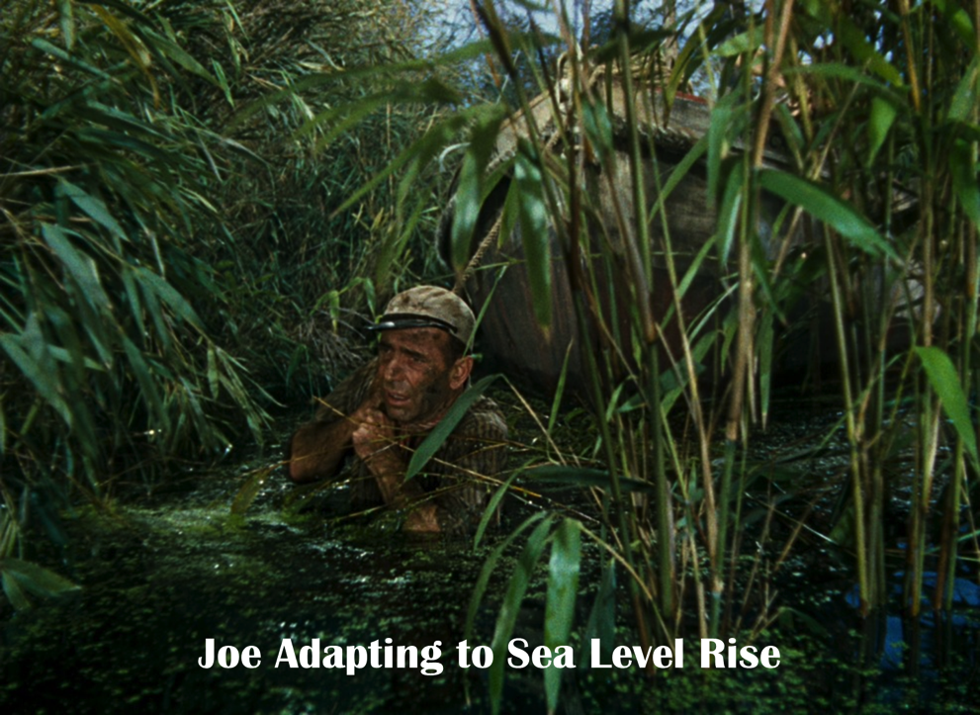
A Few Specific Needs
Local relative sea level rise projections
Highly accurate, highly granular subsidence rates
Impact of sea level rise on other physical processes
The interaction of climate change and other environmental concerns
The role of natural infrastructure
(green vs. gray infrastructure)
Better storm surge predictions
Impact on vulnerable populations
Can adaptation and resilience
measures mitigate public health
concerns?

Slide 5
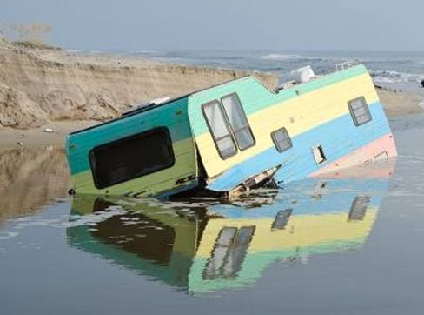
A Couple Final Thoughts
Listen to your users
Users are not interested in your academic careers
Beware debating demagogues
Do not underestimate the difficulty of educating the public
Understand the timeframes within which users think
Persevere!
Joe’s Retirement Home
How Not to Adapt to Sea Level Rise

Slide 6
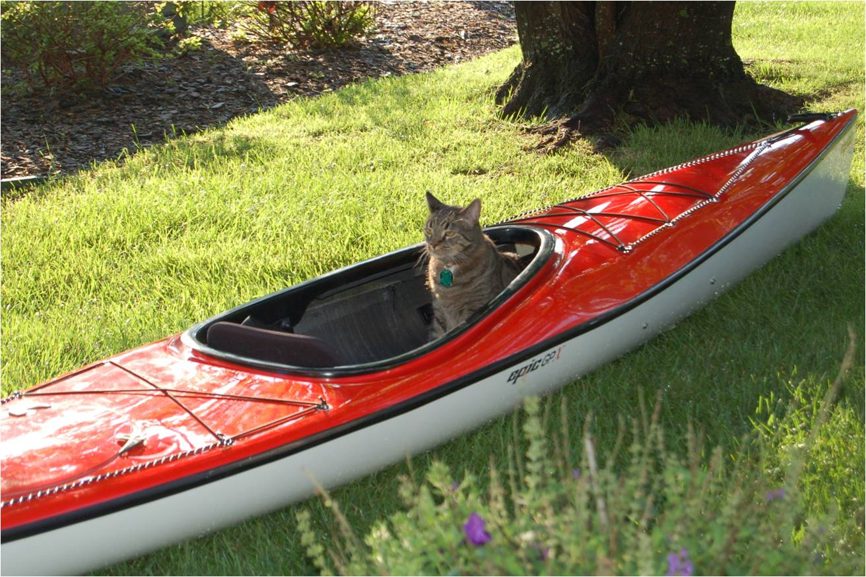
Questions, Comments, Sage Advice, Wild Applause?
Ready for Sea Level Rise

