Slide 1
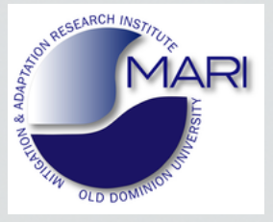
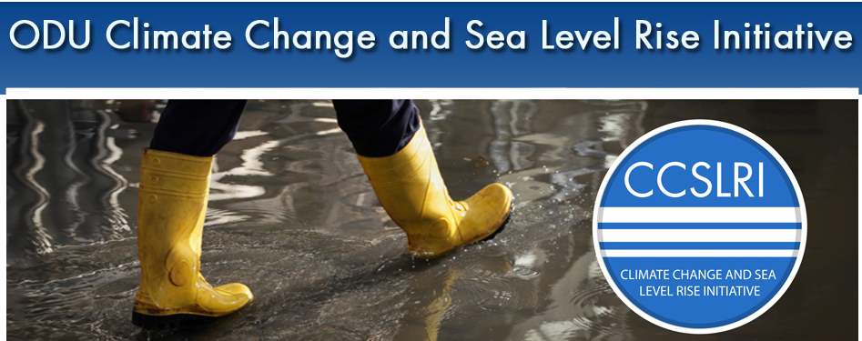


http://www.odu.edu/ao/research/ccslri/
Center for
Coastal Physical Oceanography
http://mari.odu.edu/
Mitigation and Adaptation Workshop
Suffolk, VA, 11-13 August-2015
Assessing the hazards and impacts of sea level rise in Virginia
Tal Ezer
CCPO, Old Dominion University, Norfolk, VA, USA

Slide 2
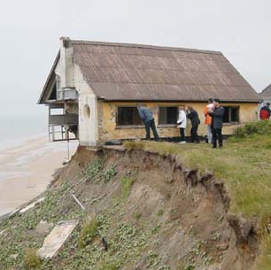
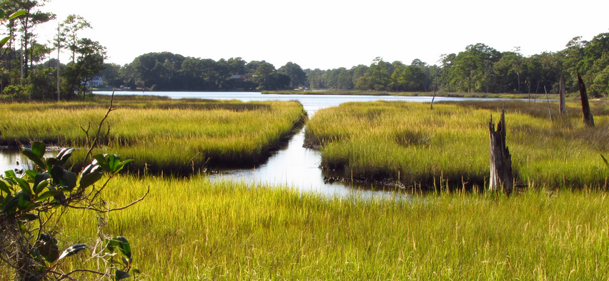
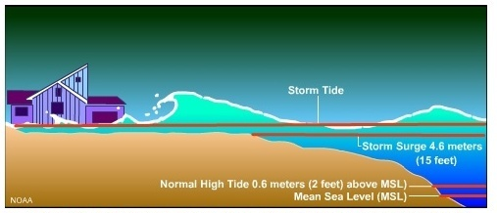
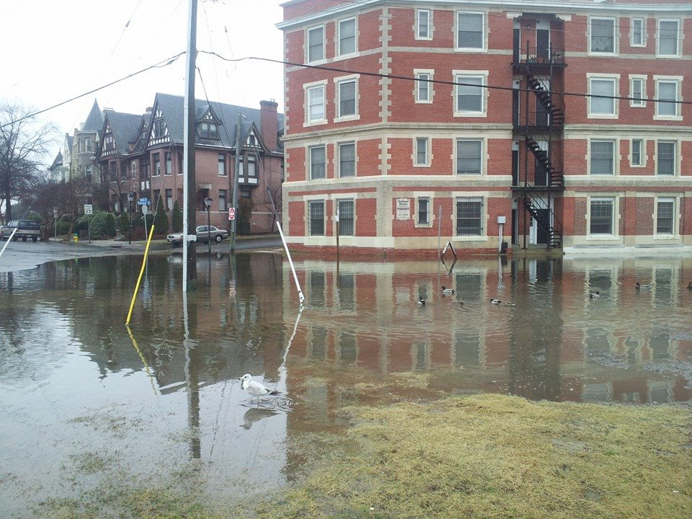
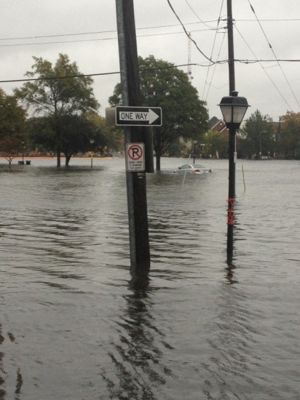
Impacts of rising seas on Virginia’s environment and coasts:
Increased coastal erosion
Saltwater intrusion into Virginia’s marshland
Increased damage from storm surges
Increased frequency of tidal flooding
Mitigation and adaptation planning must assess the risks involved in future sea level rise

Slide 3
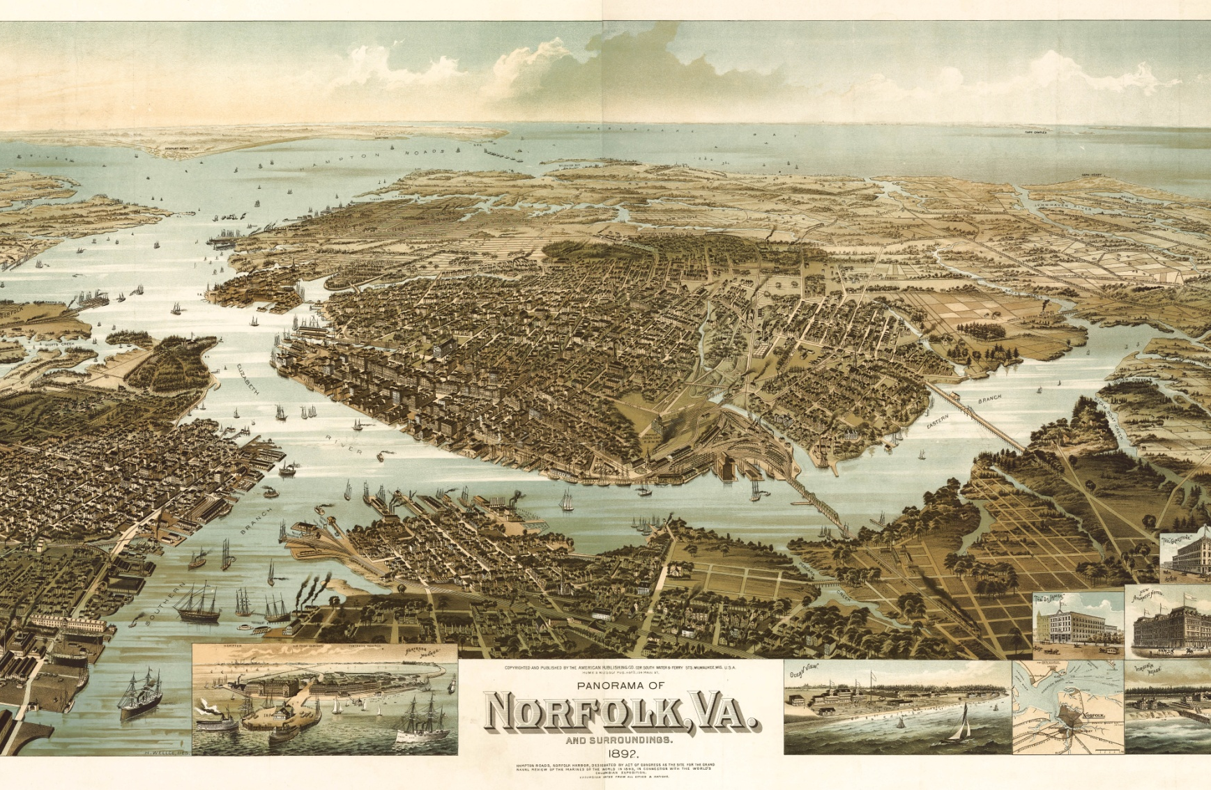
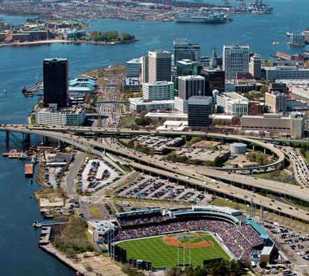
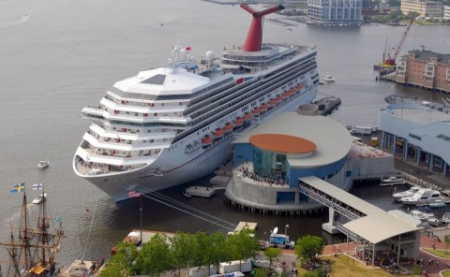
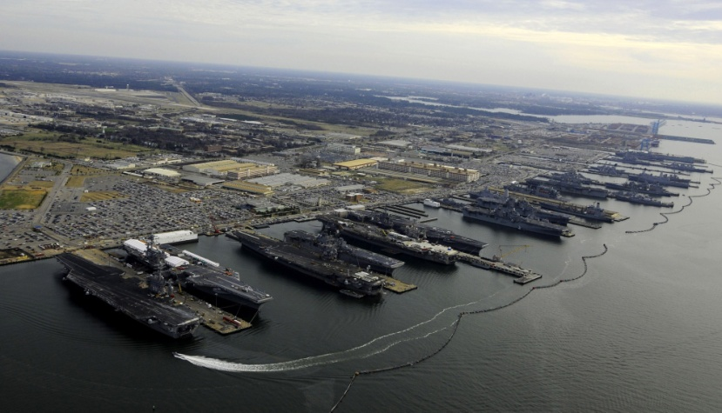
As the landscape changed, so did the vulnerability and risk associated with sea level rise.
Norfolk in 1897 (population ~20,000)
Chesapeake Bay
Elizabeth River
… and Norfolk today (pop. ~250,000)
Cruise ship terminal World’s largest Navy base

Slide 4
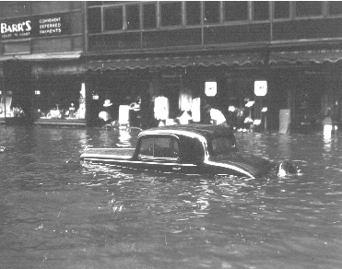
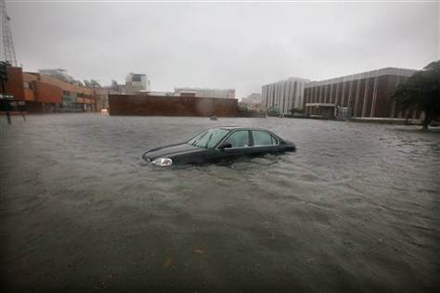
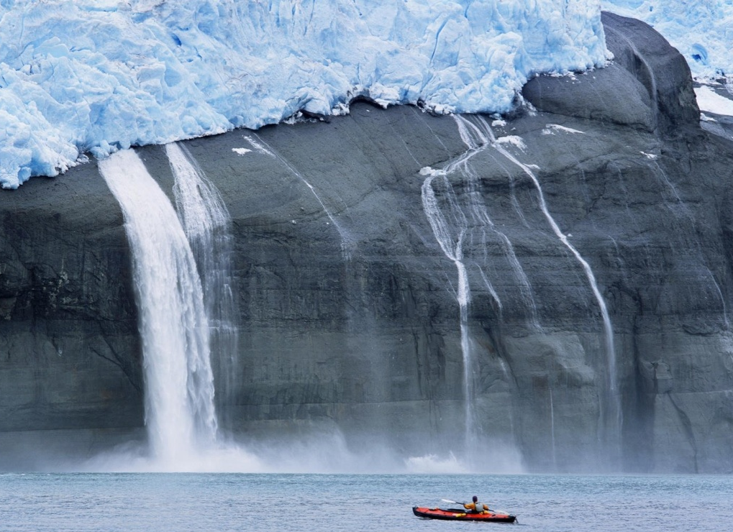
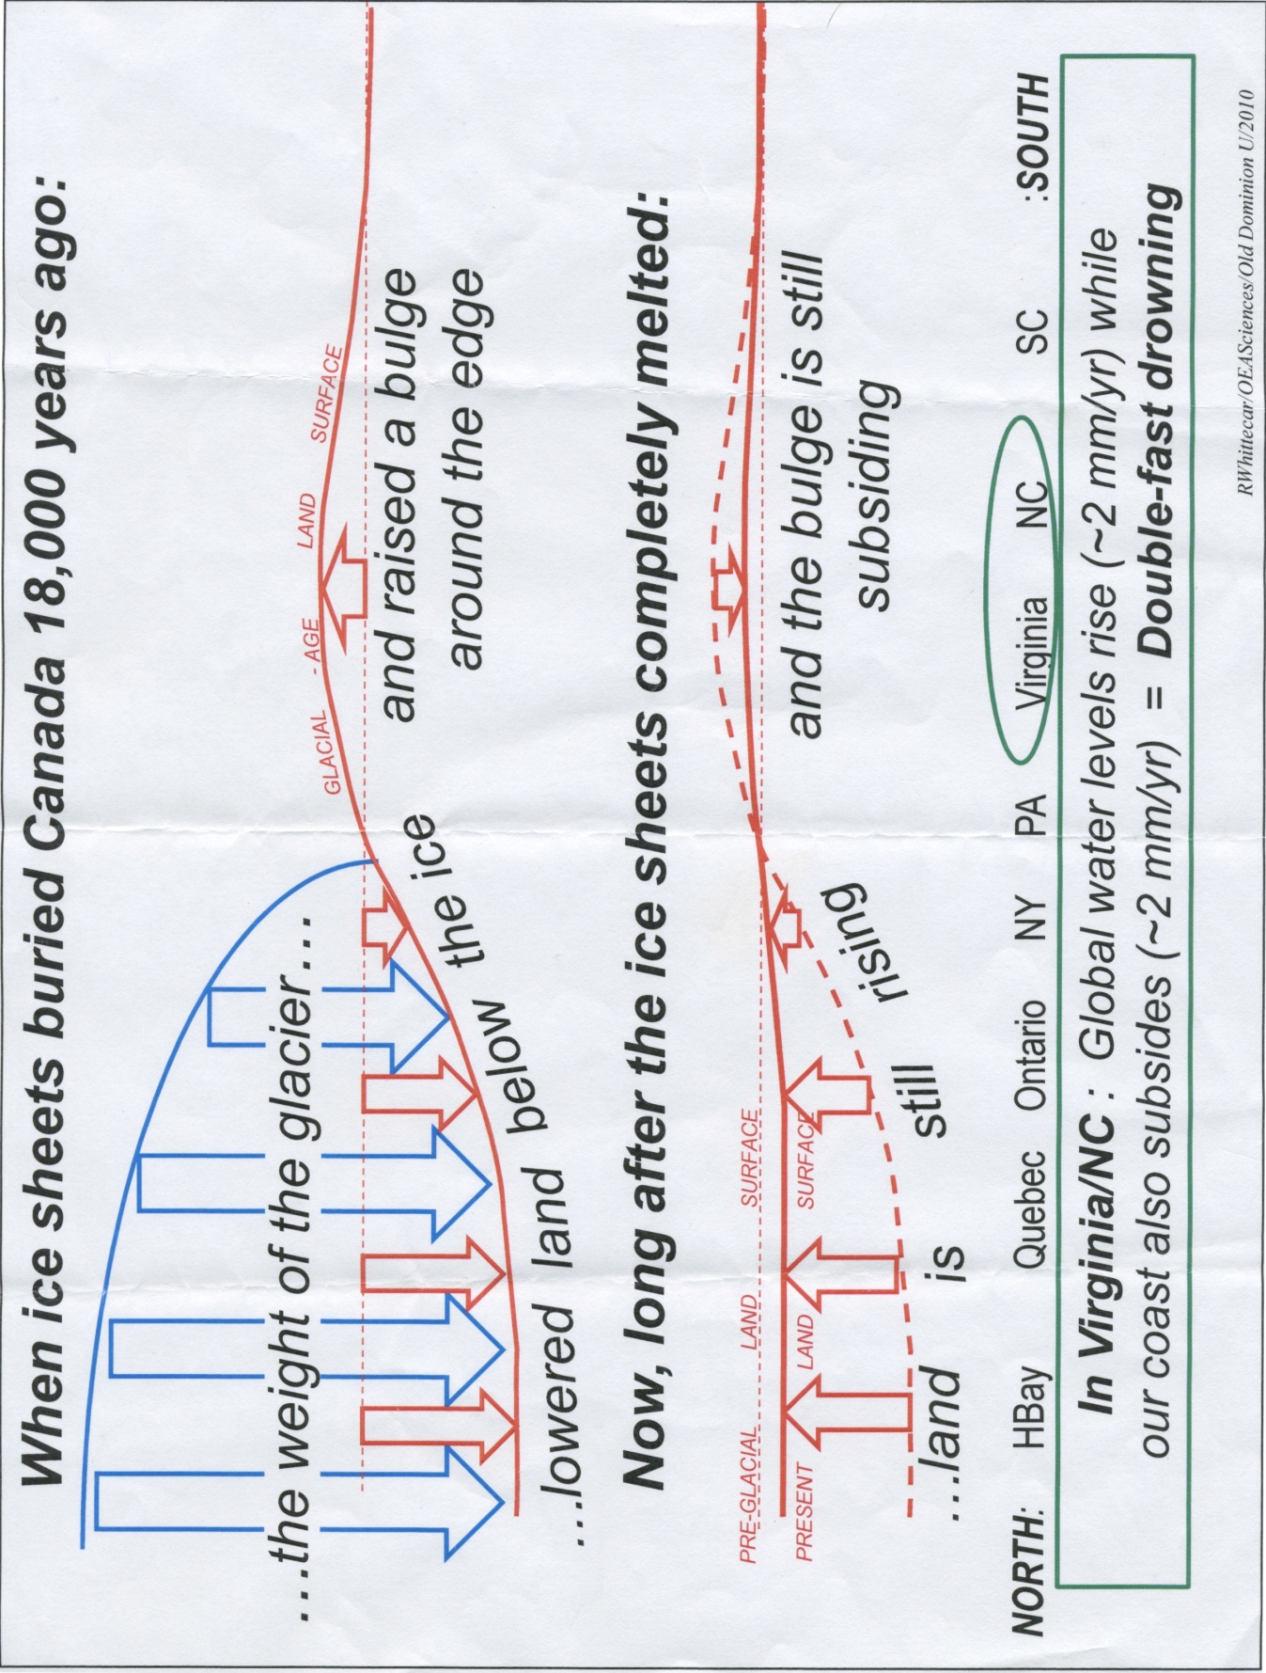
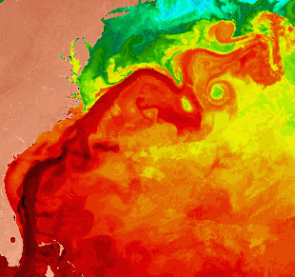
We have seen floods in Virginia for many years, but their frequency and severity increased over time…
What factors contribute to local risks?
Norfolk, 1933
Norfolk, 2009
thermal expansion
melting ice sheets & glaciers
volume change
Global Sea Rise
Risk: acceleration in Greenland & Antarctic ice melt could be catastrophic…
Glacial Isostatic Adjustment (GIA)
groundwater extraction, hydrology, geology, etc.
Land Subsidence
Risk: local SLR is much faster in VA than farther north or south…
In VA/NC: land is sinking while SL is rising
Oceanic & Atmospheric Dynamics
MD
VA
NC
Gulf Stream, Atlantic Circulation (AMOC), N. Atlantic Oscillations (NAO)
Gulf Stream
Risk: acceleration of SLR is larger in some locations; unpredictable variations in sea level over short periods…

Slide 5
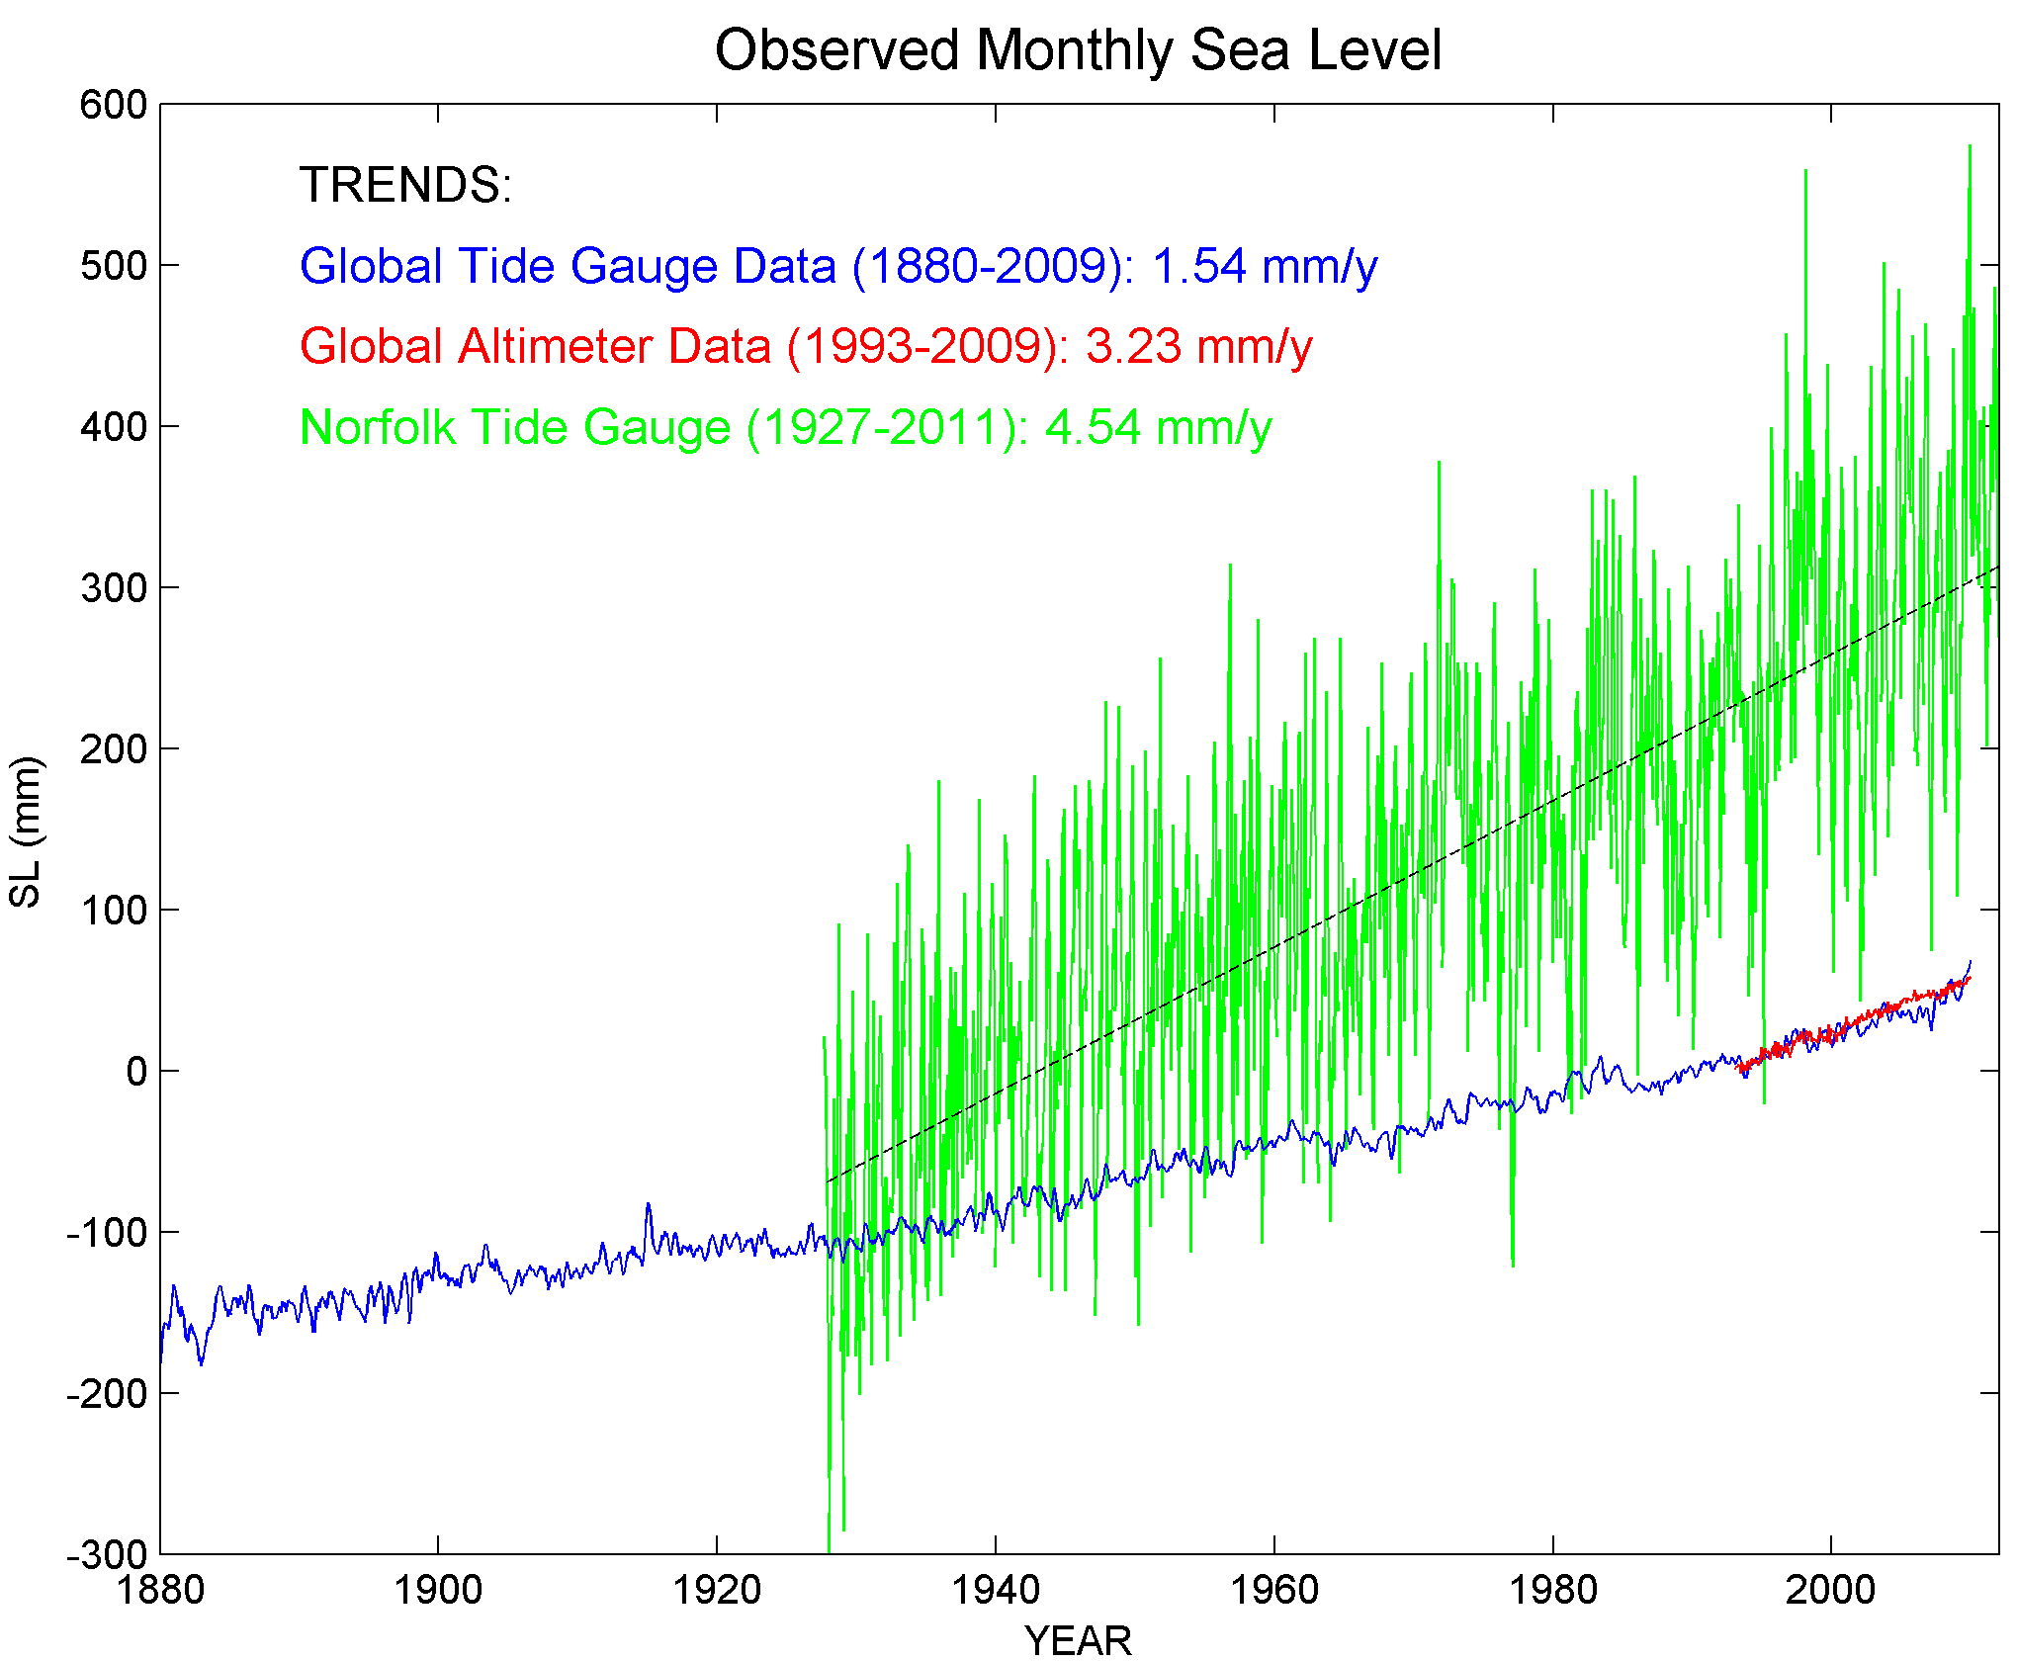
Impact of Sea Level Rise (SLR) on local storm surge in Norfolk, VA
Recent SLR acceleration due to ocean dynamics
Storm surge →
Storm and tide
Local tide gauge (Norfolk)
Local SLR
Post glacial land
subsidence
Satellite
data
Tide gauge data (global)
Global SLR

Slide 6
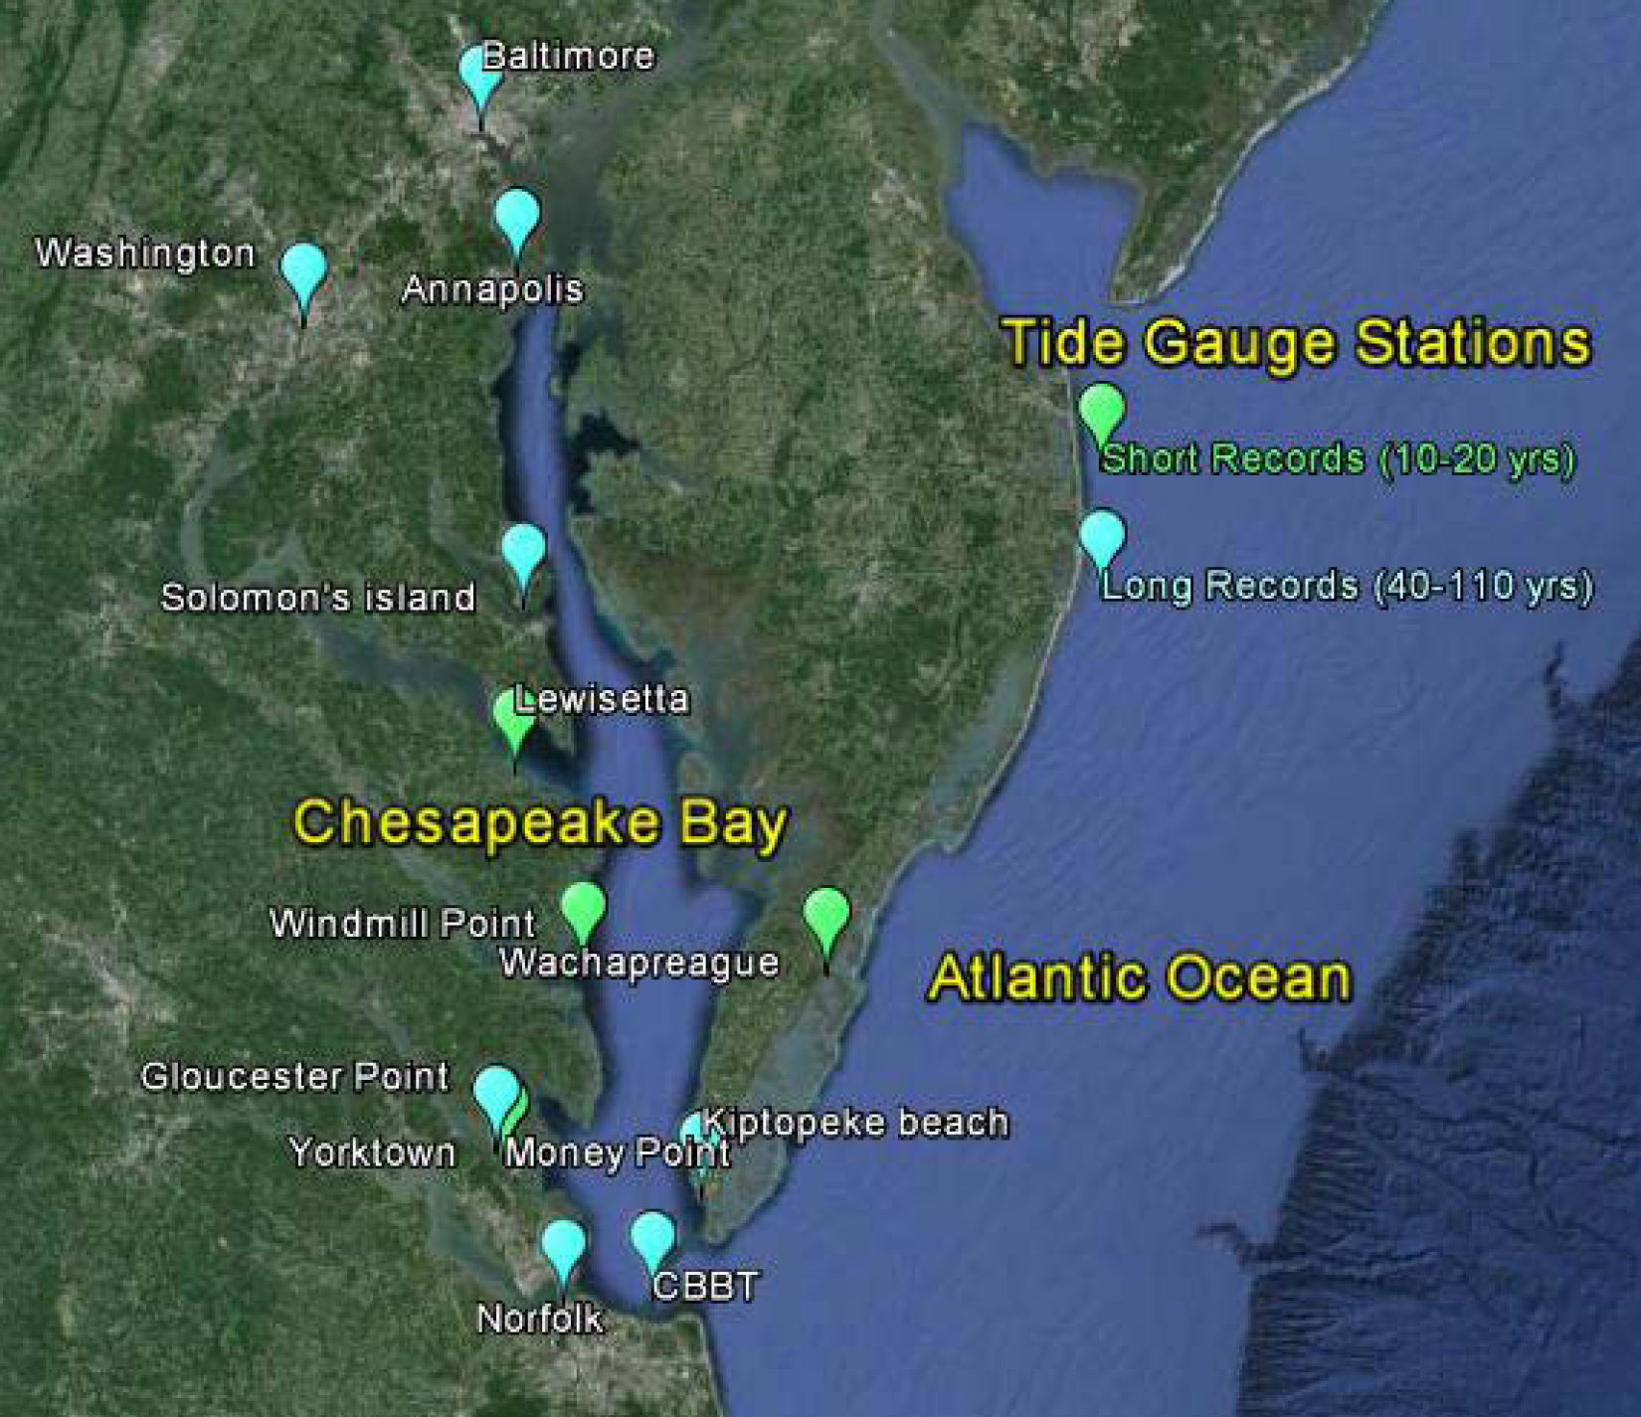
To prepare for future sea level rise (SLR) we need to know:
What are the trends of SLR in Virginia?
Are they constant or changing?
How are they compared to Global SLR?

Slide 7
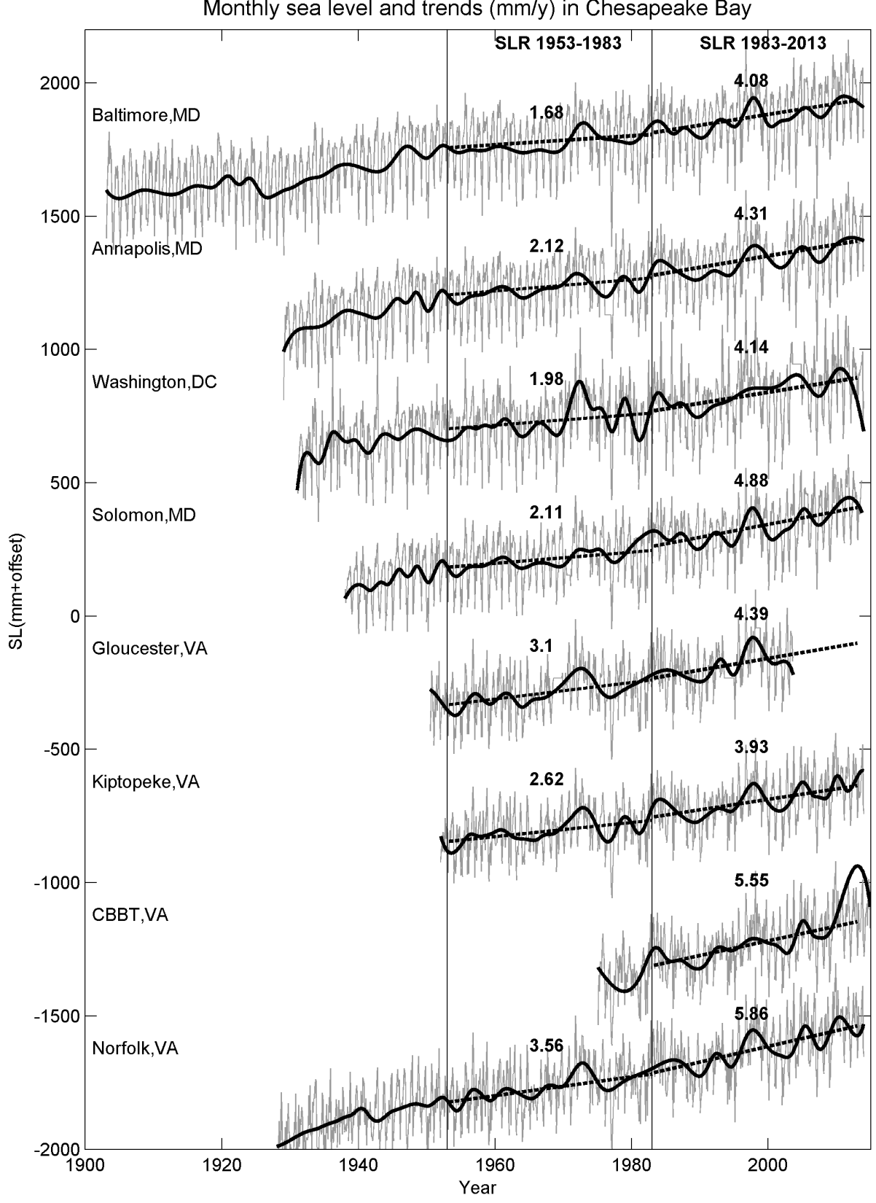
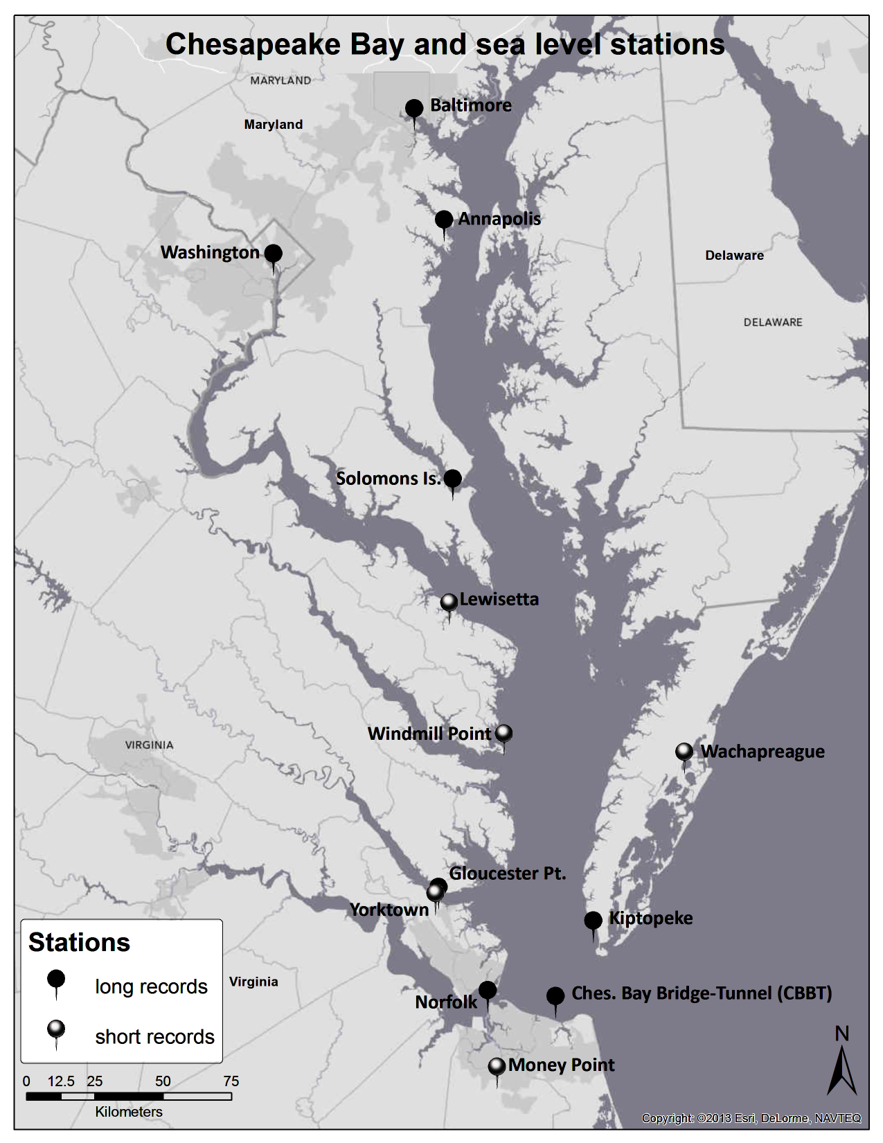
Monthly Sea Level
1953-1983
1983-2013
Long (40-110 yrs) sea level records:
increase SLR rate from ~2.4 mm/y (50s-80s) to ~4.5 mm/y (80s-today)
higher SLR in lower CB, ~5.3 mm/y, than upper CB, ~4.3 mm/y and Eastern Shore Peninsula, 3.9 mm/y
SLR past 30yr
4.08 mm/y
4.14 mm/y
4.31 mm/y
4.88 mm/y
4.39 mm/y
3.93 mm/y
5.86 mm/y
5.55 mm/y

Slide 8
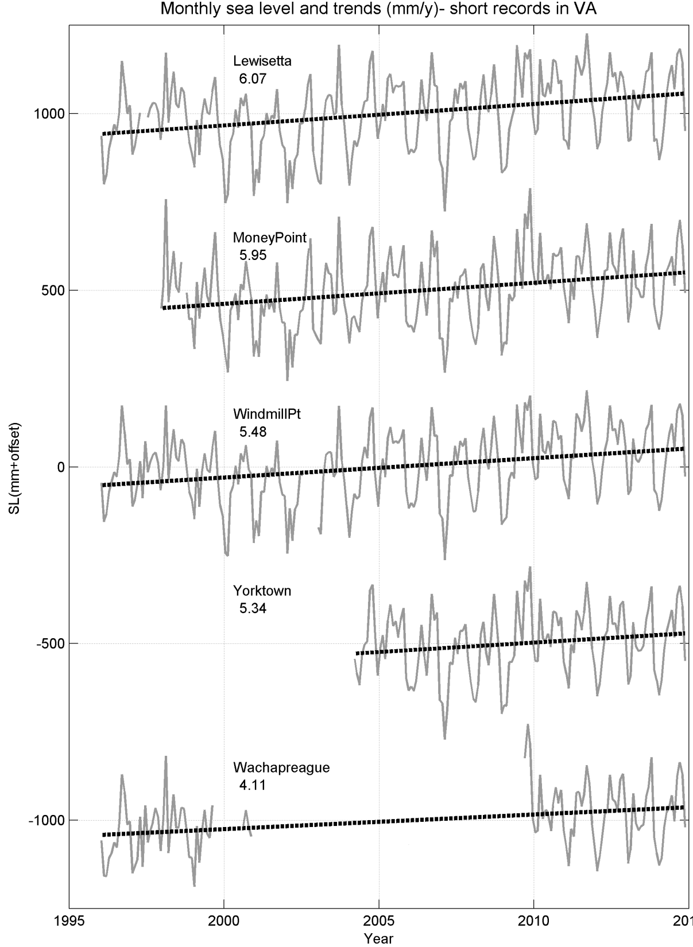
Short (10-20 yrs) sea level records in VA:
even larger SLR rate, ~5.7 mm/y , in recent years than in long records
6.07 mm/y
4.11 mm/y
5.48 mm/y
5.34 mm/y
5.95 mm/y

Slide 9
Summary of estimated sea level rise around the Chesapeake Bay:
Rising faster than global SLR and rates increase (acceleration)
SLR (mm/year)
SLR (feet/century)
6 -
- 2.0
5 -
- 1.5
4 -
Global SLR past 20yrs
(from satellites)
3 -
- 1.0
2 -
Global SLR 100 yrs
(from tide gauges)
1953-1983
1983-2013
2000-2014

Slide 10
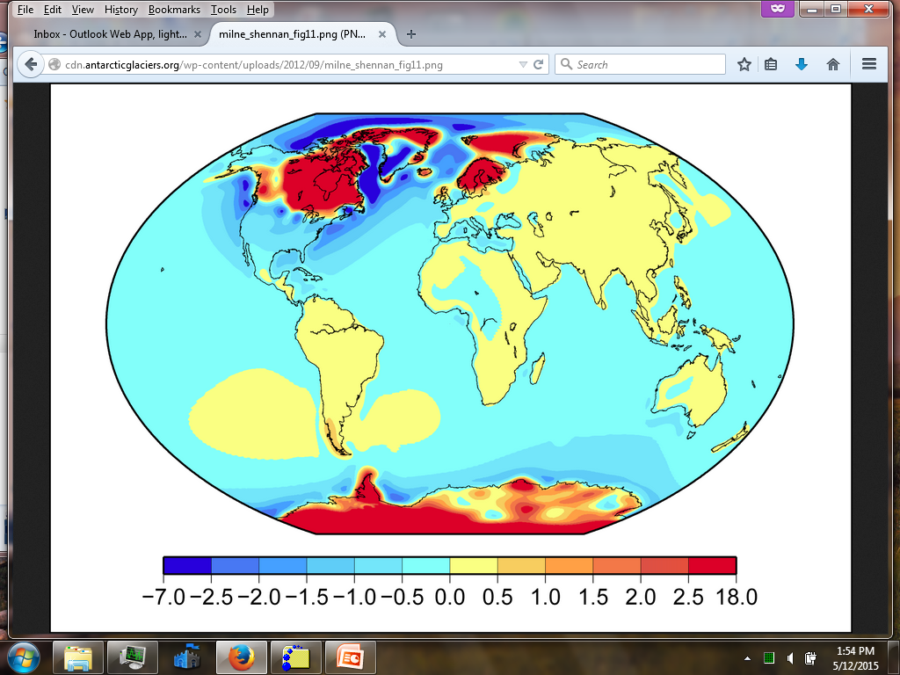
Land Subsidence:
due to Post Glacial Rebound the land around VA/NC is sinking
land uplift
land sinking
Other contributions to subsidence: sediment compactions, groundwater removal, etc. (Boon et al., 2010)

Slide 11
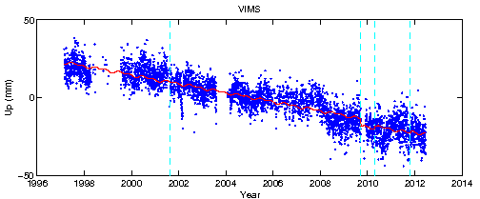
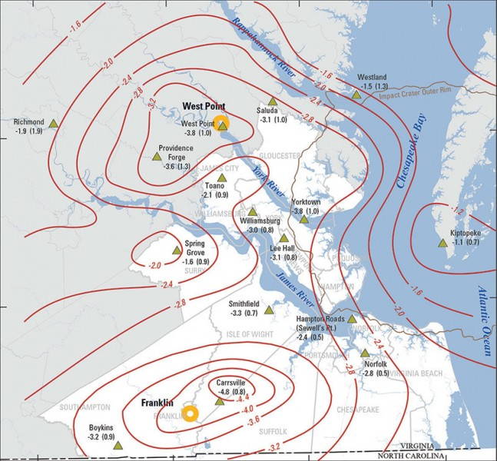
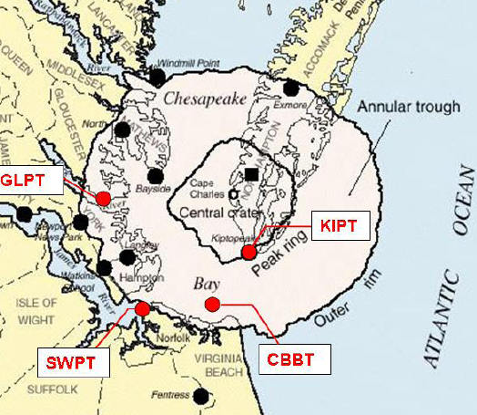
While global sea level is rising, land is sinking (~1.5-3 mm/yr in VA)
GPS measurement of vertical land movement
Post glacial rebound
Underground water extraction (West Point & Franklin paper mills)
Other geological reasons (Chesapeake Impact Crater?)
Nevada Geodetic Lab
Paper Mills
Map of land subsidence (USGS)

Slide 12


Slide 13
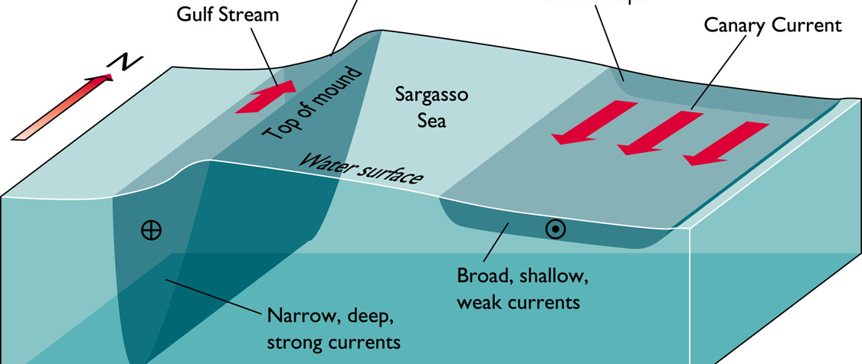
What about Ocean Dynamics?
Sea level is not level: ocean currents → sea level slope
Atlantic Ocean circulation
US East Coast
~1m
European Coasts
~100km
The Gulf Stream “pulls” water away from the US coast, keeping sea level on VA coasts ~1-1.5 m (3-5 feet) lower than water offshore.
In warmer climate the Atlantic Ocean circulation is expected to weaken
If the Gulf Stream slows down → coastal sea level would rise!!!

Slide 14
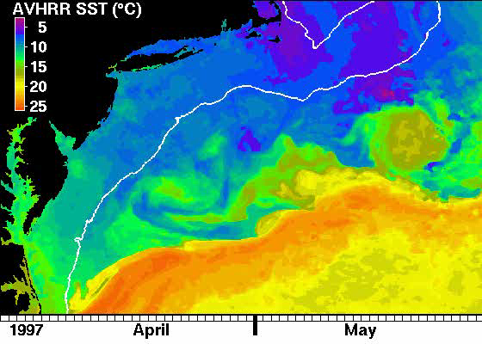
The Gulf Stream is dynamic and unpredictable
Mid-Atlantic Bight
(cold, low sea level)
Eddy
Norfolk
Gulf Stream
(warm, high sea level)

Slide 15
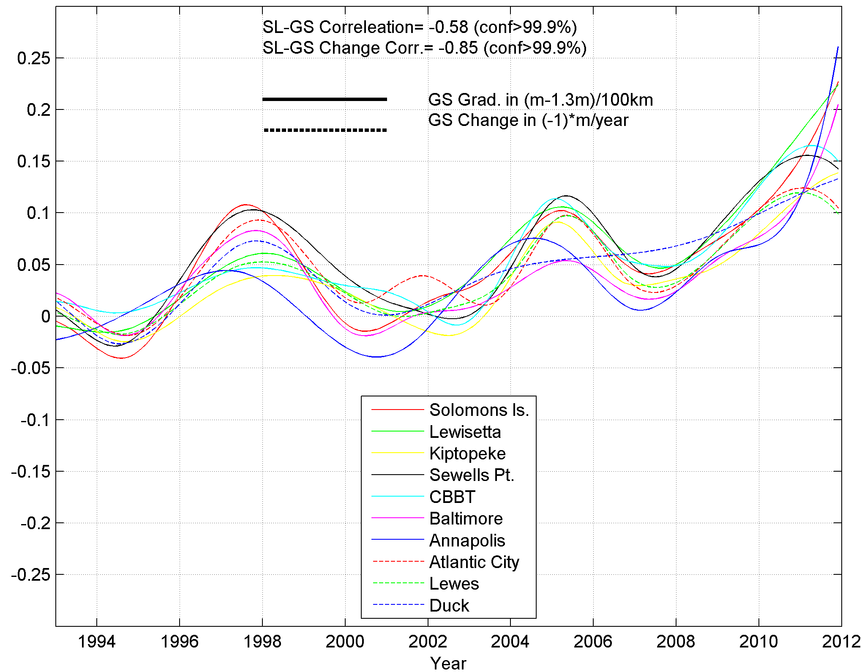
Why do stations in different locations show the same pattern?
Correlation between change in GS and SL:
R=-0.85 (99% conf. lev.)
Acceleration in sea level
Sea Level
Gulf Stream
strength
SL (m)
Chesapeake Bay
Decline in Gulf Stream strength since 2004
Atlantic Coast

Slide 16
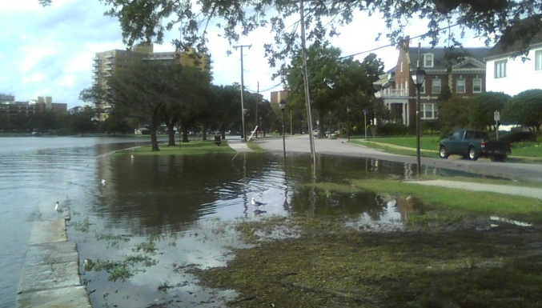
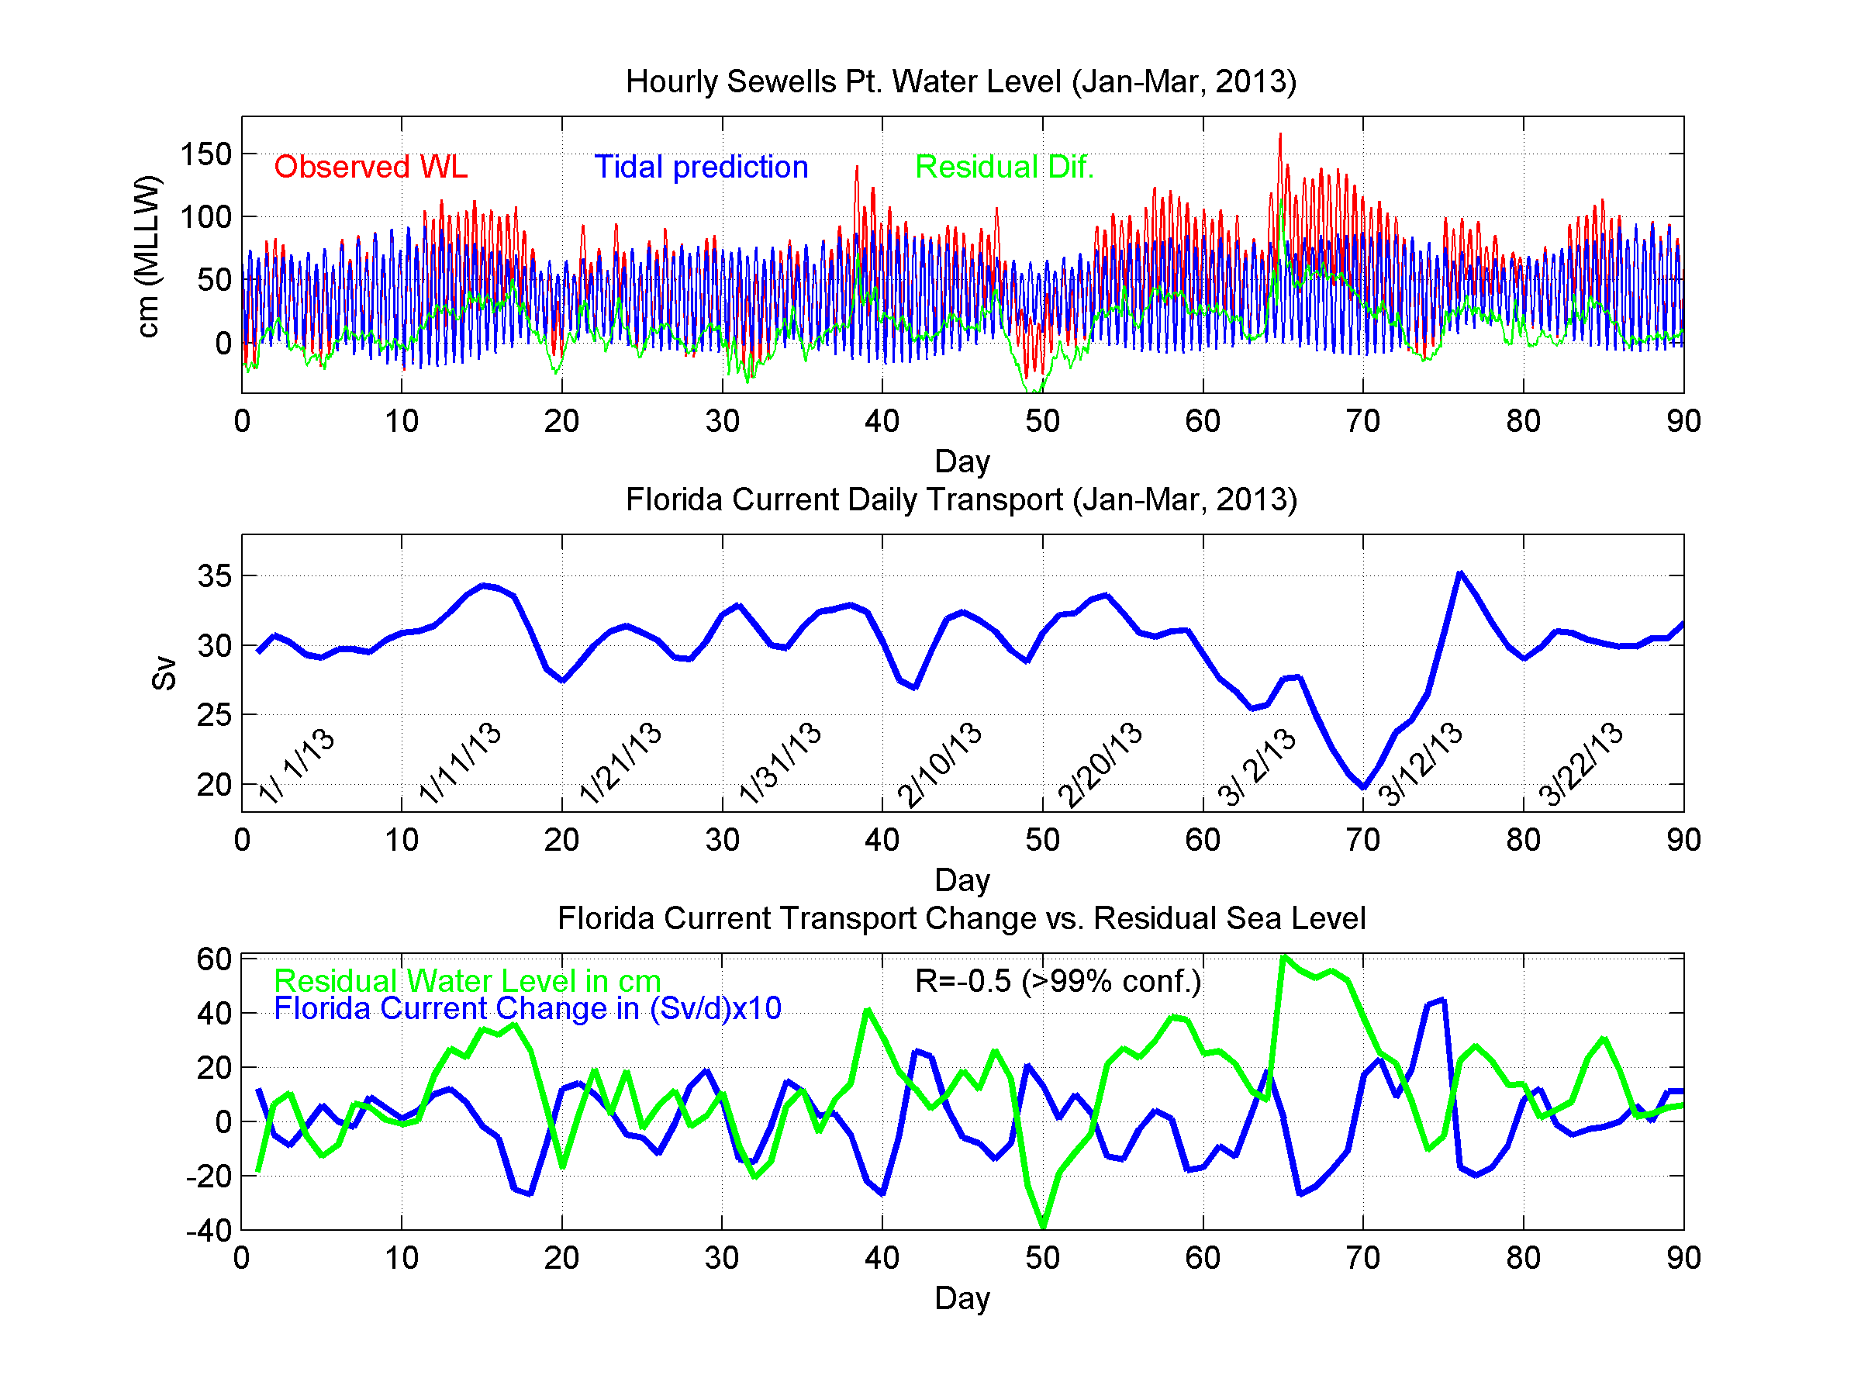
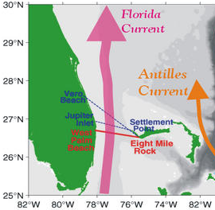
Are short-term sea level variations also affected by the Gulf Stream?
Week-long tidal flooding in Norfolk
(no storms!!!)
~35% decline in FC transport
FL
← 2ft high WL
Weakening Gulf Stream across the Florida Strait is correlated with flooding in Norfolk…
← Weakening GS

Slide 17
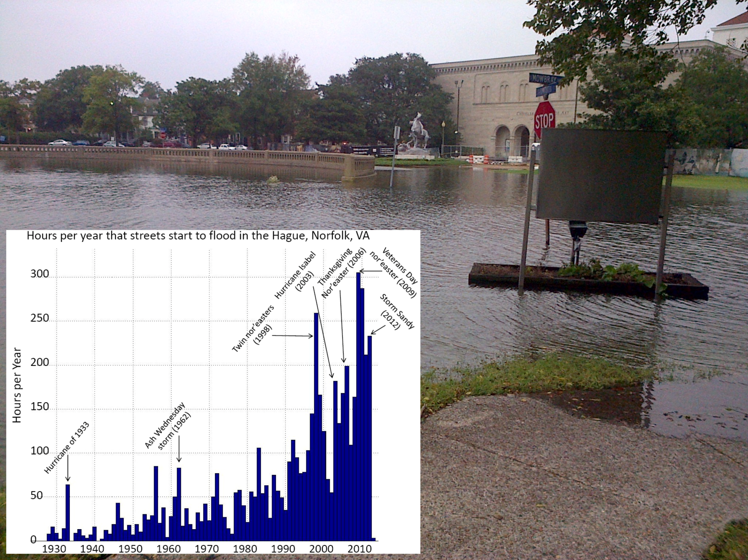

Consequence of sea level rise: Increase flooding
Chrysler
Museum of Art
flood wall

Slide 18
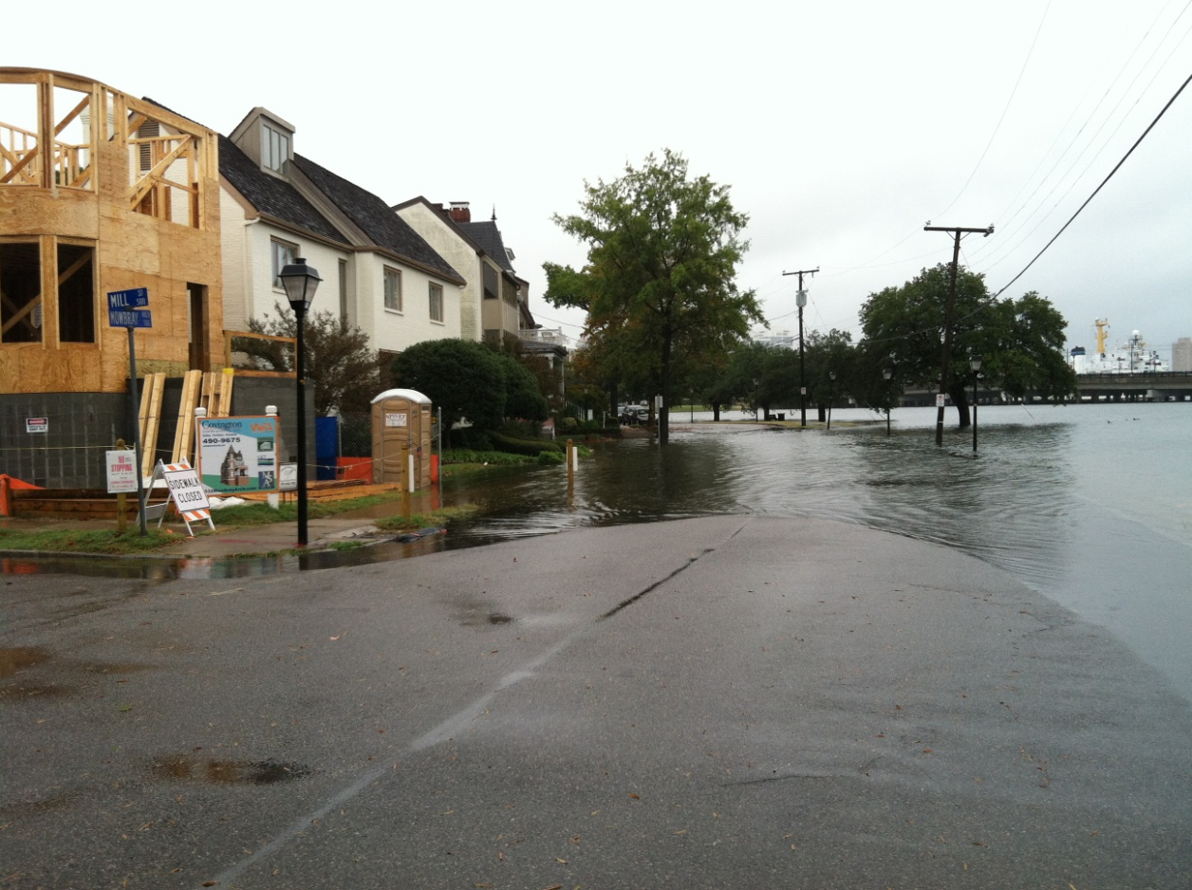
Despite the risk, new houses are being built in flood-prone streets.
An example of adaptation, but is it a smart planning?....
~6ft
flood wall

Slide 19
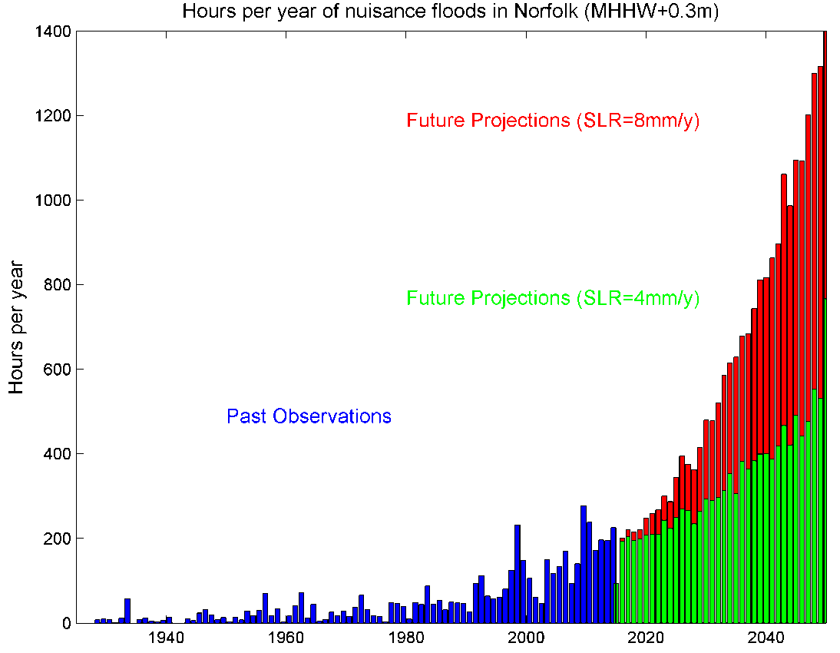
2050: ~60 full days of flooding per year
(SLR=4.5 mm/y)
Today: ~10 full days of flooding per year
Until the 1970s: ~20 hours of flooding per year

Slide 20
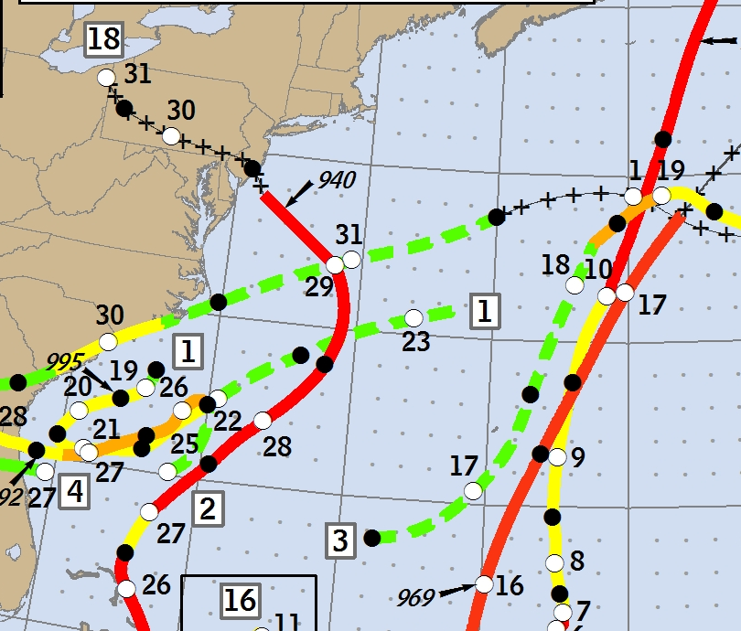
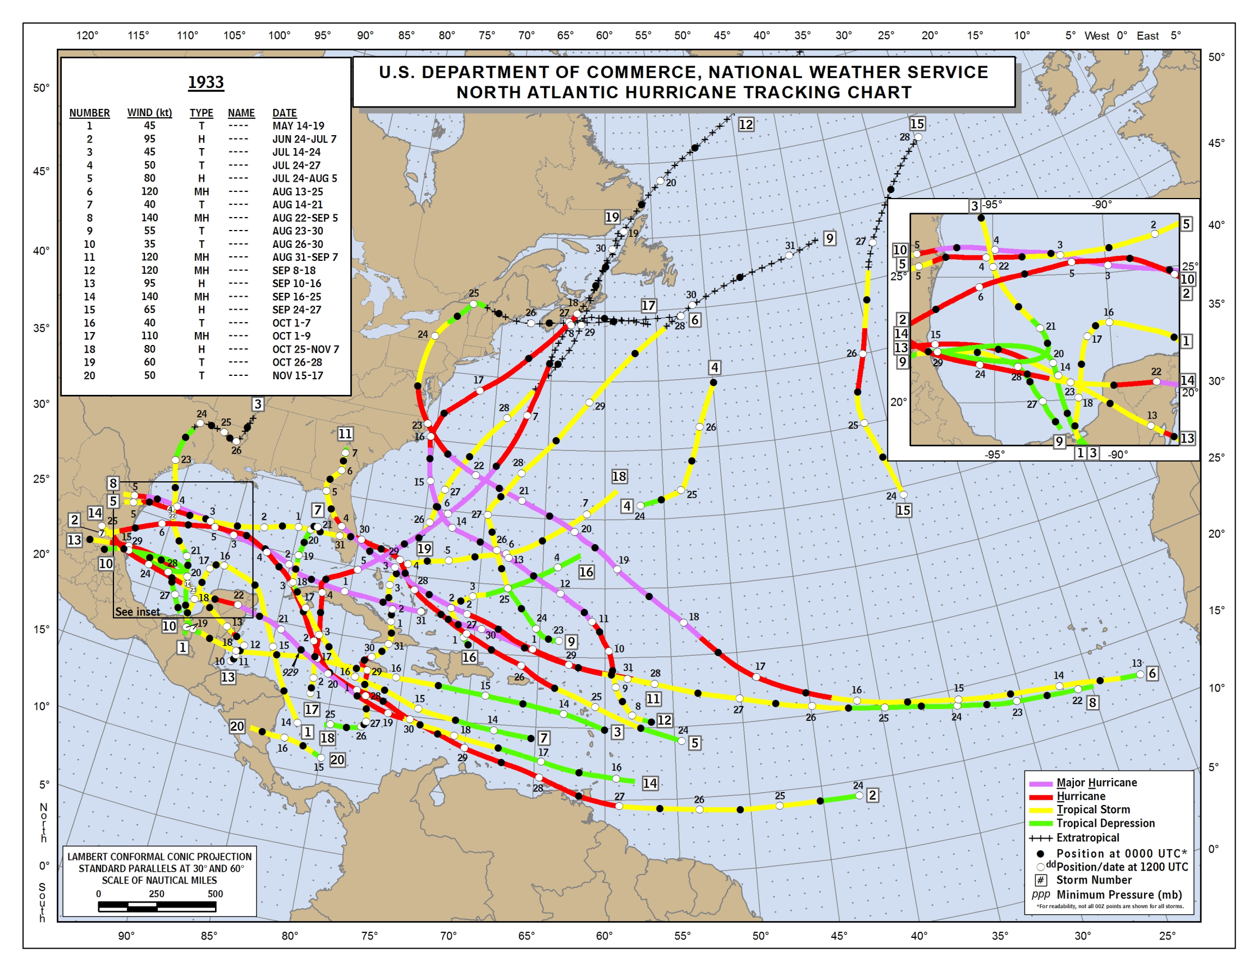
“Super-storm” Sandy-
~100 mph winds
Chesapeake-Potomac Hurricane of 1933- ~120 mph winds
2012
How would the frequency, path and intensity of tropical storms and hurricanes change in the future?
Even if future storms will not be stronger, SLR would result in higher storm surge and more damage!
1933

Slide 21
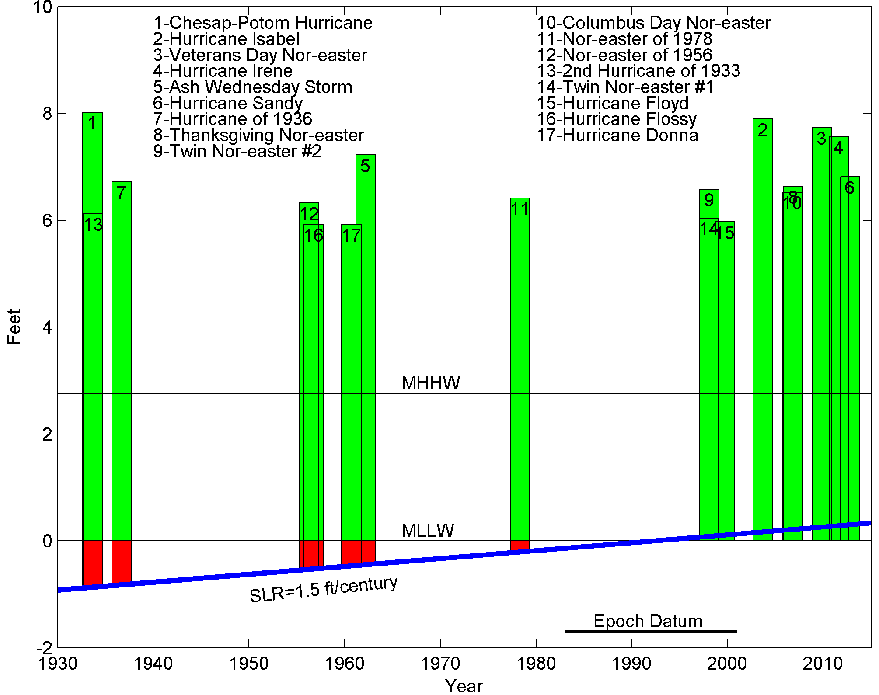
Top storm surges in Norfolk, VA

Slide 22
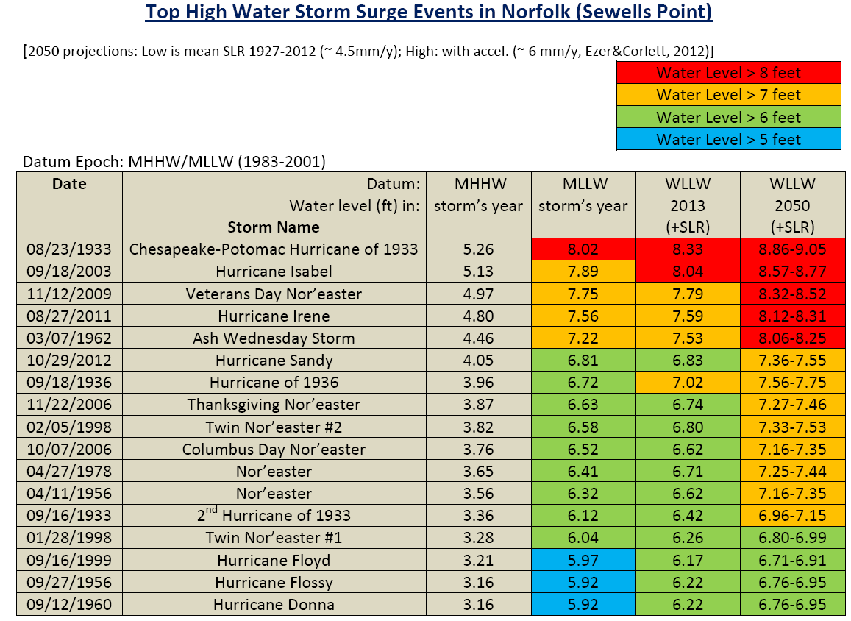

Slide 25
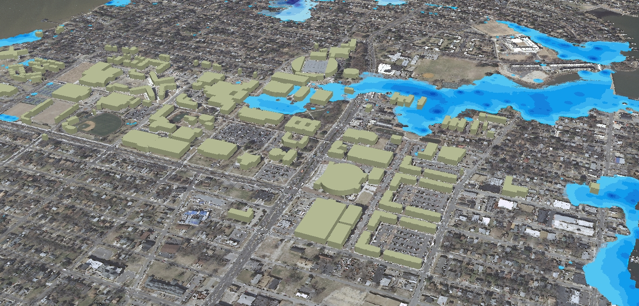
Flooding affects universities, navy, commerce, medical facilities, etc.
Major road to Naval Station Norfolk
(world’s largest navy base)
Old Dominion Univ.
campus
Hampton Blvd, Norfolk, VA
← my office
to Eastern VA Medical School and Sentara Norfolk General Hospital

Slide 26
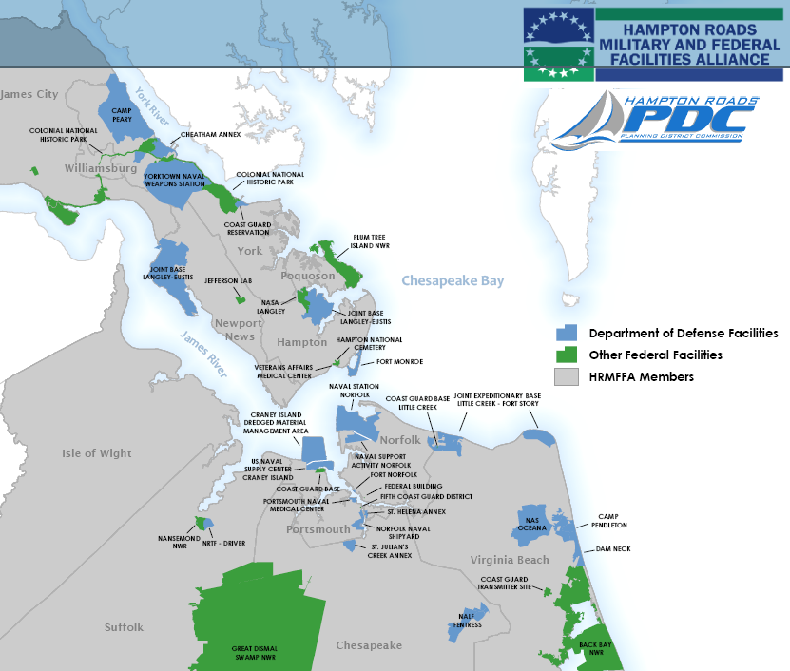
Major federal facilities in Hampton Roads may be affected by rising seas:
Air bases
Navy bases
Coastguard
NASA Langley
Jefferson Lab
Shipyards

Slide 27
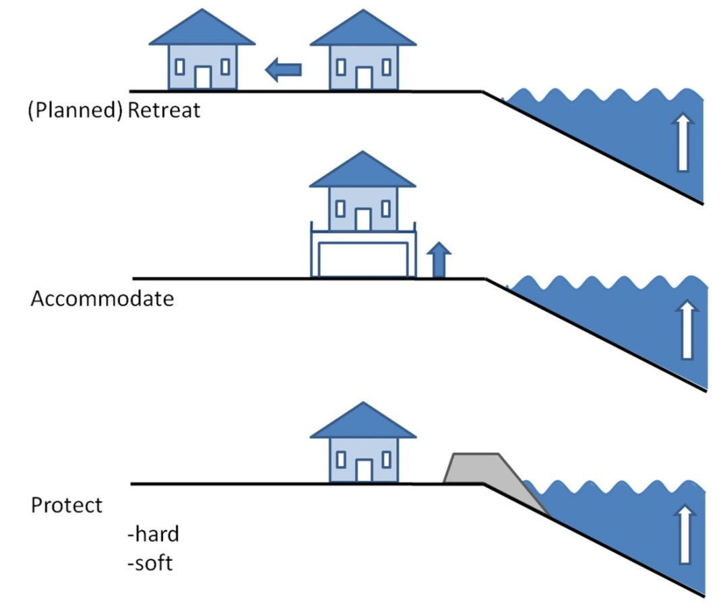
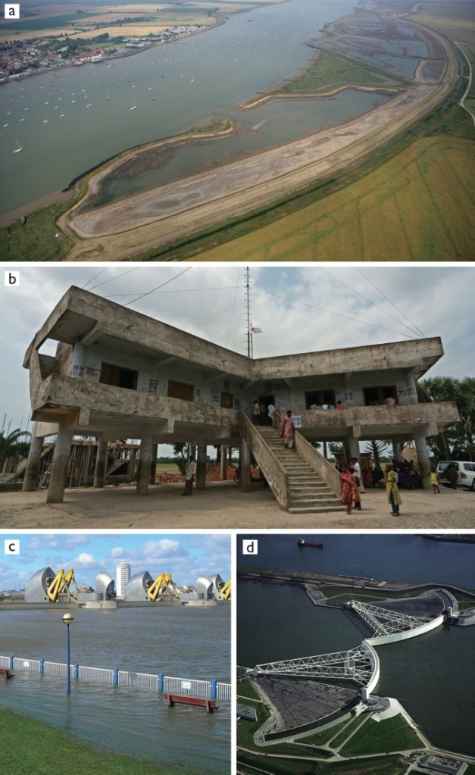
What can we do to reduce the risk?
Adaptation and mitigation options
(Note: many European countries are far ahead of the US in developing strategies to address sea level rise- see Amsterdam, Venice, London, etc.)
Source: Nicholls (2010) “Understanding Sea-Level Rise and Variability”

Slide 28
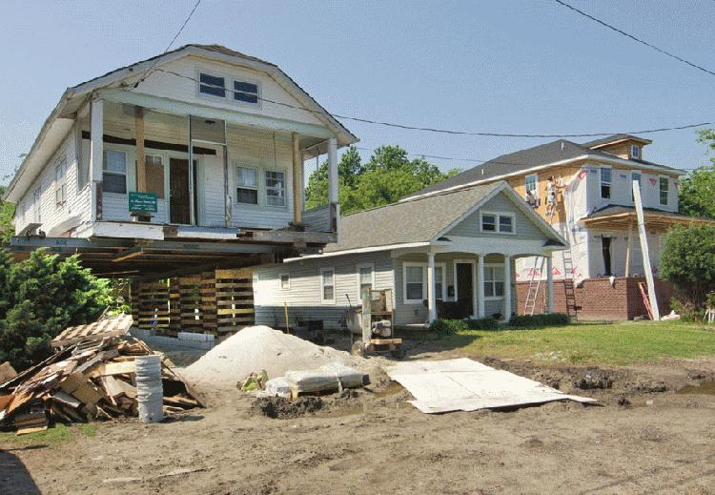
Example of accommodation: raising houses in Norfolk
Cost: ~$100,000 per house
Repetitive flood damage claims in Norfolk:
(source: Norfolk City Planning Dept.)
2009- ~200 claims
2011- ~750 claims
2012- ~900 claims

Slide 29
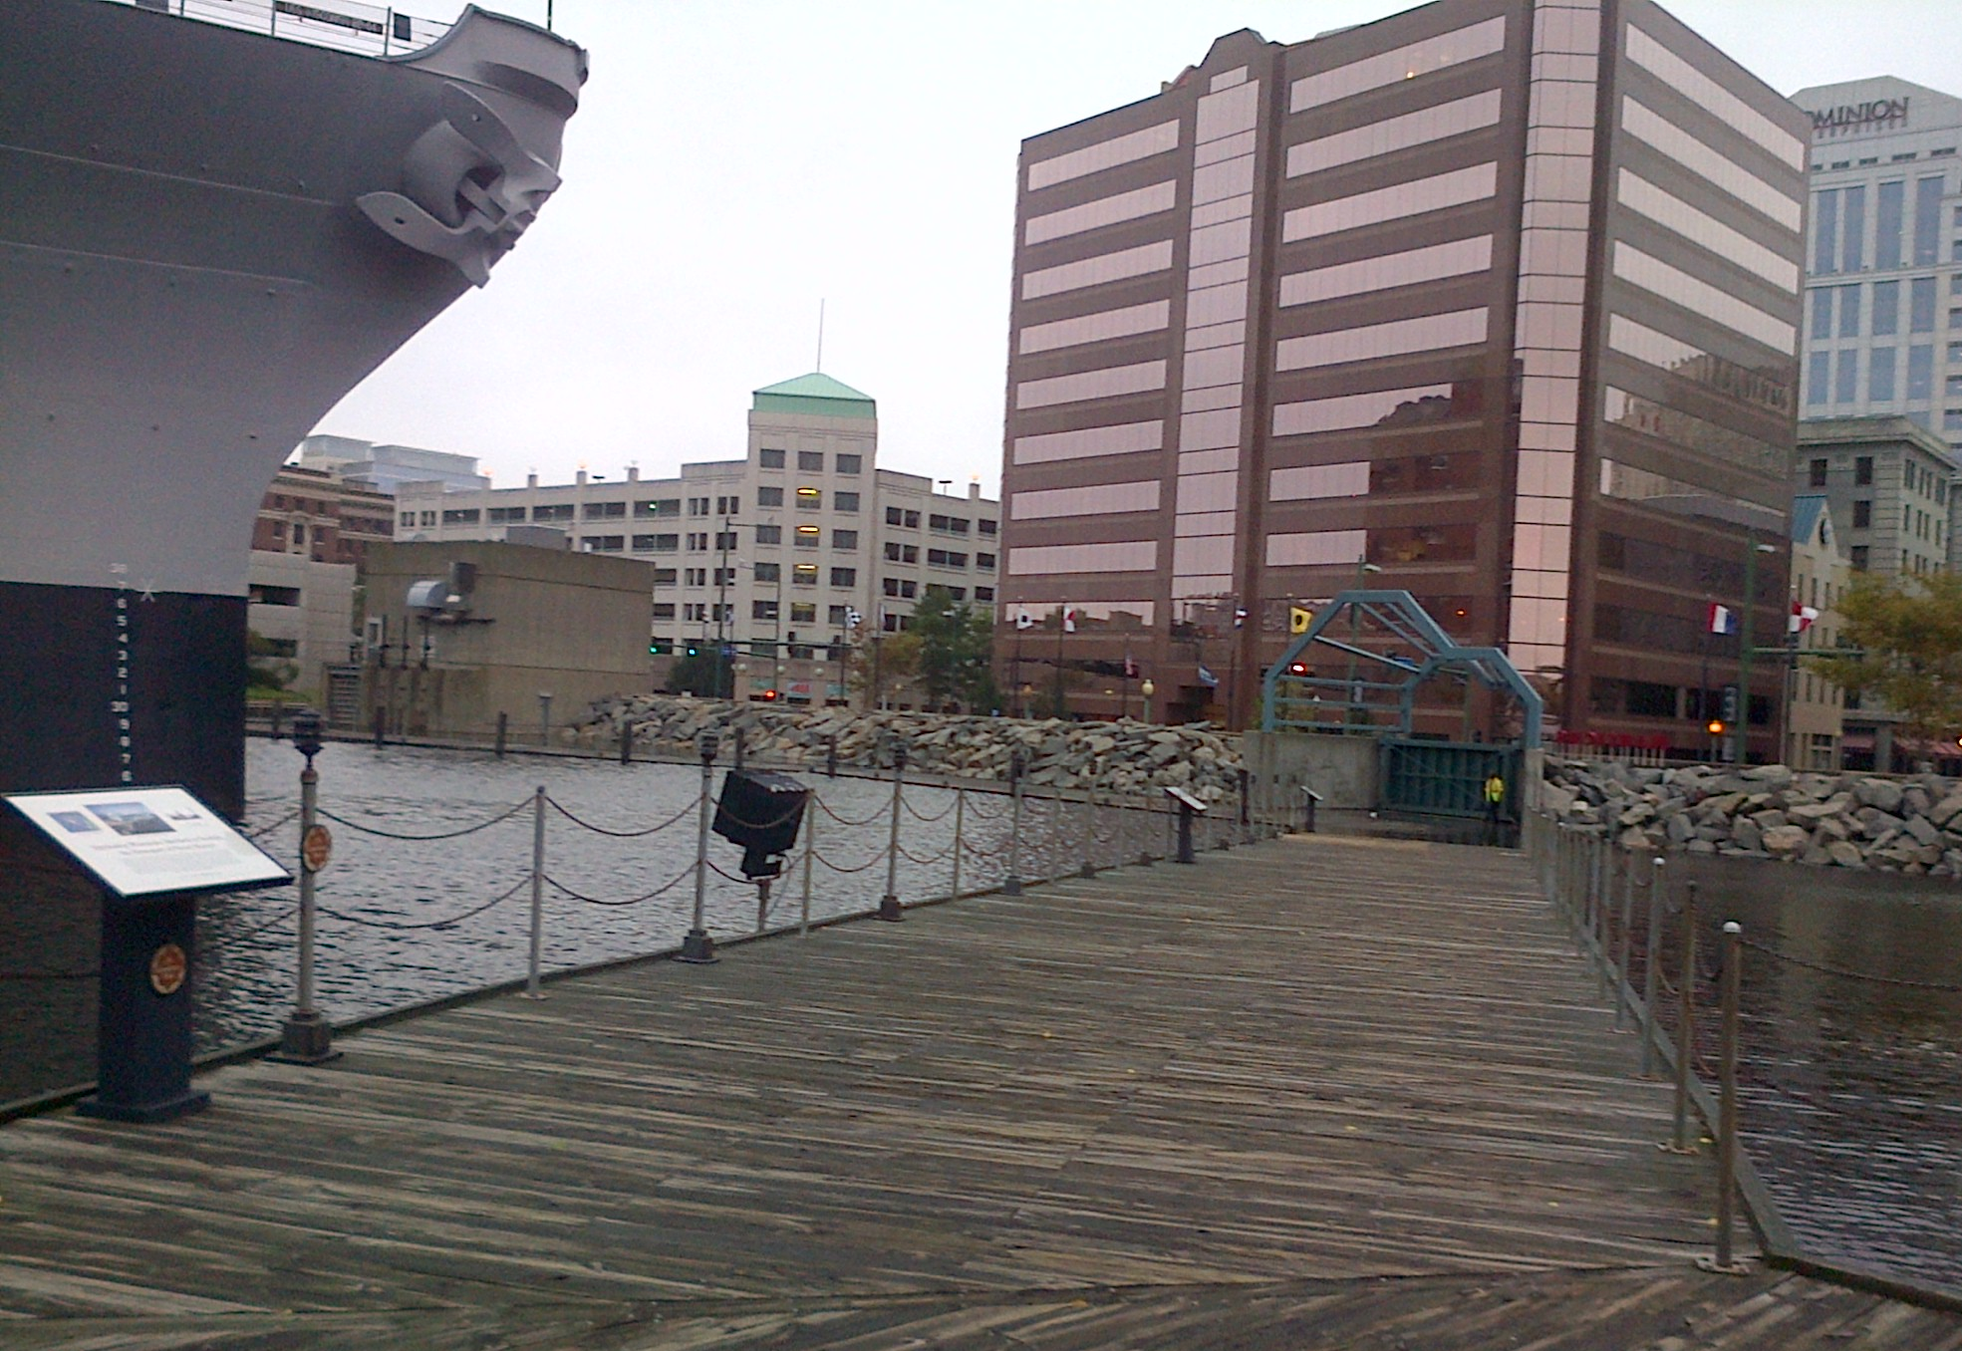
Example of protecting methods:
flood gates in downtown Norfolk (may need more…)
pumping station
flood wall
flood gate

Slide 30
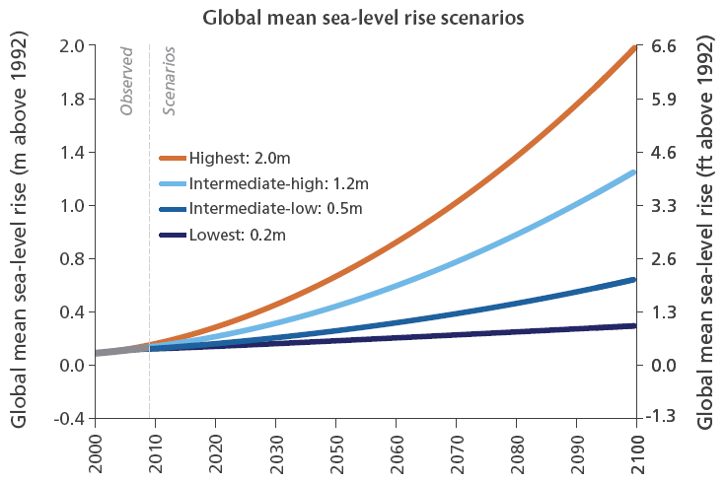
Future projections of global SLR (e.g., IPCC reports) give too large range for practical local planning….
So we need to do better in projecting local sea level rise and assess the increased risks

Slide 31
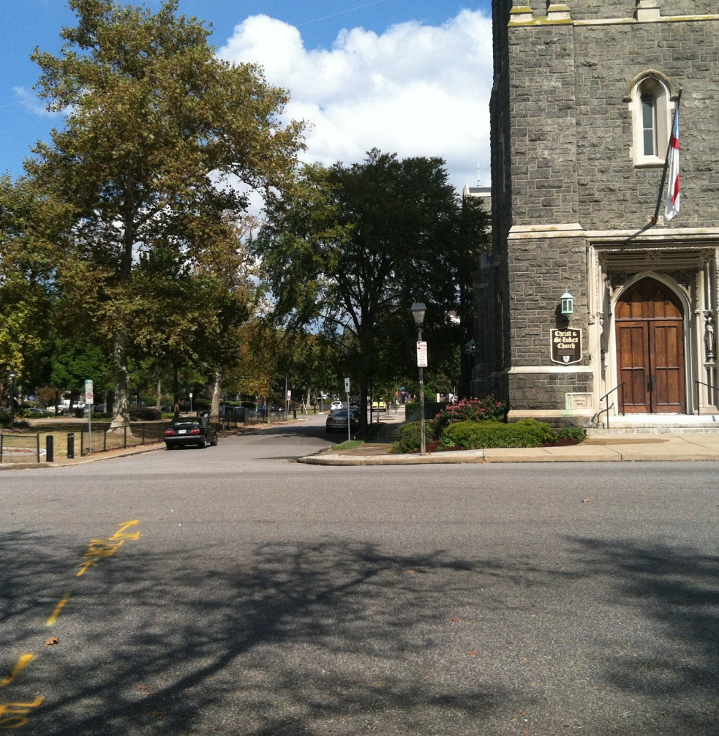
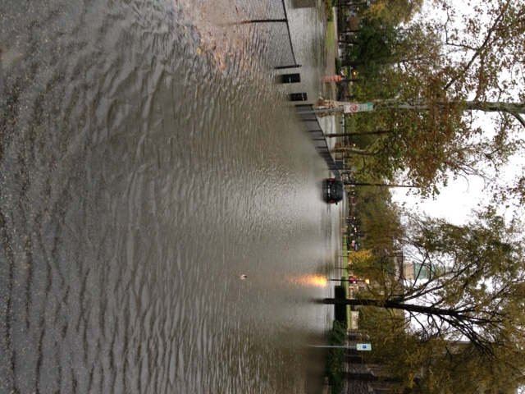
Thank You
before Sandy
after Sandy

