Slide 1
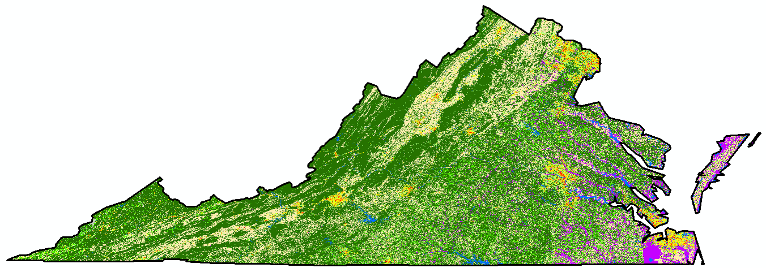
Interactions between Climate Change and Land Use Land Cover Changes in Virginia
Hua Liu, Ph.D.
Associate Professor of Geography
Department of Political Science and Geography
Old Dominion University, Norfolk, VA

Slide 2
Causes of Land Use Land Cover Change (LULCC)
Population growth/migration and social infrastructure
Changing economic conditions and governmental policies
Markets influenced by local/global factors
Earth surface processes and landforms (e.g., earthquake) and extreme climatic events, e.g., hurricanes
Human-environment interaction, e.g., the use of air conditioning
Others
Factors may work together to modify landscape and ecosystems

Slide 3
Influences of LULCC
Contributes to local and global climate change
Affects biotic diversity worldwide
Impacts ecosystem and accelerates soil degradation
Influences population vulnerability to climatic and socio-economic changes

Slide 4
Impacts of LULCC on Climate
LULCC reflects human influence on atmospheric temperature trends, e.g., urban heat islands
LULCC can alter the winds near the ground due to
the changes of the aerodynamic roughness,
the effects of buildings and other obstacles to the airflow
Urban-induced heat island and surface roughness influence clouds, rainfall patterns, and lightning
LULCC impacts surface fluxes of latent and sensible heat

Slide 5
Remote Sensing in LULCC studies
Can be used to investigate the spatial distributions of LULC at both local and global scales
Helps to identify the temporal changes of LULC at refined scale
Can also help to evaluate:
vegetation and impervious surface coverages,
vegetation height and structure,
soil moisture and snow depth
the effects of urban heat islands,
land surface temperature,
surface fluxes of latent and sensible heat

Slide 6
LULCC in Virginia
No substantial changes in land structure have been identified in Virginia over the past 20 years
The state overall has experienced notable decreases in barren land, forest, and agriculture, and significant increases in developed land, according to National Land Cover Database (NLCD)
More LULCC has been identified at various localities in the state, especially in some urban cores and their surrounding areas, and also along the coast

Slide 7
Total Surface Area, by Land Cover/Use In thousands of acres, with margins of error
Land Cover/Use |  | 1982 | 1987 | 1992 | 1997 | 2002 | 2007 | 2010
Federal land |  | 2,608.3 -- | 2,626.2 -- | 2,646.4 -- | 2,646.4 -- | 2,646.4 -- | 2,646.4 -- | 2,646.4 --
Water areas |  | 1,916.3 -- | 1,918.7 -- | 1,926.0 -- | 1,927.0 -- | 1,931.9 -- | 1,938.5 -- | 1,942.0 --
Non-Federal Land | Developed | 1,825.3 ± 106.2 | 2,065.2 ± 108.4 | 2,265.2 ± 115.1 | 2,602.3 ± 110.4 | 2,858.4 ± 115.5 | 3,043.3 ± 111.5 | 3,122.8 ± 113.1
 | Rural | 20,737.2 ± 106.6 | 20,477.0 ± 107.8 | 20,249.5 ± 114.5 | 19,911.4 ± 110.3 | 19,650.4 ± 116.8 | 19,458.9 ± 112.6 | 19,375.9 ± 114.6
 | Total | 22,562.5 ± 13.4 | 22,542.2 ± 13.6 | 22,514.7 ± 13.9 | 22,513.7 ± 14.7 | 22,508.8 ± 15.0 | 22,502.2 ± 20.1 | 22,498.7 ± 20.0
Total surface area |  | 27,087.1 -- | 27,087.1 -- | 27,087.1 -- | 27,087.1 -- | 27,087.1 -- | 27,087.1 -- | 27,087.1 --
Cited from National Resources Inventory (NRI) Provided by Dr. Yuhao Wu

Slide 8
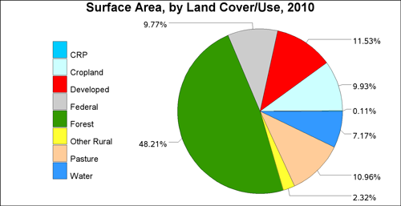
Total Surface Area, by Land Cover/Use In thousands of acres, with margins of error (contd.)
Cited from National Resources Inventory (NRI) Provided by Dr. Yuhao Wu

Slide 9
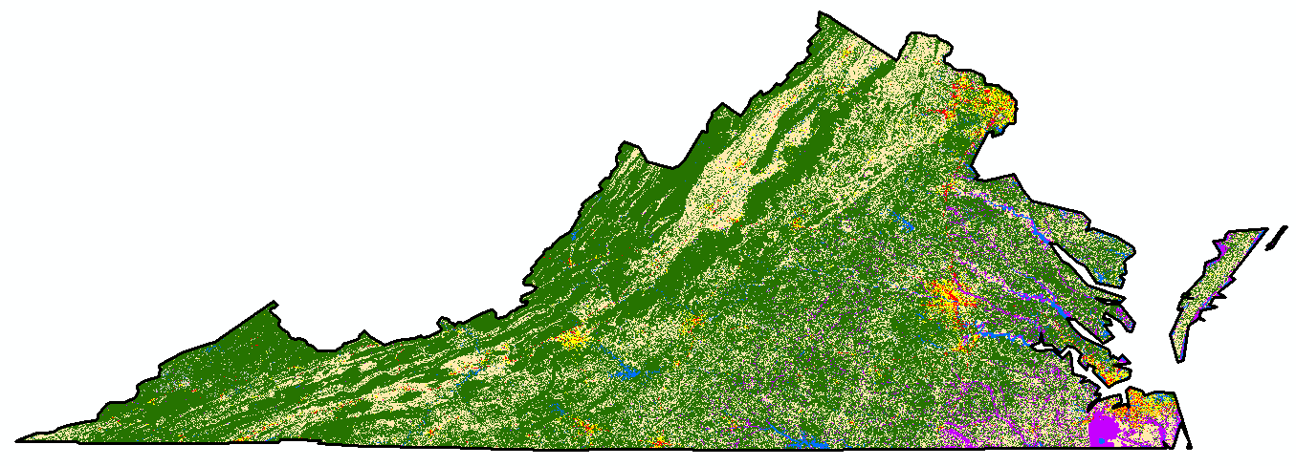
Virginia LULC in 1992

Slide 10

Virginia LULC in 2011

Slide 11
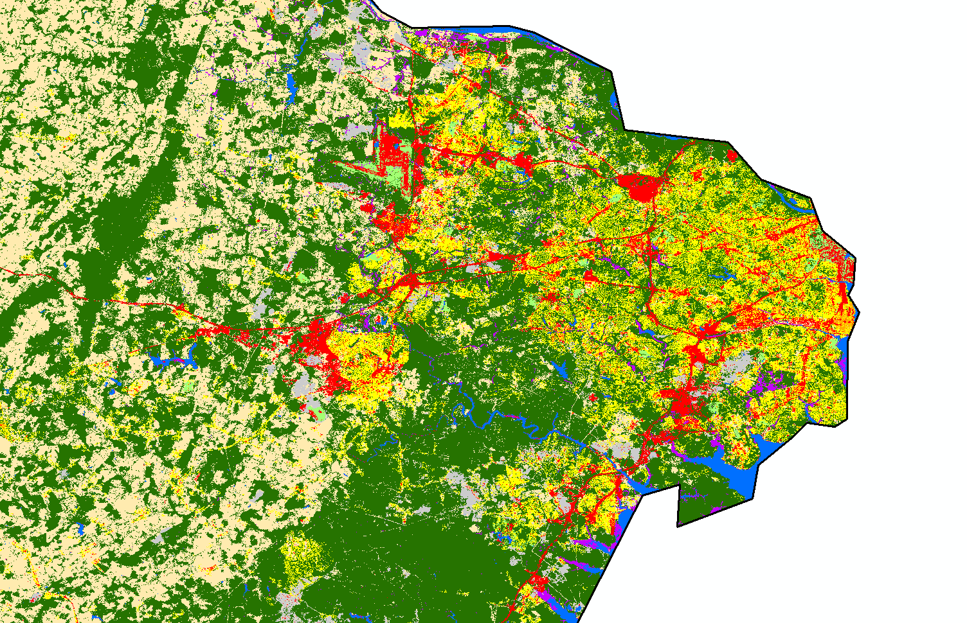
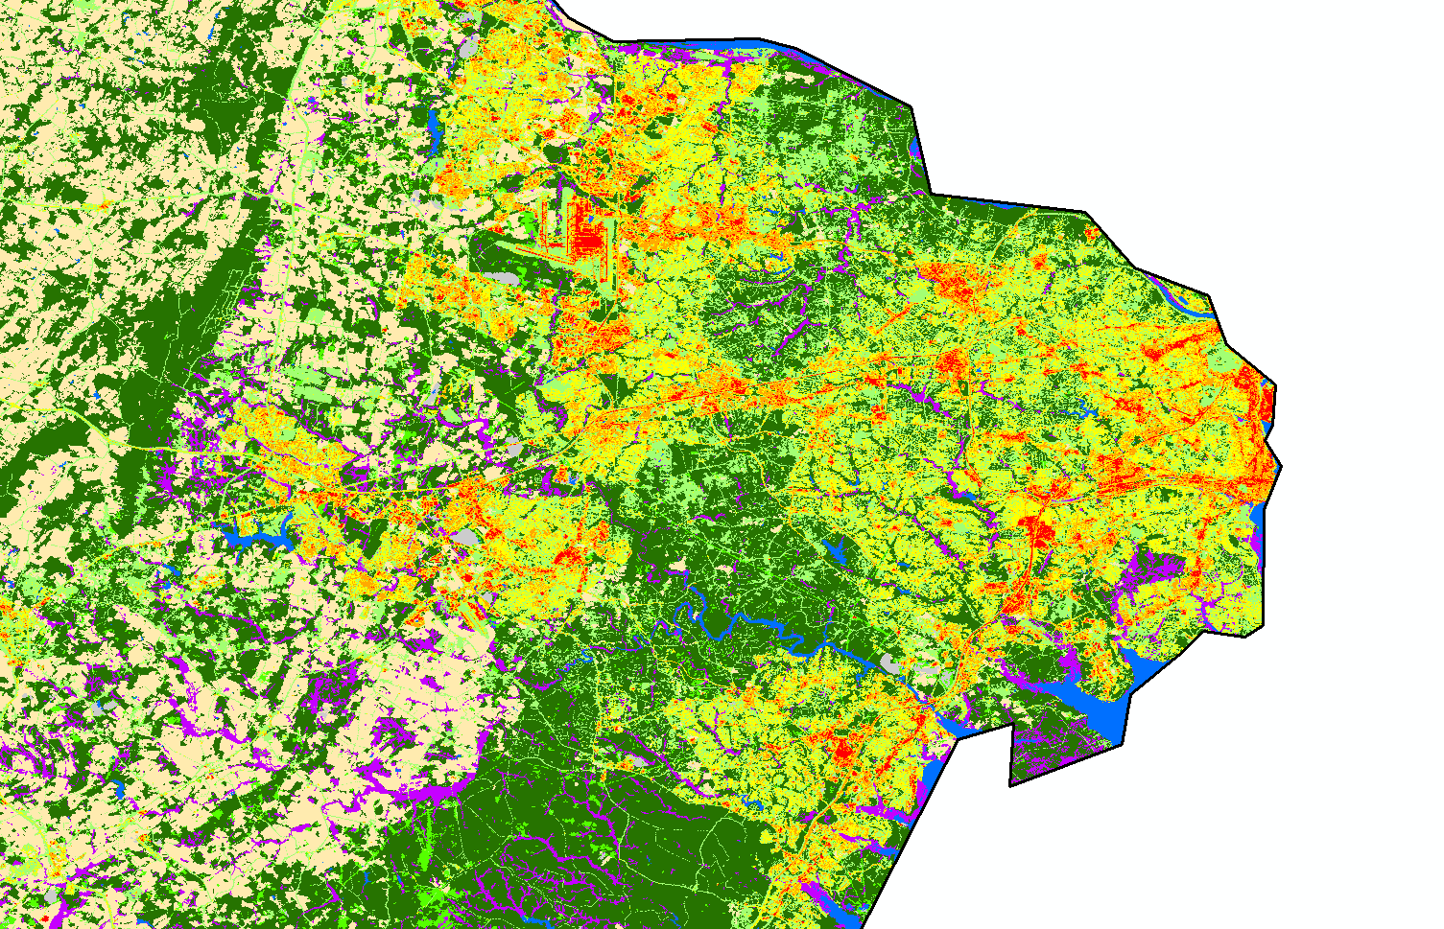
LULCC in Northern Virginia
Year 1992
Year 2011

Slide 12
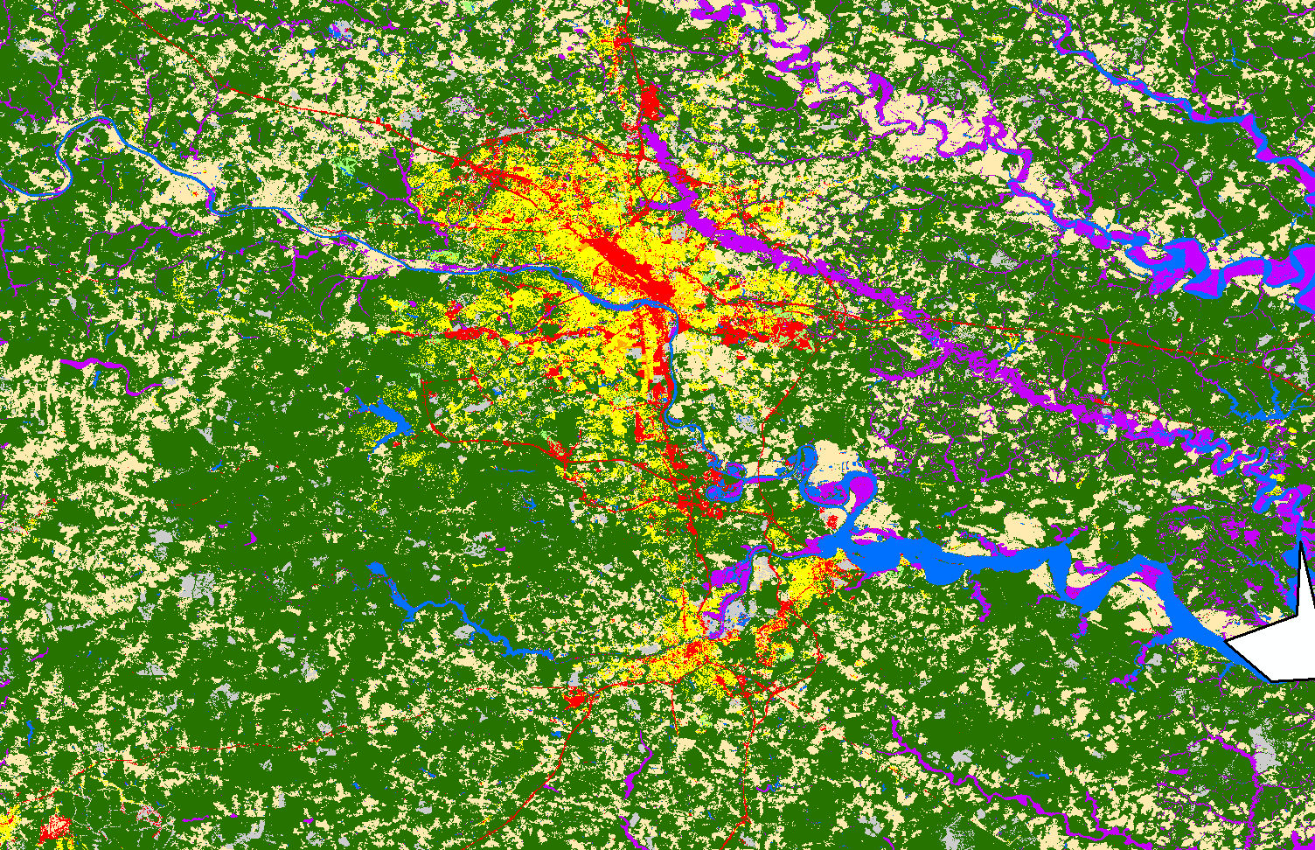
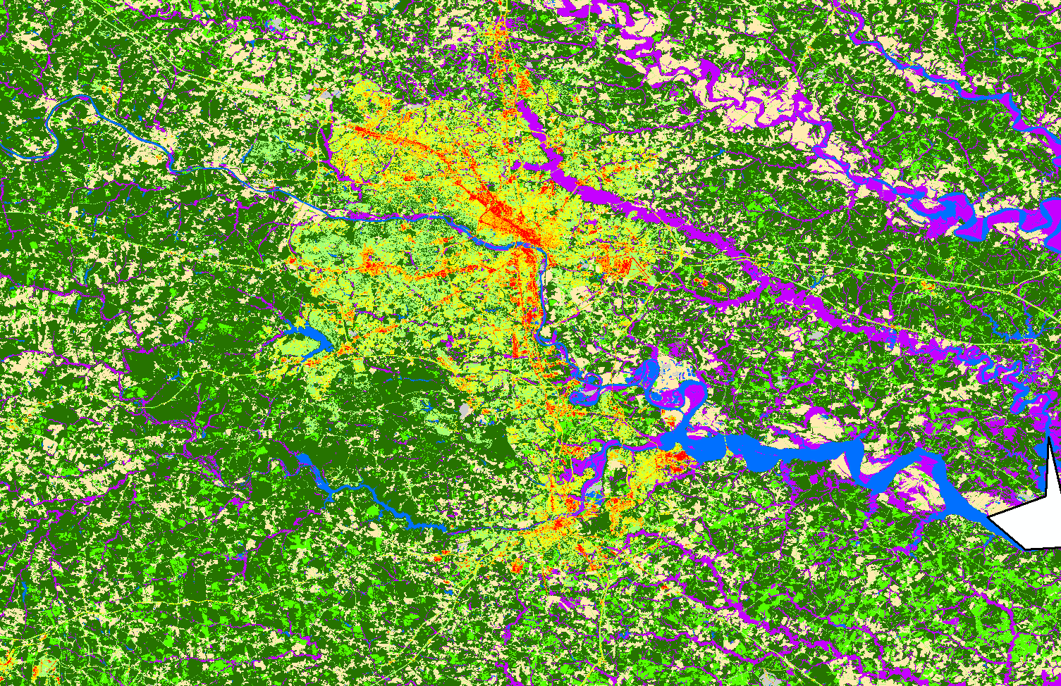
LULCC in Richmond area
Year 1992
Year 2011

Slide 13
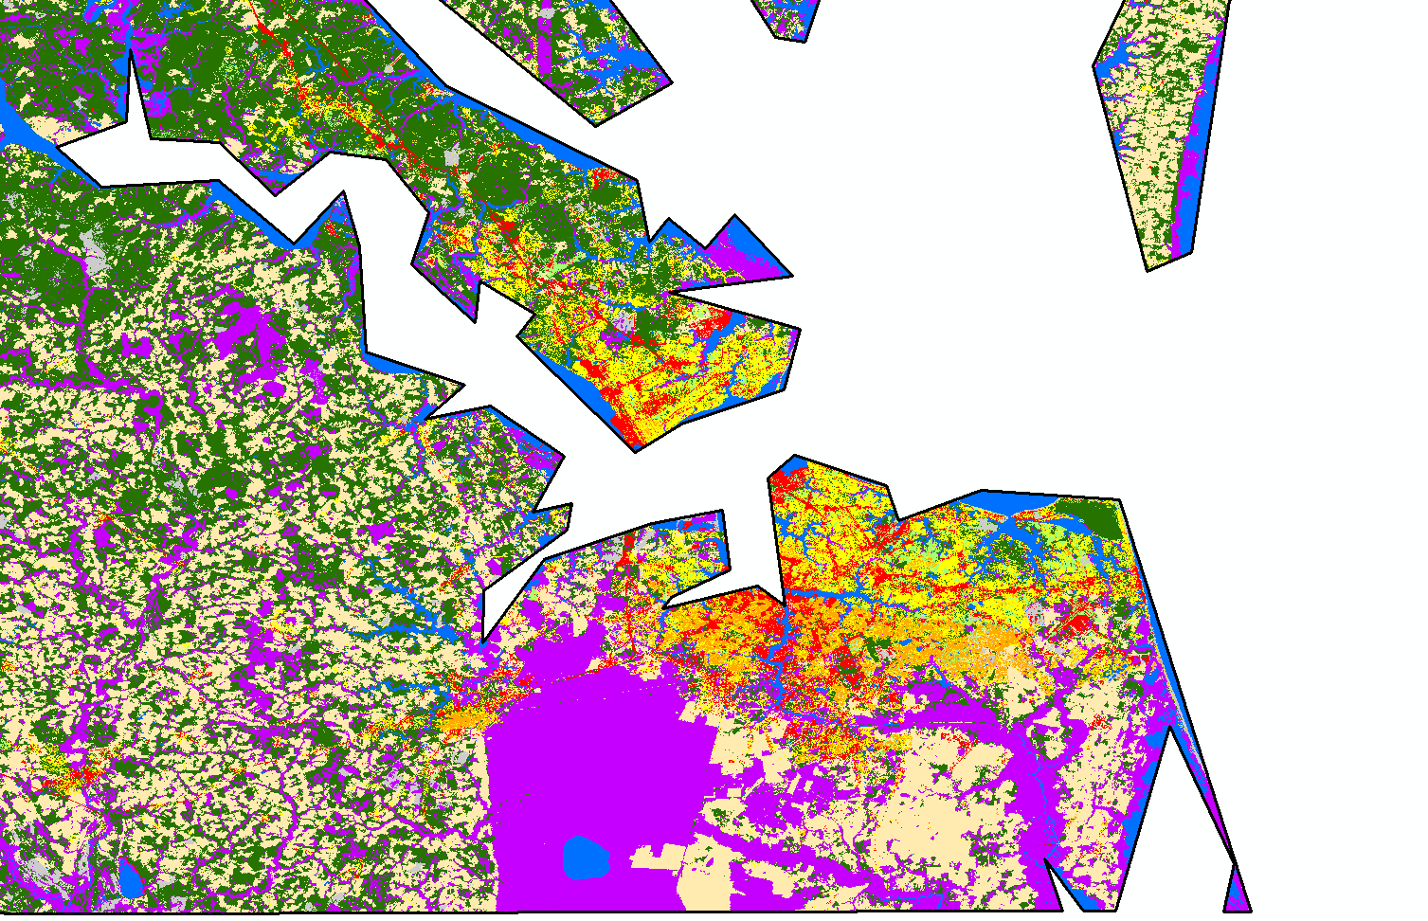
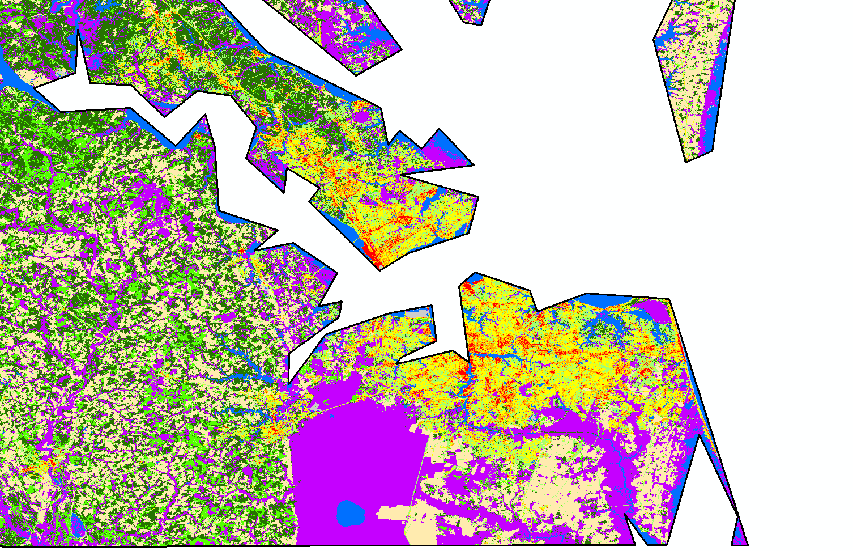
LULCC in Hampton Roads
Year 1992
Year 2011

Slide 14
A case study: Wetland changes in 1992-2011 at the Lynnhaven Bay, Virginia Beach, VA
Original land cover datasets from National Land Cover data were reclassified
Wetland pixels were derived
Woody Wetlands
25%-100 % forest or shrubland vegetation
soil or substrate is periodically saturated with or covered with water
Emergent Herbaceous Wetlands
75%-100% perennial herbaceous vegetation
soil or substrate is periodically saturated with or covered with water

Slide 15
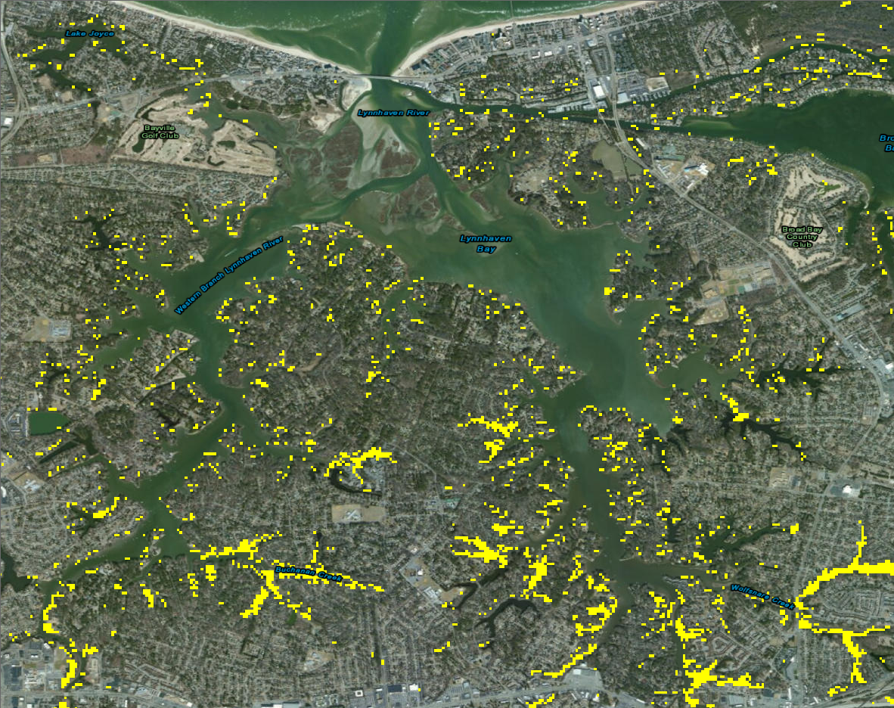
Wetlands around Lynnhaven Bay in 1992

Slide 16
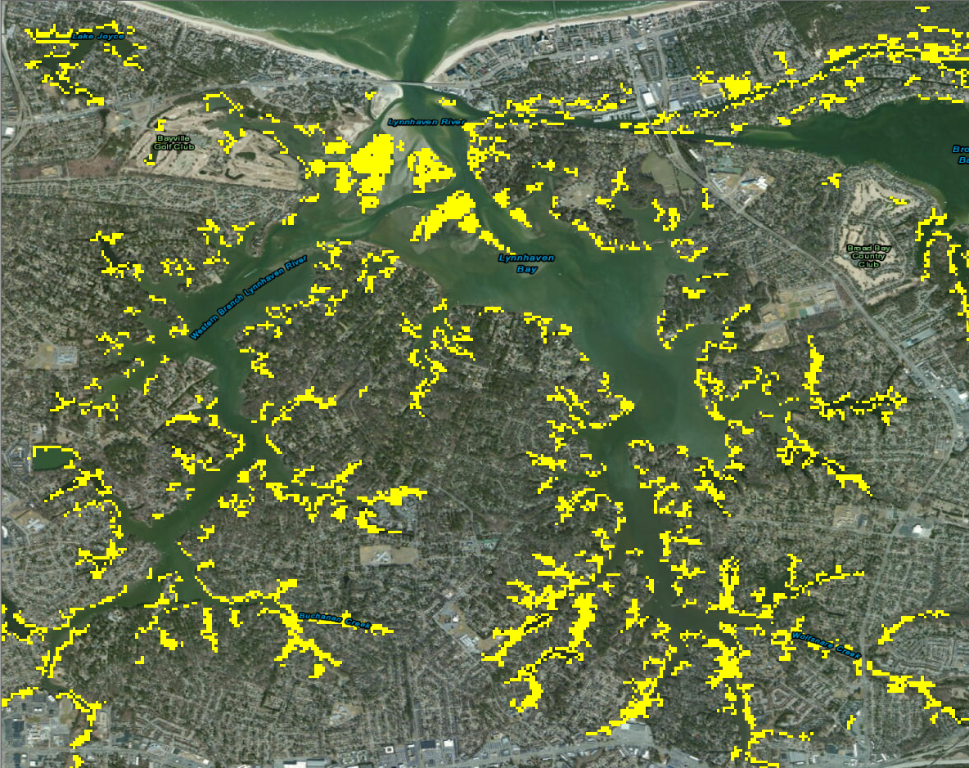
Wetlands around Lynnhaven Bay in 2001

Slide 17
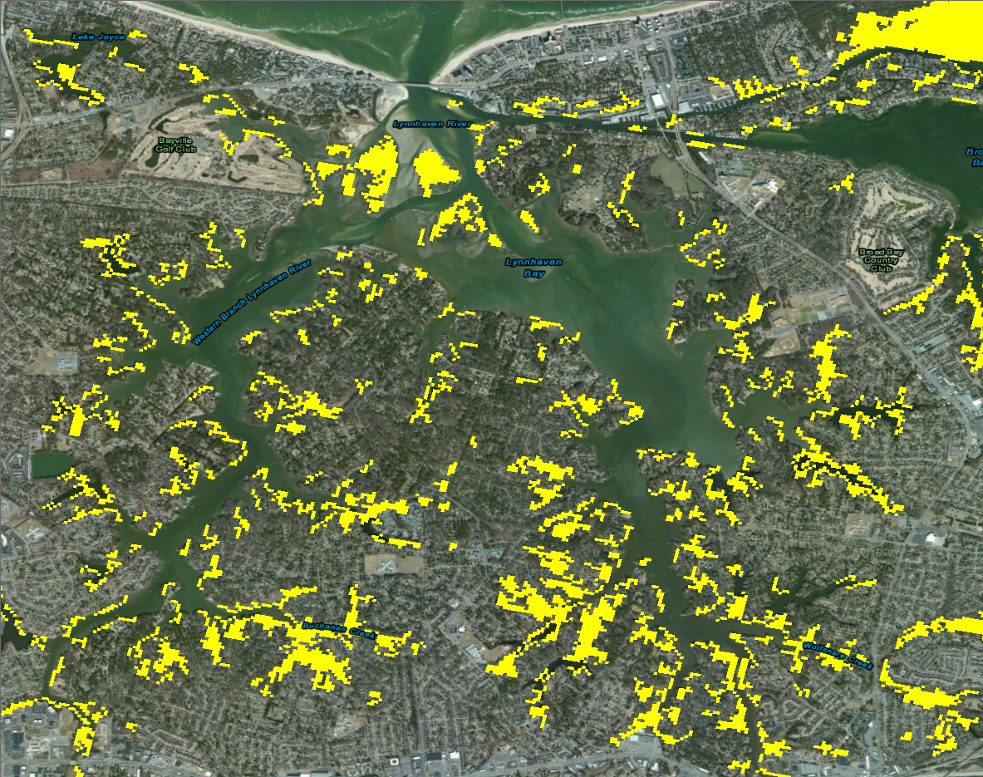
Wetlands around Lynnhaven Bay in 2006

Slide 18

Wetlands around Lynnhaven Bay in 2011

Slide 19
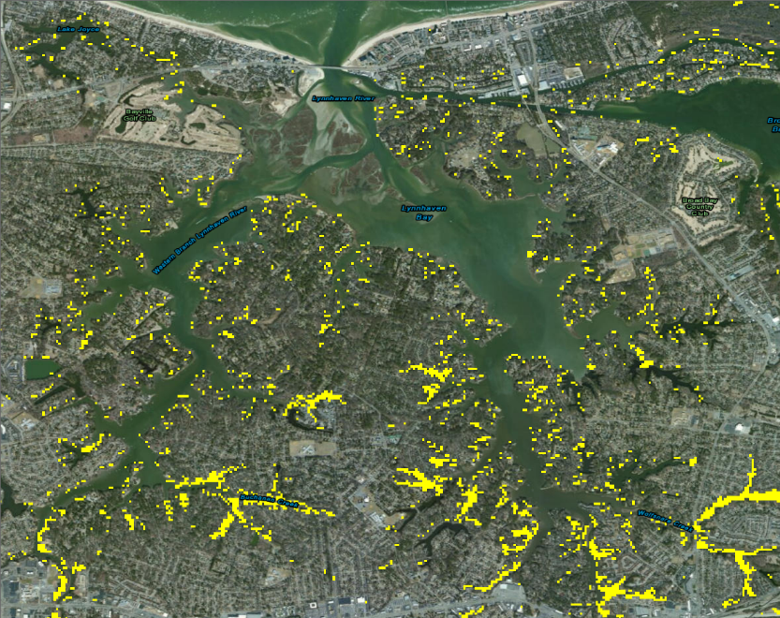



1992
2001
2006
2011

Slide 20
Current Limitations
Data used in existing long-term climate assessment (e.g., the U.S. Historical Climatology Network) include undocumented biases due to:
meteorological station moves,
instrument changes,
Improper exposure of instruments,
changes in observation procedures, etc.

Slide 21
Current Limitations (contd.)
Limited studies have been done to evaluate how regional LULCC is associated with regional and global climate responses, e.g., local min air temperature

Slide 22
Future Research Priorities
To include more comprehensive climate indices in LULCC studies:
magnitude of the spatial redistribution of land surface latent and sensible heating
magnitude of the spatial redistribution of precipitation and moisture convergence
the normalized gradient of regional radiative heating changes
To evaluate human effects on climate at regional instead of global scale, e.g., urban planning and policy making
To separate the impacts of LULCC on temperature & precipitation and actual bias

