Slide 1

Oluwakemi Izomo

Slide 2
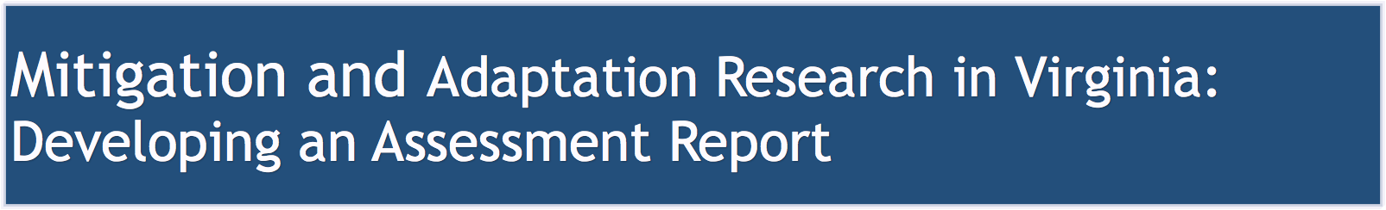

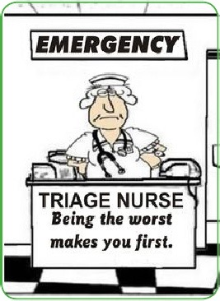
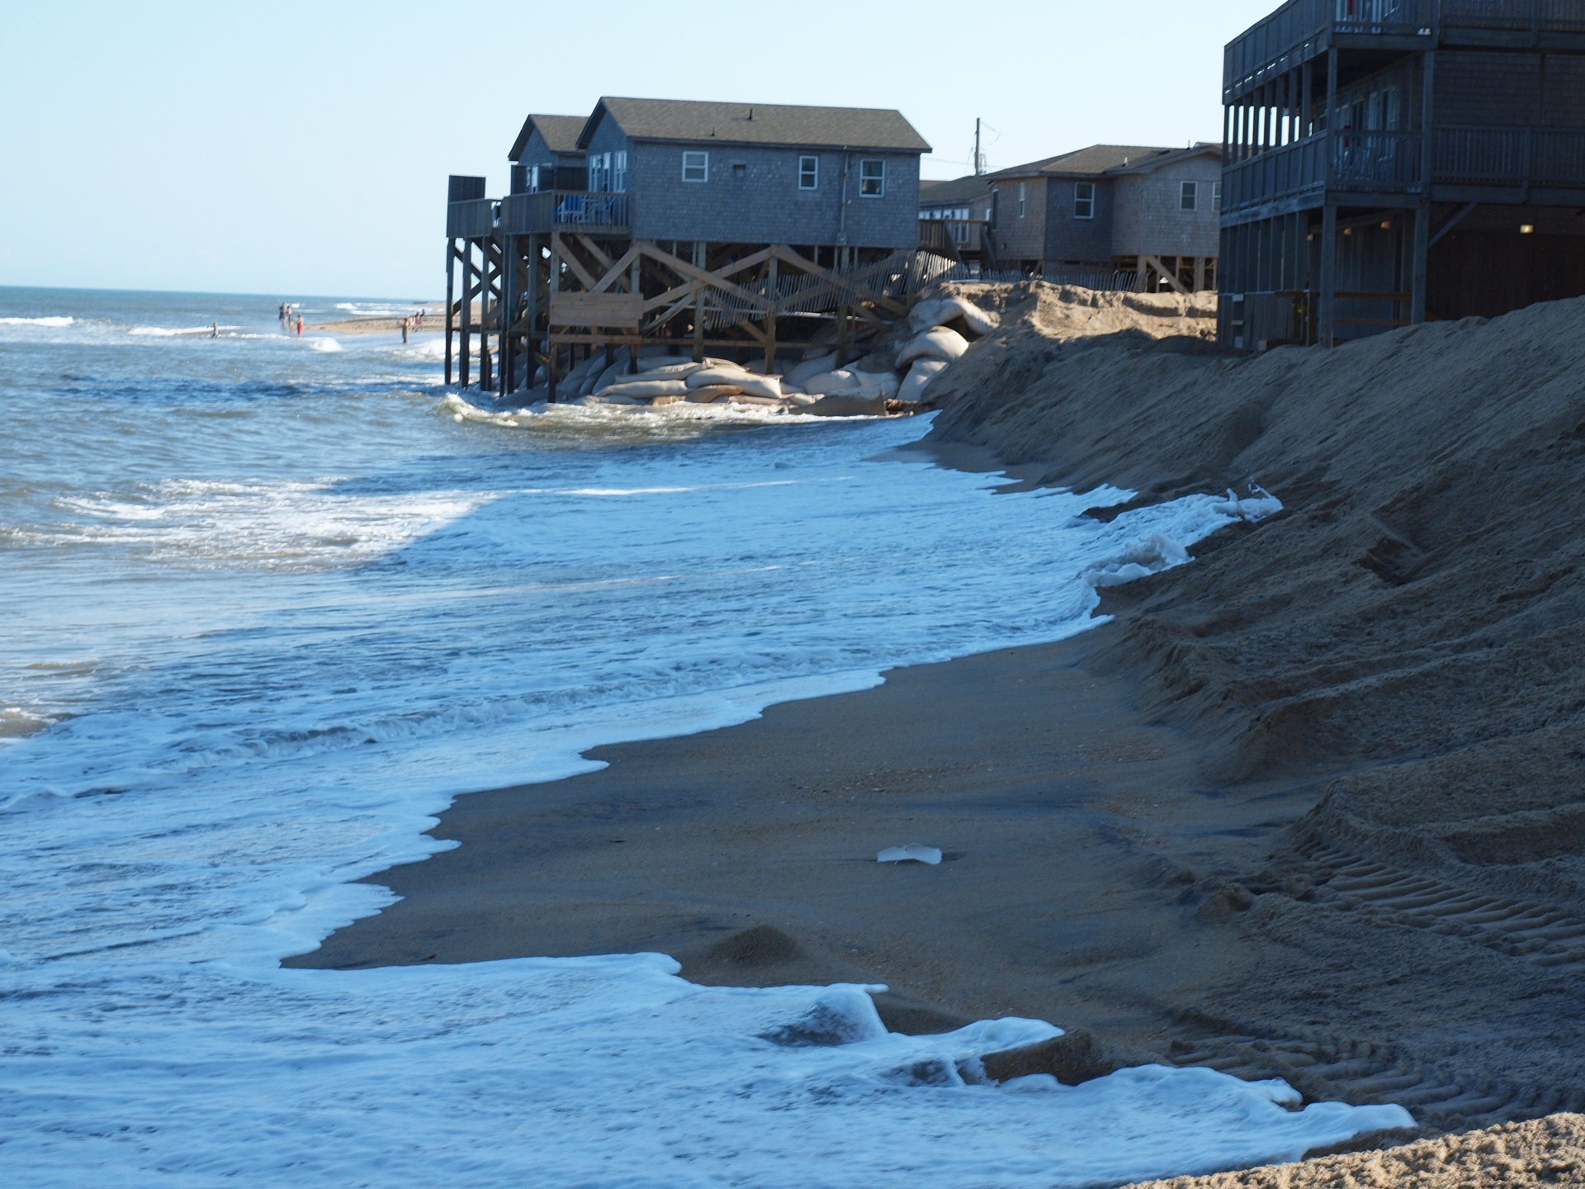
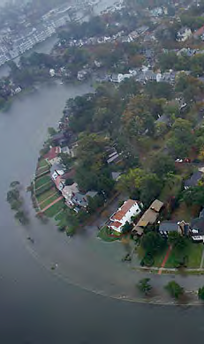
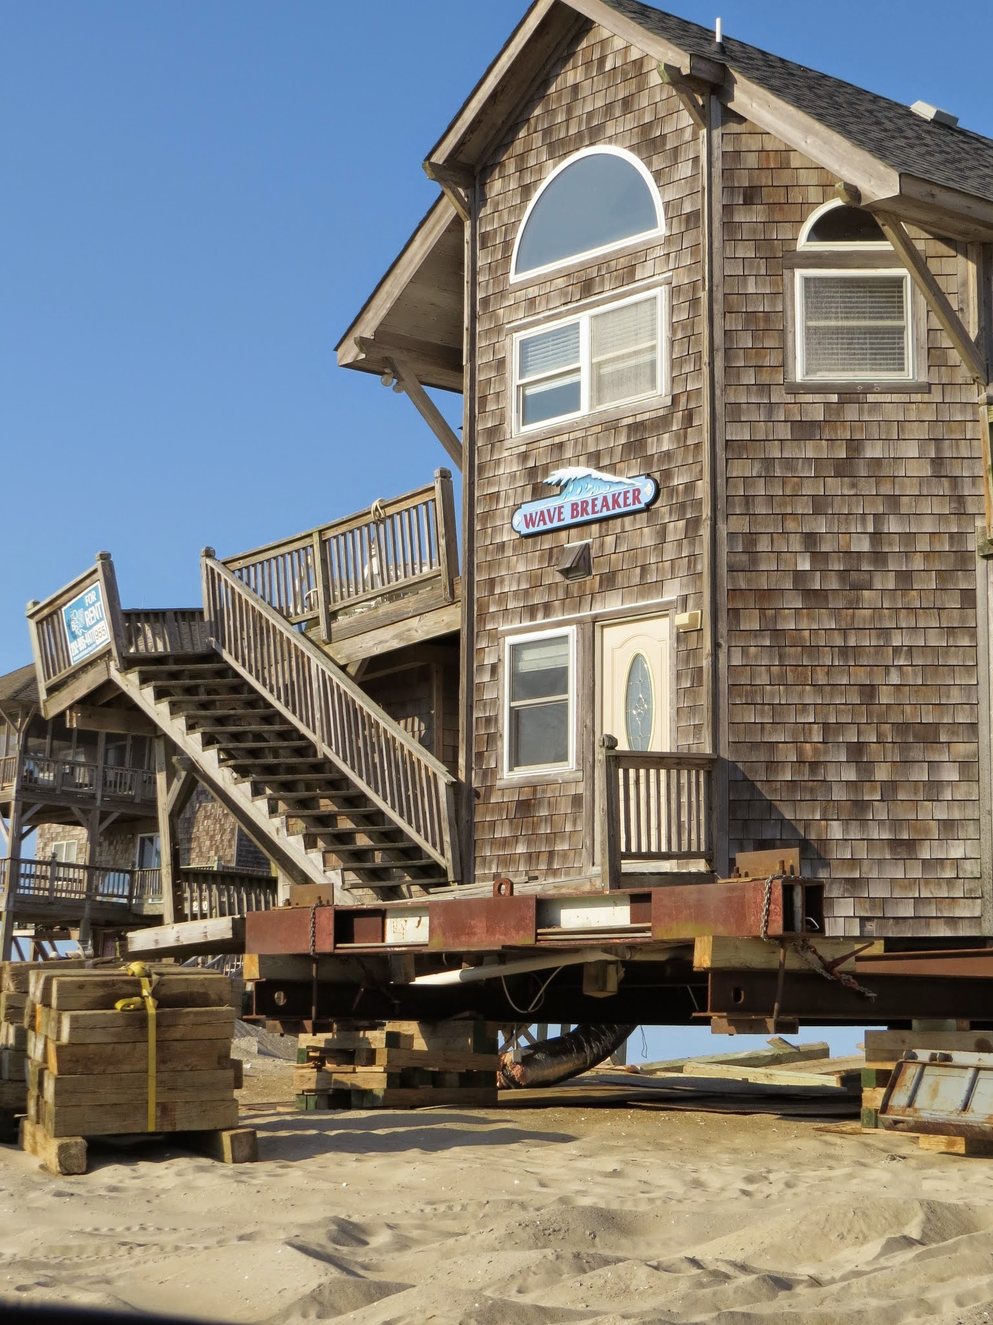
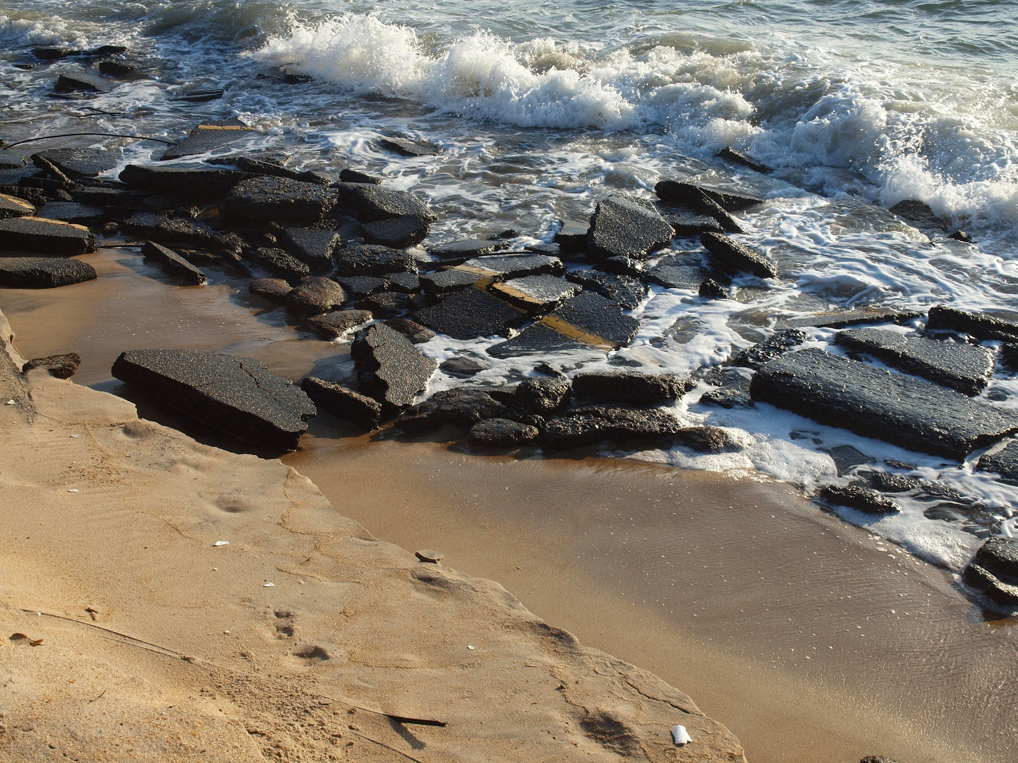
Introduction: Mitigation and Adaptation
Outline of (Mitigation and) Adaptation Science
Towards the Assessment Report
Hans-Peter Plag
August 11, 2015

Slide 3

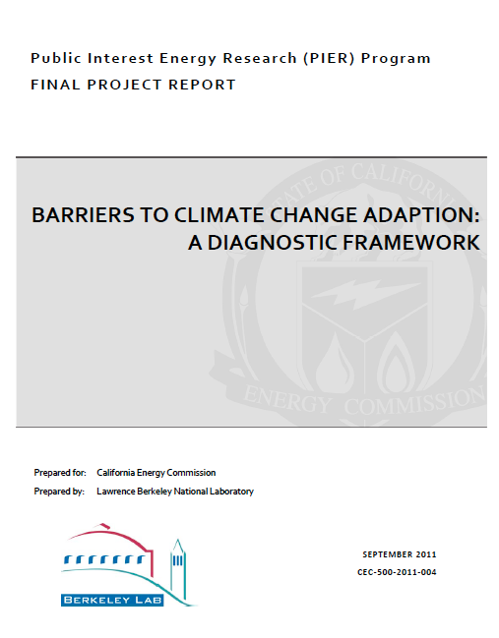
Early usage in discussions of environmental hazards and changes (1980-ies):
- adjustments: short-term, relatively small-scale or minor changes;
- adaptation: longer-term, more systemic changes
Lack of foresight/forward-looking capacity limited society to reactive adjustments/adaptation.
Most recent studies do not distinguish between adjustments/mitigation of impacts and adaptation in response to stimulus.
Ekstrom et al., 2011

Slide 4
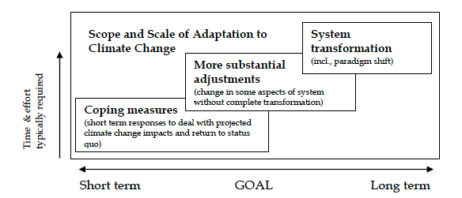
Time and effort as function of scope and scale of adjustments and adaptation
Ekstrom et al., 2011

Slide 5
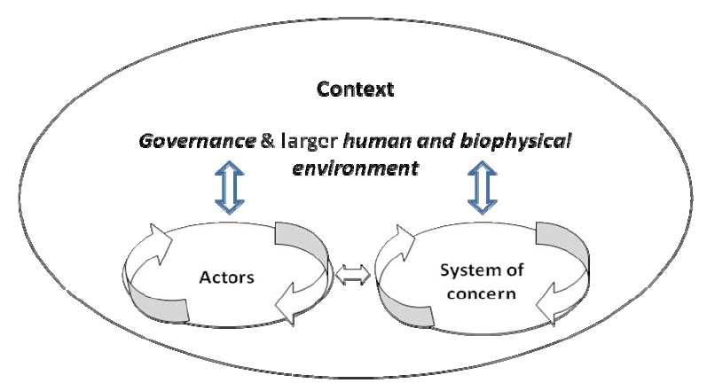
Three main elements:
- system of concern
- actors
- governance and environment
Ekstrom et al., 2011

Slide 6
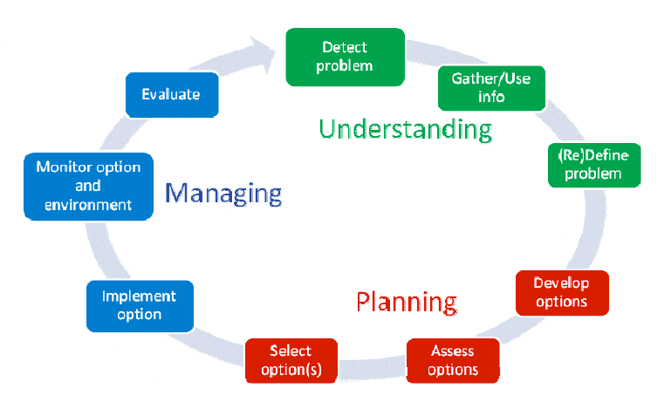
Phases of traditional approach
Ekstrom et al., 2011
Has issues if time scales are very long

Slide 7
Intergovernmental Panel on Climate Change (IPCC):
- climate change mitigation: the process of mitigating (i.e., reducing) climate change mainly by reducing the climate forcing that results from increasing atmospheric concentration of Greenhouse Gases (GHG) or other anthropogenic forcing factors, such as albedo changes.
In a more general sense, climate change mitigation is any action taken to permanently eliminate or reduce the long-term risk and hazards of climate change.
- climate change adaptation: the process of enabling the built environment, social communities, and ecosystems to function and exist under the changing climate conditions that could not be mitigated.
In a more general sense, Climate change adaptation refers to adjustments in natural and human systems in response to actual or anticipate climate stimuli or their effects, which moderate harm or exploit beneficial opportunities.

Slide 8
Disaster Communities:
- mitigation: process of preventing a hazardous situation turning into a crisis or disaster;
- adaptation: refers to the process of handling the crisis.
FEMA, see http://www.fema.gov/what-mitigation):
"Mitigation is the effort to reduce loss of life and property by lessening the impact of disasters. Mitigation is taking action now—before the next disaster—to reduce human and financial consequences later (analyzing risk, reducing risk, insuring against risk). Effective mitigation requires that we all understand local risks, address the hard choices, and invest in long-term community well-being. Without mitigation actions, we jeopardize our safety, financial security, and self-reliance."

Slide 9
The recent White House Executive Order - Preparing the United States for the Impacts of Climate Change (see http://www.whitehouse.gov/the-press-office/2013/11/01/executive-order-preparing-united-states-impacts-climate-change) does not apply the term mitigation and includes the term “mitigation of impacts” into “adaptation.” It defines:
(a) "preparedness" means actions taken to plan, organize, equip, train, and exercise to build, apply, and sustain the capabilities necessary to prevent, protect against, ameliorate the effects of, respond to, and recover from climate change related damages to life, health, property, livelihoods, ecosystems, and national security;
(b) "adaptation" means adjustment in natural or human systems in anticipation of or response to a changing environment in a way that effectively uses beneficial opportunities or reduces negative effects; and
(c) "resilience" means the ability to anticipate, prepare for, and adapt to changing conditions and withstand, respond to, and recover rapidly from disruptions.

Slide 10
Insurance industry:
- mitigation denotes activities, efforts, and investments that reduce the likelihood (probability) or consequences (severity) of a threat.
- adaptation: not explicitly used widely.
Risk is the product of hazard probability, vulnerability, and exposed assets.
For most natural hazards:
- we have little means to impact hazard probability,
- we can reduce vulnerability: often equates to mitigating impacts of the hazard
- we can reduce exposure: requires a change in life and land use (adaptation).
Although insurances do not use the term adaptation, it is implicitly addressed as a way of reducing disaster risk.

Slide 11
At all levels we always have the choice to:
- mitigate threats and impacts (prevent, protect) or
- adapt (manage, change),
with rather different social and economic consequences.
It is helpful to distinguish between those processes that aim to protect against (climate change) impacts and those that enables us to adapt to these changes.
Our language should be flexible enough to reflect these choices.
For MARI, we therefore consider three terms as relevant, combining:
- the definition of climate change mitigation;
- a narrower definition of climate change adaptation;
- mitigation of climate change impacts (in the sense of crisis management and disaster risk reduction)

Slide 12
MARI’s Definitions:
Mitigation of Climate Change and SLR: actions that limit and reduce changes in the Earth's system that are known to force climate change or increase SLR.
Mitigation of climate change and SLR impacts: actions that aim to protect against certain levels of impacts of climate change and/or SLR.
Adaptation to climate change and SLR: actions that increase our preparedness for a wide range of probable climate change and SLR and allow us to adapt to the changes if and when they happen.

Slide 13
We can characterize:
mitigation as a more “external” process that protects an organism by reducing a threat or severe condition;
adaptation as a more “internal” process that alters an organism or its behavior.
- mitigation: technological solution
    - adaptation: behavioral changes,
paradigm shifts
mitigation: requires knowledge of the future to avoid failure (although “planning for failure” is developing),
adaptation: develop capability to handle an uncertain future (preparedness, resilience).

Slide 14
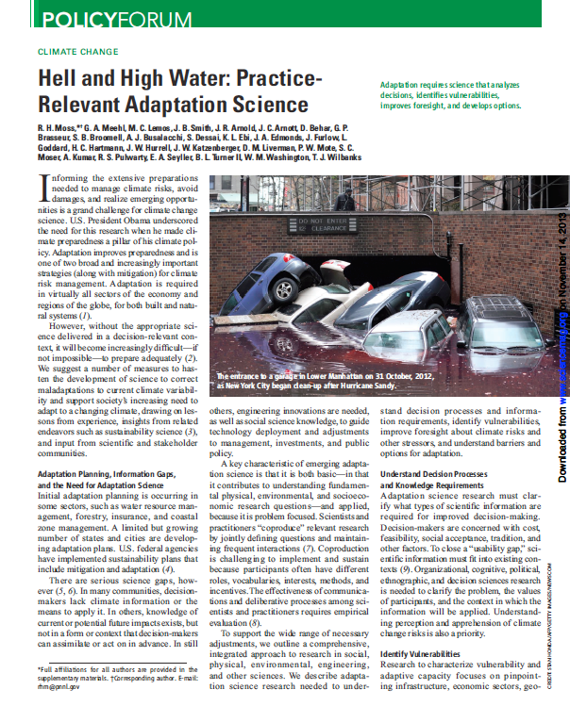
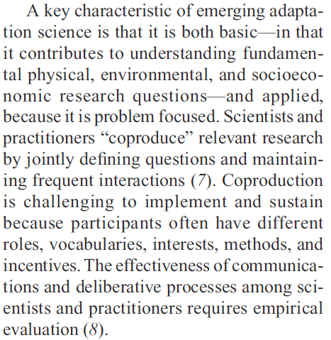
There is an urgent need for “practice-relevant adaptation science”
Outline of Adaptation Science
Moss et al., 2013
Published on November 8, 2013 in Science

Slide 15
There is an urgent need for “practice-relevant adaptation science”
Adaptation requires science that analyses decisions, identifies vulnerabilities, improves foresight, and develops options
Adaptation Planning, Information Gaps, and the Need for Adaptation Science
Understanding Decision Processes and Knowledge Requirements
Identifying Vulnerabilities
Moss et al., 2013
Published on November 8, 2013 in Science

Slide 16
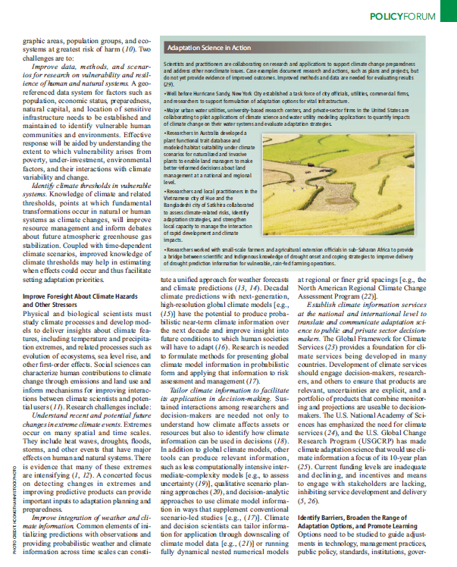
There is an urgent need for “practice-relevant adaptation science”
Improve Forsight About Climate Hazards and Other Stressors
Identify Barriers, Broaden the Range of Adaptation Options, and Promote Learning
Moss et al., 2013
Published on November 8, 2013 in Science

Slide 17
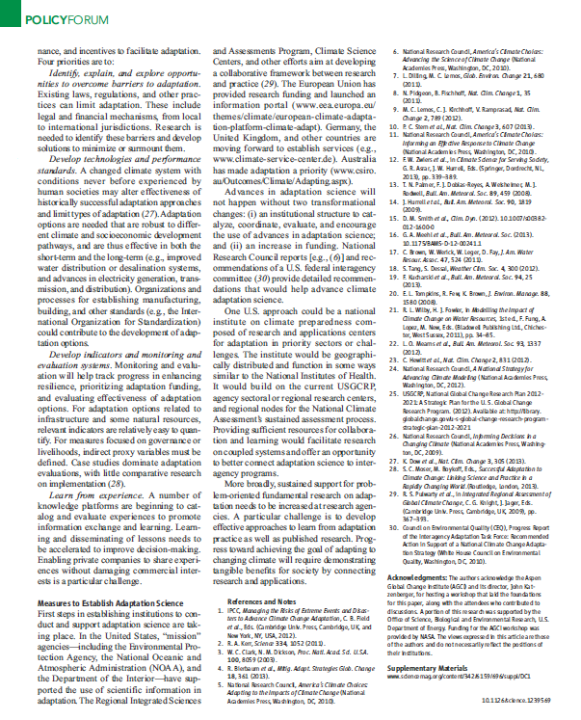
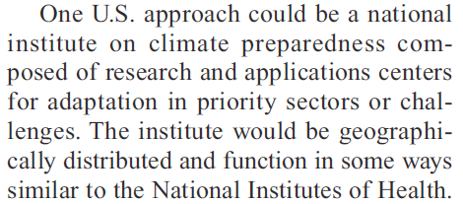
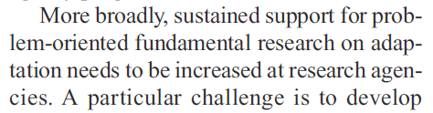
There is an urgent need for “practice-relevant adaptation science”
Moss et al., 2013
Published on November 8, 2013 in Science

Slide 18
Five main areas in adaptation science:
deepen the understanding of the changing hazards
knowing our vulnerabilities to these hazards
improving our foresight
understanding the decision making processes and the socio-economic context
developing options for mitigation of impacts and adaptation

Slide 19
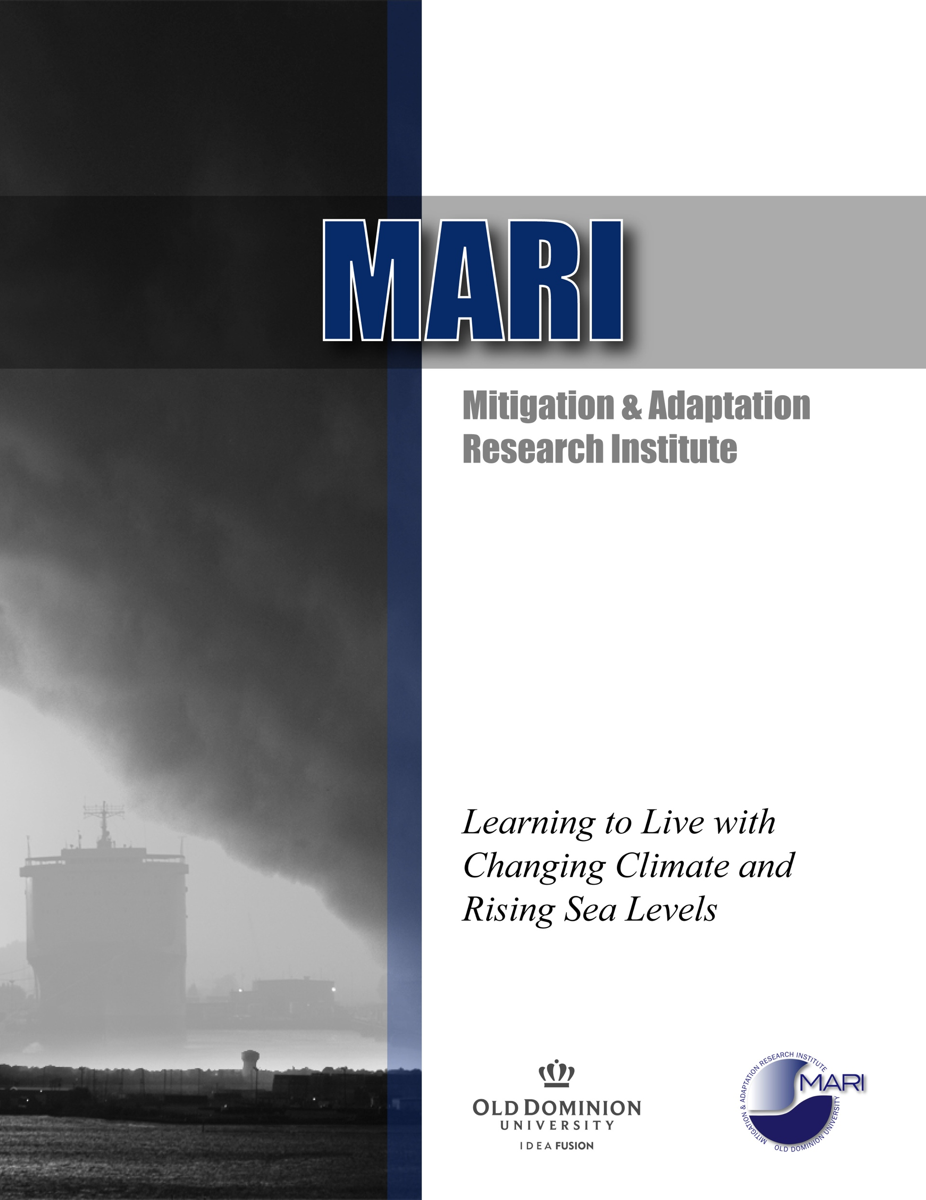
The Science of Mitigation and Adaptation
in Virginia
- Introduction
- The Hazards
- Vulnerabilities
- Foresight
- Decision making
- Options
- Knowledge Gaps
- Research Needs
- Towards a Research Framework
- Assessment and Recommendations
Schedule
- Preparation up to August 2015
- First author meeting:
August 2015
- Draft Report Available:
December 2015
- Academic Review and Hearing:
January-February 2016
- Final Report available:
April 2016
The Science of Mitigation and Adaptation
in
Virginia
The Report will be:
- first comprehensive assessment of our knowledge and research needs
- produced by the academic community in Virginia
- comparable to IPCC and national assessments
- open to non-peer reviewed publications (e.g., state-mandated
reports),
- not seeking government endorsement

Slide 20
Oluwakemi Izomo

