Slide 1
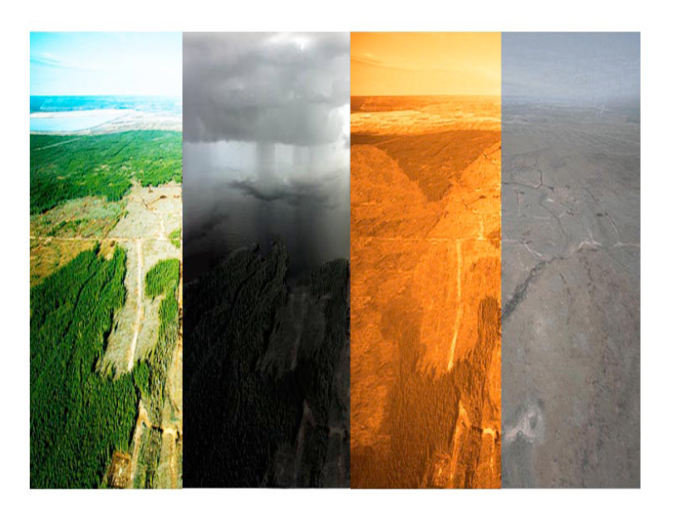
Oluwakemi Izomo

Slide 2


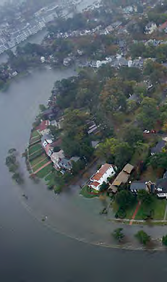
Half empty or half full? Where should the focus be?
DMUU: Using Uncertainties to Delay Action
Foreseeability: Extracting the Signals from Noise
DMUF: Making a Pro-Security Choice
Hans-Peter Plag
August 11, 2015

Slide 3
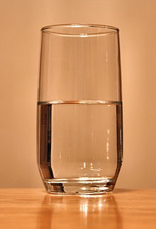
Focus on:
“The glass is 1/2 empty”
“The glass is 1/2 full”
Risk assessment:
“The glass is 1/3 empty”: focus on uncertainties, what we do not know: We don’t know enough to make decisions and take action
“The glass is 2/3 full”: focus on what is foreseeable risk, what we know: We acknowledge the risk and aim to manage and reduce it.

Slide 4

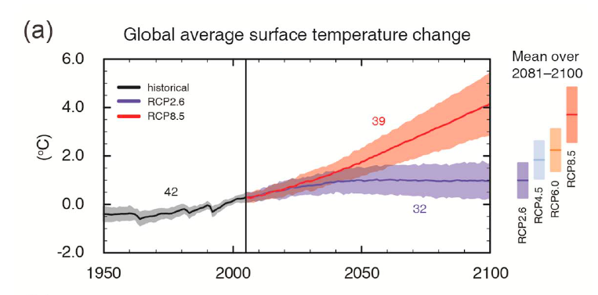
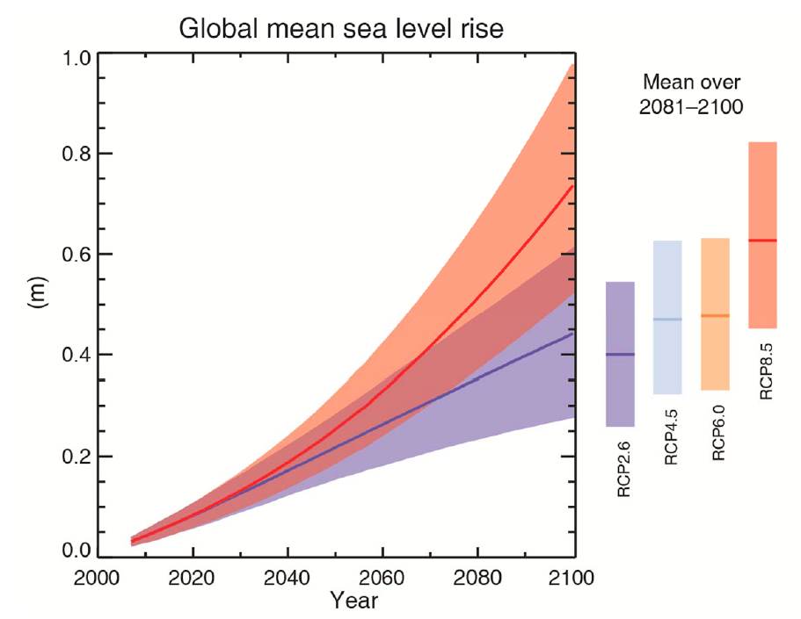
IPCC, 2013

Slide 5
Note: No accelerated contribution from Greenland and Antarctic ice sheets considered
IPCC, 2013
Modified from Church et al. (2010)

Slide 6
Foreseeability
The facility to perceive, know in advance, or reasonably anticipate that damage or injury will probably ensue from acts or omissions.
In the law of Negligence, the foreseeability aspect of proximate cause—the event which is the primary cause of the injury—is established by proof that the actor, as a person of ordinary intelligence and circumspection, should reasonably have foreseen that his or her negligent act would imperil others, whether by the event that transpired or some similar occurrence, and regardless of what the actor surmised would happen in regard to the actual event or the manner of causation of injuries.
West's Encyclopedia of American Law, edition 2. Copyright 2008 The Gale Group, Inc. All rights reserved.
foreseeability
n. reasonable anticipation of the possible results of an action, such as what may happen if one is negligent or consequential damages resulting a from breach of a contract. (See: foreseeable risk, negligence)
From: http://legal-dictionary.thefreedictionary.com/Foreseeability

Slide 7
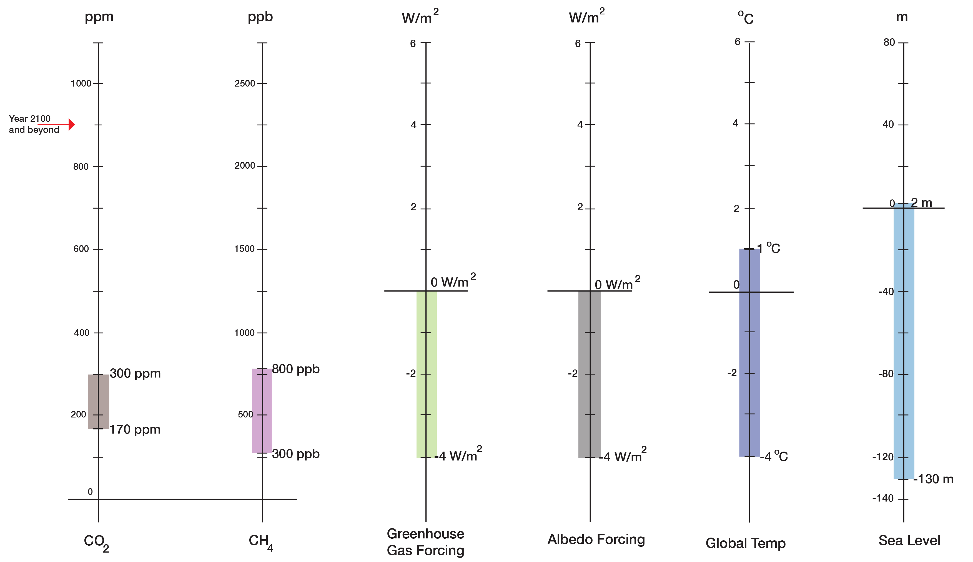
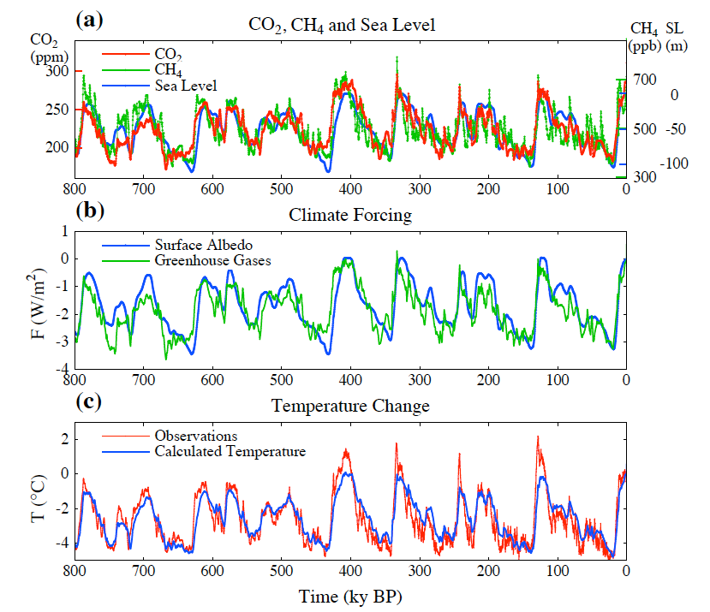
Long-term (centuries to millennia) correlations:
130 ppm CO2 <=> 5ºC
130 ppm CO2 <=> 130 m in sea level
Normal Range up to 1900
Holocene

Slide 8
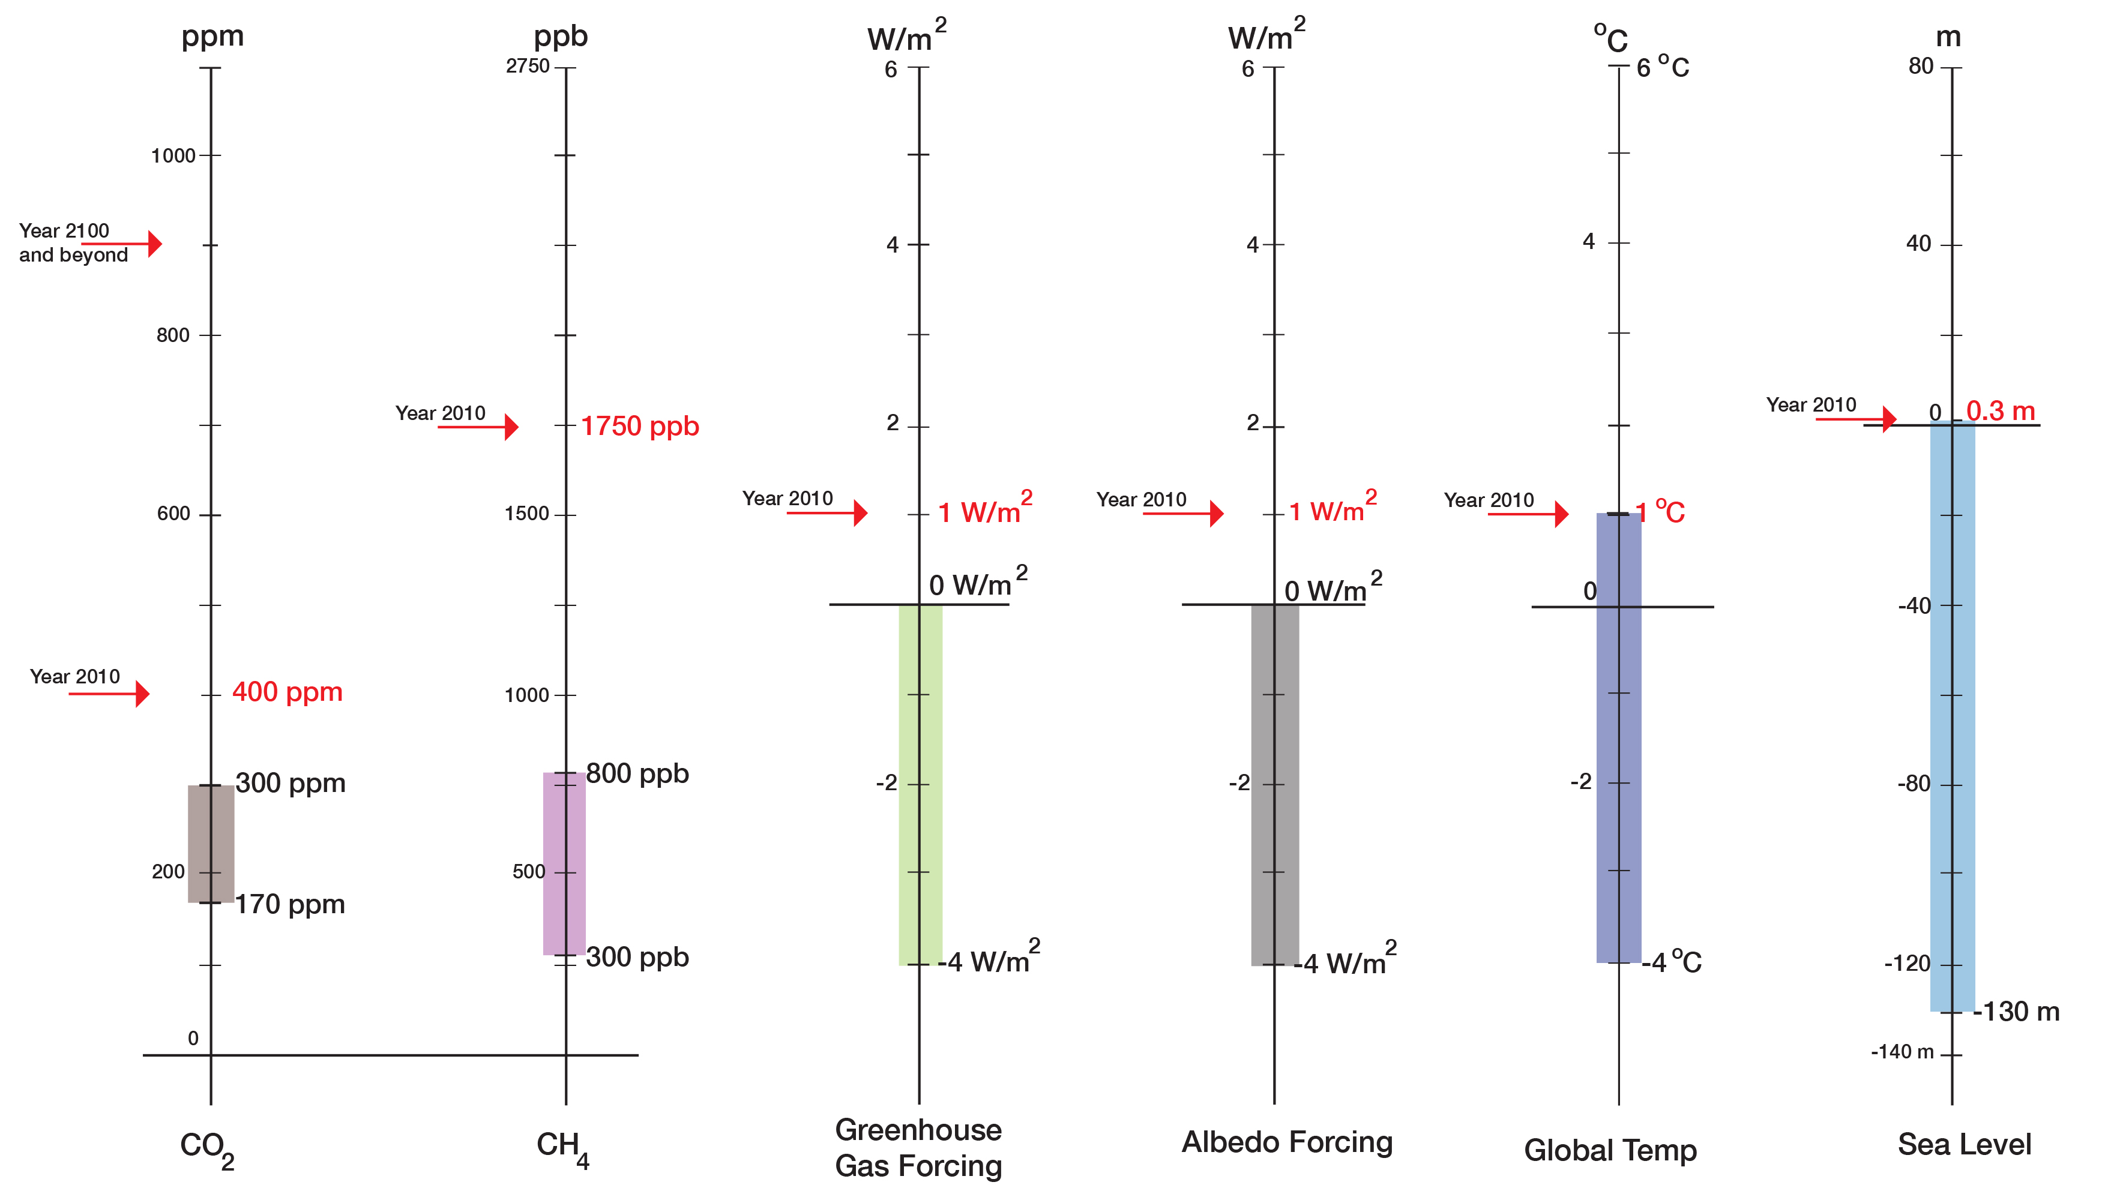
“Current State”
“Normal Range”
(800,000 years)

Slide 9
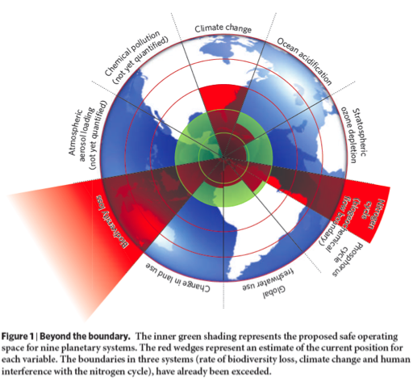
We are moving out of the Holocene and the “safe operating space for humanity” (Rockstroem et al., 2009):
Climate Change (***)
Ocean acidification (**)
Stratospheric ozone depletion (*)
Nitrogen (******) and Phosphorous cycles (**)
Global freshwater (*)
Change in land use (*)
Biodiversity loss (*******)
Atmospheric aerosols (?)
Chemical pollution (?)
Climate change and sea level rise are symptoms, not the cause,
the “sickness.”

Slide 10
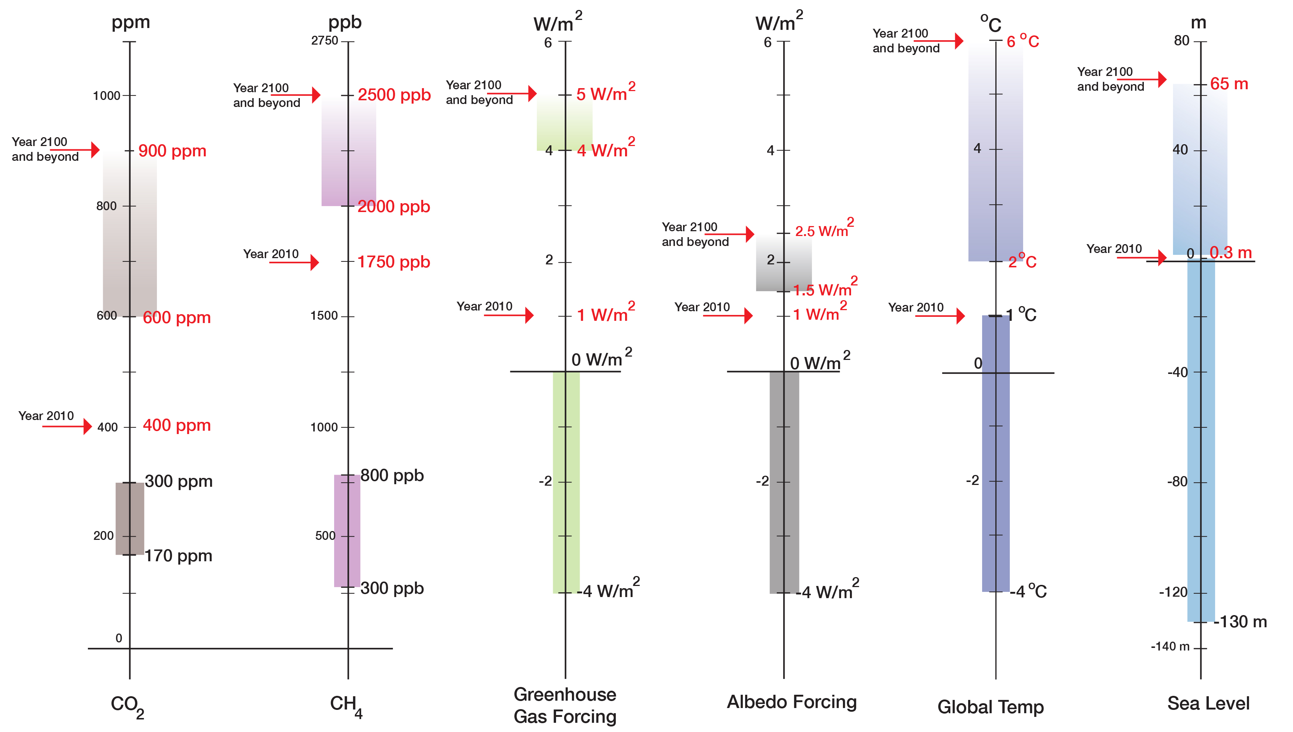
“Prognosis”
“Current State”
“Normal Range”
(800,000 years)

Slide 11
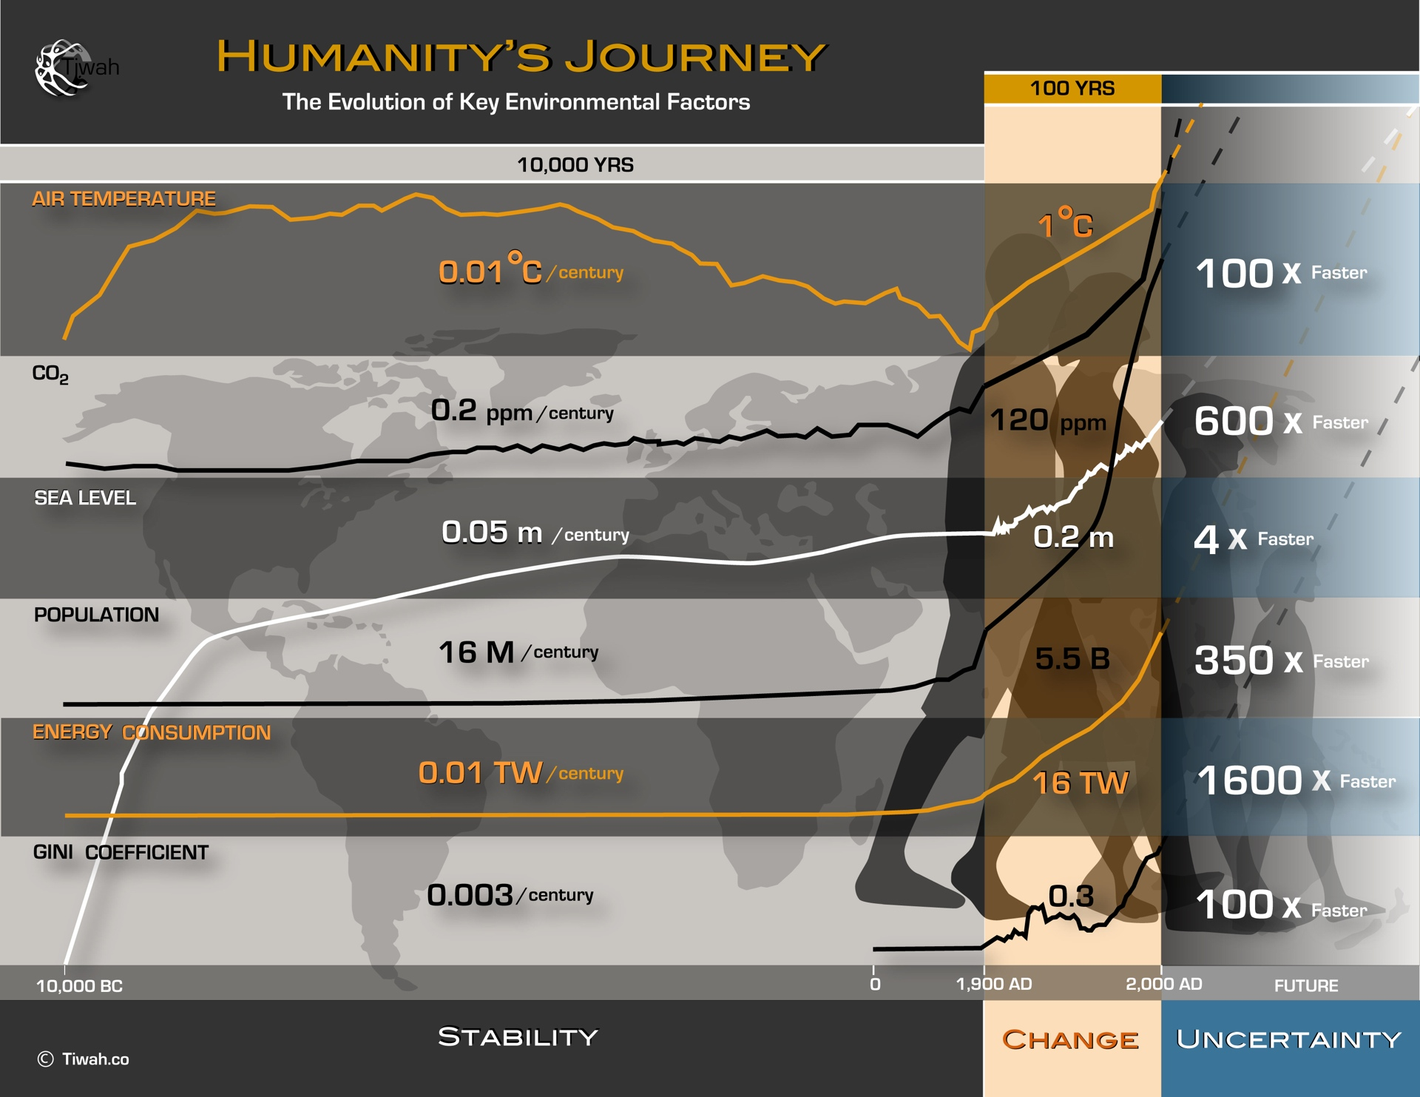
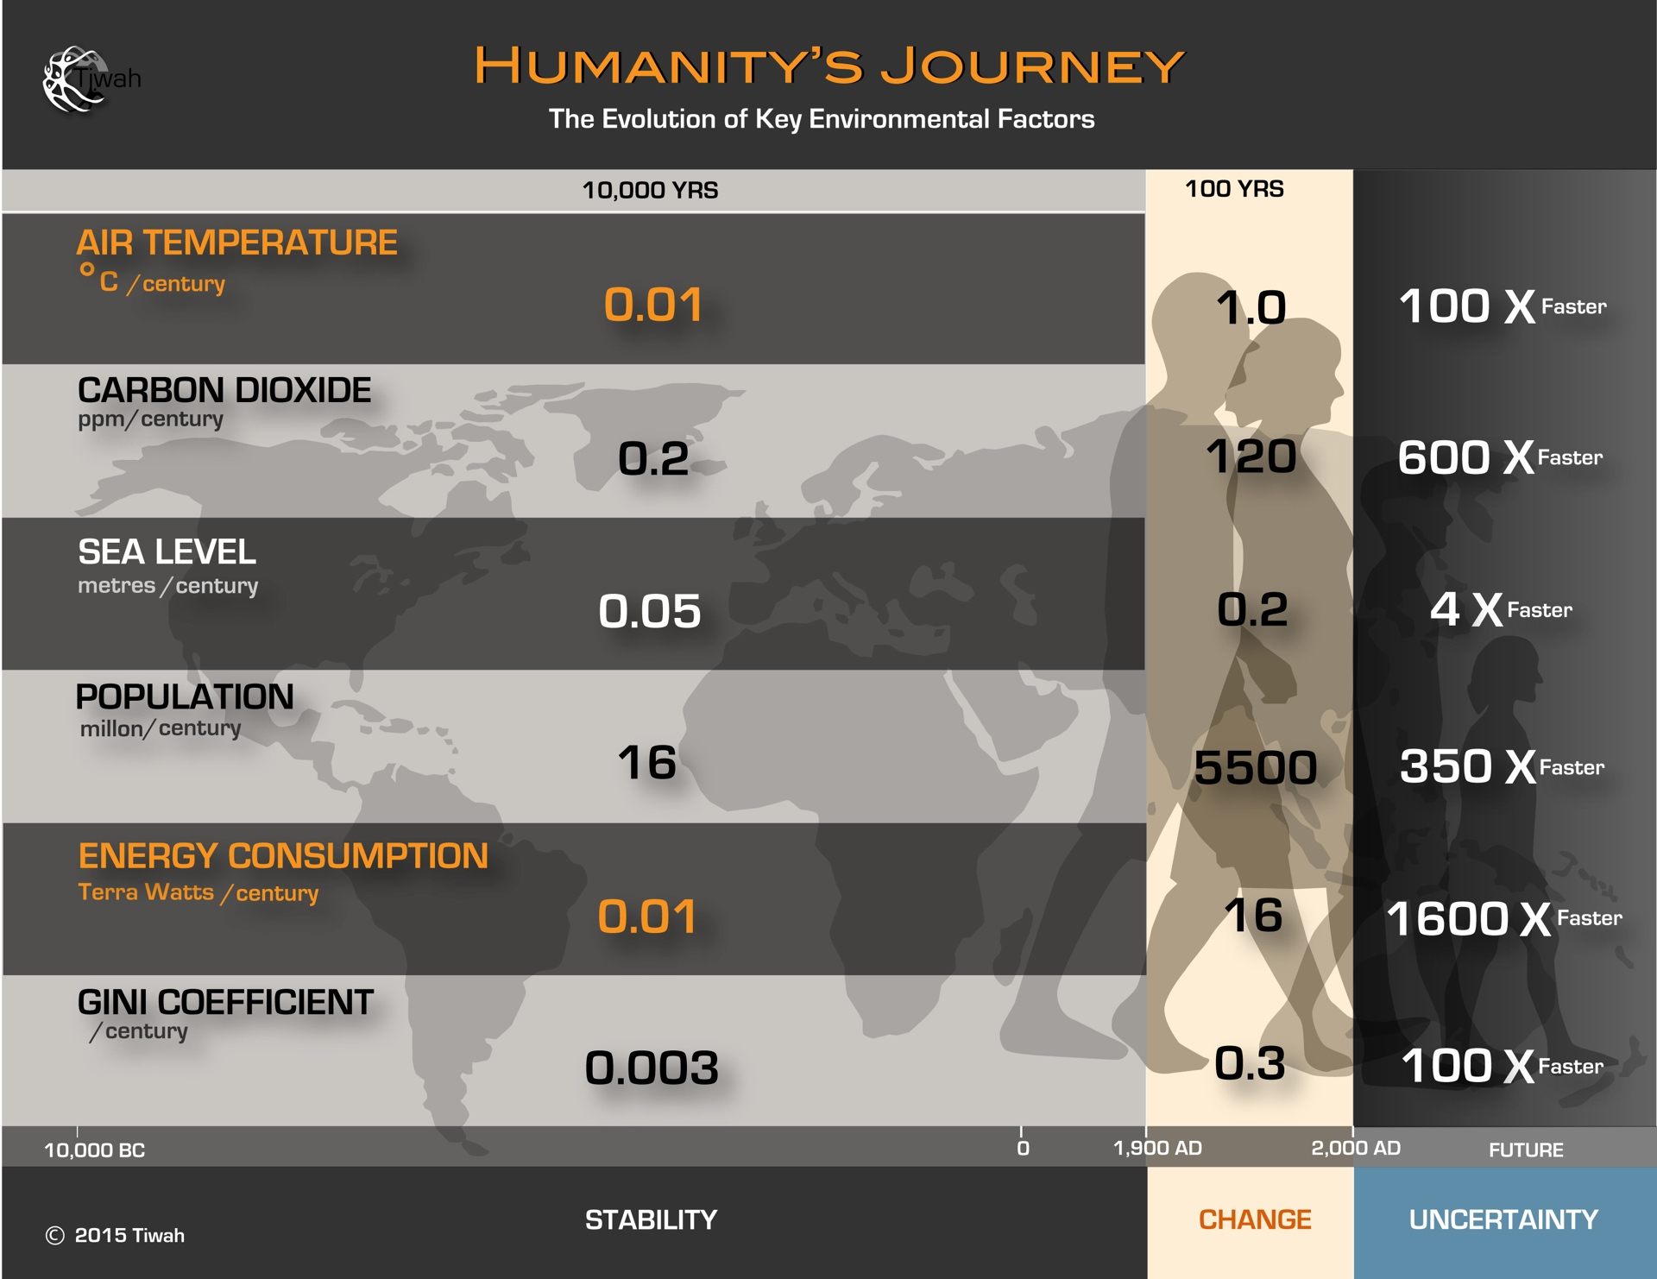
Humanity is in the “Emergency Room”
Best news from the Emergency Room?
“The patient is stable”
Holocene
20th and 21st Century
Future

Slide 12
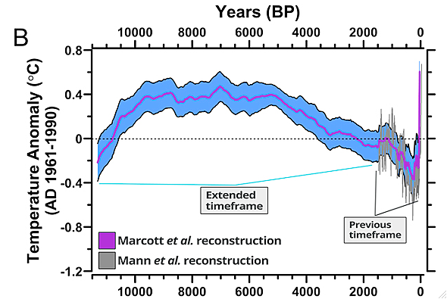
}
4
<--Post-Holocene
3
IPCC Assessment:
Very Likely by 2100
2
o
1 C
<--Holocene--->
Marcott et al., 2013

Slide 13
}
4
How do we present the facts?
<--Post-Holocene
3
IPCC Assessment:
Very Likely by 2100
2
o
1 C
<--Holocene--->
The presentation of facts impacts the perception of risk
Marcott et al., 2013

Slide 14
How stable is our knowledge?
Findings in the last 2 years changed our understanding of the drivers of sea level rise completely
Modified from Church et al. (2010)
Our knowledge is rapidly evolving, changing the perspective

Slide 15
What about predictive capabilities of our models?
…
For example, he said, on Saturday the Rocky Fire grew by 22,000 acres, a
plot of land that computer models indicated would take about a week to
burn. But that plot was consumed in five hours.
“We can’t just say, ‘We’ll turn up the volume on the models a bit,’ ”
Mr. Shelton said. “We have to put new science to the back of this. We
have to go back to square one and prove these models again with new
information based on the new reality.”
That new reality, Mr. Shelton said, is that “fire seasons are lasting
longer, fires are burning harder, hotter and faster.”
Our models lag behind the “new reality”

Slide 16
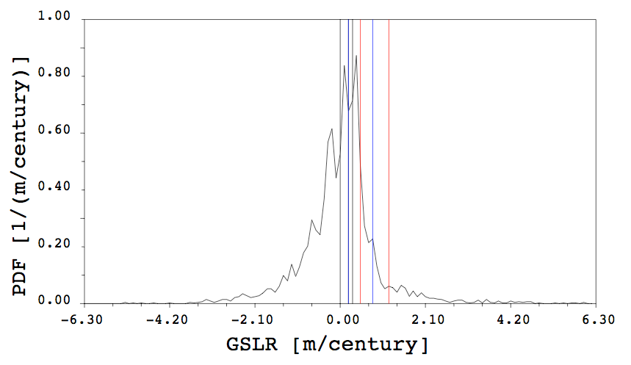
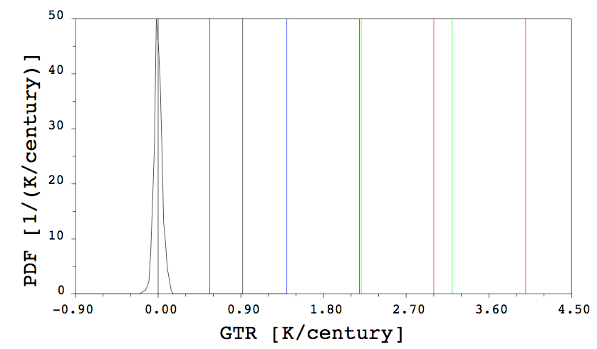
Probabilistic approach:
What has happened in the past could happen tomorrow
Even small temperature changes per century produced large sea level changes.

Slide 17
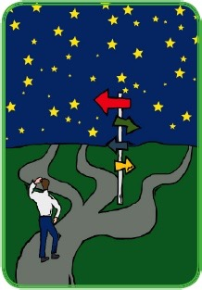

We often talk about the lessons learnt and notice them
… but then we continue to do the same
It is time to use the lessons learnt.
We should make a pro-security choice.

Slide 18
LONG-PERIOD LOCAL SEA LEVEL CHANGES
- mean global and local sea level are not stationary in time
Century Global Sea Level Changes
Scientifically, we cannot exclude a large, rapid global sea level rise with large spatial variability in local sea level rise.
Century Global Surface Temperature Changes
Hansen et al. (2008)
Plag and Jules-Plag (2013)

Slide 19
Oluwakemi Izomo

