Slide 1
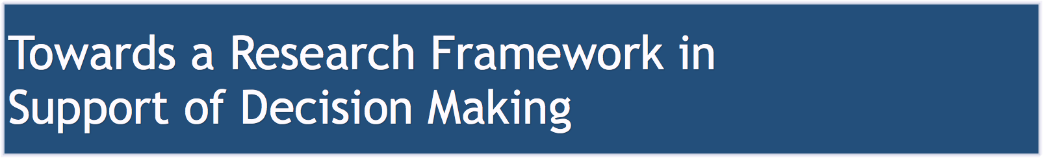
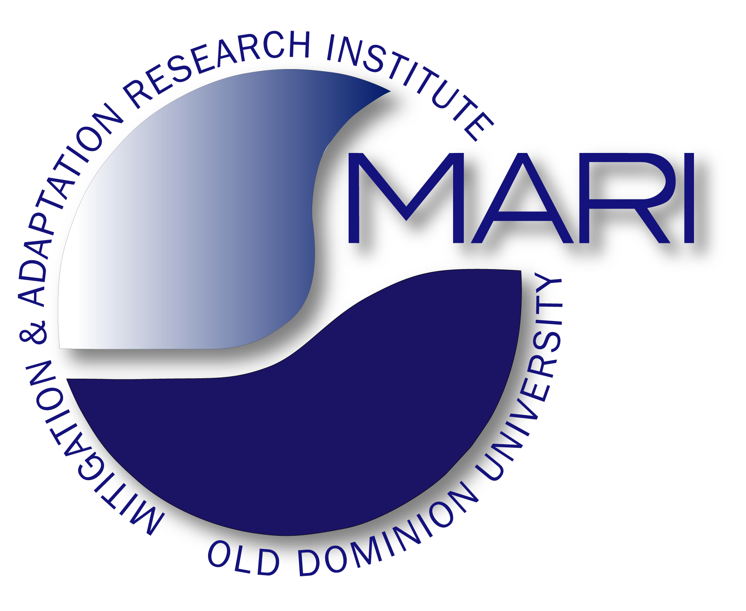
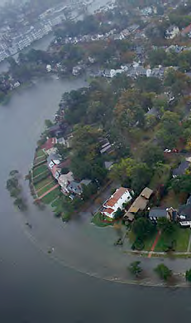
Goals
Hazards, Early Warning and Foresight
Vulnerability and Risk Assessment
Decision Making and Options
Hans-Peter Plag
August 12, 2015

Slide 2
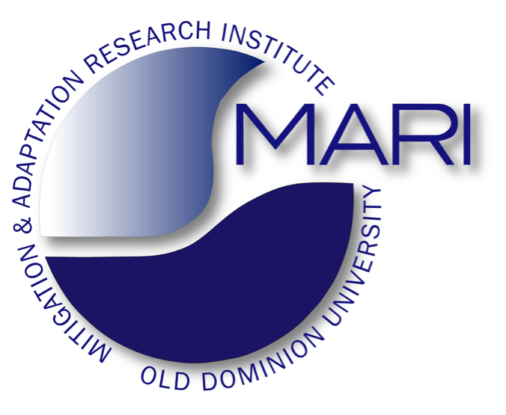
Goals:
Provide the practice-relevant knowledge to support comprehensive risk assessment (including causes, impacts, and threats), development of options for disaster risk management and reduction, and adaptive management based on comprehensive foresight.
Adaptive is not the same as Reactive
Objective:
Develop a strategic research framework for climate change impacts and sea level rise:
assess the knowledge on the threats from climate change and sea level rise
address knowledge gaps
deliver tactical science response to the related hazards, including the extremes
seamlessly integrate into warning, preparedness, mitigation and responses implemented by governments, communities, and the private sector

Slide 3
Assess and improve the knowledge on climate change and sea level rise hazards
Support comprehensive risk assessments through probability density functions
Provide tactical support through better understanding of cascading hazards
Ensure comprehensive monitoring with the goal to track emerging hazards and impacts and provide early warnings of new trends in support of adaptive management and response
Develop forecasting services for hazards (including sea level forecasting) and impacts

Slide 4
Scenario contingency planning should be used to better understand threats and risks:
develop specific hazard scenarios, including worst cases, with stakeholders and decision makers;
work through cascading hazards and impacts;
fully assess the risk;
identify political, social, and economic constraints and opportunities;
develop options based on available resources

Slide 5
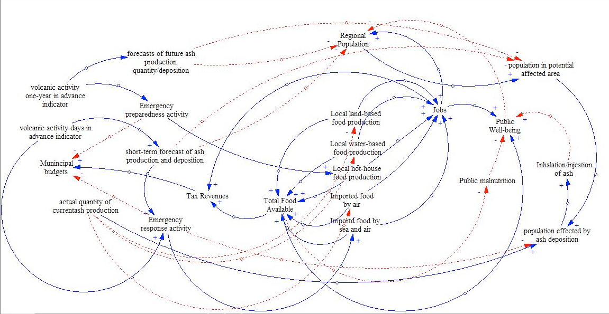
Scenario contingency planning:
requires complex couple natural-human system models

Slide 6
Effort to increase risk awareness in population through dissemination of concise and clear information on risk associated with climate change and sea level rise and through training for copying with emergency scenarios
Implement a process for repeated risk assessment, including the assessment of the knowledge we have on risks and threats and the options we have for risk reduction and management
Co-design research agenda and scenarios with stakeholders and decision makers (participatory modeling, stakeholder forums and assemblies)
Co-creation and co-usage of knowledge with stakeholders and decision makers through use cases
Develop a governance structure that could respond to emerging threats and coordinate regional measures to increase preparedness and resilience and reduce risk (Pilot Project?)

