Slide 1
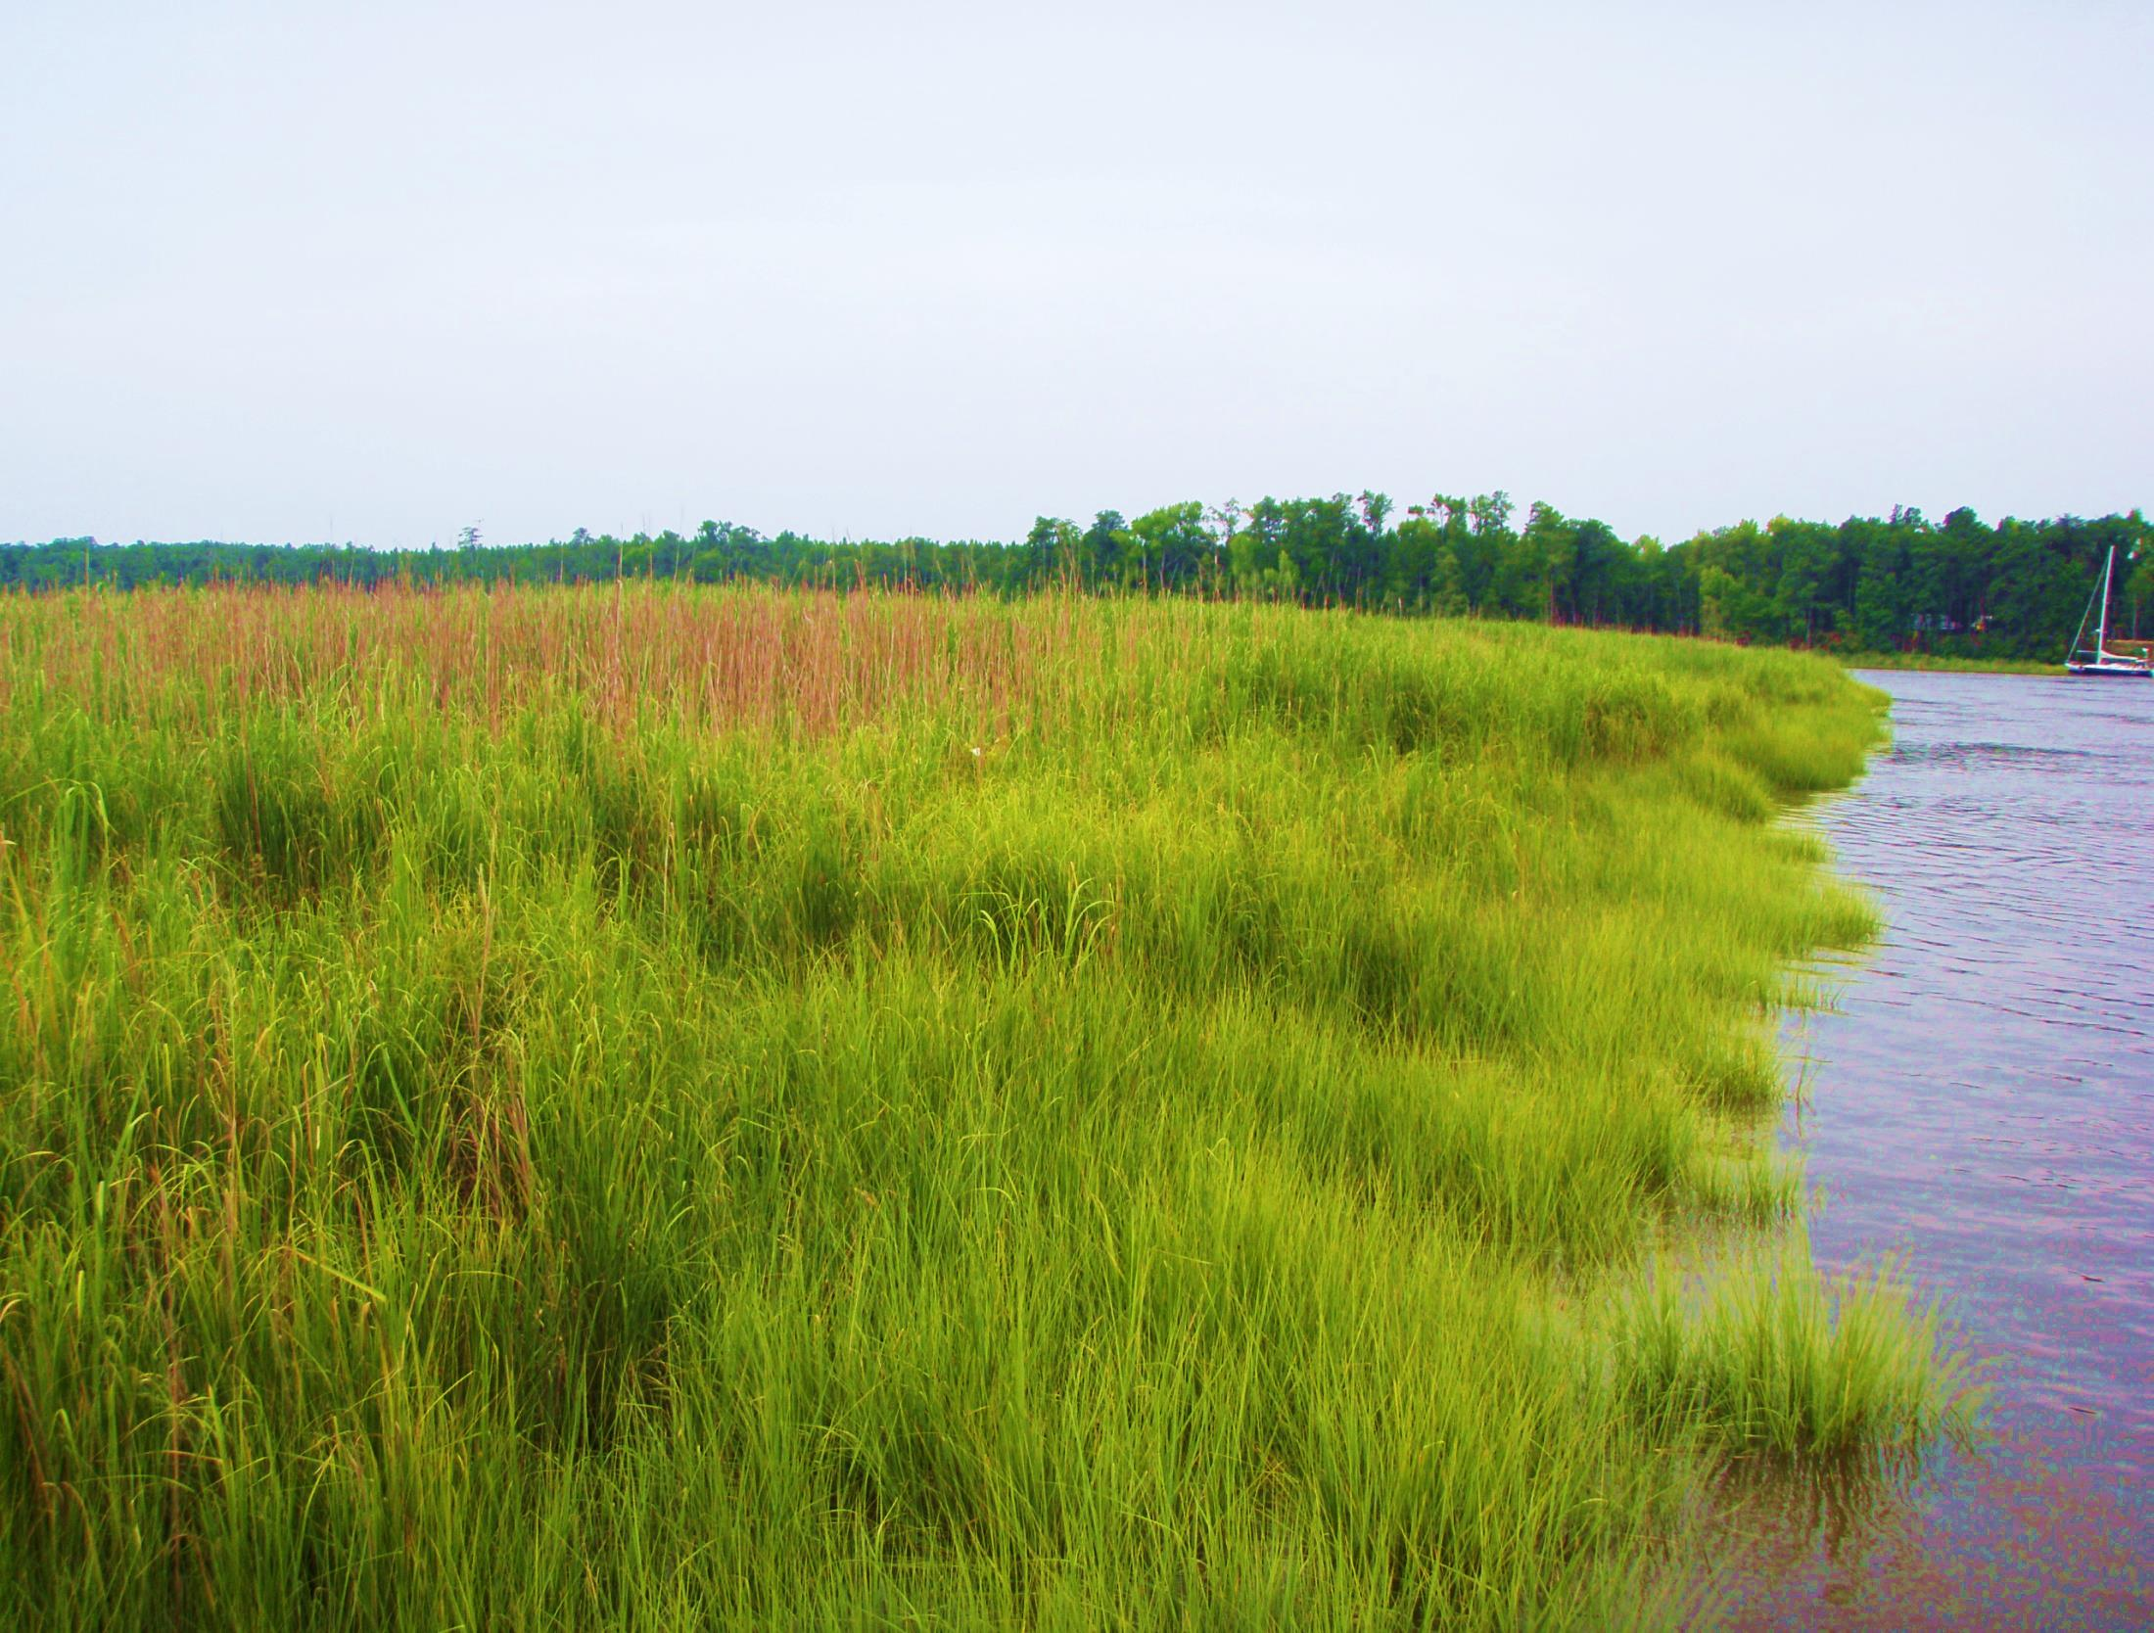


Anticipating changes in hazards and their consequences in the coastal zone
August 11-13, 2015
MITIGATION AND ADAPTATION RESEARCH IN VIRGINIA
Hilton Garden Inn, Suffolk, VA
Molly Mitchell

Slide 2





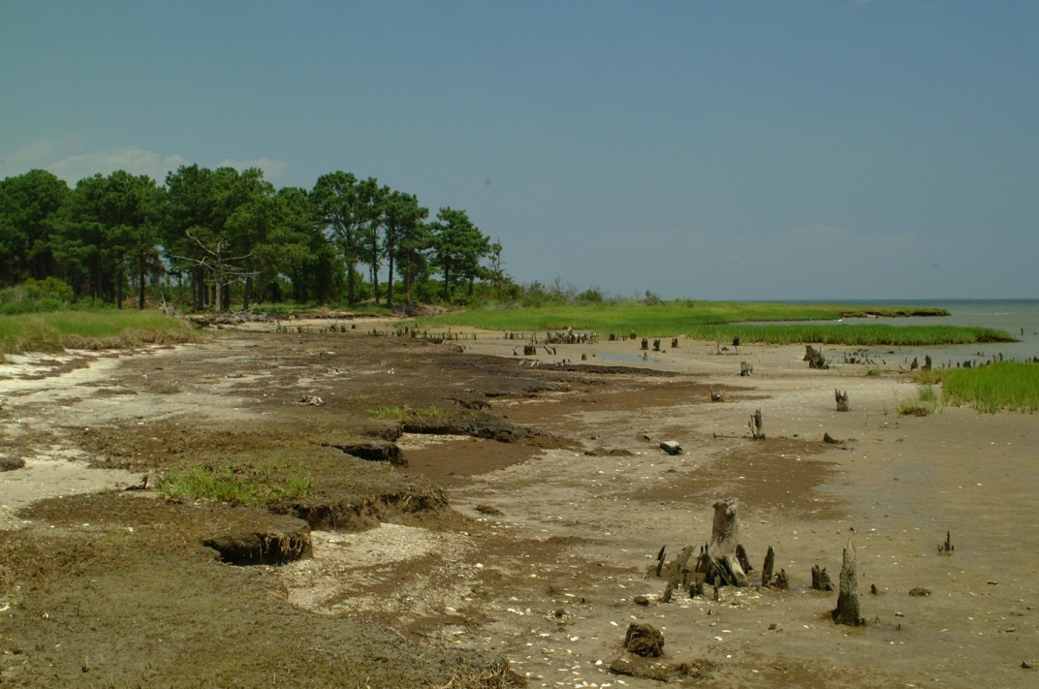

-
+
+
+
+
-
Adaptation
+
Inundation & Flooding
Salinity distributions
Erosion
+
+
+
+
Marsh loss/shifts
-
-
Fisheries
Marsh dependent species

Slide 3
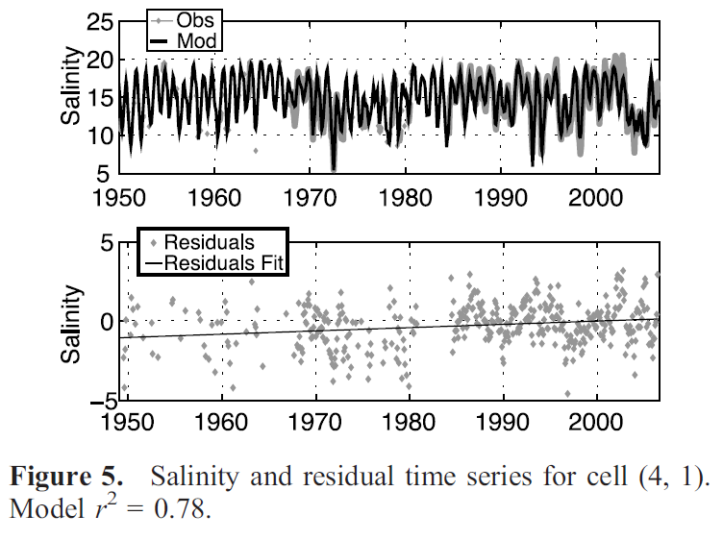
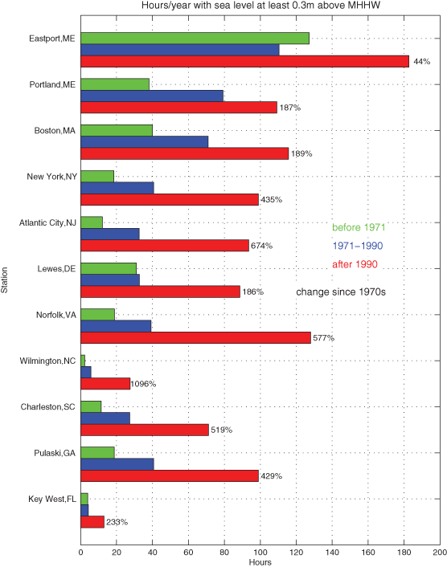
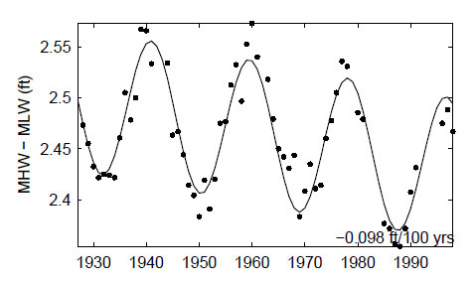
Changes we know about
Salinity has increased ~ 0.5 ppt since 1949, water levels have increased by ~ .22m (8.6 in) – mid-Bay
Hilton, T. W., Najjar, R. G., Zhong, L., & Li, M. (2008). Is there a signal of sea‐level rise in Chesapeake Bay salinity?. Journal of Geophysical Research: Oceans (1978–2012), 113(C9).
Tide range has decreased (slightly) since the 1930s
Hours of inundation have increased greatly since the early part of the century
Ezer, T., & Atkinson, L. P. (2014). Accelerated flooding along the US East Coast: on the impact of sea‐level rise, tides, storms, the Gulf Stream, and the North Atlantic oscillations. Earth's Future, 2(8), 362-382.
Flick, R. E., Murray, J. F., & Ewing, L. (1999). Trends in US tidal datum statistics and tide range: A data report atlas. Center for Coastal Studies, Scripps Institution of Oceanography.
Notes:
NOAA’s National Weather Service as between one to two feet above local high tide, occurs more than 30 or more times a year.

Slide 4
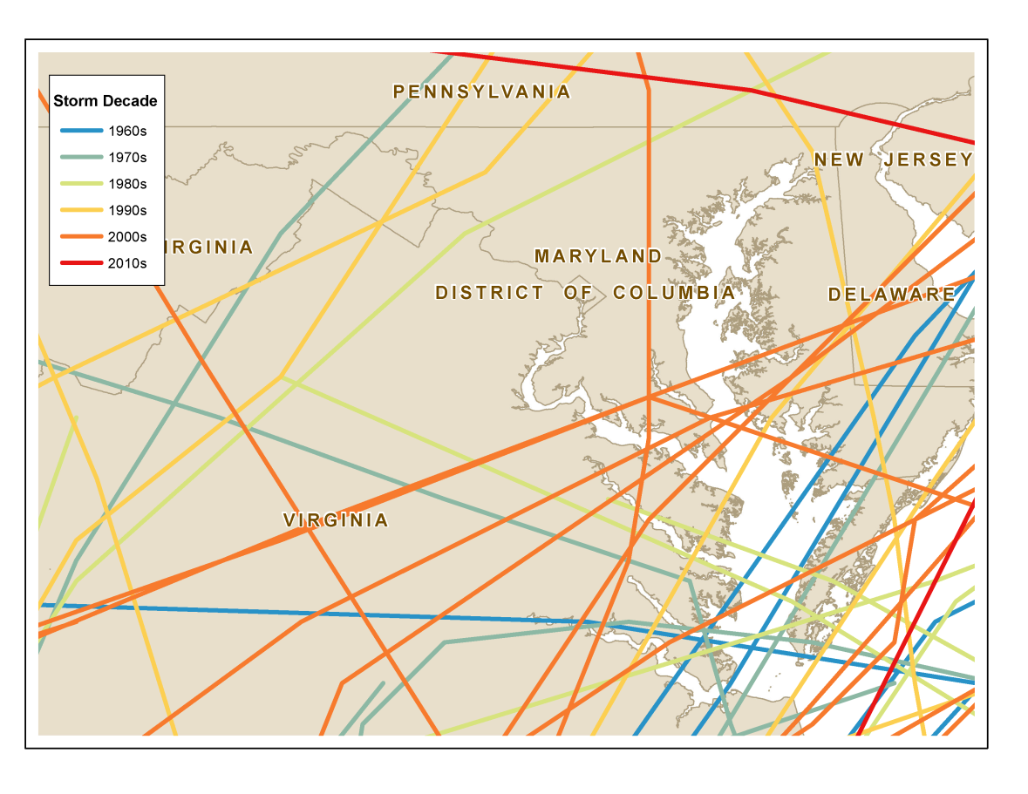
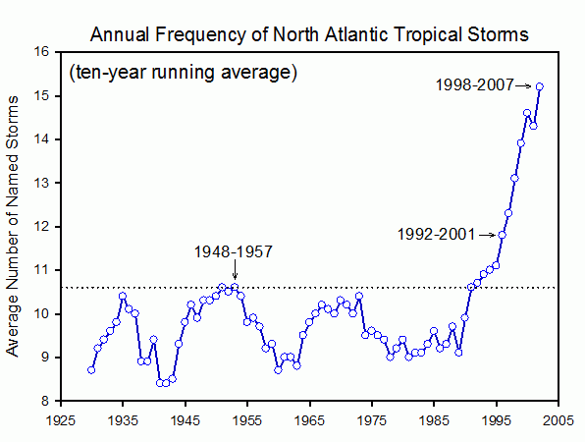
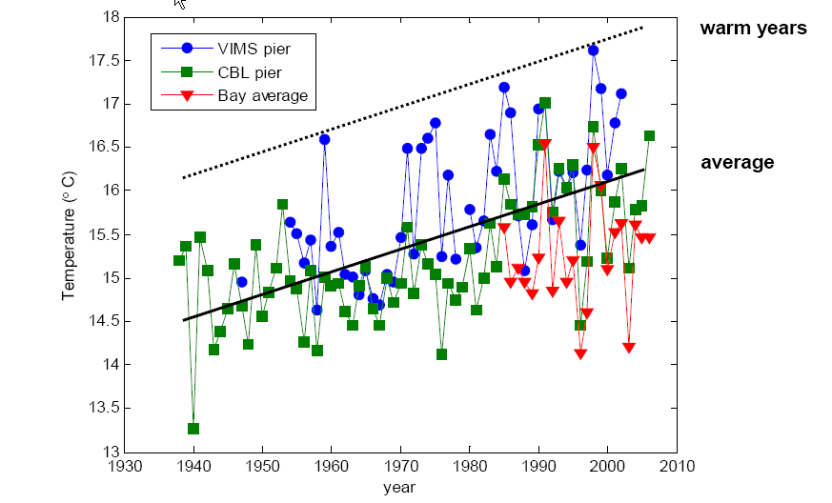
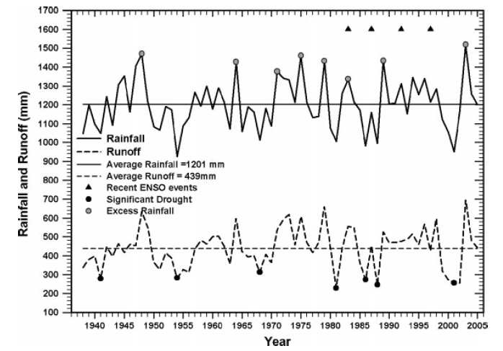
Changes we know about
Surface Water Temperature
Mean & max annual temps have increased by more than 1°C (1.8°F) over the past 5-6 decades
Seasonal warming occurring ~3 weeks earlier than in the 1960s
Rose, S. (2009). Rainfall–runoff trends in the south‐eastern USA: 1938–2005. Hydrological processes, 23(8), 1105-1118.
There have been no consistently positive or negative long-term temporal trends in rainfall, runoff and the runoff/rainfall ratio within the south-eastern USA

Slide 5
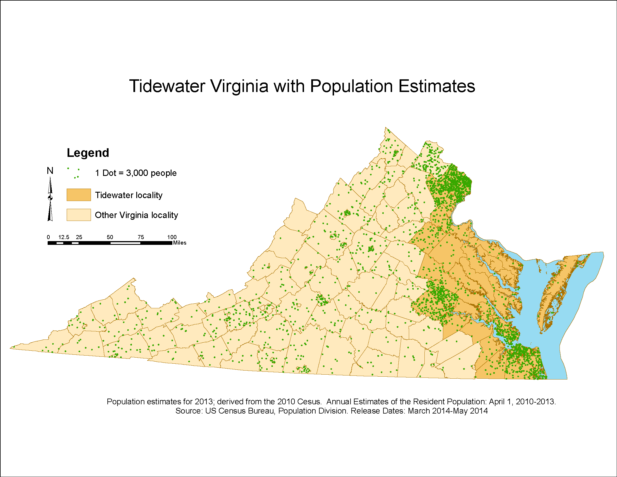
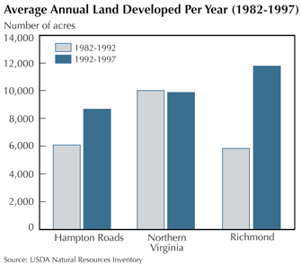
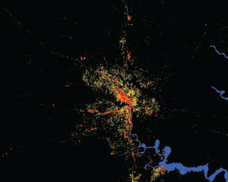
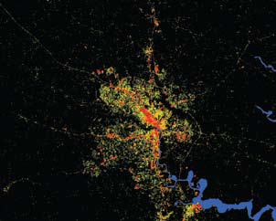
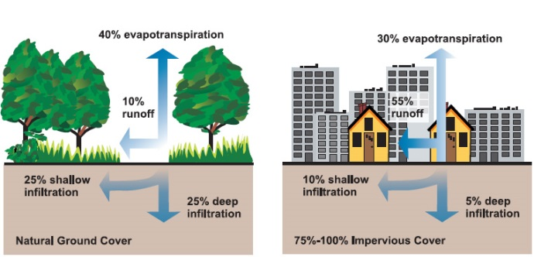
Development in Virginia
Richmond impervious surfaces
1992 2001

Slide 6
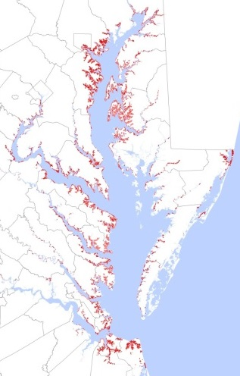
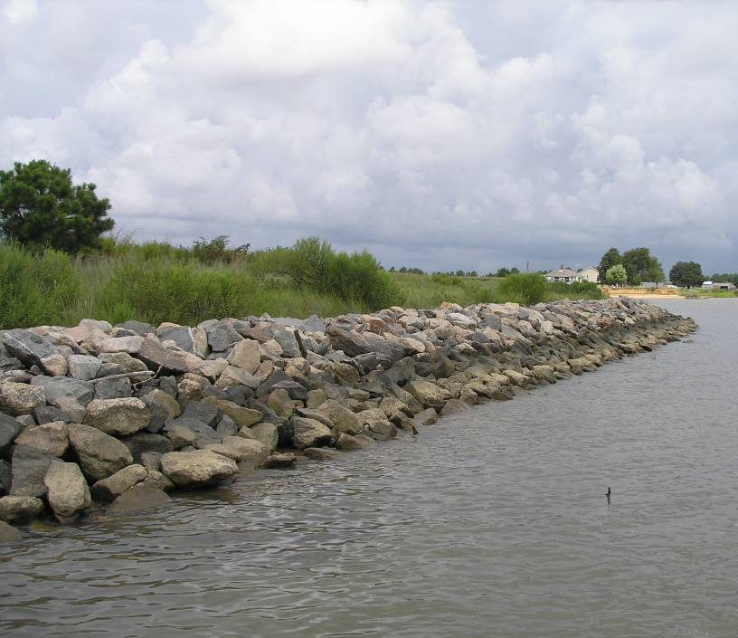
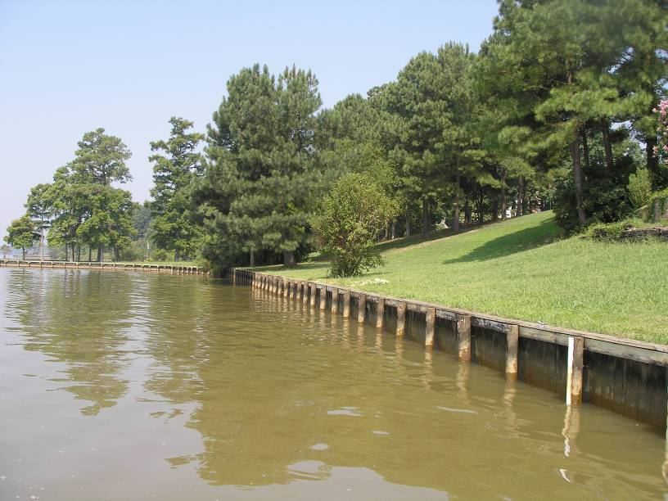
Impacts of shoreline development & hardening
Habitat loss & fragmentation – forest, wetlands (Peterson and Lowe 2009; Dugan et al 2011)
Sediment supply & transport altered, increased scouring, turbidity (Bozek and Burdick 2005, NRC 2007)
Increase in invasive spp (Chambers et al 1999)
Decrease fish & benthos, marsh bird diversity, terrapin presence (Peterson et al 2000, Chapman 2003, King et al 2005, Bilkovic et al 2006, Seitz et al 2006, Bilkovic & Roggero 2008, Morley et al 2012, Isdell et al in press)
Prevents natural migration of habitats with SLR
Evidence of Low Thresholds (e.g. >5% riprap–no increase in SAV (Patrick et al 2014)
Chesapeake Bay
18% of tidal shoreline hardened
VA: 11% MD: 28%
32% riparian land developed
~5 km² of artificial substrate introduced (intertidal impacted)
Data from CCRM,VIMS 2014
Notes:
loss of marsh area due to erosion and inundation;
wetland transgression into low-lying uplands; and
plant community shifts driven by sea level rise and salinity shifts.

Slide 7
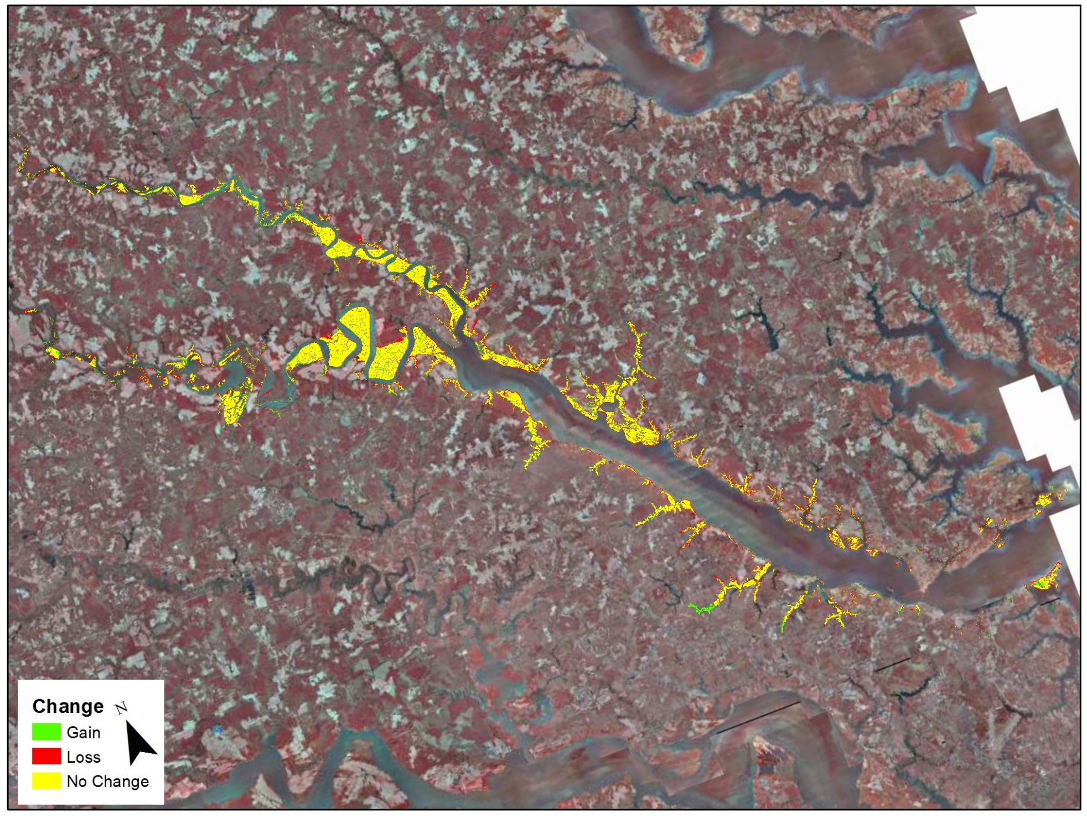
Preliminary Results:
Fringe marshes = 69% of the original marshes lost
Embayed marshes (34%); extensive marshes (15%), and marsh islands (29%).
Mitchell, M.M., M.R. Berman, J., H. Berquist, Bradshaw, K. Duhring, S. Killeen and C.H. Hershner, 2011. Strengthening Virginia’s Wetlands Management Programs, final report to US EPA Region III, Wetlands Development Grant Program.

Slide 8
Community shifts between the 2 surveys
Purtan Bay
Shift from fairly diverse marshes to almost monotypic Spartina alterniflora.
Lost fresh water community at top of creek
Pamunkey River
Increased S. alterniflora presence
Shift in dominant species
= shift in salinity, innundation, or both?
Mitchell, M.M., M.R. Berman, J., H. Berquist, Bradshaw, K. Duhring, S. Killeen and C.H. Hershner, 2011. Strengthening Virginia’s Wetlands Management Programs, final report to US EPA Region III, Wetlands Development Grant Program.

Slide 9
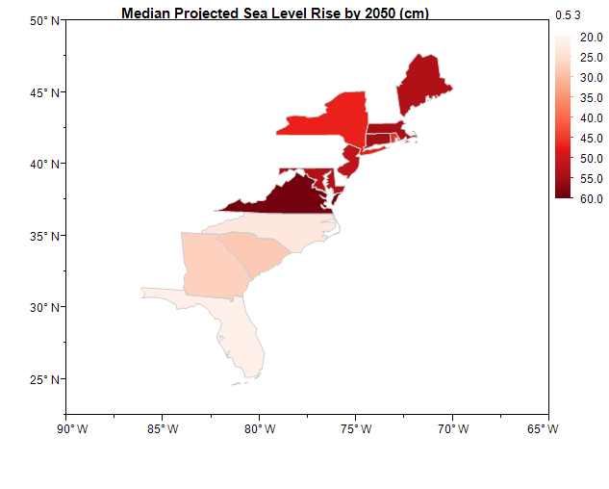
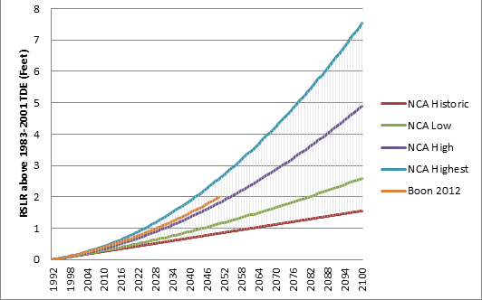
Sea Level Rise in the CB
Data from Boon & Mitchell (2015) Nonlinear Change in Sea Level Observed at North American Tide Stations. Journal of Coastal Research In-Press.
Boon & Mitchell (2015) Nonlinear Change in Sea Level Observed at North American Tide Stations. Journal of Coastal Research In-Press.
Data from: Kopp, R. E., R. M. Horton, C. M. Little, J. X. Mitrovica, M. Oppenheimer, D. J. Rasmussen, B. H. Strauss, and C. Tebaldi (2014), Probabilistic 21st and 22nd century sea-level projections at a global network of tide-gauge sites, Earth’s Future, 2, 383–406, doi:10.1002/2014EF000239.

Slide 10
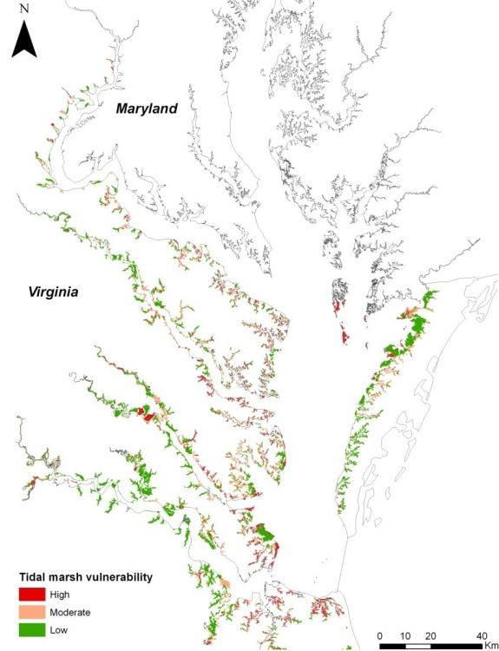
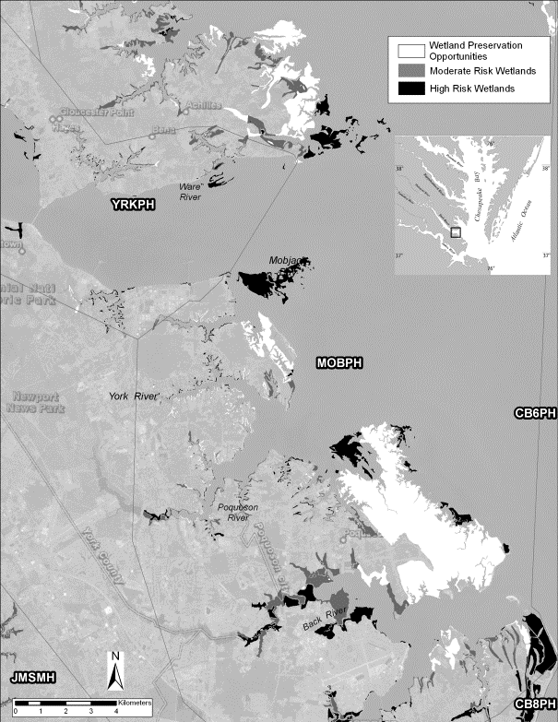
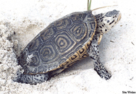
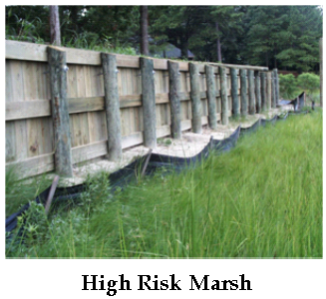
Tidal Marshes – SLR & barriers to migration
Tidal marshes in the meso-polyhaline reaches at highest risk due to land development & SLR
Nearly 40% of Virginia marshes are vulnerable to SLR due to adjacent development
Bilkovic et al. 2009 Vulnerability of shallow tidal water habitats in Virginia to climate change. http://ccrm.vims.edu/research/climate_change/index.html

Slide 11
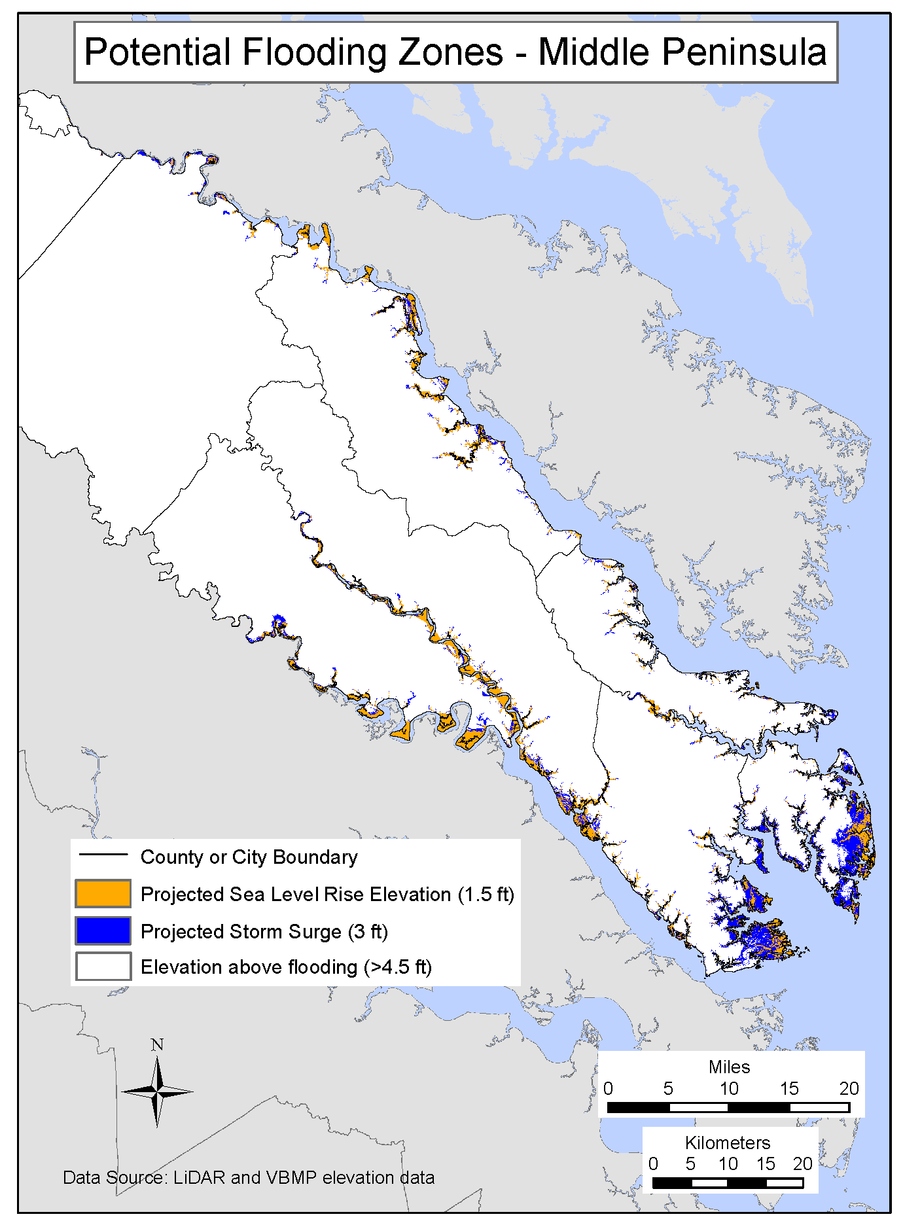
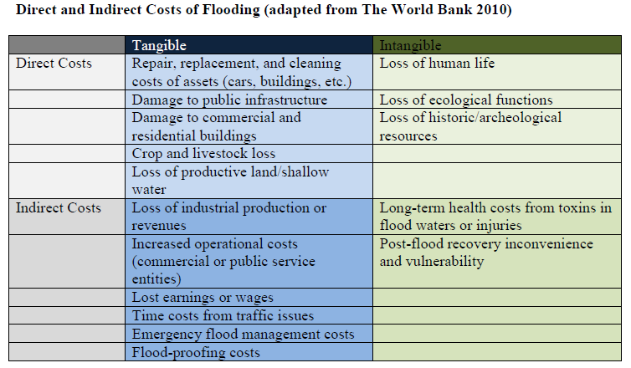
Storm surge and coastal flooding get worse
Locality | Road miles flooded
Accomack * | 326
Northampton | 44
Virginia Beach | 289
Chesapeake * | 103
Gloucester* | 118
Mathews | 139
James City* | 11
Locality | Road miles in flooded area
Poquoson | 38
York* | 24
Newport News | 15
Hampton | 50
Portsmouth | 51
Norfolk | 119
King William* | 14
Data from Mitchell, M., C. Hershner, J. Herman, D. Schatt, E. Eggington and S. Stiles. 2013. Recurrent Flooding Study for Tidewater Virginia. Virginia Senate Document No. 3. Richmond, Virginia.
* Indicates that the area is predicted to see greater than 30% increase in population by 2030

Slide 12
1-2 ft
3 ft
5 ft
Percent of schools flooded at these water levels
 | 1 ft | 2 ft | 3 ft | 4 ft | 5 ft | 6 ft | 7 ft | 8 ft | 9 ft | 10 ft
Accomack County | 7.7 | 7.7 | 7.7 | 7.7 | 15.4 | 23.1 | 23.1 | 23.1 | 23.1 | 23.1
Virginia Beach city |  |  | 1.1 | 1.1 | 1.1 | 3.4 | 5.6 | 7.9 | 11.2 | 18
Norfolk city |  |  | 1.6 | 3.3 | 4.9 | 6.6 | 9.8 | 14.8 | 26.2 | 42.6
Chesapeake city |  |  |  |  | 1.9 | 1.9 | 7.5 | 7.5 | 7.5 | 28.3
Portsmouth city |  |  |  |  | 3.6 | 3.6 | 14.3 | 17.9 | 39.3 | 50
Hampton city |  |  |  |  |  | 5.7 | 17.1 | 28.6 | 34.3 | 40
Newport News city |  |  |  |  |  |  | 2 | 3.9 | 3.9 | 3.9
York County |  |  |  |  |  |  |  |  |  | 5
Poquoson city |  |  |  | 50 | 50 | 100 | 100 | 100 | 100 | 100
Gloucester County |  |  |  |  |  |  | 10 | 10 | 10 | 10
Climate Central (2014). Sea level rise and coastal flood exposure of Public Schools by County in VA, in Surging Seas Risk Finder. Retrieved from ssrf.climatecentral.org/#state=Virginia&category=Schools_public&geo=County

Slide 13
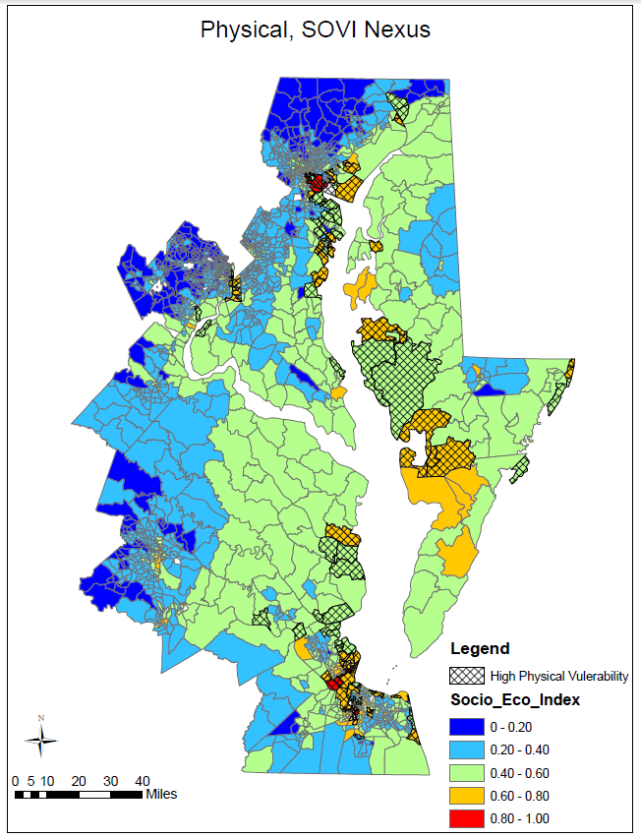
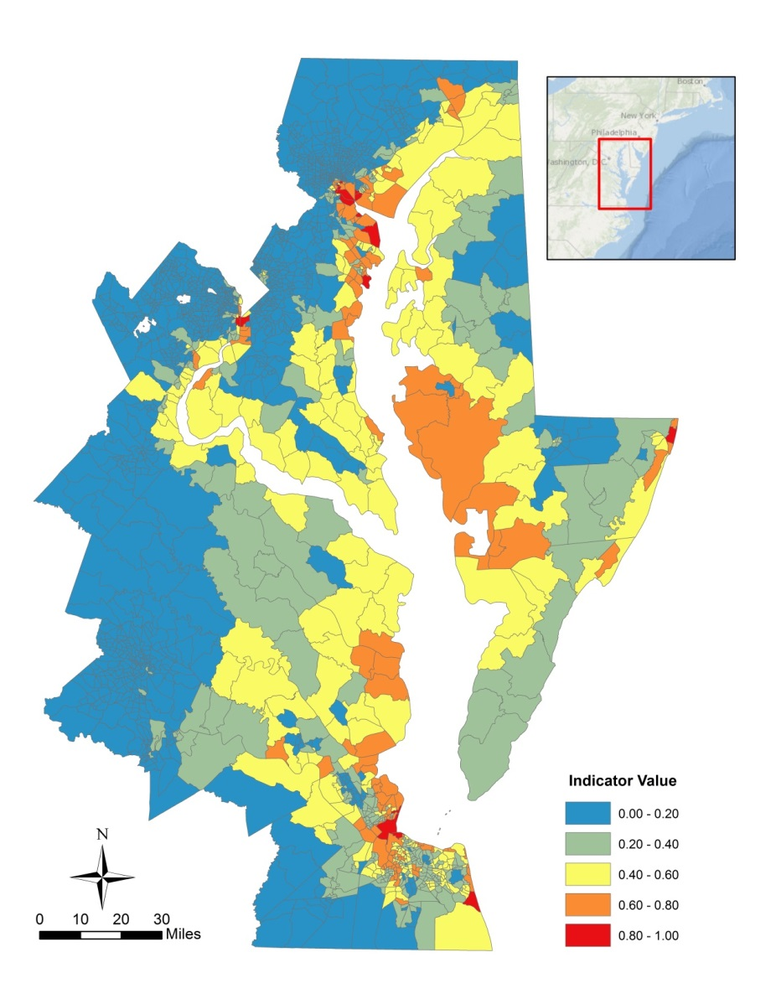
Are there areas where both physical and social vulnerability indices coincide to make certain areas the most vulnerable?

Slide 14
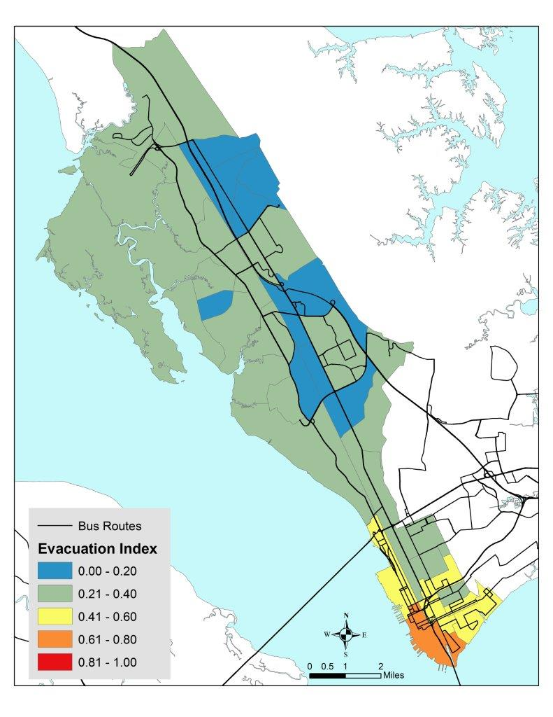
Combined Physical and Social vulnerability by census tract
This area has:
Combination of low income, people under 18 and above 65, and disabled population
Few households with cars
High physical risk
Possible Adaptations:
Increased shelter capacity
Clear bus evacuation plans
Education on “shelter in place”

Slide 15

Existing Model Framework
Adaptation
$ Impact
Flood loss
Ecosystem
Trophic Shifts
Physical
Habitat Shifts
Physical
Bay Dynamics
Climate shifts
$ Impact
Wages
Flood Risk
Fisheries
Social Impact
Waterfront Communities
Social Impact
Fishing Communities
Climate shifts
Climate shifts
Notes:
Not sure this is in the right place, but thought something like this might be helpful—especially if we want to keep the same structure moving forward. The two orange arrows show what we want to add into the model moving forward. Others show existing model.

Slide 16
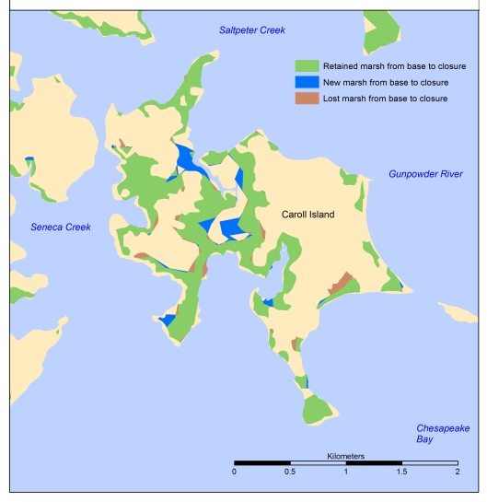
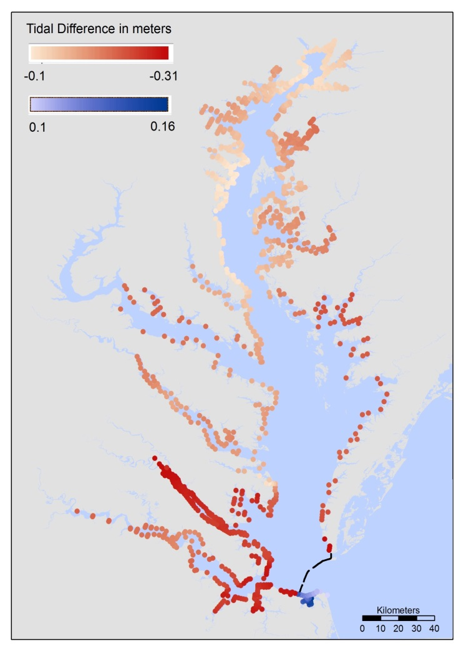
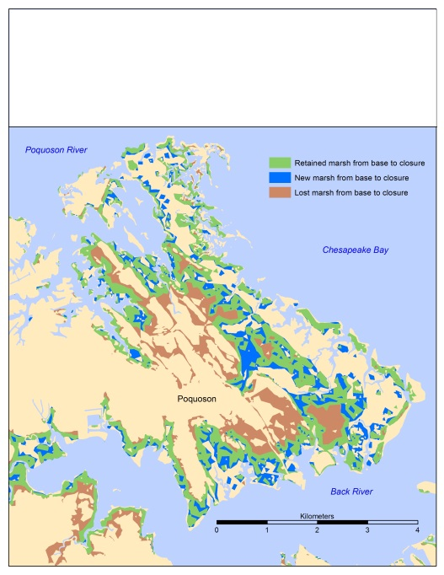
Shifts in tide range impact marsh
The hypothetical barrier (90% closure) lessens the tidal range inside the Bay, with a greater effect seen in the lower Bay.
The model shows a loss of approximately 10% of total marsh area.

Slide 17
CAM model sensitivity runs
All biological groups are modeled simultaneously, in nitrogen units, consequently, all axes are relative to one another, and trade-offs can easily be compared between different scenarios. Model runs for 20-30 years.
50 percent of marsh lost
fish groups decrease substantially, but forage fish decrease only slightly from status quo
SAV production decreases by 30%
phytoplankton and birds both increase
50 percent of submerged aquatic vegetation lost
fish groups stay the same
all other plants increase
birds increase by more than 40%.
Suspended solids decrease
bird production increases strongly
all fish also become much more productive

Slide 18
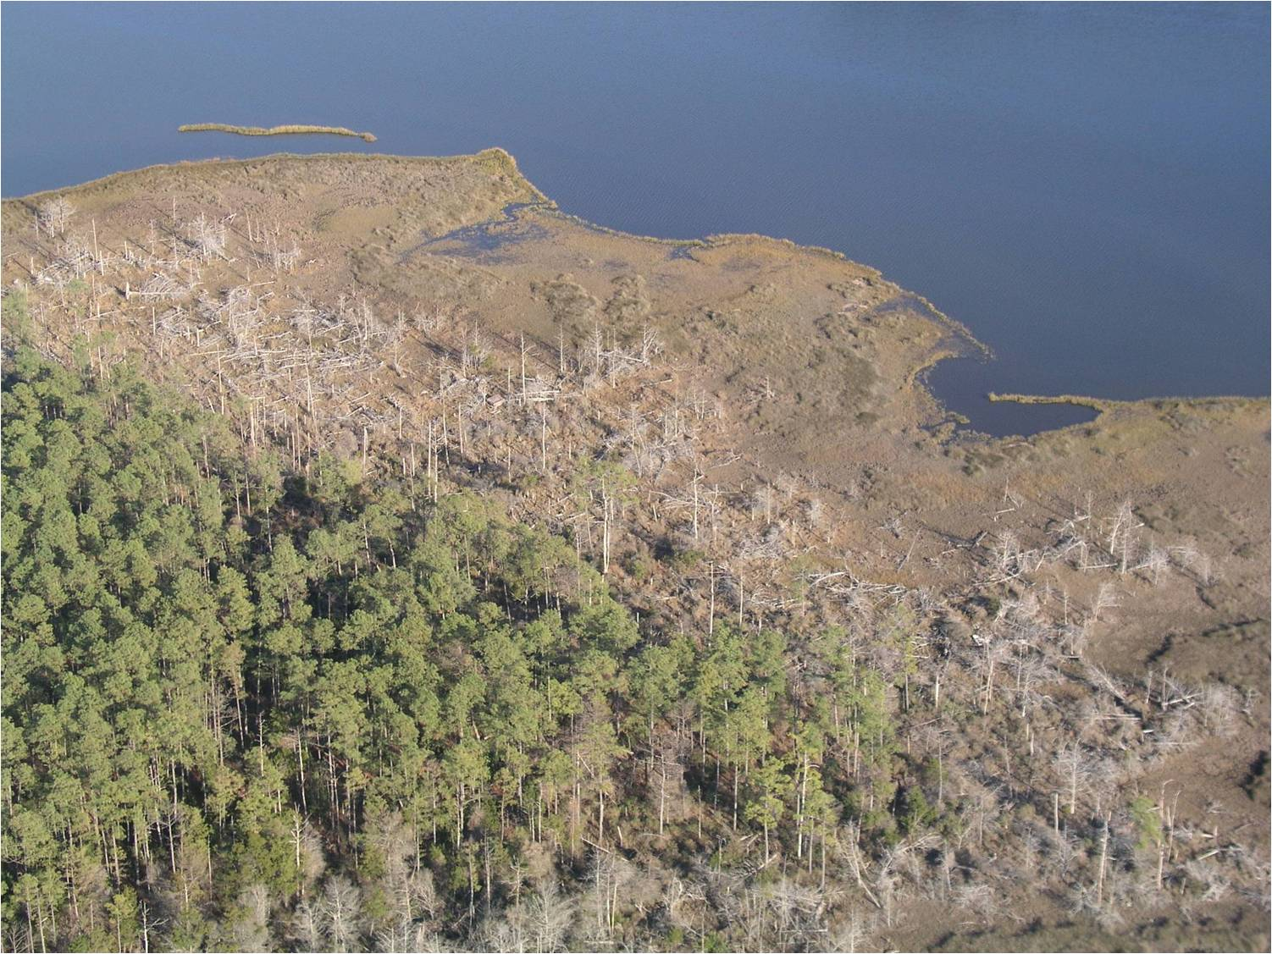
Future Challenges & Strategies
Adaptation efforts should complement and incorporate the natural setting
Natural adaptation efforts should be flexible and target landscapes where ecosystem complexes are most likely to be sustainable
Update existing coastal habitat datasets to refine predictions (baseline)
Improve the knowledge base regarding changes in future flood potential including SLR and precipitation; tropical and extra-tropical storms
Consider social implications of adaptation efforts within and across jurisdictional boundaries
Conduct ecosystem-based evaluation of ecological consequences of climate change (e.g. effects of tidal marsh loss on fish productivity)

