Slide 1

Climate Change Associated Flooding Impacts in Virginia, a Review of Methods and Projections
David J. Sample, Ph.D., P.E.
Associate Professor and Extension Specialist
Biological Systems Engineering
Presentation at the
1st Mitigation and Adaptation Research in Virginia Workshop
Mitigation and Adaption Research Institute
Suffolk, VA
August 12, 2015

Slide 2
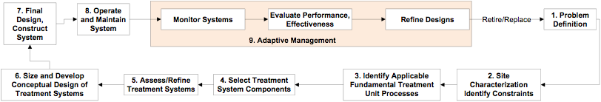
Research Program
Adaptive management applied to design, monitoring, and modeling of urban stormwater BMPs
Integrating life-cycle cost analysis with predictive models, assessing Cost-Benefits
Improving predictive models and tools applied in urban watersheds w/ BMPs
Providing education and guidance on urban stormwater, and BMPs to various audiences
http://www.bse.vt.edu/site/urban-stormwater/

Slide 3
Selected Impacts of Climate Change
Primary:
  Precipitation
  Air temperature
  Water temperature
Secondary:
  Sea Level Rise
  Frequency and magnitude of storm surges
  Frequency and magnitude of precipitation
  Duration of dry periods
  Evapotranspiration
  Landscape hydrogeochemistry and downstream water quality

Slide 4
CC Impacts to SW and Potential Adaptations
Water Cycle Change | Stormwater Impact | Adaptation
Decreased precipitation | Decreased runoff volume, increased recurrence intervals, increased pollutant concentrations | Protect and establish wetlands to retain runoff and recharge groundwater
Increased precipitation | Increased runoff volume, increased peak flow, decreased recurrence intervals, increased waterway erosion and flood risk, increased water turbidity | Increase storage, install detention retention facilities, improve channel stability, improve emergency response capacity, increase storm drain pipe size, install observational networks for flood forecasting
Altered precipitation timing – seasonal and interannual | No significant impact | No adaptation necessary
Increased precipitation intensity | Decreased annual recurrence intervals, increased peak flow runoff, erosion, flood risk, and turbidity | Increase storage, improve emergency response capacity, install observational networks for flood forecasting
Decreased precipitation intensity | Decreased runoff, decreased pollutant loading | Minimal adaptation necessary
Increased ET | Increased removal of stored runoff in detention in retention basins | Minimal adaptation necessary
Increase streamflow | Increased flood risk, increase dilution | Implement risk management studies, minimize impervious surfaces, encourage riparian buffer zones along waterways, install observational networks for flood forecasting
Raised groundwater table | Waterlogging of green infrastructure | Relocate BMPs using improved mapping of GW and soils, reduce leaks in stormwater system
Increase surface water temperature | Decreased DO, altering biota, increased impact of pollutant loading | Use green infrastructure in place of detention/retention
Burian, S.J., T. Walsh, A.J. Kalyanapu and S.G. Larsen. 2013. 5.06 - Climate Vulnerabilities and Adaptation of Urban Water Infrastructure Systems. In: R. Editor-in-Chief: Pielke, editor Climate Vulnerability. Academic Press, Oxford. p. 87-107.

Slide 5
Methods for Modeling Runoff-Induced CC
Design Storm based analyses
  Advantage: quick, applicable to most
  Disadvantage: does not incorporate ET, soil moisture, difficult to assess WQ
Continuous simulation
  Advantage: Simulates hydrologic cycle during entire
  period of simulation, including ET, soil moisture, etc. Can be adapted for WQ analyses
  Disadvantages: Long simulation times, complexity,
  reference to existing standards

Slide 6
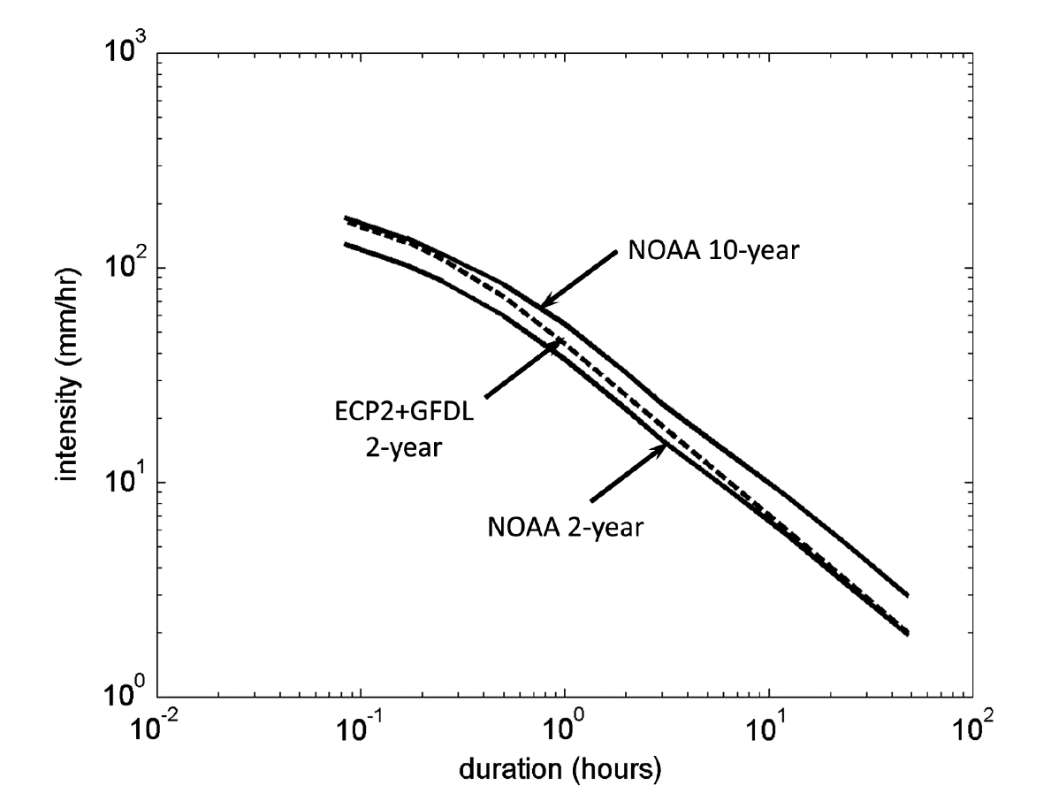
Modeling SW Using Design Storm Approach
Analysis of 3-hr NARCCAP models, comparing 1971-2000 with 20141-2070, Northern VA (Arlington)
Intensity-duration-frequency curves for 2 and 10 yr return periods generated using Log-Pearson Type III fit
Evaluated Ratios at inflow,
outflow, storage
Analysis of detention
storage indicates ponds are
undersized, 72% in 2-yr,
53% in 10-yr duration
Ratio of land use change
much greater than CC high
frequency changes
Moglen, G. and G. Rios Vidal. 2014. Climate Change and Storm Water Infrastructure in the Mid-Atlantic Region: Design Mismatch Coming? J. Hydrol. Eng. 0: 04014026. doi:doi:10.1061/(ASCE)HE.1943-5584.0000967.

Slide 7
Continuous Simulation
Requires method for downscaling GCM/RCM
model outputs (such as Temp, Precip, Radiation):
Statistical downscaling of (GCM model)s
Dynamical downscaling (from RCMs)
Methods
Linear interpolation
Spatial disaggregation
Bias-corrected spatial disaggregation
Jang, S. and M.L. Kavvas. 2015. Downscaling Global Climate Simulations to Regional Scales: Statistical Downscaling versus Dynamical Downscaling. J. Hydrol. Eng. 20. doi:10.1061/(asce)he.1943-5584.0000939.
Wood, A.W., L.R. Leung, V. Sridhar and D.P. Lettenmaier. 2004. Hydrologic Implications of Dynamical and Statistical Approaches to Downscaling Climate Model Outputs. Climatic Change 62: 189-216.

Slide 8
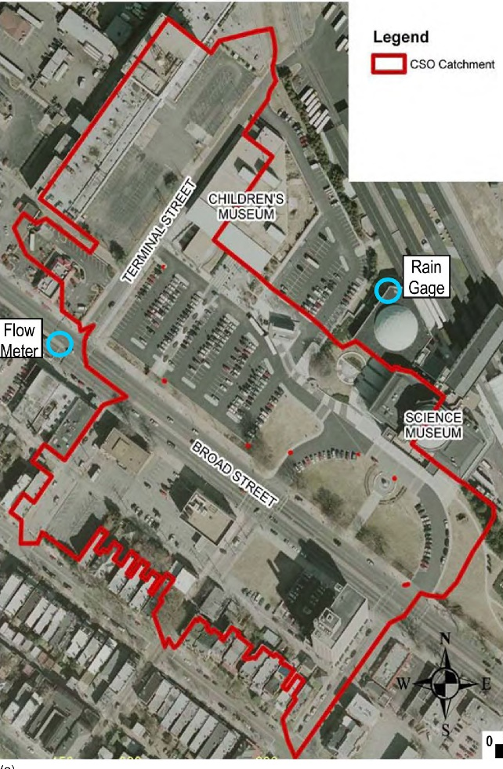
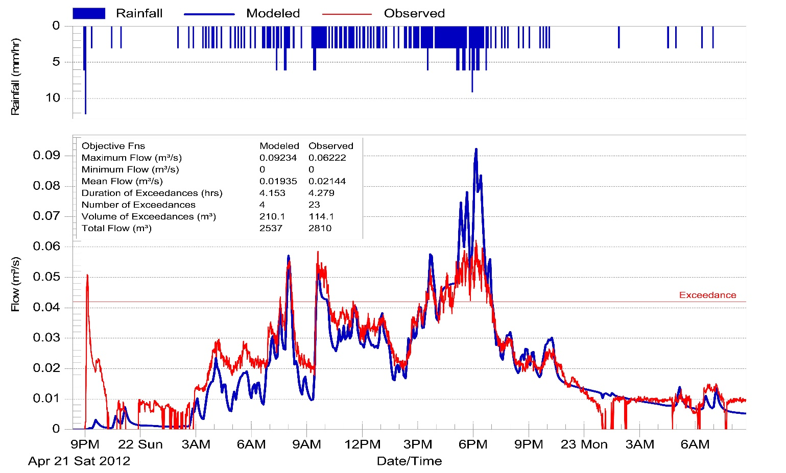
Assessment of LID Using Continuous Simulation Methods (hybrid)
Lucas, W.C. and D.J. Sample. Reducing combined sewer overflows by using outlet controls for Green Stormwater Infrastructure: Case study in Richmond, Virginia. J. Hydrol. doi:http://dx.doi.org/10.1016/j.jhydrol.2014.10.029.

Slide 9
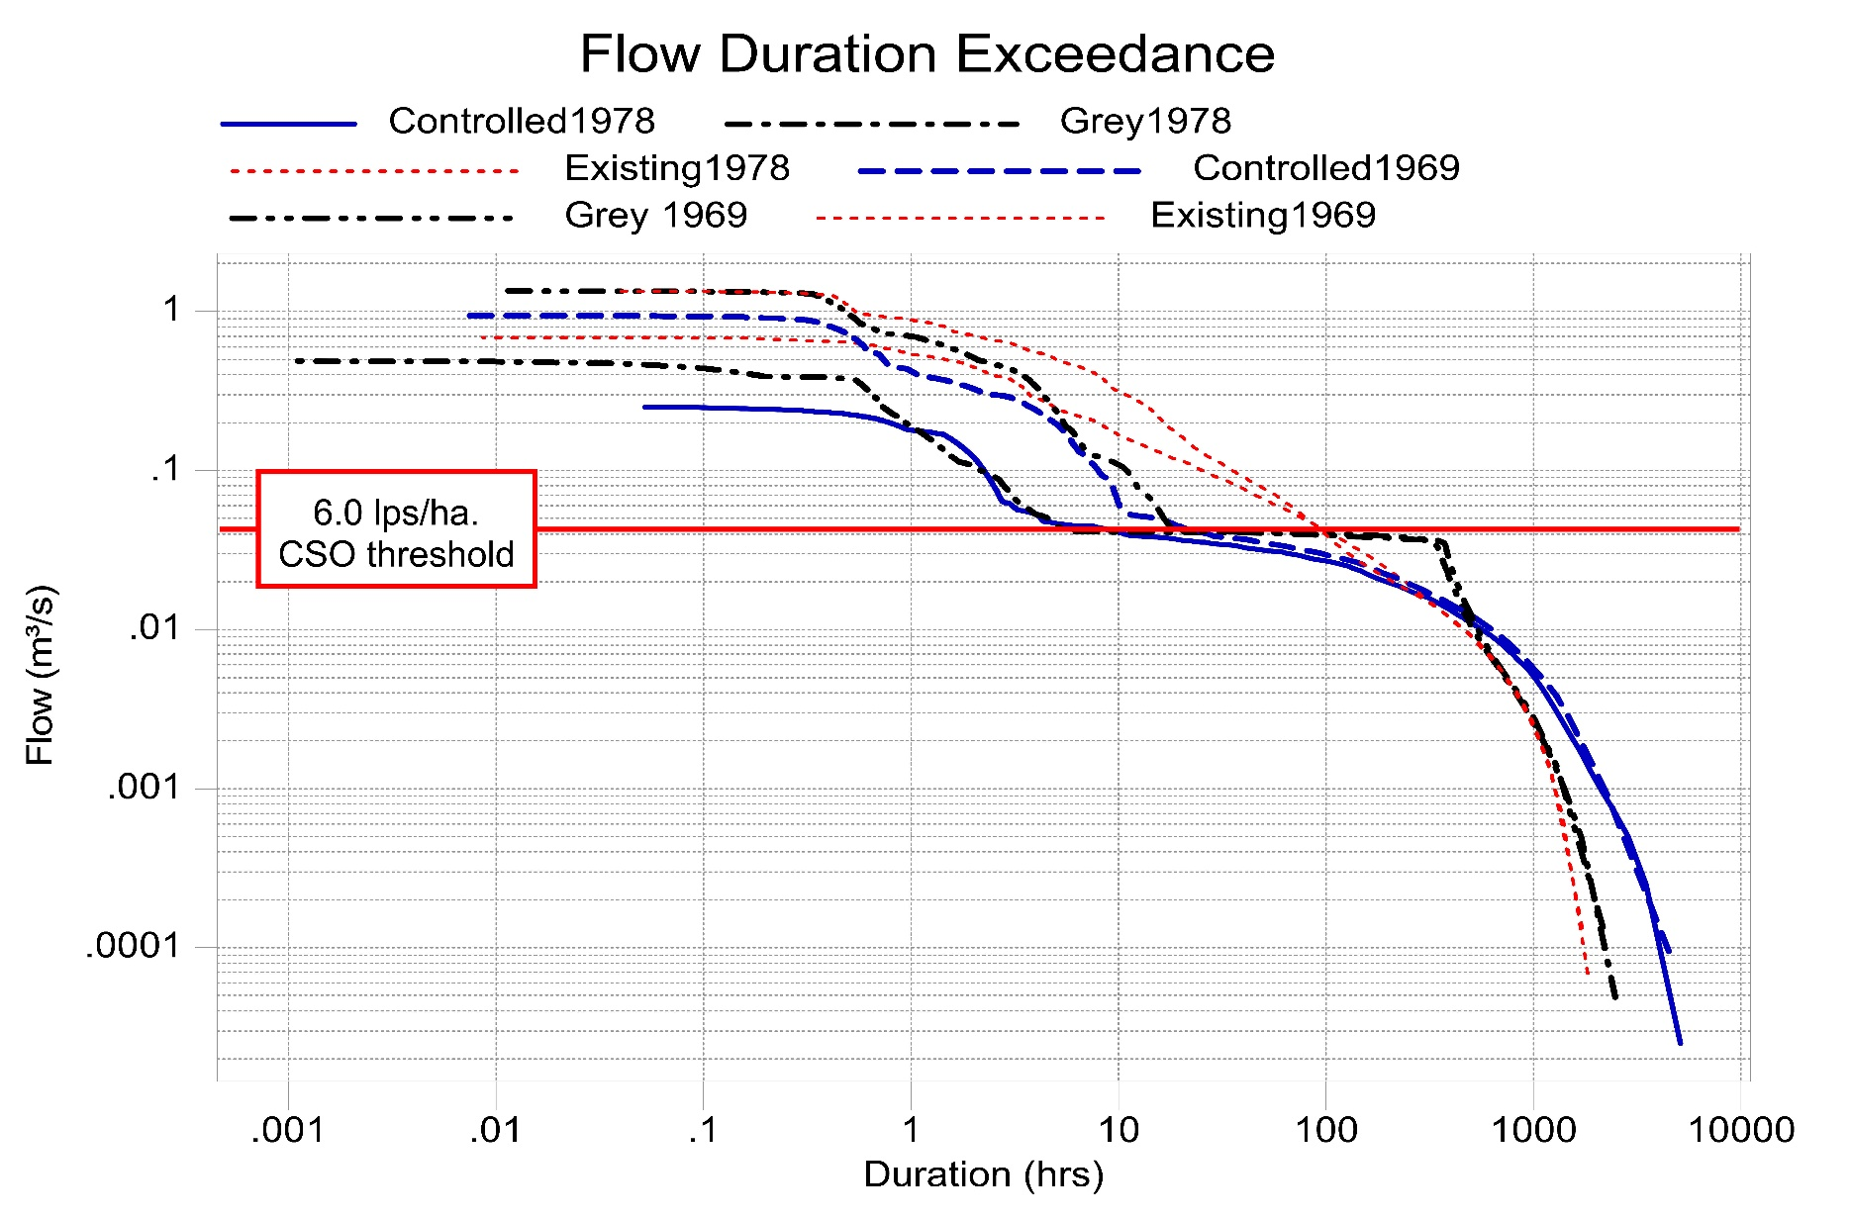
Assessment of LID Using Continuous Simulation Methods
Lucas, W.C. and D.J. Sample. Reducing combined sewer overflows by using outlet controls for Green Stormwater Infrastructure: Case study in Richmond, Virginia. J. Hydrol. doi:http://dx.doi.org/10.1016/j.jhydrol.2014.10.029.

Slide 10
Bioretention Projections in North Carolina
Used a weather generator to downscale climate model data, 2055-2058 compared with 2001-2004
Simulated single bioretention with DRAINMOD
Frequency and magnitude of untreated overflows increased
Additional catchment storage of 9-31 cm is required
Dry periods increased
Hathaway, J.M., R.A. Brown, J.S. Fu and W.F. Hunt. 2014. Bioretention function under climate change scenarios in North Carolina, USA. J. Hydrol. 519, Part A: 503-511. doi:http://dx.doi.org/10.1016/j.jhydrol.2014.07.037.

Slide 11
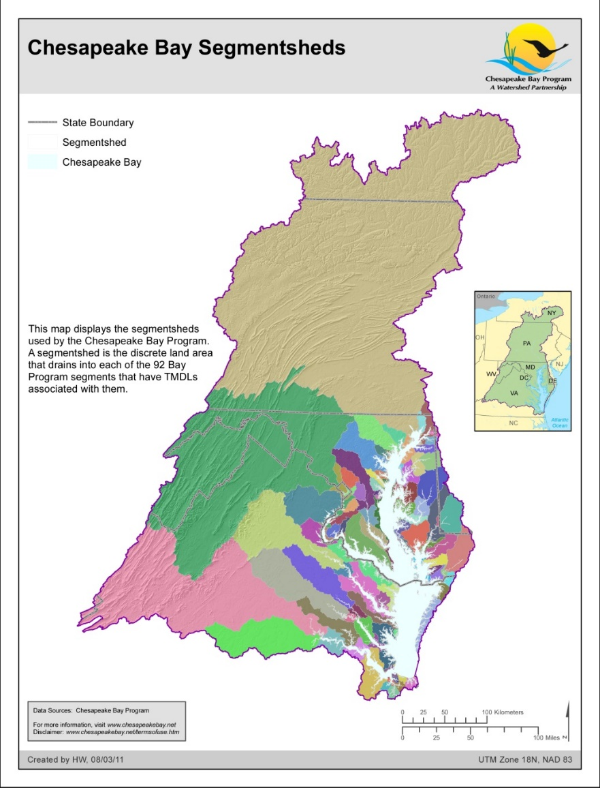
NSF Water Sustainability and Climate Project
Goal: To develop a scalable and predictive framework to explain interactions among climate, hydrology, biogeochemistry and economics to inform new and more effective water quality protection strategies.
Bracket the mid-century changes in climate for the CB Watershed with downscaled high-resolution climate models.
Evaluate changes in landscape patterns and magnitudes of N and P cycling and erosion using downscaled climate model outputs coupled to multi-scale landscape models.
Scale up the patterns we predict at the fine scale in the test-bed watersheds (e.g., 5-10 m) to prioritize landscape protection and BMP implementation strategies.
Estimate the range of impact of CC uncertainty may have on the Estuary
Assess tradeoffs between costs of BMPs to control nitrogen (N) loads and variability of N loads under alternative CC scenarios.
Easton, Z., Sample, D., Bosch, D., Najjar, R.G. and Li, M., 2014. Water Sustainability and Climate-Category 1 Collaborative Proposal: Coupled Multi-Scale Economic, Hydrologic and Estuarine Modeling to Assess Impacts of Climate Change on Water quality Management, National Science Foundation Proposal.

Slide 12
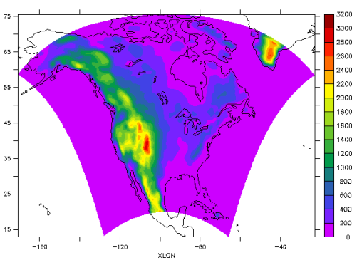
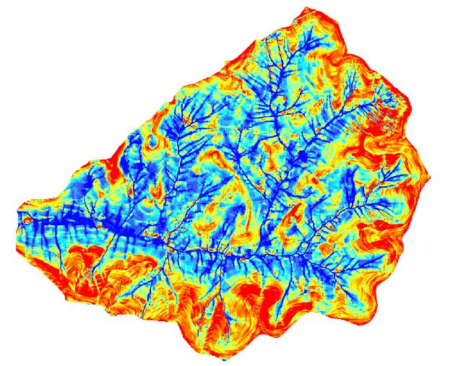
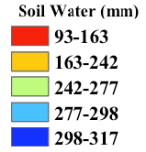
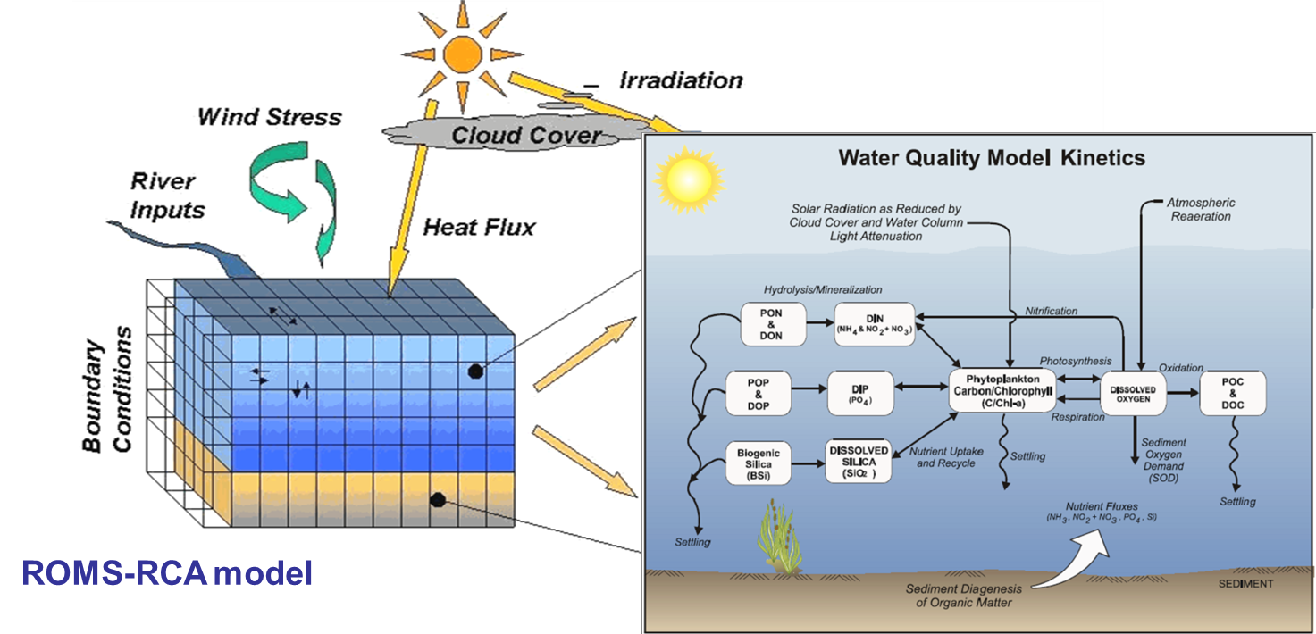
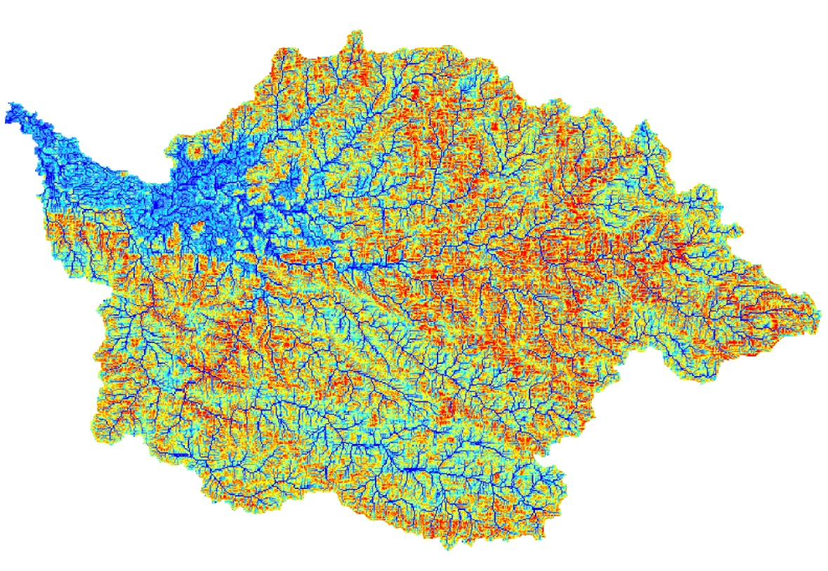
Climate-Najjar
Test-beds-Easton, Sample
Predict critical source areas
Run scenarios
SWAT-VSA, SWMM (Obj 2)
Downscaled GCMs (Obj 1)
Tradeoffs between costs of BMPs to control pollutants and variability of pollutant w/ CC (Obj 5)-Bosch
Upscale test-beds - Easton
Run Scenarios
SWAT-VSA, SWMM (Obj 3)
Deliver N, P and Sed to ROMS-RCA-Li
Run Scenarios (Obj 4)

Slide 13
Climate
Output from NARCCAP (North American Climate Change Assessment Program) dynamical downscaling at 50-km resolution
Global model forcing is from the Coupled Model Intercomparison Project (CMIP3)
Historical period (1971-2000) and a future period (2041-2070) under a medium-high greenhouse gas emissions scenario (A2)
Ten different regional-global climate model combinations
Najjar, R.G., C.R. Pyke, M.B. Adams, D. Breitburg, C. Hershner, M. Kemp, et al. 2010. Potential climate-change impacts on the Chesapeake Bay. Estuarine, Coastal and Shelf Science 86: 1-20. doi:DOI: 10.1016/j.ecss.2009.09.026.

Slide 14
Watersheds
Utilize test bed watersheds with good hydro and biogeochemical data to build proof of concept models
  Changes in primarily N-Cycling (although P and sediment too) and hydrology from CC

Slide 15
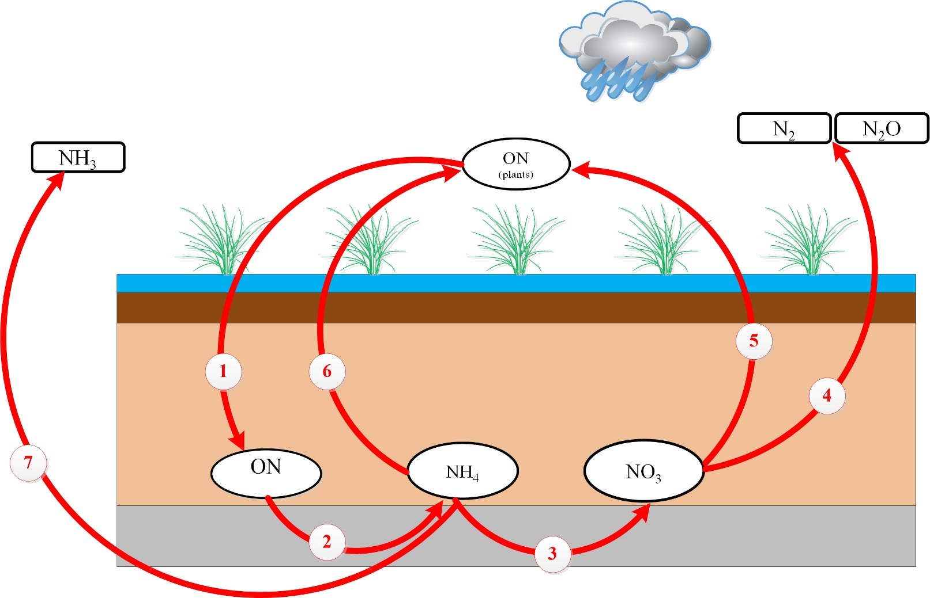
Potential Impacts to Bioretention
Defoliation
Ammonification
Nitrification
Denitrification
Plant uptake
Plant uptake
Volatilization
Fixation
Alamdari, N., Sample, D., and Easton, Z., 2015, Potential modifications to agricultural and urban runoff water quality from climate, Poster Presentation, NSF Meeting, January 15-16, Arlington, VA

Slide 16
Potential Impacts to Riparian Buffers
N₂
N₂O
1
N₂
2
NH₄
ON
3
NO₃
NH₄
NO₃
Increased precipitation could raise water table and which would promote anoxic conditions and denitrification.
Rising temperature may lead to more cover crop coverage during offseason, increasing fixing of N2 and production of NO3 and NH4.
Rising water table may transport NO3 more quickly, before denitrification

Slide 17
Agricultural Test Beds
Hypothesis. Increased precipitation will increase the saturated extent of the watershed, increasing denitrification
  Alternative 1. Increased precipitation will be balanced by increased temperature (increasing ET) and result in no net change to denitrification.
  Alternative 2. Even if soil moisture status remains more-or-less constant, denitrification will increase as a result of increased temperatures.
Hypothesis. Extreme events mobilize more sediment and sediment bound constituents (P) relative to N while increases in the annual water balance favor increased N production and transport.

Slide 18
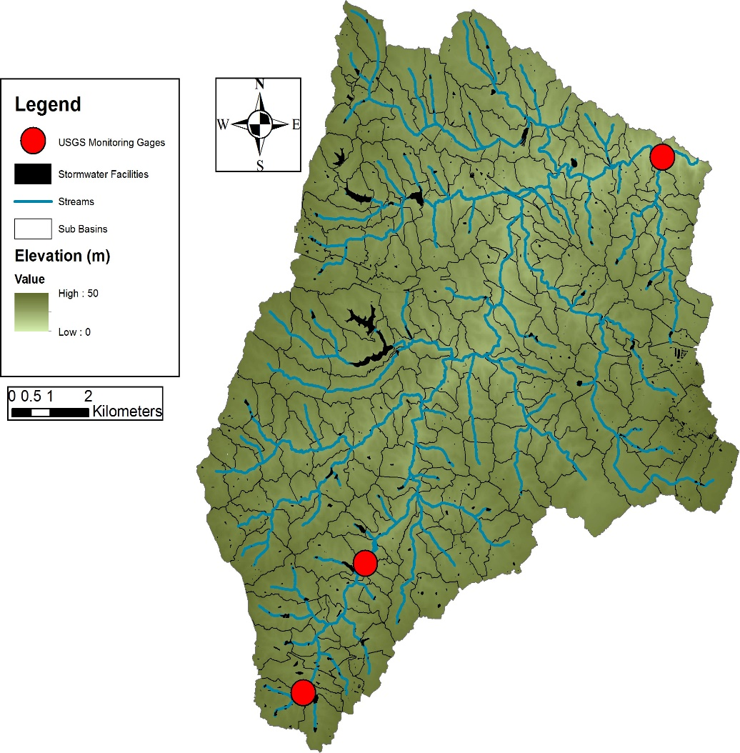
Urban Test-Bed
Hypothesis. Altered flow regime and extreme events will reduce BMP performance
Difficult Run
Fairfax County, VA
151 km²
18.4% impervious
900 existing BMPs

Slide 19
Selected Impacts of Climate Change
Primary:
  Precipitation
  Air temperature
  Water temperature
Secondary:
  Sea Level Rise
  Frequency and magnitude of storm surges
  Frequency and magnitude of precipitation
  Duration of dry periods
  Evapotranspiration
  Landscape hydrogeochemistry and downstream water quality

Slide 20
Questions? dsample@vt.edu

