Slide 1
Climate Change Adaptation to Sea Level Rise in Atlantic Canada
Blair Greenan
Bedford Institute of Oceanography

Slide 2
Outline
Introduction (BIO, DFO, ACCASP)
Sea Level Change (IPCC AR5)
Sea Level Allowances (CAN-EWLAT)
Coastal Vulnerability Index (CanCoast)
Summary

Slide 3

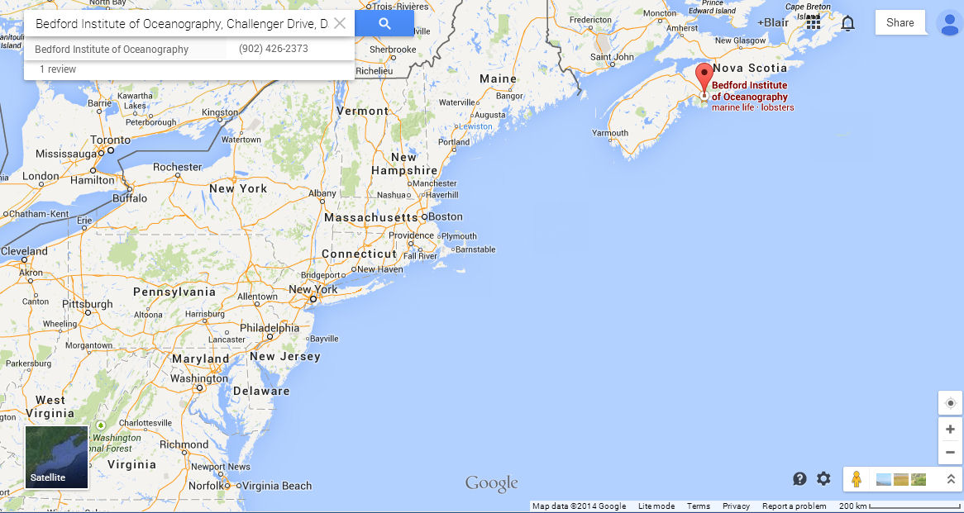
Est. 1962
Notes:
Canada's largest centre for ocean research (ca. 600 employees), which:
Provides advice and support to government decision-making
Assists with development of the ocean sector by funding extensive research and development
Practices integration of Marine Science across Federal Departments to serve Canadians
Partnering essential to deliver our mission
Recent developments: CERC, HMRI
Over it’s nearly 50 years of operation has created world class products and services that have earned an enviable reputation through ongoing design and service improvement.

Slide 4
Government of Canada @ BIO
Est. 1962
Fisheries and Oceans Canada
    Science
    Ecosystem Management
    Canadian Coast Guard
    Information Management & Technology Services
Natural Resources Canada
    Geological Survey of Canada - Atlantic
Department of National Defence
    Route Survey - Canadian Navy
Environment Canada
    Marine Water Quality Monitoring Program
Notes:
Canada's largest centre for ocean research (ca. 600 employees), which:
Provides advice and support to government decision-making
Assists with development of the ocean sector by funding extensive research and development
Practices integration of Marine Science across Federal Departments to serve Canadians
Partnering essential to deliver our mission
Recent developments: CERC, HMRI
Over it’s nearly 50 years of operation has created world class products and services that have earned an enviable reputation through ongoing design and service improvement.

Slide 5
Introduction - Fisheries and Oceans Canada
Role
  Fisheries and Oceans Canada (DFO) has the lead federal role in managing Canada's fisheries and safeguarding its waters.
The Department's work is guided by five key pieces of legislation:
  the Oceans Act;
  the Fisheries Act;
  the Species at Risk Act;
  the Coastal Fisheries Protection Act; and
  the Canada Shipping Act, 2001 (Transport Canada-led).
Strategic Outcomes
  Economically Prosperous Maritime Sectors and Fisheries;
  Sustainable Aquatic Ecosystems;
  Safe and Secure Waters.

Slide 6
Aquatic Climate Change Adaptation Services Program (ACCASP)
ACCASP is the DFO component of a Government of Canada initiative with $149 million funding over five years, beginning in 2011.
Objectives:
  To advance knowledge and understanding of the risks, impacts and opportunities created by climate change for Fisheries and Oceans’ mandated areas of responsibility
  To mainstream climate change adaptation science into decision-making processes across DFO Sectors

Slide 7
Aquatic Climate Change Adaptation Services Program (ACCASP)
Program Components
  Science-based trends and projections, and ecological risk assessments; as a component of integrated regional risk assessments to identify departmental key vulnerabilities to climate change
  Ocean and freshwater science research projects to increase understanding of climate change impacts
  Development of tools for adaptation within Fisheries and Oceans Canada

Slide 8
Aquatic Climate Change Adaptation Services Program (ACCASP)
Fisheries and Oceans Canada assessment (2005, updated 2012) of the risks that climate change poses to the department in its ability to deliver on its mandate.
Assessments were national in scope;
based on a review of the scientific literature; &
validated by departmental sectors
6 DFO CLIMATE RISKS
Risk 1 Ecosystem and Fisheries Degradation and Damage
Risk 2 Changes in Biological Resources
Risk 3 Species Reorganization and Displacement
Risk 4 Increased Demand to Provide Emergency Response
Risk 5 Infrastructure Damage
Risk 6 Changes in Access and Navigability of Waterways

Slide 9
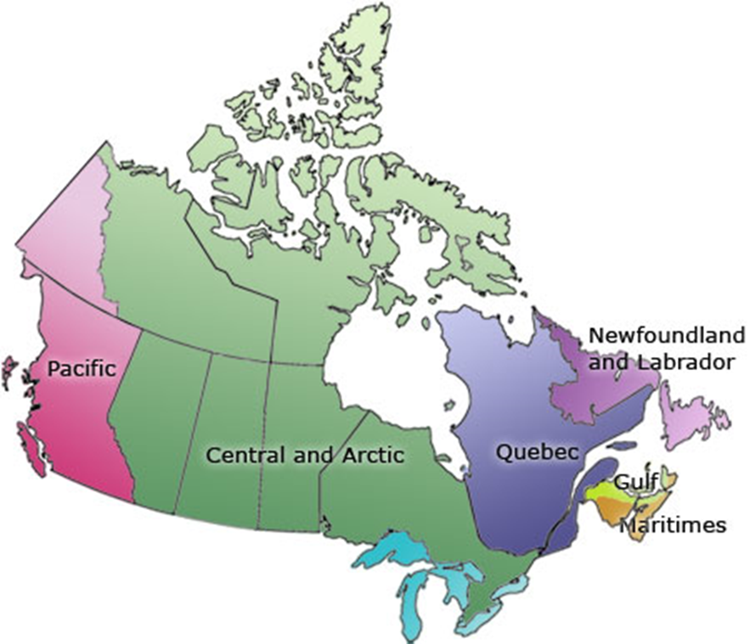
Aquatic Climate Change Adaptation Services Program (ACCASP)
DFO is a regional-based department. Canada is surrounded by three oceans with substantial inland waters
4 BASINS
  Atlantic
  Arctic
  Pacific
  Freshwater

Slide 10
ACCASP – Integrated Risk Assessments
Update 2005 National Risk Assessment
On going
Science stream
Lead – Ecosystems and Oceans Science
Detailed science products
Draft Trends and Projections, and Impacts Vulnerabilities and Opportunities reports and summary tables
(for each Basin)
Risk summaries
(for each Bain)
CSAS Science climate change risk assessments
(in each Basin)
Socio-economic stream
Lead - Strategic Policy
Integrated climate change risk management workshop
(in each Basin)
Draft framework for identifying socioeconomic
impacts
Draft reports on socioeconomic
impacts
(for each Basin)
Risk Summaries (for each Basin)
Establish socio-economic analysis framework
Establish policy analysis framework
Policy considerations stream
Lead - Strategic Policy
Policy analysis
Policy priority
Program area stream
Lead – DFO Program Areas
Operational perspective in terms of applied risks that impact the delivery of programs, products and services to Canadians
On going

Slide 11
ACCASP – Understanding Climate Sensitive Decisions
Science Evidentiary Information
(Ecosystem Mgt, Int. Fish. Resource Mgt, CCG, SCH)
Socio-Economic Evidentiary Information
(Ecosystem Mgt, Int. Fish. Resource Mgt, CCG, SCH)
Inventory of Existing Adaptation Tools Relevant to the Work of DFO
Integrated Risk Assessment Results
(4 LABs)
Summer 2013
DFO Framework for Identifying Climate Sensitive Decisions
Key Organisational Areas Climate Sensitive Decisions
Fall 2013
Ecosystem Mgt
Int. Fish.Resource Mgt
CCG
SCH
Climate Sensitive Decisions Workshop
January 2014
Prioritized List of DFO Climate Sensitive Decisions for DFO Sectors
Development of Adaptation Tools

Slide 12
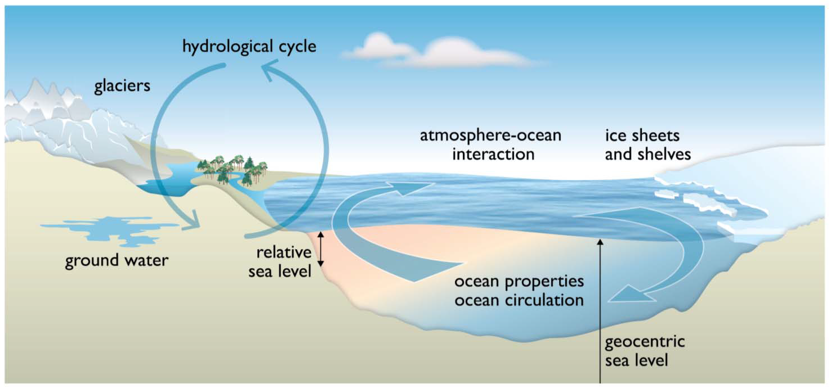
Sea Level Change
Notes:
Discuss GIA, thermal expansion, ocean circulation, glaciers,

Slide 13
IPCC AR5 WGI (2013)
The rate of sea level rise since the mid-19th century has been larger than the mean rate during the previous two millennia. Over the period 1901 to 2010, global mean sea level rose by 0.19 [0.17 to 0.21] m
Since the early 1970s, glacier mass loss and ocean thermal expansion from warming together explain about 75% of the observed global mean sea level rise.
Global mean sea level will continue to rise during the 21st century. Under all RCP scenarios, the rate of sea level rise will very likely exceed that observed during 1971 to 2010 due to increased ocean warming and increased loss of mass from glaciers and ice sheets.
Notes:
Proxy and instrumental sea level data indicate a transition in the late 19th to the early 20th century from relatively low mean rates of rise over the previous two millennia to higher rates of rise (high confidence). It is likely that the rate of global mean sea level rise has continued to increase since the early 20th century. {3.7, 5.6, 13.2}
It is very likely that the mean rate of global averaged sea level rise was 1.7 [1.5 to 1.9] mm yr–1 between 1901 and 2010, 2.0 [1.7 to 2.3] mm yr–1 between 1971 and 2010, and 3.2 [2.8 to 3.6] mm yr–1 between 1993 and 2010. Tide-gauge and satellite altimeter data are consistent regarding the higher rate of the latter period. It is likely that similarly high rates occurred between 1920 and 1950. {3.7}
Since the early 1970s, glacier mass loss and ocean thermal expansion from warming together explain about 75% of the observed global mean sea level rise (high confidence). Over the period 1993 to 2010, global mean sea level rise is, with high confidence, consistent with the sum of the observed contributions from ocean thermal expansion due to warming (1.1 [0.8 to 1.4] mm yr–1), from changes in glaciers (0.76 [0.39 to 1.13] mm yr–1), Greenland ice sheet (0.33 [0.25 to 0.41] mm yr–1), Antarctic ice sheet (0.27 [0.16 to 0.38] mm yr–1), and land water storage (0.38 [0.26 to 0.49] mm yr–1). The sum of these contributions is 2.8 [2.3 to 3.4] mm yr–1. {13.3}
There is very high confidence that maximum global mean sea level during the last interglacial period (129,000 to 116,000 years ago) was, for several thousand years, at least 5 m higher than present, and high confidence that it did not exceed 10 m above present. During the last interglacial period, the Greenland ice sheet very likely contributed between 1.4 and 4.3 m to the higher global mean sea level, implying with medium confidence an additional contribution from the Antarctic ice sheet. This change in sea level occurred in the context of different orbital forcing and with high-latitude surface temperature, averaged over several thousand years, at least 2°C warmer than present (high confidence). {5.3, 5.6}

Slide 14
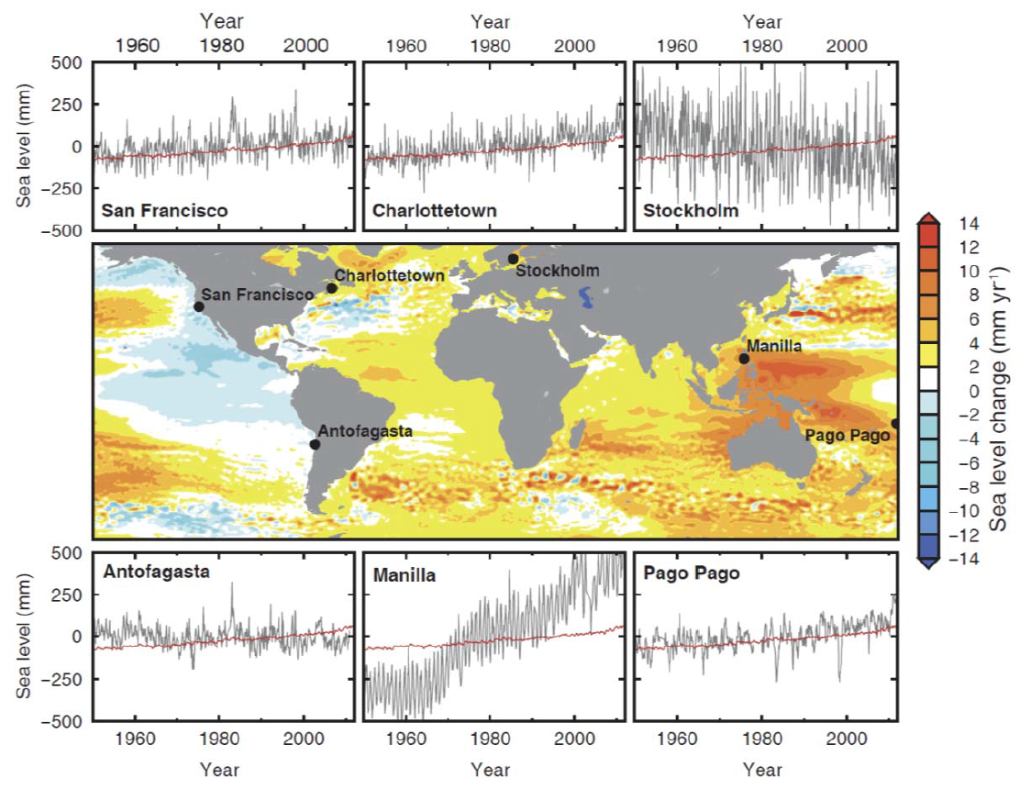
Sea Level Trends - IPCC AR5 WGI (2013)
Notes:
Time series from tide gauge data
Color plot from satellite altimetry 1993-2012

Slide 15
IPCC AR5 Summary for Policymakers (2013)
 |  | 2046-2065 |  | 2081-2100
 | Scenario | Mean | Likely Range | Mean | Likely Range
Global Mean Surface Temperature Change (°C) | RCP2.6 | 1.0 | 0.4 to 1.6 | 1.0 | 0.3 to 1.7
 | RCP4.5 | 1.4 | 0.9 to 2.0 | 1.8 | 1.1 to 2.6
 | RCP6.0 | 1.3 | 0.8 to 1.8 | 2.2 | 1.4 to 3.1
 | RCP8.5 | 2.0 | 1.4 to 2.6 | 3.7 | 2.6 to 4.8
 | Scenario | Mean | Likely Range | Mean | Likely Range
Global Mean Sea Level Rise (m) | RCP2.6 | 0.24 | 0.17 to 0.32 | 0.40 | 0.26 to 0.55
 | RCP4.5 | 0.26 | 0.19 to 0.33 | 0.47 | 0.32 to 0.63
 | RCP6.0 | 0.25 | 0.18 to 0.32 | 0.48 | 0.33 to 0.63
 | RCP8.5 | 0.30 | 0.22 to 0.38 | 0.63 | 0.45 to 0.82

Slide 16
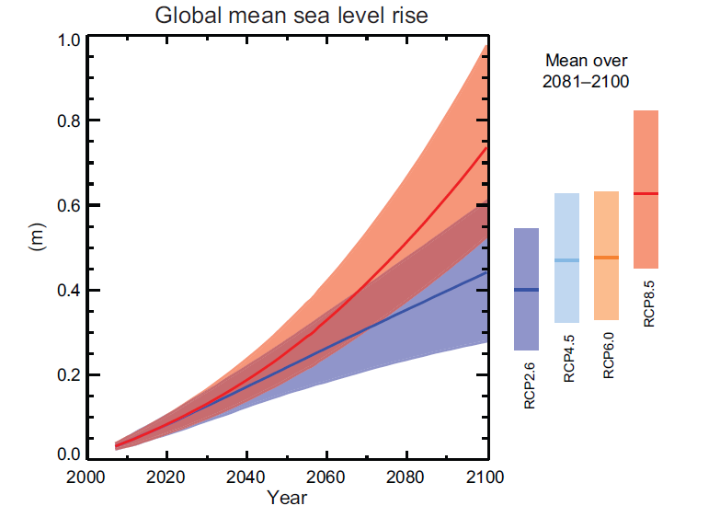
IPCC AR5 Summary for Policymakers (2013)

Slide 17
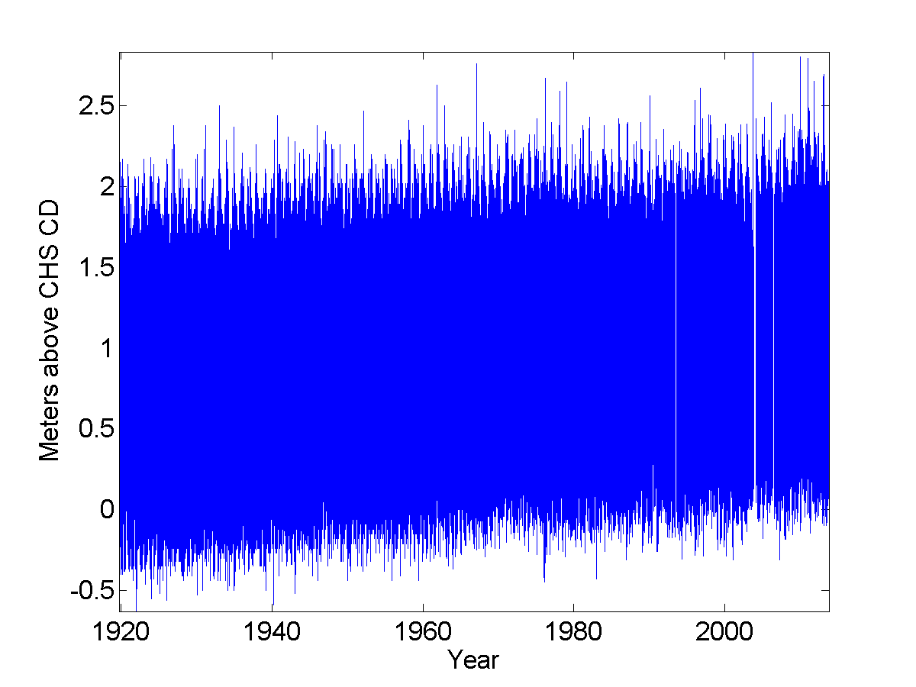
Hourly Sea Level at Halifax
Level (m) | Number of exceedances
94 years of data

Slide 18

Hourly Sea Level at Halifax
Level (m) | Number of exceedances
2.4 | 69
94 years of data

Slide 19
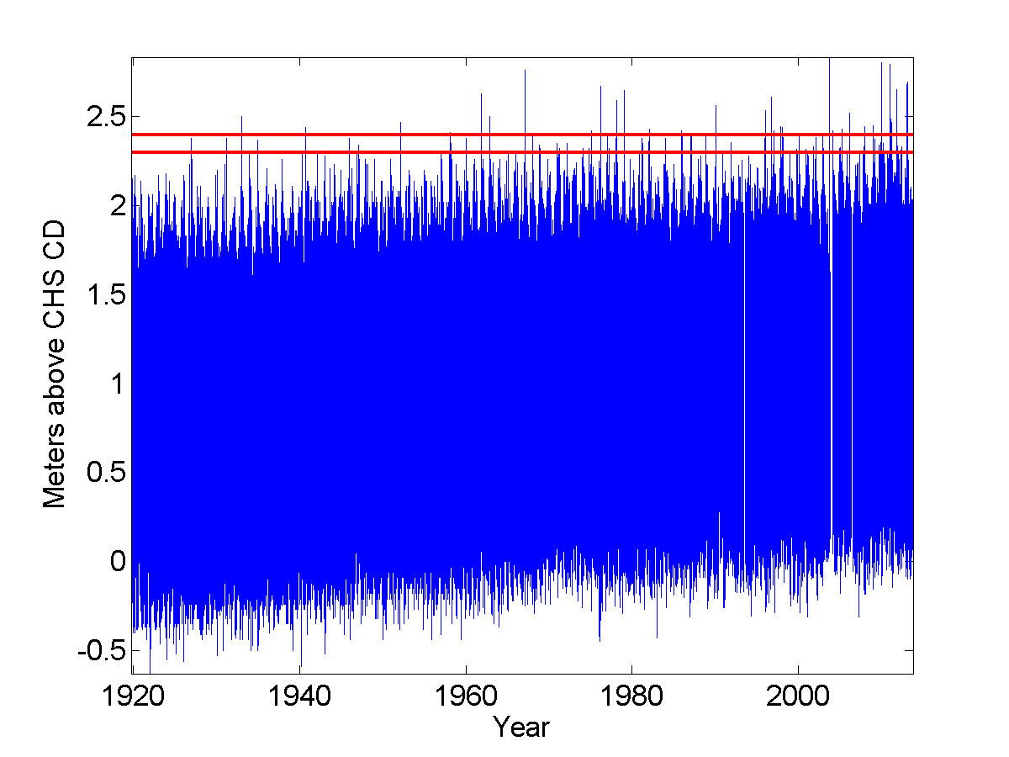
Hourly Sea Level at Halifax
Level (m) | Number of exceedances
2.4 | 69
0.1 | X3.1
2.3 | 217
94 years of data

Slide 20

Hourly Sea Level at Halifax
Level (m) | Number of exceedances
2.4 | 69
0.1 | X3.1
2.3 | 217
0.1 | X2.7
2.2 | 581
94 years of data
Notes:
Number of exceedances varies approximately exponentially with height.
Rule of thumb:
0.1 metres increase in sea level results in a factor of 3 change in number of exceedences

Slide 21
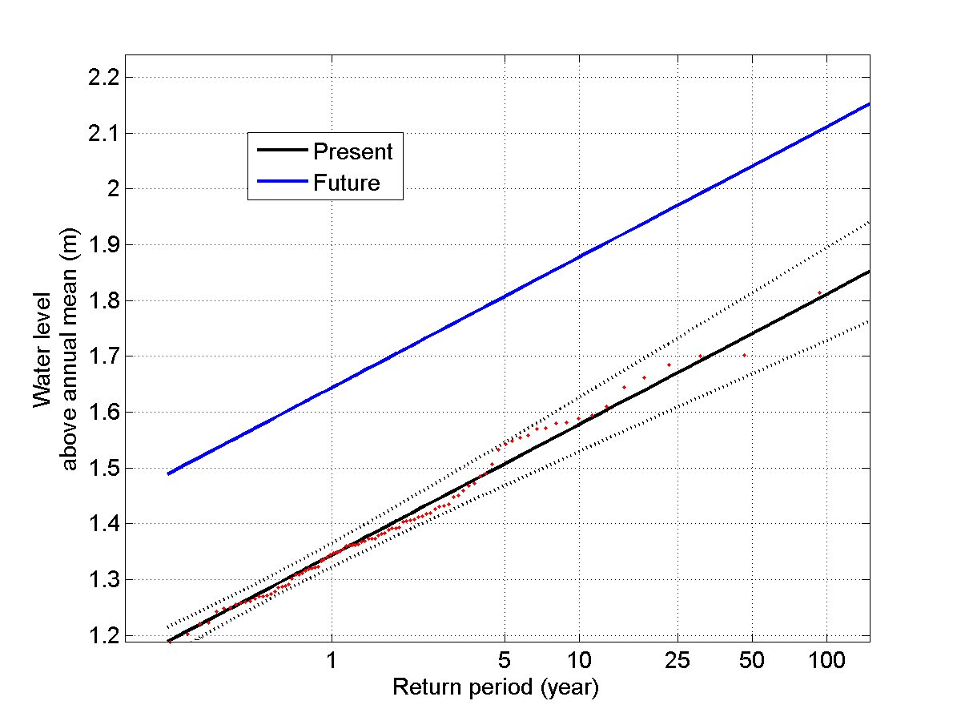
Probability of Flooding in Halifax:
Today vs Future
0.3 m
Hurricane Juan, 2003
Notes:
Black line is the present return-level line fitted to the tide gauge data, blue line is the future return-level line assuming 0.3 m sea level rise.
SLR will reduce the return period. An extreme event of return period similar to Hurricane Juan will occur more frequently, i.e. on average every 5 years.

Slide 22
Hourly Sea Level at Fort Denison (Sydney), RCP8.5
Level (m)
Number of exceedances
1.5
1.45
(NOW)
1
(ABOUT EVERY 100 YEARS)
1
Metres above AHD
0.5
0.95 2707
(2100 LOW) (ABOUT EVERY
12 DAYS)
0
88.7 years of data
-0.5
0.70
(2100 MID)
14500 (ABOUT EVERY 2 DAYS)
-1
National Tidal Centre Sydney Ports Corporation
1980 2000
0.45 38845
-1.5
(2100 HIGH) (ABOUT EVERY
1920
1940
1960
Year
DAY)

Slide 23
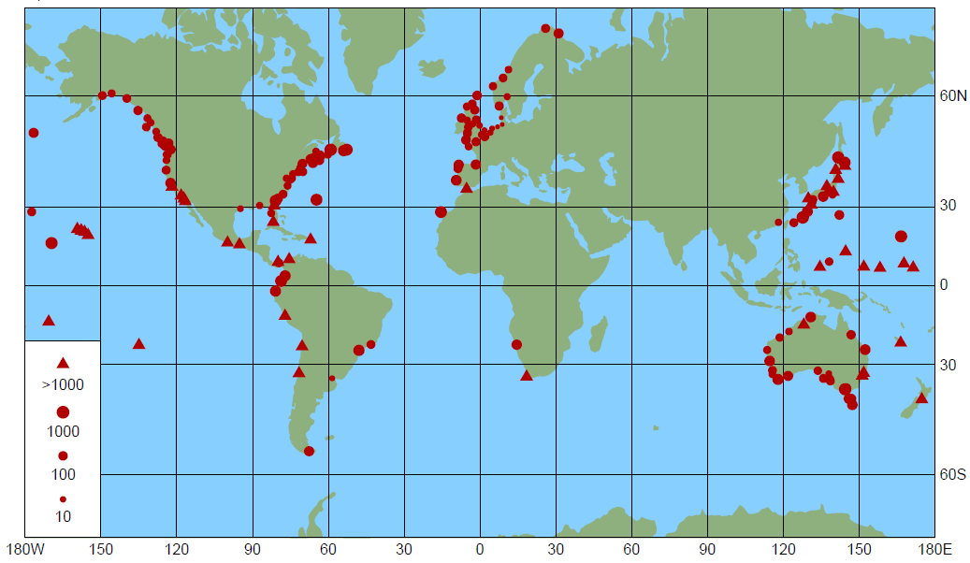
Increase in Flood Frequency for Sea Level Rise of 0.5m
IPCC AR5

Slide 24
IPCC AR5 WGII
To date, observed trends in extreme sea levels are mainly consistent with Mean Sea Level (MSL) trends (e.g. Menendez and Woodworth, 2010; Marcos et al., 2009; Haigh et al., 2010, Losada et al., 2013) indicating that MSL trends, rather than changes in weather patterns, are primarily responsible.

Slide 25
What is an Allowance?
“Safe" is defined in terms of not exceeding a given frequency of flooding events ("exceedances")
“Safe” height to build with sea level rise
Allowance
“Safe” height to build without sea level rise
Present building standard
Fixed level or datum

Slide 26
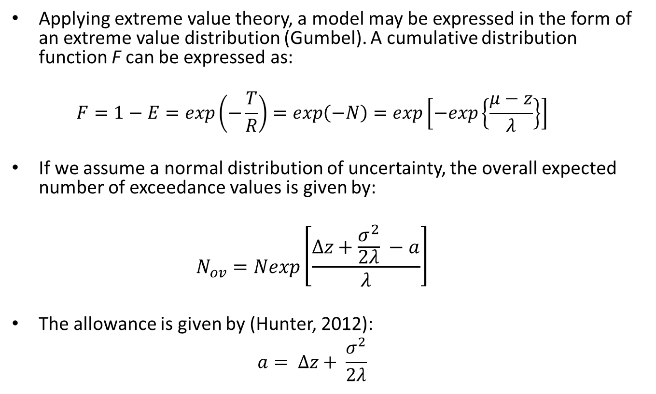
Estimating an Allowance for Sea Level Rise
Applying extreme value theory, a model may be expressed in the form of an extreme value distribution (Gumbel). A cumulative distribution function F can be expressed as:
  $$F=1−E=\exp\left(−\frac{T}{R}\right)=exp\left(−N\right)=exp\left[−exp\left\{\frac{μ−z}{λ}\right\}\right]$$
If we assume a normal distribution of uncertainty, the overall expected number of exceedance values is given by:
  $$N_{ov}=Nexp\left[\frac{Δz+\frac{σ^{2}}{2λ} −a}{λ}\right]$$
The allowance is given by (Hunter, 2012):
  $$a= ∆z+ \frac{σ^{2}}{2λ}$$
Notes:
The Hunter’s allowances method combines the statistics of present extreme sea levels (tides and storm surges) and projections of the relative rise in mean sea levels and their associated uncertainties

Slide 27
Estimating an Allowance for Sea Level Rise
There exists a simple technique to estimate the allowance which preserves the expected number of exceedances at some future time, under (uncertain) sea−level rise (Hunter, 2012)
Slope = scale parameter
Note that number of exceedances varies approximately exponentially with height (approximately Gumbel)
height, z
Log(number of exceedences, N)

Slide 28
Estimating an Allowance for Sea Level Rise
What is needed to compute the allowance:
  The scale parameter
  The best estimate of future sea level rise
  The uncertainty of future sea level rise
Caveats
  Assumption that the scale parameter will not change with time (storminess)
  Allowance does not account for wave runup
  Allowance includes no contribution for changes in tides with SLR
  Allowance depends on the shape of the uncertainty distribution of the mean SLR projections
  Allowance only relates to effect of SLR on inundation, not on recession of soft shorelines or other impacts

Slide 29
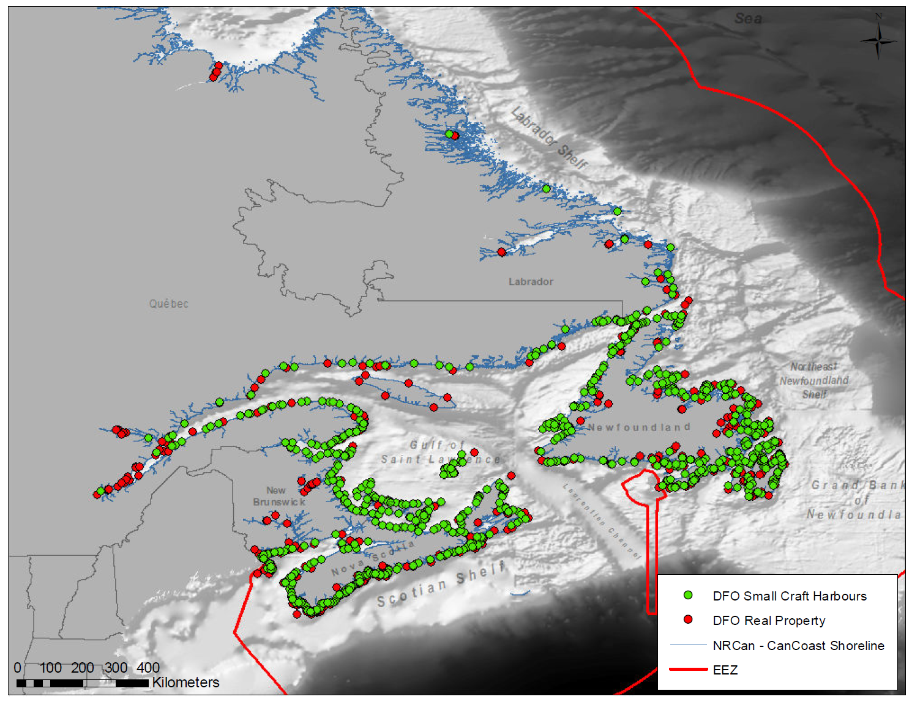
CAN-EWLAT: Canadian Extreme Water Level Adaptation Tool

Slide 30
DFO Small Craft Harbours (SCH) Program
SCH is currently responsible for 1078 commercial fishing harbours.
Together, these harbours include almost 7,000 structures with an estimated replacement cost of $3.7B.
Nearly 90% of all fish landings in Canada, valued at approximately $1.6B annually, occur at small craft harbours.
Notes:
DFO owns and maintains a national system of commercial fishing harbours that provide commercial fish harvesters and other harbour users with safe and accessible facilities
The fishing industry is an important part of the Canadian culture and economy and small craft harbours are crucial to the fishing industry.
SCH provides an important commercial interface as it represents the direct link between oceans and market.
The mandate of SCH is to keep harbours that are critical to the fishing industry open and in good repair.

Slide 31
DFO Small Craft Harbours (SCH) Program
Accumulated rust out of facilities caused by years of deferred repairs and replacement of facilities at core fishing harbours
Annual funding required to keep core harbours in good working condition based on life cycle management principles has been estimated at over $135M
Current budget for repair and maintenance projects is ~$70M annually including ~$10M for dredging
Planning time frame of interest: 10-50 years.
Notes:
Facilities in poor condition are more vulnerable to climate-change
Overcrowding at some harbours is becoming a hazard because:
Traditional fishing patterns are evolving and size of vessels is increasing;
Aquaculture industry is placing increasing demands for basic services on the Program, particularly in Atlantic Canada.
Recent increases in First Nations participation in the commercial fisheries and more transient fisheries have affected the distribution of fishing effort which is causing further congestion at some fishing harbours, especially in Atlantic Canada.

Slide 32
CAN-EWLAT Overview
Objective: Develop a web-based planning tool to accommodate for extreme sea level associated with climate change
This tool will incorporate various data sources (e.g. tide gauge, GPS, models) along the uncertainty in the estimates of future sea level rise
Compute a vertical allowance, which is the amount that infrastructure should be raised above its current height in order to maintain the risk of flooding to be the same as it is today

Slide 33
IPCC AR5 Relative Sea-level Change for periods 1995-2050 and 1995-2099 at Selected Sites for RCP8.5 scenario
Sea Level Station | 1995-2050 |  | 1995-2099
 | Mean (m) | Likely Range (m) | Mean (m) | Likely Range (m)
Churchill | -0.56 | -1.03 to -0.31 | -0.98 | -1.89 to -0.07
Charlottetown | 0.30 | 0.06 to 0.54 | 0.73 | 0.23 to 1.22
Halifax | 0.32 | 0.13 to 0.50 | 0.80 | 0.38 to1.21
North Sydney | 0.34 | 0.13 to 0.55 | 0.82 | 0.36 to 1.28
Rimouski | 0.12 | -0.18 to 0.42 | 0.43 | -0.20 to 1.06
St. John’s | 0.33 | 0.19 to 0.47 | 0.81 | 0.44 to 1.17
Tuktoyaktuk | 0.29 | 0.18 to 0.40 | 0.69 | 0.36 to 1.03
Vancouver | 0.11 | 0.03 to 0.20 | 0.39 | 0.14 to 0.64
Global Mean | 0.30 | 0.22 to 0.38 | 0.63 | 0.45 to 0.82
Notes:
Here we use global mean as reference to compare with regional sea-level change.
In Hudson Bay, SLR is negative.
Along the coast of NS, PEI and southern NFL, SLR is higher than the global mean.
In Beaufort sea, SLR is comparable to the global mean.
Along the BC coast, SLR is lower than global mean.
Uncertainty range is increasing with time and can be as large as the mean values.

Slide 34
Sea-level Allowances for periods 1995-2050 and 1995-2099 for RCP8.5 at Selected Sites
Sea Level Station | Allowance (cm)
 | 1995-2050 | 1995-2099
Churchill | -31 | -5
Charlottetown | 37 | 102
Halifax | 38 | 111
North Sydney | 41 | 115
Rimouski | 29 | 115
St. John’s | 38 | 111
Tuktoyaktuk | 30 | 78
Vancouver | 12 | 49
Notes:
The allowances are negative in Churchill due to the land uplift caused by the GIA effect.
In NS and PEI, southern NFL the allowances in 2050 are slightly larger than the global mean SLR. Towards the end of century, they increase rapidly because the uncertainty range of SLR is getting larger.
on the west coast, allowances are lower than the global mean SLR. Tectonic effect is significant for western Canada, but GIA models do not take into account this effect. Tectonic motions may reduce or increase future allowances.

Slide 35
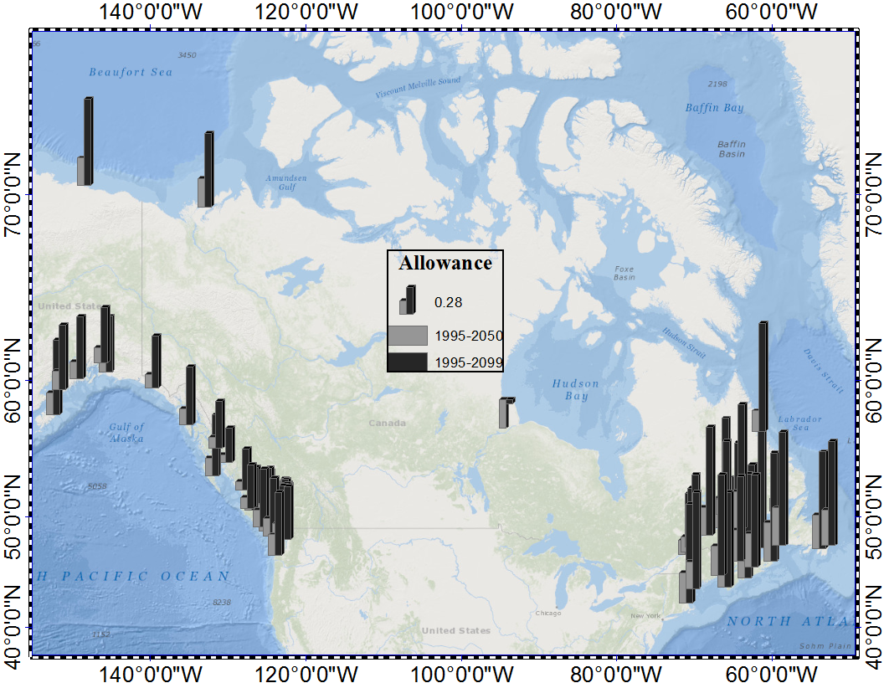
Sea-level Allowances for periods 1995-2050 and 1995-2099 for RCP8.5 at Tide-gauge Sites
Zhai et al, 2014 (DFO Technical Report)
Notes:
This figure shows clearly strong spatial variations of allowances, with larger values in Atlantic Canada than those on the west coast.
It remains challenge to estimate allowances in the Canadian Arctic due to the lack of long-term tide gauge data and difficulty in numerical modelling of storm-surge in this region.

Slide 36
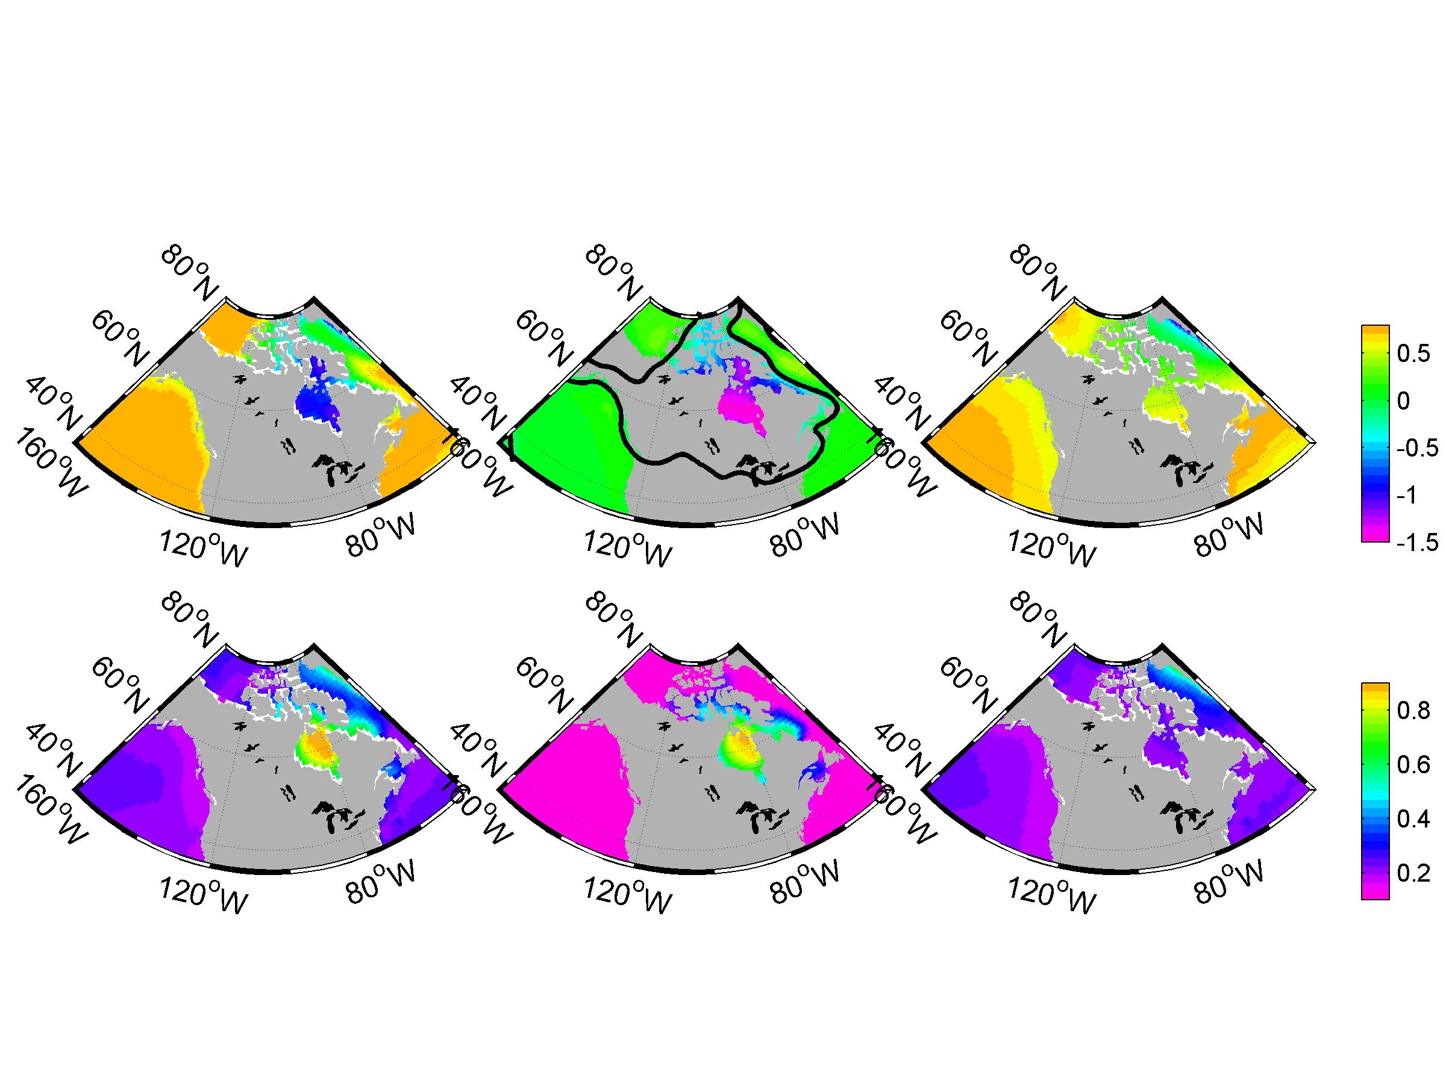
IPCC’s AR5 Projections of Relative Sea-level Change between 1995-2099 for RCP8.5 scenario
Total Sea-level Change
Glacial Isostatic Adjustment (GIA) Contribution
Non GIA Contribution
m
Standard Deviation
SD of GIA
SD of Non GIA m
Notes:
Sea-level change referred in this talk, is measured relative to land.
Left two panels show total sea-level change and associated SD, including effects of steric and dynamic change, inverse barometer, Antarctic and Greenland surface mass balance and dynamic ice, melting glaciers, ground water and GIA.
Middle panels show GIA part of projection at SD. GIA is caused by glaciation at the end of last ice age. Black line represents the hinge between uplift and subsidence.
Right panels show the sea-level change without GIA contribution.
We can see that GIA effect is dominant in Hudson Bay, whereas non-GIA effects are dominant in the rest of the region.
Steric slr caused by the slowdown of AMOC contribute to the large slr in Atlantic Canada.

Slide 37
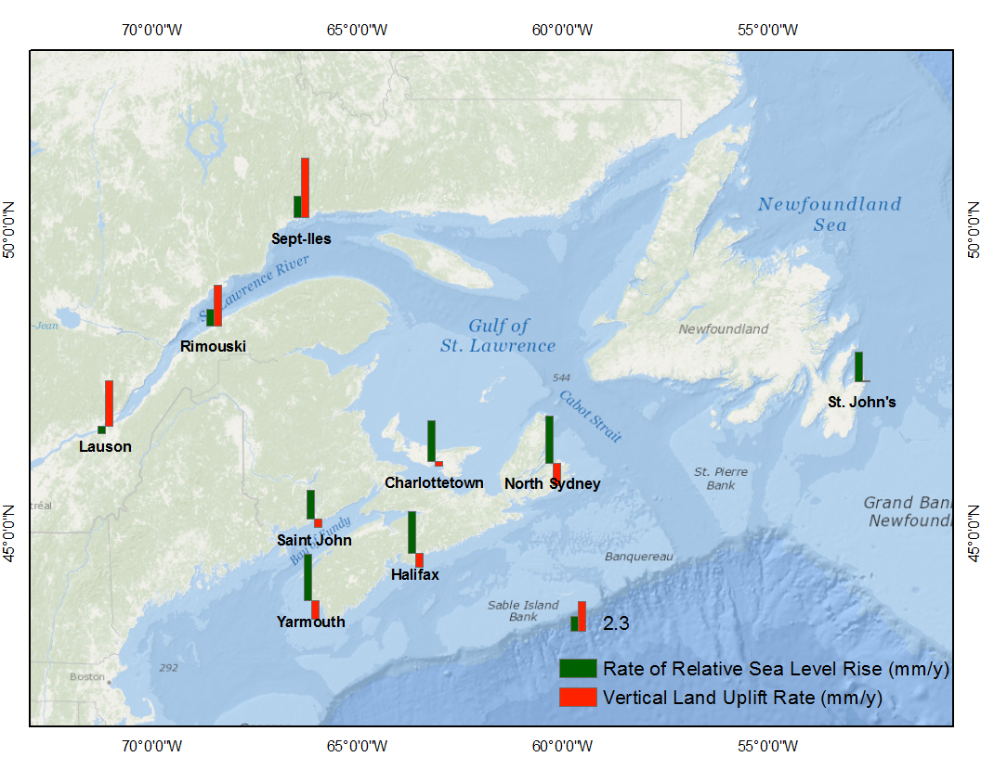
Vertical Land Uplift: Regional Variability (GPS)
Notes:
Blue vertical bars show the rate of relative sea level rise at 9 tide. 3-4 mm/y SLR in NS, about 2 mm/y in NF and NB and about 1 mm/y in the St Lawrence River. Red bars show the rate of vertical land motion, sinking 1 mm/y in NS, is stable in NB and NF, rising 3-4 mm/y in the St Lawrence River.
The average of the sum of the tide gauge and GPS rates is consistent with AR4 estimates of 20th century rate of sea-level rise 2 mm/y.
Most of tide-gauge data show higher rate of SLR than the global averaged rate (1.9 mm/year). The areas in St. Lawrence Esturary and along the north shore of Gulf of St. Lawrence show lower rate of SLR than the global averaged rate due probably to land rising in these region.
The file has a column "SIGMA", which is the formal uncertainty of the linear regression, assuming a coloured noise model, and then a second column "Uncertainty", which includes an estimate of the uncertainty of the terrestrial reference frame realization (0.2 mm/yr scale and 0.5 mm/yr translation) which are added in quadrature (square root of summed squares) to get the final uncertainty. The reference frame errors dominate and nearly all the GPS vertical rates have uncertainties at the 0.5 to 0.6 mm/yr level. The GPS data were processed using the Geodetic Survey Division Precise Point Positioning (PPP) software.

Slide 38
Adjusted GIA – Atlantic Canada Tide Gauge Sites
Zhai et al, 2014 (submitted)
Notes:
Modelled GIA rate based on the AR5 GIA models (Peltier et al., 2004 and Lambeck et al. 1998) versus adjusted GIA rate based on the corrected GPS measurements. Solid line is the regression: <Adjusted GIA rate> = 0.96*<Modelled GIA rate> + 0.47. The error bars in the y direction mark the range of two standard deviations. The error bars in the x direction mark the absolute difference of two GIA models.

Slide 39
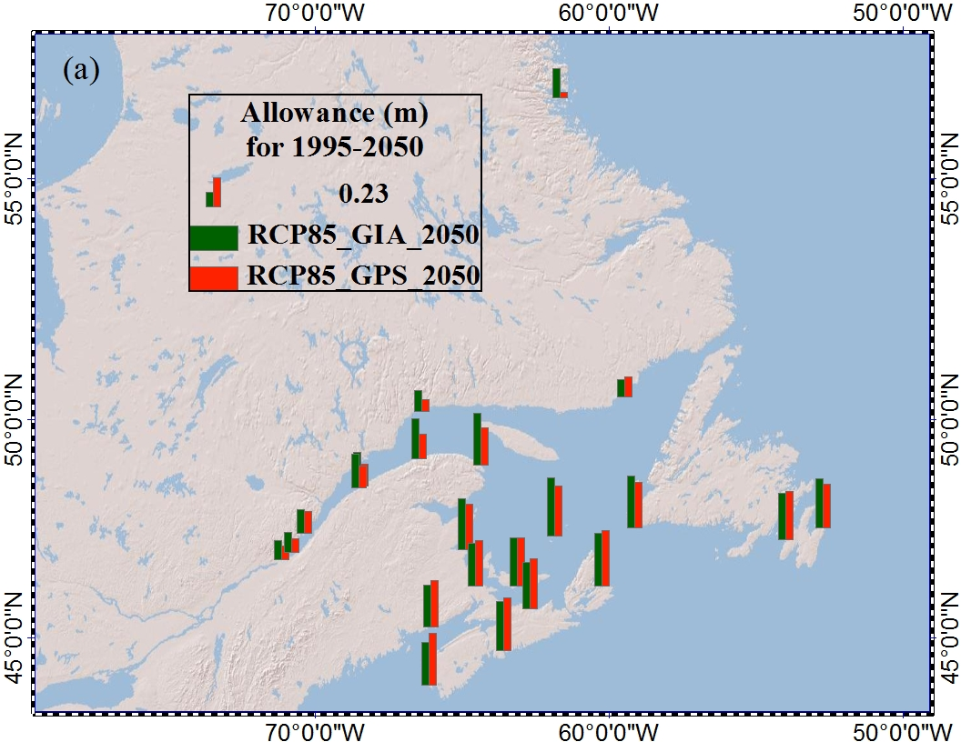
Vertical Allowances for Atlantic Canada
Notes:
It should be noted that in the Bay of Fundy, as the tidal amplitudes will increase with sea-level rise, the allowances would be about 10-30 cm larger than the values given in this study, depending where you are.

Slide 40
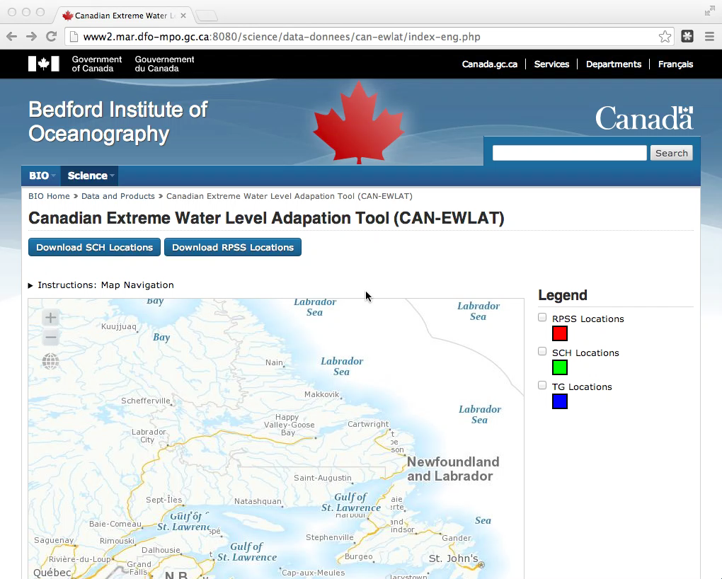

Slide 41
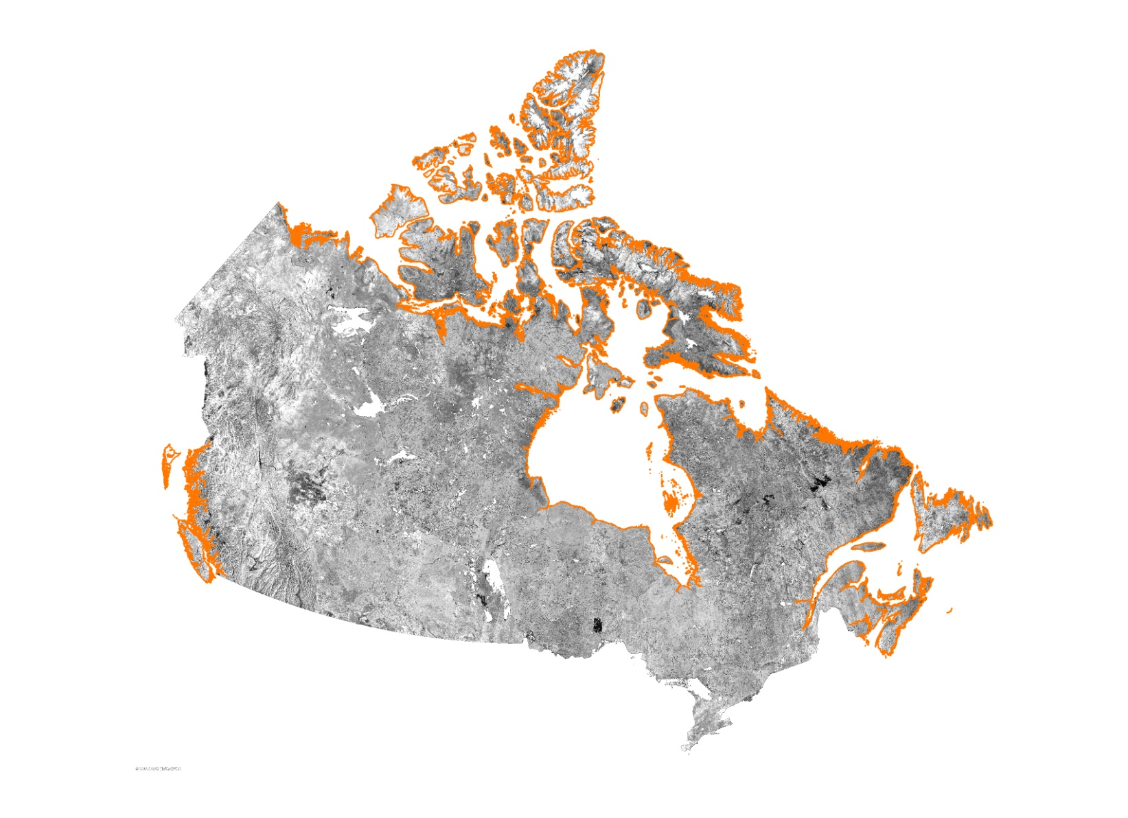

CanCoast – Developing a Coastal Vulnerability Index for Harbour Infrastructure
National scale digital geodatabase
Contains digital coastal data
  Shoreline
  Thematic attribute layers
Multi-purpose
  Assist in climate change adaptation planning
  Improve knowledge of shoreline variability and change
  Identify coastal information and data gaps
  Contribute to sustainable development of marine coasts
  Potential for access to stakeholders
  Support coastal modeling research

Slide 42
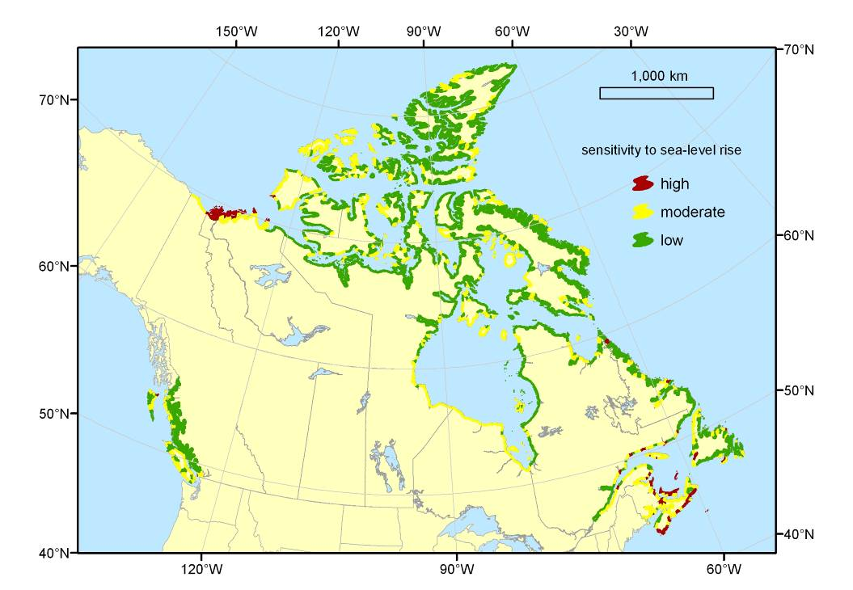
CanCoast – Developing a Coastal Vulnerability Index for Harbour Infrastructure
7 attributes
  Relief
  Rock type
  Landform
  Sea level change
  Shoreline
  displacement
  Tidal range
  Wave heights
Sensitivity to sea level rise (Shaw et al., 1998)
  Values assigned to attributes
  Index created and reclassed to high/medium/low

Slide 43
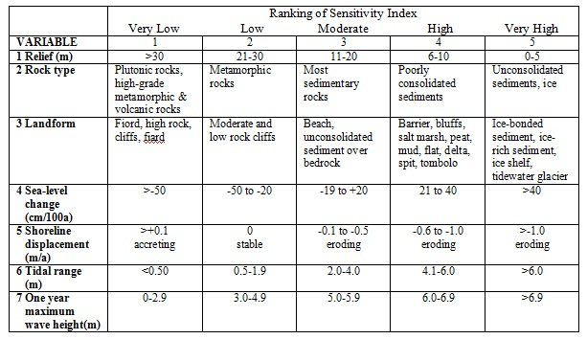
Scoring attributes
Shaw et al. variables scored from 1 = very low → 5= very high
SI = √((a1*a2*a3*a4*a5*a6*a7)/7)

Slide 44
Summary
Global sea level will continue to rise throughout the remainder of this century
There is regional variability in sea level rise in the Atlantic Canada region, due primarily to vertical land motion. Issues remain with GIA models.
DFO ACCASP risk assessment identified infrastructure damage as a result of climate change as an important issue to address in Atlantic Canada
CAN-EWLAT will be a tool to help SCH engineers account for sea level rise – attempting to connect to provincial and municipal planners as well.

