Slide 1
Functional Dependency Network Analysis towards Resilience
MARI and CCPO Seminar
24 Nov 2014

Slide 2
Summary
How network-based functional modeling currently used to describe dependencies when designing, building, and managing engineered systems can be used in resilience to climate change and sea-level rise (CCSLR)

Slide 3
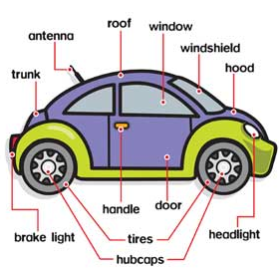
How we see a car

Slide 4
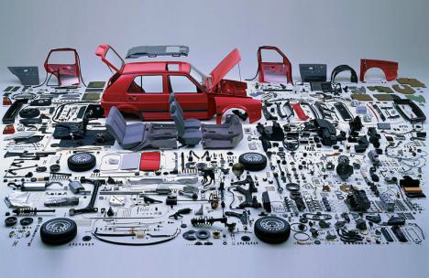
How we see a car
What are its parts

Slide 5
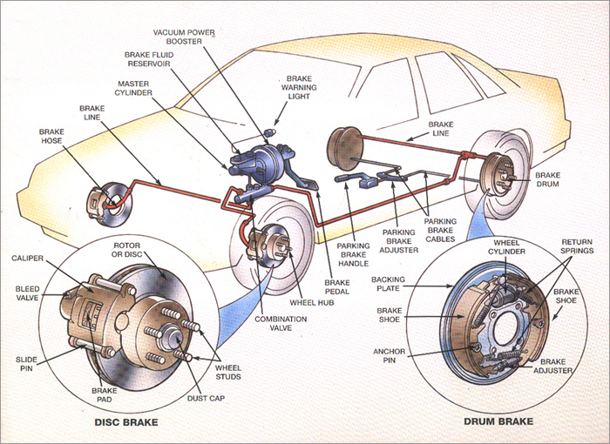
How we see a car
What are its parts
How they work

Slide 6
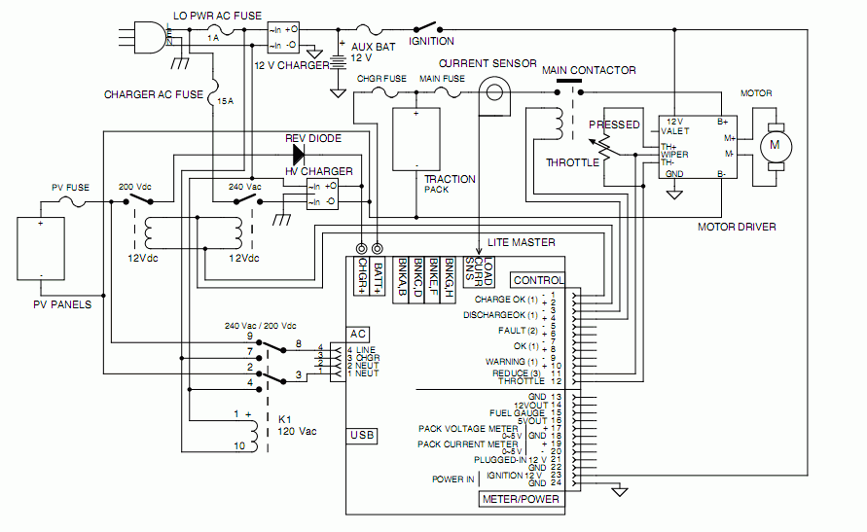
How we see a car
What are its parts
How they work
What are the functions that make them work together

Slide 7
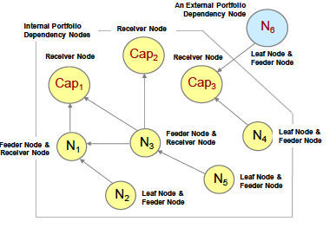
How we see a car
What are its parts
How they work
What are the functions that make them work together
How are these functions (or capabilities) dependent?

Slide 8
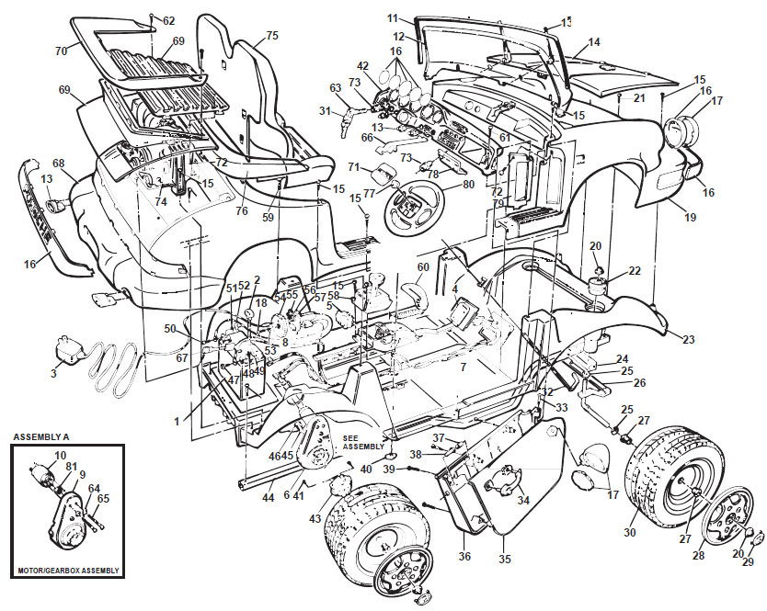
How we see a car
What are its parts
How they work
What are the functions that make them work together
How are these functions (or capabilities) dependent
How will this work better and what parts will be needed

Slide 9
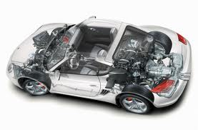
How we see a car
What are its parts
How they work
What are the functions that make them work together
How are these functions (or capabilities) dependent
How will this work better and what parts will be needed
How will the better car look like

Slide 10
What are its parts
How they work
What are the functions that make them work together
How are these functions (or capabilities) dependent
How will this work better and what parts will be needed
Deconstruct
Recognize
Question
Redesign
Reconstruct
How we see a car
How will the better car look like

Slide 11
FDNA
Functional Dependency Network Analysis
https://esd.mit.edu/symp09/presentations/day3.session4c.garvey.pdf
http://www.inderscience.com/info/inarticle.php?artid=60880
What are the functions that make them work together and how they are dependent

Slide 12
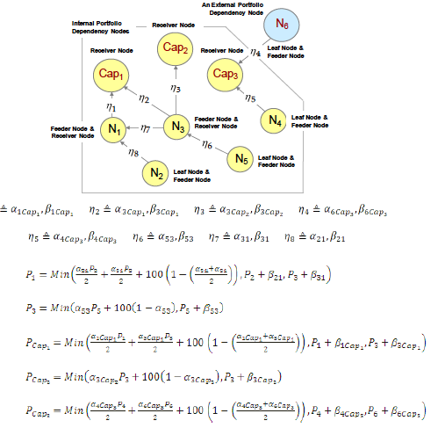
FDNA helps…
…articulate what we know
…recognize what we do not know
…find causalities
…look for alternative ways
…rationalize what is and what can be

Slide 13
FDNA
Functions based on…
mechanical
physical
economic
social
political
legal
…relationships

Slide 14
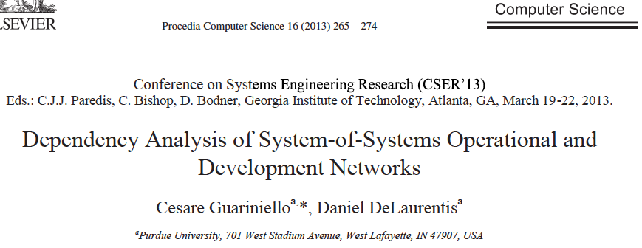
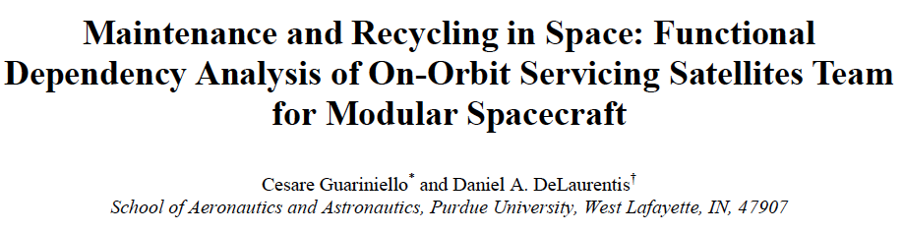
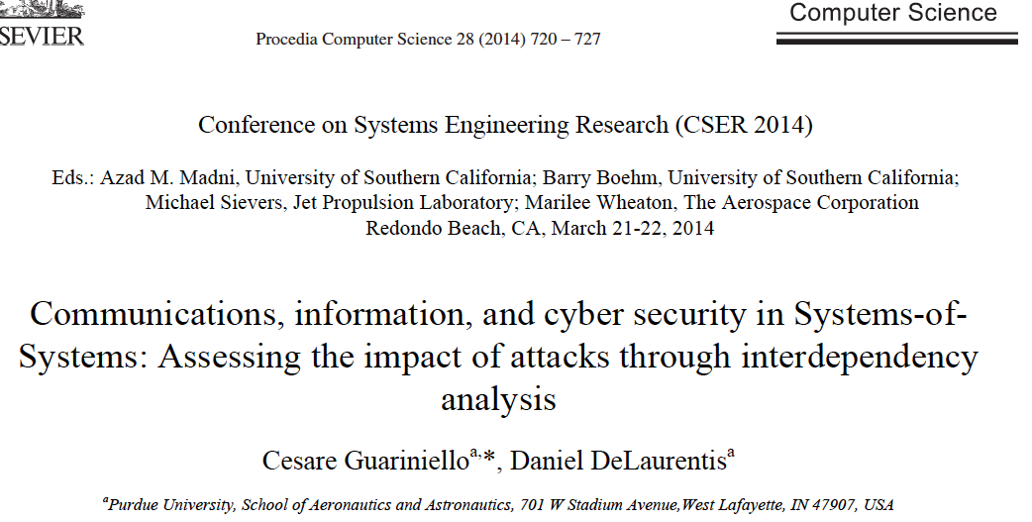

FDNA, recent extensions…

Slide 15
FDNA, extension to CCSLR, flooding
Network-based functional modeling towards resilience as adaptation to flooding [brought by climate change and sea-level rise]

Slide 16
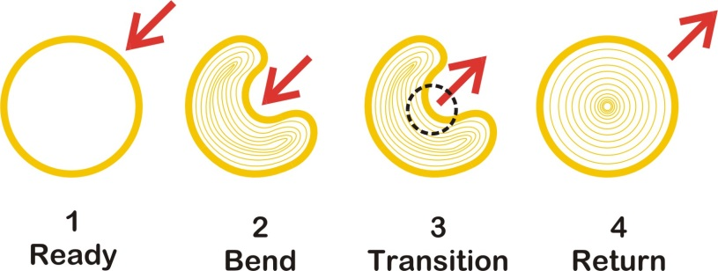
Resilience
Source:
http://www.cultivatingexcellence.com/eChngEbook/S2d/ResilienceDilemma.html

Slide 17
CCSLR
flooding scenario
What we know
How we knew it
Source:
FEMA The Full‐Spectrum Risk Knowledgebase
Flooding Hazard Threat Network
https://riskknowledge.fema.gov

Slide 18
CCSLR
flooding scenario, challenges
There is no grand plan
Structures evolve through time
Invisible constraints
Source:
FEMA The Full‐Spectrum Risk Knowledgebase
Flooding Hazard Threat Network
https://riskknowledge.fema.gov

Slide 19
Model the functions that make them work together and how they are dependent to affect resiliency

Slide 20
Source:
FEMA The Full‐Spectrum Risk Knowledgebase
Flooding Hazard Threat Network
https://riskknowledge.fema.gov

Slide 21
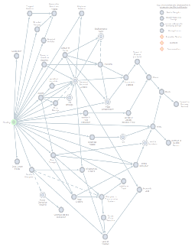
Nodes
Scenarios, elements, and their relationships
Infrastructure closure
Road closure
Traffic disruption
Disruption to transportation systems
Inability to travel
Supply chain disruption
Loss of revenue
Economic loss
Source:
FEMA The Full‐Spectrum Risk Knowledgebase
Flooding Hazard Threat Network
https://riskknowledge.fema.gov

Slide 22
Nodes
Scenarios, elements, and their relationships
Infrastructure closure
Which infrastructure combinations?
Road closure
Which roads?
Traffic disruption
For how long? How severe?
Disruption to transportation systems
Which modes?
Inability to travel
Who/what cannot travel?
Loss of revenue
Which revenue performance aspect?
Due to which cost/revenue shift?
Economic loss
What economic indicators?
Supply chain disruption
Which element of the chain? Why?

Slide 23
Supply (& value) chain disruption
Which element of the chain? Why?

Slide 24
Entrepreneurship
Resilient supply & value chains
Loss control planning & engineering
Business continuity planning

Slide 25
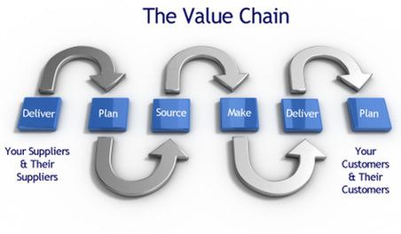
From The Pilot Group
http://www.thepilotgroup.us/valuechainexpertise.html
Deconstruct
Recognize
Question
Redesign
Reconstruct
How will the more resilient supply & value chains look like
How we see supply & value chains

Slide 26
Thank you & Keep dry

