Slide 1
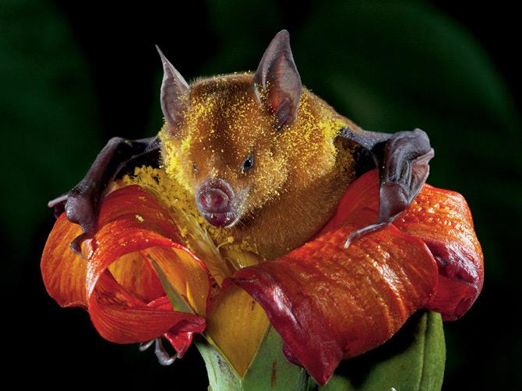
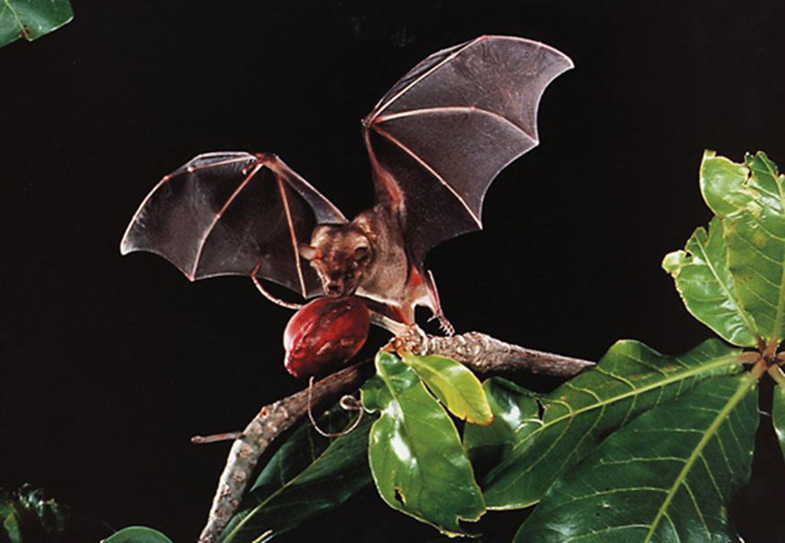
Knowing the Hazards:
Ecosystem services 2
Class 10

Slide 2
Critical Ecosystem Services
Climate and Biogeochemical Cycles
Regulation of Hydrologic Cycle
Soils and Erosion
Biodiversity and Ecosystem Functions
Mobile Links
Balance of Diseases Transmission

Slide 3
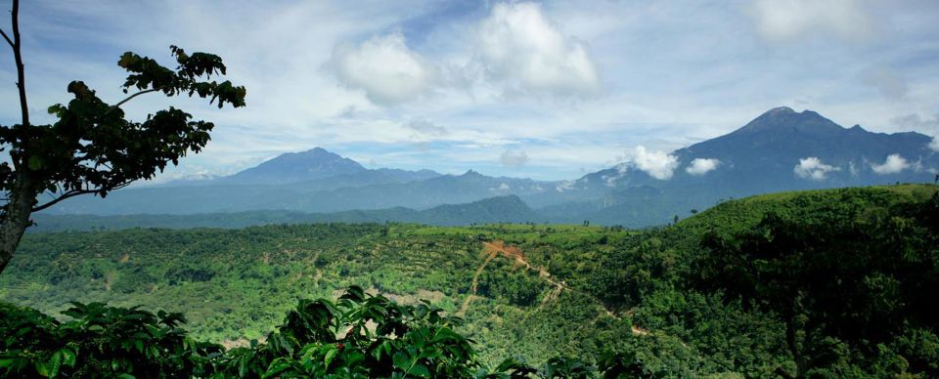
Biodiversity and Ecosystem Function
Increased biodiversity improves ecosystem functioning in plant communities (Naeem and Li 1997; Tilman 1997)→ different plant species capture different resources, leading to greater efficiency and higher productivity (Tilman et al. 1996).
More biodiverse ecosystems are likely to be more stable and more efficient due to the presence of more pathways for energy flow and nutrient recycling.
Diversity is thought to stabilize overall ecosystem functioning (Chapin et al. 2000; Tilman 1996) and make the ecosystem more resistant to perturbations (Pimm 1984).

Slide 4
Interactions between Biodiversity, Ecosystem Services, Human Well-being, and Drivers of Change
Biodiversity is both, a response variable affected by global change drivers and a factor modifying ecosystem processes & services and human well-being

Slide 5
Main Drivers Impact on Biodiversity
Changes in biodiversity and in ecosystems are almost always caused by multiple, interacting drivers.
The Living Planet Index currently incorporates data on the abundance of 555 terrestrial spp, 323 freshwater spp, and 267 marine spp around the world.
While the index fell by some 40% between 1970 and 2000, the terrestrial index fell by about 30%, the freshwater index by about 50%, and the marine index by around 30% over the same period.

Slide 6
Main Drivers Impact on Biodiversity
Causes for biodiversity lost are changing

Slide 7
Climate Change impact on Biodiversity
Climate change is projected to exacerbate the loss of biodiversity and increase the risk of extinction for many species, especially those already at risk due to factors such as low population numbers, restricted or patchy habitats, and limited climatic ranges (medium to high certainty).
Water availability and quality are projected to decrease in many arid and semiarid regions (high certainty).
The risk of floods and droughts is projected to increase (high certainty).
The biomass production is projected to decrease in some regions (high certainty).
Agricultural productivity is projected to decrease in the tropics and sub-tropics for almost any amount of warming (low to medium certainty), and there are projected adverse effects on fisheries.
Projected changes in climate during XXI century are very likely to be without precedent during at least the past 10,000 years and, combined with land use change and the spread of exotic or alien species, are likely to limit both the capability of species to migrate and the ability of species to persist in fragmented habitats.

Slide 8
Critical Ecosystem Services
Climate and Biogeochemical Cycles
Regulation of Hydrologic Cycle
Soils and Erosion
Biodiversity and Ecosystem Functions
Mobile Links
Balance of Diseases Transmission

Slide 9
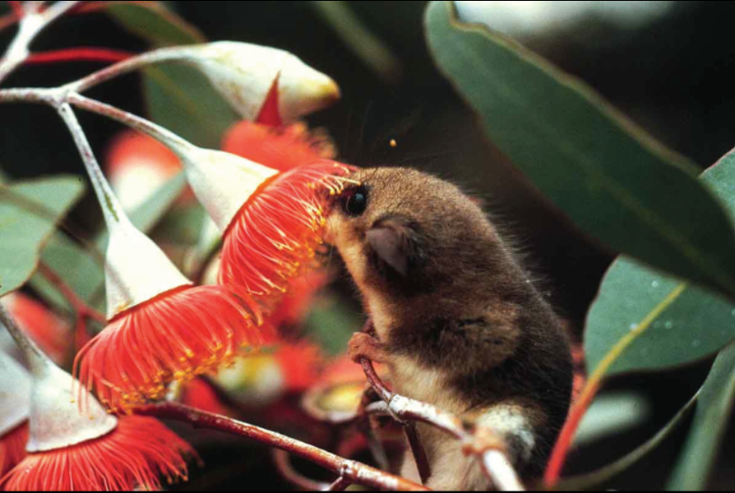
Mobile Links
“Mobile links” are animal species that provide critical ecosystem services and increase ecosystem resilience by connecting habitats and ecosystems as they move between them (Gilbert 1980; Lundberg and Moberg 2003)
Ecosystems connections via:
  Gene flow
    Pollinators and dispersers
  Processes
    Trophic process: pray-predator, scavengers-infected carcasses
    Nutrient process: nutrient in animals and birds droppings
    Physical processes (ecosystem engineers): beavers, woodpeckers
  Resource links
    Long-distance migration

Slide 10
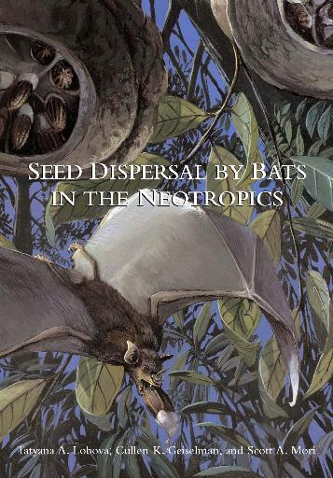
Seed Dispersal
Seed dispersal is thought to benefit plants in three major ways (Howe and Smallwood 1982):
Escape from density-dependent mortality caused by pathogens, seed predators, competitors, and herbivores (Janzen-Connell escape hypothesis)
Chance colonization of favorable but unpredictable sites via wide dissemination of seeds.
Directed dispersal to specific sites that are particularly favorable for establishment and survival.

Slide 11
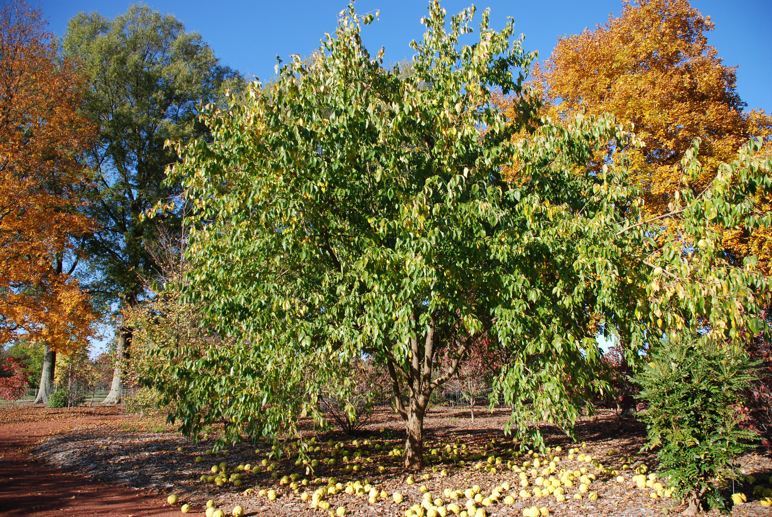
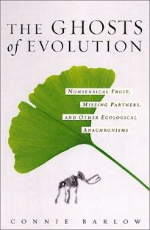
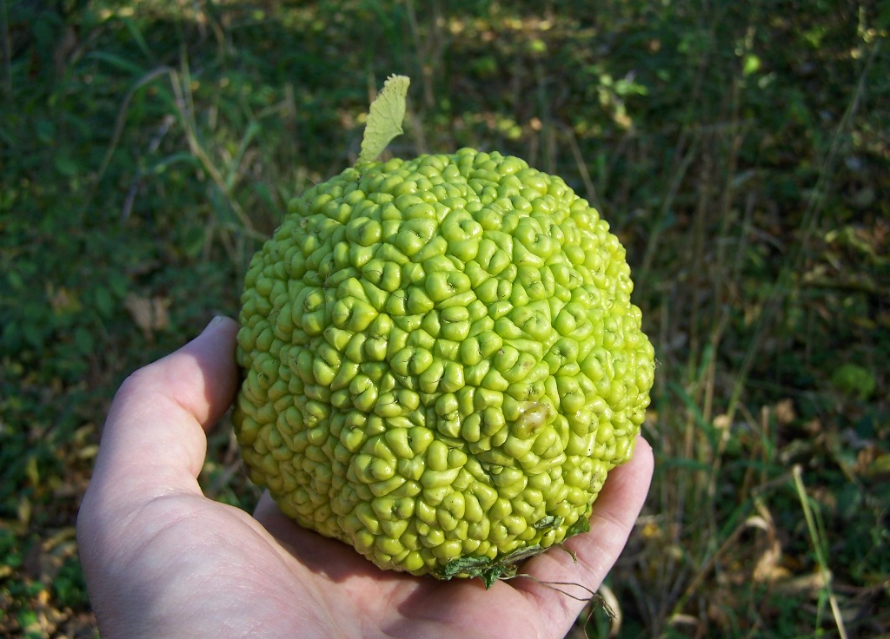
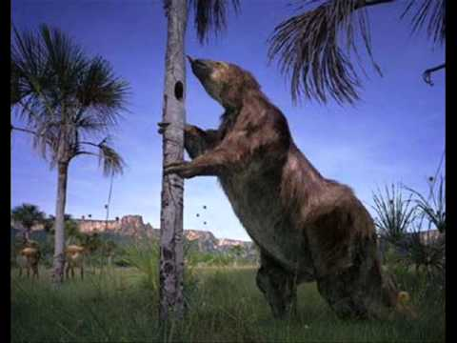
Missing Seed Dispersers
Overhunting
Loss of habitat
Habitat fragmentation
Loss of Biodiversity
Poor Forest Regeneration
Osage-orange

Slide 12
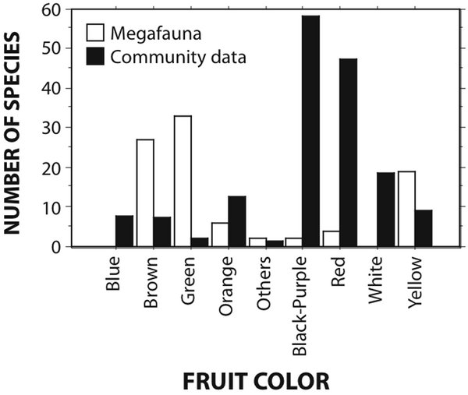
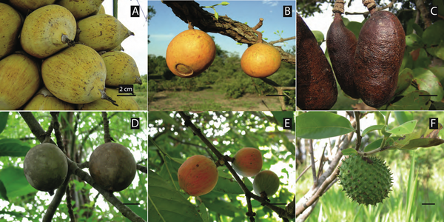

Missing Seed Dispersers
Frequency of megafauna species with different fruit colors (blank bars) compared to the summed frequency in different communities (filled bars).
Fleshy fruited megafaunal-dependent species illustrating size, shape, and color variation.
Guimarães PR Jr, Galetti M, Jordano P (2008) Seed Dispersal Anachronisms: Rethinking the Fruits Extinct Megafauna Ate. PLoS ONE 3(3): e1745. doi:10.1371/journal.pone.0001745
http://journals.plos.org/plosone/article?id=info:doi/10.1371/journal.pone.0001745

Slide 13
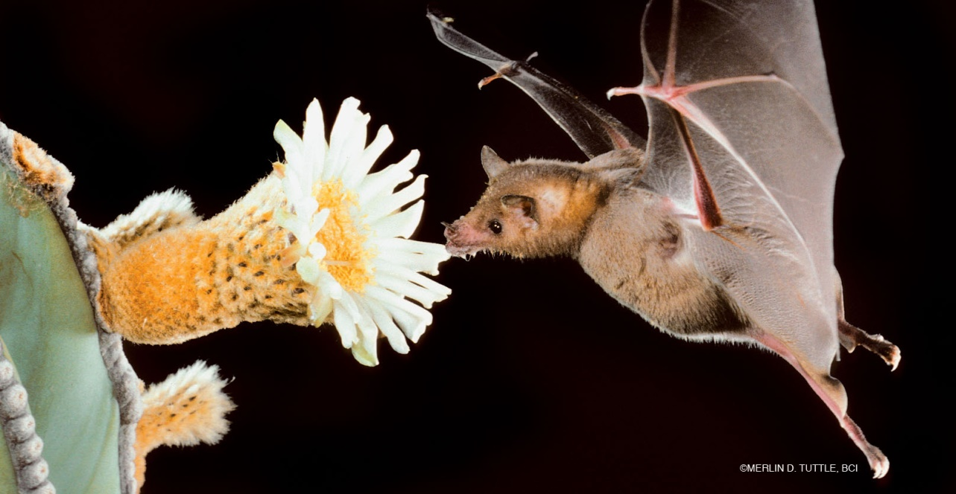
Pollination
98% of tropical trees are animal pollinated
More than 1,200 vertebrate and about 289,000 invertebrate spp are involved in pollinating over 90% of flowering plant spp and 95% of food crops (Nabhan and Buchmann 1997).
75% of globally important crops rely on animal pollinators, providing up to 35% of crop production (Klein et al. 2007)

Slide 14
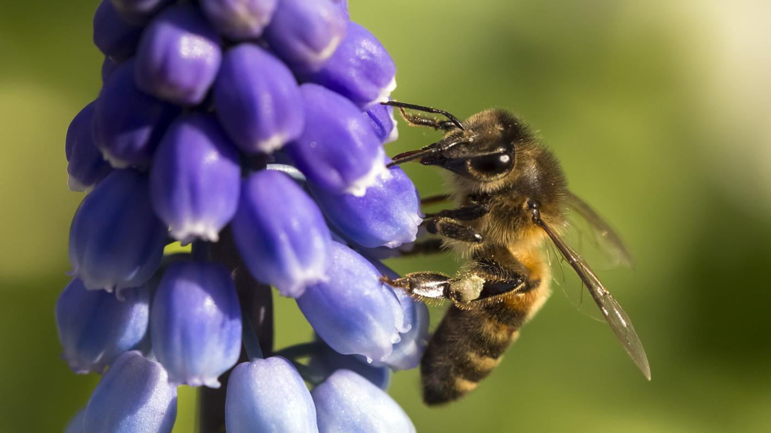
Pollination
Plants are more likely to be pollinator-limited than disperser-limited (Kelly et al. 2004)
Survey of pollination experiments for 186 spp showed that about half were pollinator-limited (Burd 1994).
Compared to seed dispersal, pollination is more demanding due to the faster ripening rates and shorter lives of flowers (Kelly et al. 2004).

Slide 15
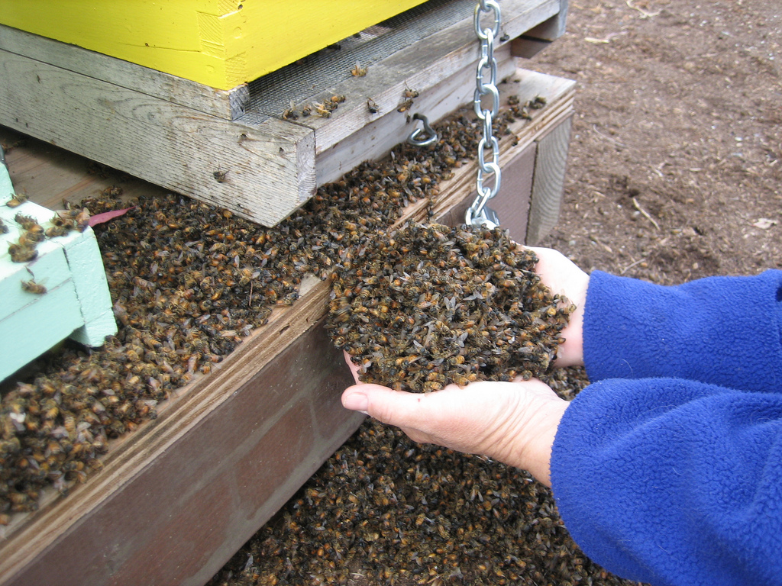
Missing Pollinators
Habitat Loss
Habitat modification
Pesticides
Extreme risk of relying on a single pollinator for crops
Bees pollinate 2/3 of flowering plant spp and ¾ of food crops, that provide us with dietary diversity

Slide 16
Mobile Links
“Mobile links” are animal species that provide critical ecosystem services and increase ecosystem resilience by connecting habitats and ecosystems as they move between them (Gilbert 1980; Lundberg and Moberg 2003)
Protection of mobile links should be a top conservation priority to prevent collapses in ecosystem services:
  Seed dispersers,
  Pollinators,
  Scavengers,
  Predators
  Nutrient depositors

Slide 17
Critical Ecosystem Services
Climate and Biogeochemical Cycles
Regulation of Hydrologic Cycle
Soils and Erosion
Biodiversity and Ecosystem Functions
Mobile Links
Balance of Diseases Transmission

Slide 18
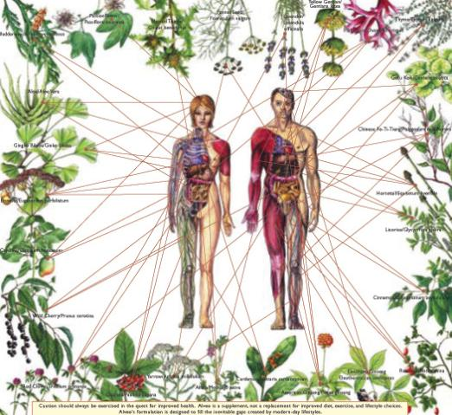
Nature heals and hurts
40% of our prescription medicine comes from plants
Of the 3,000 plants identified by the US National Cancer Institute as active against cancer cells, 70% come from rainforests
The planet’s organisms also include countless diseases, many of which are making the transition to humans as people increasingly invade the habitats of the hosts of these diseases and consume the hosts themselves.
¾ of human diseases might have origin in domestic or wild animals
Monkeypox, malaria, HIV and Ebola have came from African primates to people that killed, butchered and consumed them

Slide 19
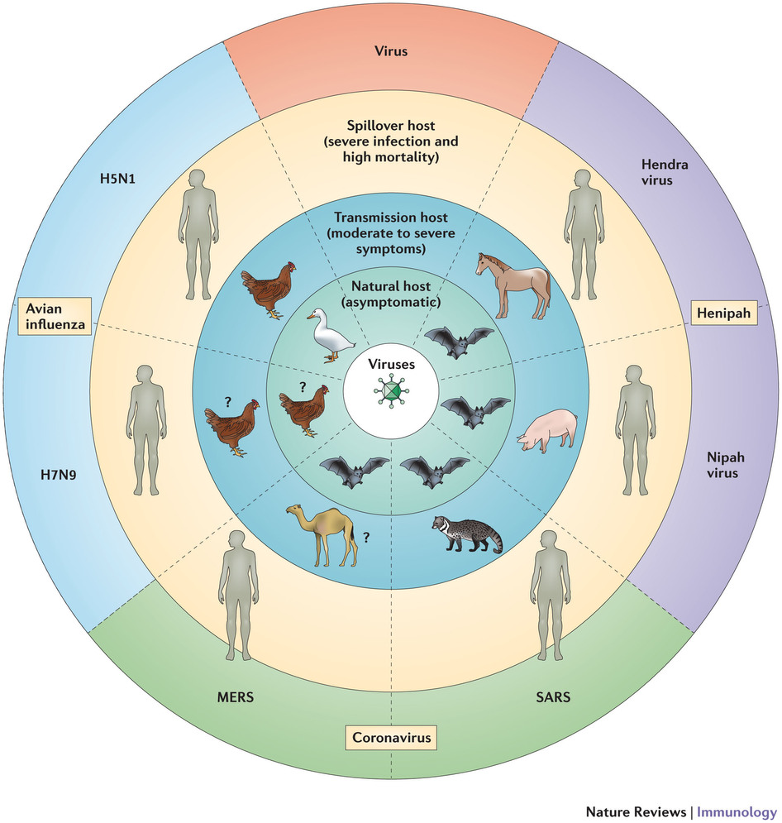
Zoonotic Diseases
Zoonotic Diseases are diseases that can be passed between animals and humans. Viruses, bacteria, parasites, and fungi can cause zoonotic diseases.

Slide 20
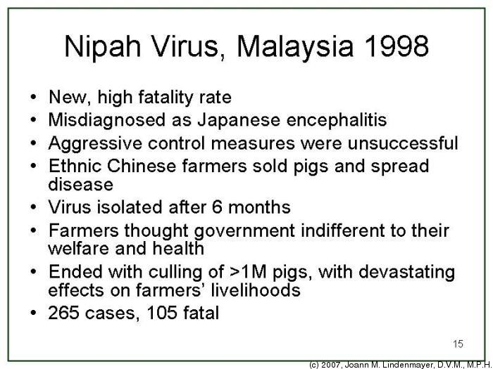
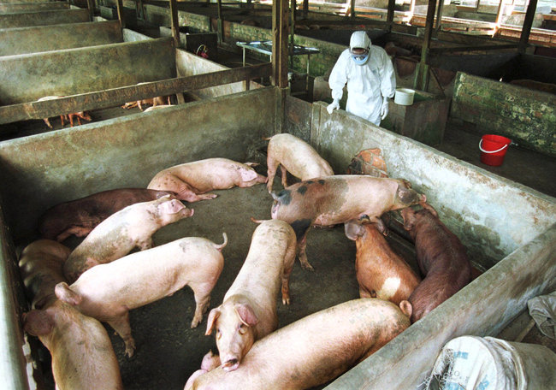
Emerging Diseases: Nipah

Slide 21
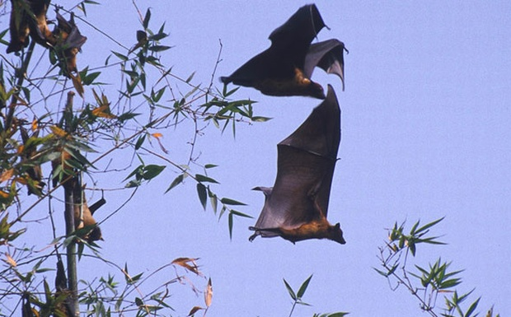
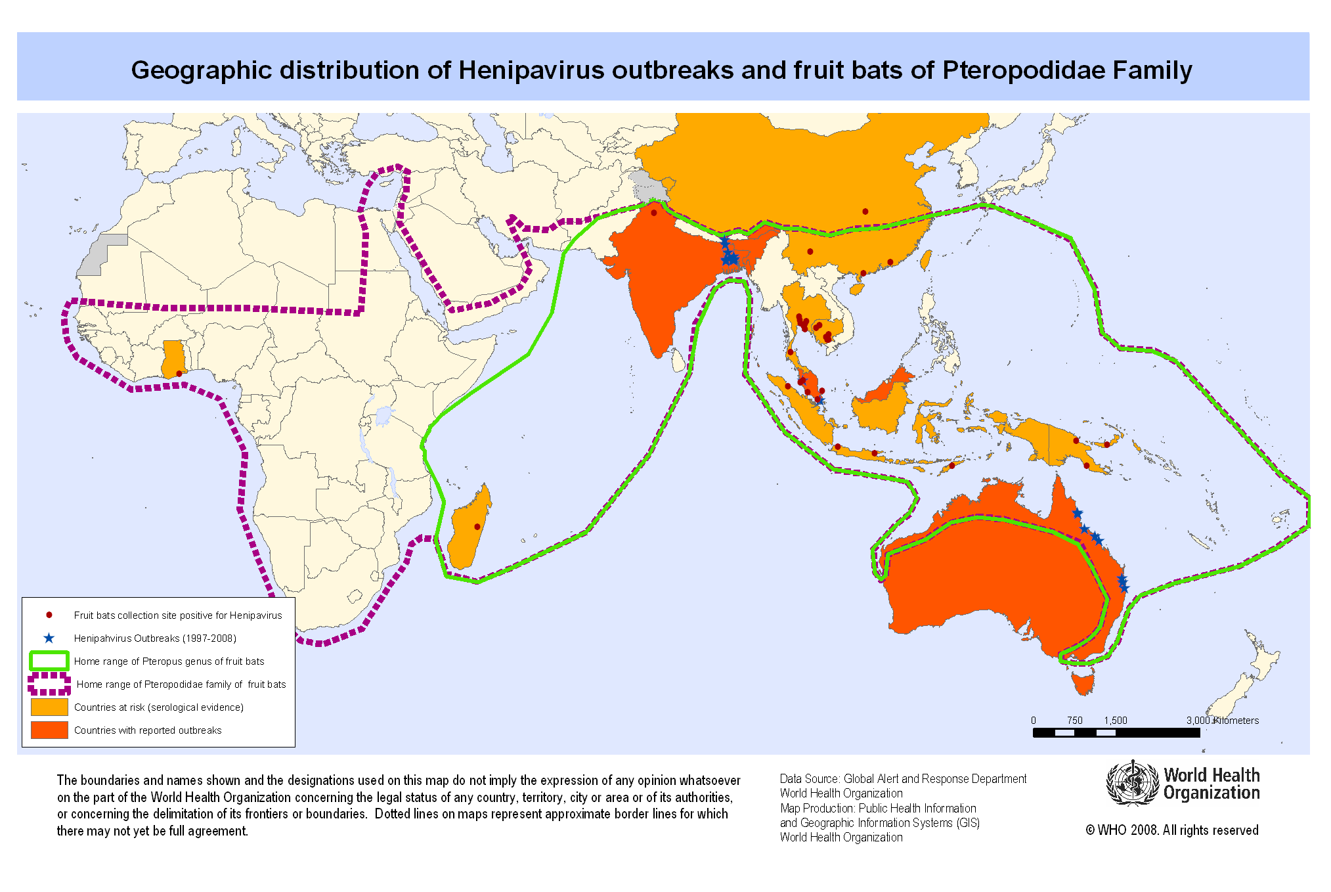
Emerging Diseases: Nipah
Massive forest fires in 1997-1998 in SE Asia → forest destruction and smoke → forced fruit bats to feed on fruiting orchards, mainly mangoes → pigs were farmed among the fruiting trees and ate mangoes from the ground → bats are hosts to Nipah virus → passed to pigs → passed to people (Chivian, 2002)

Slide 22

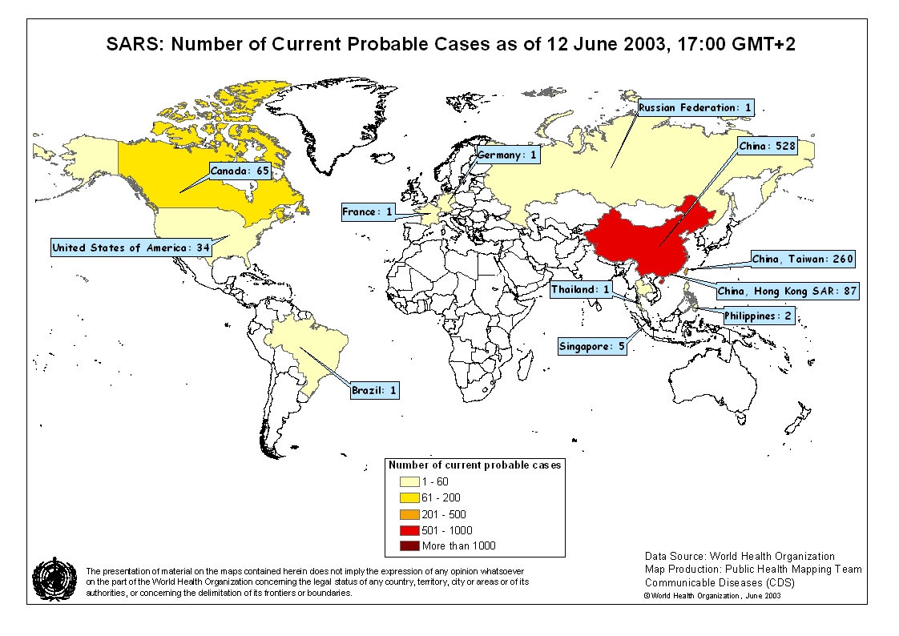
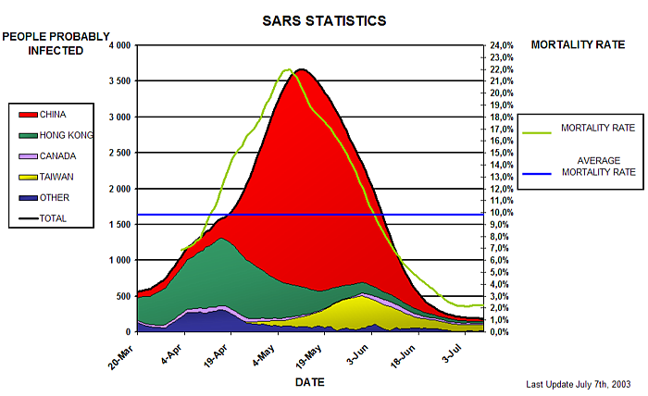
Emerging Diseases: SARS

Slide 23
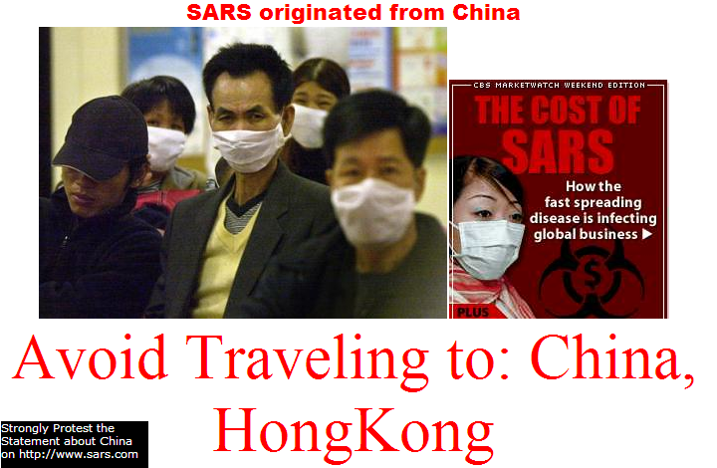
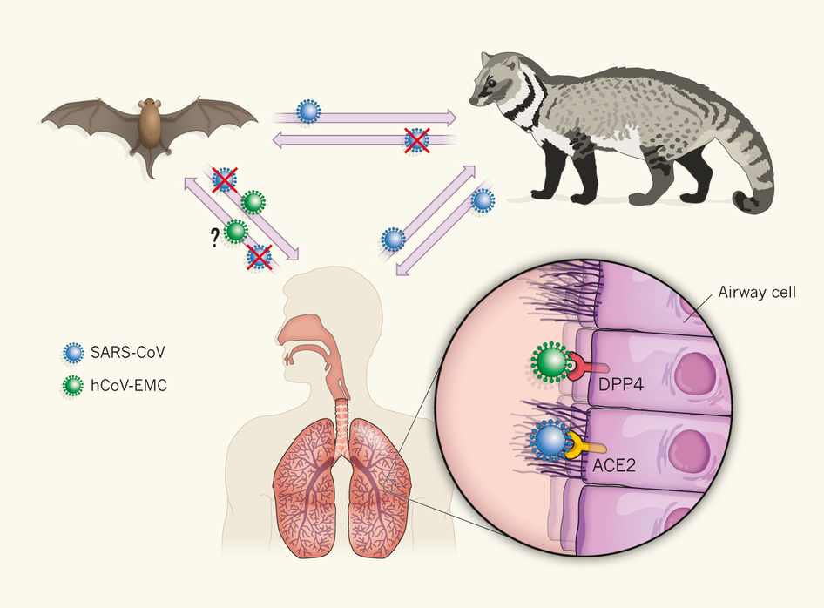
Emerging Diseases: SARS
Fruit bats are native hosts → partially eaten fruits → wild frugivorous animals, like civets and raccoon dogs → passed to other animals in wildlife market → people eat wild animals

Slide 24
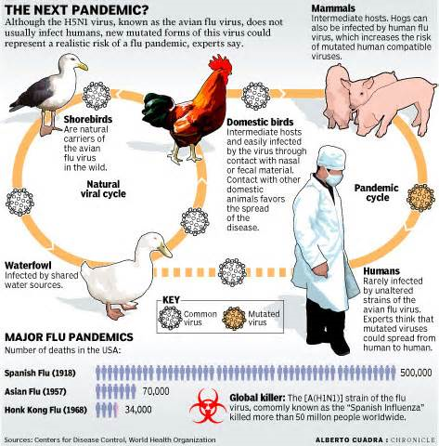
Emerging Diseases: Avian Flu
WHO data indicate 60% of cases classified as H5N1 resulted in death

Slide 25
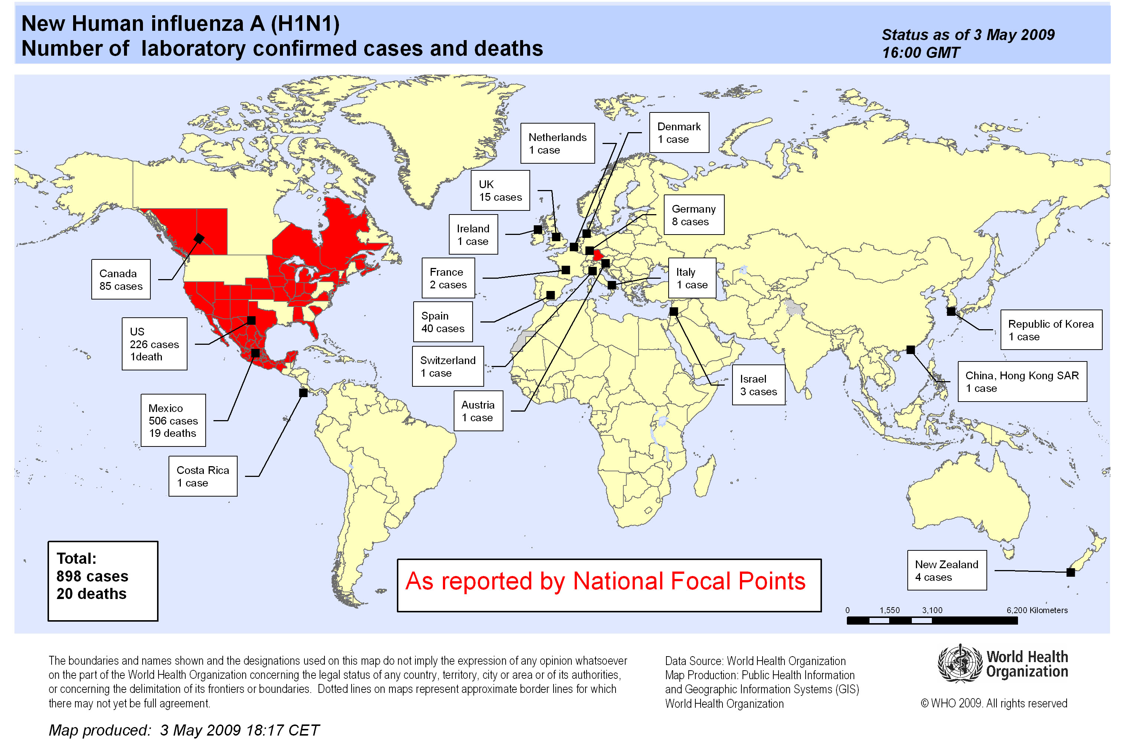
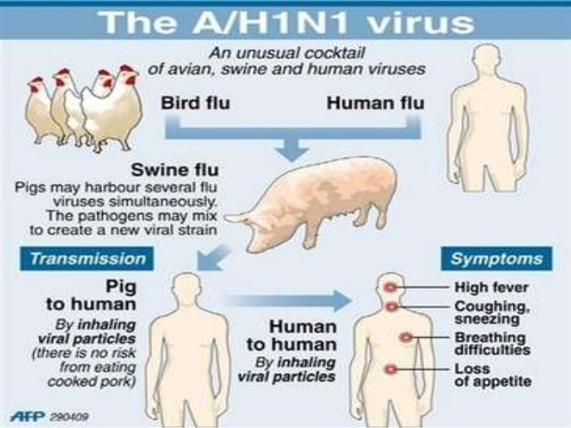
Emerging Diseases: Swine Flu
Declared a pandemic in 2009 →May 30, 2010 more than 214 countries and overseas territories have confirmed cases and over 18,138 deaths (WHO) → vaccination in 2010

Slide 26
Zoonotic Diseases
Tropical deforestation, combined with
climate change, human migration, agricultural intensification, and animal trafficking create the perfect storm for the emergence of new diseases as well as the resurgence of old ones.
In the face of rapid global change, ecologically intact and relatively
stable communities may be our best weapon against the emergence of new diseases.

