Slide 1

Leaving the “Safe Operating Space”

Slide 2
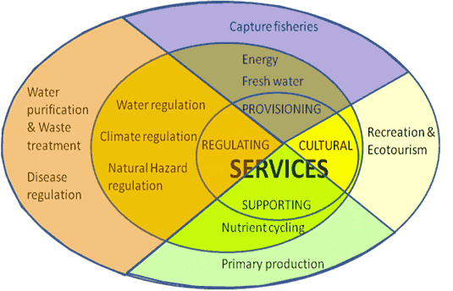
We rely on ecosystem services
Natural resources are “goods” produced by nature
Earth’s natural systems provide “services” to us
Ecosystem services: arise from the normal functioning of natural services and allow us to survive = the set of ecosystem functions that are useful for humans
Purify air and water, cycle nutrients, regulate climate
Pollinate plants
Receive and recycle wastes

Slide 3
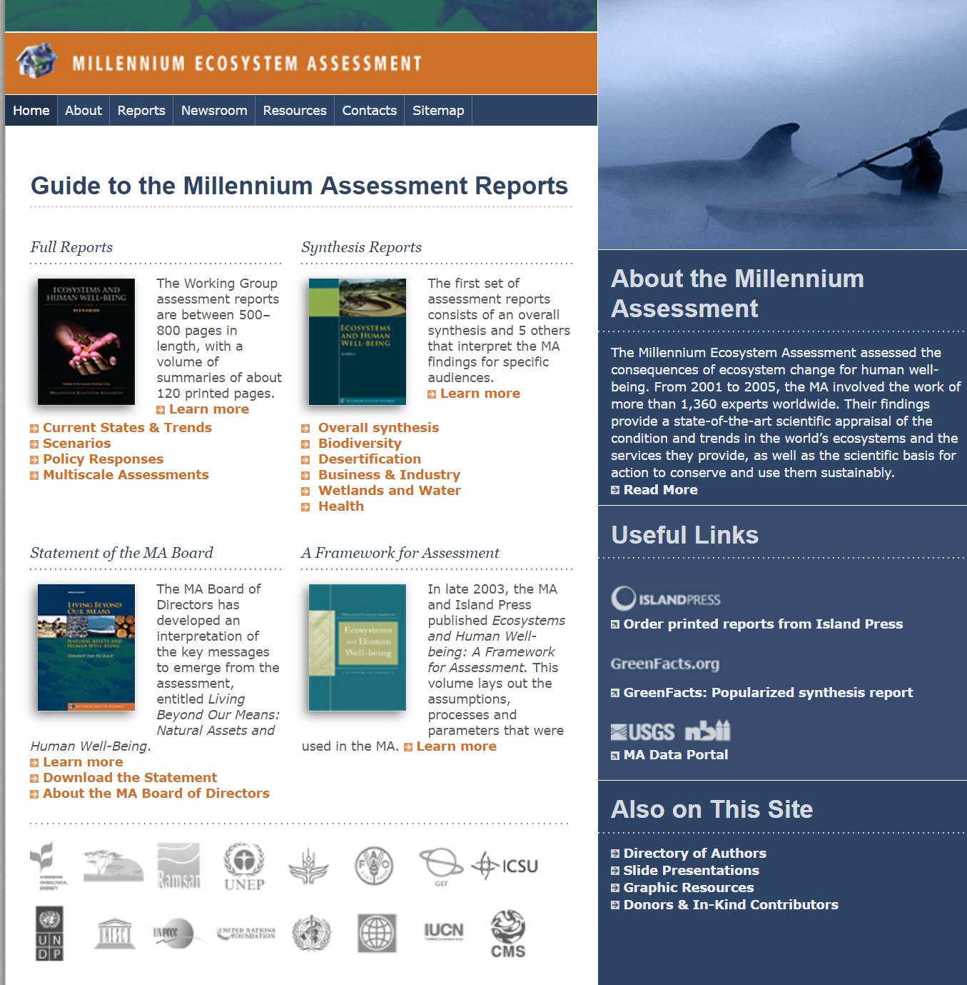

Slide 4
What are the main findings of MA?
Over the past 50 years, humans have changed ecosystems more rapidly and extensively than in any period of time in human history, largely to meet rapidly growing demands for food, fresh water, timber, fiber and fuel. This has resulted in a substantial and largely irreversible loss in the diversity of life on Earth.
The changes that have been made to ecosystems have contributed to substantial net gains in human well-being and economic development, but these gains have been achieved at growing costs in the form of the degradation of many ecosystem services, increased risks of nonlinear changes, and the exacerbation of poverty for some groups of people. These problems, unless addressed, will substantially diminish the benefits that future generations obtain from ecosystems.
The degradation of ecosystem services could grow significantly worse during the first half of this century and is a barrier to achieving the Millennium Development Goals.
The challenge of reversing the degradation of ecosystem while meeting increasing demands for services can be partially met under some scenarios considered by the MA, but will involve significant changes in policies, institutions and practices that are not currently under way. Many options exist to conserve or enhance specific ecosystem services in ways that reduce negative trade-offs or that provide positive synergies with other ecosystem services.
The bottom line of the MA findings is that human actions are depleting Earth’s natural capital, putting such strain on the environment that the ability of the planet’s ecosystems to sustain future generations can no longer be taken for granted. At the same time, the assessment shows that with appropriate actions it is possible to reverse the degradation of many ecosystem services over the next 50 years, but the changes in policy and practice required are substantial and not currently underway.

Slide 5
What’s new?
The balance sheet.
60% of a group of 24 ecosystem services are being degraded.
Nonlinear changes (accelerating or abrupt) .
Ecosystem changes are increasing the likelihood of nonlinear changes in ecosystems. Examples include disease emergence, abrupt alterations in water quality, the creation of “dead zones” in coastal waters, the collapse of fisheries, and shifts in regional climate.
Drylands.
While major problems exist with tropical forests and coral reefs, from the standpoint of linkages between ecosystems and people, the most significant challenges involve dryland ecosystems. These ecosystems are particularly fragile, but they are also the places where human population is growing most rapidly, biological productivity is least, and poverty is highest.
Nutrient loading.
Excessive nutrient loading of ecosystems is one of the major drivers today and will grow significantly worse in the coming decades unless action is taken. The issue of excessive nutrient loading, although well studied, is not yet receiving significant policy attention in many countries or internationally.

Slide 6
Critical Ecosystem Services
Climate and Biogeochemical Cycles
Regulation of Hydrologic Cycle
Soils and Erosion
Biodiversity and Ecosystem Functions
Mobile Links
Balance of Diseases Transmission

