Slide 1
Degradation of the Earth's Life-Support System
Class 6
Content:
Crossing the Planetary Boundaries
The Life-Support System: Ecosystem Services, Essential Biogeochemical Cycles and Feedback Loops

Slide 2

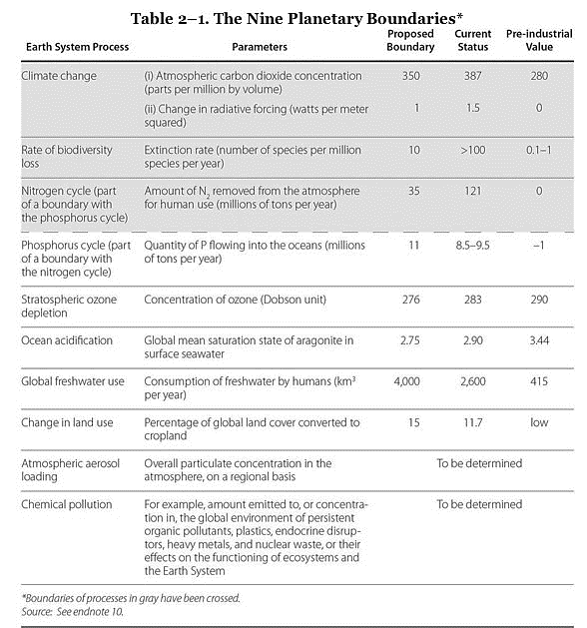
Leaving the “Safe Operating Space”
Rockstrom and Klum, 2015

Slide 3
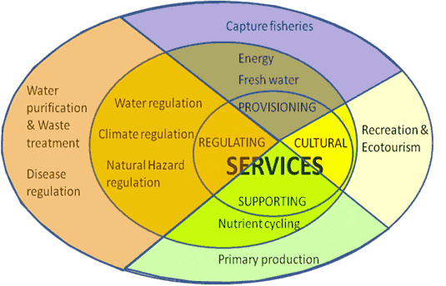
We rely on ecosystem services
Natural resources are “goods” produced by nature
Earth’s natural systems provide “services” to us
Ecosystem services: arise from the normal functioning of natural services and allow us to survive = the set of ecosystem functions that are useful for humans
  Purify air and water, cycle nutrients, regulate climate
  Pollinate plants
  Receive and recycle wastes

Slide 4


Slide 5
What are the main findings of MA?
Over the past 50 years, humans have changed ecosystems more rapidly and extensively than in any period of time in human history, largely to meet rapidly growing demands for food, fresh water, timber, fiber and fuel. This has resulted in a substantial and largely irreversible loss in the diversity of life on Earth.
The changes that have been made to ecosystems have contributed to substantial net gains in human well-being and economic development, but these gains have been achieved at growing costs in the form of the degradation of many ecosystem services, increased risks of nonlinear changes, and the exacerbation of poverty for some groups of people. These problems, unless addressed, will substantially diminish the benefits that future generations obtain from ecosystems.
The degradation of ecosystem services could grow significantly worse during the first half of this century and is a barrier to achieving the Millennium Development Goals.
The challenge of reversing the degradation of ecosystem while meeting increasing demands for services can be partially met under some scenarios considered by the MA, but will involve significant changes in policies, institutions and practices that are not currently under way. Many options exist to conserve or enhance specific ecosystem services in ways that reduce negative trade-offs or that provide positive synergies with other ecosystem services.
The bottom line of the MA findings is that human actions are depleting Earth’s natural capital, putting such strain on the environment that the ability of the planet’s ecosystems to sustain future generations can no longer be taken for granted. At the same time, the assessment shows that with appropriate actions it is possible to reverse the degradation of many ecosystem services over the next 50 years, but the changes in policy and practice required are substantial and not currently underway.

Slide 6
What’s new?
The balance sheet.
  60% of a group of 24 ecosystem services are being degraded.
Nonlinear changes (accelerating or abrupt).
  Ecosystem changes are increasing the likelihood of nonlinear changes in ecosystems. Examples include disease emergence, abrupt alterations in water quality, the creation of “dead zones” in coastal waters, the collapse of fisheries, and shifts in regional climate.
Drylands.
  While major problems exist with tropical forests and coral reefs, from the standpoint of linkages between ecosystems and people, the most significant challenges involve dryland ecosystems. These ecosystems are particularly fragile, but they are also the places where human population is growing most rapidly, biological productivity is least, and poverty is highest.
Nutrient loading.
  Excessive nutrient loading of ecosystems is one of the major drivers today and will grow significantly worse in the coming decades unless action is taken. The issue of excessive nutrient loading, although well studied, is not yet receiving significant policy attention in many countries or internationally.

Slide 7
Critical Ecosystem Services
Climate and Biogeochemical Cycles
Regulation of Hydrologic Cycle
Soils and Erosion
Biodiversity and Ecosystem Functions
Mobile Links
Balance of Diseases Transmission

Slide 8
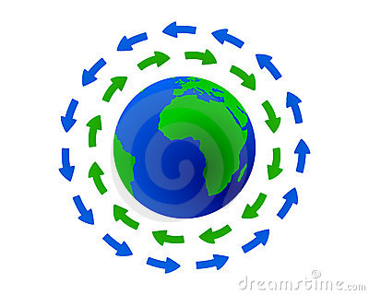
Critical Ecosystem Services
Biogeochemical Cycles = “the
transport and transformation of substances in
the environment through life, air, sea, land, and
ice” (Alexander et al. 1997)
Carbon cycle
Nitrogen cycle
Phosphorus cycle

Slide 9
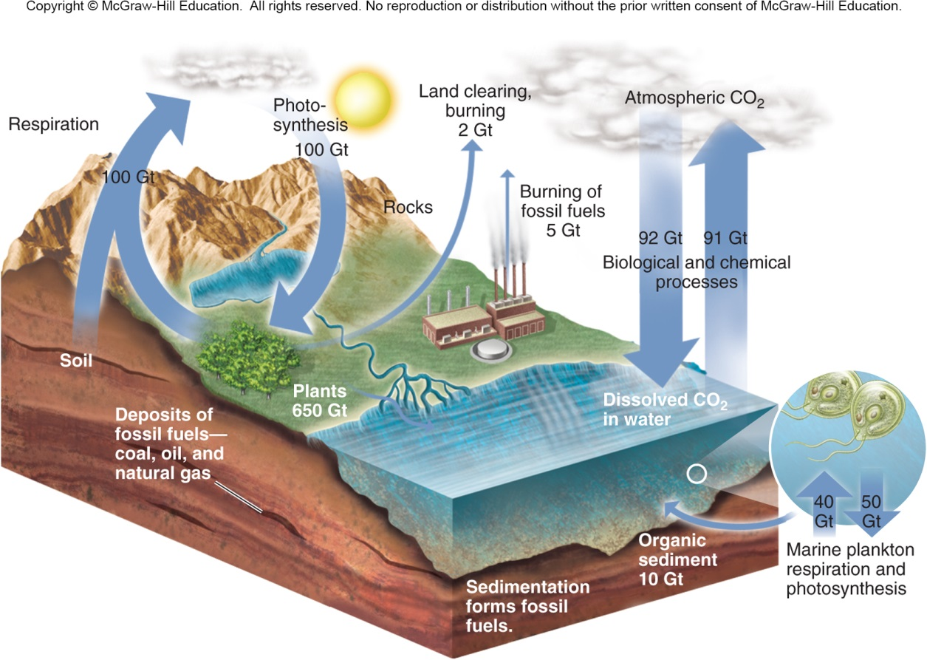
Carbon Cycle
Begins with intake of CO₂ during photosynthesis → incorporated into sugar → released by cellular respiration either in plant or in organisms that consumed it.
Sometimes the carbon is not recycled for a long time. Coal and oil are the remains of organisms that lived millions of years ago. The carbon in these is released when we burn them. Some carbon is also locked in calcium carbonate (fossil shell deposits of limestone).

Slide 10
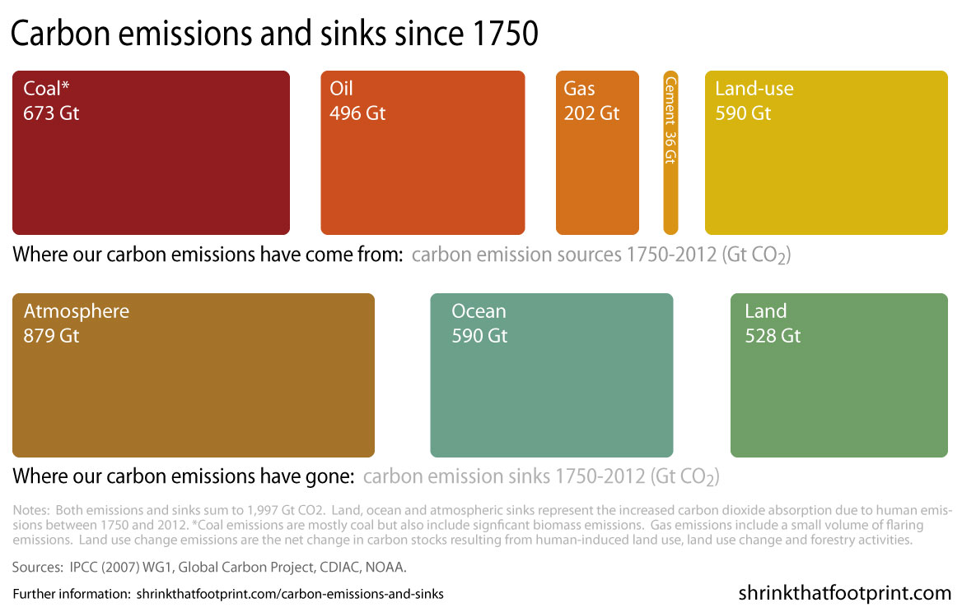
Carbon Cycle
The global carbon cycle has been disturbed by about 13% compared to the pre-industrial era -- as opposed to 100% or more for nitrogen, phosphorous, and sulfur cycles (Falkowski et al. 2000). BUT it has been enough to lead to the global climate change!
Main Carbon Sinks:
Forest
Ocean
Soil

Slide 11
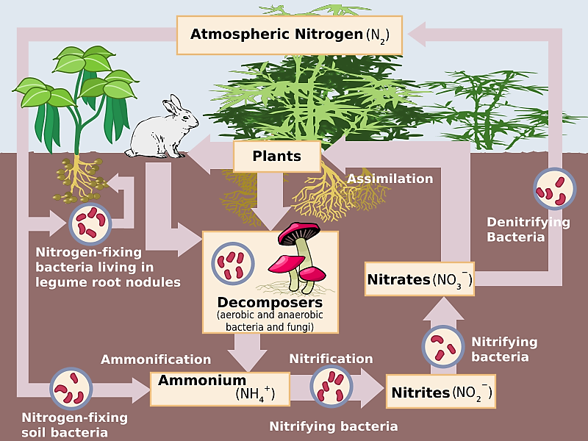
Nitrogen Cycle
Plants take up inorganic nitrogen from the environment and build protein molecules which are later eaten by consumers.
Nitrogen-fixing bacteria change nitrogen to a more useful form by combining it with hydrogen to make ammonia. Other bacteria convert ammonia to nitrites and nitrates, which can be taken up by plants to make proteins.

Slide 12
Nitrogen Cycle
N₂ makes up 78% of the atmosphere, → only made available to organisms through nitrogen fixation by cyanobacteria, nitrogen-fixing bacteria and algae
Since 1945, industrial agriculture, industry and automobile emission have more than doubled N in circulation
80 million tons of nitrogen every year are fixed artificially by industry to be used as fertilizer → nutrient overload, eutrophication, and elimination of oxygen in water bodies (hypoxia).
Nitrogen oxides (N₂O) regularly produced as a result of fossil fuel combustion → potent greenhouse gases that increase global warming and also lead to smog, breakdown of the ozone layer, and acid rain

Slide 13
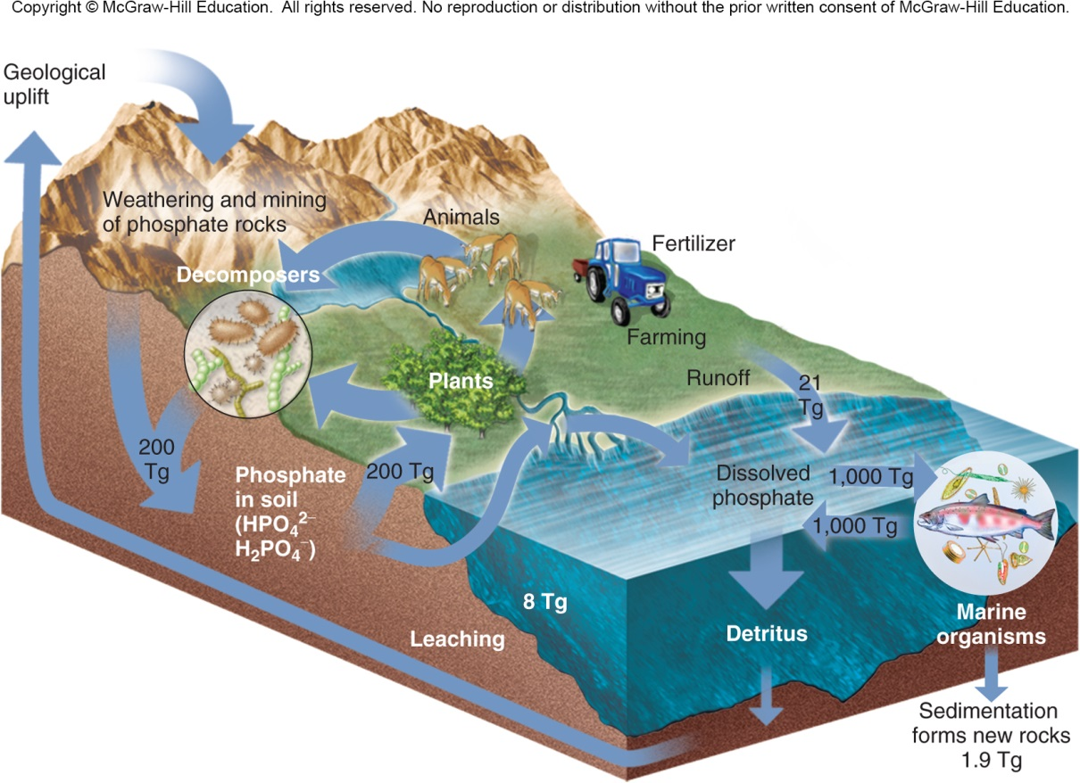
Phosphorus Cycle
P is least naturally available of major nutrients
P is leached from rocks and minerals → transported in aqueous form →taken in and incorporated by producers → consumers → returned to environment by decomposition
Cycle takes a long time as deep ocean sediments are significant sinks

Slide 14
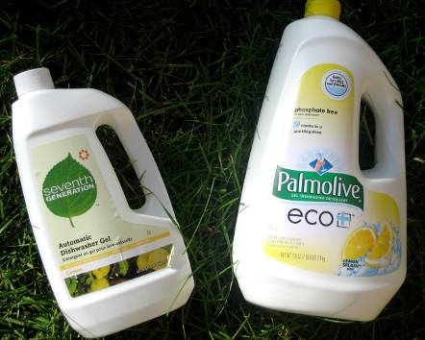
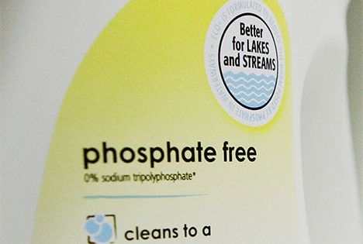

Phosphorus Cycle
Use of phosphorous in artificial fertilizers, detergents and runoffs from animal husbandry often also leads to eutrophication in aquatic systems
The mining of phosphate deposits and their addition to terrestrial ecosystems as fertilizers represents a x6 increase over the natural rate of mobilization of P by the weathering of phosphate rock and by plant activity

Slide 15
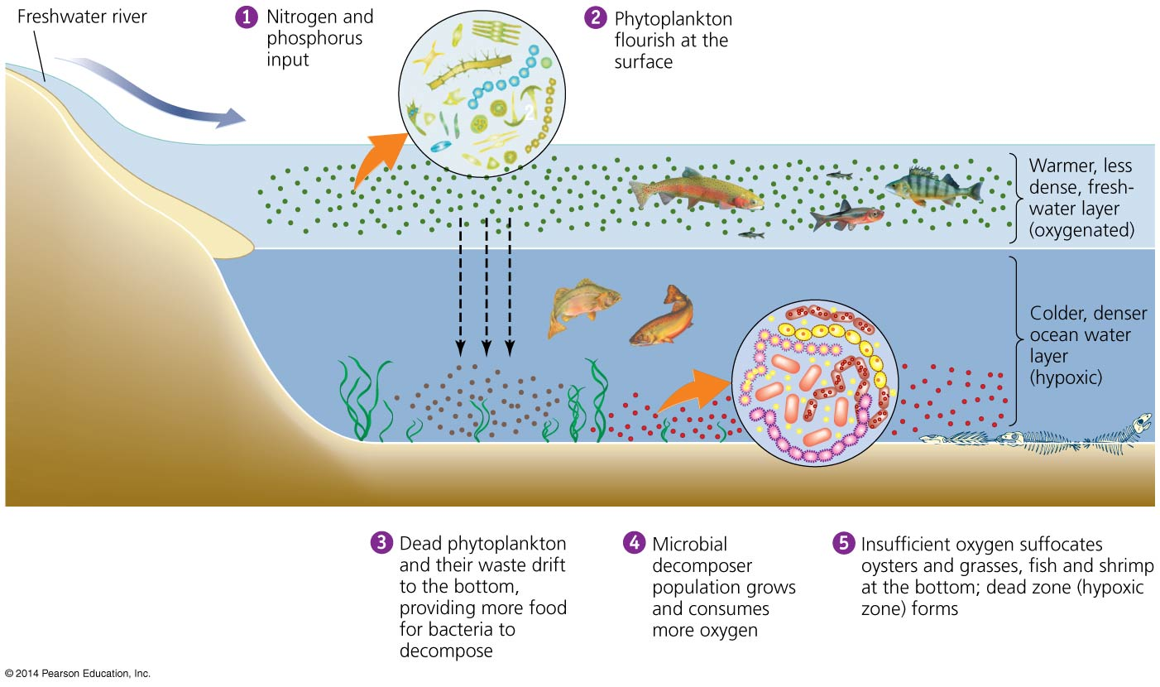
Environmental systems interact
Addition of excess nutrients (N and P) to a water body
leads to: Blooms of algae → Increased production of organic matter that dies and sinks → Decomposition and loss of dissolved oxygen → eutrophication & hypoxia

Slide 16
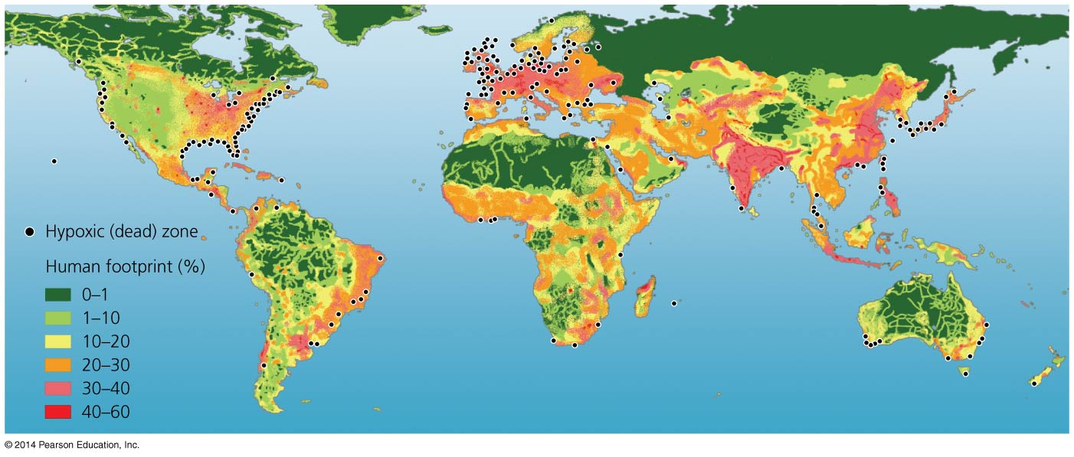
Environmental systems interact
Over 500 hypoxic dead zones occur globally
  Most are off the coasts of Europe and the U.S.
  Mostly due to farm, city, and industrial pollution
  Some are seasonal; others are permanent
Fisheries and ecosystems are devastated
  Causes over $2 billion/year in lost harvests

Slide 17
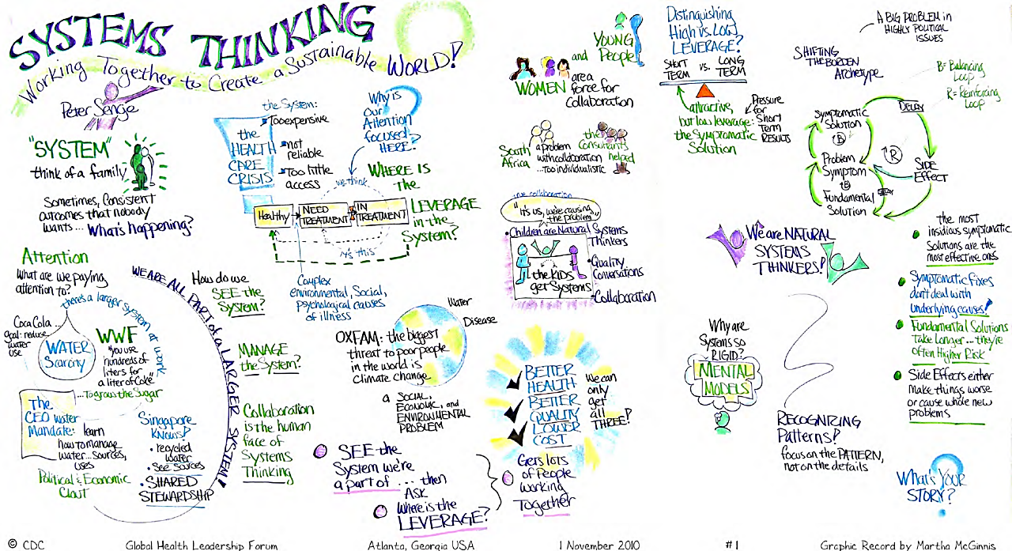

Slide 18

Systems
are networks of interdependent components and processes, with materials and energy flowing from one component of the system to another.
  Together have properties beyond those of individual parts
Central concept in environmental science.
Examples: ecosystems, climates systems, geologic systems, economic systems

Slide 19
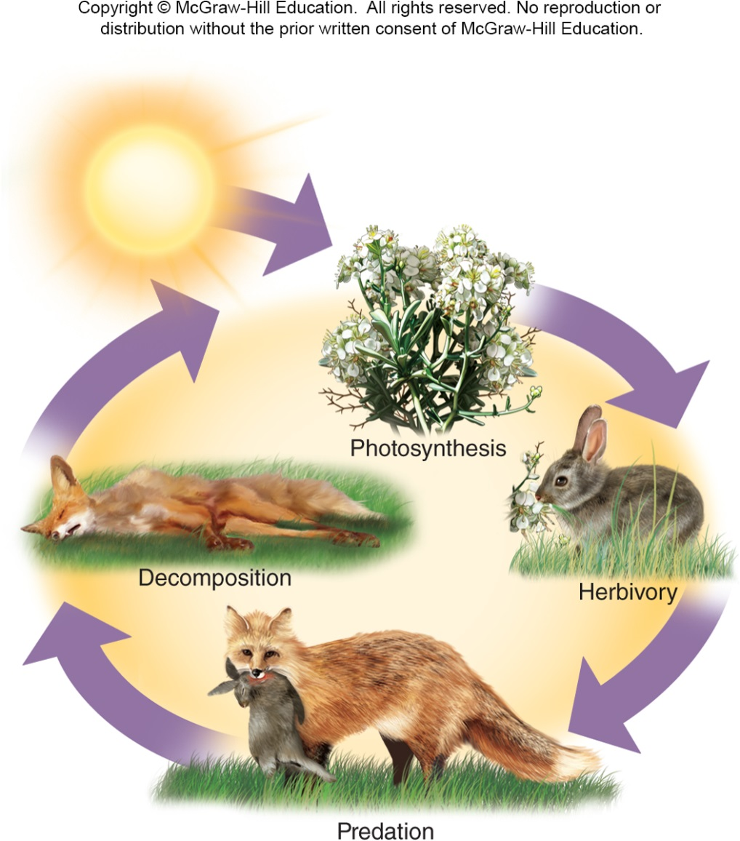
Components of a System
State Variables store resources such as matter or energy or have the pathways through which these resources move from one state variable to another

Slide 20
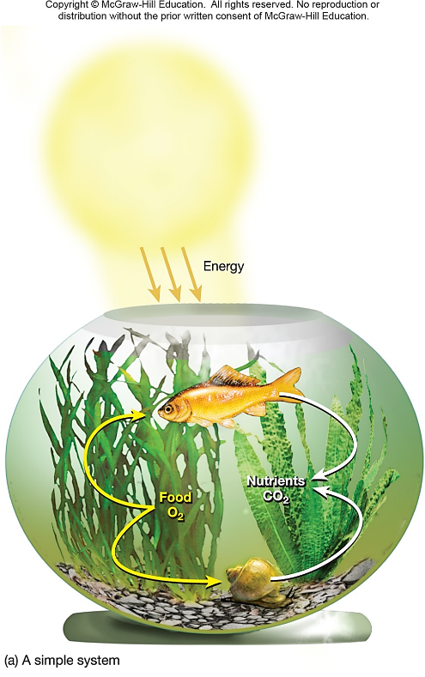
System Characteristics
A System can be closed or open.
  Open – exchanges matter and energy with surroundings
  Closed - self contained, exchanges no matter or energy with the outside
Throughput –the energy and matter that flow into, through, and out of a system

Slide 21
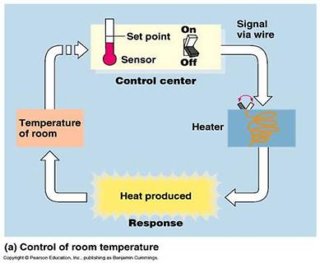
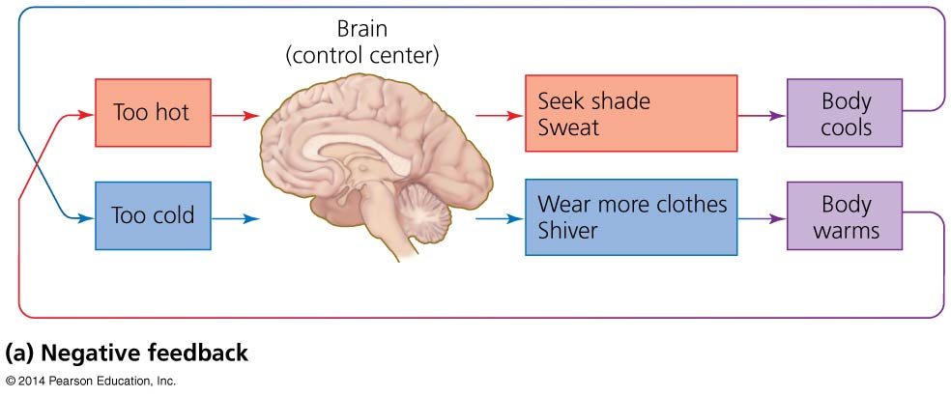
Systems involve feedback loops
Negative feedback loop = system changes and moves in one direction; that movement acts as an output, and as an input back into the system; the input then moves the system in the other direction
Input and output neutralize one another
  Stabilizes the system
  Example: body temperature
Most systems in nature

Slide 22
Systems show several defining properties
Dynamic equilibrium = when system processes move in opposing directions; balancing their effects
Homeostasis = when a system maintains constant (stable) internal conditions
Emergent properties = system characteristics that are not evident in the components alone
  The whole is more than the sum of the parts
It is hard to fully understand systems; they connect to other systems and do not have sharp boundaries

Slide 23
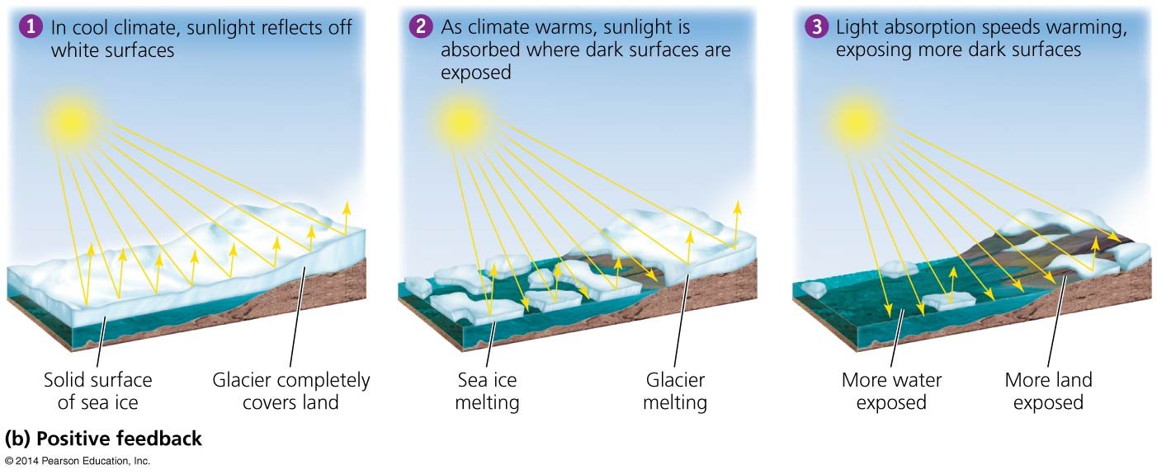
Systems involve feedback loops
Positive feedback loop = system output causes the system to change in the same way and drives it further toward one extreme or another
  Exponential population growth, spread of cancer, melting sea ice
Rare in nature
  But is common in natural systems altered by humans

Slide 24
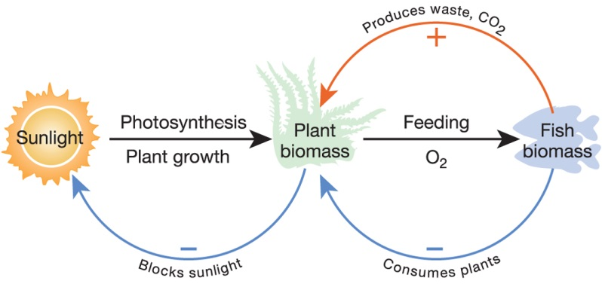
System Characteristics
Dynamic equilibrium

Slide 25
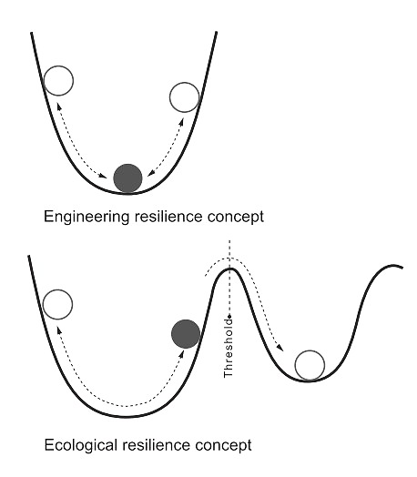
Stability of Systems
Disturbance - periodic destructive events such as fire or flood that destabilize or change the system
Resilience - ability of system to recover from disturbance
State Shift –a severe disturbance in which the system does not return to normal but instead results in significant changes in some of its state variables

Slide 26
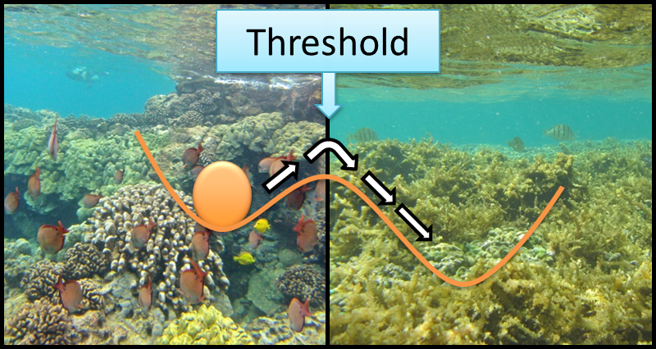
Stability of Systems
Disturbance - periodic destructive events such as fire or flood that destabilize or change the system
Resilience - ability of system to recover from disturbance
State Shift –a severe disturbance in which the system does not return to normal but instead results in significant changes in some of its state variables

Slide 27
Leaving the “Safe Operating Space”

Slide 28
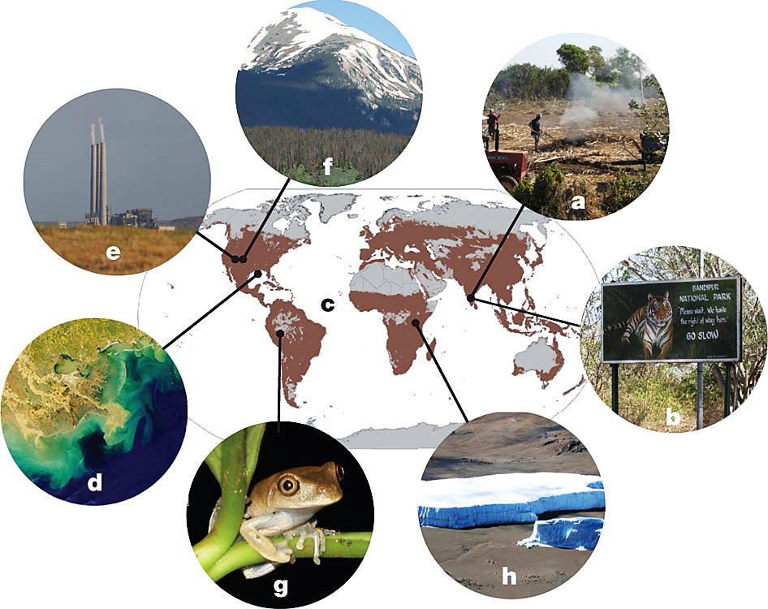
Drivers of a potential planetary-scale critical transition
brown color indicates ~ 40% of terrestrial ecosystems that have now been transformed to agricultural landscapes
A D. Barnosky et al. Nature 486, 52–58 (2012) doi:10.1038/nature11018
Notes:
a, Humans locally transform and fragment landscapes. b, Adjacent areas still harboring natural landscapes undergo indirect changes. c, Anthropogenic local state shifts accumulate to transform a high percentage of Earth’s surface drastically; brown coloring indicates the approximately 40% of terrestrial ecosystems that have now been transformed to agricultural landscapes, as explained in ref. 34. d, Global-scale forcing emerge from accumulated local human impacts, for example dead zones in the oceans from run-off of agricultural pollutants. e, Changes in atmospheric and ocean chemistry from the release of greenhouse gases as fossil fuels are burned. f–h, Global-scale forcings emerge to cause ecological changes even in areas that are far from human population concentrations. f, Beetle-killed conifer forests (brown trees) triggered by seasonal changes in temperature observed over the past five decades. g, Reservoirs of biodiversity, such as tropical rainforests, are projected to lose many species as global climate change causes local changes in temperature and precipitation, exacerbating other threats already causing abnormally high extinction rates. In the case of amphibians, this threat is the human-facilitated spread of chytrid fungus. h, Glaciers on Mount Kilimanjaro, which remained large throughout the past 11,000 yr, are now melting quickly, a global trend that in many parts of the world threatens the water supplies of major population centres. As increasing human populations directly transform more and more of Earth’s surface, such changes driven by emergent global-scale forcings increase drastically, in turn causing state shifts in ecosystems that are not directly used by people. Photo credits: E.A.H. and A.D.B. (a–c,e–h); NASA (d).

Slide 29
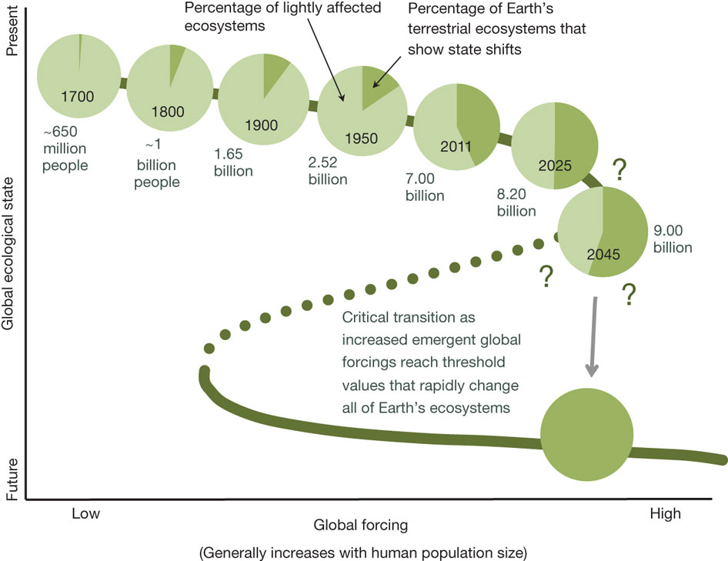
Quantifying land use as one method of anticipating a planetary state shift
A D. Barnosky et al. Nature 486, 52–58 (2012) doi:10.1038/nature11018
Notes:
The trajectory of the green line represents a fold bifurcation with hysteresis¹². At each time point, light green represents the fraction of Earth’s land that probably has dynamics within the limits characteristic of the past 11,000 yr. Dark green indicates the fraction of terrestrial ecosystems that have unarguably undergone drastic state changes; these are minimum values because they count only agricultural and urban lands. The percentages of such transformed lands in 2011 come from refs 1, 34, 35, and when divided by 7,000,000,000 (the present global human population) yield a value of approximately 2.27 acres (0.92 ha) of transformed land for each person. That value was used to estimate the amount of transformed land that probably existed in the years 1800, 1900 and 1950, and which would exist in 2025 and 2045 assuming conservative population growth and that resource use does not become any more efficient. Population estimates are from refs31–33. An estimate of 0.68 transformed acres (0.28 ha) per capita (approximately that for India today) was used for the year 1700, assuming a lesser effect on the global landscape before the industrial revolution. Question marks emphasize that at present we still do not know how much land would have to be directly transformed by humans before a planetary state shift was imminent, but landscape-scale studies and theory suggest that the critical threshold may lie between 50 and 90% (although it could be even lower owing to synergies between emergent global forcings). See the main text for further explanation. Billion, 10⁹.

