Slide 1
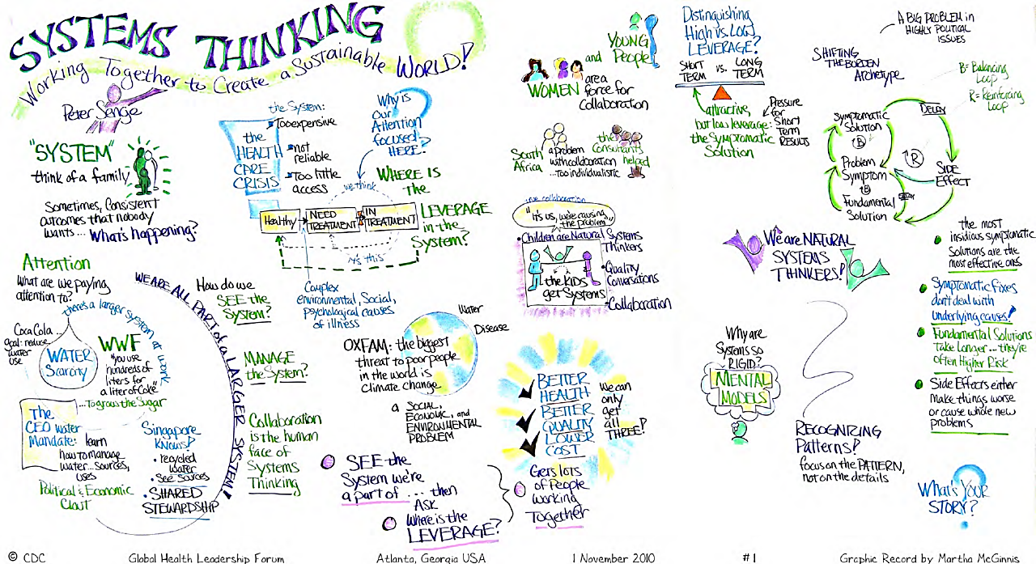

Slide 2

Systems
are networks of interdependent components and processes, with materials and energy flowing from one component of the system to another.
  Together have properties beyond those of individual parts
Central concept in environmental science.
Examples: ecosystems, climates systems, geologic systems, economic systems

Slide 3
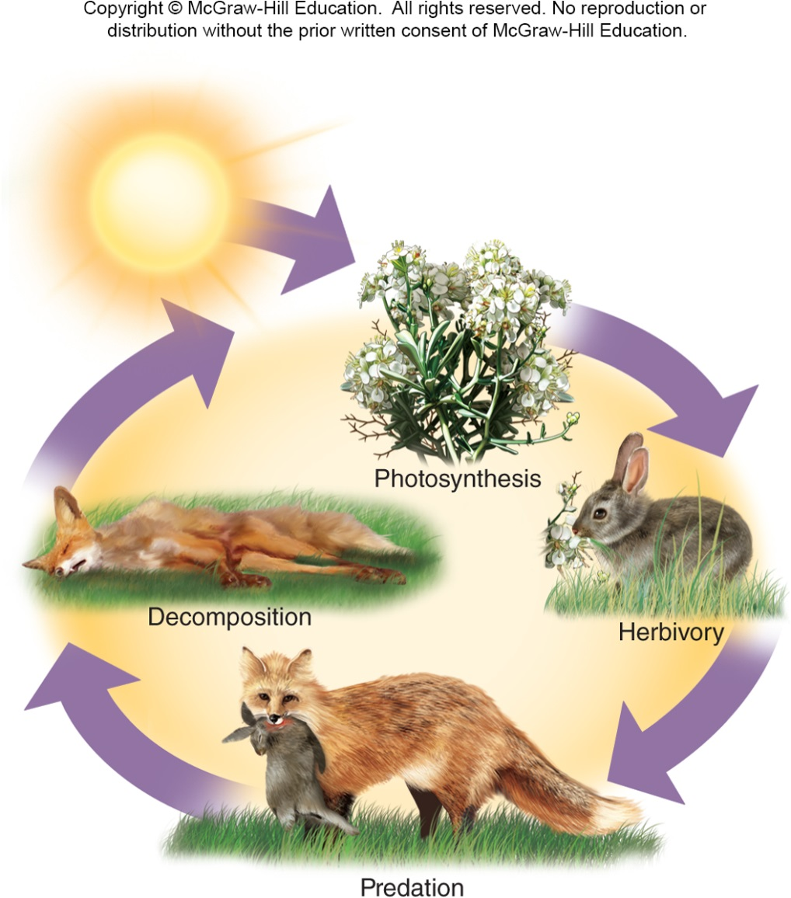
Components of a System
State Variables store resources such as matter or energy or have the pathways through which these resources move from one state variable to another

Slide 4
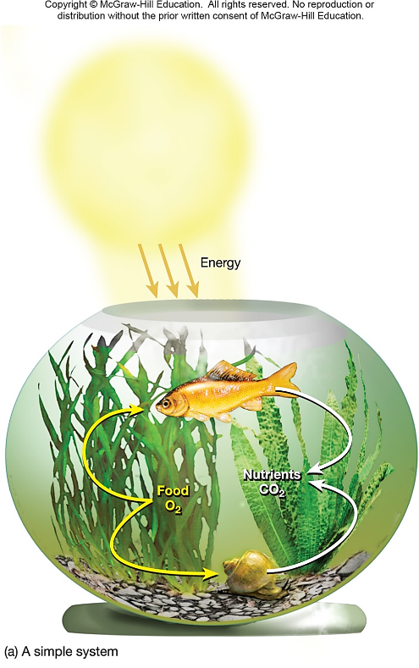
System Characteristics
A System can be closed or open.
  Open – exchanges matter and energy with surroundings
  Closed - self contained, exchanges no matter or energy with the outside
Throughput –the energy and matter that flow into, through, and out of a system

Slide 5
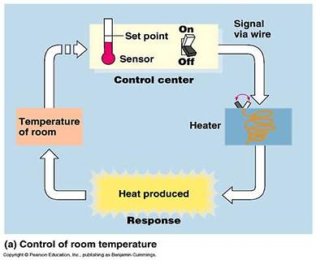
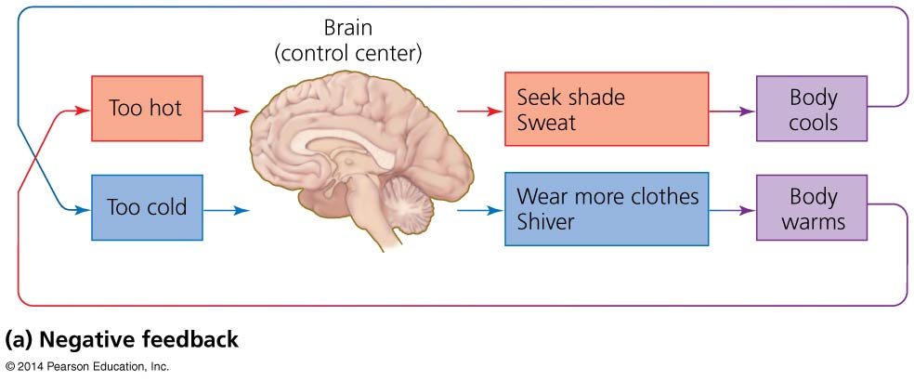
Systems involve feedback loops
Negative feedback loop = system changes and moves in one direction; that movement acts as an output and as an input back into the system; the input then moves the system in the other direction
Input and output neutralize one another
  Stabilizes the system
  Example: body temperature
Most systems in nature

Slide 6
Systems show several defining properties
Dynamic equilibrium = when system processes move in opposing directions; balancing their effects
Homeostasis = when a system maintains constant (stable) internal conditions
Emergent properties = system characteristics that are not evident in the components alone
  The whole is more than the sum of the parts
It is hard to fully understand systems; they connect to other systems and do not have sharp boundaries

Slide 7
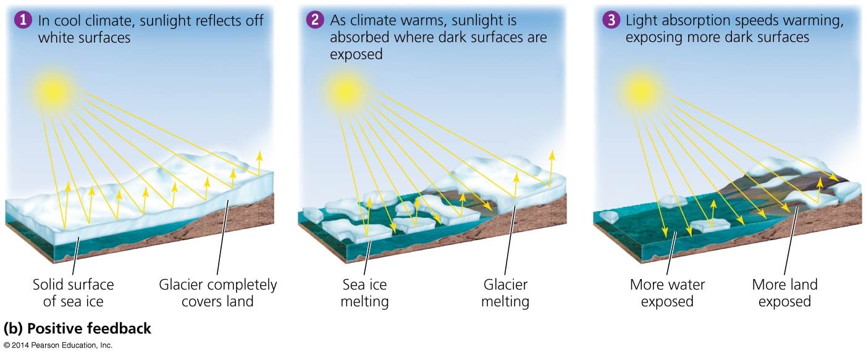
Systems involve feedback loops
Positive feedback loop = system output causes the system to change in the same way and drives it further toward one extreme or another
  Exponential population growth, spread of cancer, melting sea ice
Rare in nature
  But is common in natural systems altered by humans

Slide 8
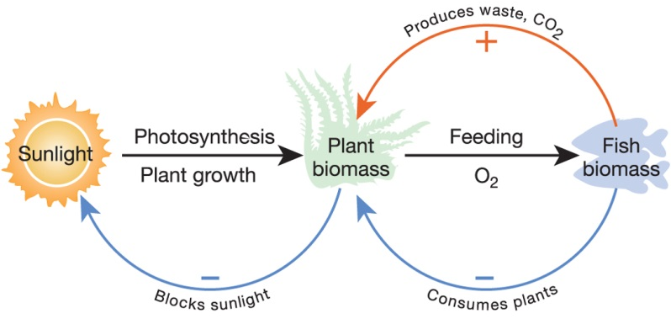
System Characteristics
Dynamic equilibrium

Slide 9
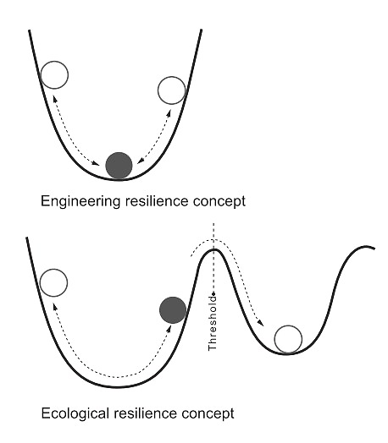
Stability of Systems
Disturbance - periodic destructive events such as fire or flood that destabilize or change the system
Resilience - ability of system to recover from disturbance
State Shift –a severe disturbance in which the system does not return to normal but instead results in significant changes in some of its state variables

Slide 10
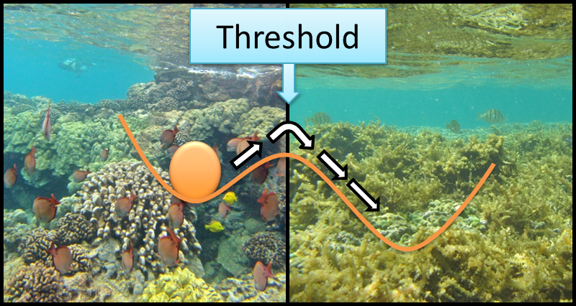
Stability of Systems
Disturbance - periodic destructive events such as fire or flood that destabilize or change the system
Resilience - ability of system to recover from disturbance
State Shift –a severe disturbance in which the system does not return to normal but instead results in significant changes in some of its state variables

Slide 11

Leaving the “Safe Operating Space”

Slide 12
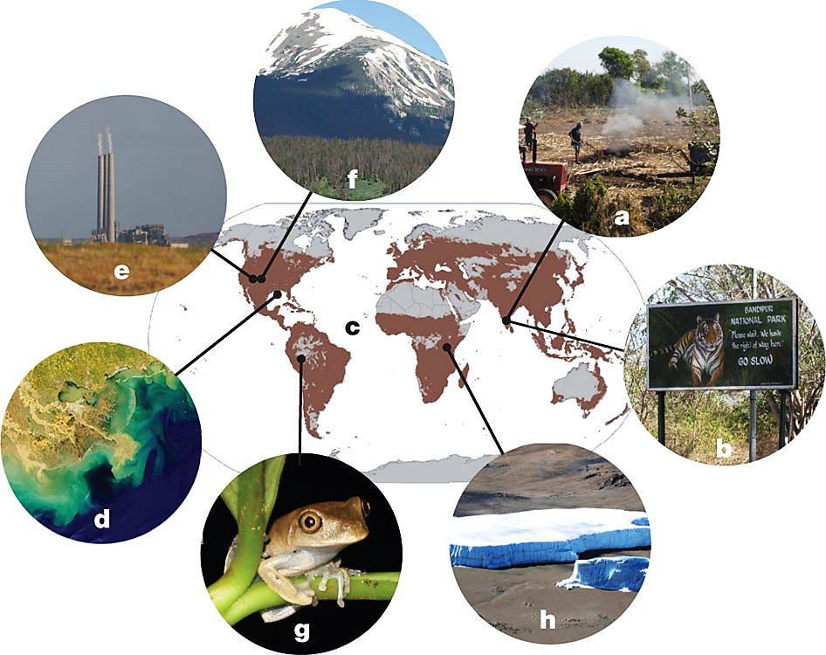
Drivers of a potential planetary-scale critical transition
brown color indicates ~ 40% of terrestrial ecosystems that have now been transformed to agricultural landscapes
A D. Barnosky et al. Nature 486, 52–58 (2012) doi:10.1038/nature11018
Notes:
a, Humans locally transform and fragment landscapes. b, Adjacent areas still harboring natural landscapes undergo indirect changes. c, Anthropogenic local state shifts accumulate to transform a high percentage of Earth’s surface drastically; brown coloring indicates the approximately 40% of terrestrial ecosystems that have now been transformed to agricultural landscapes, as explained in ref. 34. d, Global-scale forcing emerge from accumulated local human impacts, for example dead zones in the oceans from run-off of agricultural pollutants. e, Changes in atmospheric and ocean chemistry from the release of greenhouse gases as fossil fuels are burned. f–h, Global-scale forcings emerge to cause ecological changes even in areas that are far from human population concentrations. f, Beetle-killed conifer forests (brown trees) triggered by seasonal changes in temperature observed over the past five decades. g, Reservoirs of biodiversity, such as tropical rainforests, are projected to lose many species as global climate change causes local changes in temperature and precipitation, exacerbating other threats already causing abnormally high extinction rates. In the case of amphibians, this threat is the human-facilitated spread of chytrid fungus. h, Glaciers on Mount Kilimanjaro, which remained large throughout the past 11,000 yr, are now melting quickly, a global trend that in many parts of the world threatens the water supplies of major population centres. As increasing human populations directly transform more and more of Earth’s surface, such changes driven by emergent global-scale forcings increase drastically, in turn causing state shifts in ecosystems that are not directly used by people. Photo credits: E.A.H. and A.D.B. (a–c,e–h); NASA (d).

Slide 13
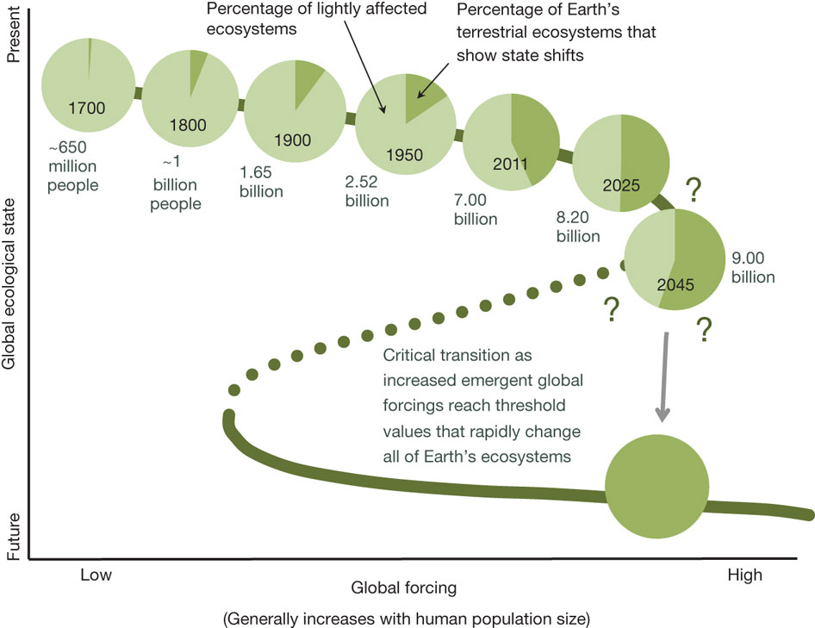
Quantifying land use as one method of anticipating a planetary state shift
A D. Barnosky et al. Nature 486, 52–58 (2012) doi:10.1038/nature11018
Notes:
The trajectory of the green line represents a fold bifurcation with hysteresis¹². At each time point, light green represents the fraction of Earth’s land that probably has dynamics within the limits characteristic of the past 11,000 yr. Dark green indicates the fraction of terrestrial ecosystems that have unarguably undergone drastic state changes; these are minimum values because they count only agricultural and urban lands. The percentages of such transformed lands in 2011 come from refs 1, 34, 35, and when divided by 7,000,000,000 (the present global human population) yield a value of approximately 2.27 acres (0.92 ha) of transformed land for each person. That value was used to estimate the amount of transformed land that probably existed in the years 1800, 1900 and 1950, and which would exist in 2025 and 2045 assuming conservative population growth and that resource use does not become any more efficient. Population estimates are from refs31–33. An estimate of 0.68 transformed acres (0.28 ha) per capita (approximately that for India today) was used for the year 1700, assuming a lesser effect on the global landscape before the industrial revolution. Question marks emphasize that at present we still do not know how much land would have to be directly transformed by humans before a planetary state shift was imminent, but landscape-scale studies and theory suggest that the critical threshold may lie between 50 and 90% (although it could be even lower owing to synergies between emergent global forcings). See the main text for further explanation. Billion, 10⁹.

