Slide 1
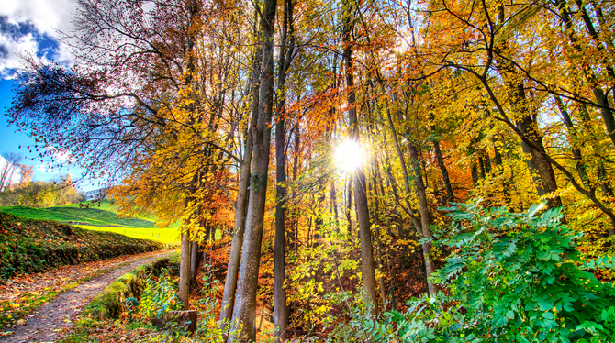
Knowing the Hazards:
Ecosystem services
Class 10

Slide 2
Critical Ecosystem Services
Climate and Biogeochemical Cycles
Regulation of Hydrologic Cycle
Soils and Erosion
Biodiversity and Ecosystem Functions
Mobile Links
Balance of Diseases Transmission

Slide 3


Slide 4
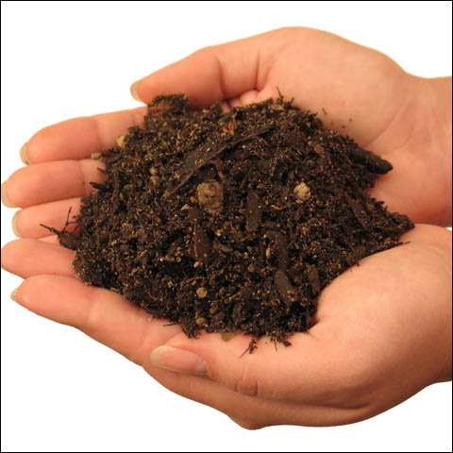
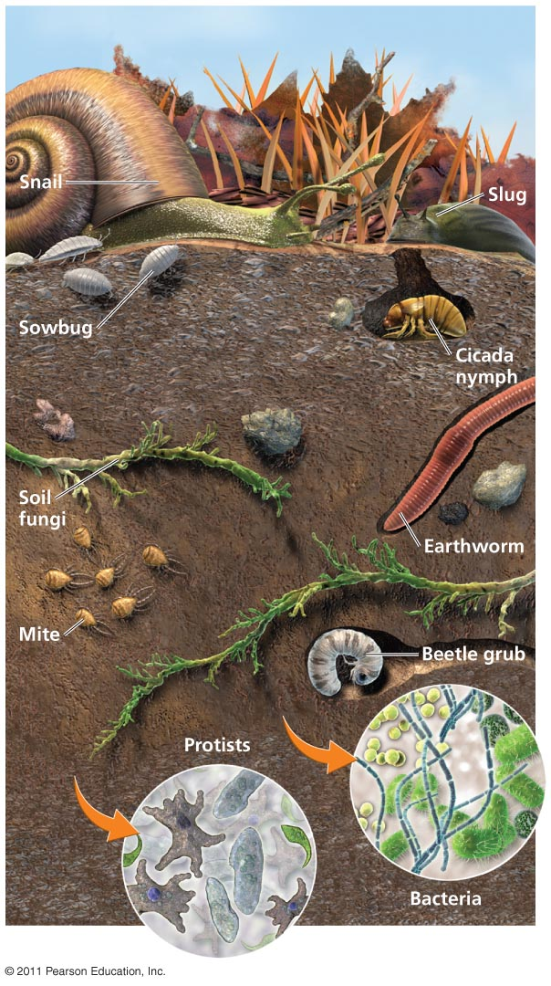
Soils and Erosion
Soil consists of mineral (50%), organic matter (5%), air, and water → composed of interacting living and nonliving matter → considered an ecosystem
Most critical and most underappreciated ecosystem
Provides 6 major ecosystem services:
  Moderating the hydrologic cycle.
  Physical support of plants.
  Retention and delivery of nutrients to plants.
  Disposal of wastes and dead organic matter.
  Renewal of soil fertility.
  Regulation of major element cycles.

Slide 5

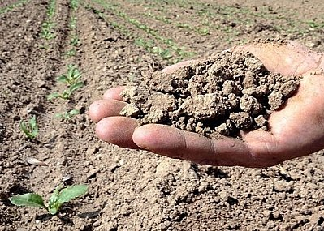
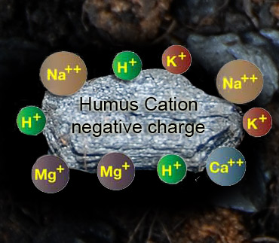
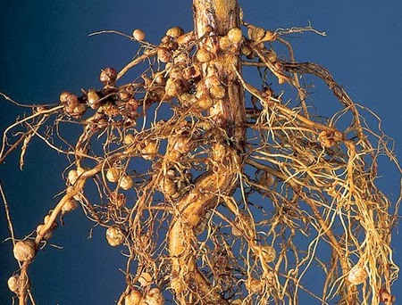
Soils and Erosion
Water retention capacity is reduced after intensive cultivation → flood, erosion, pollution
Nutrient delivery to plans (nutrient cations) → hydroponic systems cost >$250K per ha
Harbors an astonishing diversity of microorganisms, E.g., nitrogen-fixing bacteria → cost at least $320 billion/year to replace with nitrogen fertilizers
Greenhouse gases sink → per area soils stores C
x1.8 and N x18 that plants can; in peatlands C x10 greater than plants

Slide 6
Regional differences in soils affect agriculture
In rainforests the nutrients are in plants, not in the soil
  Rain leaches minerals and nutrients, reducing their accessibility to roots
  Rapid decomposition of leaf litter results in a thin topsoil layer with little humus
Swidden agriculture (=cut-and-burn) -- traditionally used in tropical areas
  After short-time cultivation, a plot is left to regrow into forest
  Swidden agriculture is not sustainable at high population densities

Slide 7
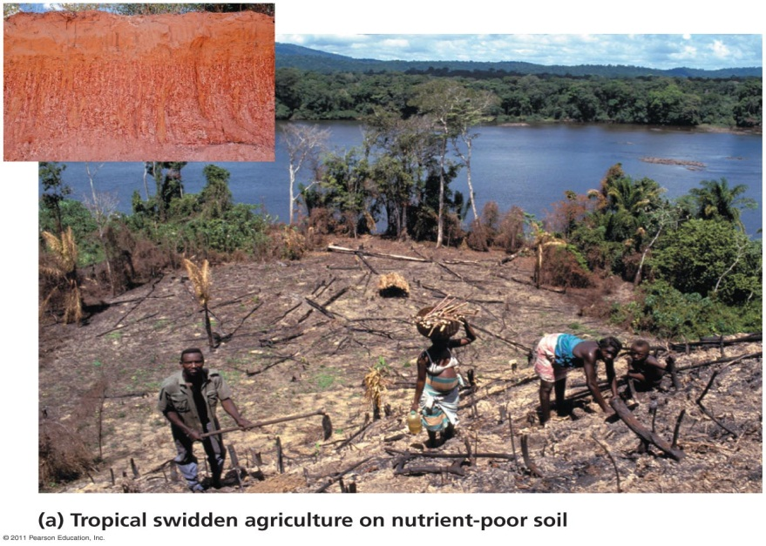
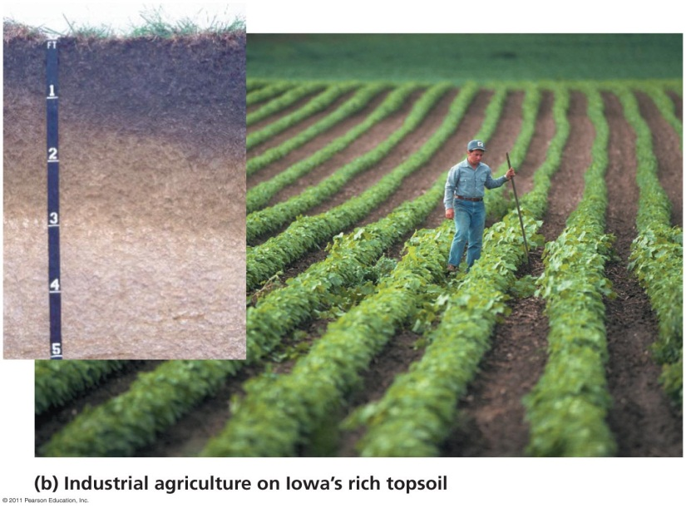
Differences in regional agriculture
Temperate prairies have lower rainfall and less nutrient leaching
Dead plants return nutrients to the soil
Thick, rich topsoil of temperate grasslands can be farmed repeatedly for many years

Slide 8
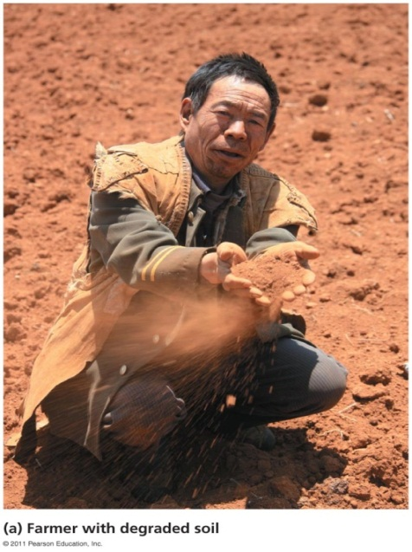
Soil erosion
Soil degradation: loss of soil quality and productivity
  17% of the Earth’s vegetated land surface (Oldeman 1998) or 23% of all land used for food production has experienced soil degradation since 1945
  Erosion: removal of material from one place to another by wind or water → happens faster than soil formation
Direct costs of erosion ~US$250 billion/year and the indirect costs (e.g. siltation, obsolescence of dams, water quality declines) ~$150 billion/year (Pimentel et al.1995).
Sufficient preventive measures would cost only 19% of this total (Pimentel et al. 1995).
We lose 5–7 million ha (size of WV) of productive cropland each year

Slide 9
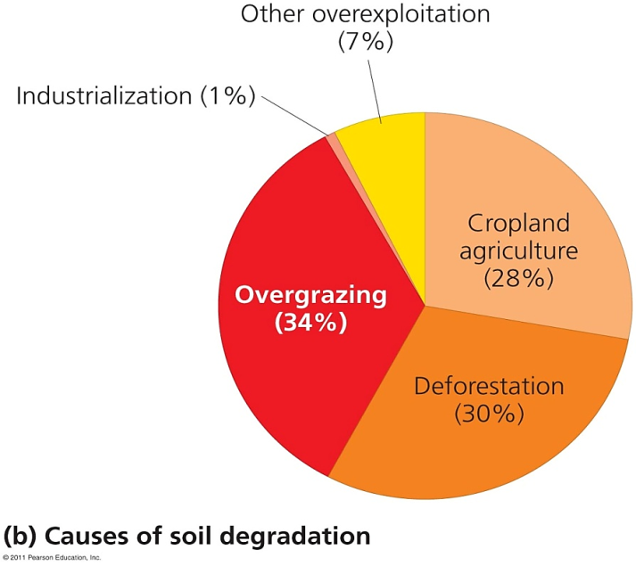
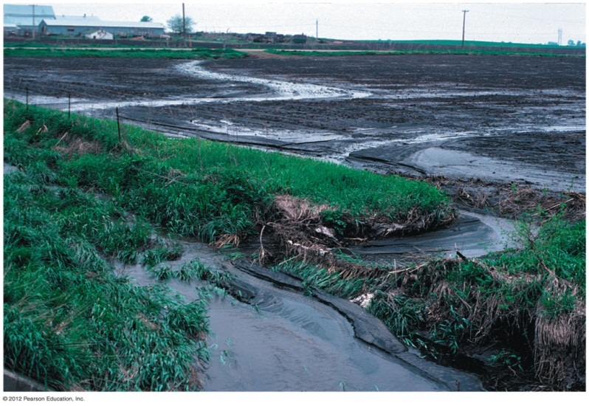
Soil erosion is a global problem
Humans are the primary cause of erosion
  It is occurring at unnaturally high rates
In Africa, erosion could reduce crop yields by 50% over the next 40 years
The U.S. loses 5 tons of soil for every ton of grain harvested
Degradation of topsoil and decreased crop yields, added to population growth are leading agriculture’s future to a crisis situation

Slide 10
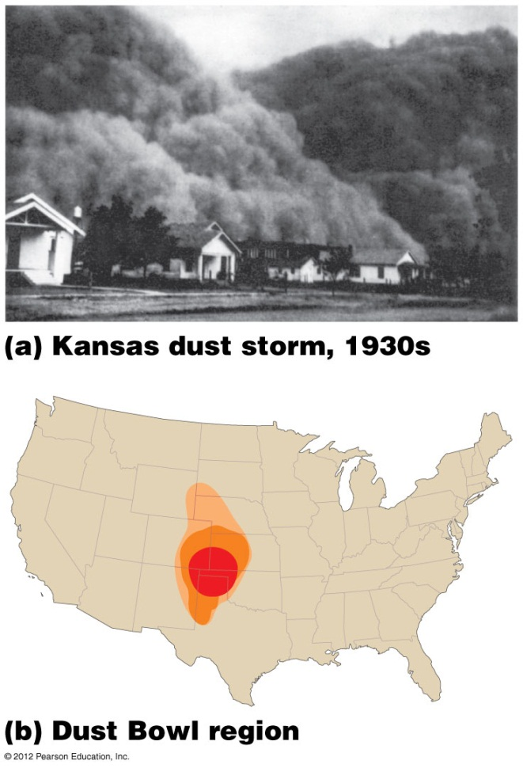
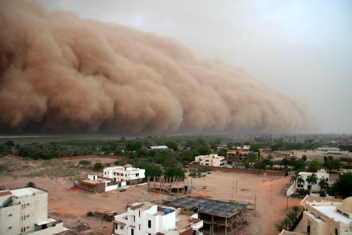
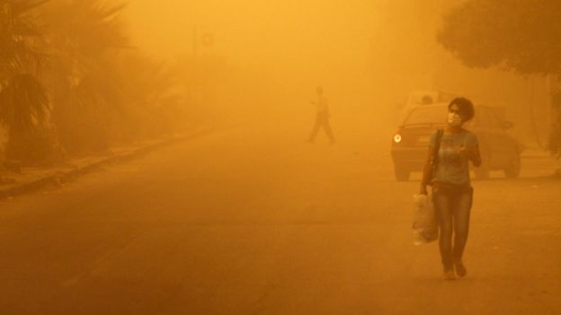
The Dust Storms
In late 1800 and early 1900, USA farmers and ranchers:
  Grew wheat, grazed cattle
  Removed native grasses
Dust Bowl: 1930s drought and erosion caused “black blizzards” of sand
Dust Storms: On the global scale happens x10 more frequently now than 50 y.a.

Slide 11
Potential development in different scenarios

Slide 12
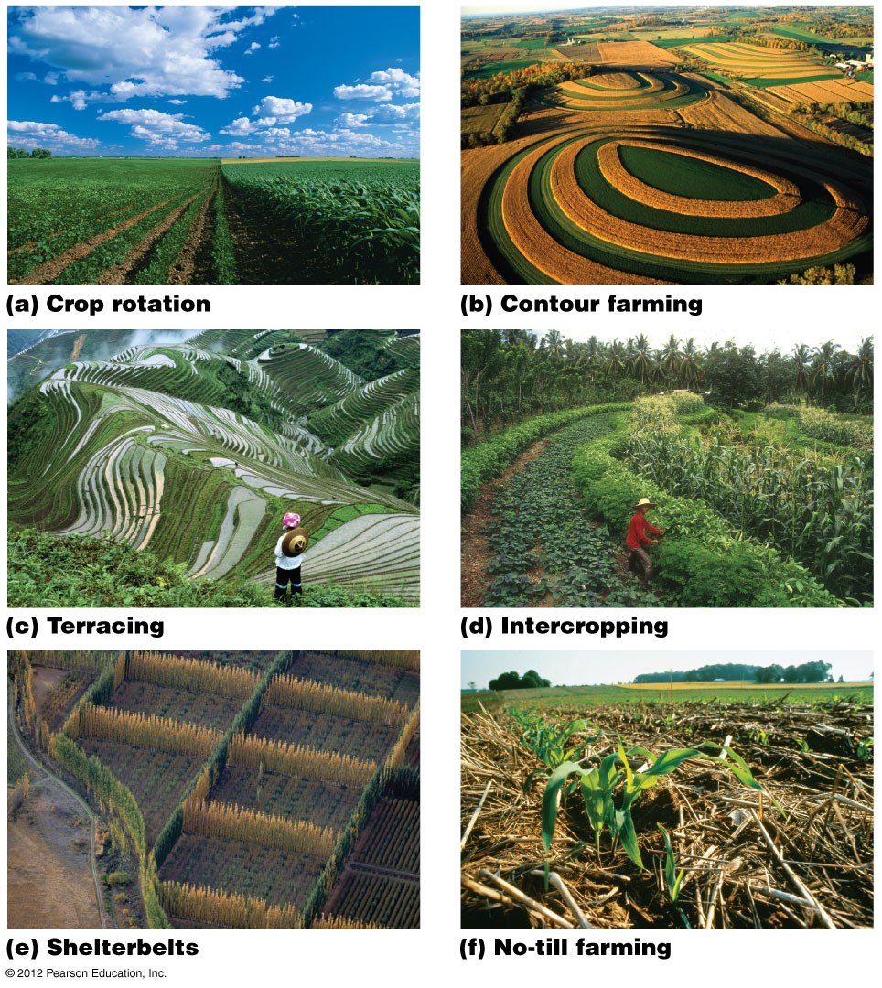
Protecting soil: terracing and intercropping
Terracing: level platforms cut into steep hillsides
  This “staircase” contains rain and irrigation water
Intercropping: planting different crops in alternating bands
  Increases ground cover
  Decreases pests and disease
  Replenishes soil

Slide 13
Protecting soil: shelterbelts and reduced tillage
Shelterbelts (windbreaks): rows of trees planted along edges of fields
  Slows the wind
  Can be combined with intercropping
Conservation tillage: reduces the amount of tilling
  No-till farming disturbs the soil even less

Slide 14
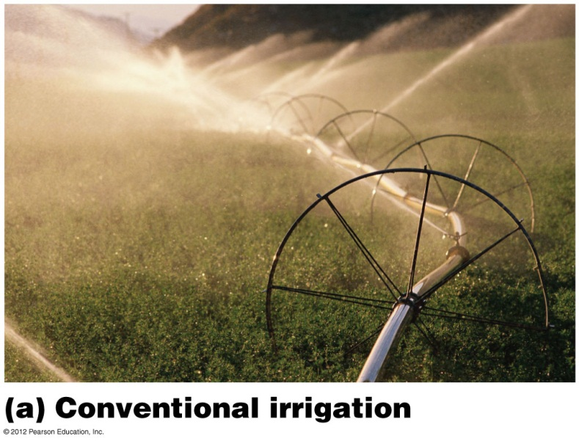
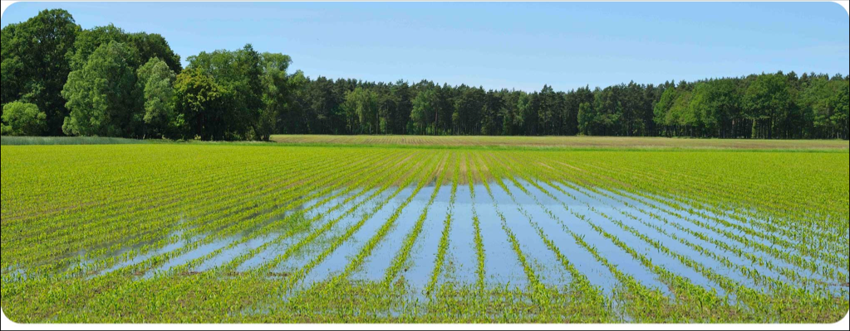
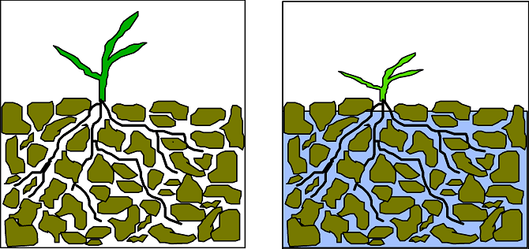
Irrigation: productivity with problems
Irrigation: artificially providing water to support agriculture
  Unproductive regions become productive farmland
Waterlogging: water suffocates roots in overirrigated soils

Slide 15
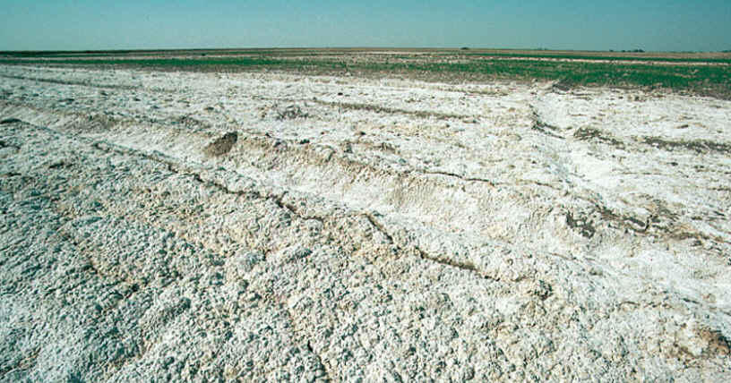
Irrigation: productivity with problems
Salinization: the buildup of salts in surface soil layers
  Worse in dryland areas
Salinization inhibits production of 20% of irrigated cropland, costing over $11 billion/year

Slide 16
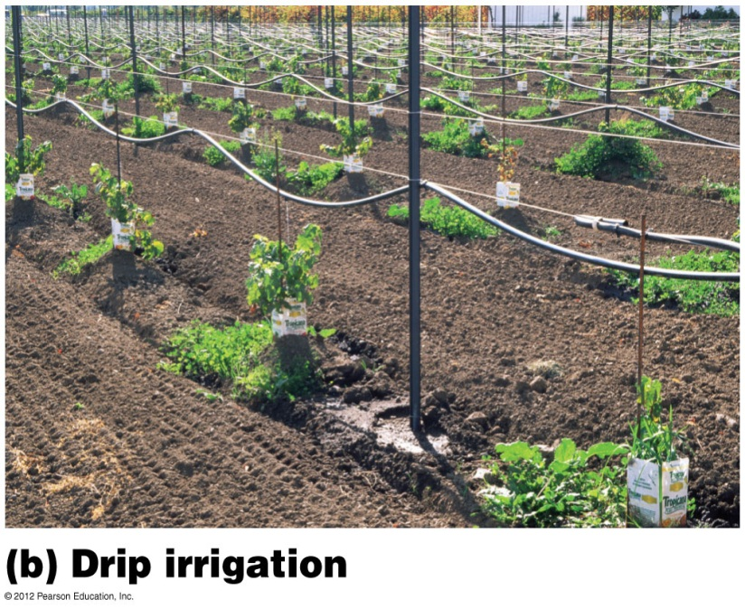
Sustainable approaches to irrigation
Match crops and climate
  Don’t plant water-guzzling crops in dry areas
  Plant beans or wheat, not rice
Subsidies make irrigation water artificially cheap
Drip irrigation delivers water directly to plants
Drip irrigation works best on smaller plots with perennial plants (fruit trees)

Slide 17
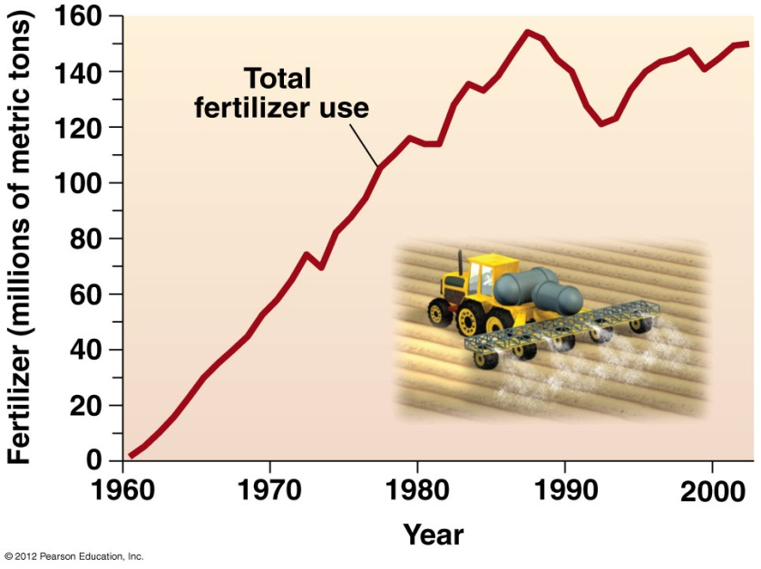
Inorganic fertilizers cause problems
Inorganic fertilizers have boosted production
  But also severely pollute
Leaching and runoff of inorganic fertilizers causes:
  Groundwater contamination
  Dead zones in water systems
  Air pollution from evaporated nitrates
Inorganic fertilizer use has skyrocketed worldwide

Slide 18
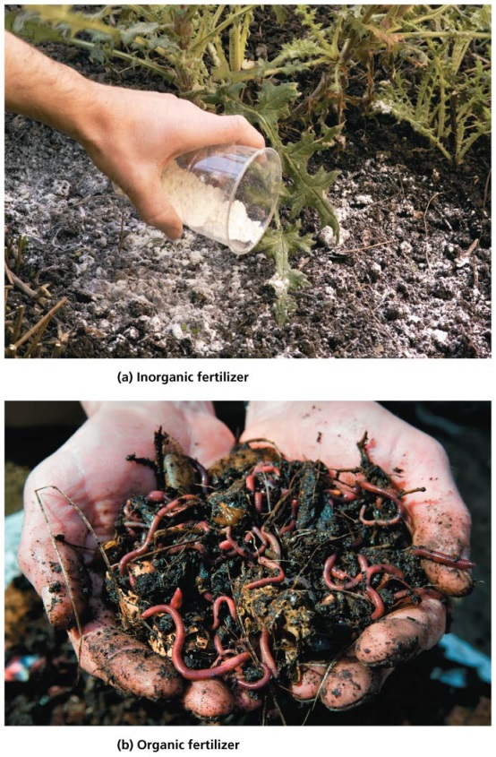
Sustainable fertilizers
Sustainable approaches to fertilizing delivers nutrients directly to plant roots and avoids overapplication
  Add fertilizers to drip irrigation water
  No-till or low-till systems inject fertilizers with seeds
  Monitor soil nutrients and add only when they are low
  Strips of vegetation along field edges and streams capture nutrient runoff
Organic fertilizers add nutrients and organic matter
  Improving soil structure, nutrient and water retention
Solution: Integrate inorganic and organic fertilizer systems

Slide 19
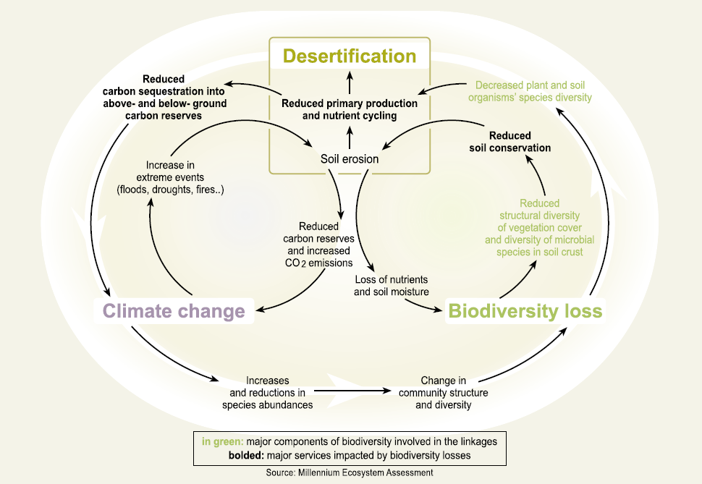
Linkage and Feedback Loops

