Slide 1
The Great Dismal Swamp Internship
Brooke Bass

Slide 2
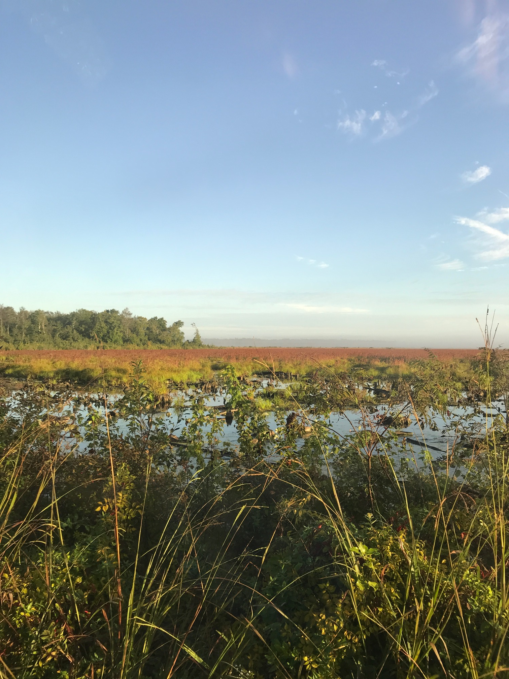

Slide 3
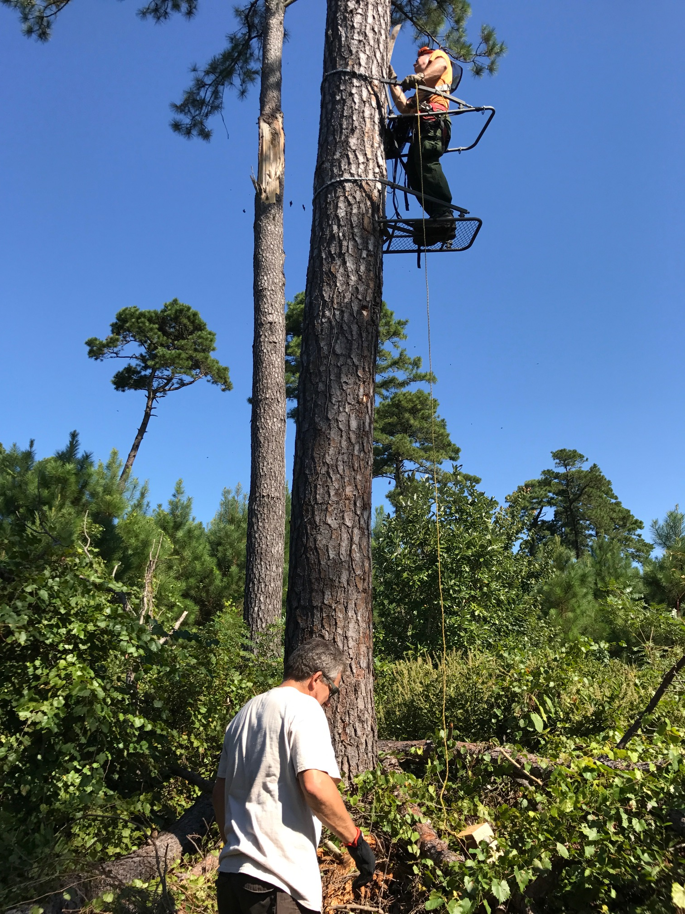
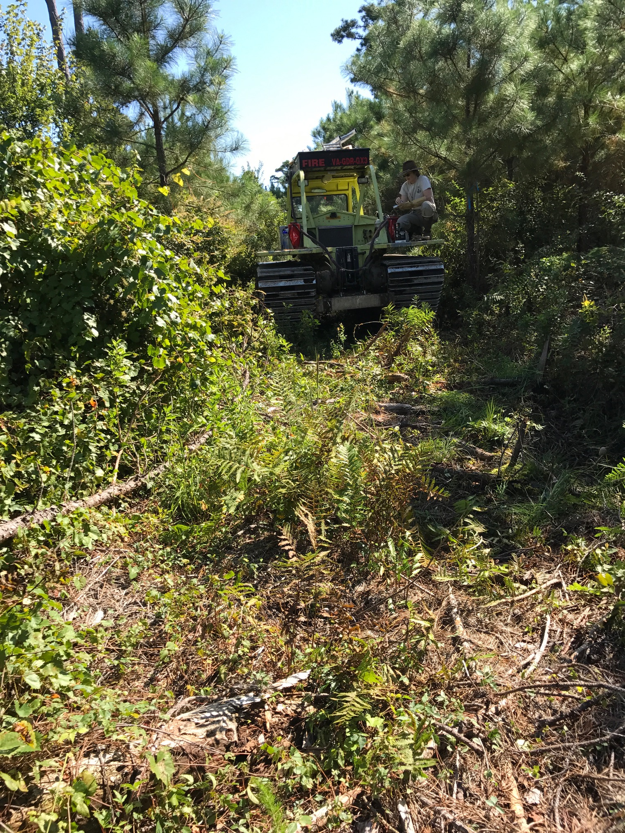

Slide 4
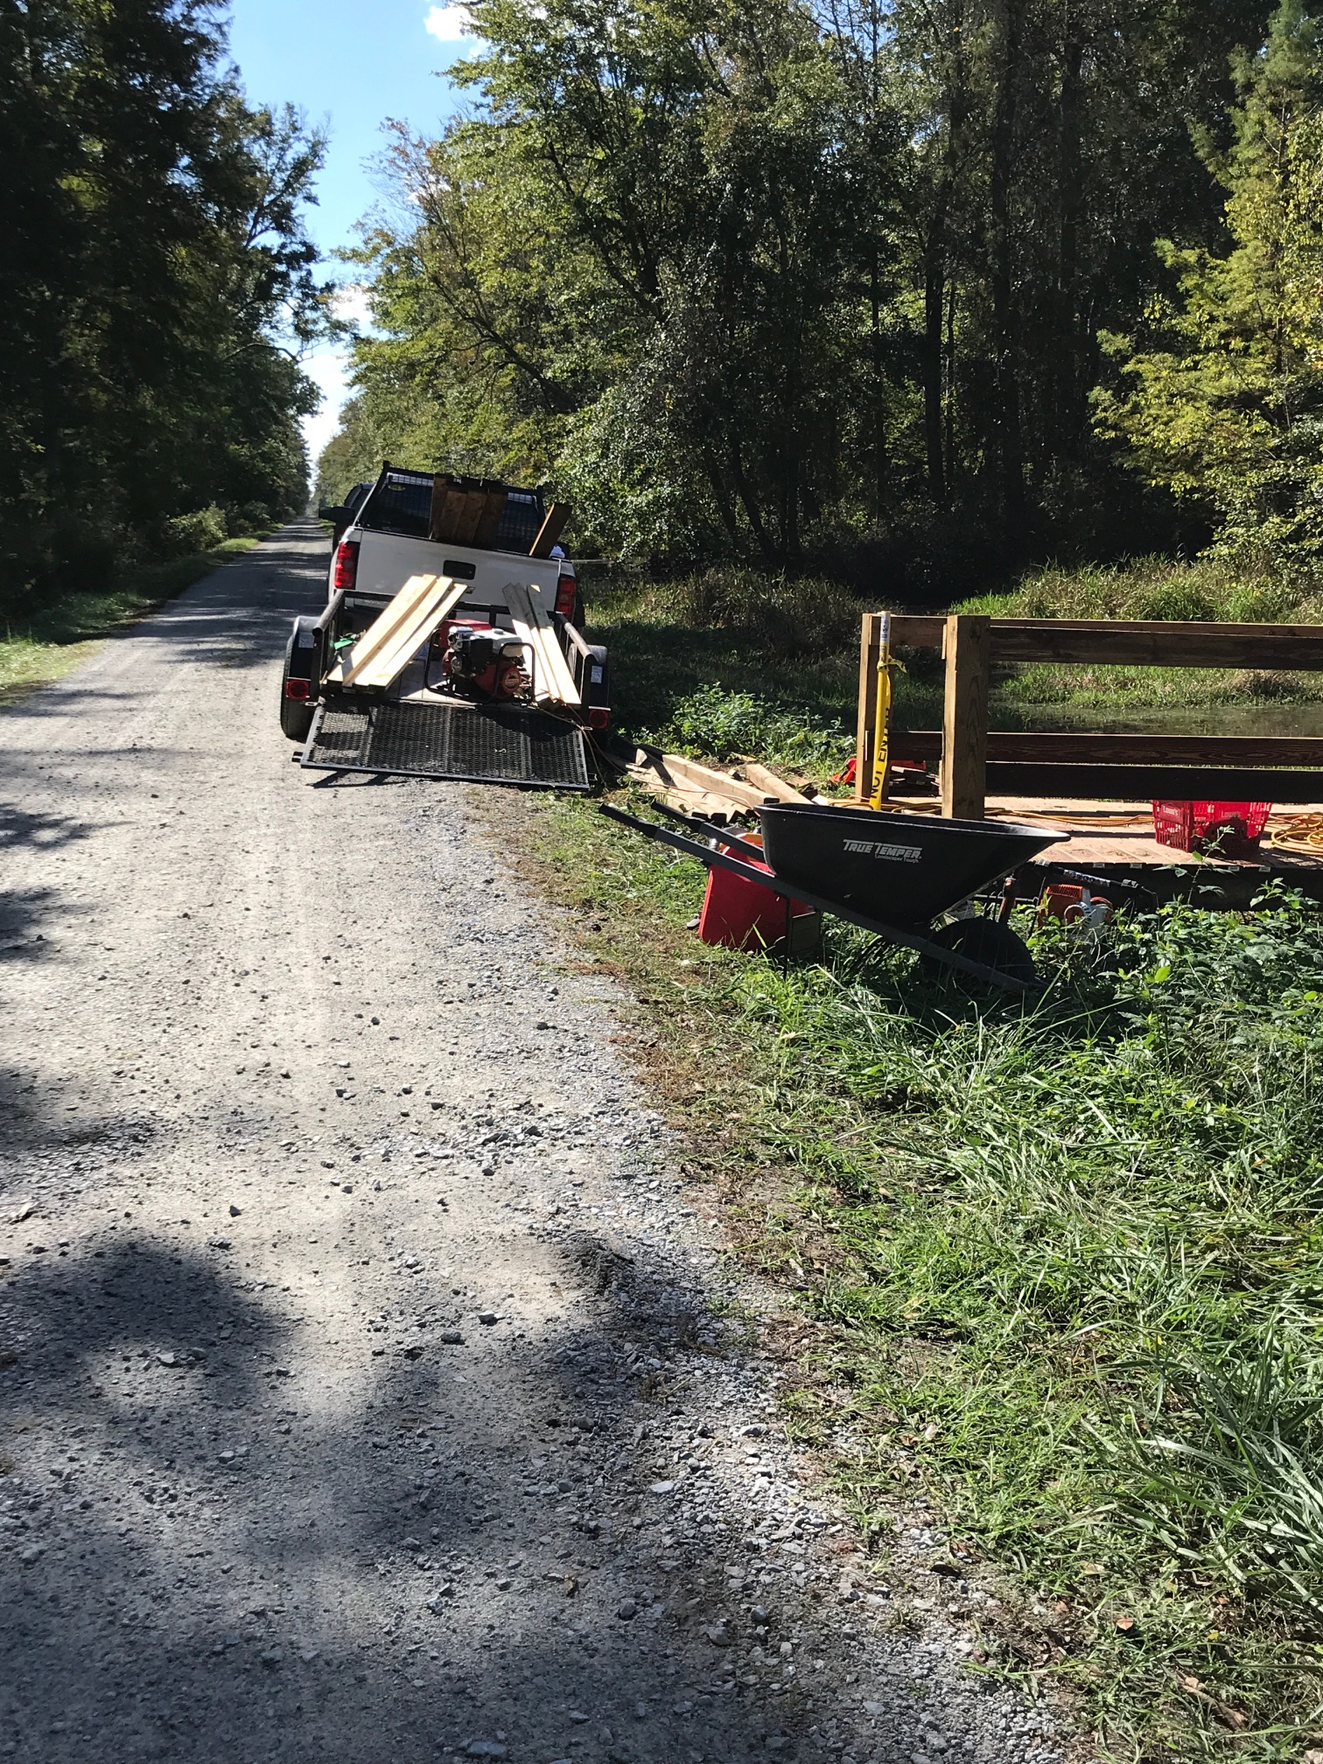

Slide 6
Thank you for listening!

