Slide 1
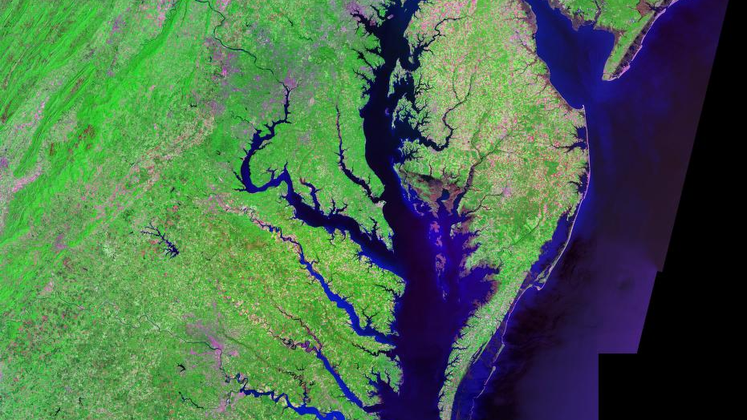
Chesapeake Bay, Sea Level Rise, and the Anthropogenic Threats It Faces
Kayla Berger
Stakeholder being addressed: Virginias Governor, Ralph Northam

Slide 2
Why It’s Important…
Largest estuary in the United States, and most productive in the world
  Over 3,600 plant and animal species
  18.1 million residents living along watershed
    Expected to rise to 20 million by 2030
Facing problems due to anthropogenic activities

Slide 3
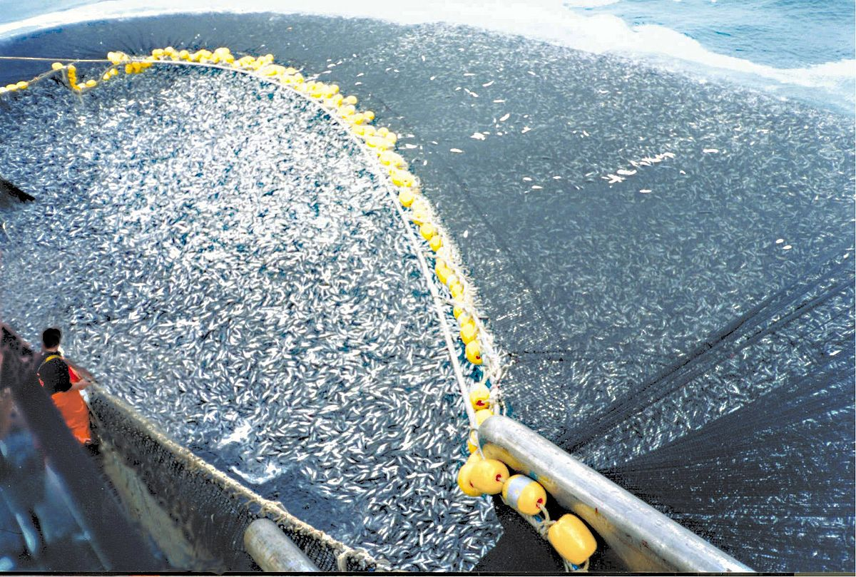
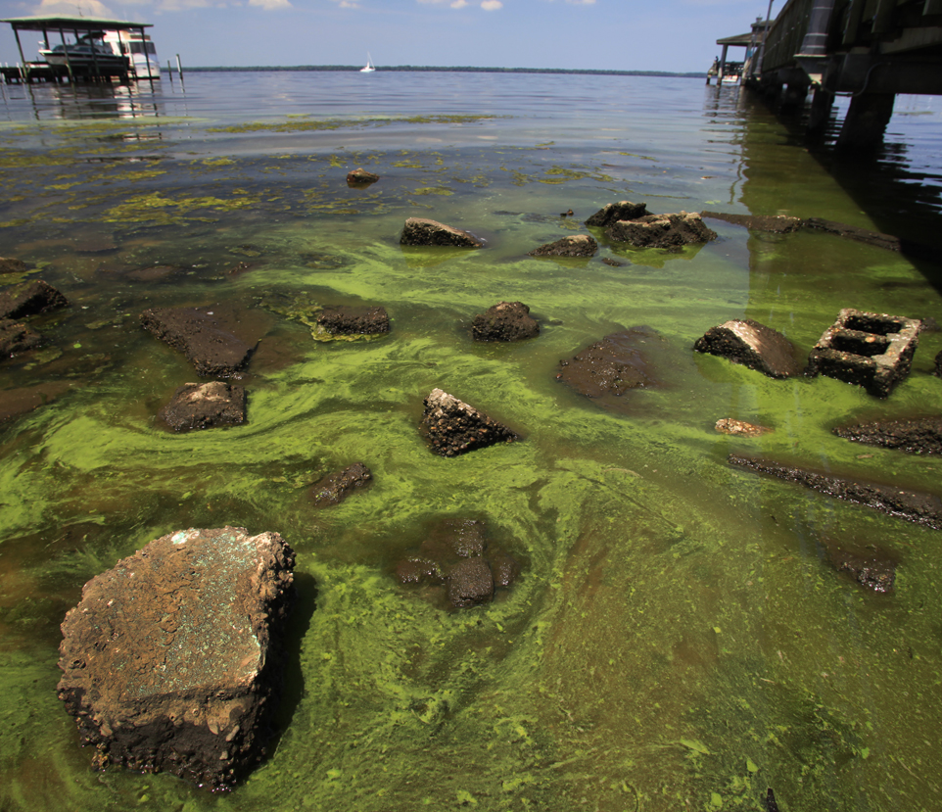
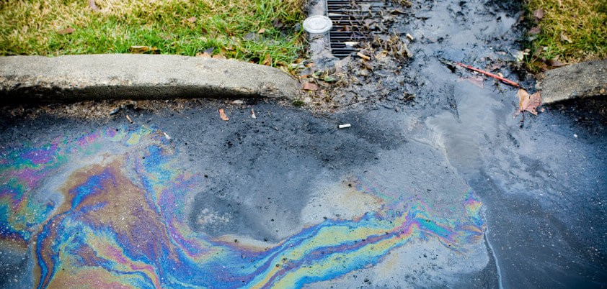
Hazards…
Overfishing
Eutrophication:
  N and P
  Fertilizer and Sewage runoff
Sea Level Rise:
  Risen ~1 foot over last 100 years
  Bay waters rising faster than global average (3.2mm/yr)

Slide 4
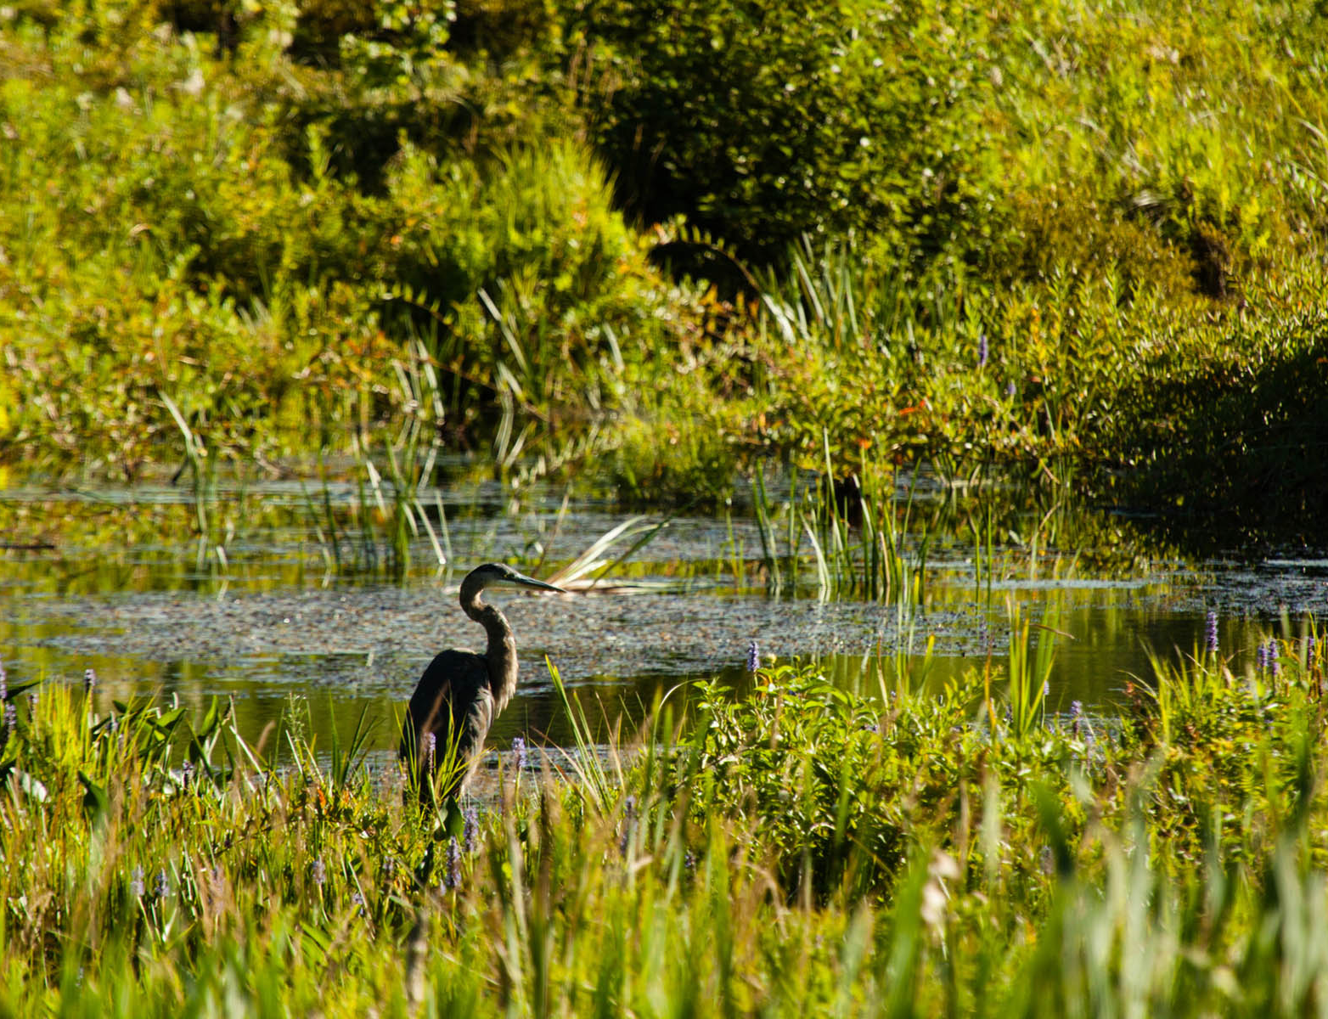
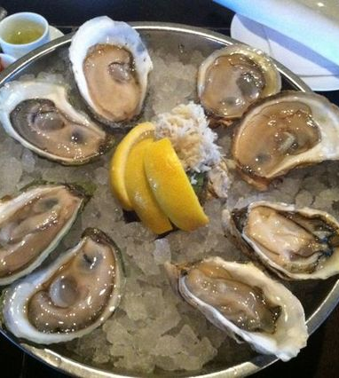
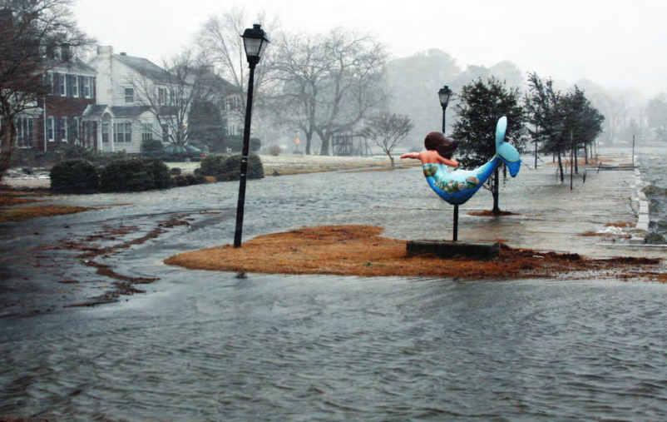
Vulnerabilities…
Sea Level Rise:
  Coastal Communities
  Wetlands
Overfishing:
  Eastern Oysters:
    Harvest <5% of what it was in 1850
    Bay’s cleanup crew
  Menhaden, Shad, Striped Bass
Eutrophication:
  Eelgrass (photosynthetic relying organisms)

Slide 5
Foresight…
By the end of the 21st century (Najjar et al, 2010):
  CO2 concentrations increase 50-120%
  Sea level increase up to 2m
  Water temp increase 2-6 degrees Celsius
Wetlands will disappear faster than plants can populate higher ground
Increase in precipitation and tropical storms
  Increase in P runoff, increase in Algae (decrease in Eelgrass)

Slide 6
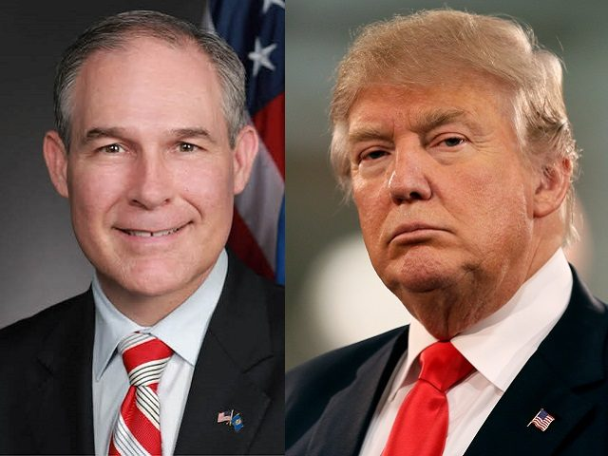
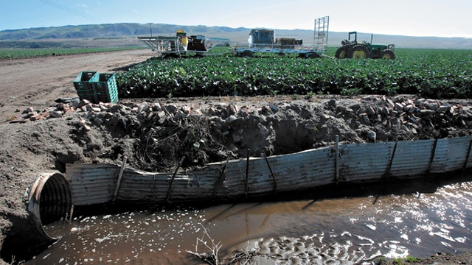
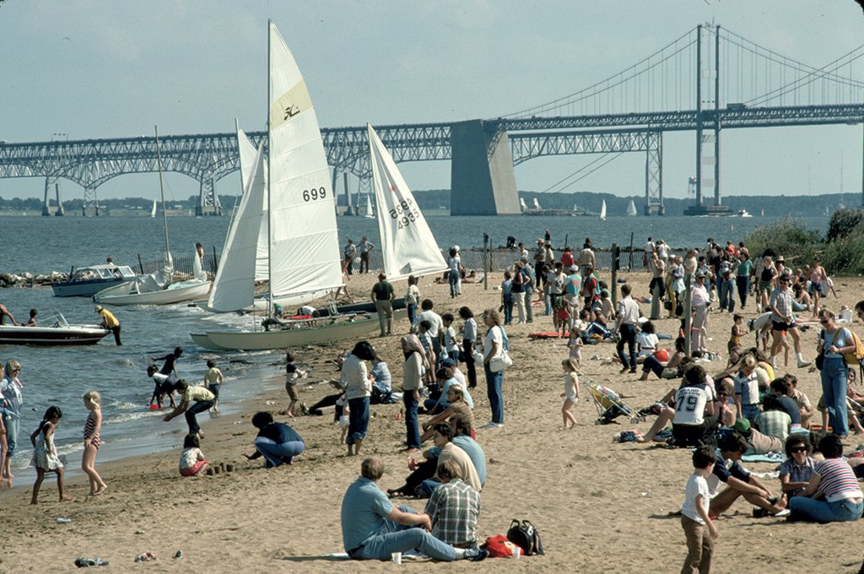
Decision Making…
EPA (Environmental Protection Agency)
  Scott Pruitt
  Chesapeake Bay Foundation
  Clean Water Act
Stakeholders
  Farmers
    40% of eutrophication comes from agricultural runoff
  Tourists
  Navy
  Fisheries

Slide 7
Options…
Option 1: Do nothing
Coastal communities will flood
Relocation
Polluted runoff will increase
Algal blooms will increase, Eelgrass will decrease
Option 2: Stick to current path
Oyster harvests on the rise
Wild vs. Farmed
Cleanup programs (TDML- Total Daily Maximum Loads)
Farmers
Floodplan management programs
Houses must be 8.5ft above sea level
Option 3: Increase regulations and Education
Strict farmed oysters
Equal education across all counties in schools
Residential regulations on runoff
Flood management plans in all counties along watershed

Slide 8
Recommendations…
Option 3:
  Flood management plans in all counties along watershed
  Regulations on residential fertilizer use
    More precipitation means more runoff
    Cap of use per square acre
  Equal education on Bay issues in all schools along the Bay
    Younger generations will eventually become the decision makers
    Less education on issues in lower income communities (Paolisso et al., 2012)
  Farmed oysters to be sold only
    Increase oyster populations faster
    Improve water quality of bay

Slide 9
References…
Beckett, L., Baldwin, A., and Kearney, M. 2016. Tidal marshes across the Chesapeake Bay Sub estuary are not keeping up with sea-level rise. Public Library of Sciences. 11.
Ezer, T., and Crolett, W. 2012. Is sea level rise accelerating in the Chesapeake Bay? A demonstration of a novel new approach for analyzing sea level data. Geophysical Research Letters. 39.
Hawkins, T. 2015. Simulating the Impacts of Projected Climate Change on Streamflow Hydrology for the Chesapeake Bay Watershed. Annals of the Association of American Geographers. 105: 627-648
Kemp, W., Boynton, W., Adolf, J., Boesch, D., Boicourt, W., Brush, G., Cornwell, J., Fisher, T., Gilbert, P., Hagy, J., Harding, L., Houde, E., Kimmel, D., Miller, W., Newell, R., Roman, M., Smith, E., and Stephenson, J. 2005. Eutrophication of Chesapeake Bay: historical trends and ecological interactions. Marine Ecology Progress Series. 303: 1-29.
Michael, J. 2007. Episodic Flooding and the Cost of Sea Level Rise. Ecological Economies. 63: 149-159.
Morgan. C., and Owens. C. 2001. Benefits of water quality policies: the Chesapeake Bay. Ecological Economies. 39: 271-284.
Najjar, R., Pyke, C., Adams, M., Breitburg, D., Hershner, C., Kemp, M., Howarth, R., Mulholland, M., Paolisso, M., Secor, D., Sellner, K., Wardrop, D., and Wood, R. 2010. Potential climate change impacts on the Chesapeake Bay. Estuarine, Coastal and Shelf Science. 86: 1-20
Paolisso, M., Douglas, E., Enrici, A., Kirshen, P., Watson, C., and Ruth, M. 2012. Climate Change, Justice, and Adaptation Among African American Communities in the Chesapeake Bay Region. Weather, Climate, Society.
Paolisso. M., Trombley, J., R. Hood., and Sellner, K. 2013. Environmental models and public stakeholders in the Chesapeake Bay watershed. Estuaries and Coasts. 38: 97-113.
Rick, T., Reeder-Meyers, L., Hoffman, C., Breitburg, D., Lockwood, R., Henkes, G., Kellogg, L., Lowery, D., Luckenbach, M., Mann, R., Ogburn, M., Southworth, M., Wah, J., Wessen, J., and Hines, A. 2016. Millennial-scale sustainability of the Chesapeake Bay native American oyster fishery. National Academy of Sciences. 113: 6568-73
Ryberg, K., Blomquist, J., Sprague, L., Sekellick, A., and Keisman, J. 2018. Modeling drivers of phosphorus loads in Chesapeake Bay tributaries and inferences about long-term change. Science of the Total Environment. 616-617: 1423-1430

