Slide 1
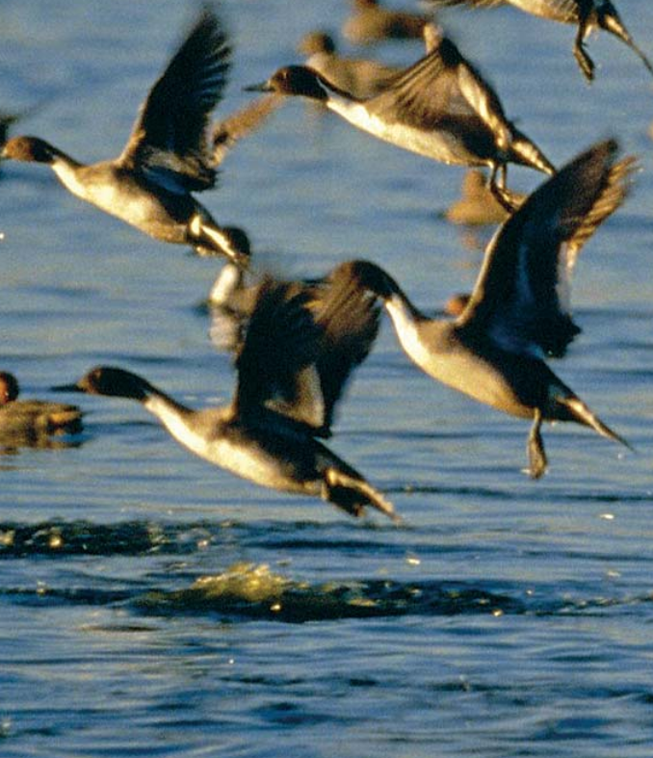
Impacts of Sea Level Rise & Climate Change on the Back Bay Wildlife Refuge
Preserving the refuge’s natural resources for future generations and opportunities for public use will continue to build a solid coexistence between the wildlife and the people.
System: Back Bay Ecosystem
Challenge: Preserve Wetlands & Safeguard wildlife & fish populations
Stakeholders: Back Bay NWR, US FWS, Private businesses & homeowners, City (VA Beach)& State agencies
-Angela Kennedy-

Slide 2
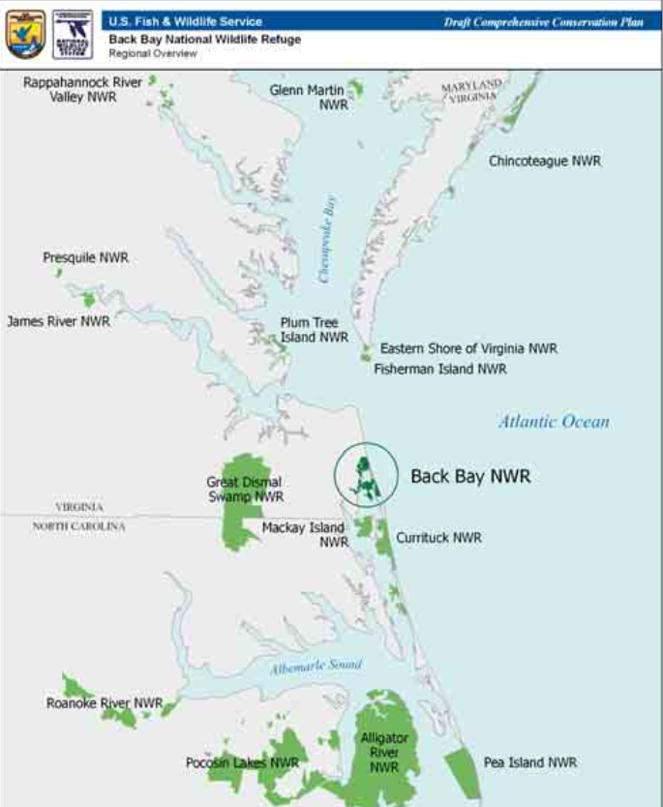
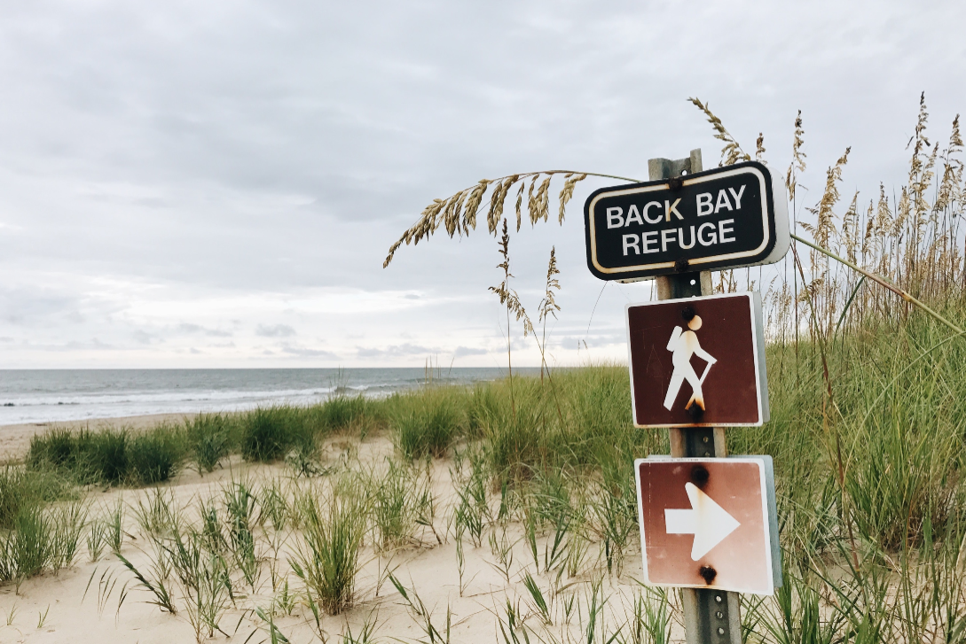
Back Bay Wildlife Refuge: Challenge
Back Bay:
9,120 Acres, SE VA
Open water, nearly F.W. estuary with barrier beach, beach & dunes
Rich ecosystem
Climate Change
Sea level rise
Saltwater intrusion
Land loss
Developmental pressures
Major ecosystem changes
(Anon, 2011)

Slide 3
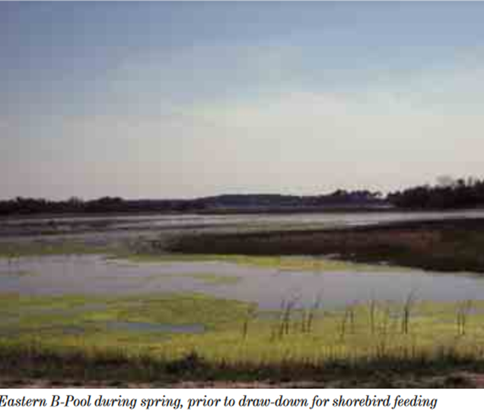
Back Bay: Hazards
Climate Change
Result of human activities, increased greenhouse gases
Ocean expansion
sea level rise
Extreme weather events
Extreme patterns of high precipitation & drought
Breaches of barrier beaches & saltwater intrusion, flooding, erosion
Rising temperatures
Climate change amplifying other effects on ecosystem
(Stein et al., 2018, Anon, 2010)

Slide 4
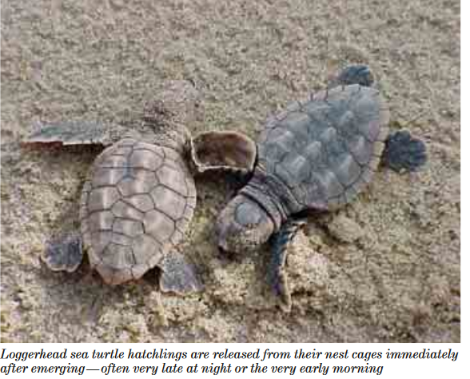
Back Bay: Vulnerabilities
Expansive coastline, low topography=very vulnerable to sea level rise
Prone to increasing erosion rates
Barrier Islands at risk
Freshwater estuary sensitive to salinity changes
Fish, plant, and animal populations in the ecosystem
Ex. Loggerhead turtle, Green sea turtle (threatened)
Adapted to freshwater estuary
(Smallegan et al., 2017, Anon, 2010)

Slide 5
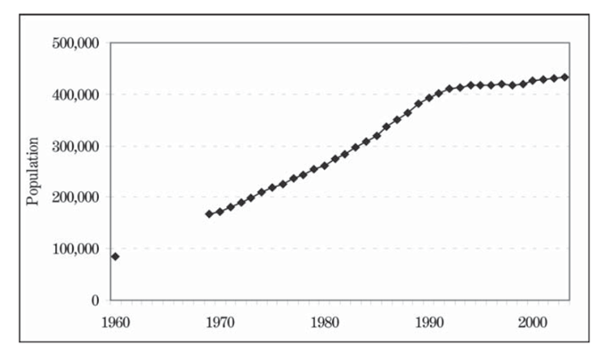
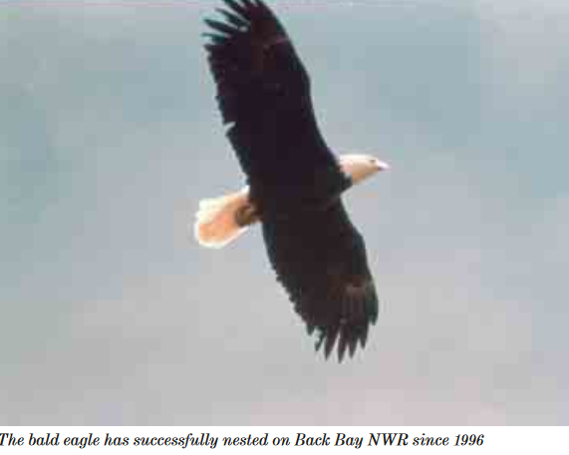
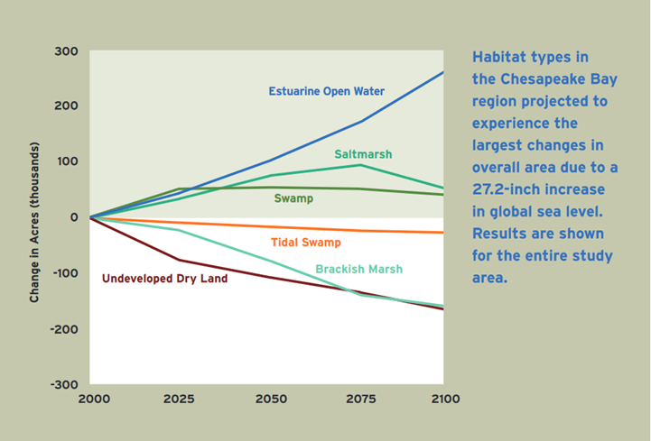
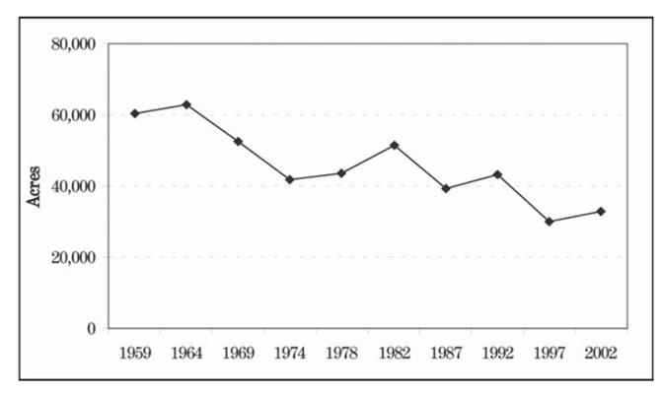
Back Bay: Foresight
Extreme Weather events, hurricanes, temperature increases
Change forest ecosystems
Species behavioral and range shifts
Changes in breeding and migration patterns
Decreasing wetland & Coastal habitats
Able to compensate for moderate changes
Ability for ecosystems to migrate inland is hindered due to coastal development
Accelerating population growth & decreasing developmental land
13,000 to 5,000 acres in 6 yrs
W/O beach re-nourishment, projected 79% loss of beaches, 29% loss of brackish marsh by 2100
Sea Level Rise
SLAMM Analysis: sea level rise in back bay predicted a 0.691m increase by 2100
Major ecosystem changes
Open ocean estuarine 38% to 77%
Land submergence
Decreased drylands, inland F.W. marshes, salt marshes
Saltwater intrusion
Barrier islands inundated
Ecosystems stressed
(Glick et al., 2008, Anon, 2011))

Slide 6
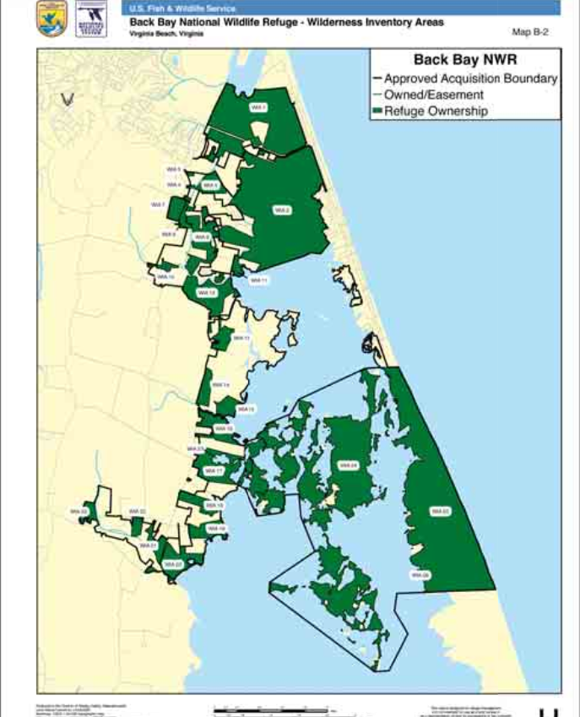
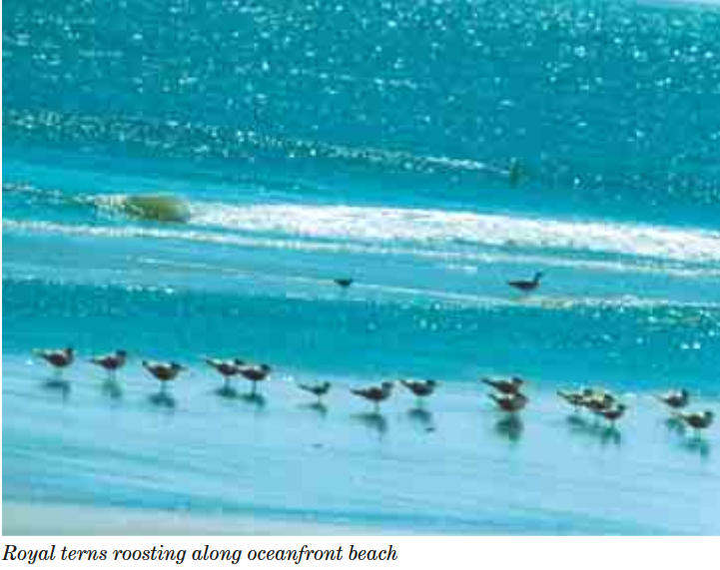
Back Bay: Decision-Making
Managers and directors of Back Bay Wildlife Refuge
Preservation of the habitat
Land ownership & easement
US Fish & Wildlife service
Management of waterfowl species
Private homeowners and businesses in sandbridge area
Ocean front property, tourism
Protection of assets
City of Virginia Beach & State agencies
Land permits, land development
Non-government, private organizations
Research & funding
(Anon, 2010)

Slide 7
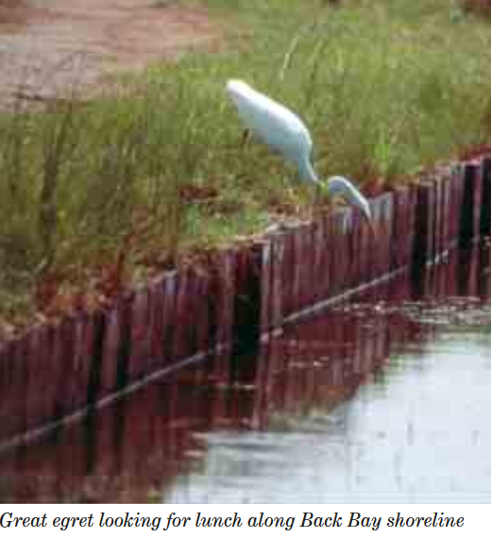
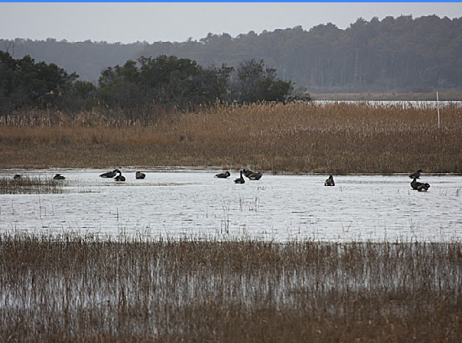
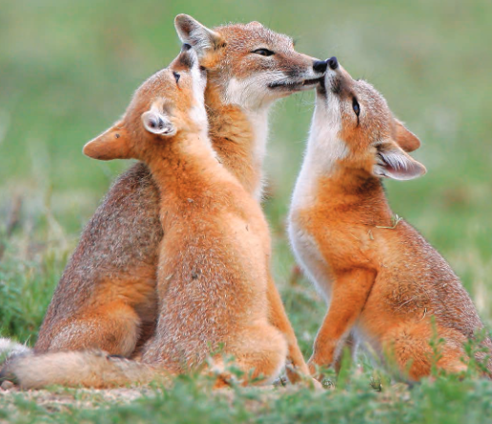
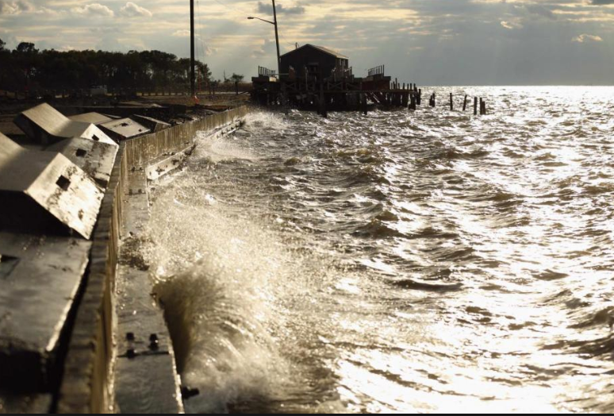
Back Bay: Options
Preventative measures to decrease erosion
Beaches/dunes & forcing mechanisms (storm surges, tides, etc.)
Re-nourishing the beach, elevating the dunes
Raising barrier island levels
Buried sea wall
Pro’s vs Con’s
Simulation studies
Raising barrier island yielded best results
Continue current management efforts of the refuge
Infrastructures & impoundments
Supporting SAV
Preserve & protect wetland ecosystems
Supports resiliency of species & ecosystem
Back Bay NWR acquires more land via ownership & easement
Allowing 880-acre impoundment of the F.W. barrier island to return to natural state
Intention is to promote biological integrity
Changes in water levels will not be interfered with
Would promote common wetland and shrub-scrub
Potential plant diversity decrease
Invasive plant species
(Smallegan et al., 2017, Anon, 2010, Meihl et al., 2005)

Slide 8
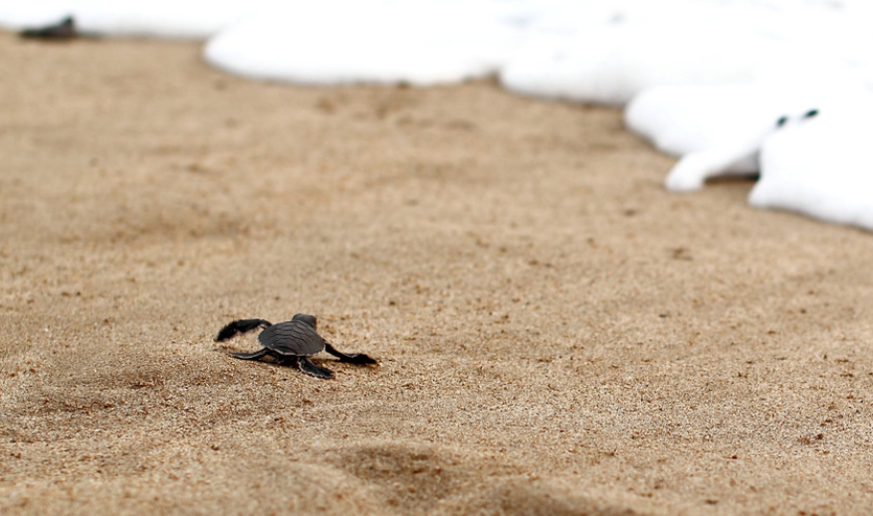
Back Bay: Recommendations
Actions recommended for Back Bay NWR managers & directors, US FWS, VA Beach city & state agencies, other federal agencies
2nd Option
Continue current management and efforts of preserving the wetland habitats & species
Maintain infrastructures & impoundments
Support appropriate SAV populations and species populations to promote resiliency
Land acquisition to ease habitat migration
& Rise Barrier island to increase erosion protection

