Slide 1
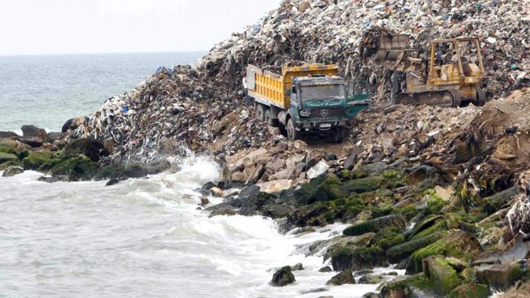
Connection between Sea Level Rises and Coastal Landfills
WHAT TO DO WITH COASTAL LANDFILLS AMID A INCREASING SEA LEVEL RISE
Stakeholders: city planners

Slide 2

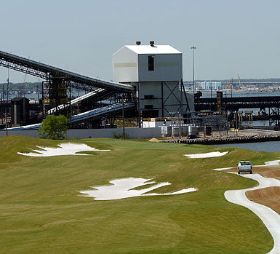
Coastal landfills
  a system of trash and garbage disposal in which the waste is buried between layers of earth to build up low-lying land.”
  They are at a great risk of flooding due to the dramatic sea level rising on the coast
Lambert’s Point Golf course built onto a landfill was subject to erosion during hurricane Irene 2011

Slide 3
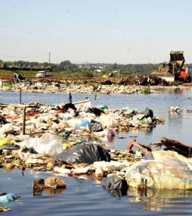
Hazards
Coastal Landfills are subject to flooding due to the fact that they are built in low laying areas on the coast areas
  Flooding is a major factor
Rising of water in Paraguay leads to a flood in the landfill.

Slide 4
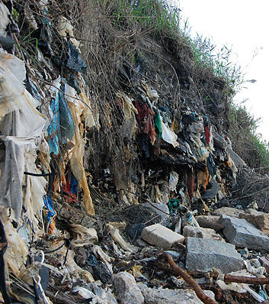
Vulnerabilities
Unpredictable water deposits in landfills
Waste depositing all over ecosystem could cause toxic gas waste emissions into a communities’ air and the body of water around them.
    Mercury released into air/water.
    Methane gas exposure
Lambert’s Point landfill emissions into the Elizabeth River caused by Hurricane Irene

Slide 5
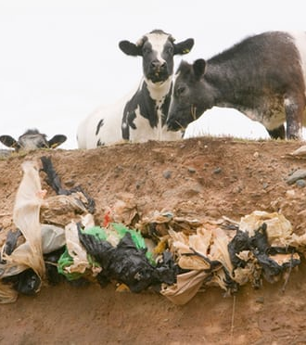
Foresight
“What if?:
  The landfill gets flooded
    Erosion
    Trash deposited into water
Scenarios for sea level rise:
  Local relative sea level scenario
  Extreme weather event scenario

Slide 6
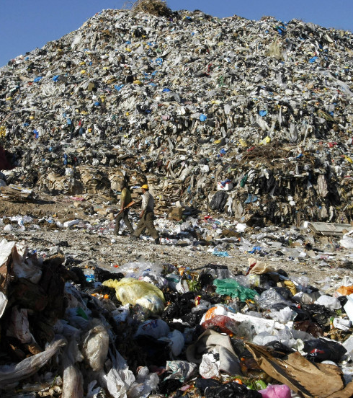
Decision Making
Landfills flooding is a public health issue.
  It also effects the ecosystems surrounding the landfills by depositing trash all over leading to a pollution epidemic.
Stakeholders:
  Those who live/own property near a landfill
  Federal, state & local government regulators (agencies)

Slide 7
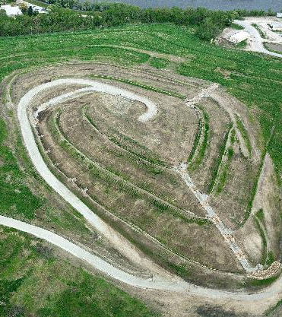
Options
Option 1:
  Just capping the landfill.
    Its hard to say if all the gas emission can be completely blocked.
    For example: the capping of the Florida’s Virginia Key
Option 2:
  Building a sea wall around the landfill.
    The sea wall could still eventually be flooded.
Option 3: Moving the existing landfills into a space away from coastal flood zones.
  It is costly
Option 4:
  No action
    Letting the sea level rise and keeping the landfill where it is with no capping, not moving and no sea wall built.

Slide 8
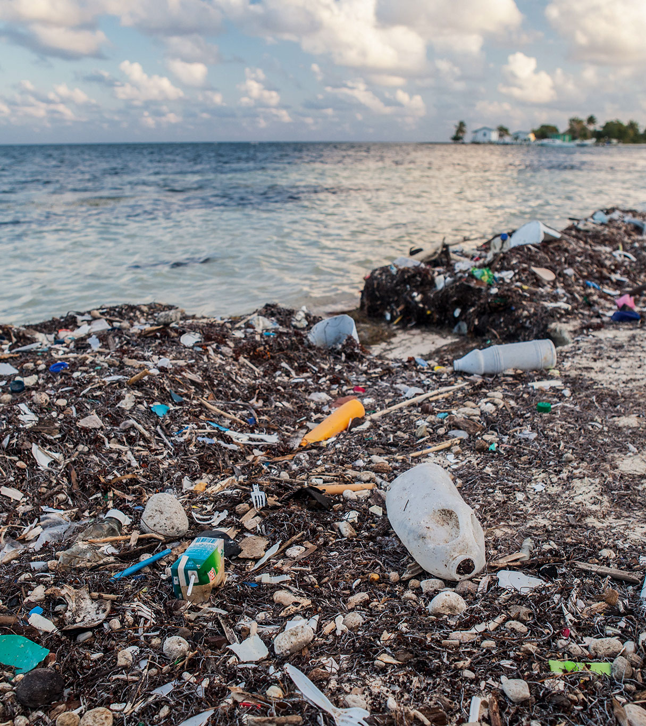
Recommendations
Making a standard for how the landfills are capped.
  Make sure the way they are capped is effective enough to where the gas emission do not effect the water, air and ecosystems surrounding it.

