Slide 1
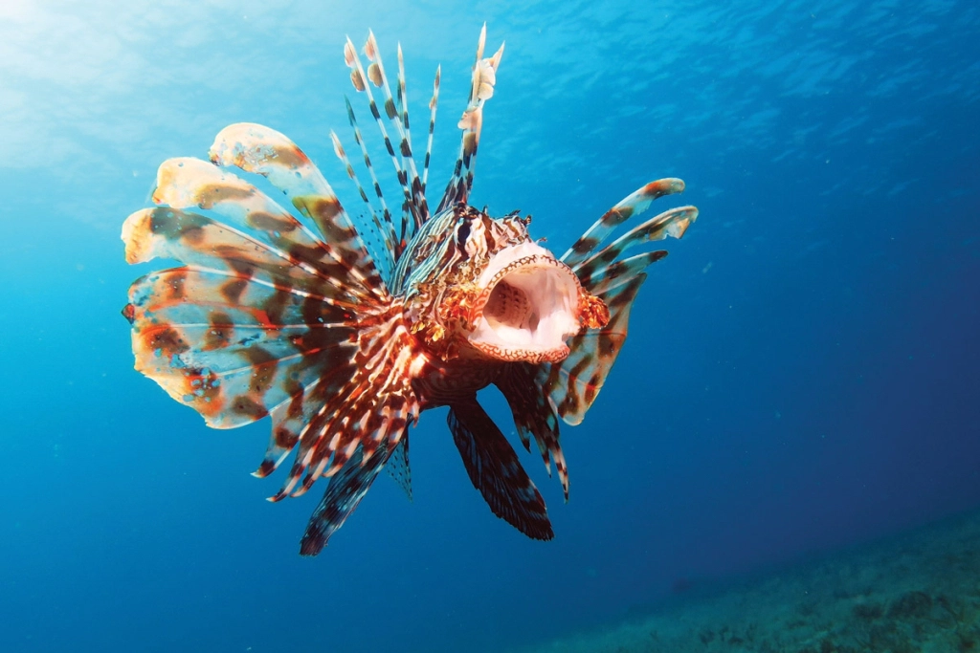
Invasive Lionfish along the Atlantic coast from Rhode Island to Brazil
The System:
Ecosystem of corals and native fish in the Southern Atlantic Ocean and the Caribbean Sea
The Challenge:
Invasive lionfish are reeking havoc on the ecosystem
The Stakeholders:
The locals that rely on tourism economy, Florida Fish and Wildlife Conservation Commission, and the Northern Atlantic Oceanic and Atmospheric Administration
Alexa Zwicker

Slide 2
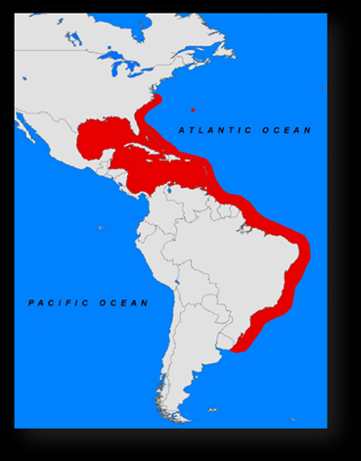
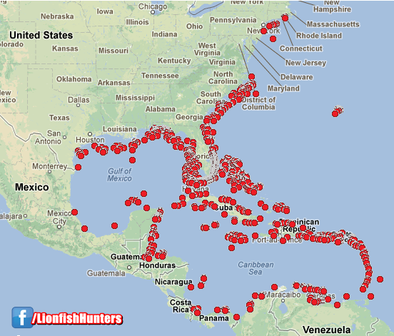
Lionfish, invasive or just non-native?
Invasive vs. non-native
Native to the South Pacific and Indian Oceans
Currently invading the Atlantic coast and Caribbean Sea
Decreasing the local fish population
Causing eutrophication in coral reefs
(Ziska and Dukes, 2014)

Slide 3
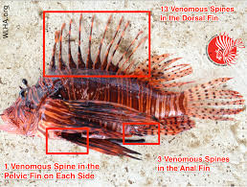
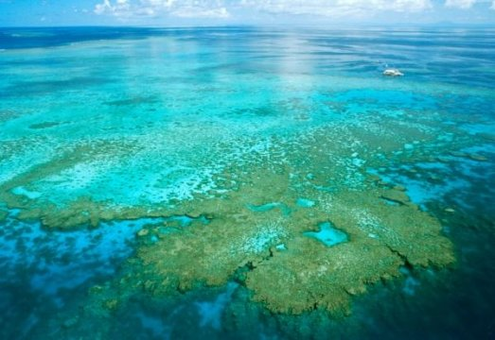
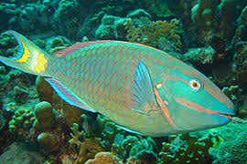
The Hazards
Eutrophication of corals
What does this mean?
Altering the native fish population
Predators or prey?
Venomous dorsal spines
(Green et al., 2013)

Slide 4
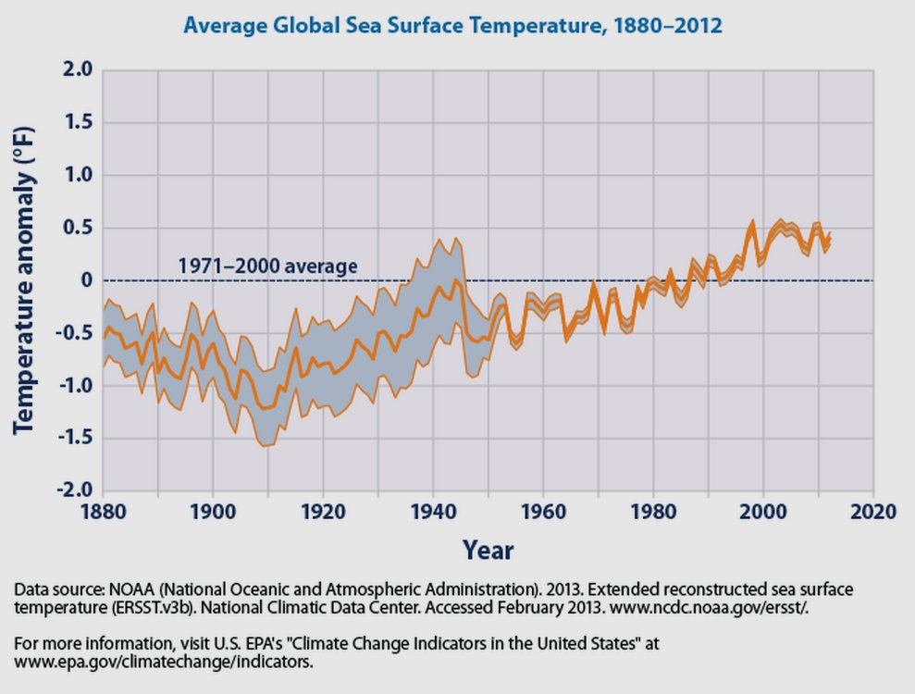
The vulnerabilities
Economically vulnerable fish market and local tourism decline
The possibility of the temperature of oceanic water increasing
lionfish have the possibility to move further north and south
Lionfish will eat any living organism they can
(Johnston and Purkins., 2015)

Slide 5
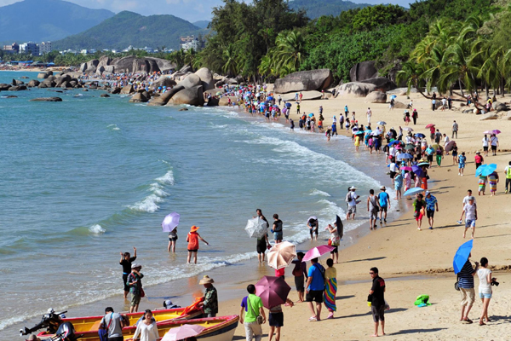
Foresight
Lionfish could eat all of the native fish due to their fast reproduction and developmental rate
This would cause a faster rate of eutrophication because coral reefs cannot be cleaned off
Tourism to see these fish and coral reef ecosystems would diminish because everything has died
Local economies would deteriorate because they are based on tourism
New economy based on using lionfish as a food source
Vaughn Martin, CEO of Serenity Dive in Saint Vincent
(Hare and Whitfield, 2003)

Slide 6


Decision Making
The locals that rely on tourism economy
They would like to continue living their lives so they would want to eradicate the lionfish
Although lionfish may increase locals revenue
Florida Fish and Wildlife Conservation Commission
Want to protect the environment
Northern Atlantic Oceanic and Atmospheric Administration
Fishery companies
(Mumbly et al., 2011)

Slide 7
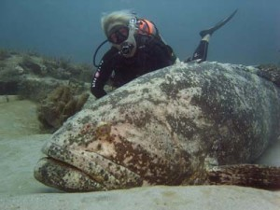
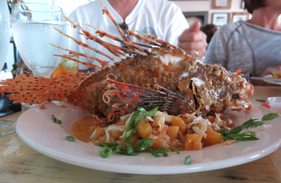
Options
Option A - Do nothing
Lionfish population would increase substantially
Ecosystem would deteriorate
Option B - Sustainably decrease the population
Introduce them as a human food source
Venomous not poisonous
Introduce more predators
Monthly culls
Option C – Kill all of the lionfish possible
(Barbour, et al., 2011) (Matthew, et al., 2015)

Slide 8
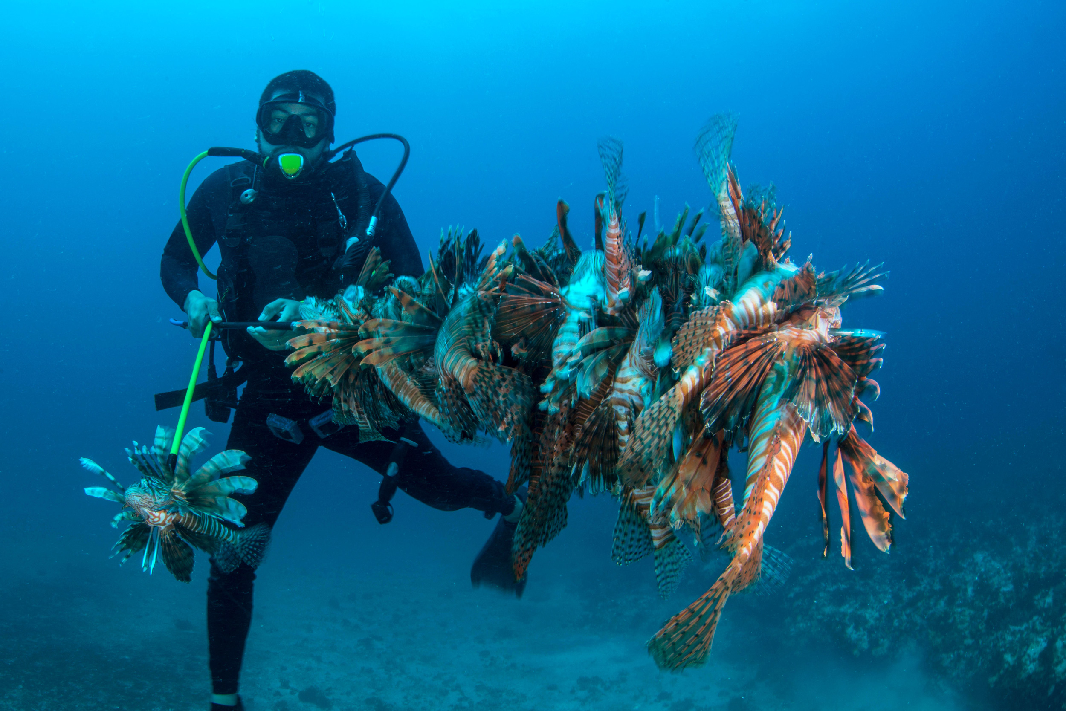
My Recommendations
Option B – Sustainably decrease the population
Tell fish companies to stop catching grouper and start catching lionfish
Have restaurants introduce lionfish as a delicacy to peak human interest
Have state and government conservation organizations monitor breeding sites and host monthly culls to decrease the lionfish population
“We have to eat them to beat them” – Vaughn Martin

