Slide 1
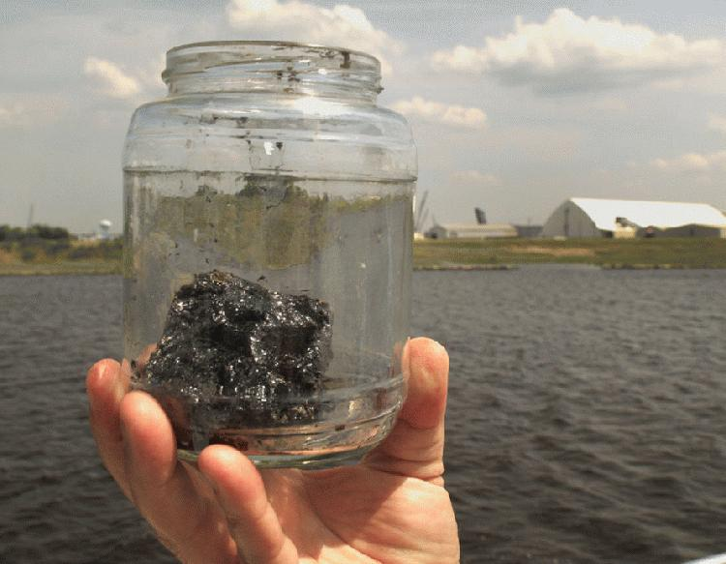
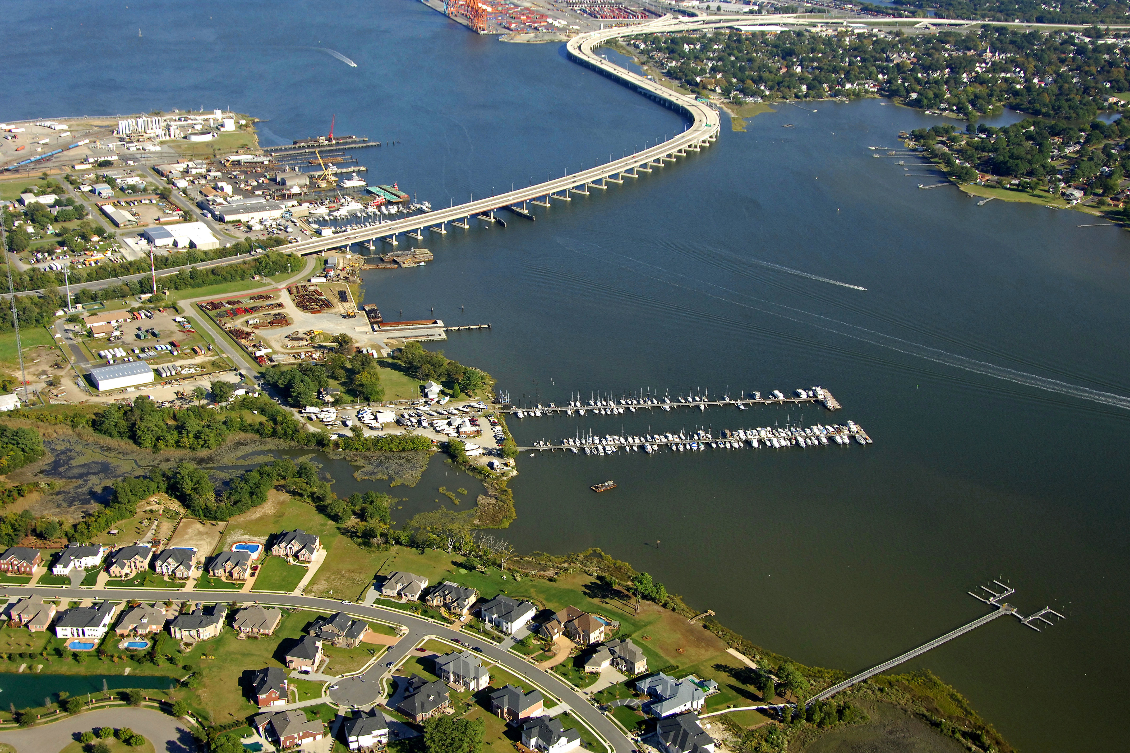
Pollution Alissa Ralston
System: The Elizabeth River
Challenge: Pollution from surrounding plants, runoff from surrounding neighborhoods, and how climate change affects the river.
Stakeholders: The business owners surrounding the river, locals, local politicians, and wildlife.
4275 × 2850Images may be subject to copyright

Slide 2
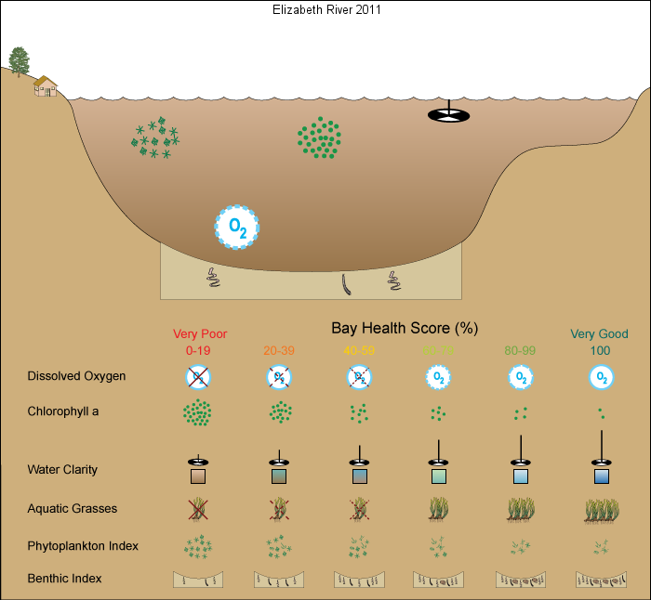
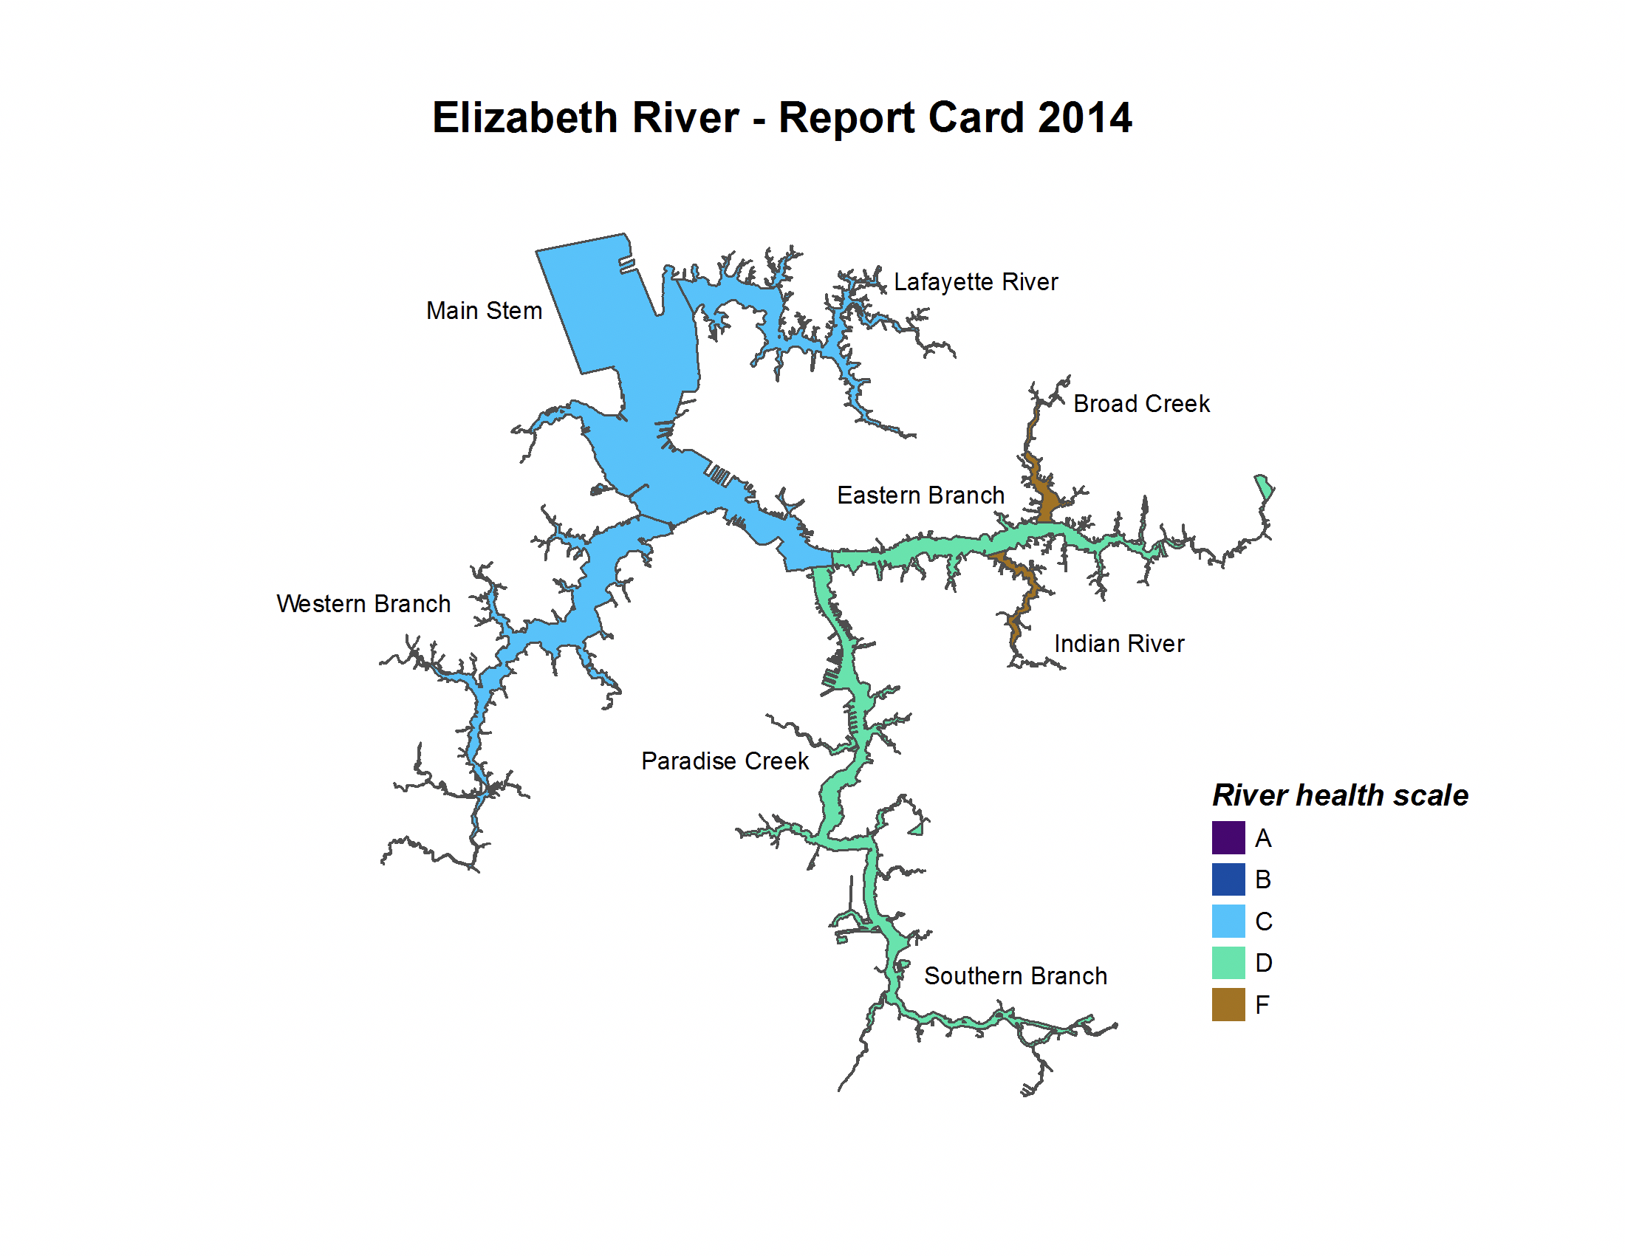
Defining the system
Integration, 2011
State of the River. Elizabeth River Project. (November 2014). https://elizabethriver.org/sites/default/files/State-Of-The-River-2014.pdf
A 23 mile estuary, and one of the most popular rivers to use for commercial shipping.
Classified in the top three most polluted rivers in the state of Virginia, in the early 1990’s was also classified as a toxic zone.
Has been receiving report cards since 2011.
Notes:
Pollution in this river started when settlers first cleared the trees along the banks of the river to build houses, following this the river was dredged and filled in on the sides in order to make it easier for ships to get to the Chesapeake Bay.

Slide 3
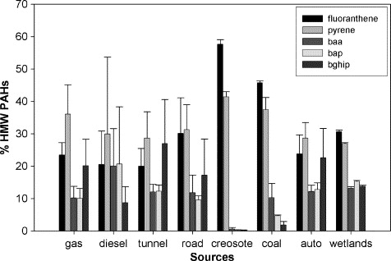
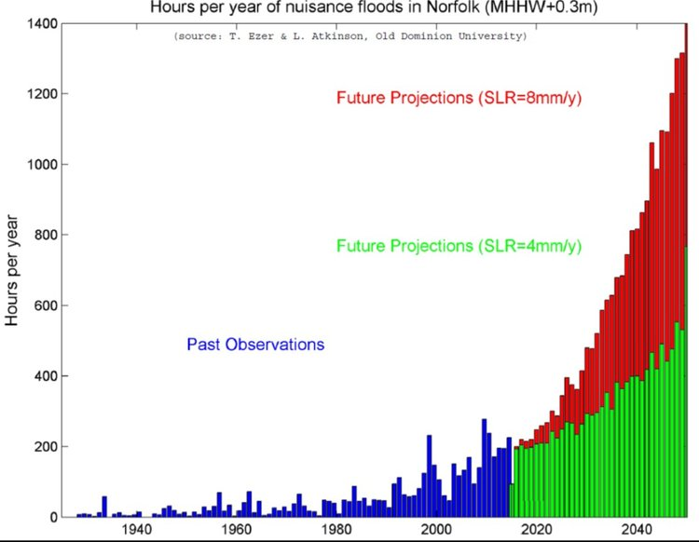
Hazards
(Kimbrough, 2006)
476 × 318Images may be subject to copyright
Dredging the river to create more room for ships to get to and from the Chesapeake Bay.
Wood treatment plants deposited a coal derived wood preservative called PAH, causes health problems to the fish in the water.
Climate change has resulted in sea level rise, causing the river to flood more frequently.
Over fertilization on lawns or not picking up after your dog runs off into the river, causing toxic algal blooms in the summer.
Notes:
Dredging is hazardous because it destroys the ecosystems on the bottom of rivers, because the plants can’t survive at new depths. How would sunlight reach them? It wouldn’t. The river is about 55 feet deep at its deepest areas. Originally this river was not very deep so plant life flourished. The water clarity is also very poor, so poor that it received a zero on the report.
Around 60 killifish were collected and roughly 90% of the fish displayed high amounts of lesions on the liver. Studying the fish showed they contained high levels of hydrophobic DNA adduct in their blood and organs such as the spleen. This simply means that there is a modification to the DNA that can only occur when carcinogens are present. This research proves that there is a link between PAH in the water and the cancer in the fish.

Slide 4
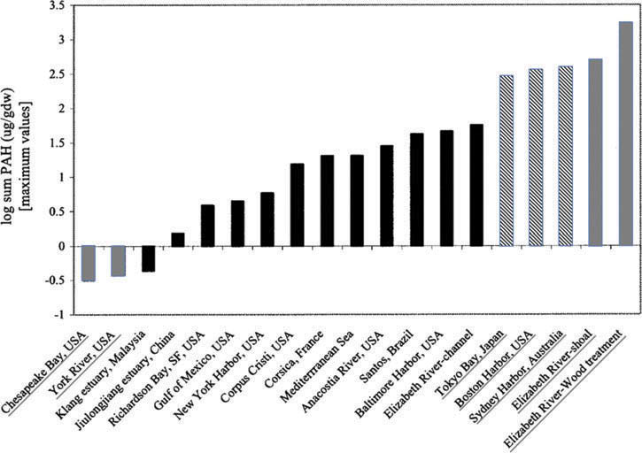
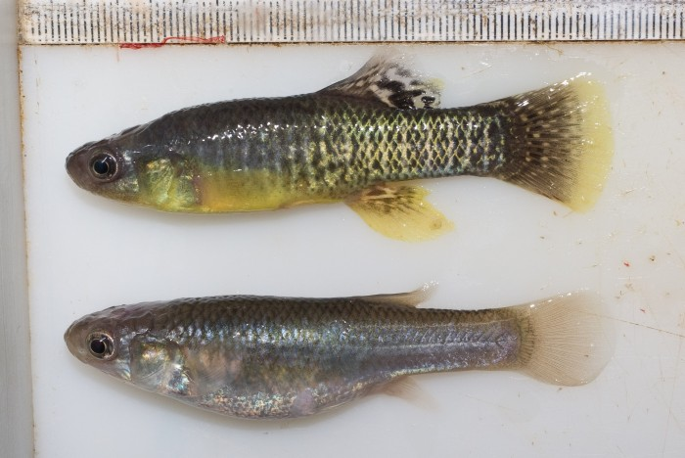
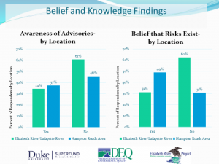
Vulnerabilities
Killifish- vulnerable to blue-sac disease from the PAH in the water.
Bottom dwelling wildlife- when contamination is present, life on the bottom of the river is reduced.
Locals- The river is still not safe to swim or eat fish, and only 37% of anglers and fishermen are aware of any advisories.
Everyone- Because of climate change, it’s expected that flooding will get worse in this area.
Giulio, 2015
Kroeger, 2014
Kroeger, 2014
Notes:
When exposed to PAH, killifish can pass on resistance to their offspring so before they hatch they’ll still be exposed to those chemicals but it’s not going to cause any health issues. Killifish that do not pass on any resistance to PAH, and then the unhatched offspring are exposed to PAH will develop blue-sac disease. This essentially means they’ll form cardiovascular issues such as tube hearts and decreased circulation (Guilio, 2015).
A good indicator for researchers to tell whether or not a river is in bad health is if there are a lot of river otters. This is because river otters eat things like crabs, turtles, and oysters. If there are contaminants in the water none of those things will be edible for the river otters (besides the fact there is wood treatment chemicals in the water), so the otter numbers will decline.
Locals fish and crab in this river, this means they’re taking contaminated fish and crabs home and there is little communication on the restrictions that state whether or not the fish are edible. Only 37% of fishermen know there is an advisory on the fish in the river.
Flooding from the Elizabeth River accounts for about 10% of the damage in the tidewater area (Mitchell, 2013). Due to sea level rise and climate change, tropical storms are expected to increase and even rainfall is expected to increase around 30% in the next twenty years.

Slide 5
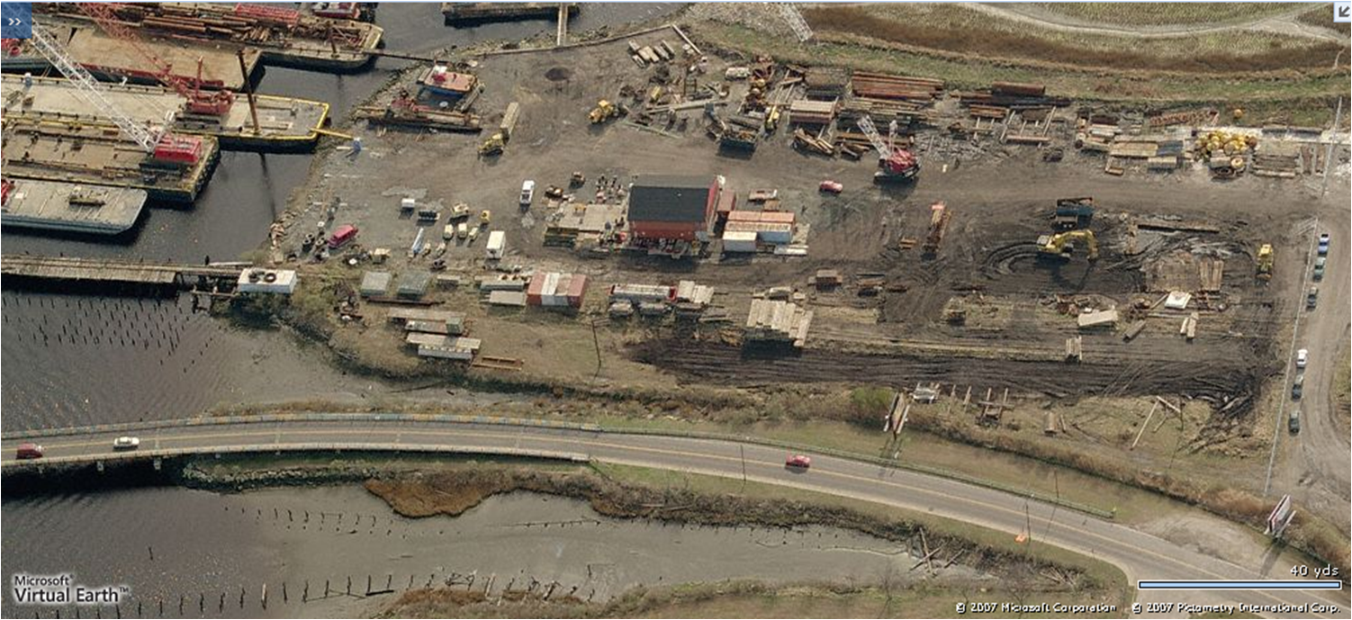
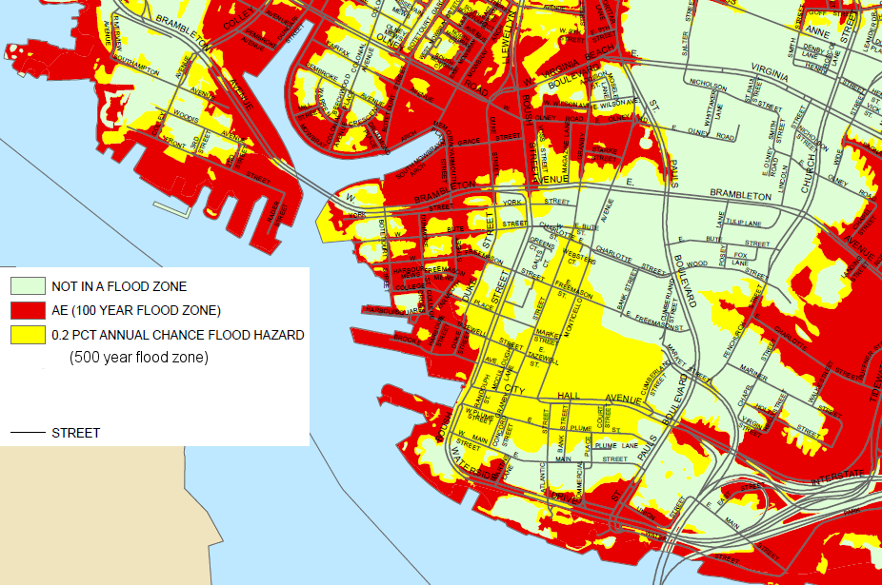
Foresight
Duke University
Will Norfolk Drown
Current Scenario: The Elizabeth River project is a main contributor to improving the health of the river, and have a goal to have its health restored by 2020.
Climate change is expected to cause a dramatic increase in the amount of flooding in the area.

Slide 6
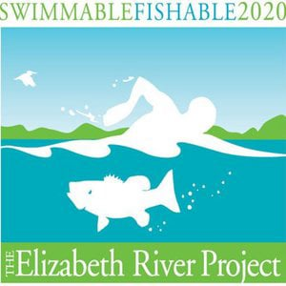
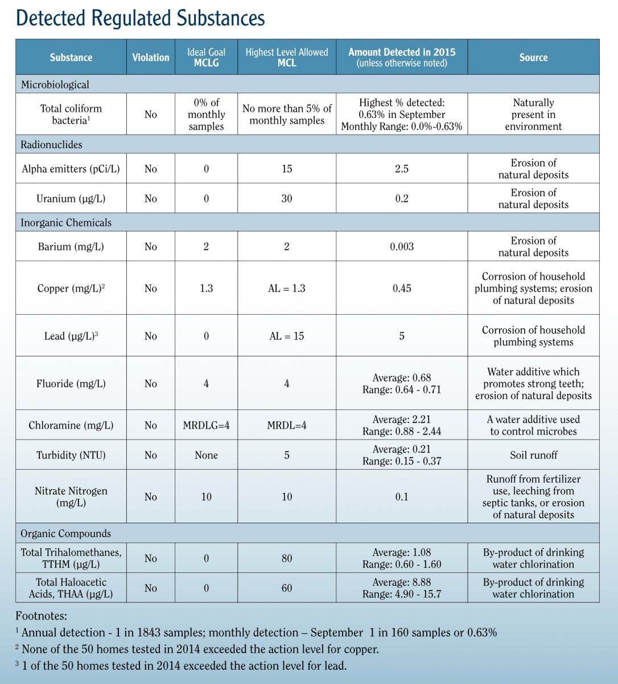
Decision
There is a group called the Elizabeth River Project which has been instrumental in improving the health of the river.
The EPA has water quality standards.
It’s the job of local officials to create plans for when flooding does happen.
2016, 2017
Elizabeth River Project
Notes:
Local government also takes it upon themselves to create flood plans for the neighborhoods in high flood risk areas. This can be difficult because they can’t think of every scenario, and no plan is perfect.
The Elizabeth River Project is a company that was developed when the river was classified as a toxic zone. A lot of their work goes into educating locals and hosting cleanups for the river.

Slide 7
Options
UVA architect students suggested creating wetlands to absorb the flood waters.
Move the neighborhoods in high flood risk areas to areas with low flood risk.
Closing down coal and gasification plants could help get rid of some of the chemicals in the water.
Officials instill regulations on lawn care for locals.
VBAlert

Slide 8
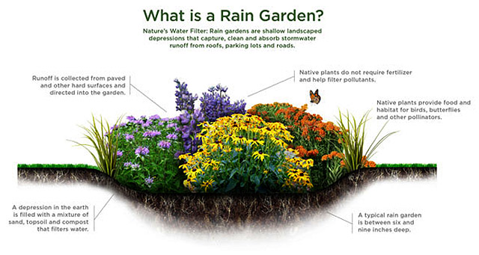
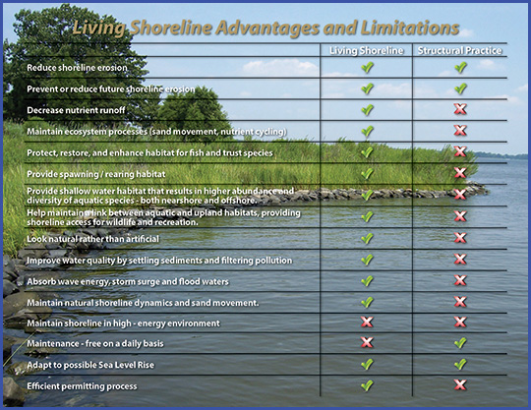
Recommendations
Explore, 2018
Local businesses can plant rain gardens, they’re a great option to lessen run off into storm drains.
Officials relocating residents to safer areas.
The Elizabeth River Project building more living shorelines.
Road workers making the pavement more permeable for rainwater to get through and absorb under the ground.
Living Shorelines
Notes:
Rain gardens are popular in urban areas, like Norfolk, and they’re depressions in the ground and they absorb run off from roofs, parking lots, sidewalks, etc. so instead of running down the drains to the river they’ll be absorbed into the plants and that would help with the excessive fertilizer run off. They are a natural filtration system, and they can brighten up an ugly city street.

Slide 9
Citations
Giulio, Richard T.; Clark, Bryan W. The Elizabeth River Story: A Case Study in Evolutionary Toxicology. Journal of Toxicology and Environmental Health, Part B. 18, 259–298 (Oct. 2015). https://www.ncbi.nlm.nih.gov/pmc/articles/PMC4733656/.
Elizabeth River Facts. University of Virginia. https://elizabethriver.org/sites/default/files/LB-Facts.pdf.
A. Jones, Chesapeake Bay - Reporting Region Summary: Region Summaries - Elizabeth River - Chesapeake Bay Report Card - Chesapeake EcoCheck. http://ian.umces.edu/ecocheck/report-cards/chesapeake-bay/2013/summaries/elizabeth_river/#_Scores_&_Conceptual_Diagram .
Kimbrough, K.L., Dickhut R.M.,, Science Direct. Assessment of polycyclic aromatic hydrocarbon input to urban wetlands in relation to adjacent land use. Pages 1355-1363 (November,2006). https://www.sciencedirect.com/science/article/pii/S0025326X06001263.
Kroeger, G. Duke University. Recent publication: passing on resistance to some toxic effects of PAH exposure. (February 2014). http://sites.nicholas.duke.edu/superfund/recent-publication-passing-on-resistance-to-some-toxic-effects-of-pah-exposure/.
Rainfall Intensity Increasing the Flood Threat: Most Localities Left At Risk. Wetlands Watch. (April 2018). http://wetlandswatch.org/directors-blog/.
Luukenin, B. Duke University. Angling for Understanding on the Elizabeth River. (August 2016). http://sites.nicholas.duke.edu/superfund/angling-for-understanding-on-the-elizabeth-river/.
VBAlert: Flood Information. https://www.vbgov.com/residents/emergency-preparedness/Pages/vblaert-notify.aspx.
Integration & Application Network. Chesapeake Bay- Reporting Region Summary. (2011). http://ian.umces.edu/ecocheck/report-cards/chesapeake-bay/2011/summaries/elizabeth_river/.
Nature Conservancy. Explore Rain Gardens. 2018. https://www.nature.org/ourinitiatives/regions/northamerica/unitedstates/newjersey/explore/rain-gardens-1.xml.
2016 Annual Water Quality Report. Portland Water District (2017). Available at: https://www.pwd.org/publications/2016-annual-water-quality-report.

