Slide 1

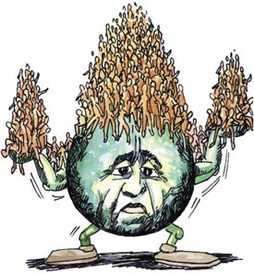
Population Growth and Sustainability
By Rachel Case
The System The Challenge
Humanity Population Growth
and Unsustainability
The Stakeholders
Government, The World Bank, The Voting Public and Religious leaders
“It’s not just the depth of your carbon footprint, it’s the number of footprints “-Travis Rieder
(Wordpress, 2013)

Slide 2
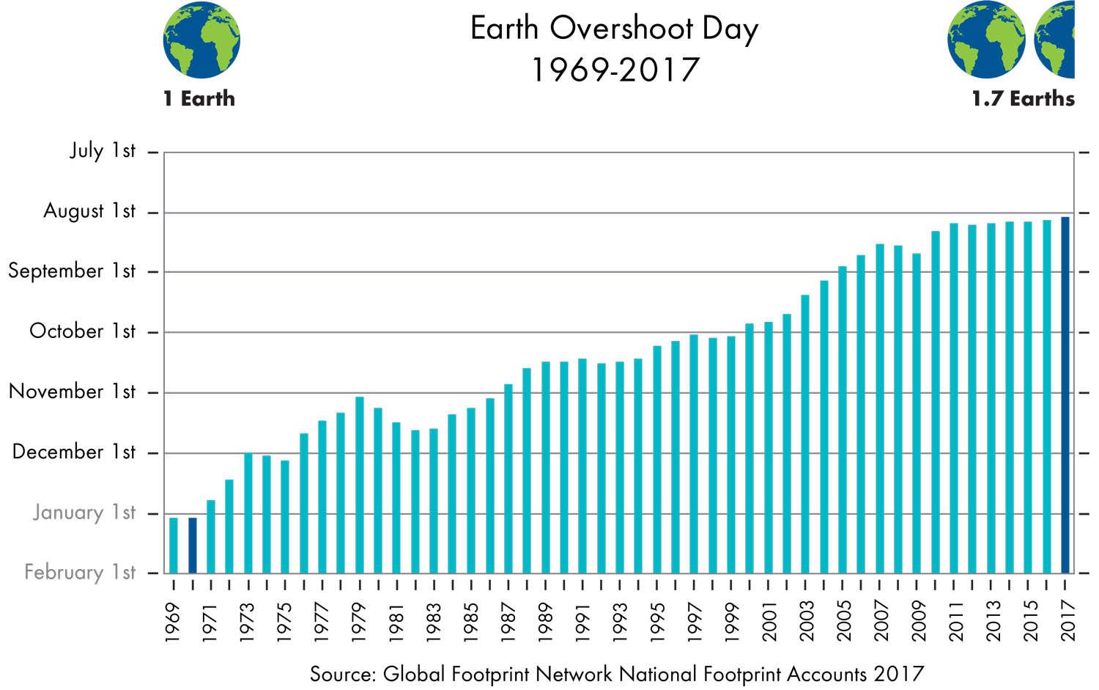
A Little Bit About The System
For the last 11,000 years Earth brought about a relatively stable environment-Holocene
Allowed humanity to transfer from hunter-gather lifestyle, to that of agriculture (slow growth for global population)
Recent technological advancements and easy access to energy has led to a rapid growth in population
A Little Bit About The Challenge
Global population is set to reach 9 billion by 2050 (Griggs et al., 2007)
The current population (7,632,819,325 ), is using resources faster than the Earth can replenish them (Global Footprint Network,2012)
More people require more resources and this is causing a real hazard for humanity and Earth’s life support system
Global Footprint Network, 2017

Slide 3
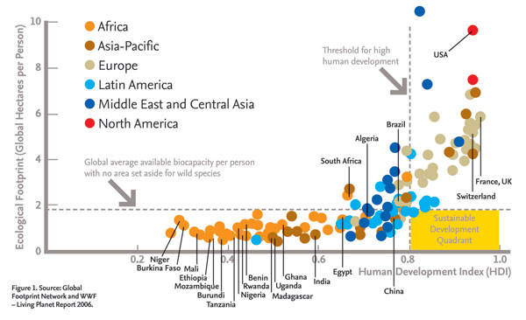
Hazards
Population Growth
Human Activity
Climate change-Increased anthropogenic GHG emissions (IPCC, 2013) In 2013, total carbon emissions 9.6 billion tons (Rieder,2016)
This is causing oceans to warm and acidify, changing the hydrological systems, compromising water quality/quantity, and causing extreme weather events (IPCC,2013)
Extreme weather events and shifts to climate zones are altering food production (IPCC, 2013)
Pollution
Changing the attributes of Earth’s surface through Land use changes
Deforestation: Farming, timber, housing
Urban developments-replacing vegetate with impervious surfaces which generate a lot of heat
Agriculture-more people need more food
-Leads to harmful runoff
The Developed and Developing
Global footprint Network, 2006
Developed Countries-GHG emissions are the highest, population growth rates are the lowest (IPCC, 2013)
Developing Countries-GHG emissions are the lowest, populations growth rates are the highest (IPCC,2013)

Slide 4
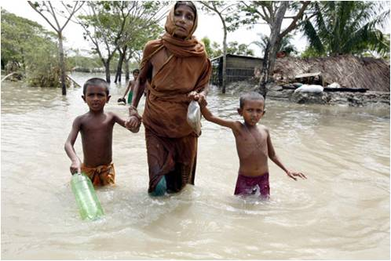
Vulnerabilities
Biodiversity
Biodiversity is disappearing from human pressures and increased population (IPCC, 2013)
Humanity is very vulnerable to changes or losses in biodiversity because biodiversity is strongly correlated to economy (Mollendorf, 2014), which supports society and human-well being
Developing Countries
Currently experiencing the harshest effects of climate change (IPCC,2013)
Living in extreme poverty with limited means to protect themselves from disease and the effects of a changing climate
This inequality is leading to mass migrations, social unrest, and wars
Human Well-being
As oceans warm, fisheries are likely to die off or relocate (IPCC,2013) altering production at local and global level
Rising temperatures and extreme weather patterns are also likely to alter the production of wheat, rice, and maize (IPCC, 2013)
Rising temperatures are likely to increase the introduction of Vector-borne diseases (IPCC, 2013)
Changes in climate and temperatures are likely to increase allergenic symptoms, heat strokes, and dehydration (IPCC, 2013)
Damaged infrastructure (IPCC, 2013)
World bank, 2010

Slide 5
Foresight
What if Population Reaches 9 billion by 2050
Will it be Sustainable?
1) We Stop all Anthropogenic GHG Emissions- The rich down size, population levels off, people become vegetarians, people living in extreme poverty find human well being, we introduce green cities, find renewable energy, and treat biodiversity with respect-YES!
2) We Change Nothing- Evidence suggest there Earth cannot sustain the current population at the current rate of consumption. No!
3) We Use More- Population grows, more people seek out wealth, the developing countries emit like the developed, and we extract, extract, extract! NO, NO, NO
IPCC predicts with just a 2 degree warming we are likely to experience catastrophic events- SL rise of several feet, increased severity of storms, increased flooding and storm surges, water stress and food shortages, and decreased human health

Slide 6
Decision Making
Religious Leaders
Religious practices do differ among cultures but, it appears that most religions are helpful in the promotion of values that enhance life and human good.
For a number of religions, if not all, human life is considered sacred and abortions are considered immoral because “Thou shalt not kill”.
This proposes an interesting look into the ethics of what human good may look like for current and future generations based off the actions of those that live today.
The Voting Public
In order to see a significant change for the system compromise across countries and the legislation that governs them is mandatory.
The general public, for the most part, decides who will be put into the positions that govern policy
Government
Puts laws into effect, such as carbon tax or procreation taxes/incentives
Work closely with institutions like the World Bank, who fund developing countries to further development that leads to human well-being

Slide 7
Options
Changing the ethics of procreation
The most carbon intensive activity a person can engage in, is procreation (Rieder, 2016)
With what looks like a very harsh unstable future for current and future generations, it may be time to stop asking those without children what their reasons are for not having them, and start asking those with children, what their reasons are for having them.
This could be accomplished by getting religious leaders involved and increasing awareness. Extending health care, Education, and Green cities
Developed countries have the lowest population growth rates, highest GHG emissions. Developing countries reflect the opposite.
By increasing health care and education population rates are likely to slow down. However, if the developing emit like the developed, we are in trouble.
Green cities aim to reduce greenhouse gas emissions, lower waste, expand recycling, and increase housing density to open space for gardens and trees, decrease urban heat island heat effect
Could be beneficial for biodiversity
Carbon Tax
Establishes a price on GHG emissions so companies are charged for every ton of emissions produced
Provides incentive to reduce emissions and find new technologies to decrease carbon needs
Top 10% of wealth should be taxed more because they produce 50% of lifestyle emissions

Slide 8
Recommendations
Option 1,2,and 3
Religious Leaders
I recommend to change the ethics of procreation-get the stigma off contraceptives, let woman choose
If human life is scared, then where is the justice for those living in extreme poverty and future generations that are likely to suffer form the consequences of the actions being carried out today
Give people the chance to decide whether or not they want to subject their children to this
Governments and The World Bank
Set into place a carbon tax to reduce pollution and GHG emissions, tax the top 10 percent of the wealth based off their actions
Use this Revenue to advance green technology and help developing countries
Increase education and health care services to the developing to allow access for contraceptives
Introduce green cities into the developing and the developed countries

