Slide 1
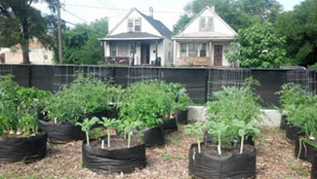
Urban Agriculture & the city of Portland, Oregon
System – urban agriculture
Challenge – ensuring food security and social equality for all city inhabitants
Stakeholders – producers, assistive services, lower & middle level government officials, community residents in or bordering the cities
Austin Greenhill

Slide 2
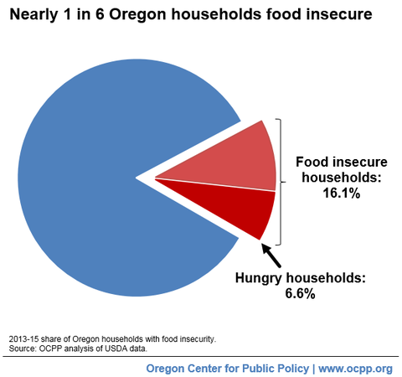
Food Insecurity in Portland
Urban farming is defined as the growing of plants and raising of animals within or around cities.
Food insecurity is the state of being without reliable access to a sufficient amount of affordable, nutritious food.
As of November 21, 2016 16.1% of Portland’s population was deemed food insecure.

Slide 3
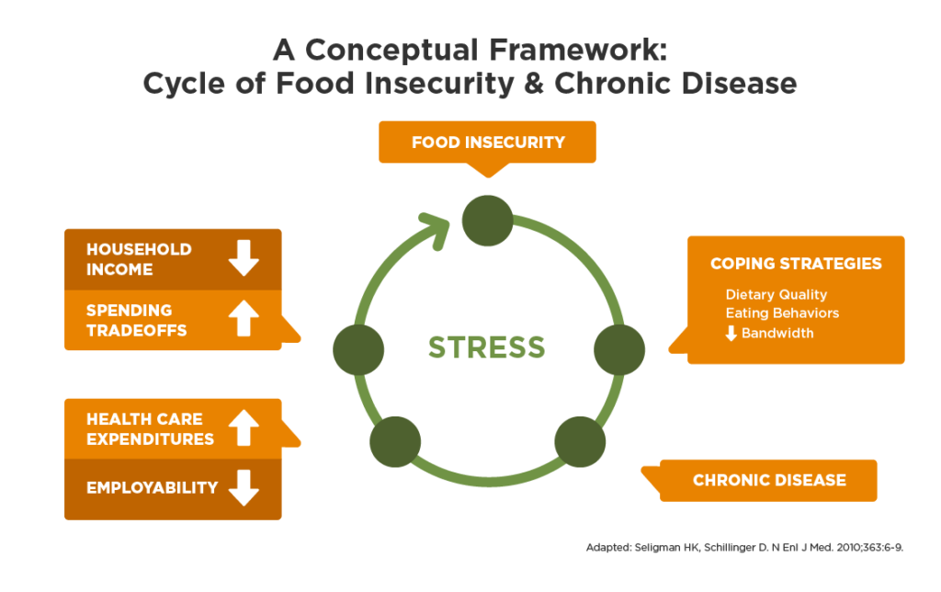
Social Status in Relation to Food Insecurity
In Multnomah county communities of color and/or subject to poverty are prone to experience more environment and socio-economic risk than predominantly white communities.
Social determinants of health. Of 735,334 people in Portland 10.5% do not have a high school diploma, 33% live impoverished, 28.1% are people of color, and 19.1% speak another language other than English.
The governing factors that influence health and social determinants are the same factors that influence people’s resiliency to the effects of climate change and their likely-hood to utilize urban agriculture.

Slide 4
Hazards of Urban Gardening
Residential poor soil quality due to prior contamination or in proper care.
Soil ingestion of toxins increasing chances of produce contamination .
Recycling gardening materials that are not of food grade caliber increasing public health risk.
Visitation of unwanted organism such as stray animals or homeless people due to the large variety of diseases possibly contracted and passed on.
Climate change increasing local extreme weathering events.

Slide 5
Vulnerabilities of Urban Agriculture
Unwanted pests/insects
Loss of soil
Funding of production
Water access
Overregulation of community projects/rejection of people
Produce market failure

Slide 6
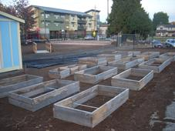
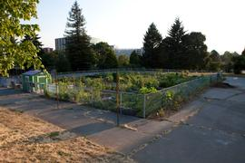
Foresight of Urban Agriculture in Portland
Currently in Portland efforts toward developing urban agriculture consist of increased rooftop garden utilization, incorporation of friend groups to manage city owned property, preservation of land through land trust, floor area ratio bonuses for rooftop gardens allowing buildings to be constructed higher than normal and even right of way land usage to allocate lands to families and groups willing to tend them.
Who is engaged? Agencies such as ONI, school developmental programs such as OSU or PSU, politicians, the public population, farmers, and agricultural parks.
1. If no action is taken Portland and Oregon will continue to hold high rankings in terms of food insecurity and hunger. Urban agriculture will remain undeveloped compared to other cities as well as increased food security issues.
2. A second scenario involves the continued development of policies and tactics involving urban agriculture to address food insecurity in the city. Advancement of the methods and regulations listed above should increase urban agriculture utilization, methods, as well as decrease food insecurity.
3. A third scenario consists of the public continuing to advance urban agriculture utilization and development without the push of incentive from the government. Urban agriculture will most likely develop slowly if at all, but ultimately progression would come to a stand still without political compliance.

Slide 7
Decision Making in Portland
Stakeholders involved in progressing urban agriculture are mainly comprised of the government. Officials set forth policies to increase public incentive of developing urban agriculture are necessary as well as allowing urban agriculture practices in all parts of the city. They also oversee urban agriculture regulations.
Community development corporations and the Portland Bureau of Housing help develop the market with training people in urban agriculture with the metropolitan area for jobs and personal use.

Slide 8
Options in Portland
1. Continuing urban farming practices as is would eventually lead to the system in Portland becoming underdeveloped compared to other cities not comprehensively addressing the food security issue.
2. A mitigation influenced option would consist of increased utilization of urban agriculture through schools, community centers, government programs, public health, and food security driven agencies. Not only should utilization increase, but the development of methods should as well. Government regulation and incentive policies would be needed to drive the development throughout the city and mitigate the food security problem.

Slide 9
Options continued
A third option in developing urban agriculture practices involves the continuation of developing new methods, increased incentive to develop the system, micro financing to increase shareholders able to part take in urban farming, and government officials making green areas open to the public.

Slide 10
Recommendations to Portland
To the government officials in the state of Oregon I recommend continued development of policies and tactics involving urban agriculture to address food insecurity in the city. Advancement of rooftop garden utilization, incorporation of friend groups to manage city owned property, preservation of land through land trust, floor area ratio bonuses for rooftop gardens allowing buildings to be constructed higher than normal and right of way land usage to allocate lands to families and groups should continuously advance urban agriculture and address food insecurity.

Slide 11
References
Adams, E., Alto, C., Ching, D., Hargunai, D., Hoisington, A., Stubenvoll, J., Weed, N., VanderWoude, T., 2008. Childhood Food Insecurity. Childhood Hunger Coaltion of Oregon.
Bartuska, A., 2016. Urban Agriculture Tool Kit. United States Department of Agriculture.
Bondar, L., Freeman, B., Helser, G., Jennings, O., Lee, B., Mclntrye, B., Petrillo, F., Rea, S., Seregejev, I., Smith, M., Thiem, A. Urban Agriculture – Asset Mapping Capstone. Portland State University.
Eberrhardt, C., 2016. Winter 2016. Partners for a Hunger-Free Oregon- Finding Food Security in Portland.
Golden, S., 2013. Urban Agriculture Impacts: Social, Health, and Economic: A Literature Review. UC Sustainable Agriculture Research and Education Program Agricultural Sustainability Institute at UC Davis.
Logan, D. R., 2014. Climate Change Preparation Strategy – Risk and Vulnerabilities Assessment. Preparing for Local Impacts in Portland and Multnomah Country, 2014.
Lovell, S. T., Wortman, S. E., 2014. Environmental Challenges Threatening the Growth of Urban Agriculture in the United State. doi:10.2134/jeq2013.01.0031
OCCP, 2016. Winter 2016. Oregon’s Spike in Food Insecurity Worst Among All States. https://www.ocpp.org/2016/11/21/fs20161121-oregon-food-insecurity-spike-worst/. Date accessed April 6, 2018.
Public Health Divison, 2016. Technical Briefing on Exposure Risk from Garden Soils. Oregon Health Authority.

