Slide 1
Towards Sustainable Fishing and aquaculture in the Caribbean
System: The Caribbean
The Challenge: Overfishing, economical concerns, changes in ecosystem function
Stakeholders: Caribbean governments, fishermen, locals
Samantha Hagedorn

Slide 2
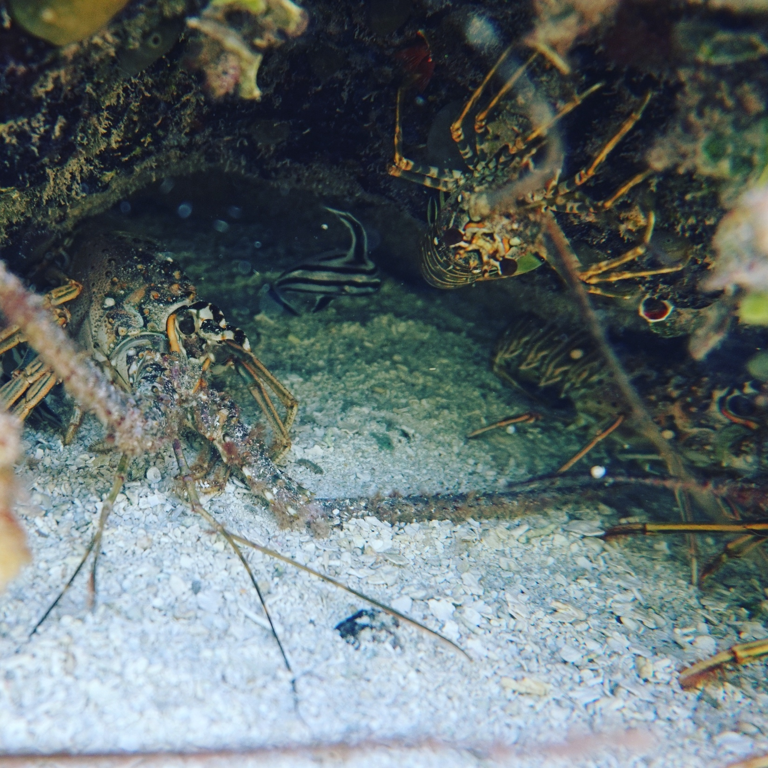
Background information
Rapid increase in human population growth
Seafood became an important resource in many countries
  Medicine
  Food
  Income
1960s – transition in fisheries management
  Maximum sustainable yield
1990s – marine ecosystems drastically changing
Notes:
From 1900-2000 the population grew from 1.5 b to 7.0 b
Figure 1: Coastal food webs illustrating changes in interactions of species due to overfishing (9). Bold font represents abundance; normal font represents rarity; “X” represents extinction. Thin arrows represent weak interactions between species; thick arrows represent strong interactions.
200 billion people are employed by a marine fishery globally
40% live near the coast

Slide 3
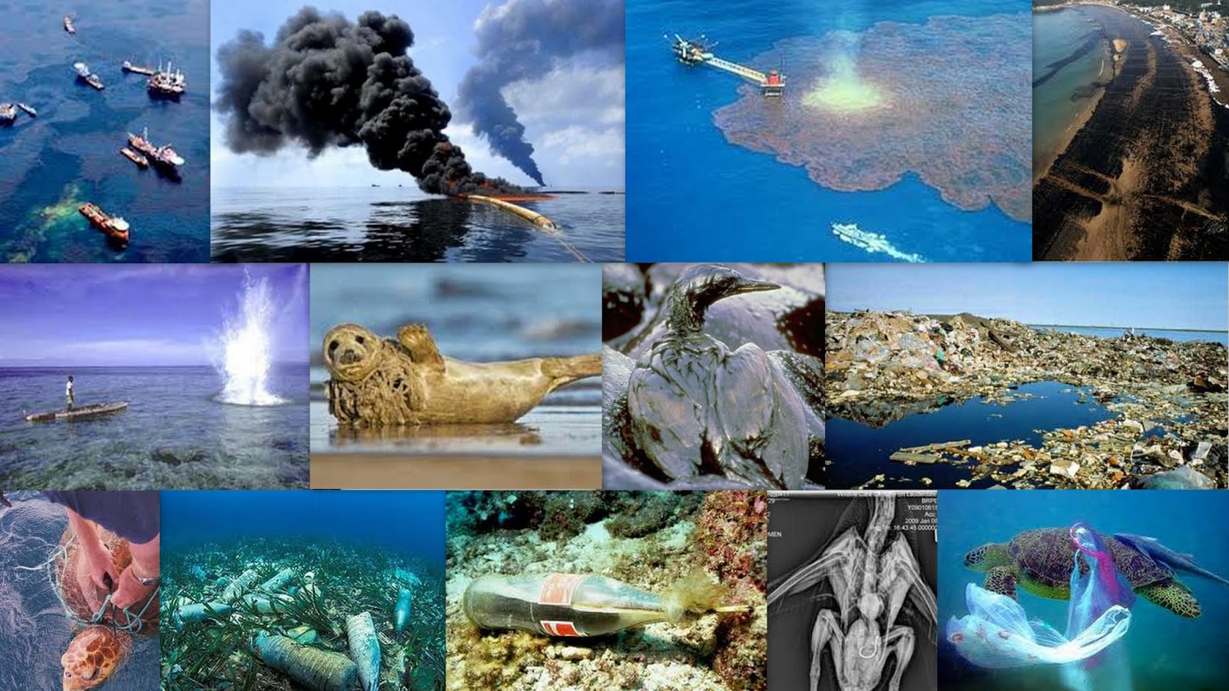
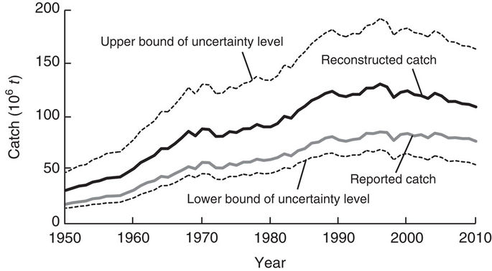
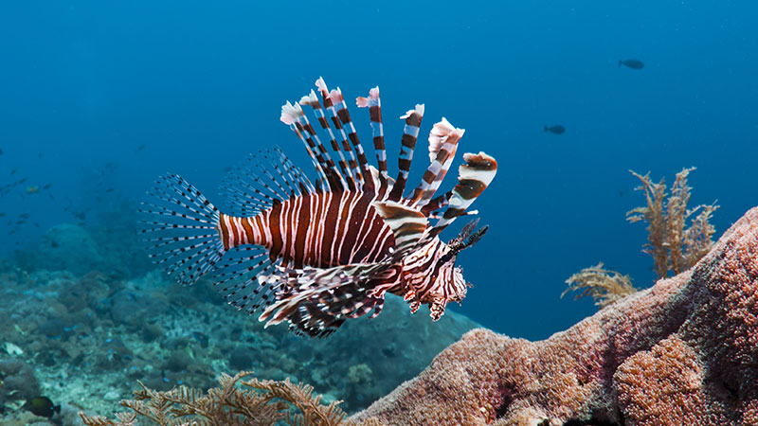
Hazards
Human impacts
  Oil spills
  Pollution
  Unsustainable fishing practices
  Climate change
Overfishing
  Mismanagement
  Misreported catches
  Illegal fishing
Invasive species
  Lionfish
(Pauly & Zeller, 2016)
Notes:
Ocean warming
Overfishing has declined fish stocks from biologically sustainable levels in 1974 of 90% to 68.6% in 2013
MPAs are important mechanisms for safeguarding ocean life. In 2017, they covered 13.7% of the marine environment under national jurisdiction, .25% beyond national jurisdiction, and 5.3% of total global ocean area

Slide 4
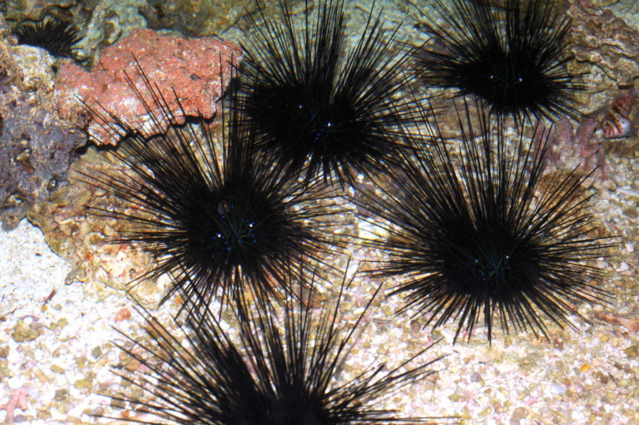
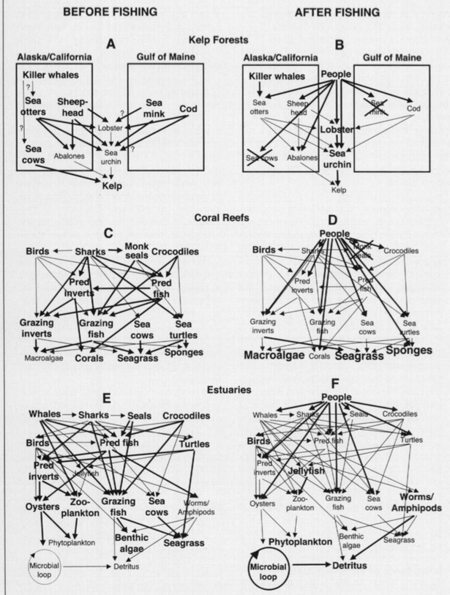
Vulnerabilities
Loss of biodiversity
  Destabilization of the ecosystem
  Habitat loss
Environmental changes
Fishery management
  Policies and regulations
(Jackson et al., 2001)
Notes:
Loss of biodiversity – O2 production, carbon sink, tourism, adversely affects ecosystem services
Destabilization through interruption of food chains; In 1983 D. antillarum experienced a massive die-off all across the Caribbean; some areas lost up to 97% of mature individuals. The die-off is thought to be due to a water-borne pathogen that has not yet been identified. The great reduction of D. antillarum in the reefs caused an extreme increase in the algal cover, and thus a reduction of larval coral settlement. Microalgae has become more abundant in the time since the die-off; the greater amount of algae allows the reefs to support a greater number of herbivorous fish, which can result in more damage to the reefs. (Bruckner and Bruckner, 1998; Hendler, et al., 1995)

Slide 5
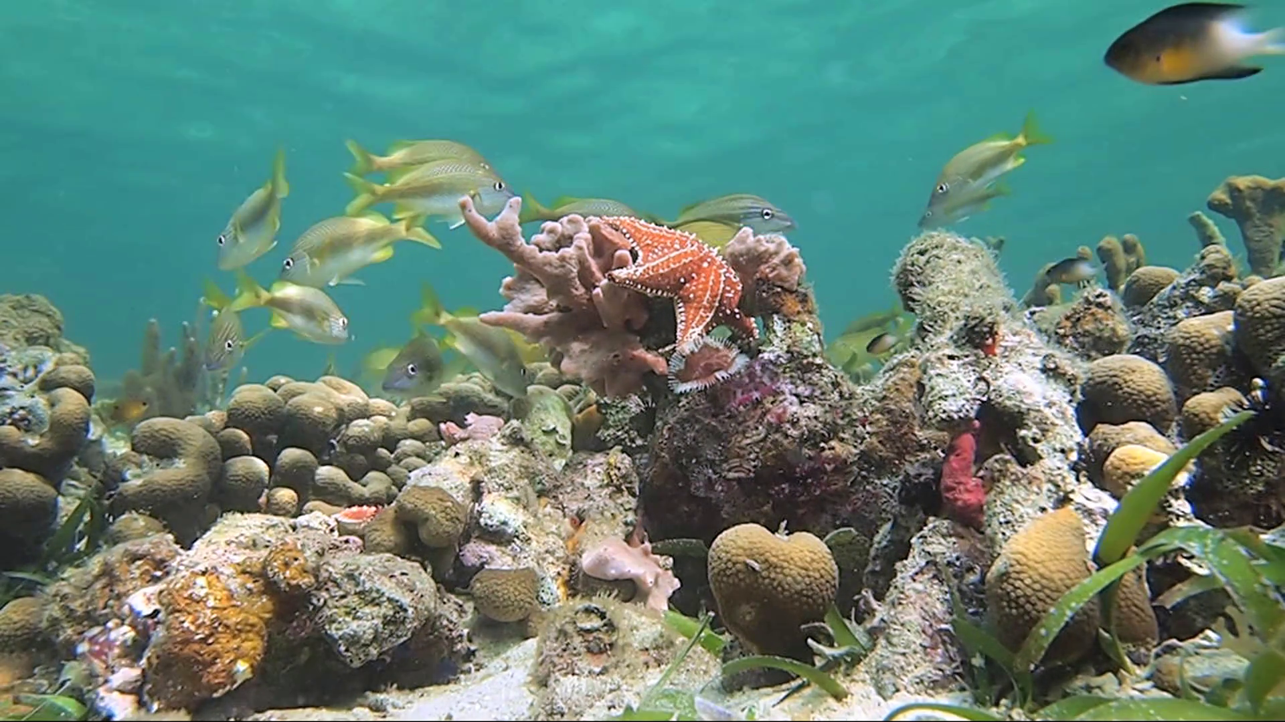
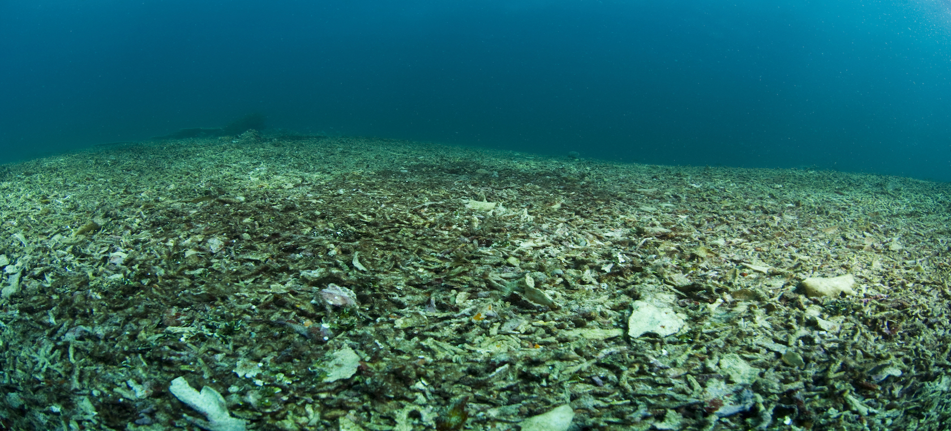
Foresight
Marine ecosystem degradation
  Decline in tourism
  Interruptions in the food chain
  Coastal buffer
Fish stock decline
  Loss of jobs
  Food depravation
  Increase in primary producers, decrease in top predators
Notes:
if small to medium sized fishes are overfished, larger predators starve and plankton/algae anything the smaller fishes eat thrive
Fish – due to no fish to catch, no fish to eat (would need to find another source) maybe trade with other near by countries

Slide 6
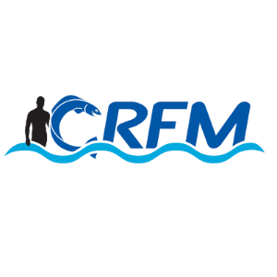
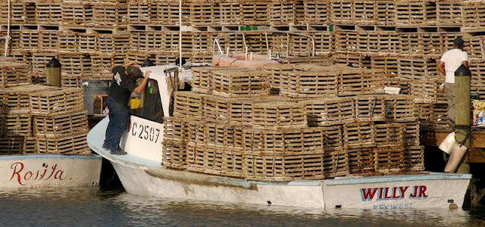
Decision making
Caribbean governments
Fishermen
Locals
Caribbean Regional Fisheries Mechanism (CRFM)
  Create efficient management and sustainable development regulations within the Caribbean fisheries
Sustainable Development Goal 14
  Conserve and sustainably use the oceans, seas, and marine resources

Slide 7
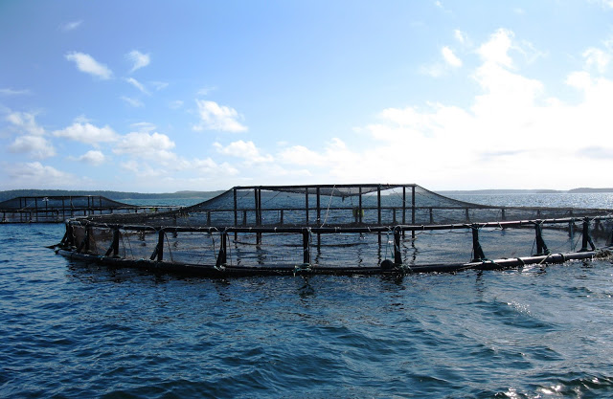
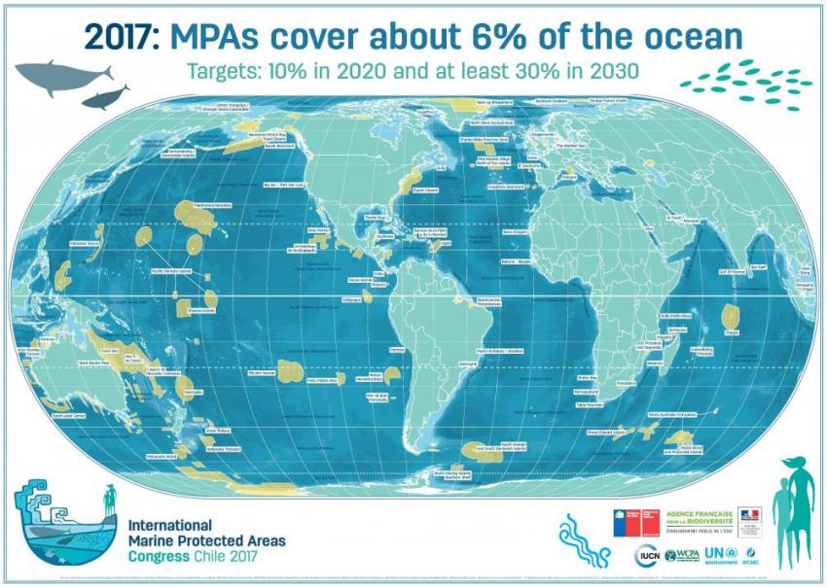
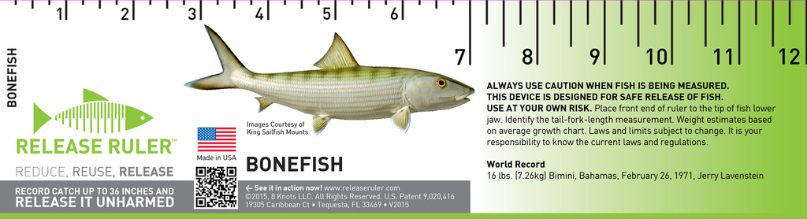
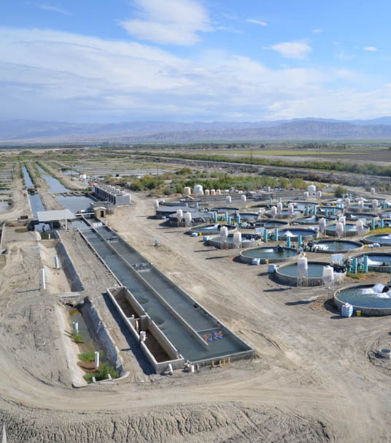
options
Aquafarming
  Mitigation of at risk species
  Allows for maximum sustainable yield
  Life history stages unknown
Size limits
Marine protected areas (MPAs)
  Increase catch size
  Decrease illegal fishing
  Pushback from fishermen
(Cayton, 2018)
Notes:
Productivity increases with age
MPA- 70% of fisheries stated increase in catches marine areas, 60% decrease in illegal fishing

Slide 8
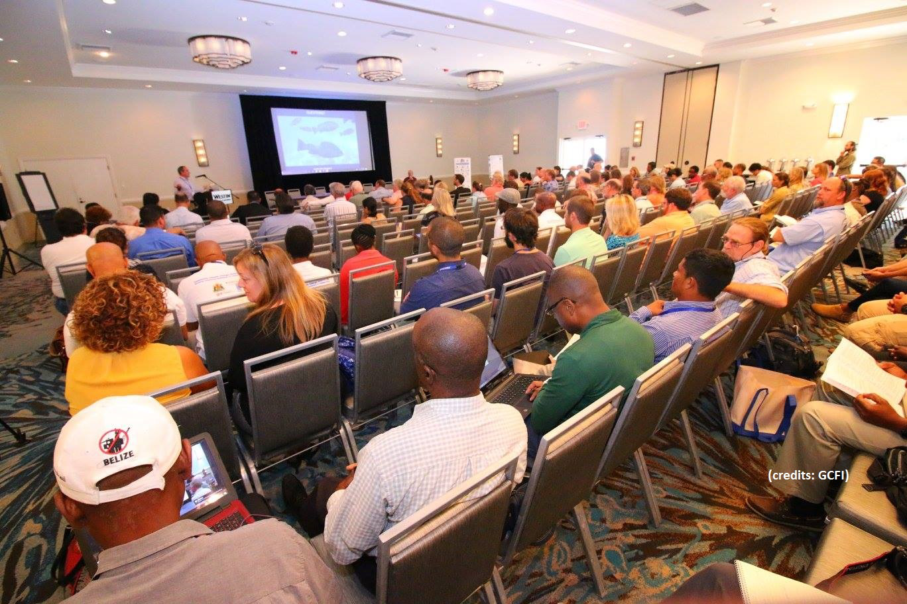
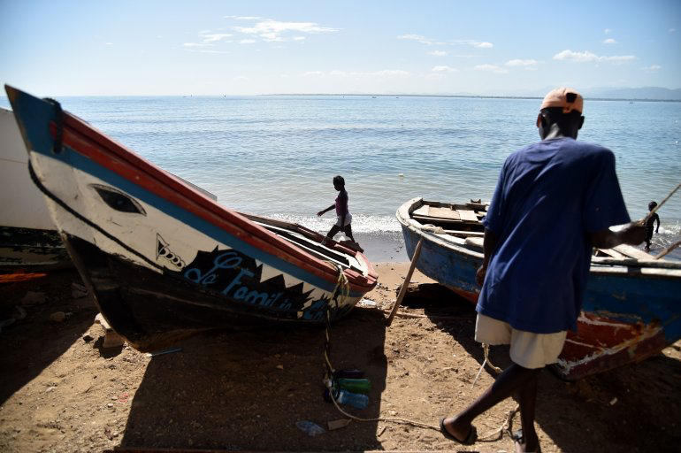
Recommendations
Aquafarming
  Protect fish stocks from overfishing and misreported catches
  Provides jobs
  Fish free of pollutants and contaminants
Better enforcement of policies and regulations
Workshops for local fishermen
Create size limitations
  Maximum and minimum
  Bigger is not always better
Notes:
Aqua – benefits outweigh disadvantages
Enforcement – bahamas
Work – fishermen can express their ideas, feel like they are being heard

Slide 9
Citations
Cayton, H. (2018,). How can marine protected area networks be better designed? Retrieved April 14, 2018, from http://conservationcorridor.org/2018/01/how-can-marine-protected-area-networks-be-better-designed/
Jackson Jackson, J. B., Kirby, M., Berger, W., Bjorndal, K., Botsford, L., Bourque, B., . . . Cooke, R. (2001). Historical Overfishing and the Recent Collapse of Coastal Ecosystems. Science, 293(5530), 629-637. doi:10.1126/science.1059199
Pauly, D., & Zeller, D. (2016). Catch reconstructions reveal that global marine fisheries catches are higher than reported and declining. Nature Communications, 7, 10244. doi:10.1038/ncomms10244

