Slide 1
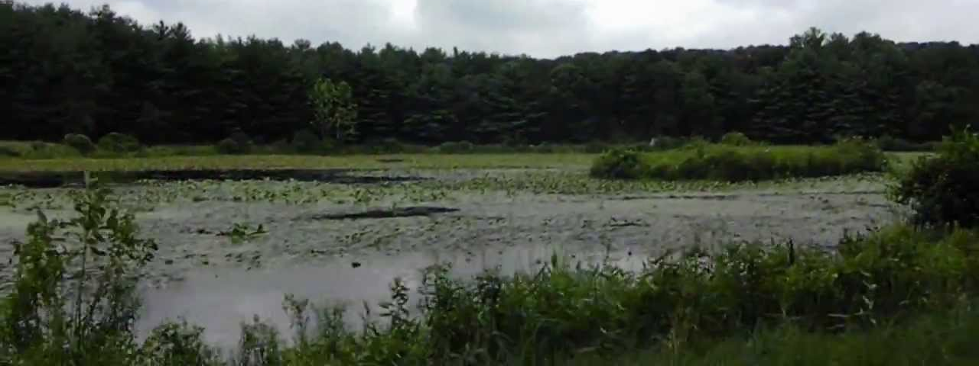
Spatterdock and Lake Allen
Patuxent Research Refuge
By Rachel Case

Slide 2
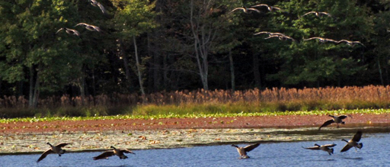
The System
Lake Allen
The Challenge
Overgrowth of Aquatic Plant, the Spatterdock
Stakeholders
Fish and Wildlife, Local Fisherman/Community
Goal
To find balance between the biological needs of Lake Allen and the fishing needs of community

Slide 3
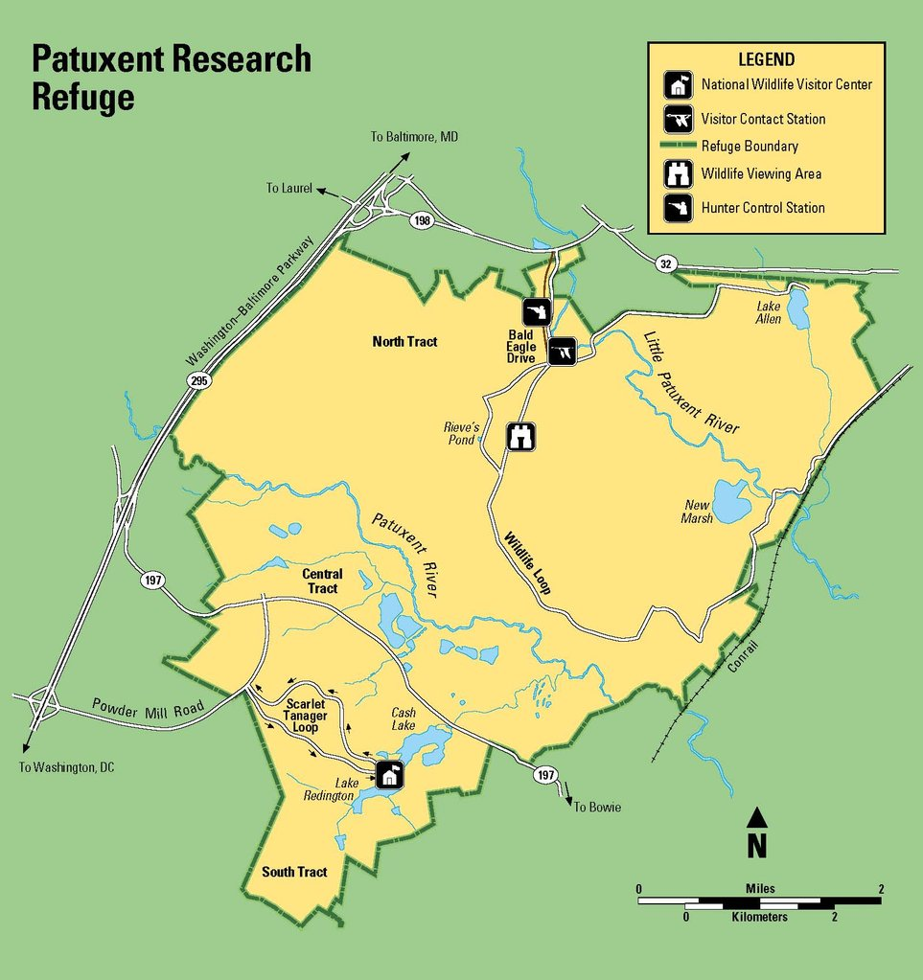
Introduction
Refuge Established in 1936 By Franklin Roosevelt
  Long drought of 1930’s and human wetland drainage devastated N.A. Waterfowl population
  Warn out farm lands were converted to habitats for research: forest, fields, meadows
  Primary purpose is wildlife research
  Currently, 12,841 acres, split into 3 sections: North Tract, Central Tract, and South Tract
Lake Allen
  Located in the North Tract: hunting, fishing, wildlife observations, and trails
  Fort Meade
  Habitat for many species inhabiting refuge
  Open for fishing
  Overgrowth of spatterdock

Slide 4

Threats To Lake Allen
Spatterdock
  Dense overgrowth, over 25% of surface area, could interfere with aquatic life and recreation (Virginia Tech, 2009)
  Reduces light penetration, causes oxygen depletion, kills aquatic life
  Aquatic life acts as indicator species for lake health
Runoff, nutrient source to the spatterdock
  Human related
    Limited water quality and/or impaired biota: The Patuxent River, The Little Patuxent, Midway Branch
    Past land use
  Waterfowl
    Fecal waste could be significant nutrient contributor (up to 30 species on refuge)
Soil Erosion
  Transporter of fertilizer
  Decreases water depth

Slide 5
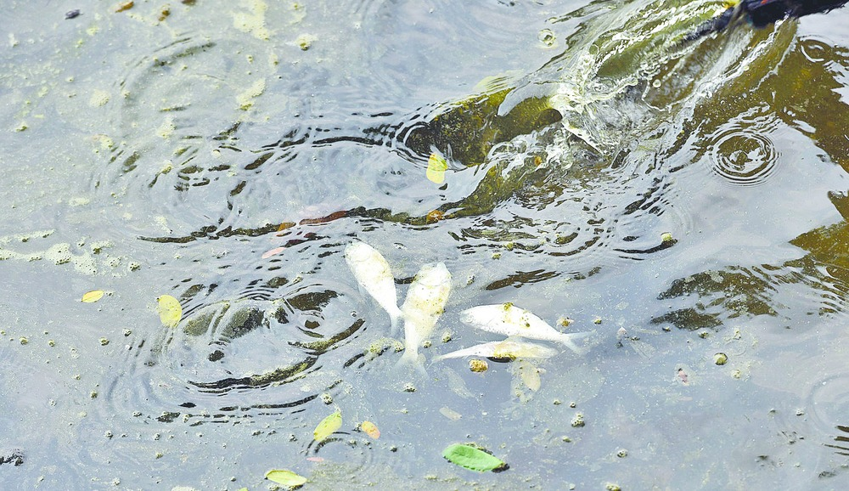
What is Threatened?
Lake Allen
  Shallow lake, 11 ft (Fish and Wildlife Service, 2012)
  Spatterdock grows best in 1–3.3 ft (Rutgers, 2018)
  Located in Patuxent, one of the most densely populated areas in MD
  Surrounded by agriculture
  Patuxent Basin, watershed of 957 square miles. Vulnerable to rapid population growth
Fish
  Vulnerable to reduction in oxygen
  Vulnerable to alterations in lake habitat

Slide 6
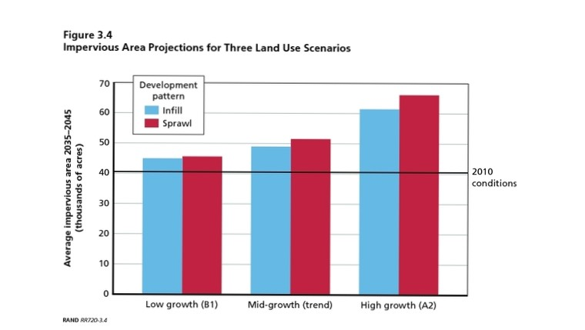
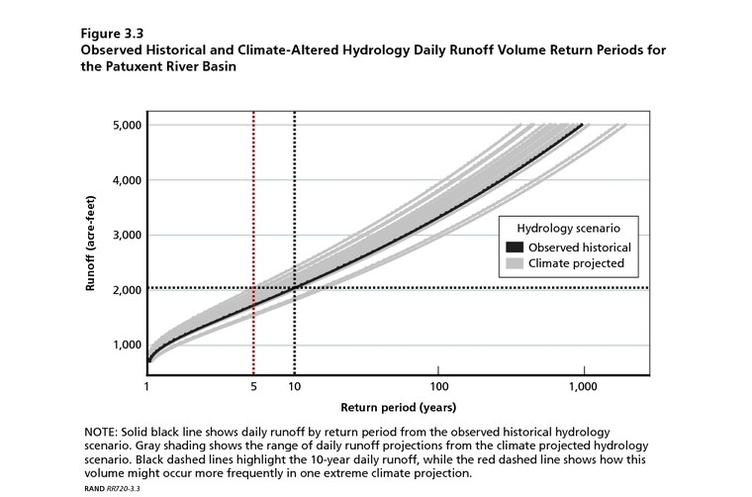
Foresight
Population Trends in Patuxent Basin
Historical Trend Scenario
  725,000, 2010 to 940,000, 2050 (Fischbach et al., 2015)
  Business as usual
Low Growth Scenario
  773,000 by 2050 because Maryland is relatively close to the coast (Fischbach et al., 2015)
  Given the correct policies and alterations to lake depth, possibility of controlling spatterdock
High Growth Scenario
  1.31 million by 2050 (Fischbach et al., 2015)
  Could be a recipe for disaster based on soil erosion
Stormwater runoff depends heavily on population growth and precipitation
(Fischbach et al., 2015)

Slide 7
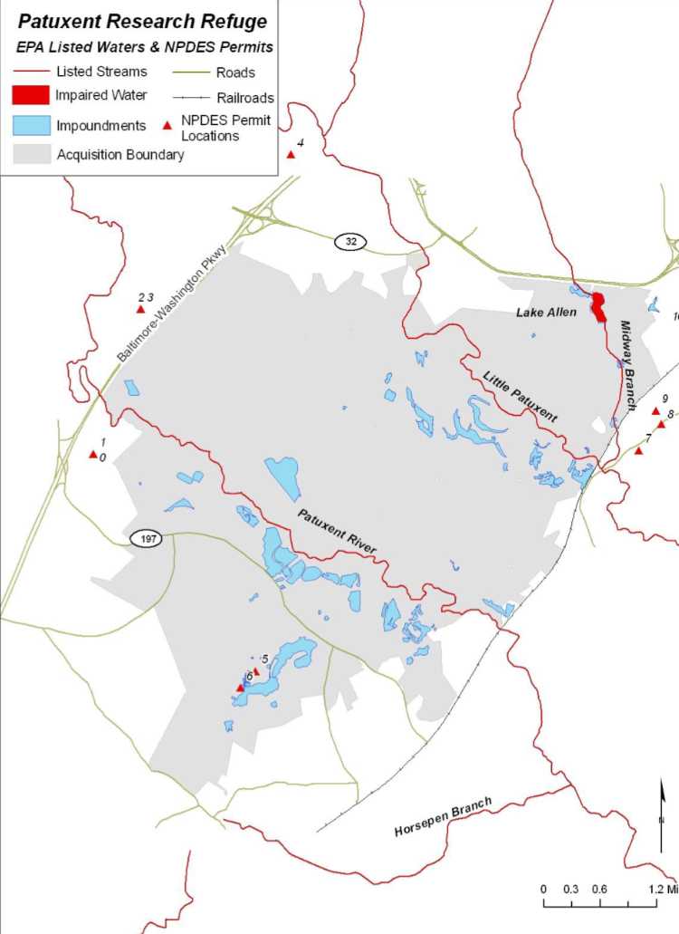
Decision Making
Brad Knudsen
Wildlife Refuge Manager/Project Leader
Strives to achieve balance between wildlife needs and the needs of the community
Promote any recommendations
Regulatory Framework
Develop a better understanding of the policies that govern Patuxent Basin
Who controls the input of water to Lake Allen
Who controls the output of water from Lake Allen
Who controls water quality outside acquisition boundary
(Fish and Wildlife Service, 2012)

Slide 8
Options
Stock and Flow Model
Use a systems thinking approach by developing stocks, variables, and flows for the system
Work Plan
Gather data on stream flow
Preform test that indicate nutrient concentrations for both soil and water
Work closely with biologist on site to better understand biological communities
Gather data on the ecological make up of Lake Allen
Develop better foresight for the future of Lake Allen based on a variety of climate change scenarios
Provide recommendations

