Slide 1
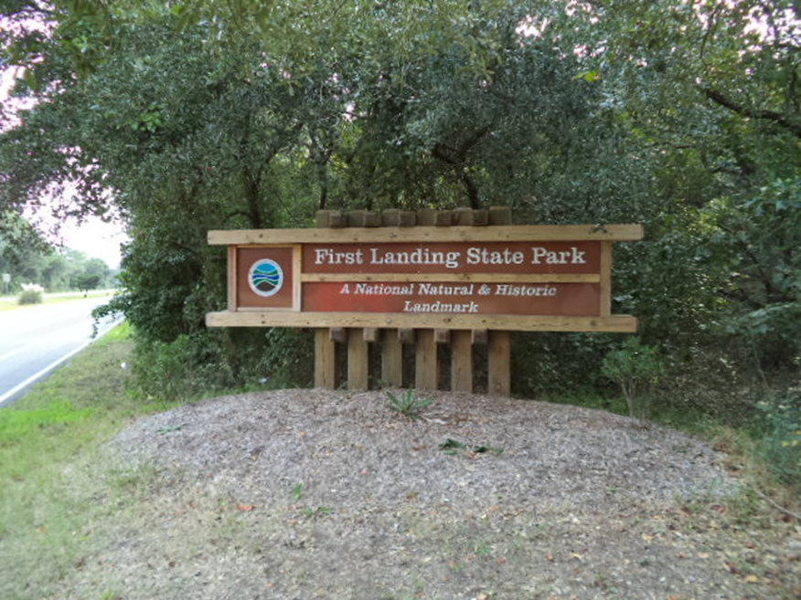
Current and Potential Climate Change Impacts at First Landing State Park
Chase Garrison
Old Dominion University

Slide 2
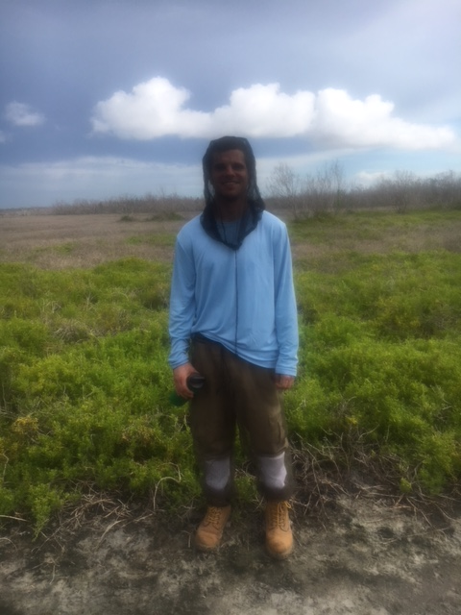
About Me
Senior at Old Dominion University majoring in Biology with a minor in Conservation Leadership
I have had a passion for wildlife of all kinds my entire life and hope to use this in my future career either as a zoologist or wildlife biologist
I am giving this presentation as an overview of my research project required for my internship at First Landing State Park

Slide 3
Introduction to First Landing
First opened to the public in 1936 at Cape Henry in northern Virginia Beach, Virginia
Contains variety of rare/endangered species and natural communities, accommodates most annual visitors of any Virginia State Park with over 1.7 million visitors each year (Park Ranger EDU, 2018)
Services Provided
Beach access, camping, hiking/biking trails, fishing/boating
Economic Impact (total effect): 377 jobs, $17.9 million total value added, $2.3 million in local/state tax revenue (Magnini, 2018)
The goal of this project is to identify climate change threats to First Landing, its vulnerabilities to these threats, and determine options to begin the adaptation and mitigation process to best protect both wildlife and recreational opportunities at the park

Slide 4
Climate Change Hazards to First Landing
Changes in Surface Temperature and Precipitation
Increase in extreme hydrological drought frequency (low water supply) (Strzepek et al., 2010
More intense precipitation events in terms of amount of precipitation and wind speeds (IPCC, 2015)
Increasing hurricane intensities (Rahmstorf et al., 2018)
Poleward migration of area where hurricanes reach peak intensity (Kossin et al., 2014)
likely that as heat waves will occur more often, for longer periods and with higher temperatures, although occasional cold temperature extremes may still occur (IPCC, 2015)
Potential migration of native species and/or local or global extinctions
Invasive Species and Migration of Non-Native Species
Red-eared Sliders
Japanese Stilt Grass
Potential migration of non-native species as temperatures increase
Land Use Changes
Interest in outdoor recreation is increasing (Monz et al., 2010)
Impacts on vegetation, soil, wildlife, and water quality (Monz et al., 2010)
Projected increase in Virginia Beach Population (Weldon Cooper Center for Public Service, 2017)

Slide 5
Vulnerabilities of First Landing to Climate Change
Changes in Surface Temperature and Precipitation
A large proportion of soil in First Landing is sandy soil, including trail areas (Division of State Parks, 2000)
Sandy soils are highly susceptible to wind and water erosion (Agriculture and Agri-Food Canada, 2014)
Virginia as a whole, particularly the coast, is vulnerable to increasing drought frequency (Strzpek et al., 2010)
Native species near southernmost geographic limit are vulnerable to increasing temperatures
Will have to either migrate further north or face extinctions; vulnerability increase due to increasing heat wave frequency and durations (IPCC, 2015)
Invasive Species
Japanese Stilt Grass: able to overtake forest understory, reduces soil pH (Leicht et al., 2005)
Even if eradicated in areas, low pH may not allow for native species to repopulate
Not only affects native plants, but also can impact other species that rely on natives for resources (food, shelter, etc.)
Red-eared Sliders: outcompete native turtles for resources (especially when they are limited), reach sexual maturity and have more offspring that most other turtle species (Pearson et al., 2015; Polo-Covia et al., 2011; Perez-Santigosa et al., 2008)
Native species likely to be impacted by competition for resources, which may become reduce due to other climate change hazards (loss of nesting sites, shaded areas, etc.)

Slide 6
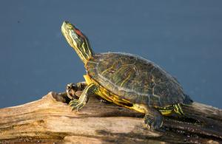
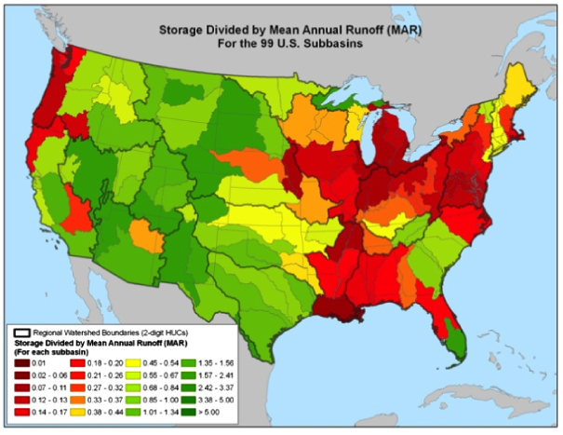
Vulnerabilities Cont.
Virginia drought vulnerability (Strzpek et al., 2010)
Picture of Red-Eared Slider (photo by Missouri Department of Conservation Staff)

Slide 7
Foresight on Climate Change at First Landing
Surface Temperature Scenarios: global mean surface temperature increase based on CO₂ concentrations by 2100 (IPCC, 2015)
RCP2.6 (stringent mitigation): atmospheric CO₂ under 500 ppm, 0.3-1.7ºC increase by 2100
RCP4.5 & 6.0 (intermediate): CO₂ 500-700 ppm, 1.1-3.1ºC increase
RCP 8.5 (“business-as-usual”): CO₂ high as 1500 ppm, 2.6-4.8 ºC increase
Extreme precipitation events projected to increase under all scenarios (IPCC, 2015)
Future Virginia Beach Population Scenarios
Future Virginia Beach Population Estimates (Weldon Cooper Center for Public Service, 2017)
2020: 467,134; 2030: 482,578; 2040: 491,054
Potential Future Scenarios
Low scenario – population projections are significantly higher than actual future population
Medium scenario – population projections are relatively similar to actual future population
High scenario – population projections are significantly lower than actual future population

Slide 8
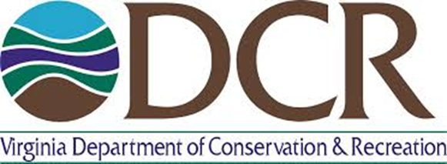
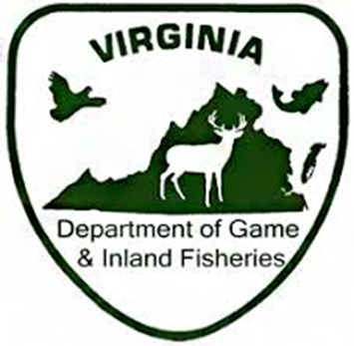
Decision Making: Stakeholders, Agencies, and Legislation
Virginia Department of Conservation and Recreation (DCR)
Virginia Department of Game & Inland Fisheries (DGIF)
First Landing Sate Park Management
Virginia Beach Local Community
Virginia State Government
Virginia Beach Local Government
Virginia Code of Law
Title 10.1. Conservation, Chapter 2.Parks and Recreation, § 10.1-200.1. State park master planning

Slide 9
Options for Preserving First Landing Wildlife and Recreation
Create new methods of monitoring usage of trails
Questionnaires/surveys of visitors, GPS tracking, etc. (Wolf et al., 2012)
Establish new management techniques to minimize impacts of recreation activities
Mulched rip lines, reduce slope of trails
Further research on possible ecological impacts of invasive and/or non-native species such as red-eared sliders and coyotes
Develop a citizen science program to monitor early warnings of climate change impacts

Slide 10
Recommendations for Preservation
Collect Data on Trail Usage Via GPS Tracking
Research on Potential Effects of Invasive and Non-Native Species
Develop Citizen Science Program on Climate Change Impacts

Slide 11
Internship Overview
What did the larger community gain?
Knowledge on importance of First Landing, the threats of climate change, and why it is important to protect the park
What did you gain?
I learned about the history of First Landing and became familiar with a variety of wildlife at the park
Valuable experience working as a Park Ranger, educating the public, etc.
What are you most proud of?
Being able to teach people about the wildlife found at First Landing and Chesapeake Bay and make them interested
For the opportunity to participate in protection and maintenance of First Landing

Slide 12
References
Agriculture and Agri-Food Canada, 2014. Soil texture and water quality. Government of Canada. http://www.agr.gc.ca/eng/science-and-innovation/agricultural-practices/soil-and-land/soil-and-water/soil-texture-and-water-quality/?id=1197483793077. Accessed on August 1, 2018.
Division of State Parks, 2000. First Landing State Park Resource Management Plan. Virginia Department of Conservation & Recreation.
IPCC, 2015. Climate Change 2014: Synthesis Report. Intergovernmental Panel on Climate Change.
Kossin, J. P., Emanuel, K. A., Vecchi, G. A., 2014. The poleward migration of the location of tropical cyclone maximum intensity. Nature, 509, 349-352. DOI: 10.1038/nature13278
Leicht, S. A., Silander Jr., J. A., Greenwood, K., 2005. Assessing the competitive ability of Japanese stilt grass, Microstegium vimineum (Trin.) A. Camus. Journ. Torr. Botan. Soc., 132, 573-580
Magnini, V. P., 2018. Virginia State Parks – 2017 Economic Impact Report. Virginia Department of Conservation and Recreation & Virginia Tech.
Missouri Depart of Conservation, 2018. Red-eared Slider: Trachemys scripta elegans. https://nature.mdc.mo.gov/discover-nature/field-guide/red-eared-slider. Accessed on September 9, 2018.
Monz, C. A., Cole, D. N., Leung, Y-F., Marion, J. L., 2010. Sustaining Visitor Use in Protected Areas: Future Opportunities in Recreation Ecology Research Based on the U.S.A. Experience. Environmental Management, 45, 551-562. DOI: 10.1007/s00267-009-9406-5
Park Ranger EDU, 2018. Virginia Park Ranger Training and Degree Requirements. https://www.parkrangeredu.org/virginia/. Accessed on July 30, 2018.
Pearson, S. H., Avery, H. W., Spotila, J. R., 2015. Juvenile invasive red-eared slider turtles negatively impact the growth of native turtles: Implications for global freshwater turtle populations. Biological Conservation, 186, 115-121. DOI: 10.1016/j.biocon.2015.03.001
Perez-Santigosa, N., Diaz-Paniagua, C., Hidalgo-Vila, J., 2008. The reproductive ecology of exotic Trachemys scripta elegans in an invaded area of southern Europe. Aquatic Conserv: Mar. Freshw. Ecosyst., 18, 1302-1310.
Polo-Cavia, N., López, P., Martín, J., 2011. Aggressive interactions during feeding between native and invasive freshwater turtles. Biological Invasions, 13, 1387-1396. DOI:10.1007/s10530-010-9897-2.
Rahmstorf, S., Emanuel, K., Mann, M., Kossin, J., 2018. Does global warming make tropical cyclones stronger? http://www.realclimate.org/index.php/archives/2018/05/does-global-warming-make-tropical-cyclones-stronger/. Accessed on July 30, 2018.
Strzpek, K., Yohe, G., Neumann, J., Boehlert, B., 2010. Characterizing changes in drought risk for the United States from climate change. Environ Res Lett, 5. DOI: 10.1088/1748-9326/5/4/044012.
Weldon Cooper Center for Public Service, 2017. Virginia Population Projections. University of Virginia. https://demographics.coopercenter.org/virginia-population-projections/. Accessed on August 1, 2018.

