Slide 1
MATTAMUSKEET NATIONAL WILDLIFE REFUGE: THE THREATS THE LAKE AND THE SURROUNDING COMMUNITIES FACE
Lena Midgette

Slide 3
Lena Midgette
Senior at Old Dominion University.
I am creative and do my best to always think outside the box.
Passionate about wildlife, education, and conservation.
This presentation is made to represent the system of Lake Mattamuskeet and the issues it faces from its surrounding communities.

Slide 4
The System:
Lake Mattamuskeet is a freshwater lake that requires severe restoration efforts.
The lake provides economic value during peak seasons to Hyde County.
High eutrophic levels are frequent developing primarily from agricultural runoff.
Changes in climate and sea level rise can result in flooding, salinity changes, and other hazards in this system.
Challenge: Eutrophication caused the decline in aquatic vegetation. As sea level continues to rise, there are now limited options to drain polluted water.

Slide 5
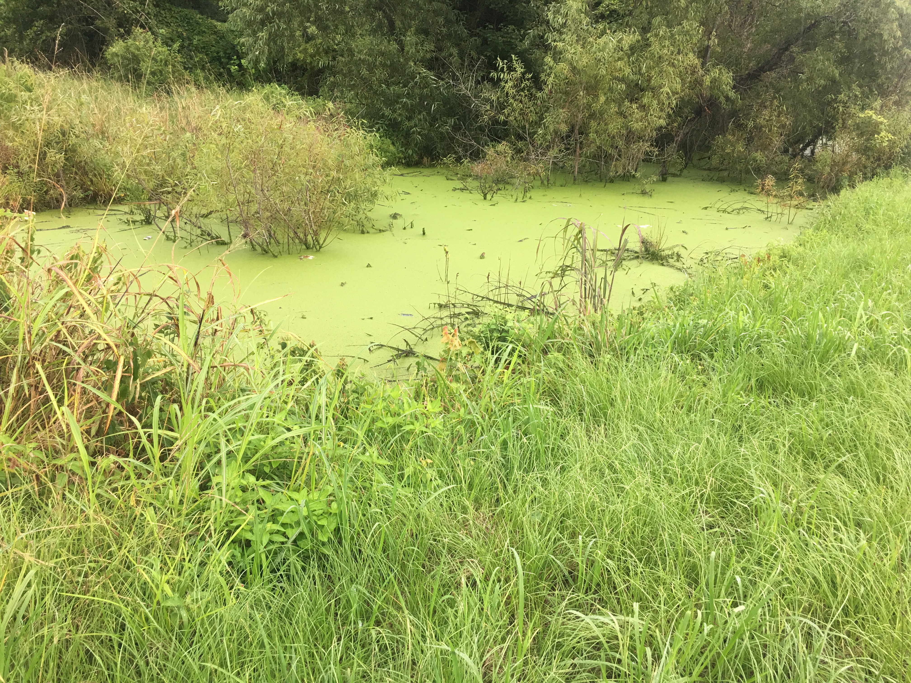
Key Info:
Hazards:
Land Use and Socio-economic Activities
Sea Level Rise
Vulnerabilities:
Water Quality and Freshwater Wildlife
Local Economy

Slide 6
Foresight
Nutrient loading can cause economic decline
Scenario 1: Continuing nutrient loading=hypoxia (dead lake)
Scenario 2: Reduction in nutrient input=slow increase in water quality
Scenario 3: Stop harmful chemicals in agriculture=tourism influx, increase in water quality
Sea Level Rise/Climate Change
Scenario 1: 0.5 m sea level rise=10% inundation (UCS,2017)
Higher salinity
Scenario 2: 1.2 m sea level rise=20% inundation (UCS,2017)
Significant salt water intrusion
Scenario 3: 2.0 m sea level rise=40% inundation (UCS,2017)
Completely inundated by salt water

Slide 7
Options:
Options:
Restore the Lodge
Cultural significance
Economic benefit
Agricultural Management Plan
Cover crops
No-till
Riparian buffers
Educational programs
Tide Gates
Currently inefficient
Increase in sea level leads to gates eventually becoming ineffective

Slide 8
Next Steps:
Recommendations:
Reopen the Lodge
Creates new tourist destination and an increase revenue.
Allows for programs to interact with the refuge while increasing awareness
TDML Regulations
Creates a maximum amount of fertilizer, controlling the level of pollution runoff.
Open the Gates
As salinity is known to decrease nutrient loads, opening the gates could be beneficial to the water quality.
Projected saltwater intrusion due to sea level rise is inevitable based on current foresight. Opening of gates allows a transition in the ecosystem.

Slide 9
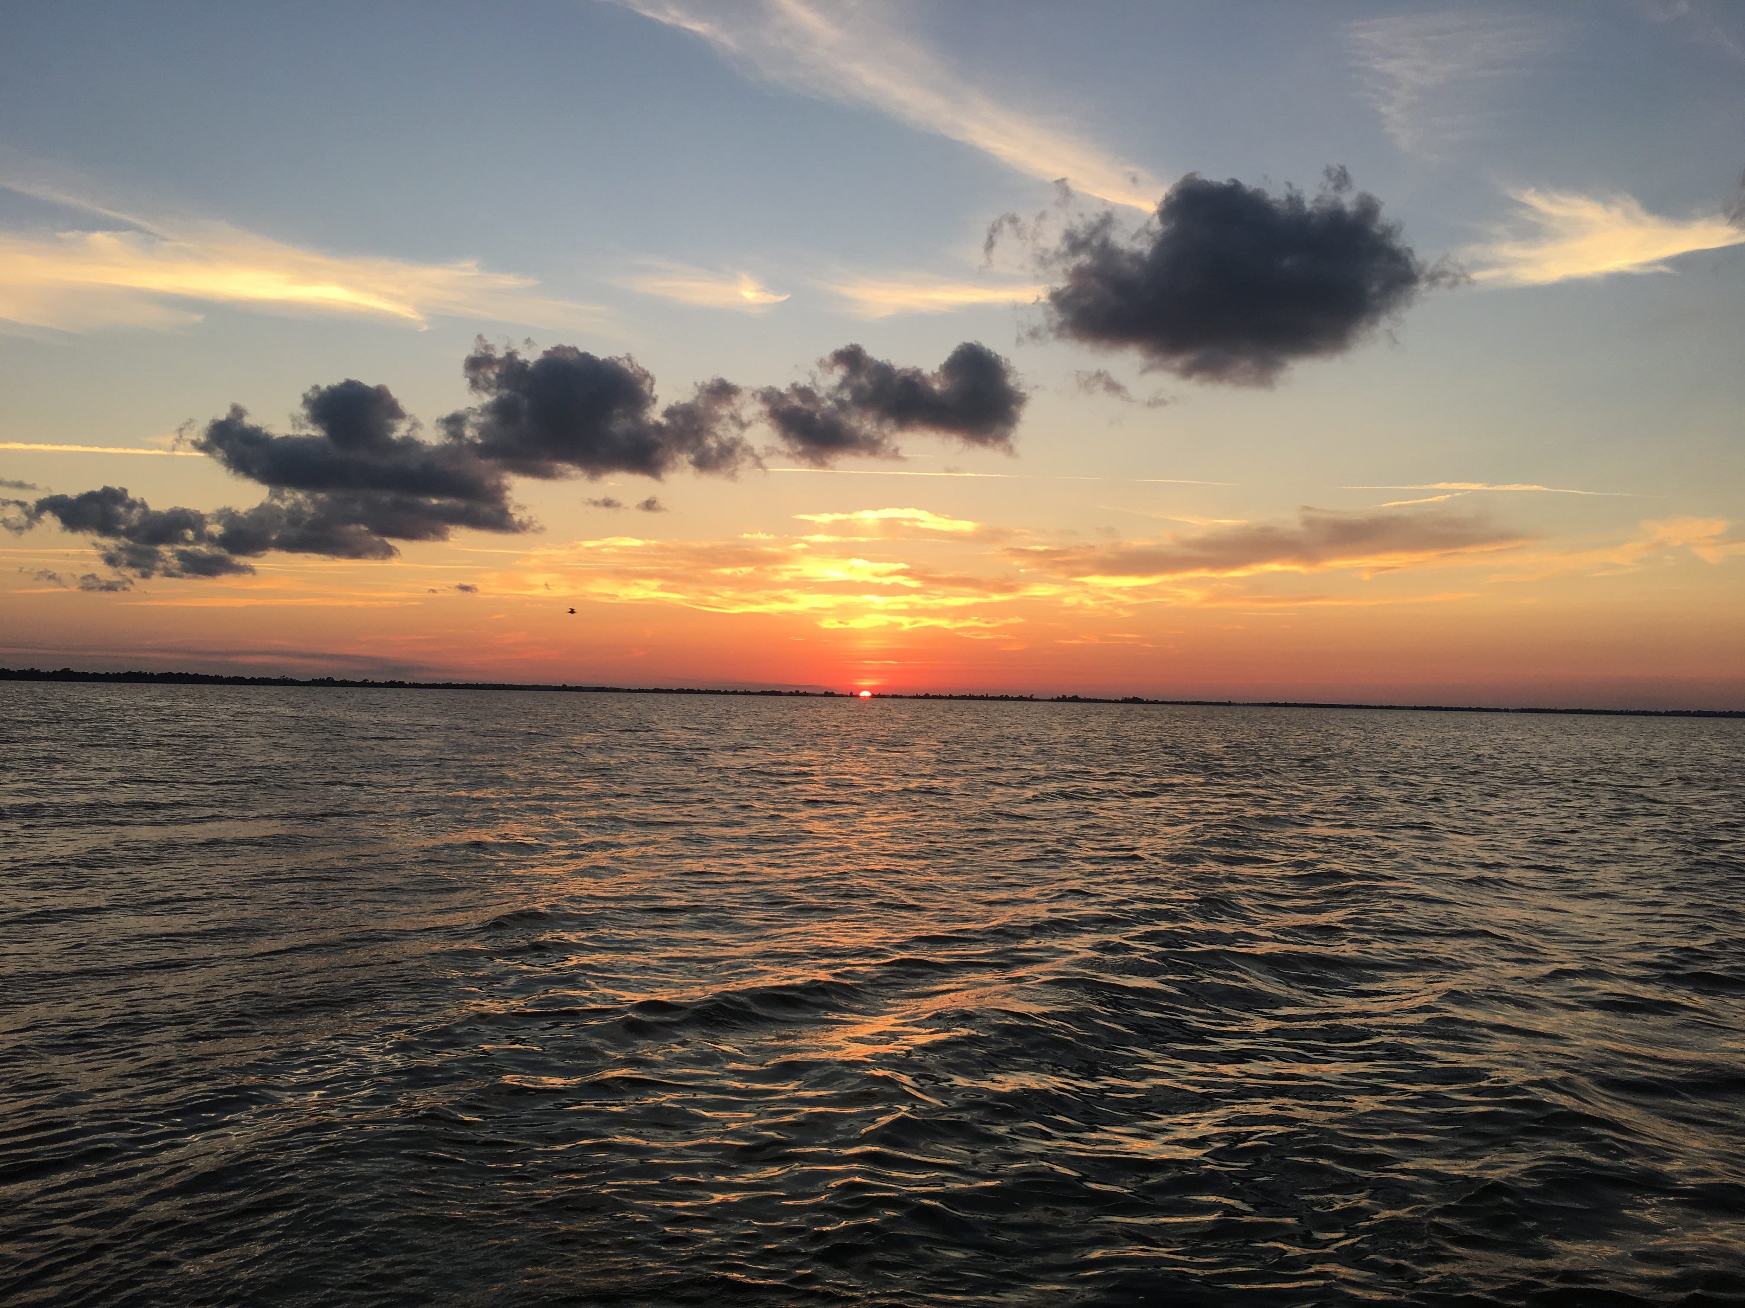
Message:
What did the larger community gain?
Insight as to the futures of the lake and it’s county.
What did you gain?
Insight on a troubled system, and what futures it faces.
What are you most proud of?
Conducting research on a community that I was unable to talk to.
Lesson Learned:
Community outreach can play a significant impact on the system.

Slide 10
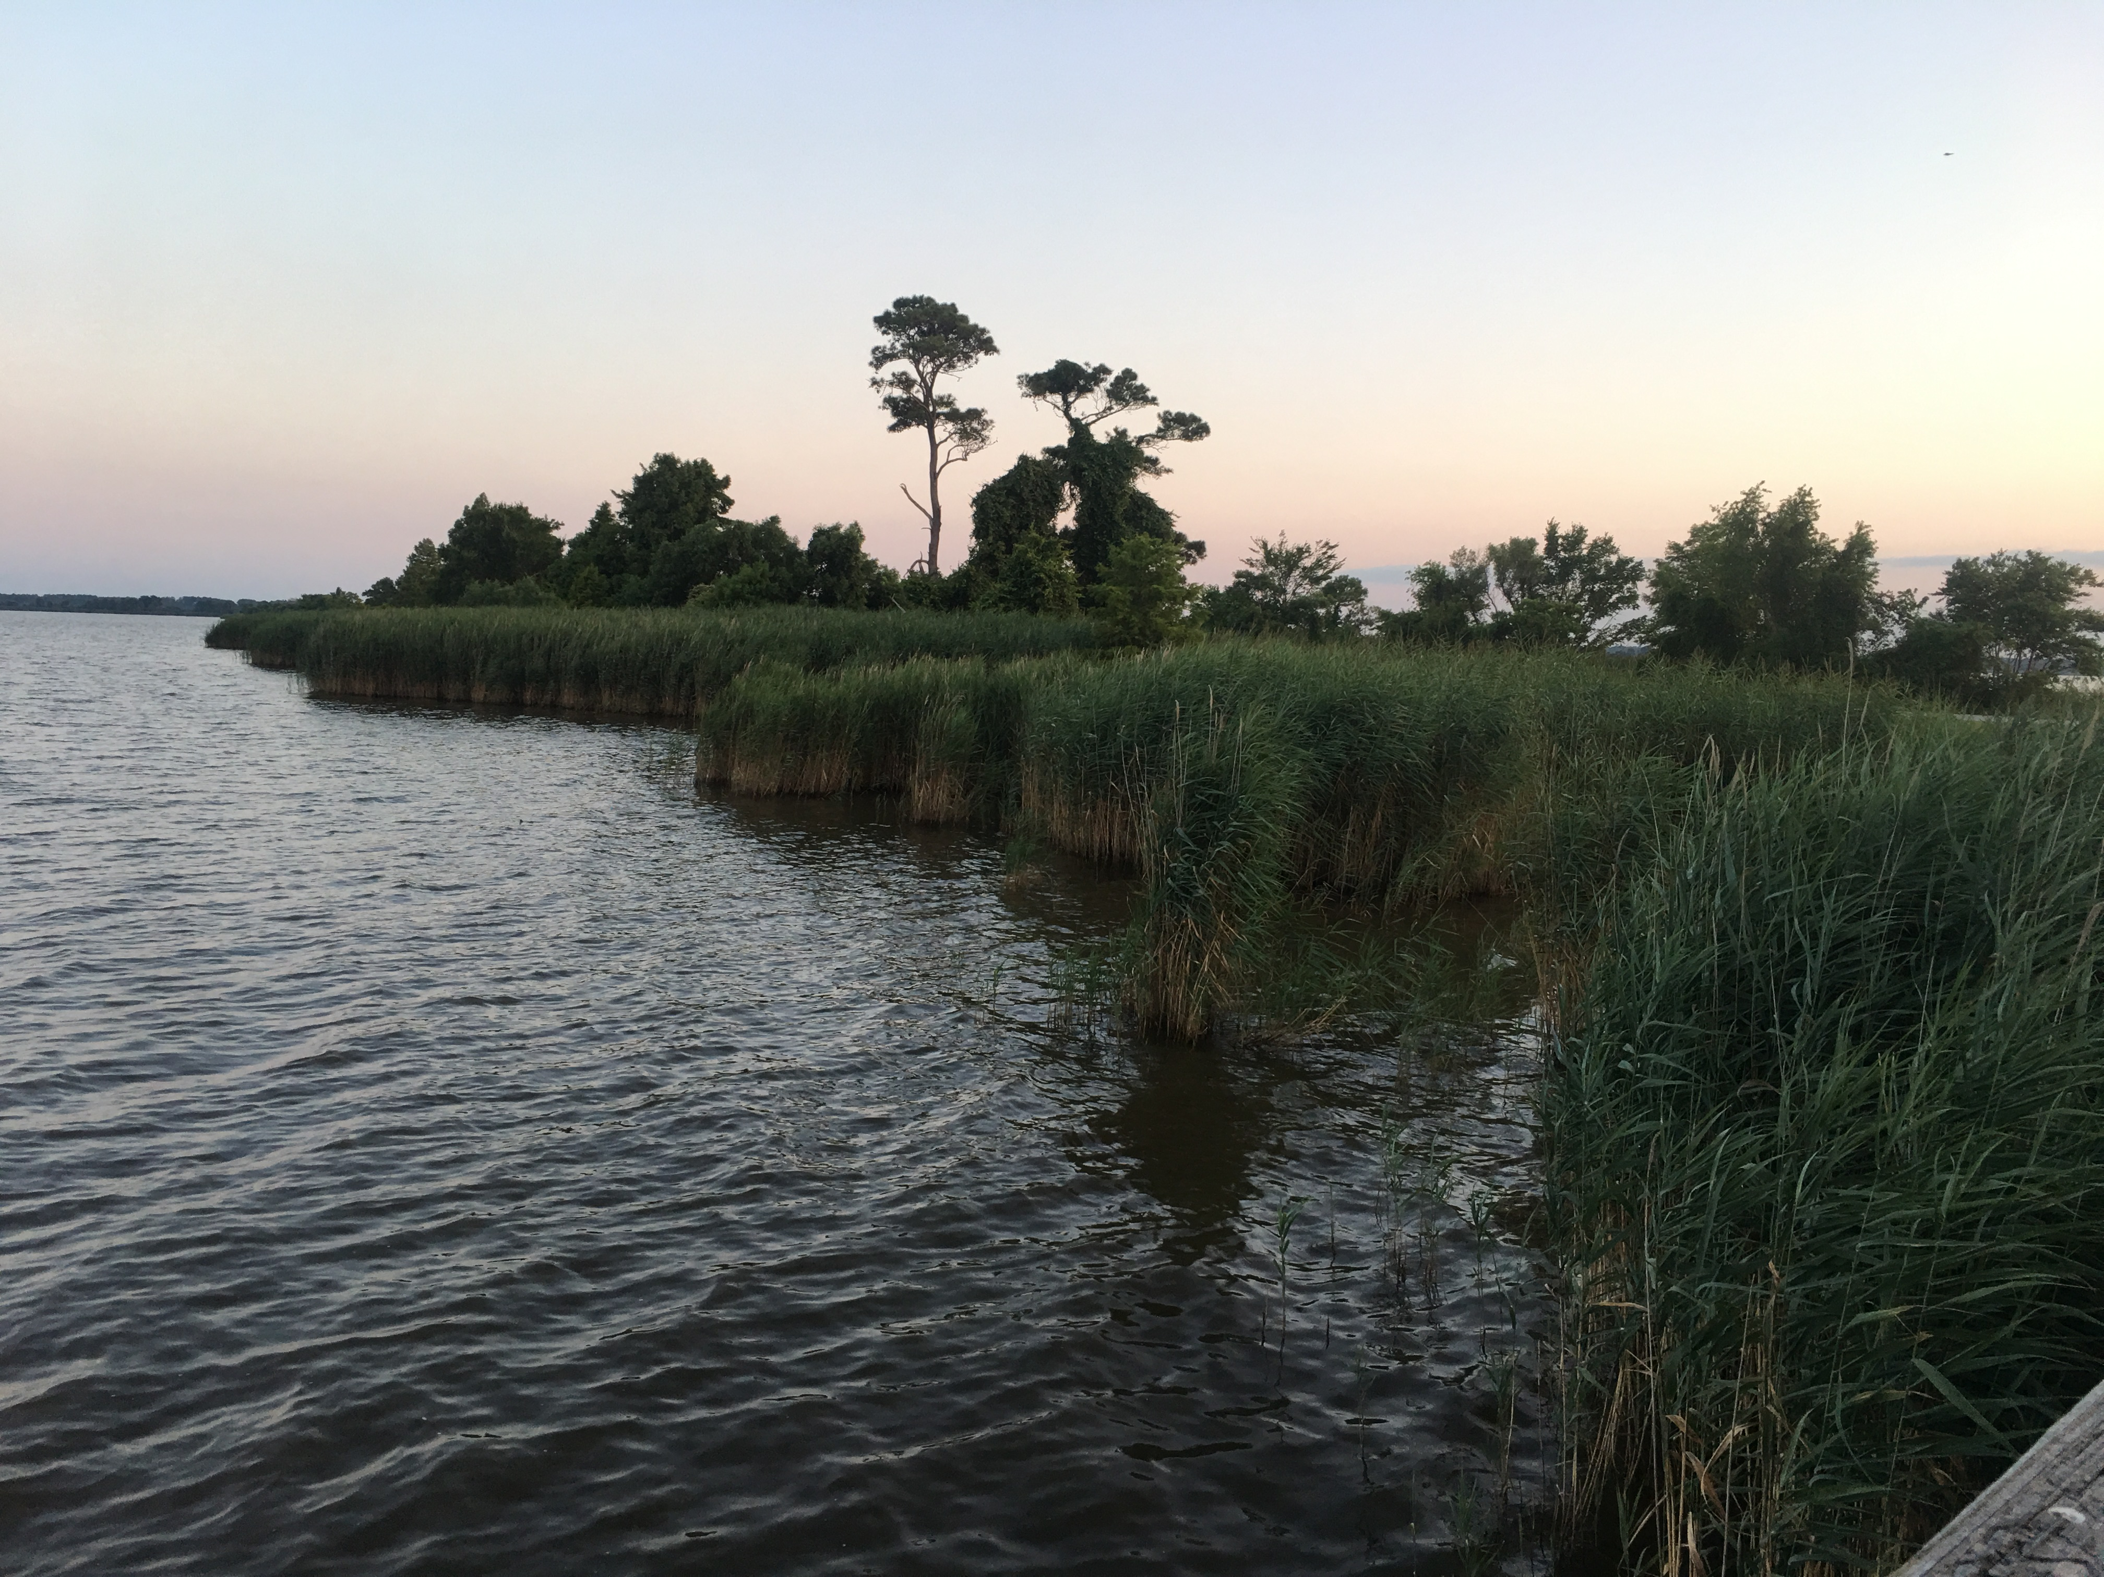
Thank you for your time.
PowerPoint by
Lena Midgette
Old Dominion University
Lmidg003@odu.edu

