Slide 1

Elizabeth River Project Intern
By: Alissa Ralston

Slide 2
Join the revolution to save the Elizabeth River. You make all the difference! -Elizabeth River Project

Slide 3
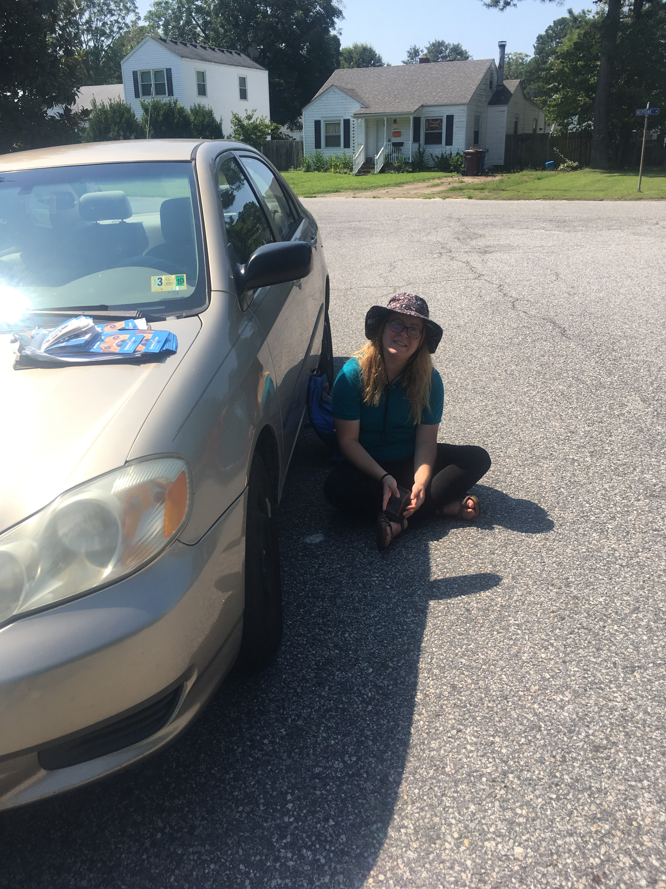
About me!
Alissa Ralston
Senior at Old Dominion University
I’m passionate about Wildlife, Plant life, and Conservation
I’m giving this presentation to shed some light on me and my internship at the Elizabeth River Project.

Slide 4
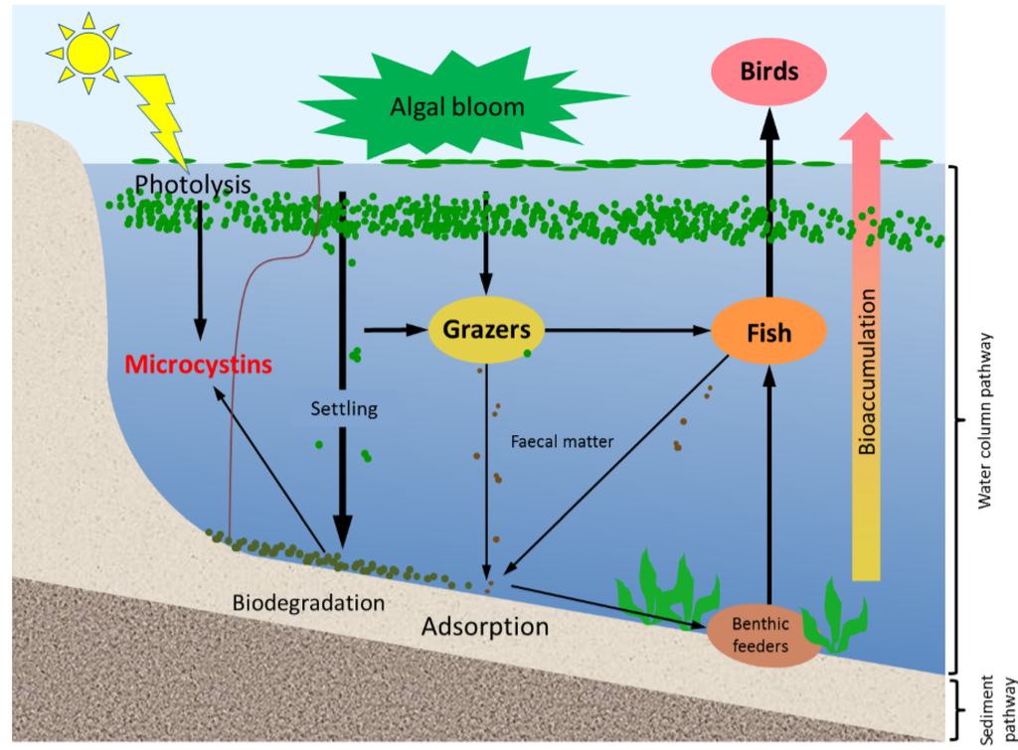
Hazard
The Indian River received a failing grade for water health.
80% of the bacteria in the water is from dog waste.
This leads to hookworms, enterococci, salmonella, and hepatitis possibly infecting residents.
Algal blooms are a result of the Nitrogen and phosphorus in the water.
The chances of algal blooms goes up in the summer time.

Slide 5
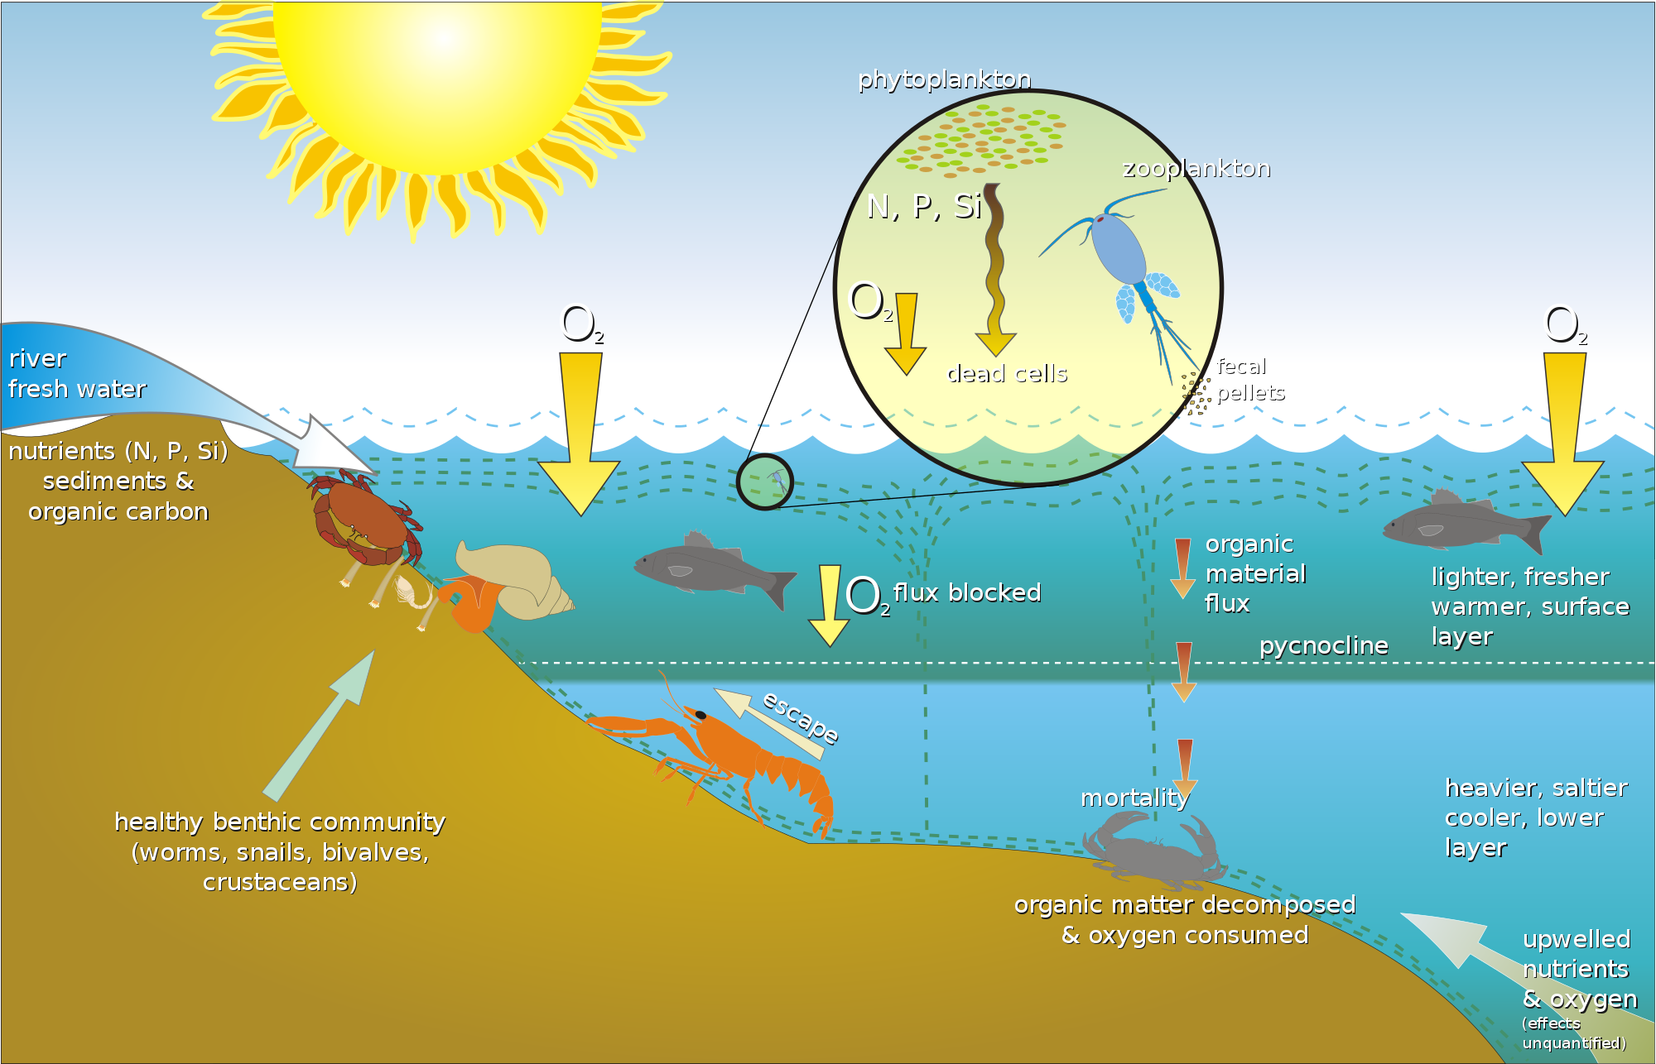
Vulnerabilities
Shellfish are susceptible to absorbing the pollution and cyanobacteria.
When they absorb these toxins, they can have detrimental effects on the food chain.
Dissolved dog waste absorbs dissolved oxygen, resulting in fish kills.
Humans are at risk from consuming fish or water from the river.

Slide 6
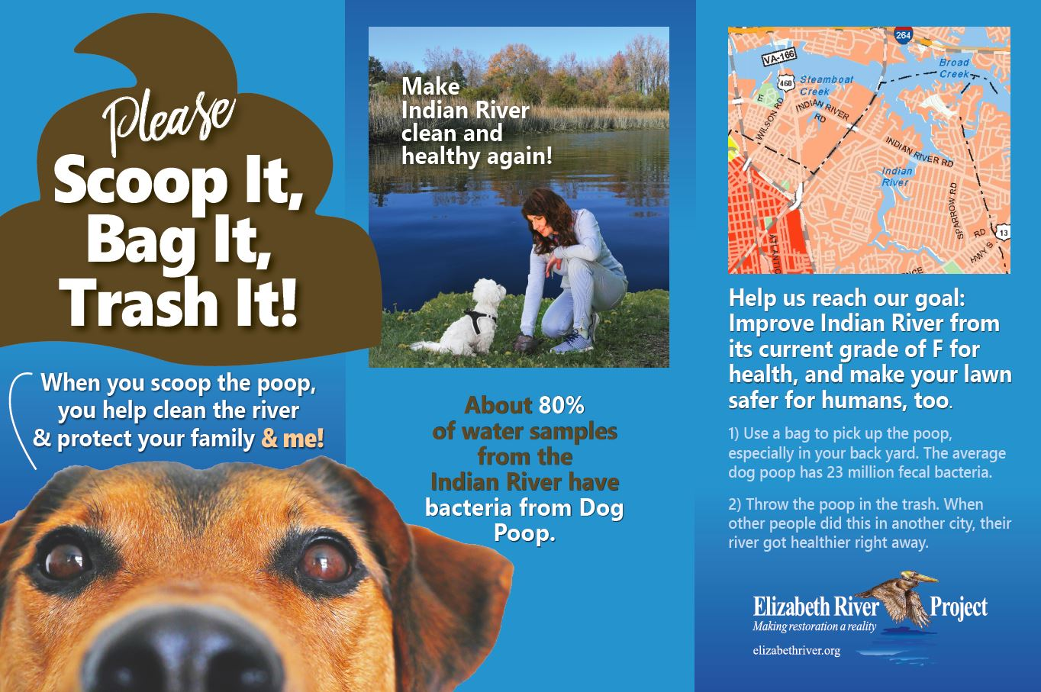
foresight
If everyone picks up after their dog, then the amount of bacteria in the water will decline exponentially.
Some people may not pick up after their dogs, this will mean that the amount of bacteria will lessen.
If no one picks up after their dogs the amount of bacteria will increase exponentially.

Slide 7
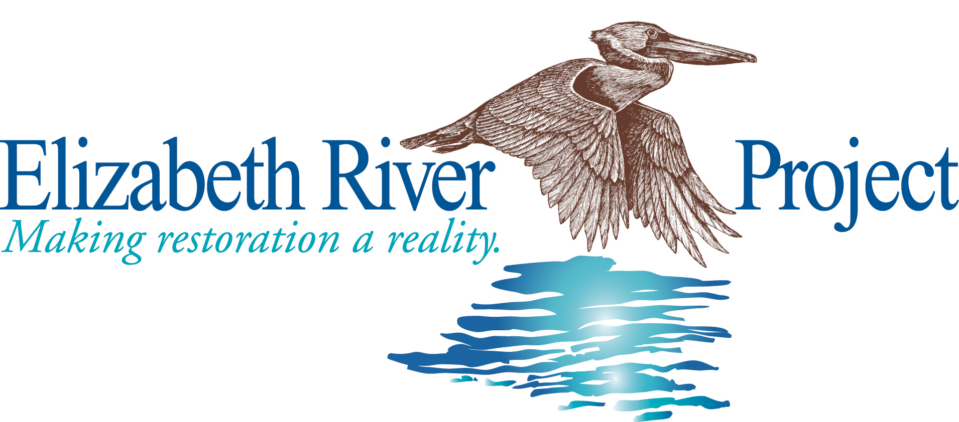
Stakeholders
Elizabeth River Project
US Army Corps of Engineers
Indian River Residents
The Sanitation District

Slide 8
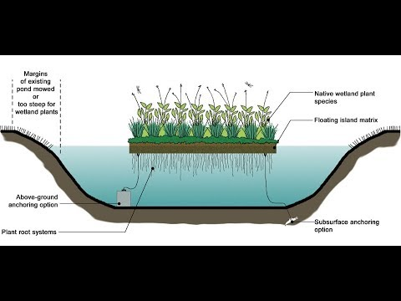
Options
Interactive website available for Indian River Residents.
Homeowner’s Association fee to have a service clean up dog poop.
Floating Treatment Wetlands: will take up any extra nutrients in the water.

Slide 9

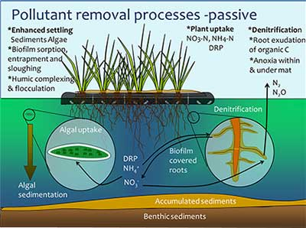
Recommendations
Easily accessible interactive website: Educates the residents about the issues with the Indian river.
Homeowner’s Association fee: Civic league can hire a company to clean up after the dogs in the neighborhood.
Freshwater treatment Wetlands: Does not require excessive maintenance and works well with natural processes.

Slide 10
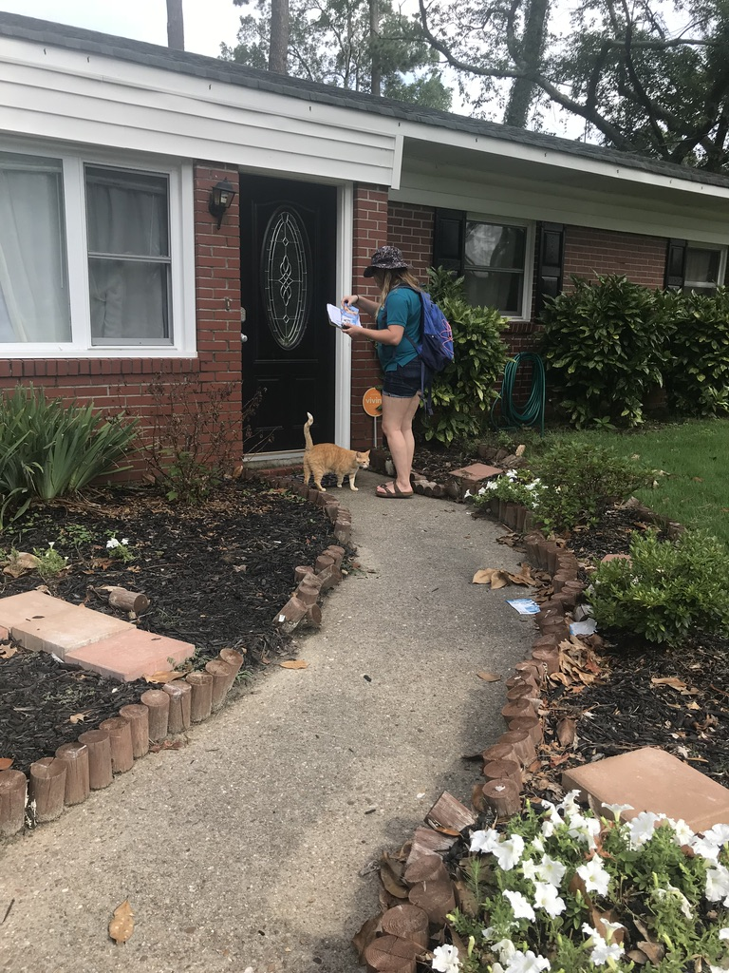
What was gained
A lot of residents were aware that there is a dog feces issue in their neighborhood.
When we actually talked to the residents, only a handful of them would not agree to pledge to pick up after their dogs.
I gained leadership skills and a better understanding of non government organizations.

Slide 11
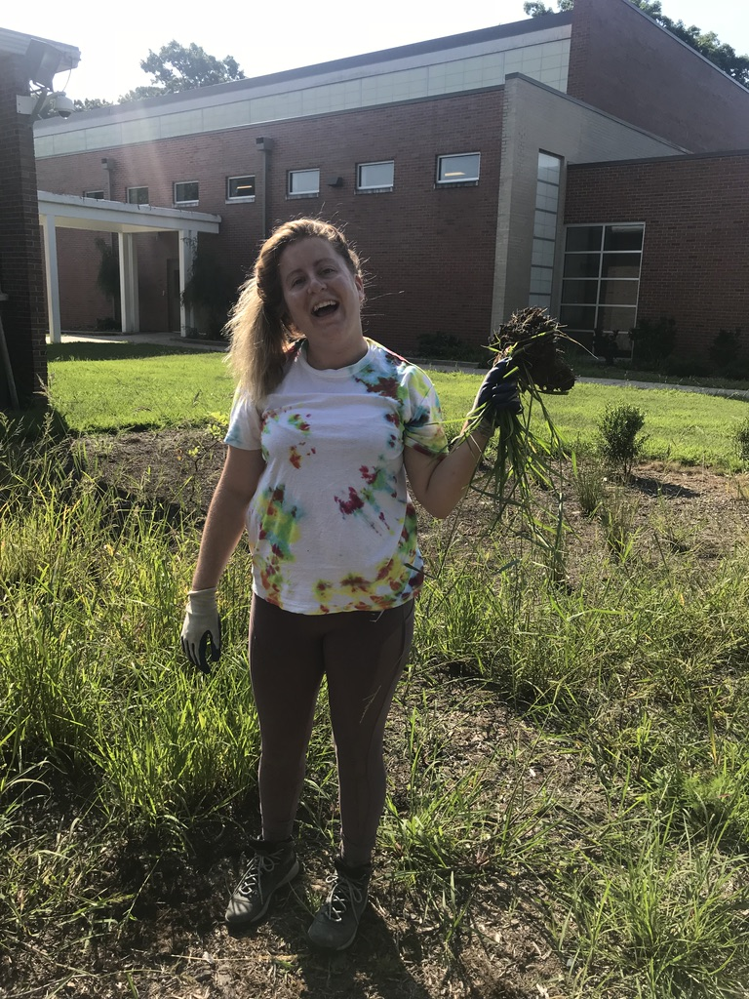
Final thoughts
I’m not sure how I made a difference.
This internship made a difference in me by showing me I can connect with other businesses even when I’m unfamiliar with them.
Lesson Learned: Trying to get a community to come together over pressing issues can be difficult, but it can happen.

