Slide 1
Elizabeth river project: internship
Fallon M.Woolford

Slide 2

Notes:
Non-profit organization founded in 1993. As old as me! To “save” the Elizabeth river from being a dead river.

Slide 3
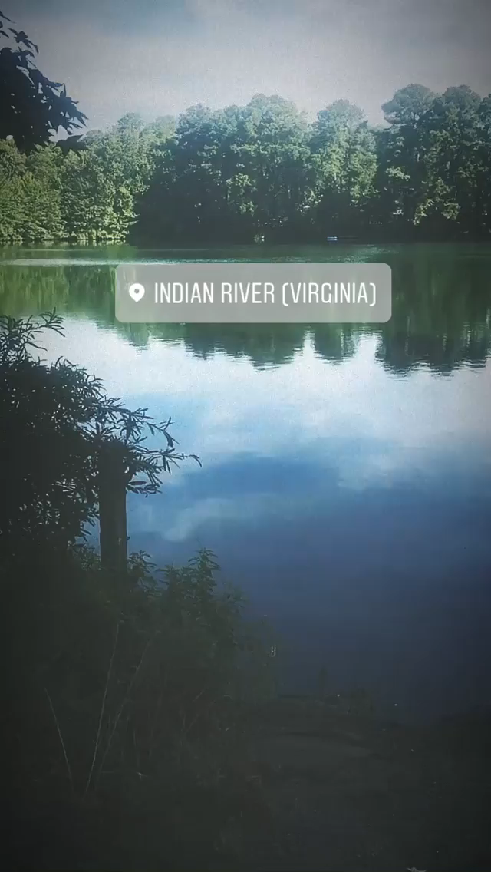
“adapt the pace of nature; her secret is patience.”
-ralph waldo emerson

Slide 4
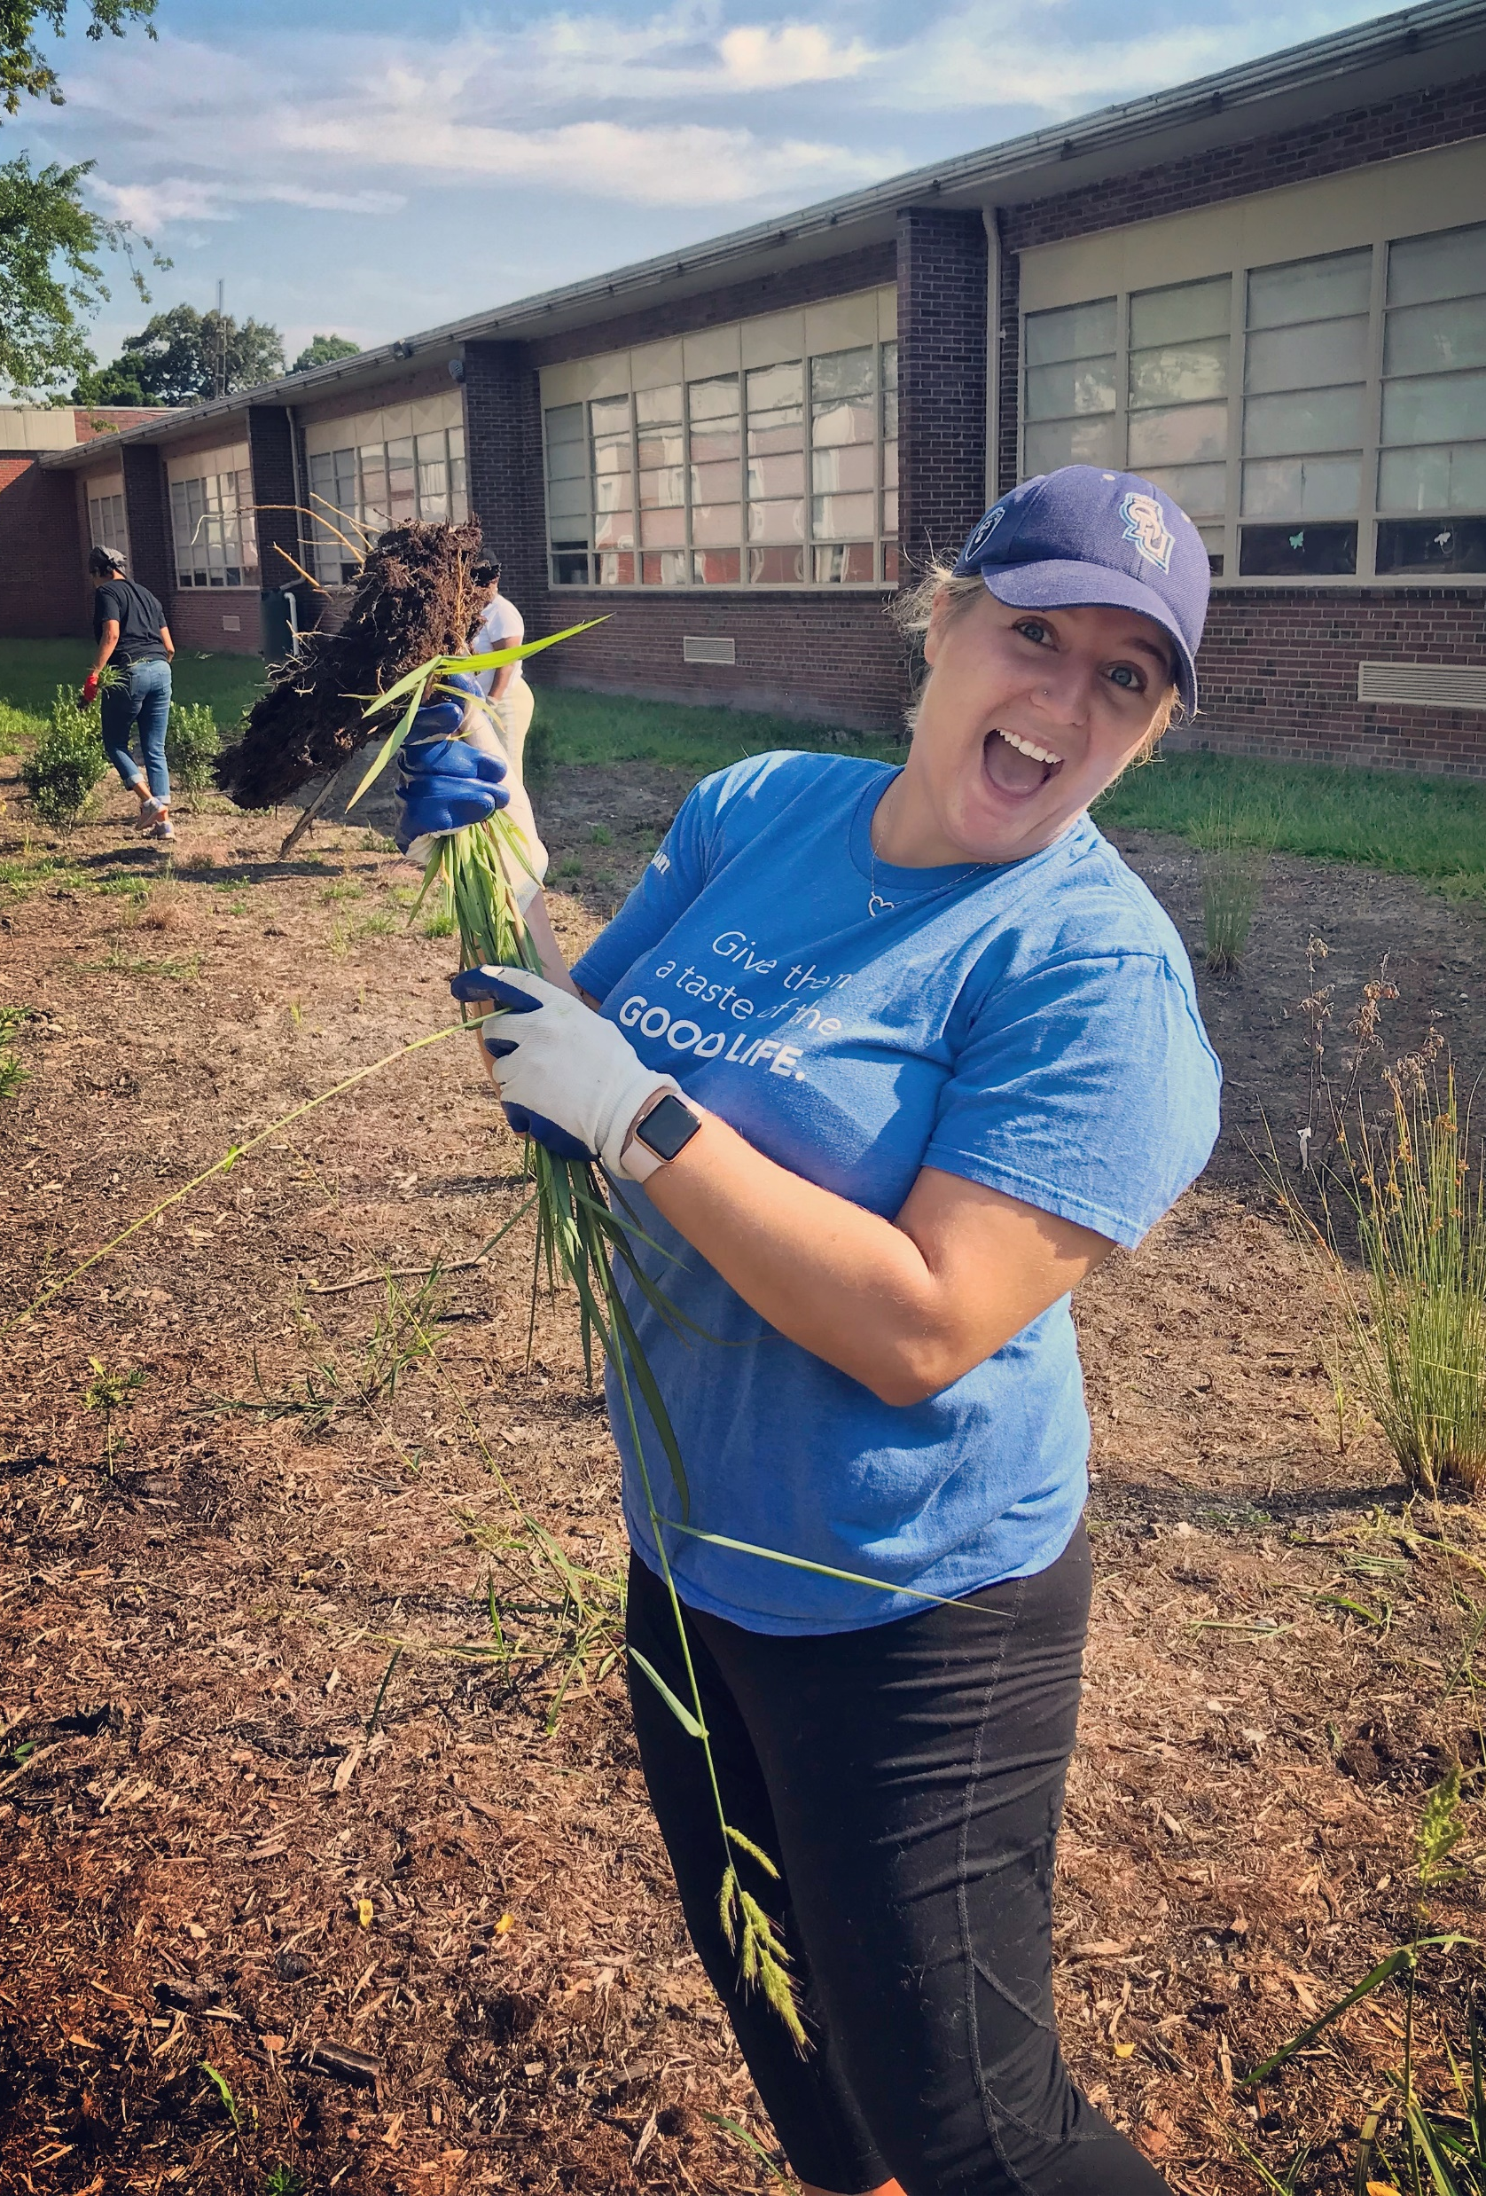
Fallon m. Woolford
Senior at ODU
Passionate about saving the planet, and making people aware of everything that is going on around them in the environment.
Interned this summer for the non-profit organization, Elizabeth River Project on a campaign.
Interesting fact: I sell and feed snakes for a living!

Slide 5
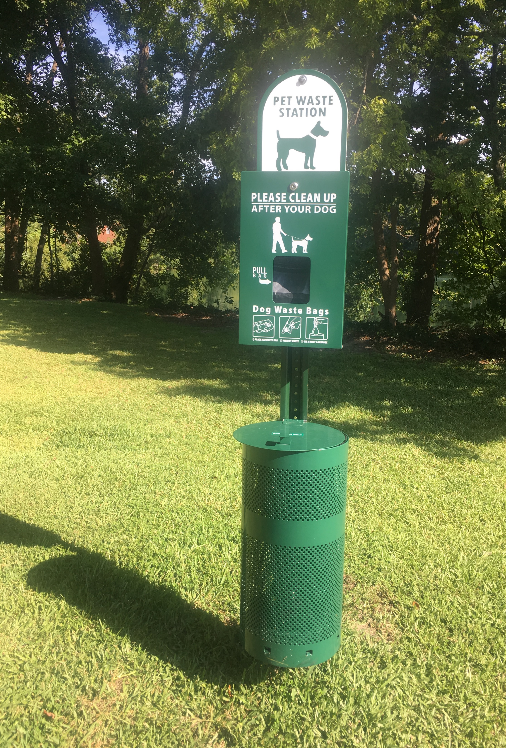
“Scoop the poop”
Co-leader of a scoop the poop campaign
  Door-to-door campaign around the Tanglewood neighborhood surrounding the Indian River.
  Promoted behavior change to the residents to “scoop the poop” of their dogs.
  Also working on a research paper concerning the chemical aspects affecting the health of the river.

Slide 6
More information on the internship
Inside the workings of a non-profit VS. a government agency.
Interacting with the public in a very interesting way.
Getting to do public outreach and waiting to see if the citizens change their behavior or continue “business as usual”.
Some residents were not at all receptive and seemed annoyed that we were there.

Slide 7
Total number of houses in tanglewood: 1,001.
Week 1 | Week 2 | Week 3 | Week 4 | Total Houses
228 | 62 | 84 | 136 | 510
We campaigned around the Tanglewood neighborhood for 4 out of the 5 weeks of our internship.

Slide 8
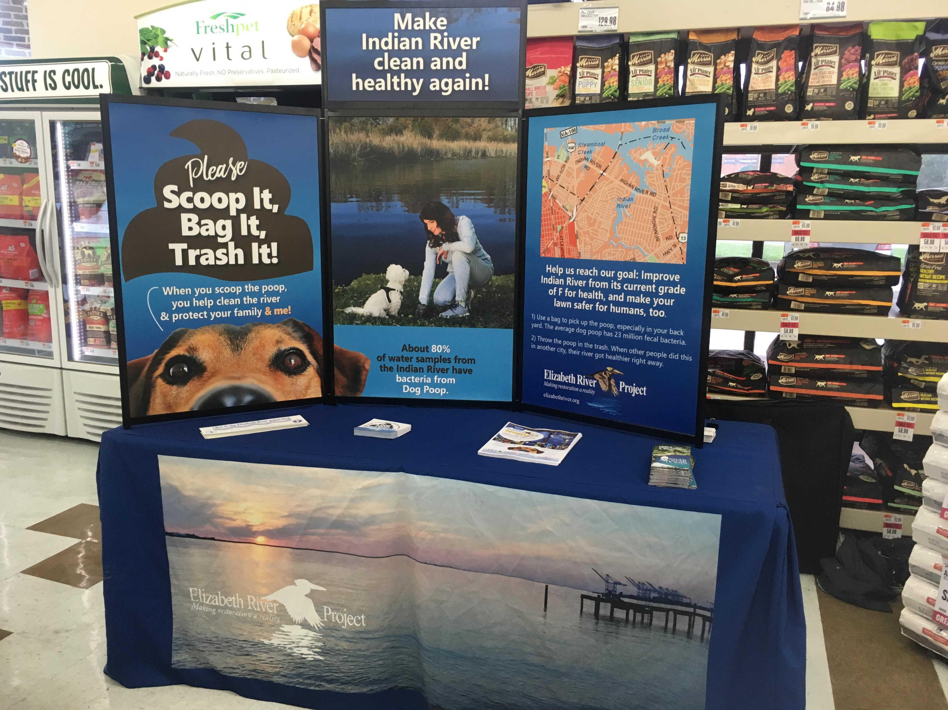
Additional campaigning/projects
Completed table top events at different pet stores in the Indian River area to reach a wider audience of residents.

Slide 9
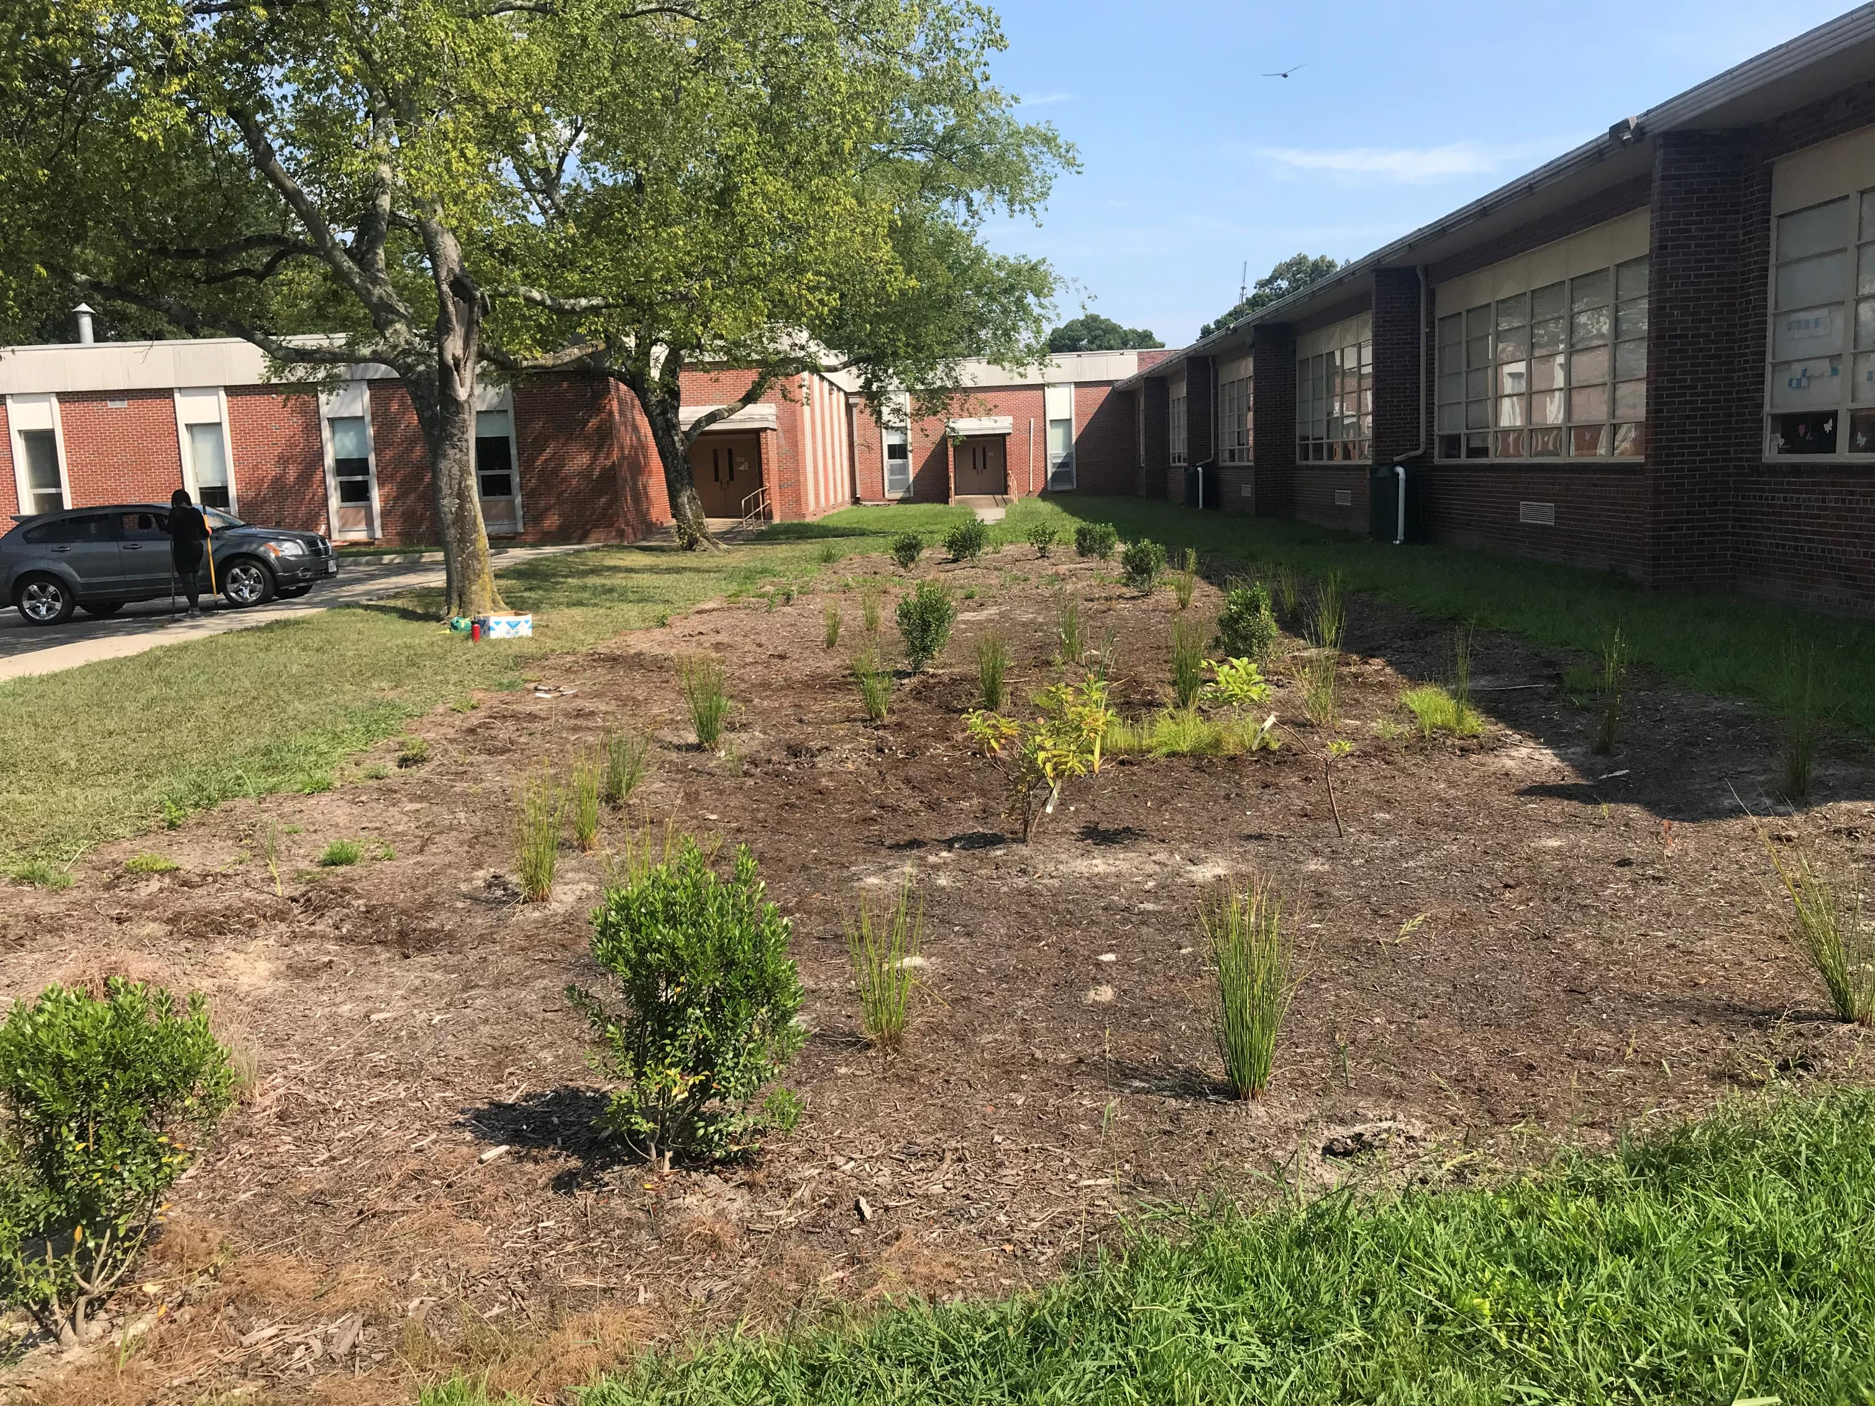
Additional campaigning/projects
Elizabeth River Project has constructed rain gardens and living shorelines around the Hampton Roads area
Pictured: Ingleside Elementary school’s rain garden.

Slide 10
impacts
Community gained a better knowledge of their surroundings and hopefully a behavior change.
Gained the confidence to speak to the public.
Proudest moment: was able to set table-top events up and make connections with local businesses through the internship.
Biggest lesson learned: you can’t change the mind of people who don’t see the error in their ways. The best thing you can do is give them the information they need to change their behavior.
PICK UP AFTER YOUR DOG NOT ONLY ON WALKS BUT IN YOUR OWN BACKYARD!

Slide 11
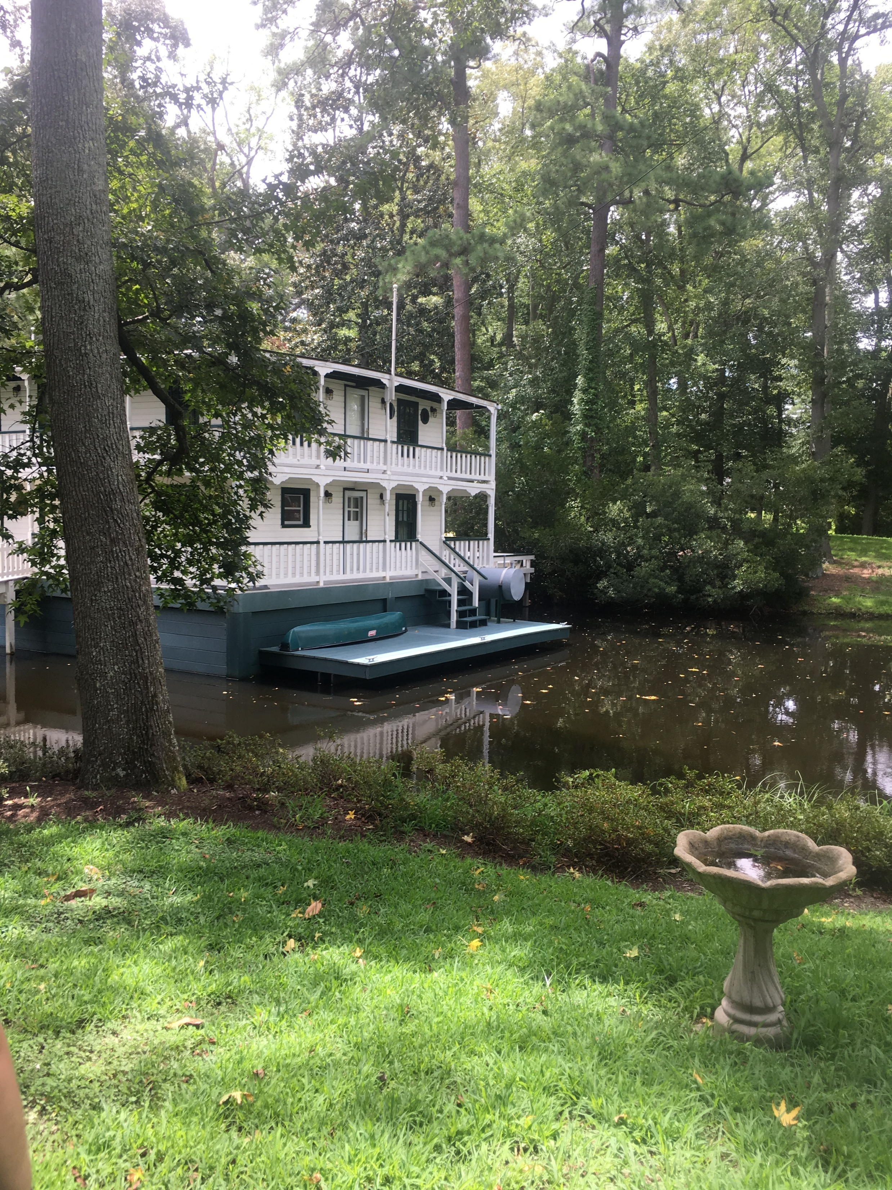
Thanks for your time!
Don’t forget to SCOOP THE POOP!

