Slide 1
Invasive Privet and Climate Change at Paradise Creek Nature Park
Conservation Leadership Internship
Elton Van Buskirk

Slide 2

About Conservation Leadership Internship
Second internship under Conservation Leadership
Uses a method called system thinking to understand the problem
Not a conventional research paper but looks at a broader scale of topics

Slide 3
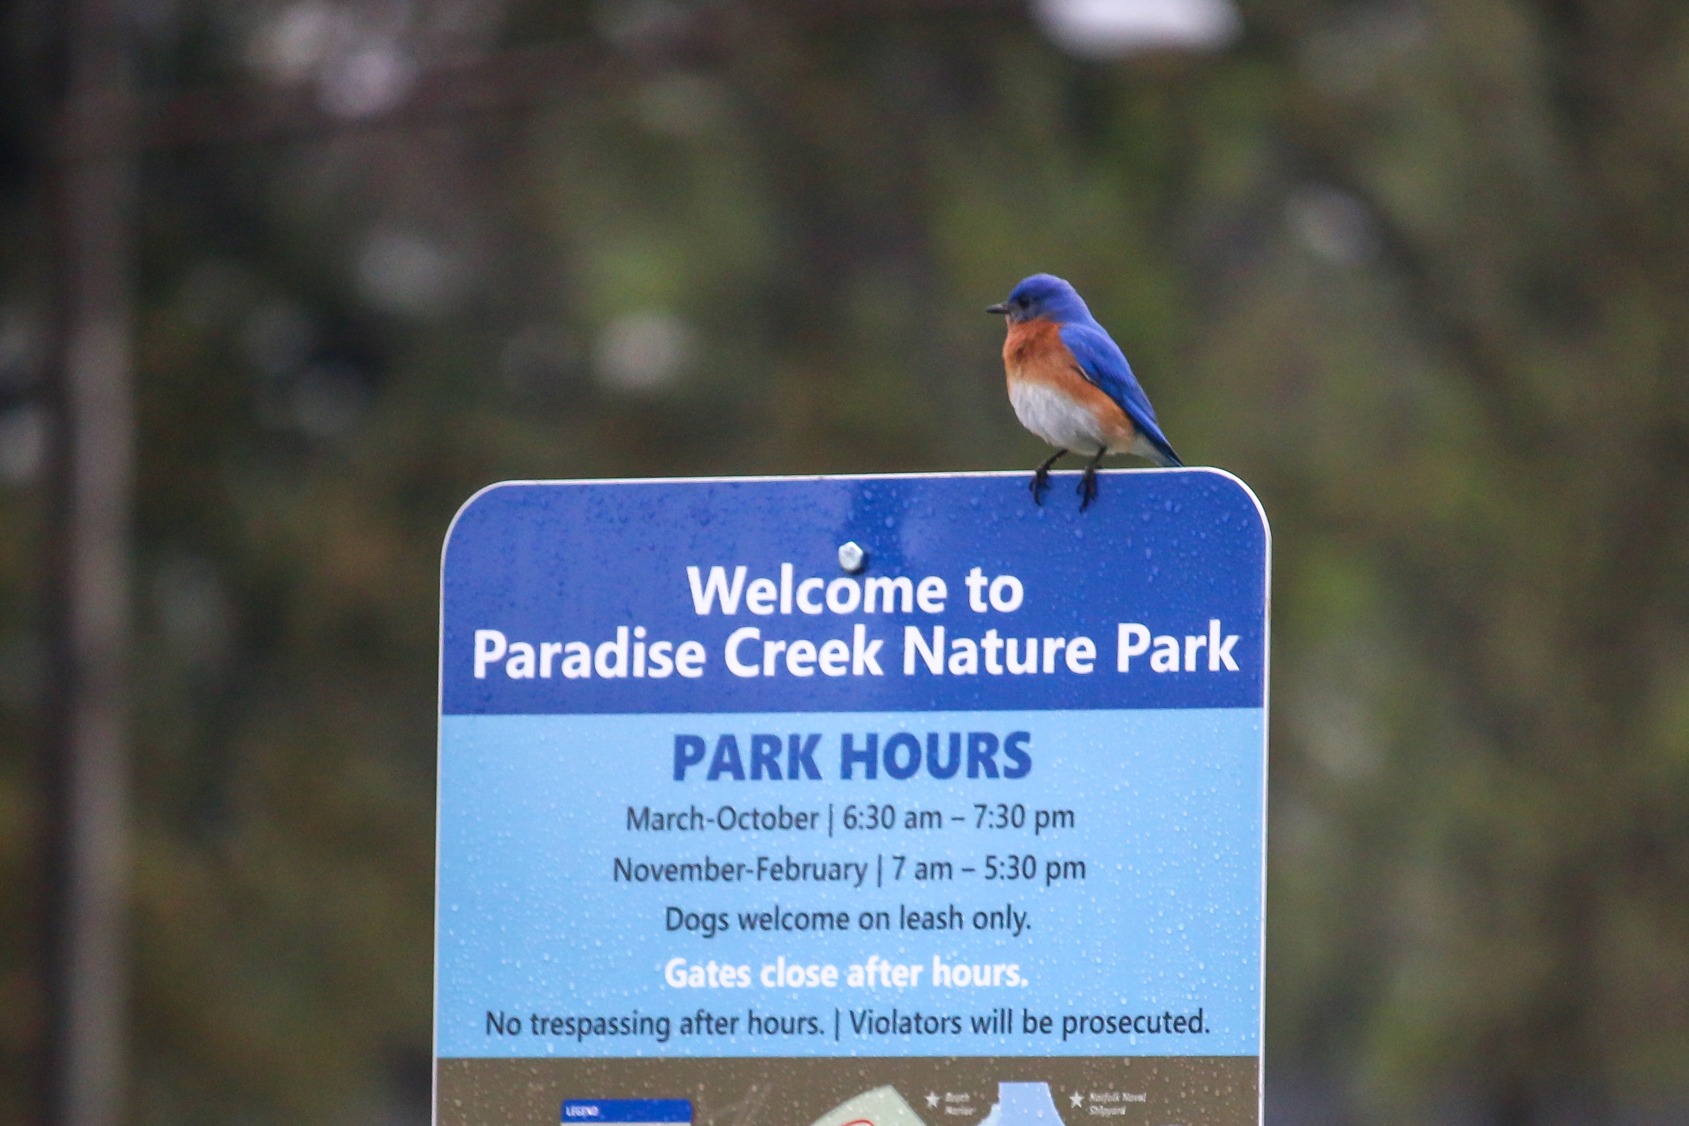
Introduction
Case study focused on specific problems affecting or will affect Paradise Creek Nature Park (PCNP).
One of the main concerns is invasive species and its relationship with the natural area
Climate change and its related effects will cause widespread change
The internship paper hopes to look at these two problems and understand how it will affect the park in the future

Slide 4

Decision Makers
Decision makers are the stakeholders that have a vested interest in the project or area being looked at
Decision makers might have different powers and responsibilities
Therefore their goals related to the problem at hand may be different
Two major decision makers
  Paradise Creek Nature Park (Elizabeth River Project)
  City of Pourtsmouth

Slide 5
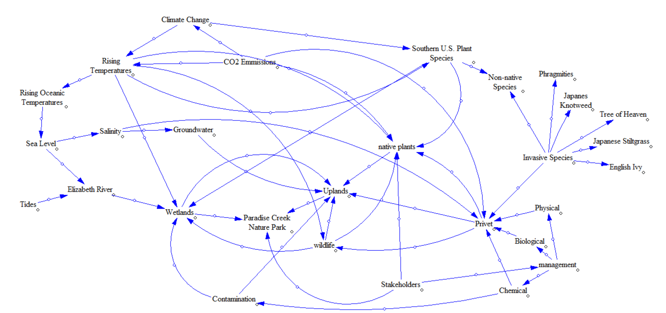
Wicked Problem
Wicked problems are problems with certain characteristics that make creating a solution extremely difficult.
Invasive species (in this case privet) are very hard to manage especially in such a large area where resources may be scarce
Climate change and its effects cannot be mitigated by the park itself
This is a wicked problem because there is a massive trade off being addressed between adapting to natural changes (such as plant growth, sea level rise, and temperature rise) and the management of invasive plants such as privet at the park.

Slide 6
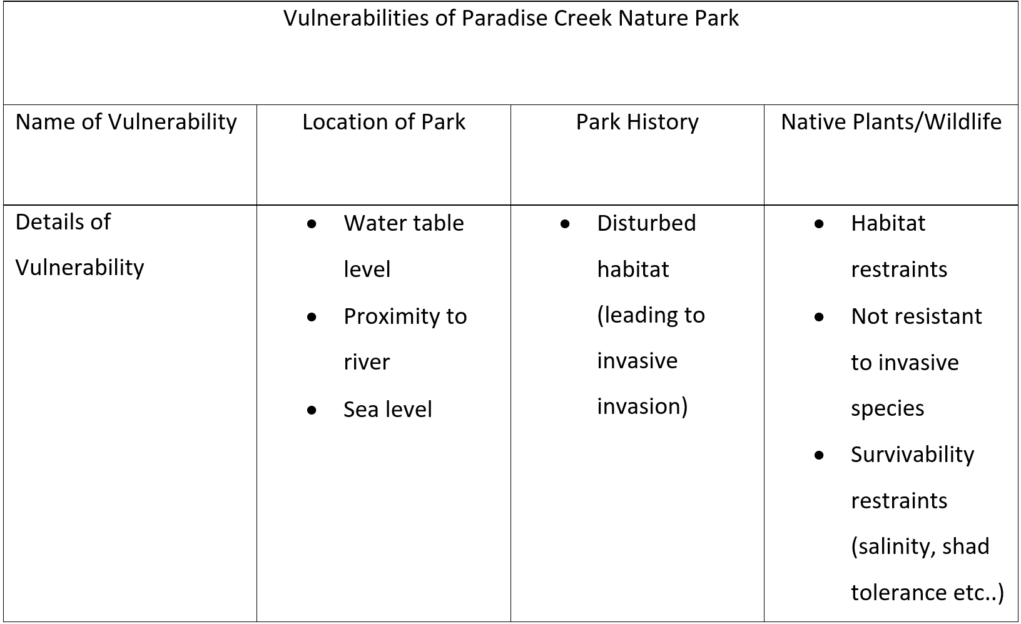
System Vulnerabilities
Vulnerabilities are inherent to the system and will always be present but is exacerbated by hazards/ threats
Vulnerabilities include
  Location of park
  Disturbed habitat
  Vulnerabilities of plants/animals
  Resources

Slide 7
Hazards and Threats
Hazards and threats are critically important to understand as well as understanding how they connect in the system.
Hazards/threats include:
Invasive species
  Privet
Climate Change
  Sea level rise
  Temperature shifts
  CO2 concentration

Slide 8
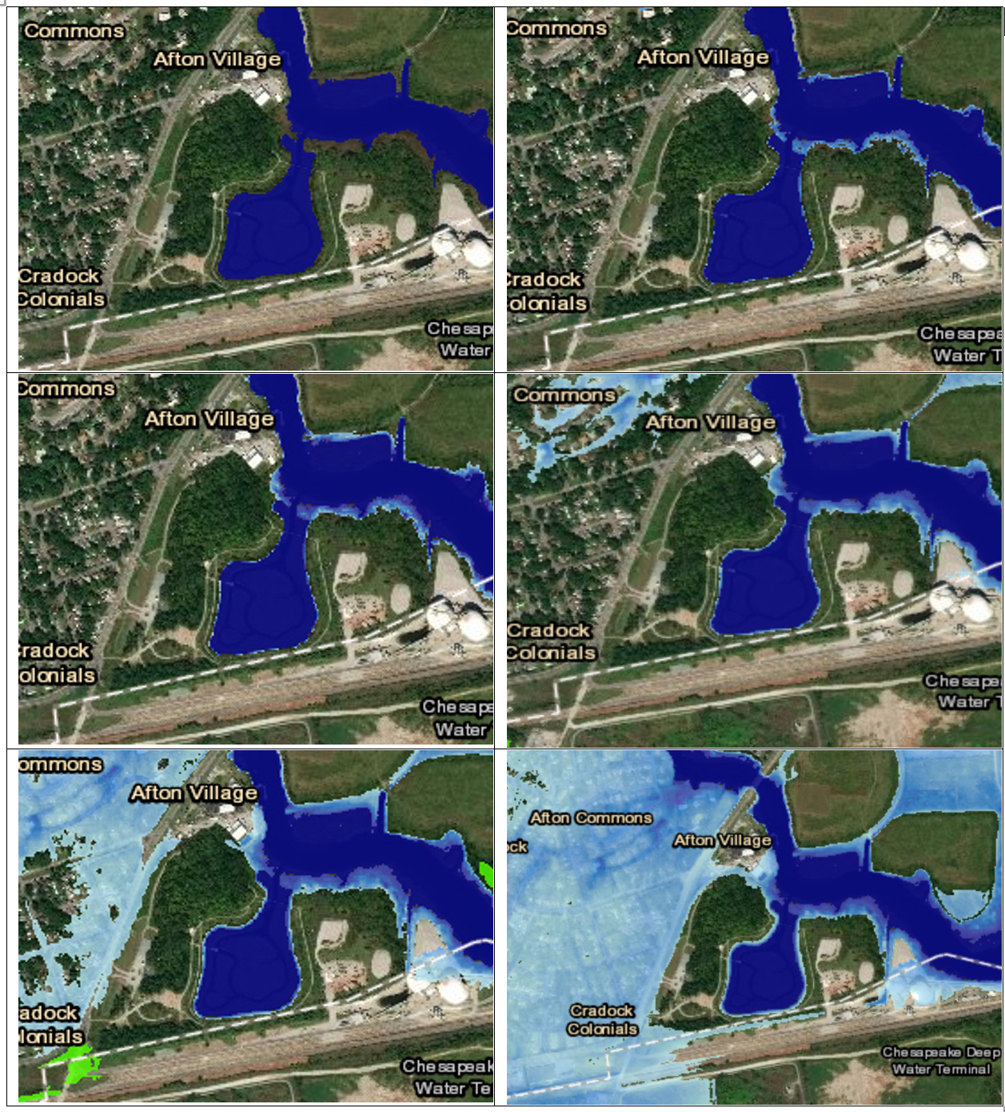
Foresight and Possible Futures
No action
Business as usual
Lower emission scenario (2100)
  Temperature rise: 2.3°–6.7°F (1.3°–3.7°C)
  Sea level Rise: 1-4 feet or (0.3-1.2 meters
Higher emission scenario (2100)
  Temperature rise: 5.4°–11.0°F (3.0°–6.1°C)
  Sea Level Rise: 4-8 feet or (1.2-2.4 meters)

Slide 9
Interventions
Complete eradication
Partial removal
Biological control
Spray and cut
Adapting to sea level rise
  Biologically
  Physically (hyrdrology/landscape)

Slide 10
Conclusion
Wicked problem which will only worsen in time
Invasive species such as privet may never be removed
New species will most likely move into the area by the year 2100 if not sooner

Slide 11
Recommendations
Recognize limate change in the scale of effect
Acknowledge climate change interaction on privet and other invasive species
Recommended that ERP
  Use citizen scientists to map out wetland areas
  Manage privet only in certain key areas
  Plant species that will meet future criteria to be successful

Slide 12
References
Billeaud, L. A., & Zajicek, J. M. (1989). Influence of mulches on weed control, soil pH, soil nitrogen content, and growth of Ligustrum japonicum. Journal of Environmental Horticulture, 7(4), 155-157.
Blaylock, A. D. (1994). Soil salinity, salt tolerance, and growth potential of horticultural and landscape plants. University of Wyoming, Cooperative Extension Service, Department of Plant, Soil, and Insect Sciences, College of Agriculture.
Bradley, B. A., Wilcove, D. S., & Oppenheimer, M. (2010). Climate change increases risk of plant invasion in the Eastern United States. Biological Invasions, 12(6), 1855-1872.
Brock, M.A., D.L. Nielsen, R.J. Shiel, J.D. Green, and J.D. Langley, 2003: Drought and aquatic community resilience: The role of eggs and seeds in sediments of temporary wetlands. Freshwater Biology, 48 (7), 1207-1218
Burgiel, S. W., & Muir, A. A. (2010). Invasive Species, Climate Change and Ecosystem-Based Adaptation: Addressing Multiple Drivers of Global Change. Global Invasive Species Programme (GISP). GISP, United Nations Avenue PO Box, 633, 56.
Carter, L., A. Terando, K. Dow, K. Hiers, K.E. Kunkel, A. Lascurain, D. Marcy, M. Osland, and P. Schramm, 2018: Southeast. In Impacts, Risks, and Adaptation in the United States: Fourth National Climate Assessment, Volume II [Reidmiller, D.R., C.W. Avery, D.R. Easterling, K.E. Kunkel, K.L.M. Lewis, T.K. Maycock, and B.C. Stewart (eds.)]. U.S. Global Change Research Program, Washington, DC, USA, pp. 743–808. doi: 10.7930/NCA4.2018.CH19
Carter, L. M., J. W. Jones, L. Berry, V. Burkett, J. F. Murley, J. Obeysekera, P. J. Schramm, and D. Wear, 2014: Ch. 17: Southeast and the Caribbean. Climate Change Impacts in the United States: The Third National Climate Assessment, J. M. Melillo, Terese (T.C.) Richmond, and G. W. Yohe, Eds., U.S. Global Change Research Program, 396-417. doi:10.7930/J0NP22CB.
Corlett, R. T., & Westcott, D. A. (2013). Will plant movements keep up with climate change?. Trends in ecology & evolution, 28(8), 482-488.
González‐Moreno, P., Diez, J. M., Richardson, D. M., & Vilà, M. (2015). Beyond climate: disturbance niche shifts in invasive species. Global Ecology and Biogeography, 24(3), 360-370.
Hanula, J. L., & Horn, S. (2011). Removing an invasive shrub (Chinese privet) increases native bee diversity and abundance in riparian forests of the southeastern United States. Insect Conservation and Diversity, 4(4), 275-283.
Hanula, J. L., Horn, S., & Taylor, J. W. (2009). Chinese privet (Ligustrum sinense) removal and its effect on native plant communities of riparian forests. Invasive Plant Sci. Manage. 2: 292–300. doi: 10.1614. Weed Science Society of America.
Maddox, V., Byrd, J., & Serviss, B. (2010). Identification and control of invasive privets (Ligustrum spp.) in the middle southern United States. Invasive Plant Science and Management, 3(4), 482-488.
Kalina, J., Braman, S. K., & Hanula, J. L. (2017). Developmental Biology of Leptoypha mutica (Hemiptera: Tingidae) on Chinese Privet (Lamiales: Oleaceae). Journal of entomological science, 52(2), 154-160.

Slide 13
References
McKee, K.L., I.A. Mendelssohn, and M. D. Materne, 2004: Acute salt marsh dieback in the Mississippi River deltaic plain: A drought-induced phenomenon? Global Ecology and Biogeography, 13 (1), 65-73. http:// dx.doi.org/10.1111/j.1466-882X.2004.00075.x
Merriam, Robert, and W. Feil. "The Potential Impact of An Introduced Shrub on Native Plant Diversity and Forest Regeneration." Biological Invasions 4.4 (2002): 369-73. Web.
Nuttle, W. K., & Portnoy, J. W. (1992). Effect of rising sea level on runoff and groundwater discharge to coastal ecosystems. Estuarine, Coastal and Shelf Science, 34(2), 203-212.
Rogers, C. E., & McCarty, J. P. (2000). Climate change and ecosystems of the Mid-Atlantic Region. Climate Research, 14(3), 235-244.
Smith, K. E., Rumon, G. B., Prior, S. A., Price, A. J., Rogers, H. H., & Torbert, H. A. (2008). Chinese Privet (Ligustrum sitíense) in an elevated C02 Environment.
Sorte, C. J., Ibáñez, I., Blumenthal, D. M., Molinari, N. A., Miller, L. P., Grosholz, E. D., ... & Dukes, J. S. (2013). Poised to prosper? A cross‐system comparison of climate change effects on native and non‐native species performance. Ecology letters, 16(2), 261-270.
USGCRP, 2018: Impacts, Risks, and Adaptation in the United States: Fourth National Climate
Assessment, Volume II: Report-in-Brief [Reidmiller, D.R., C.W. Avery, D.R. Easterling, K.E. Kunkel,
K.L.M. Lewis, T.K. Maycock, and B.C. Stewart (eds.)]. U.S. Global Change Research Program,
Washington, DC, USA, 186 pp. doi:
USDA Fact Sheet
Walsh, J., D. Wuebbles, K. Hayhoe, J. Kossin, K. Kunkel, G. Stephens, P. Thorne, R. Vose, M. Wehner, J. Willis, D. Anderson, S. Doney, R. Feely, P. Hennon, V. Kharin, T. Knutson, F. Landerer, T. Lenton, J. Kennedy, and R. Somerville, 2014: Ch. 2: Our Changing Climate. Climate Change Impacts in the United States: The Third National Climate Assessment, J. M. Melillo, Terese (T.C.) Richmond, and G. W. Yohe, Eds., U.S. Global Change Research Program, 19-67. doi:10.7930/J0KW5CXT.
Walther, G. R., Roques, A., Hulme, P. E., Sykes, M. T., Pyšek, P., Kühn, I., ... & Czucz, B. (2009). Alien species in a warmer world: risks and opportunities. Trends in ecology & evolution, 24(12), 686-693.
Wang, H. H., & Grant, W. E. (2012). Determinants of Chinese and European privet (Ligustrum sinense and Ligustrum vulgare) invasion and likelihood of further invasion in southern US forestlands. Invasive Plant Science and Management, 5(4), 454-463.
Ward, R. W. (2002). Extent and dispersal rates of Chinese privet (Ligustrum sinense) invasion on the upper Oconee River floodplain, North Georgia. Southeastern Geographer, 42(1), 29-48.
Wilcox, J., & Beck, C. W. (2007). Effects of Ligustrum sinense Lour.(Chinese privet) on abundance and diversity of songbirds and native plants in a southeastern nature preserve. Southeastern Naturalist, 6(3), 535-550.

