Slide 1
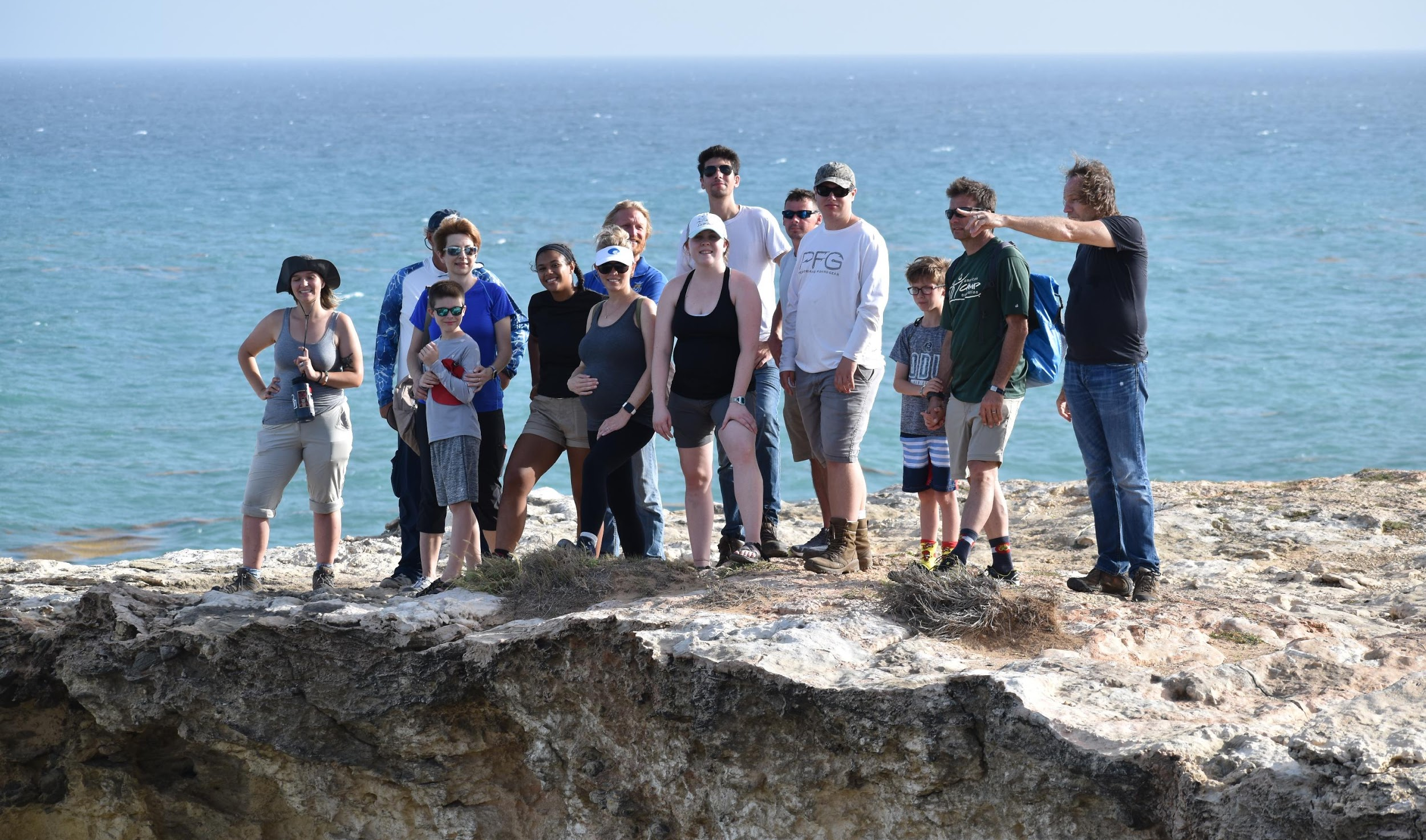
Sustainability Leadership
Summer 2019
IDS 467/567

Slide 2
Overview
01
02
03
Discuss Case Study in broad strokes
Explore the Puerto Rico Experience
Talk about Lessons Learned

Slide 3
Case Study

Slide 4
Case Study and Methods
Participatory modeling and role-playing stakeholder meeting

Slide 5
Case Study and Methods
Meeting the water needs of the people of Puerto Rico while safeguarding freshwater ecosystems

Slide 6
Case Study and Methods
Daily group meetings
Meetings with outside organizations
Cara con Causa
Wastewater treatment facility (PRASA)
Sandra Farms Coffee
Individual research on assigned stakeholder
Lead author of designated section
MARI case study template

Slide 7
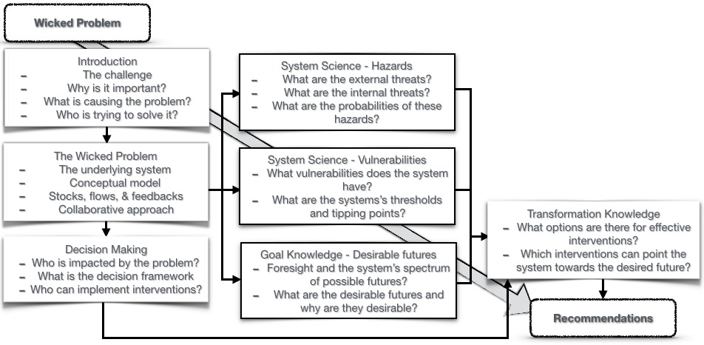

Slide 8
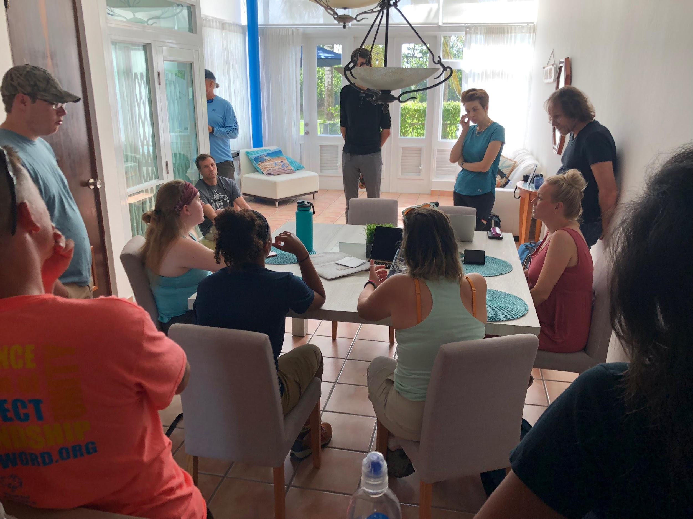

Slide 9
Findings and Recommendations
Current challenges to water management
Leakage (57% of water transported lost)
Sedimentation (Loss of reservoir capacity)
Complexity of oversight and governance
Current threats to freshwater ecosystems
Segmentation of ecosystems
Pollution of ecosystems (trash, run-off, regulation of wastewater disposal, etc...)
Policies (Q99)

Slide 10
Findings and Recommendations
Future challenges to management and ecosystems
Modern climate change
Lack of rainfall
Increase in temperatures
Increase in severe storm intensity and frequency
Sea level rise
Destruction of coastal ecosystems and wetlands
Salt water intrusion
Increased pollution of freshwater ecosystems

Slide 11
Findings and Recommendations
Recommendations
Promote waste reduction
Better monitoring and building databases
Expand decentralized water storage
Creation of leakage hotline
Promote transparency in water management
Increase staffing for quality testing and inspections

Slide 12
Puerto Rico Experience

Slide 13
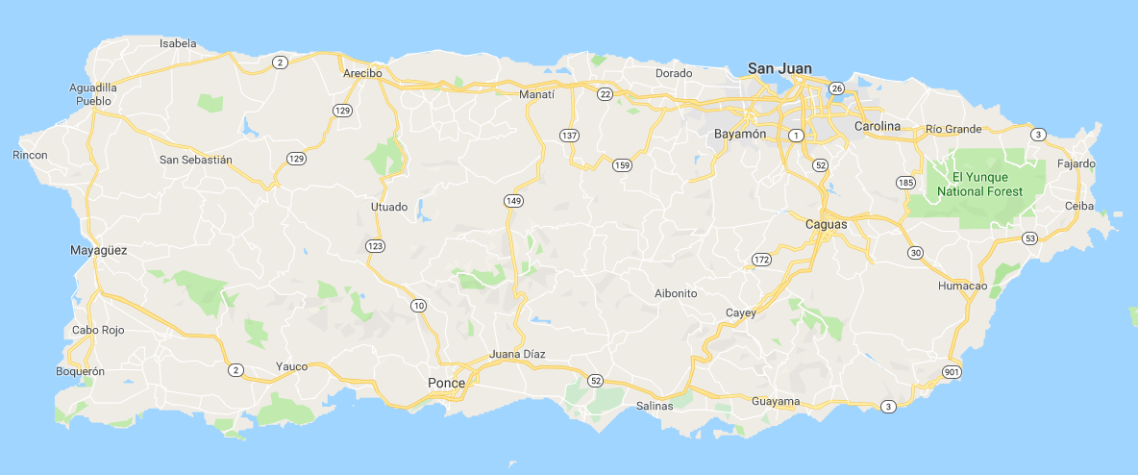
Our Journey Begins…

Slide 14
Study Area

Slide 15
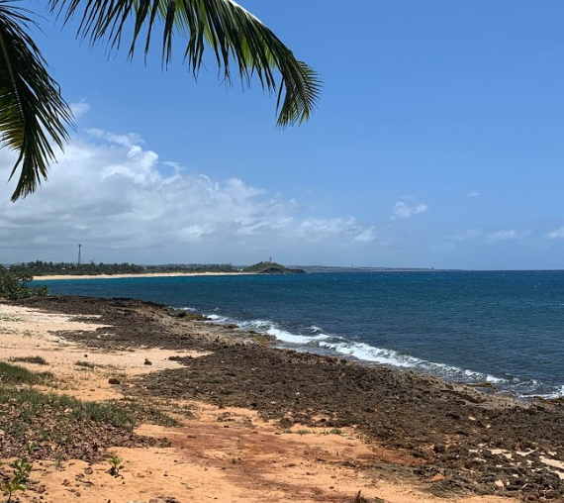
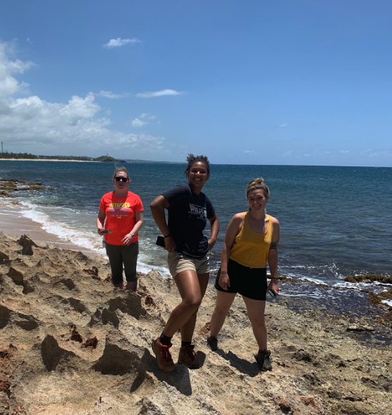
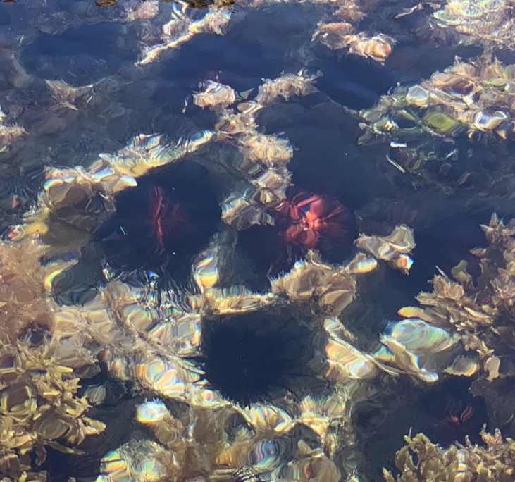
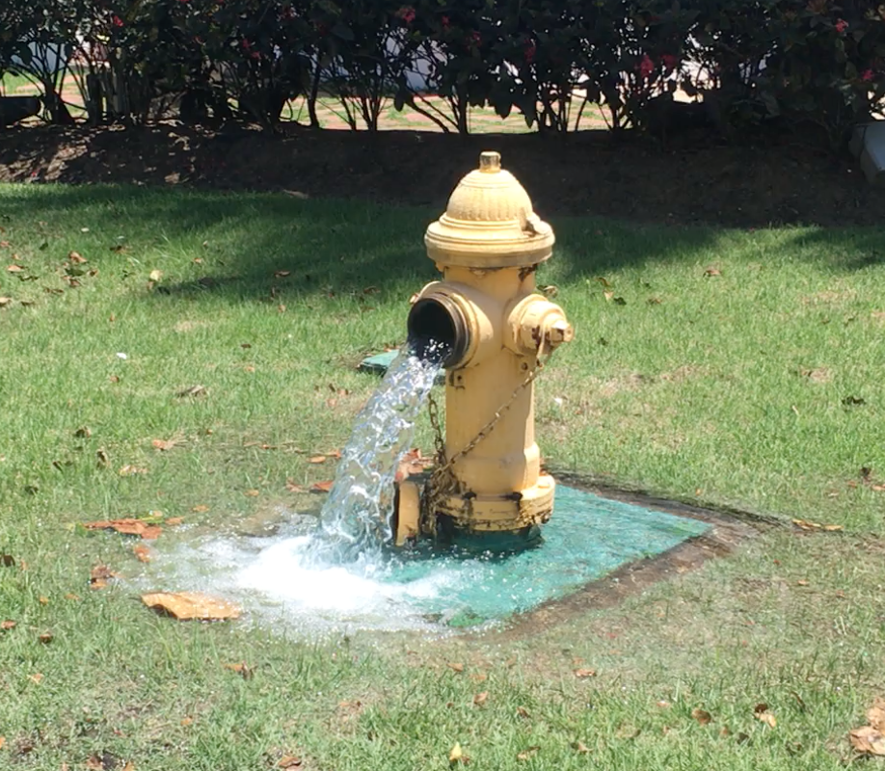
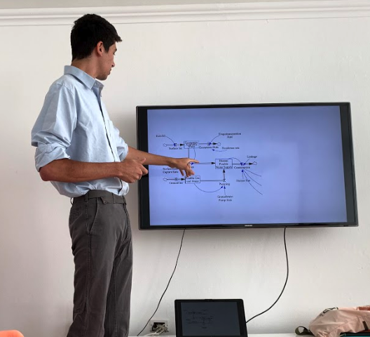
Home Base - Dorado

Slide 16
Arecibo and Northern Coast

Slide 17
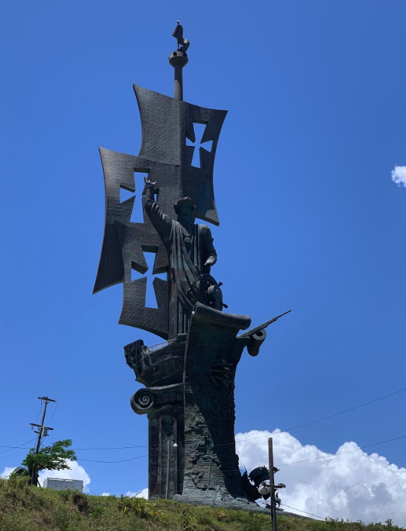
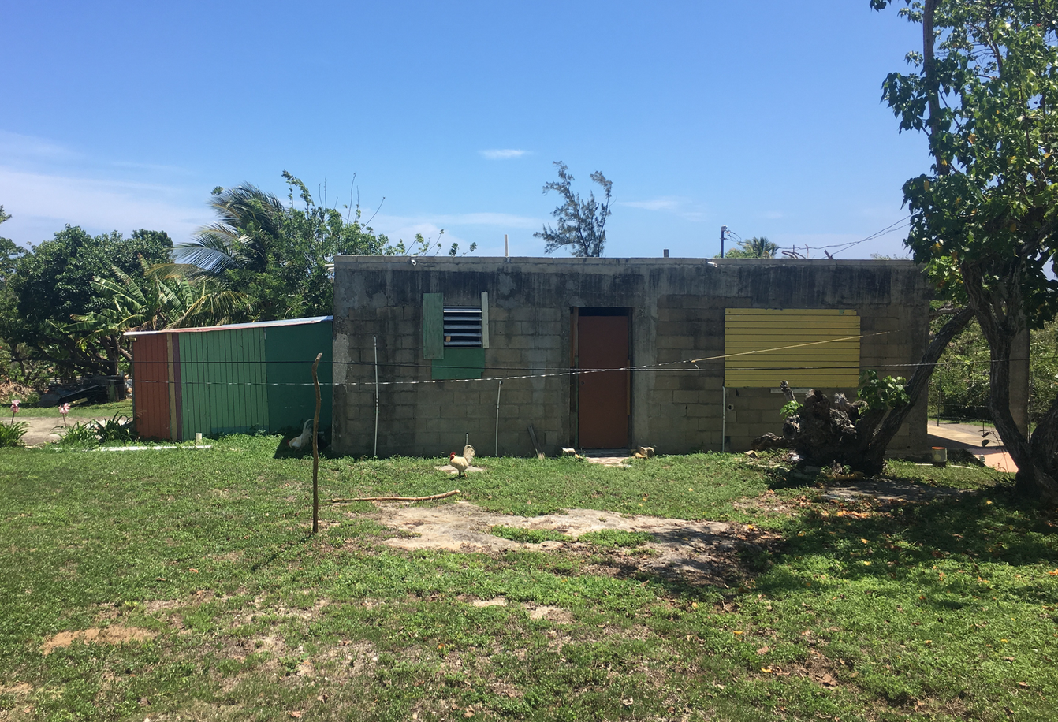
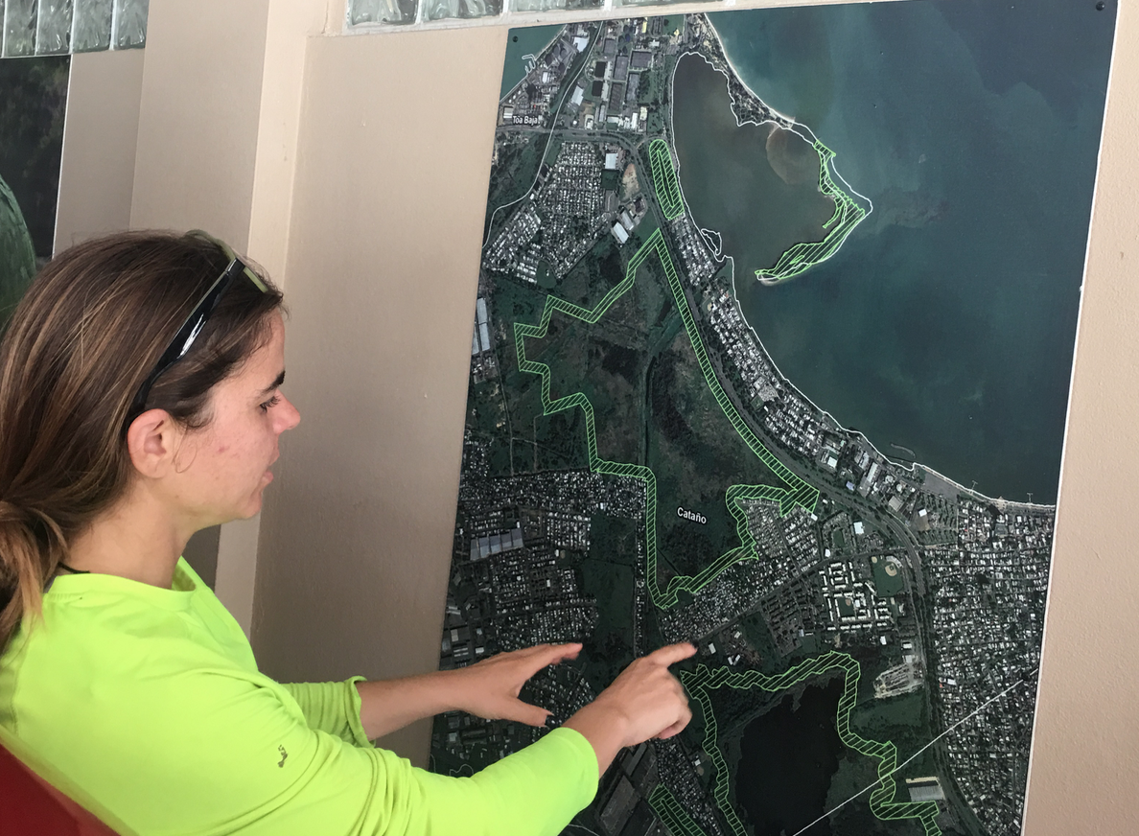
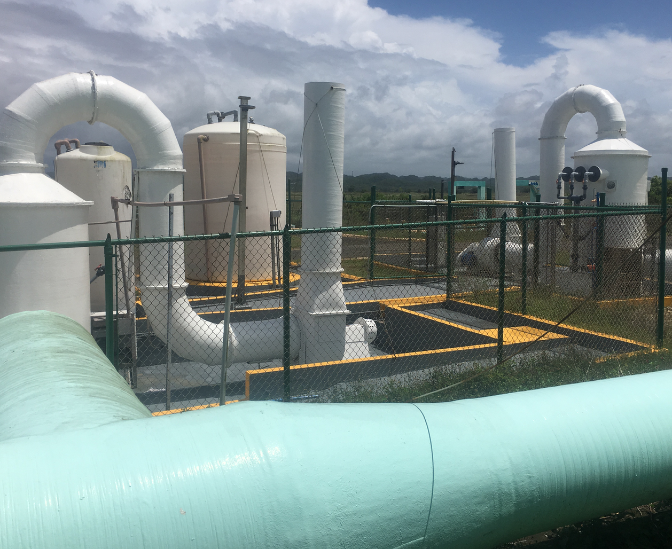
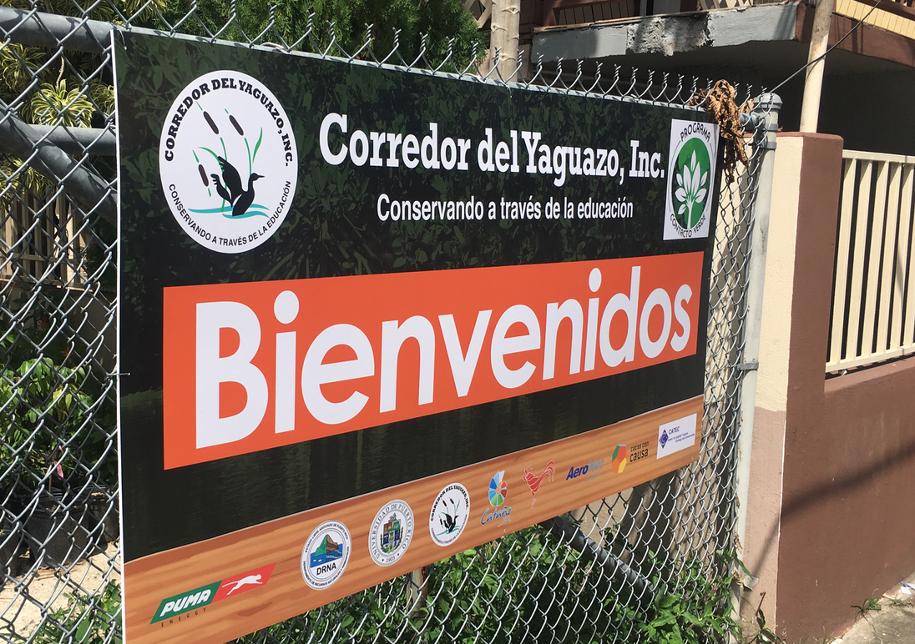
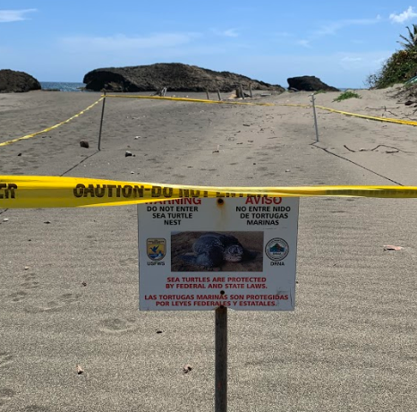
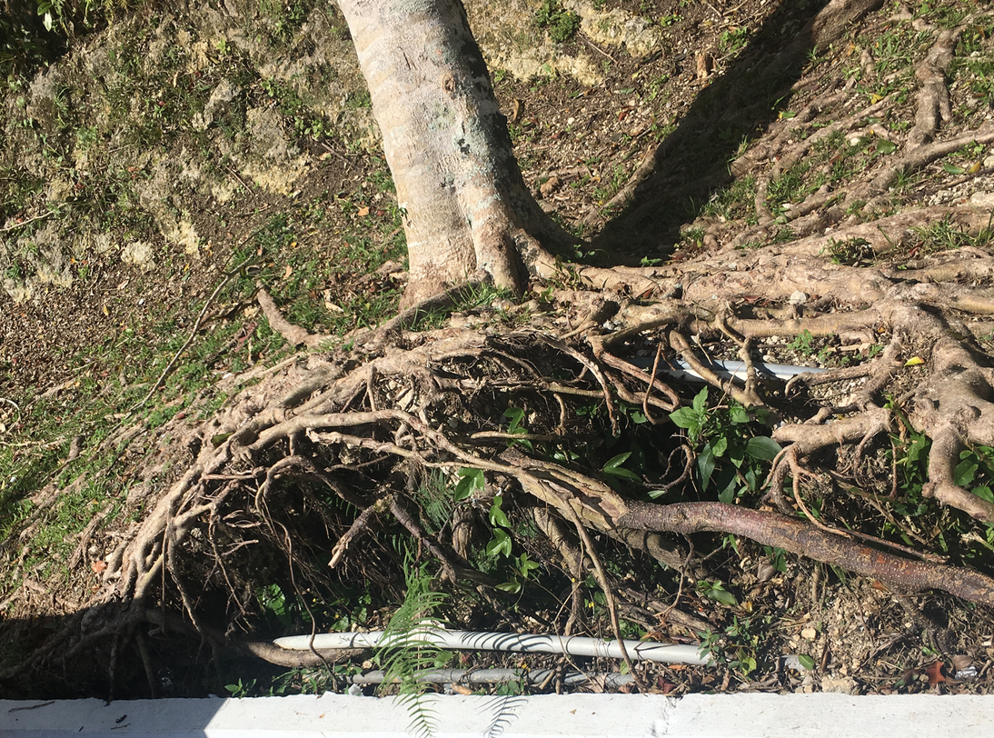
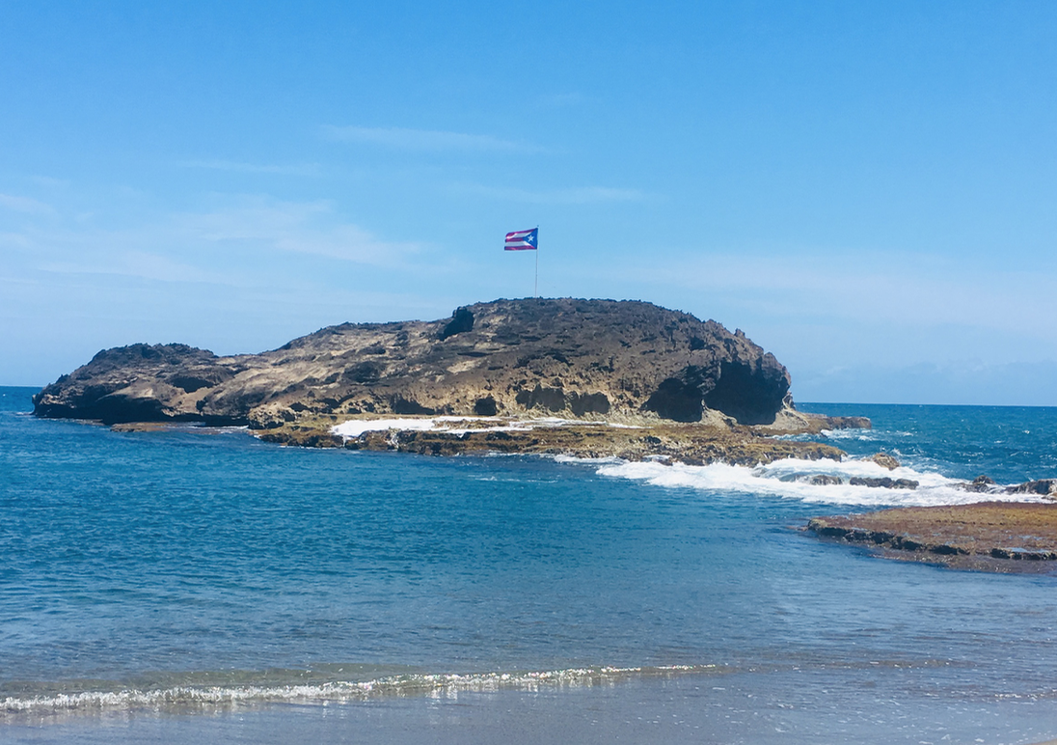
Arecibo and Northern Coast

Slide 18
Rio Grande De Arecibo

Slide 19
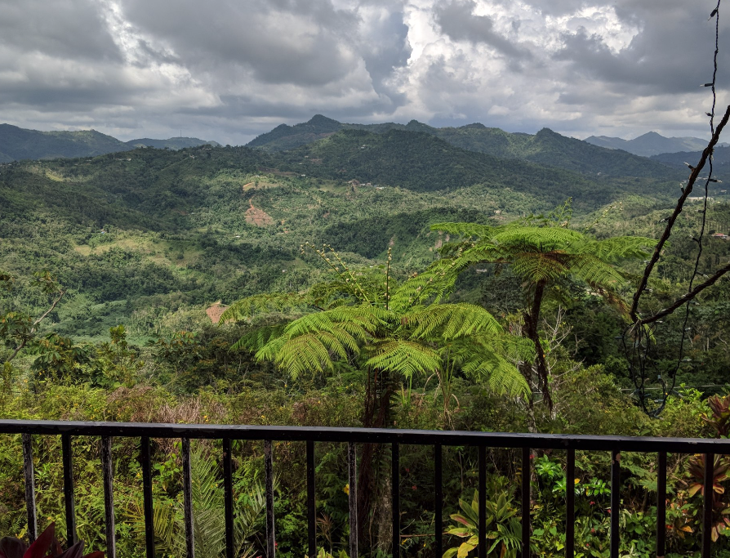
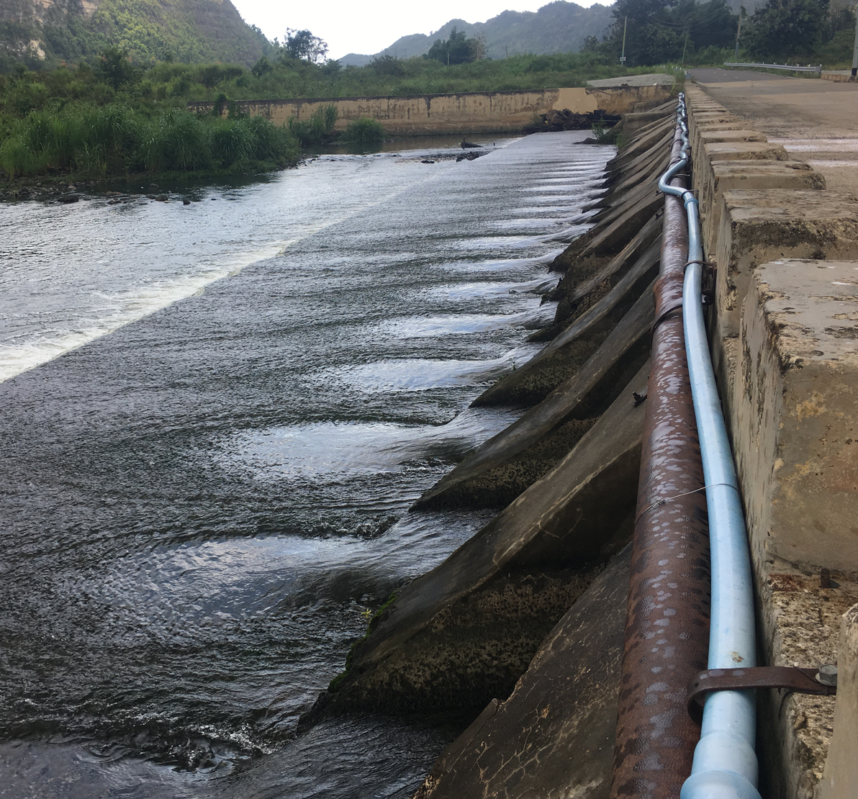
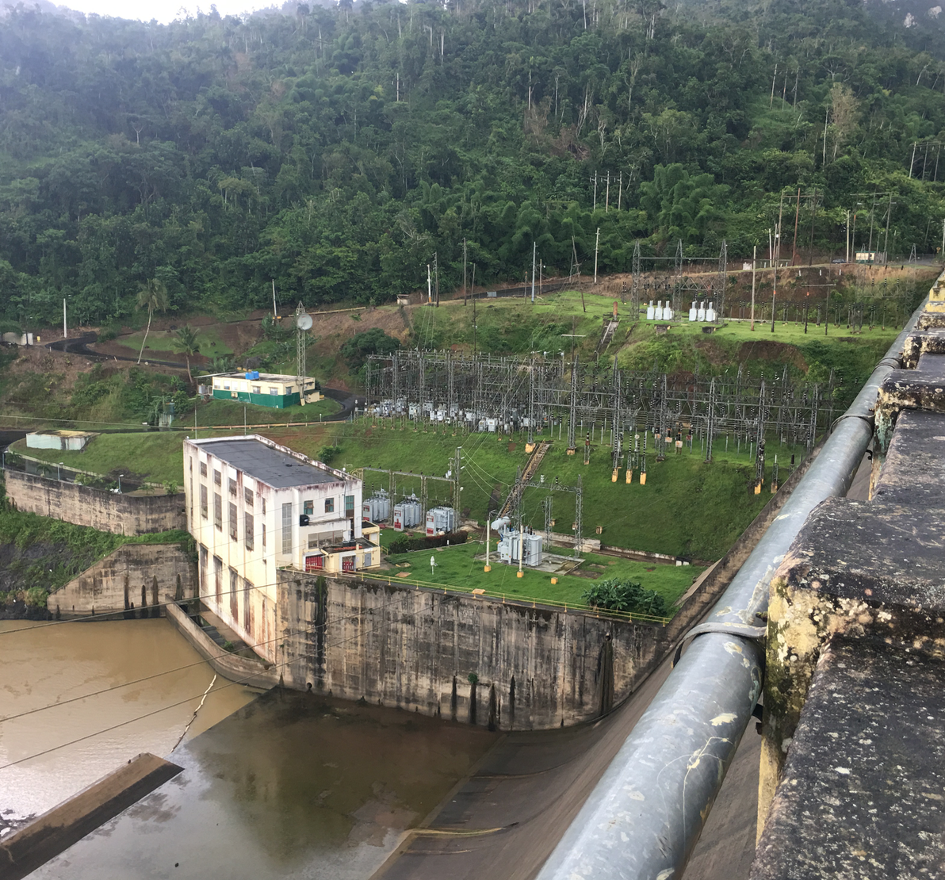
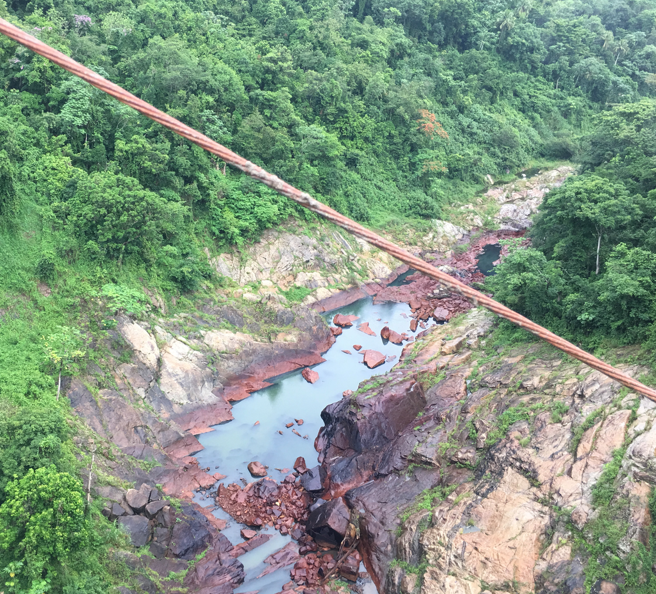
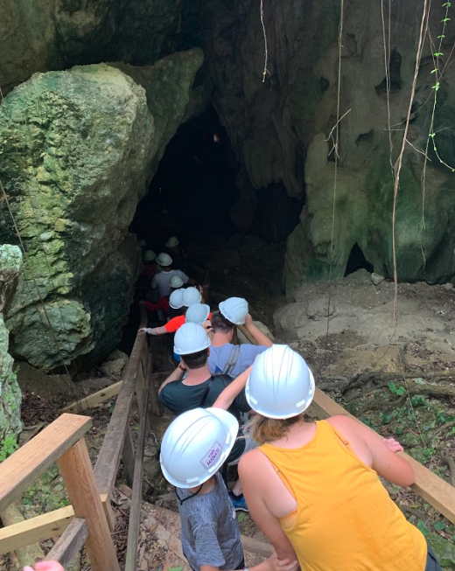
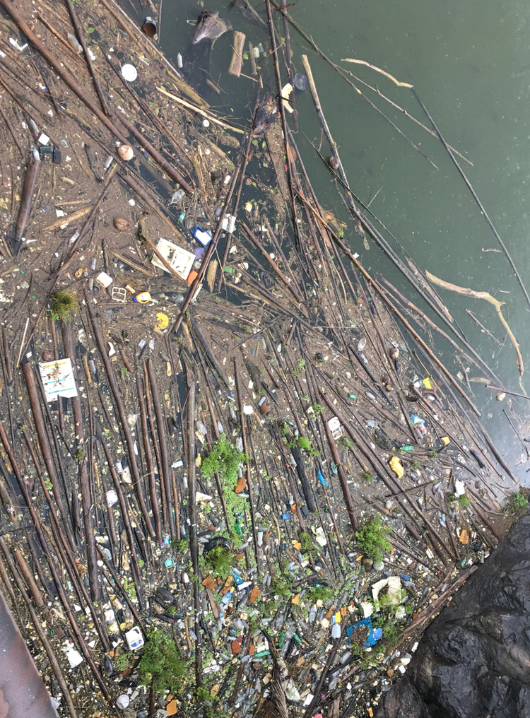
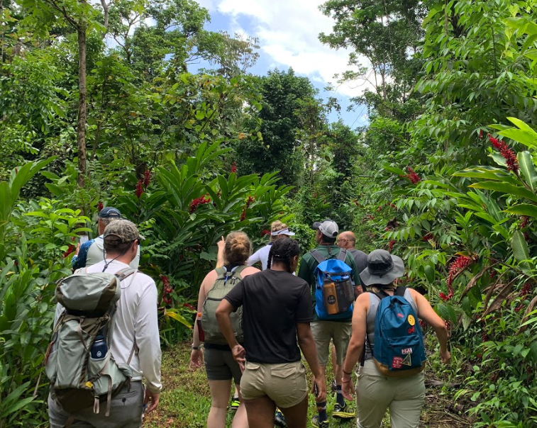
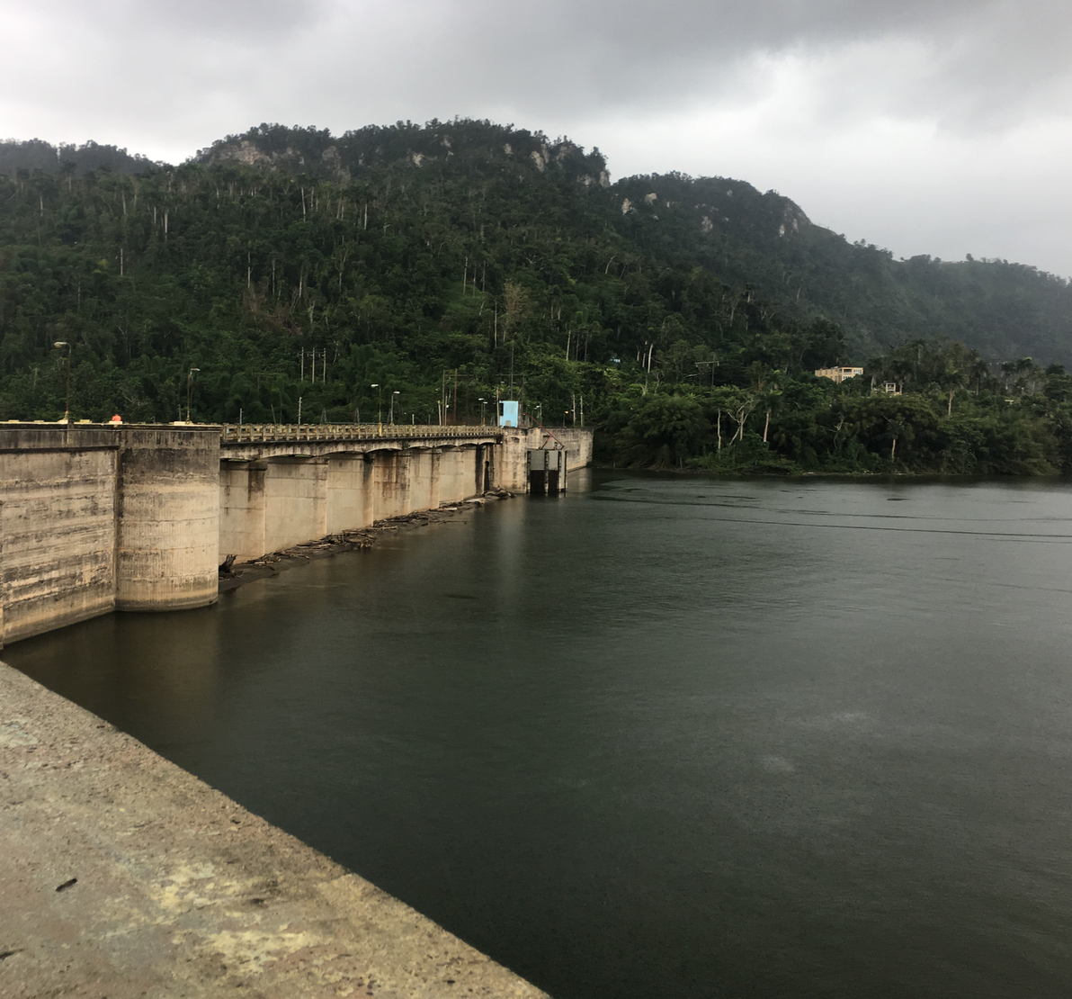
Rio Grande De Arecibo

Slide 20
Southwest

Slide 21
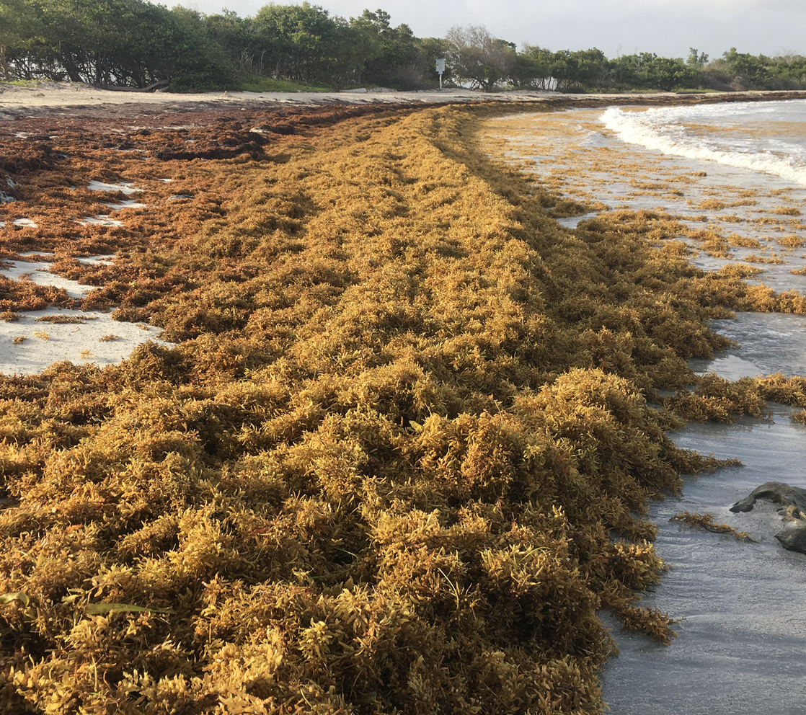
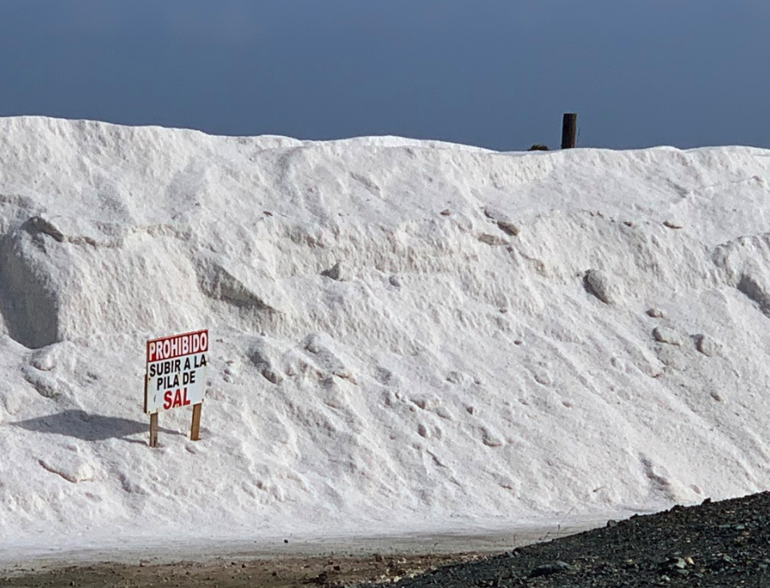
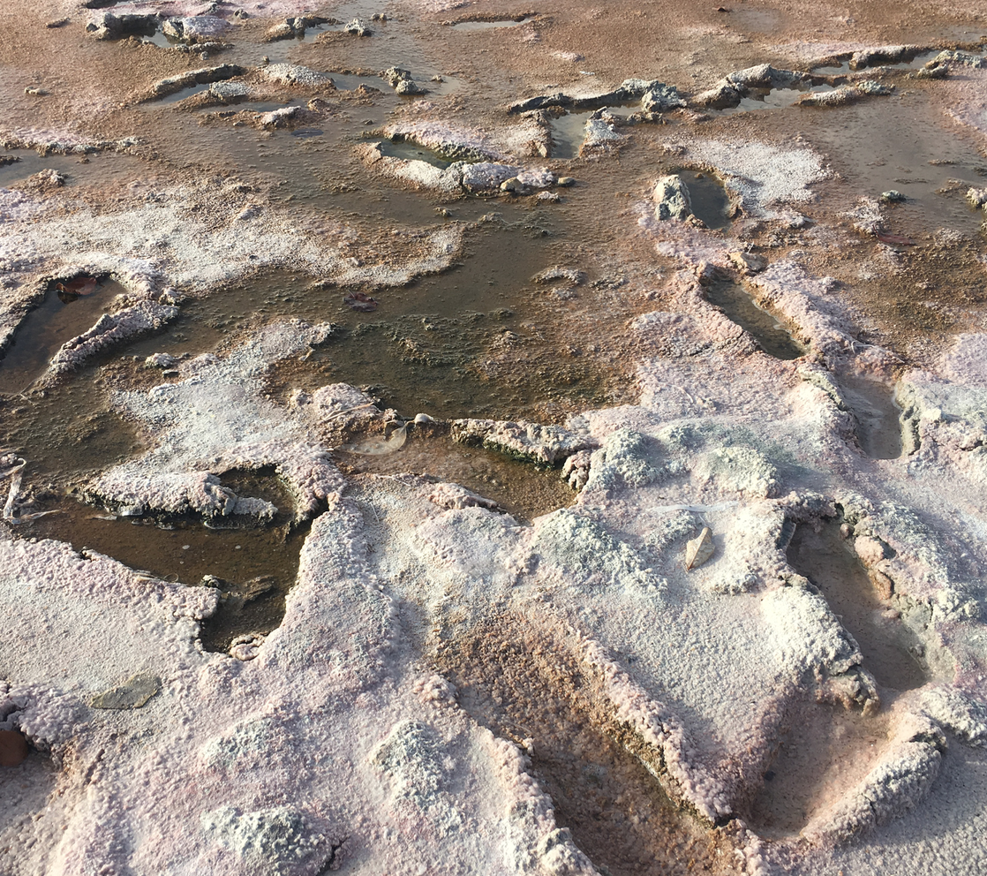
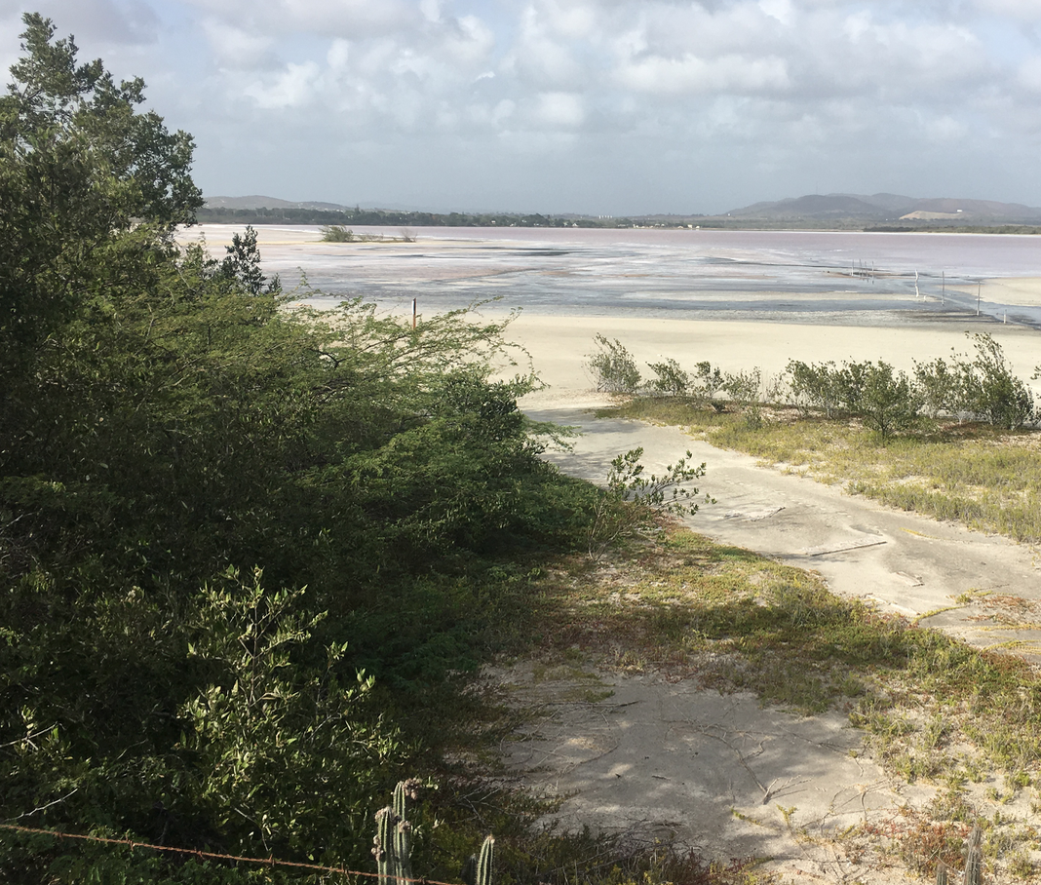
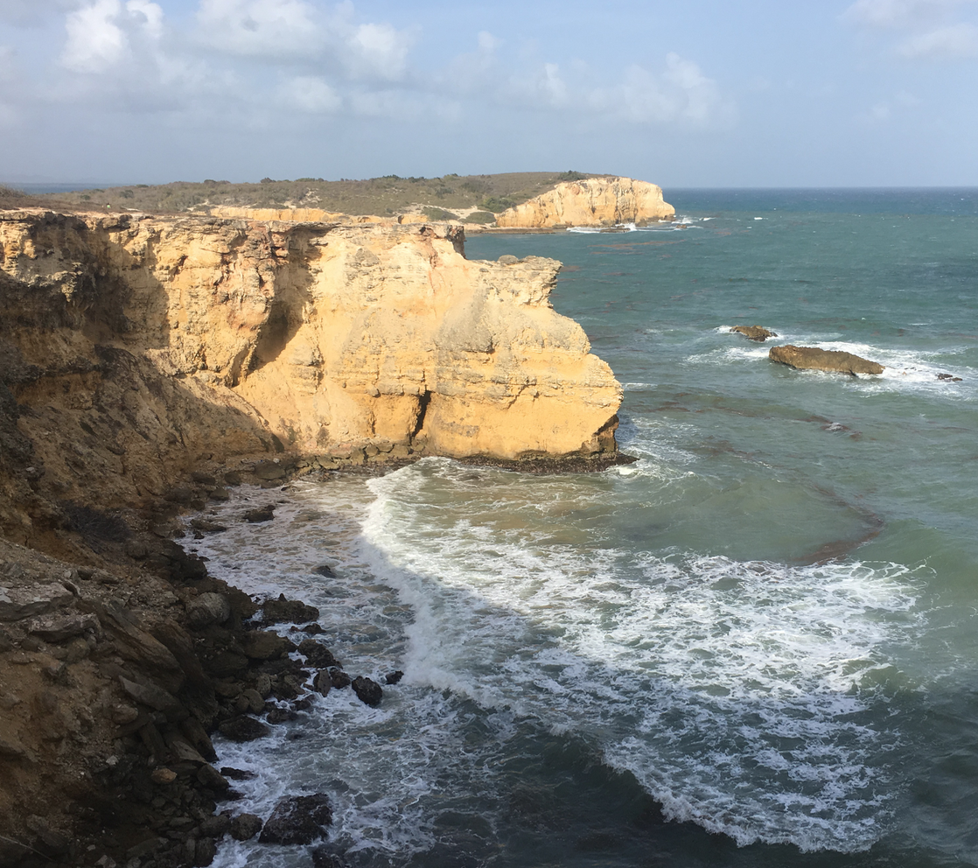
Southwest

Slide 22
Lessons Learned

Slide 23
System Thinking
Definition: is a way of thinking, and a language for describing and understanding, the forces and interrelationships that shape the behavior of systems.

Slide 24
System Thinking
Definition: is a way of thinking, and a language for describing and understanding, the forces and interrelationships that shape the behavior of systems.
Meaning: A system works in feedback loops. To be able to understand the system you most understand how the feedback loops work.

Slide 25
System Thinking
Definition: is a way of thinking, and a language for describing and understanding, the forces and interrelationships that shape the behavior of systems.
Meaning: A system works in feedback loops. To be able to understand the system you most understand how the feedback loops work.
What we learned:

Slide 26
Participatory Modeling
Definition: Collaborative; Engaging all stakeholders in order to find the best possible solution for all stakeholders.

Slide 27
Participatory Modeling
Definition: Collaborative; Engaging all stakeholders in order to find the best possible solution for all stakeholders.
Involves meetings in which issues and ideas are discussed and shared understanding is developed.
A common, agreed approach is formulated.
Chosen solution has a good chance of being supported by most stakeholders.

Slide 28
Participatory Modeling
Definition: Collaborative; Engaging all stakeholders in order to find the best possible solution for all stakeholders.
Involves meetings in which issues and ideas are discussed and shared understanding is developed.
A common, agreed approach is formulated.
Chosen solution has a good chance of being supported by most stakeholders.
Meaning:

Slide 29
Participatory Modeling
Definition: Collaborative; Engaging all stakeholders in order to find the best possible solution for all stakeholders.
Involves meetings in which issues and ideas are discussed and shared understanding is developed.
A common, agreed approach is formulated.
Chosen solution has a good chance of being supported by most stakeholders.
Meaning:
What we learned:

Slide 30
Life lessons taken away
How to work as a group

Slide 31
Life lessons taken away
How to work as a group
Doing something that impacts others and understanding how to take a stance and fight for what matters

Slide 32
Life lessons taken away
How to work as a group
Doing something that impacts others
Understanding how to take a stance and fight for what matters
This type of class and its impacts

