Slide 1
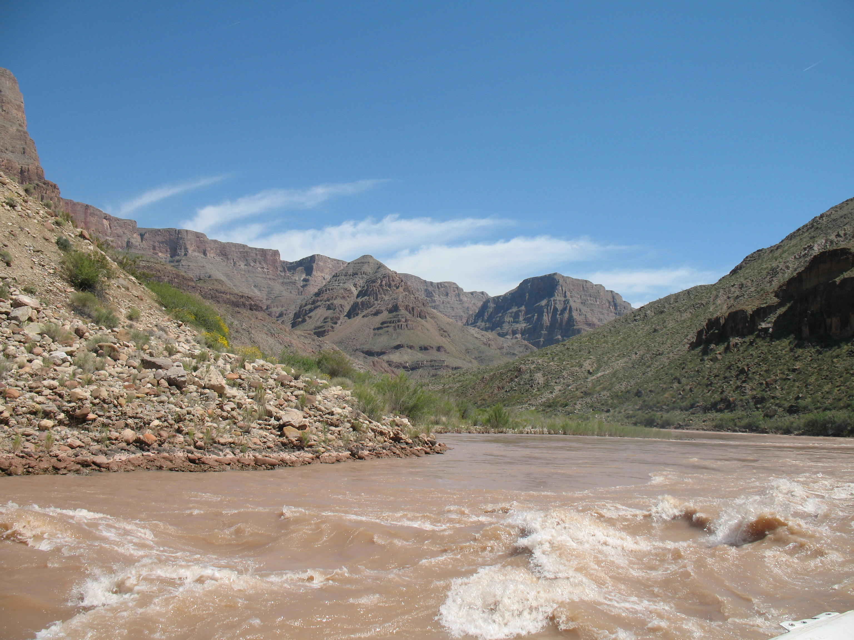


Managing Fisheries in a Conflicting World
Aaron Bunch
7/1/2019

Slide 2
The talk…
Parallels b/w fisheries issues in U.S.
  Grand Canyon
  Chesapeake Bay
Ecological & political components discussed
You should:
  Pick out common themes
  Think about where you fit in the mix as a future fisheries professional

Slide 3
Invasive
Non-native species
Native species
Ecological
Political

Slide 4
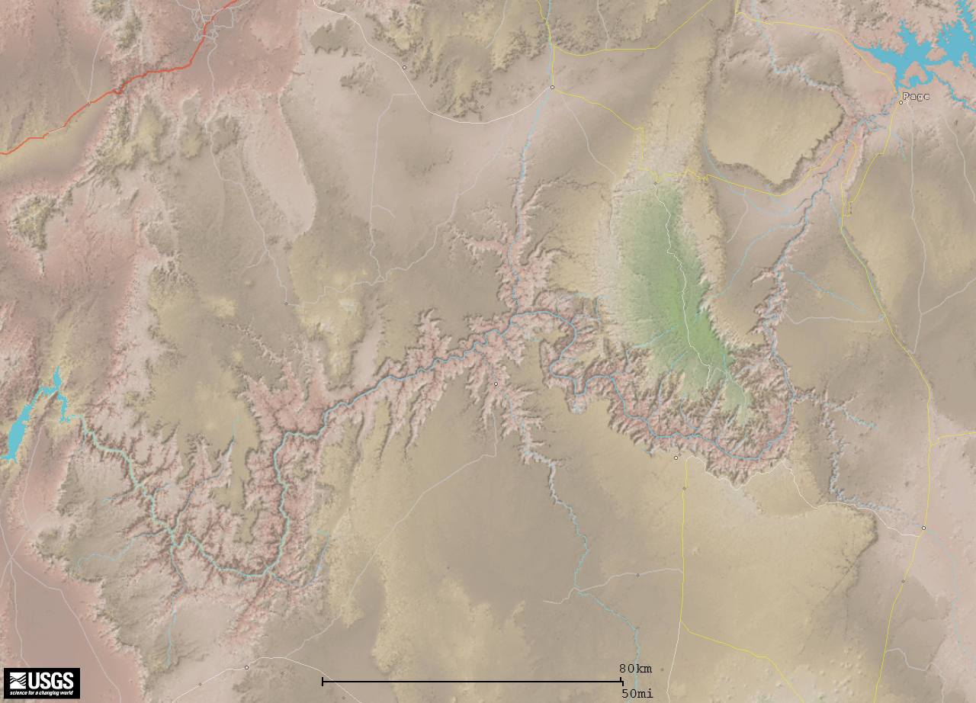
Grand Canyon

Slide 5
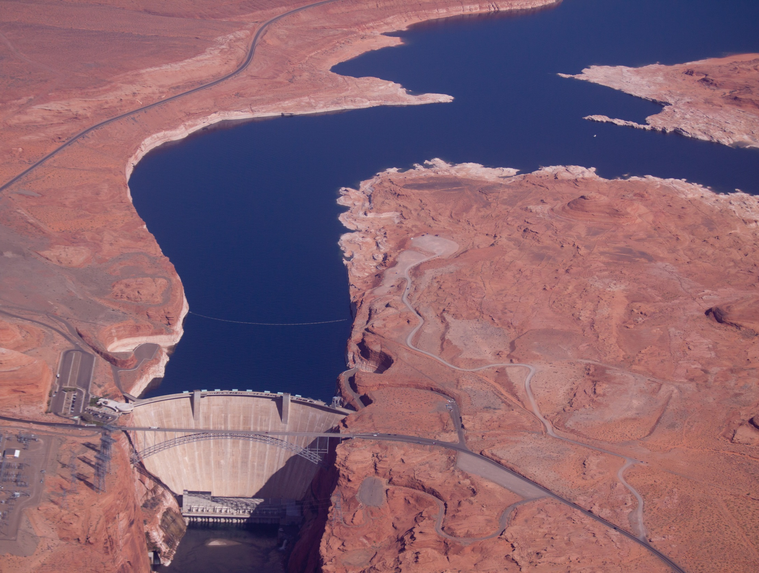

Slide 6
Glen Canyon Adaptive Management Program
Issues
  Water allocation
  Power generation
  Recreational tours/rafting
  Vegetation
  Fish populations
    Endangered humpback chub/other natives
    Blue Ribbon rainbow trout tail water fishery (established 50+ years ago)
  Many others
  *Mitigation for ecosystem disturbance*

Slide 7
Glen Canyon Adaptive Management Program
Federal agencies
State agencies (multiple States)
Tribal entities
Power companies
Water companies
Recreational interests
NGOs
http://www.usbr.gov/uc/rm/amp/

Slide 8
Fish Programs
Little Colorado River monitoring
Lees Ferry trout monitoring
Mainstem fish monitoring
Mainstem aggregation monitoring
Nonnative removals
Various short-term studies
Bright Angel Creek trout monitoring

Slide 9
Fish Programs
Little Colorado River monitoring
Lees Ferry trout monitoring
Mainstem fish monitoring
Mainstem aggregation monitoring
Nonnative removals
Various short-term studies
Bright Angel Creek trout monitoring

Slide 10
Lees Ferry Rainbow Trout Monitoring | Grand Canyon Fish Monitoring
Fishery established in 1964 following completion of Glen Canyon Dam | Concerns regarding nonnative-native fish interactions (predation, competition, etc.)
Various research and management since 1964 (creel surveys during the early portion of the time-series) | Expert panel suggested river-wide fish sampling
Electrofishing surveys began in 1984, and standardized in 1991. | Electrofishing from Lees Ferry to Lake Mead began in 2000

Slide 11
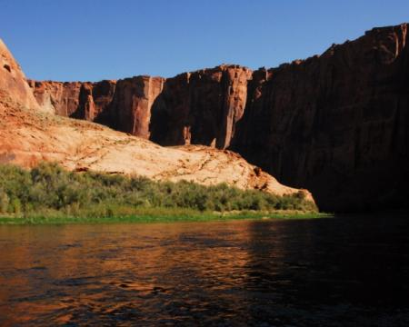
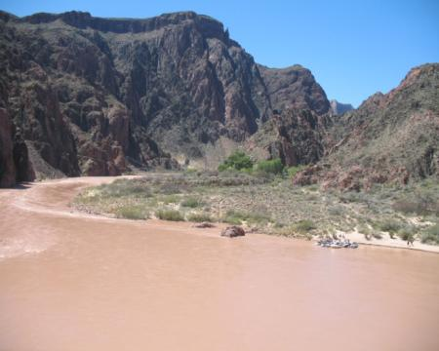
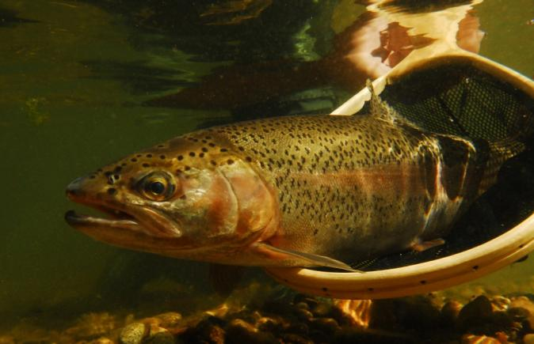
Lees Ferry
Rainbow Trout Fishery
Downstream
Native Fish
Objective:
Maintain both!!!

Slide 12
Major native-nonnative overlap?
Where do they come from?
Why do they persist?
What patterns do you see?
What variables contribute to patterns?

Slide 13
Grand Canyon
Lake Powell
Lees Ferry
Kanab Creek
Lake Mead
Havasu Creek
Bright Angel Creek
Little Colorado River
Last major strong-hold for endangered humpback chub Gila cypha on the planet.
Diamond Creek

Slide 14
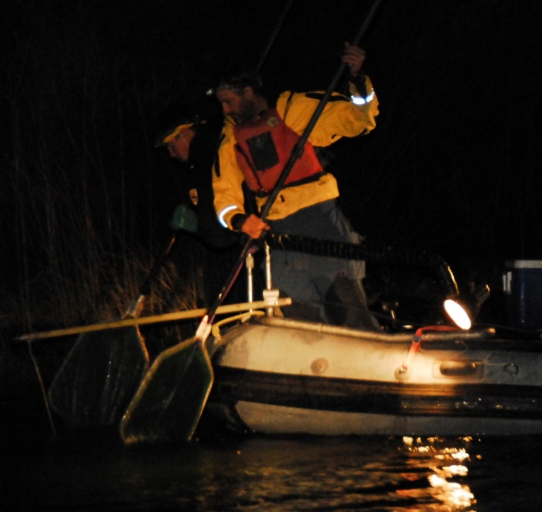

Slide 15

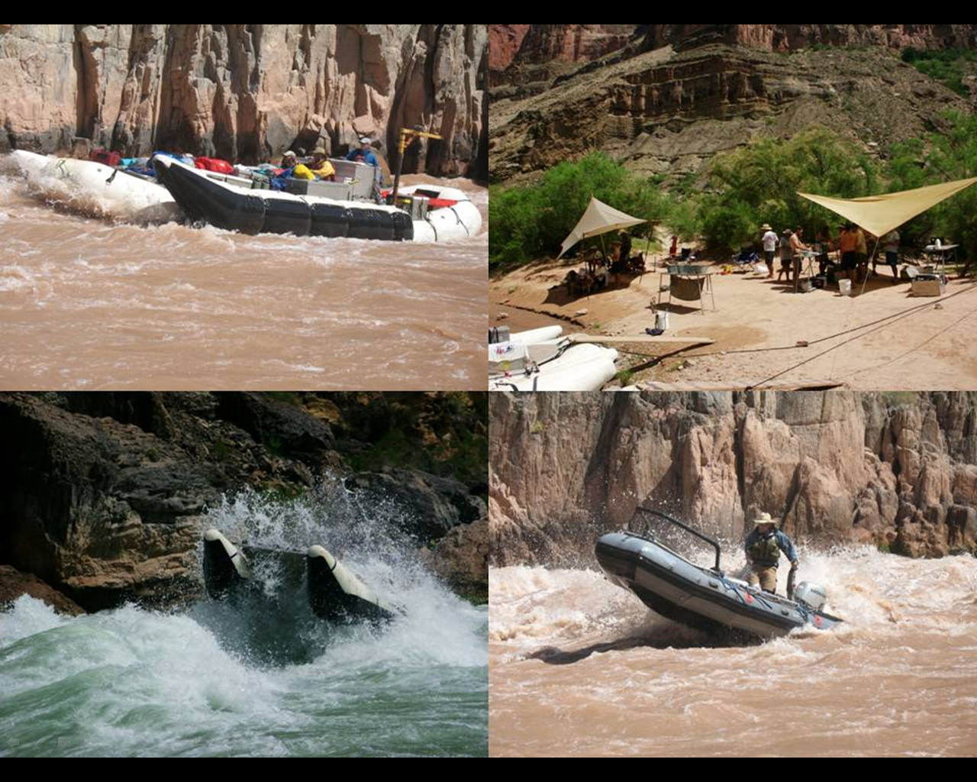

Slide 16
What resolution (i.e., zoom in or out)?

Slide 17
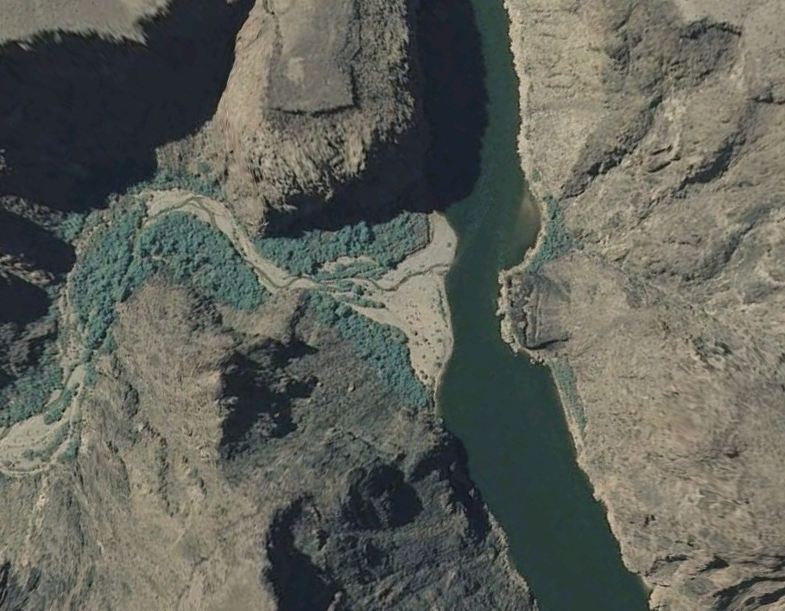
What resolution (i.e., zoom in or out)?

Slide 18
What resolution (i.e., zoom in or out)?

Slide 19
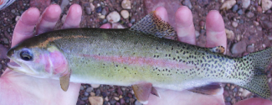
Rainbow trout
CPUE
GCD

Slide 20
Rainbow trout
CPUE
GCD

Slide 21
Rainbow trout
Major fish issue – competitive interactions b/w nonnative salmonids and humpback chub/native species
CPUE
GCD

Slide 22
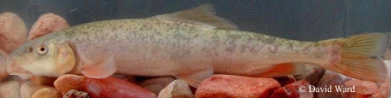
Flannelmouth Sucker
CPUE
GCD

Slide 23
Flannelmouth Sucker
CPUE
GCD

Slide 24
Catch composition

Slide 25
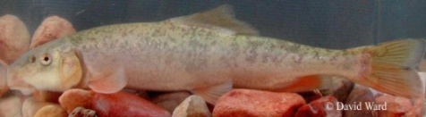
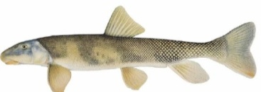
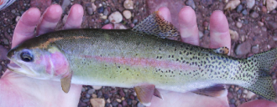
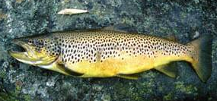
Catch composition

Slide 26
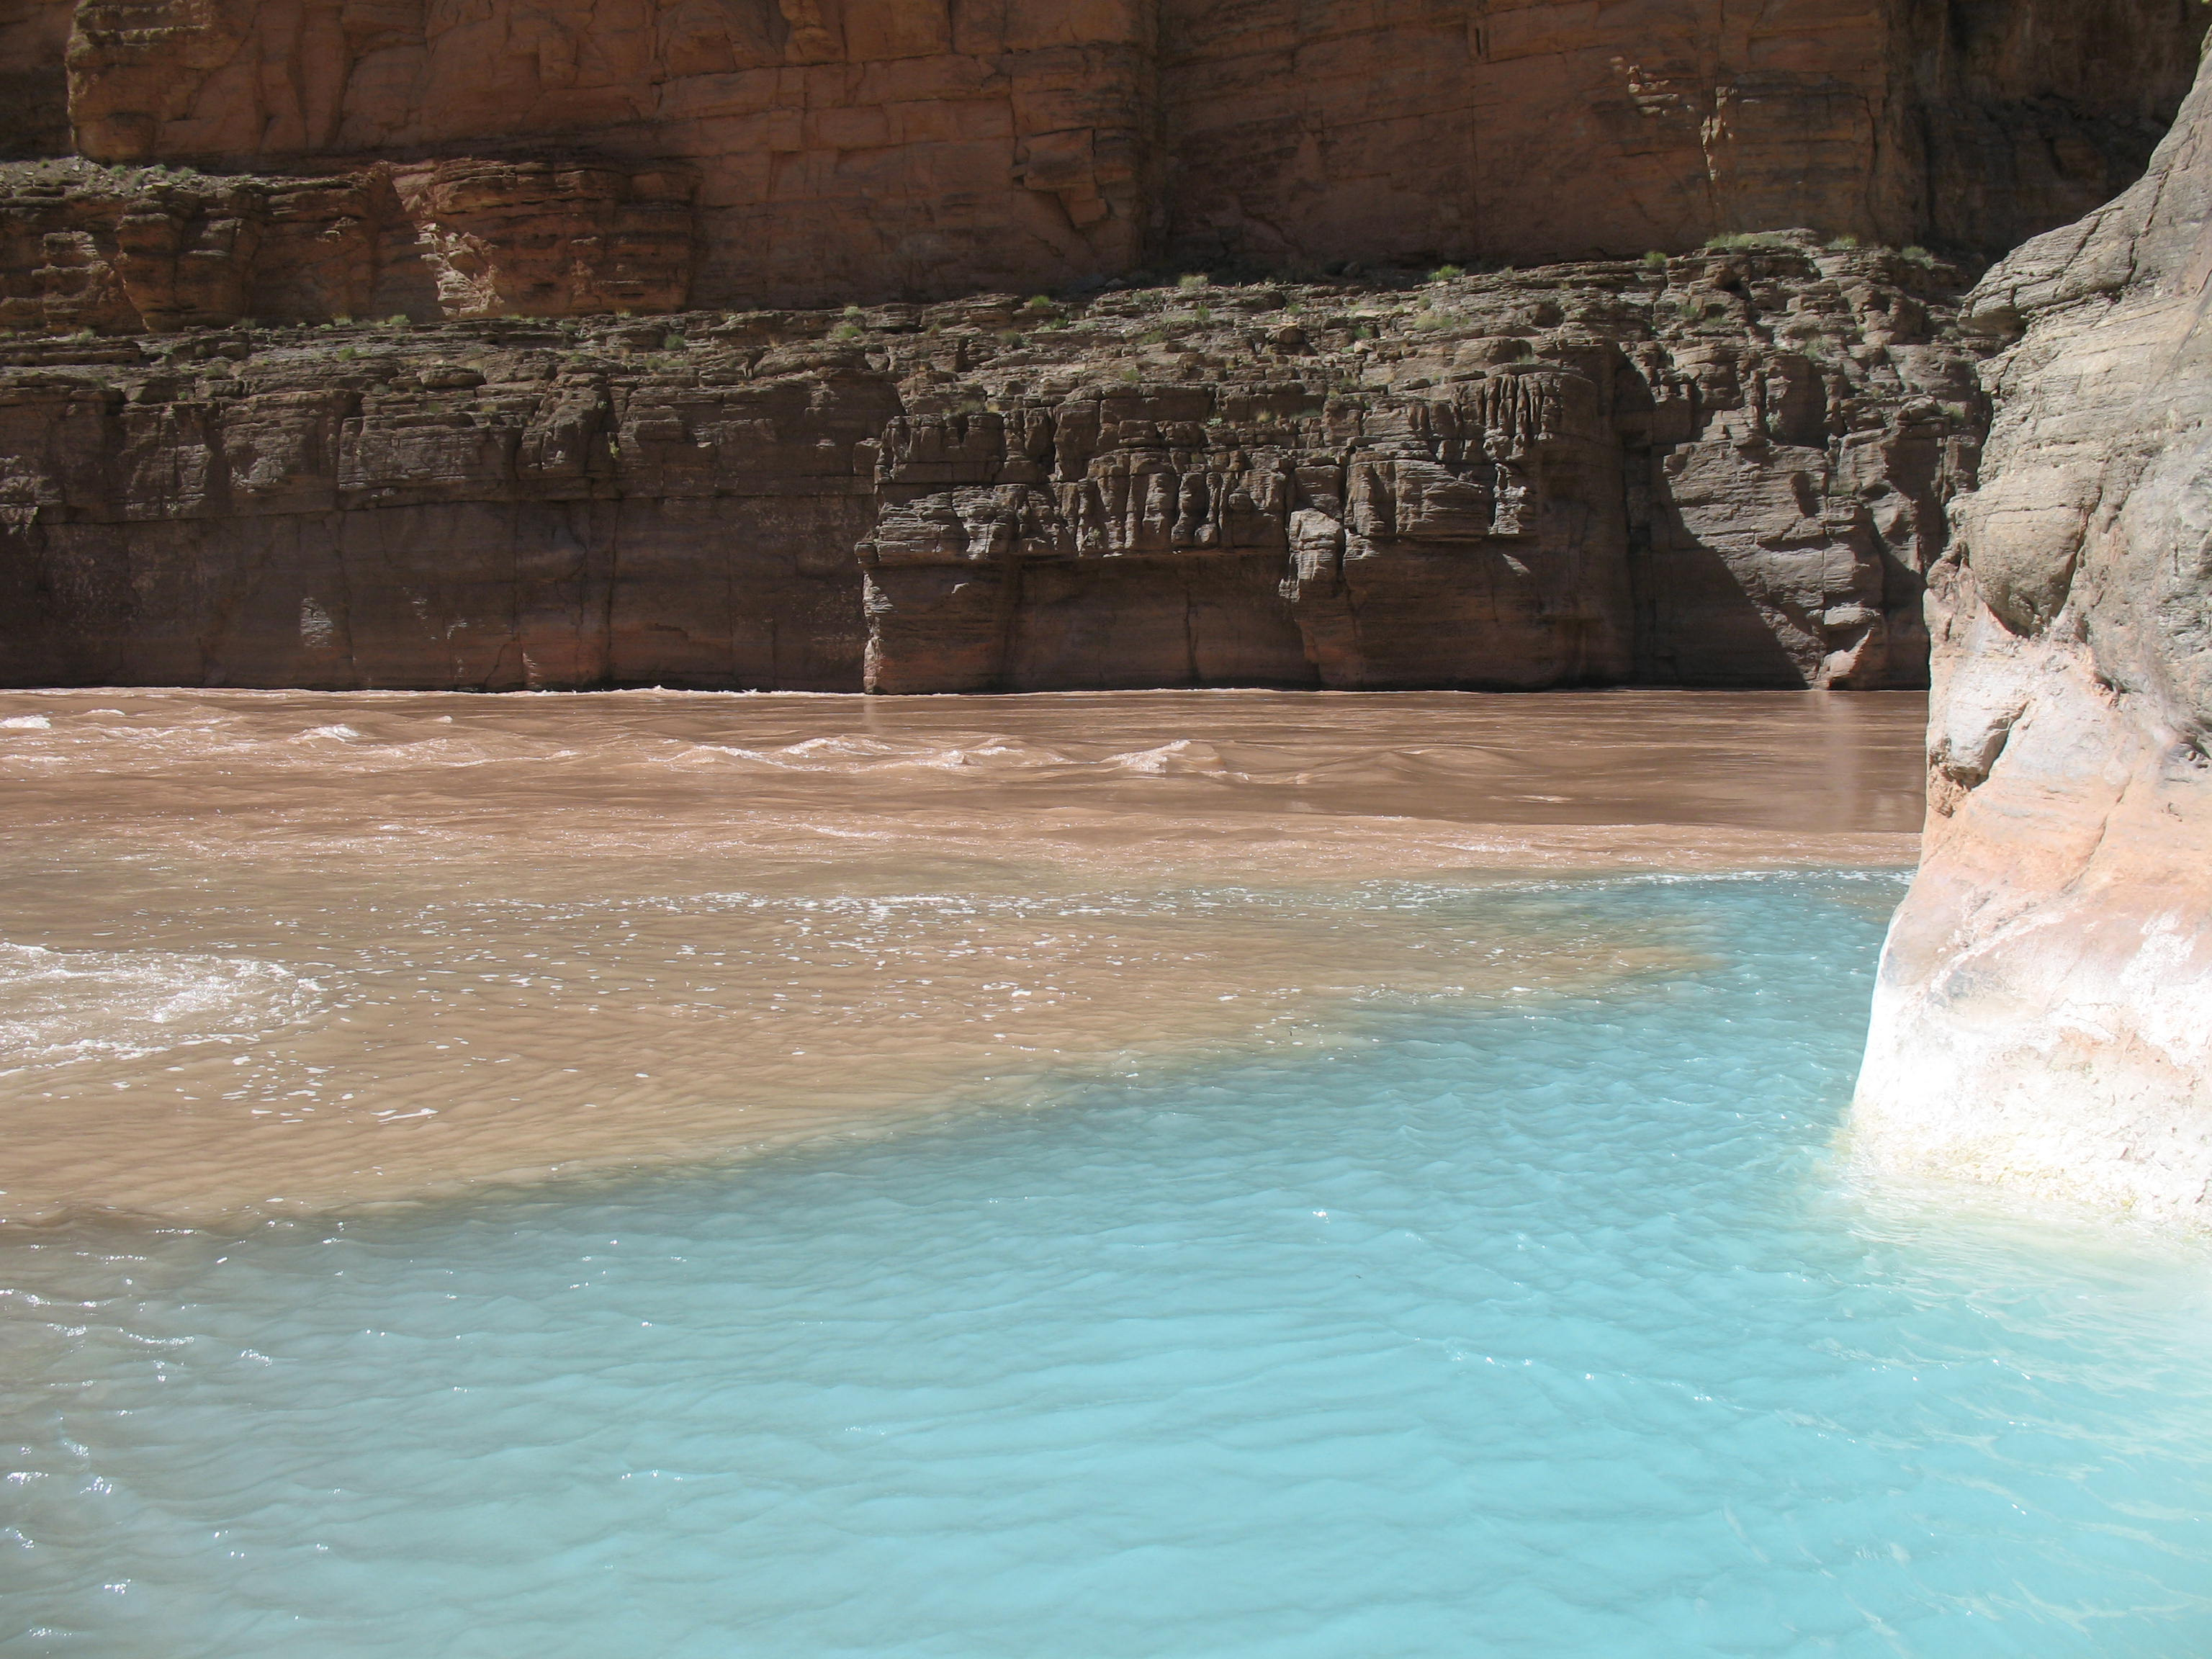
Why?

Slide 27
What factors contribute to status and distribution?
Water temperature
Dissolved oxygen
Turbidity
Food availability
Proximity to source population
Migratory behavior
Physical habitat requirements
Many others
Water quality parameters

Slide 28
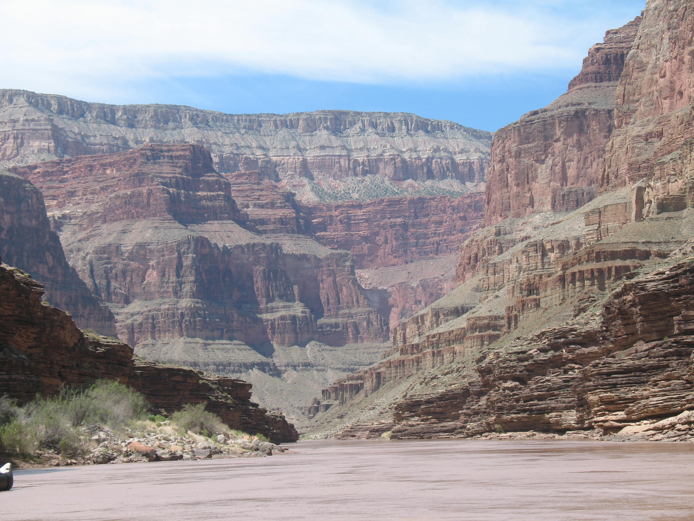
Lake levels/Dam discharge
Tributaries
Fish Patterns
Turbidity
Food
Temperature
Nonnative removals
Predation
Competitive interactions

Slide 29
Fish Patterns
Turbidity
Food
Temperature

Slide 30
Fish Patterns
Turbidity
Food
Temperature

Slide 31
Turbidity
Carothers and Brown 1991; Gloss et al. 2005

Slide 32
Food
Downstream direction
Carothers and Brown 1991; Gloss et al. 2005

Slide 33
Food
What if you were a trout sight feeding on simuliids (black flies)?
Figure from Carothers and Brown 1991; Gloss et al. 2005

Slide 34
Food
Figure from Carothers and Brown 1991; Gloss et al. 2005

Slide 35
Food
Figure from Carothers and Brown 1991; Gloss et al. 2005

Slide 36
Food
Figure from Carothers and Brown 1991; Gloss et al. 2005

Slide 37
Food
Figure from Carothers and Brown 1991; Gloss et al. 2005

Slide 38
Food
  Food abundance and feeding efficiency probably influences distribution patterns.
Figure from Carothers and Brown 1991; Gloss et al. 2005

Slide 39
Fish Patterns
Turbidity
Food
Temperature

Slide 40
How would you characterize these patterns in water temperature?
226
166
87
61
0
Data courtesy of Nick Voichick, GCMRC

Slide 41
How would you characterize these patterns in water temperature?
226
CLIMATE CHANGE EFFECTS??
166
87
61
0
Data courtesy of Nick Voichick, GCMRC

Slide 42
Temperature
Data courtesy of USGS Grand Canyon Monitoring and Research Center

Slide 43
Temperature
Let’s look at temperature optima for rainbow trout
Data courtesy of USGS Grand Canyon Monitoring and Research Center

Slide 44
Temperature
Optimal range for all rainbow trout life stages
Data courtesy of USGS Grand Canyon Monitoring and Research Center; Temperature optima data compiled by Lamarra (2007)

Slide 45
Temperature
Optimal for rainbow trout growth
Data courtesy of USGS Grand Canyon Monitoring and Research Center; Temperature optima data compiled by Lamarra (2007)

Slide 46
Temperature
Data courtesy of USGS Grand Canyon Monitoring and Research Center; Temperature optima data compiled by Lamarra (2007)

Slide 47
Temperature
Data courtesy of USGS Grand Canyon Monitoring and Research Center; Temperature optima data compiled by Lamarra (2007)

Slide 48
Temperature
What about flannelmouth suckers?
Data courtesy of USGS Grand Canyon Monitoring and Research Center

Slide 49
Temperature
Optimal range for larval and juvenile flannelmouth suckers
Data courtesy of USGS Grand Canyon Monitoring and Research Center; Temperature optima data compiled by Lamarra (2007)

Slide 50
Temperature
Optimal for adult flannelmouth sucker growth
Optimal range for larval and juvenile flannelmouth suckers
Adult flannelmouth suckers known to inhabit 10-30°C
Data courtesy of USGS Grand Canyon Monitoring and Research Center; Temperature optima data compiled by Lamarra (2007)

Slide 51
Temperature
Optimal for adult flannelmouth sucker growth
Optimal range for larval and juvenile flannelmouth suckers
Data courtesy of USGS Grand Canyon Monitoring and Research Center; Temperature optima data compiled by Lamarra (2007)

Slide 52
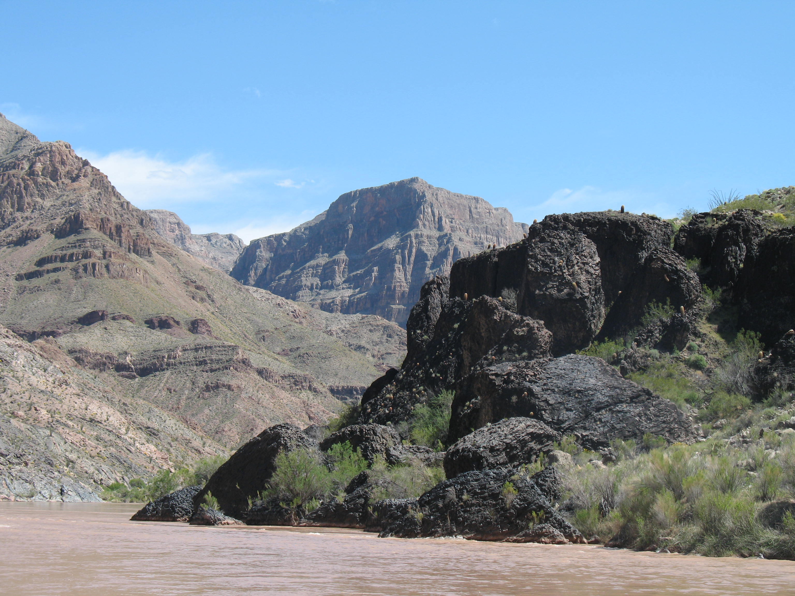
Let’s switch gears…

Slide 53
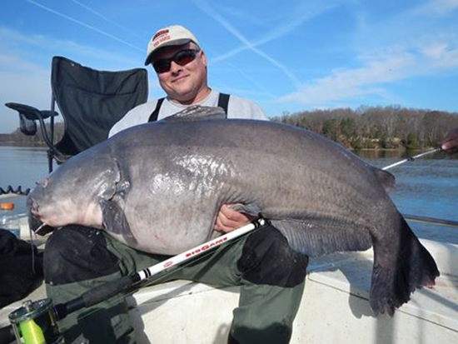
Tidal River Blue Catfish

Slide 54
Chesapeake Bay Program
Issues
  Pollution
  Invasive species
  Climate change
  Watershed development
  Vegetation
  Fisheries
  Many others…
  http://www.chesapeakebay.net/

Slide 55
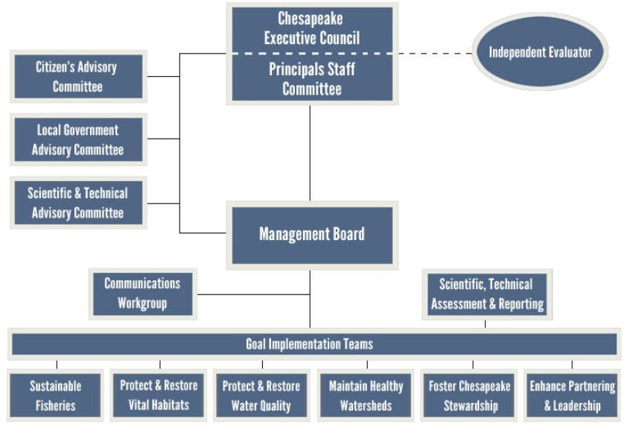
Chesapeake Bay Program
Federal agencies
State agencies (multiple States)
Universities
Recreational interests
NGOs

Slide 56
Fish Programs
Many sampling programs exist, too many to name. Most not directly funded through CBP.
VDGIF
  Long-term catfish monitoring
  Long-term fish community monitoring

Slide 57
Blue Catfish History
First introduced in early 1970’s in the tidal James and Rappahannock rivers.
In 1985, released in the Mattaponi River, and eventually populated the Pamunkey River.
Currently established throughout Chesapeake Bay watershed

Slide 58
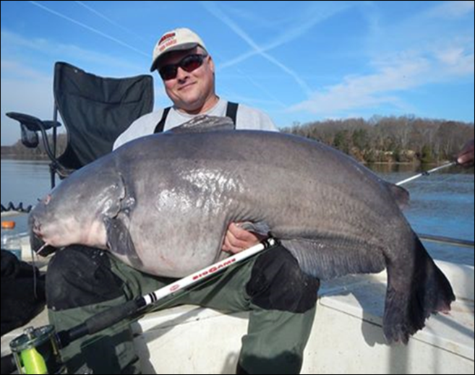
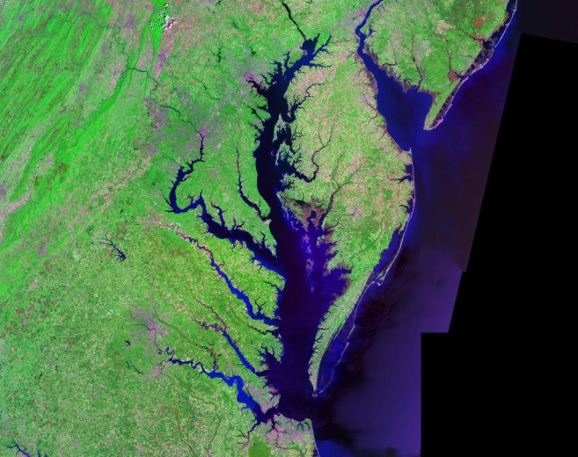
Trophy Blue Catfish Fishery
Healthy CB Ecosystem
Objective:
Maintain both!!!

Slide 59
What we do
Stun and collect fish (electrofishing)
  Fixed site locations in all major tidal rivers
Process and throw back 90% of catch
Other 10% are taken for age samples
Catch rates over time, length and weight based plots
Mark-recaptures 2007, 2014, 2015

Slide 60
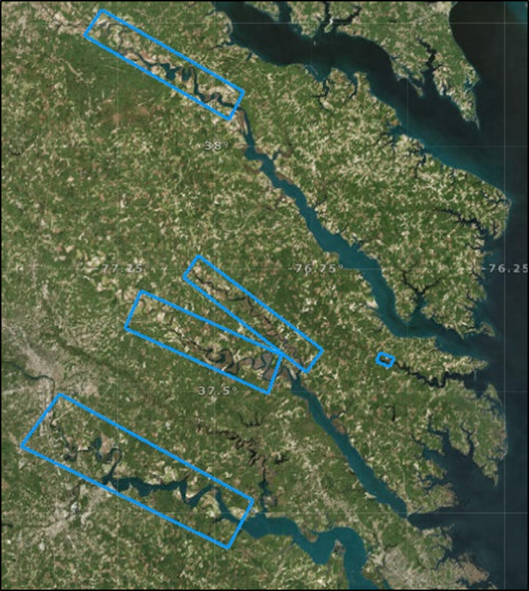

Slide 61
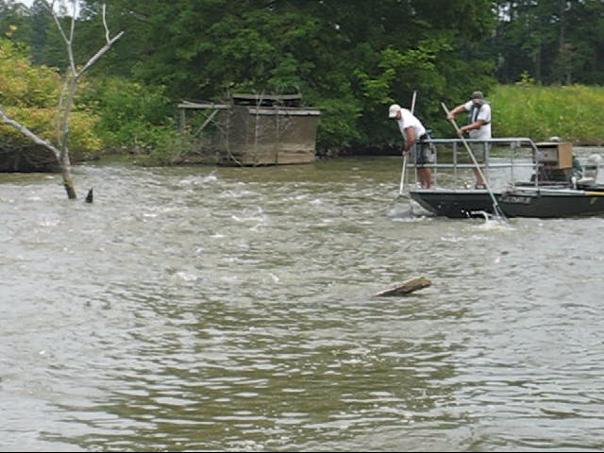

Slide 62
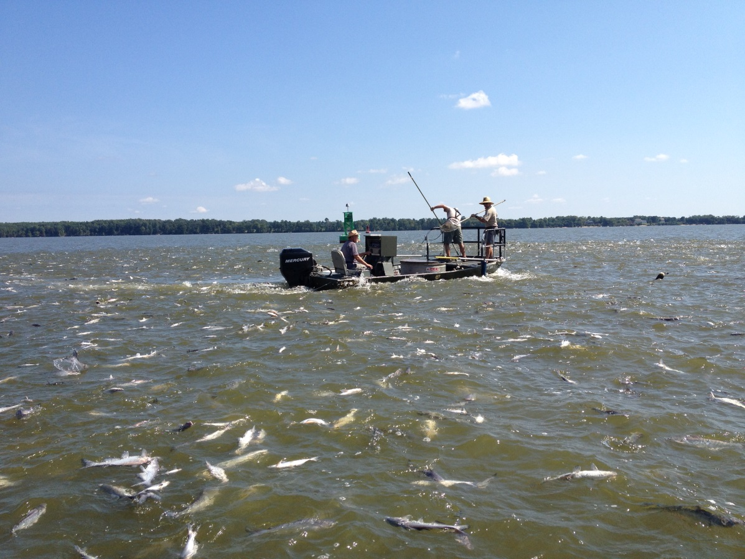
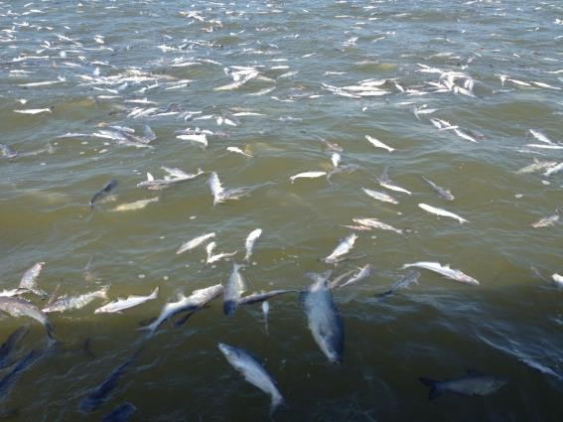
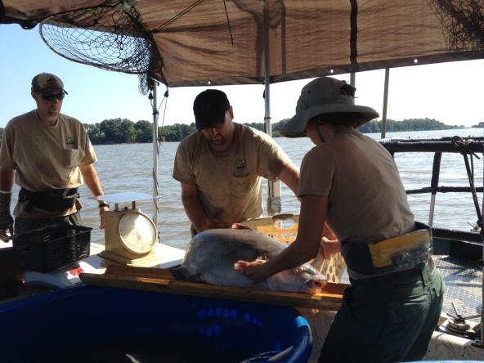

Slide 63
Catch Rate Data (James River)

Slide 64
Catch Rate Data (James River)

Slide 65
Powell Creek Population Estimates
Notes:
Biomass was estimated independently for each year using length-frequency from day 1, L/W relationship, bayesian population estimate (converted to density).

Slide 66
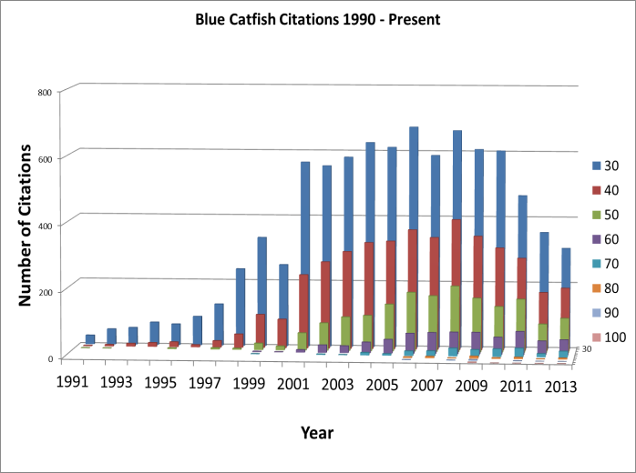
Angler Citations Data
Blue Catfish Citations – James River

Slide 67
Shift Towards Slower Growth

Slide 68
Shift Towards Slower Growth

Slide 69
Shift Towards Slower Growth

Slide 70
Shift Towards Slower Growth

Slide 71
Why?
Changes to system productivity, food availability?
Density dependence in upstream locations forcing population to expand downstream
Fundamental invasion ecology principles apply
  Introduction→Establishment→Expansion

Slide 72
Classic Post Introduction Response
2008
2014
?
1990’s
1970’s

Slide 73
Blue Catfish Future
Overall impacts not well understood
Studies currently underway to evaluate impact
Removals unrealistic
Commercial fishing probably not enough
Here to stay – but at what abundance level?

Slide 74
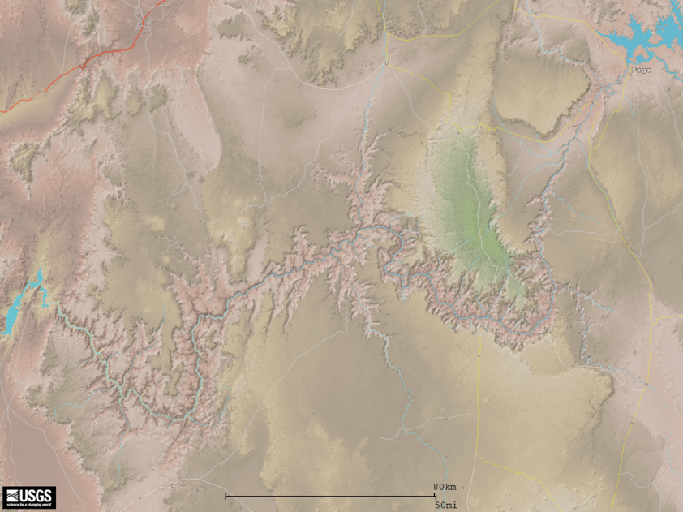
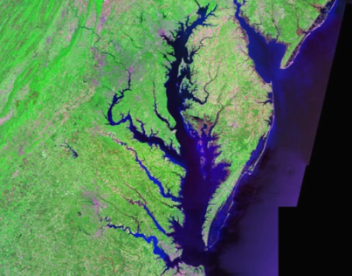
Now what?
You’ve seen 2 major fisheries issues in the U.S.
Economically relevant nonnative introductions w/ ecological implications
What are the similarities?

Slide 75
Similarities
Large over-arching programs developed to maintain important resources
Adaptive management prevalent
Societal paradigms have shifted – now agencies would likely not have stocked

Slide 76
Similarities
Attempts to reverse now common or…
WE WANT IT ALL! Maintain viable sport fish populations, while not impacting native resources!

Slide 77
How to manage in a conflicting world?
Monitoring and research is key to inform management
Work efficiently, effectively, and harmoniously
Appreciation for the issues and willingness to work together toward common goals

Slide 78
How to manage in a conflicting world?
Monitoring and research is key to inform management
Work efficiently, effectively, and harmoniously
Appreciation for the issues and willingness to work together toward common goals
Work well with other humans…fish are easy!

Slide 79
Where do you fit?
University researcher, technician, agency biologist, program manager?
All need to have the knowledge and experience to work with native nongame species and nonnative sportfish…

Slide 80
Where do you fit?
University researcher, technician, agency biologist, program manager?
All need to have the knowledge and experience to work with native nongame species and nonnative sportfish…
and value both…
(or at least understand the importance of each)

