Slide 1
Albert Spells U.S. Fish and Wildlife Service Virginia Fish and Wildlife Conservation Office Charles City, Virginia

Slide 2
Sturgeon Reward Program In James River Upstream of James River Bridge
$50 for Live Sturgeon in Good Condition
($10 for fresh dead fish)
Start Date: May 2, 2005
Stop Date: June 30, 2005
Participants Must Have in Their Possession a
VMRC Scientific Collector’s Permit
To Obtain Permit Call (804) 829-5627
To Report Sturgeon Capture Call These #s:
Pager:1-888-232-0270
Cell Phone: (804) 677-7268
Calls Must Be Received Between 7:00 a.m. and 12:00 noon,
Monday through Friday only

Slide 4
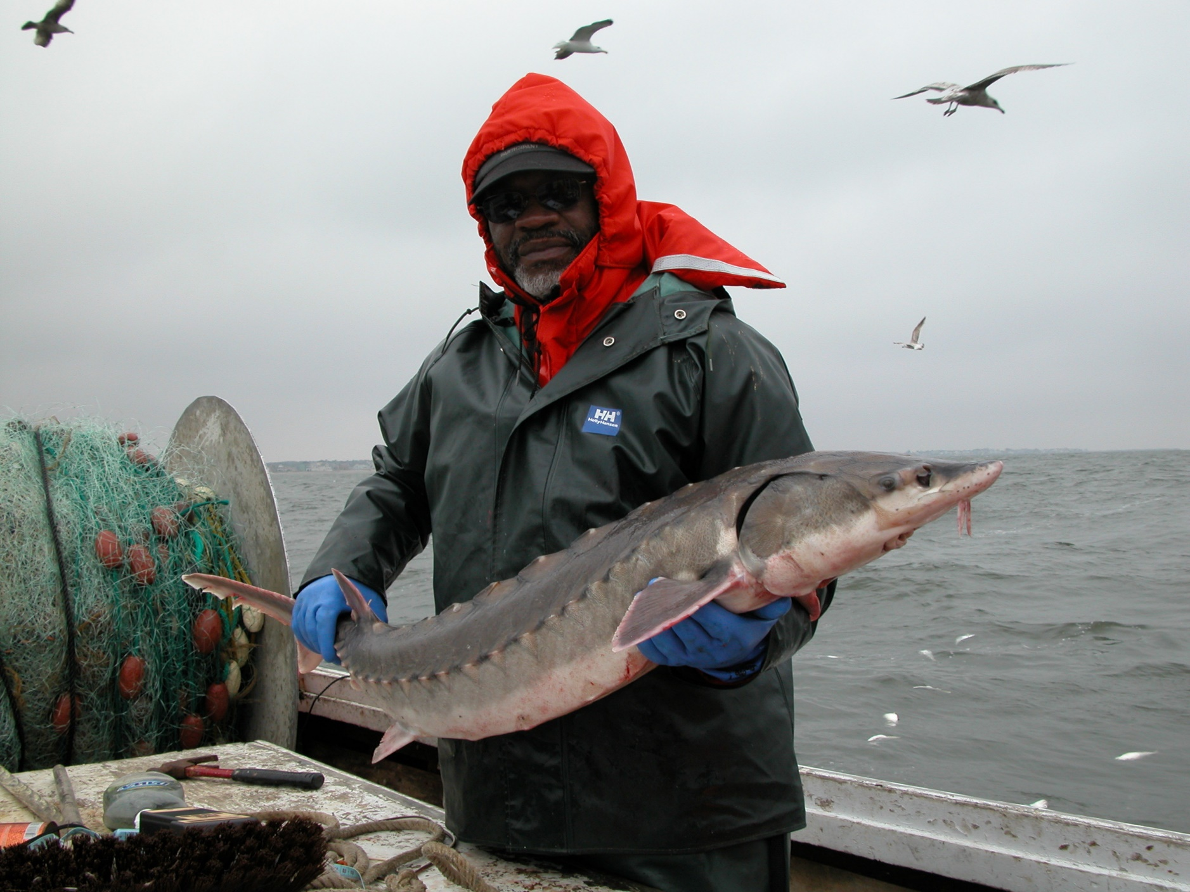

Slide 5
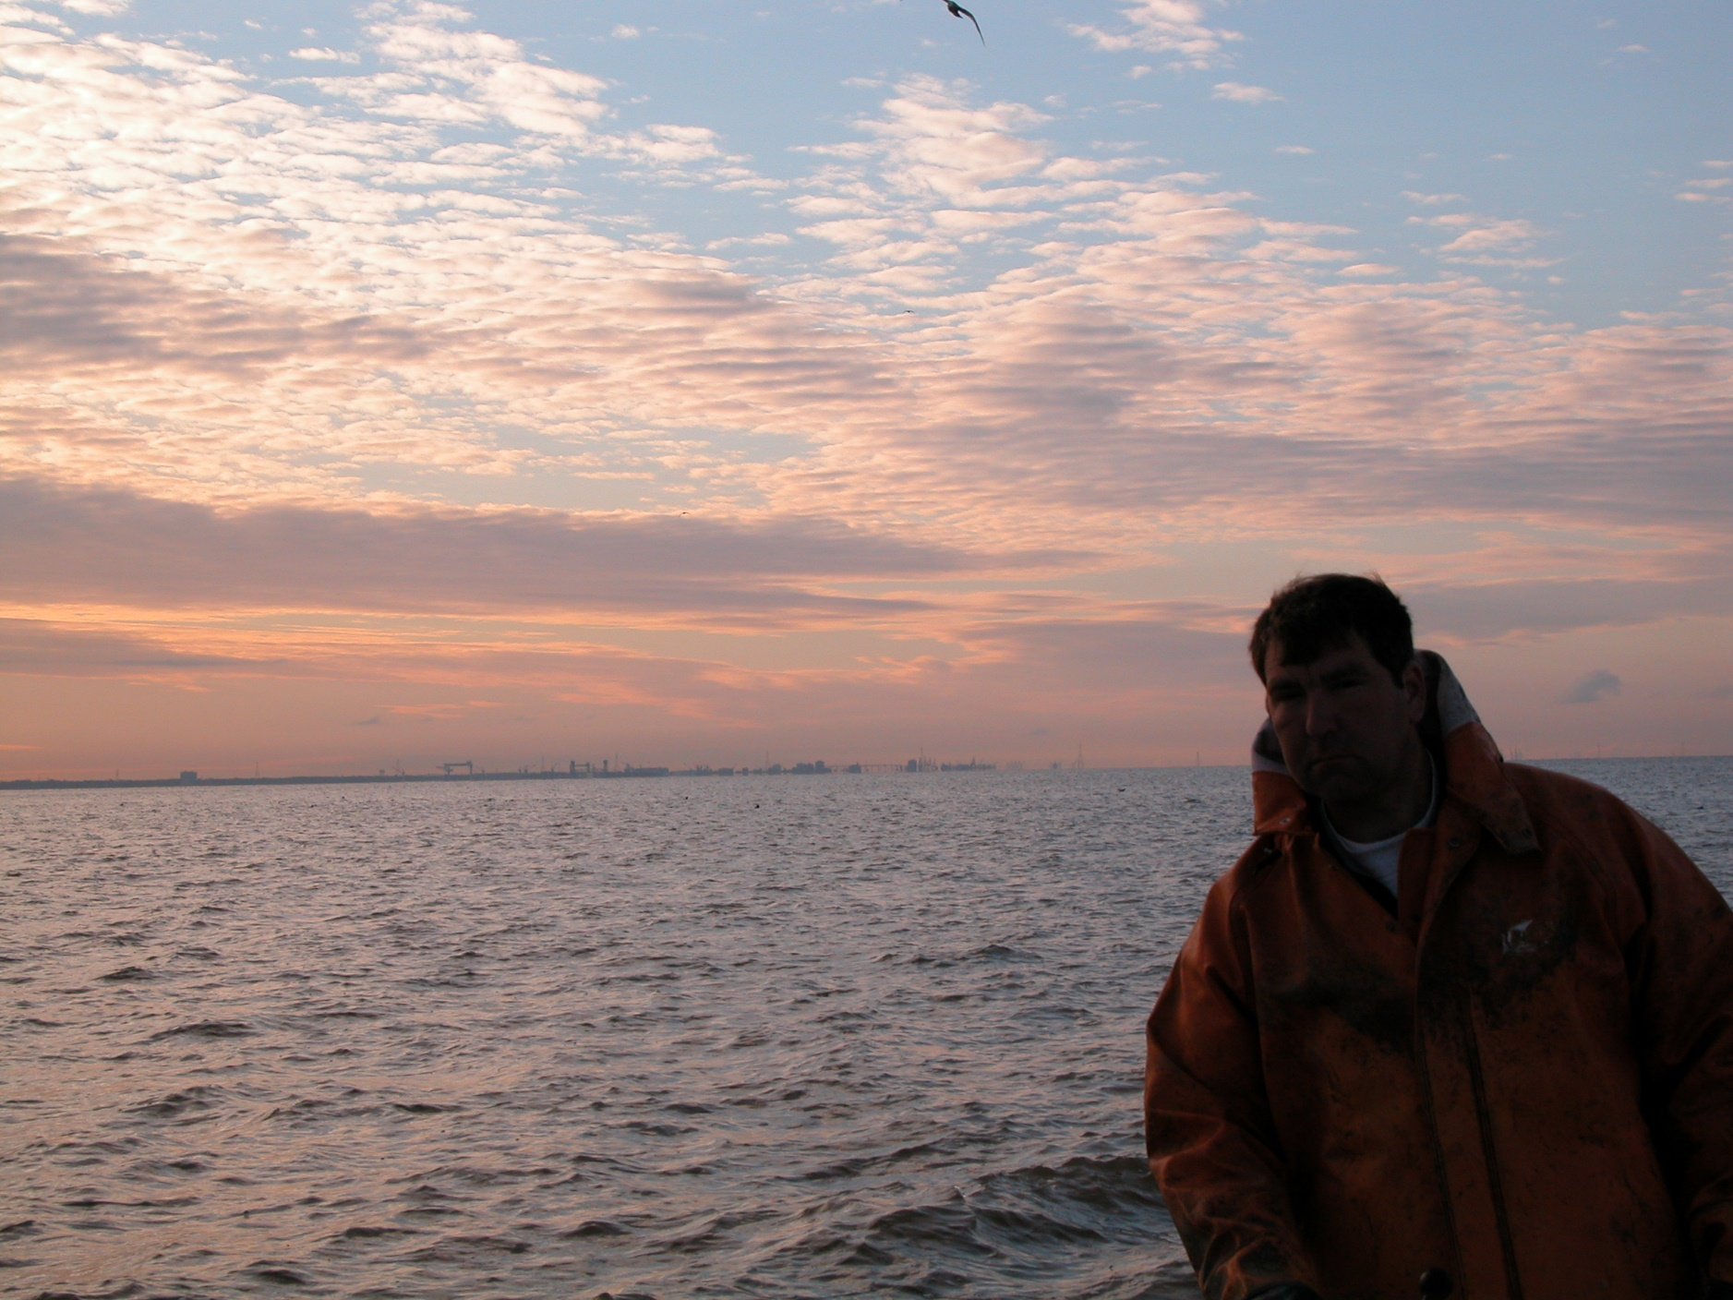

Slide 6
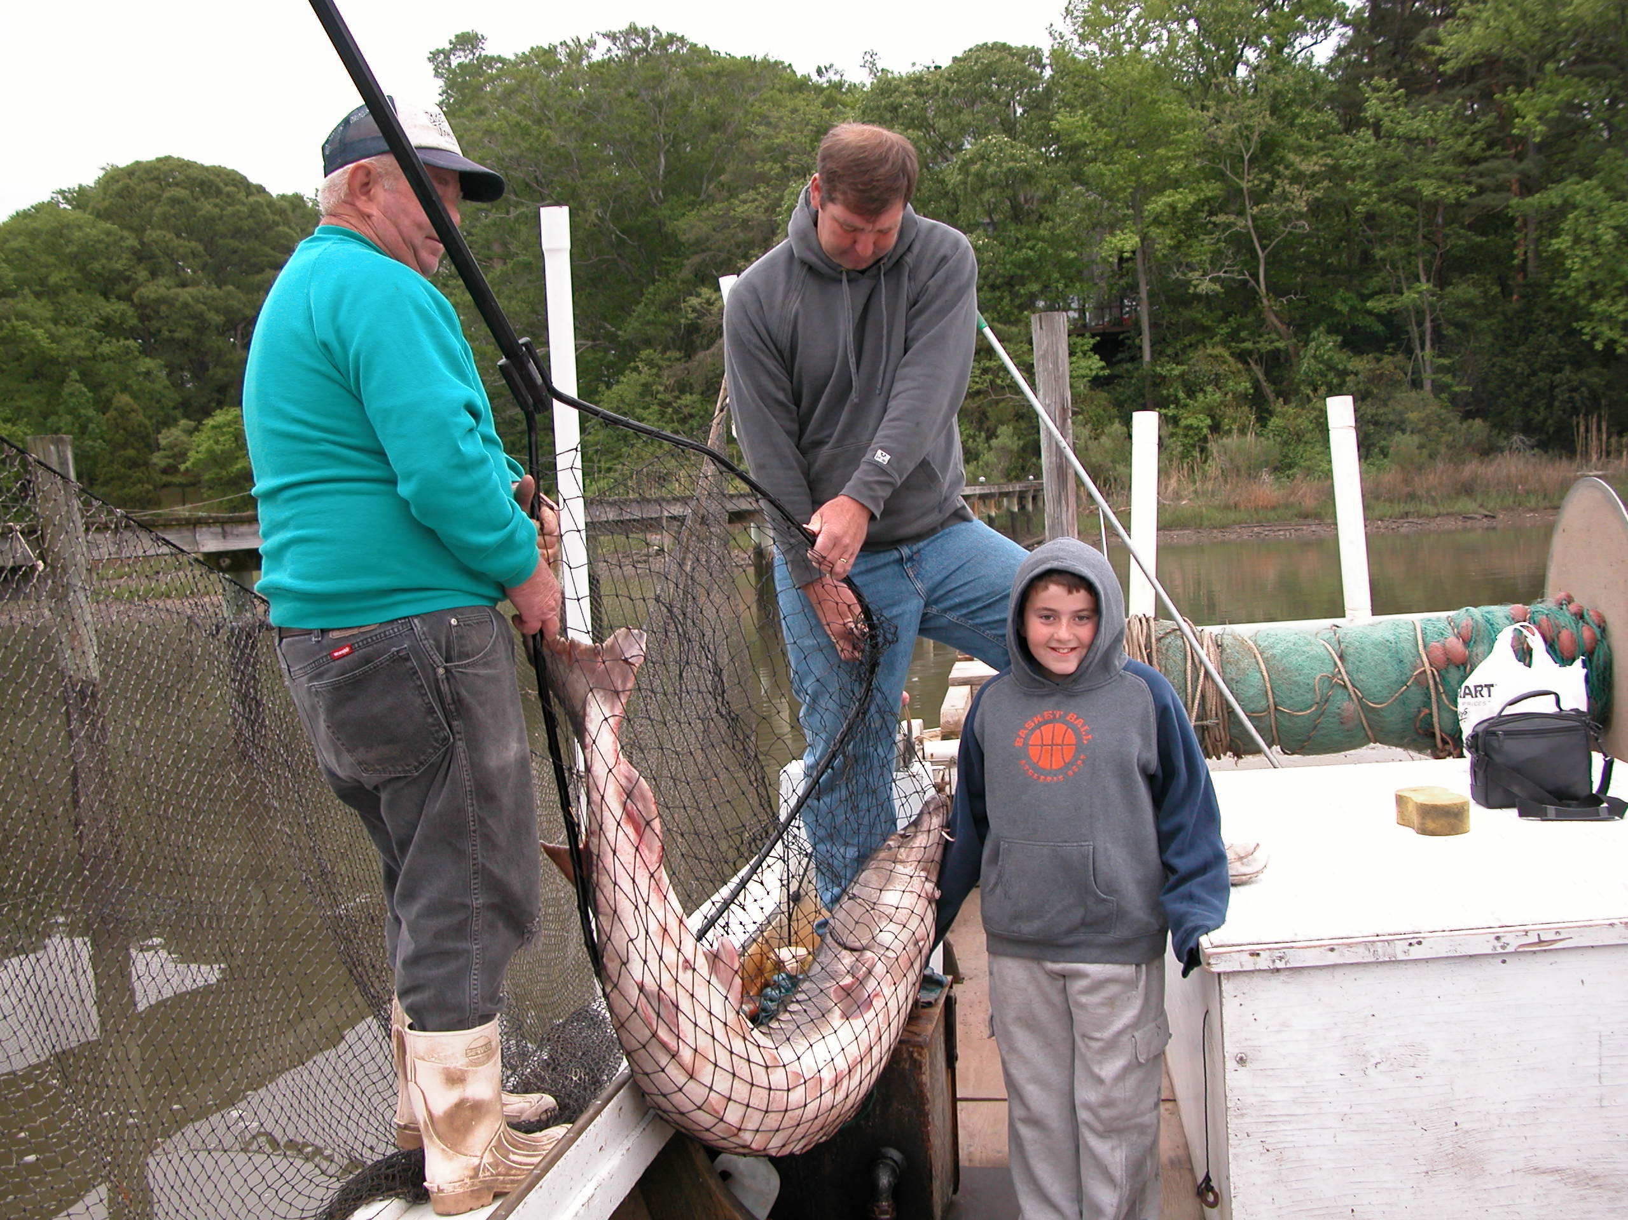

Slide 7
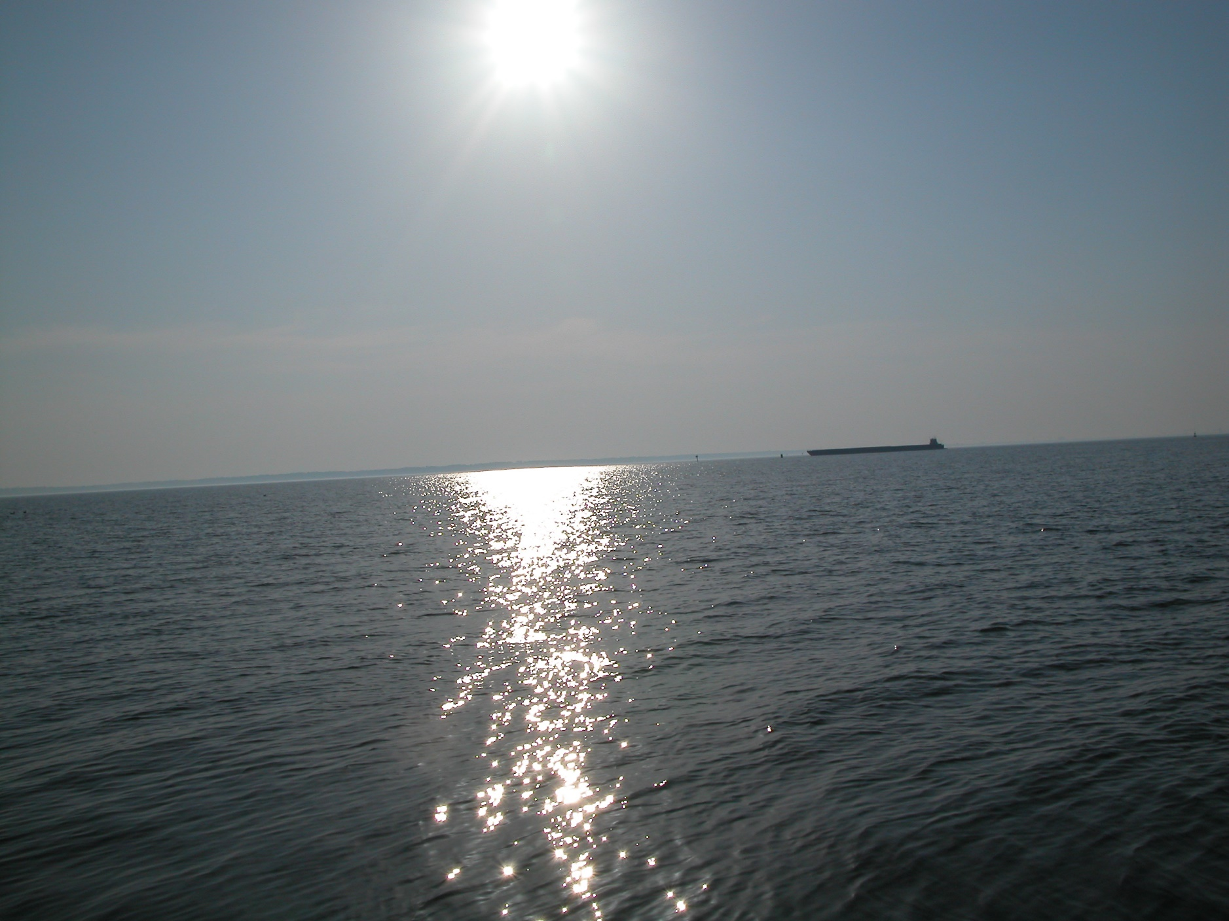

Slide 8
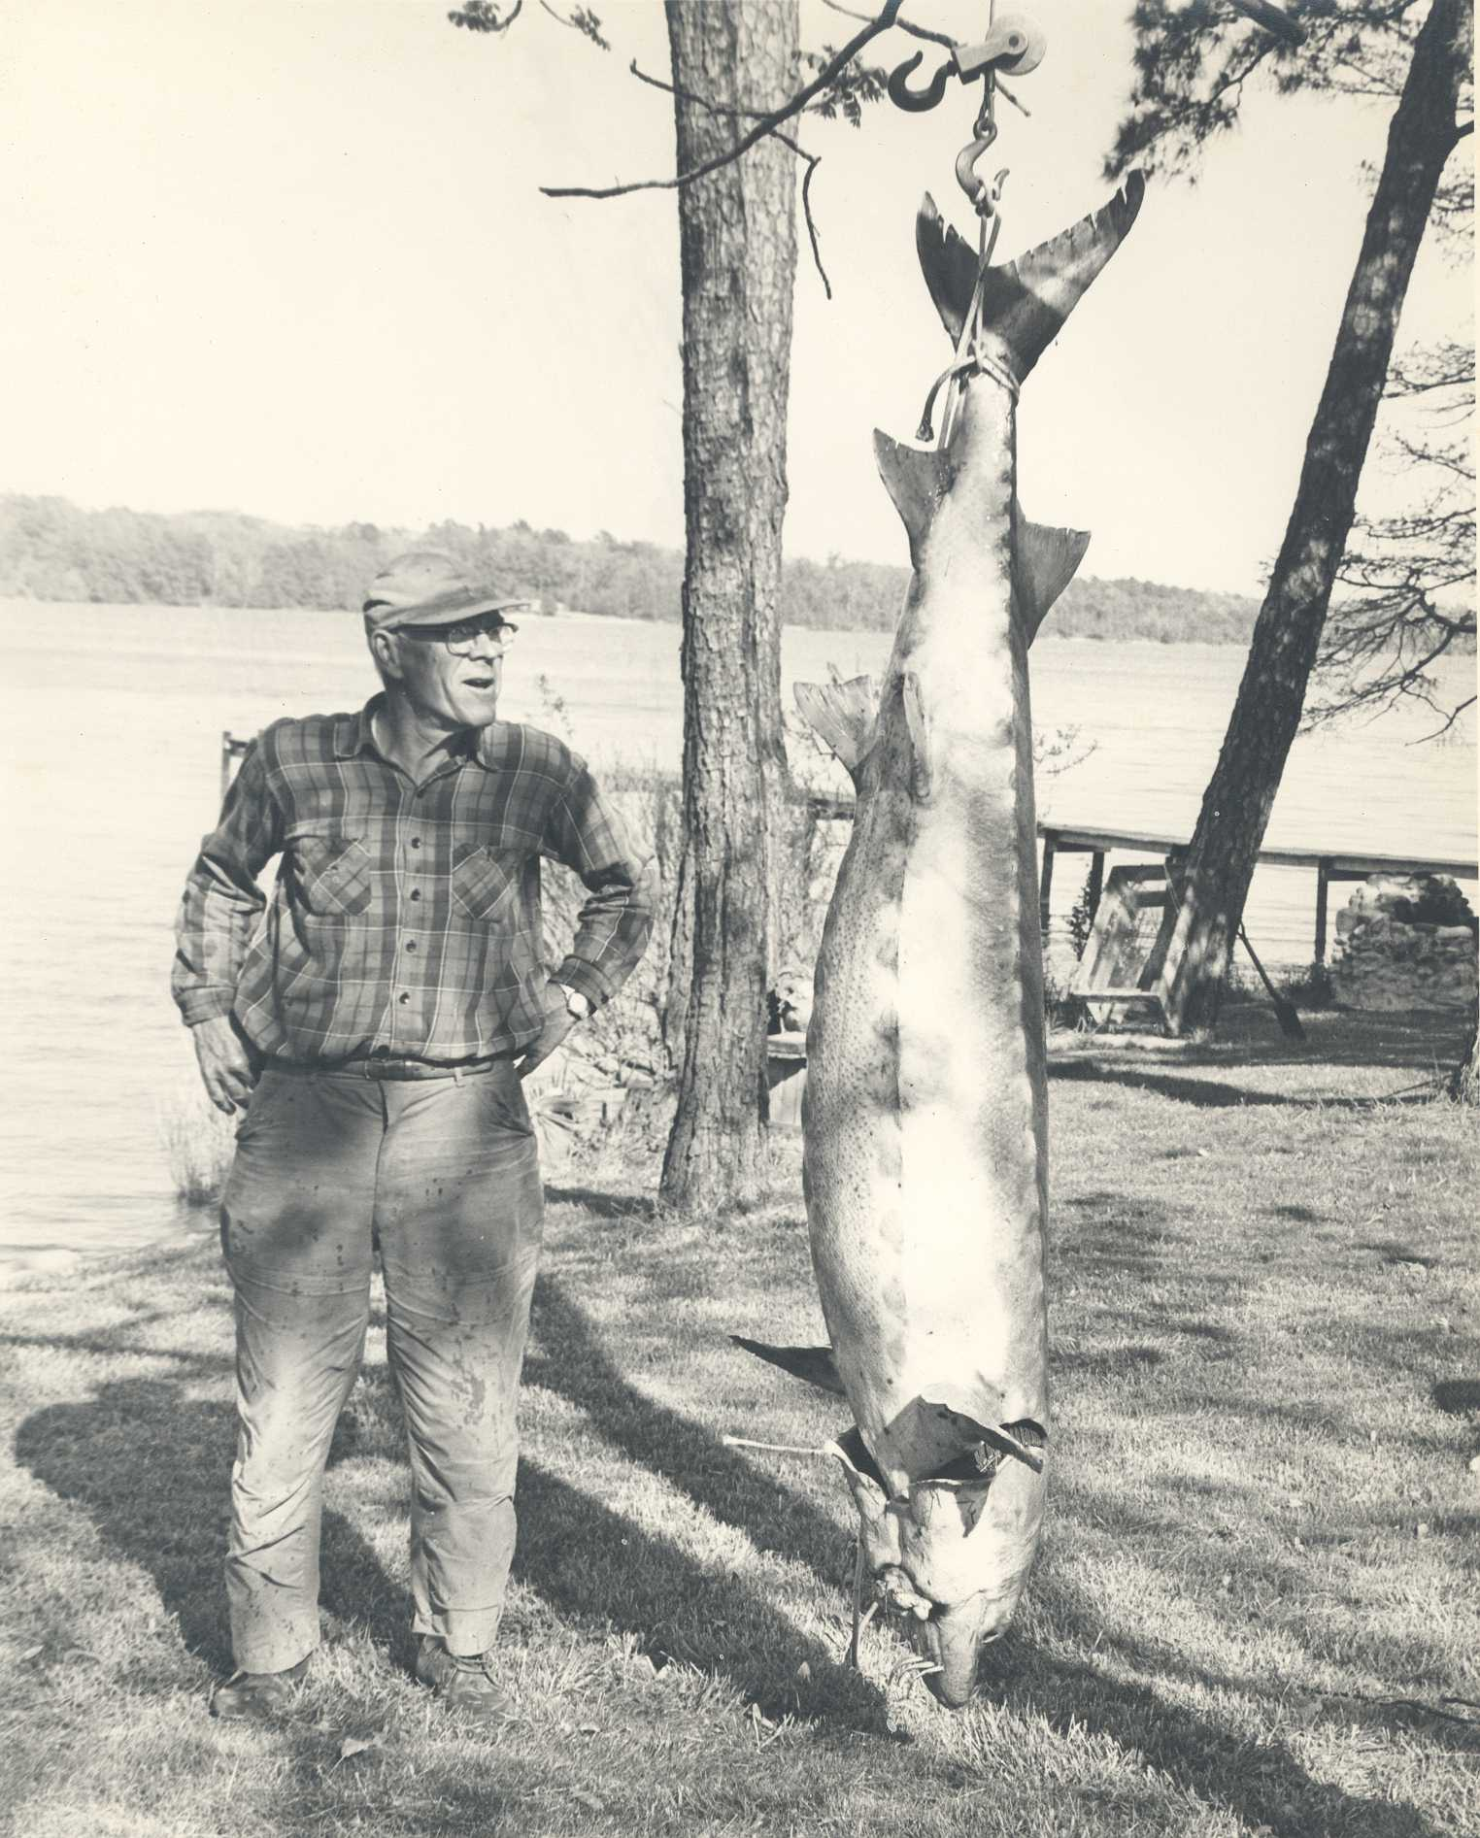

Slide 9
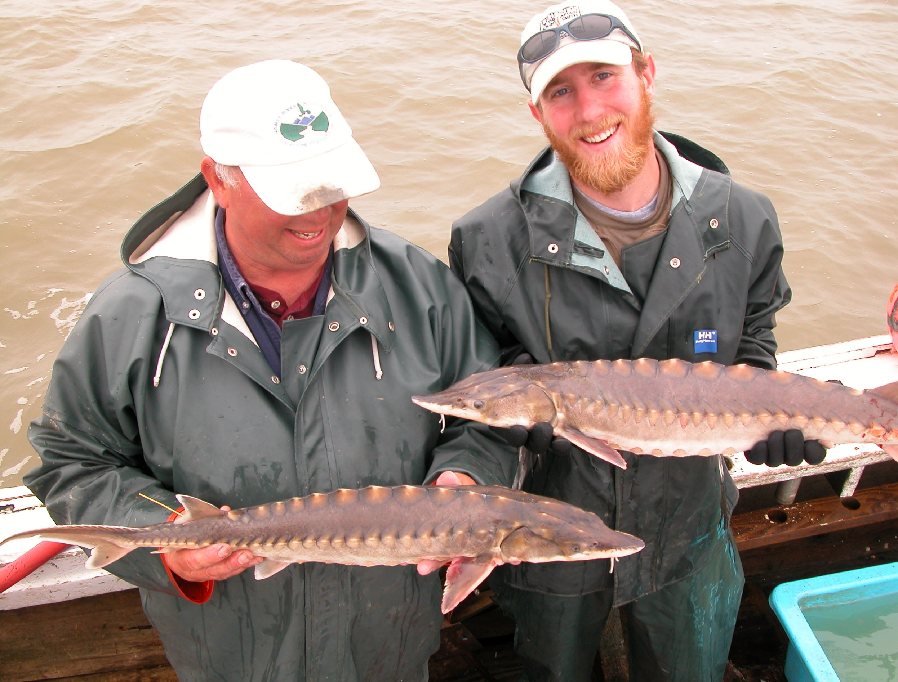

Slide 10
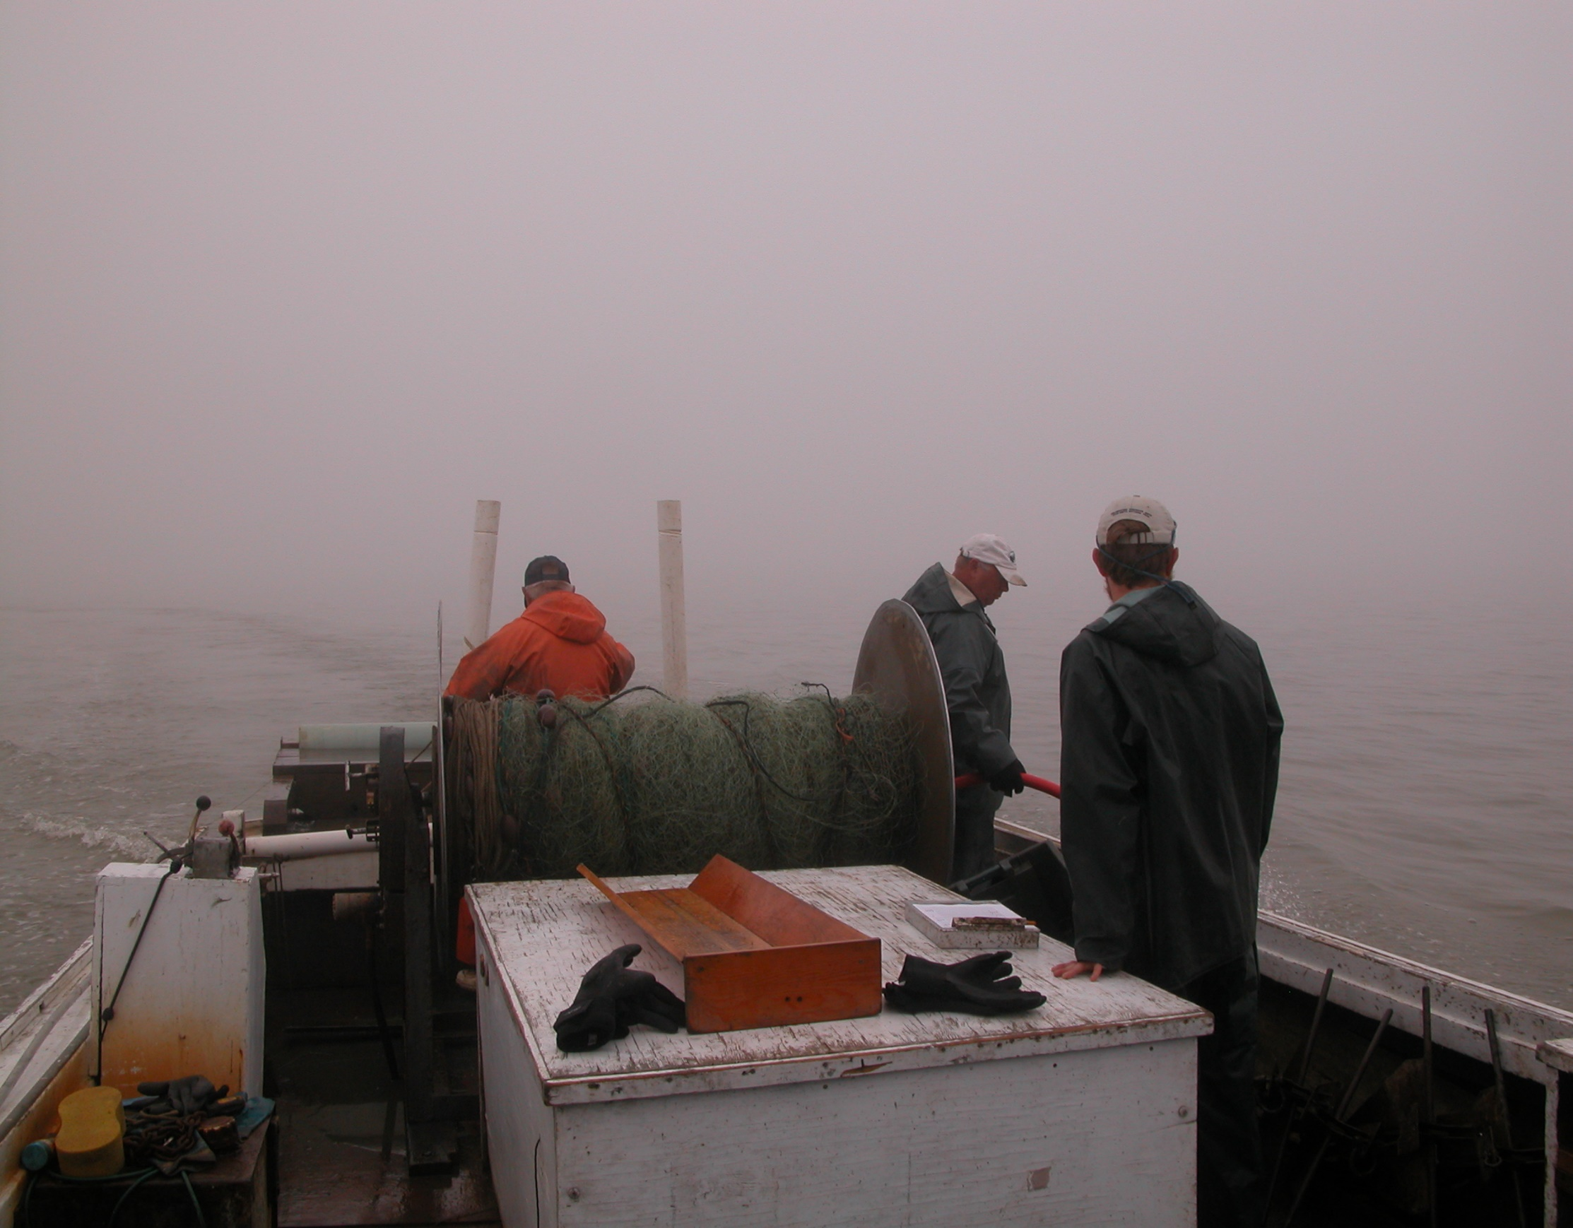

Slide 11
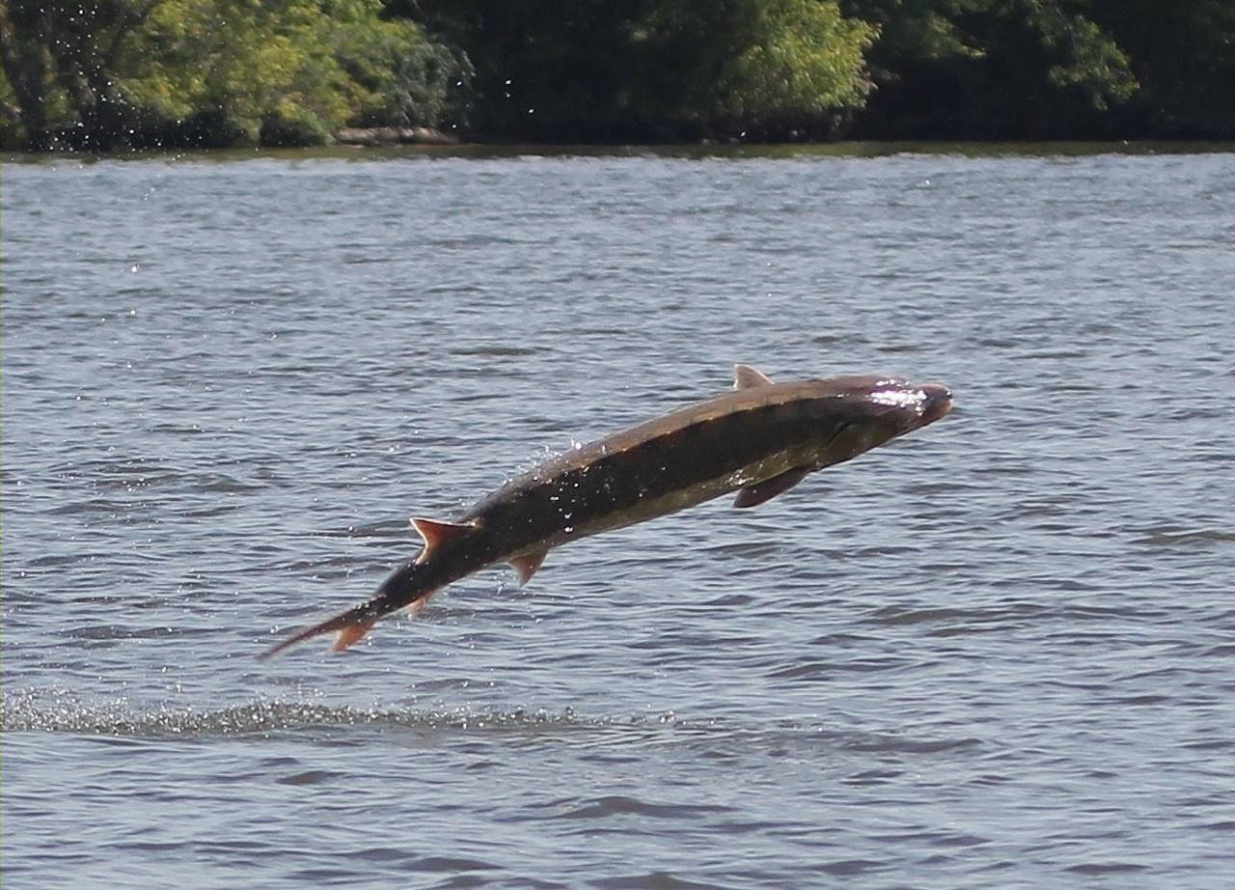

Slide 13
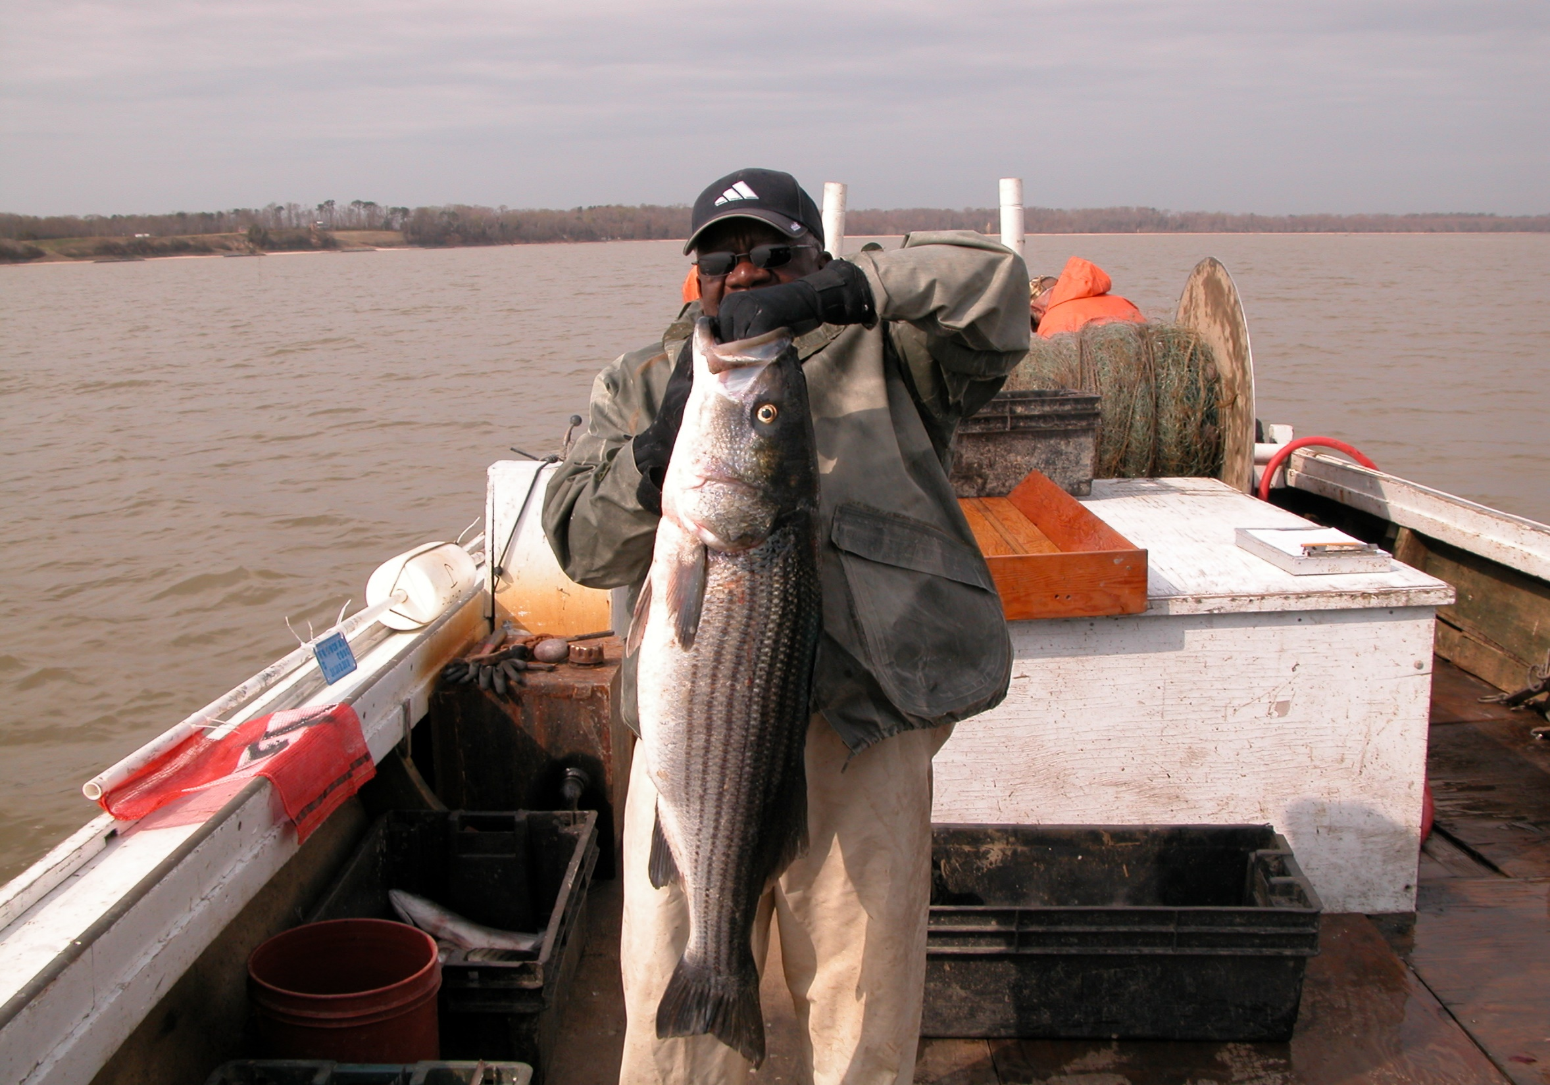

Slide 14
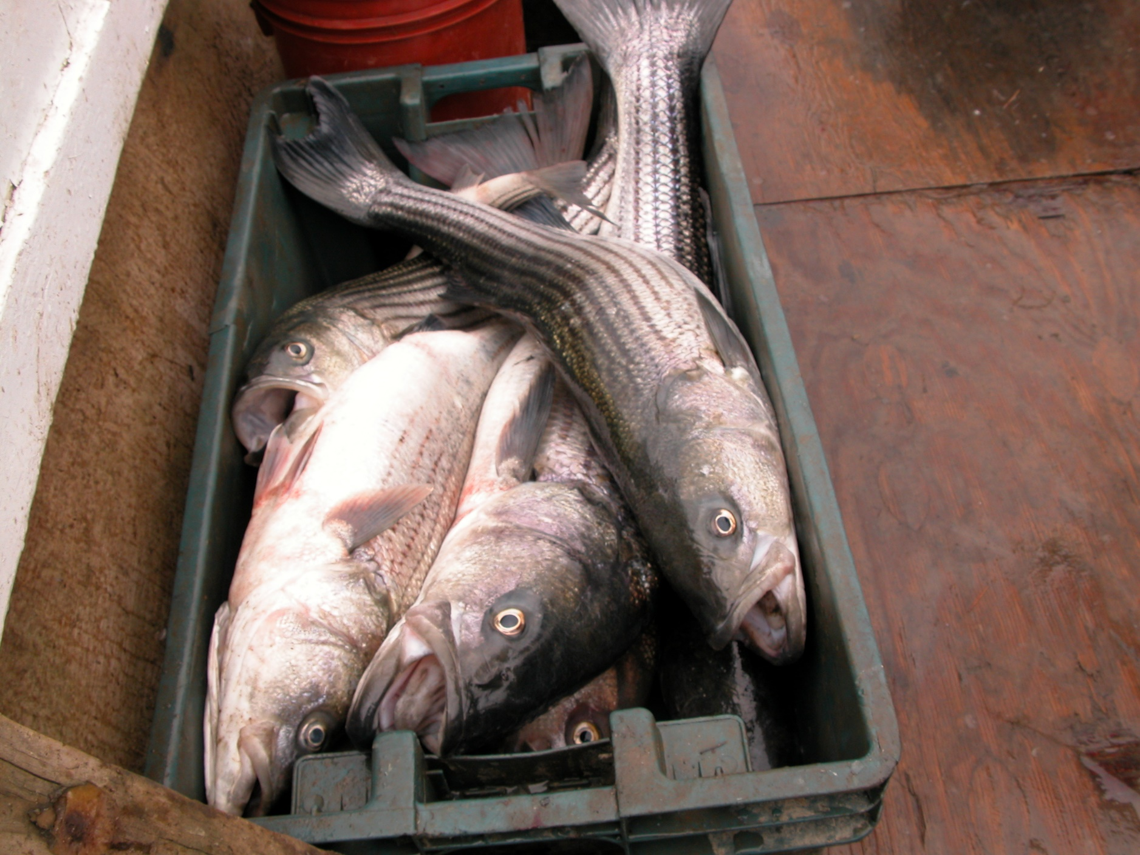

Slide 19
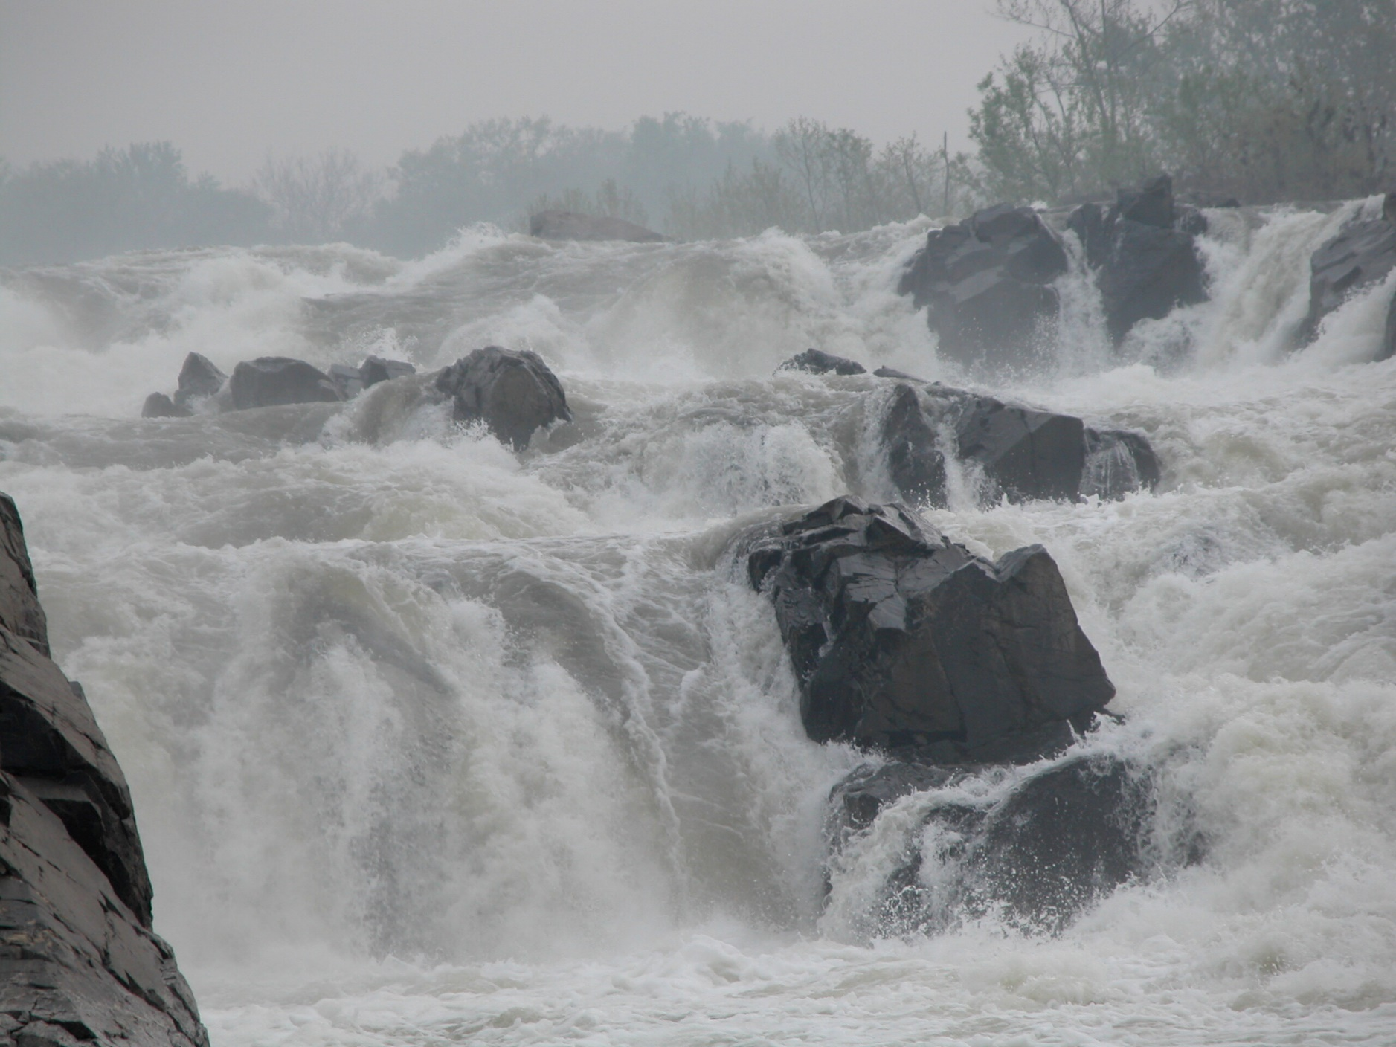

Slide 20
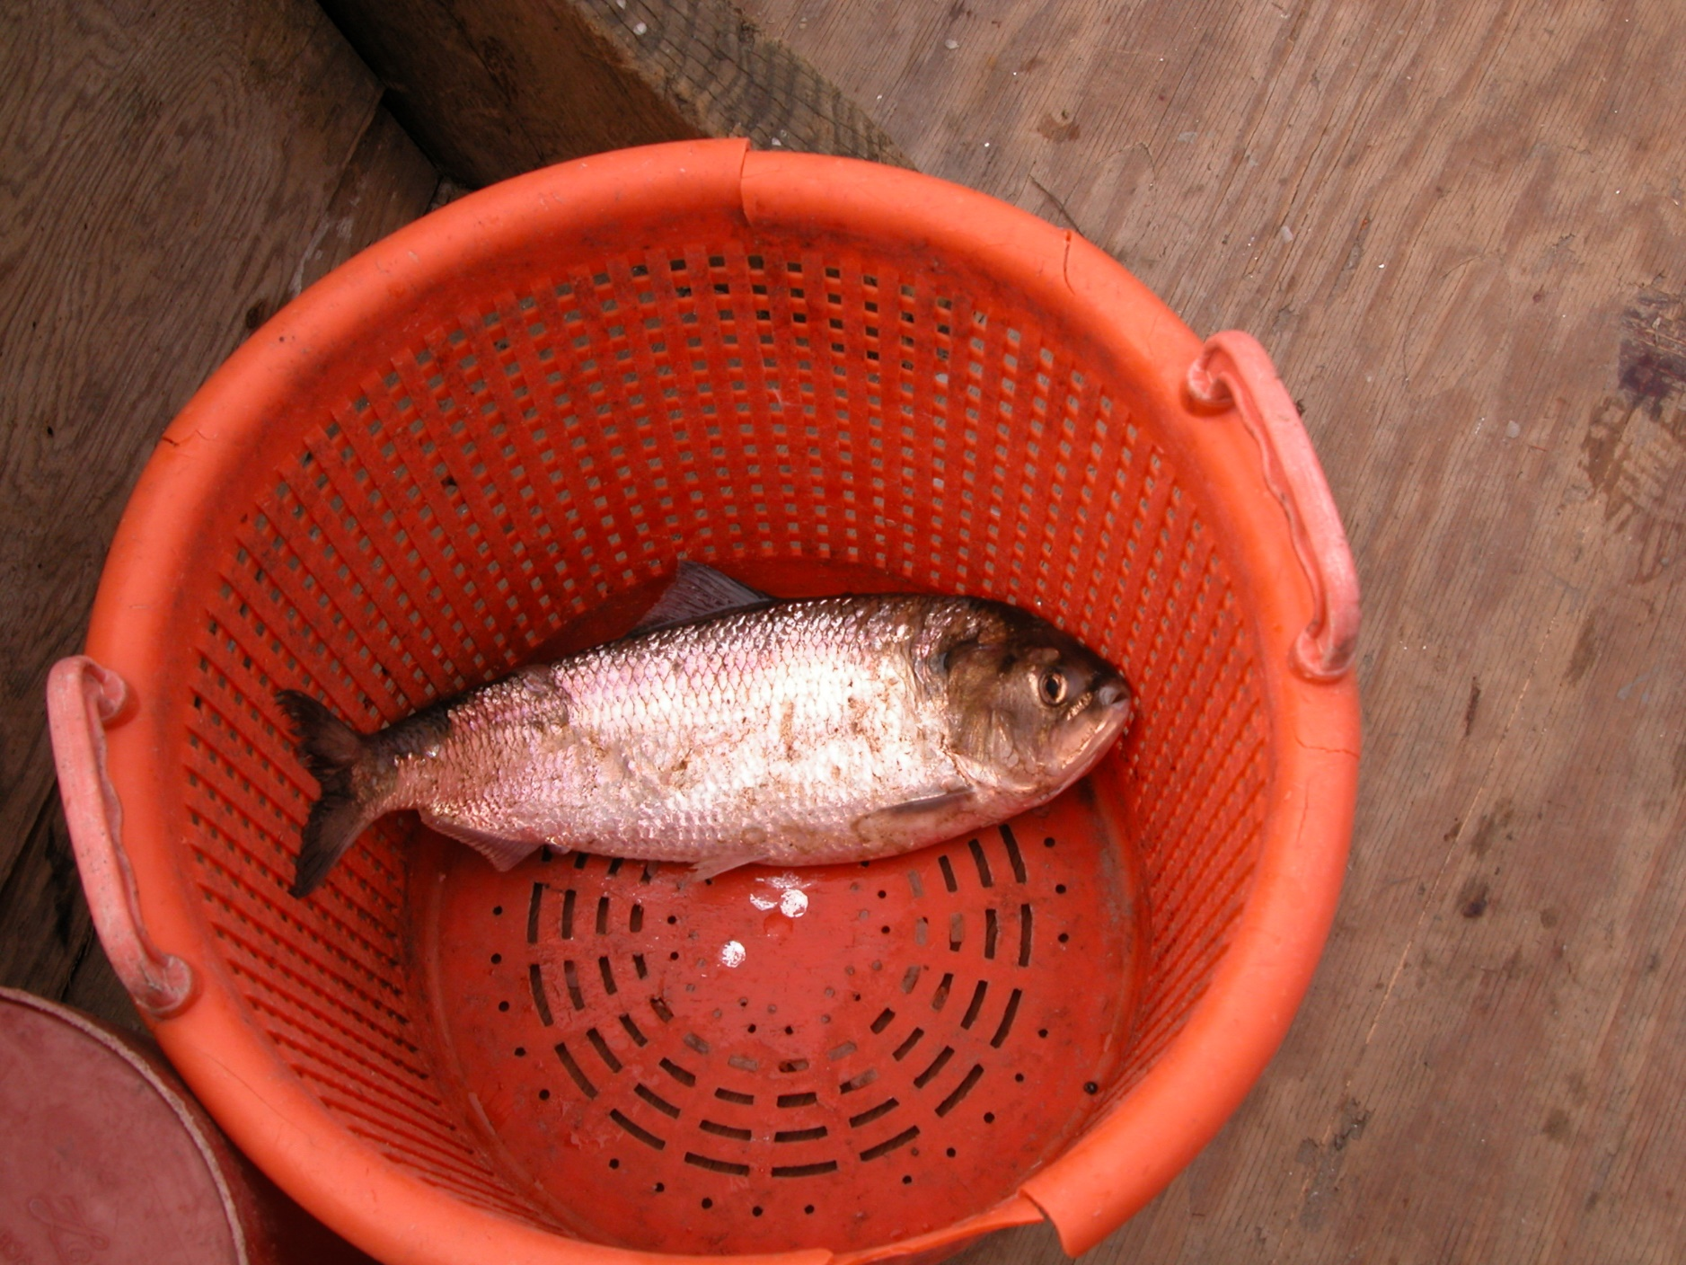

Slide 21
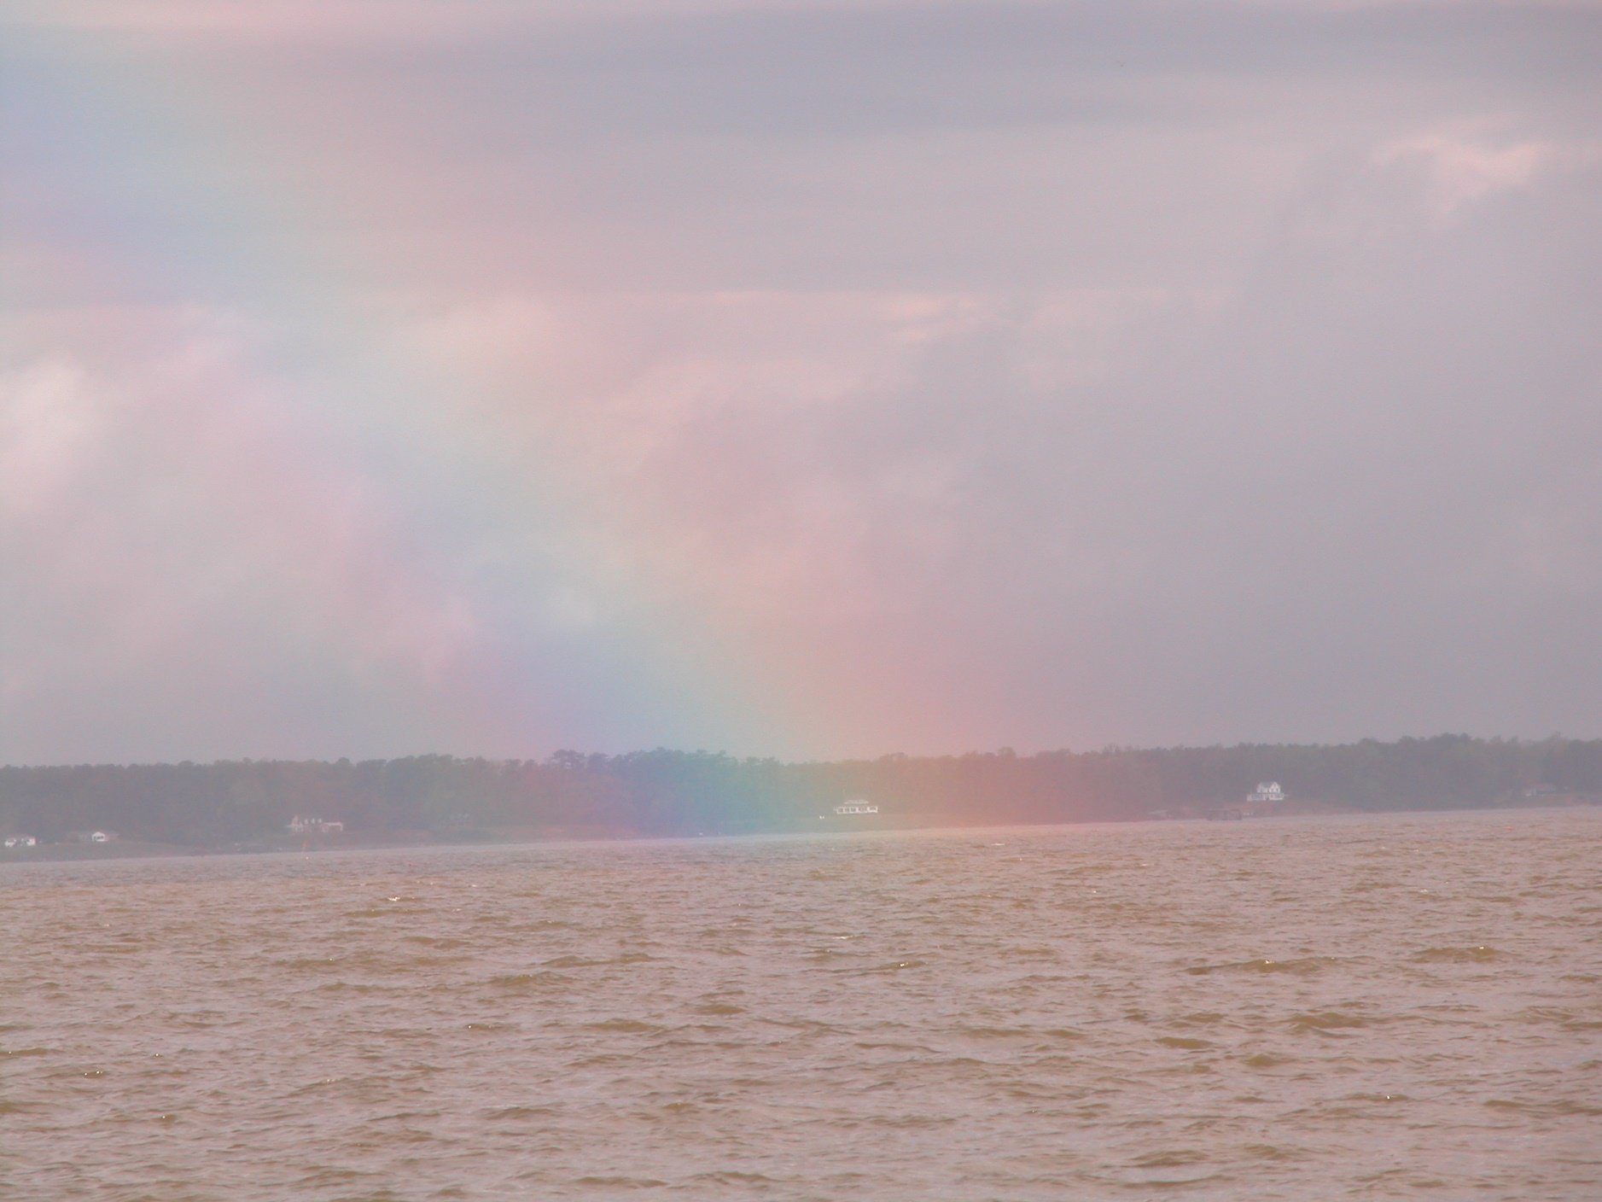

Slide 22
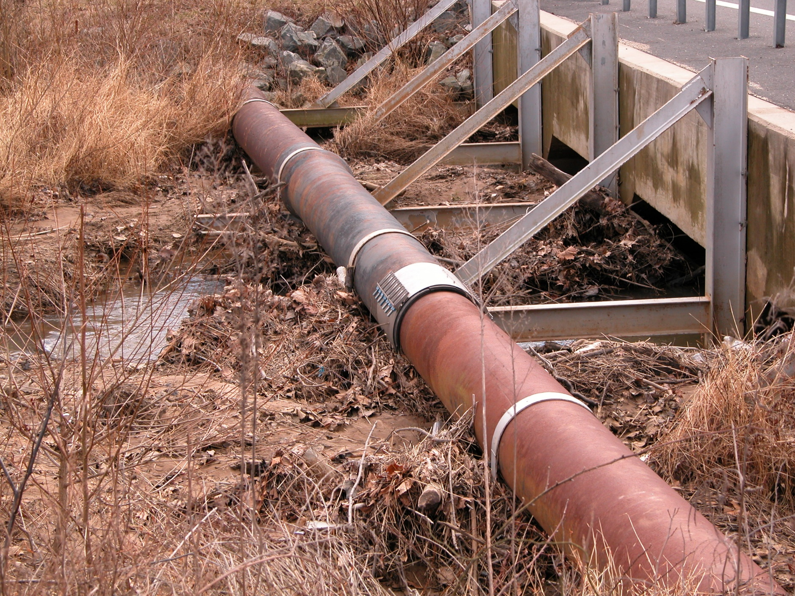

Slide 23
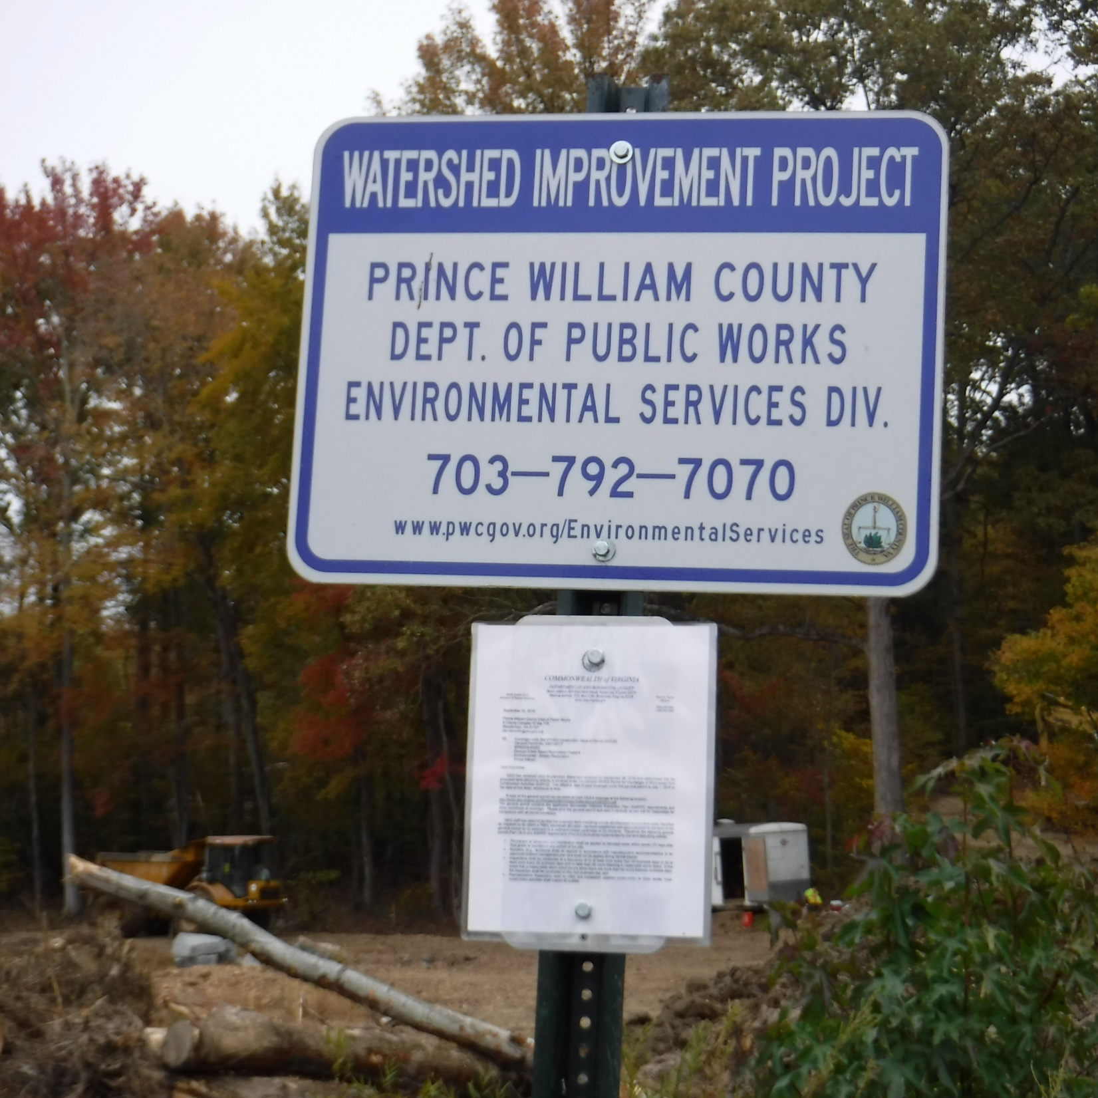

Slide 24
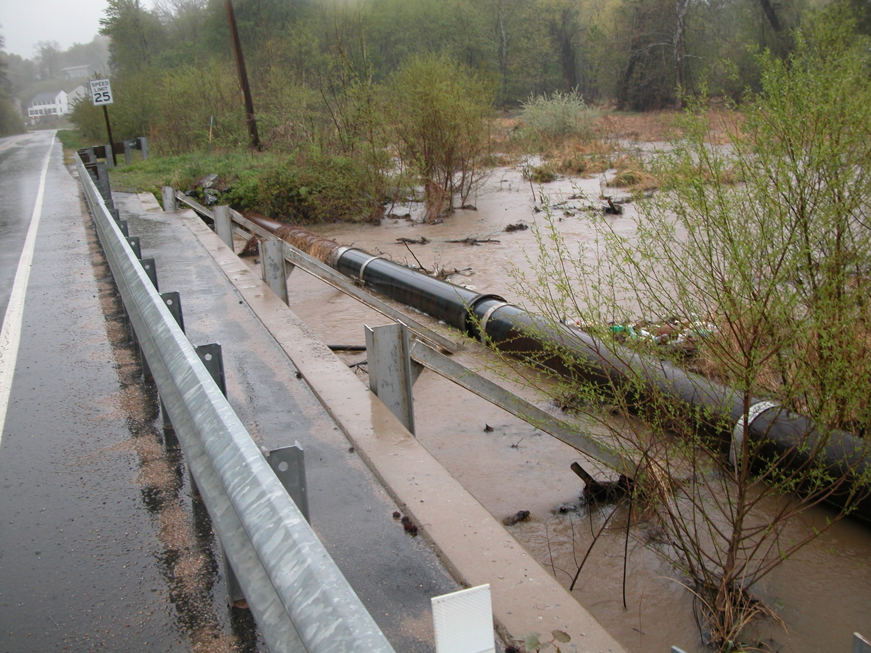

Slide 25
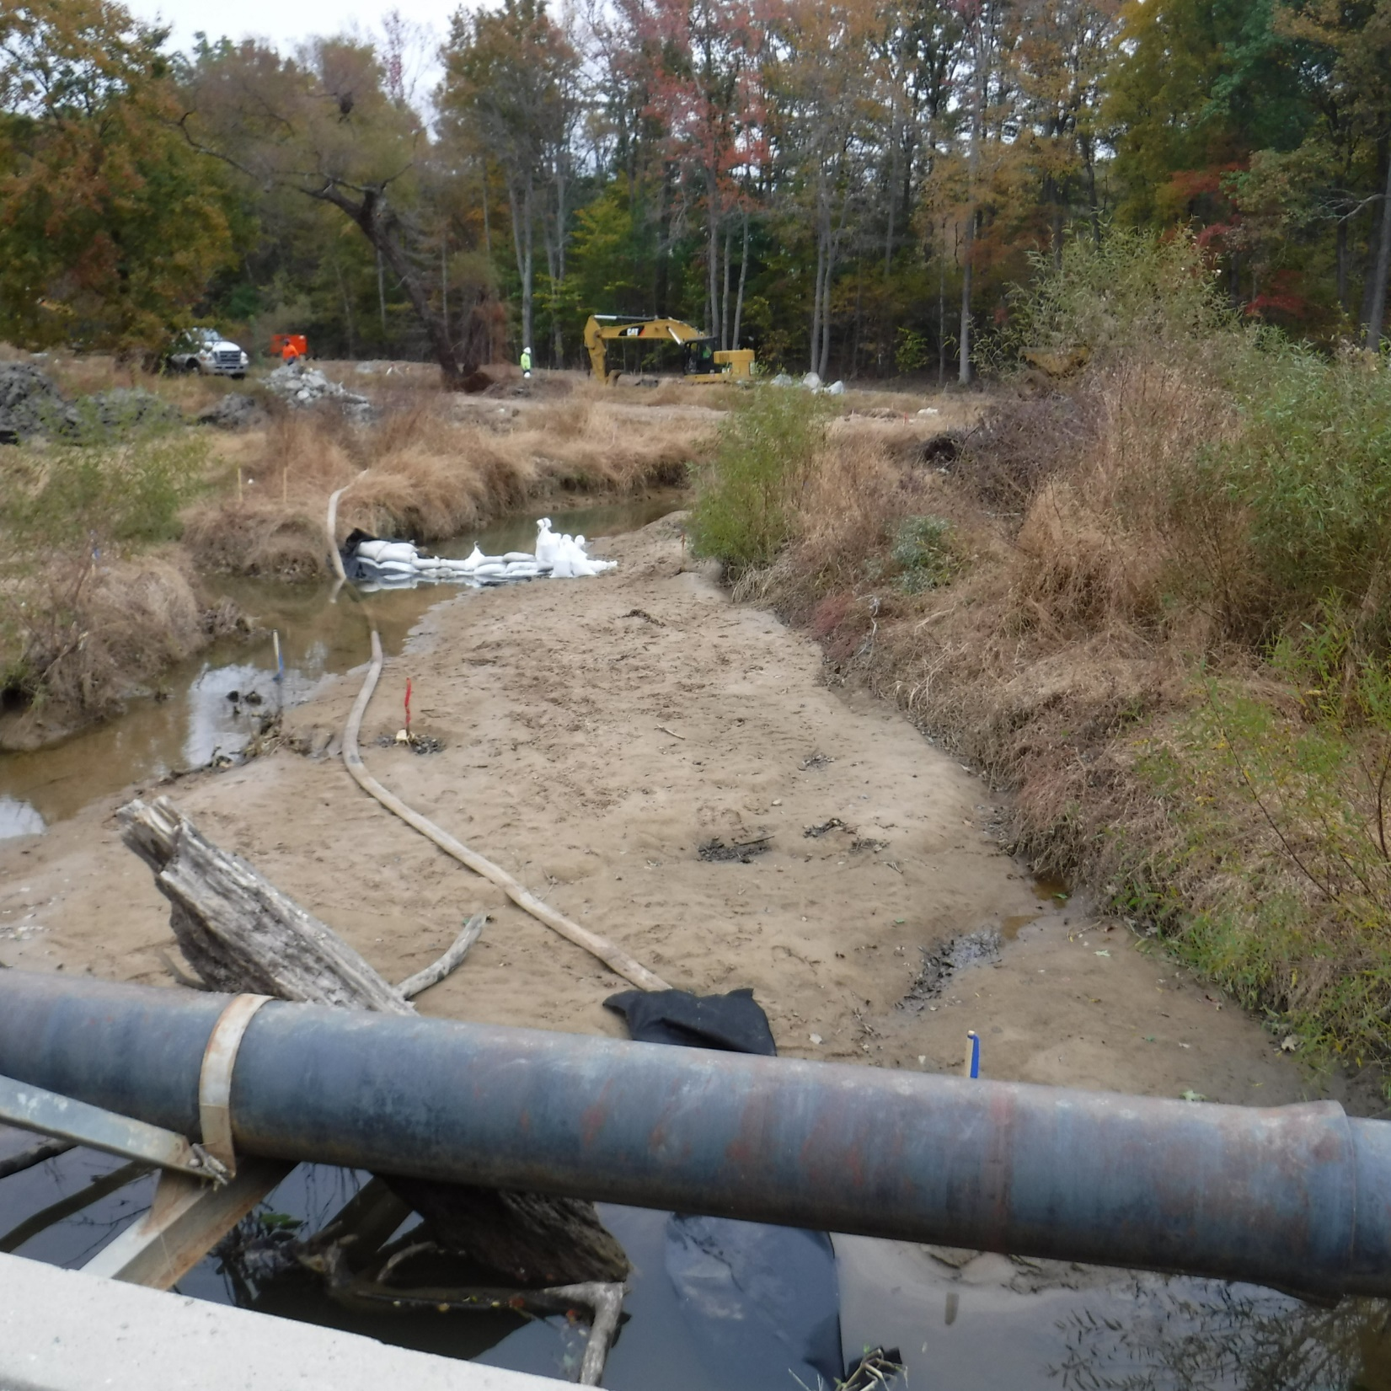

Slide 26
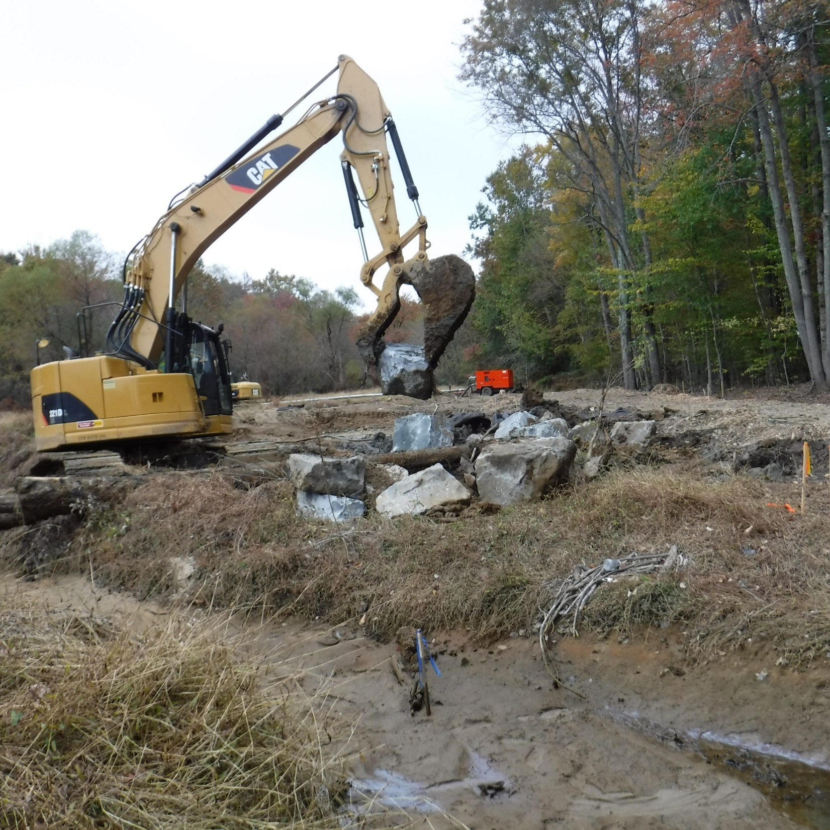

Slide 27
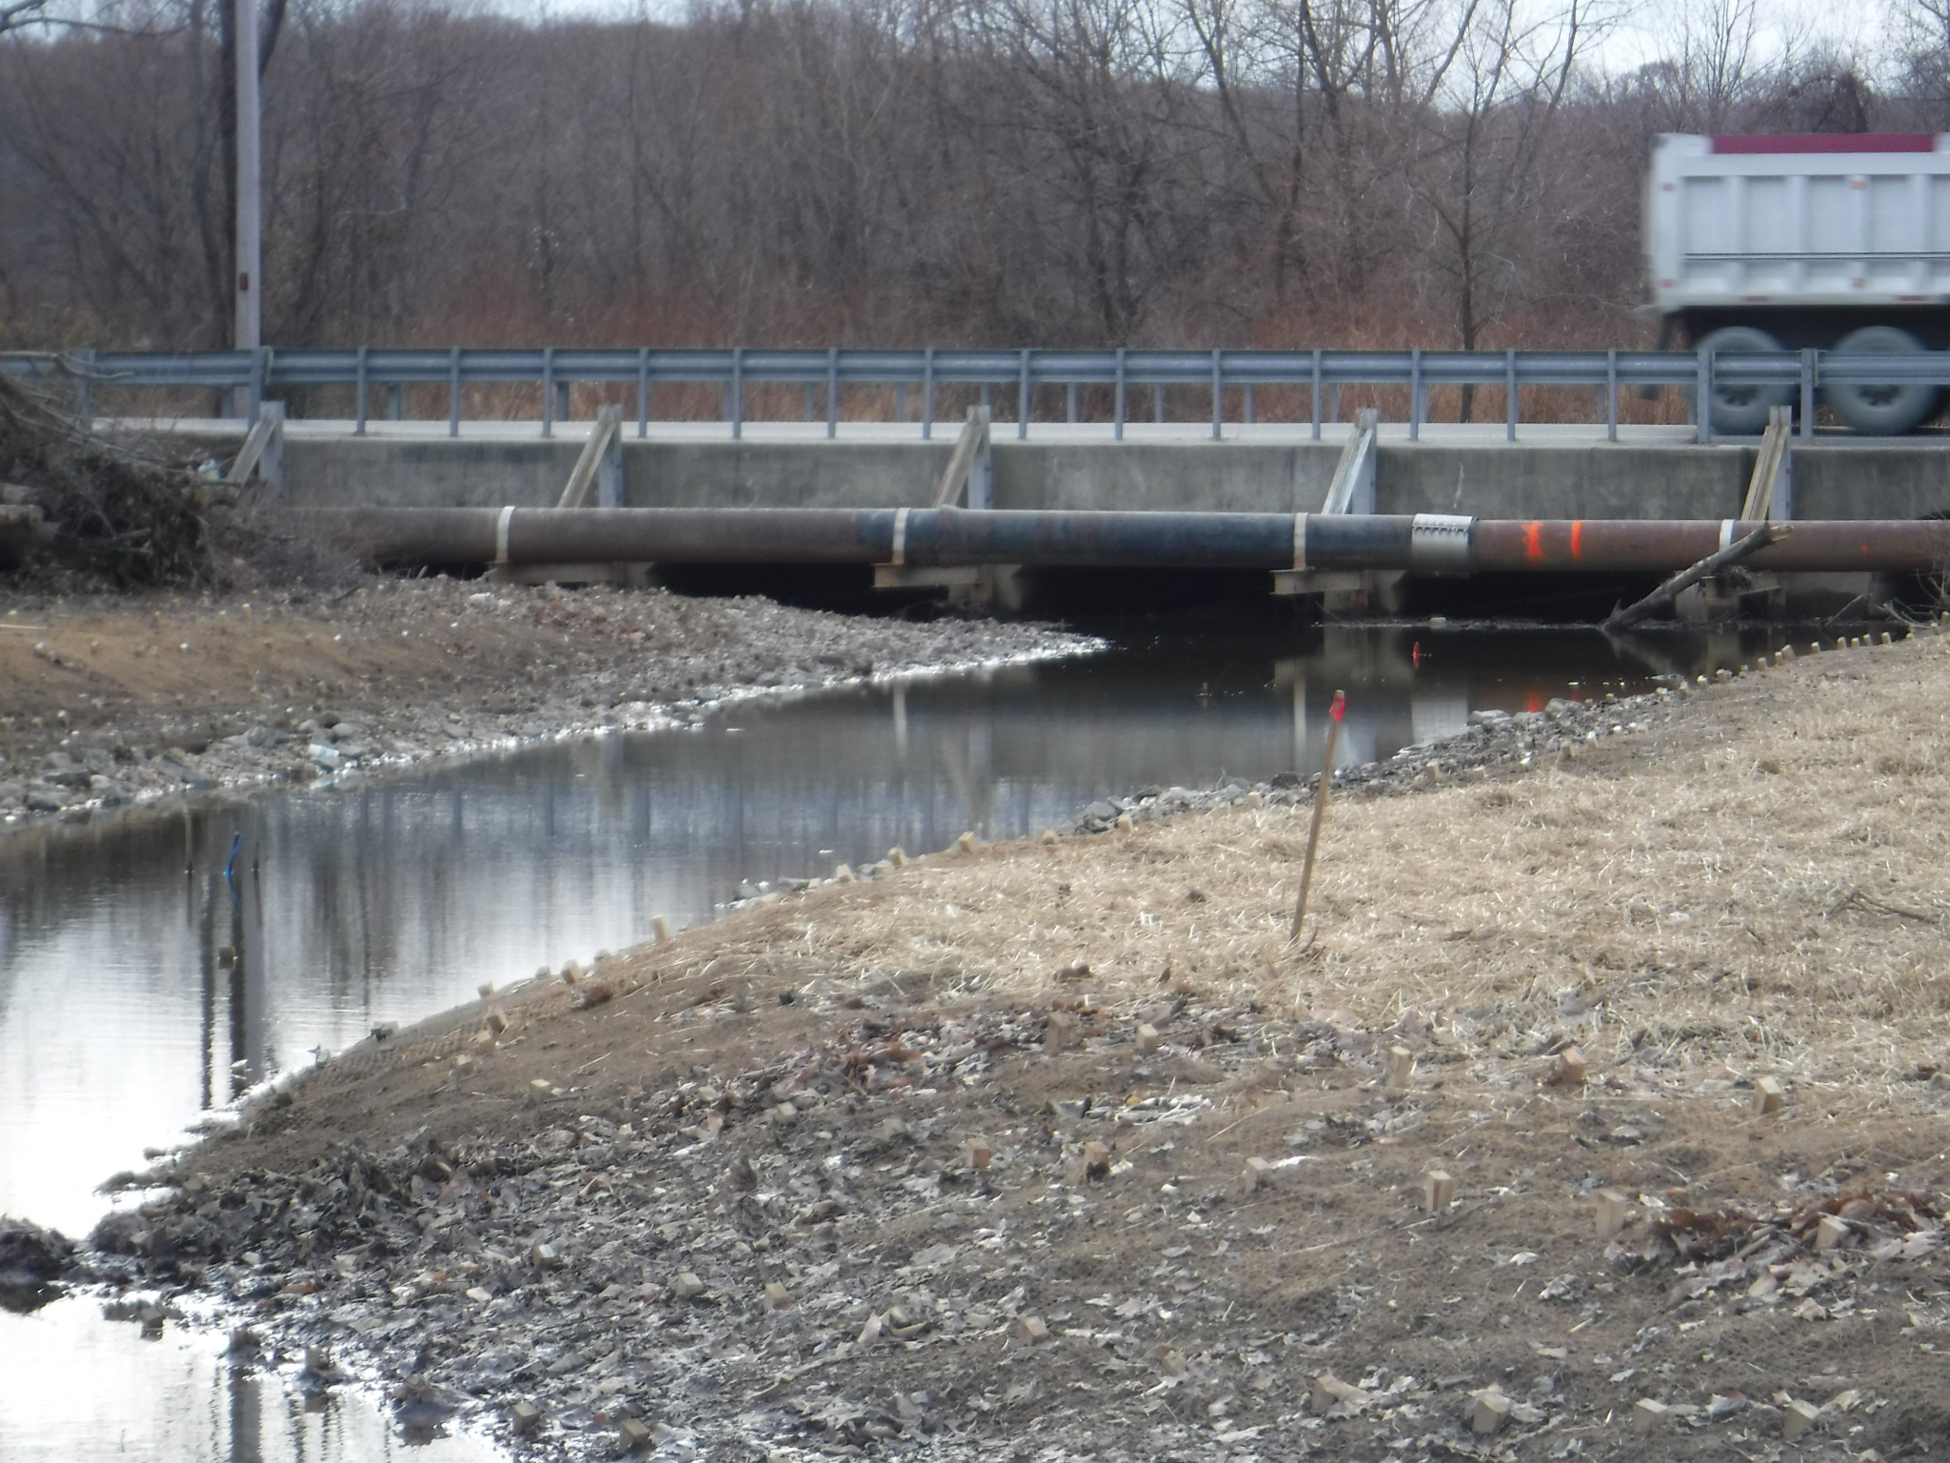

Slide 28
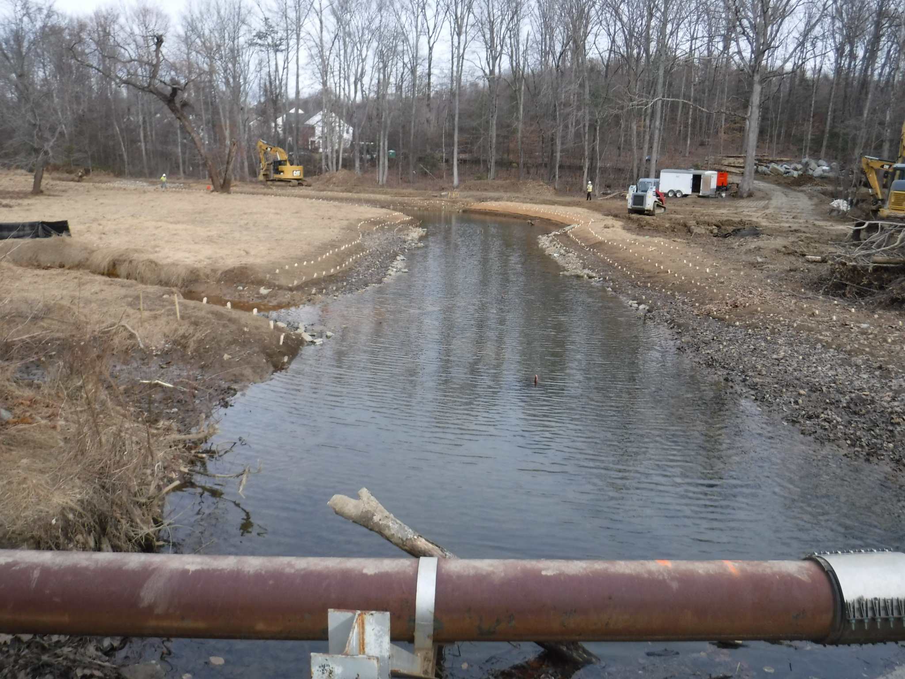

Slide 30
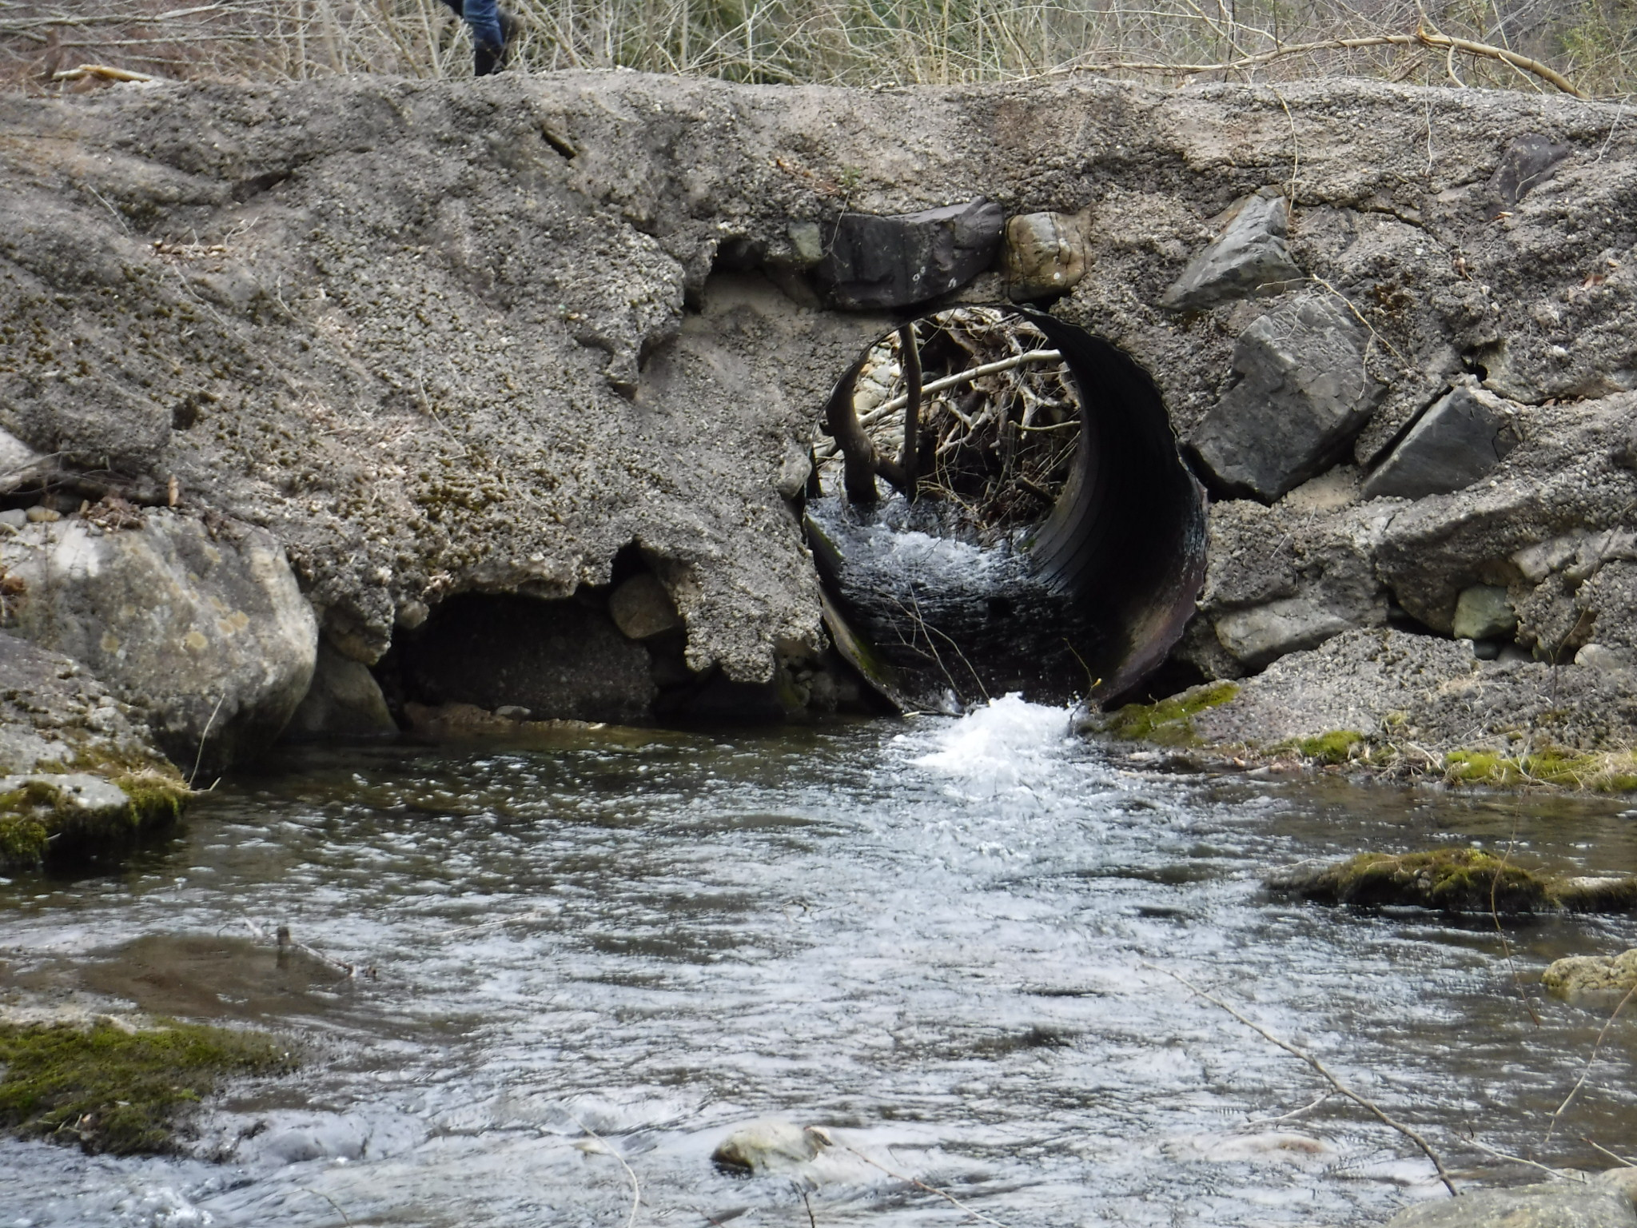

Slide 31
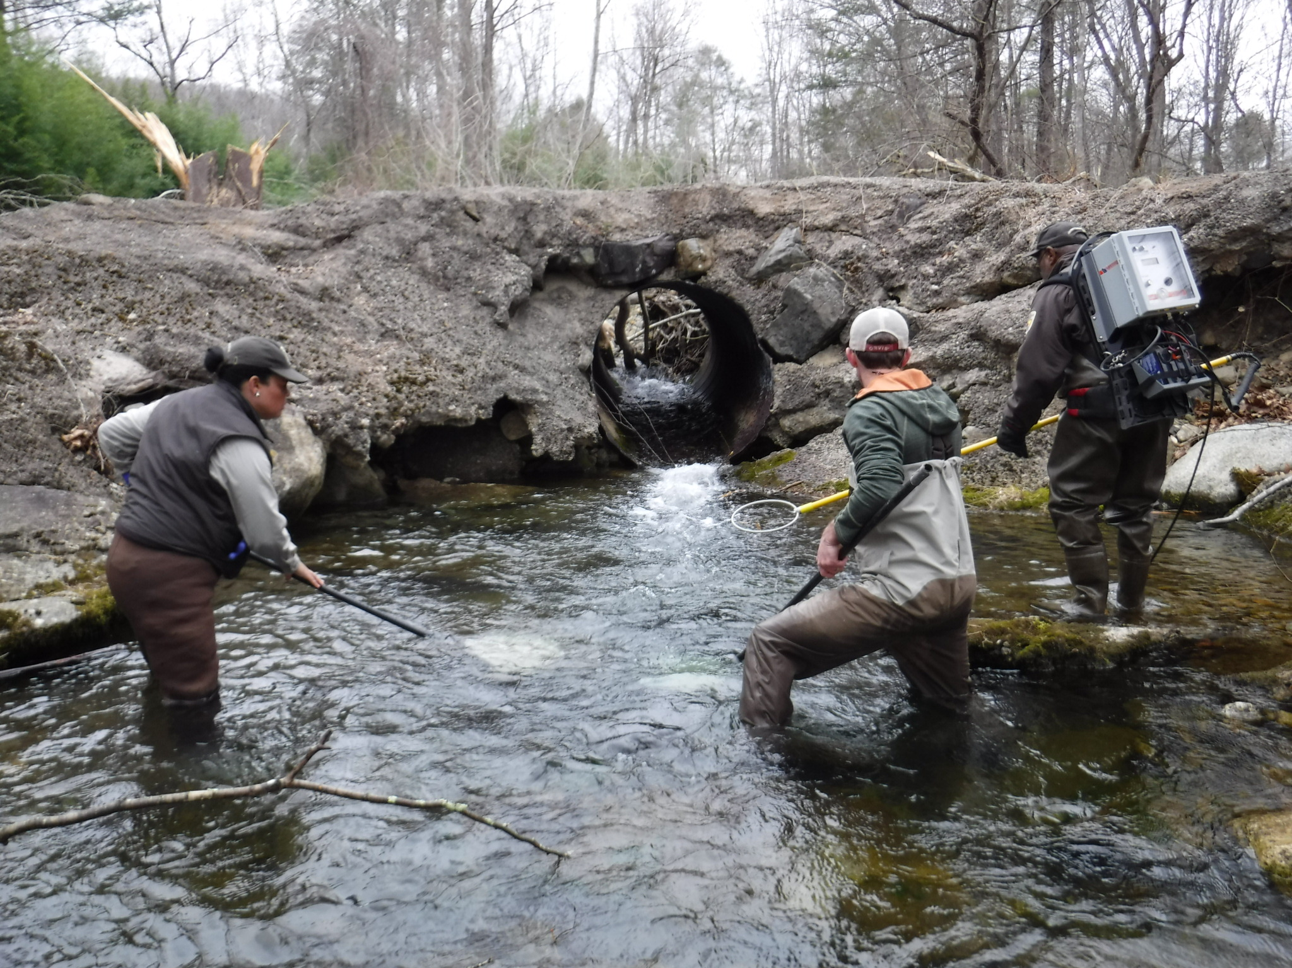

Slide 32
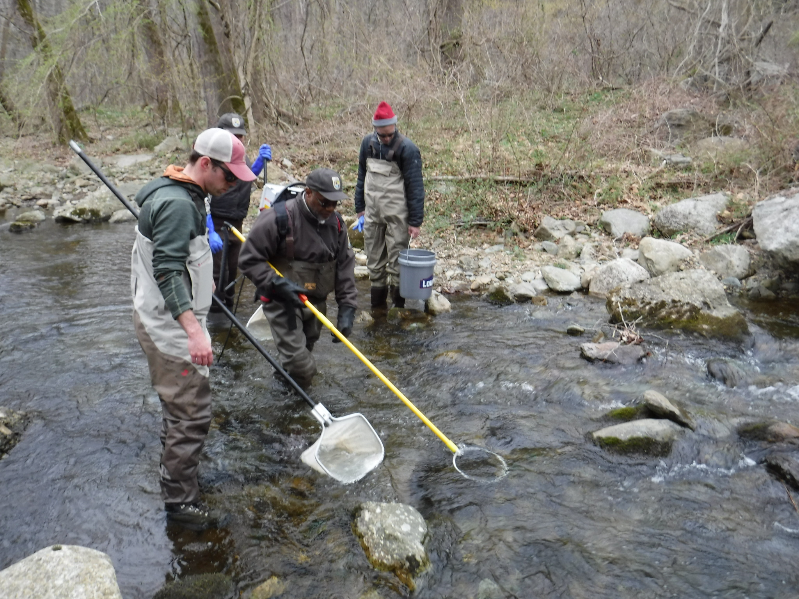

Slide 33
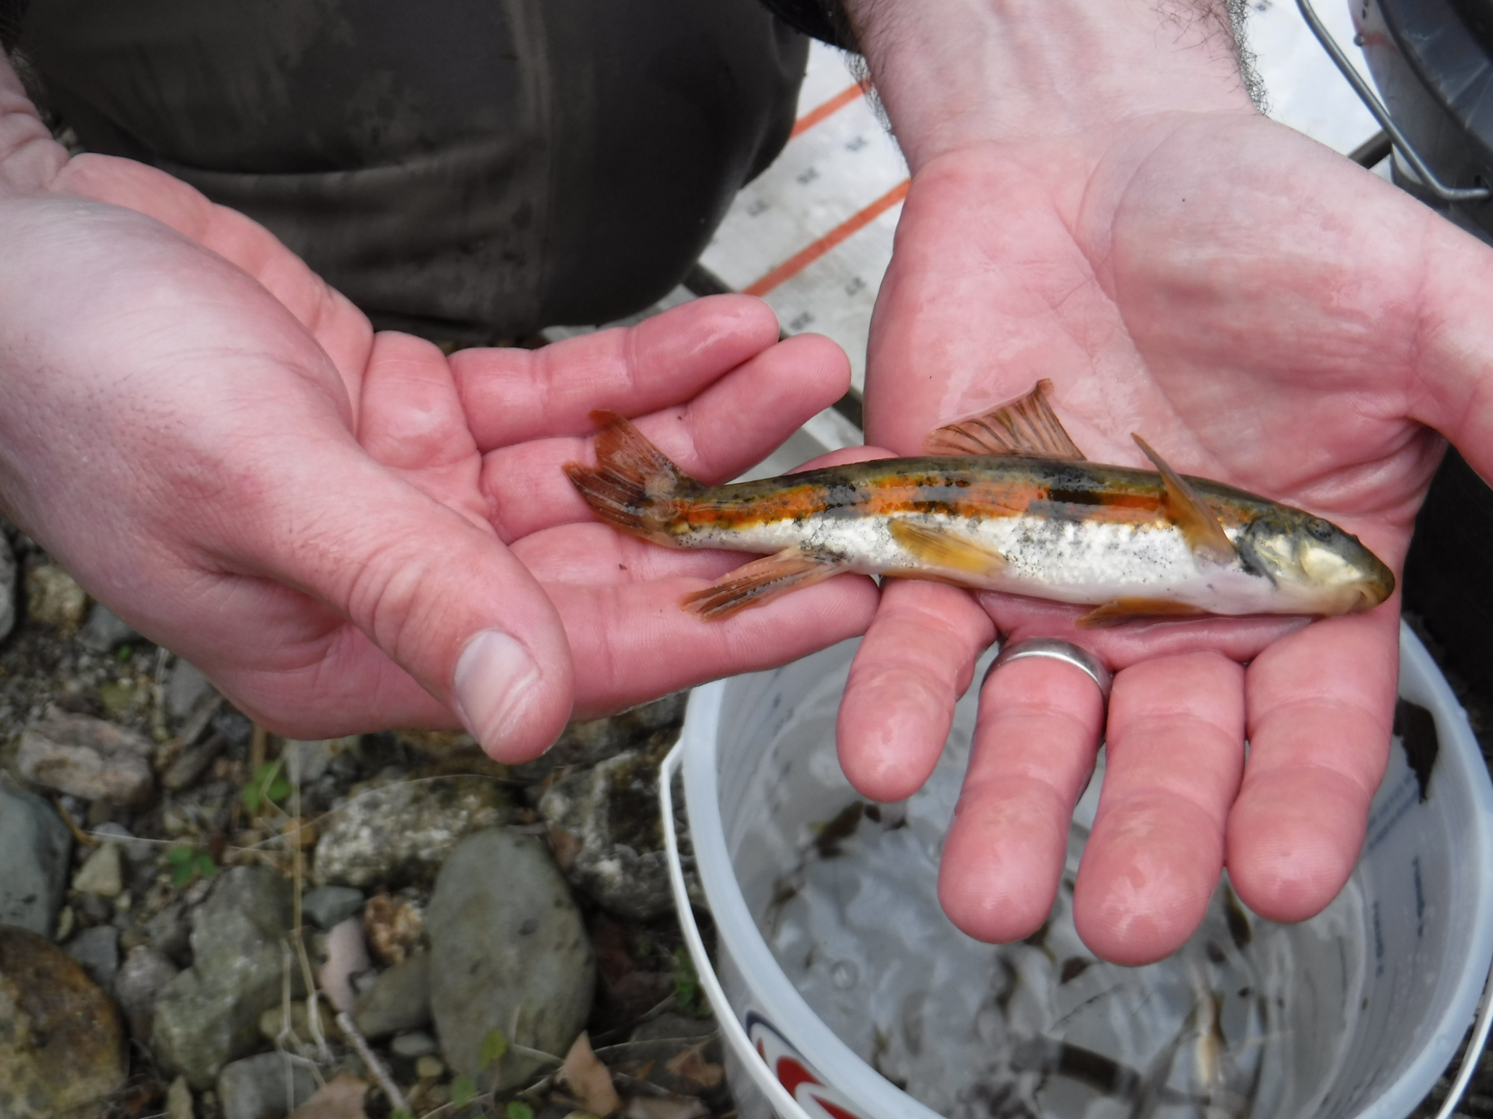

Slide 34
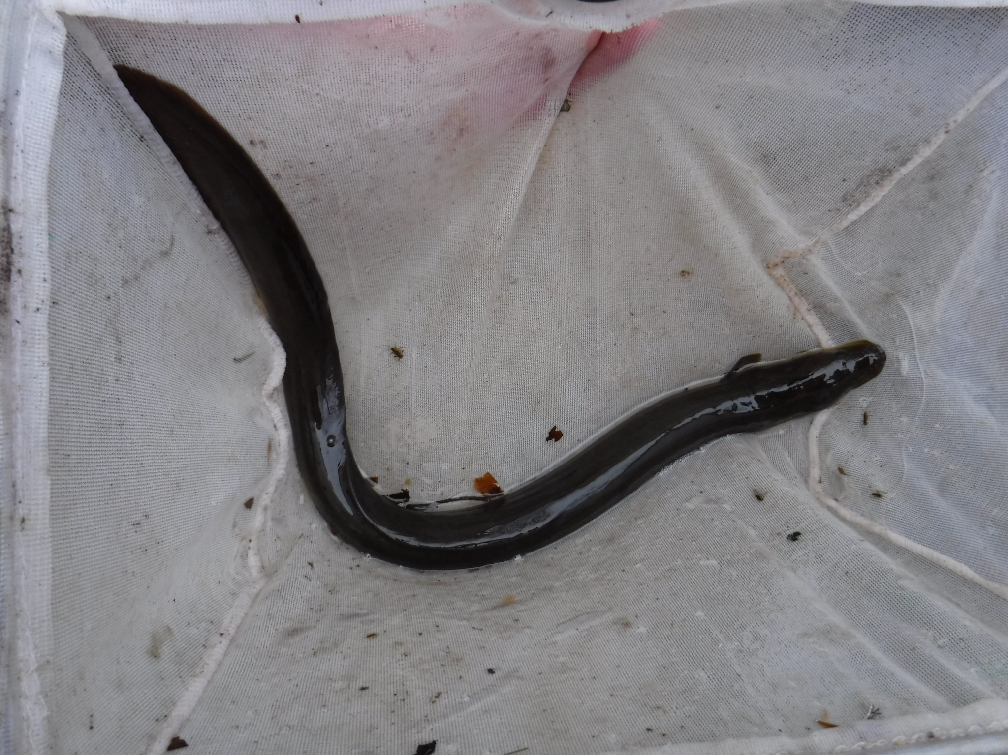

Slide 35
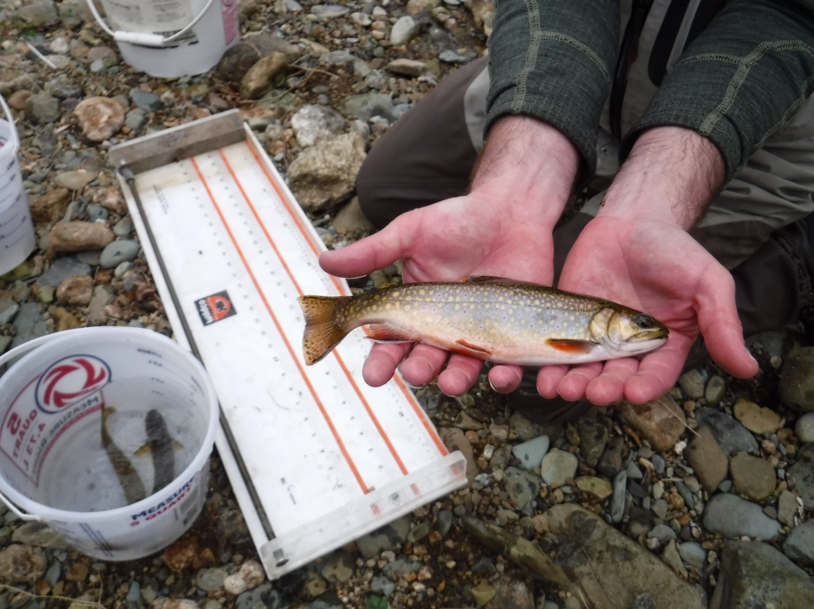

Slide 38
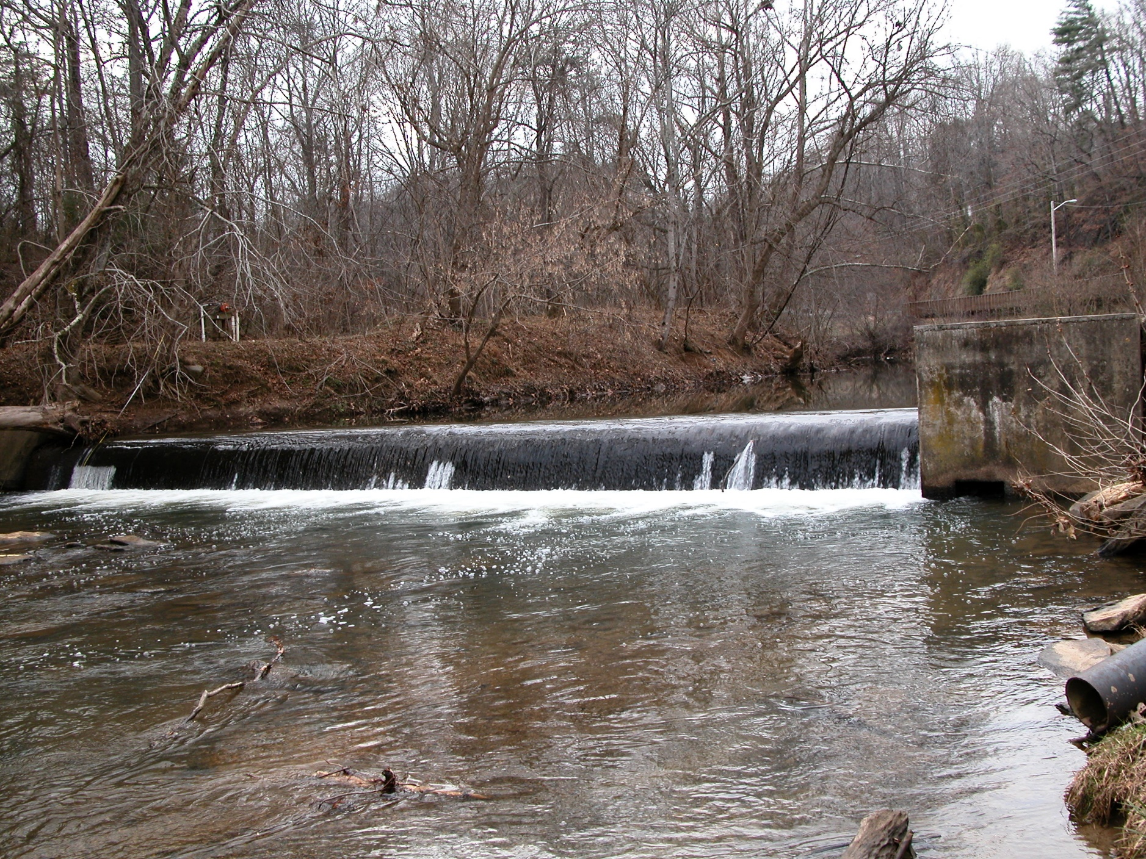

Slide 40
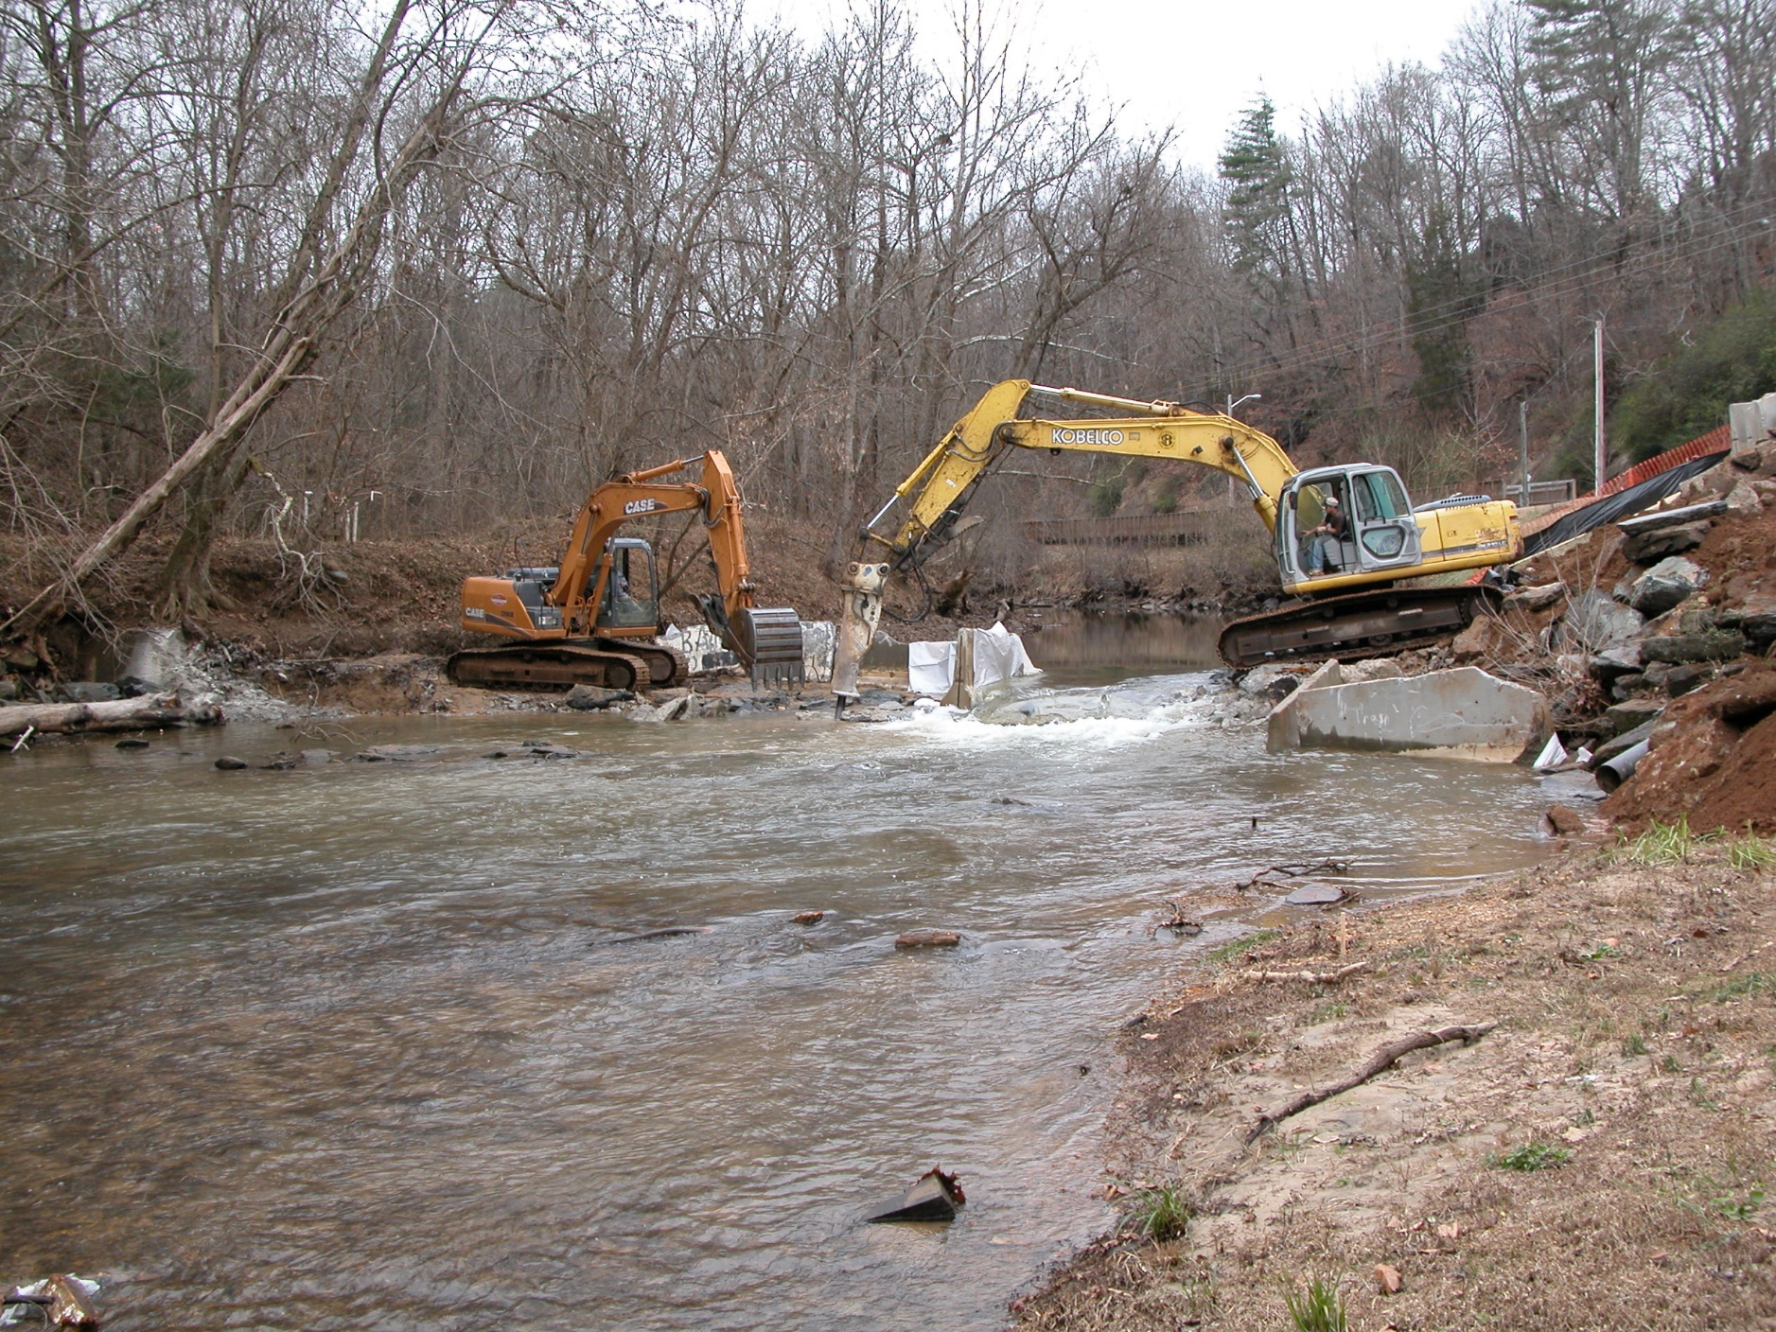

Slide 41
Appomattox River dam will be removed to help
fish, boating
BY JOEY UKROP Richmond Times-Dispatch | Posted: Saturday, July 12, 2014 12:00 am
On Tuesday, the fish migration in the Appomattox River will start moving in the right direction.
Constructed more than 150 years ago, the Harvell Dam in Petersburg is slated for demolition.
The dam, which was used for hydropower during its earliest years, has fallen into disrepair. Rather
than trying to update the Harvell, state and national groups have come together in support of the dam’s
removal.
These groups include the Virginia Department of Game and Inland Fisheries, the U.S. Fish and
Wildlife Service, the National Oceanic and Atmospheric Administration, American Rivers, the
Harvell Dam Corporation and the city of Petersburg.
Alan Weaver, the game department spokesman, said the project will help restore breeding areas for
migratory fish. This change will open 127 miles of upstream habitat for species such as the American
and Hickory shad, American eel and river herring.
After the dam had sat idle for close to six years, the Virginia Hydrogenation and Historical Society
sold it to current owner William Patton.
“When you approach a dam owner, it takes some convincing,” Weaver said. “We ended up having good
cooperation with the owner and the city of Petersburg.”
Patton said when he purchased the dam for $70,000 four years ago, his initial plan was to preserve it.
As one of more than 84,000 outdated dams across the country, the Harvell needed to be demolished,
the state ruled. But Patton remained optimistic and saw the surrounding area as a potential historic
site.
Through the aid of the Wildlife Service’s National Fish Passage Program and NOAA’s Open Rivers
Initiative, the Appomattox will be able to flow naturally once again.
Serena McClain, the American Rivers director of restoration

Slide 42
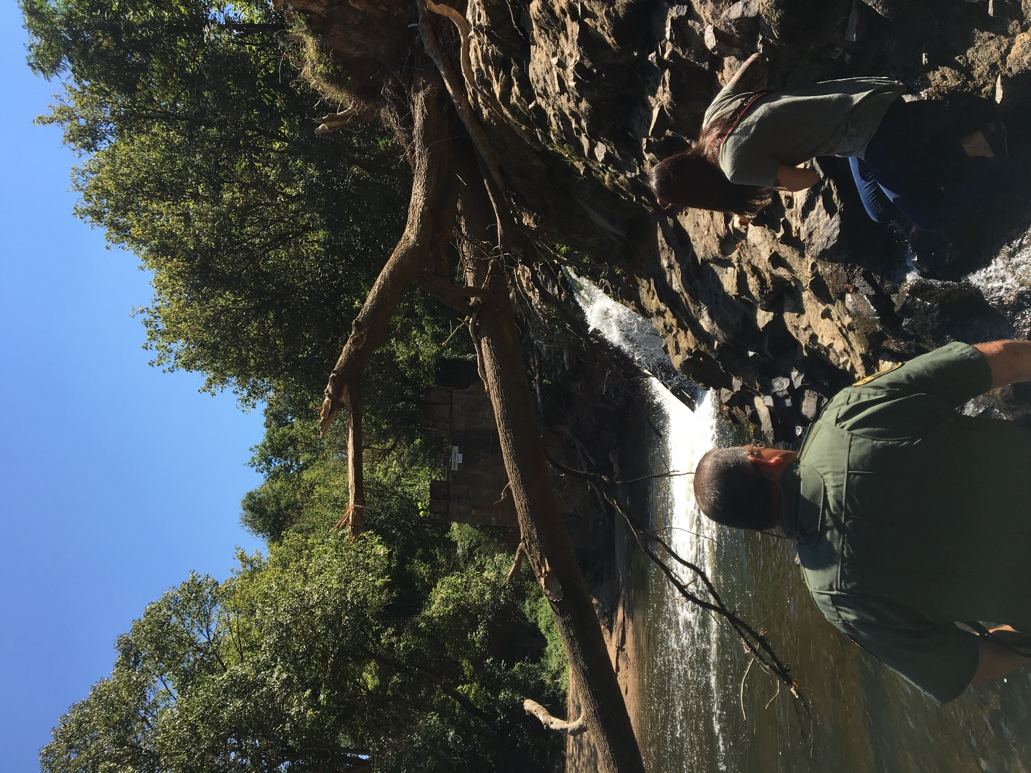

Slide 43
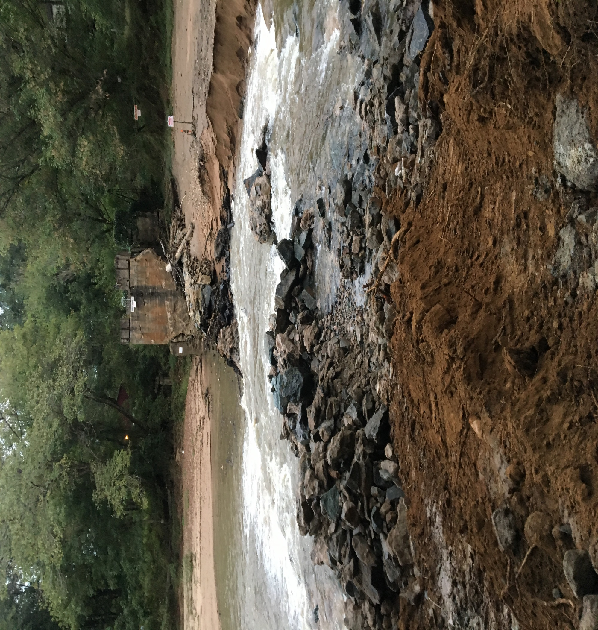

Slide 44
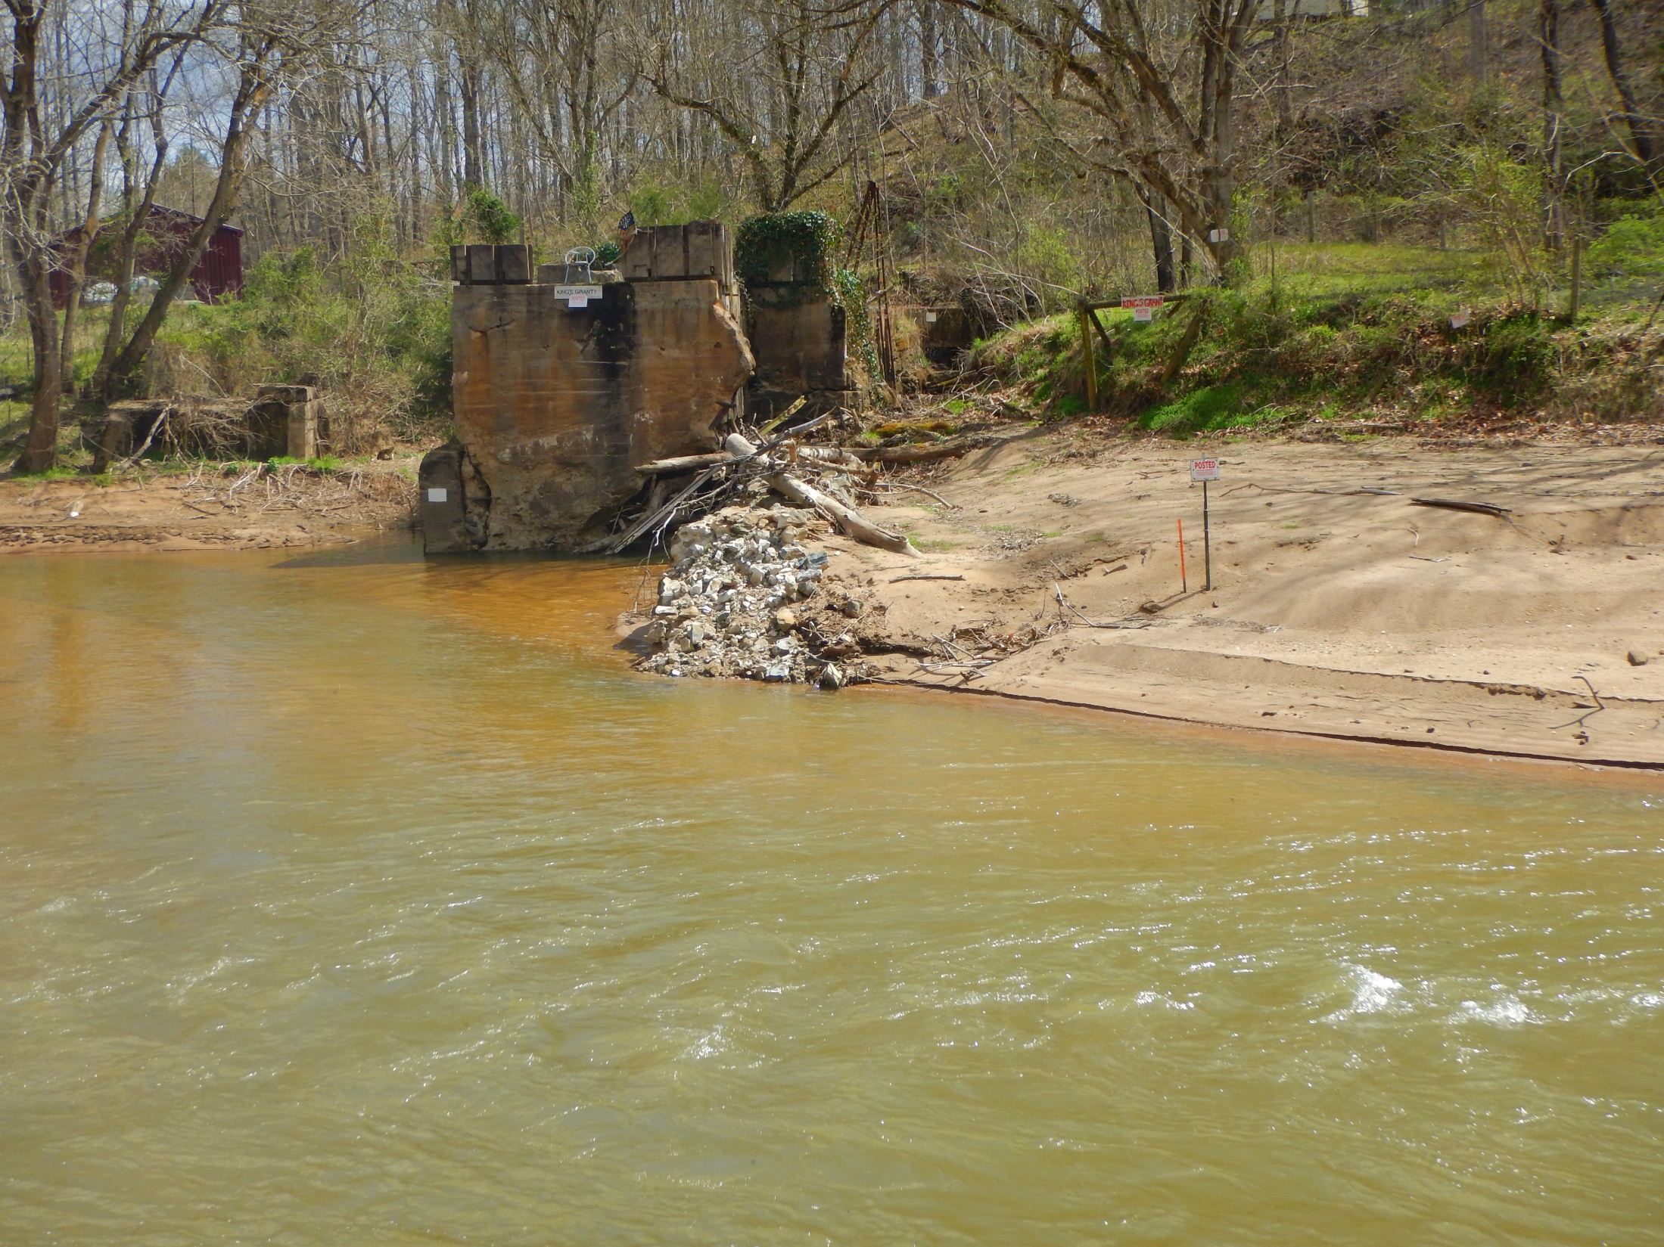

Slide 45
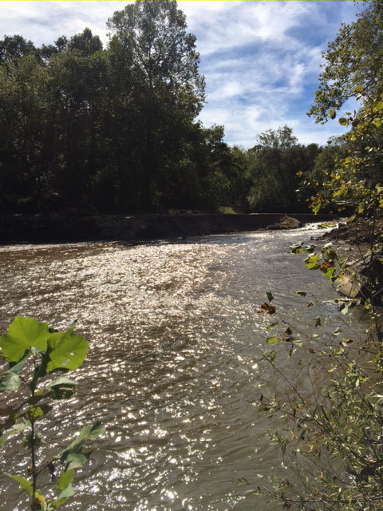

Slide 46
