Slide 1
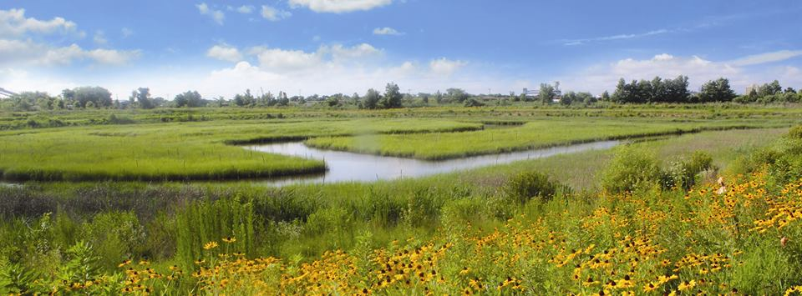
Paradise Creek Nature Park
Photo: Elizabeth River Project
James McCann Parks, Recreation, & Tourism Studies Conservation Leadership Old Dominion University

Slide 2
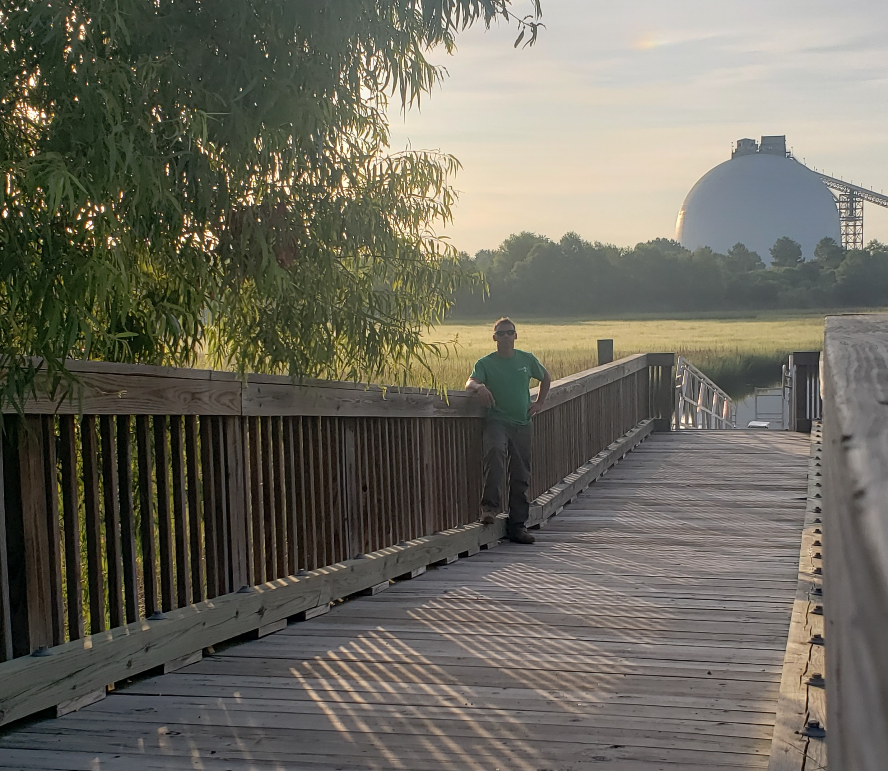
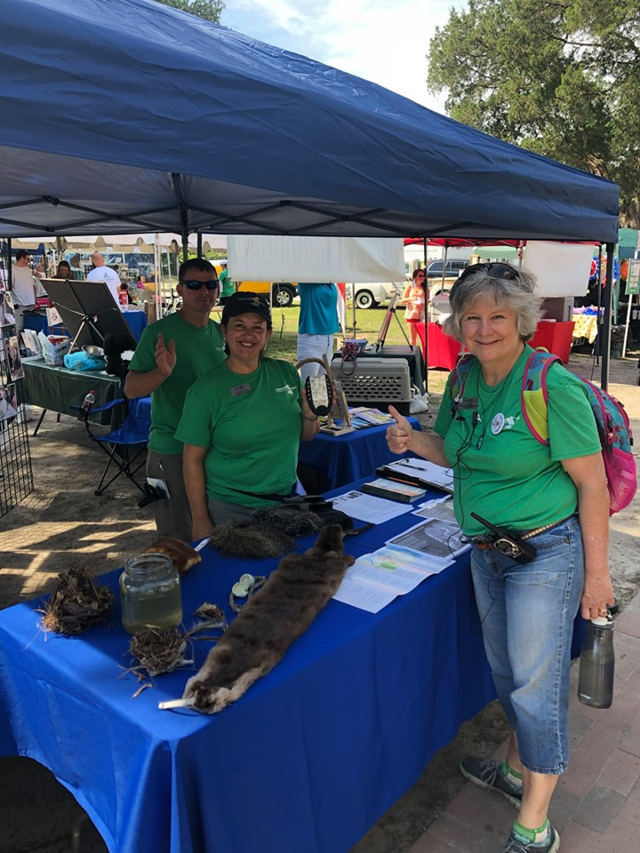
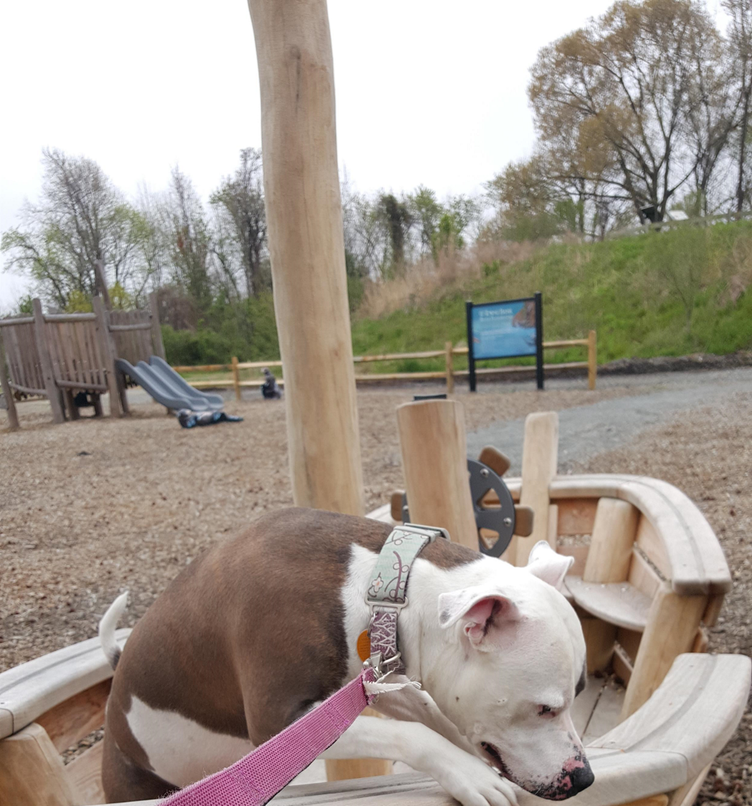
About me…
Parks, Recreation & Tourism Management Studies Major; Interdisciplinary minor in Conservation Leadership
Fun fact: I have a 1.5 y/o American bulldog named Piggly Wiggly!
My passion has always been to help educate our youth and help those in need. I aim to achieve this by working in the National Park System, with the goal of fostering youth in environmental education.
This is an overview of my internship with Paradise Creek Nature Park
Photos by James McCann
Photo: Elizabeth River Project

Slide 3
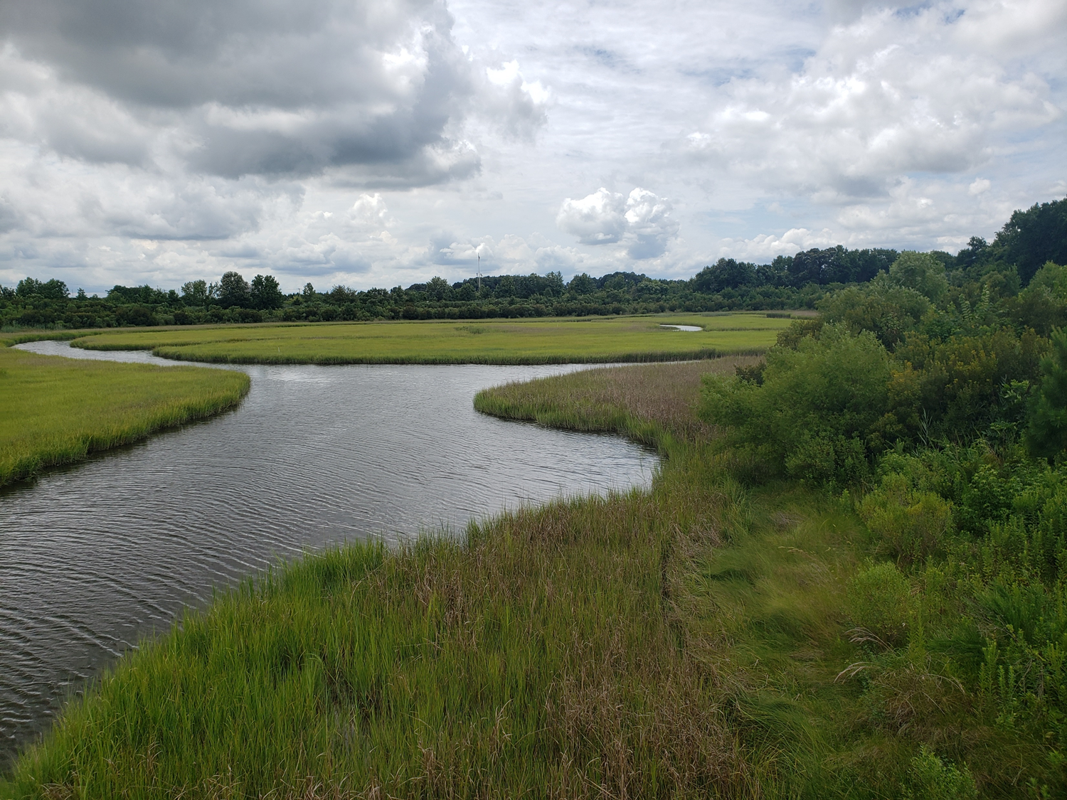
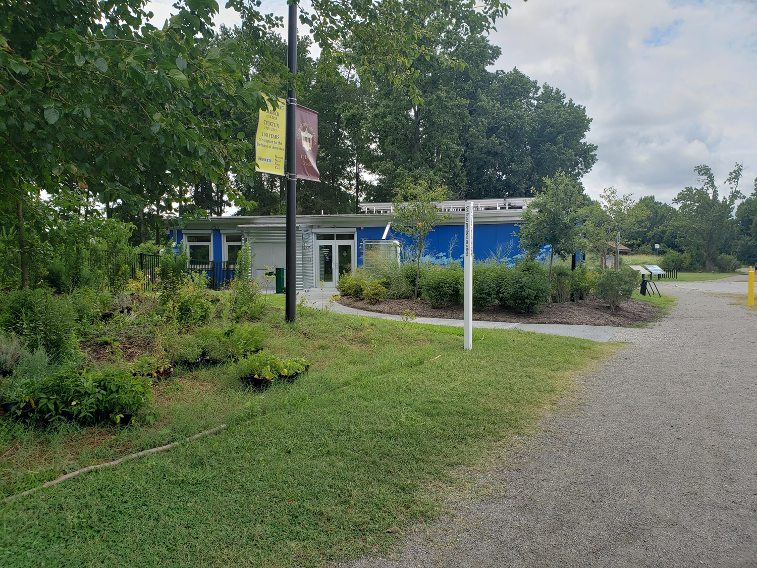
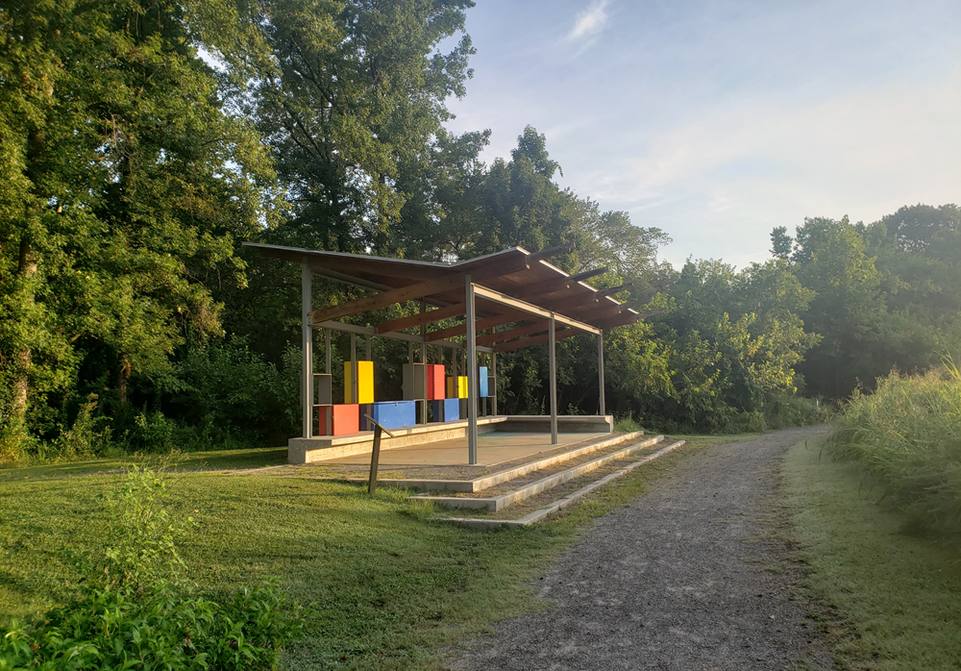
Paradise Creek Nature Park Internship
Mission
Focus on restoring 11 acres of wetlands and 29 acres of woodlands
Elizabeth River Project operates park
Restoration
Invasive Species Mitigation
Planting native species
Environmental Education
Wetlands Learning Lab
Youth Conservation Interns
Restored Wetlands
Photos by James McCann
Beazley River Academy
Wetlands Learning Lab

Slide 4
Project: Plant of the Week
Created plant guide
Discussed identification, mitigation, and cultivation of one invasive and one native species each week with Youth Conservation Interns
Created by James McCann

Slide 5
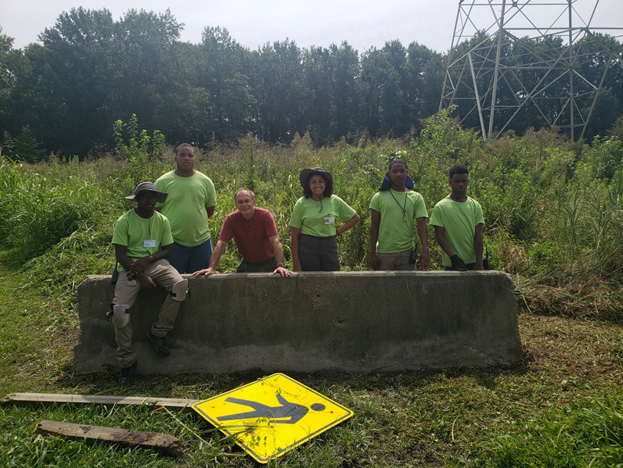
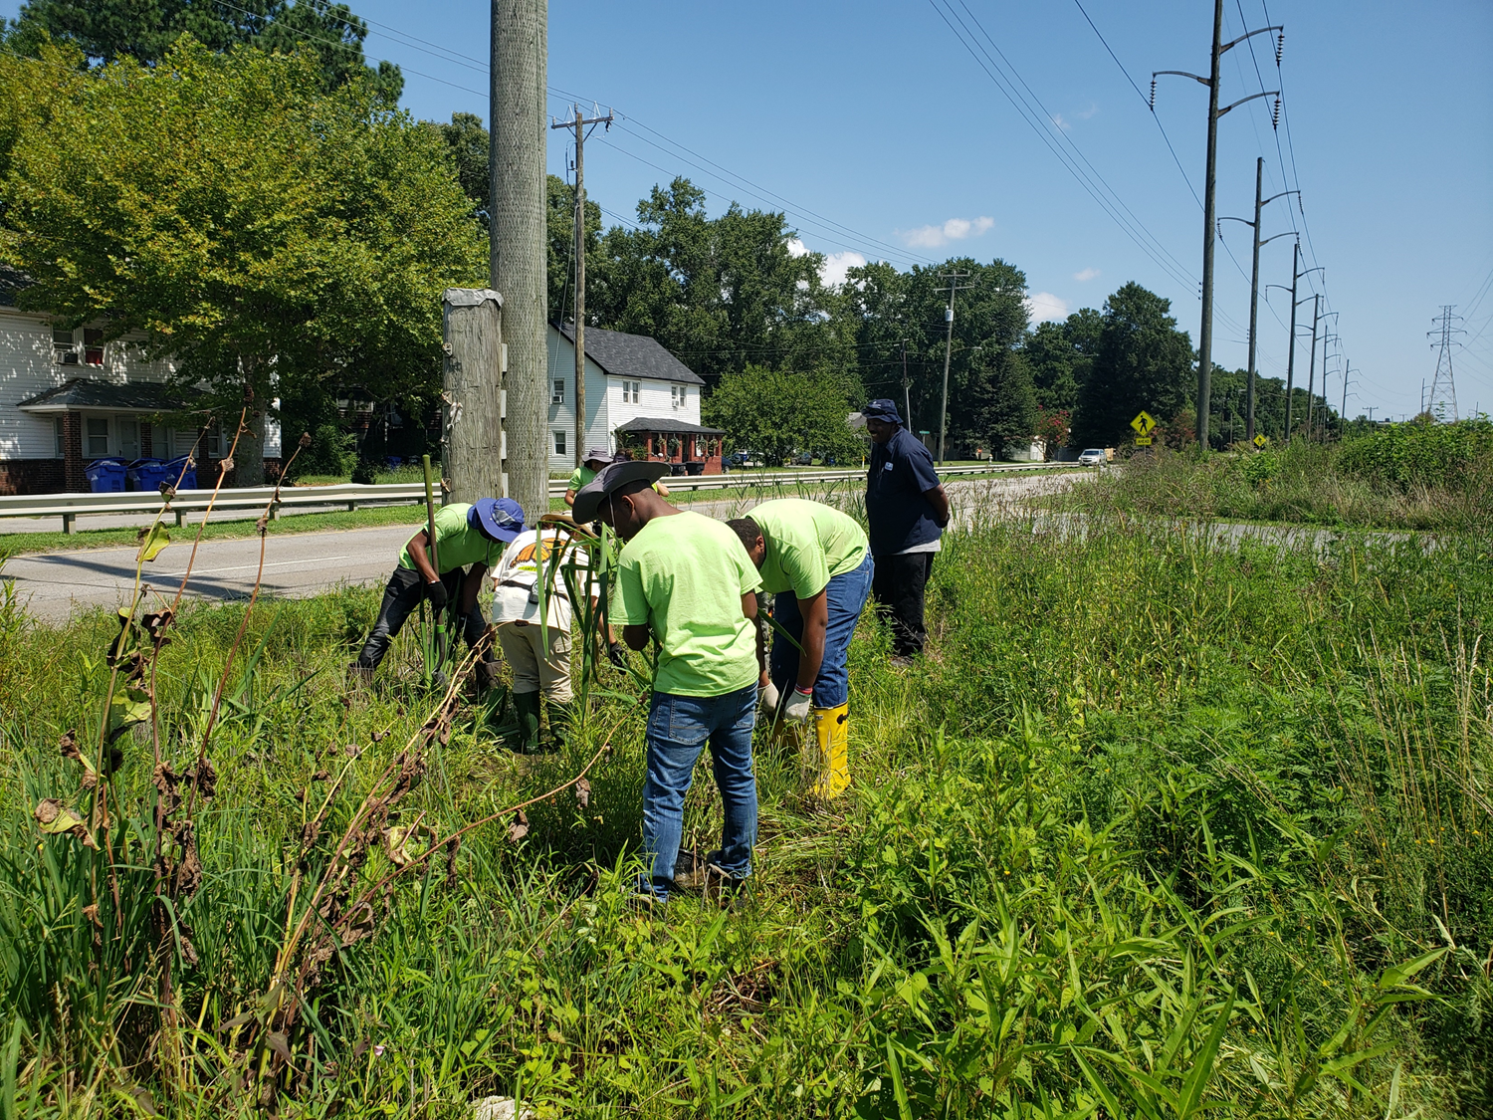
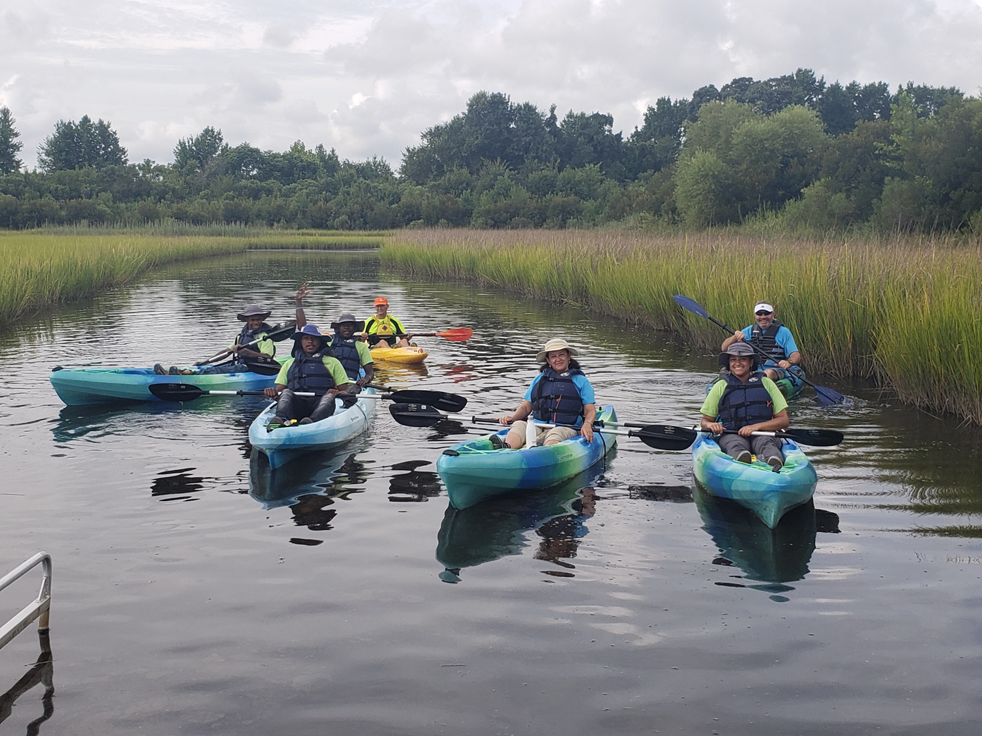
Project: Leave No Trace curriculum
Developed LNT program based on 7 principles of LNT
Taught curriculum to Youth Conservation Interns in weekly blocks
By the end, most were able to discuss principles in context of daily activities
Photos by James McCann

Slide 6
Leave No Trace 7-Week Curriculum with Youth Activities*
Wk | Topic | Definition | Goals/Outcomes | Activity
1 | Know Before You Go | Plan ahead and prepare. Know regulations. Travel in small groups. Prepare for weather and emergencies. | Define sustainability Discuss importance of not impacting ecosystems Relate this principle to daily lives | Specific is Superior. Divide into two groups. Each group is given a scenario to plan for. 5 min to brainstorm items to bring/prepare. Discuss.
2 | Choose the Right Path | Travel and camp on authorized surfaces, such as clearly marked paths and sites. Don’t alter campsites. Walk in the middle of trails. | Define impact, durable surface Discuss biodiversity, fragility Identify appropriate hiking and camping sites | Watch Your Step! Pairs get a length of string, choose a good area for hiking/camping, and place string around it. Count all living organisms inside string. Discuss fragility.
3 | Trash Your Trash | Dispose of waste properly. Pack out what you pack in, including wrappers and peels. Use cat-holes for solid waste. | Define micro-trash. Discuss water contamination Increase pro-environmental behaviors | Balancing Impacts in the Outdoors. Teeter totter, with one end representing zero impacts and the other end representing high impacts to the environment.
4 | Leave What You Find | You can touch, but leave natural objects as you found them. Do not introduce or transport non-natives. | Discuss impacts of invasive species Promote use of native species in homes and landscaping | Invasive Attack! Divide group into native and invasive species; discuss. Natives hold a rope in a circle. Invasive push through the circle, fragmenting the ecosystem.
5 | Be Careful With Fire | Minimize campfire or barbecue impacts. Use a camp stove instead of a fire. Keep fires small and use provided equipment. Put out fires completely and scatter cool ashes. | Describe mound fire technique Discuss impacts of campfires and barbecues; cleaning up after use Be aware of safe barbecuing practices | Okay Vs. No Way. Two teams, situation cards. Each team decides whether situation is good or bad, runs to safety zone. Tagged players join other team. Discuss each card.
6 | Respect Wildlife | Observe from a distance. Do not follow or approach wildlife. Obey posted signs concerning wildlife. Store rations and trash securely. | Discuss why it is important to respect wildlife Discuss common wildlife and their habits Understand wildlife behaviors | Impacts and Wildlife. Each participant plays a native wild animal. The “it” person is assigned a harmful behavior and tries to tag the “animals”.
7 | Be Kind to Other Visitors | Respect other campers. Take breaks on durable surfaces away from trail. Keep noise down. | Discuss effects of impacting others’ experiences of nature (eg discourage visiting/ caring for ecosystems) Exhibit respectful behaviors | Close Encounters of the Unkind. Take a short hike with one group. Another group plays unkind visitors. Discuss behaviors.
* Adapted from Leave No Trace Center for Outdoor Ethics

Slide 7
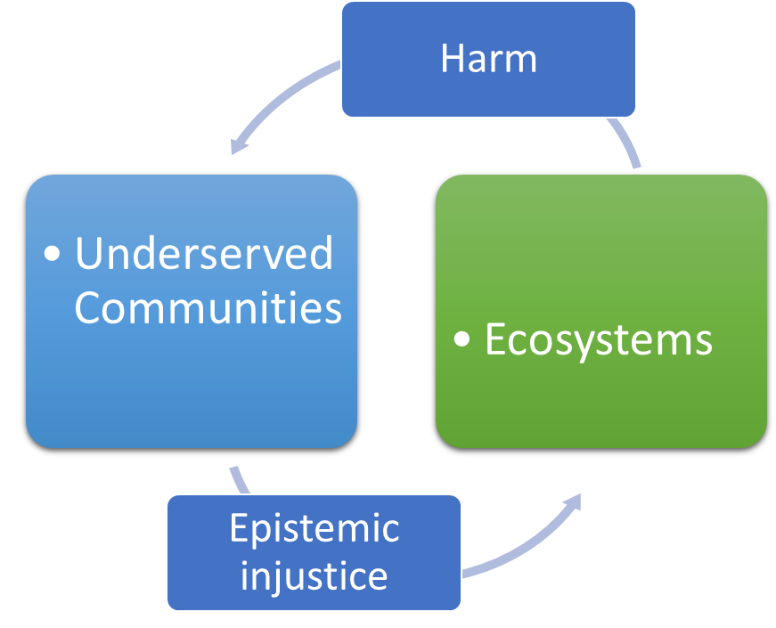
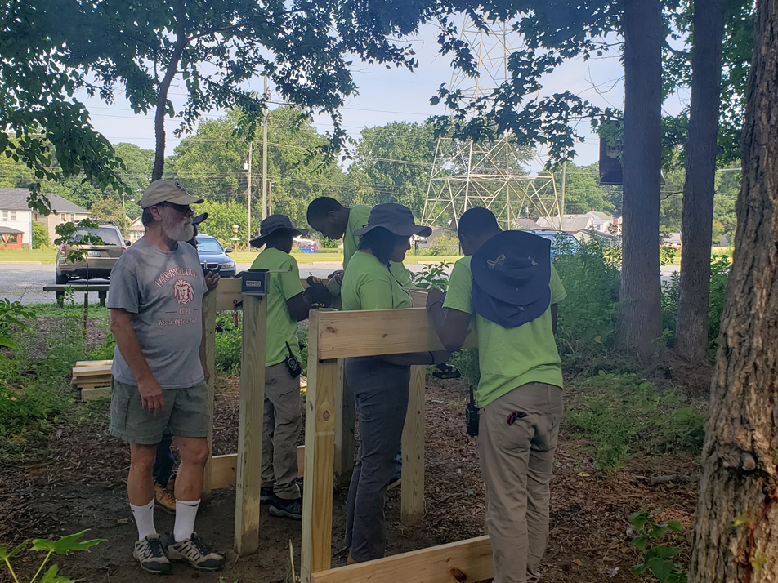
Case Study: Overcoming epistemic injustice and providing environmental literacy to underserved youth
Hazards
Economic resources, local/state support, accountability, political/social priorities (attitudes)
Foresight
Worst case scenario: Increased focus on jobs/wealth at cost of environmental education (EE) leading to relaxed environmental policies
Current trajectory: Inconsistent/inadequate EE, mostly available to high-income school districts, leading to negative feedback loop in low-income communities
Best case scenario: Equal, high quality EE across income levels leads to a society concerned with the well-being of the environment
Photo and conceptual model by James McCann

Slide 8
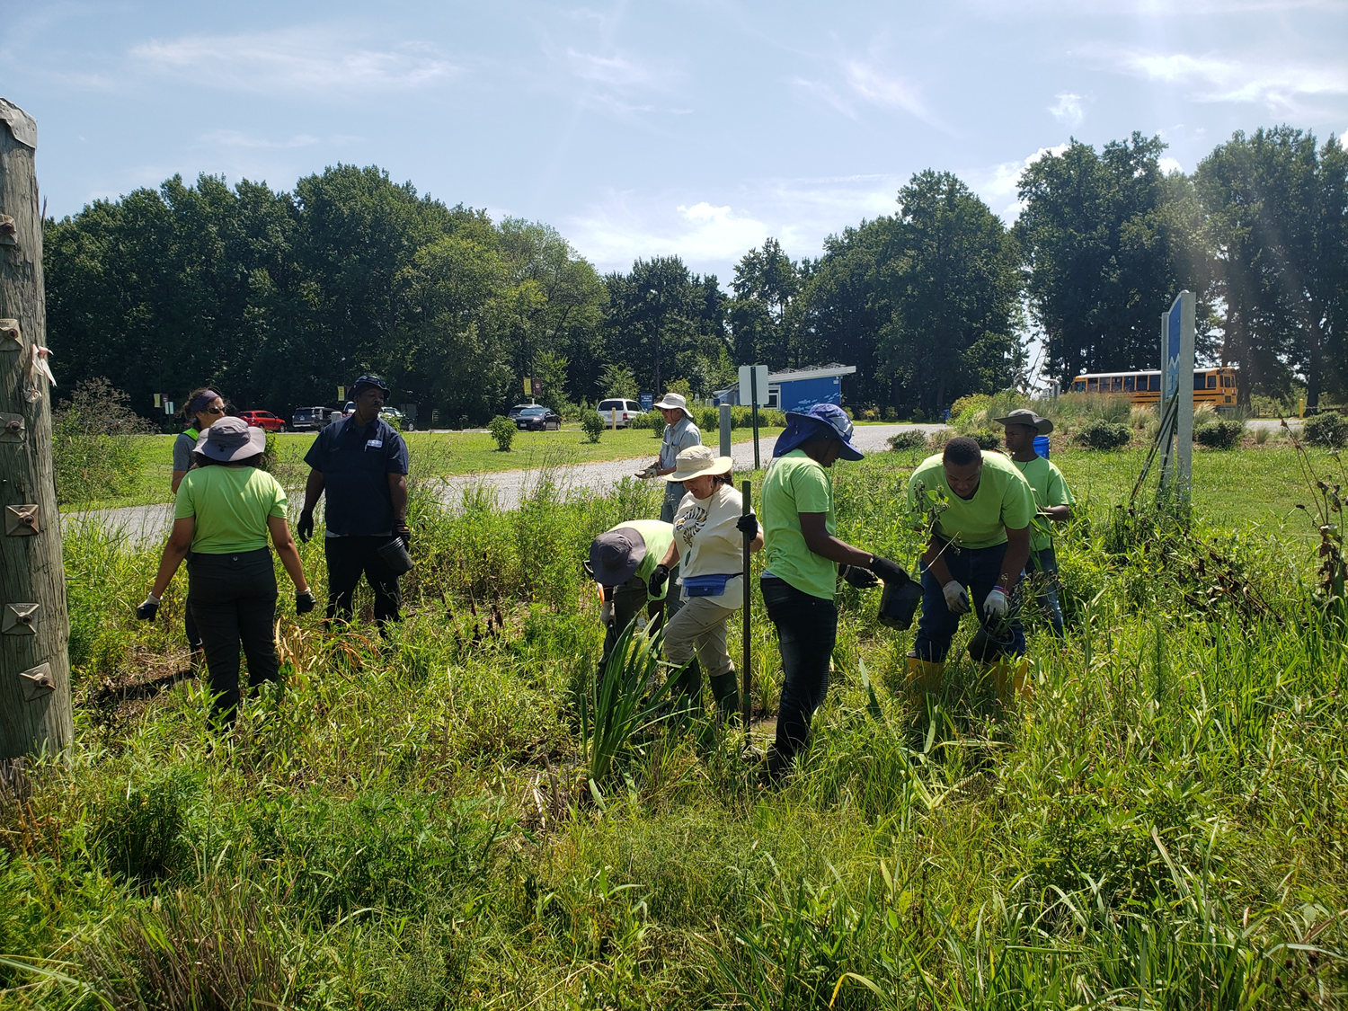
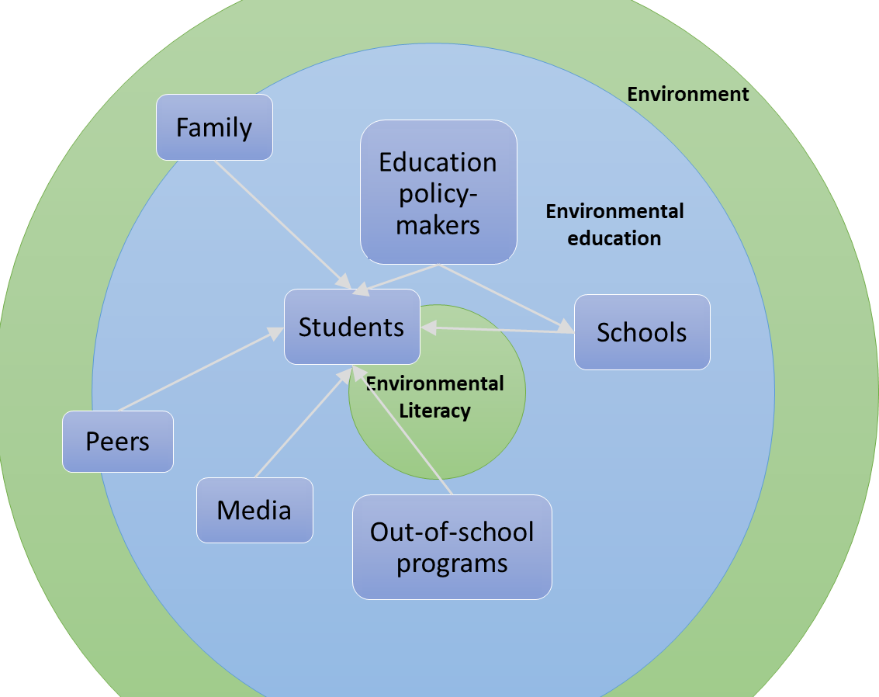
Recommendations
Legislative
Appropriate funds, mandate EE curriculum
Educational framework
Mandate school reporting of EE curriculum
State-level oversight
Local Schools
Engage with local university (i.e. ODU) to study effectiveness of EE programs
Partner with local groups such as PCNP, Lynnhaven River NOW, Chesapeake Bay Society to offer EE programs to students
Photos by James McCann

Slide 9
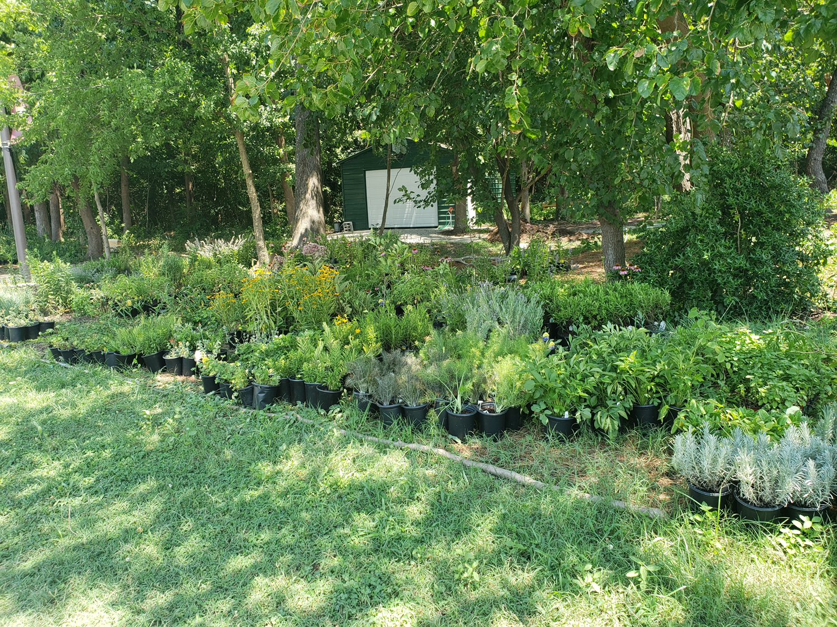
Challenges, highlights, next steps
Challenges
Unresponsive case study stakeholders (schools)
Lack of existing research on topics
Conducting a case study on a different (more theory-based) type of problem
Invasive species control with limited staff and resources
Highlights
Working with youths was extremely rewarding
Introducing visitors, volunteers to conservation issues
Teaching Leave No Trace improved my skills
Next steps
Continuing to assist at PCNP occasionally
Monitoring air quality on the Elizabeth River Trail
Photos by James McCann

Slide 10
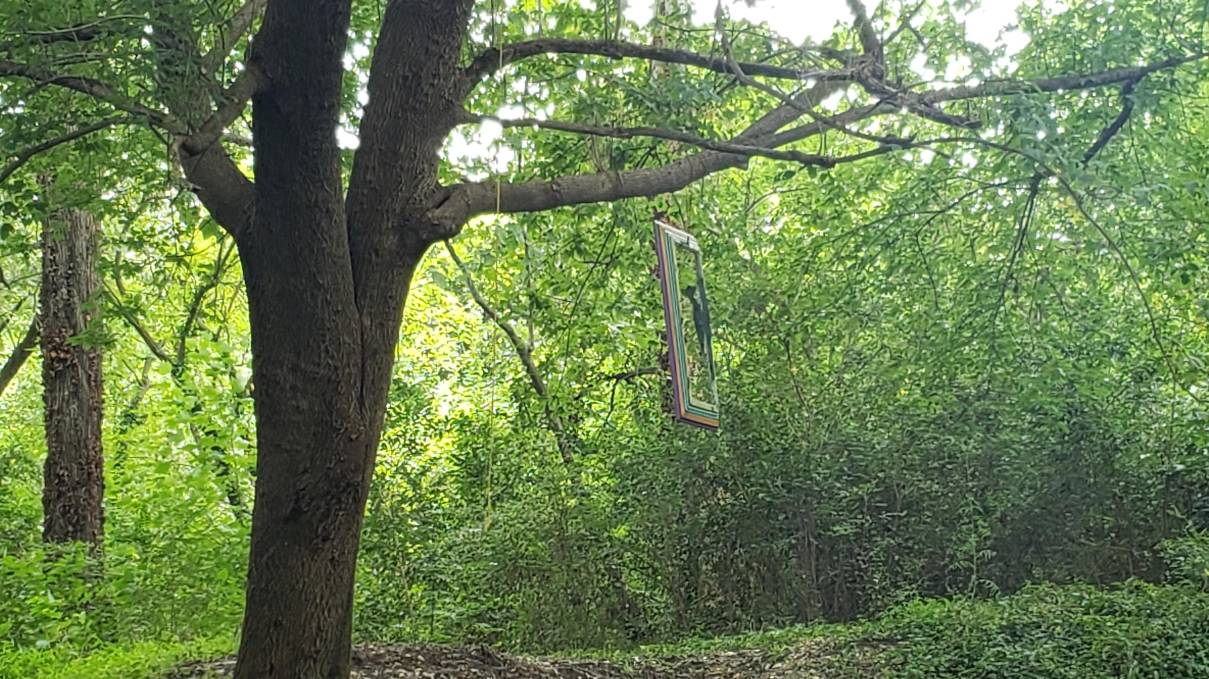
Thank you: Elizabeth River Project Old Dominion University Paradise Creek Nature Park U.S. Fish & Wildlife Service
Special thanks: Dr. Hans-Peter Plag Dr. Eddie Hill Ms. Yolima Carr Mr. Larry Lapell
James McCann
Old Dominion University
Parks, Recreation & Tourism Studies
Conservation Leadership
jmcca018@odu.edu

