Slide 1
Anticipating the Future of the Blackbanded Sunfish
Christianna Morton
Bachelor’s Student in Marine Biology

Slide 2
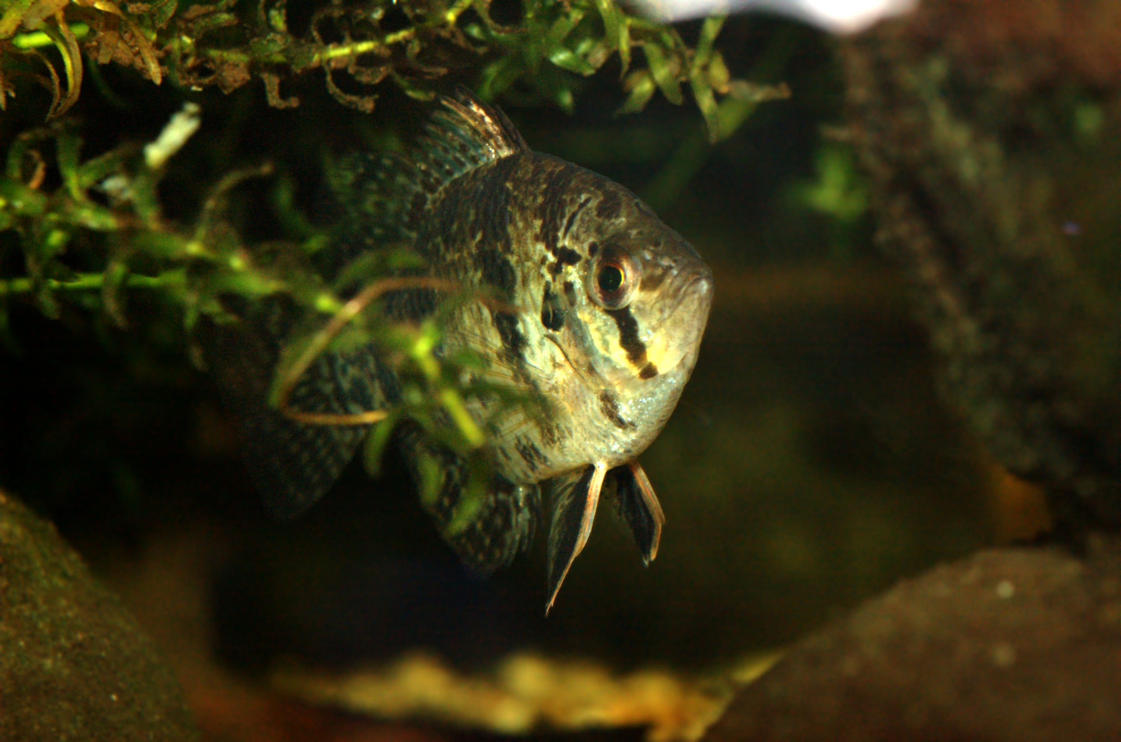
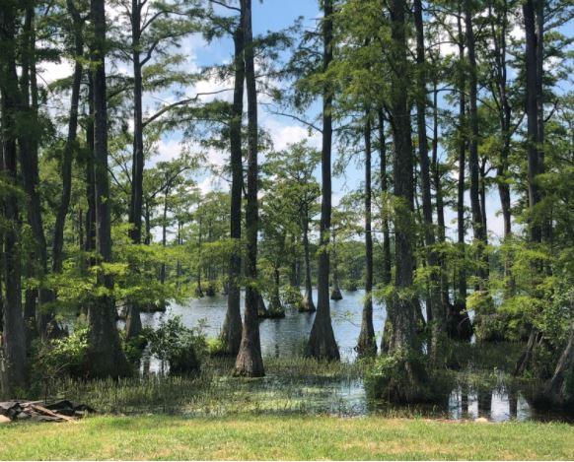
Introduction
Internship with the Department of Wildlife Resources
Intern during summer of 2020, July-August
Assisted with department projects and created a case study
The Blackbanded Sunfish
Freshwater Sunfish Species
Found in humic lakes and ponds on the East Coast of the U.S.
Endangered or threatened in many states, including Virginia

Slide 3
The Challenge
Changes to weather patterns and and the environment as a result of climate change threaten Blackbanded Sunfish populations and habitats
Interventions that mitigate these impacts are key to preventing extirpation.

Slide 4
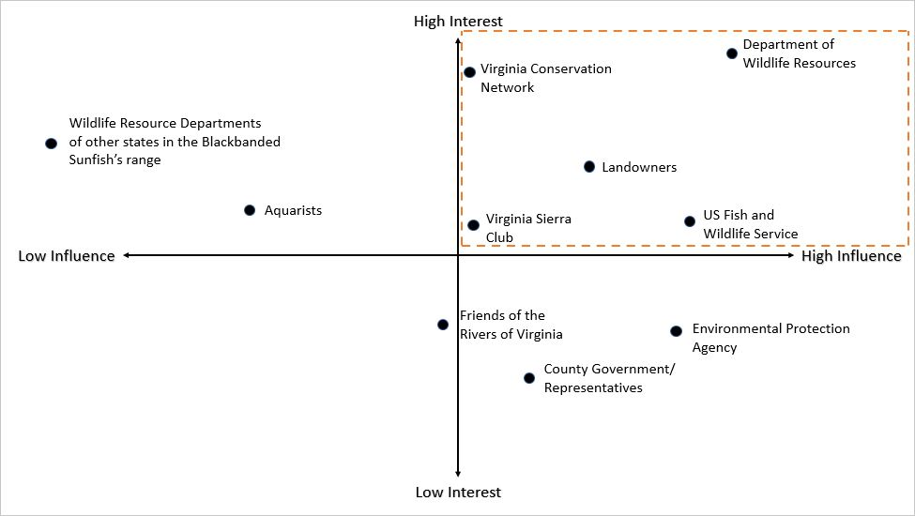
The Decision Making Space
Stakeholders: evaluated based on relative interest and influence.
Box at the top right of the diagram displays the key stakeholders.

Slide 5
Participatory Modeling and Goal Statement
The potential concerns and perspectives of the key stakeholders were researched and evaluated.
Goal Statement:
Encourage stability and resilience in Virginia Blackbanded Sunfish populations and their habitats under future conditions influenced by climate change, while taking into account the needs of local community members.

Slide 6
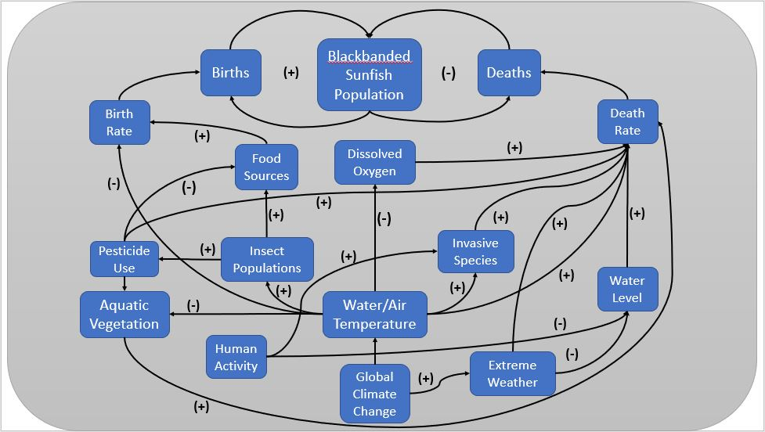
Conceptual Model for the Wicked Problem

Slide 7
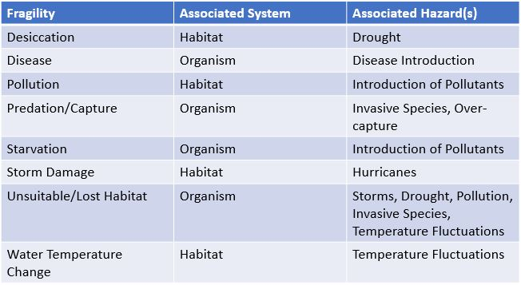
Fragilities
Fragility: Inherent property of an agent or system that can lead to damage from a hazardous event.

Slide 8
Hazards
Hazard: An event that exploits an agent or system’s inherent fragilities, and causes harm.
Hazards that can impact the Blackbanded Sunfish and its habitat include:
Hurricanes
Drought
Introduction of Pollutants
Overfishing
Invasive Species
Disease Introduction
Temperature Fluctuations

Slide 9
Foresight
What might the future of the species in Virginia look like in scenarios of:
Increasing water temperature
Reduced birth rates, reduced dissolved oxygen
Increasing hurricane strength and frequency
Water loss due to destroyed dams
Increasing disease
Loss of populations
Increasing pesticide pollution
Destruction of habitats
Invasive species
Increased predation and competition

Slide 10
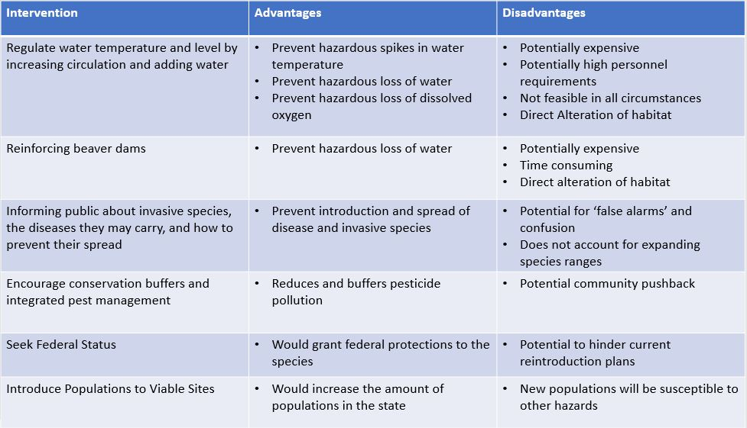
Interventions

Slide 11
Discussion
The Blackbanded Sunfish has declined in VA in part due to pesticide pollution.
This and other hazards are likely to increase due to climate change, and threaten the Blackbanded Sunfish and their habitat.
Interventions are key to ensuring a desirable future.
Some interventions are more feasible and beneficial than others.

Slide 12
Recommendations
Develop an emergency plan
Plans for response to hazardous events such as drought or storms.
Develop reintroduction plans
Develop plans for reintroducing populations under different future scenarios.
Partner with local NGOs
Partner with NGOs for raising awareness and enacting other interventions.
Consider seeking a federal status
A federally threatened status could give the species additional protection.

Slide 13
References
Adrian, R., O’Reilly, C.M., Zagarese, H., Baines, S.B., Hessen, D.O., Keller, W., Livingstone, D.M., Sommaruga, R., Straile, D., Donk, E.V., Weyhenmeyer, G.A., and Winder, M. 2010. Lakes as sentinels of climate change. Limnology and Oceanography, 54, 2283-2297.
Boyd, C. E. 2011. Dissolved Oxygen Requirements in Aquatic Animal Respiration. Https://www.aquaculturealliance.org/advocate/dissolved-oxygen-requirements-in-aquatic-animal-respiration/
Burkett, V., and Kusler, J. 2007. Climate Change: Potential Impacts and Interactions in Wetlands of the United States. Journal of the American Water Resources Association, 36.
Castro, J., Pollock, M., Jordan, C., Lewallen, G., and Woodruff, K. 2015. The Beaver Restoration Guidebook: Working with Beaver to Restore Streams, Wetlands, and Floodplains. United States Fish and Wildlife Service.
Climate Central. 2020. States at Risk: Virginia.
Https://statesatrisk.org/virginia/all
Cochran‐Biederman, J. L., Wyman, K. E., French, W. E., Loppnow, G. L. 2014. Identifying correlates of success and failure of native freshwater fish reintroductions. Conservation Biology, 29, 175-186.

Slide 14
Delcour, I., Spanoghe, P., and Uyttendaele, M. 2015. Literature Review: Impact of Climate Change on Pesticide Use. Food Research International, 68, 7-15.
DWR. 2020. Blackbanded Sunfish Conservation Plan. Virginia Department of Wildlife Resources, Aquatic Wildlife Resources Division. Richmond, VA. 22 pp.
Emanuel, K. 2011. Global Warming Effects on U.S. Hurricane Damage. American Meteorological Society, 3, 261-268.
EPA, 2016. What Climate Change Means for Virginia. Https://19january2017snapshot.epa.gov/sites/production/files/2016-09/documents/climate-change-va.pdf
Freeman, B., Vives, S., and Albanese, B. 2019. Enneacanthus chaetodon. Https://georgiabiodiversity.a2hosted.com/natels/profile?es_id=16264
Gardner, R. 2020. How to Prevent Water Contamination. Https://pesticidestewardship.org.water.prevent-contamination/
Gunn, J.M., Snucins, E., Yan, N.D., and Arts, M.T. 2001. Use of Water Clarity to Monitor the Effects of Climate Change and Other Stressors on Oligotrophic Lakes. Environmental Monitoring and Assessment, 67, 69-88.
Harrod, C. 2015. Climate Change and Freshwater Fisheries. In Craig, J.F.: Freshwater Fisheries Ecology. John Wiley & Sons, Ltd. DOI: 10.1002/9781118394380
Hayhoe, K., and Swain, S. 2014. Virginia Climate Fever. University of Virginia Press.
International Union for Conservation of Nature. 2020. Invasive Alien Species and Climate Change.
Https://www.iucn.org/resources/issues-briefs/invasive-alien-species-and-climate-change

Slide 15
Kane, A., T.C. Burkett, S. Kloper, and J. Sewall. 2013. Virginia’s Climate Modeling and Species Vulnerability Assessment: How Climate Data Can Inform Management and Conservation. National Wildlife Federation.
Karvonen, A., Rintamaki, P., Jokela, J., Valtonen, E.T. 2010. Increasing Water Temperature and Disease Risk in Aquatic Systems: Climate Change Increases the Risk of Some, but not all, diseases. Int J Parasitol. 40(13): 1483-1488.
Kilian, J.V., Stranko, S.A., Raesly, R.L., Becker, A.J., and Ciccotto, P. 2009. Enneacanthus chaetodon (Blackbanded Sunfish): an imperiled element of Maryland’s coastal plain icthyofauna. Southeastern Naturalist, 8, 267-276.
May, N. 2016. Blackbanded Sunfish (Enneacanthus caetodon). NatureServe.
Mayes, M.A., 1973. Monogenetic Trematodes from the Bluespot Sunfish Enneacanthus gloriosus (Holbrook) in North Carolina. Trans Am Microsc Soc, 92, 280-284.
Mitchell, A., Overstreet, R., Goodwin, A., and Brandt, T. 2005. Spread of an Exotic Fish-Gill Trematode: A Far-Reaching and Complex Problem. 30.
National Park Service. 2020. Invasive and Non-native Species: Prevention.
Https://www.nps.gov/subjects/invasive/prevention.html
Palmer, M.A., Liermann, C.A.R., Nilsson, C., Florke, M., Alcamo, J., Lake, S.P., and Bond, N. 2008. Climate change and the world’s river basins: anticipating management options. Frontiers in Ecology and Environment, 6.
Poulin, R. 2006. Global warming and temperature-mediated increases in cercarial emergence in Trematodes parasites. Parasitology, 132, 143-151.
Rittel, H. W. J., Webber, M. W., 1973. Dilemmas in a General Theory of Planning. Policy Sciences, Volume 4, pages 155-169.

Slide 16
Schwartz, F.J. 1961. Food, age, growth, and morphology of the Blackbanded Sunfish, Enneacanthus chaetodon, in Smithville Pond, Maryland. Chesapeake Science, 2, 82-88.
Sternburg, J.G. 1986. Spawning the Blackbanded Sunfish. North American Native Fishes Association.
Texas Cooperative Extension. 2004. Avoiding a Fish Fry: Hazards of Warm Water in Your Pond.
Https://Aggie-horticulture.tamu.edu/newsletters.hortupdate/hortuprdate_archives/2004/FishFry.html
United States Fish and Wildlife Service. 2020. Listing and Critical Habitat: Overview.
Https://www.fws.gov/endangered/what-we-do/listing-overview.html
United States Geological Survey. 2020. Dissolved Oxygen and Water. Https://www.usgs.gov/special-topic/water-science-school/science/dissolved-oxygen-and-water
University of Georgia, 2014. Managing Fish Ponds During Drought. Https://extension.uga.edu/publications/detail.html?number=SB49&title=Managing%20Fish%20Ponds%20During%20Drought#AerationandPondOxygen
Wuebbles, D. J., et al. 2017. Climate Science Special Report: Fourth National Climate Assessment. U.S. Global Change Res. 1.

