Slide 1
Climate Change Affect on Living Shoreline and Oyster Restorations
By: Rocco Boyd and Alivia Markham

Slide 2
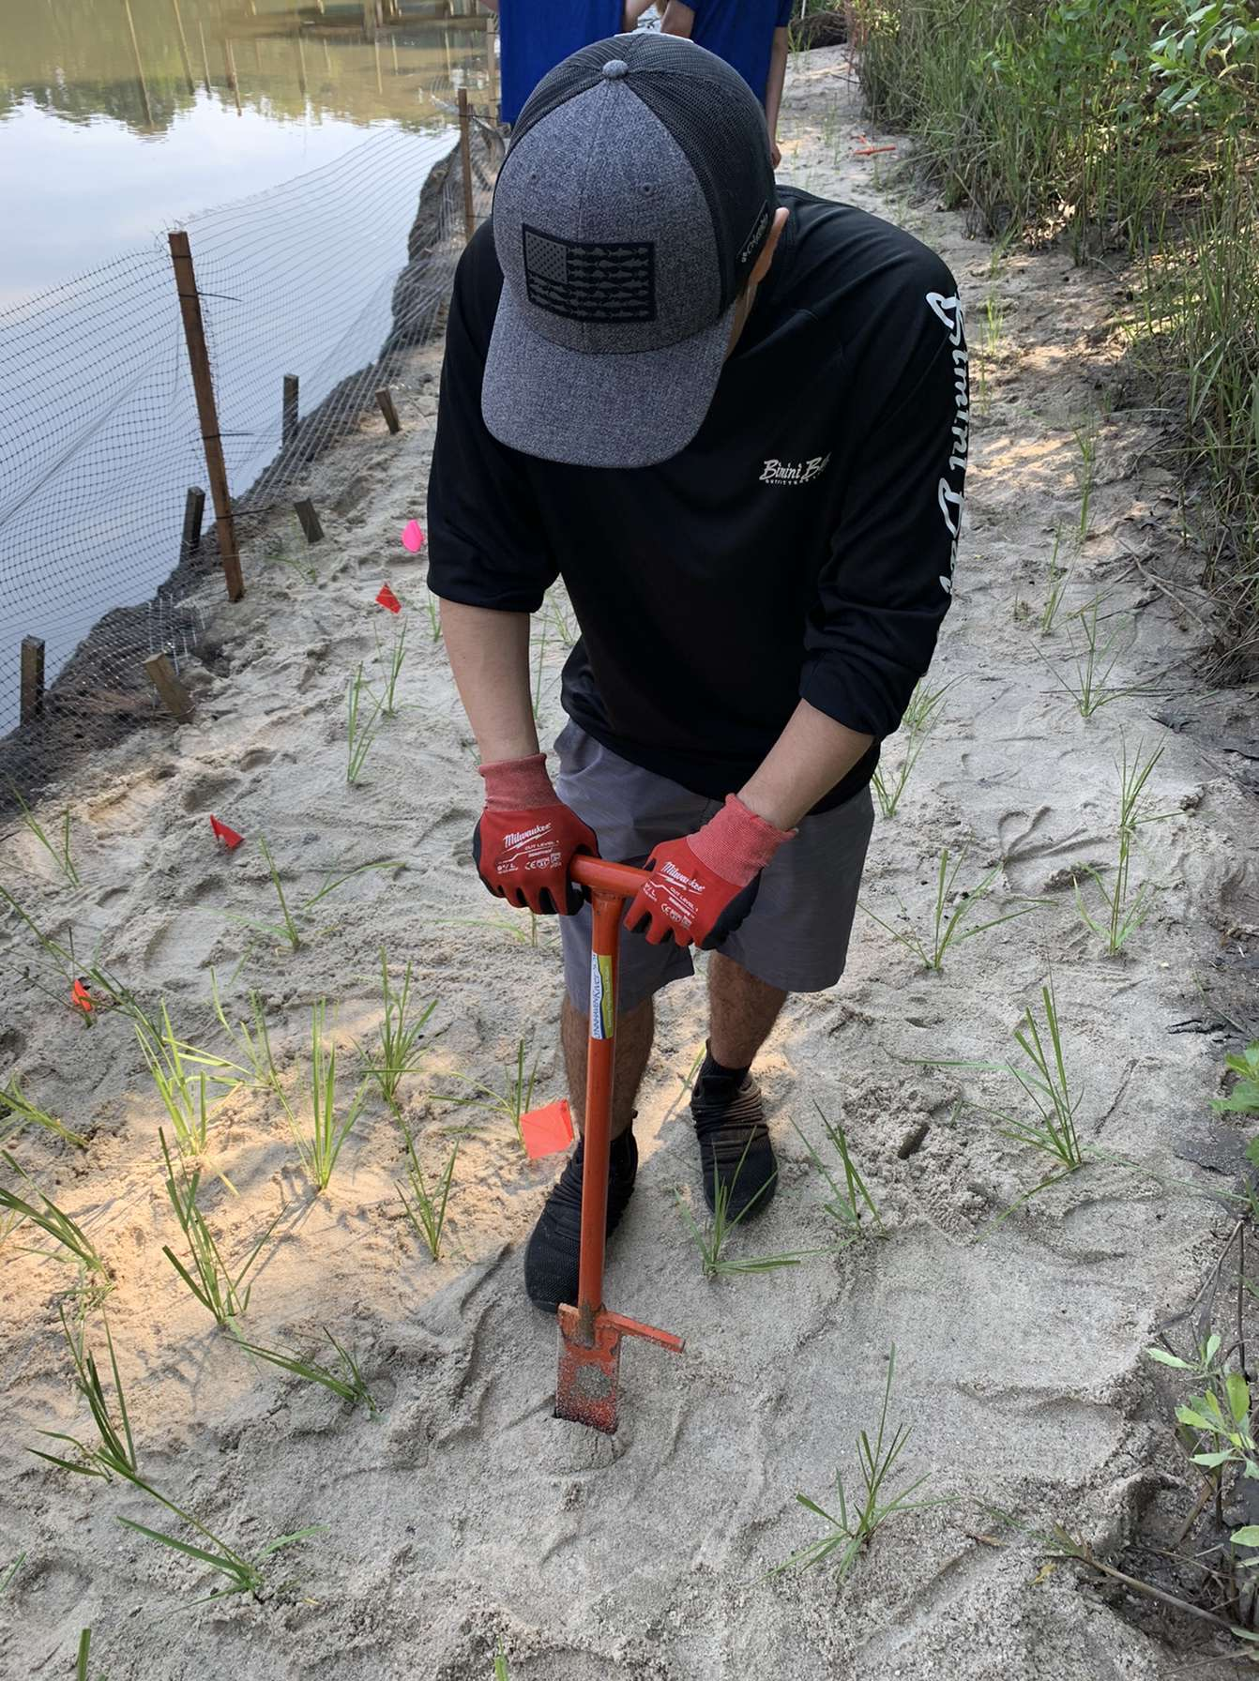
Self Introduction
Rocco Boyd
Old Dominion University
Majoring in Biology with a concentration in Marine Biology minoring in Sustainability and Conservation Leadership
Interests: Fisheries Biology and Freshwater Ecology

Slide 3
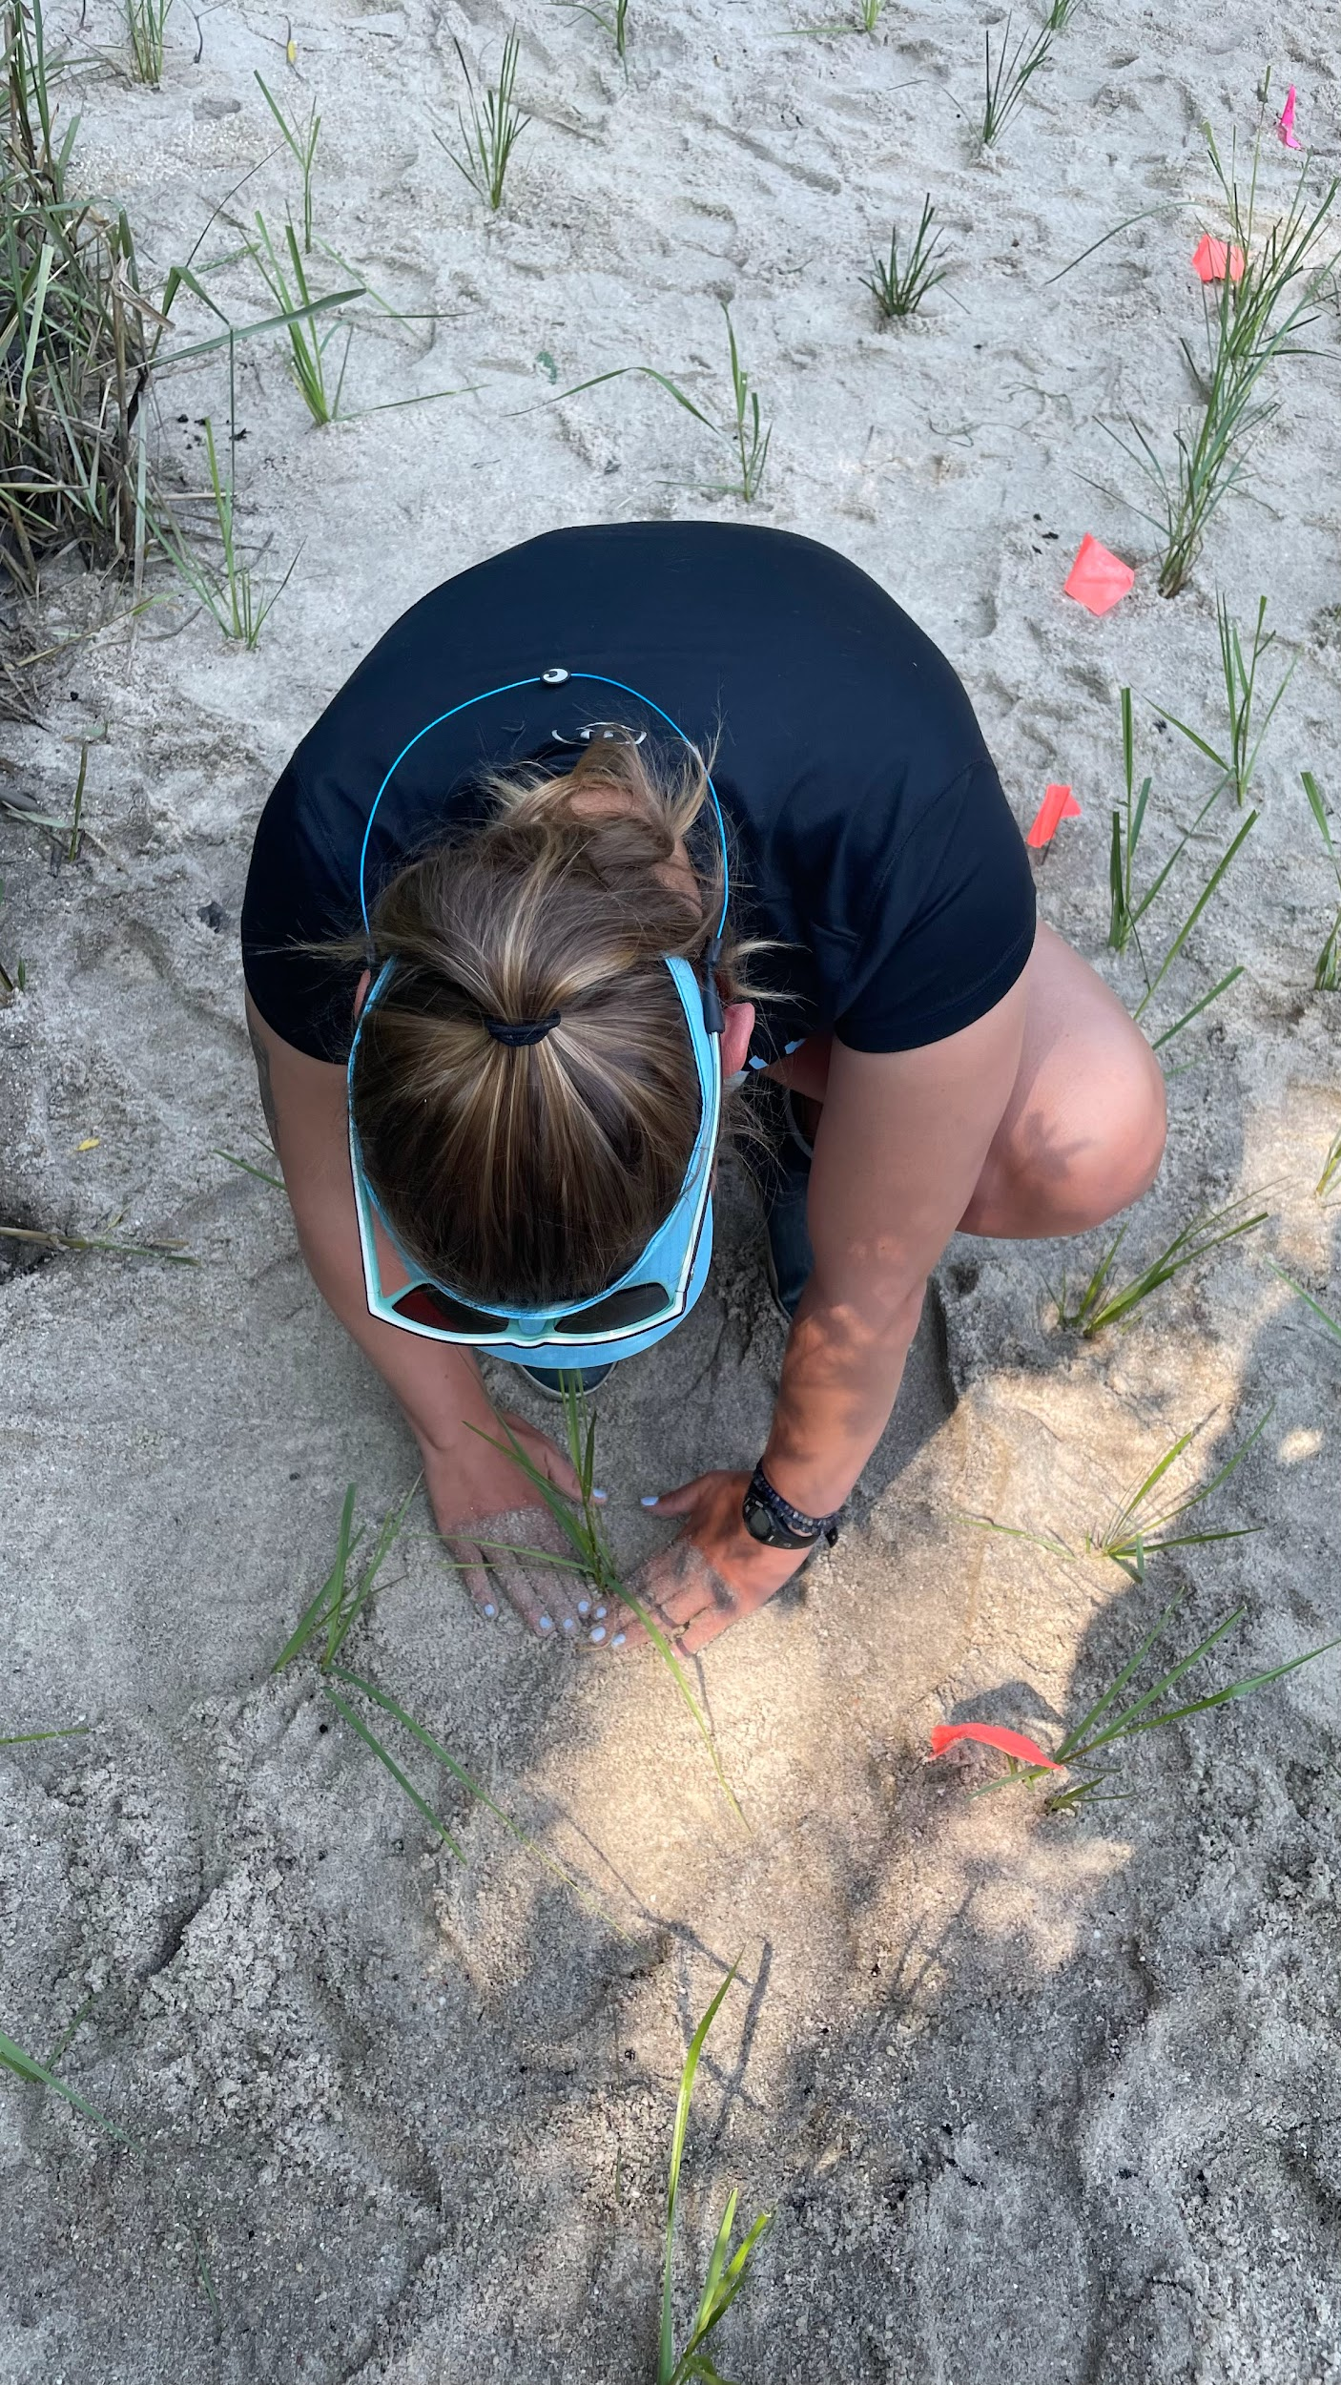
Self Introduction
Alivia Markham
Old Dominion University
Majoring in Biology with a concentration in Marine Biology minoring in Sustainability and Conservation Leadership
Interests: Marine biology and conservation

Slide 4
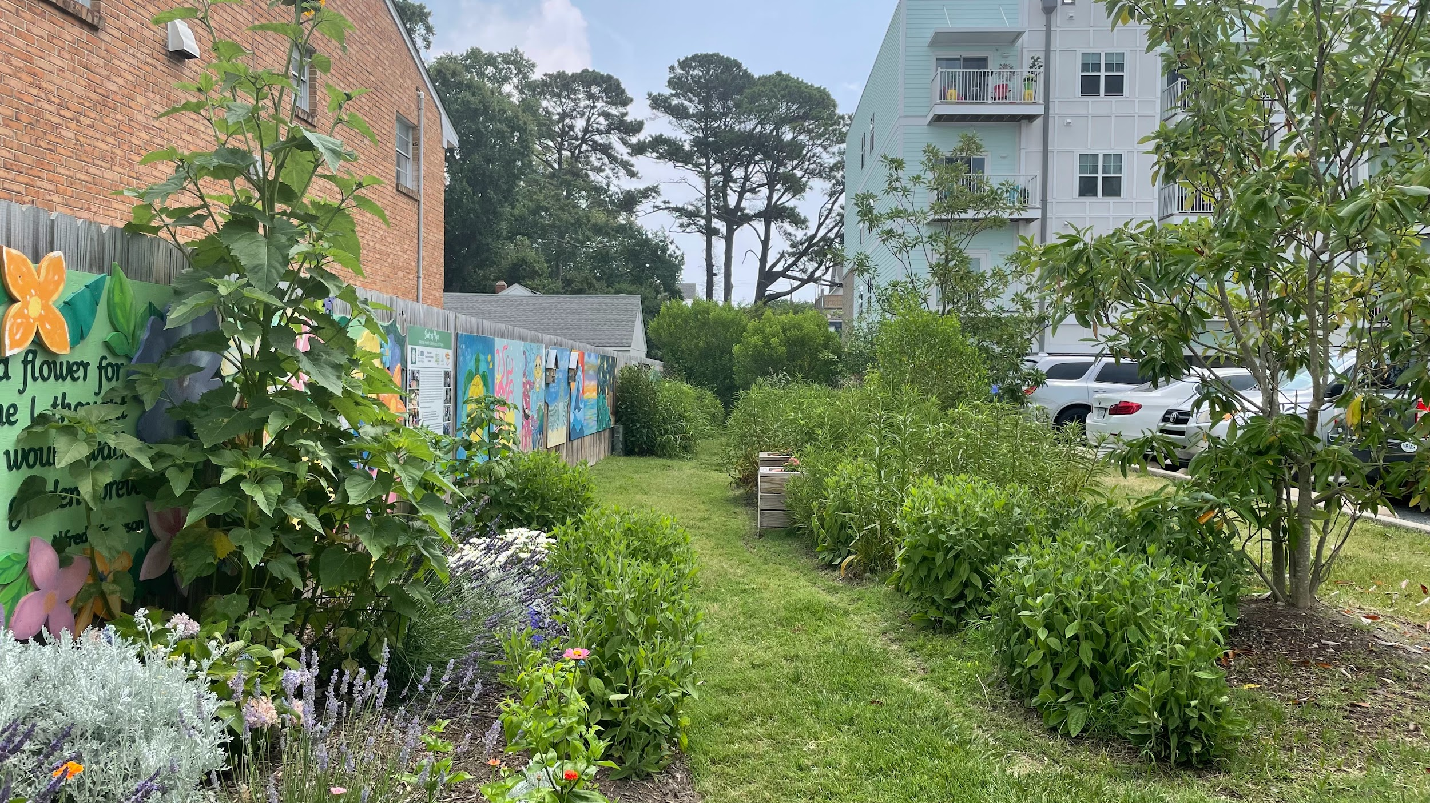
Intro of Lynnhaven River NOW
Began in 2002 focusing on the lynnhaven river watershed
Then expanded to other Virginia Beach watersheds
Objectives
Identify and reduce sources of contamination in our waterways
To educate and engage the community and partner organizations in restoring and protecting our waterways and natural areas
To restore lost habitats

Slide 5
Case Study topic
Final Topic
Climate Change effect on restoration projects in Virginia Beach

Slide 6
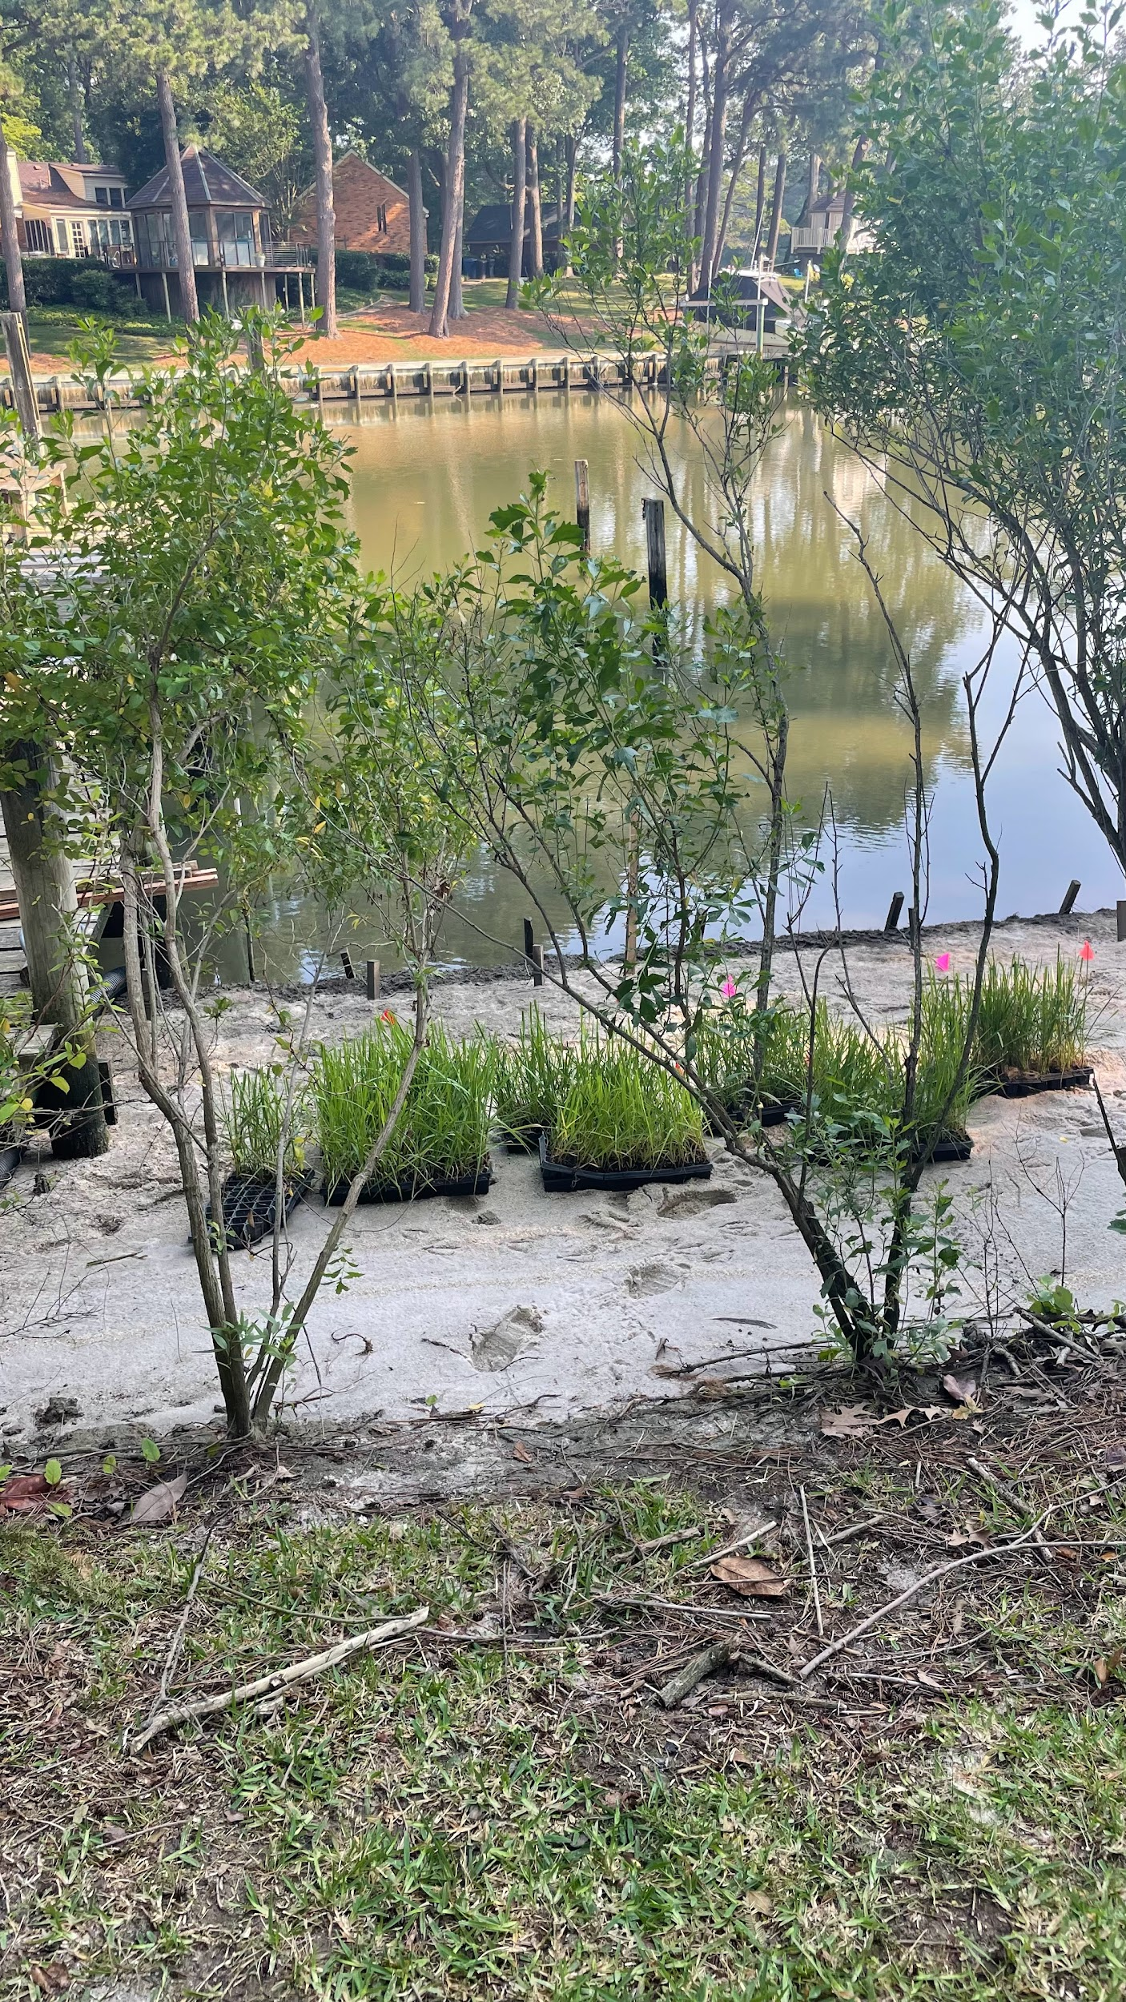
Our Objectives
Goal Statement: to ensure the resilience and viability of coastal ecosystems in the face of climate change, contributing to the preservation of biodiversity, the protection of coastal communities, and the sustainable use of natural resources for current and future generations.
Worked at community events, went to meetings, and restoration project installations

Slide 7
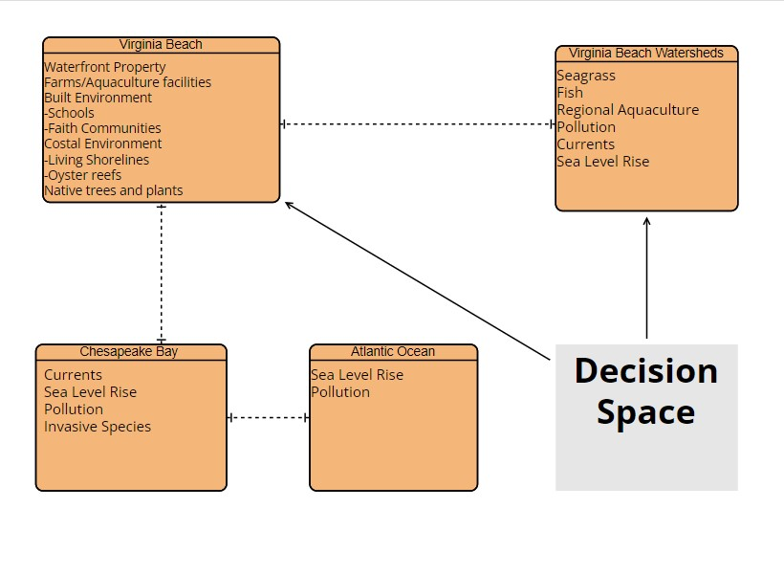
Conceptual Model
Differing levels going from the global scale to the near environment
Shows relationships between all environments
Also shows fragilities that act between system aspects

Slide 8
Recommendations
Made to Lynnhaven River NOW
Oyster Restoration
Buy local oysters
Upkeep and monitoring of restoration projects and reefs
Research and Development area for new aquaculture technologies
Tree Restoration
Nonnative trees to adapt Virginia Beach
Planting trees in high urban heat areas
Public Education and Outreach
Education on benefits of restoration
Ecotourism on waterways
Dive Against Debris clean up dives

Slide 9
Whats Next
Our case study report will be shared with Lynnhaven River NOW where they will assess our work
Recommendations may be taken into consideration in their actions moving forward
Our final evaluation and meeting with our supervisor will help LRnow make changes to better their internship program

Slide 10
What was gained
Deep connection with the communities we interacted with
Learned and experienced how oyster farmers are treated by the public and how their daily operations work
Better understanding of how to properly organize a self run project
We feel our recommendations will improve the resilience of not only restoration projects but the coastal communities and businesses of Virginia Beach

Slide 11
Our Reflections
Learned how to interact with different communities who express differing interests on a professional level
Useful in careers dealing with large areas such as government jobs
Helped me to find a possible job in the oyster industry
The connections made between us and Lrnow are forever lasting as we really felt like we were included in their Lrnow ‘family’

