Slide 1
Finding Our Footing
A journey towards facilitating the adaptation of Back Bay National Wildlife Refuge to an uncertain future

Slide 2
“The journey of a thousand miles begins with a single step.” –Lao Tzu

Slide 3
About Me
Undergraduate in Marine Biology at ODU
Passionate about pursuing conservation and stewardship of our natural resources
Completed a summer internship for Back Bay NWR and created a case study focused on facilitating its adaptation to an uncertain future

Slide 4
The History
Back Bay NWR
Established June 6, 1938, as waterfowl refuge to preserve healthy bird populations for hunters
Currently:
Santuary for wintering waterfowl
Provides habitat for many species
Protected nesting site of four species of engangered sea turtles
Loggerhead
Kemps Ridely
Green
Leatherback

Slide 5
The Project
Wicked Problem: In the next few decades, Back Bay will experience system altering effects from
Rising Sea Levels
Increasing Temperatures
Dwindling Funding
Decreased Social Engagement

Slide 6
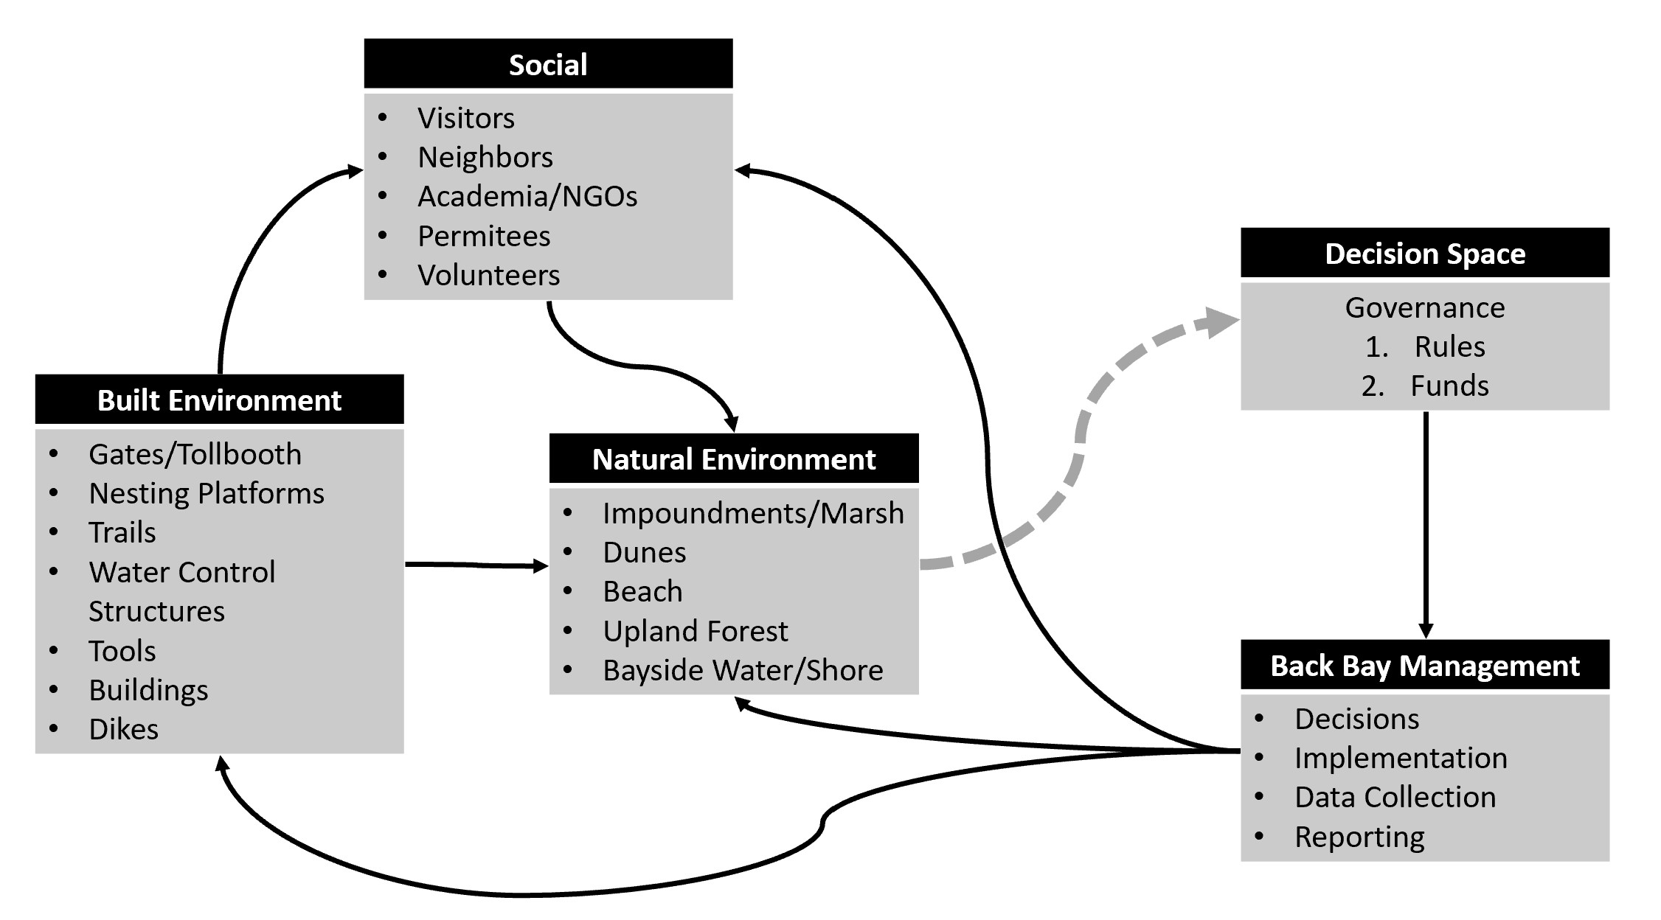
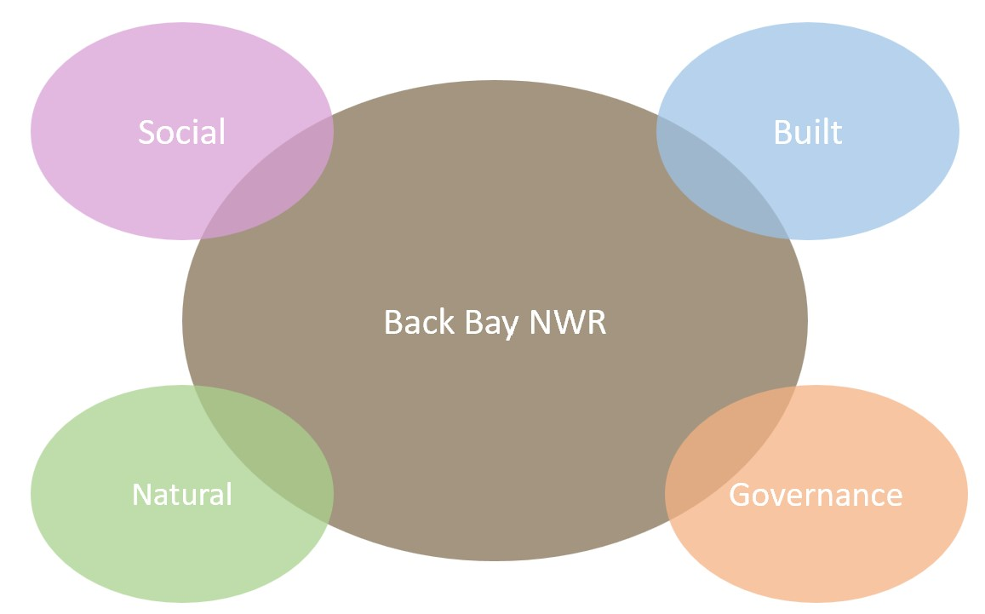
The Process
Back Bay system split into four sections:
Governance
Social Environment
Built Environment
Natural Environment
Participatory modelling used:
During interviews with stakeholders
Determining Goal Statements
Determining Desirable Futures

Slide 7
The Goal
“To facilitate the adaptation of Back Bay National Wildlife Refuge to an uncertain future so that it may continue to ensure that healthy habitat for wintering waterfowl is preserved and safeguarded for generations to come.”

Slide 8
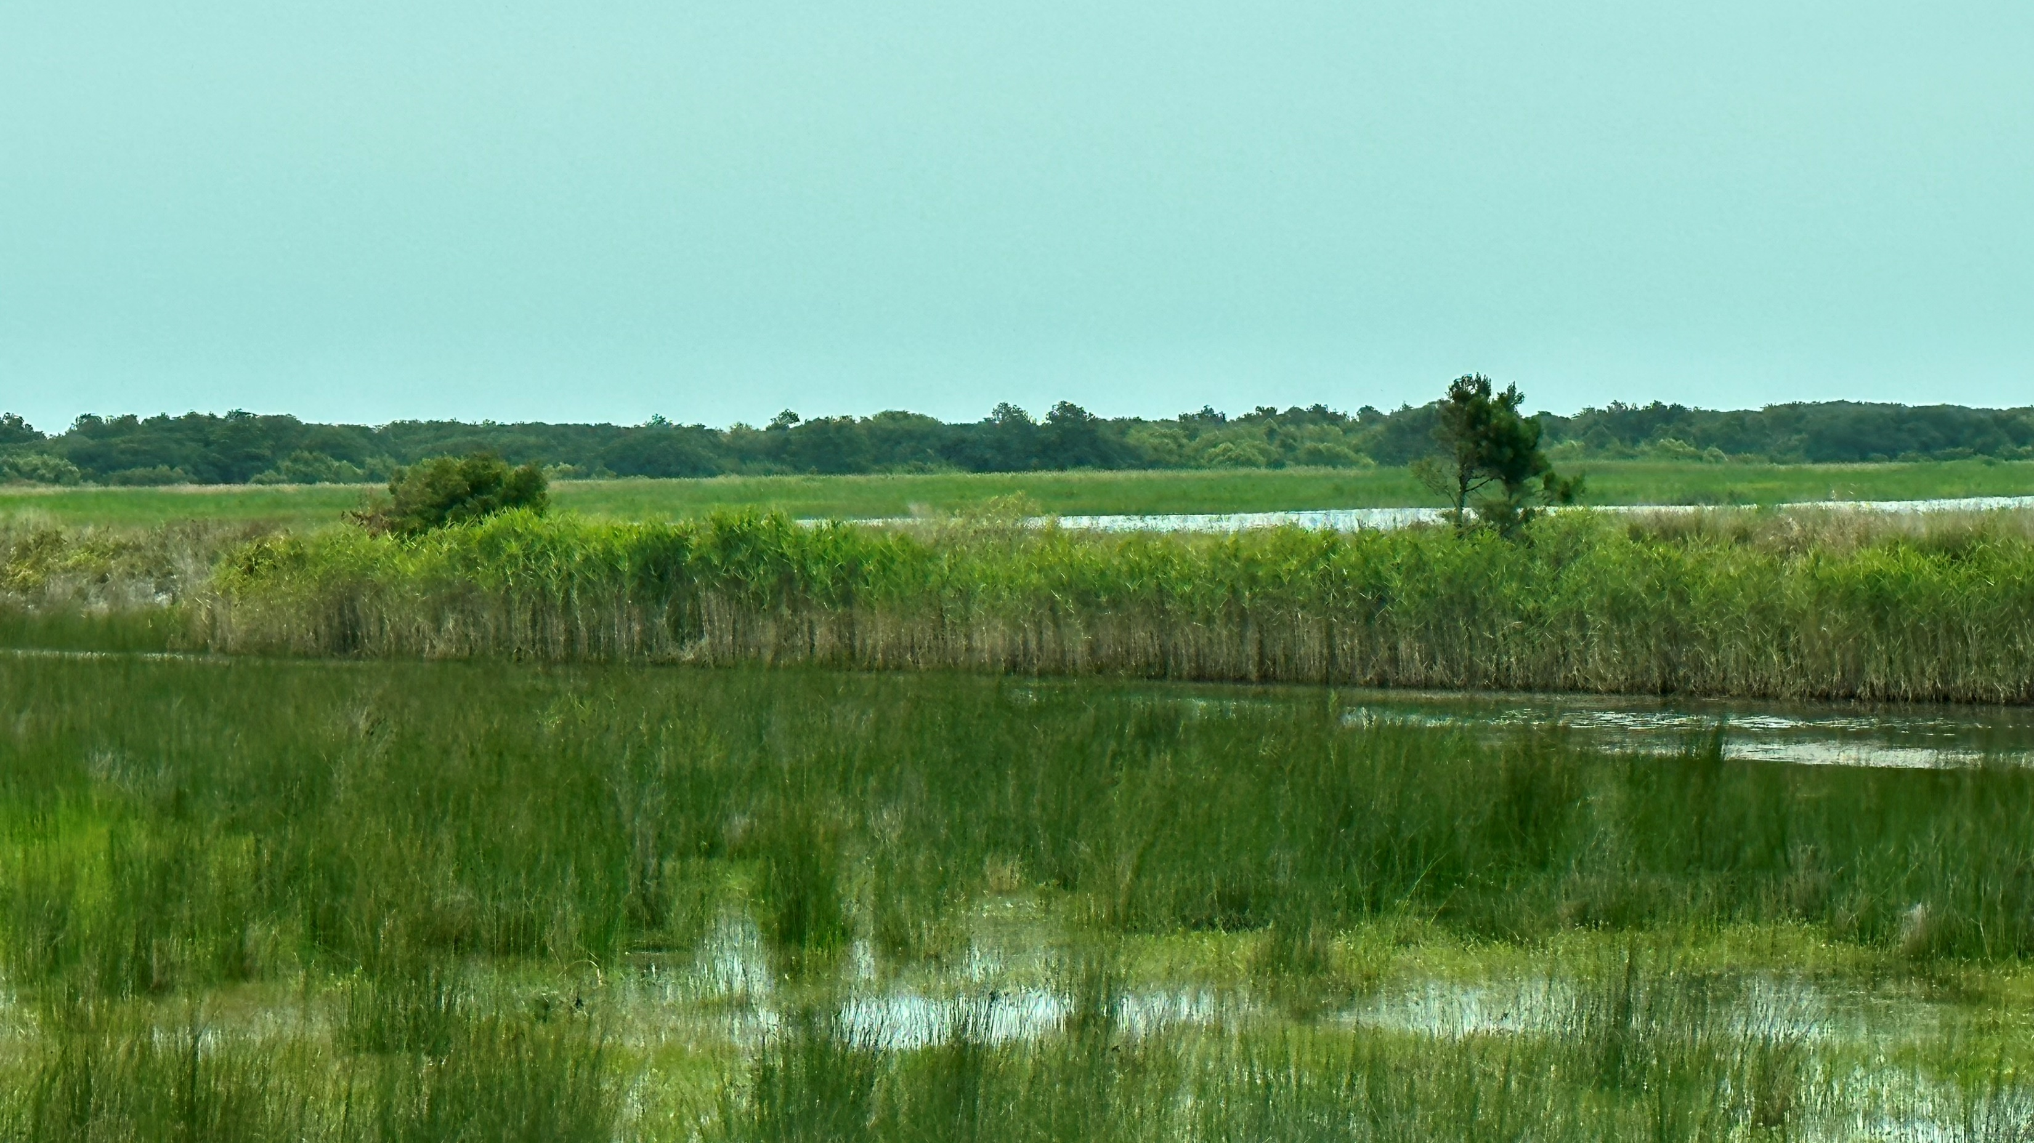
The Outcome:
Recommendations:
Back Bay
Forms an Invasive Control Team
Creates training manual for volunteers
Partners with nearby military bases for volunteers
Creates QR codes
Develops a Back Bay Ambassadors Program
Organizes a ‘Free for the Public Day”
FWS Headquarters
Decentralize control
Revoke permits for beach access
Acquires reliable internet
Implements card readers
Department of the Interior
Funds the purchasing of additional land for refuge use

Slide 9
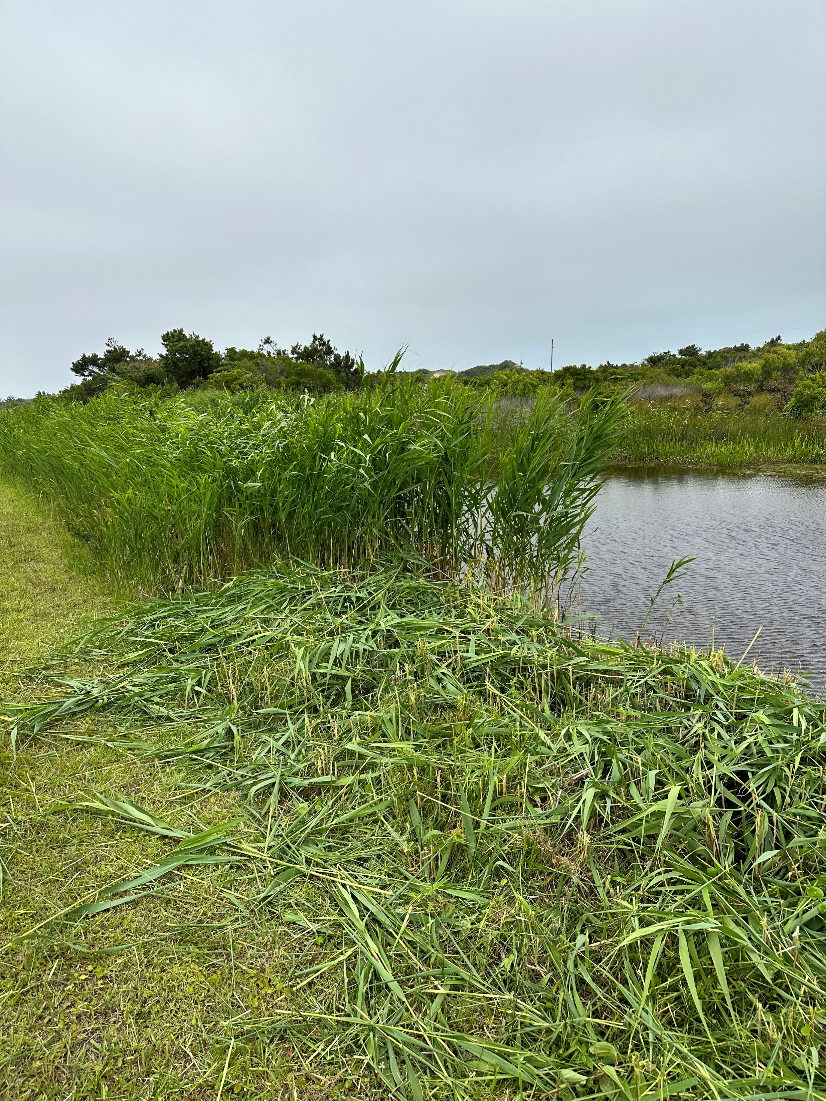
The Internship: Challenges
Snakes!
Equipment Vs. Invasives

Slide 10
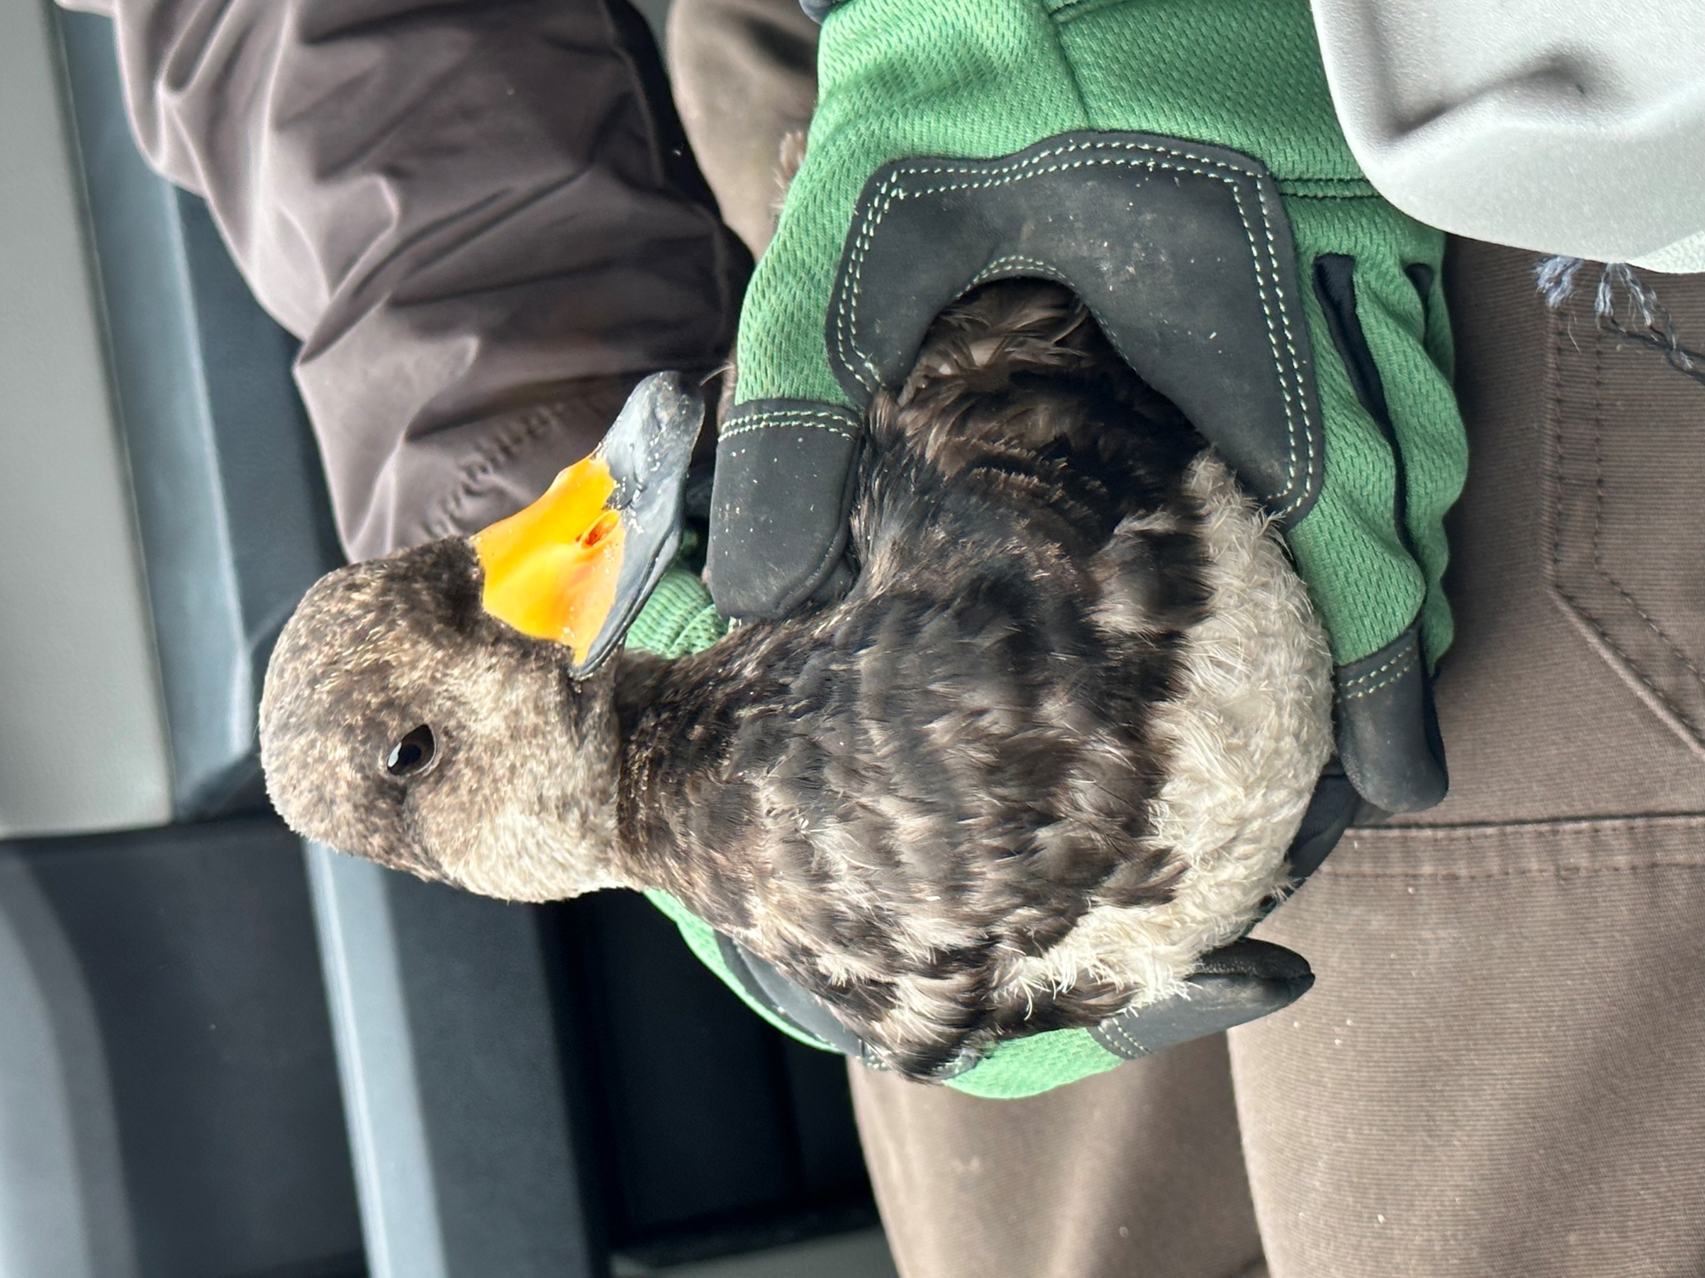
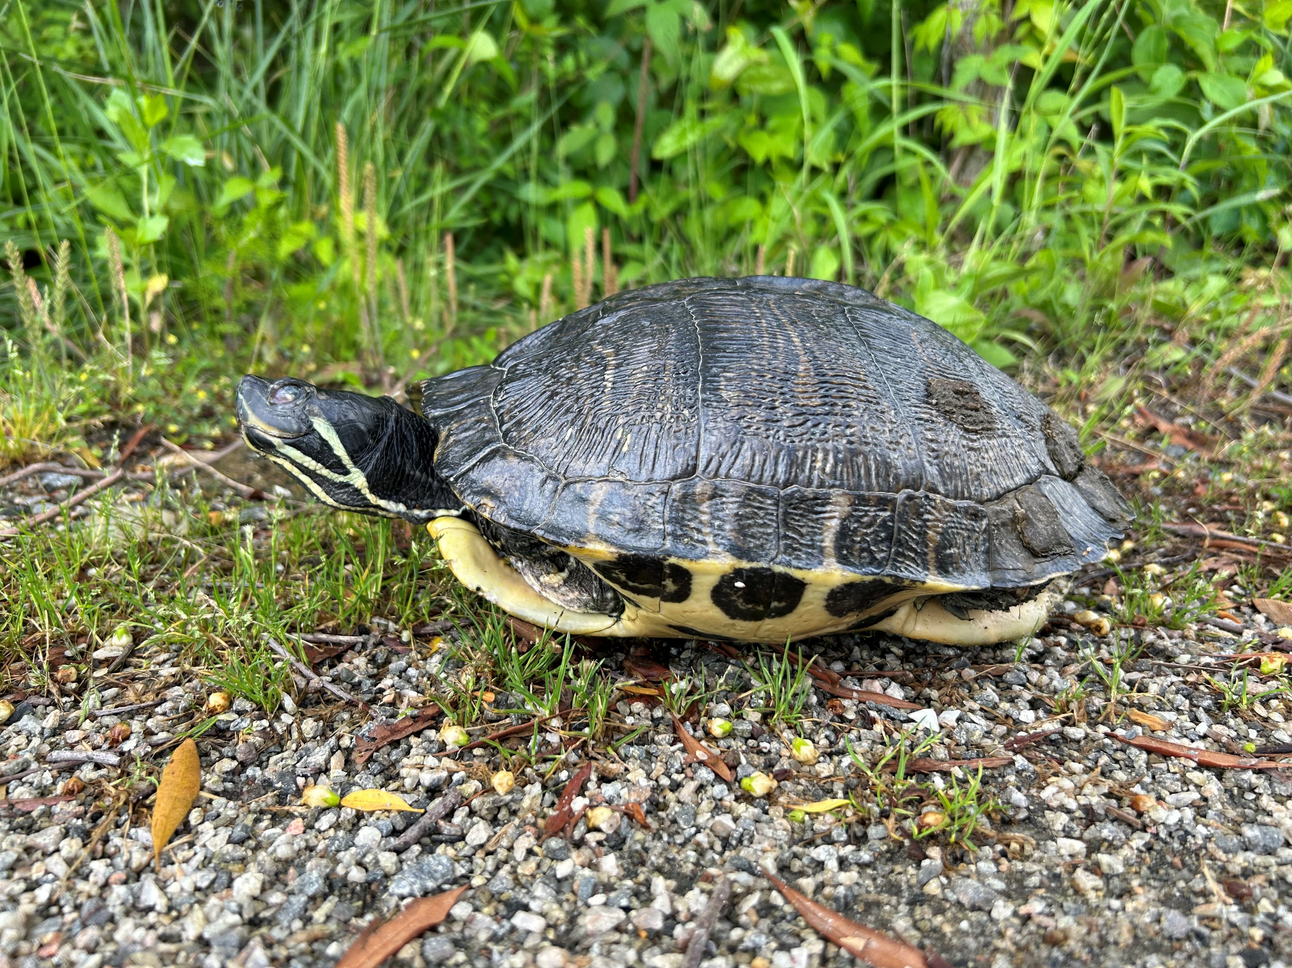
The Internship: Standout Moments
Sea Turtle Nesting
Diverse Wildlife

Slide 11
In Conclusion
Back Bay NWR is a beautiful piece of wilderness that deserves our protection and consideration for generations to come.
No one action or single stakeholder will be able to preserve this integral
Only with cooperative action and engagement does Back Bay have a chance for successful adaptation to an uncertain future

Slide 12
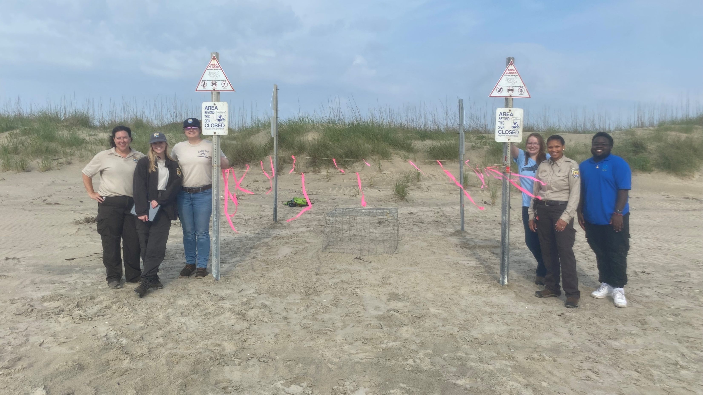
Thank you to the incredible staff, interns, and volunteers at Back Bay who made this internship an unforgettable experience!
Contact: Mdunc018@odu.edu

