Slide 1
Sewerology VCC & Grenada’s Water Sector
TinaMarie Haskell

Slide 2
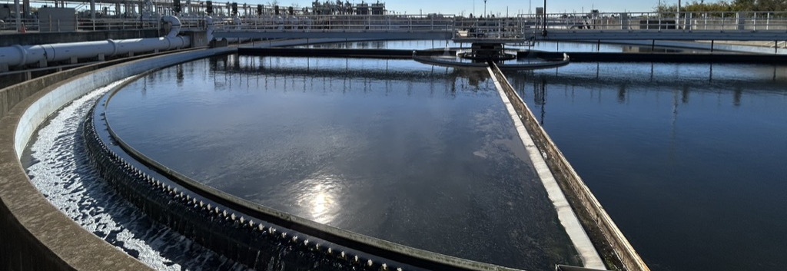

Slide 3
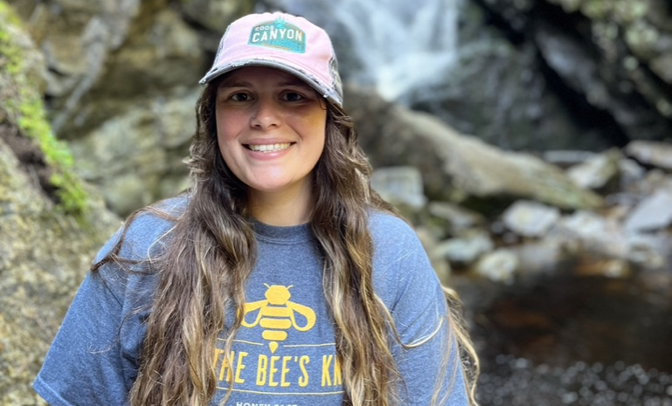
Who am I?
Tina
About me
Technician for a wastewater utility
Grew up immersed in nature
Passionate about the environmental protection and sustainability
Finishing up my graduate certificate in Conservation Leadership

Slide 4
Project
Building the VCC

Slide 5

Sewerology: Wastewater Science and Education
Logo
Constructed Layout
Collected Information
Included floors for
Deliberation rooms
Resources in the library
Story sharing
Current events and news
Found relevant videos, articles, and other information to share
Developed an understanding to start a discussion in the deliberation room

Slide 6
Case Study
Grenada’s Water Sector

Slide 7
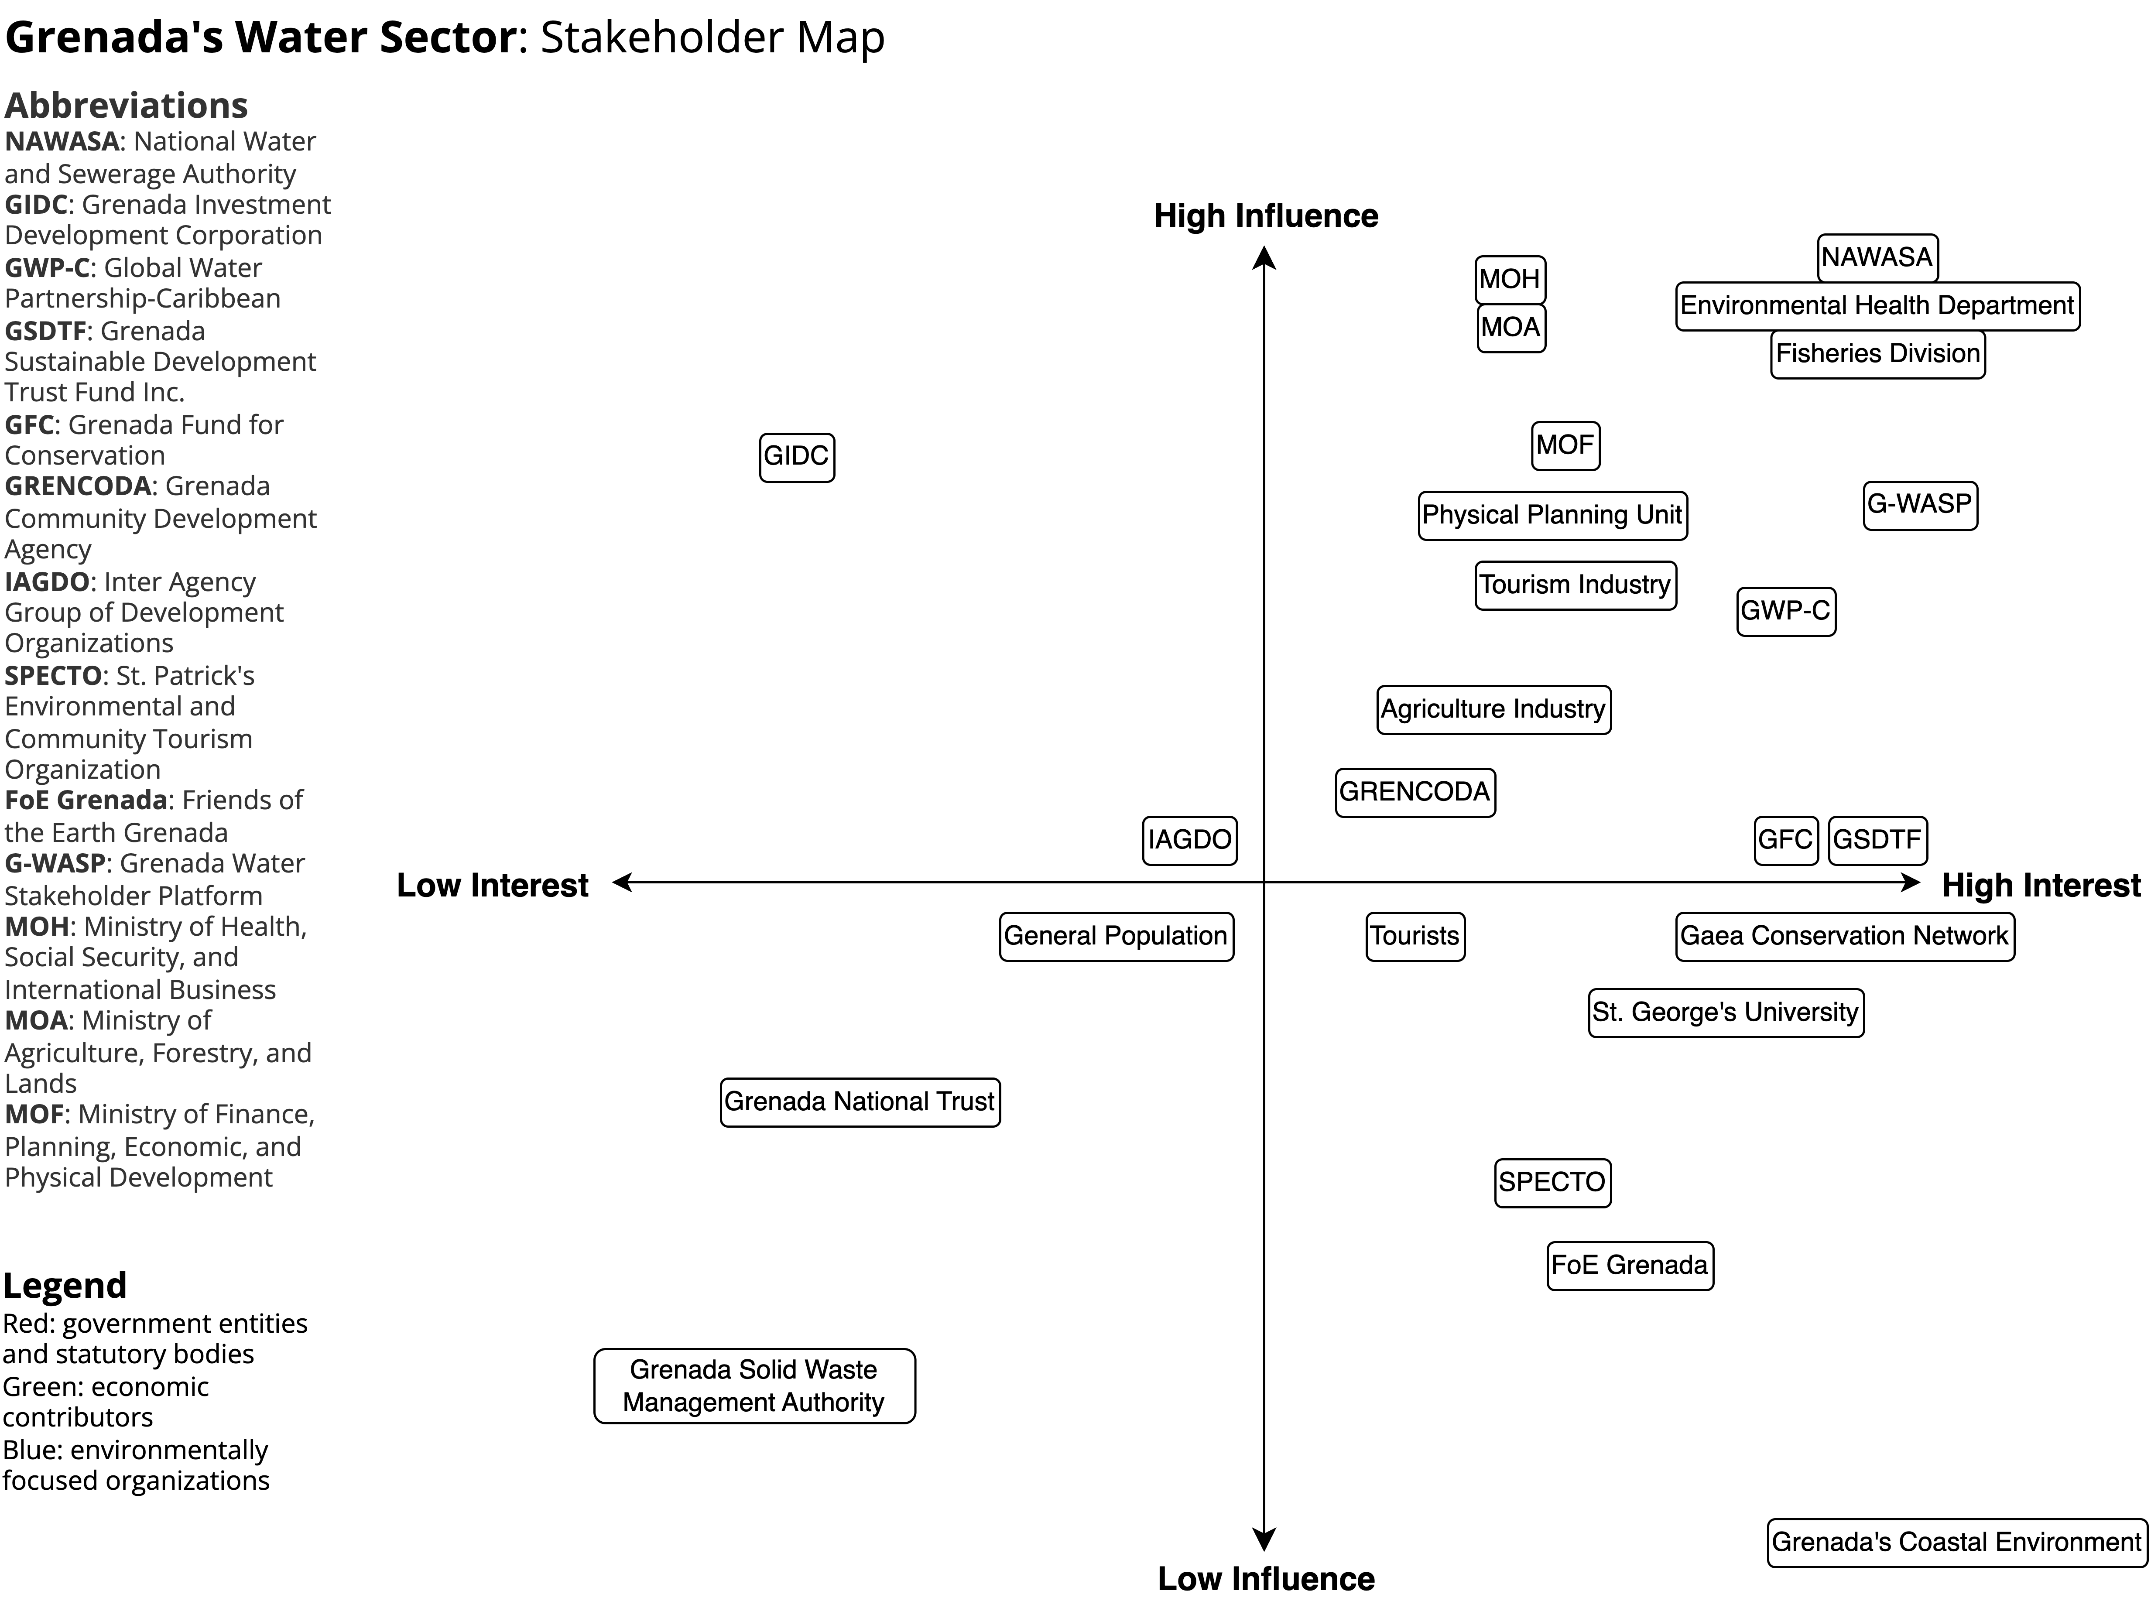
Main Stakeholders
National Water and Sewerage Authority (NAWASA)
Environmental Health Department
Fisheries departments
Physical Planning unit
Tourism industry
Tourists
The agriculture industry
The general population
Grenada’s coastal environment

Slide 8
A future where water needs are met, water and wastewater are well managed, and the purpose of Grenada’s ecosystems are protected
Goal Statement

Slide 9
Wicked Problem
Natural water sources are not enough to meet demand
Economy relies on water and water usage
Population, tourism, and agriculture continue to expand, increasing water demand
With increased water usage there is increased wastewater
The current water system is inadequate regarding wastewater treatment
Public and environmental health rely on proper wastewater treatment

Slide 10
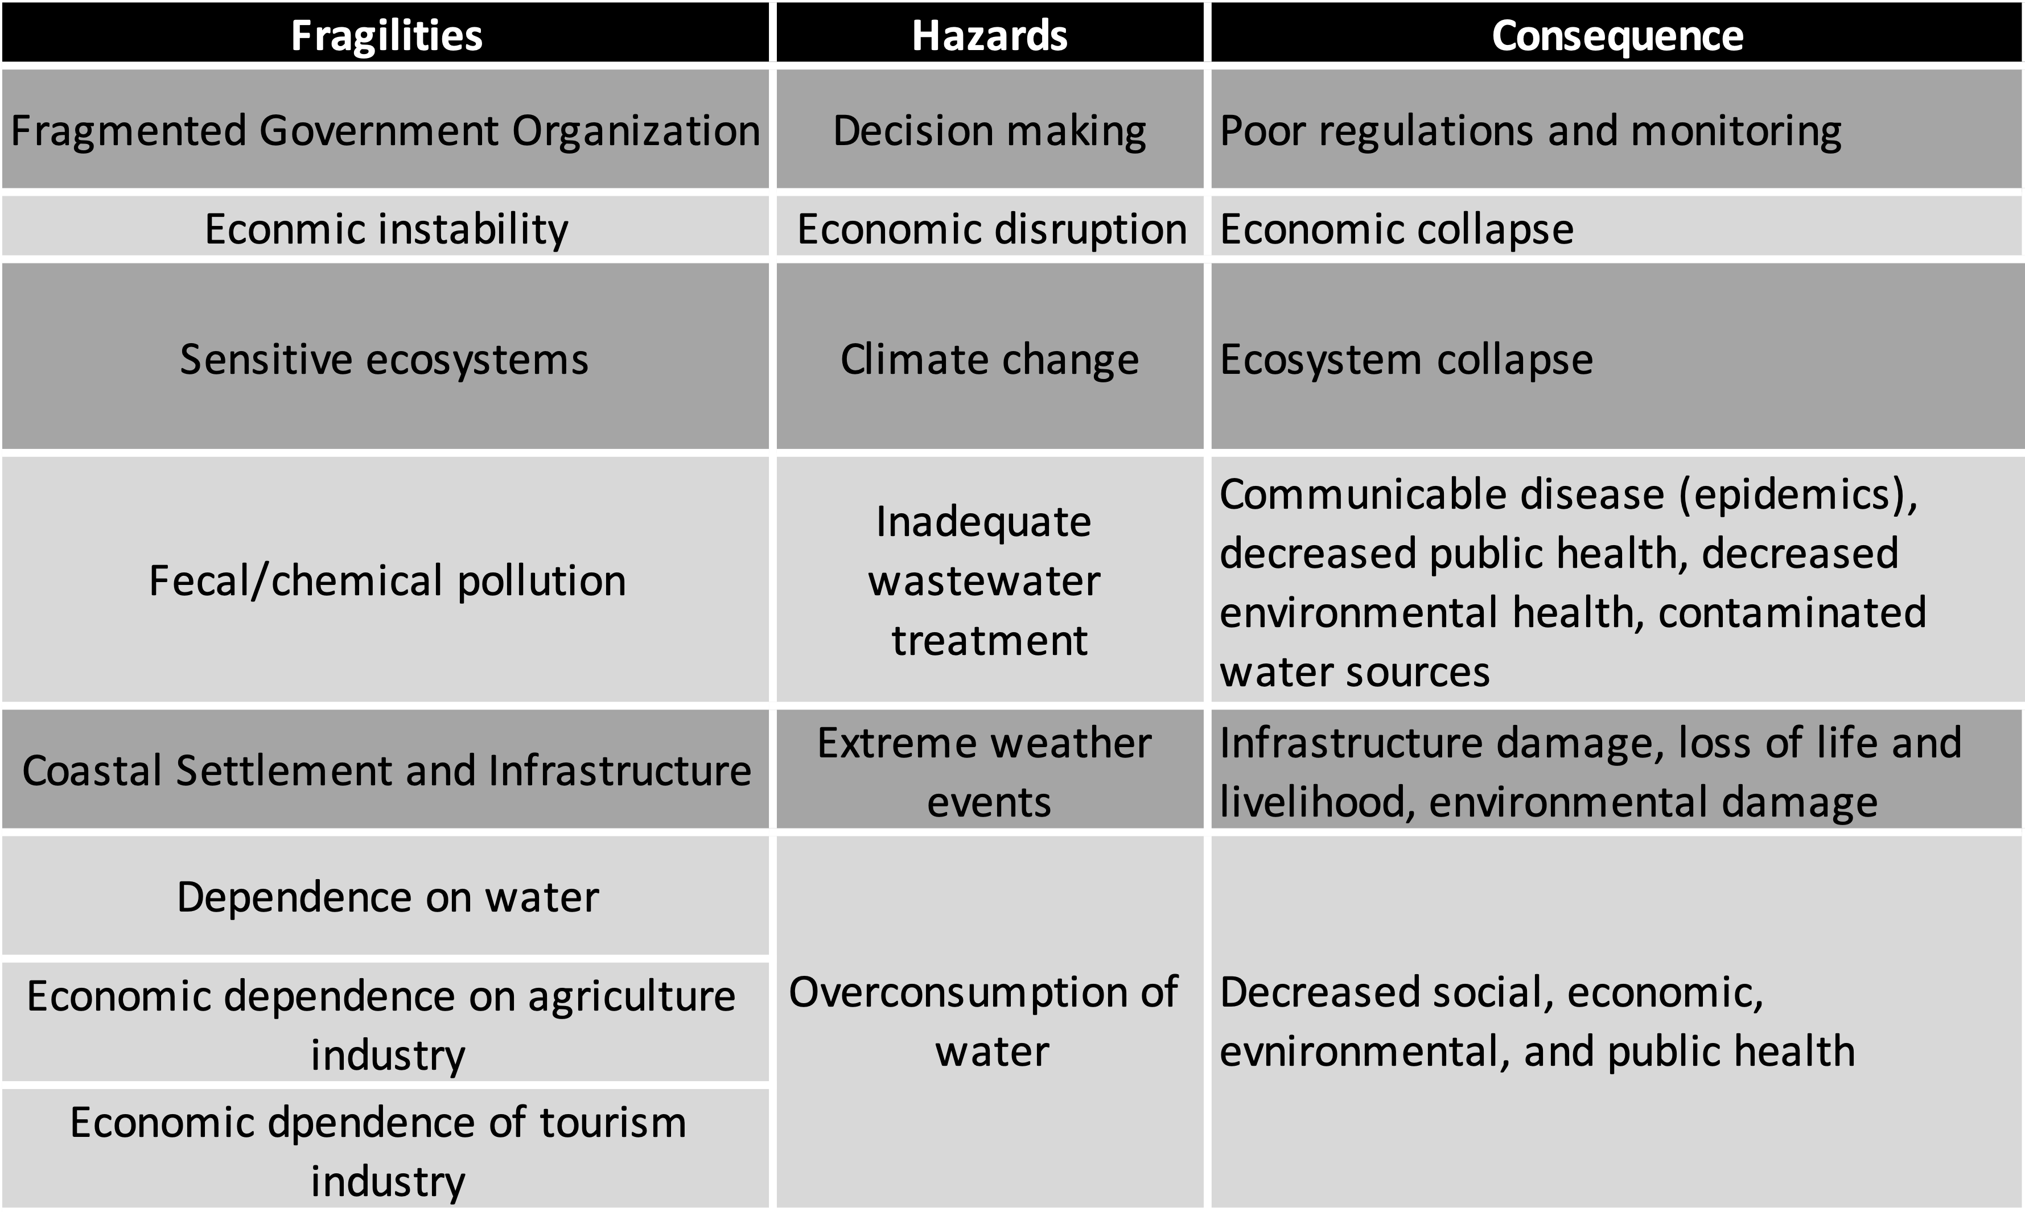
Hazards and Fragilities

Slide 11
Recommendations to Grenada’s Government
Recognizing
Acknowledging
Recommending
Climate change is changing water resources
Grenada’s government has a fragmented approach to managing the water sector
Water supply is not meeting water demand
Wastewater is not adequately treated or managed
There are many stakeholders with interest in the water sector
Addressing water and wastewater management will not be easy to accomplish
Grenada is aware of many of its current water sector issues
Improving cross sector coordination to better manage the water sector
Improve current treatment plants and wastewater infrastructure
Implementing non potable water reuse to supplement water supply

Slide 12
Reflections - VCC
Believe there is a lot of value in a shared community space for science
VCC’s can help break down the barriers to science communication
Bringing awareness to the need for wastewater treatment
Bringing awareness to the sanitation gap

Slide 13
Reflections – Case Study
Challenging to assess a place that I am completely unfamiliar with
Eye-opening to learn about Grenada’s water and wastewater situation

Slide 14
Reflections - Overall
Grateful to been able to use and apply my wastewater knowledge
I enjoyed the amount of learning I was able to do
I am most proud of my recommendations to Grenada’s government

Slide 15
Thank you
TinaMarie Haskell
thask004@odu.edu
www.place4us.net/Sewerology

