Slide 1
Environmental Education, Inspiration, and Stewardship at Edisto Beach State Park
By Elaine Walters
Old Dominion University (ODU), Mitigation & Adaptation Research Institute (MARI)
Edisto Beach State Park (EBSP) Sea Turtle Intern

Slide 2
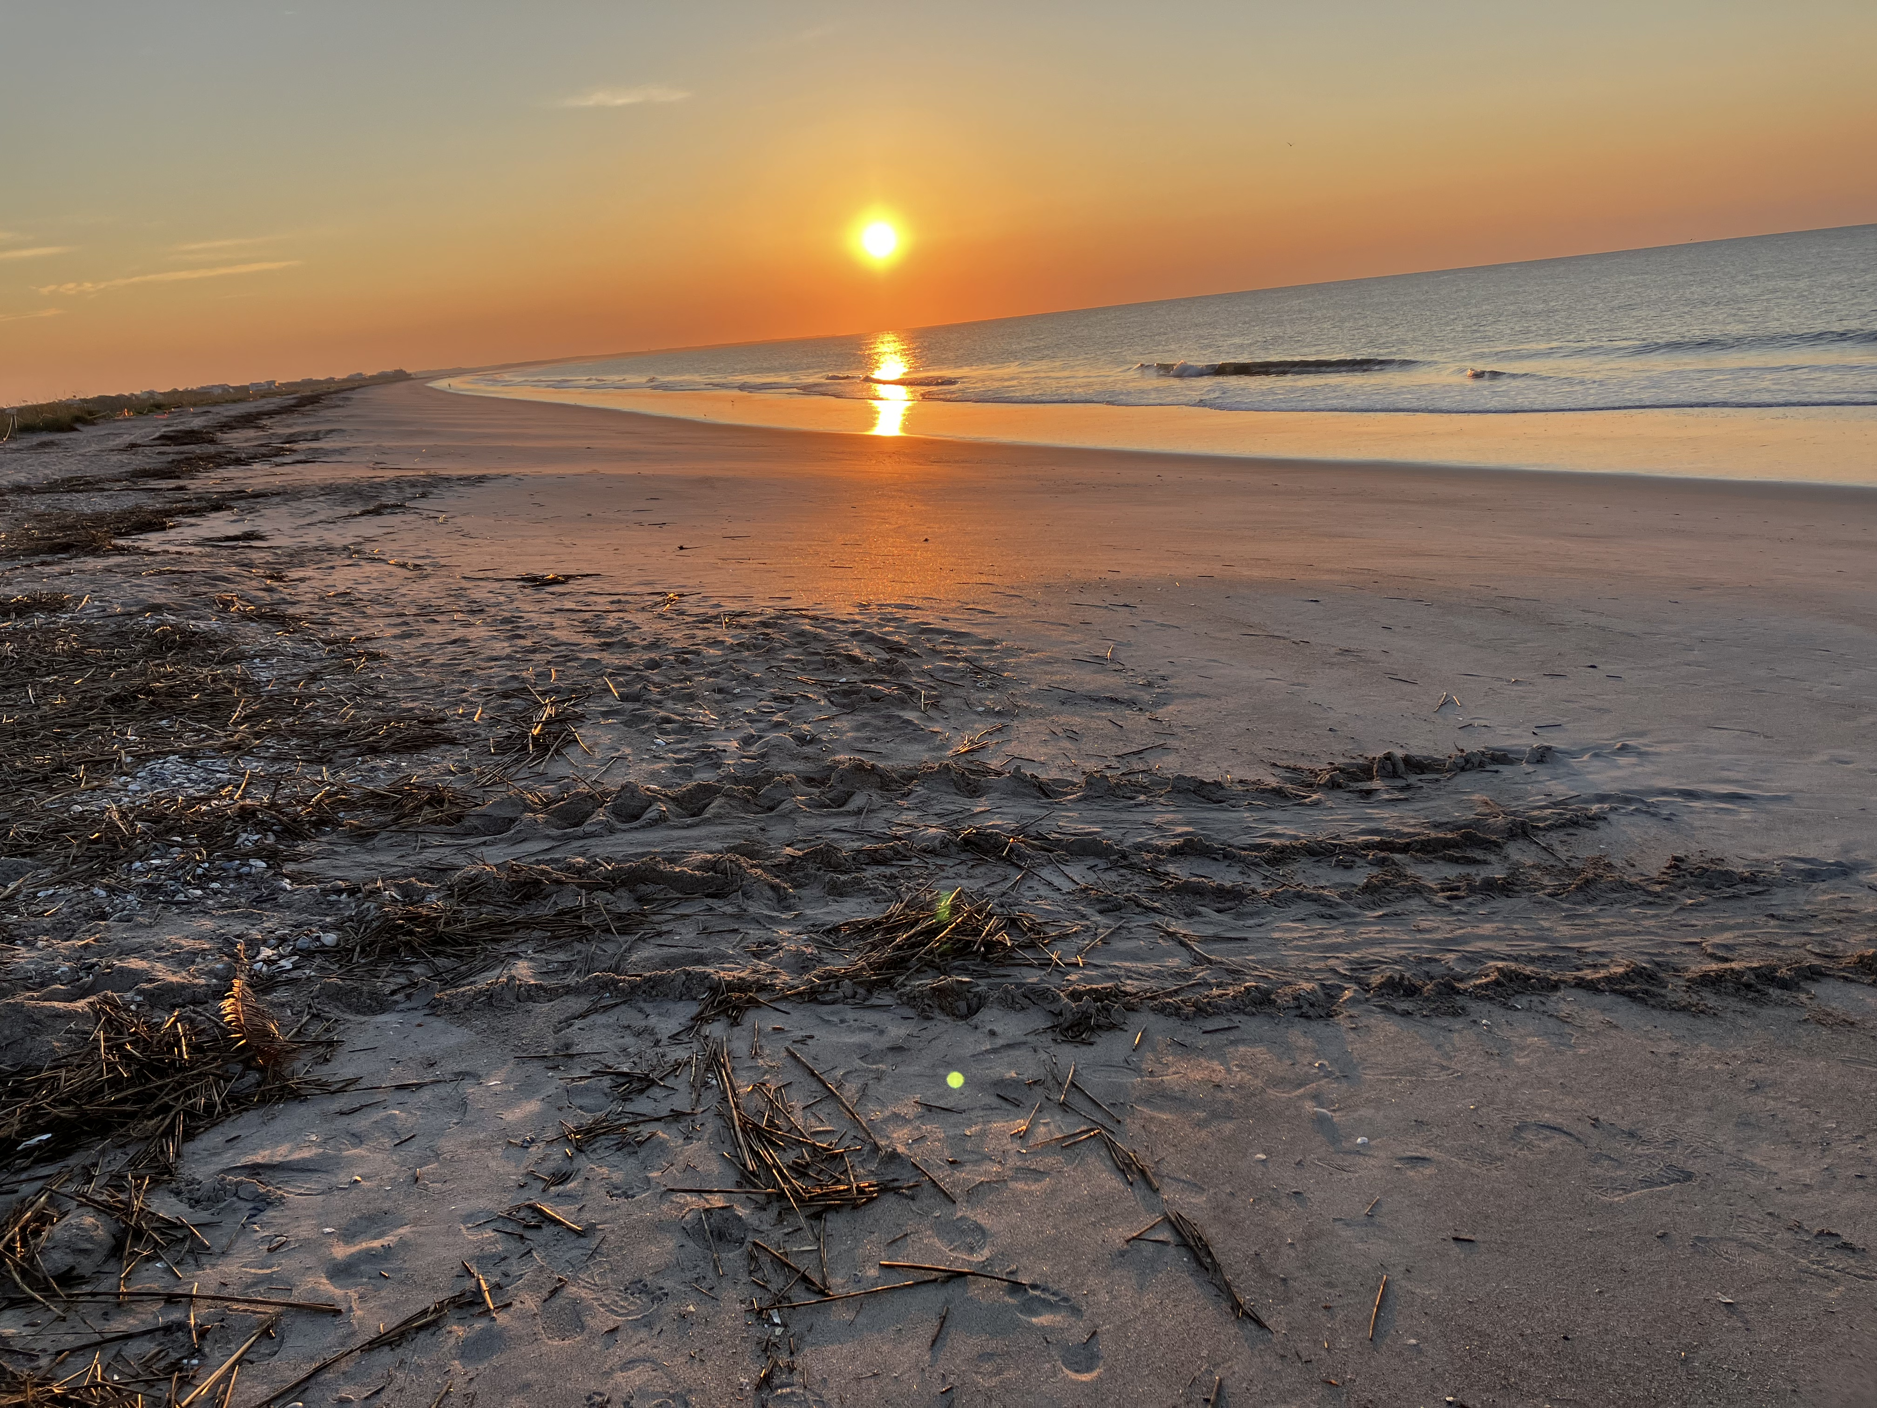
Working towards a future where Edisto Beach State Park Creates Experiences for its visitors that inspire them to become better environmental stewards.

Slide 3
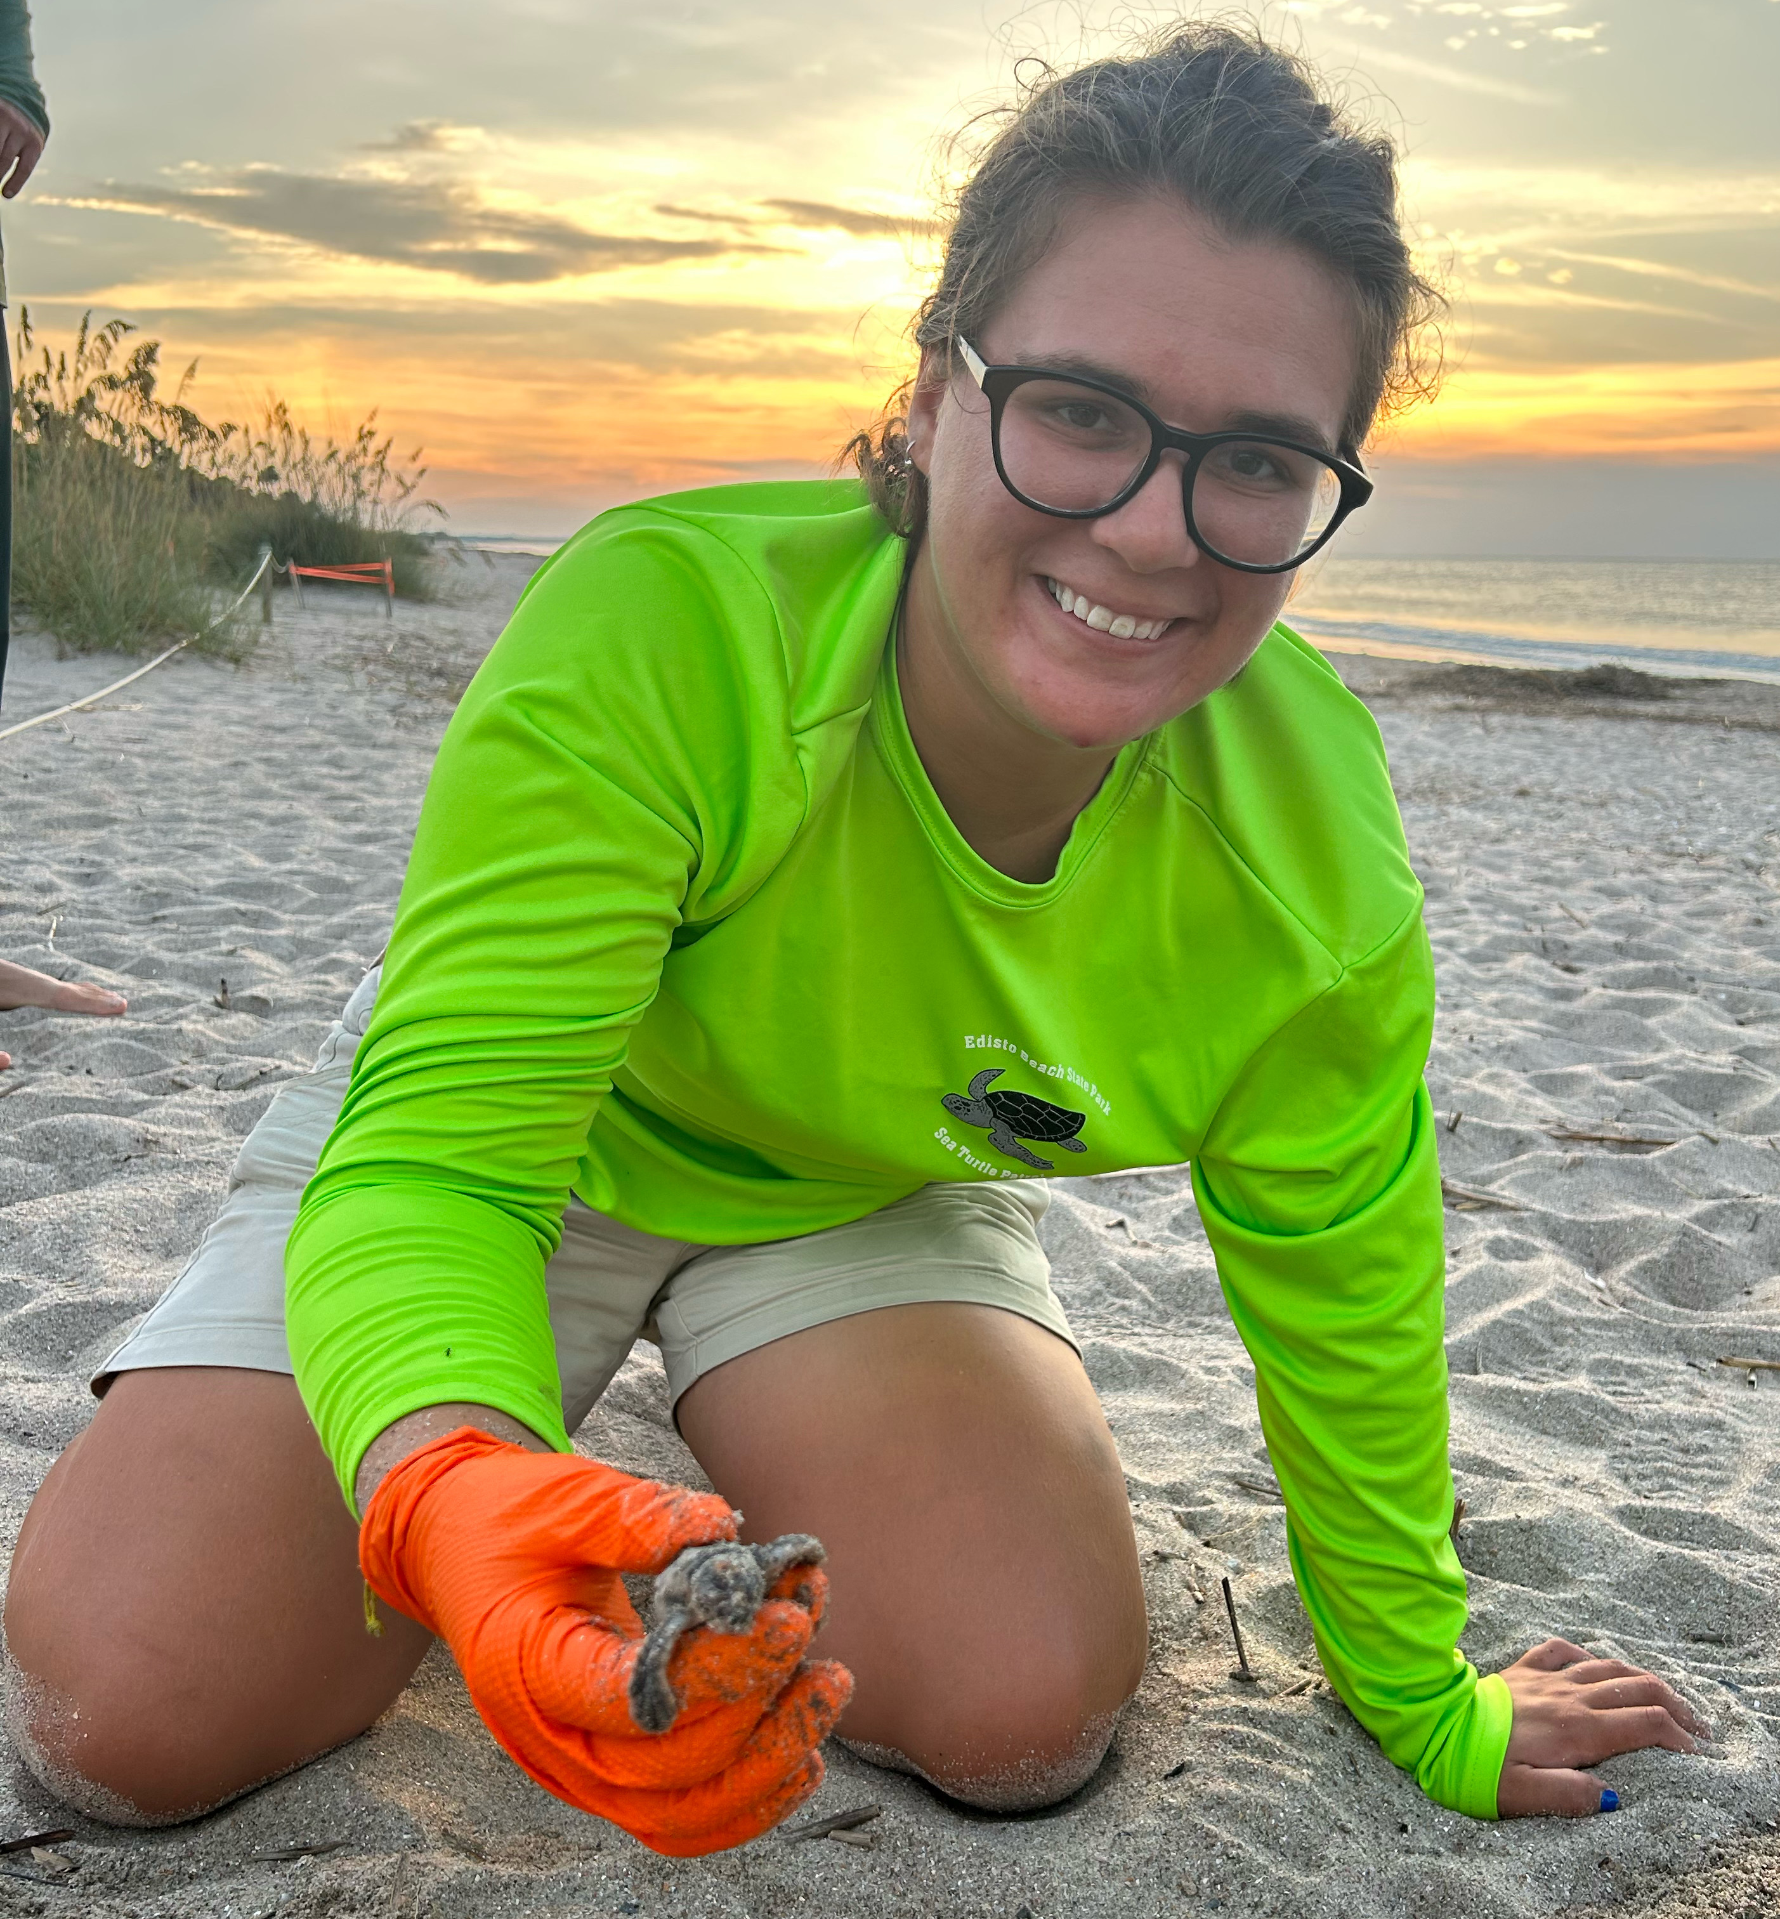
A bit about me…
Summer sea turtle intern studying marine biology & sustainability
A lifelong visitor of Edisto Island
Passionate about learning and sharing what I know with others
This presentation shares the results of my case study project
Notes:
Try to establish a rapport with your audience by balancing personal details with relevance. For example, you might be passionate about coin collecting, but unless you’re giving a talk the local chapter of the American Numismatic Society, that may not be relevant to the presentation (<-----See what we did there? Did you even know the word “numismatic” before today?)

Slide 4
A bit about the host & case study…
MARI Case Study
Place-based learning
Transdisciplinary participatory approach to tackling wicked problems
Students work independently to examine all aspects of a system, identify the hazards and fragilities, and finally make recommendations.
Edisto Beach State Park (EBSP)
One of South Carolina’s important coastal state parks, located between Charleston and Beaufort
Comprised of saltmarsh, maritime forest, and beach
Part of several conservation projects, including a loggerhead sea turtle nesting program
Dedicated to promoting environmental stewardship
Notes:
Use the slides as a prompt, not a crutch! You can put additional specifics you might need help remembering here in the notes section. Only you will be able to see it while in slideshow mode.

Slide 5
Definition: Wicked Problem
There is no definitive formula for a wicked problem.
Wicked problems have no stopping rule
Solutions cannot be true or false, only better or worse.
There is no test of success.
There is no trial and error, each proposed solution is the only one that can be implemented
The potential solutions are infinite
Every wicked problem is unique, although many share characteristics.
The planner has no right to be wrong and must be fully responsible for their actions

Slide 6
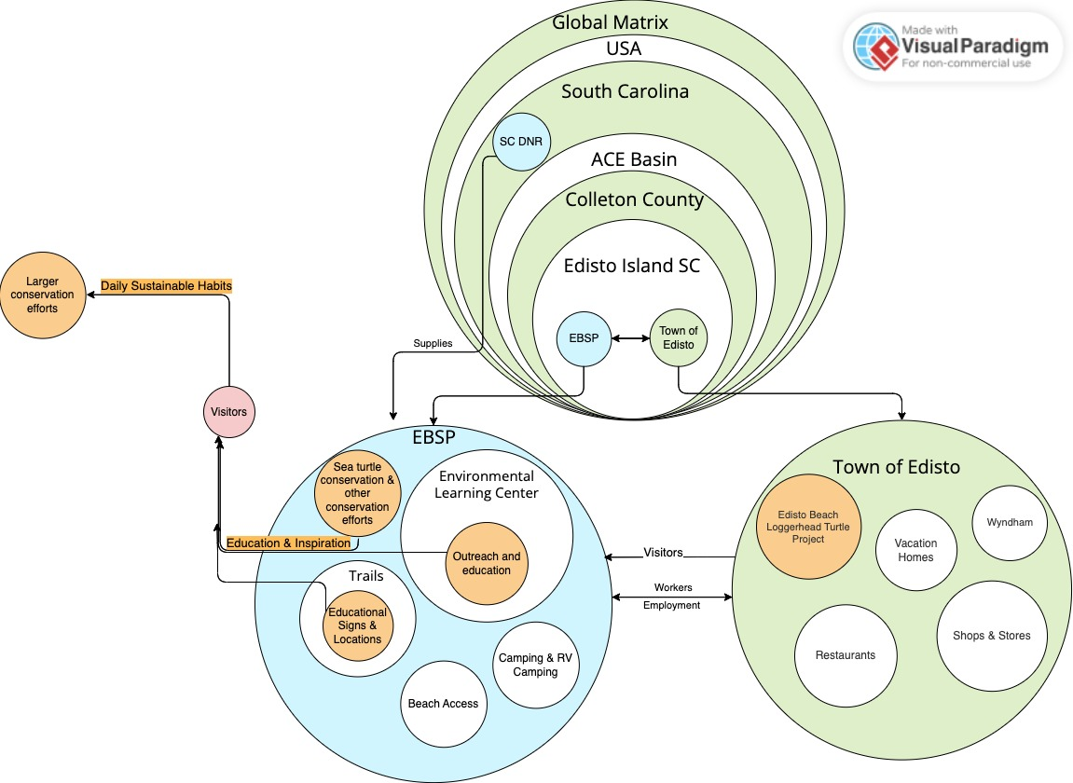
A deeper look: Conceptual Model
Notes:
The number of slides varies (we suggest no more than 15-20) but remember -- Use the slides as a prompt, not a crutch! You can put additional specifics you might need help remembering here in the notes section. Only you will be able to see it while in slideshow mode.

Slide 7
Conceptual Model Explained
Global matrix is everything outside of the system
Two parts of the system, EBSP & Town of Edisto
They are connected by workers and employment and visitors.
Visitors also enter the system from the global matrix
Other inputs include resources from the DNR
Blue represents the parks and DNR
Orange represents parts related to environmental stewardship
Pink denotes the visitors and social impacts

Slide 8
A deeper look: Stakeholder map

Slide 9
Stakeholder Map Explained
The stakeholder map introduces the stakeholders, plotting them based on their levels of interest and authority.
The main stakeholders (marked with red outlines) were identified as: EBSP, FRESPACE, DNR, Shops & Restaurants, and tourists
Blue boxes denote conservation activities, pink are social, and orange are economic.
The horizontal axis goes from low interest on the left to high interest on the right, and the vertical axis goes from high resources at the top to low resources at the bottom

Slide 10
System Fragilities & Hazards
Fragility definition: Fragilities are constitutional properties of the system that can lead to a breakdown in or harm to the system.
Hazard definition: Hazards are the forces that can exploit fragilities, they can be either internal (endogenic) or external (exogenic).
Example: Human bones are fragile in that they can be broken, and high force is the hazard that could exploit that fragility.
The following slides outline the fragilities, hazards, and potential outcomes.
They are divided into physical, social, and economic systems. In reality, these systems are highly interconnected and difficult to isolate neatly.

Slide 11
P H Y S I C A L
Fragility | Hazard | Outcome
Low lying land | Sea level rise | Inundation
 | Storm surge
 | Saltwater intrusion | Soil salination and loss of freshwater
 | Increased flooding | Inundation
Dependency on specific food types | Loss of dunes, maritime forest, & salt marsh | Biodiversity loss
Narrow range of food types
Need for terrestrial carbon storage | Marsh/maritime forest die-off | More atmospheric carbon, temperature increase, ocean acidification
Narrow range of temperatures & pH’s tolerable to marine life | Temperature increase & ocean acidification | Marine organisms die, biodiversity loss
Plants and animals need oxygen | Eutrophication | Anoxia
Location & beach composition, sensitive ecosystems on beach | Hurricanes | Loss of habitat and ecosystem
Edisto Island’s composition is mainly sand & marsh | Vegetation loss, erosion of dunes | Loss of storm buffer
Maritime forest & marsh vegetation tolerate narrow salinity ranges | Soil & water salination | Forest & marsh die, loss of habitat & biodiversity
Maritime forest & marsh vegetation tolerate narrow depth ranges | Sea level rise
Sea turtles & other reptiles have temperature influenced development | Rising Temperatures | Biodiversity loss

Slide 12
S O C I A L
Fragility | Hazard | Outcome
Limited staff capacity | Inability to fully achieve mission | No development of sustainable habits, or only superficial solutions reached
Self interested nature | Solutions to global modern change require selfless actions
Lack of future planning | Temperature increasing above the wet bulb temperature | If people cannot go outside, they cannot fully gain the Park’s message
Tourist’s expectations | Messages interfere with expectations | Conservation actions are not taken seriously during trip, and forgotten upon return to daily life
Lack of understanding about scientific permits | People feel entitled or qualified to engage with protected species | More harmful interactions due to park activities
Overwhelming and discouraging information | Hopelessness & helplessness | People do not develop more sustainable lifestyles, or only superficial solutions are reached
Habits are difficult to change | Daily obligations can cause people to stop sustainable habits

Slide 13
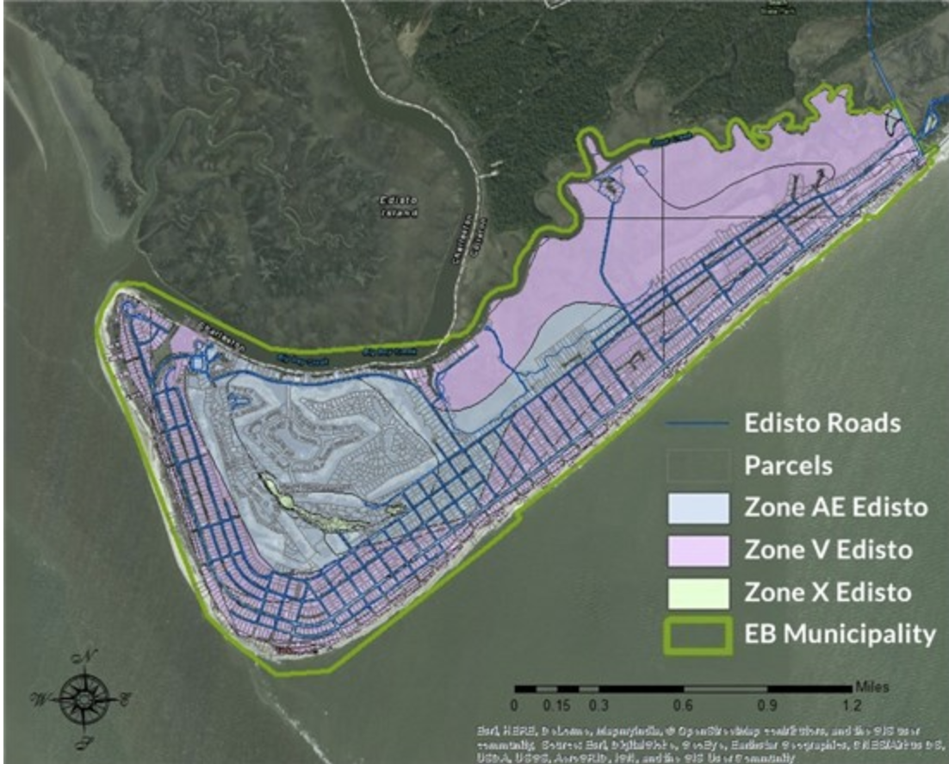
E C O N O M I C
Fragility | Hazard | Outcome
Built environment at low elevations | Sea level rise, storm surge, nuisance flooding | Inundation, loss of buildings and infrastructure, expensive repairs or protection measures, loss of tourist activities
Fisheries depend on stable environmental conditions | Sea level rise, temperature change, ocean warming, eutrophication | Loss of revenue and disruption of tourist activities
https://www.townofedistobeach.com/flood-info
Map of flooding vulnerability from the town of Edisto Beach website. As can be seen it covers the whole island.

Slide 14
Foresight and Possible Futures
The foresight and possible futures are based on the hazards of the system and the fragilities they exploit.
A prognosis will be stated for a range of possibilities for each hazard and fragility combination.
These will range from plausible to implausible and desirable to undesirable, allowing each possible future to be explored fully.
Sea Level Rise, temperature increase, biodiversity & habitat Loss, increased tourism, mental shutdown, ineffective message receival, and extreme weather are the scenarios explored.

Slide 15
Sea Level Rise
Controlled Retreat
Desirable and implausible.
Sea level rise is slow enough to allow the physical system to migrate inward.
Efforts are used to educate visitors about sea level rise mitigations. This future is
Not probable because many areas inland of the park are privately owned or already managed.
Educational expansion, no retreat
Plausible but less desirable.
Increased outreach and available information about sea level rise
No efforts to move or retreat.
EBSP would educate people on the issues of sea level rise, but may not inspire people to change as the park would not be leading by example.
Ignorance
Least desirable.
No effort made to mitigate the effects of sea level rise.
EBSP is lost and does not provide education or outreach for visitors.

Slide 16
High SLR (10 ft), island fully submerged
Medium SLR (5 ft), island partially submerged or converted to marsh
No change (0 ft), island remains the same

Slide 17
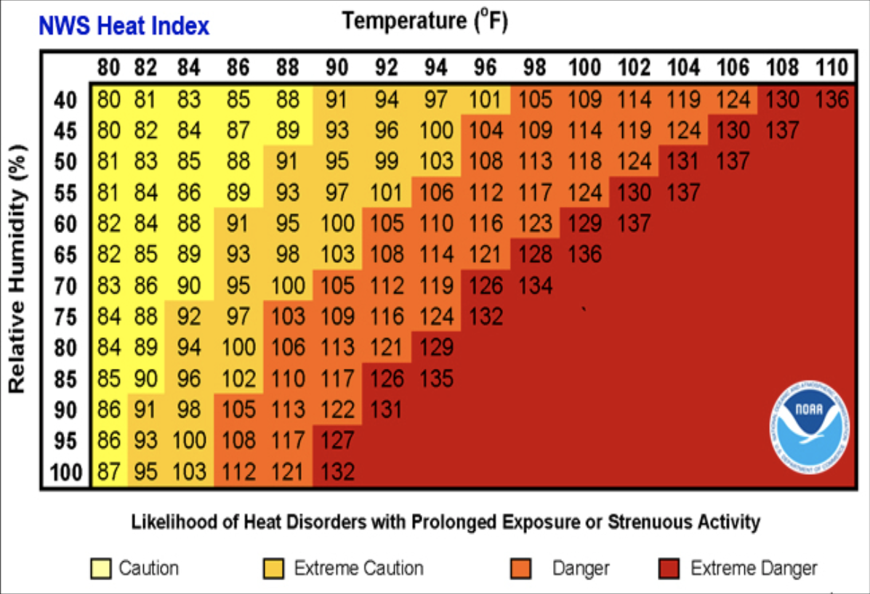
Temperature increase
Little to No Increase:
Desirable and implausible.
No increase is no longer possible based on current emissions.
Moderate Increase:
Plausible.
Currently seeing the effects of moderate change.
Personal changes could still have an effect
Massive Increase:
Undesirable but increasingly plausible.
Would halt park operations
Major disruptions in the ecological system.
Personal changes would have little to no effect.
As can be seen in this chart, as both temperature and relative humidity increase so does the potential for heat related health risks.

Slide 18
Biodiversity and Habitat Loss
Some Mitigation
Plausible and desirable.
Already headed in this direction.
Ecosystems are protected, protecting the biodiversity within. Increases in protected species and areas.
System Transformation
Implausible but highly desirable.
Physical and ecological components work to support each other.
Human system would be set up in such a way that the ecological system would be protected by it and integrated for the benefit of both.
EBSP message provides a map towards this future (potentially aided with virtual reality programs).
No Mitigation
Implausible and undesirable.
No measures are put in place or enforced to protect habitats and biodiversity.

Slide 19
Increased Tourism
Tourism over Environment
Undesirable.
Tourist behaviors come before conservation efforts.
EBSP has failed to inspire visitors to become environmental stewards.
Slowed Tourism
Undesirable and implausible.
Less visitors reduces any outreach or education, EBSP would be unable to inspire visitors.
Increased hurricanes, a decline in economic stability, and temperature increases making it too dangerous to be on the beach could cause this.
Ecotourism
Desirable and plausible
People would be coming to EBSP to vacation and travel sustainably.
Previously absorbed its message or would be engaged with the information provided by the park.

Slide 20
Mental Shutdown
Ignorance
Undesirable and plausible.
Existential dread causes people to coping by hiding from the issue.
For example: "It is not as bad as they are saying" or "Someone else will solve this, it does not have to be me."
There are many variations, as seen in the biases of the population.
Limited Inspiration
Desirable and plausible.
Inspiration to engage in lifestyle changes, but none that would majorly change the interactions of park visitors with the environment.
A continuation of the existing scenario.
Transformative Inspiration
Highly desirable.
Experiences provided by EBSP both inspire and enable change within the lives of park guests.

Slide 21
Ineffective Message Receival
Not Received
Undesirable future.
Messaging from EBSP did not reach its visitors. This future is not implausible if little to no changes are made.
Incorrectly received
Plausible and undesirable
Information provided by EBSP is not sufficient to give visitors the full picture of what kinds of actions are needed to become better environmental stewards.
Message Received Correctly
Most desirable.
EBSP is successful at inspiring people to be better environmental stewards (potentially aided with virtual reality programs).
Creates long-lasting change, including the implementation of more sustainable action at home and advocating for environmental issues.

Slide 22
Extreme Weather (focus on hurricanes)
No Change
Most desirable, implausible.
Frequency and intensity of incoming hurricanes remain the same.
Based on the current warming trends there will be an increase in the frequency of tropical depressions and storms.
Intensity increase, no mitigation
Undesirable and implausible.
The system would do nothing to mitigate more intense storms.
This is unrealistic because the system is already accustomed to mitigating the effects of strong hurricanes.
Intensity increase, with mitigation
Desirable and plausible
Better evacuation information is provided (potentially aided with virtual reality programs).
Conservation programs develop more effective mitigations through protection, restoration, and migration of buffering ecosystems.

Slide 23
Interventions & Recommendations
There are a great many possible interventions that would prove beneficial. These occur on both a large and small scale, with varying degrees of impact.
Recommendations are a continuation of the interventions. They have been analyzed and modified such that they can be suggested to the host. The best effort has been made to make them both highly effective and possible to implement.

Slide 24
Social Interventions
Social media programs ($)
Pros: These would help the park reach a wider audience over a greater distance. Existing outreach blogs could be expanded or used as a model.
Cons: This would take time and more importantly reliable access to internet within the park.
Animal art projects ($)
Pros: This would help generate awareness and positive experience with species in the ELC, it could also help raise funds directly for park projects.
Cons: It may cause stress to animals, take time for employees, and require highly specific supplies.
Access to the internet ($$$)
Pros: Access to internet would expand the resources available for both staff and visitors.
Cons: It is not currently possible given park resources and authority.
Monthly sustainability challenges ($)
Pros: They would help to engage people after their visit and would inspire positive action.
Cons: Mailing list may be hard to establish, might get relegated to spam, or need some other motivating factor for participation.
An actionable list ($)
Pros: This would help visitors engage in sustainability at home. It would remove the guesswork by giving direct actions.
Cons: Visitors may not understand the significance of each action, the list may be too long and overwhelming, and it it limited to guests who choose to take the flyer.

Slide 25
Educational interventions
Virtual reality (cost $$$)
Pros: Illustrates and expands educational programs about climate change and sea level rise
Cons: To be effective they must be emotionally moving, which risks causing mental shutdown.
New trail signage ($$)
Pros: It would help illustrate and expand educational programs.
Cons: The cost of replacing the signage may take time to accumulate and interfere with other expansion projects.
Specific sustainability programs (Cost $)
Pros: It could be beneficial to have one directly about sustainability.
Cons: It would take time and may not gather much visitor interest as other programs would.

Slide 26
Physical Interventions
Water bottle filling station (Cost, $$)
Pros: This is commonly requested and would help to reduce the overall ecological footprint of the park.
Cons: The plumbing cost and disturbance from installation may be disruptive to other goals.
Purchasing areas for SLR retreat (Cost $$$$)
Pros: It would be beneficial to begin looking for alternatives to the current system as sea level is rising.
Cons: It would be very expensive and could damage the park’s credibility if the surrounding properties are not interested.
Solar panels, compost, & increased recycling (Cost, $-$$$)
Pros: This would make the park more resilient and show visitors how to be more sustainable at home.
Cons: Depending on which action is carried out, the cost could be very great. Alternatively, the proposal may not be efficient given the nature of the campgrounds and cabins.
Transitioning all park vehicles to electric ($$$)
Pros: This would reduce the park’s impact and therefore help to mitigate warming and its associated issues like hurricanes.
Cons: It would be expensive and it may require expansion of park infrastructure to accommodate charging them.
Increase permeable surfaces & rain management ($-$$$)
Pros: Permeable pavement options would help to reduce both heatwaves and issues from rainwater runoff. Rainwater gathering systems would also aid in this and help reduce the water waste in the park
Cons: Depending on which action is carried out, the cost could be very great.

Slide 27
Recommendations
Recognizing that
EBSP already has many significant educational programs and;
Is limited by funding and regulations;
And by the receptiveness of their guests.
Acknowledging that EBSP is
Aware of how to engage guests of all kinds on a diversity of levels;
Already working towards a more educated populous regarding ecological systems and conservation.
It is recommended that
Virtual Reality displays are implemented in the ELC to show the potential effects of biodiversity loss, climate change, and SLR on the system.
The interpretive staff of EBSP generate a specific program regarding ways to become more sustainable and how these eco friendly habits positively impact the environment.
A handout containing daily sustainable habits be given out at Park information areas.
A series of monthly sustainability challenges be distributed via email to interested persons.
Social media programs such as Instagram pages, Facebook, blogs and other platforms become more active, featuring ways to become better stewards.

Slide 28
Recommendations
Recognizing that
EBSP is limited by funding and regulations for infrastructure changes;
And that these changes may be rendered redundant in the face of rapid SLR.
Acknowledging that EBSP is
Making significant efforts to be sustainable as an institution, and may lack the resources currently to implement significant infrastructure changes.
Already working towards a more educated populous regarding ecological systems and conservation.
It is recommended that
EBSP interpretive staff works to generate new trail signage to specifically highlight environmental issues, including information regarding the following infrastructure change recommendations.
EBSP management works towards the implementation of water bottle filling stations at central park locations.
And the implementation of better waste management systems, including rain catchment, permeable parking surfaces, compost, and more efficient recycling.
Over an extended period of time solar panels be implemented on all buildings from cabins to administrative structures, and the gas powered vehicles be replaced with electric as they get retired.

Slide 29
To summarize!
Visitors
Education
Inspired stewards
Experiences
With some of these proposed mitigations, visitors, educational programs, and experiences combine to create inspired environmental stewards leaving EBSP
EBSP
Notes:
Other examples of presentation enhancements might include audio clips, charts and graphs, or accompanying handouts or worksheets.

Slide 30
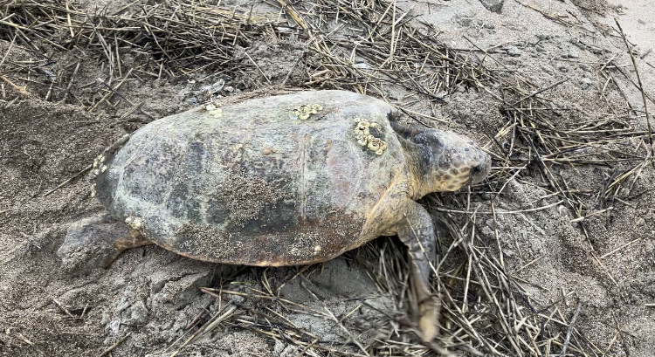
In the End….
The case study enabled me to generate ideas which benefit EBSP and their mission.
I gained a tremendous amount of field experience and enhanced my interpersonal communication skills.
It is a point of pride that I have been able to work with EBSP and on projects that will directly improve the ecological footprint of the park
Including rain water runoff systems and informational materials
My main takeaway has been that for every ecological challenge there are extremely dedicated and intelligent people working to meet them. I am honored to have worked among them.
Notes:
What’s the “take home” message for your audience? What do you REALLY want them to walk away knowing?

Slide 31
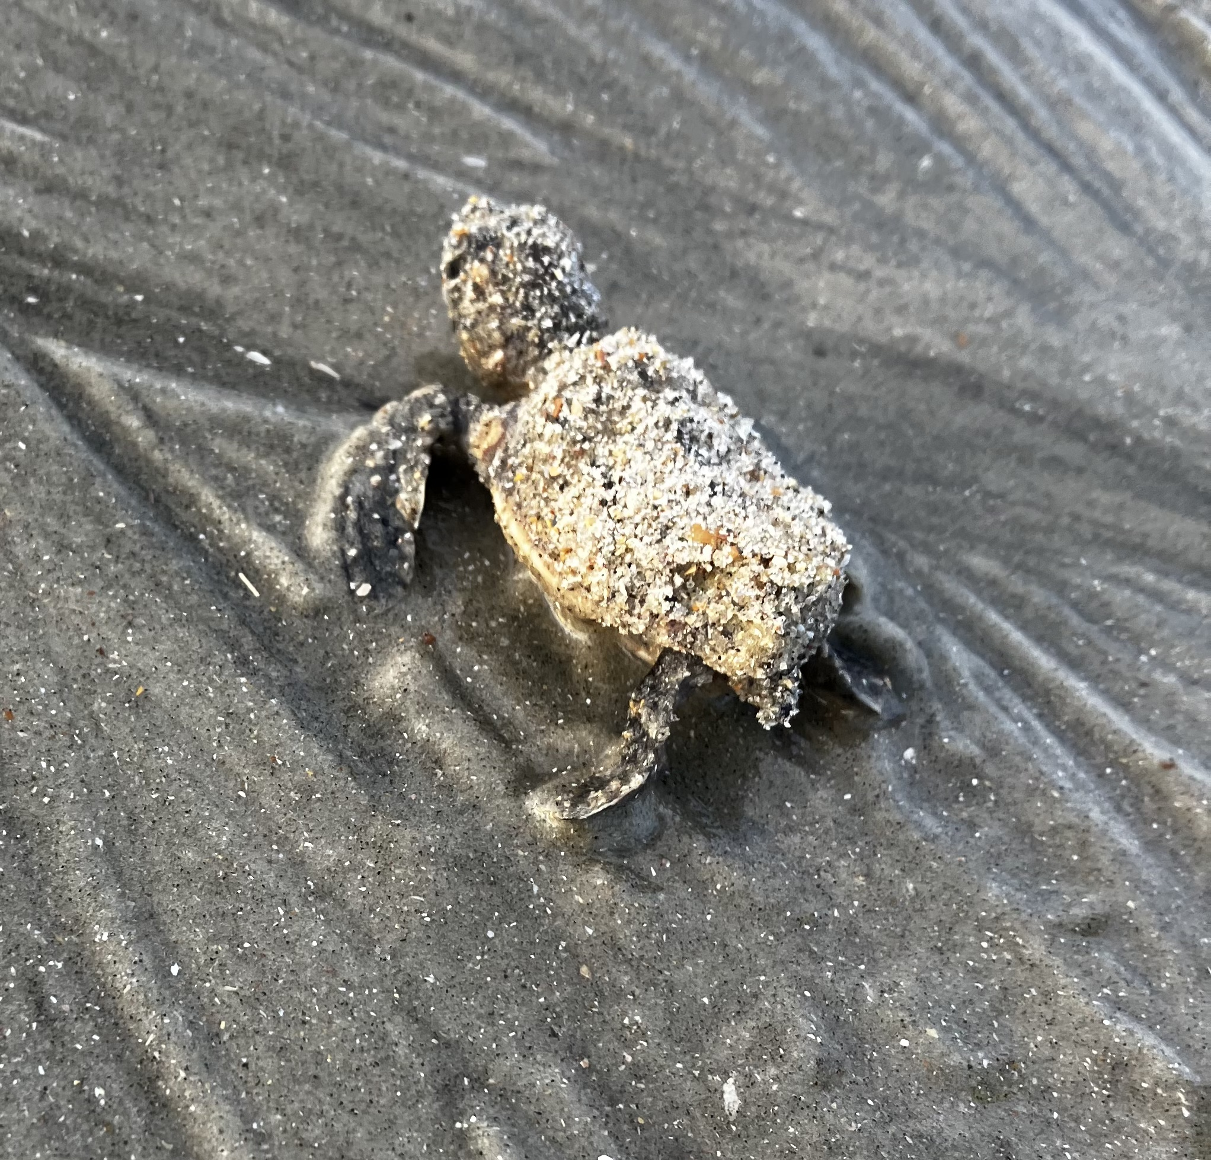
Thanks for your time!
Notes:
Always include a closing slide with “thanks” and contact information.

