Slide 1
City of Norfolk – Urban Forestry
Blaizen Buckshot Bloom

Slide 2
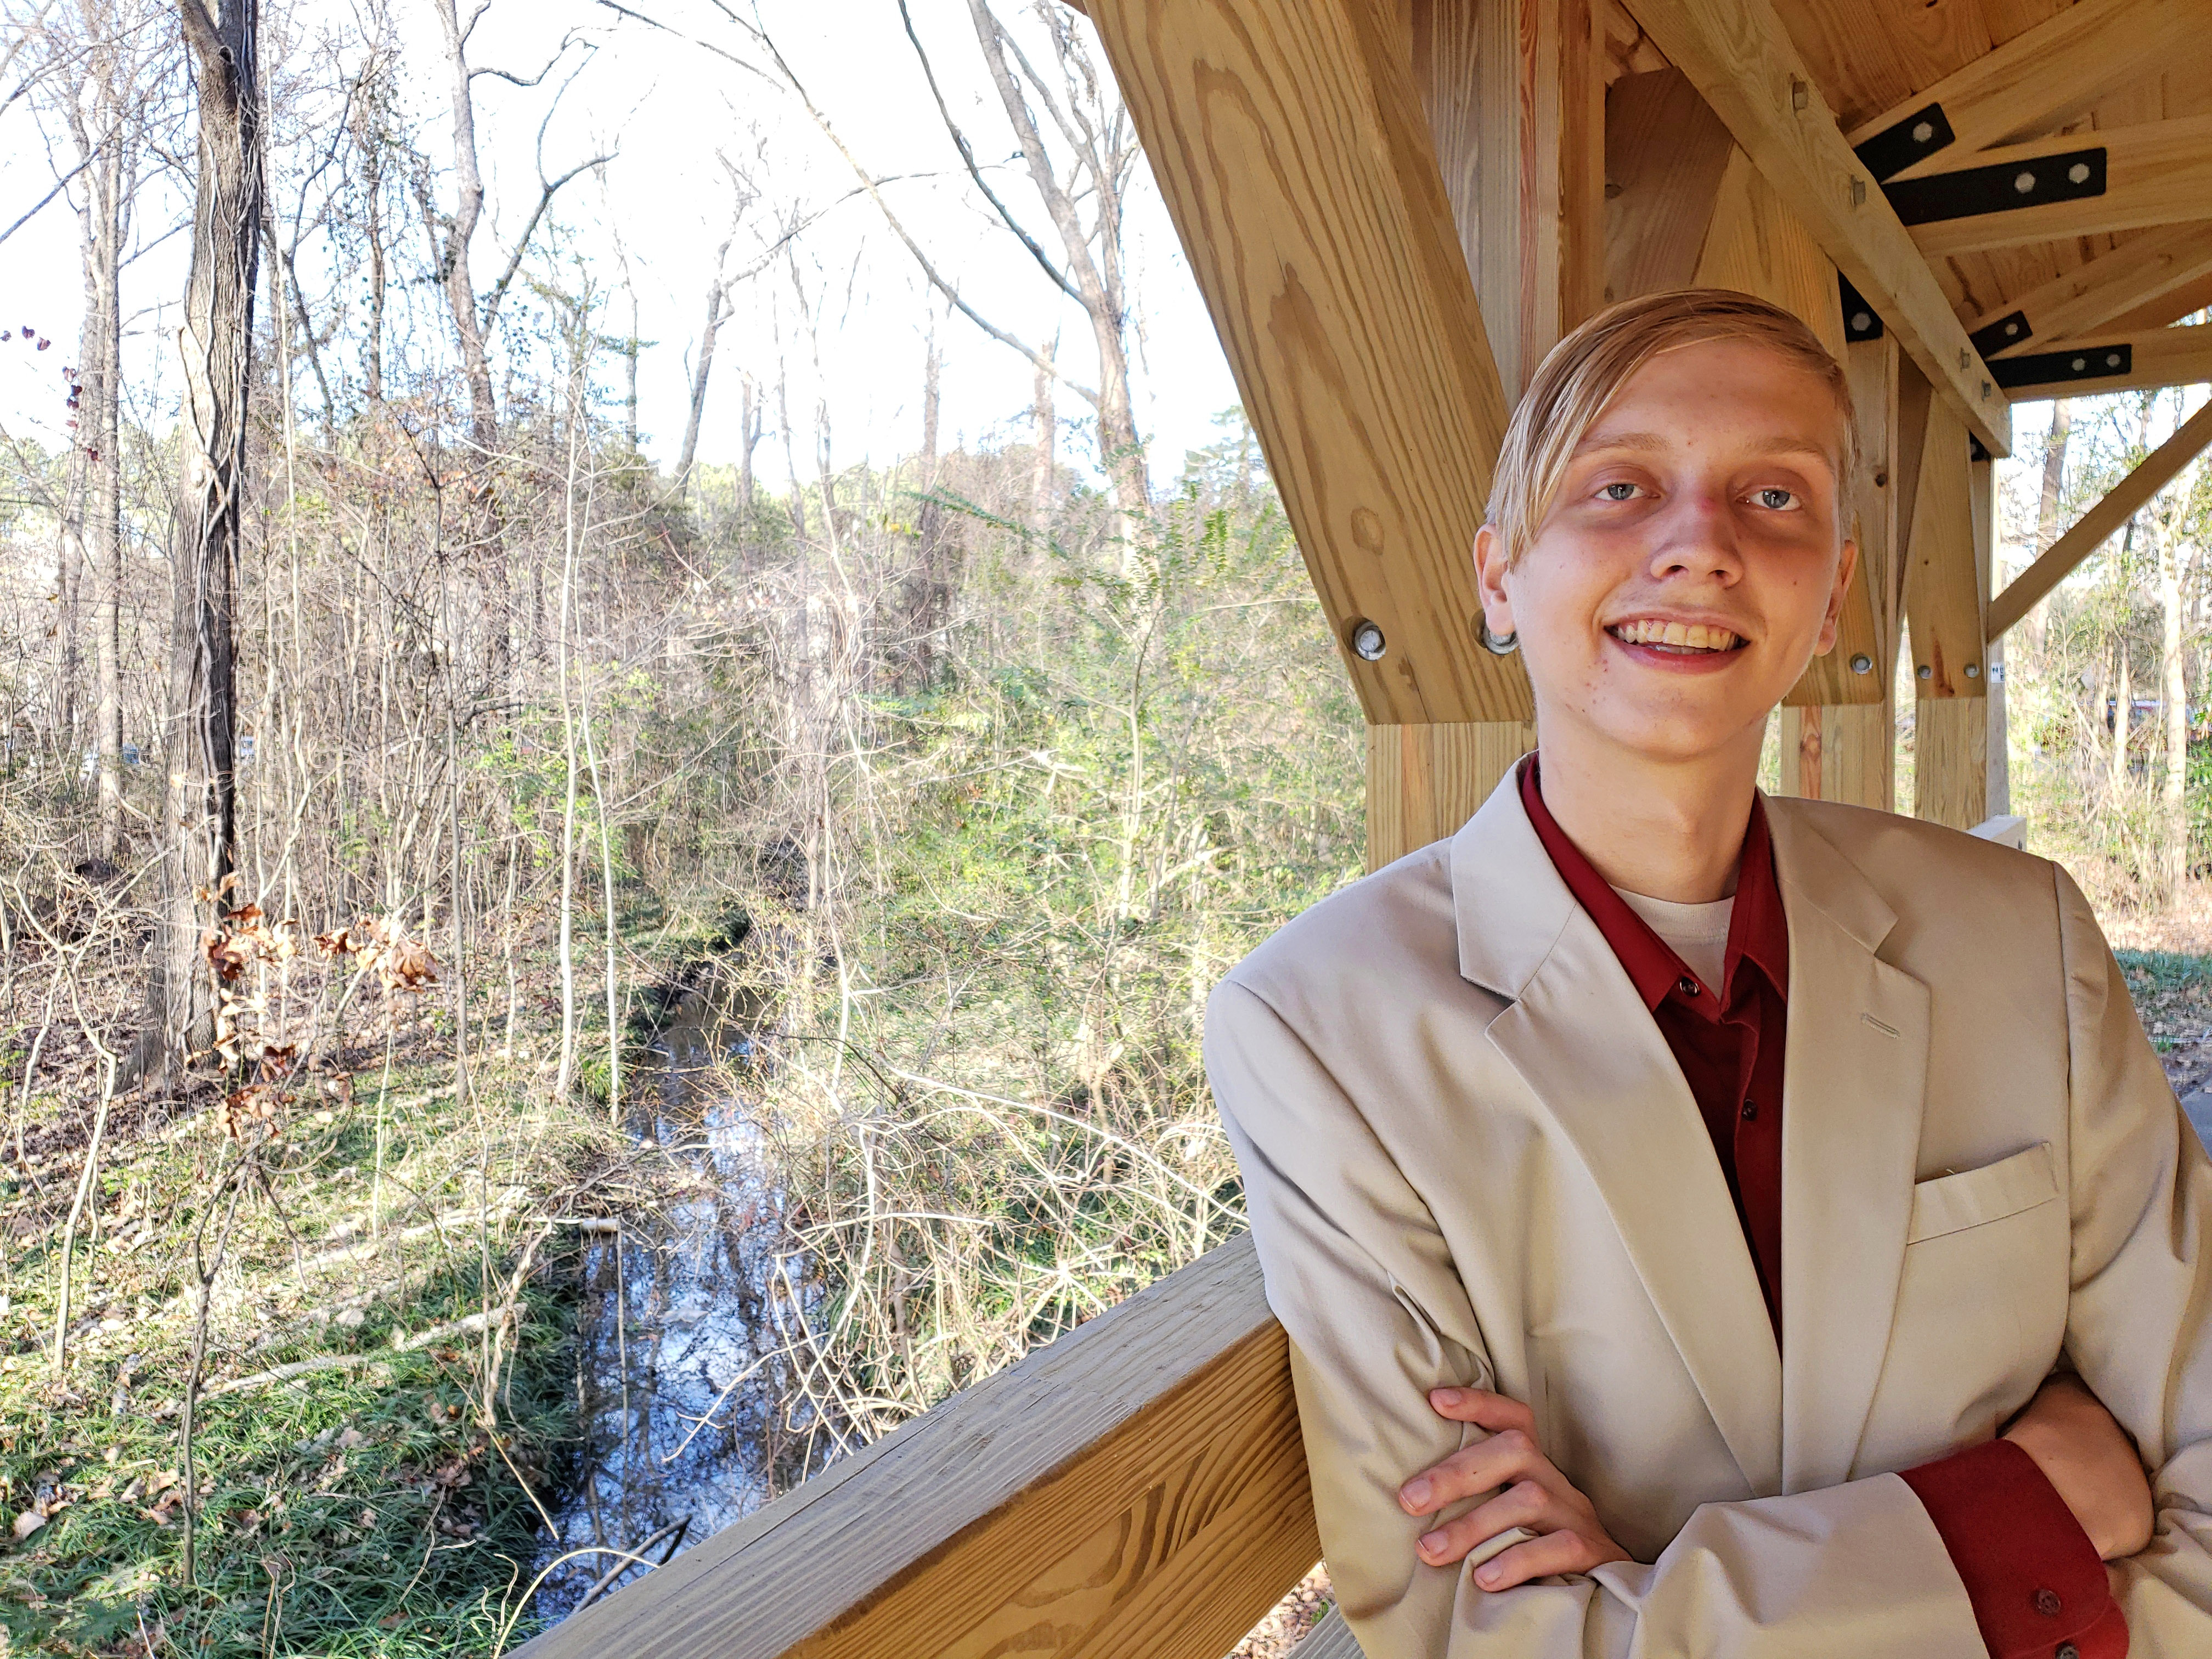
Who am I?
Blaizen Buckshot Bloom
Rising Senior
Major: Ocean & Earth Sciences
Minors: Political Science / Sustainability & Conservation Leadership
Ran for School Board for Chesapeake, VA in 2022
Passionate about Environmental Policy on Wicked Problems & Societal Injustices
Notes:
Try to establish a rapport with your audience by balancing personal details with relevance. For example, you might be passionate about coin collecting, but unless you’re giving a talk the local chapter of the American Numismatic Society, that may not be relevant to the presentation (<-----See what we did there? Did you even know the word “numismatic” before today?)

Slide 3
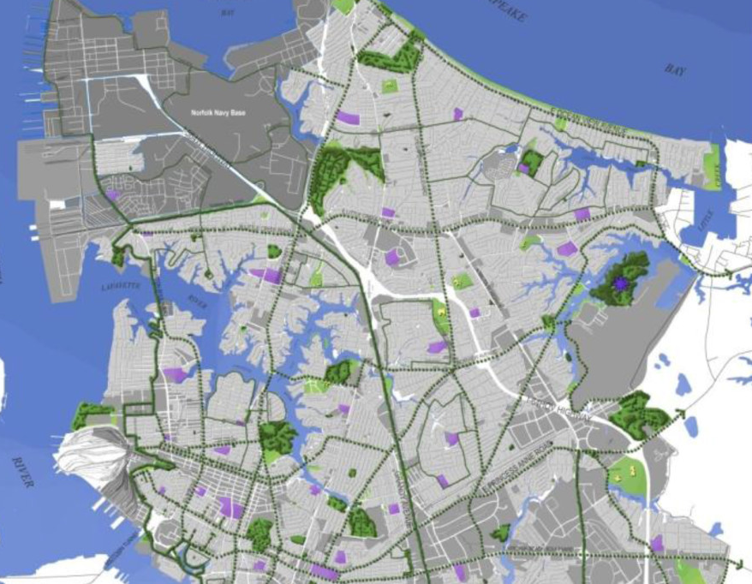
City of Norfolk’s Urban Forestry Department
About
Subset of Parks & Recreation
Manage 200,000 trees across the City
80,000 are considered street trees
Service’s Provided
Servicing of Urban Forests within the City
Scale of necessity for trees posing public danger
Free tree planning & advising within the City
Celebrate Trees Initiative
Notes:
Use the slides as a prompt, not a crutch! You can put additional specifics you might need help remembering here in the notes section. Only you will be able to see it while in slideshow mode.

Slide 4
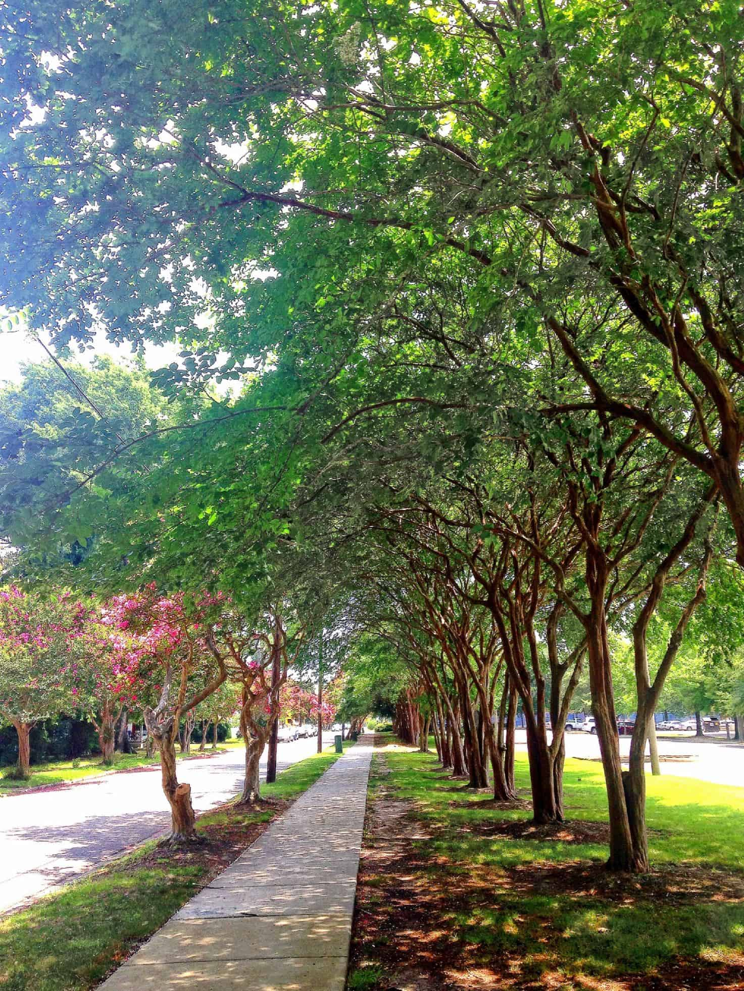
Topic of the Case Study?
Under Consideration
Racial Inequities in Urban Canopy Concentration
Negative impacts from urban heat island effect
Consequences in natural flood mitigation
Notes:
The number of slides varies (we suggest no more than 15-20) but remember -- Use the slides as a prompt, not a crutch! You can put additional specifics you might need help remembering here in the notes section. Only you will be able to see it while in slideshow mode.

Slide 5
Approaching the Study
Internship Opportunities
Review existing literature and efforts by the City
Compile and Analyze current data of canopy distribution in Norfolk & cross-reference with census data
Solicit feedback on existing policies & input on possible future possibilities from historically marginalized communities
Developing a plan of research & execution within the period of the case study.
Experience in municipal environmental management & policy crafting
Mix of office & field work
Opportunity for collaboration with everyday people most impacted by consequences of case study topic
Possibility of incorporating educational components into the study’s interventions
Notes:
What’s the “take home” message for your audience? What do you REALLY want them to walk away knowing?

Slide 6
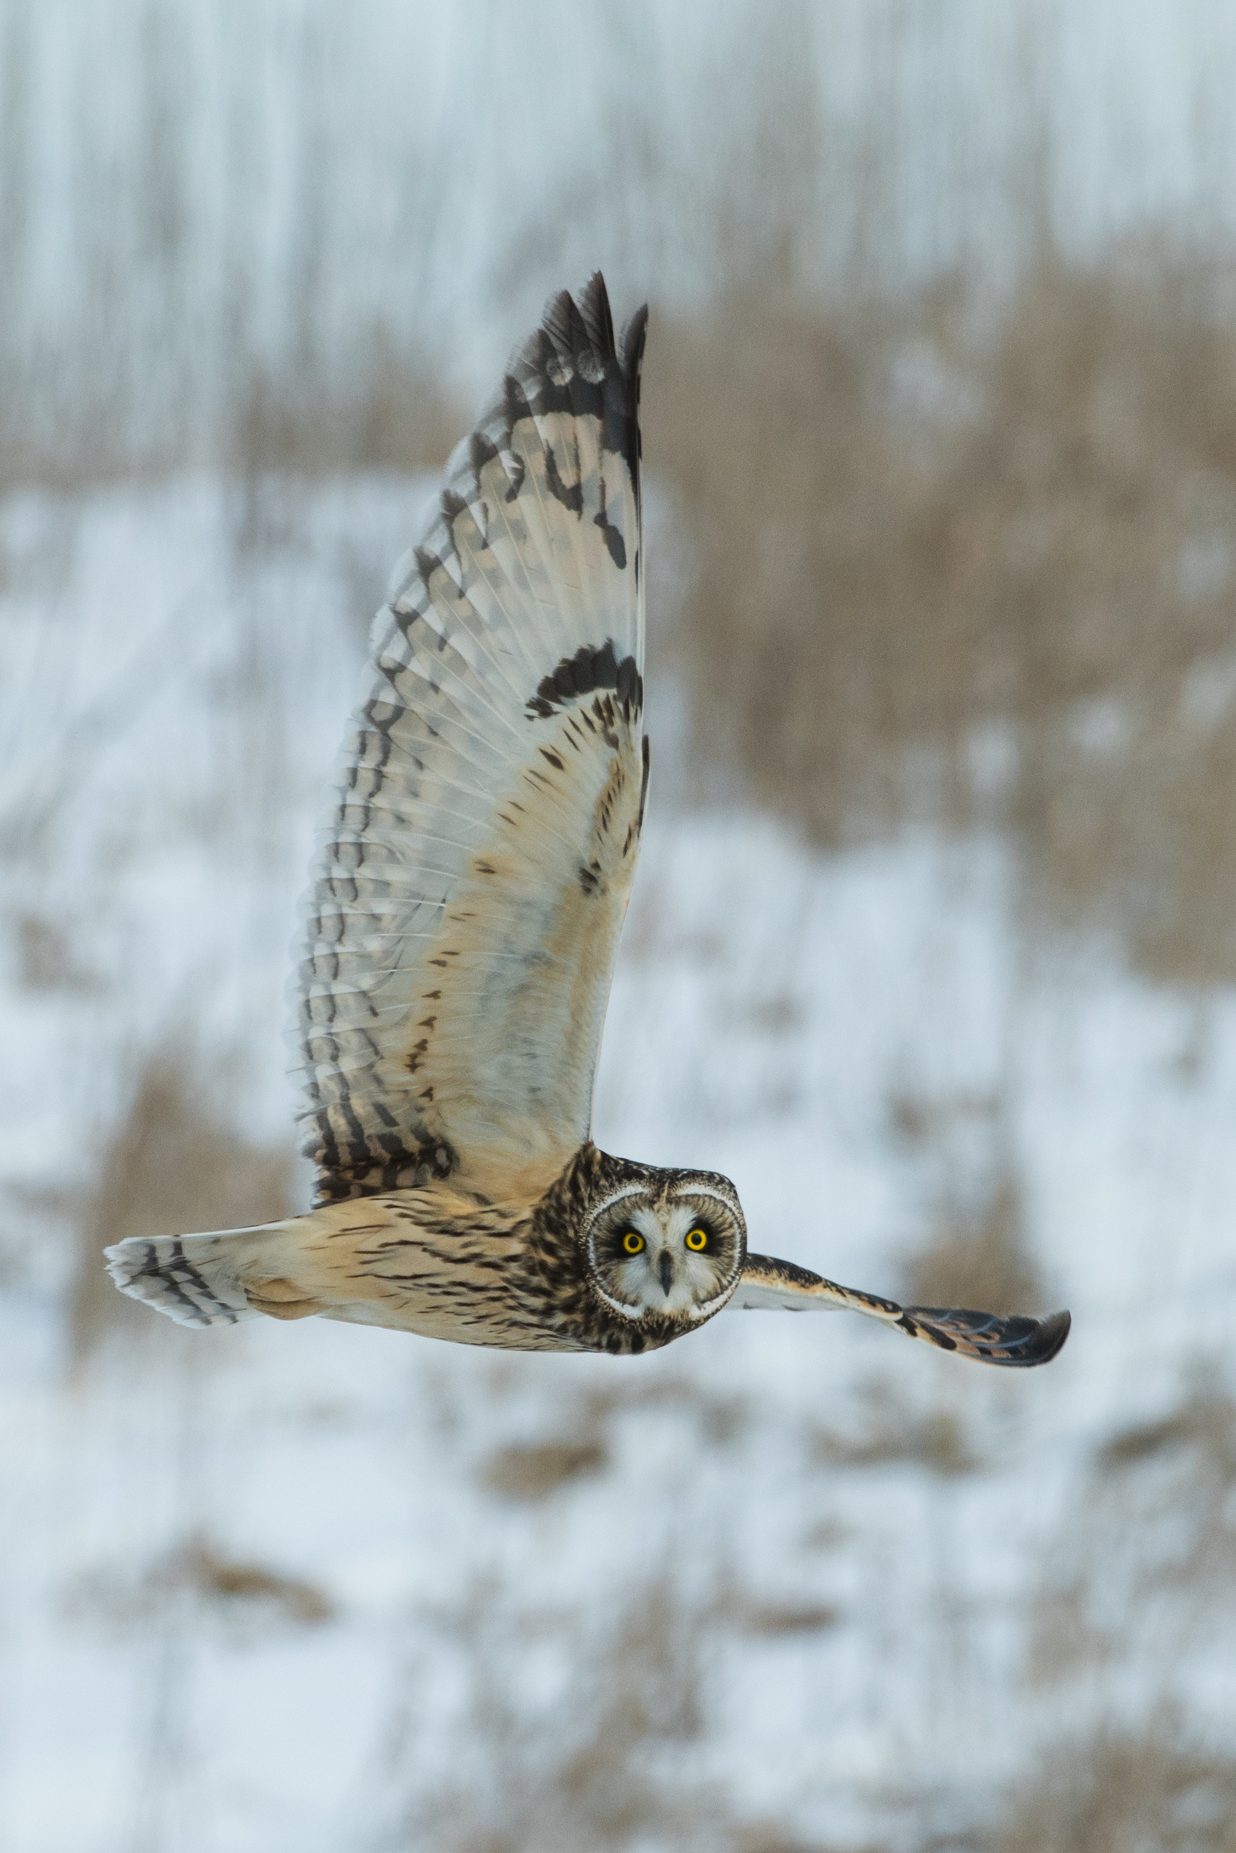
Thanks for your time!
PowerPoint Template by
Dr. Alison Sasnett, US Fish and Wildlife Service
703-358-2647
Photo by Richard Lee
Notes:
Always include a closing slide with “thanks” and contact information.

