Slide 1
Back Bay National Wildlife Refuge
By Meagan Duncan

Slide 2
Meagan Duncan
Marine Biology
Research:
Bioprospecting potential of coastal invertebrates
Coral reef conservation and restoration
Global warming and its impacts on microscopic communities found in arctic ice

Slide 3
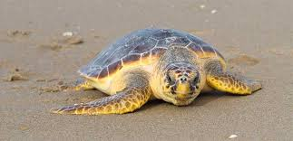
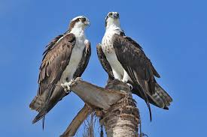
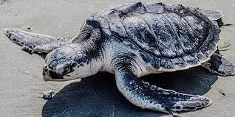
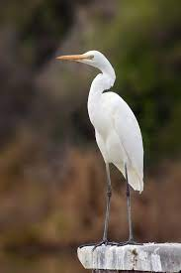
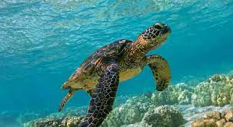
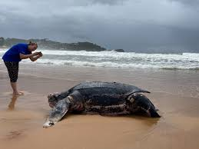
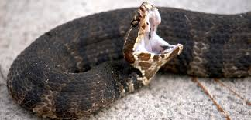
Back Bay National Wildlife Refuge
June 6, 1938→Waterfowl refuge to preserve healthy bird populations for hunters
Currently:
Sanctuary for wintering waterfowl
Provides habitat for many species (densest population of cottonmouths in U.S.)
Protected nesting site of four different species of endangered sea turtles
Loggerhead
Kemps Ridley
Green
Leatherback

Slide 4
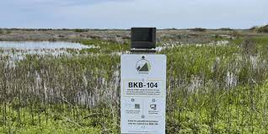
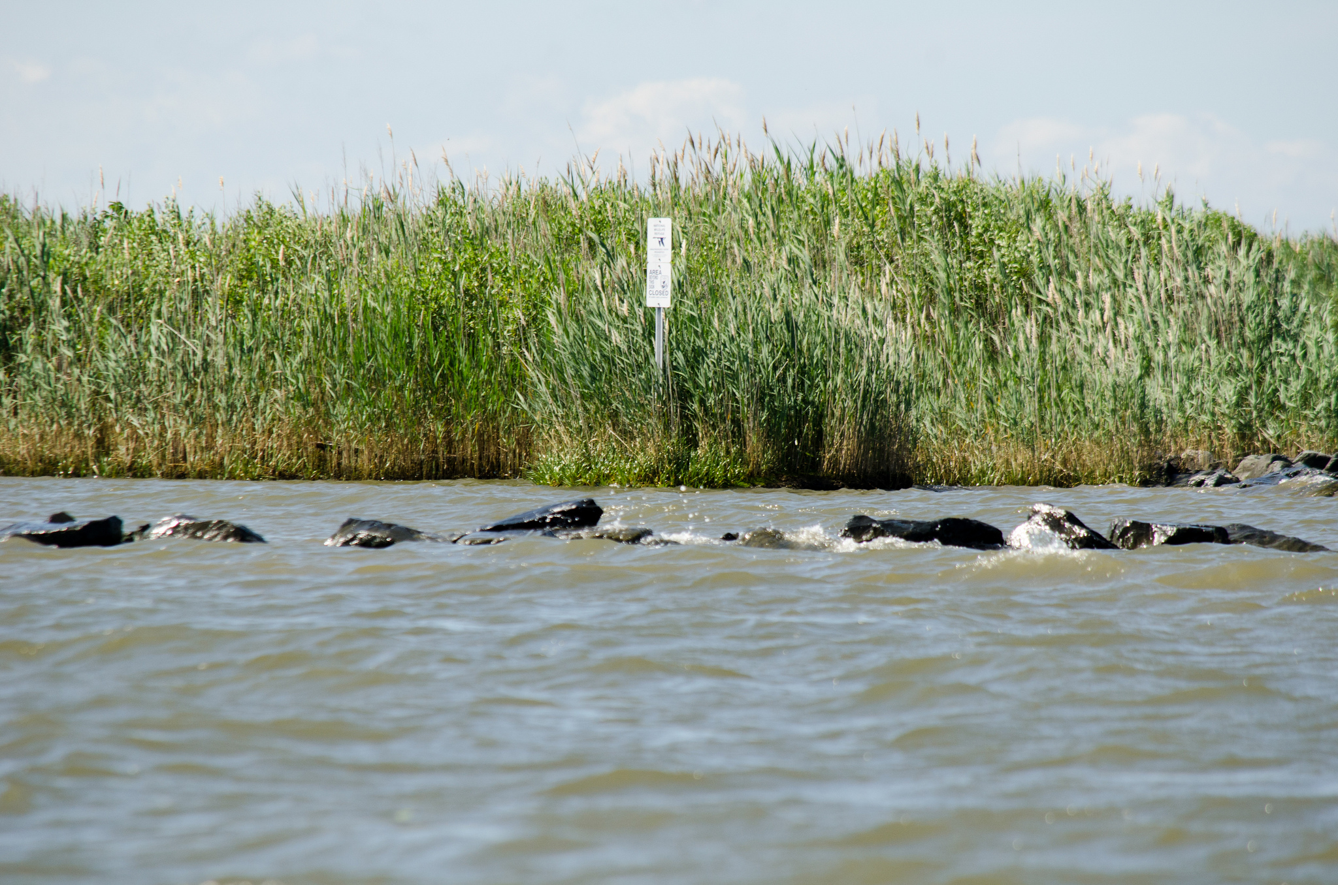
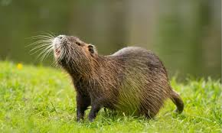
What’s the Problem?
Freshwater wetland impoundments are drained/flooded to accommodate seasonal habitat needs
Two Main Options:
Adaptation to Changing Climate
Complex system → how to successfully adapt?
Limited funding/staffing
Conflicting interests with visitors to Sandbridge Beach
Potential saltwater Inundation of impoundments from storm surge
Controlling invasive species
Non-native vs invasive
Phragmites → monoculture within wetland
Nutria → destroy root systems of beneficial species
Visitors (Ignoring warnings to disturbed nesting sites and pollution/destruction issues)

Slide 5
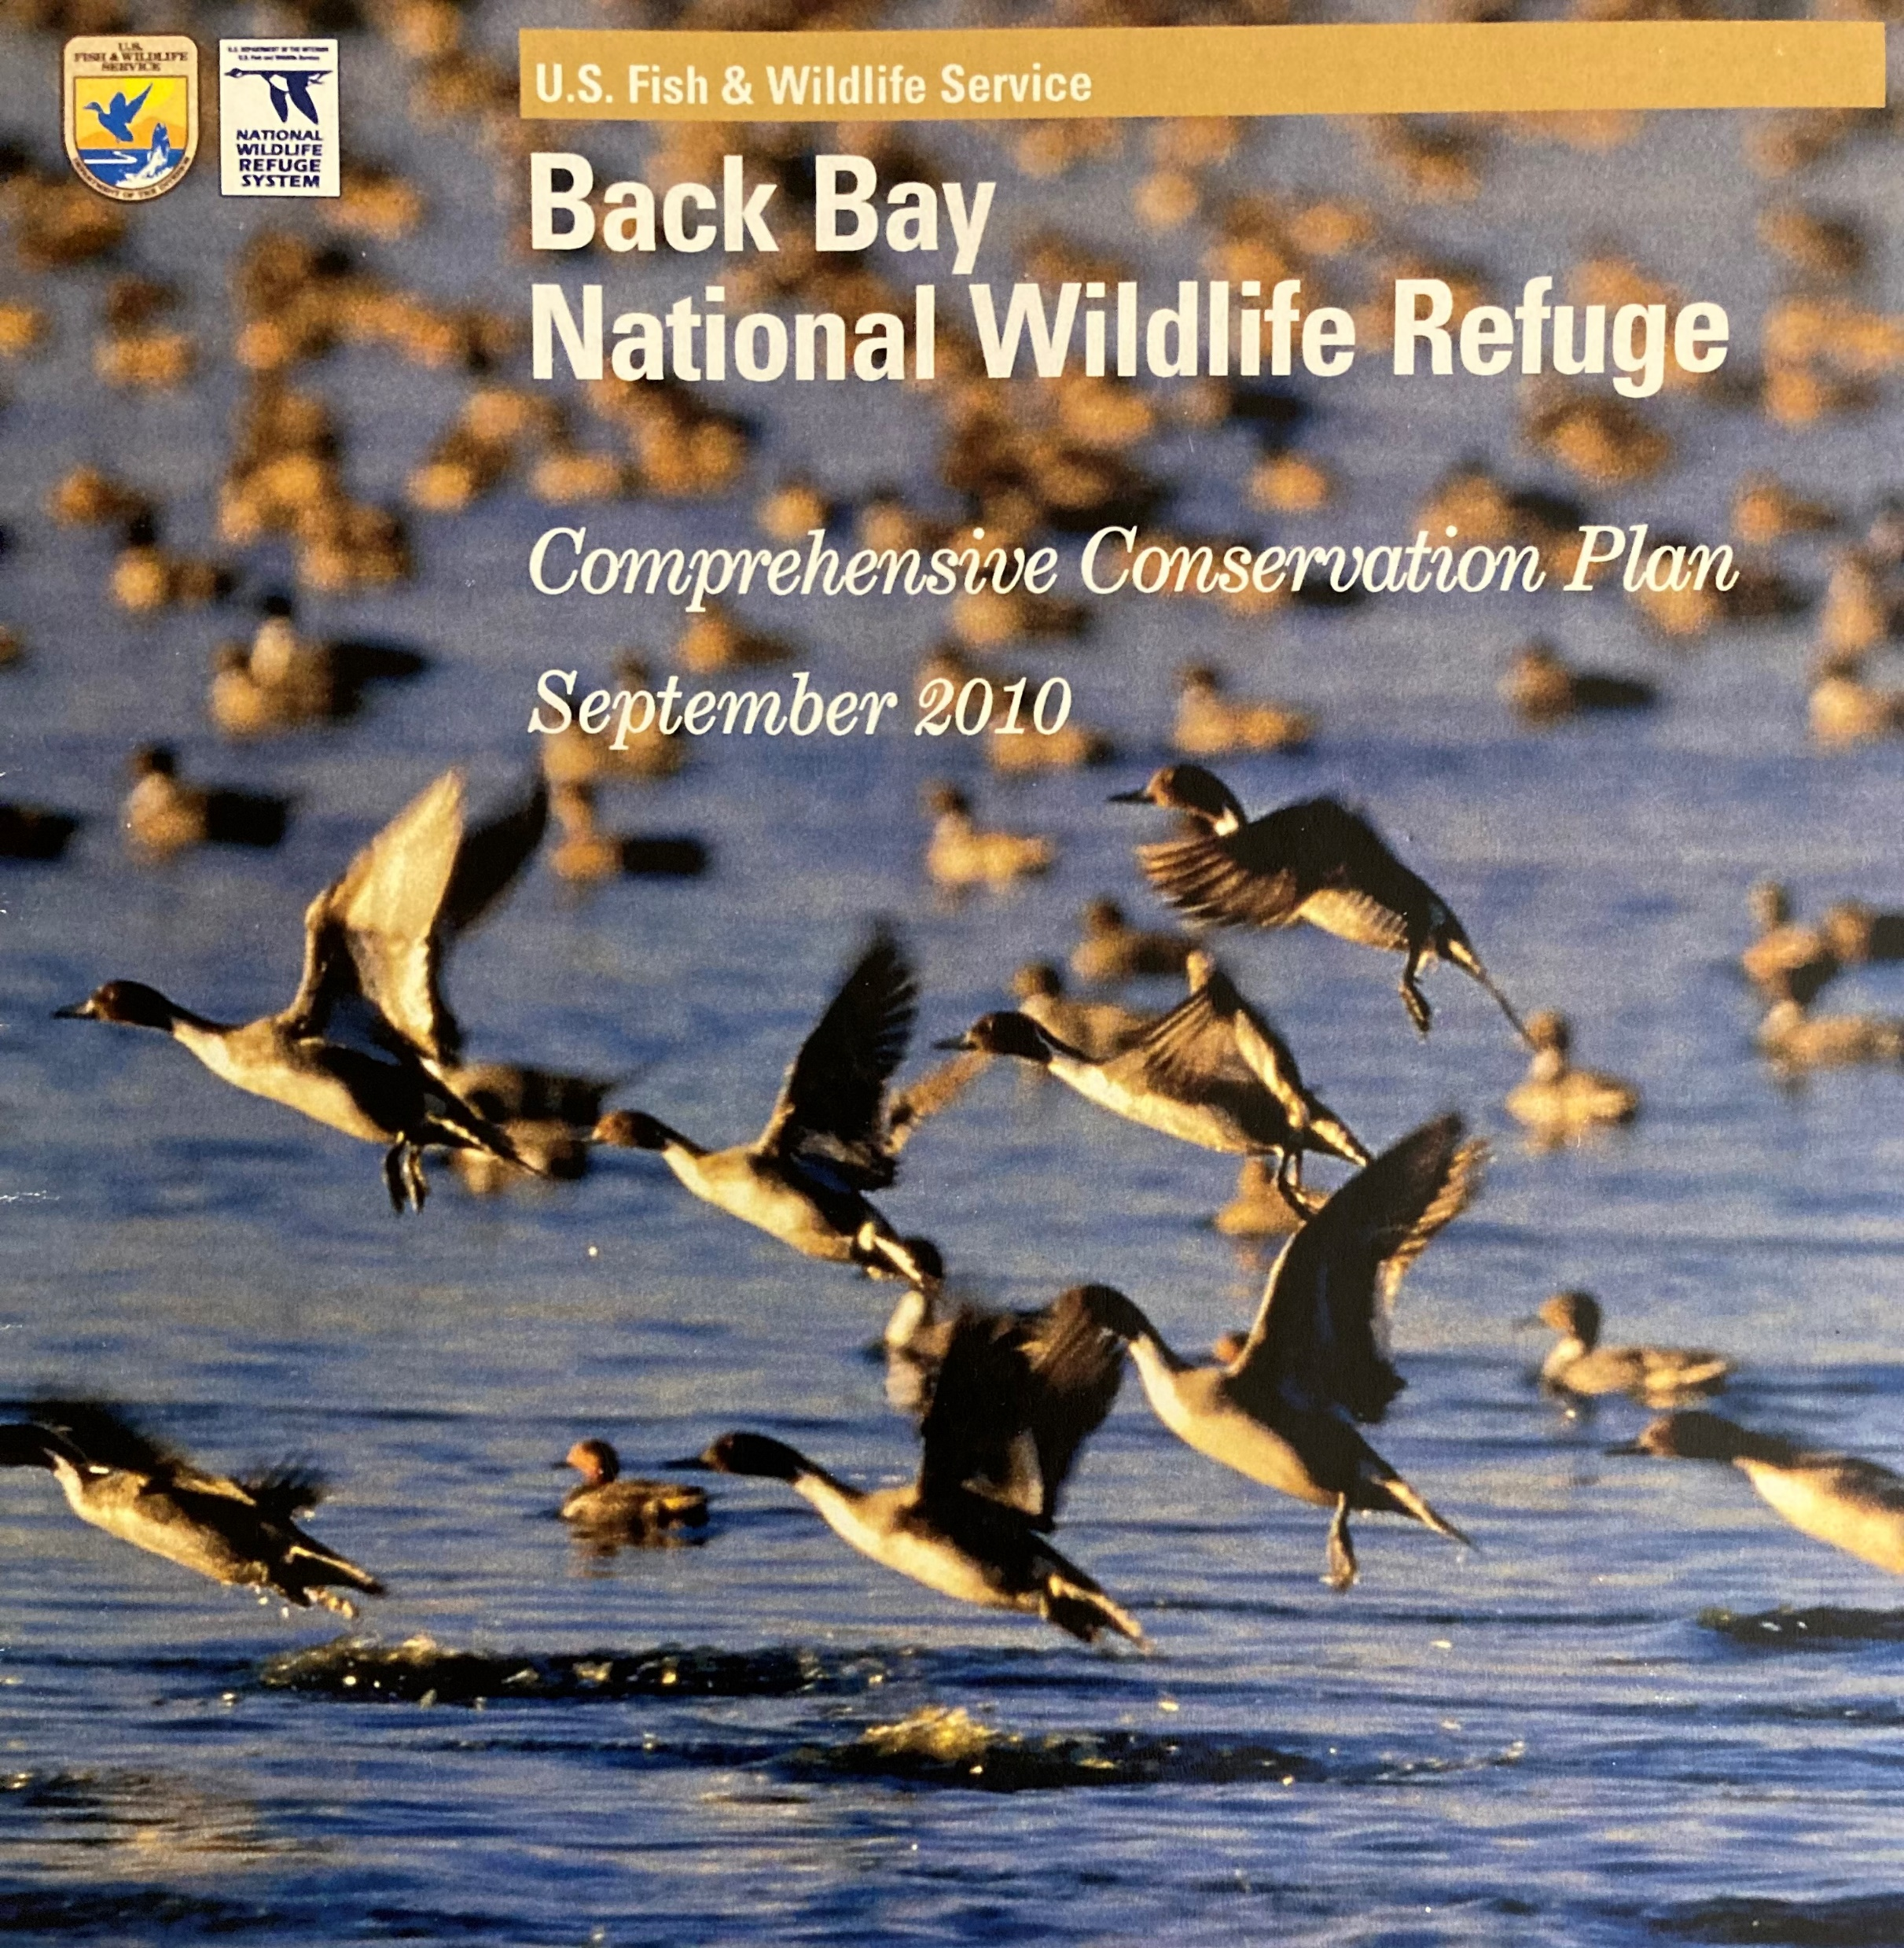
MARI Case Study Template
Rules:
Comprehensive Conservation Plan 2010 (15 years)
National Wildlife Refuge System Administration Act of 1966 (AMD. 1997)
National Environmental Policy Act of 1969 (NEPA)
Endangered Species Act of 1973
FWS service manual
Code of Federal Regulations (FWR)
National Wildlife Refuge System Improvement Act 1997
Appropriate Refuge Uses Policy
USFWS Final Compatibility Regulations and Policy 2000
Wildlife Dependent Recreation Policy (Part 605 Ch 1-7)
Maintaining Biological Integrity, Diversity, and Environmental Health Policy (601 FW 3)
Stakeholders:
Migratory Waterfowl via Back Bay NWR
FWS
False Cape State Park
City of VA Beach
Public/Visitors
Lynnhaven River NOW →Classroom grown/planting
Ducks Unlimited → Funded new dykes in impoundments
Delta Waterfowl →NGO
Congress → Funding
EPA → Albermarle-Palimco Estuary System
Back Bay National Wildlife Refuge Society → Fundraising
Ecological Service VA field office

Slide 6
Method of Approach
Interviewing stakeholders (Priorities, Knowledge of Back Bay, Desired Futures)
Back Bay Co-workers
Nearby landowners
Sandbridge Beach Users
Refuge Visitors
GIS mapping of the system
Water control structures
Phragmites mapping
Creating a conceptual model
Environment: Static and Dynamic
Social
Built
Decision Space
Prioritizing focus
Controlling Invasives?
Climate Change Adaptation?

Slide 7
Personal Goals
Hands on experience with field work
Is FWS a good fit for me?
Opportunity to learn from experienced professionals
Gaining confidence in my abilities
Expanded appreciation for natural environments
Authoring an independent case study with the potential for positive impact

Slide 8
Questions?

