Slide 1
engagement at Edisto beach state park
Elaine Walters, Old Dominion University, Sea Turtle Intern at Edisto Beach State Park

Slide 2
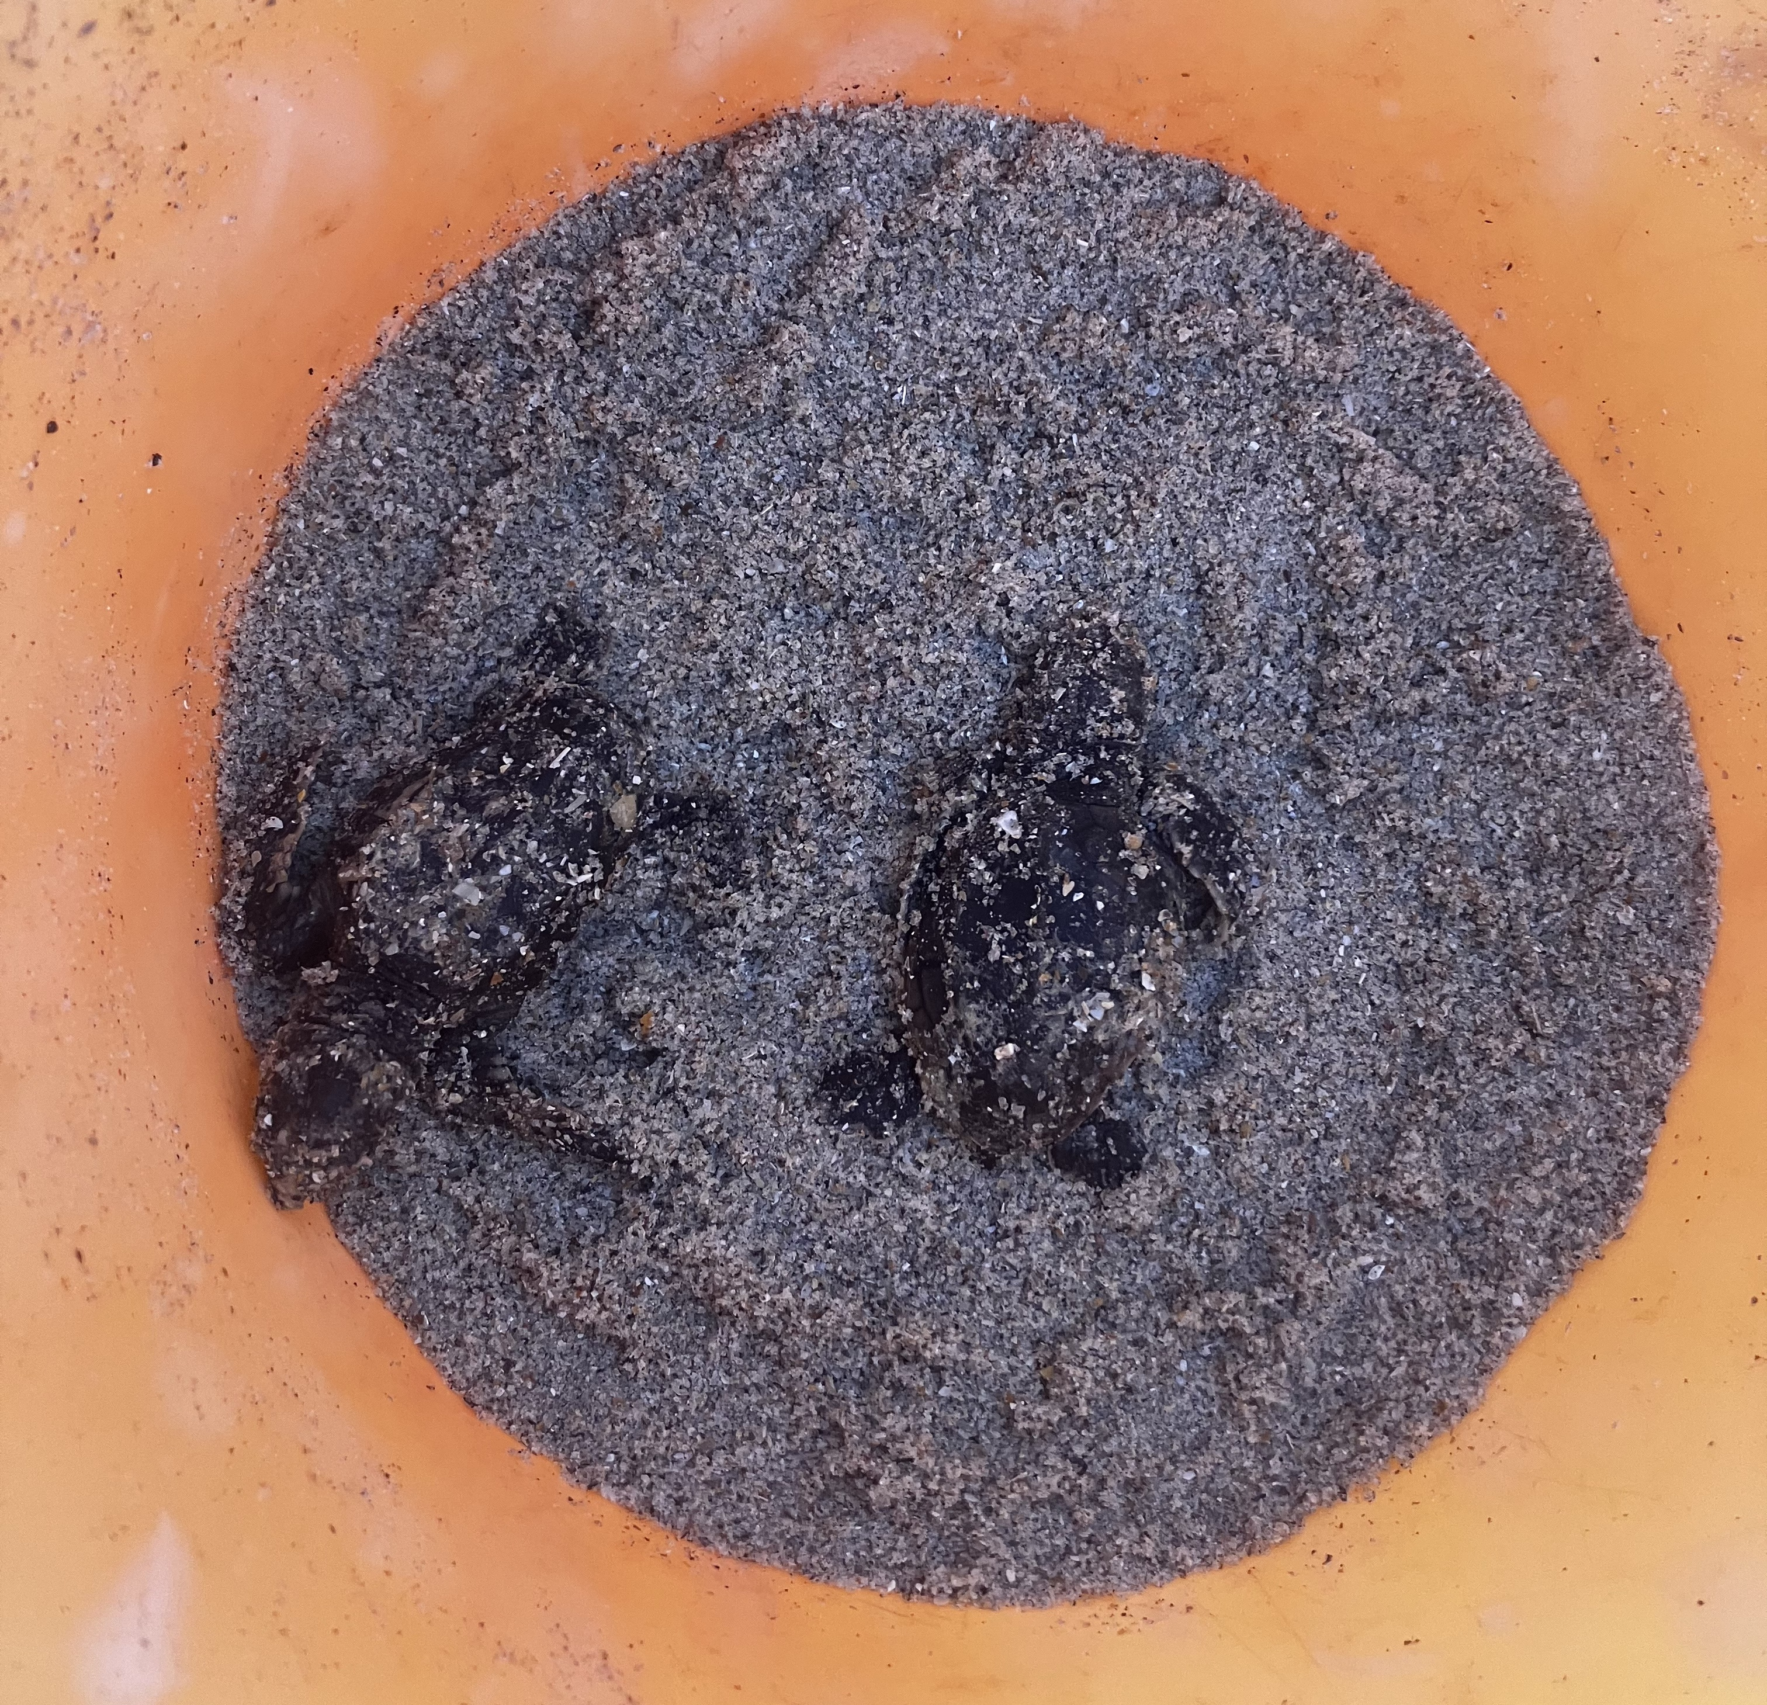
Edisto Internship
A bit about myself…
Lifelong visitor of the area
Inspired by the island to pursue my love of the ocean and environment
A bit about the internship…
Mainly focused on Loggerhead sea turtle conservation
There is a litter reduction aspect
Environmental education and information transfer (public talks, social media posts, and interpretation at the park’s learning center
I was taken on by Leah Schwartzentruber (Sea Turtle Specialist) and Sam Pettit (Head Interpreter)

Slide 3
Conservation Leadership Project
Current Goal Statement: Edisto Beach State Park creates a future where all Edisto residents and visitors are engaged with sea turtle and global environmental conservation efforts.
Sea turtles are among the world’s few marine reptiles
Facing extreme challenges from pollution and climate change, leading to a decrease in their biodiversity.

Slide 4
Rough Conceptual Model
Global Matrix
Edisto SP
Local Environment
Residents
Built environment
Visitors

Slide 5
Conclusion & Questions
Questions?
Disclaimer: All these will change with further information and experience

