Slide 1
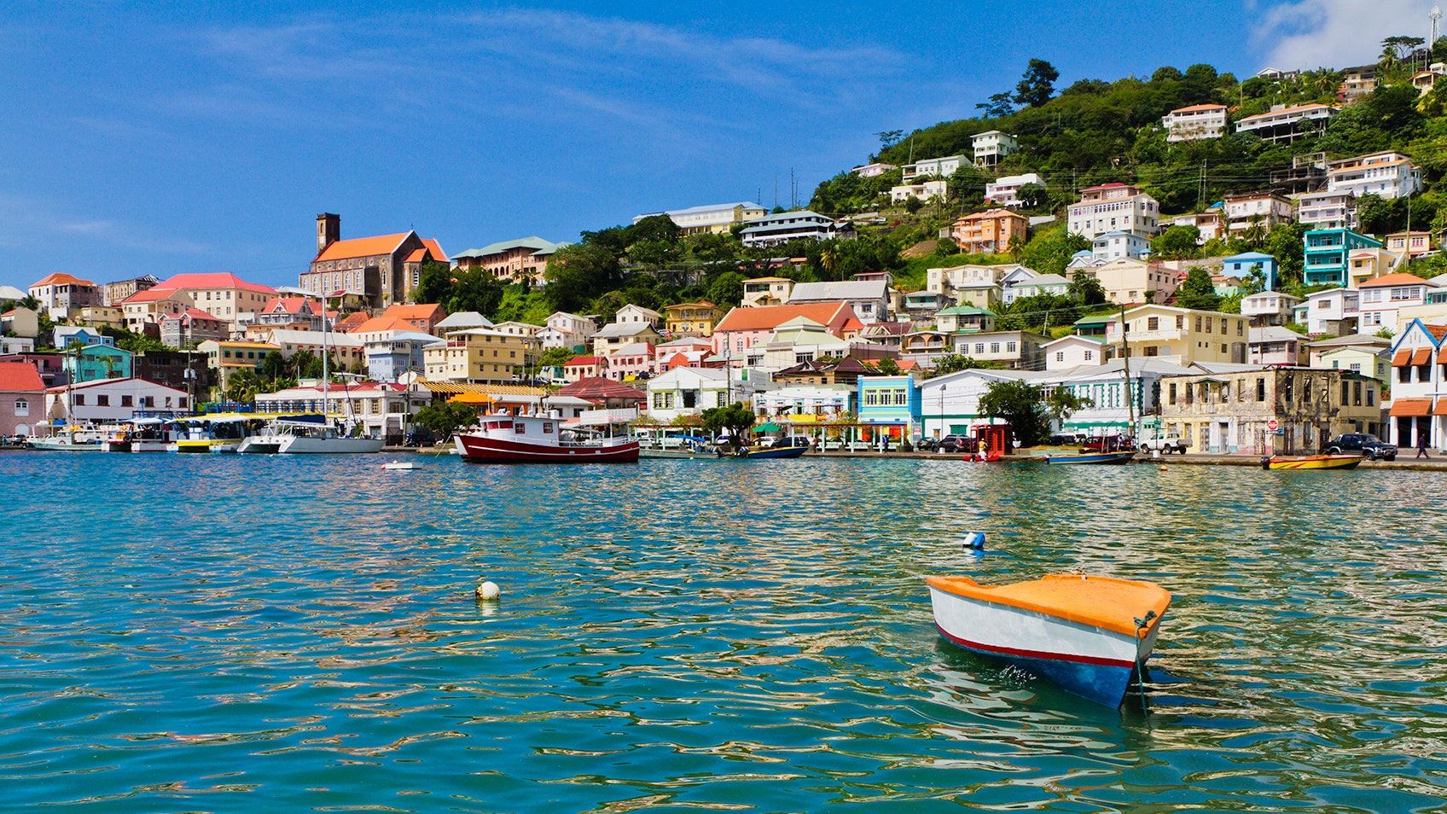
Preparing the Built Environment in Grenada for Future Sea Level Rise and Extreme Precipitation Events
Sustainability Leadership Case Study, Spring 2023
B. Bloom, R. Boyd, M. Duncan, A. Edwards, J. Lewis, A. Markham, and A. Novak
With input from N. Carpenter, H.P. Plag, and E. Walters
Notes:
Overall – make more specific to Grenada

Slide 2
Introduction
Jai Lewis

Slide 3
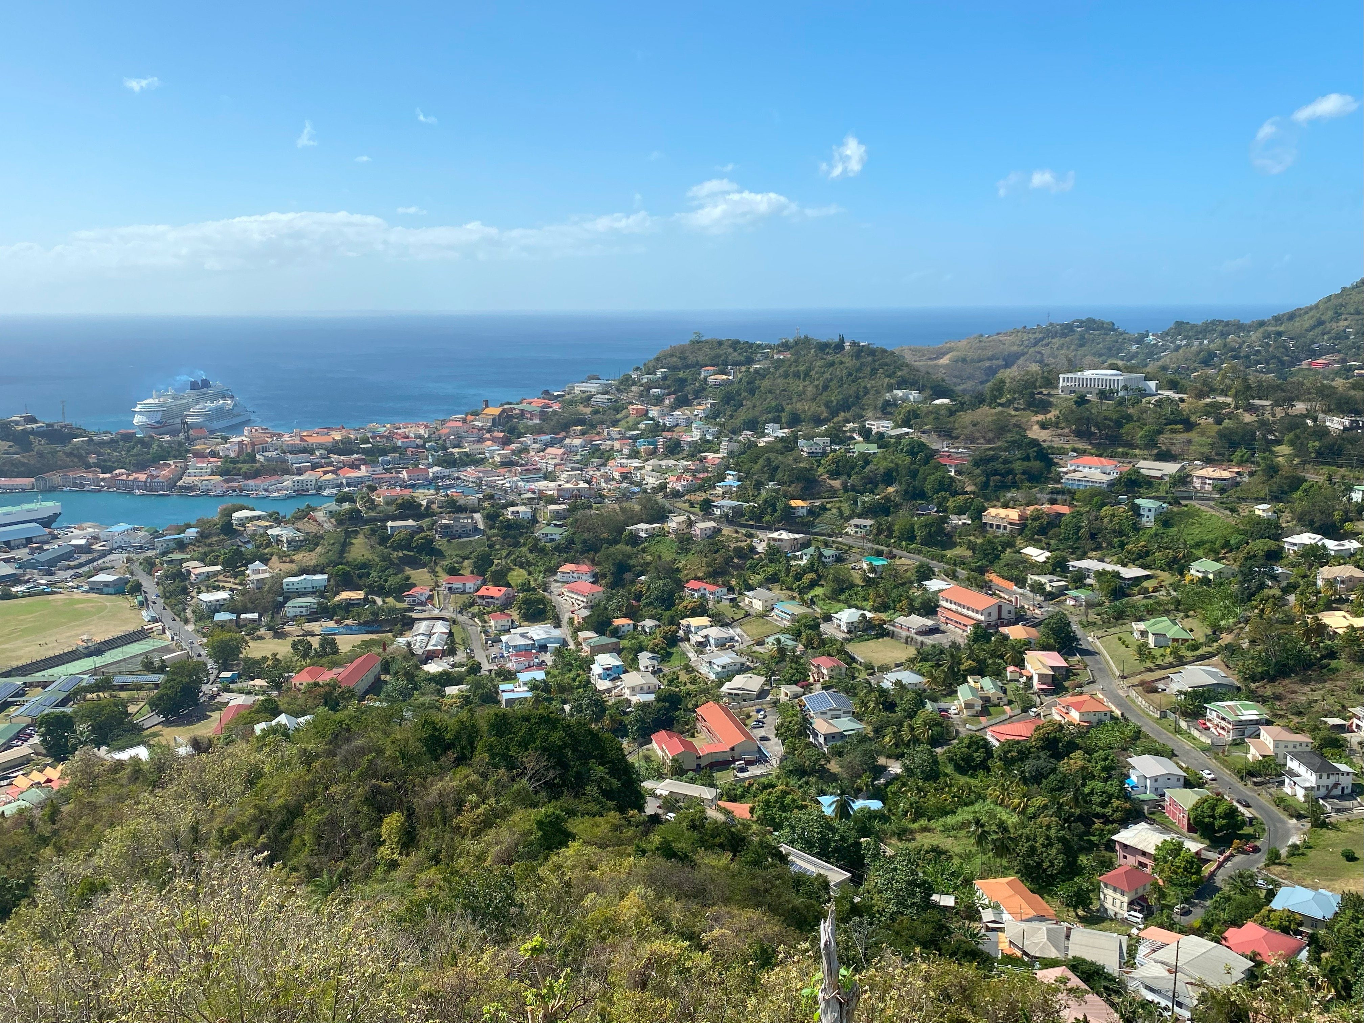
Grenada
Grenada is a small island nation in the Southern Caribbean and part of the Lesser Antilles island chain.
Economy is heavily based on tourism and agricultural exports
Like other small island nations, Grenada is negatively impacted by a problem they did not cause
  The triple challenge: pollution, sea level rise, and biodiversity loss
  These challenges can not be isolated and addressed individually

Slide 4
The Planning and Development Authority
Focused on regulating orderly and responsible land use and development
Interested in forward planning – 50-year plan
  Modern resettlement plan
  Advanced livelihood for Grenada
  Identifying and isolating hazards to reduce impacts on Grenadian society
  Zoning plans based on analyzed impacts on tourism, agriculture, and development

Slide 5
The challenge
In general, the challenge Grenada faces involves preparing for sea level rise and heavy precipitation, which threatens coastal livelihood, tourism, and freshwater resources.
However, it is also important to understand that this general challenge is connected to other issues, such as drought and pollution.
  The complexity of this challenge requires a multi-faceted approach
  Lack of action will have significant consequences

Slide 6
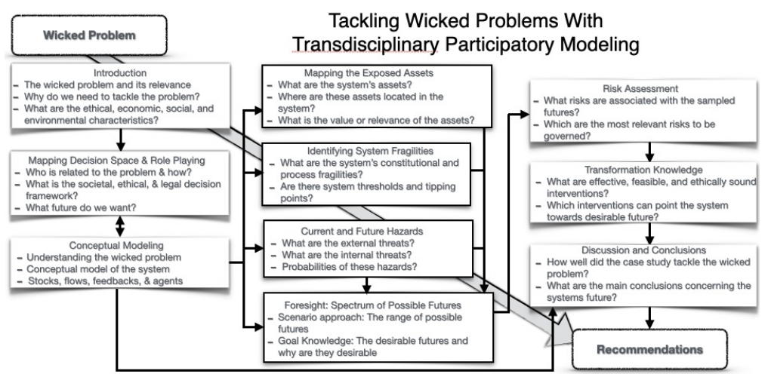
MARI Case Study Template
Notes:
Insert slide to introduce the new aspects

Slide 7
Risk informed decisions
Fragility
Constitutional property of an asset to be damaged by a hazard
Hazard
A potentially harmful event
Exposed assets
Valuable resources that may be impacted by the anticipated hazards
Risk
The potential for unwanted consequences where something of value faces an uncertain outcome
Risk Assessment
Extension of the hazard scenario(s) by mapping the severity of a particular future against the probability of its occurrence
  Dependent on hazards, fragilities, and assets
  Used to inform decision-making

Slide 8
Decision Space
Adelle Novak

Slide 9
Participatory Modeling: Understanding the system to discover ideas
Methods & Outcomes:
Determining Stakeholders
Mapping of the decision space
Rules & Regulations within the system
Role Play
  Used to discuss the decision space, when in-person meetings with the stakeholders are not feasible
  Authority & Interest of stakeholders
Stakeholder Meetings
  Meetings held in Grenada
Goal Statement
  Statement agreed upon by all stakeholders

Slide 10
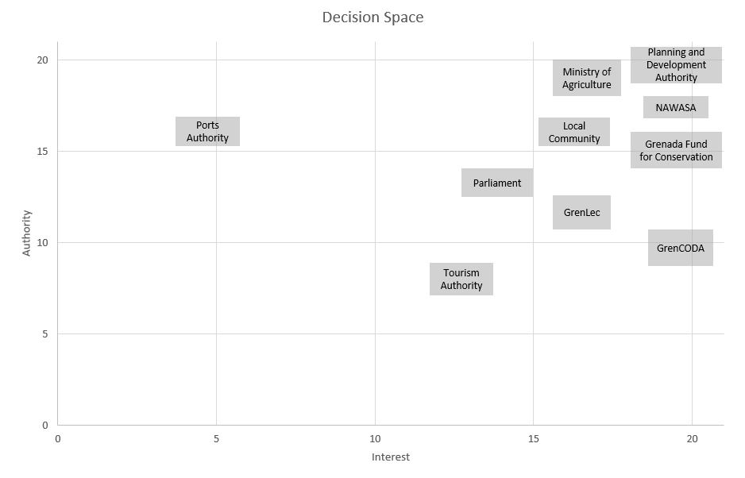
Notes:
Add data labels, move points around to make visible

Slide 11
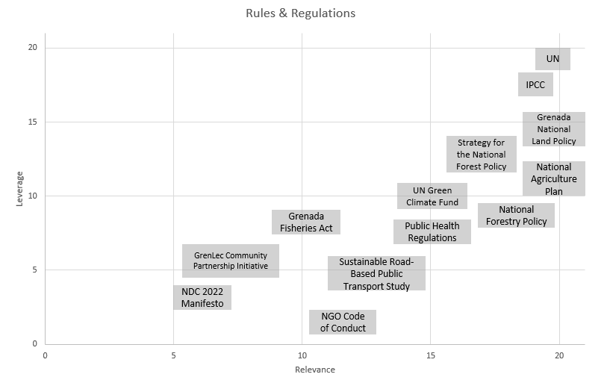
Notes:
Societal context

Slide 12
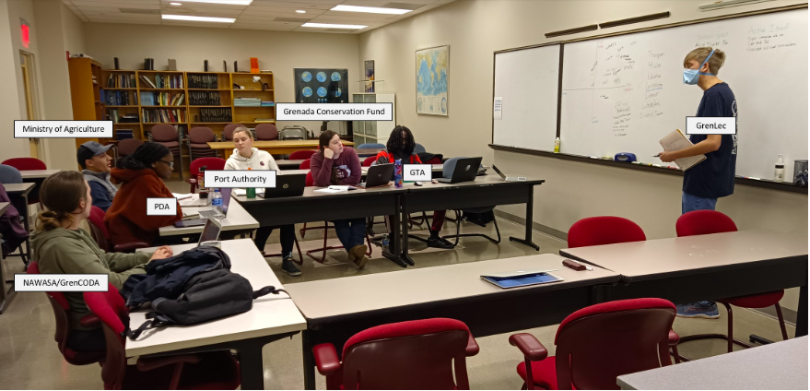
Role Play
Participatory modeling is used throughout the entire case study, and is used to find an ideal future for Grenada
A collaborative meeting between stakeholders to find a common goal in the face of climate change and associated hazards
Ministry of Agriculture
Grenada Fund for Conservation
GrenLec
Ports Authority
Tourism Authority
PDA
NAWASA/GrenCODA

Slide 13
Role Play summary
Stakeholder | Interest Level | Interest | Level of Influence | Authority
GrenLEC | Moderate | Renewable energy | High | Services businesses + homes throughout Grenada
GrenCODA | High | Equity / justice / inclusiveness | Moderate | NGO connected with local communities
NAWASA | High | Provide water for citizens | High | Services communities through Grenada
GFC | High | Raise public awareness & protect Grenada’s natural environment | Moderate | NGO which has restorations throughout Grenada.
GTA | Low | Development of tourism | High | Government Service
PDA | High | Sustainable infrastructure | High | Government Service
Port Authority | Low | Managing the port | High | Government Service
Ministry of Agriculture | High | Sustainable farming practices to enhance food security | High | Government Service + Local Farms

Slide 14
In-Person Meetings
Stakeholder | Main Focus | Authority & Interest | Ideal Future
Tyrone Buckmire [Grenada Fund for Conservation] | Conservation & Culture | Moderate Authority High Interest | Mangrove Conservation & Culture. Insight on Carriacou.
Kenrick Fullerton [Planning & Development Authority] | Community, Infrastructure & Education | High Authority High Interest | Education & Development Risks
Davon Baker [Technology Manager for Gov’t of Grenada]] | Conservation & Innovation for applied sustainability for local communities | High Authority High Interest | Strategic Planning for Sustainable Communities
Kate Charles [Ocean Spirits] | Levera Ramsar Wetland The National Resort Conservation | Moderate Authority High Interest | Community Involvement & Commercial Development
Andre Joseph Witzig [The Nature Conservancy] | Mangrove Restoration & Safeguarding habitats which people and wildlife rely upon | Moderate Authority (NGO) & High Interest | A future which safeguards Grenadians and the natural environment which is relied on by people and wildlife.

Slide 15
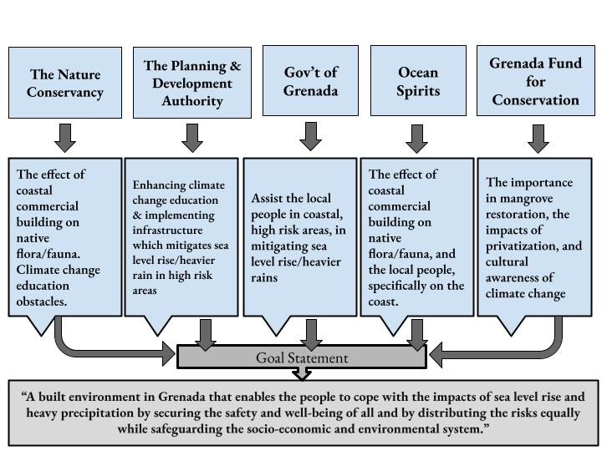
Goal Statement

Slide 16
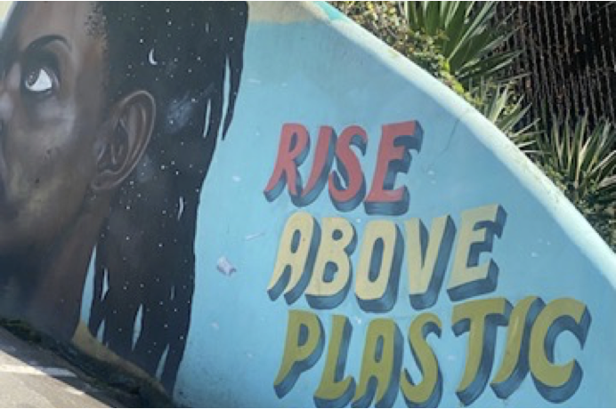
Question for The Audience
Why are rules and regulations valuable when addressing global sea level rise in Grenada?

Slide 17
Conceptual Modeling
Ashawne Edwards

Slide 18
Conceptual modeling
No two wicked problems are the same
The wicked problem of SLR and heavy precipitation in Grenada is different than other countries
There is no solution to a wicked problem. You can only improve the situation

Slide 19
Continents
Economic crises
Social crises
Disasters
Nationals
Caribbean Islands
Economic crises
Social crises
Grenadian Islands
Public
Visitors
Other Residents
Residential
Built Environment
Global Climate System
Earth Energy Imbalance
Global warming
Circulation changes
Changes in extremes
Melting of ice
Commercial
Public
Social Fabric
Territorial Waters
Infra- structure
Economy in Grenada
Global Ocean
pollution
overfishing
acidification
warming
Coastal Ecosystems
Terrestrial
Ecosystems
Service
Industry
Agriculture
Agricultural land
Freshwater Ecosystems
It’s Environment
The System

Slide 20
Public
Economy
in Grenada
Grenadian Islands
Residential
single family
multi f.
Coastal Ecosystems
coral reefs
mangroves
wetlands
Built Environment
Industry 15%
Construction
assembly
food/beverages
textiles
Service Industry
78%
Health
Education
Transp./Travel
Hospitality
Information
Sales/Shops
Wellness
EnWaWaSe
Finance
Insurance
Consulting
Culture
Professional
Management
Agricultural
land
cropland
pastures
rangeland
Commercial
offices
production
Public
health
education
government
Territorial Waters
It’s Environment
Infra- structure
Agriculture 7%
Nationals
by birth
acquired
Livestock
Spices
Vegetables
Sugar cane
Freshwater Ecosystems
Rivers
lakes
wetlands
Visitors
tourists
business
Other Residents
students
workers
Terrestrial Ecosystems
forests
brushland
Social Fabric
The System

Slide 21
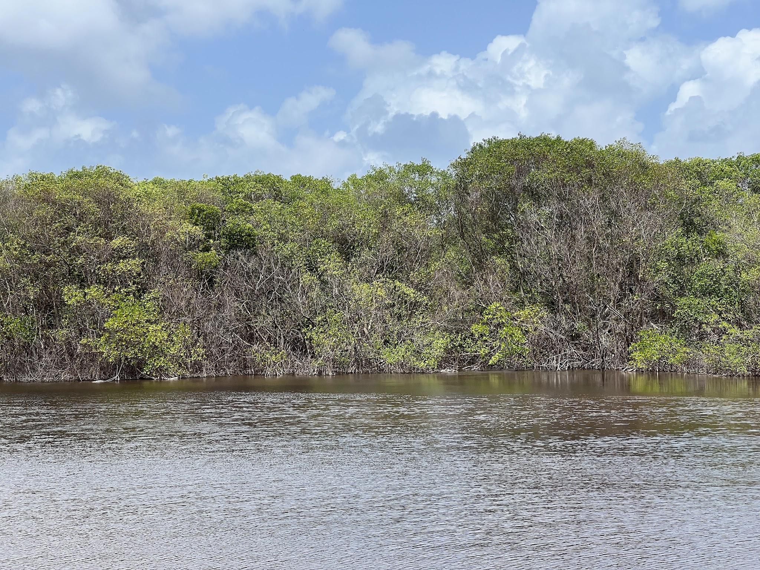
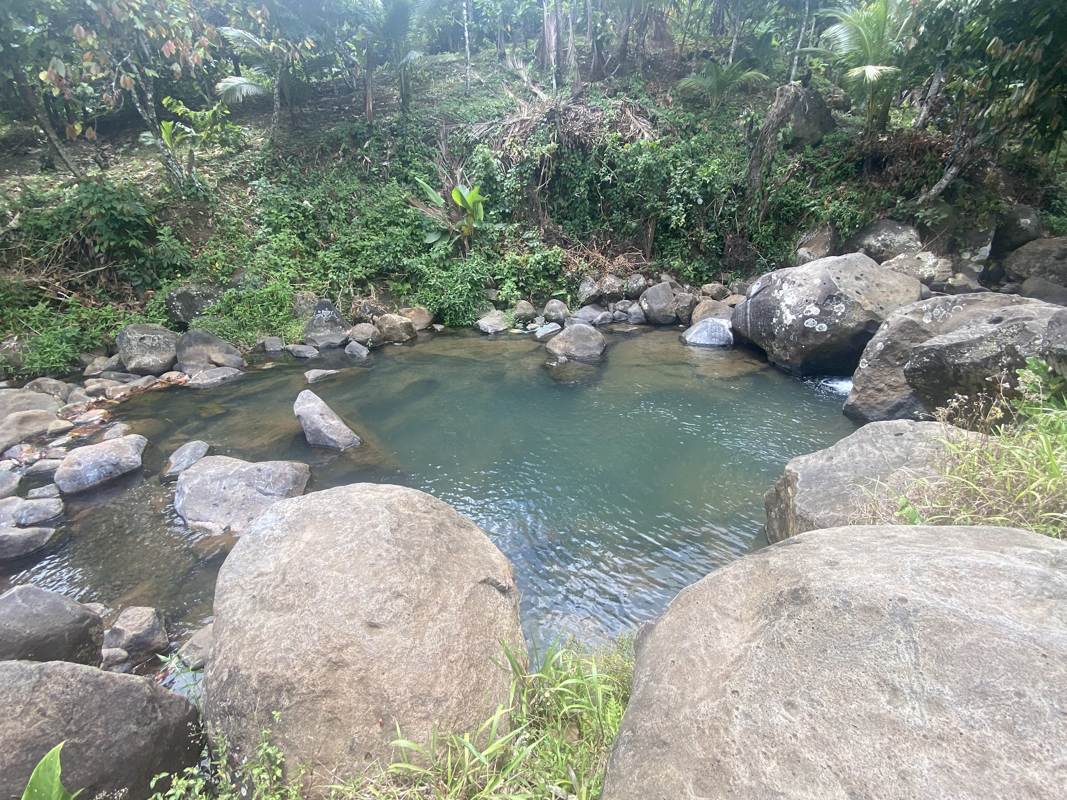
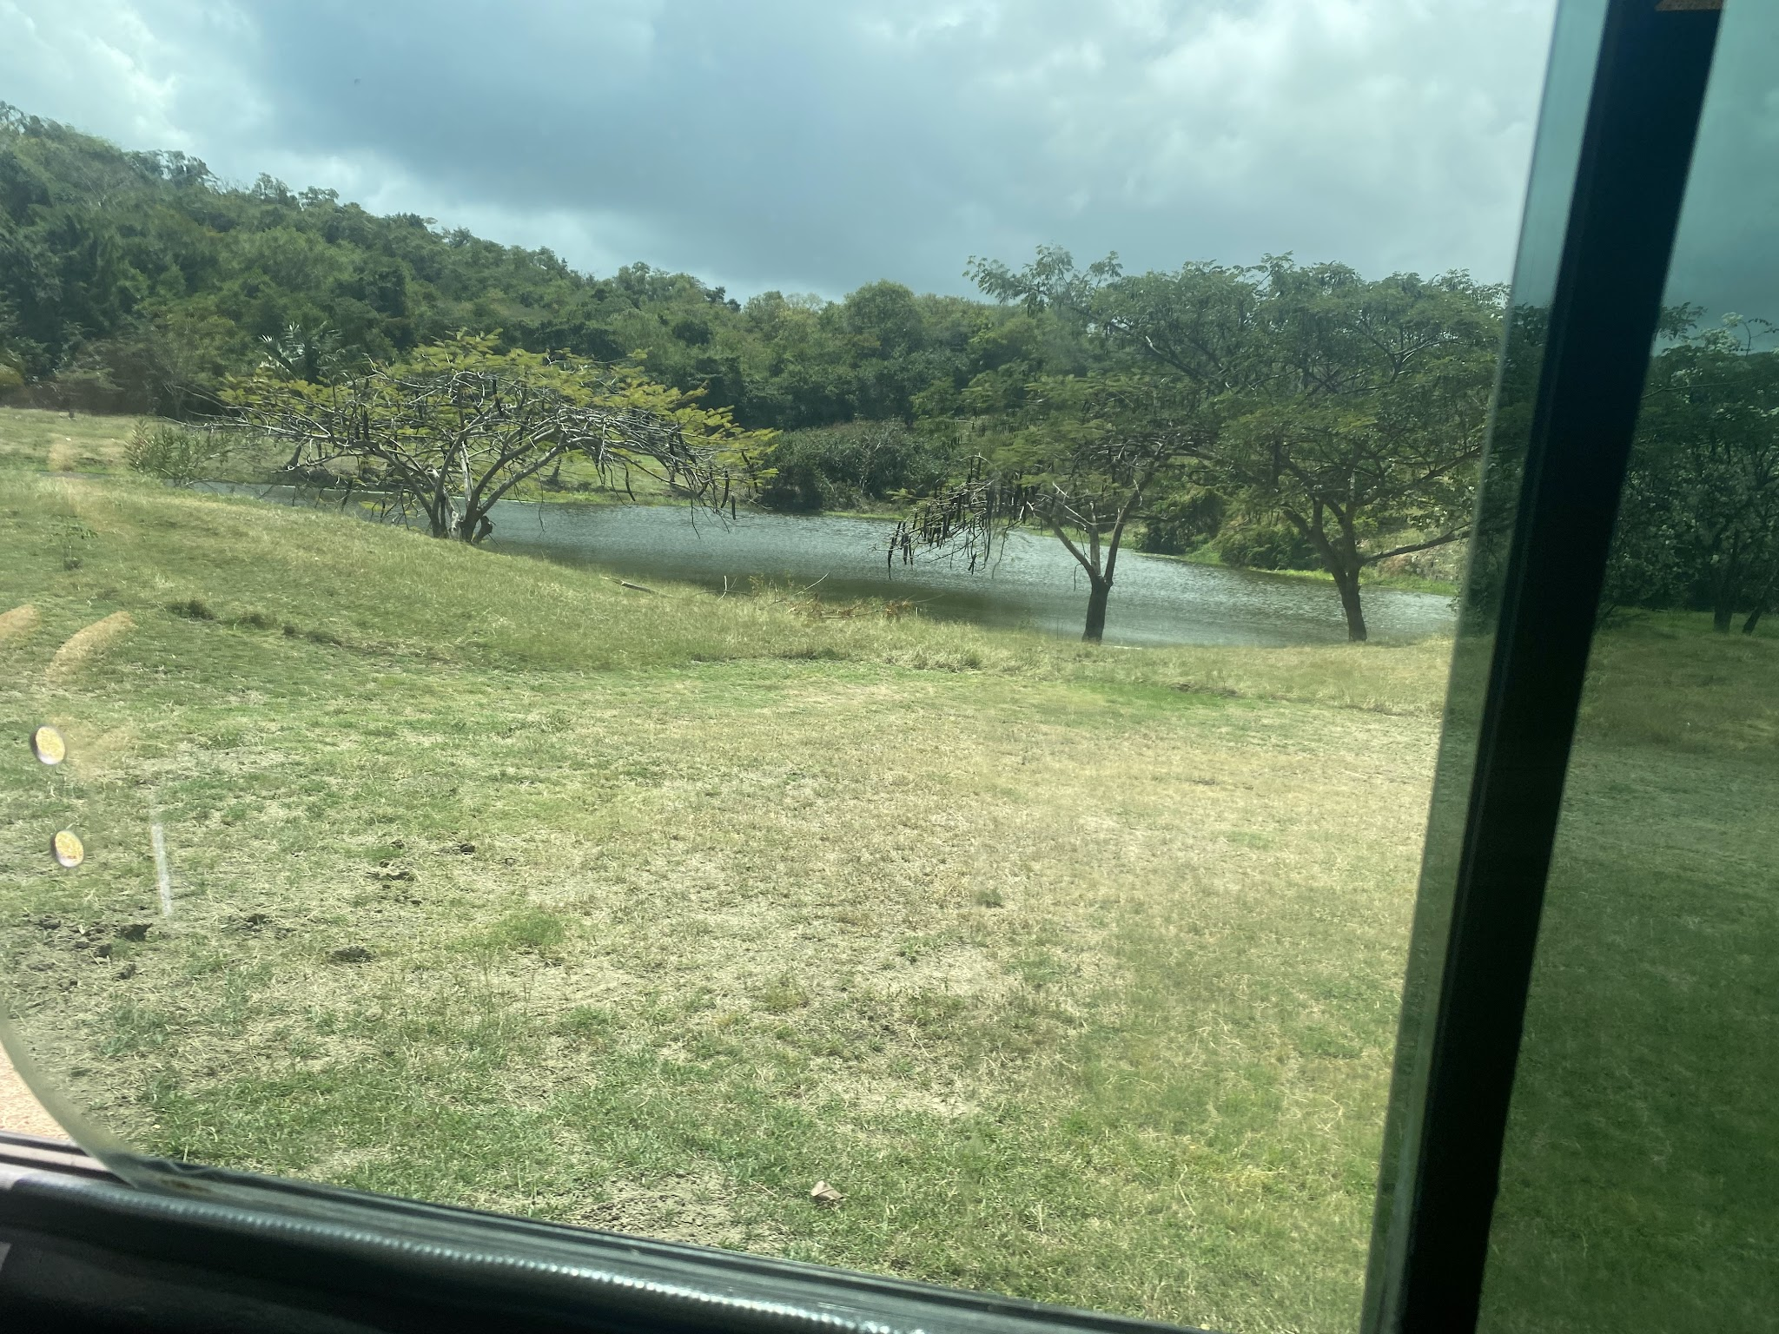
Terrestrial Waters and Land areas
Terrestrial waters (salt)
Coral reefs
Other marine ecosystems
Mangroves
Beaches
Terrestrial waters (fresh)
Wetlands
Rivers
Lakes
Springs
Agricultural land
Areas transformed for human purposes
Forested areas for agriculture (50%)
Cropland and pastures

Slide 22
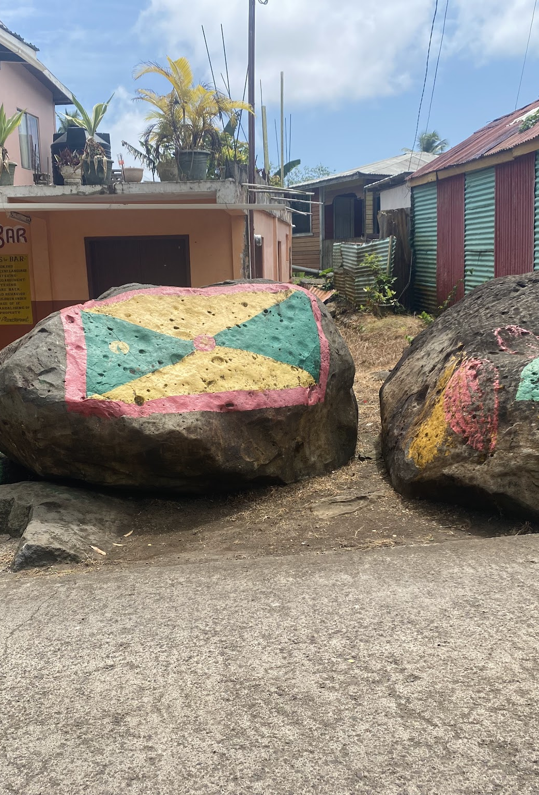
Built environment
Mostly in/near the coastal zone
Residential
Spread out
Getting closer to undisturbed ecosystems
Commercial
Less steep topography
Near coast lines
Public
Hospitals
Schools

Slide 23
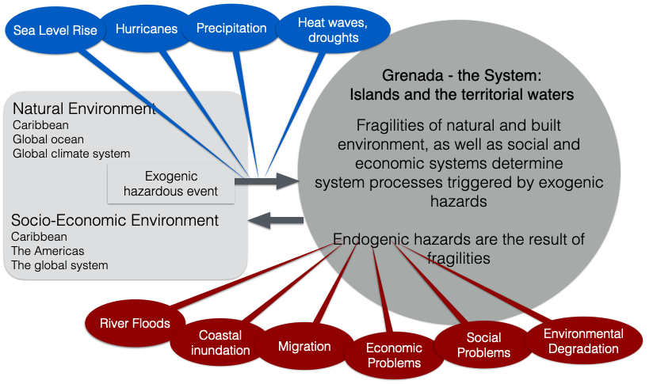
Exogenic and endogenic hazards

Slide 24
Endogenic Hazards Caused by Exogenic Hazards
Coastal flooding (caused by storm surges)
Impacts major roads and buildings
Leads to erosion
Inundation
Impacts agricultural land
Social/economic problems
Destruction of commercial buildings
Disruption to supply chains
Environmental degradation
Results from coastal/river flooding
Increase pollution caused by flooding events

Slide 25
Exposed Assets
Adelle Novak

Slide 26
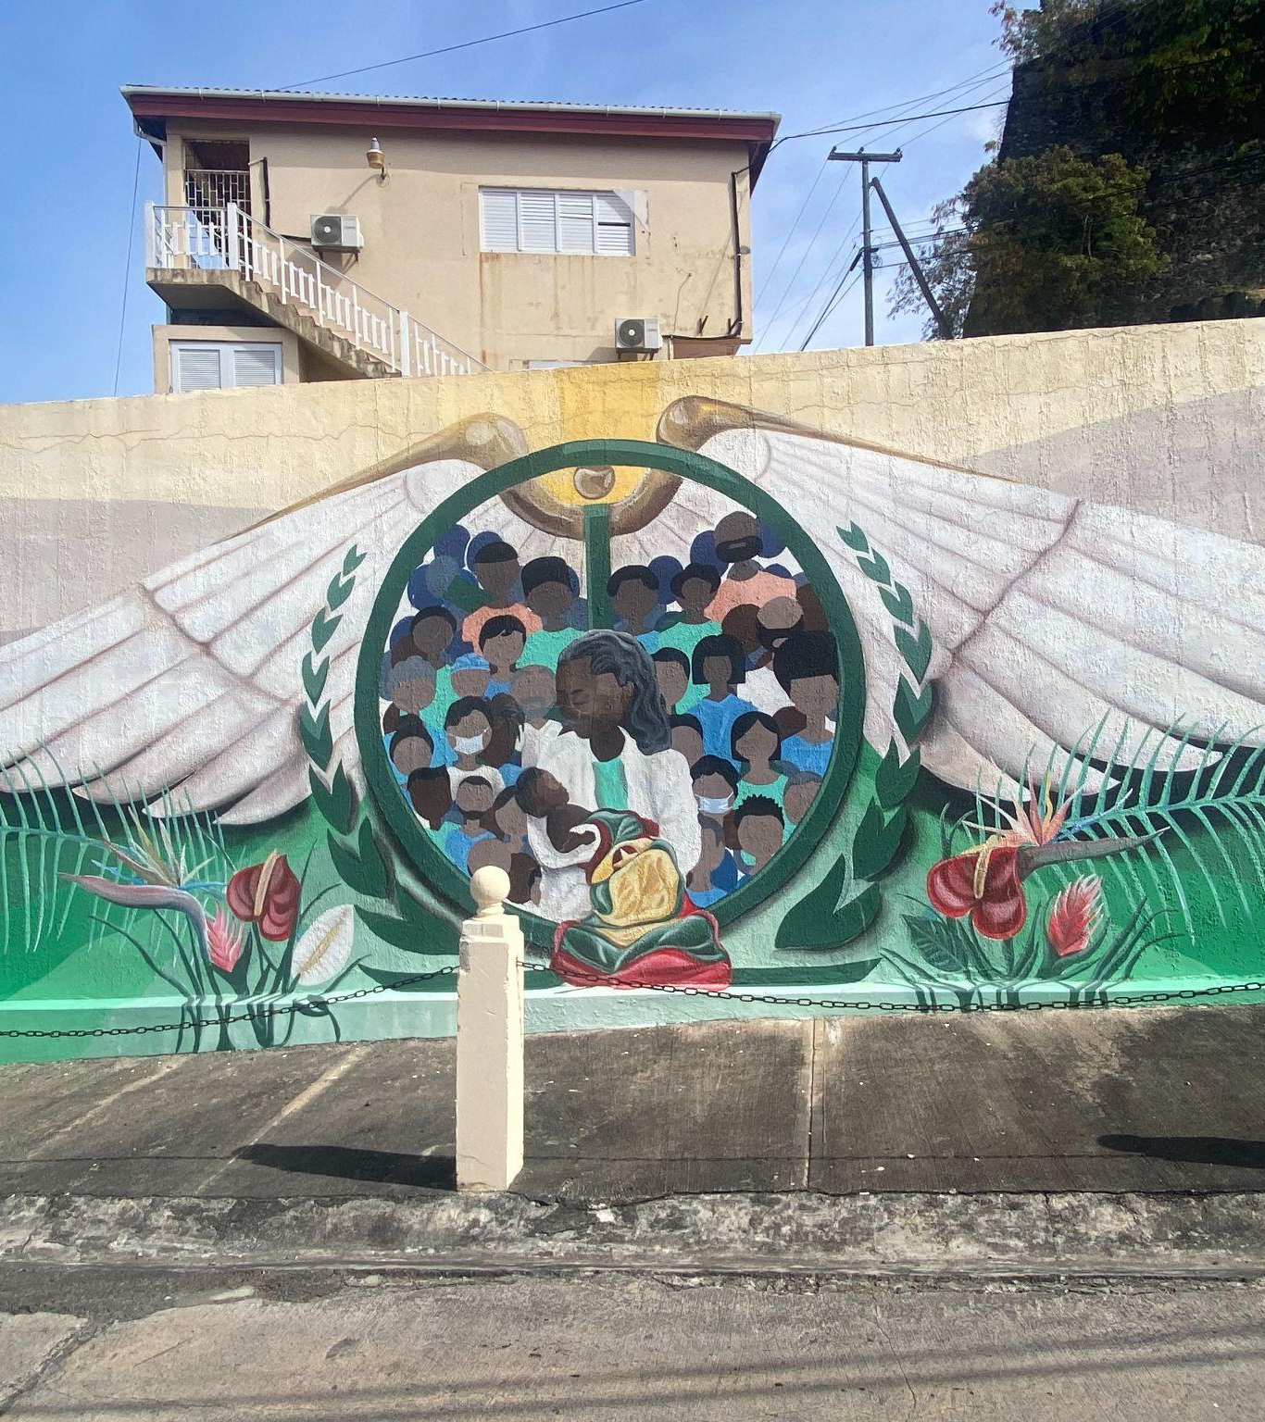
Types of assets
Natural Environment
Built Environment
Production
Core Asset
  Most valuable, and is affected by all other assets & hazards
Determining Factors: value, service, associated hazards, and relativity to the sea level rise (SLR) & extreme precipitation
Notes:
Introduce groups

Slide 27
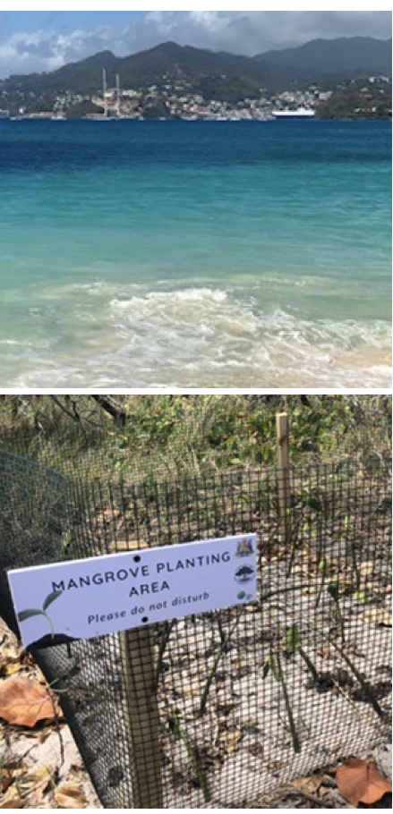
Natural Assets | Service | Value | Associated Hazards
Mangroves | Protects inland from natural disasters Serves as a nursery for several species Value to other ecosystems Resources Filter pollutants from water | Mangroves protect over billions of dollars worth of global flooding damage every year (2022, Michael Beck and Pelayo Menendez). | Sea level rise Ocean warming Unchecked expansion Sea Walls/Dikes Inequitable Wealth Distribution
Sandy Beaches | Public access recreation (community hotspots) Value to other ecosystems Turtle nesting habitat (critical) | Beach restoration is very expensive, if feasible at all (2018, Song) | Dependency on foreign investment Construction Coastal Erosion
Notes:
Purposes listed. Not vale

Slide 28
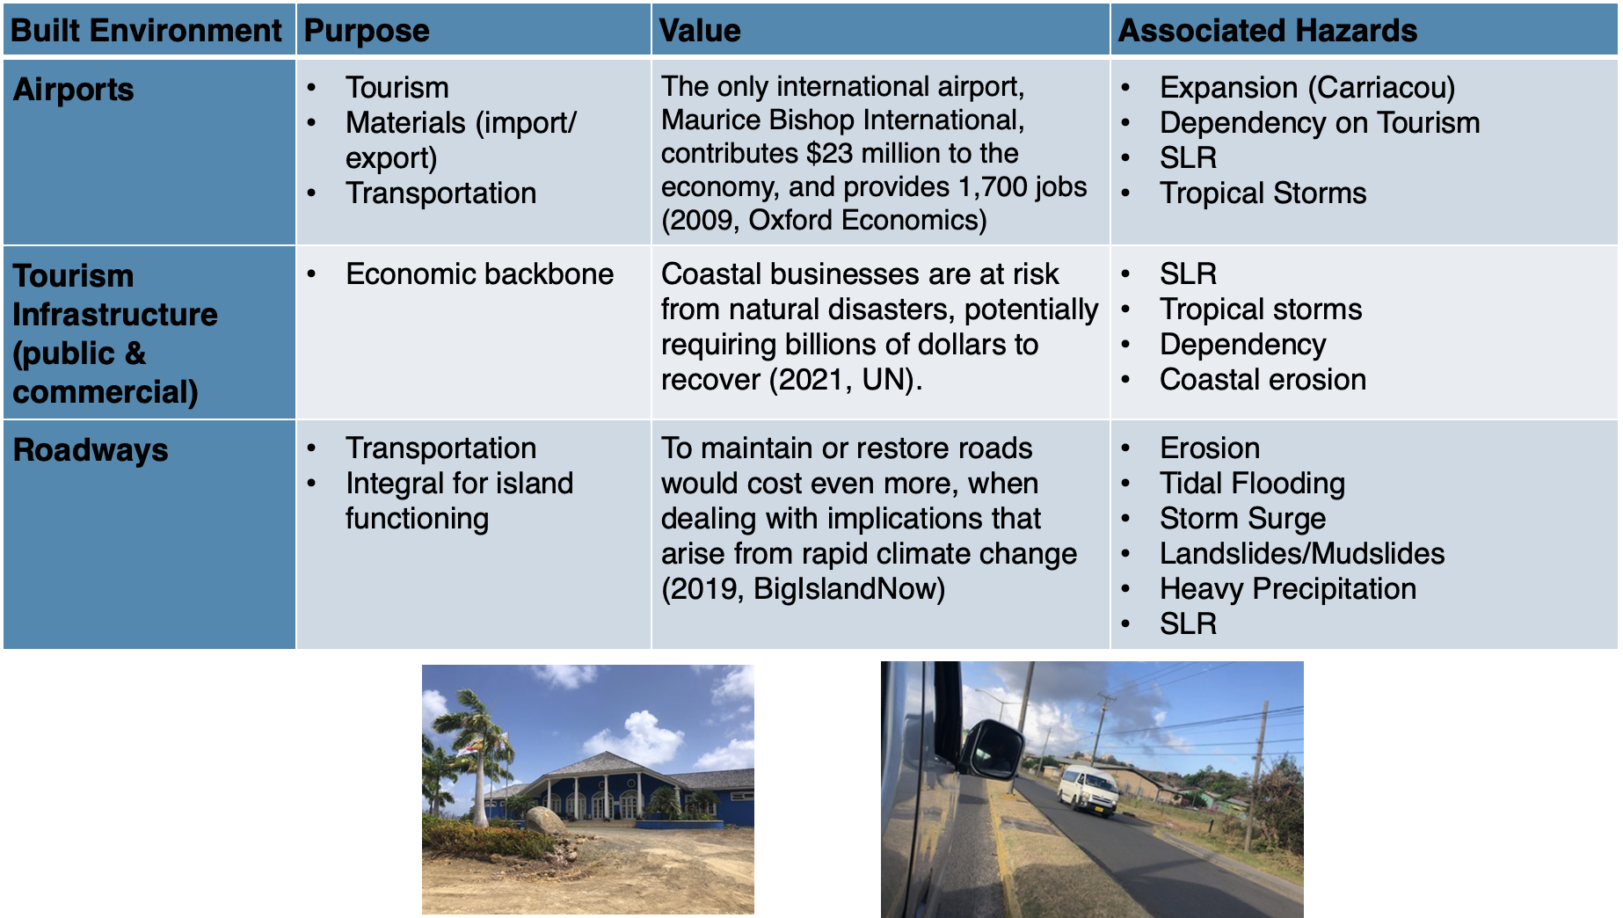
Built Environment | Purpose | Value | Associated Hazards
Airports | Tourism Materials (import/export) Transportation | The airport in Grenada, Maurice Bishop International, contributes $23 million to the economy, and provides 1,700 jobs (2009, Oxford Economics) | Expansion (Carriacou) Dependency on Tourism SLR Tropical Storms
Tourism Infrastructure | Economic backbone | Coastal businesses are at risk from natural disasters, potentially requiring billions of dollars to recover (2021, UN). | SLR Tropical storms Dependency on foreign investment Coastal erosion
Roadways | Transportation Integral for island functioning | To maintain or restore roads would cost even more, when dealing with implications that arise from rapid climate change (2019, BigIslandNow). | Erosion Tidal Flooding Storm Surge Landslides/Mudslides Heavy Precipitation SLR

Slide 29
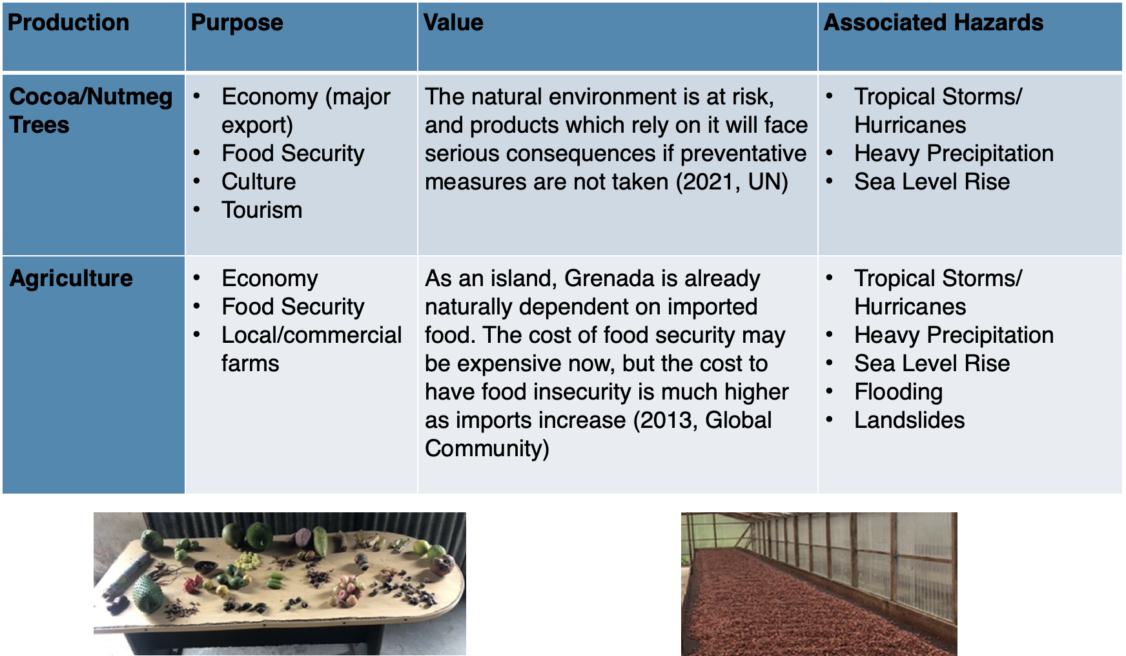
Production | Purpose | Value | Associated Hazards
Cocoa/ Nutmeg Trees | Economy (major export) Food Security Culture Tourism | The natural environment is at risk, and products which rely on it will face serious consequences if preventative measures are not taken (2021, UN) | Tropical Storms/Hurricanes Heavy Precipitation Sea Level Rise
Agriculture | Economy Food Security Local/ commercial farms | As an island, Grenada is already naturally dependent on imported food. The cost of food security may be expensive now, but the cost to have food insecurity is much higher as imports increase (2013, Global Community) | Tropical Storms/Hurricanes Heavy Precipitation Sea Level Rise Flooding Landslides

Slide 30
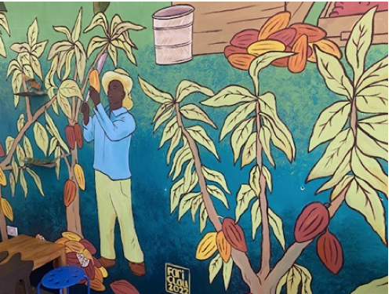
Core Assets | Purpose | Value | Associated Hazards
The Local People | Economy Culture Source of value for all other assets (Core Asset) Cost of human life | Natural disasters enhanced by rapid climate change will cost trillions of dollars (2020, UNDRR/CRED) | All Hazards
The Grenadian citizens are exposed to all the possible hazards previously mentioned. It is known that Grenadians are vital to Grenada’s system, and unequal risk distribution will greatly affect the outcome of possible futures for sea level rise and extreme precipitation.

Slide 31
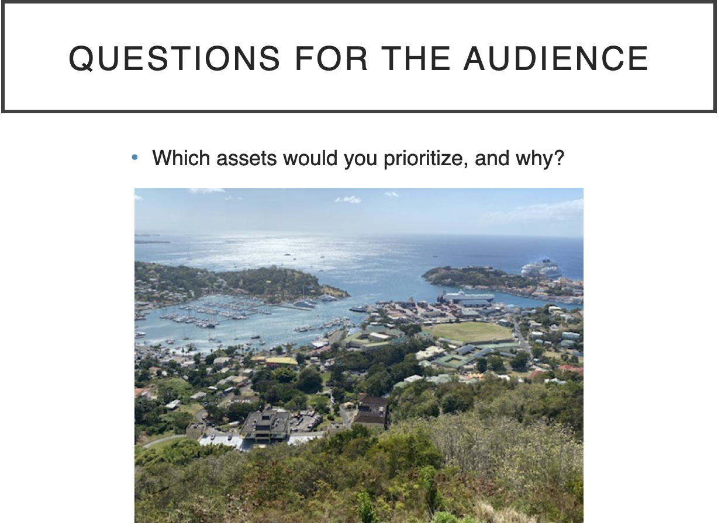
Question for The Audience
Which assets would you prioritize? Why?

Slide 32
Fragilities
Alivia Markham

Slide 33
Fragilities
A fragility is a constitutional system property that can lead to degradation of the system’s functioning or to significant changes in the system if exposed to external or internal hazards.

Slide 34
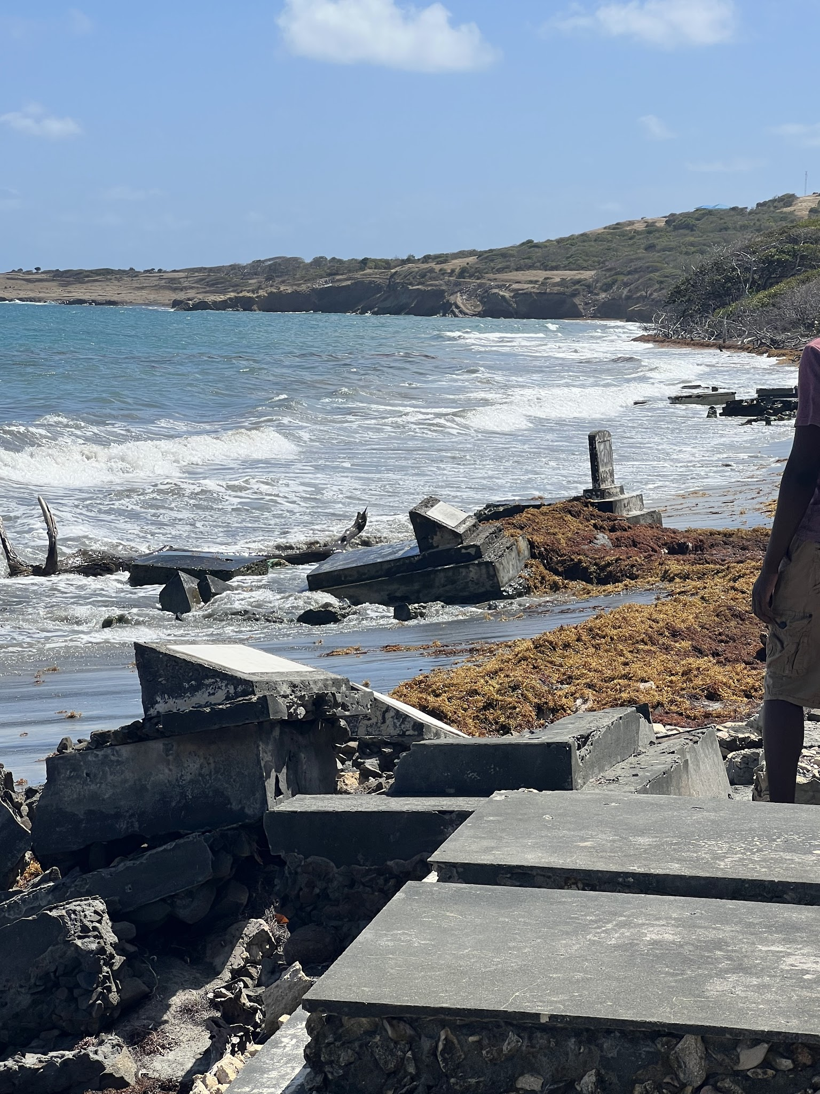
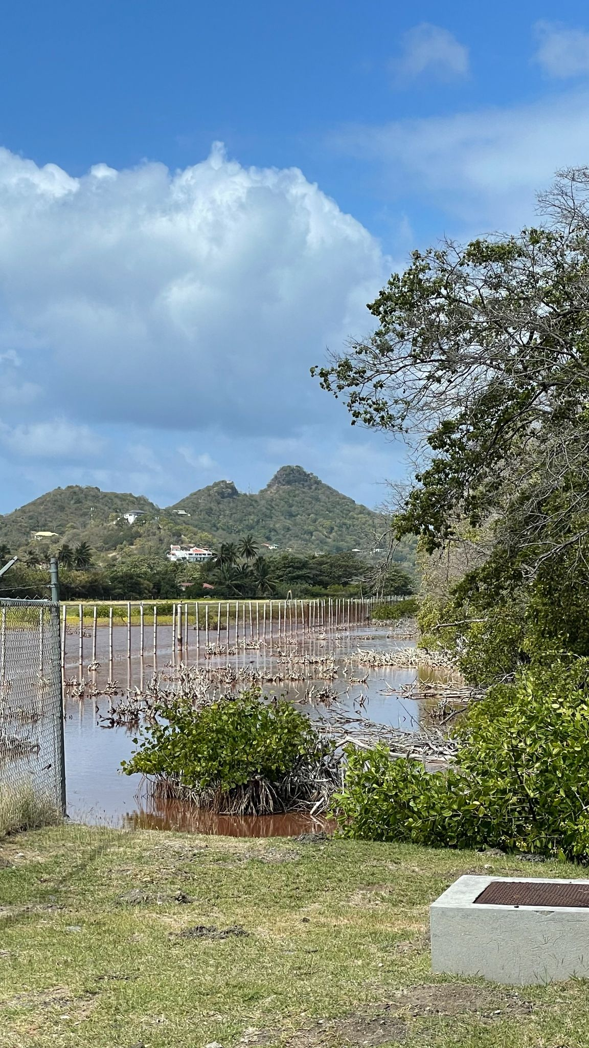
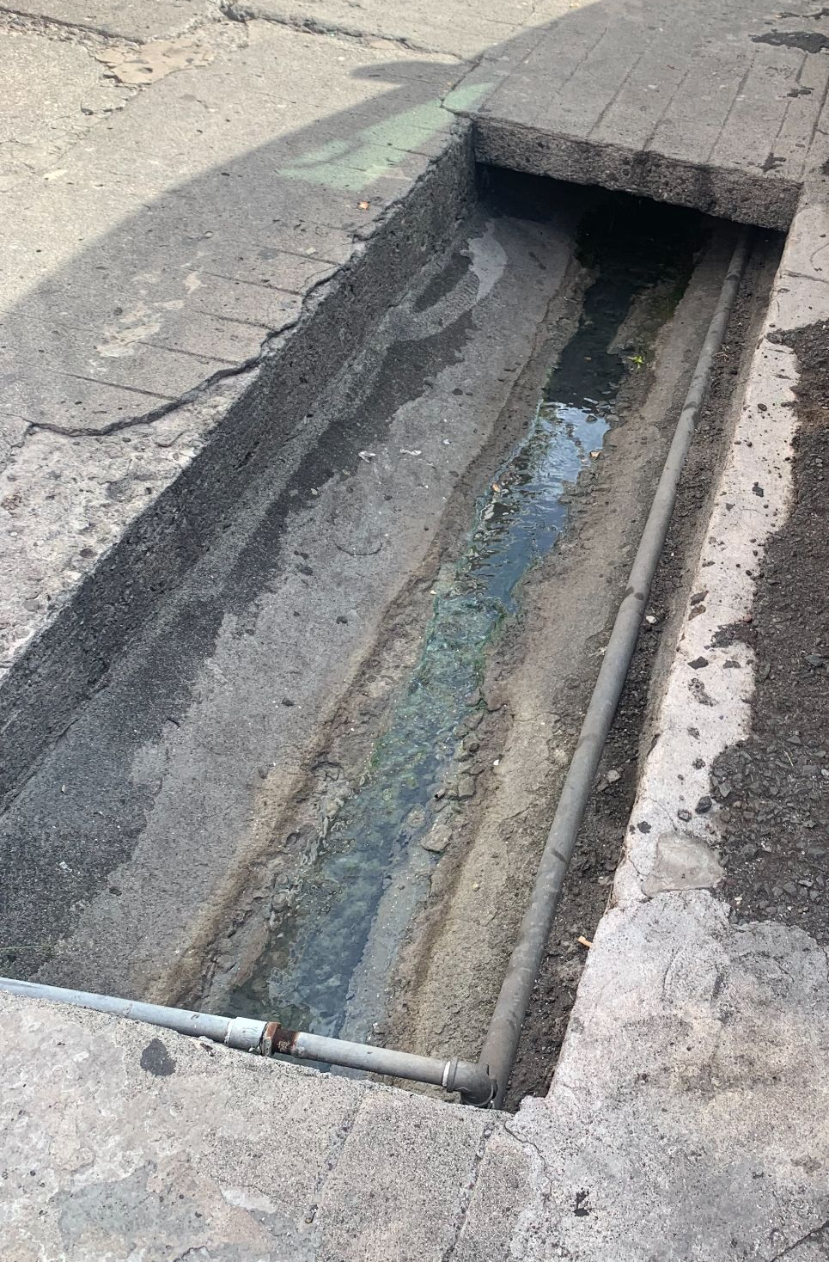
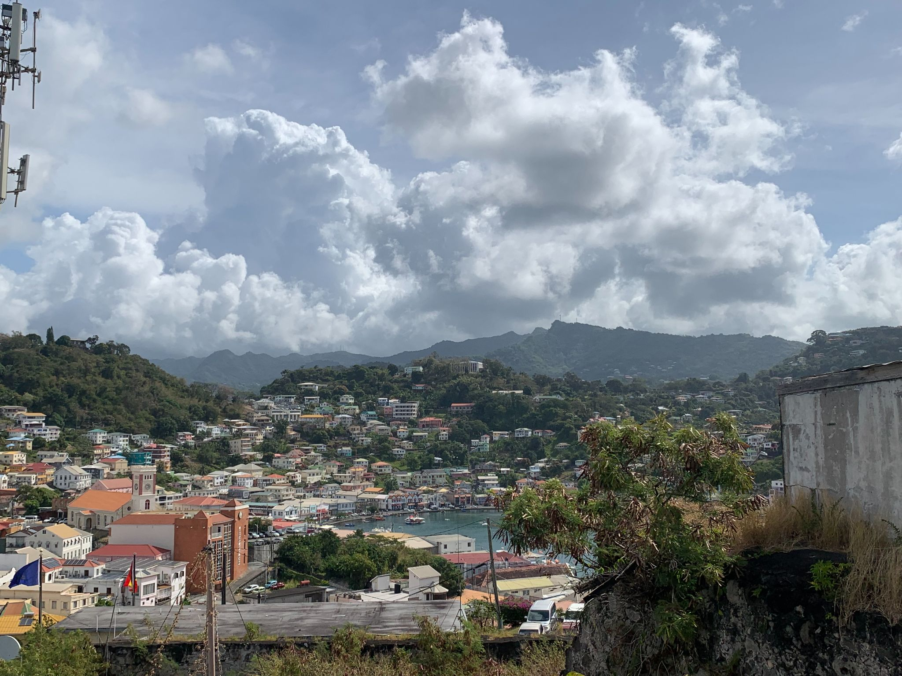
Built Environment
Steep topography is less stable
Low lying areas
Incomplete sewage
Inability of beaches and mangroves to move horizontally

Slide 35
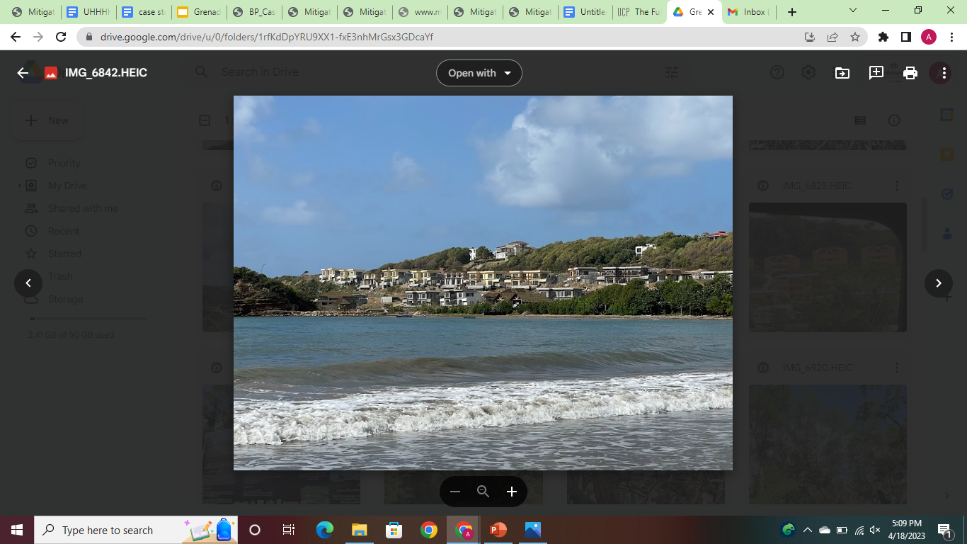
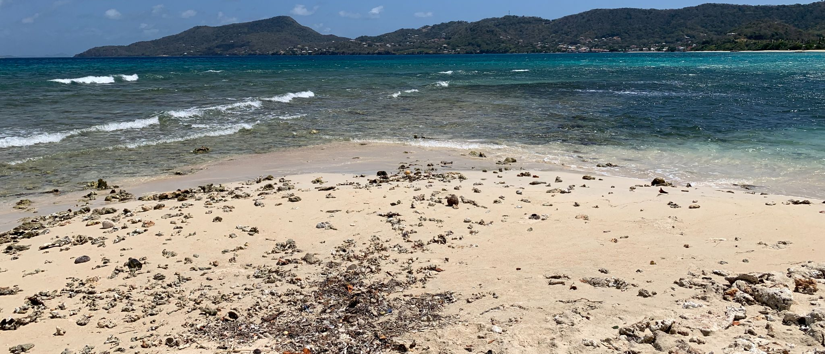
Natural Environment
Coral reefs’ narrow tolerance of changing environmental conditions
Mangroves unable to migrate vertically
Long maturation period of valuable crops

Slide 36
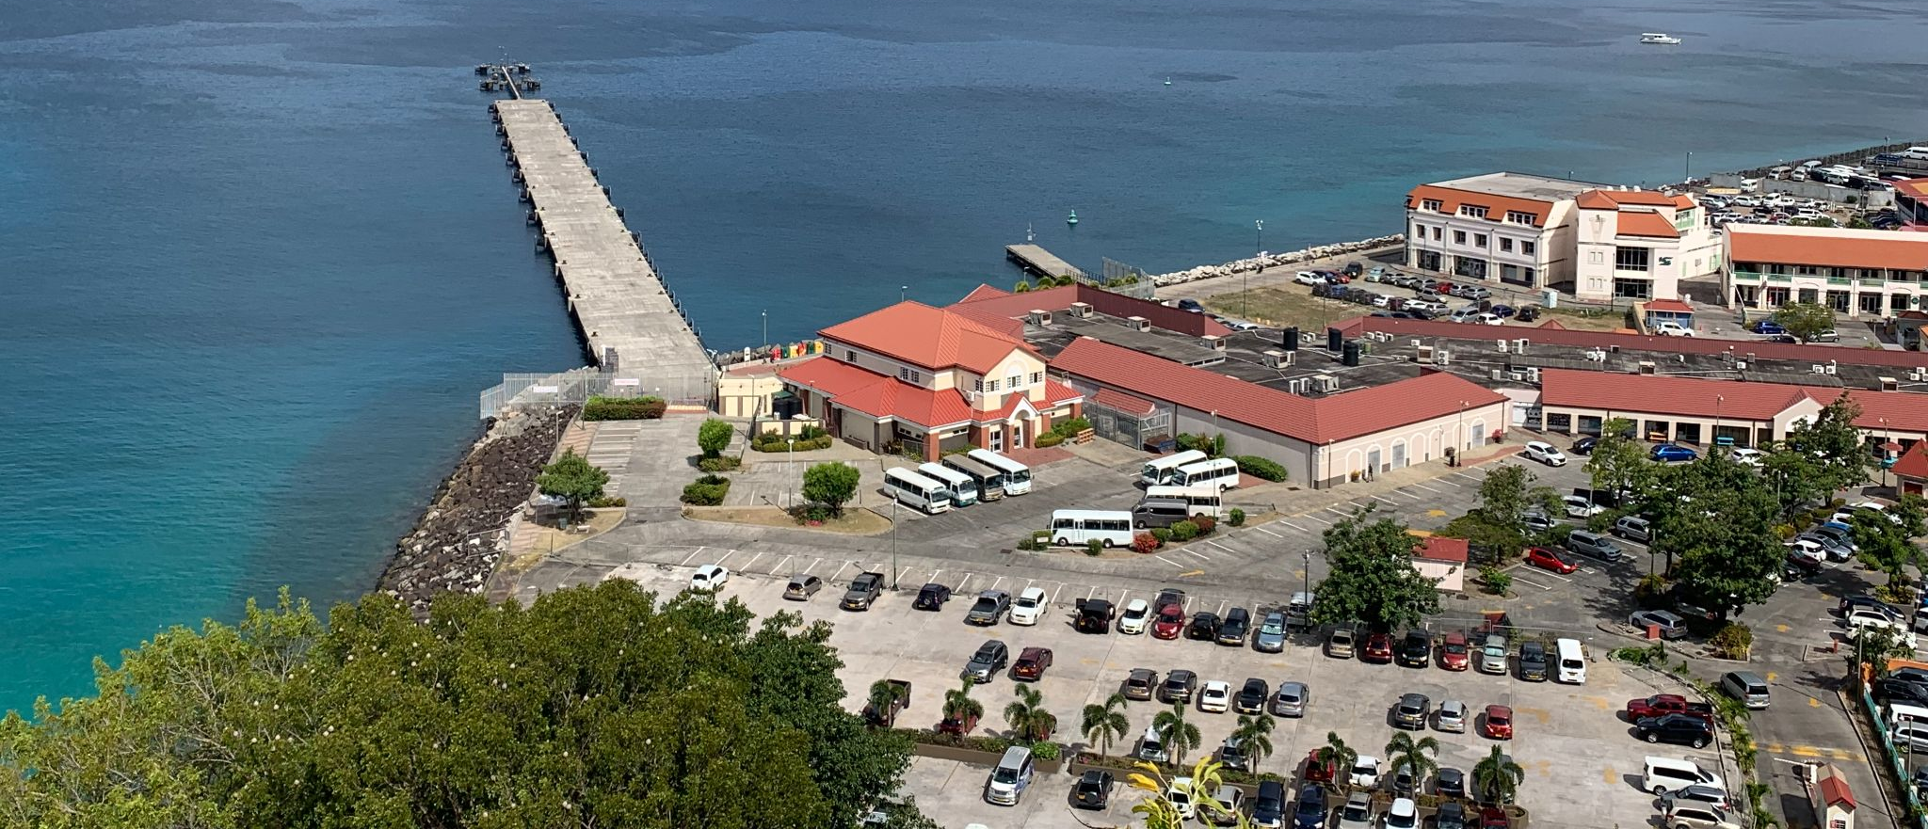
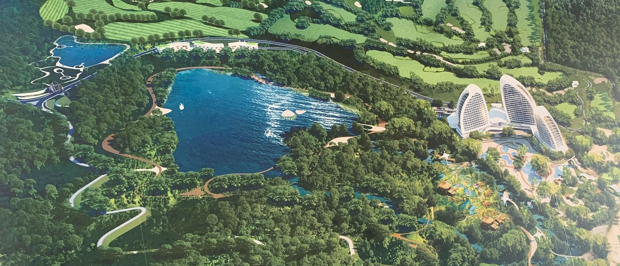
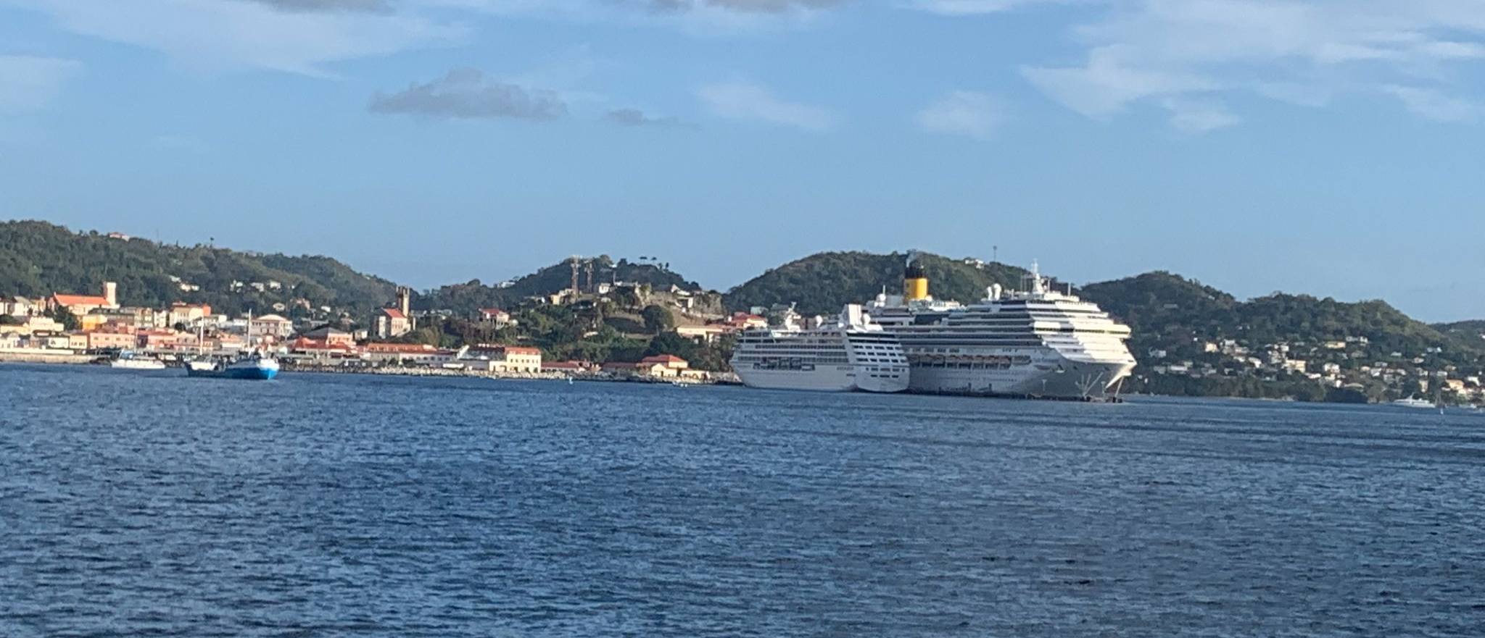
Socio-economic System
Inequitable/polarized wealth distribution
Lack of foresight/education in current developments
International supply chain
Limited capacity of healthcare
Economic homogenization
Food security
Diminished availability of land

Slide 37
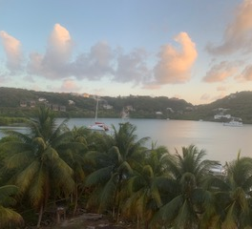
Question for The Audience
What do you believe is the biggest fragility in Grenada?

Slide 38
Hazards
Ashawne Edwards

Slide 39
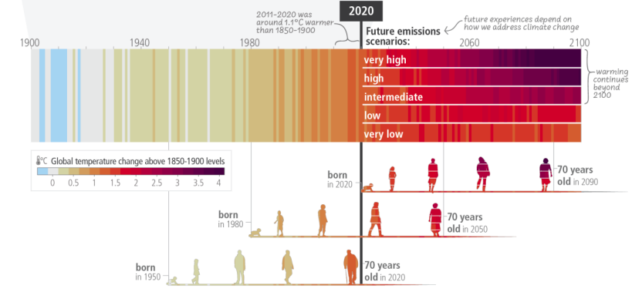
Hazards
Grenada is exposed to a wide range of endogenic and exogenic hazards.
The latter of these cause more intense and frequent hydrometeorological hazards.

Slide 40
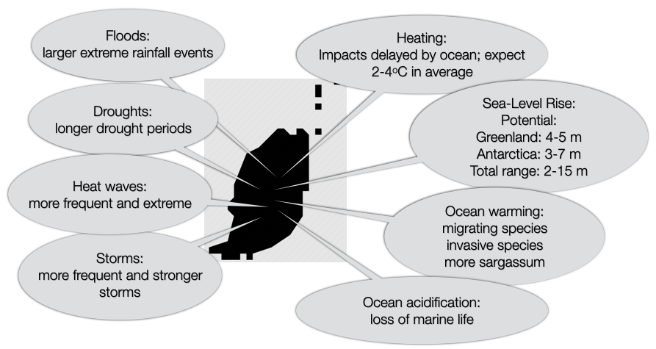
Climate Change Related Hazards
Far more events of rapid intensification
Storms become more intense in a short period

Slide 41
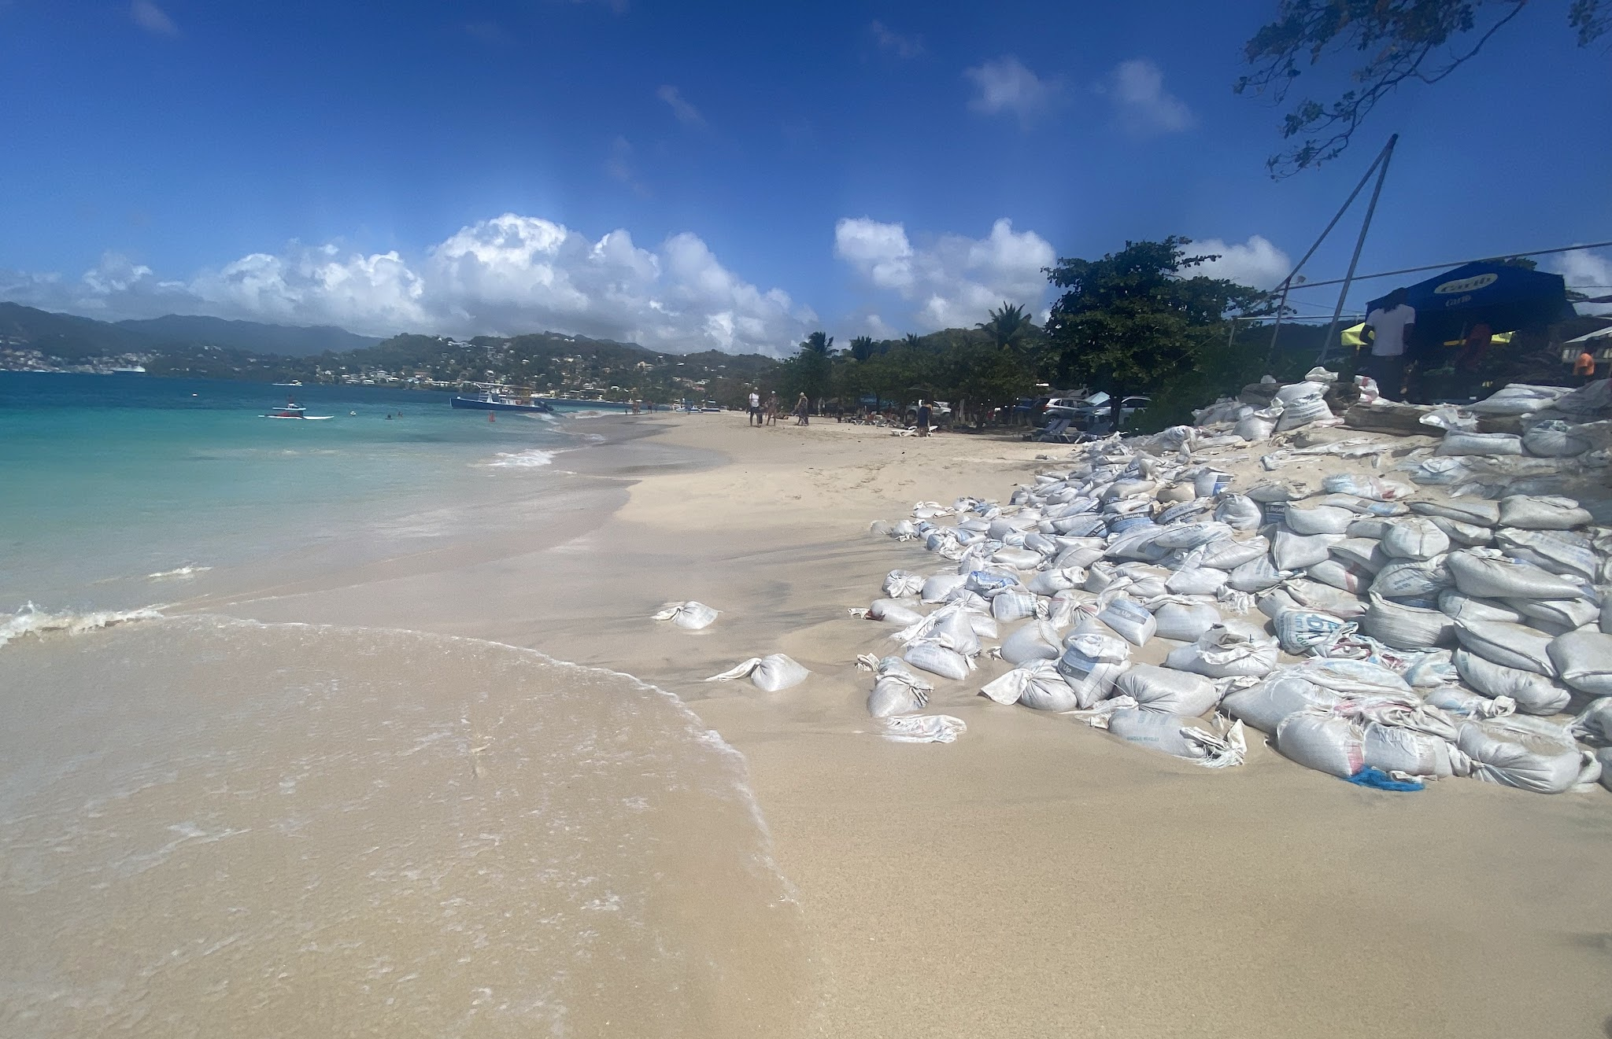
Contribution to SLR
Changes in the height of the sea and land surface:
For Grenada its on the order of 5 mm/yr
Melting of glaciers and ice sheets (large uncertainty on the impact on Grenada)
Change in ocean heat content and mass balance of the ocean
Ocean circulation

Slide 42
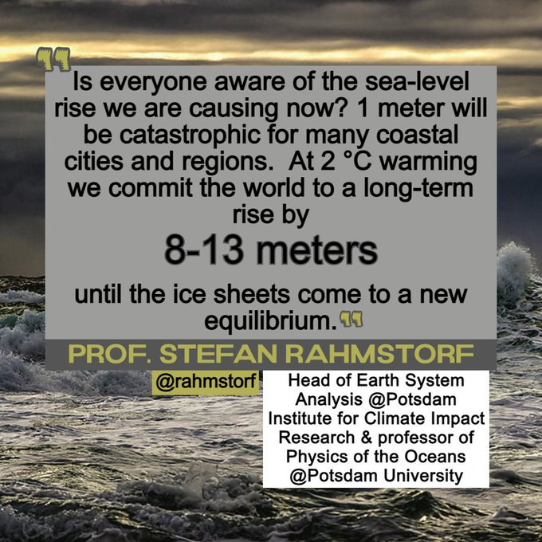

Slide 43
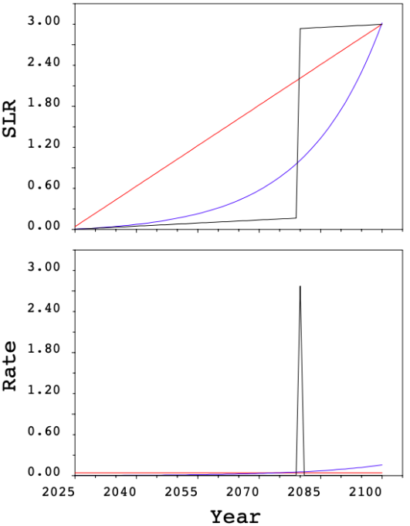
Local SLR Trajectory
Constant LSLR (red) Constant adaptation
  Linear increase in SLR
  Adaptation is required early on
Exponential LSLR (purple) Delayed preparation
  Delays the rate of adaptation
  Damage to buildings and the economy will increase rapidly (as LSLR gets higher)
Low/Rapid LSLR (black) Too late
  Low risk awareness & adaptation rate
  Build environment would not be ready for should a rapid increase

Slide 44
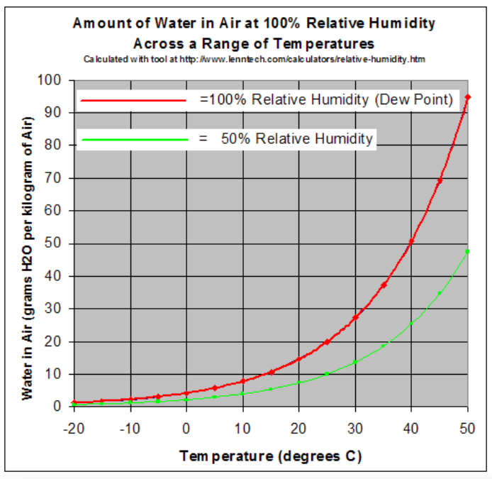
Air Temperature regarding Stored Atmospheric Water
Warmer atmosphere takes long to reach 100% humidity
When rain falls there a lot more water to contribute to heavy precipitation/flooding
1℃ increase in air temperature = 7% increase in water stored in the atmosphere

Slide 45
The trade off
Preparing society for potentially extreme storms in the future (high cost)
In many assessments of climate change impacts, the worst cases are ignored

Slide 46
Probability density function (pdf)
The probability an event will take place
  Can be used to model the frequency and intensity of hydrometeorological hazards
The Long Tail of (PDF)
  The chance an extreme hazard taking place
  Ex: an extremely rare heavy precipitation event that causes major flooding in certain areas

Slide 47
Foresight & Possible Futures
Meagan Duncan

Slide 48
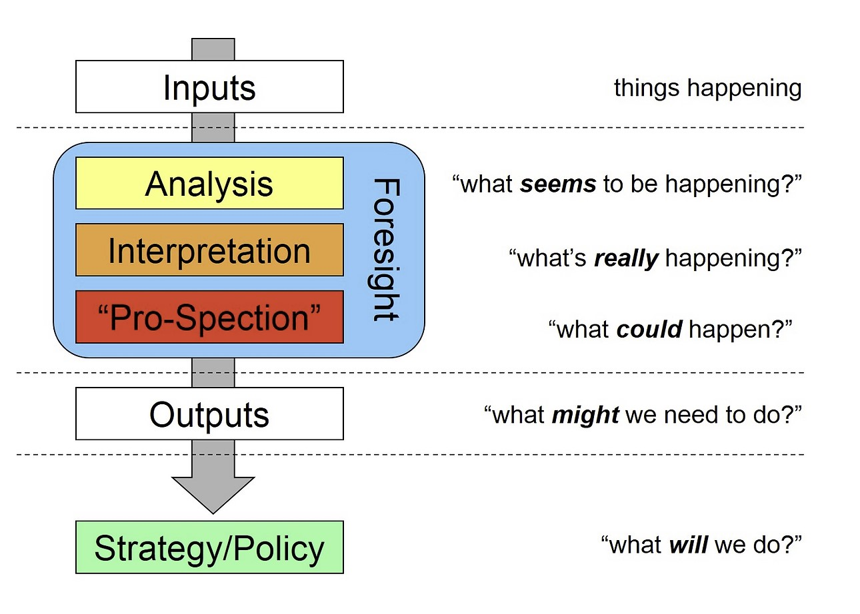
What is foresight and why do we need it?
Foresight:
Does not attempt to predict the future
Uses past and present knowledge to model possible futures
Accounts for varying levels of stakeholder action
Effective when used with a hazard scenario baseline
Should be utilized prior to the planning stage of a system’s response
Source: https://www.exploringfutures.net/generic-foresight-process

Slide 49
Sea Level Rise | Hurricanes, Storm Surge, and Extreme Precipitation Events | Droughts and Heatwaves
Comprehensive Response: Migration of current vital/non-vital infrastructure and services above 3m discontinuance of low-lying construction | Comprehensive Response: Inland migration Soil stabilization Reinforcing infrastructure | Comprehensive Response: Increased water capture during wet season Expanded storage capacity Conservative Use
Moderate Response: Focus on critical infrastructure migration such as hospitals/grocers | Moderate Response: Critical infrastructure migration | Moderate Response: Increased water capture during wet season
No Action: No migration Continued coastal construction | No Action: No migration No reinforcement to built or natural environment | No Action: No increased water capture or expanded storage Unsustainable water consumption allowed

Slide 50
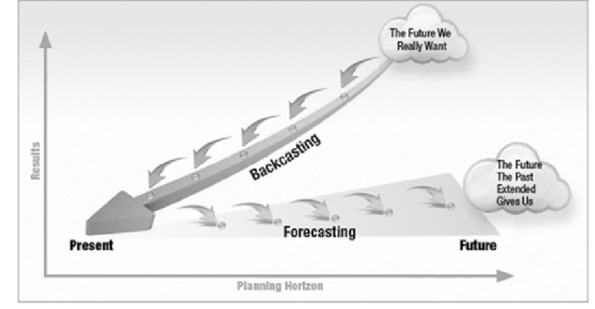
Source: Faldi and Macchi (2017)

Slide 51
Back Casting
Desirable Future (formulated based on the goal statement):
SLR doesn’t negatively impact daily living
Minimal risk of harm/damage from extreme weather and flooding via a reinforced/resilient environment
Water supply adequately meets the needs of the island without relying on costly, supplemental imports
How do we get there?
Engaging in comprehensive system responses
Changing attitudes toward the definition of economy
Transformation of current living practices to create a resilient system

Slide 52
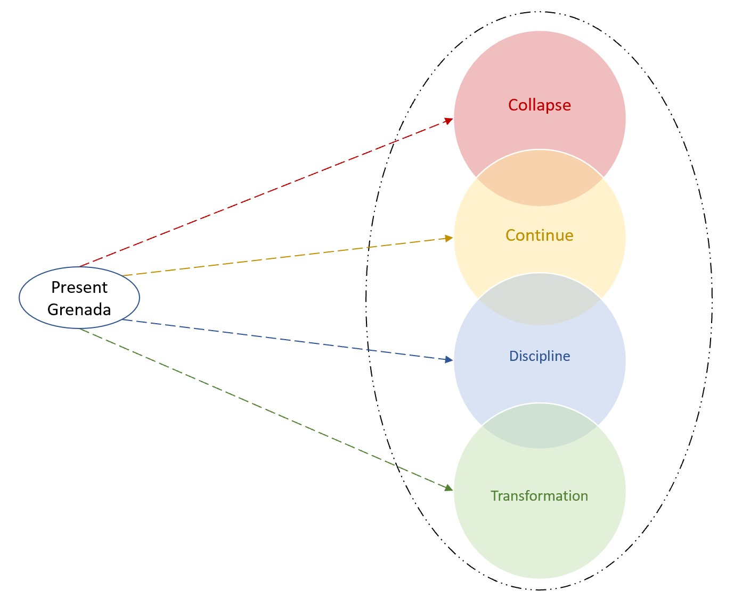
Defining Archetypal Outcomes
Collapse - worst outcome archetypal future being driven primarily by a lack of action, exacerbated by the rapid development of hazards
Continue - would be expected if a system maintained its current trajectory with no change
Discipline - a system’s response incorporates and maintains actions intended to mitigate the effect of hazards, can strict adherence to a limited range of response-based mitigation or the deployment of long-term planning that addresses some, but not all, of the hazards impacting the system
Transformation- embodies the most desirable, best-case outcomes for a system
In order to achieve a Transformative future, trajectories must involve a total reestablishment of current processes based on a value shift away from continuing trends and towards revitalizing action.

Slide 53
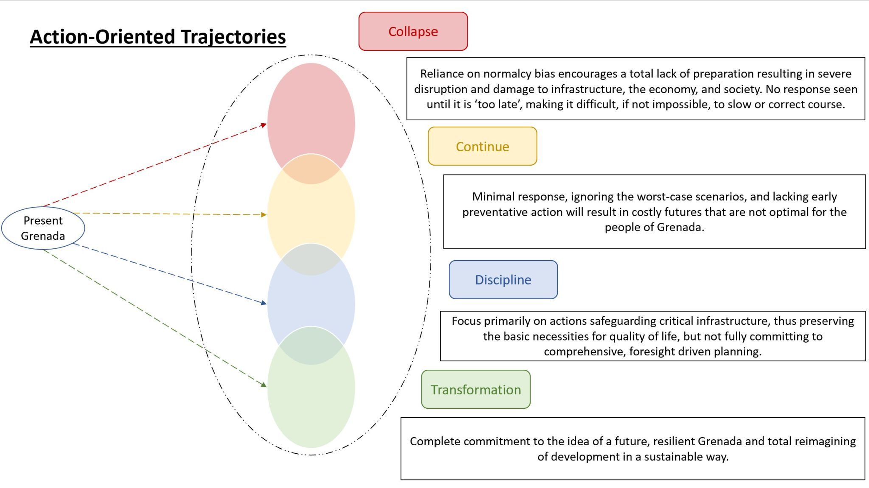
COLLAPSE!
Desired futures from backcasting reside within Transformation archetype
Notes:
Meagan requested transitions for this slide

Slide 54
Questions for the Audience
What does a desirable future for Grenada look like from your perspective, and what can you do as a stakeholder to ensure Grenada is guided towards this future?

Slide 55
Risk Assessments
Blaizen Bloom

Slide 56
WHAT IS RISK ASSESSMENT?
How do we Quantify Risk?
Identifying Hazards
Analyzing Probability & Impact of Hazard Scenarios
Exposure & Value of Fragile Assets
When do we Assess Risk?
When we travel
Deciding when to go to the doctor
Choosing a place of work

Slide 57
WHY IS ASSESSING RISK IMPORTANT?
Purpose of Assessing Risk:
Allows us to identify the highest risk hazards within our system
Informs our decision making on what interventions to examine and recommendations to conclude with
Highlights the most vulnerable populations and geographic areas
Occurs multiple times to allow reassessment on interventions and effects within the system

Slide 58
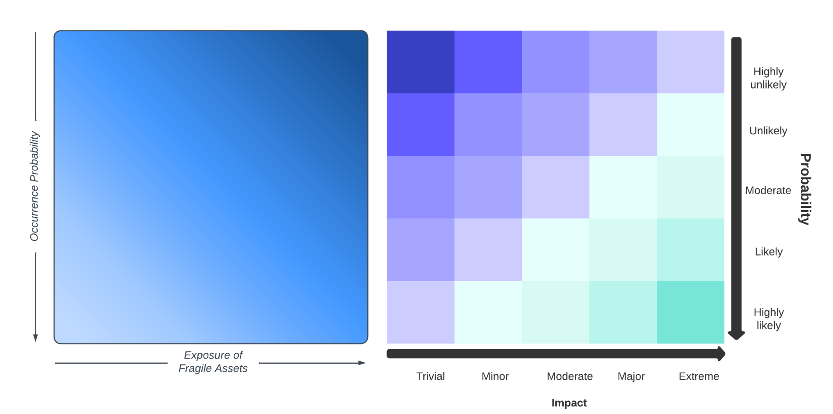
Visualizing risk

Slide 59
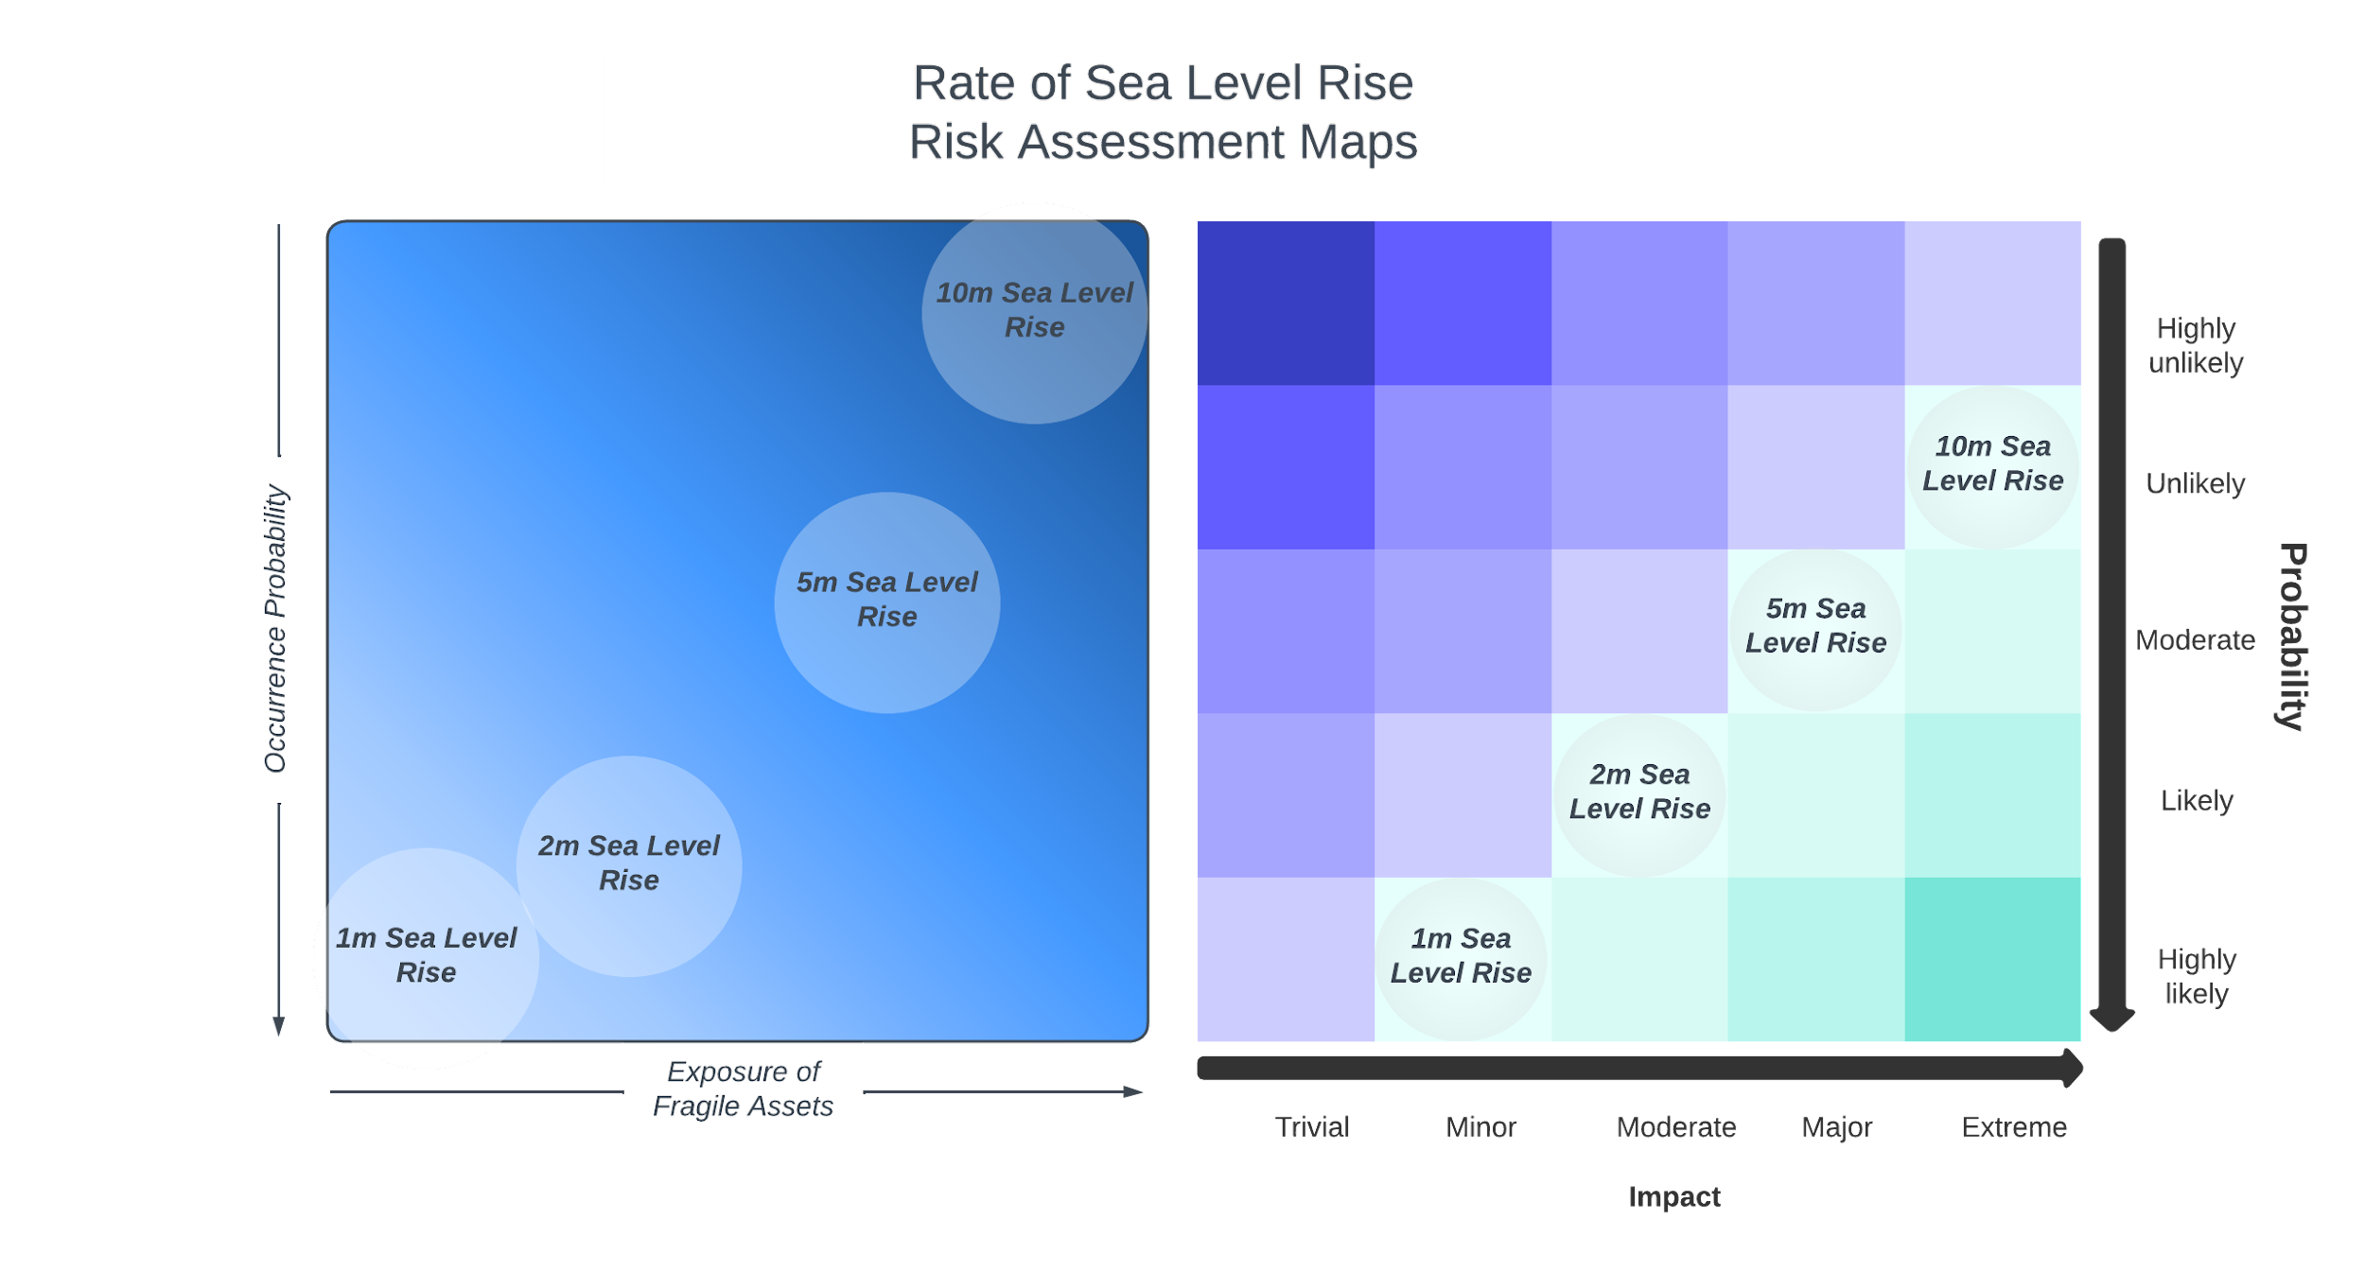
Mean Sea level rise
Probability of Occurring:
Ocean warming
Glacial melt
Impact on Fragile Assets:
Flooding of coastal settlements
Destruction of critical infrastructure
Mangrove, coral reef loss

Slide 60
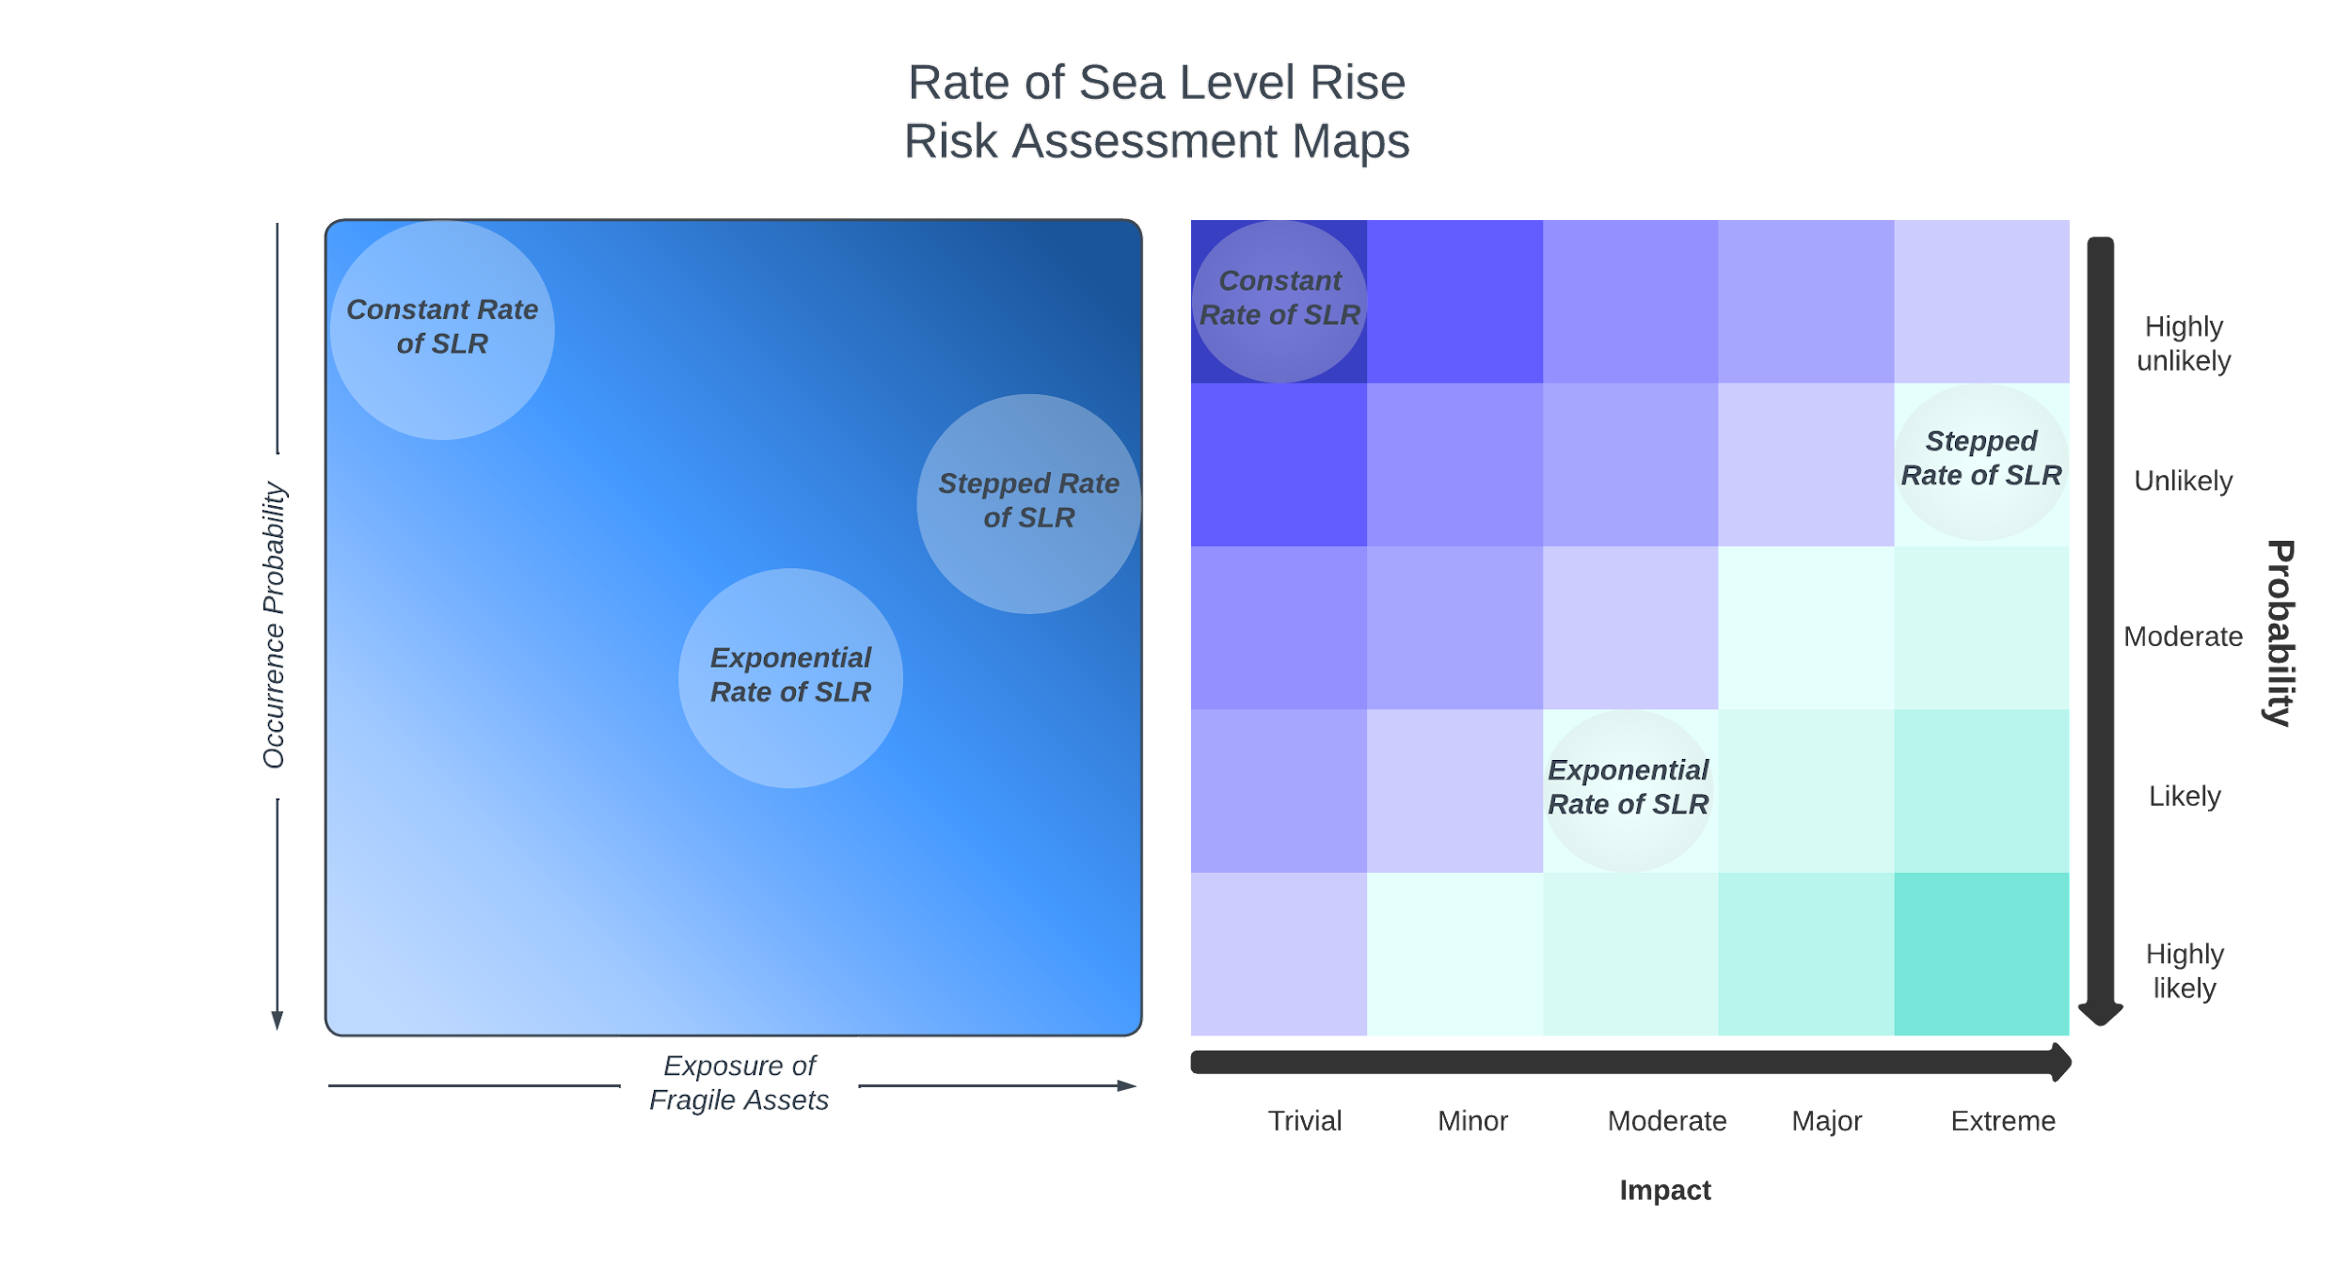
Rate of Sea Level Rise
Probability of Occurring:
Historic, exponential trends
Glacial instability for rapid collapse
Impact on Fragile Assets:
Inability for Grenada to adapt to changes
Lack of public support for adaptation

Slide 61
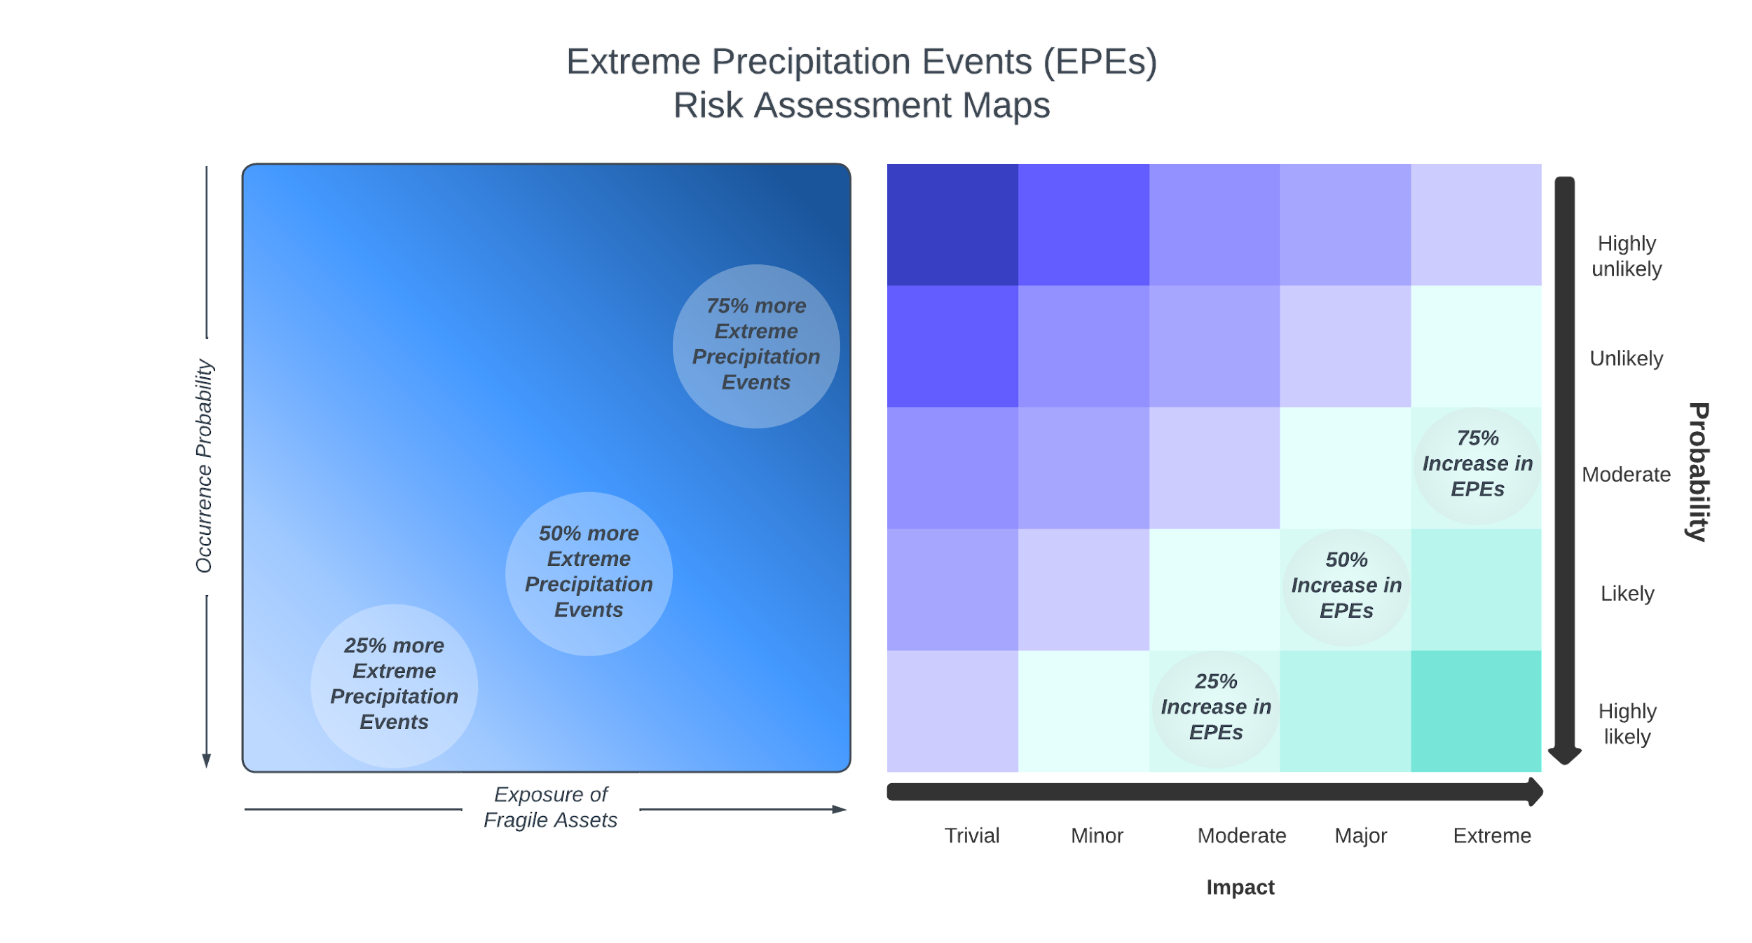
Heavy Precipitation
Occurrence Probability:
Increasing global frequency
Atmospheric temperature increases
Exposure of Fragile Assets:
Landslides onto roadways
  i.e. Deadliest Car Accident in Grenada
Heightened flooding of coastal populations; St. George’s

Slide 62
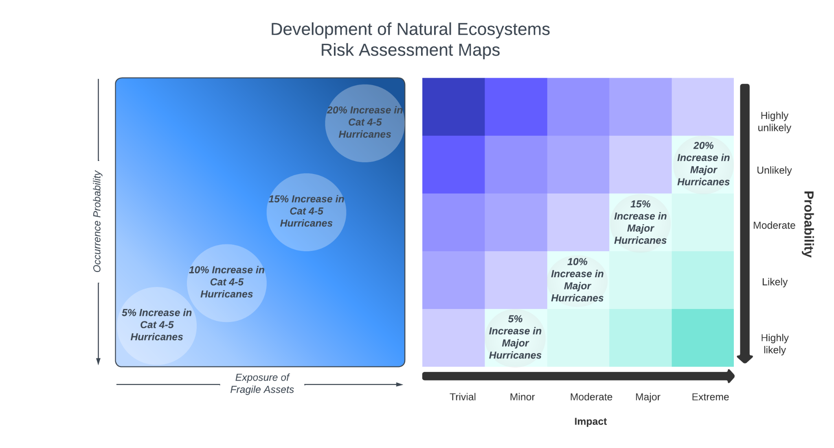
Hurricanes & Storm Surge
Occurrence Probability:
Warming of oceans
Increased atmospheric water content
Exposure of Fragile Assets:
More severe storm surges impacting coastal communities
Stronger winds & rainfall of landing hurricanes

Slide 63
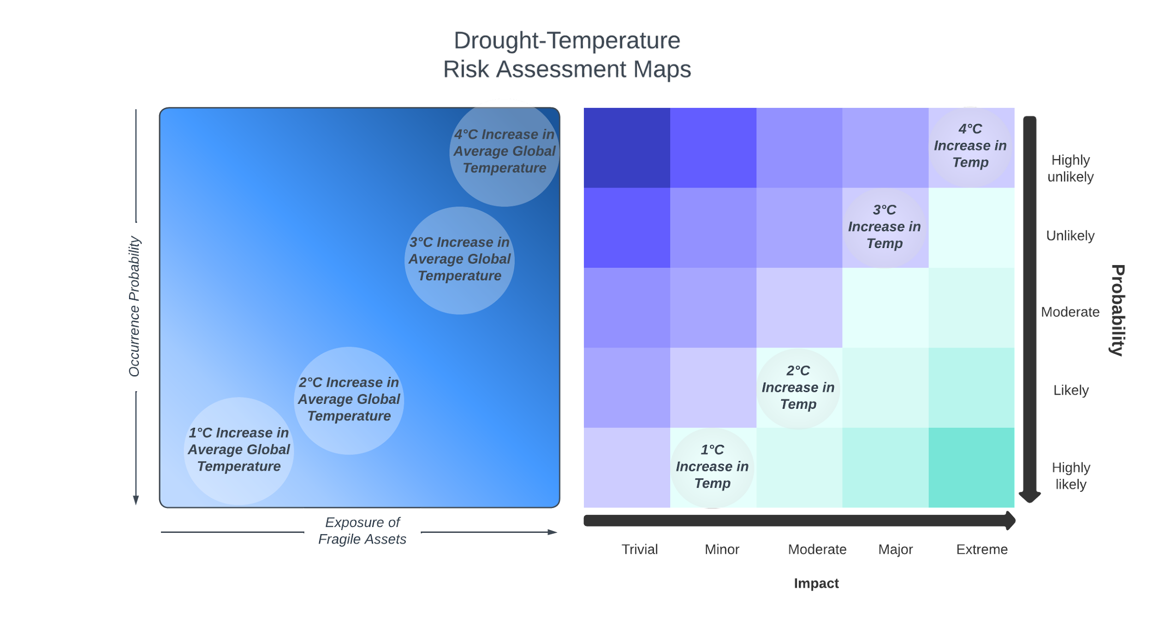
Droughts & Heatwaves
Occurrence Probability:
Success rate of Paris Accords for reducing emissions
Probability of emission overshoot
Exposure of Fragile Assets:
Extended dry periods; shorter wet periods
Drier soil = Worse Landslides

Slide 64
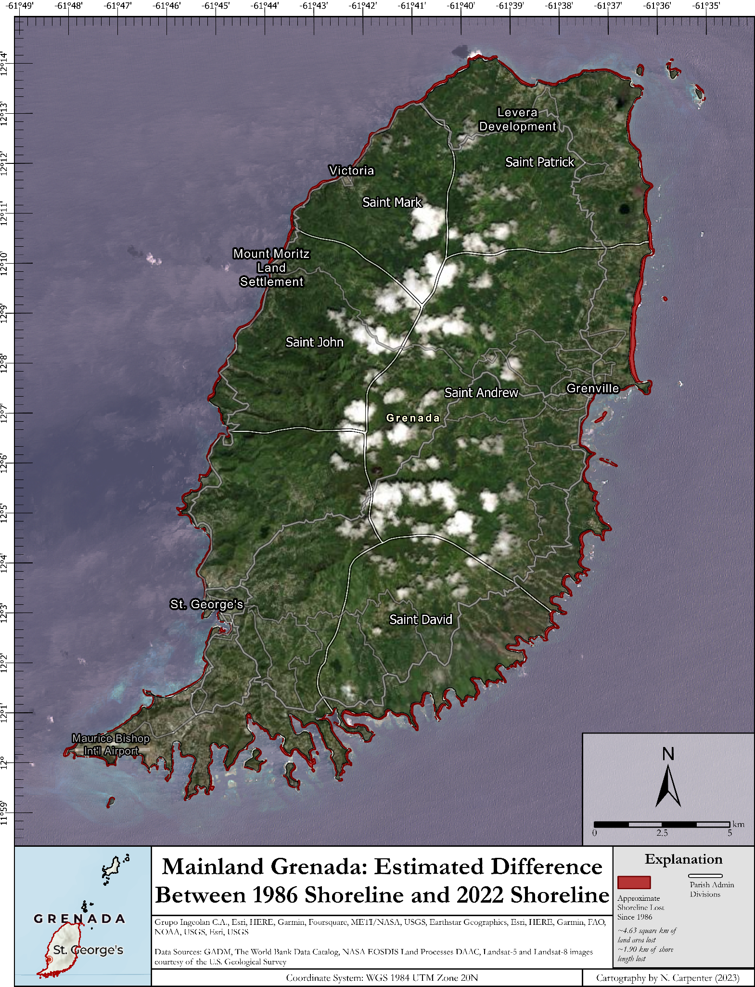
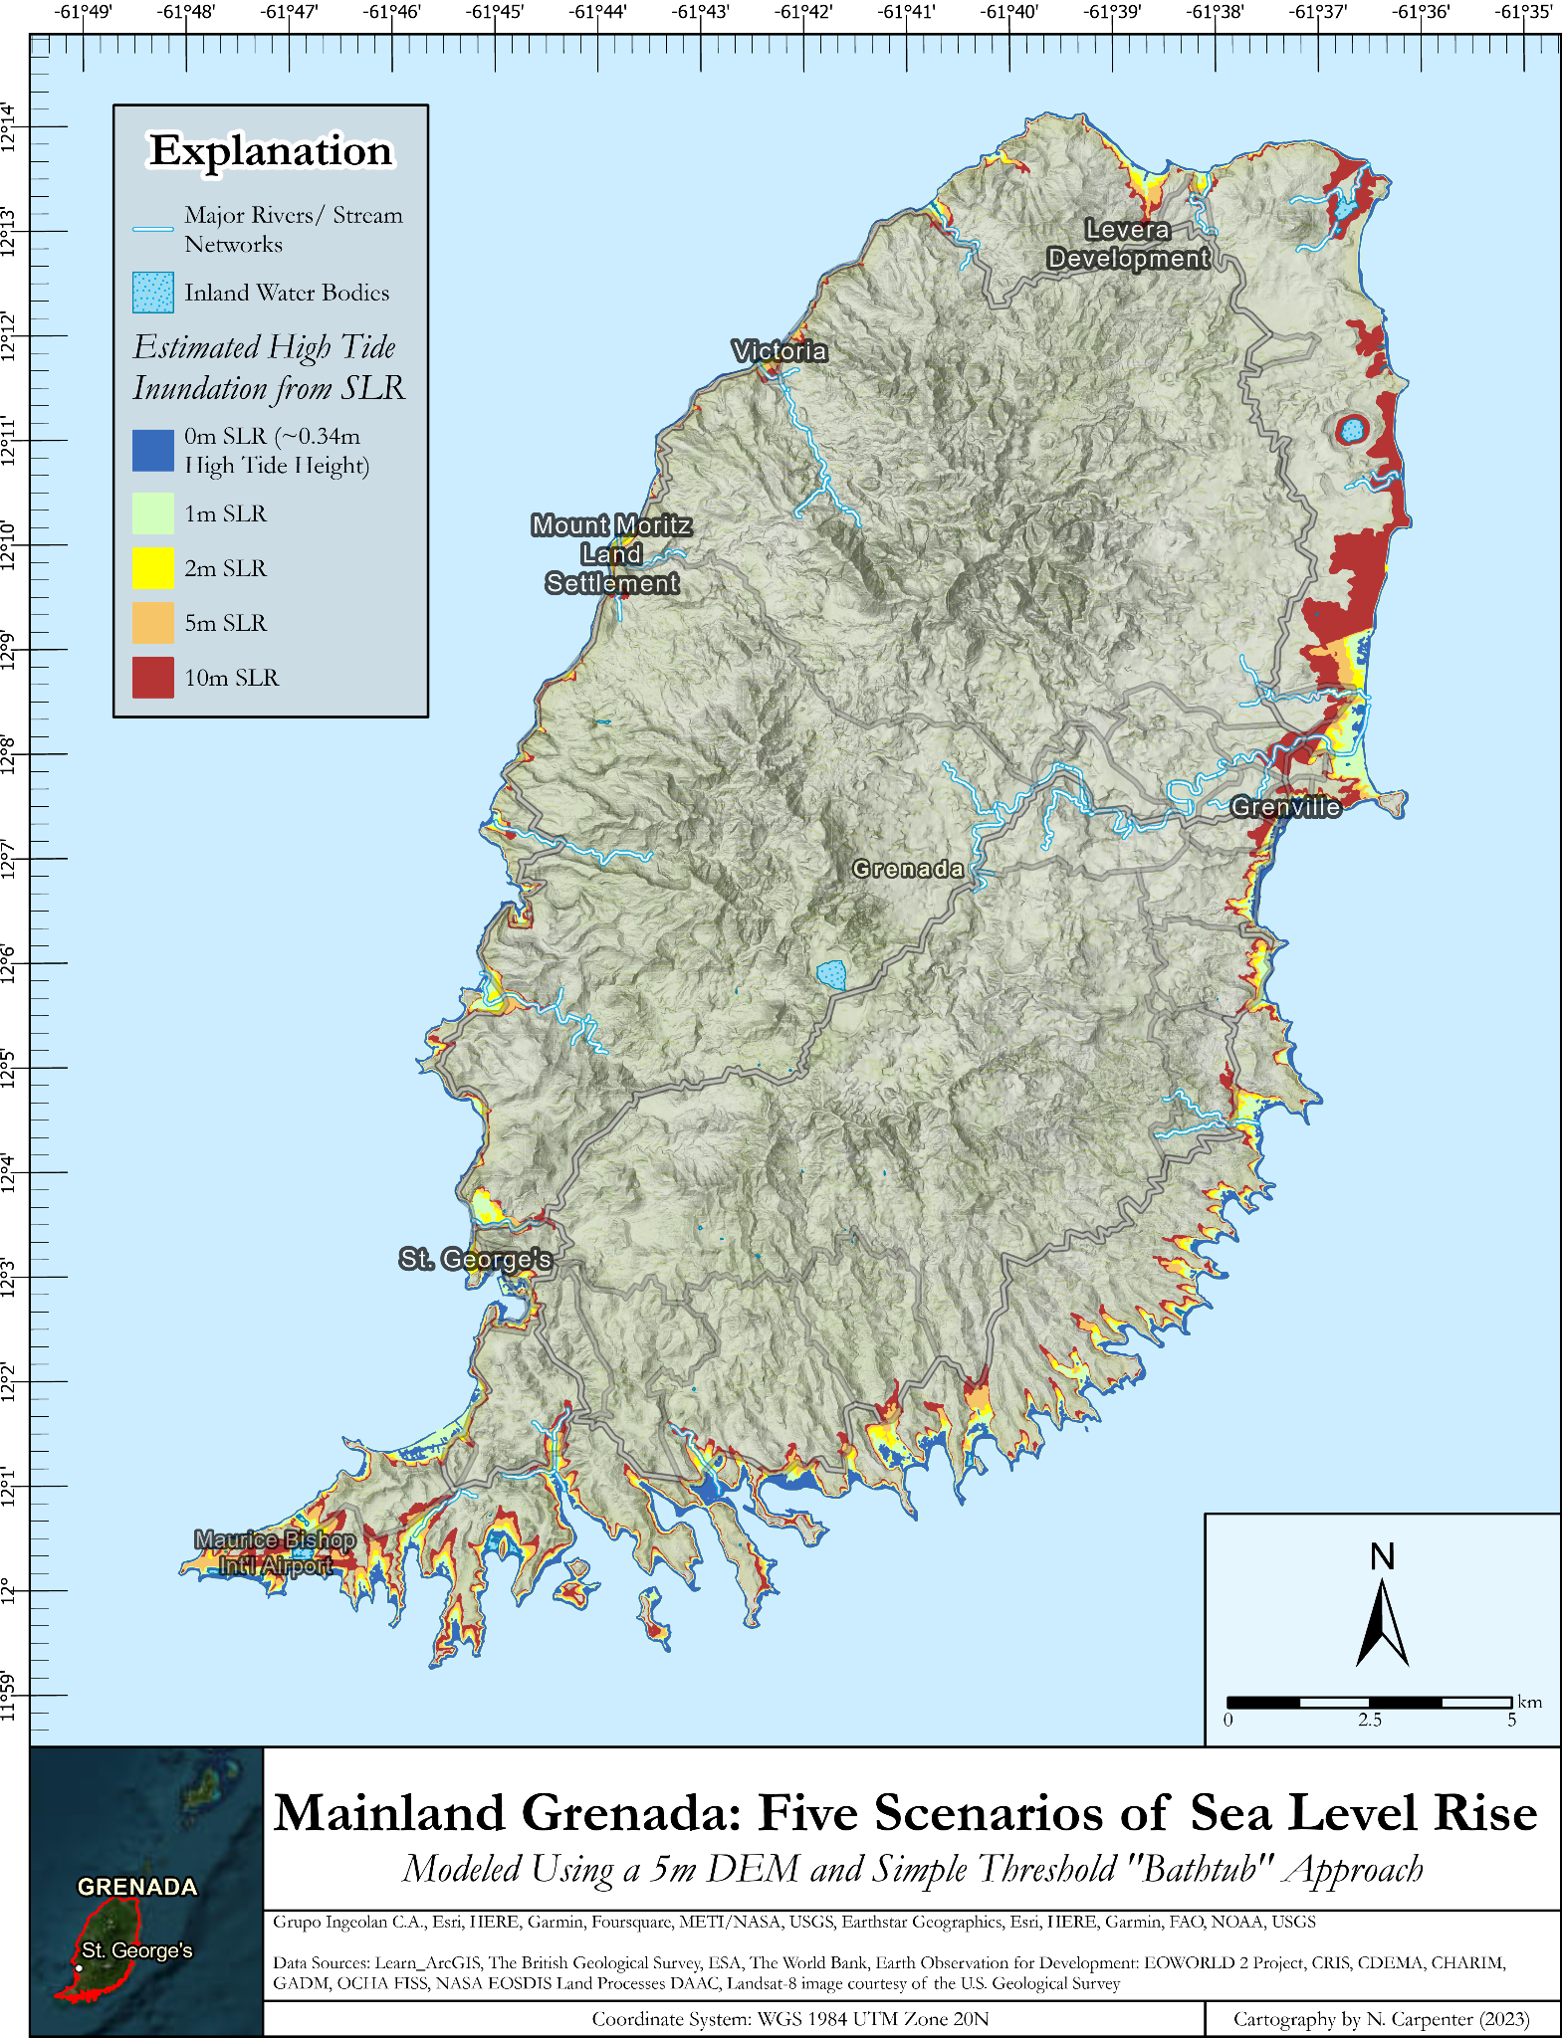
Slr for grenada

Slide 65
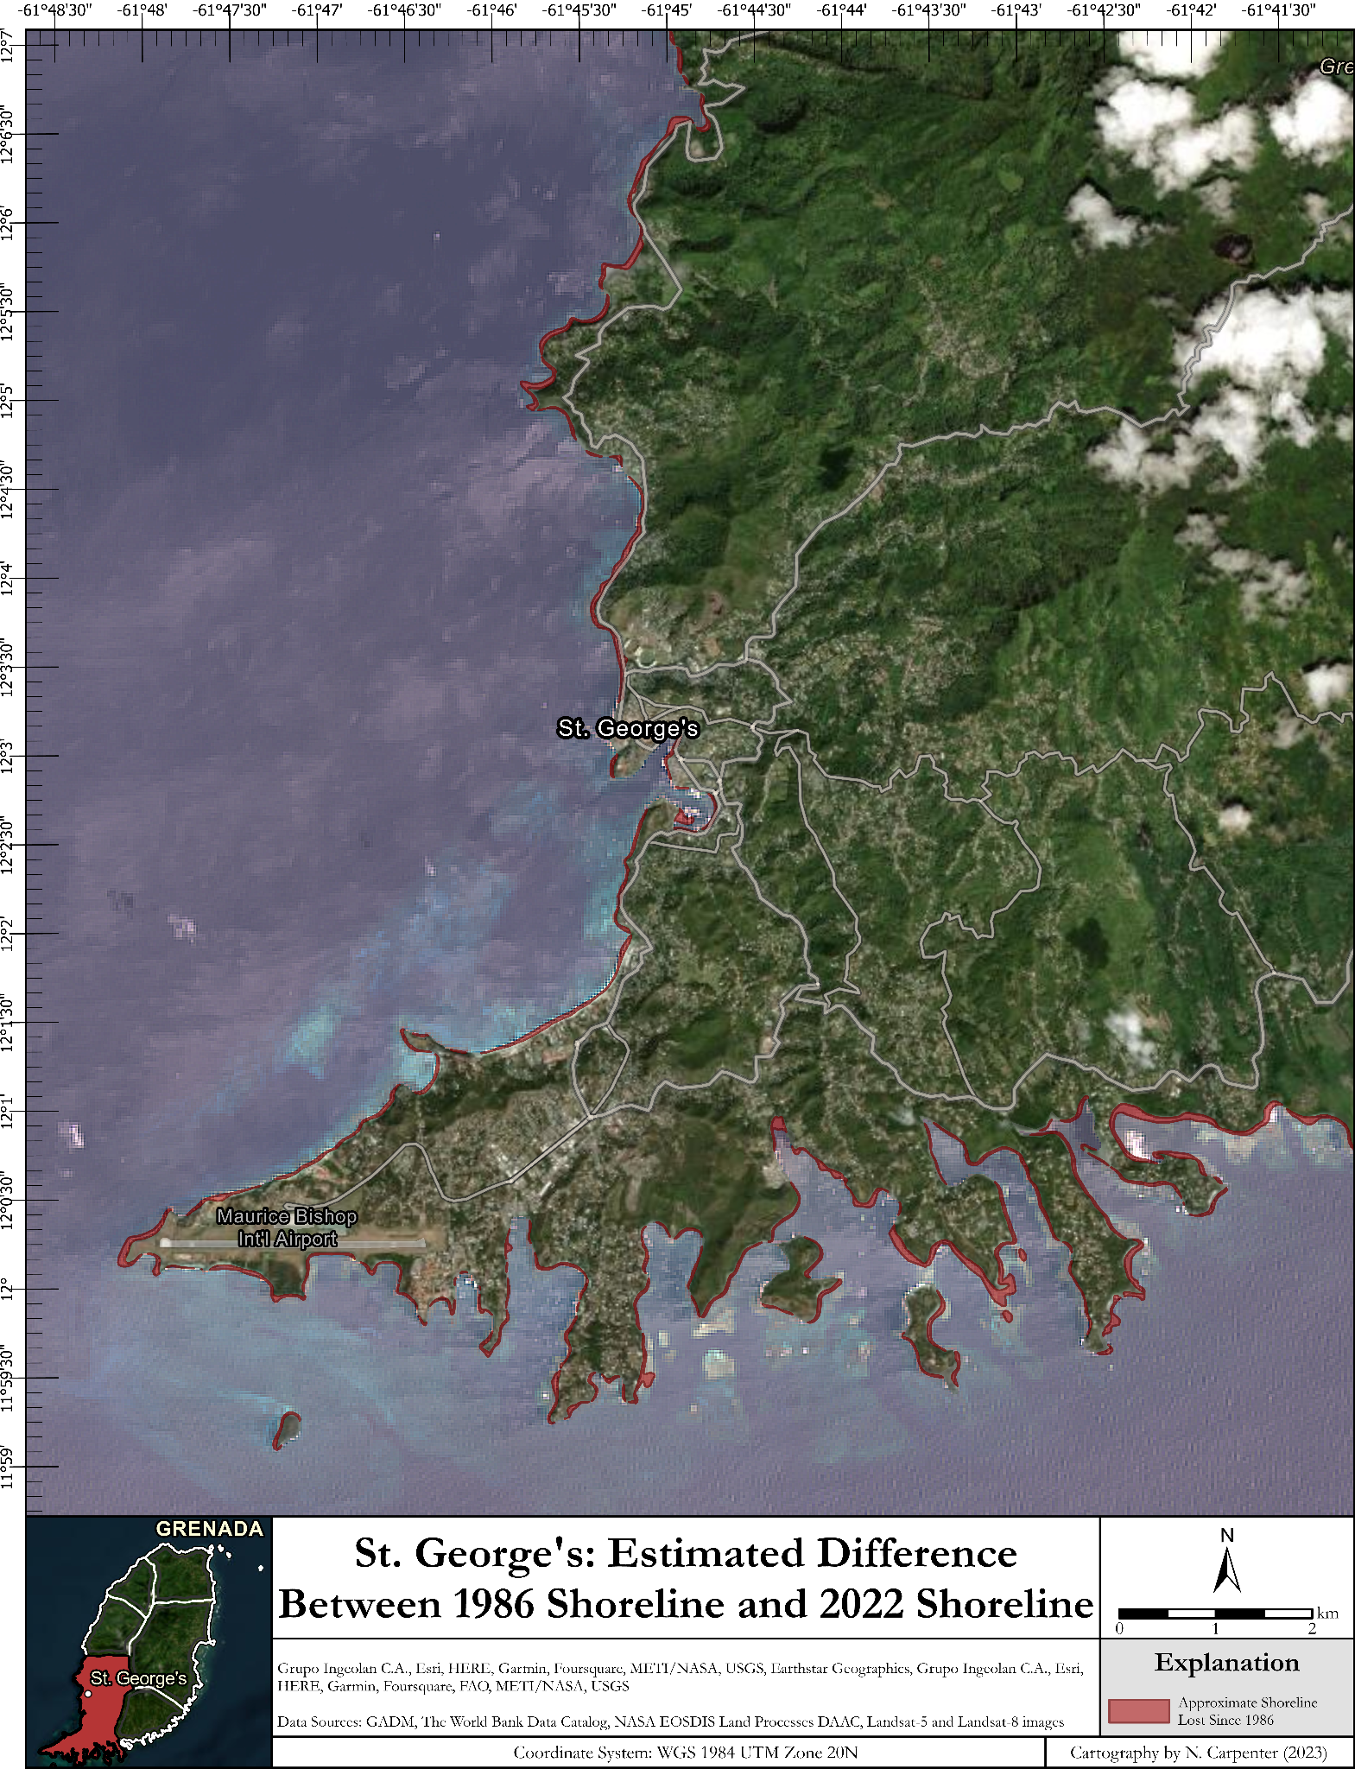
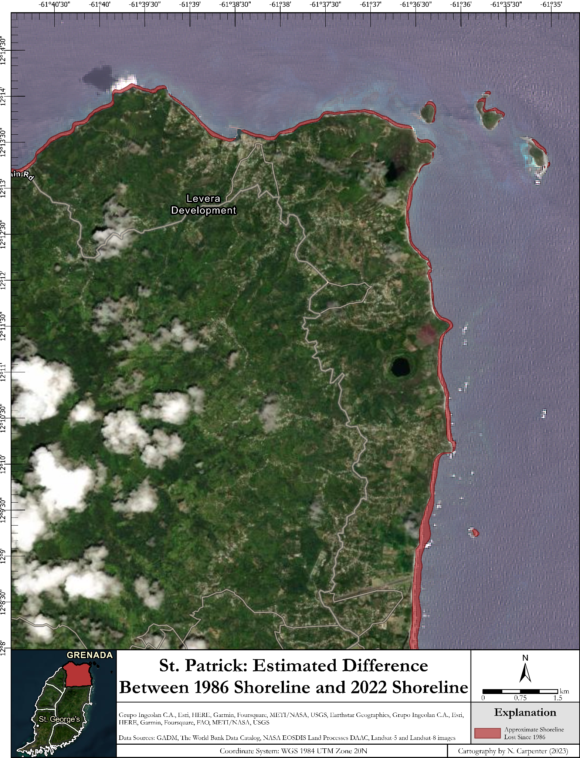
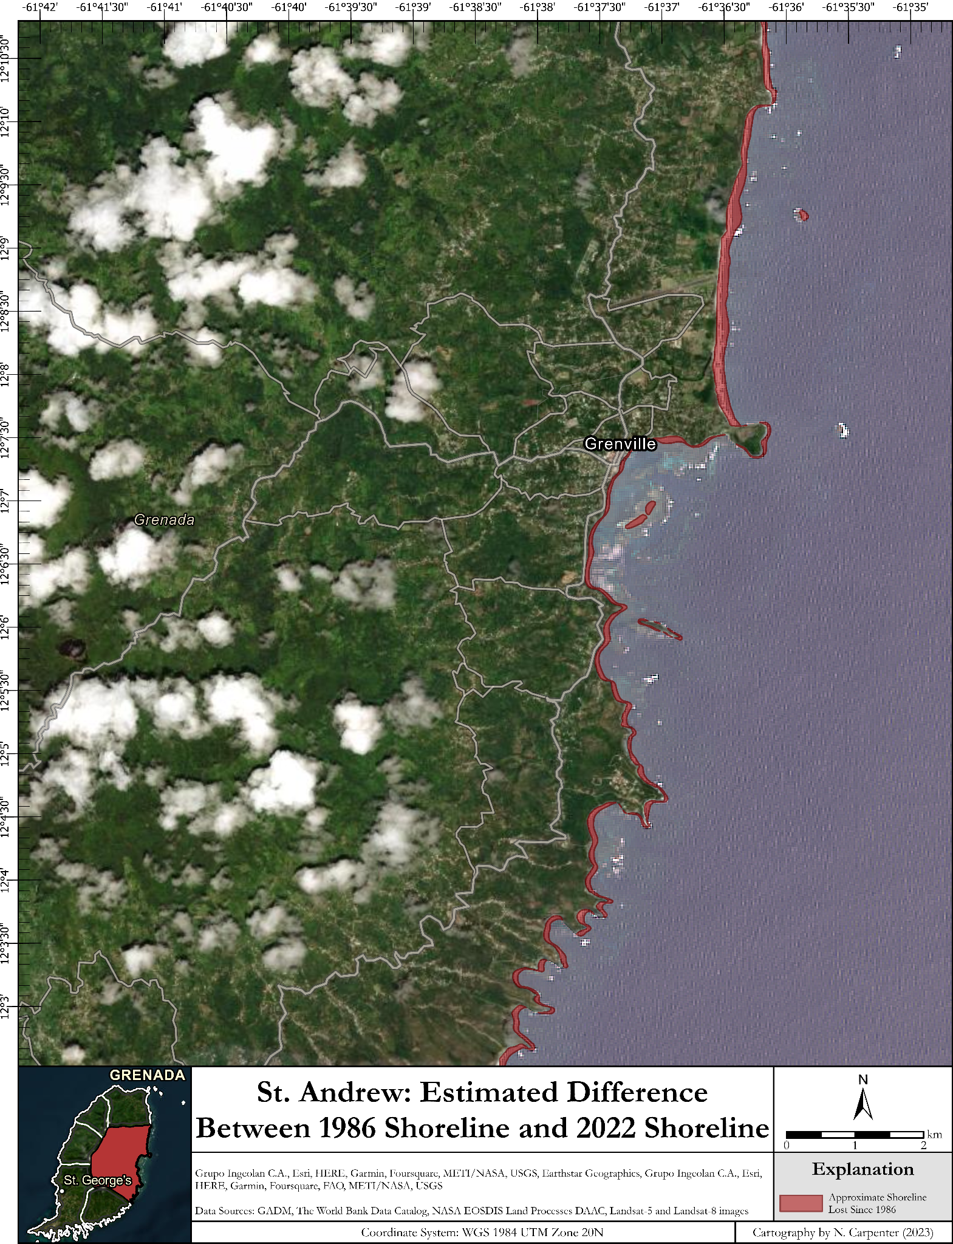
Past slr

Slide 66



Future slr projections

Slide 67
Questions for the audience
Which futures do you think pose the greatest risk to Grenada over the next century?
What areas are under threat the most in the risk assessments?

Slide 68
Assessing Interventions
Rocco Boyd

Slide 69
Possible Interventions
Built Environment
Identifying critical Infrastructure
Preparing for migration
Creation of seawalls
Mapping and preparing future flood zones
Increase resilience of electric grid
Ecosystems
Mangrove restoration
Natural landslide prevention
Local Economy
Strengthening global supply chain
Sustainable tourism
Desalination of seawater
Atmospheric extraction of water
Swales for agricultural use
Improvements for stored water
Improved rain capture systems
Social Fabric
Public education programs
Dynamic education in school systems

Slide 70

Interventions –
Built Environment
Identifying Critical Infrastructure
Pros
Early identification of high-risk areas
Timely preparation of infrastructure to move
Cons
Logistics of movements
Costs
Time it would take to move

Slide 71

Interventions – built environment
Preparing the Built Environment to Move to Higher Grounds
Pros
Movement of populations out of high-risk areas
Allows for mangroves and beaches to migrate
Cons
Environmental impact
  Further research would be needed to determine environmental impact of the movement of the built infrastructure

Slide 72

Interventions –
Built environment
Sea walls at identified locations
Target areas would include around the port in St. Georges and Grenville
Pros
  Keeps seawater out
Cons
  Cement used may not be able to withstand the sea water, resulting in leaks
  Cement may contain harmful chemicals and microplastics which would affect local marine communities if dislodged
  Intensify beach/coastal erosion
Notes:
Show where they can work

Slide 73
Interventions –
Built Environment
Mapping and Preparations of Future Flood Zones
Similar to identification of critical infrastructure
Pros
  Better mapping of soil and land
  Improvements in rainfall data gathering
  Identification of future flood zones
  LiDAR DEM already Available
Cons
  Logistics of conducting LiDAR surveys
  Costs

Slide 74

Interventions –
Built Environment
Increasing Resilience of Critical Electrical Service Infrastructure
Decentralization of Electrical Grid
Pros
  Increased resilience of electric grid
  Shift towards renewable energy
Cons
  Costs
  Possible disproportionate considerations
  Logistics of installation

Slide 75


Interventions – ecosystem
Natural Landslide Prevention System
Use of hedges, trees, crops, mangroves, etc. to stabilize soil
Pros
  Additional crops could be planted
  Ground stabilization
  Protection of valuable agricultural lands and infrastructure
Cons
  Additional land needed
  Logistics

Slide 76

Interventions – ecosystem
Further development of mangrove restoration projects
Restoring water flow within impounded mangrove systems
Pros
  Naturally maintain water quality
  Limits storm surge and local sea level rise
Cons
  Prevents coastal development
Notes:
Which mangroves? Map?

Slide 77
Interventions –
Local economy
Strengthening Supply Chain
Strengthening or reinforcement of supply chains
Identification of all aspects of supply chain
Diversification of suppliers
Supply chain reinforcement
Pros
Strengthening of supply chain
Economic stability
Consistent Economy
Cons
Logistics and complexity of trade routes
High costs of reinforcement
Trade offs with sustainability goals
Notes:
Do not lead with this; does not involve adaptation

Slide 78

Interventions –
Local economy
Sustainable Tourism
Ecotourism or cultural tourism that seeks to preserve the identity of Grenada while still preserving the tourism industry
Pros
Cultural preservation
Environmental protection
Protection of tourism industry
Cons
Increased costs
Reduced options for tourists
Logistics
Notes:
Mosquitos

Slide 79

Interventions –
Local economy
Swale usage for farms
Built lakes or ponds that capture rainwater and runoff
Pros
  Capture rainwater/runoff
  Sustainable water storage
  Halts soil erosion
Cons
  Contamination of groundwater
  Mosquito breeding ground
  High evaporation rates
Notes:
Mosquitos

Slide 80
Interventions –
Local economy
Intervention | Pros | Cons
Desalination of water | Grenada is surrounded by water Sustainable source of freshwater | Relatively new process High cost Not energy efficient Negative on the environment
Atmospheric extraction of water | High concentration of atmospheric water | Efficient materials still in development Small storage systems High cost

Slide 81
Interventions –
Local economy
Intervention | Pros | Cons
Improved Capture of Rainwater | Already implemented in some areas Conserves water Lowers freshwater demand | Efficiency issue with longer dry season Poor water quality Is local infrastructure capable?
Improved Storage of Rainwater | Drought preparedness Low freshwater demand | Personal Use Cost Space for storage

Slide 82

Interventions – social fabric
Public Education Programs
Using such social media platforms as Spice Isle Review or The Grenadian Voice
Pros
  Education for older generations
  Encourage interaction
  Increased understanding of climate change
  Inexpensive
Cons
  Eco-grief

Slide 83
Interventions – social fabric
Dynamic Climate Education Programs in Schools
Would vary based on grade level
Pros
Raise awareness
Spread message to younger generations
Interactions mapping software
Cons
Eco-grief
Focus of local colleges in medical field
Logistics of implication

Slide 84
Discussion & Conclusions
Blaizen Bloom

Slide 85
Moving Forward with the Results
Engaging more stakeholders:
Limited meetings in-person from limitations of time in Grenada
Incorporating more diverse perspectives from general citizens
Future focus possibilities:
Intersection with other major issues facing Grenadian stakeholders, ex:
  Environmental Issues: Climate Change, Mass Species Extinction, & Pollution
  Economic Challenges: Poverty, Wealth Inequality, Food Insecurity

Slide 86
Recommendations
Alivia Markham

Slide 87
What are recommendations?
Specific transformative interventions
Realistic potential for future impact
Clarify the recommendations to specific stakeholders
Clarify who plays a major role in implementing these recommendations

Slide 88
Making Recommendations
Recognize
Acknowledge
Recommend

Slide 89
Recognizing that…
Not one single stakeholder is responsible for making these decisions
Sea level rise is already causing flooding, increasing the severity of storm surges, causing erosion/landslides, inundation, etc.
As the climate continues to change, we will experience a further increase in sea level rise, extreme precipitation events, and an increase in the severity of droughts and heatwaves.
We do not exactly know the future of climate change and are unsure of what to expect

Slide 90
Acknowledging that…
The Planning & Development Authority wants to do something but has limited resources/influence
The people are concerned about climate change
Ministry of Agriculture is invested in the conservation missions being put forward by the Grenada Fund for Conservation
Grenada Fund for Conservation already has several outreach and educational programs which could be built upon

Slide 91
Planning and Development Authority
Identifying Critical Infrastructure
  Highlights high-risk areas and buildings that can be targeted for moving
Preparing built environment and people to move
  Movement of population centers out of high-risk areas
Seawalls
  Constructed in specific areas, around St. George’s and Grenville, to keep out sea water
Mapping and Preparation of Future Flood Zones
  Increased mapping and data collection to identify future flood zones
  Provides early warning system for high-risk areas to begin moving out of flood zones

Slide 92
Ministry of Agriculture
Develop natural systems of landslide prevention
  Planting of additional crops along riverbeds
  Placement of native trees/shrubs along rivers in population centers

Slide 93
NAWASA
Improvements to the storage of water
Larger containers to cope with longer dry seasons
Development of rainwater capture systems
  Reduced reliance on freshwater reserves
  Efficient method of water capture

Slide 94
Grenada Fund for Conservation
Public education programs
  Helps to inform public issues regarding climate change
  Generates public support

Slide 95
Education
Further education for students on climate change
  Variable education at each grade level
  Mapping software taught at higher grade levels to better identify flood risk areas in Grenada

Slide 96

Questions?
Notes:
Overall – make more specific to Grenada

