Slide 1
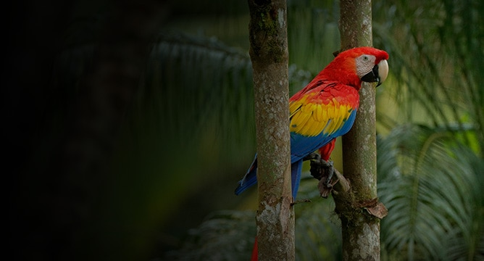
Conservation Leadership:
Lessons Learned while Working in Latin America and the Caribbean
Amanda Gonzales
Program Officer, Mexico & Caribbean
US Fish and Wildlife Service

Slide 2

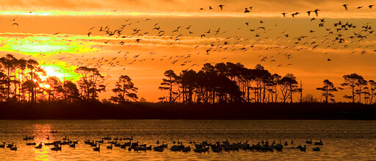
US FISH AND WILDLIFE SERVICE
We work with others to conserve, protect and enhance fish, wildlife, plants, and their habitats for the continuing benefit of the American people.

Slide 3
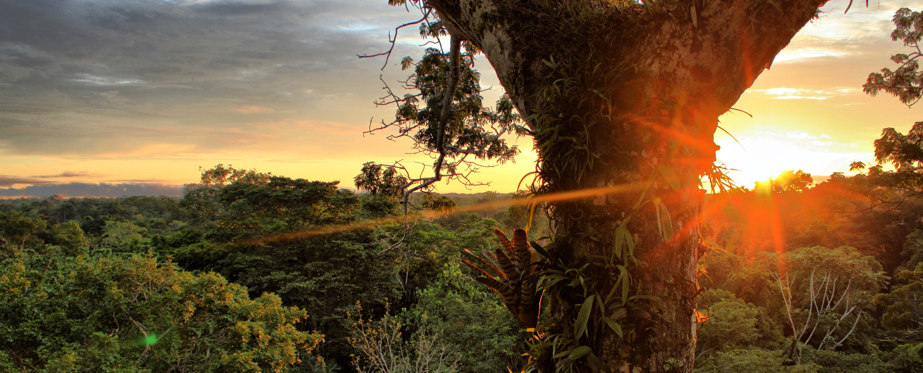
Our work spans the globe, including:
Projects funded in more than 75 countries
565 National Wildlife Refuges
20 Million Acres of Wilderness
72 National Fish Hatcheries
80 Ecological Services Field Offices
7 National Monuments
Notes:
Since then, we have grown significantly, and we currently manage 565 National Wildlife Refuges in the US and support projects in more than 75 countries.

Slide 4

We coordinate domestic and international efforts to protect, restore, and enhance the world’s diverse wildlife and their habitats with a focus on species of international concern.

Slide 5
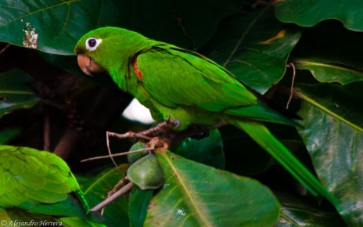
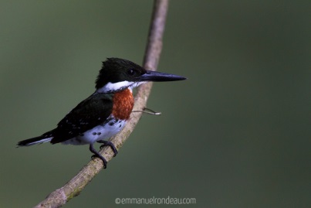
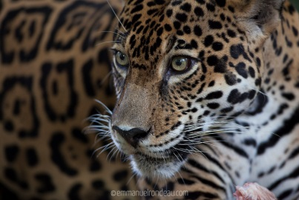
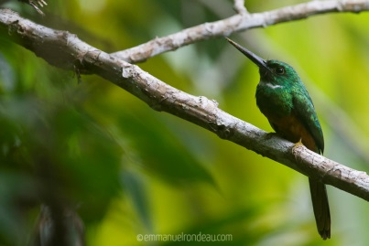
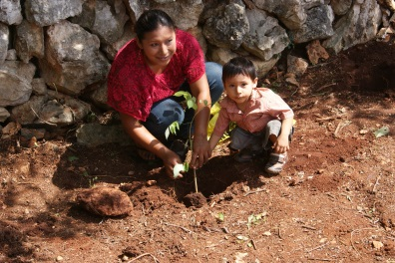
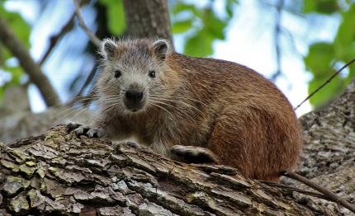
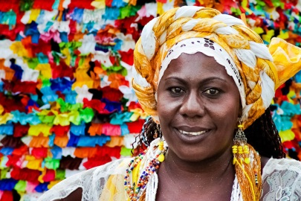
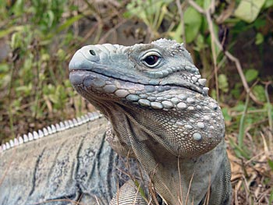
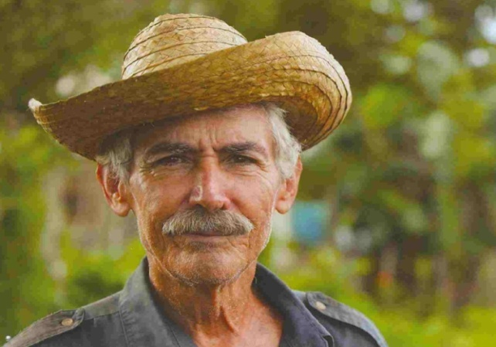
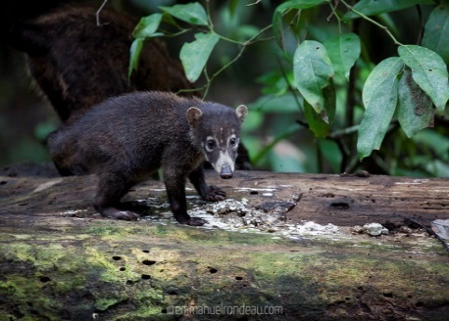
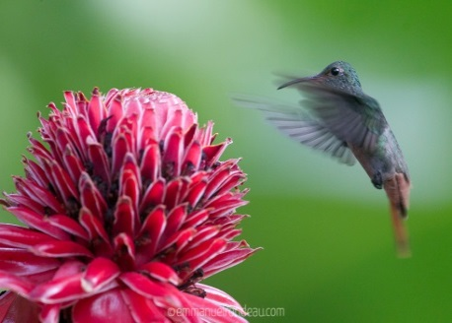
Mexico and Caribbean Programs
To conserve priority species, habitats and ecological processes across landscapes with high biodiversity value in Mexico and the Caribbean

Slide 6
Strategic Priorities
Conservation of Endangered Species and their Habitats
Addressing Illegal Trade of Wildlife
Protected Areas Management and Conservation
Sustainable Use of Natural Resources
Notes:
In order to achieve our goal, we provide financial assistance to partners (from NGOs, to local governments, academic and research institutions, and grass roots organizations) working to implement projects addressing 1 or more of the following 5 strategic priorities:

Slide 7
A Multi-Faceted Approach to Conservation
Data Gathering and
Applied Science
Building Conservation Capacity
Outreach, Education, and Behavior Change
Enforcement and Patrolling
Community-based Conservation
Human Wildlife Coexistence

Slide 8
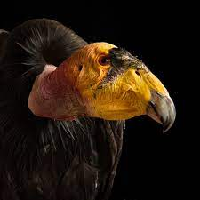

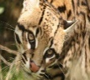

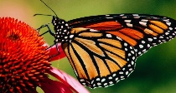

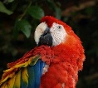


Mexico Portfolio of Projects
California Condor
Jaguar
Ocelot & Jaguar
Migratory Bats
Monarch Butterfly
Sea Cucumber
Scarlet Macaw/Parrots
Jaguar
Jaguar
Jaguar
Rain Forest

Slide 9
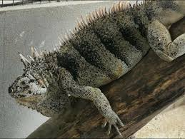
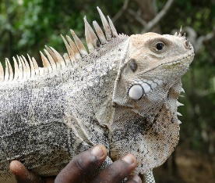
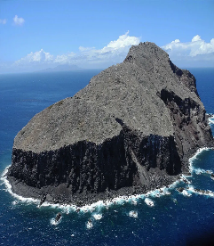
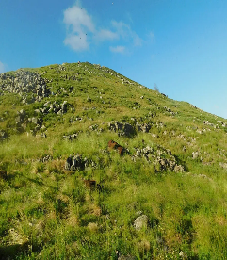

Caribbean: Success Stories
 | Project | Country | Species Benefitted | Impact
 | Combating the Surging Illegal Trade of Endangered Reptiles in the Eastern Caribbean, Phase I and II (FFI) | Barbados, Dominica, Grenada, SVG, St. Lucia | Union Island gecko Grenadines pink-rhino iguana St. Lucia boa St. Lucia Whiptail lizard | Union Island gecko listed Appendix I of CITES Union Island gecko pop. 70%↑ since 2019 57% ↓ in online sales Eastern Caribbean LE Collaborative Group created
 | Redonda Restoration Program: Ensuring the Recovery and Long-Term Protection of a Unique Assemblage of Endangered Species (FFI) | Antigua and Barbuda | 60 species benefitted including: Redonda ground lizard (800% ↑) Redonda anolis (300% ↑) Redonda pigmy gecko (25% ↑) Redonda tree lizard Invertebrates (800% ↑) Seabirds | Removal of 1K goats, 6K rats, Guinea grass, African house gecko 86%↓ Vegetation cover 50% ↑ Redonda NPA to be gazetted October 2022 Three new plant species discovered
 | A Consumer Behavior Change Campaign and Intelligence-Led Conservation Capacity Training to Address the Illegal Wildlife Trade in Trinidad and Tobago (SII) | Trinidad and Tobago | Parrots Macaws Bullfinch Channel-billed toucan Guíanan squirrel monkey Red howler monkey Anacondas Jaguars….. | Increased wildlife trade awareness. Shifts in behavior from pet keepers, public (84%) Positive response from the government Policy reform

Slide 10
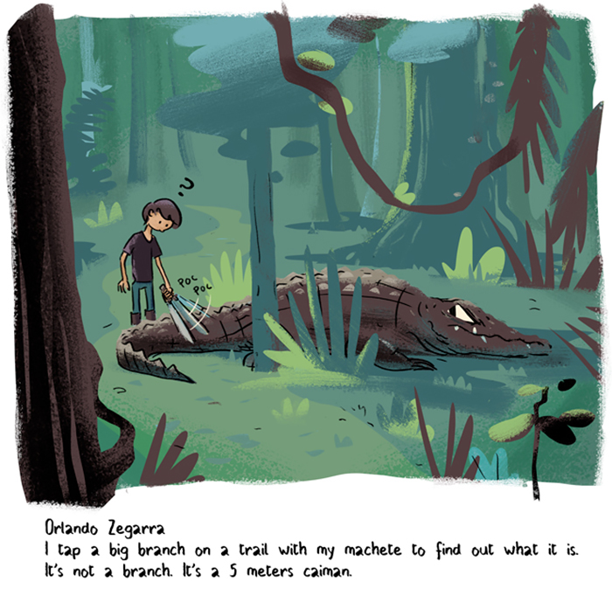
Conservation Leadership: Lessons Learned

Slide 11
A conservation leader is as a catalytic agent of change, but who is not a solitary figure - one who takes in and reflects the needs and goals of its partners Natalie Rhoades and Elizabeth Stephenson

Slide 12
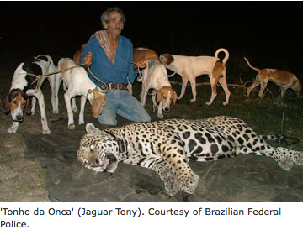
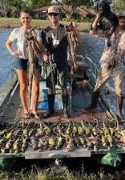
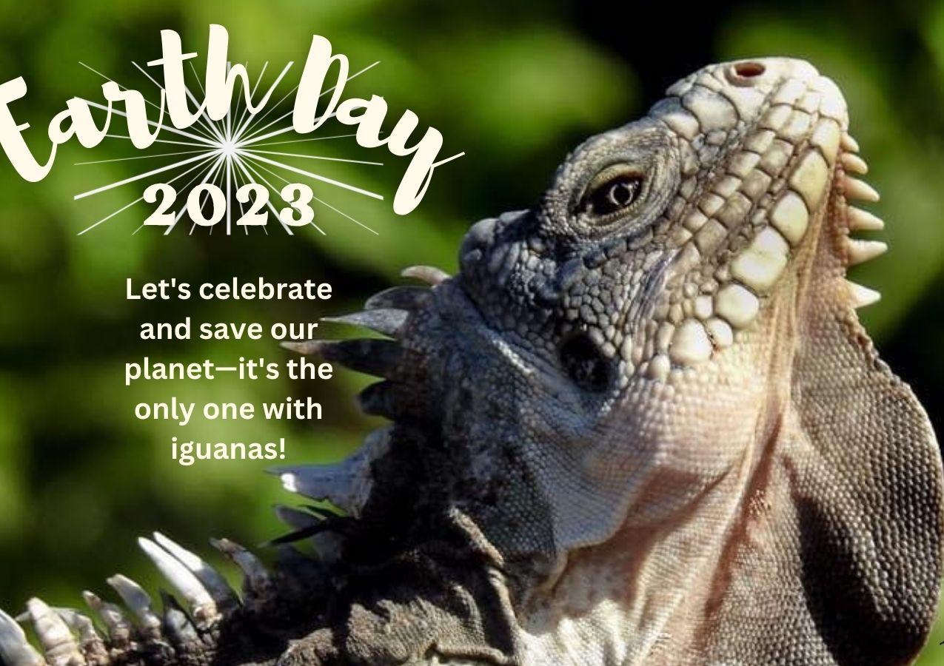
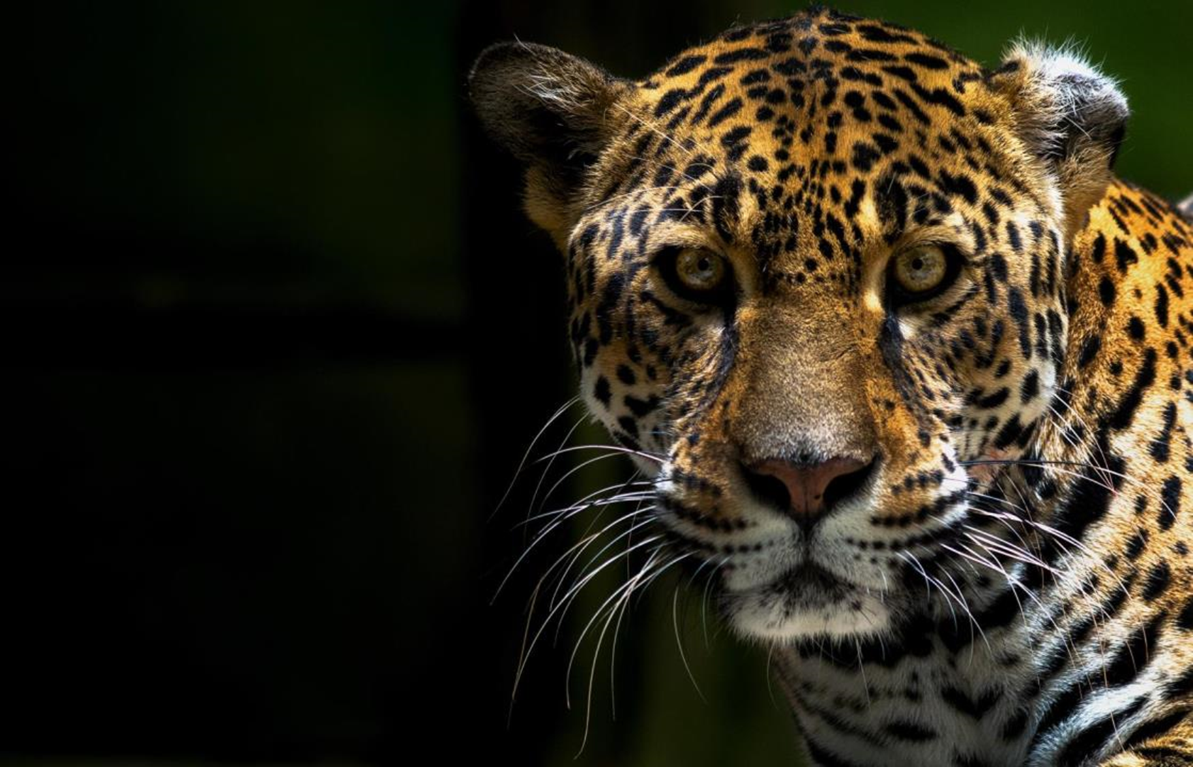
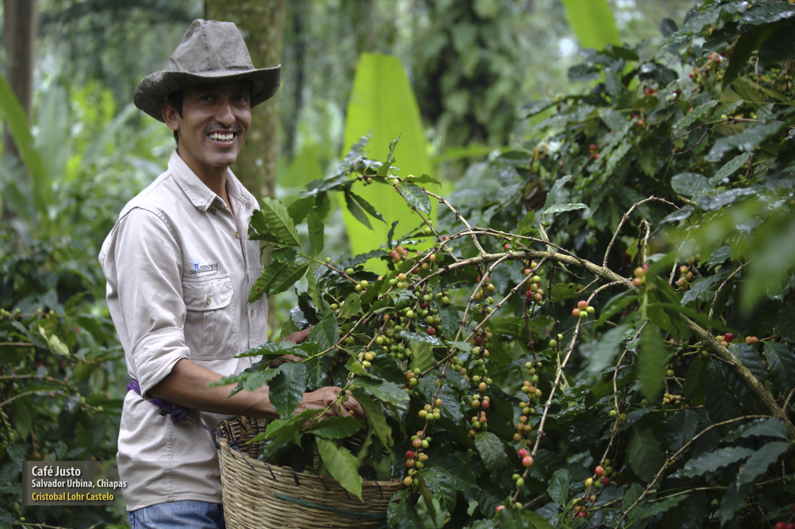
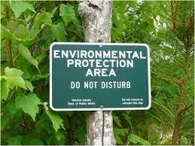
1. It is all about people!

Slide 13
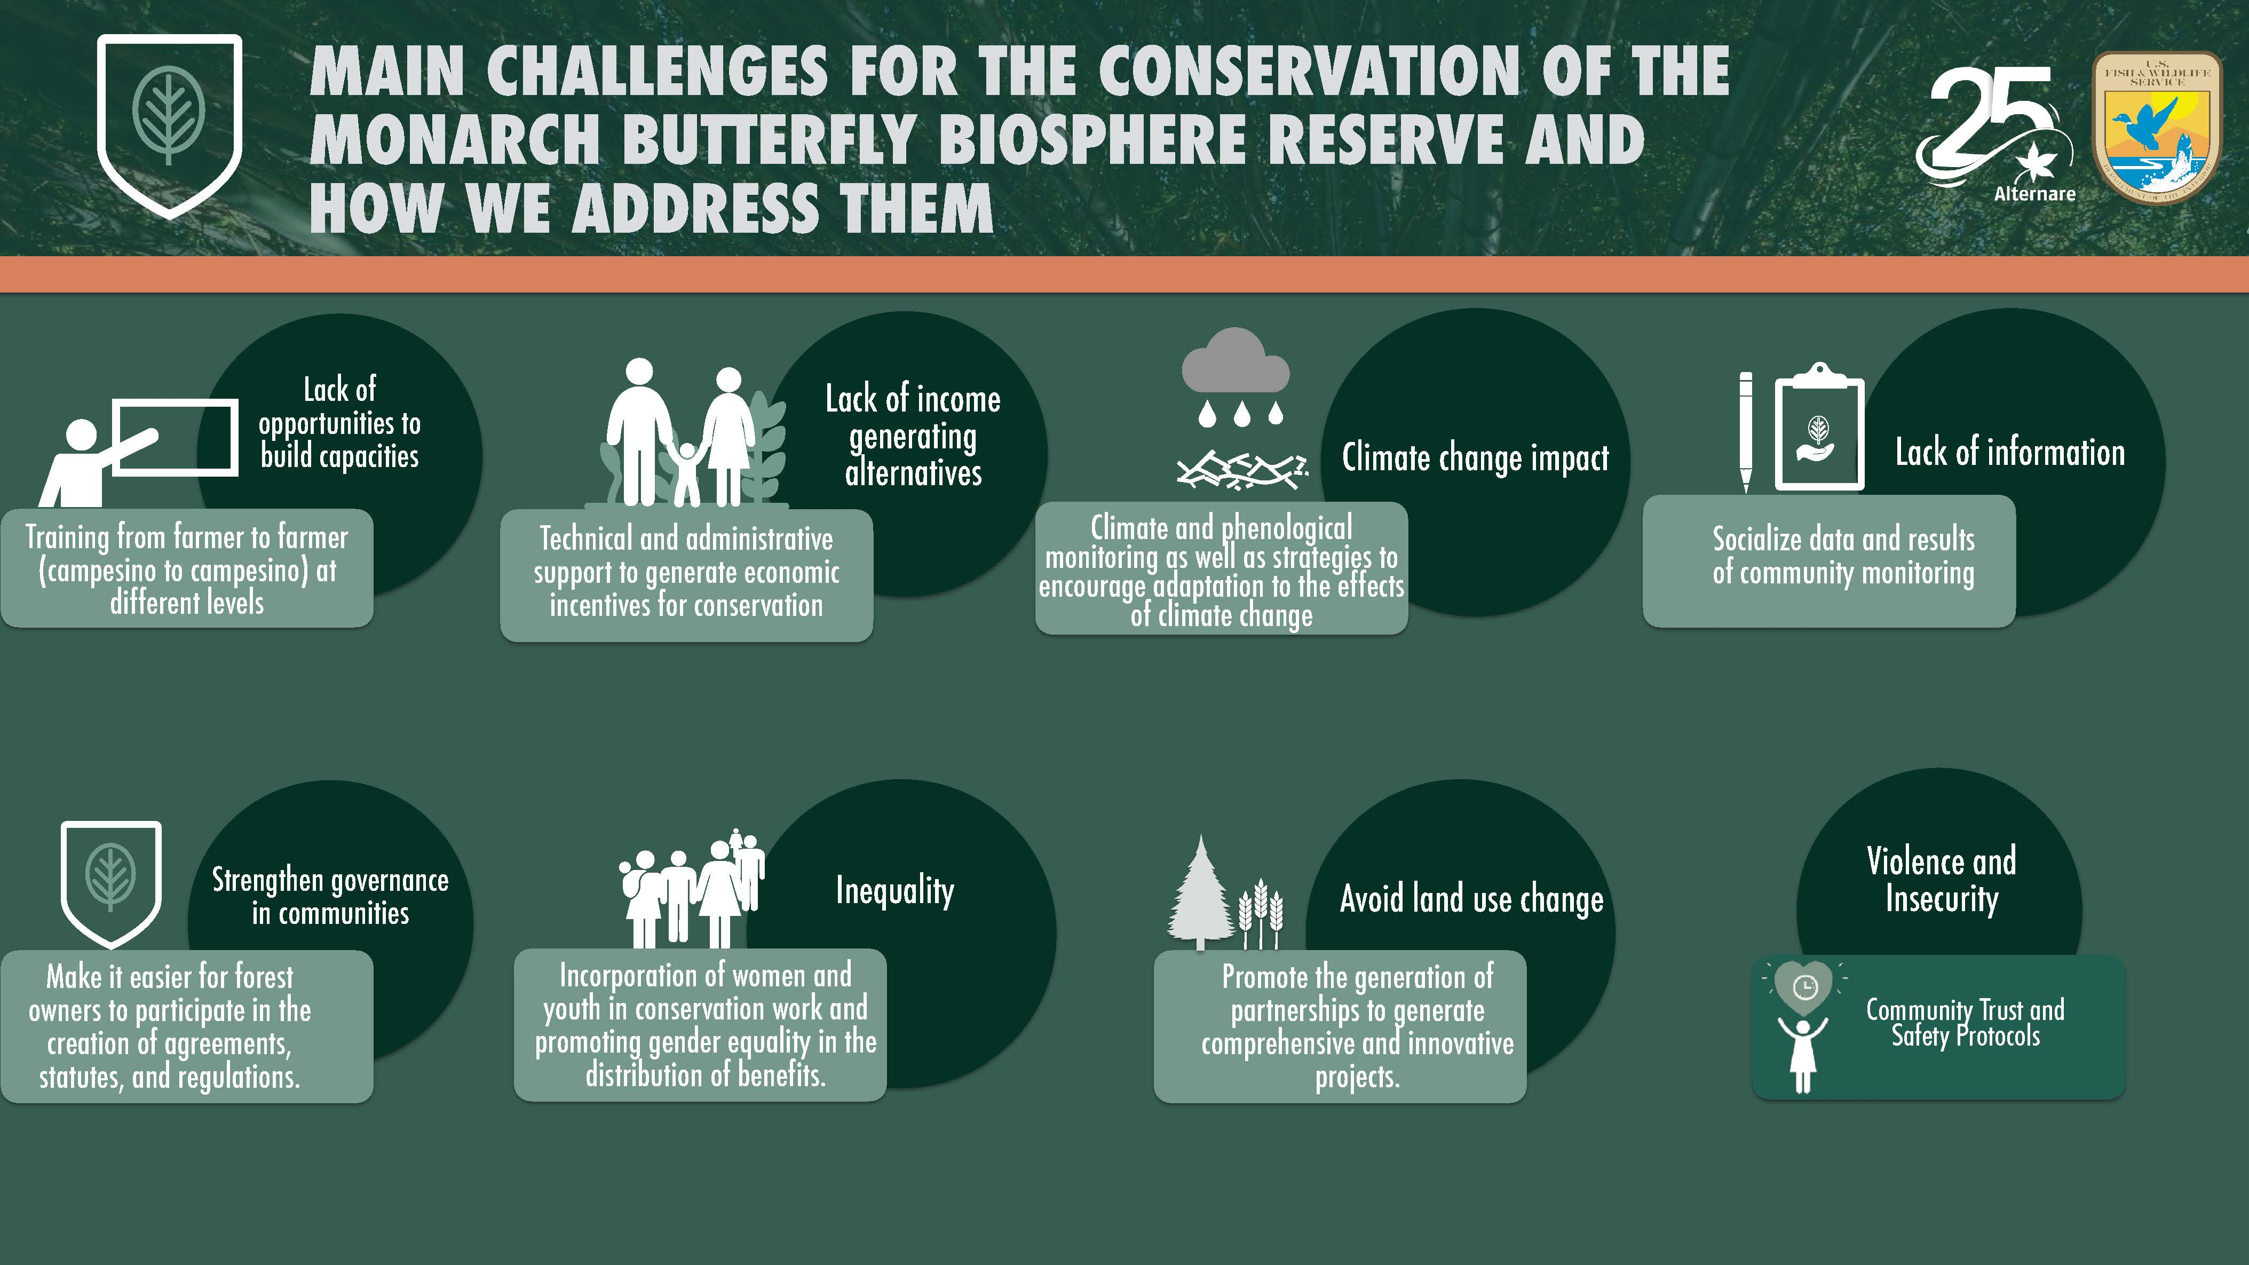
2. Be Curious

Slide 14
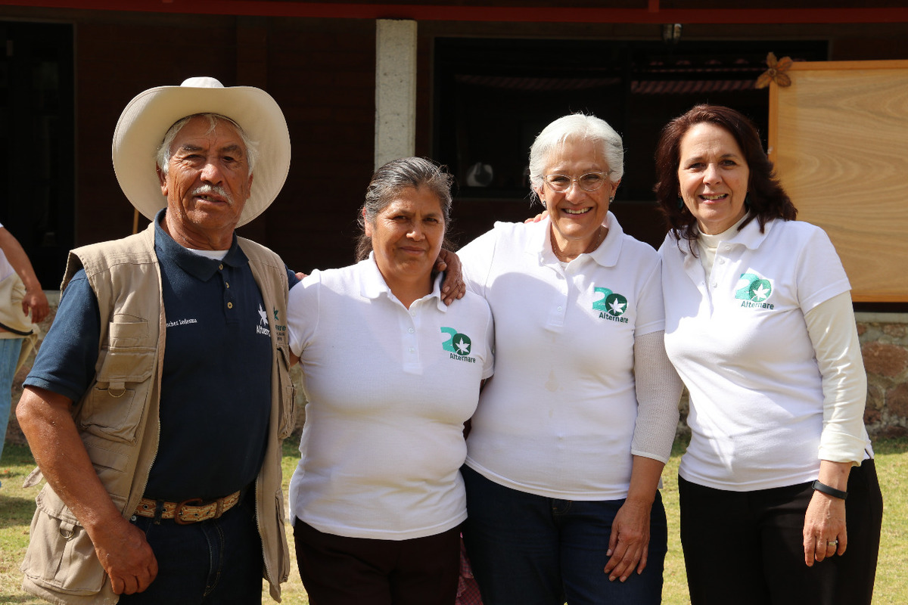
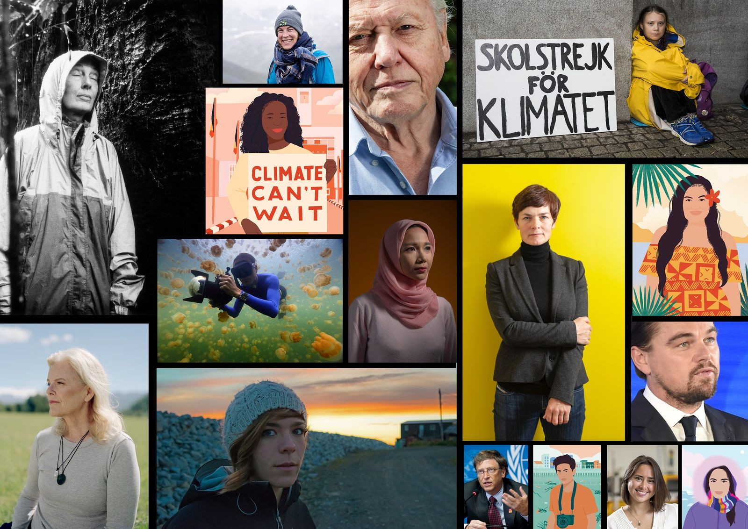
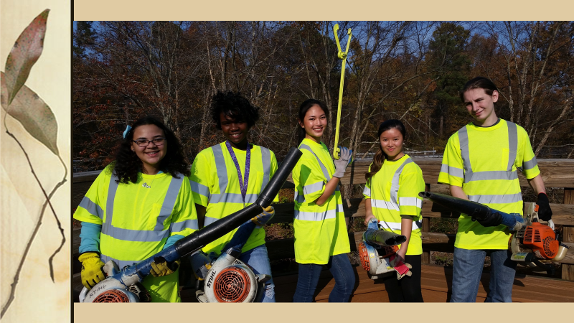
3. Leadership can be applied on many levels

Slide 15
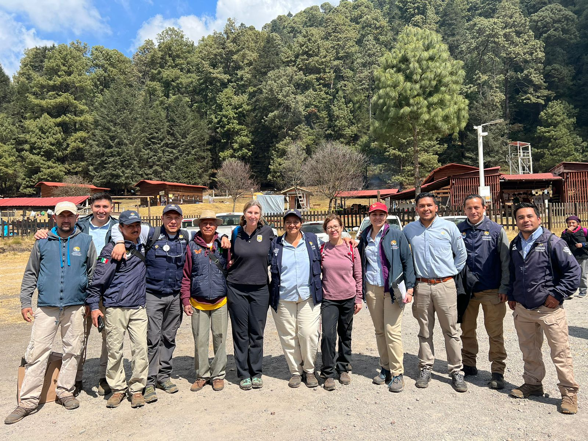
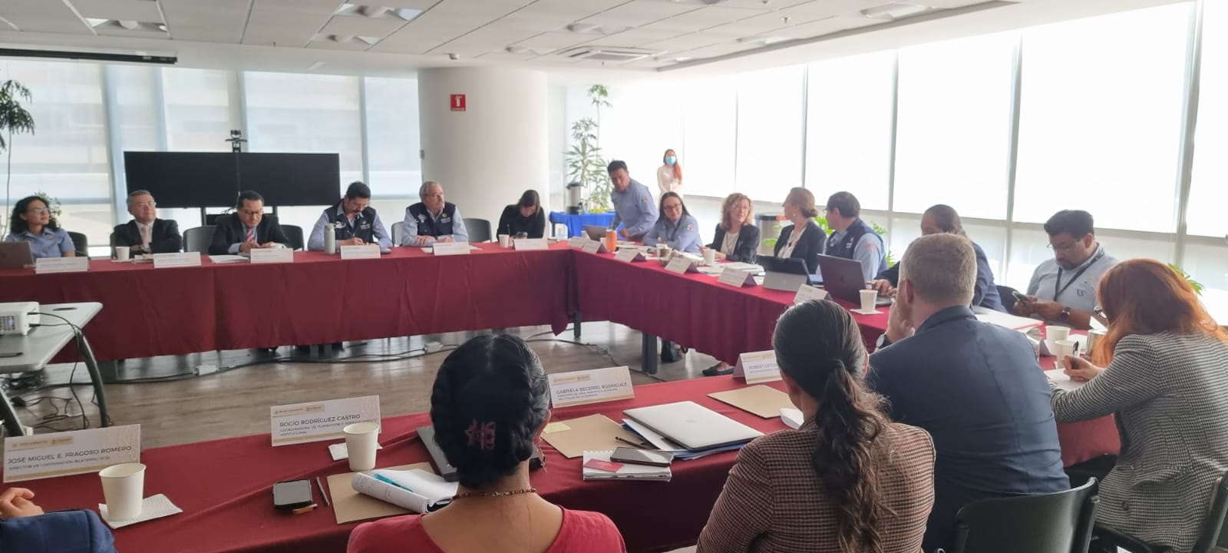



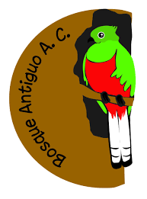




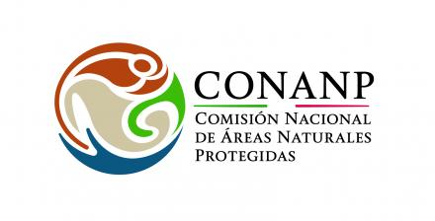



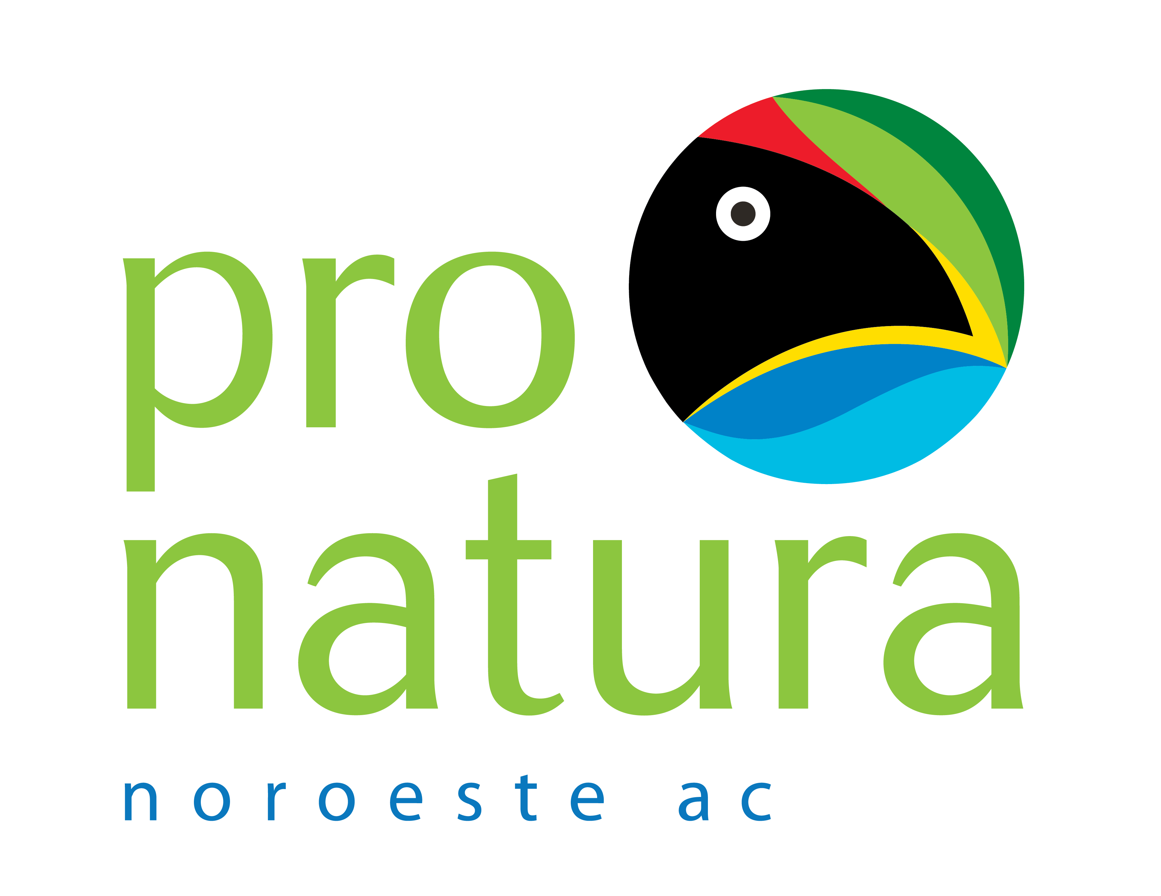




4. Practice Humble Leadership. ALWAYS!

Slide 16
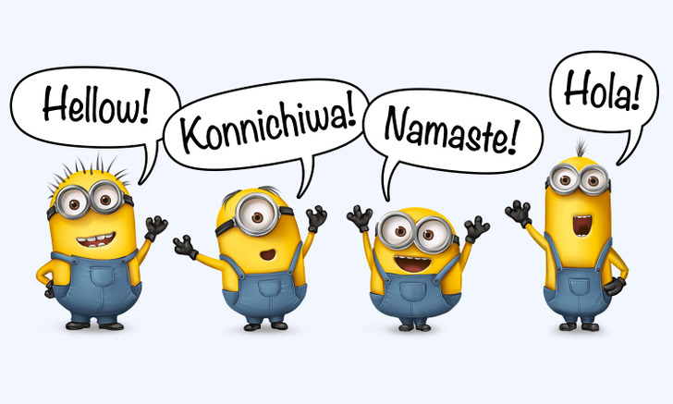
5. Learn another language
© Minions / Illumination Entertainment and co-producers

Slide 17
REMAINING CONSERVATION LEADERSHIP CHALLENGES
We need more field-based training with mentoring and experiential learning focused on finding solutions, developing capabilities and competences of the trainees, but also helping remove the obstacles to position them as future conservation leaders.
Ensure leadership programs that are truly diverse and inclusive.
Integrating a wide breath of knowledge and skills. From biology, to social science, communication, team-management, and human well-being, environmental justice, among many others.
Becoming a conservation leader requires long-term support at all levels of one’s professional career.
Notes:
I would like to end my intervention today by highlighting some of the conservation leadership challenges that still remain.
Once you enter the path to become a conservation leader, you also have the responsibility to help and to remove obstacles for those aspiring leaders that are right behind you.
For instance..

Slide 18
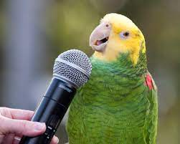
Q&A

Slide 19
Thank you – Gracias!
Visit our Website! www. fws.gov/international
Photo credits
Alternare, AC
Birds Caribbean
Bosque Antiguo, A.C.
CONABIO
FFI
Flicker.com
International Iguana Foundation
Northern Parrots
PROFEPA
Regent Seven Seas Cruises
Seemit
SII
TRAFFIC
USFWS
Wikimedia Commons
World Parrot Trust
Xcaret
Contact Information:
Amanda Gonzales
Program Officer, Mexico and Caribbean
US Fish and Wildlife Service
amanda_gonzales@fws.gov

