Slide 1
MARI Faculty Networking Meeting March 5, 2015
Agenda
12:00-12:10 Carol Simpson, Provost: Welcome
12:10-12:15 Larry Atkinson: MARI Outreach
12:15-13:00 Mujde Erten-Unal et al.: Design Project in Norfolk
13:00-13:30 Dan Bell (Urban Land Institute) and Emily Steinhilber (ODU Intergovernmental Pilot Project): Resilient Region Reality Check
13:30-13:45 Networking

Slide 2
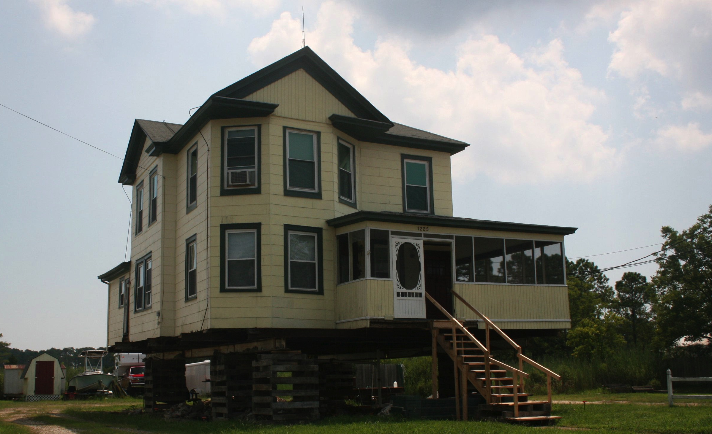

Tidewater Rising Resiliency Design Challenge
January 29, 2015
Skip Stiles
2015 Virginia Sea Grant Project Participant’s Symposium

Slide 3
Tidewater Rising Resiliency Design Challenge
SUMMARY
VASG scoping meeting last winter – can we put adaptation design on the ground NOW, before the storm, in an urban neighborhood, maintain or expand ecosystem services.
Chesterfield Heights in Norfolk –
Tidal Neighborhood, Historic Designation, Financially Stressed (avg income $28,000), Vibrant/Intact, Just Starting to flood
Using Hampton U Architecture, ODU Engineering, Hampton Roads Green Building Council, HRPDC, many private sector design, engineering, development professionals.
Only adaptation design effort in an urban neighborhood, before the storm, in the US.

Slide 4
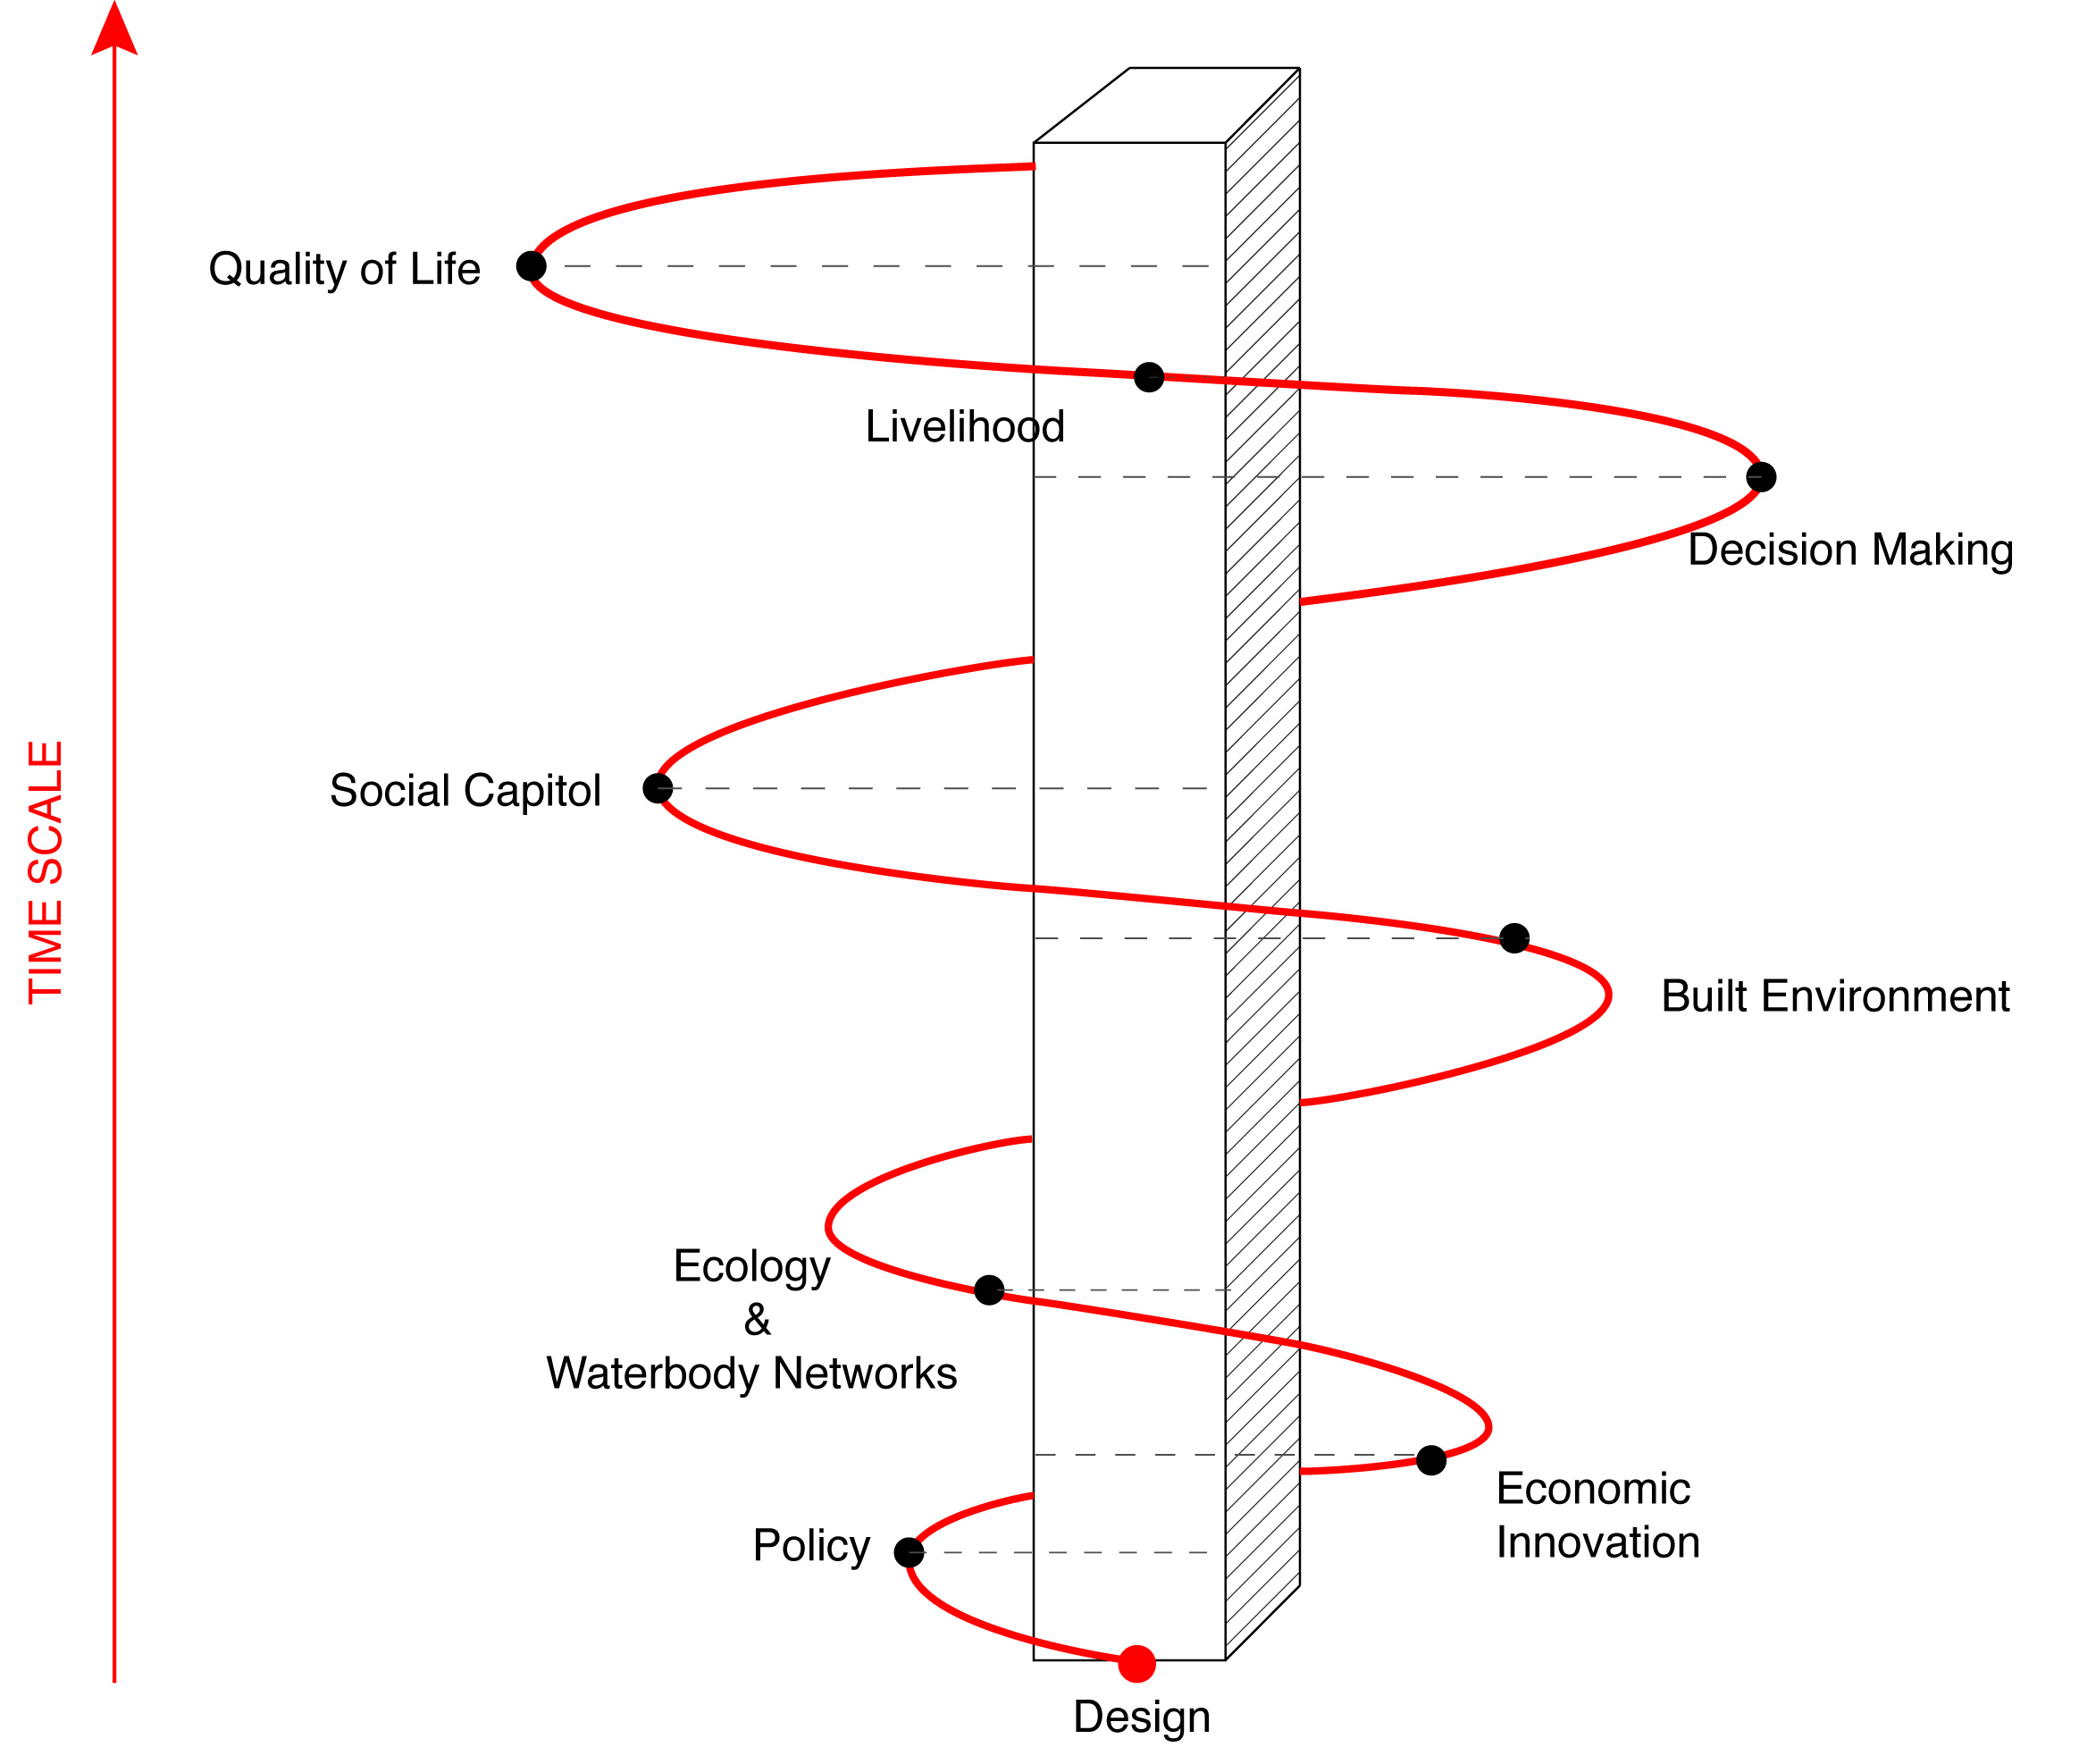
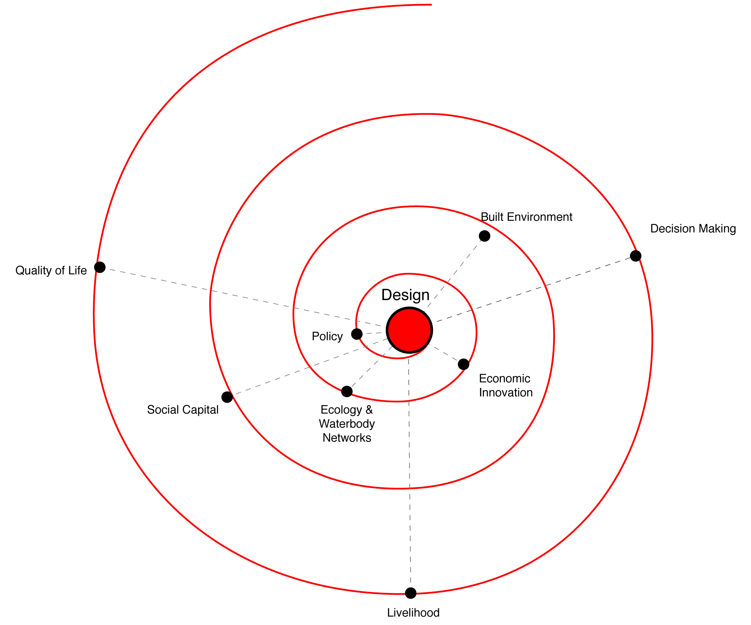

Tidewater Rising Resiliency Design Challenge
Designs by Shelly Jules Plaag

Slide 5
Tidewater Rising Resiliency Design Challenge
FRAMEWORK FOR EFFORT
Work With Community
Collect Stories – Value History & Culture
Value Community Needs & Concerns
Fix Today’s Problems
Envision Tomorrows Solutions
Have A Plan – Change over Time
Bring More Resources To Community
Maintain or Increase Ecosystem Services

Slide 6

Tidewater Rising Resiliency Design Challenge
ANTIFRAGILE Small Means and Great Ends by White Arkitekter and Arup
FARROC Competition Winner
“a series of small, affordable and smart interventions that are adaptable to future uncertainties…resilient in every way; whether it is in the event of a natural disaster, or to create a stronger socio-economic environment….”
Nassim Nicholas Taleb – “Antifragile : Things That Gain From Disorder”

Slide 7
Tidewater Rising Resiliency Design Challenge
SITE SELECTION CHARACTERISTICS
Motivated and Willing Participants
Must Provide Opportunities to Incorporate Natural Infrastructure and Ecosystem Services into the Adaptation Plan
Availability and Format of Critical Planning/Design Information
Optimum Site Scale
Must Provide Opportunities to Address Architectural, Engineering and Planning Challenges
Availability of Existing Master Plans and Community Plans

Slide 8
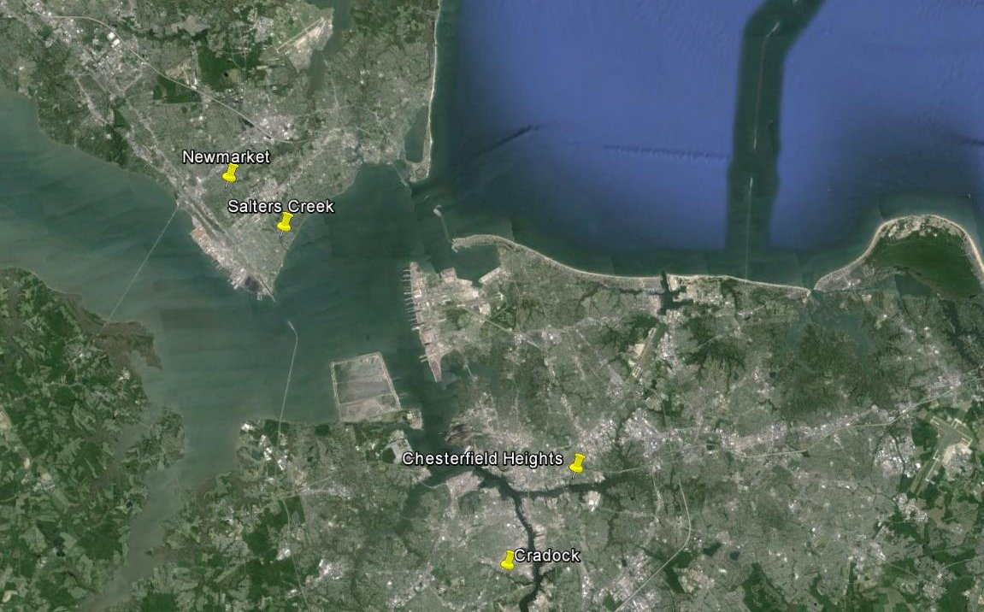
Tidewater Rising Resiliency Design Challenge

Slide 9
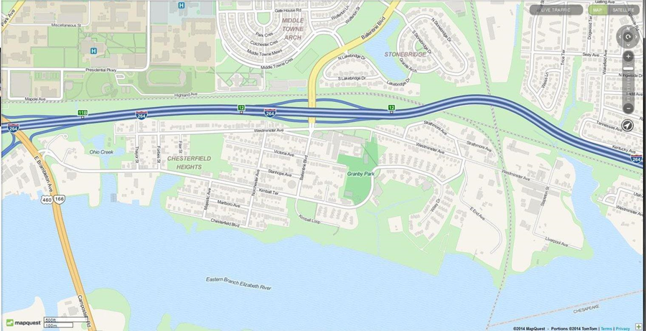
Tidewater Rising Resiliency Design Challenge
Chesterfield Heights Neighborhood/
Project Boundary

Slide 10
Tidewater Rising Resiliency Design Challenge
Chesterfield Heights ~ 1880

Slide 11
March, 1917 Virginian Pilot ad
Lots for $375!
30 min electric railroad to Virginia Beach

Slide 12
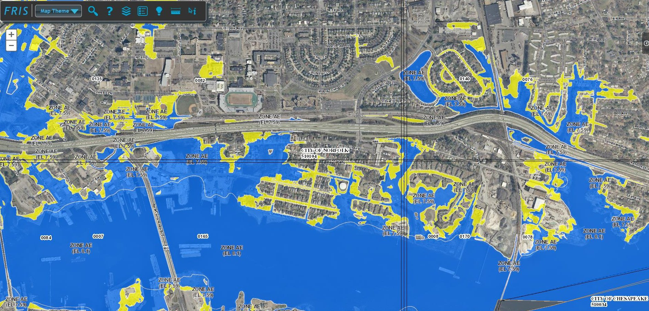
Tidewater Rising Resiliency Design Challenge
Chesterfield Heights Flood Zones Today

Slide 13









Tidewater Rising Resiliency Design Challenge

Slide 14
Tidewater Rising Resiliency Design Challenge
NEXT STEPS?
Amplify, enhance, test the ideas being developed – continuing effort in Chesterfield Heights
Incubate and expand engineering and design capability in host universities and private sector partners.
Initiate efforts in other locations that were “finalists” for this phase – Craddock, Salters Creek, Newmarket Creek

Slide 15
Tidewater Rising Resiliency Design Challenge
Lessons Learned (so far!)
Adaptation Solutions need to be “fitted” onto the physical, cultural, and economic landscape….parcel by parcel. There are no “off the shelf” solutions.
Needed information is hard to come by – hydrologic, geologic, etc. data.
This is an open field, intellectually and very exciting.
At current levels of effort and funding, there is not enough time left to adapt effectively in Tidewater, VA.

Slide 16


Senior Design Project Chesterfield Heights
March 5, 2015

Slide 17
Chesterfield Heights Neighborhood
Norfolk, VA
Notes:
Along Eastern Branch of the Elizabeth River
Bound by I-264 to the North
Western end built on old filled-in Ohio Creek
Developed 1915-1950
175 households
Average household income: $28,500

Slide 18
Chesterfield Heights Neighborhood
Norfolk, VA
Notes:
Along Eastern Branch of the Elizabeth River
Bound by I-264 to the North
Western end built on old filled-in Ohio Creek
Developed 1915-1950
175 households
Average household income: $28,500

Slide 19
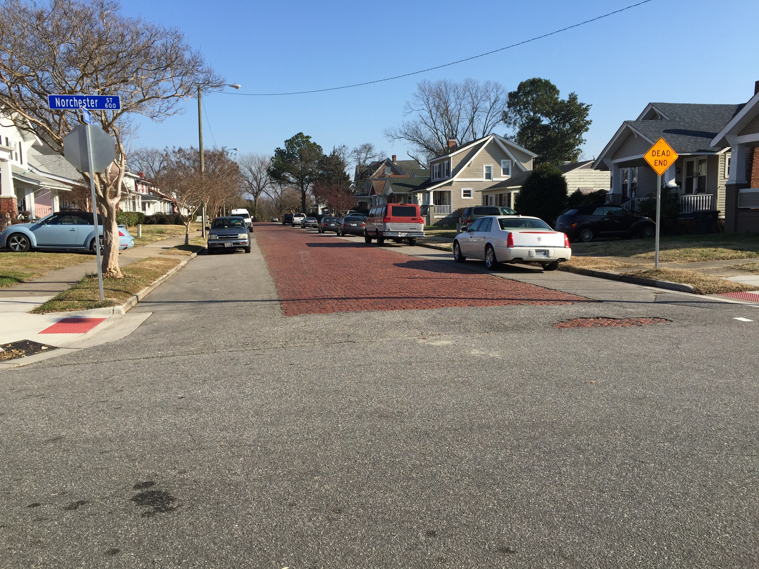
Historical Background
Added to the National Historic Register in 2003
510 buildings in the historic district
Architectural Style
Queen Anne
Italianate
Notes:
510 Buildings in the Historic District
402 Contributing Buildings
1 Contributing Site
1 Contributing Structure
106 Non-Contributing Building

Slide 20
Overview
Stormwater
Living Shoreline
Structural
Notes:
We looked

Slide 21
Stormwater

Slide 22
Existing Site Conditions
Undersized drainage pipes in poor condition
Clay pipes installed in early 1900s
Originally part of the combined sewer network
Clogged drop inlets at intersections
Submerged stormwater outfalls
Groundwater 4 to 5 feet below ground surface
High tailwater from storm surge backing up into Chesterfield Heights storm sewer system
Notes:
Combined sewage system
1920/1930
Grade drop inlets instead of curb drop inlets
Greatest impacting factor – high tailwater backing up
SLR + increased intensity of storms = water backing up into community

Slide 23
Existing Stormwater Network
Pipes are Undersized to Convey the Norfolk Design Standard 10 Year Rain Event
Notes:
Designed with 10 year storm event
SCS 24 hour – Type 2 synthetic storm of 5.0” total depth was used for modeling
Tailwater boundary conditions used included current Norfolk standard 1.7’ NAVD, 3.2’ NAVD as projected 100 yr rise, and Storm surge event 8.1’

Slide 24
Undersized Pipes and Outfalls in Poor Condition
Pipes are Partially Filled with Sediment and Submerged at Mean Low Tide
Notes:
Profile of existing 20” stormwater system along Majestic Ave.
Existing outfall for the neighborhood is already underwater at mean low tide
This dramatically impacts efficacy and performance during rain events

Slide 25
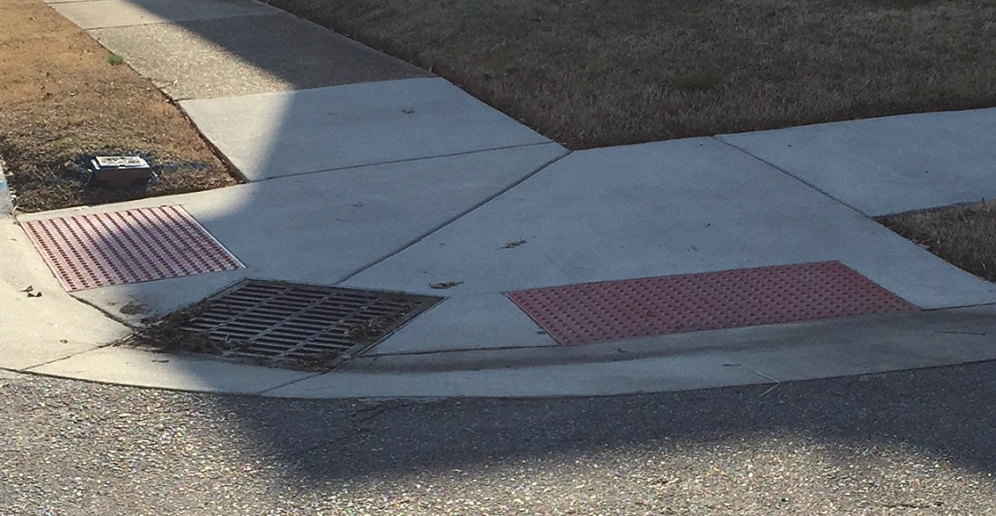
Clogged Drop Inlets at Intersections
Notes:
When our group went on a site visit, some drop inlets were completely covered.
Residents come and clean out drop inlets themselves before and after storm events
Not ideal inlets for this application in right of way

Slide 26
High Tailwater Backing Up Into Chesterfield Heights
Sea level rise will make problem worse. The existing storm system will become an extension of the Elizabeth River going allowing backflow.
Notes:
Representative of existing maximum tailwater required by city plus 1.5 feet of sea level rise
System will be full of water before rain begins to run into sewer
Sever flooding and inability to drain the neighbhood

Slide 27
Preliminary Design Solutions
Replace existing 20” and 24” stormwater trunk lines with 42” outfall pipes at higher elevation on shoreline
Replace drop inlets with curb inlets
Install tidal valves on outfalls and potential emergency stormwater sump pumps
Install roadside bio-swales with enhanced streetscape
Lot level stormwater detention and runoff reduction practices
Notes:
Conceptual design solutions
Doubling = provide extra storage and adequate velocities

Slide 28
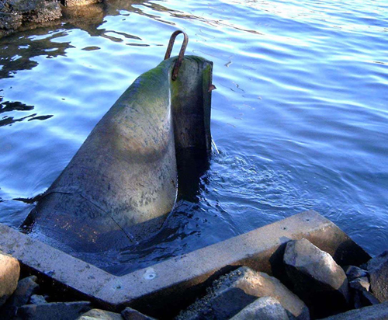
Install Adequately Sized Stormwater Pipes In Neighborhood Install Tidal Check Valves
Notes:
Installed tidal valves + replacing trunklines
Provide additional storage in pipes
Replace adjacent utilities during construction
2012 City Master Drianage Plan estimates 2.3 million in stormwater upgrades for neighbhood

Slide 29
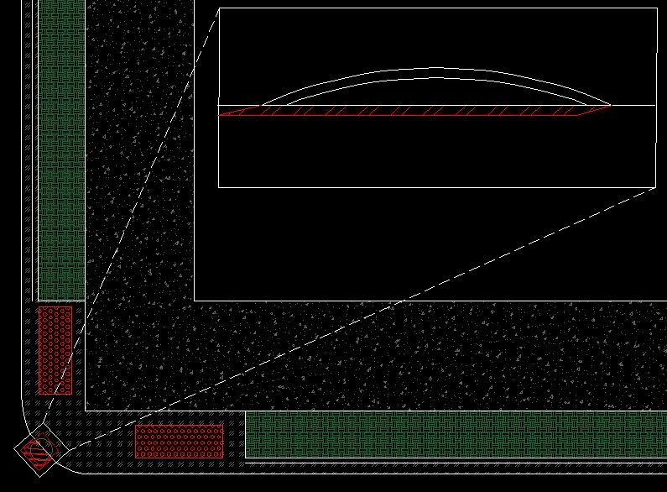
Replace Existing Grated Drop Inlets With Curb Inlets
Curb inlets have less potential to become clogged with debris.
Notes:
Green area = bioswale
Replace trees with high moisture absorbing plants

Slide 30
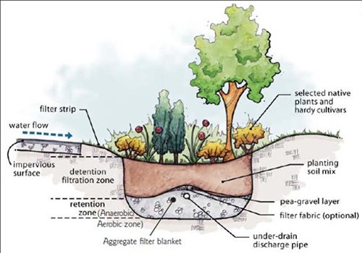
Roadside Bio-Swales
Increases stormwater storage, slows down runoff, treats stormwater runoff
Notes:
Underdrain = allows high flows to flow into existing pipes and out the neighborhood
Can be integrated into further stormwater planning
Approximately 10,000 linear feet

Slide 31
Living Shoreline

Slide 32
Existing Site Conditions
Shoreline is close to existing shipping lane
Shoreline elevation around base flood elevation
Eroded steep shoreline in poor condition
Notes:
Base flood elevation = 8 ft
Shipping channel 40 ft away

Slide 33
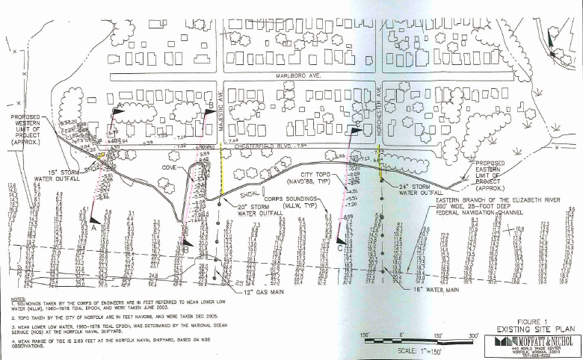
Adjacent Shipping Lane
Boat wakes causes erosion and flooding on shoreline
Notes:
When the boats go out on the Elizabeth River, the boat wakes cause erosion and flooding on shoreline.
There is 25 ft from shoreline to shipping lane.

Slide 34
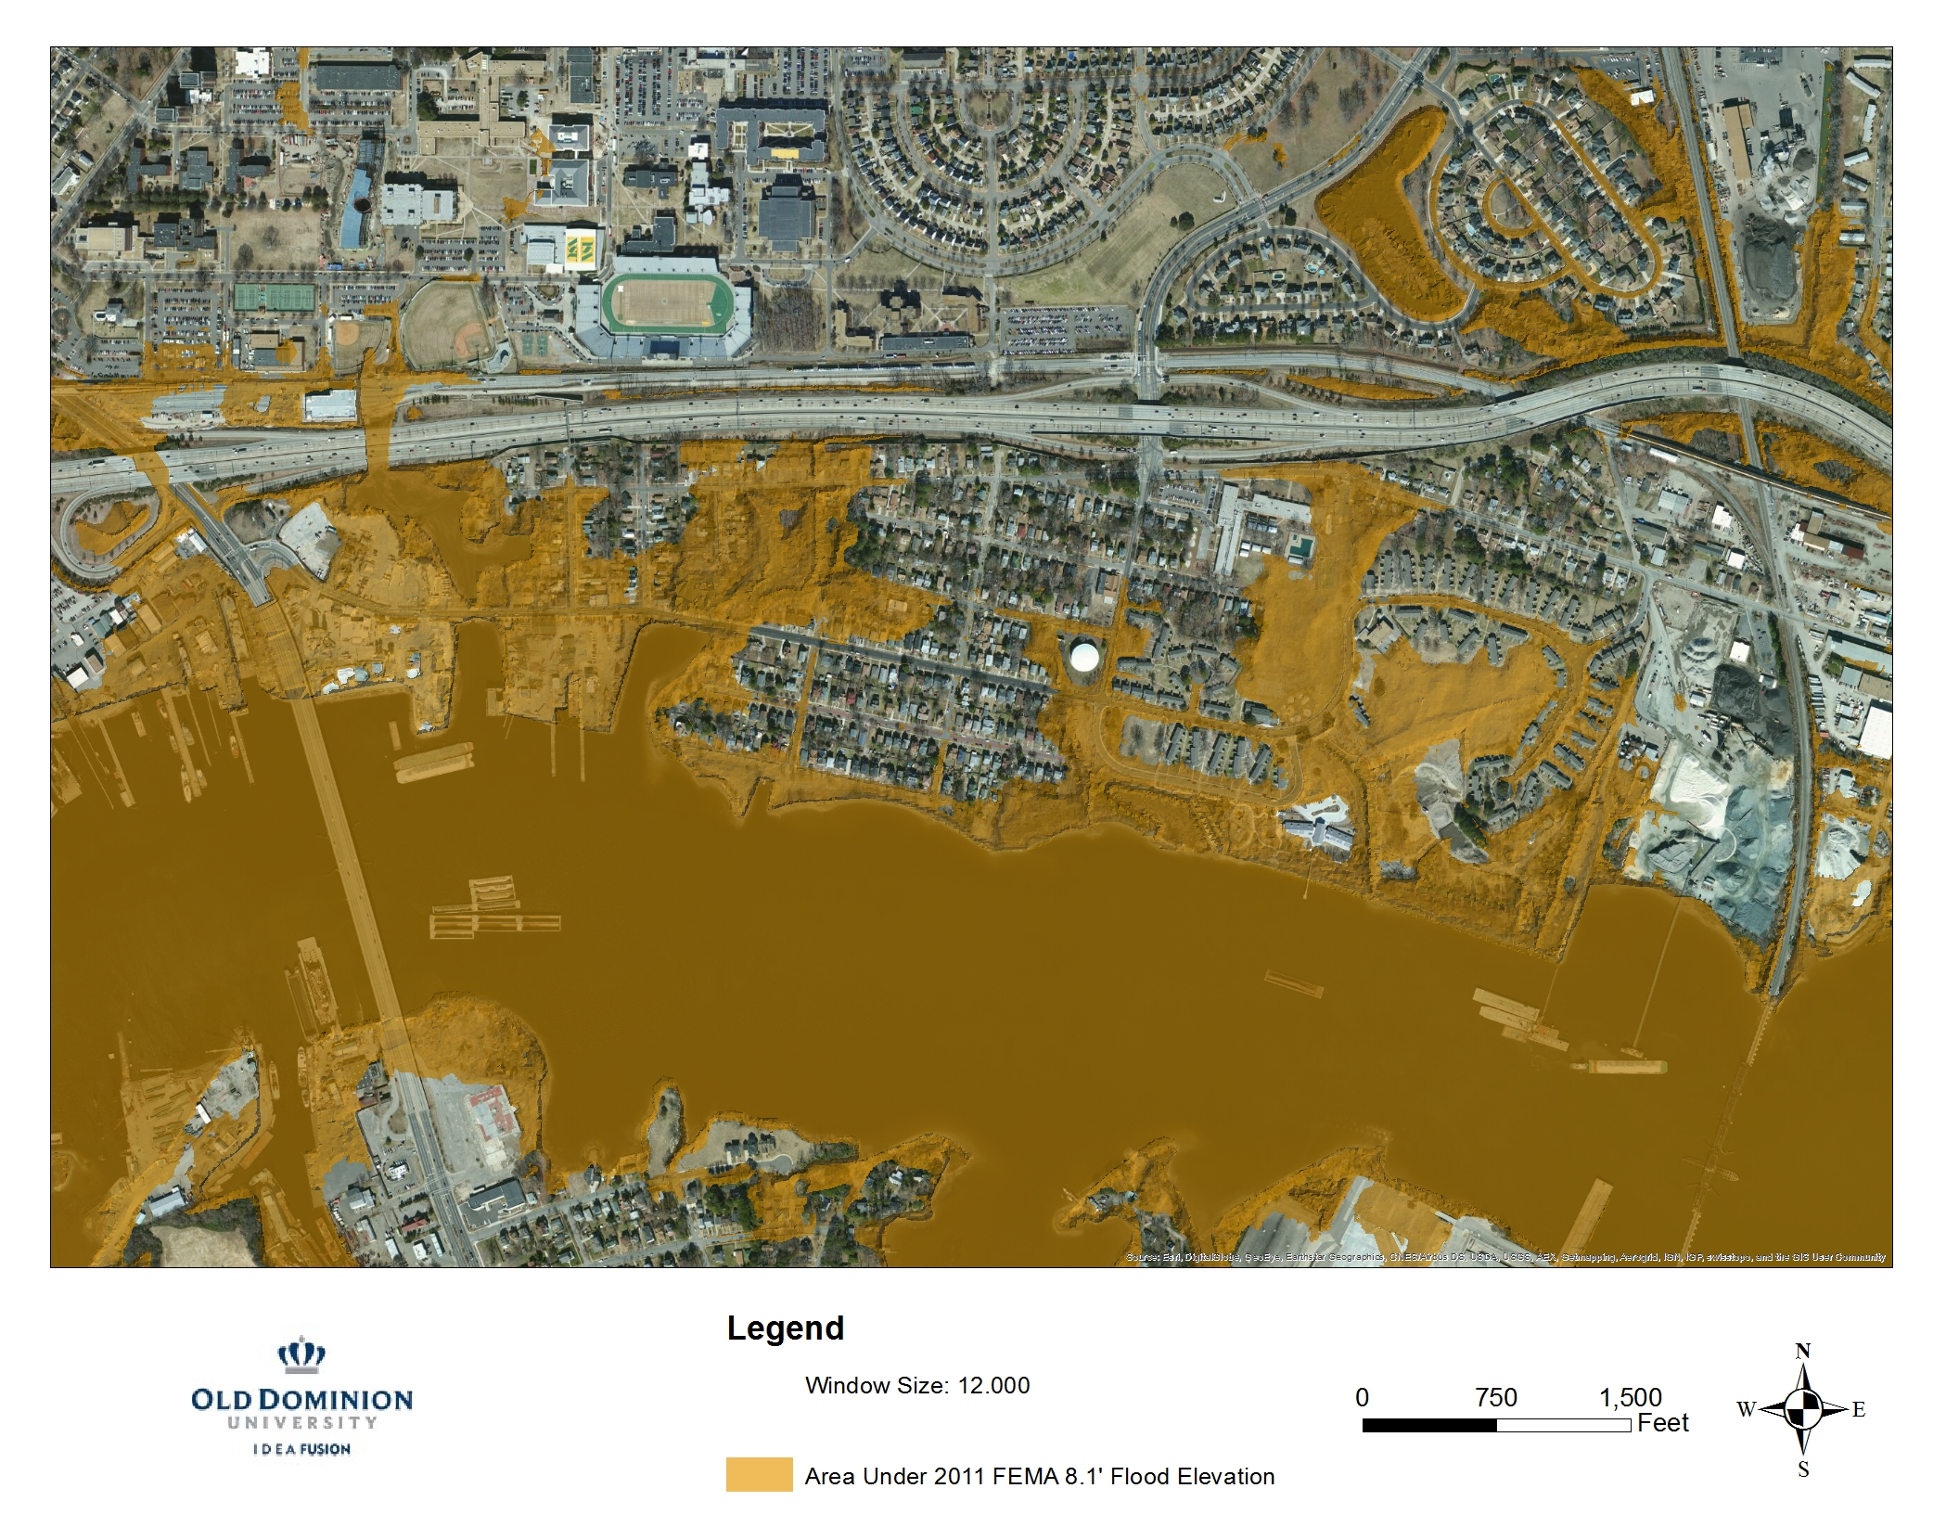
Shoreline elevation = base flood elevation
Large storm events cause street flooding
Storm Surge Flooding
Notes:
Flood from 8.1’ storm surge

Slide 35
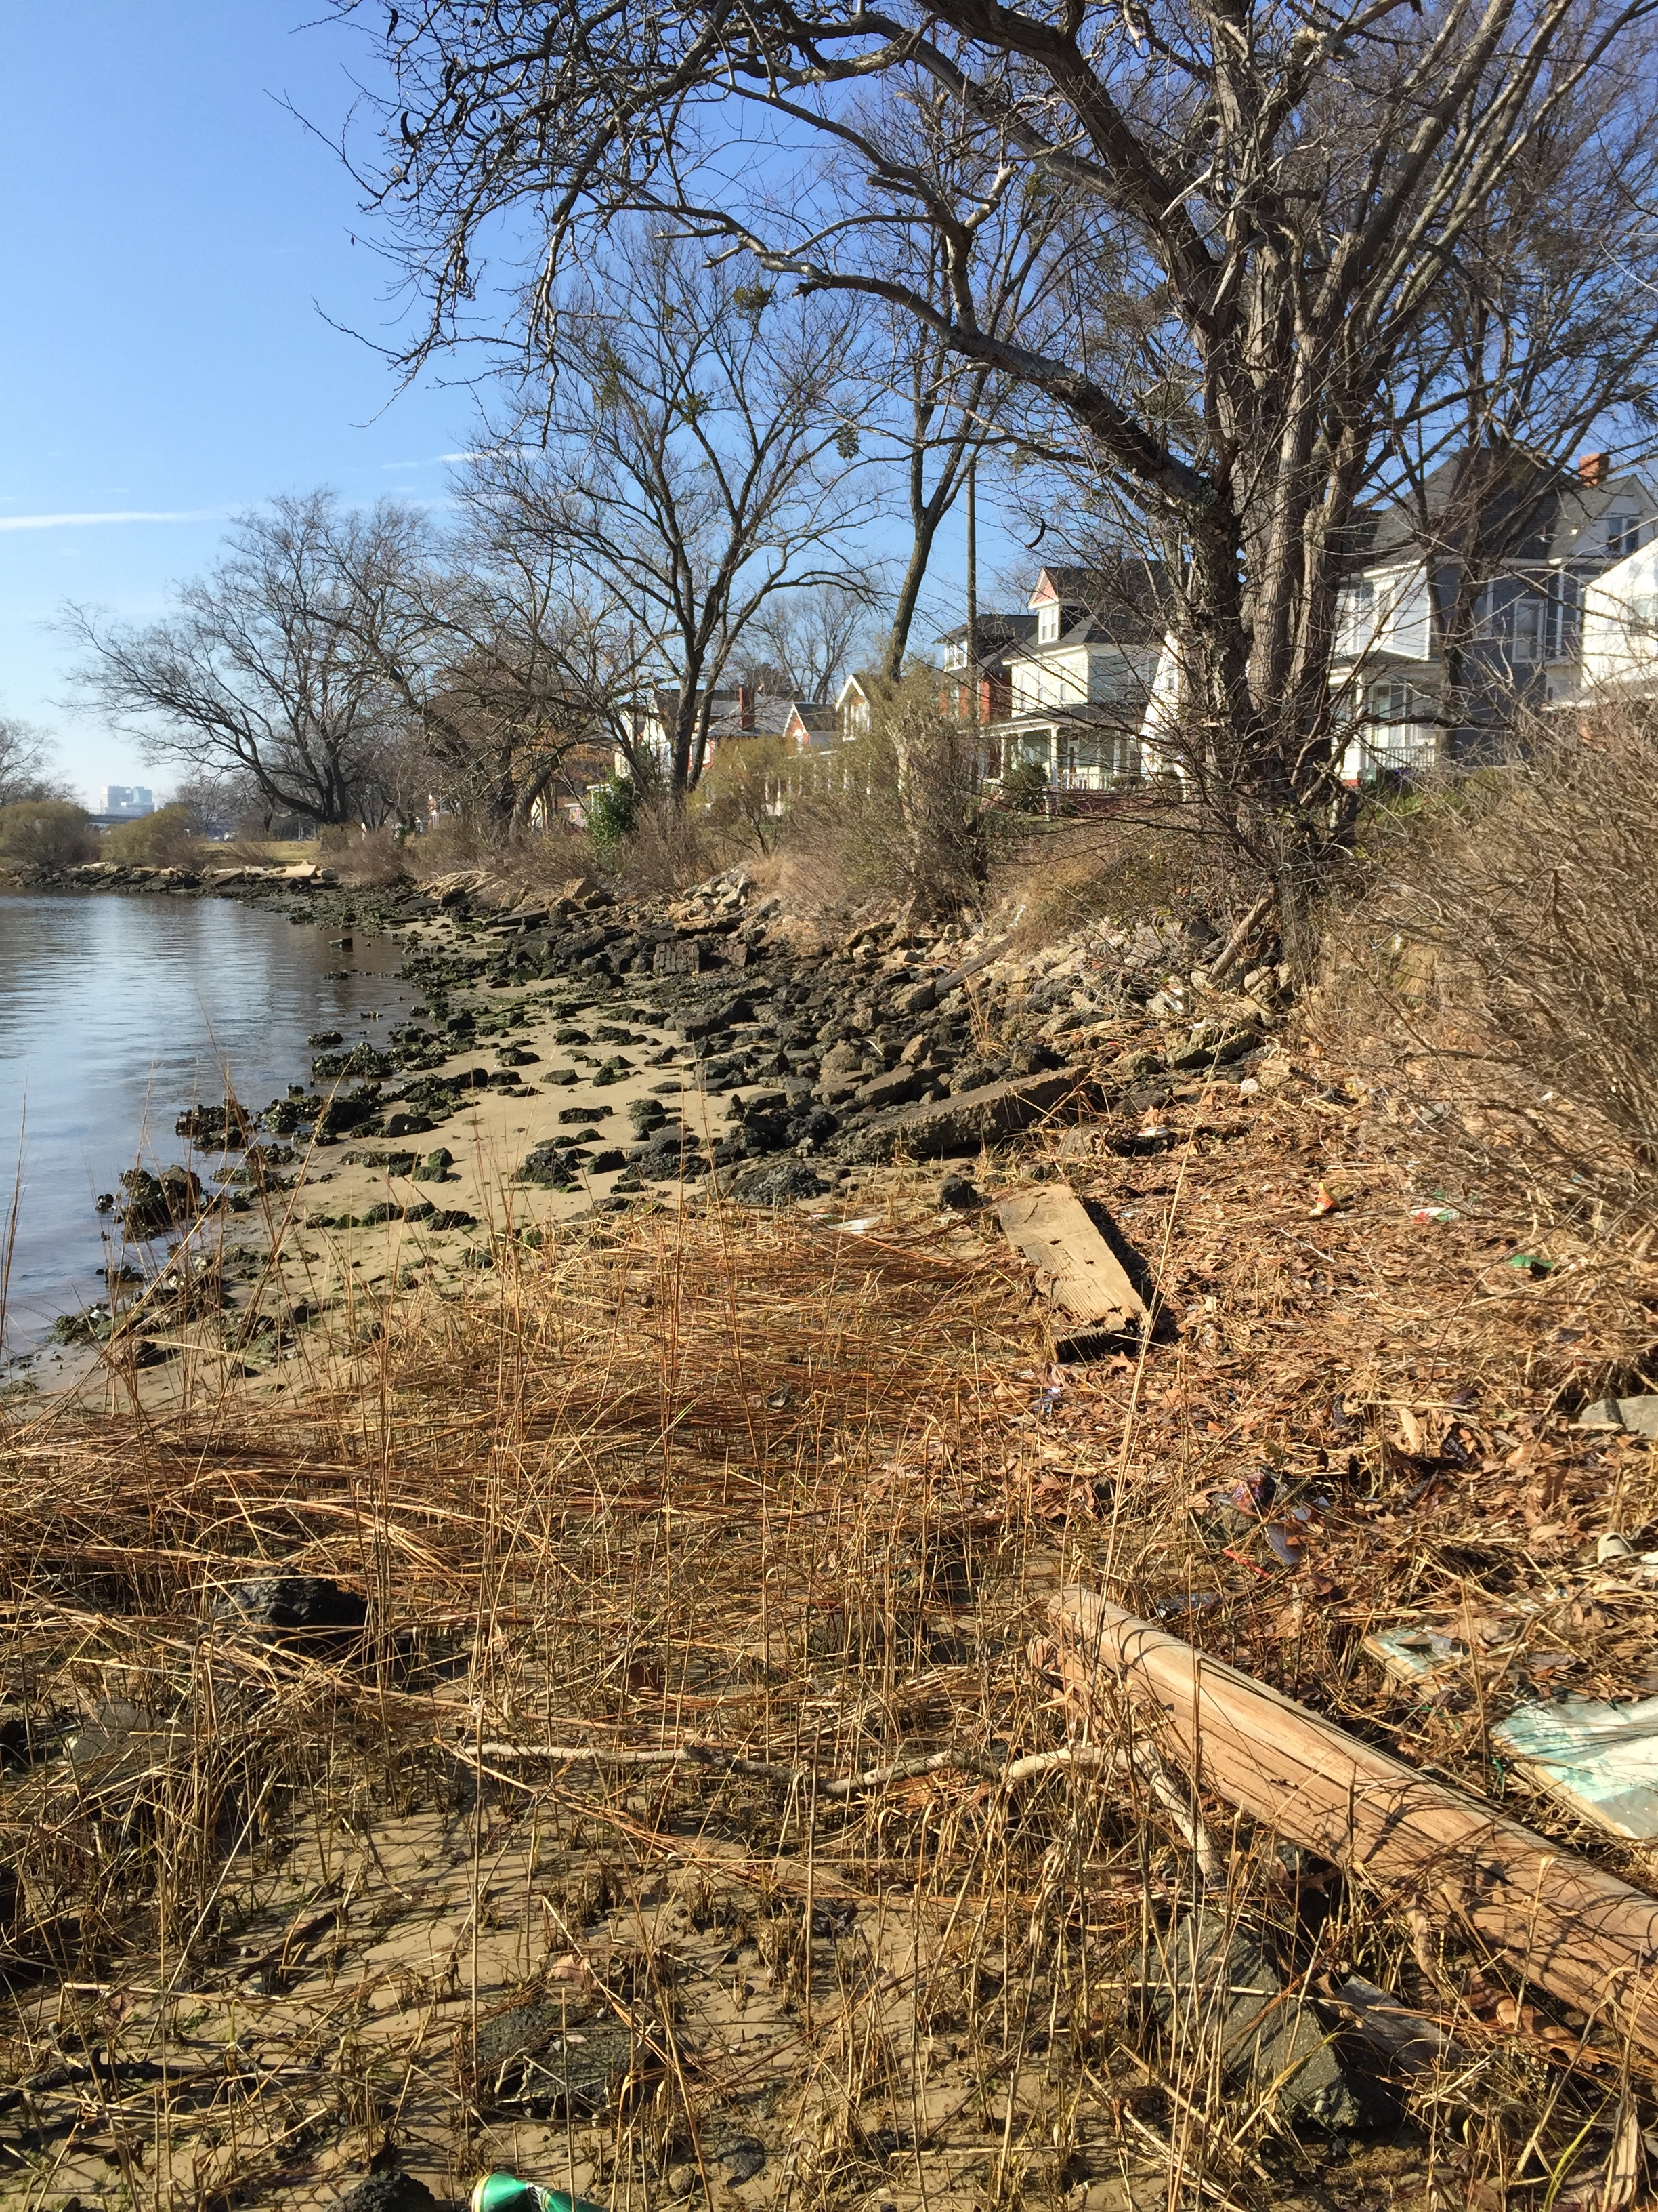
Poor Eroded Existing Shoreline with Impaired Water
Steep, scattered with debris and old pipelines

Slide 36
Community Suggestions
Oyster bed
Beach restoration
Standing docks

Slide 37
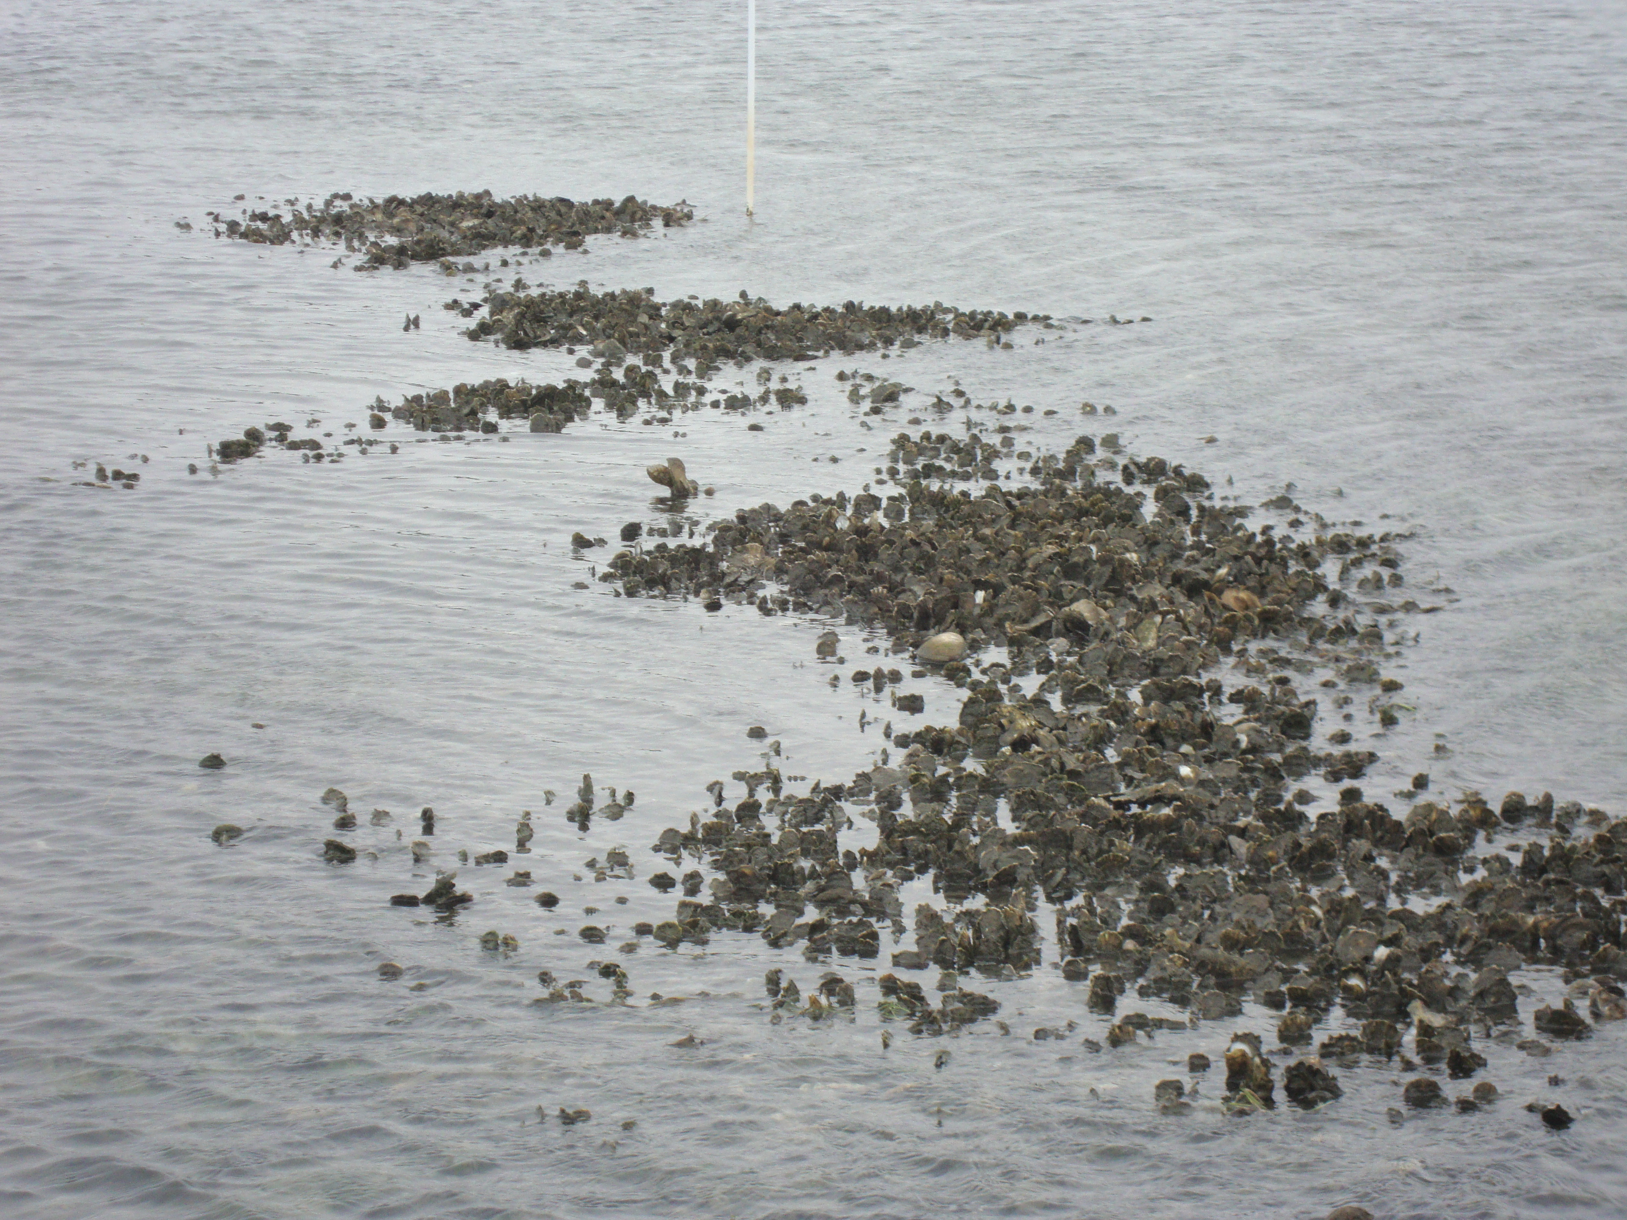
Oyster Bed
Filters and cleans water
Private, non-harvesting
Notes:
Benefits: filter and clean water
Private and non-harvesting oyster bed
Used to break wave energy
1 oyster can filter 50 gallons of water a day (PLEASE CHECK)

Slide 38
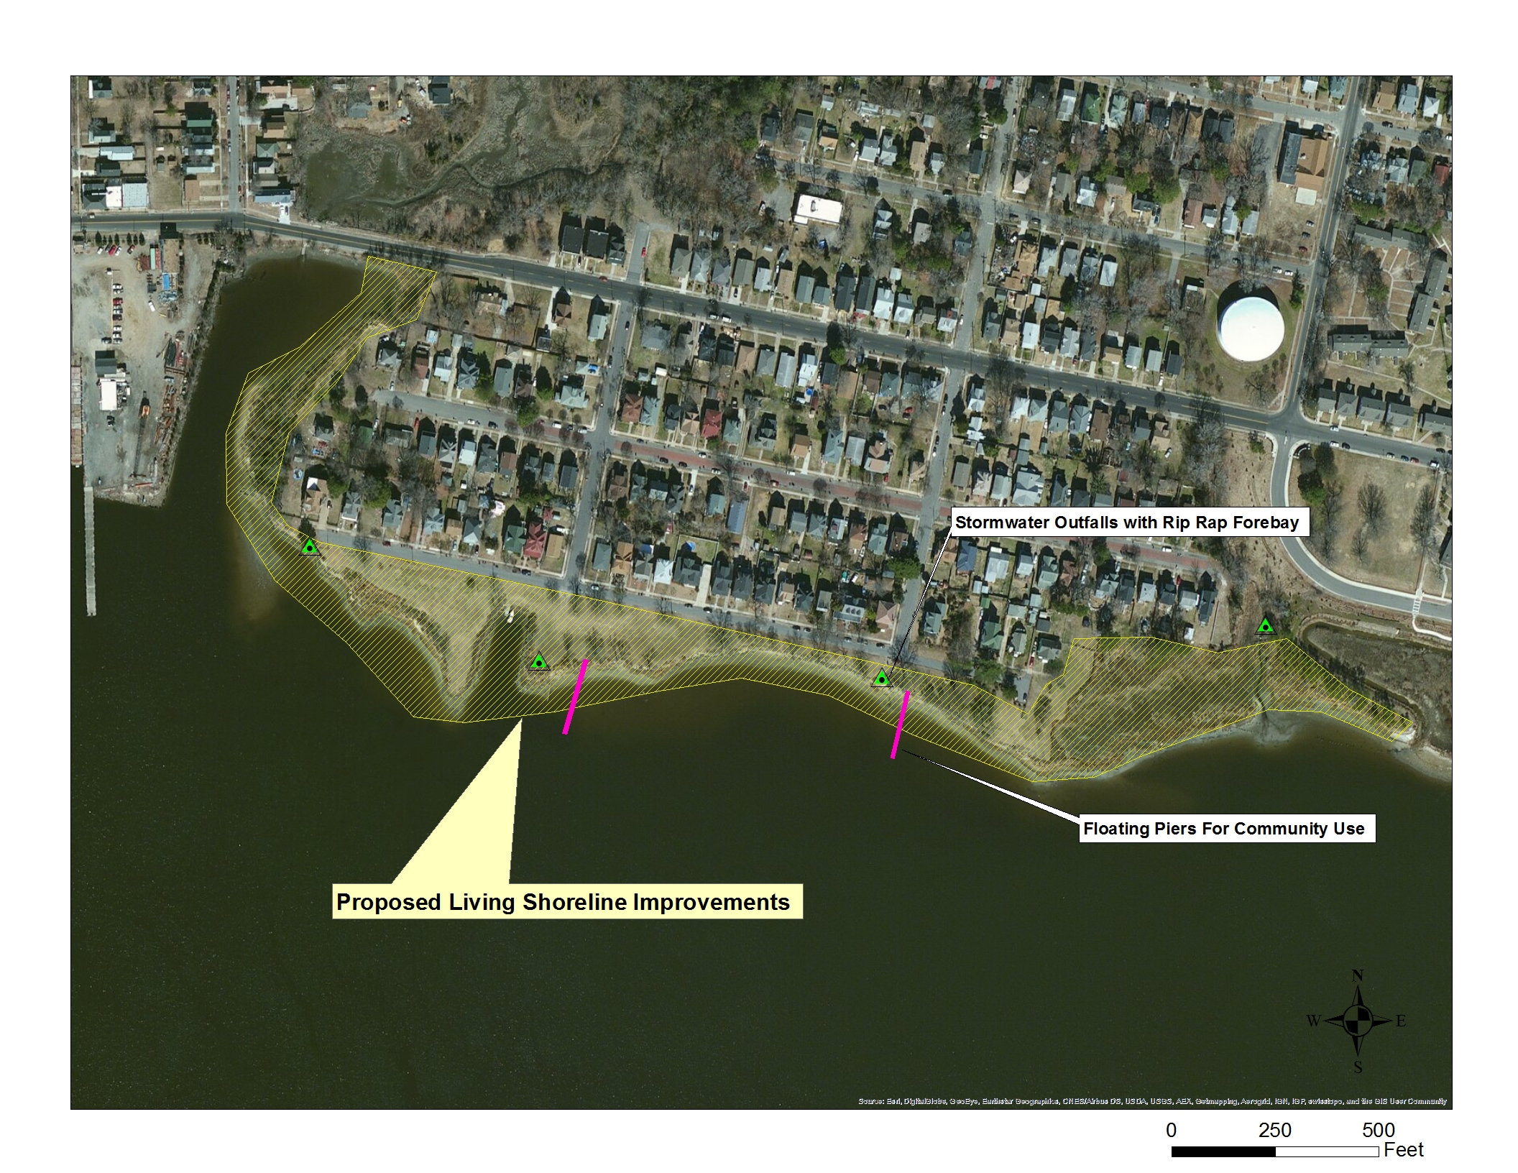
Living Shoreline Location

Slide 39
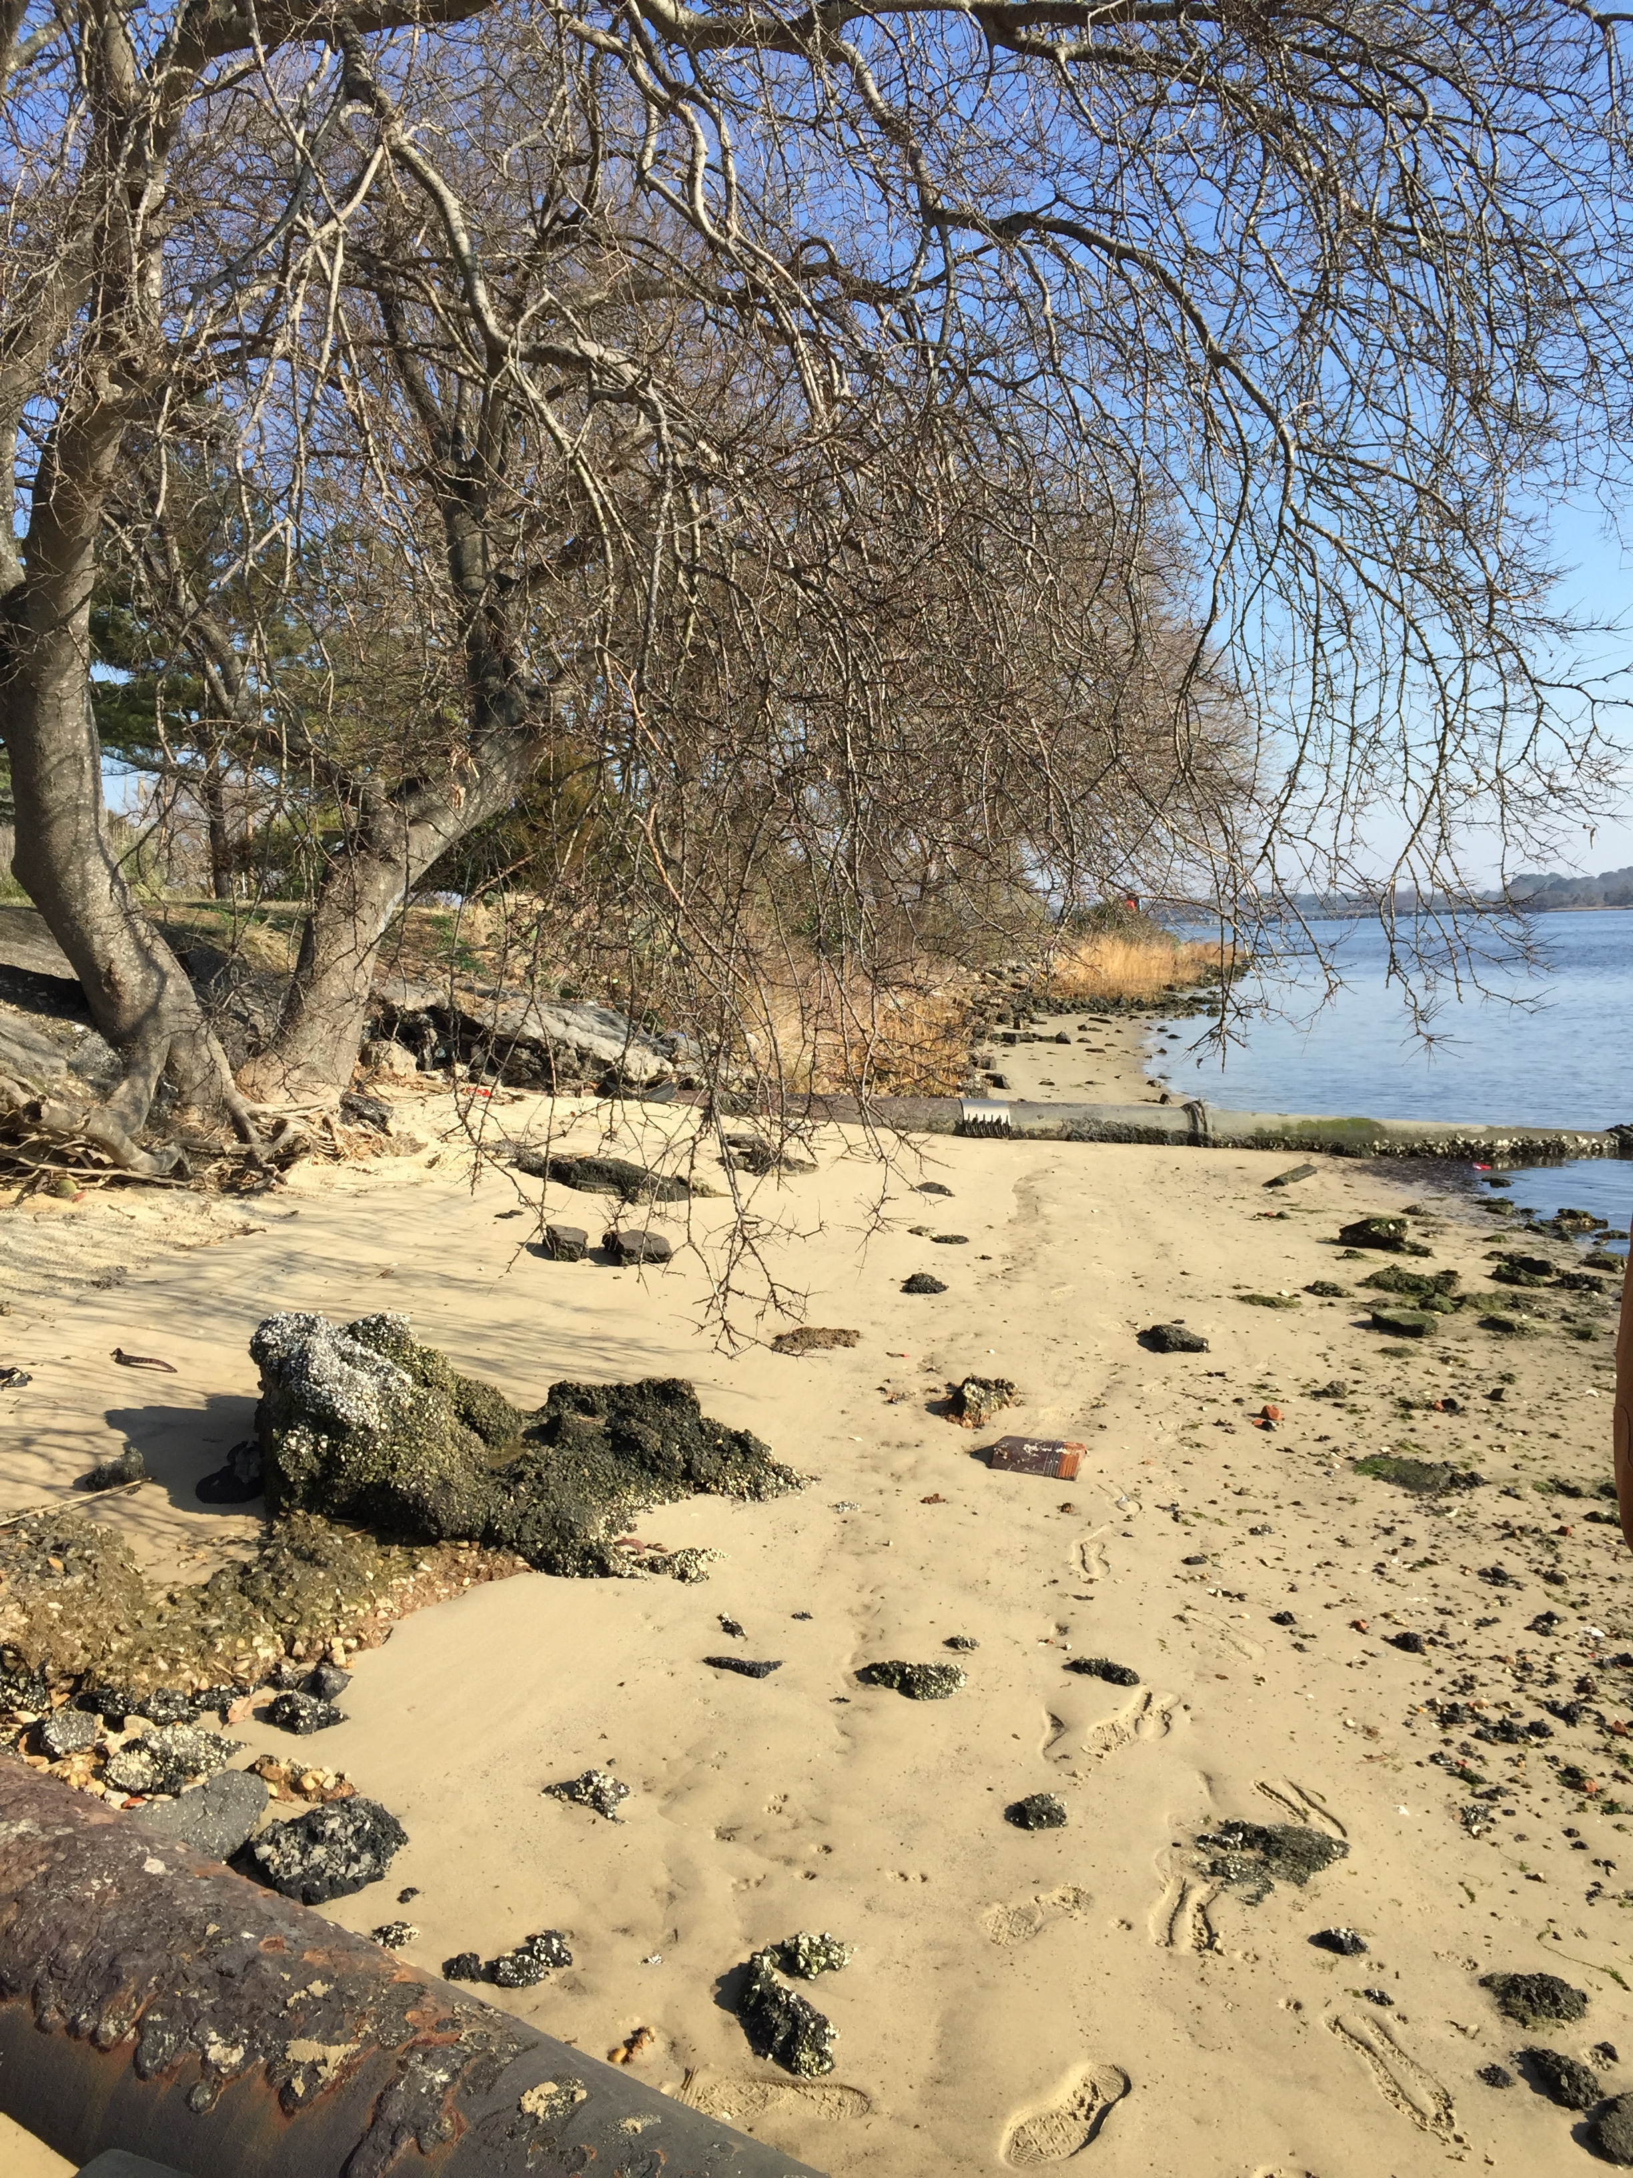
Beach Restoration
Shoreline was previously a beach that residents enjoyed

Slide 40
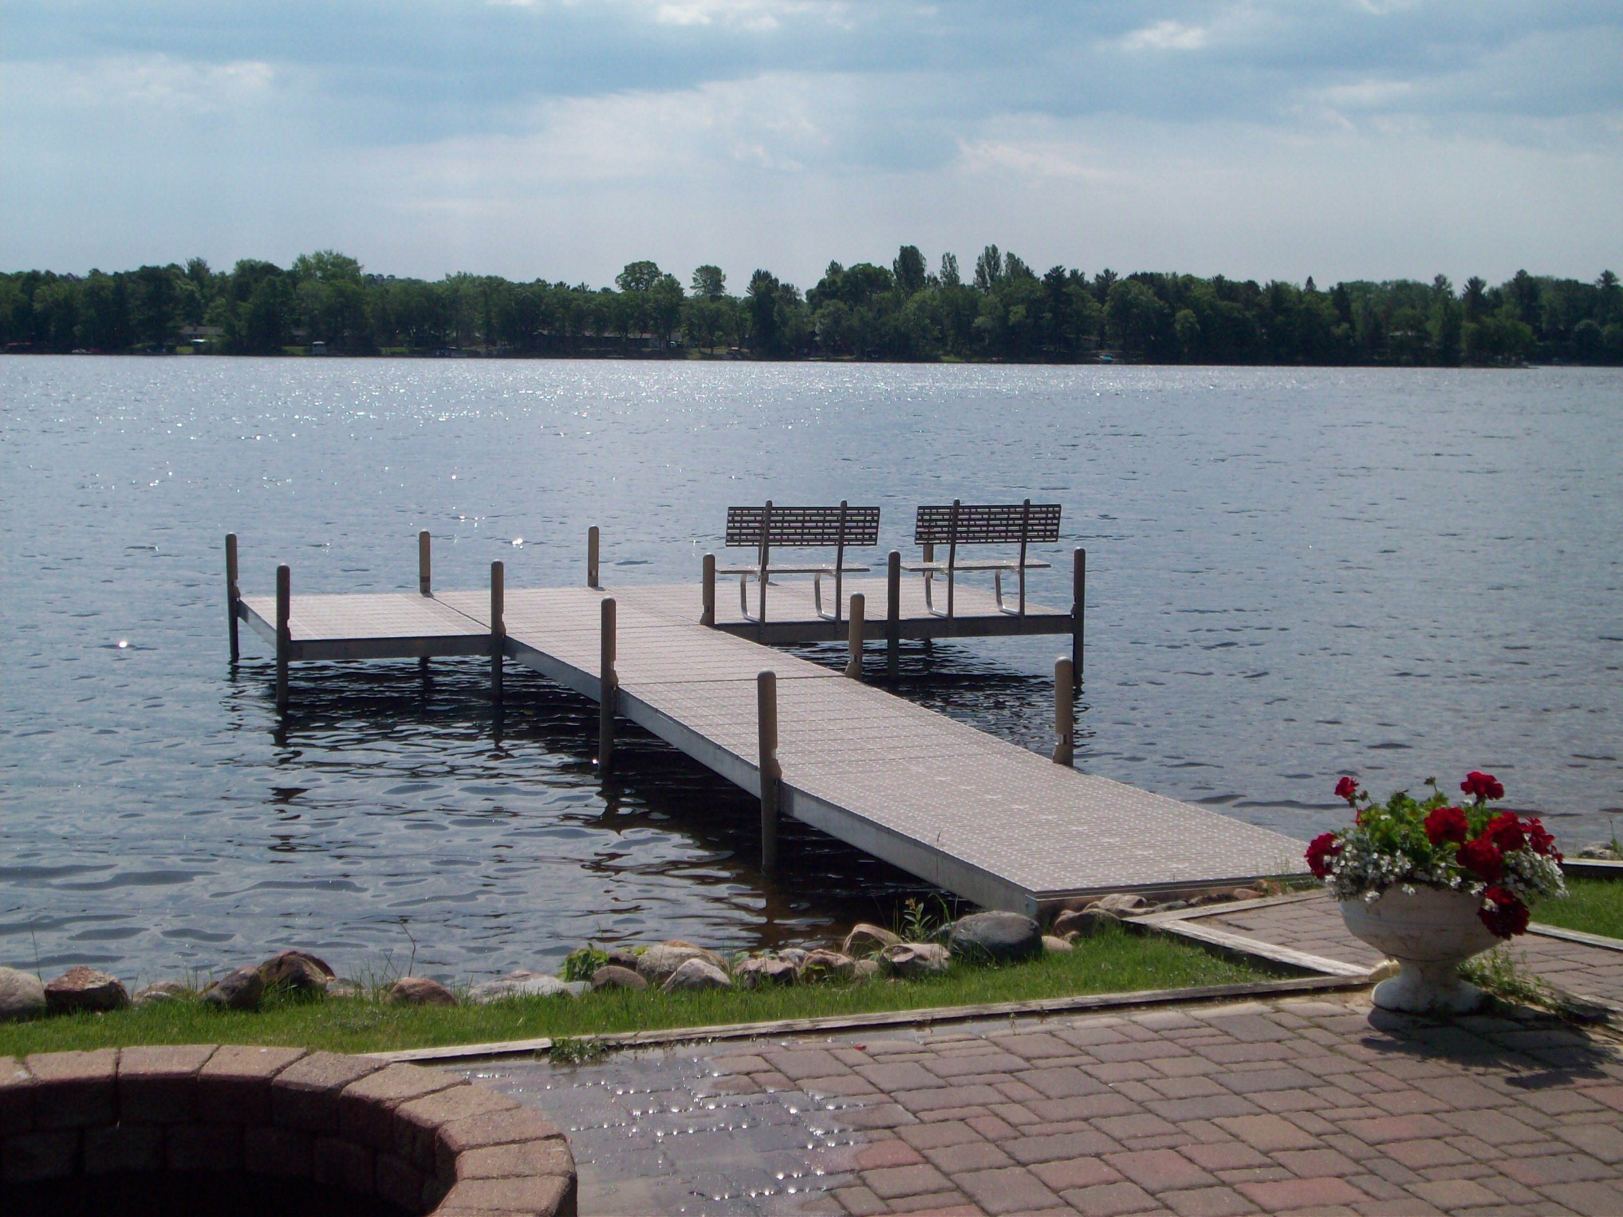
Standing Docks
Provides structure to walk out above water
Notes:
Majestic and Norchester Ave

Slide 41
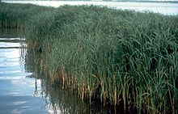
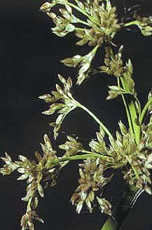
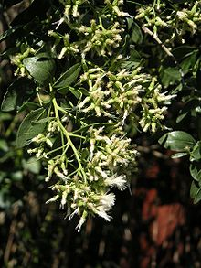
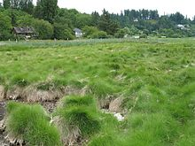
Preliminary Design Solutions
Oyster bed & Sill combination
Install floating piers
Wetlands instead of sandy beach

Slide 42
Living Shoreline Location

Slide 43
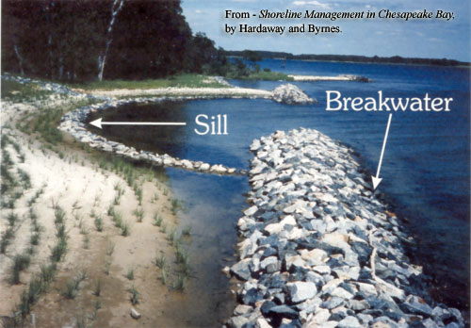
Oyster Bed & Sill Combination
Sill provides a permeable means to break wave energy. Oyster bed can use sill as cementation base
Notes:
Disrupt wave energy from boat wakes

Slide 44
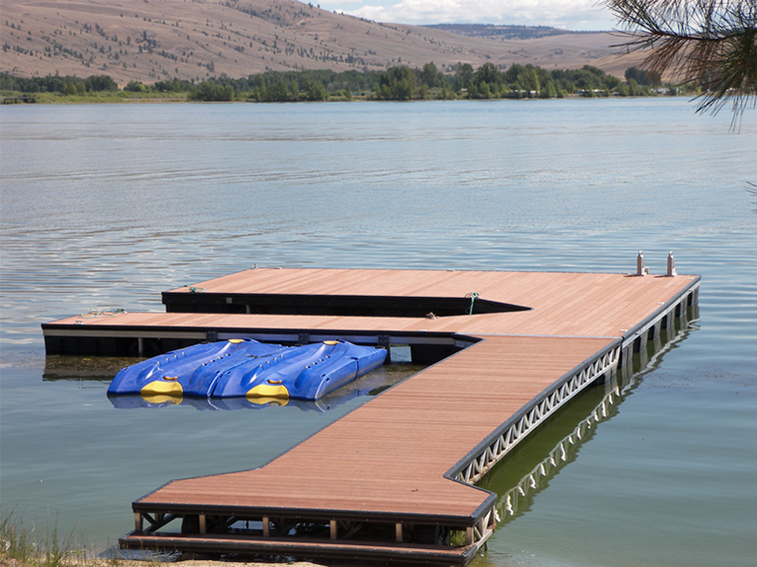
Install Floating Piers
Piers provide walking structure but also prevents local sand erosion
Notes:
Floating piers dissipates wave energy and thus reduce erosion.
Standard pier requires rip rap.
Floating pier moves with waves.
Protects shoreline and eliminates cost of rip rap.

Slide 45
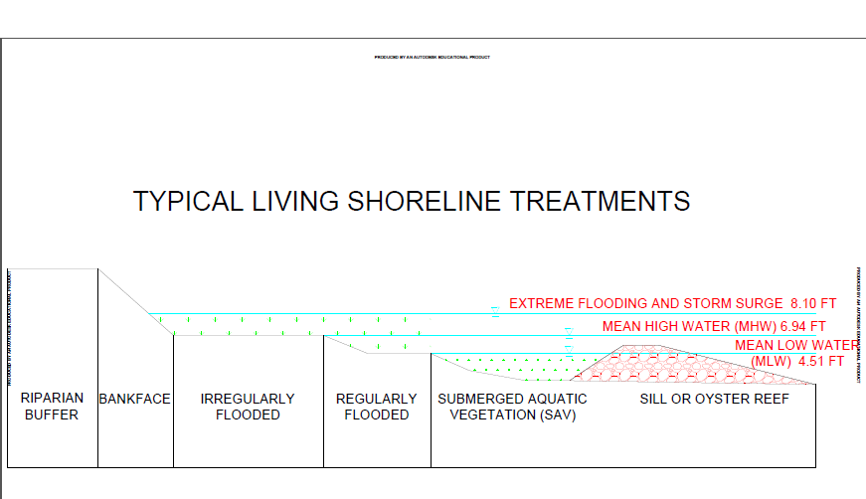
Wetlands on Shoreline
Plants will provide filtration system for first flush of storm water from Chesterfield outfall
Notes:
Enhances aesthetic
Benefits stormwater treatment process

Slide 46
Structural

Slide 47
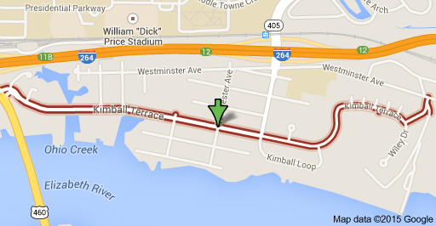
Kimball Terrace

Slide 48
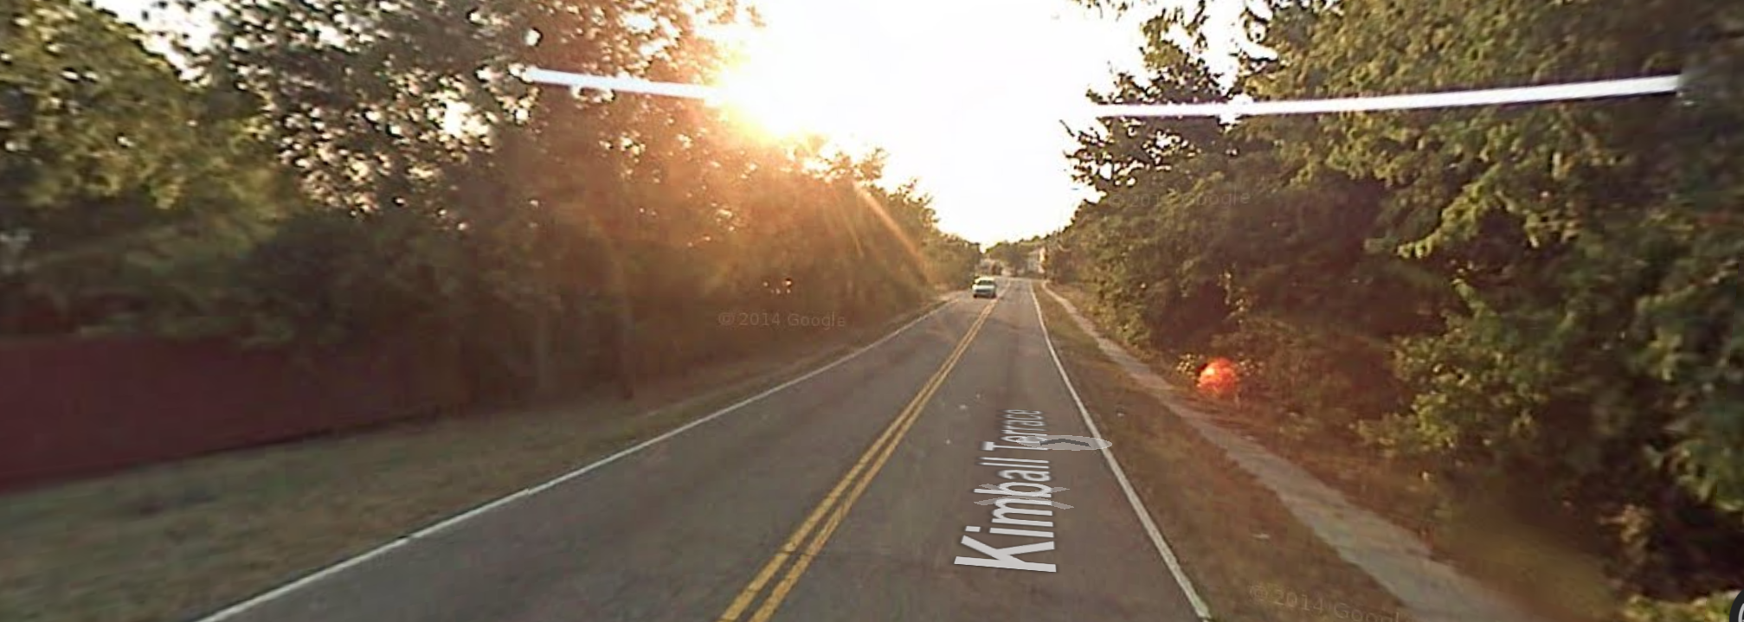
Existing Conditions & Issues Road Classification
Notes:
Urban
Serve both land access and traffic circulation in lower density residential and commercial/industrial areas
Penetrate residential neighborhoods, often only for a short distance
Distribute and channel trips between Local Roads and Arterials, usually over a distance of less than three-quarters of a mile
Operating characteristics include lower speeds and fewer signalized intersections
The Culvert is partially obstructed with silt therefore disrupting proper water flow

Slide 49
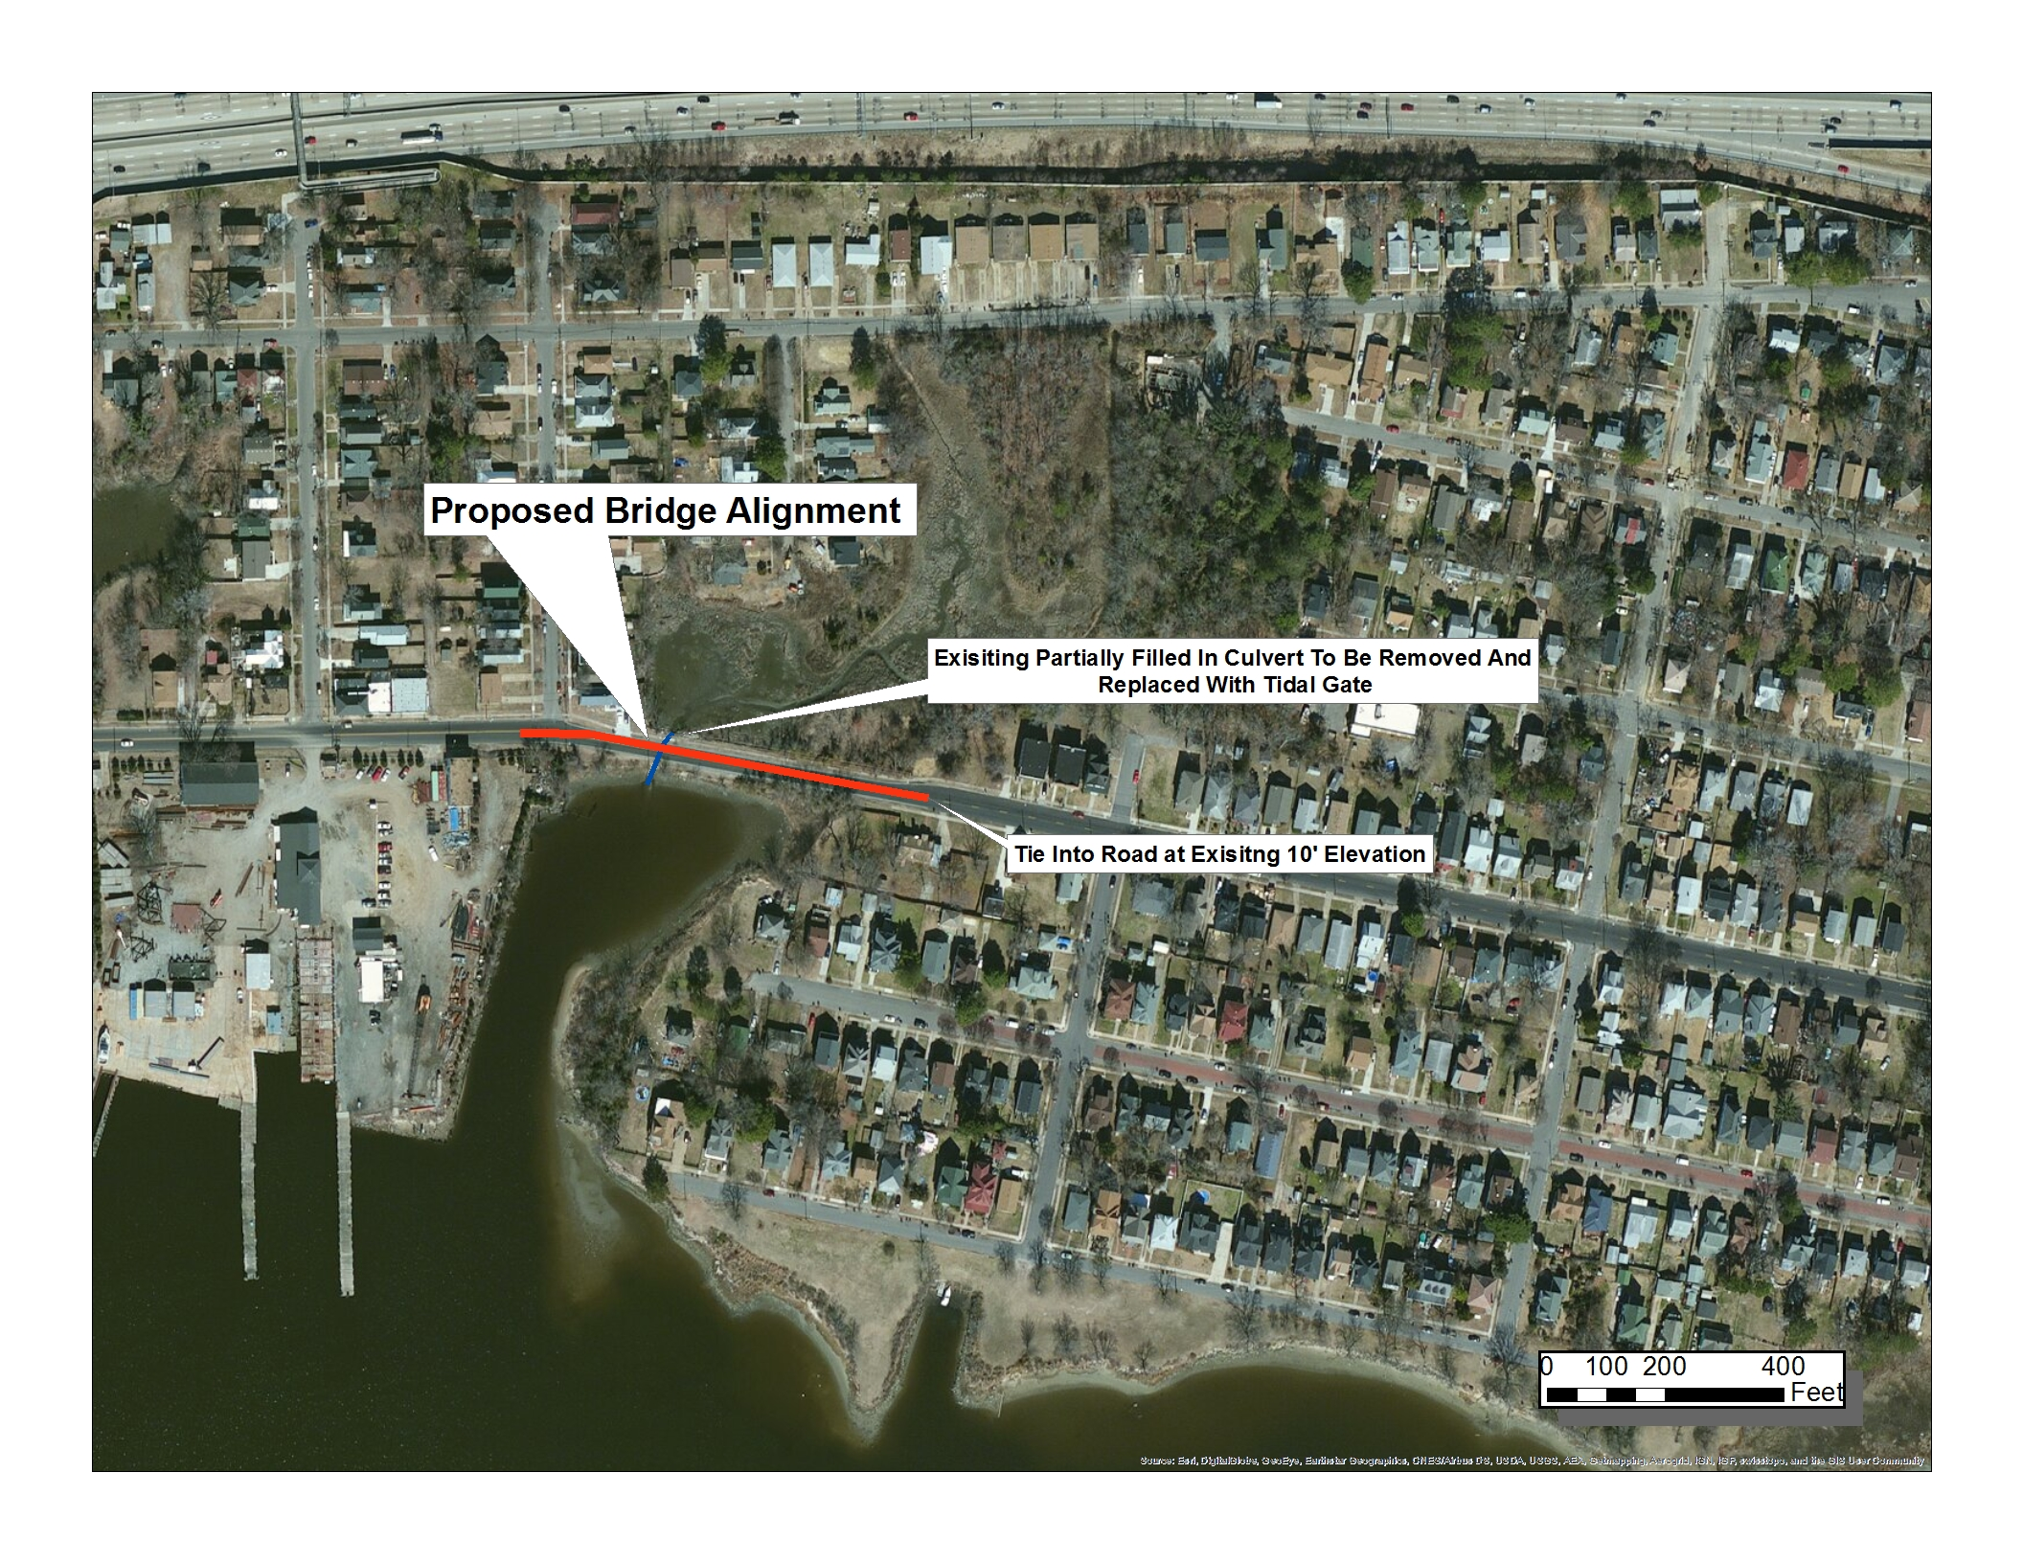
Existing Conditions & Issues Ground Depression
Notes:
Urban
Serve both land access and traffic circulation in lower density residential and commercial/industrial areas
Penetrate residential neighborhoods, often only for a short distance
Distribute and channel trips between Local Roads and Arterials, usually over a distance of less than three-quarters of a mile
Operating characteristics include lower speeds and fewer signalized intersections
The Culvert is partially obstructed with silt therefore disrupting proper water flow

Slide 50
Existing Conditions & Issues Culvert

Slide 51
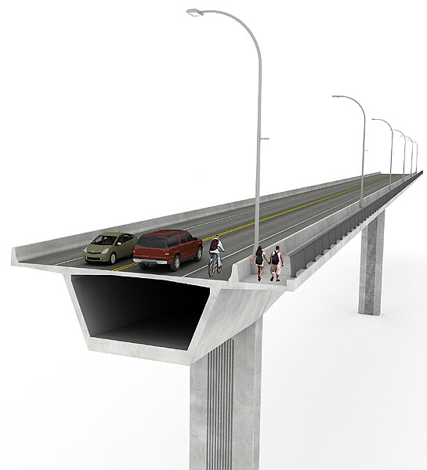
Potential Solutions
Designing for a 100-year storm
Bridge Structure
Type –Beam Bridge
Materials-Concrete & Steel
Flood Gate
Notes:
2 ft clearance above current storm surge
Allows enough flow underneath the bridge to feed the wetlands but also allowing back flow from the wetlands/creek back into the river while protecting the neighborhood.

Slide 52
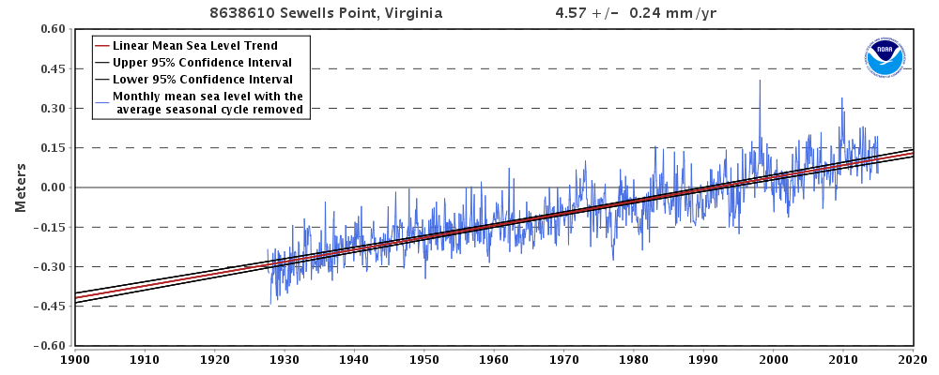
Summary

Slide 53

Special Thanks for Your Continued Help
Dr. Mujde Erten-Unal
Mason Andrews
Skip Stiles
Wetlands Watch
Chesterfield Heights
Hampton Roads Green Building Council
Virginia Sea Grant
City of Norfolk

Slide 55
MARI Networking Lunch
March 5th, 2015
INTERGOVERNMENTAL PILOT PROGRAM:
RESILIENT REGION REALITY CHECK
Emily E. Steinhilber
Assistant Director of Coastal Resilience Research
Office of Research

Slide 56
Intergovernmental Pilot Program
MISSION
Develop a regional “WHOLE OF GOVERNMENT” and “WHOLE OF COMMUNITY” approach to SLR Preparedness and Resilience Planning by June 2016
VISION
An intergovernmental planning organization that can effectively coordinate the sea level rise preparedness and resilience planning of Federal, state and local government agencies and the private sector, taking into account the perspectives and concerns of the citizens of the region.

Slide 57
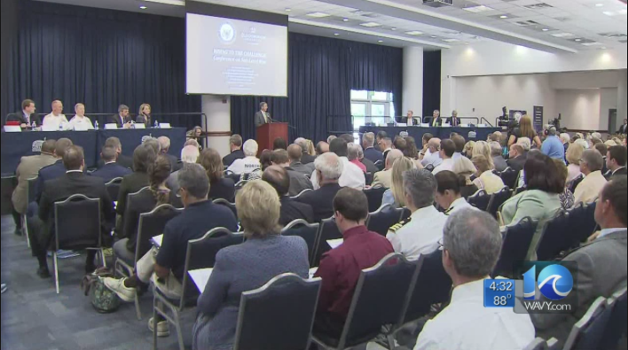
Where are we now?
June 3, 2014: Kick Off at ODU
June 30, 2014: “Rising to the Challenge,” bipartisan forum for Virginia members of Congress organized by Senator Kaine Big Blue Room
July 1, 2014: Governor’s Climate Commission announced
Oct 10, 2014: Pilot Charter signed
Dec 2, 2014: FEMA NEP Tabletop to galvanize the pilot and help transition to Whole of Community

Slide 58
What’s Next?
Ongoing:
Work Plan Development by Work Groups
Continuing Stakeholder Engagement & Committee Development
Upcoming:
March 10, 2015: Va DHCD Resiliency Plan Listening Session
March 11, 2015: FEMA Fed. Flood Risk Mgmt. Standard Listening Session
March 17, 2015: ULI & ODU 3RC Community Engagement Event
June, 2015: Regional Template Presented
June 2016: MOU & Planning Organization Established

Slide 59
Line Up
STEERING COMMITTEE
Mayor Wright, Portsmouth RDML Williamson, CNRMA
Mr. Keaton, HRPDC CAPT Rios, USN, NAVFAC
COL Olsen, USACE Mr. Redick, City of Norfolk
CAPT Bonner, USCG Mr. Feinman, DNR
Ms. Thorogood, CGD5 Mr. Fallon, Hun. Ing.
Col Allen, USAF Ms. Wood, VPA Ray Toll ODU - convener
ADVISORY
COMMITTEE
Mayor Frank
LEGAL
WORKING GROUP
Roy Hoagland
LAND USE
WORKING GROUP
Burrell Saunders
CITIZEN ENGAGEMENT
WORKING GROUP
Chris Bonney/Michelle Covi
INFRASTRUCTURE
WORKING GROUP
RDML Phillips, USN (ret)
MUNICIPAL PLANNING
COMMITTEE
Christine Morris/Joshua Behr
OUTREACH
COMMITTEE
PRIVATE INFRASTRUCTURE
COMMITTEE
Carol Considine
SCIENCE
COMMITTEE
Larry Atkinson/
Carl Hershner
ECONOMIC IMPACTS
COMMITTEE

Slide 60
Structure & Stakeholders
Steering Committee
Federal Liaisons
Advisory Committee
Legal Working Group
Land Use Working Group
Infrastructure Planning Group
Civic Engagement Group
Municipal Planning Committee
Private Infrastructure
Science Committee
Blue-Green Infrastructure*
Industry*
Economic Impacts*
Education
Committee*
* Indicates committees have not been fully formed. This map is subject to change.

Slide 61
Resilient Region Reality Check
Among others (ULI HR, HRPDC, Faculty, Municipalities) this event will inform the Pilot’s Citizen Engagement Working Group
How does flooding affect you? What are the two issues that are of most concern and why?
What to do about flooding? What is the most critical thing that people can do? What is one thing businesses can do? What is the one thing that governments can do?
What are the resources needed to address flooding issues? Who should pay?
How should scare resources/tax dollars be allocated?

Slide 62
Citizen Engagement Working Group
Chairs: Michelle Covi & Chris Bonney
Goals & Objectives:
Identify community priorities for coordinating sea level rise preparedness and resilience activities.
Create bridge between Whole of Government & Whole of Community
Create “base level” engagement and communications template suitable for all communities.
Build Capacity in Hampton Roads Communities to respond to flooding emergencies and prepare for SLR by tapping into existing networks to strengthen social capital & resilience
Inform, Identify and develop strategies for overcoming obstacles to engagement and communications.

Slide 63
Contact
Emily E. Steinhilber
esteinhi@odu.edu
(757) 692-4412
Ray Toll
Ray Toll
rtoll@odu.edu
(757) 683-6650
Online
Online
www.centerforsealevelrise.org
www.facebook.com/centerforsealevelrise

Slide 65
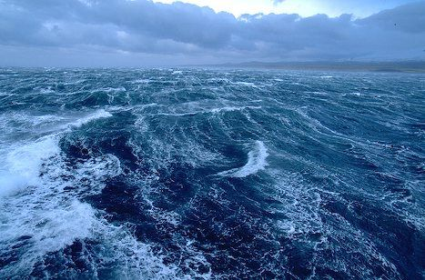

Resilient Region Reality Check;
Tuesday, March 17, 2015
At ODU, TED, Big Blue
Increasing community disaster resilience and capacity to adapt to changes
Prep Package

Slide 66
Resilient Region Reality Check;
Increasing community disaster resilience and capacity to adapt to changes
The ability of the communities in Hampton Roads to adapt physically, emotionally and mentally to sea level rise and to reduce the risk of natural disasters directly correlates with the long term economic and financial viability for the region and the livelihood and wellbeing of the people.
Our citizens must be prepared for change, as infrastructure and mitigation will not alone ensure success.

Slide 67
Resilient Region Reality Check;
Increasing community disaster resilience and capacity to adapt to changes
Program Straw Man
Step 1
Facilitated Table Discussions on the key questions to tables of like interest
Step 2
Scribed results uploaded to collecting presentation
Step 3
Tables report out to room
Step 4
Event organizers ULI and MARI
ensure community awareness
Step 5
Repeat as needed until community prepared for change

Slide 68
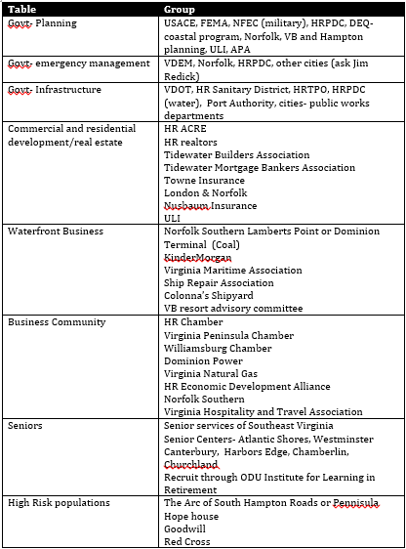

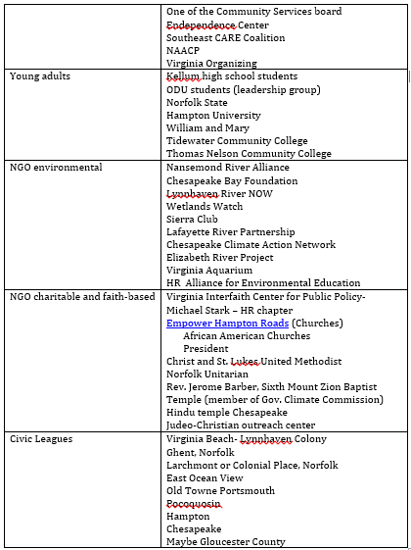
Resilient Region Reality Check;
Increasing community disaster resilience and capacity to adapt to changes
Disabled and Challenged
Students, non-students and Young Professionals
Notes:
We believe table populations should be of people who are impacted in a similar manner (for greatest table effort).
We will continue to evaluate how governmental agencies will be grouped at tables, seeking feedback along the way to ensure the greatest efficiencies and effectiveness.
High Risk Neighborhoods

Slide 69
Resilient Region Reality Check;
Increasing community disaster resilience and capacity to adapt to changes
Anticipated questions to be asked of the table participants:
AM Block 1: How do you perceive the safety or risk of living in Hampton Roads?
Q1.1: What do you think are the main threats for the communities in Hampton Roads?
Q1.2: Do you think the region is doing enough to make your life here safer?
Q1.3: How confident are you that Hampton Roads has the capability to handle sea level rise?
AM Block 2: How is the disaster risk going to change in Hampton Roads?
Q2.1: Do you think that climate change and sea level rise will impact your life and work severely and make your life less safe in the
near future?
Q2.2: What are the main impacts, today and in the future, that come to your mind when you think about sea level rise?
Q2.3: Are you determined to stay in Hampton Roads or is there a point when you would start to look for alternatives?
PM Block 3: What can we do to develop the resilience of the communities in Hampton Roads?
Q3.1: What do you think is the most important step to reduce the disaster risk from storms and flooding in Hampton Roads?
Q3.2: How should we change buildings, land use and services to reduce impacts of frequent flooding and larger storm surges?
Q3.3: What information and services would help you to better deal with both frequent flooding and for handling the disaster risk?
PM Block 4: How much should we spend, and on what should we spend this, to reduce disaster risk and increase resilience?
Q4.1: Should the region invest more to improve evacuations when needed?
Q4.2: Should the region change the way we build and invest in making the cities more flood-resilient so that evacuations would not
be needed?
Q4.3: To what extent would you be willing to pay for making Hampton Roads a safe and desirable place to life and work?
Note: We will continue to review the questions until we believe we have the best representative questions.

Slide 70
Resilient Region Reality Check;
Increasing community disaster resilience and capacity to adapt to changes
Proposed Schedule:
If we agree to four blocks, then a possible schedule would be:
07:30–08:30: Check in (table assignments) and continental Breakfast
08:30-08:40: Welcome by President Broderick, Cathy Lewis, explanation of day’s activities
08:40–09:00: Overview of ULI National Activity by Brenden McEneaney
09:00-09:40: Table discussions of Block 1 Questions
09:40-10:20: Table presentations, max 3 minutes per table.
10:20-10:40: Break
10:40-11:20: Table discussions of Block 2 Questions
11:20-12:00: Table presentations, max 3 minutes per table.
12:00-12:30: Lunch
12:30-13:10: Table discussions of Block 3 Questions
13:10-13:50: Table presentations, max 3 minutes per table.
13:50-14:10: Break
14:10-14:50: Table discussions of Block 4 Questions
14:50-15:10: Table presentations, max 3 minutes per table.
15:10–15:30: Overview of ODU Pilot Project by Ray Toll.
15:30-16:00: Overflow time, Next Steps and Thanks for Participation: Burrell Saunders.
16:00-17:00 Networking and socializing.
Tuesday, March 17, 2015
ODU, Ted, Big Blue Room

Slide 71
Resilient Region Reality Check;
Increasing community disaster resilience and capacity to adapt to changes
The relationship between the Resilient Region Reality Check and the Pilot Project is that the results from the event will be used to inform citizen engagement- “whole of community” efforts.
This information can also be used by the HRPDC, Commonwealth and local city planning an preparedness efforts to reach out to the different sectors of the community once we understand what they know about and care about.
For resilience it is crucial to connect long term goals that are often seen as distance in time and space to immediate needs and every day quality of life. By better understanding how people think about the issues, we can better plan and be more effective in our collaborations.

Slide 72
Resilient Region Reality Check;
Tuesday, March 17, 2015
At ODU, TED, Big Blue
Increasing community disaster resilience and capacity to adapt to changes
Dan Bell
ULI
danbell@Verizon.net
373-6517

