Slide 1
MARI Networking Meeting
April 28, 2015, 12:00-13:30
Agenda
• 12:00 Hans-Peter Plag: Welcome, brief news and report on relevant publications
• 12:10 Tal Ezer: Three publications on North Atlantic circulation and sea level
• 12:20 Muge Akpinar-Elci: Three publications on health impacts
• 12:30 Yongcun Cheng: Three publications on satellite altimetry and sea level variability
• 12:40 Ariel Pinto: A publication on risk assessment
• 12:50 Wie Yusuf: Two publications on governance
• 13:00 Discussion of publications in preparation
• 13:15 Networking
• 13:30 Adjourn

Slide 2
Coastal Resilience Center of Excellence (CRC)
UNC
Funded by DHS
ODU proposal:
A Tool to Measure Stress to Support Disaster Resilience Planning
2 years, $270K
Authorized by DHS
Still uncertainties concerning funding available for ODU

Slide 3
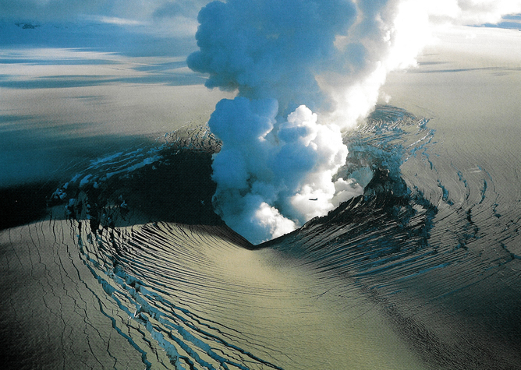
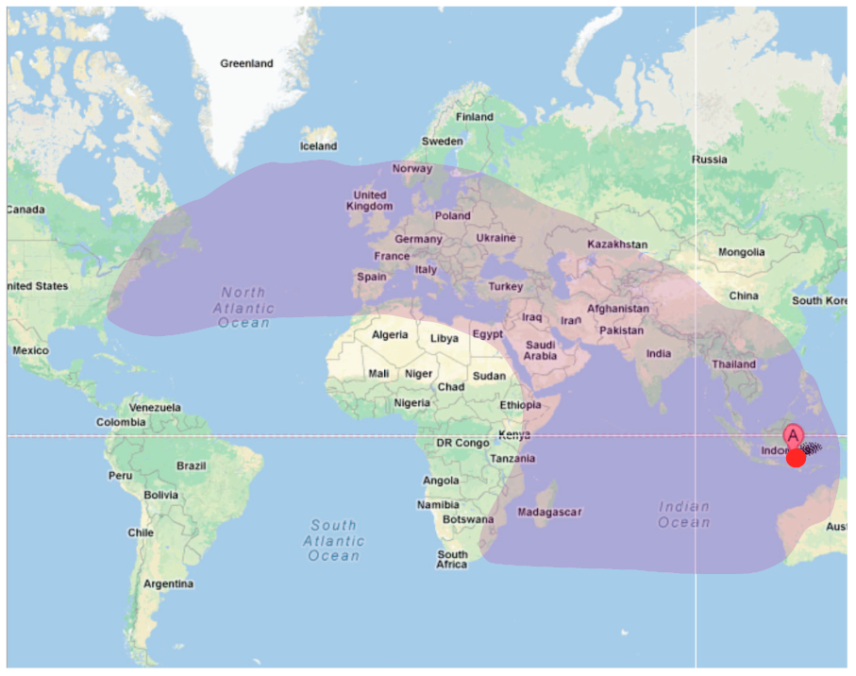

Slide 4
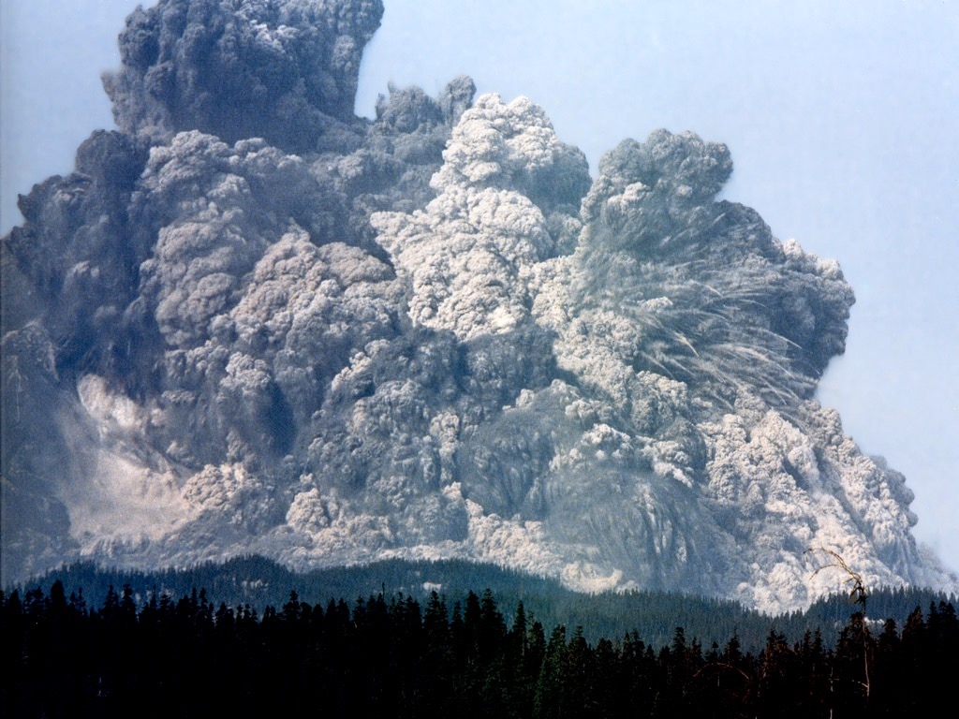
Extreme Geohazards: Reducing the Disaster Risk and Increasing Resilience
Hans-Peter Plag, Mitigation and Adaptation Research Institute,
Old Dominion University, Norfolk, VA, USA

Slide 5
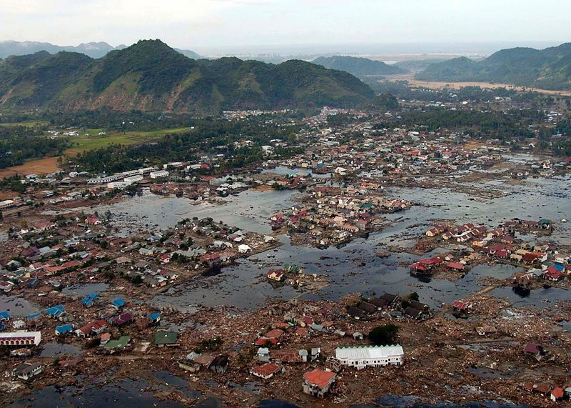
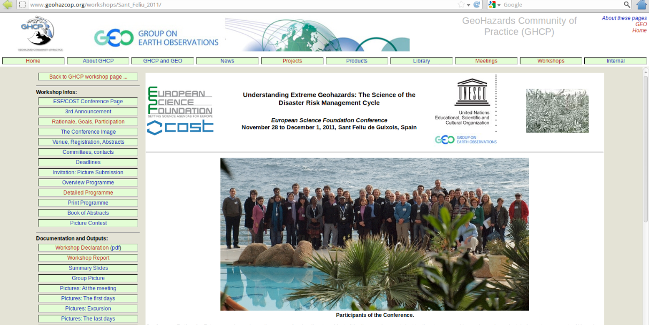
Science Position Paper
Declaration on Extreme Geohazards
and the Reduction of Disaster Risks
Resulted in two main activities:
Global Geohazards Information System for Disaster Risk Reduction (GGIS-DRR)
“White” Paper on Extreme Geohazards
1 Introduction
2 Global Disasters and Catastrophes
3 Extreme geohazards
4 Disaster Risk, Resilience, Antifragility, and Adaptive Capacity
5 Cost/Benefit Analysis of Planning for Extreme Geohazards
6 Confronting Disaster Risks for Extreme Geohazards
7 Conclusions and Recommendations
Acronyms
References

Slide 6
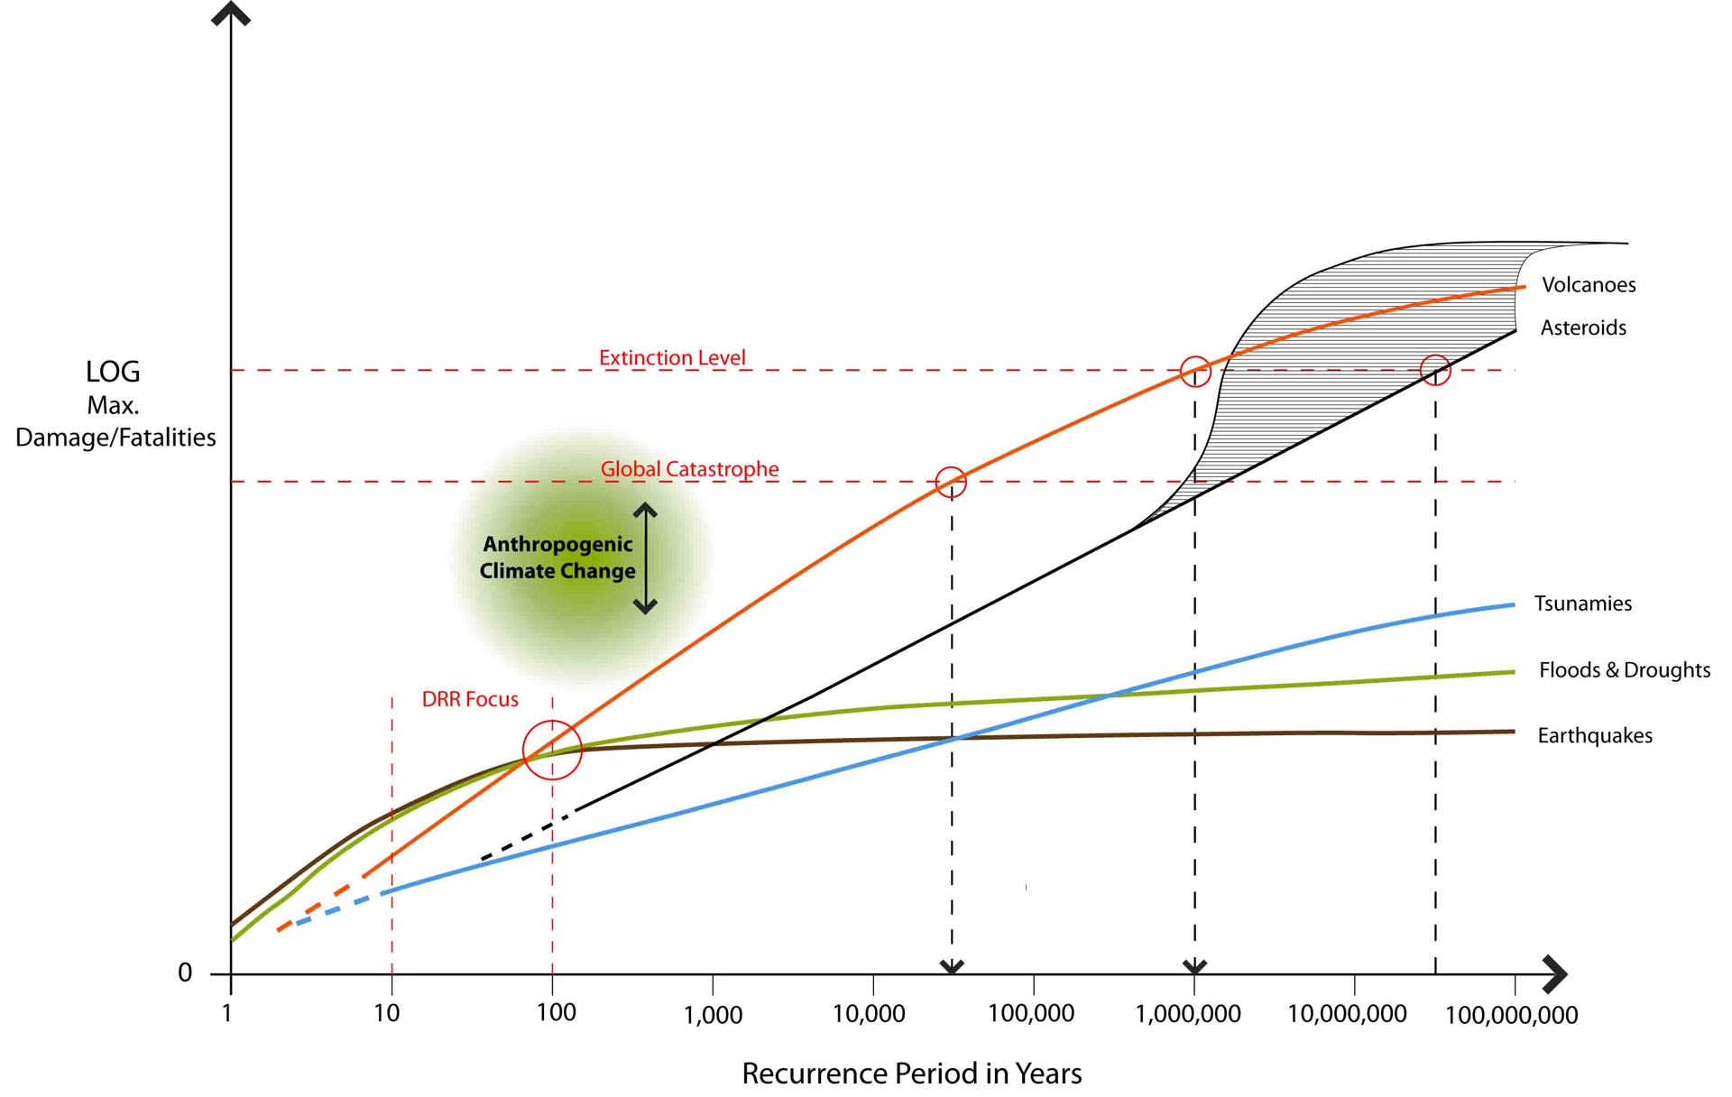
GEOHAZARDS: The Big Picture
Other potential X-Events (see, e.g., John Casti, 2012):
Pandemics: Black Death killed 30-60% of the population in impacted areas
Despots: Genghis Khan eliminated 11.1% of global population
Solar Storms: could take out major parts of the power grids
Loss of Internet: Could have extreme societal and economic consequences
...

Slide 7
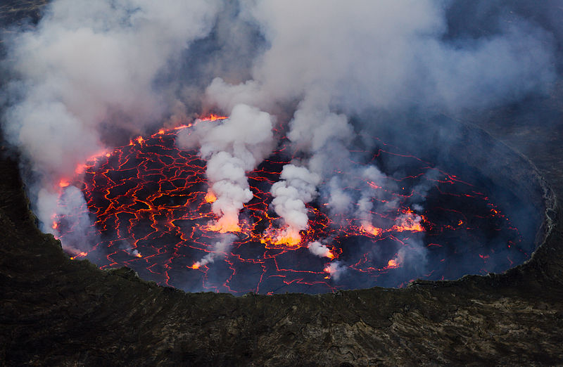
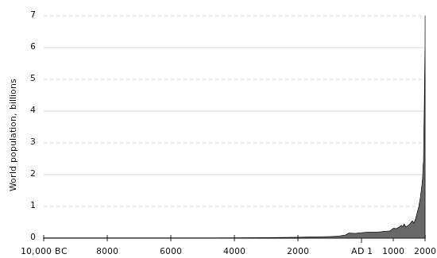
Population Growth Offsets DRR Efforts
12 Billion by 2100
VEI 7 Eruptions
Tambora, 1815
Kurile, ~5550 BC
Santorini, ~1610 BC
Changbai, ~970
Crater Lake, ~5680 BC
Kikai, 2350 BC
Taupo, 230

Slide 8
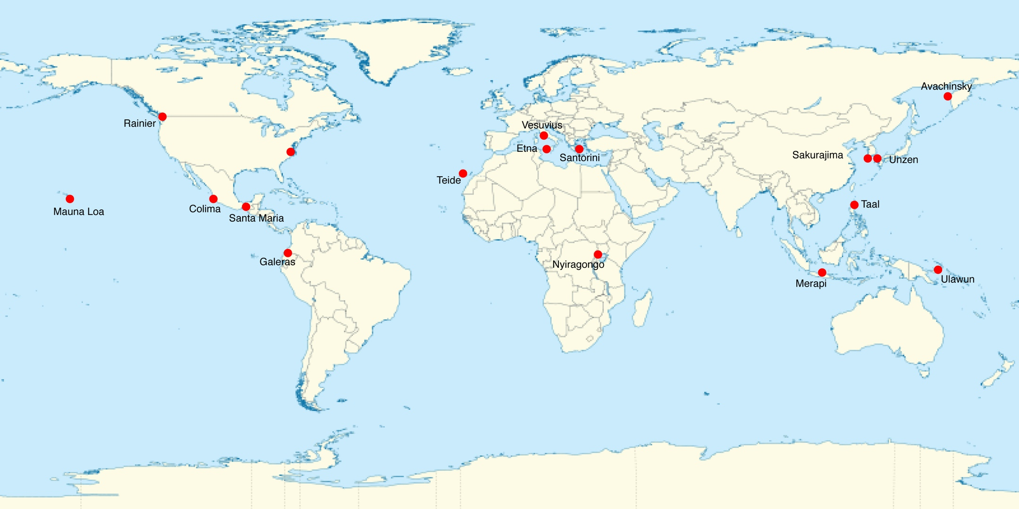
Conclusions and Recommendations
The largest volcano eruptions of the Holocene (1 in 1000 years events):
- today would threaten an already stressed food security
- challenge the crucial global transportation network
- could easily lead to a global catastrophe.
Chance of a major eruption (order VEI 7, 100 km³) in the 21st century: 5-10%:
- severe implications for food security, public health, transportation, global economy and stability.
Steps towards risk reduction and increased resilience:
(1) Scientific framework for frequent assessments of global risks
(2) Improved scientific understanding of extreme geohazards
(3) Scenario contingency planning
(4) Increased risk awareness through dissemination of information
(5) Global monitoring system for early warning (on time scales of years)
(6) Global governance to respond to early warnings
Immediate step: Extend Disaster Charter to early warning and preparedness

Slide 10

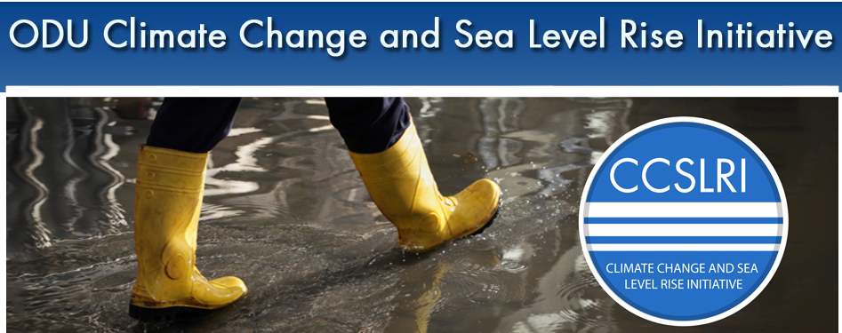
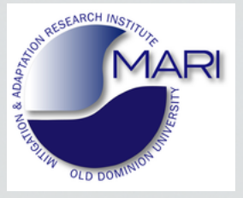

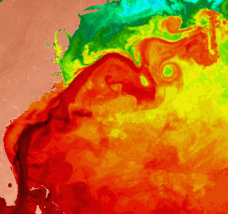
CCPO/OEAS
Sea level rise, climate changes and ocean dynamics:
Recent research and controversies
Tal Ezer, CCPO/OEAS
Focus of research: the impact of large-scale atmospheric and oceanic dynamics on local sea level rise and flooding
Gulf Stream

Slide 11
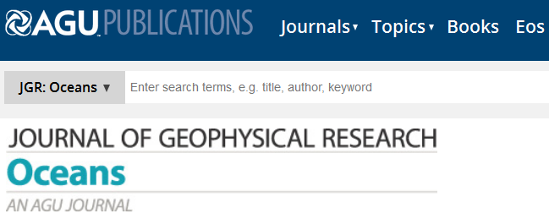
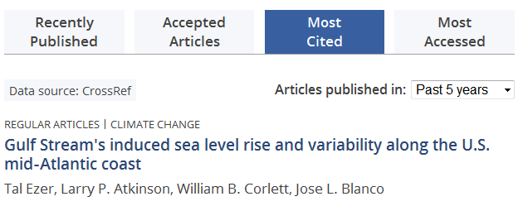
“hotspot for accelerated sea level rise”
Ezer et al. (2013) suggests:
1. climatic variations in the Gulf Stream contribute to SLR
2. The Gulf Stream started to slow down in recent years
#1 most viewed and most cited paper of JGR-Oceans
(out of ~1500 publications in this journal)
[study supported by CCSLRI, but no external funding…]

Slide 12
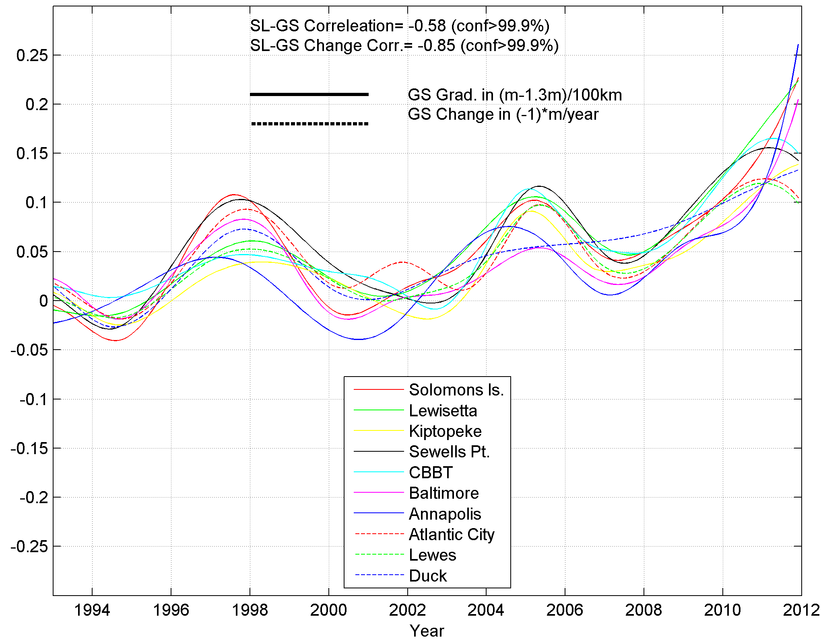
Long-time scale variability (from Ezer et al., JGR, 2013)
Why do stations in different locations show the same pattern?
Correlation between change in GS and SL:
R=-0.85 (99% conf. lev.)
Acceleration in sea level
Sea Level
Gulf Stream
strength
SL (m)
Chesapeake Bay
Decline in Gulf Stream strength since 2004
Atlantic Coast

Slide 13
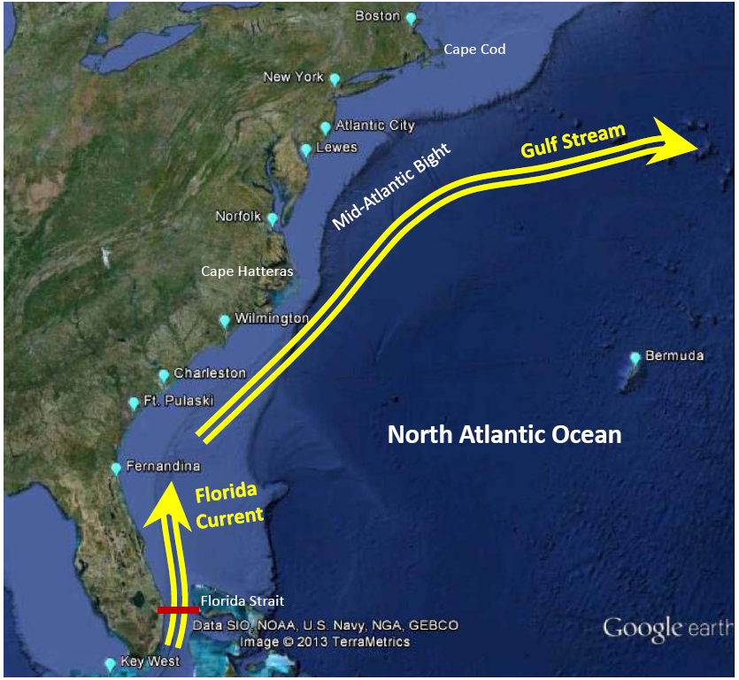
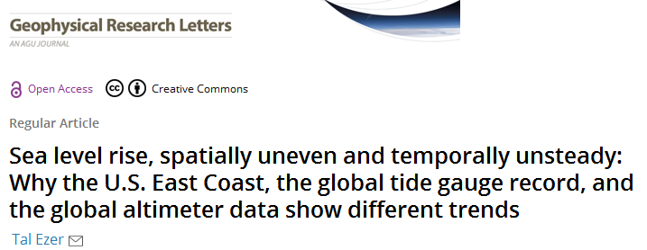
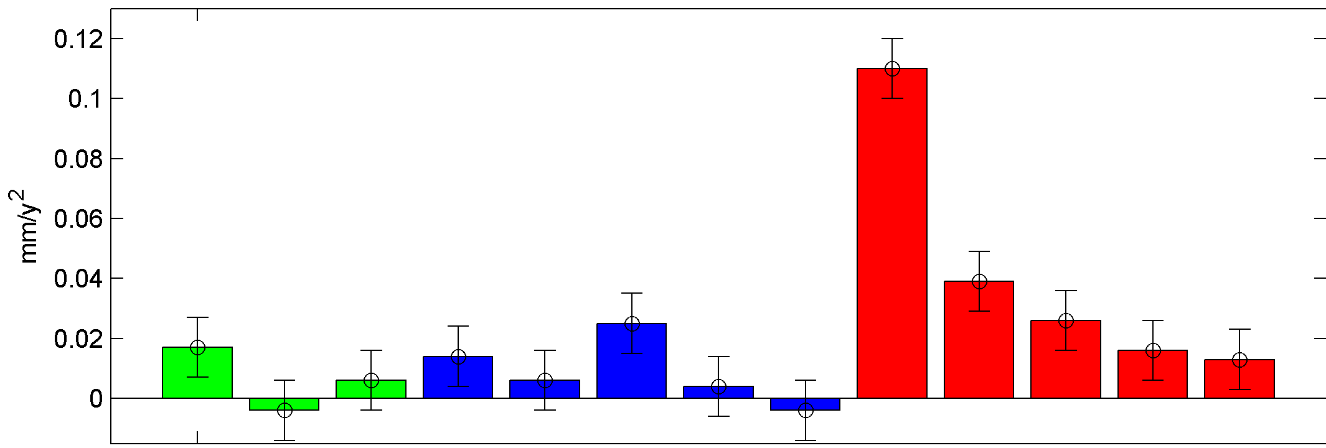
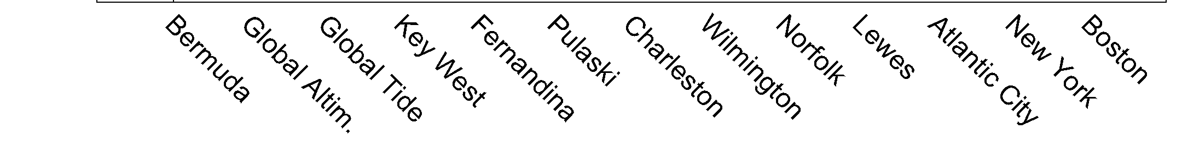
Ezer (2013)
Cape Hatteras →
Sea Level Rise Acceleration
distinctly larger north of Cape Hatteras!!!
North of Cape Hatteras
mm/y²
Atlantic
South of Cape Hatteras
Global

Slide 14
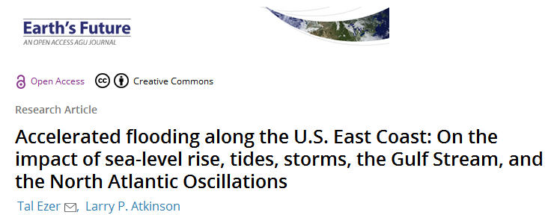
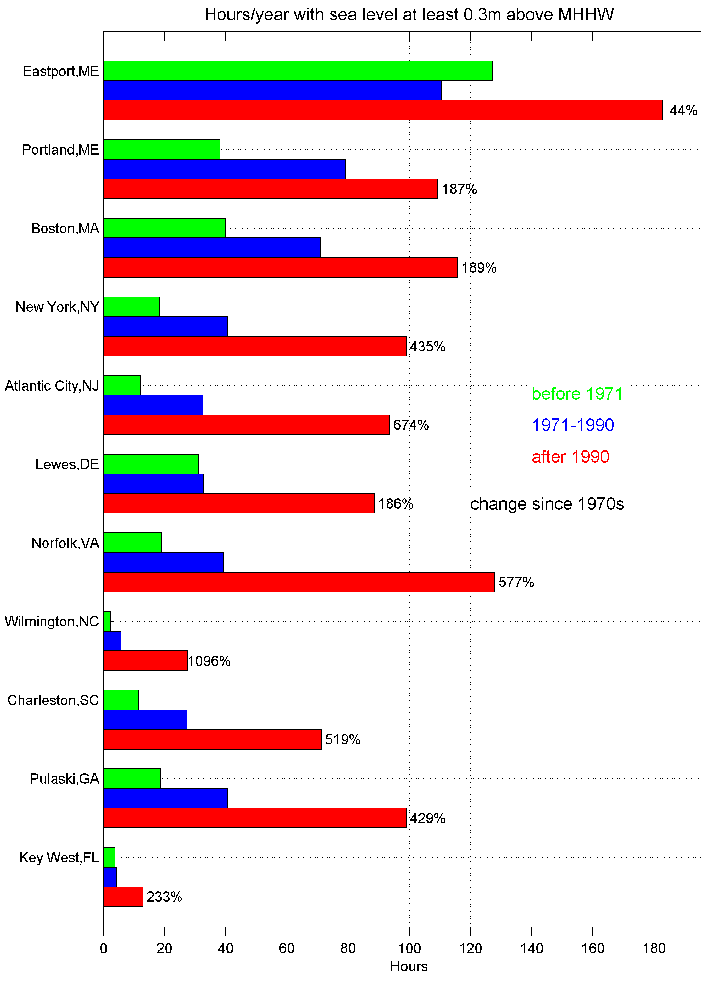
Hours per year of minor flooding (1ft>MHHW)
Followed by another paper, Ezer & Atkinson (2014), showing that the Mid-Atlantic region is also a
“hotspot for accelerated flooding”
Minor flooding in Norfolk increased by ~600% from the 1970s to 1990s

Slide 15
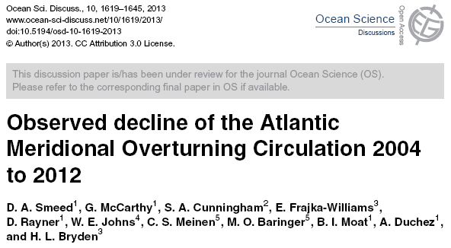
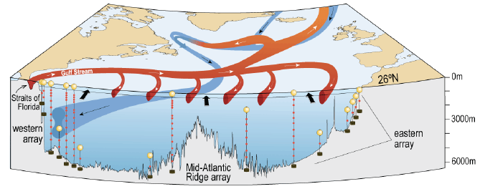
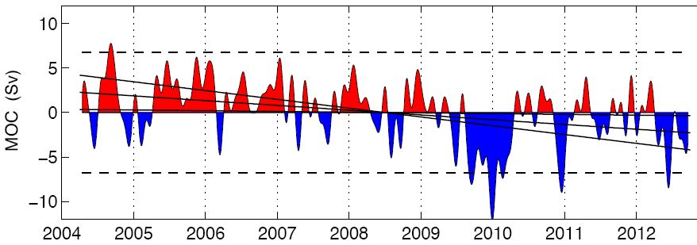
More supporting evidence for climatic changes in ocean currents…
Gulf Stream
RAPID observations
Period of increased flooding
“...30% decline in the AMOC transport between April 2009 and March 2010…”

Slide 16
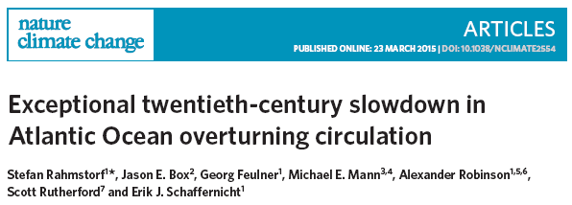
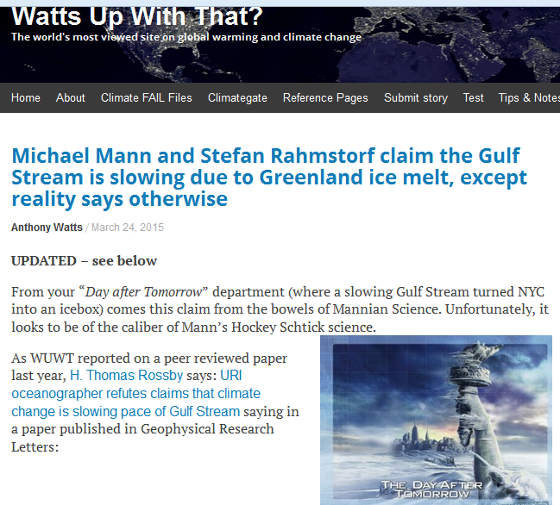
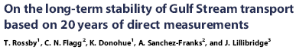
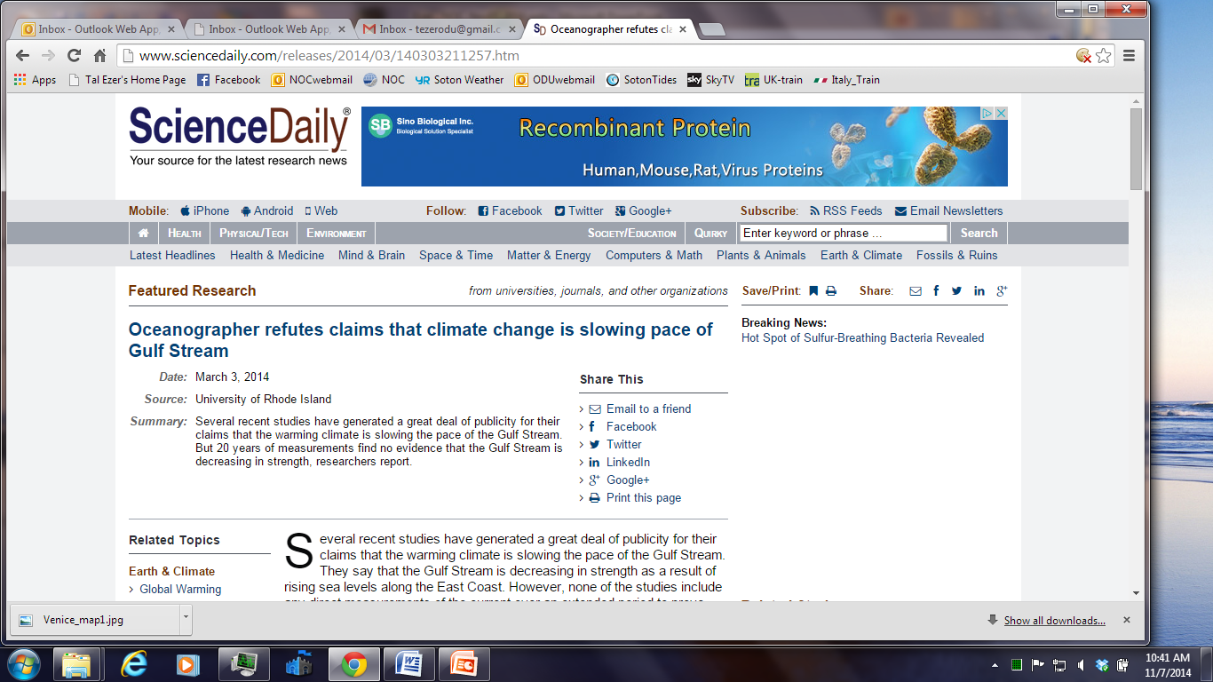
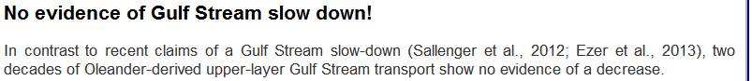
Controversy!!!
Climate change skeptics/deniers find studies with apparent contradiction…
Their favorite study is Rossby et al (2014) that claims that the Gulf Stream is stable with no sign of slowdown

Slide 17
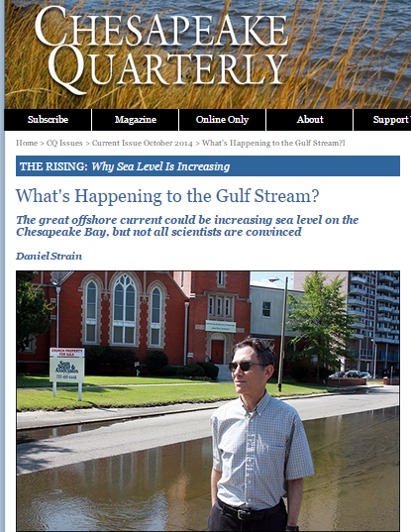
October, 2014

Slide 18
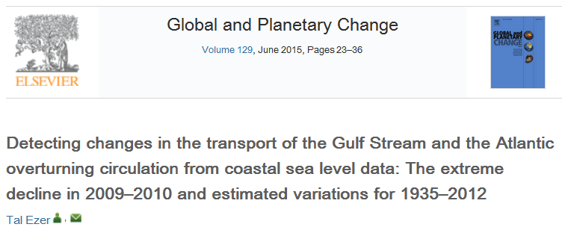
This controversy motivated a new study (Ezer , 2015), which explains the “apparent disagreement” between different data (using the same data that were used to claim that there are no significant changes in the Gulf Stream…)

Slide 19
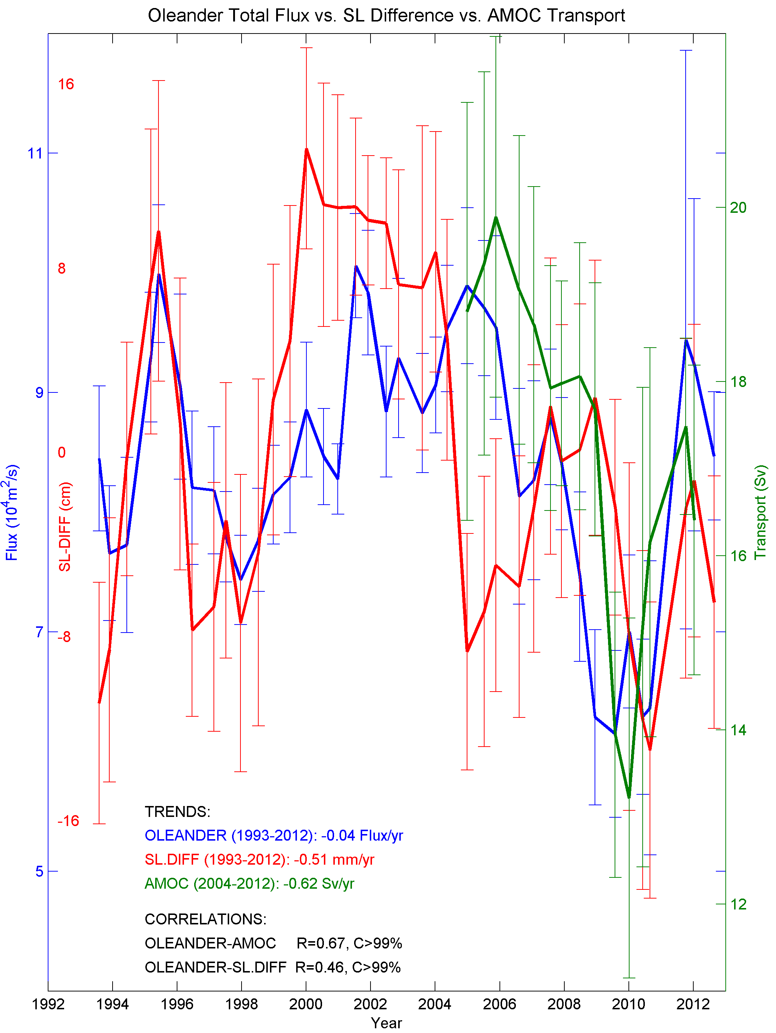
Three independent data sets all show similar trends:
AMOC transport
(RAPID obs.; McCarthy et al. 2013)
Gulf Stream Transport (GS) (incl. Slope Current)
(Oleander ADCP; Rossby et al., 2014)
Sea-level difference (SLDIF) Bermuda-US Coast
(tide gauges; Ezer, 2013)
←SLDIF
←AMOC
←GS
… longer observations are needed to verify if this trend is the start of a long-term ocean circulation weakening, or part of multi-decadal oscillations…
12mon means at 6m onintervals

Slide 20
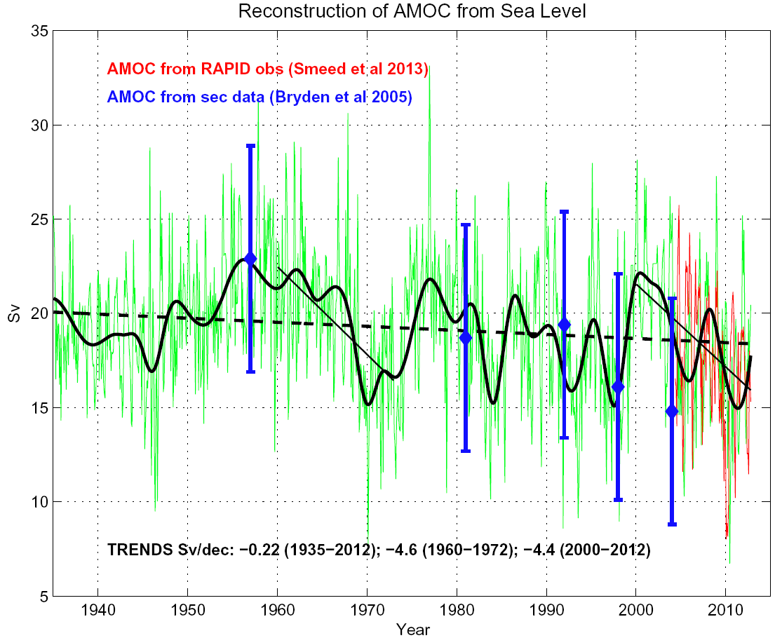
1935-2012
continuous observations
are available for only 10 yrs

Slide 21
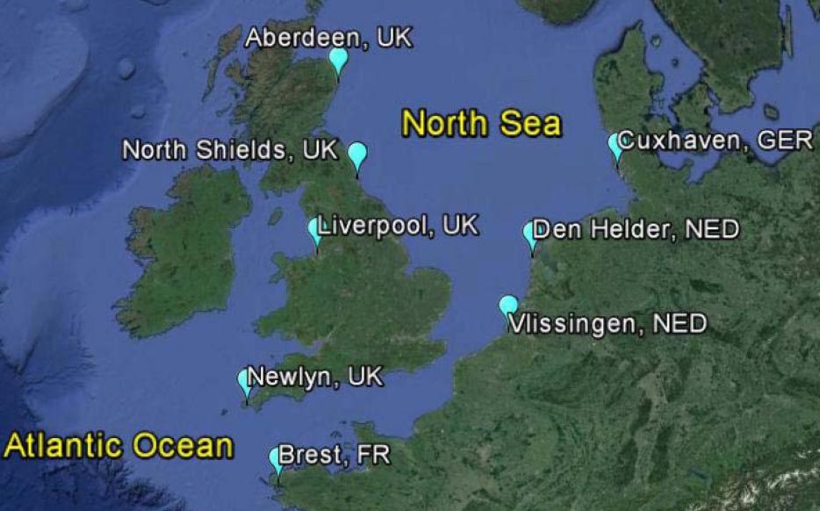
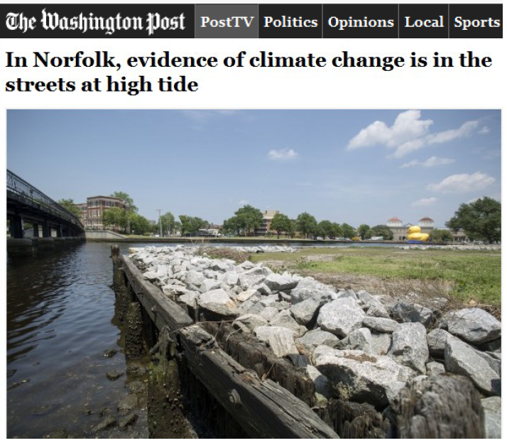
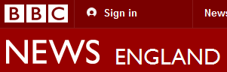
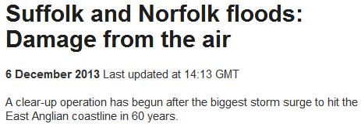
Other ongoing research: analysis of SLR in the UK and Europe-
some of the longest SL records (150-200 years)
(in collaboration with National Oceanography Center, NOC, UK)
Ezer, Haigh and Woodworth (2015)
Submitted to Ocean Dynamics
Norfolk, USA
Norfolk, UK

Slide 22
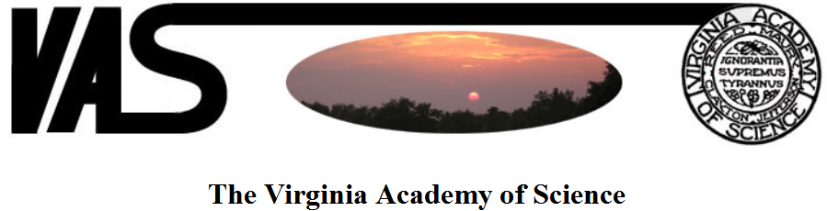
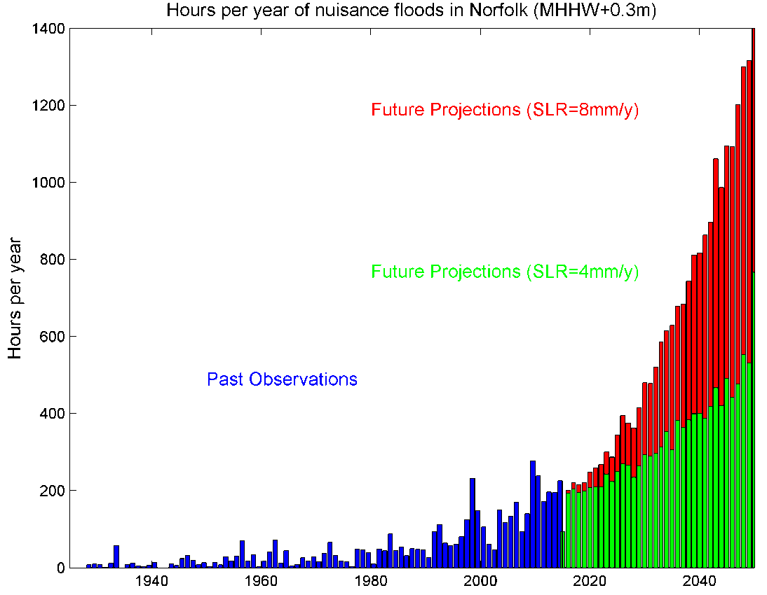
Ezer and Atkinson (2015), Sea level rise in Virginia- causes, effects and response, submitted to Virginia Journal of Science.
Projections of future flooding in Norfolk
Review of SLR science in Virginia will be presented at the annual meeting of the Virginia Academy of Sciences, JMU, May 21-22.

Slide 23
Climate and Health Impact
Muge Akpinar-Elci, MD, MPH
Director and Associate Professor
Center for Global Health
Old Dominion University, VA

Slide 24
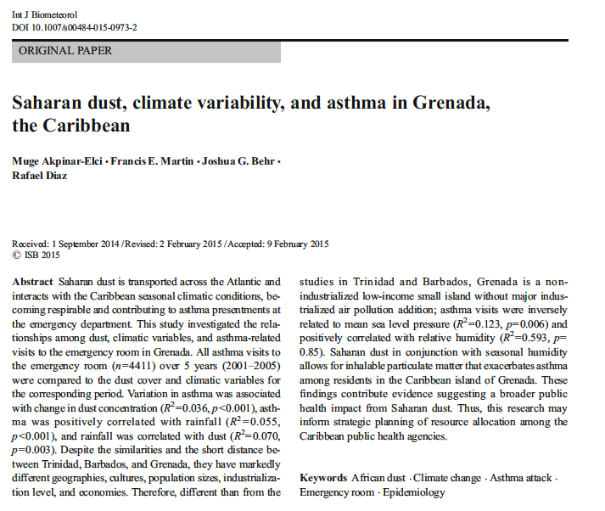

Slide 25
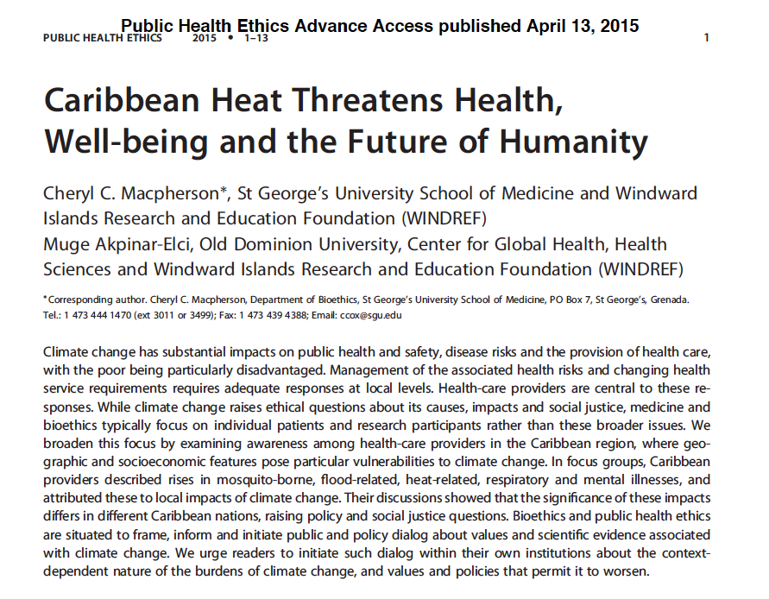

Slide 26


Slide 27
Regional Sea level variations estimated from satellite altimetry data
Yongcun Cheng

Slide 28
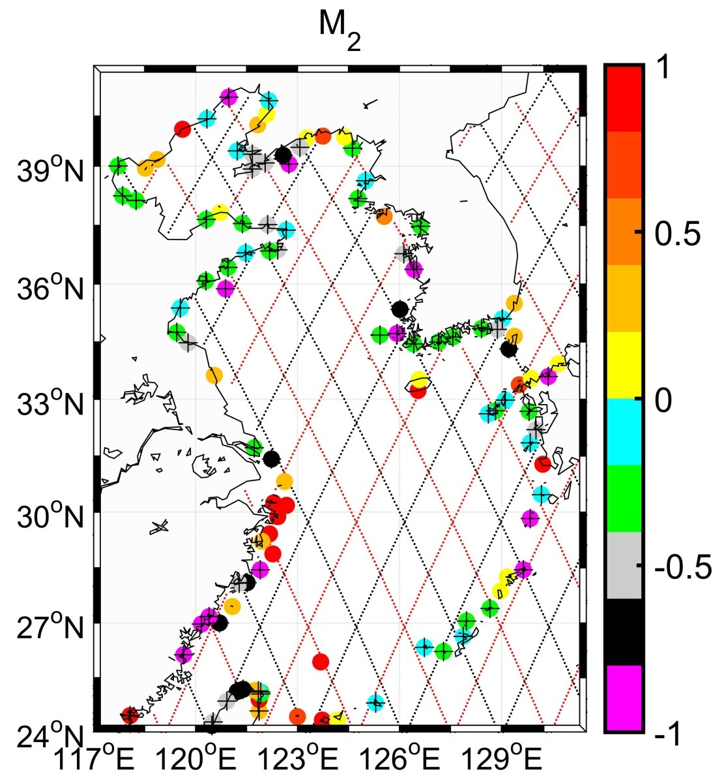
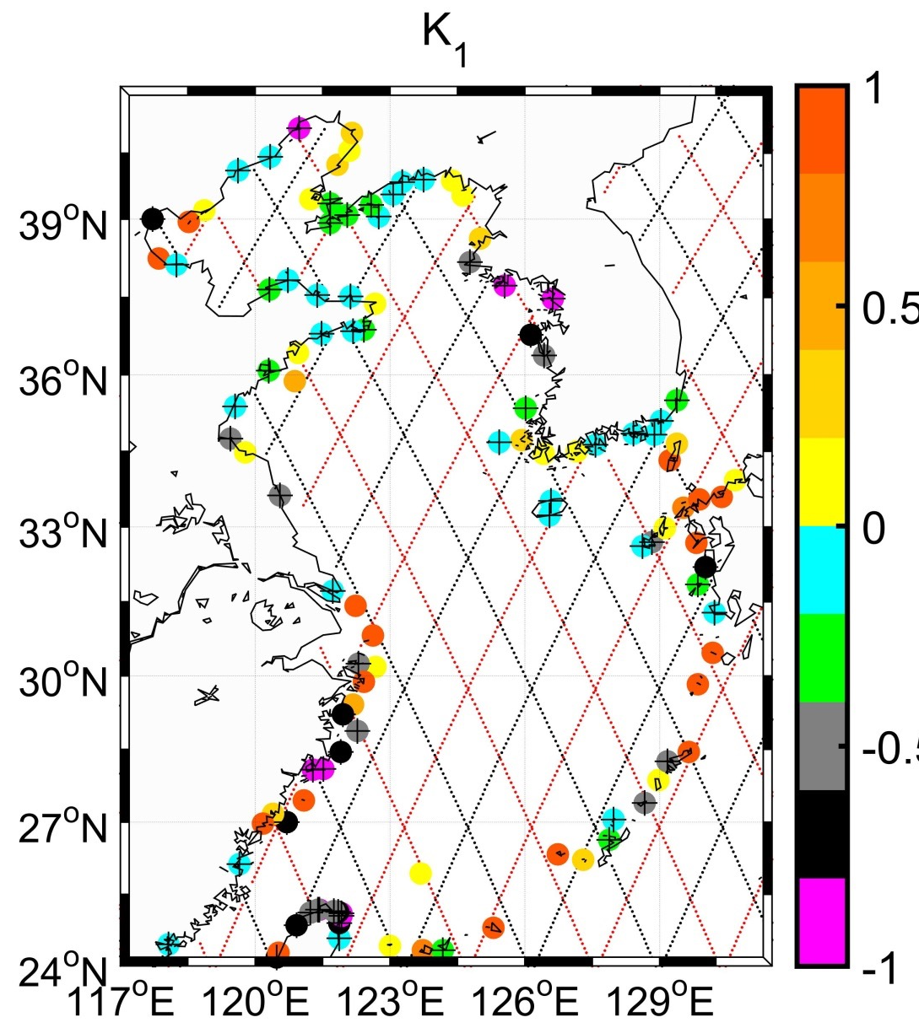
Ground-tracks of joint TOPEXJason-1-Jason-2 referenced orbit (black lines) and interlaced orbit (red lines) missions in the East Asian Marginal Seas.
(Cheng et al, 2015, Journal of Coastal Research)

Slide 29
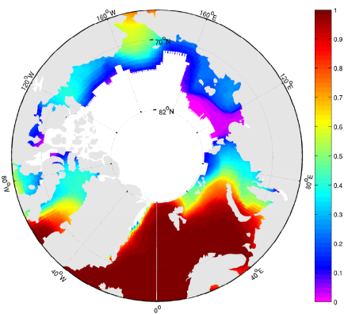
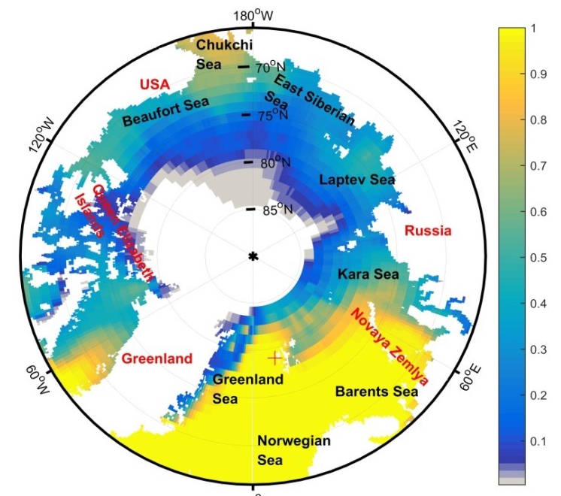
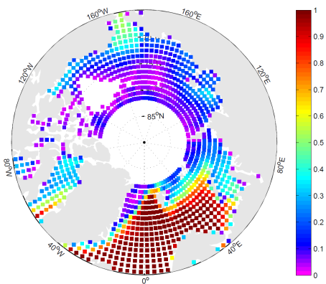
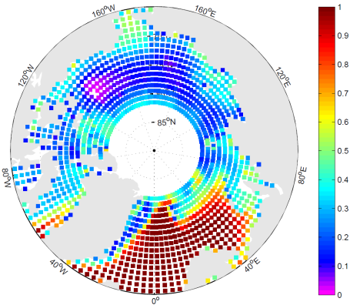
Data availability
1
0
Jul.
DUACS (V3.0.0): MSS CLS01
DUACS (V5.0.0): MSS CLS13
RADS
NEW

Slide 30
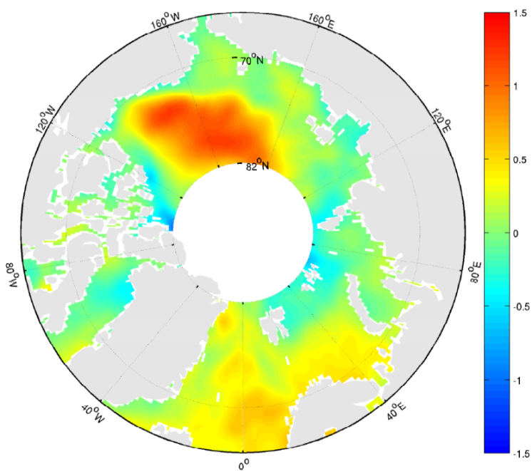
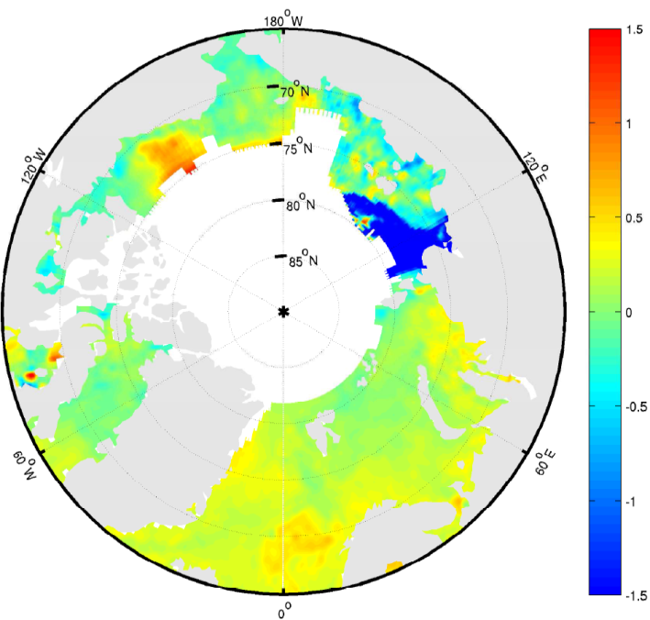
Sea level trends : 1993-2011 (cm/year)
New data: 2.1 mm/yr
DUACS: 2.0 mm/yr (Version 5)
+15
-15
(mm/yr)
New data set
AVISO/DUACS (Version 3)
(Cheng et al., 2015, Marine Geodesy)

Slide 31
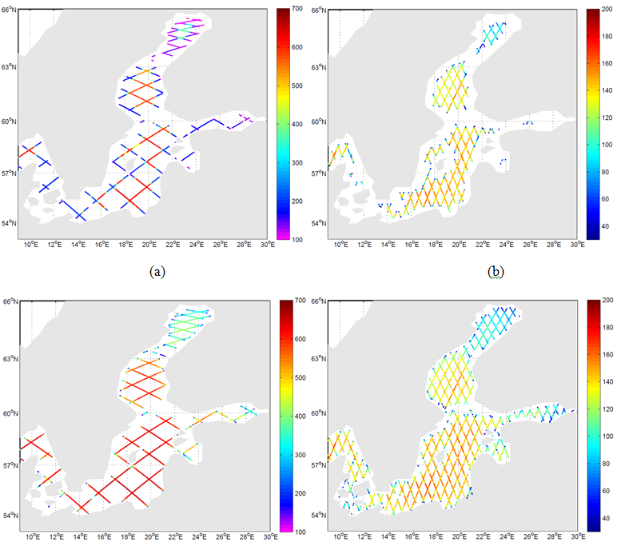

Baltic Sea

Slide 32



Sea level variations
1993-1999
2000-2006
2004-2010
(Xu, Cheng, Plag et al, 2015, IJRS)

Slide 33


Slide 34


Slide 35


Slide 36


Slide 37


Slide 38
Whither State-level SLR Policy
2 journal articles on explaining (the absence of) state-level SLR policies
Wie Yusuf, School of Public Service
Burton St John III, Communications & Theatre Arts
Ivan Ash, Psychology

Slide 39
Research Focus on State-level Policies
In the U.S., individual states have the authority to decide how to handle climate change issues such as SLR (Selin & VanDeveer 2007; Wheeler 2008).
In environmental and climate change arena, states are often “policy innovators” (Posner 2010) and “policy entrepreneurs” (Rabe 2004) that is evident in the willingness of state officials to work with industry and environmental groups
  Examples: Renewable Portfolio Standards, carbon cap-and-trade laws, carbon emissions disclosures
Localities best positioned to address SLR, but require participation from their respective states to implement policies
  Constrained by state-level policies and regulations
  Lack the autonomy to respond to SLR
  Rely on states for funding

Slide 40
The State-level SLR Policy Landscape
At the state level, the SLR policy landscape is almost barren, marked by policy inaction
Between 2008 and 2014, the National Conference of State Legislatures (2014) Energy and Environment Legislation Tracking Database noted only 15 SLR-related items in six states
  7 failed, five pending, 3 enacted
  In Virginia, the state legislature had only passed one SLR-related legislative item – targeted at studying adaptation strategies to prevent recurrent flooding in coastal regions of the state
So, what’s going on? Why the dearth of SLR policies?
Two approaches to studying the issue:
  Legislators perception of SLR as a policy issue
  Confluence of factors holding SLR back as a policy issue

Slide 41

The Role of Politics and Proximity in Sea Level Rise Policy Salience: A Study of Virginia Legislators’ Perceptions
Virginia legislators perception of
  SLR information sources,
  levels of SLR-related risk,
  policy leadership roles
2 drivers of state policymakers’ perceptions of SLR
  Politics (political party – Republicans vs. Democrats)
  Proximity (coastal vs. non-coastal)

Slide 42


Policy Leadership for Addressing SLR

Slide 43
The Sea is Rising… But Not onto the Policy Agenda: A Multiple Streams Approach to Understanding Sea Level Rise Policies
Yusuf, J., K. Neill, B. Saint John, I. Ash and K. Mahar. The Sea is Rising… But Not onto the Policy Agenda: A Multiple Streams Approach to Understanding Sea Level Rise Policies. Forthcoming. Environment and Planning C: Government and Policy
Focus on agenda setting
  How and why certain issues succeed or fail in being recognized as problems requiring government attention (Howlett, Ramesh, & Perl 2009)
Multiple streams framework (Kingdon 1995)
  Explains how various problems make it onto the policy agenda and the conditions under which a particular policy is likely to be adopted
  Instead of one definable point of origin, the policy formation process typically is a product of a combination of different factors
Three different processes, or streams, are involved in agenda setting:
  Problem recognition
  Formation of policy proposals or solutions
  Politics

Slide 44

The Sea is Rising… But Not onto the Policy Agenda: A Multiple Streams Approach to Understanding Sea Level Rise Policies

